Slide 1





Magnet constraints for proton extraction options
30th October 2025
Magnet WG meeting
J. Mańczak, D. Calzolari, S.Candido R. Franqueira Ximenes, A.Lechner, G. Lerner

Slide 2
Outline
Proton early extraction – evaluating a possibility of extracting most of the spent protons before the chicane. For the moment, the studies are focusing on 10 GeV protons, two options identified:
  8-degree target tilt
  6-degree target tilt

Slide 3
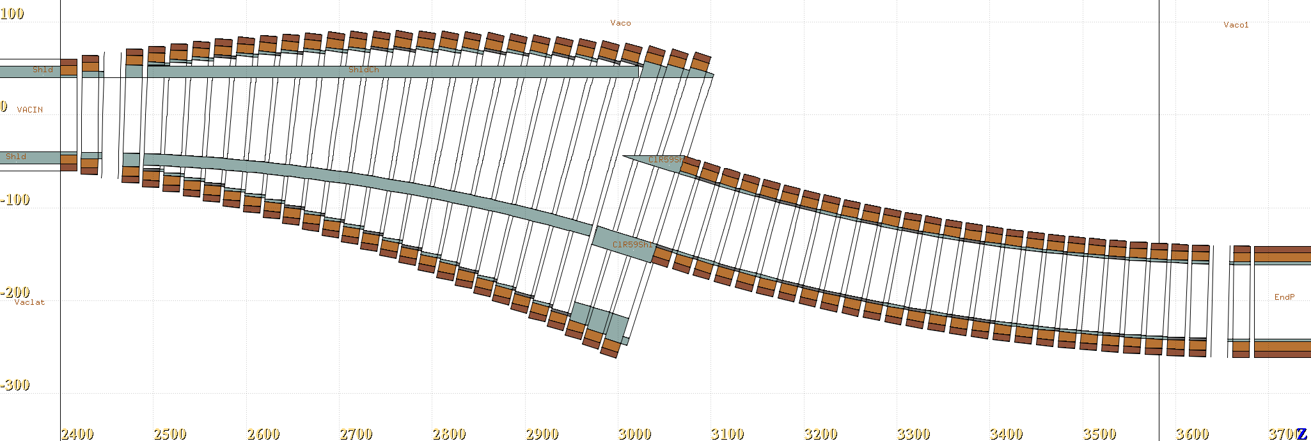
Outline
Proton extraction within the chicane - the idea is to stick to a solenoid-based chicane trying to fine tune several parameters:
  horizontal shift,
  coil size,
  shielding,
  curvature.

Slide 4
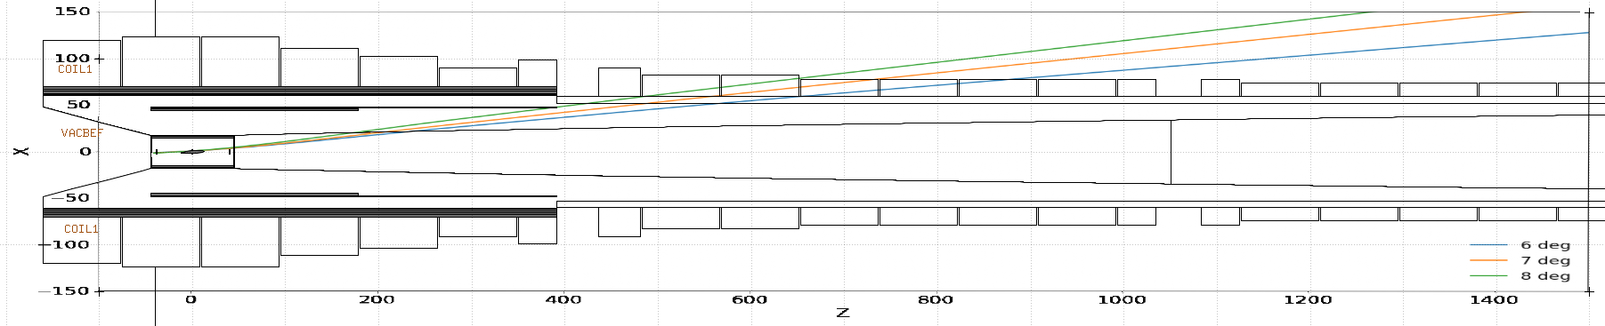
Early proton extraction - main idea
Only tested with the baseline graphite rod of 80 cm.
The azimuth rotation always 120 deg (applied after the tilt) to direct the beam away from the chicane in the horizontal plane.
HTS front-end magnet layout to be rearranged, two possible approaches:
  Extract as early as possible
  Extract at smaller angle along the tapered region and bring farther magnets closer to the beam axis

Slide 5
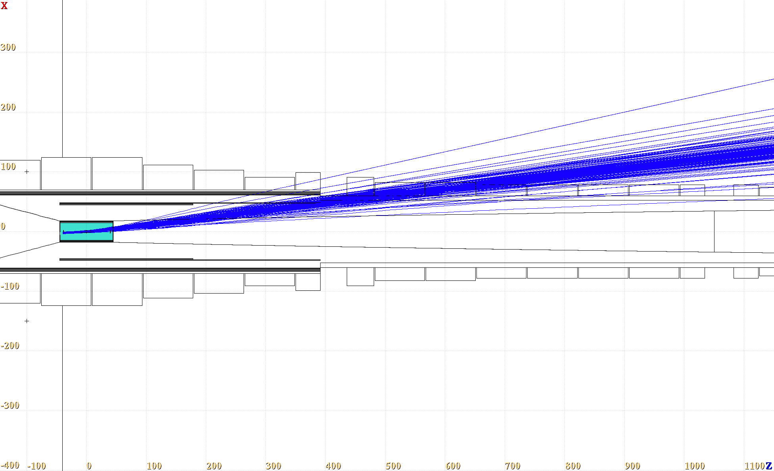
8-degree target tilt extraction
Gaussian beam and realistic target vessel
Protons E_kin > 9 GeV

Slide 6
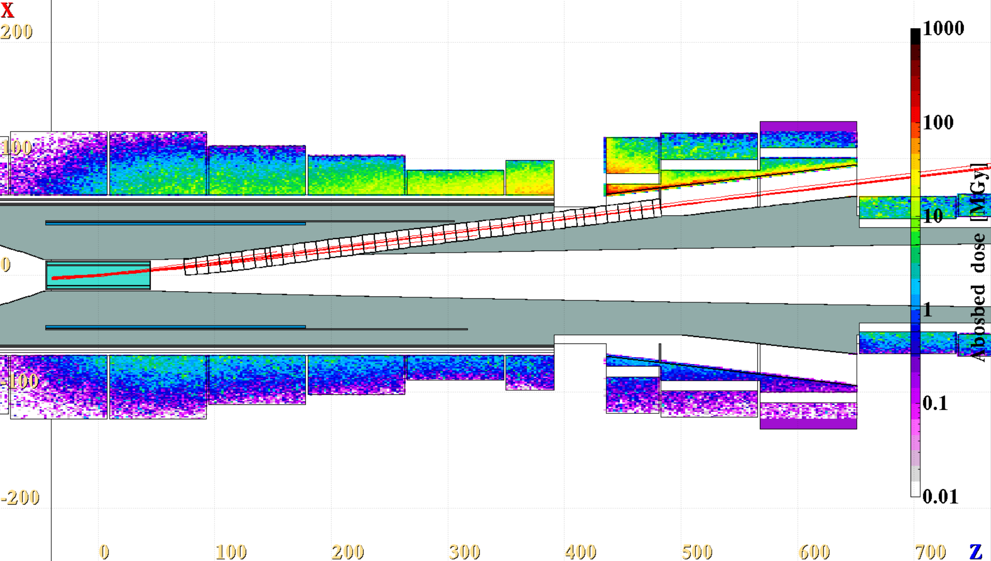
8-degree target tilt extraction
Max yearly Abs dose
~60 Mgy/year
Protons with Ekin > 9.9 GeV

Slide 7
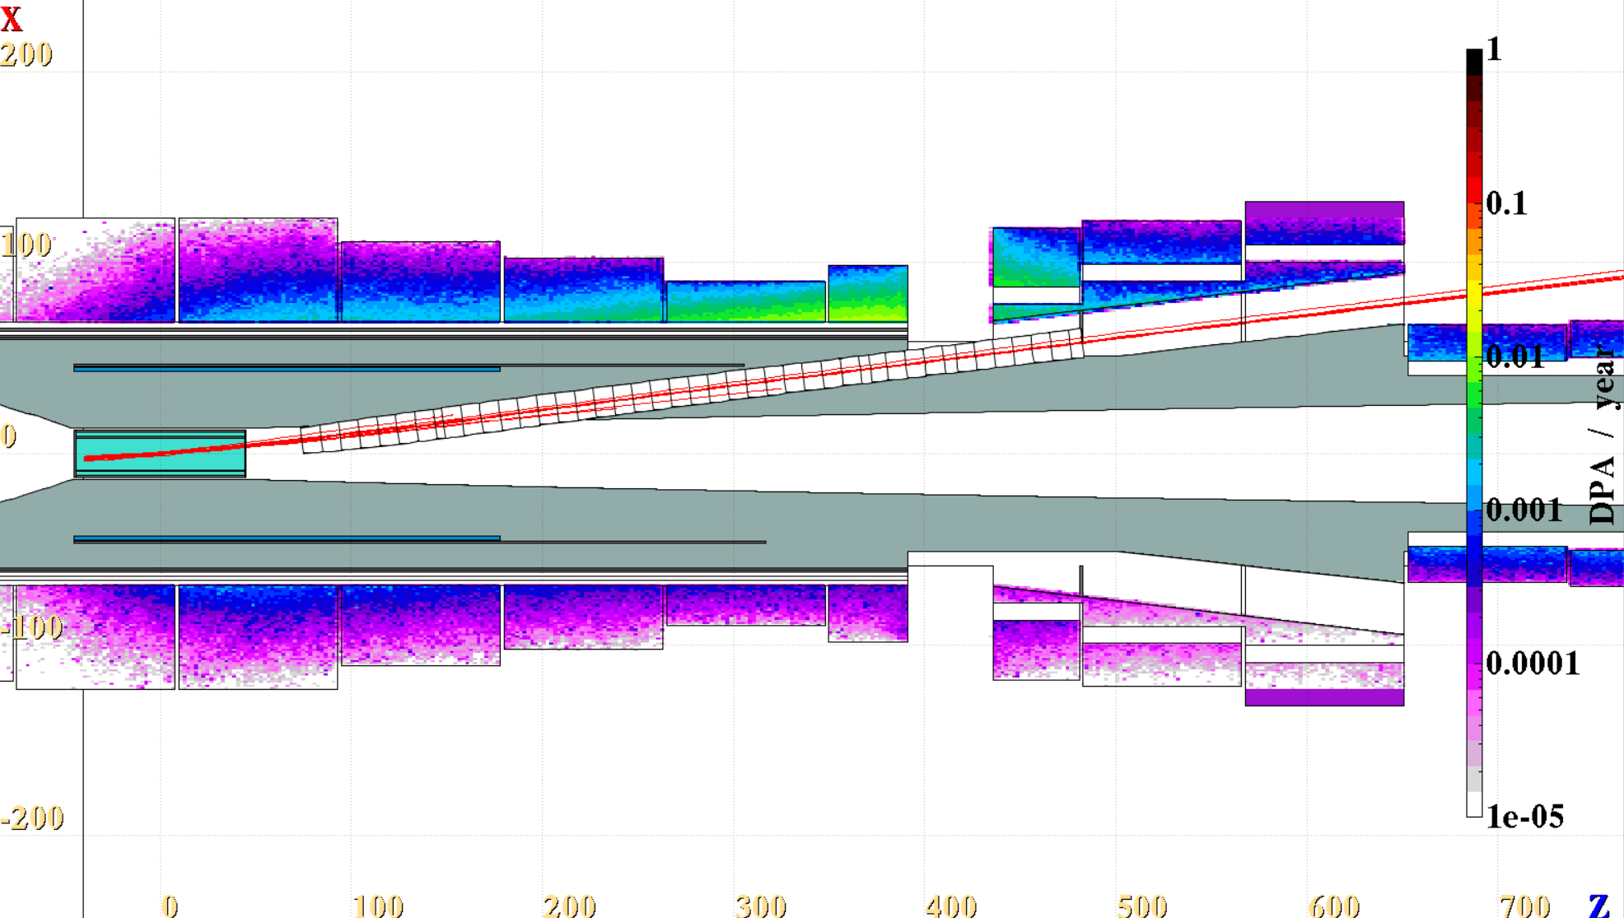
8-degree target tilt extraction
In the coils, peak
DPA/year ~ 1e-2!
Ext channel radius = 8 cm
Max diameter
2.2 m
Protons with Ekin > 9.9 GeV

Slide 8
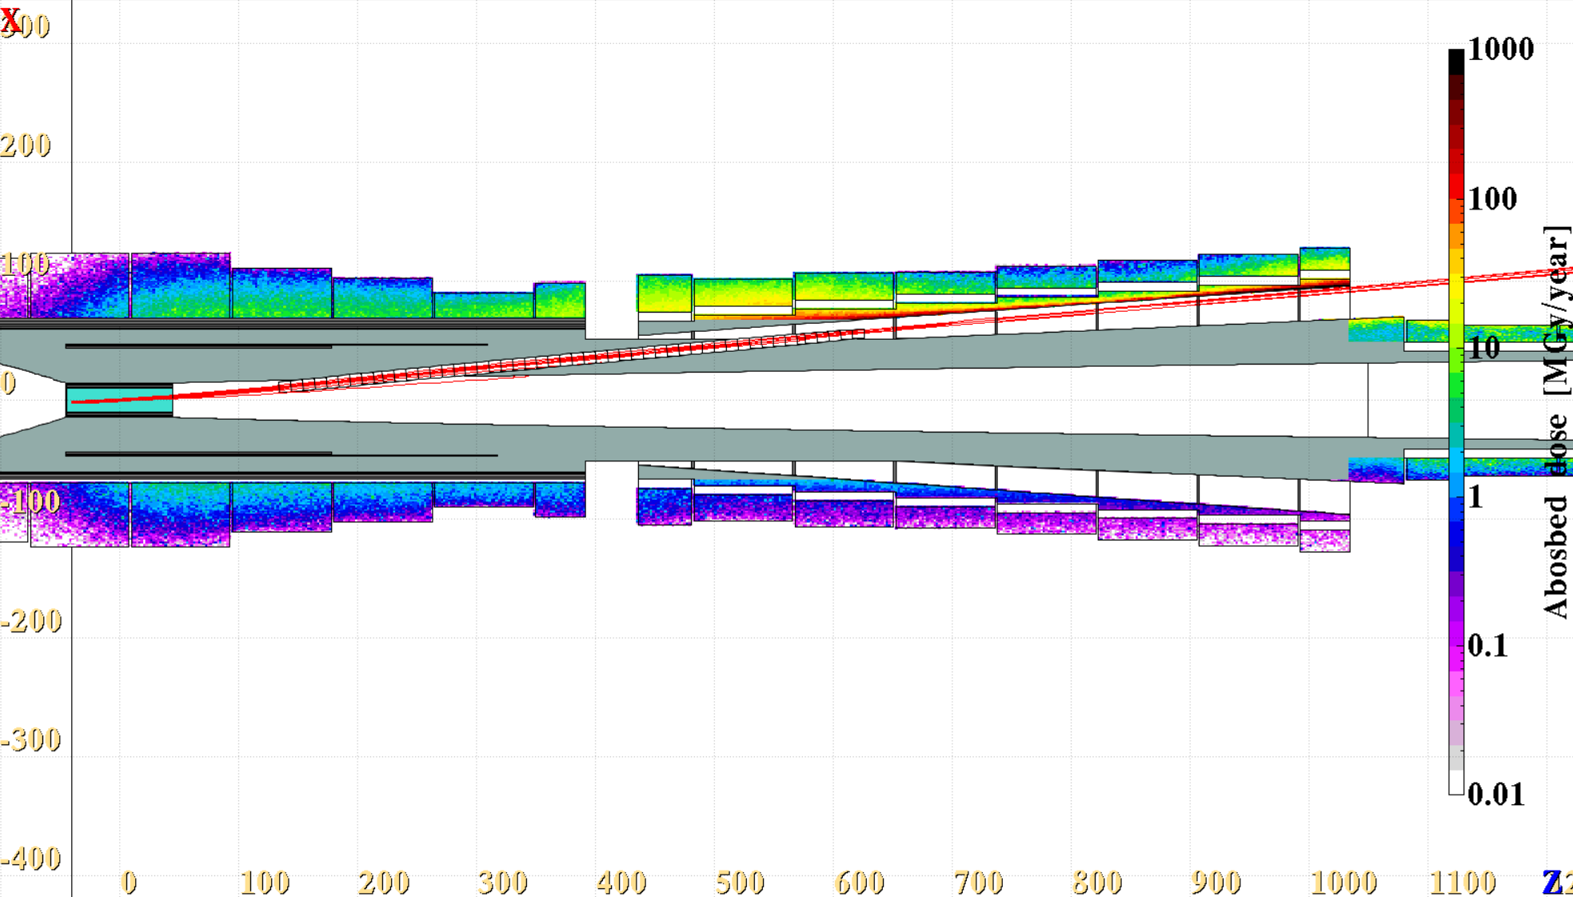
6-degree target tilt extraction
Abs. dose in the coils peaks at ~30 MGy/year
Shileding
Ext channel radius = 5 cm
Protons with Ekin > 9.9 GeV

Slide 9
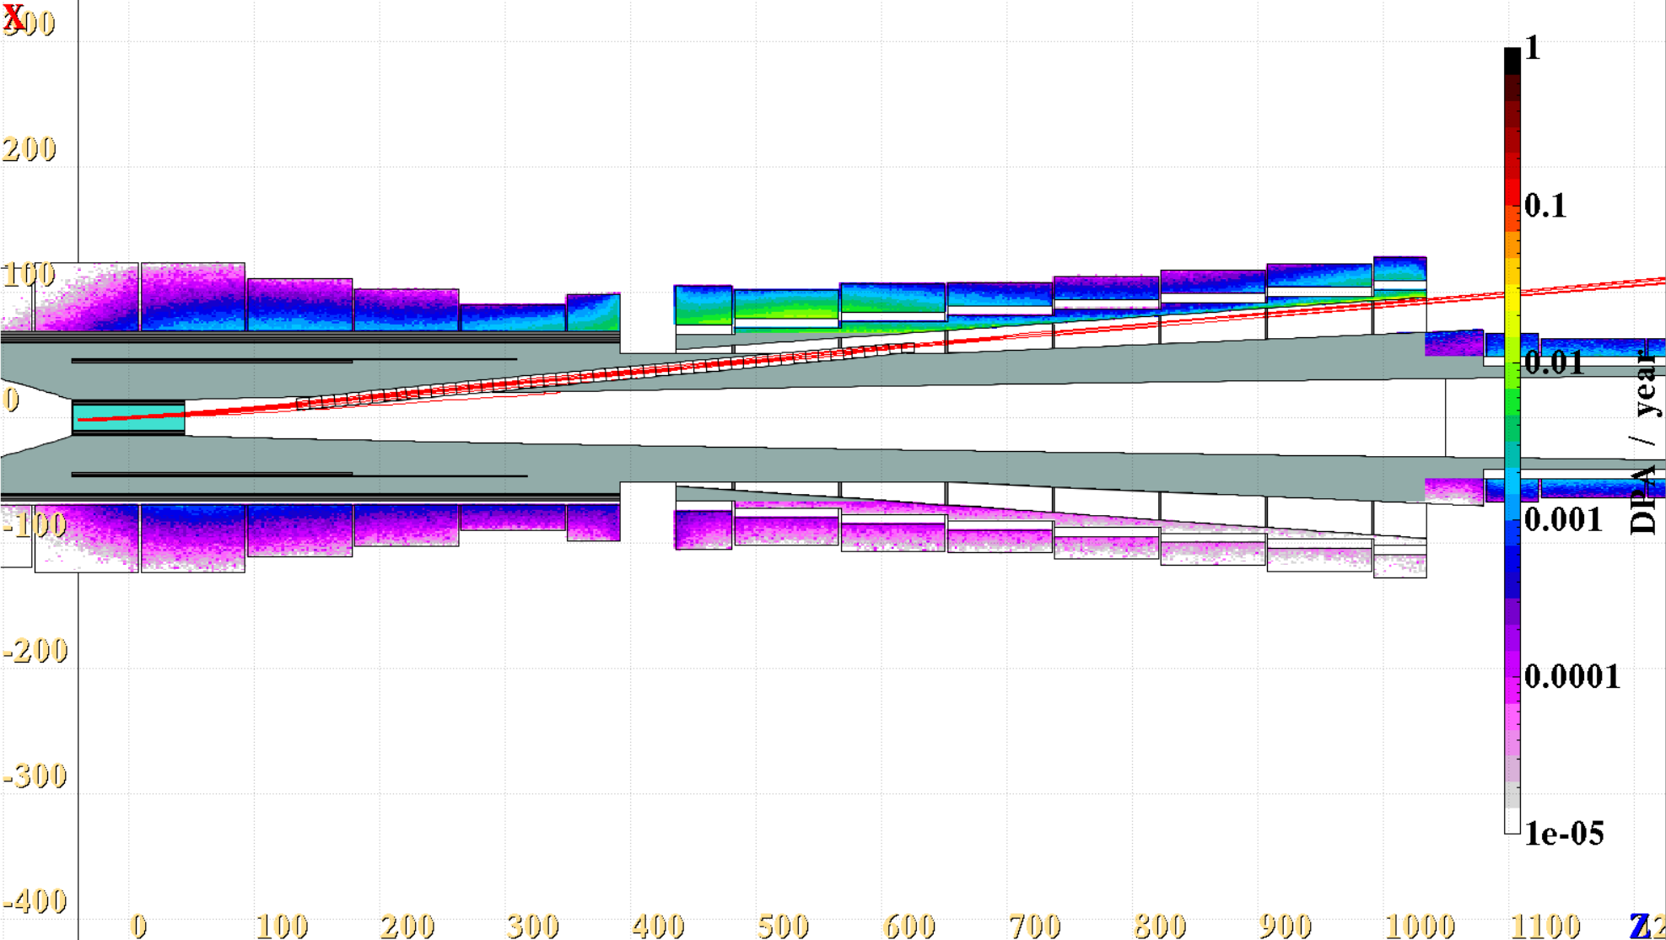
6-degree target tilt extraction
In the coils, peak
DPA/year ~ 1e-2!
Shileding
Max diameter
2.2 m
Ext channel radius = 5 cm
Protons with Ekin > 9.9 GeV

Slide 10
Early extraction and the field profile
In the presented examples, the spent beam exits the shielding mass in ~5 T region
Ideally, we should aim for extraction where the field is already tapered to its lowest value of ~1.5 T
Secondary low Energy protons will follow the field lines similarly to muons and pions

Slide 11
Conclusions – early extraction
Early proton extraction is challenging; more studies are needed.
The FLUKA model might be too simplistic, e. g no cryostats included outside of the HTS magnets.
Open questions:
  Can we use non-cylindrical coils? The problem doesn’t exhibit radial symmetry.
  Shorter taper and steeper field gradient or maybe longer taper for flatter extraction?
First conclusions:
  Try to use flatter angles <= 5 deg to increase the magnet aperture only in the low B-field region
  Prepare clearance region dimensions defined by the DPA and absorber dose yearly limits.
  If needed, extend the tapering region to give more space for extracted beam separation when small angles are used.

Slide 12
IncApt, max 153 cm, large aperture, large shielding
These magnets most likely could be SC if needed
~ +40 cm
-44 cm
~3 m
Magnet diameter
Increasing magnet aperture keeps the current densities more stable (at least in my fitting script!)
Bending radius | Opening Angle
21 m | 18
Magnet aperture increases linearly up to 1.53 m
Significant shielding introduced inside the chicane
The aperture follows the size of the tapering end!

Slide 13
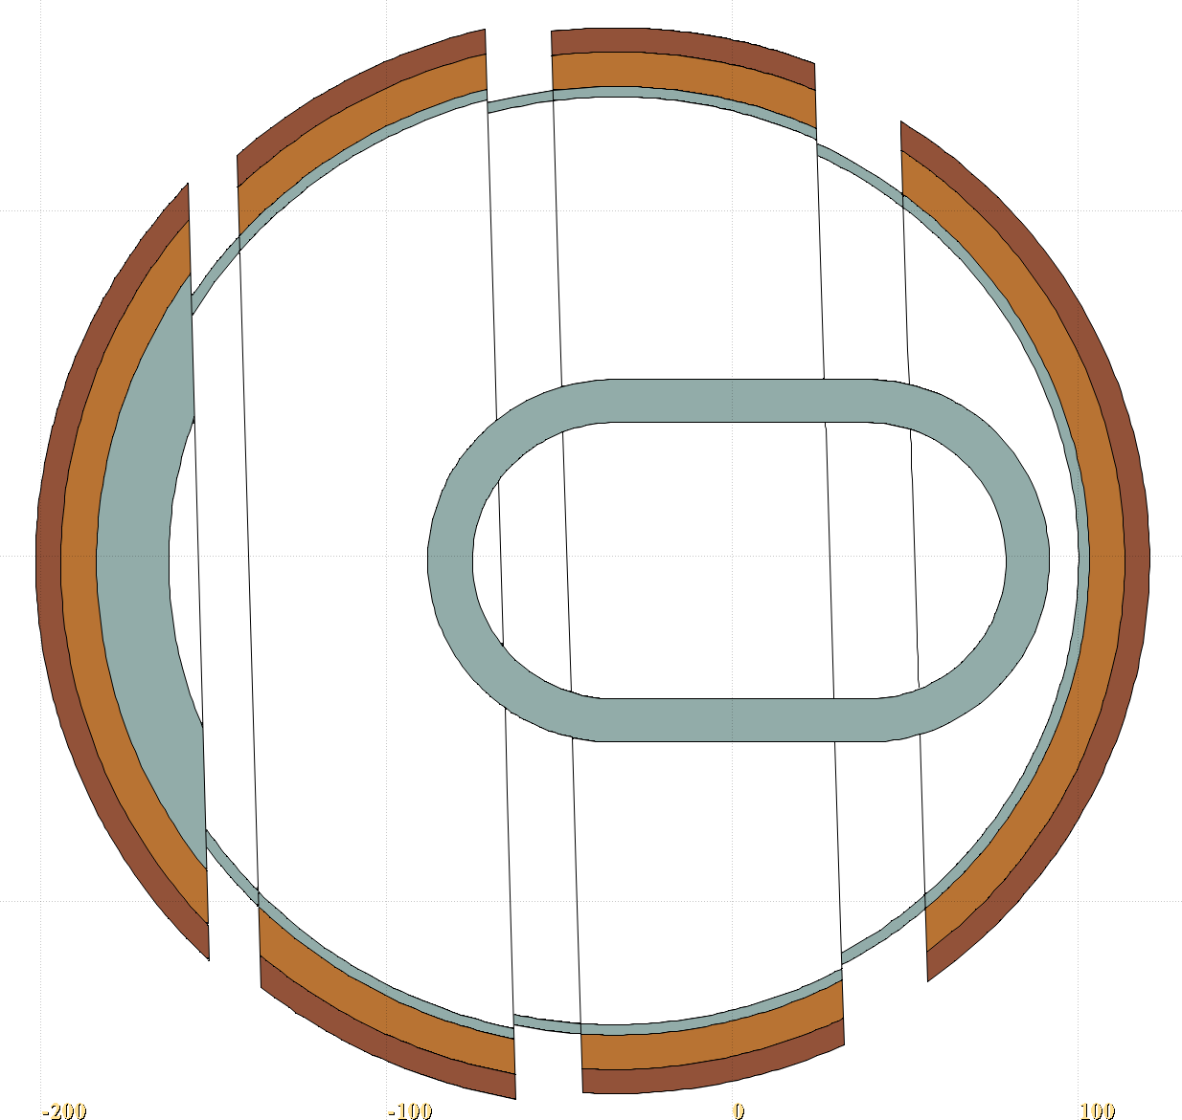
Shielding idea
The secondaries are expected to dissipate along the shielding inside the chicane, depositing their more uniformly energy on a wider distance
The nozzle shape not to intervene with the spent beam path
Shielding shape follows two cylinders connected as depicted
One cylinder is the extension of the tapering final aperture
The second one follows the curvature of the chicane, always centered around the magnet center

Slide 14
Conclusions chicane extraction
It is certain that for the proposed chicane to be sustainable, at least the biggest coils would have to be superconducting.
For 4 MW option, the radiation load is still too high. Further shielding optimization is needed.
For 2 MW option, the solution could be sustainable and the most of the wide aperture magnets can be made superconducting.
Horizontal shift allows for smaller magnet apertures, but compromises the yield.
For the moment, we will try to explore the early extraction option!

Slide 15
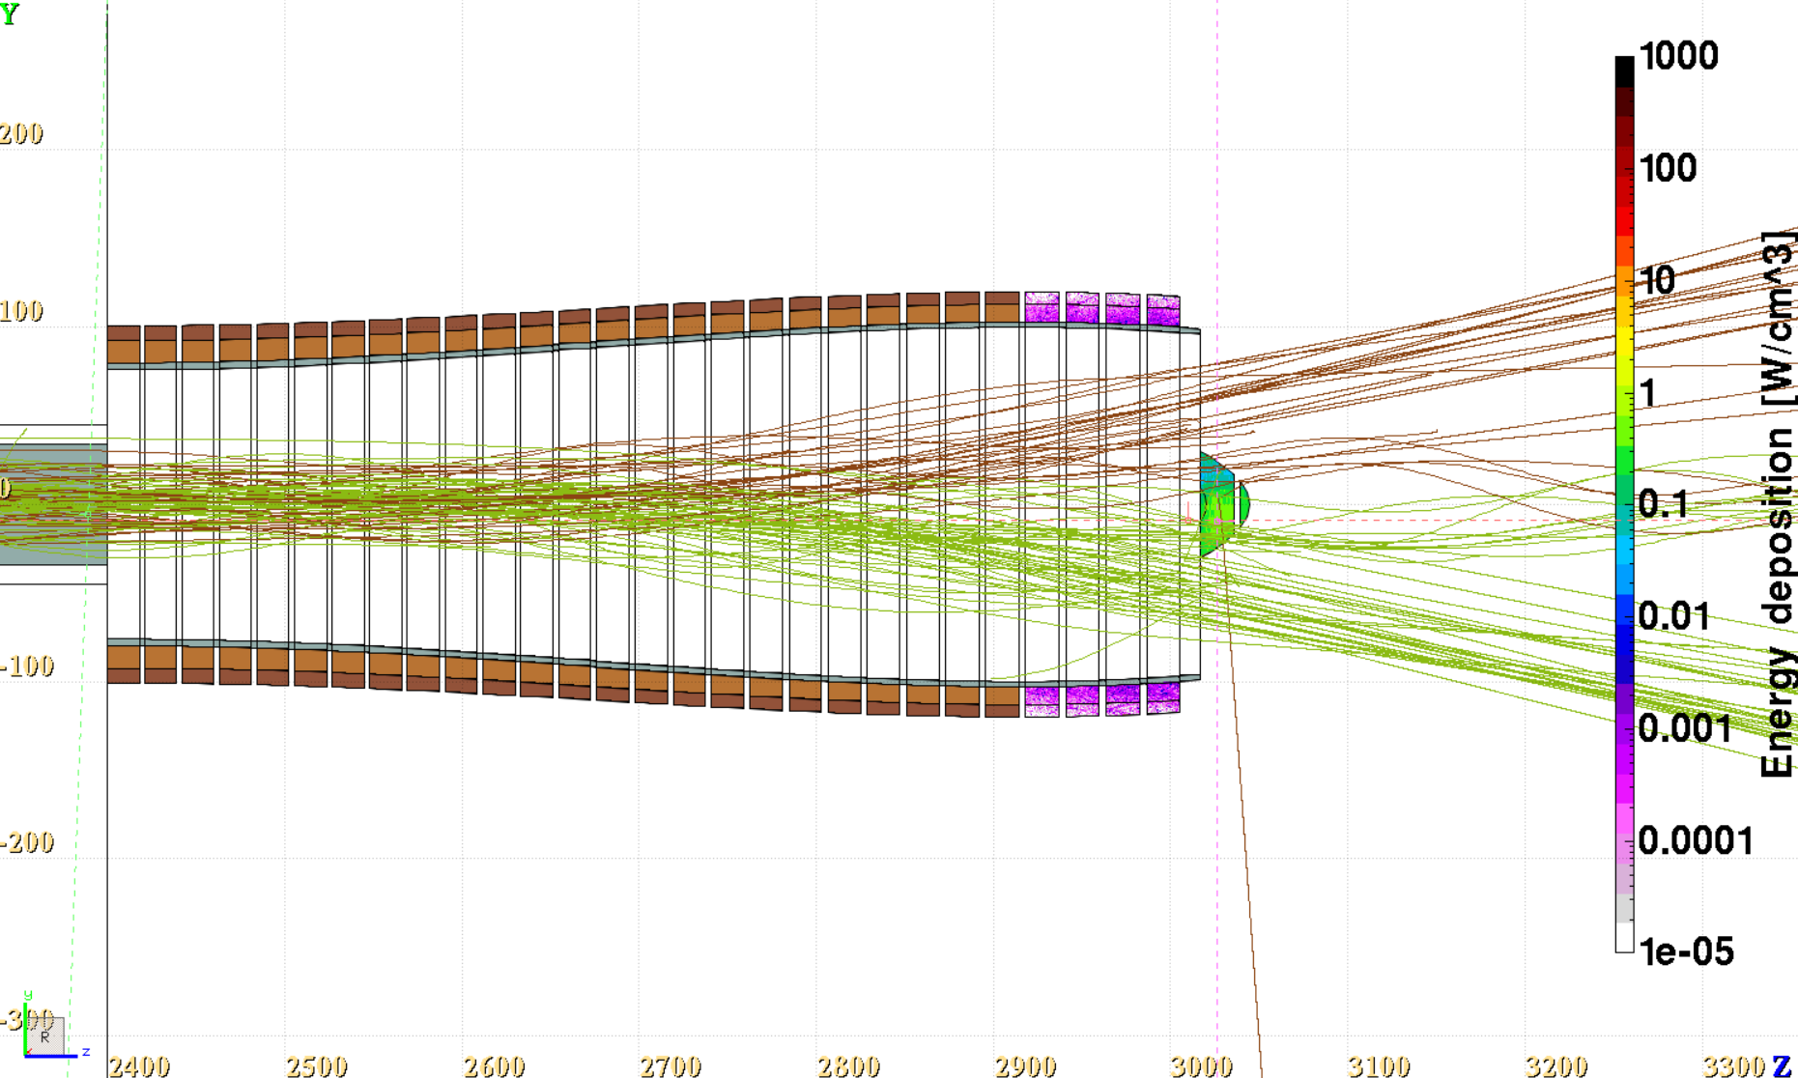
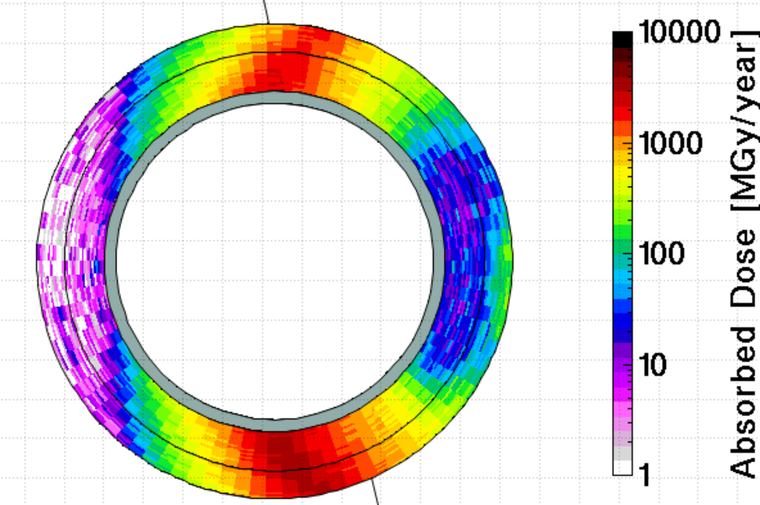
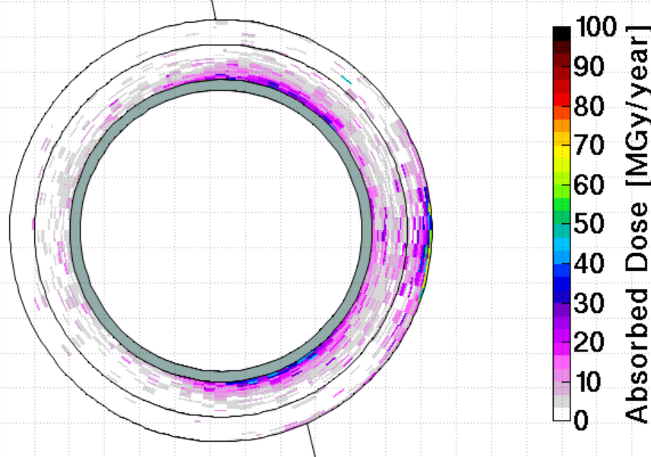
Low energy particles – persisting problem
Old chicane!
This radiation load is due to the low-E particles separated by charge in the chicane
No shielding
π ⁻
π ⁺
Low energy protons are also bent down (not shown)
Even if we extract high-E protons early in the tapering, extra shielding will still be needed inside the chicane!
With shielding
This problem dissapears with early extraction! The chicane magnets can be smaller

