Slide 1

Status of Task3
D. Fazioli^{1,2}, M. Gast^{1,3}, F. Boattini¹, M. Breschi², P. Viarouge⁴, D. Moll, P.L.
¹CERN, Switzerland; ²University of Bologna, Italy; ³Karlsruhe Institute of Technology, Germany, ⁴Université Laval, Canada
mmWG 13 November 2025

Slide 2

Dipole magnets optimization UniBo
Quadrupole magnets optimization UniBo
Transient FEM models Uni-Darmstadt
Excel-Python design suite for Dipoles CERN-UniLaval
Dipole field quality estimation Uni-Darmstadt
Powering circuits topology and components CERN-UniBO
Control problem: accuracy and repeatability CERN-UniBO
Next steps

Slide 3

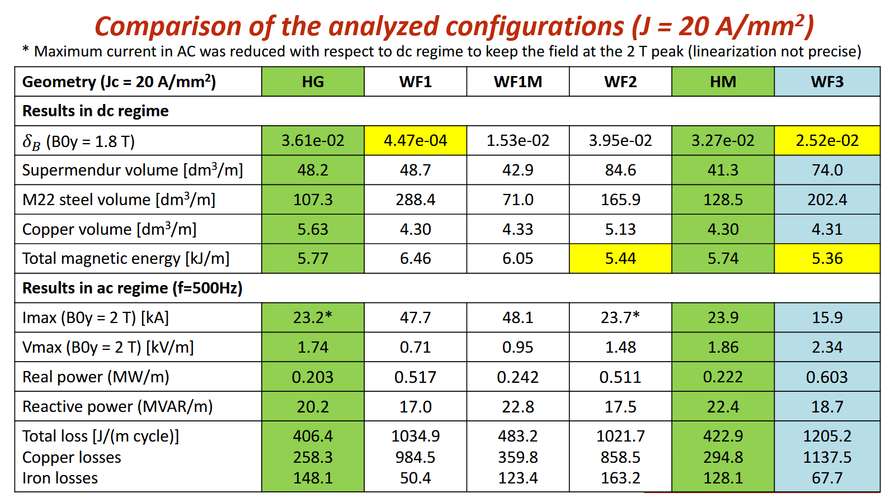
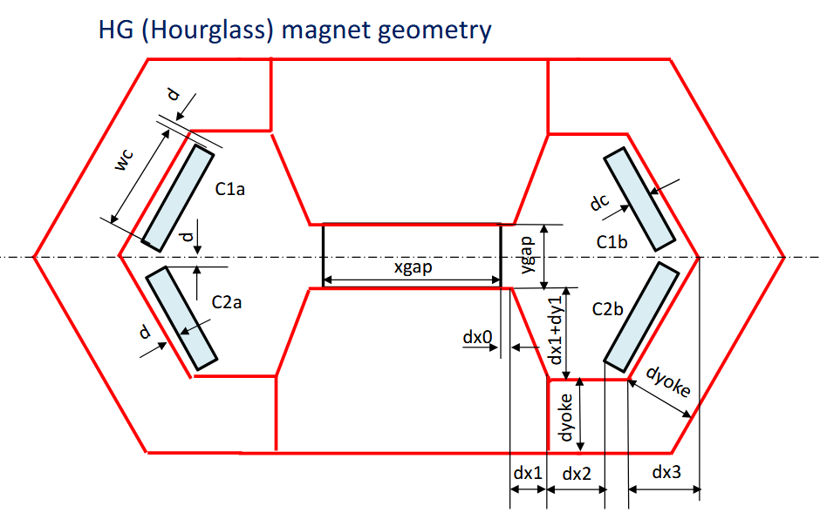
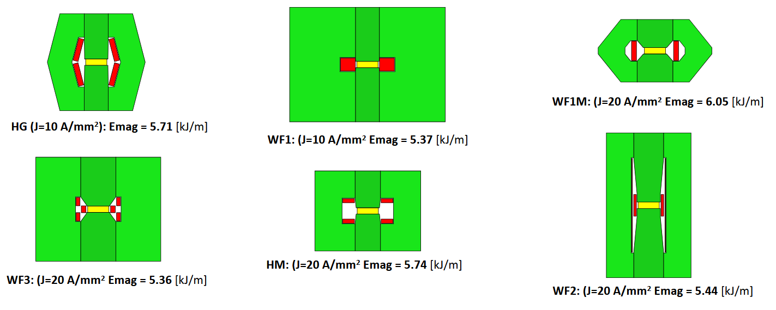
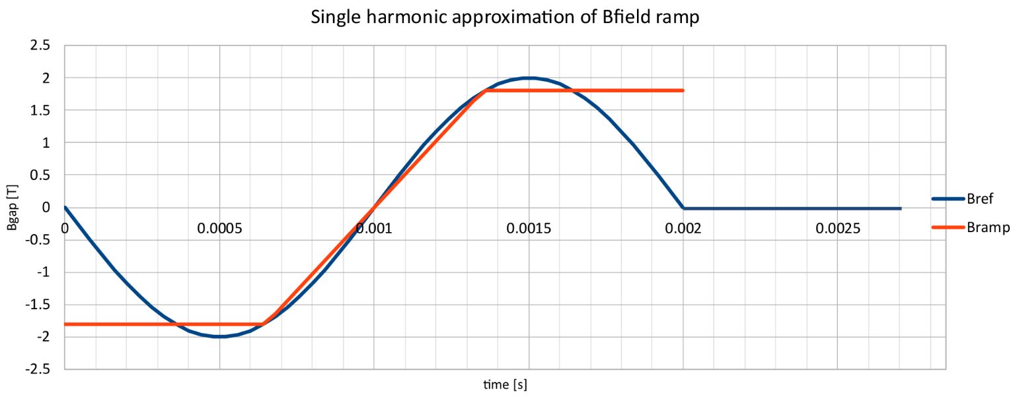
Dipole magnets Optimization
Initial generic optimization based on geometric optimization of different topologies with the goal of reducing the total magnetic energy.
Results (HG):
  Emag ≈ 5.7 kJ/m
  Copper losses ≈ 1300W/m
  Iron losses ≈ 740W/m
Ramp ≈ 700us approximated with sinusoid 500Hz

Slide 4
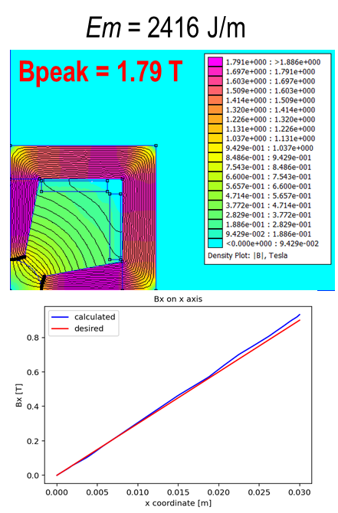
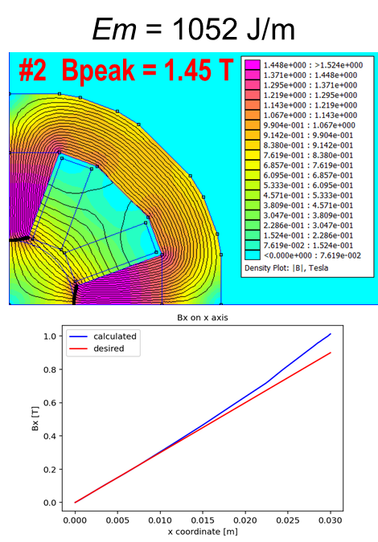
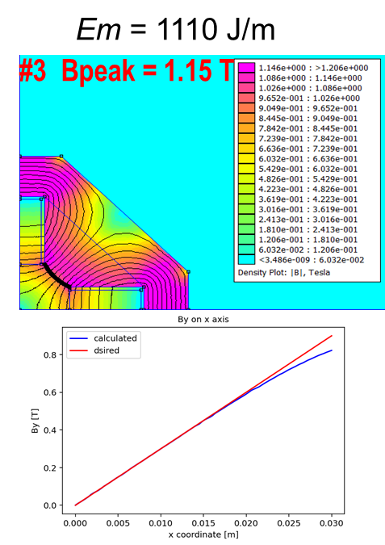
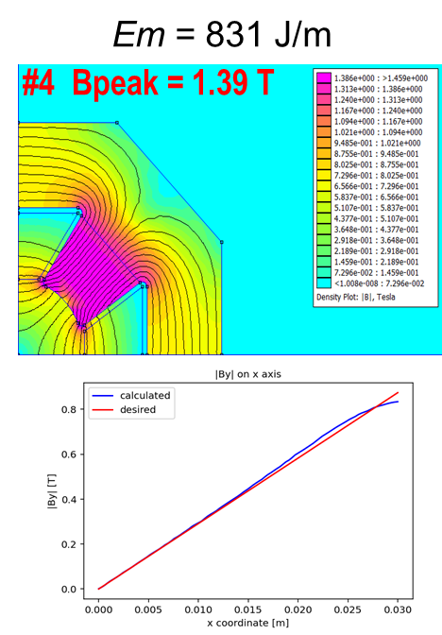
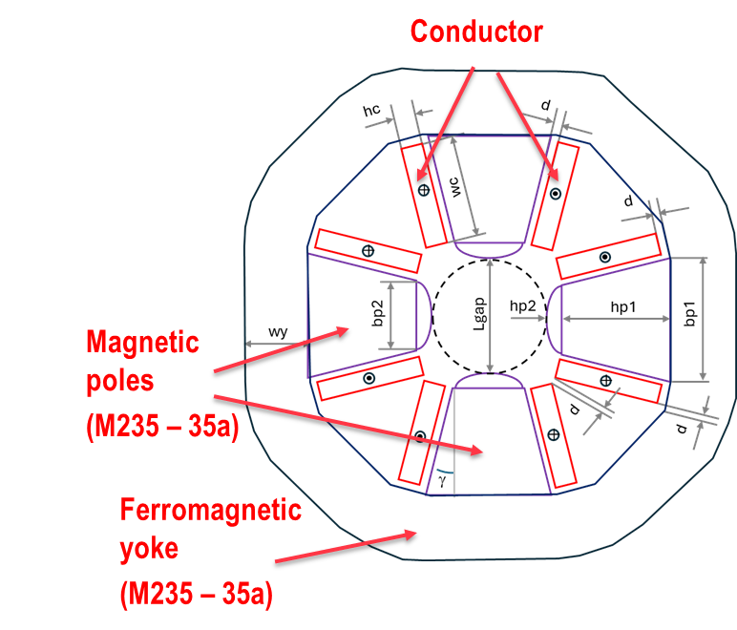
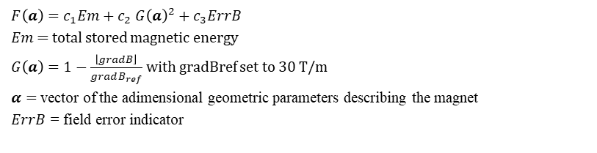

Quadrupole Optimization
Field gradient set to 30 T/m, Lgap set to 60 mm
  The results presented here correspond to the choice of c1 = 1, c2 = 0, c3 = 0
$F\left(a\right)=c_{1}Em+c_{2}$ ${G\left(a\right)}^{2}+$ $c_{3}ErrB$
$Em$ = total stored magnetic energy
$G\left(a\right)=1−\frac{\left\lfloor gradB\right\rfloor }{gradB_{ref}}$ with gradBref set to 30 T/m
$α=$ vector of the adimensional geometric parameters describing the magnet
$ErrB$ = field error indicator
$$\min{F\left(a\right)}$$
$$a_{min}≤a≤a_{max}$$
Results (#3):
  Emag ≈ 1.1 kJ/m
  Total losses ≈ 2040W/m
$$G\left(a\right)≤0$$
  More accurate design required for field gradient error

Slide 5

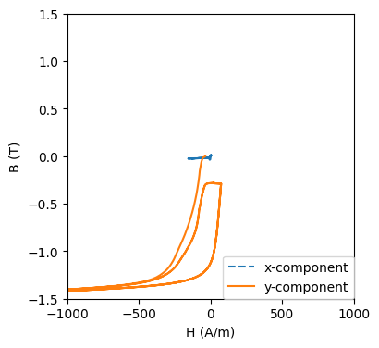
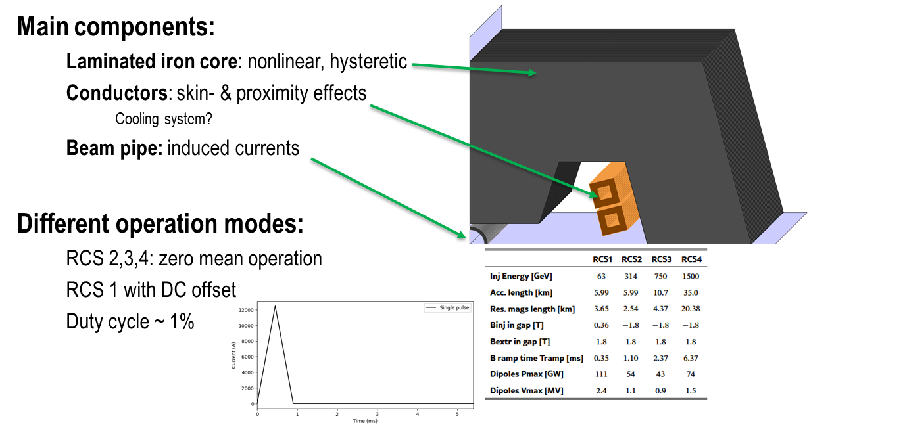
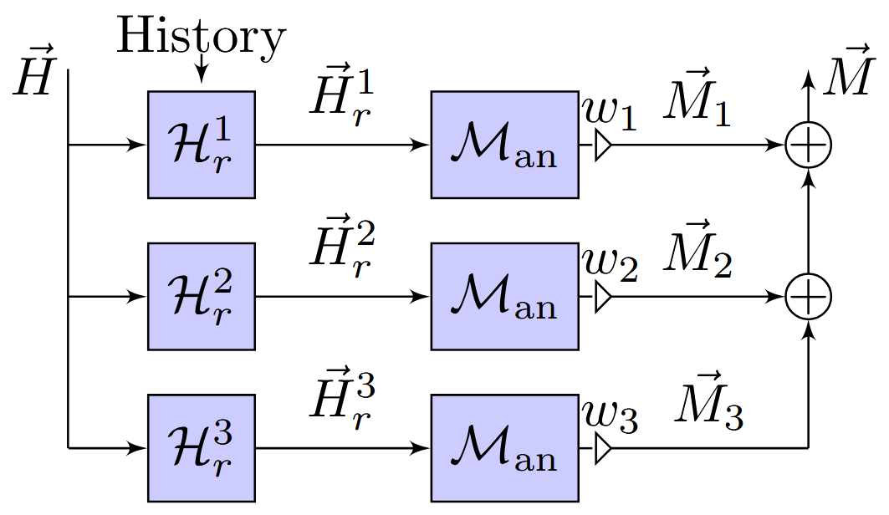
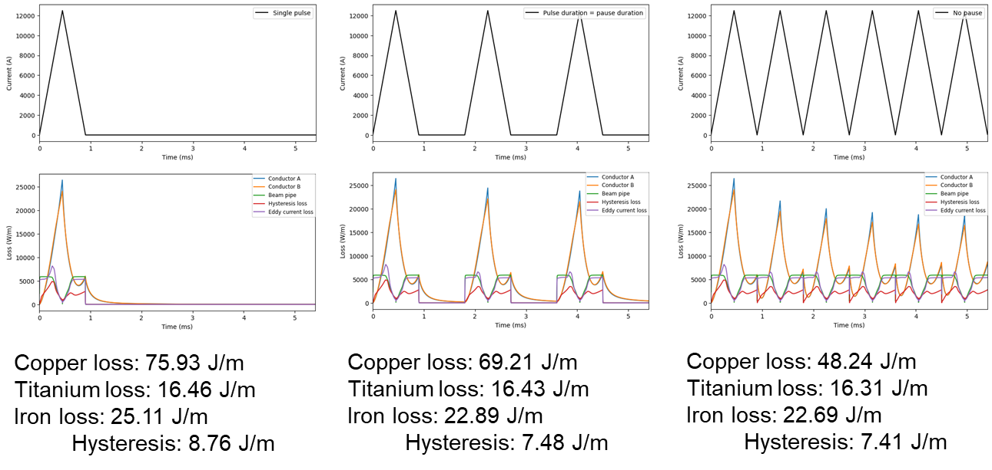
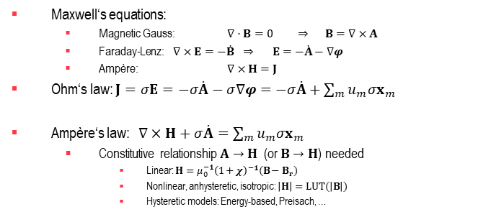
Transient Hysteretic FEM model
Maxwell‘s equations:
  Magnetic Gauss: $∇⋅B=0 ⇒ B=∇×A$
  Faraday-Lenz: $∇×E=−\dot{B} ⇒ E=−\dot{A}−∇φ$
  Ampère: $∇×H=J$
Ohm‘s law: $J=σE=−σ\dot{A}−σ∇φ=−σ\dot{A}+\sum_{m}{{u_{m}σx}_{m}}$
Ampère‘s law: $∇×H+σ\dot{A}=\sum_{m}{{u_{m}σx}_{m}}$
  Constitutive relationship $A→H$ (or $B→H$) needed
    Linear: $H=μ_{0}^{−1}{\left(1+χ\right)}^{−1}(B−B_{r})$
    Nonlinear, anhysteretic, isotropic: $\left|H\right|=LUT(\left|B\right|)$
    Hysteretic models: Energy-based, Preisach, …
Time domain Maxwell equations + hystersys model
First cycle differs due to
wrong initial state

Slide 6

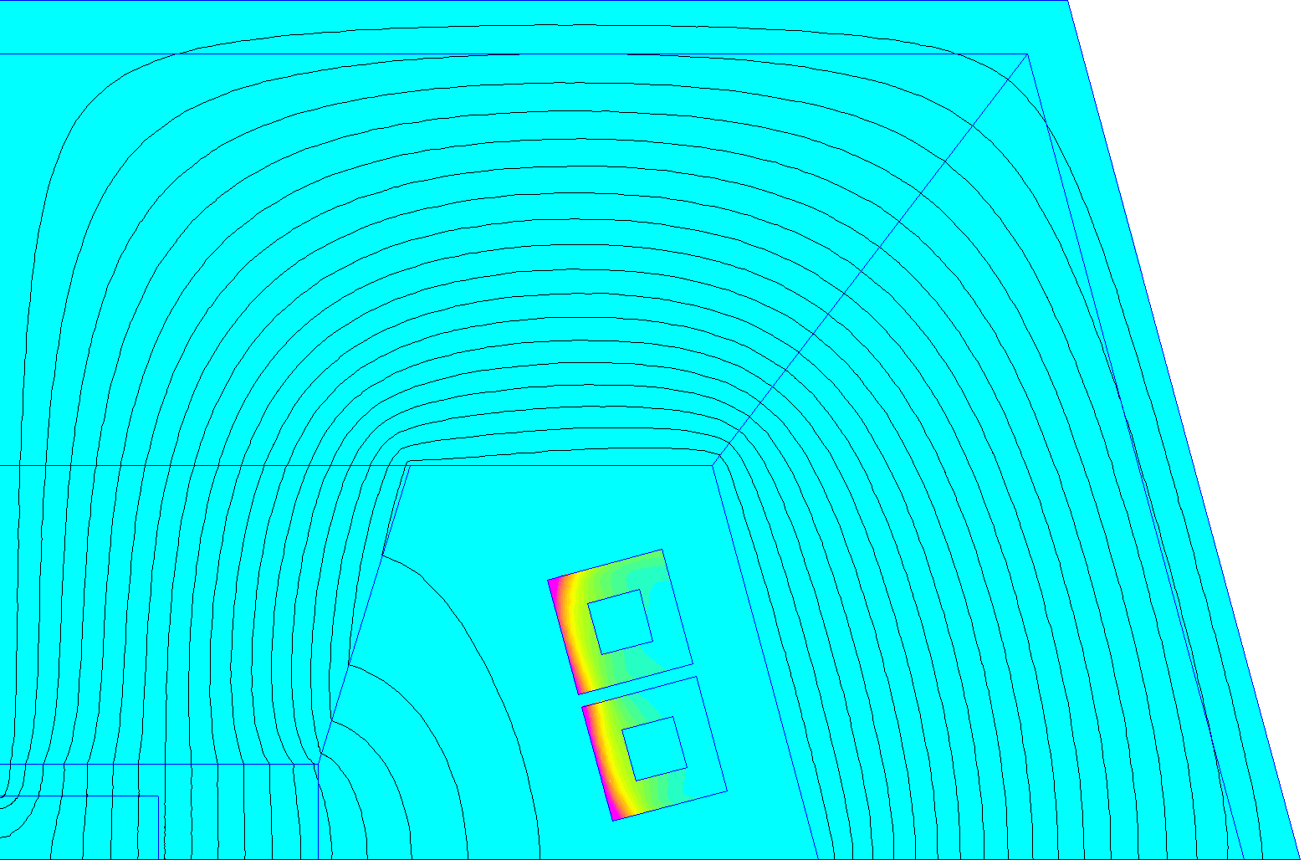
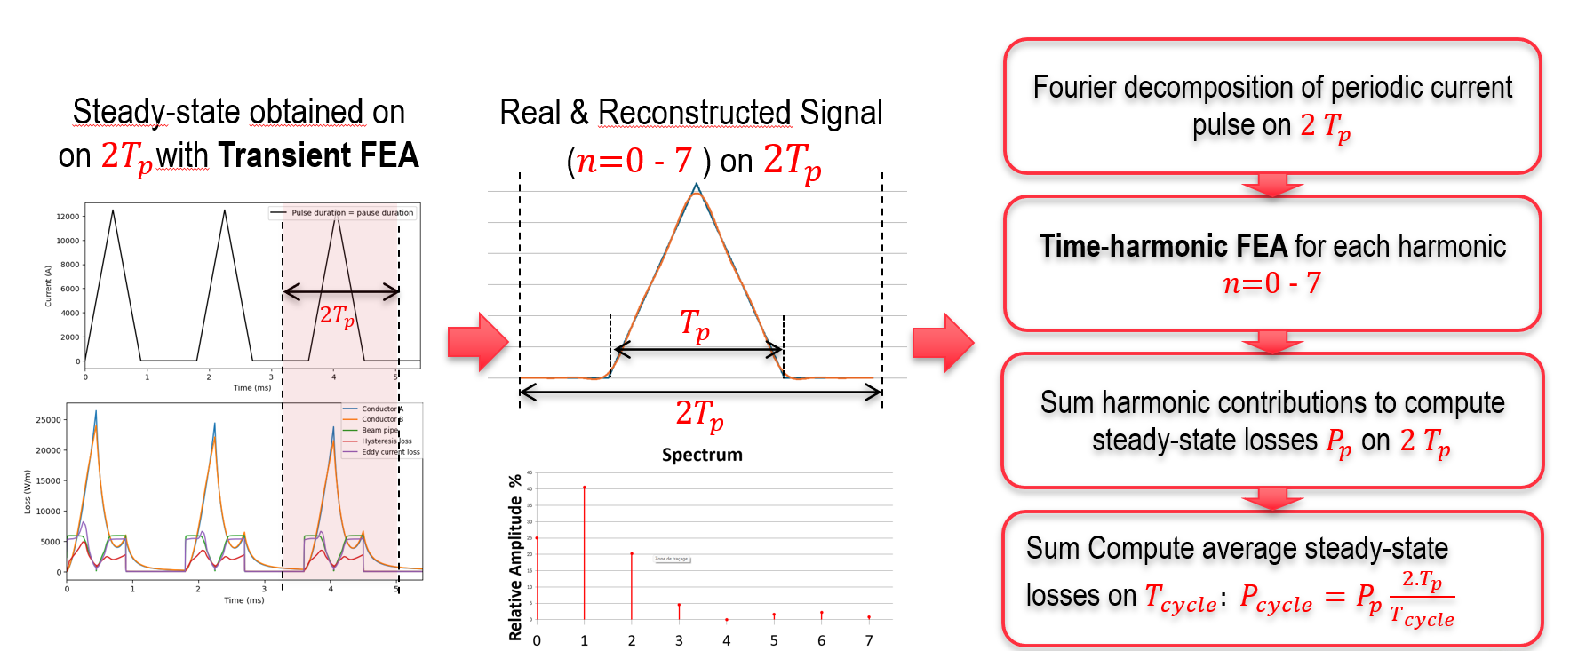
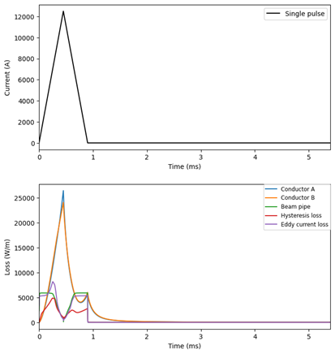
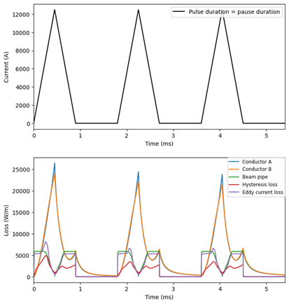
Magnets’ losses computation
Pulsed operation of Normal Conducting magnets leads to additional losses such as :
  Magnetic losses in the ferromagnetic yokes
  Joule losses in windings (skin & proximity effects)
Similar computed values
Real
Good for time harmonics approximation
Time step FEM computation
Copper loss: 75.93 J/m
Titanium loss: 16.46 J/m
Iron loss: 25.11 J/m
Copper loss: 69.21 J/m
Titanium loss: 16.43 J/m
Iron loss: 22.89 J/m
Quicker time harmonics good for rapid losses evaluation

Slide 7

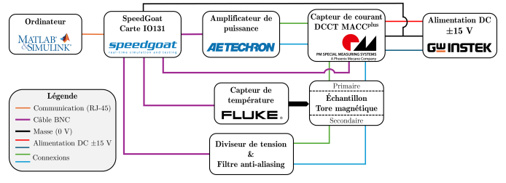
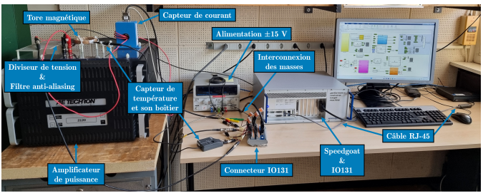
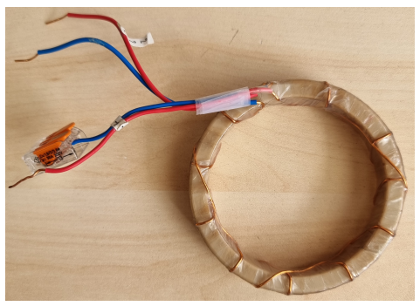
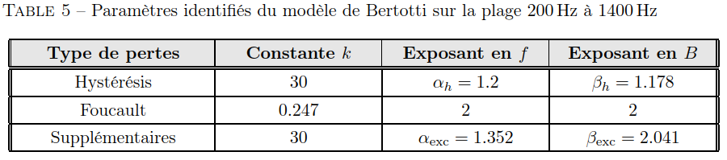
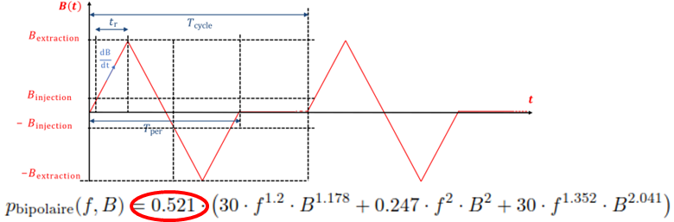
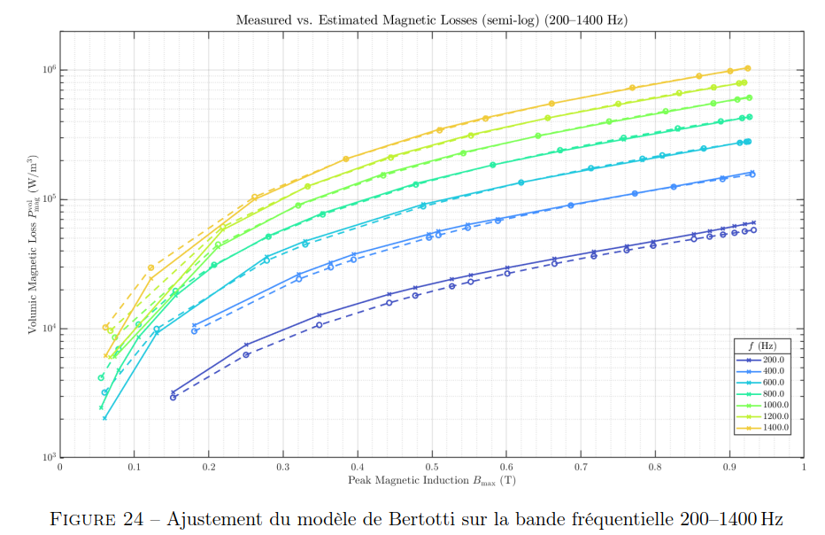
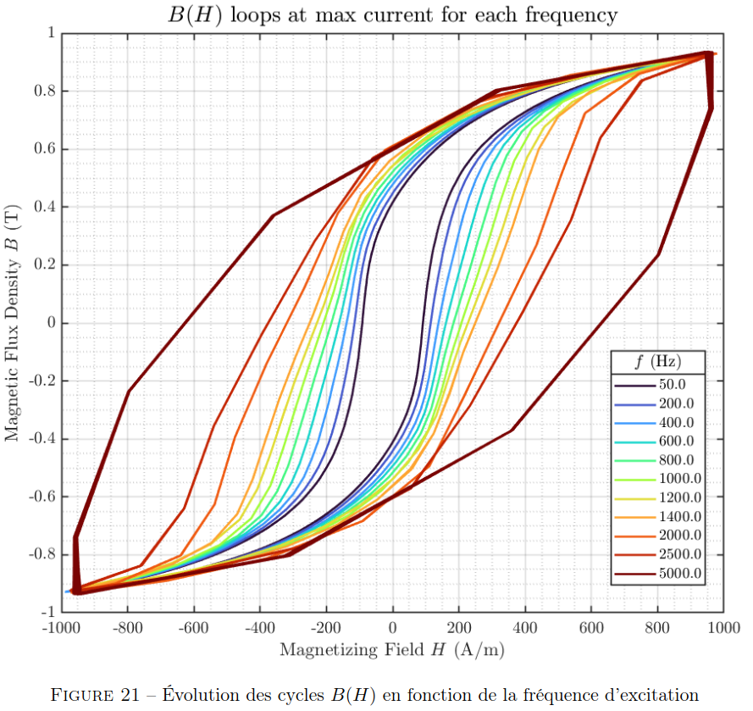
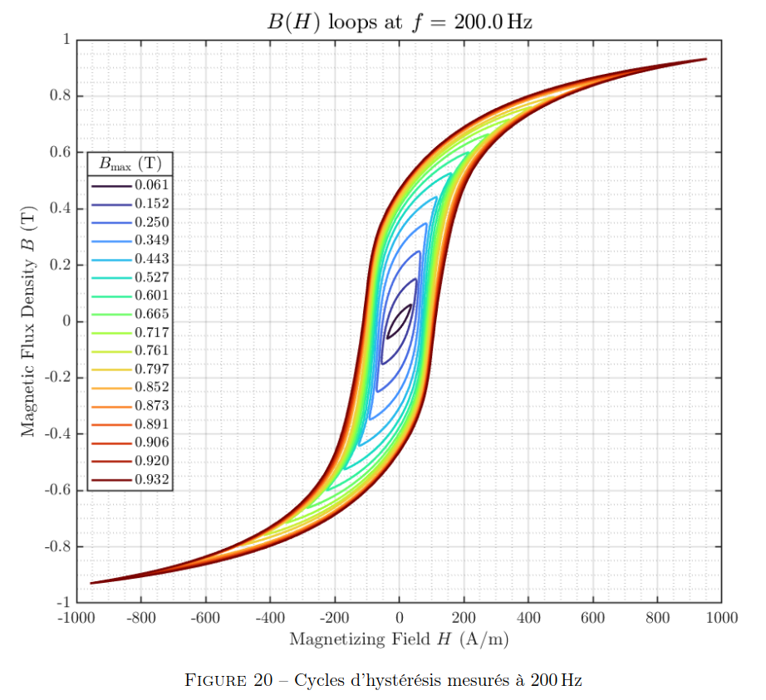
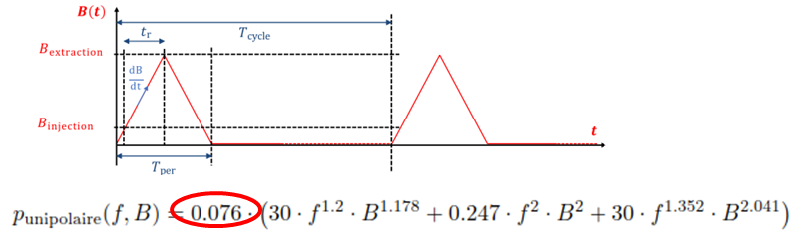
Magnets’ losses computation
Report Measurements: https://edms.cern.ch/document/3377053
Iron losses evaluation with applied time-harmonics evaluation
Tuning of Bertotti parameters in the range of frequencies 200Hz to 1400Hz (sinus)
The model applied to unipolar gives very poor results

Slide 8
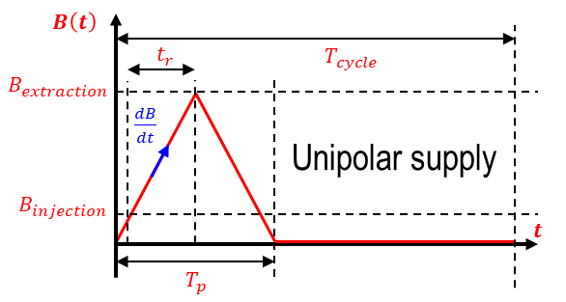
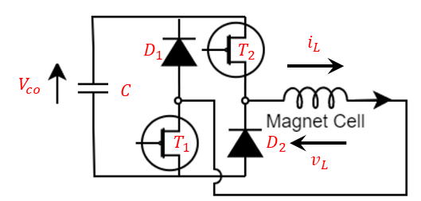
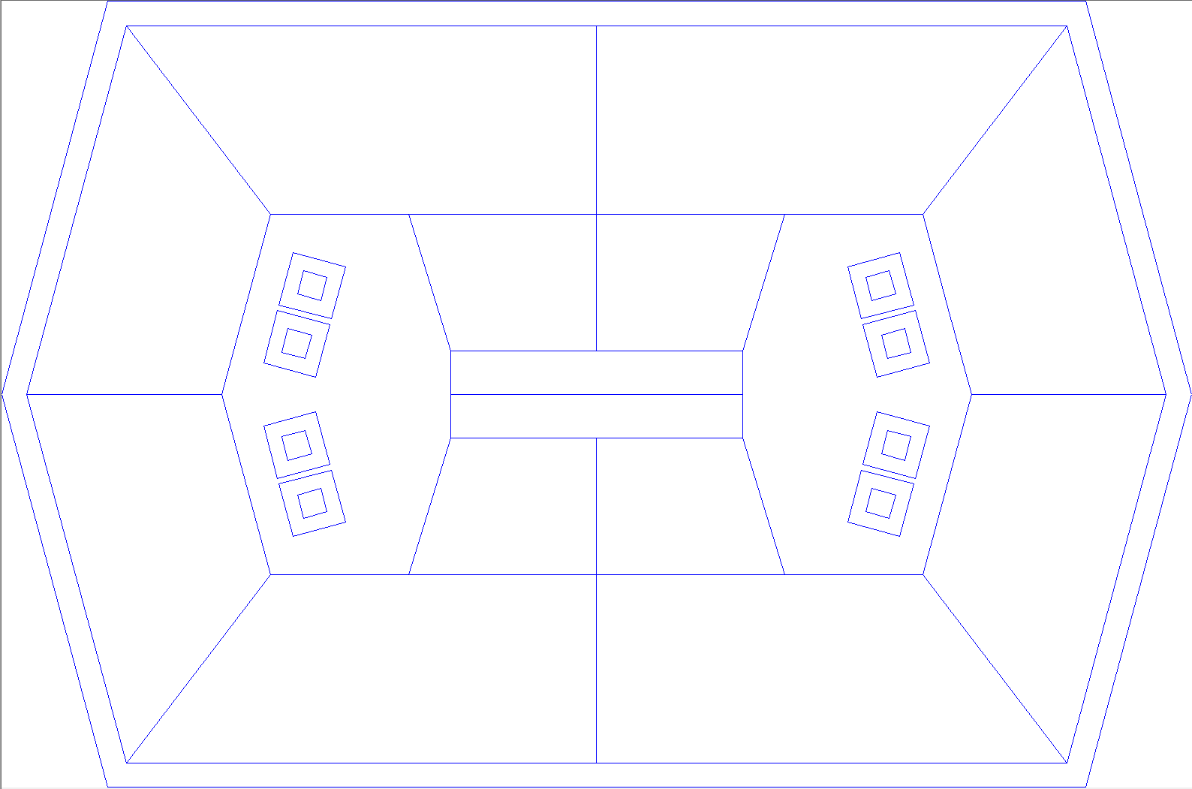
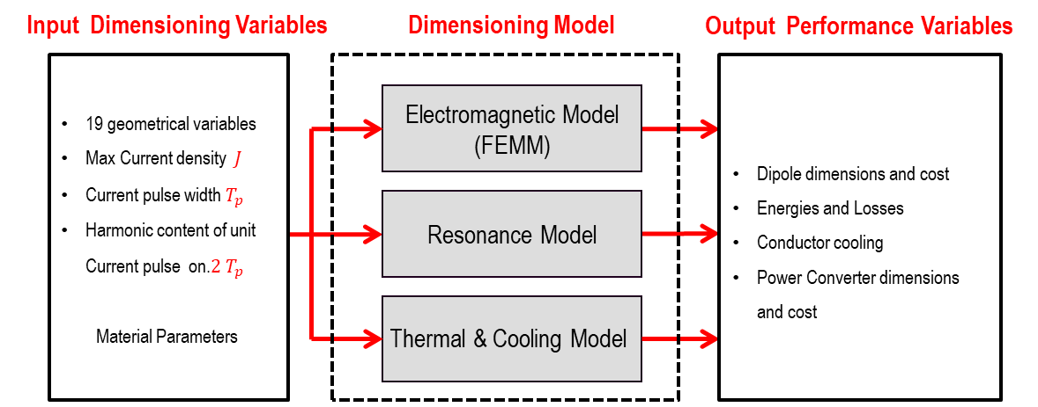
Excel Python design suite for RCS powering and magnets (POMARCS)
H-Dipole to Hourglass & Topology ( θ )
Unipolar Supply Converter Topology
θ
POMARCS → POwer and MAgnets for the RCS
Python based Suite (soon) available under gitlab:
https://gitlab.cern.ch/epc-hpc/muoncollider/-/tree/c21ba71923036aca1ab7d5a4a604070e845061ac/PoMaRCS

Slide 9
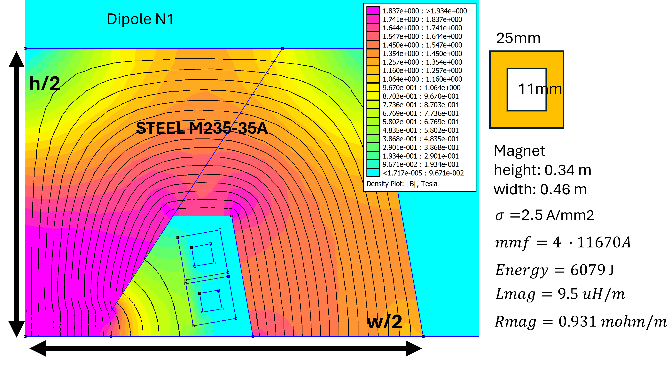
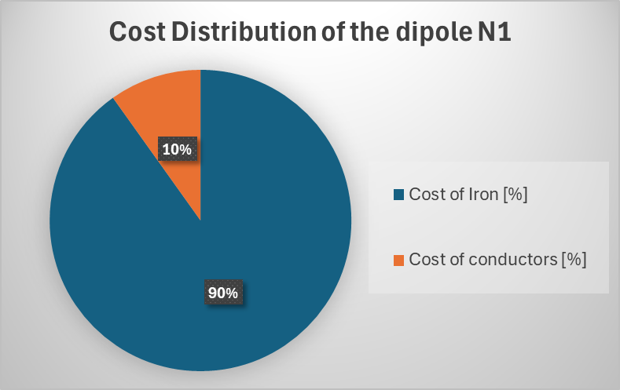
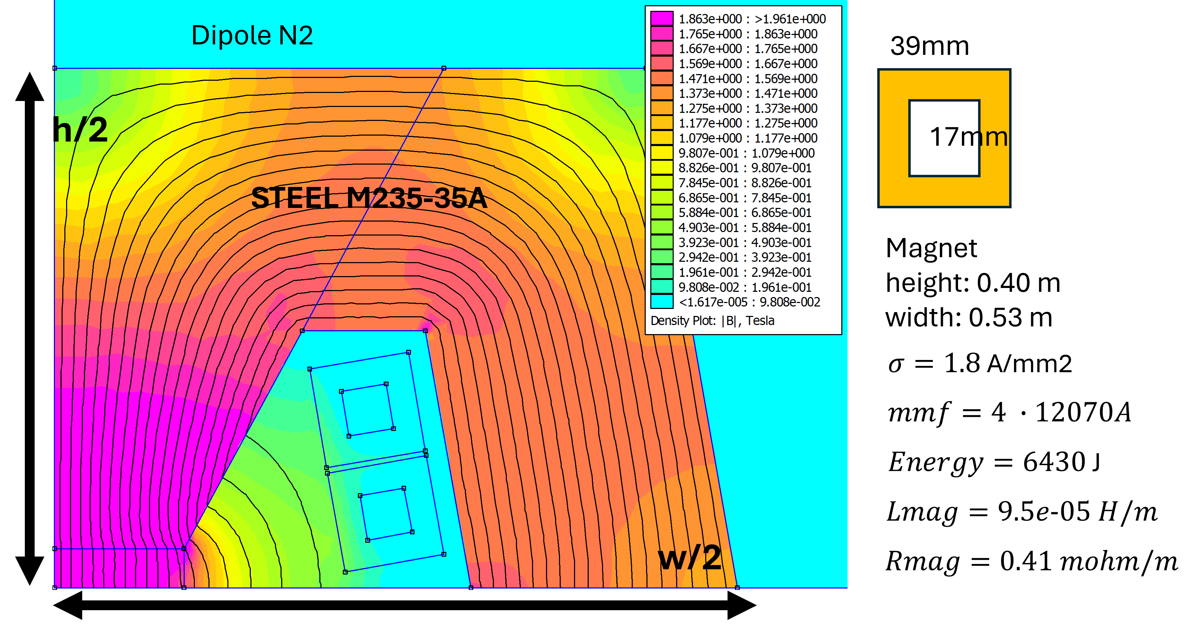
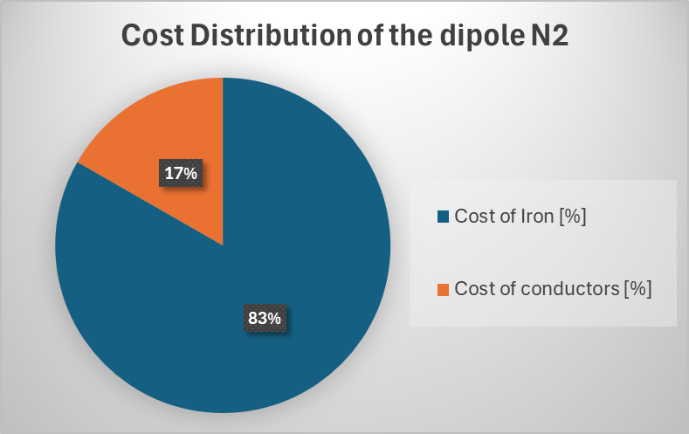
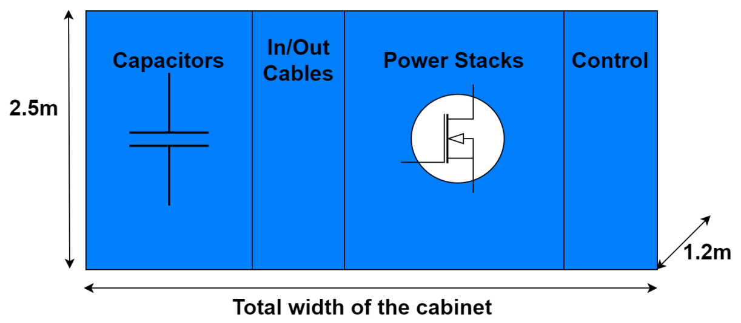
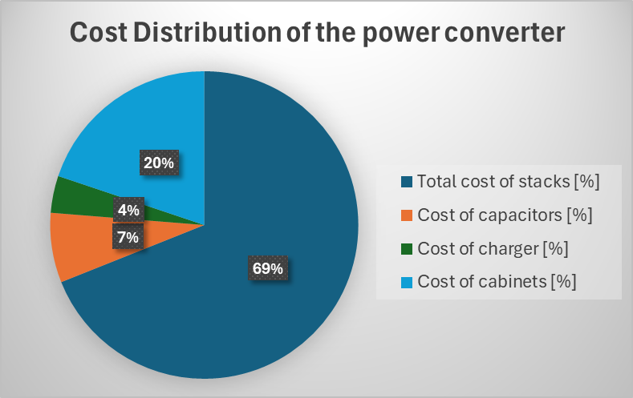
POMARCS with the two scenarios
 | Magnet cost x meter [kEu/m] | total NC length [m] | Cost NC magnet [MEu] | N Pecells | Cost Pecell [kEu] | Cost of the PC [Meu] | Total losses [MW] / [kW/m]
RCS1-CERN | 19.5 | 4103 | 80 | 1000 | 316 | 361 | 1.0 / 0.25
RCS2_CERN | 27.1 | 18650 | 505 | 1340 | 246 | 329 | 13.2 / 0.71
HCS3_CERN | 27.1 | 12940 | 351 | 1000 | 561 | 561 | 15.7 / 1.21
Total CERN |  |  | 936 |  |  | 1251 | 29.9 / 0.84
RCS1 G. Field | 19.5 | 3654 | 71 | 760 | 492 | 374 | 0.71/0.2
RCS1 G. Field | 19.5 | 2539 | 50 | 1200 | 288 | 345 | 1.52/0.60
RCS1 G. Field | 19.5 | 4366 | 85 | 1400 | 199 | 279 | 5.63/1.29
RCS1 G. Field | 27.1 | 20376 | 552 | 1600 | 372 | 595 | 33.15/1.6
Total G. Field |  |  | 758 |  |  | 1593 | 41.01/1.31
Compact high losses design →
Total cost Magnet x meter [Eur/m]: 19’553
RMS current increases
Bigger low losses design →
Total cost Magnet x meter [Eur/m]: 27’105
Example of the HCS3 CERN
Number of stacks: 15
Total cost of stacks [Eu]: 390’285
Cost of capacitors [Eu]: 41’508
Cost of charger [Eur]: 22’000
Cost of cabinets [Eu]: 112’320
Report on cost model:
https://edms.cern.ch/document/3352558

Slide 10
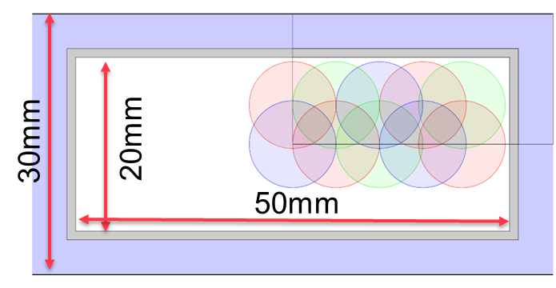
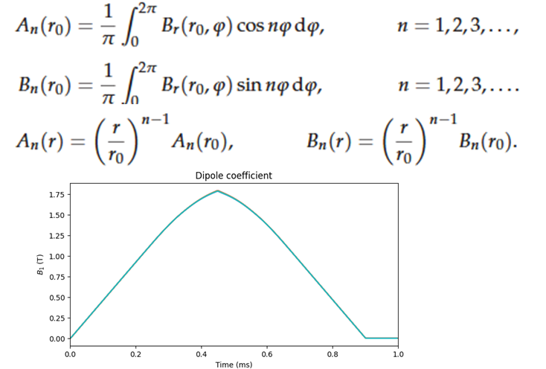
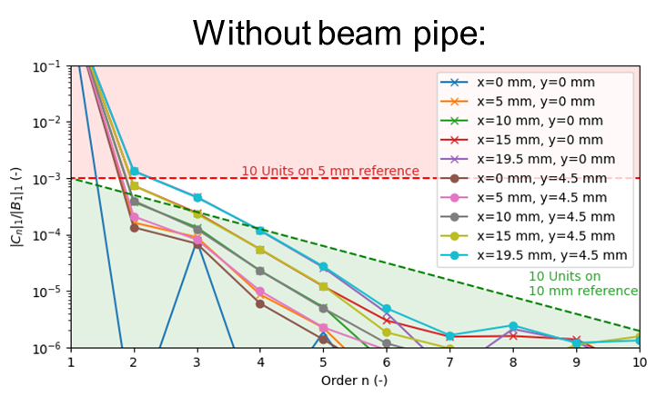
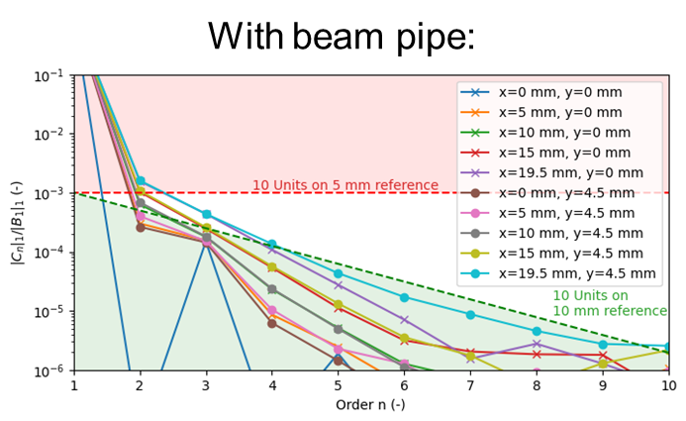
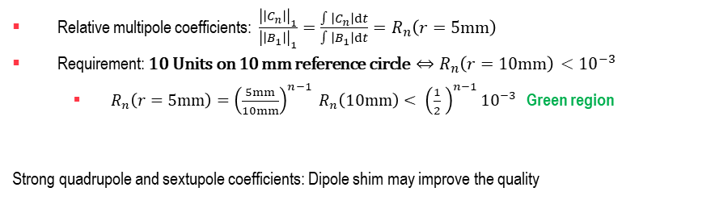
Dipole field quality estimation
Relative multipole coefficients: $\frac{{\left|\left|C_{n}\right|\right|}_{1}}{{\left|\left|B_{1}\right|\right|}_{1}}=\frac{∫\left|C_{n}\right|dt}{∫\left|B_{1}\right|dt}=R_{n}\left(r=5mm\right)$
Requirement: 10 Units on 10 mm reference circle $⇔R_{n}\left(r=10mm\right)<{10}^{−3}$
  $R_{n}\left(r=5mm\right)={\left(\frac{5mm}{10mm}\right)}^{n−1} R_{n}\left(10mm\right)< {\left(\frac{1}{2} \right)}^{n−1}{10}^{−3}$ Green region
Strong quadrupole and sextupole coefficients: Dipole shim may improve the quality

Slide 11
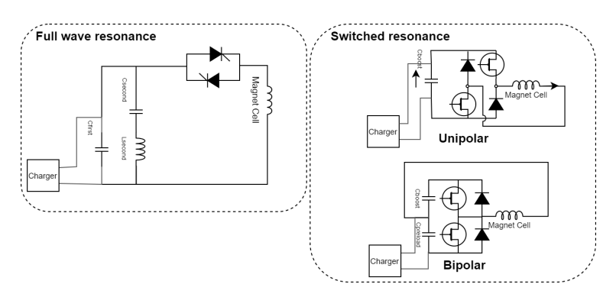
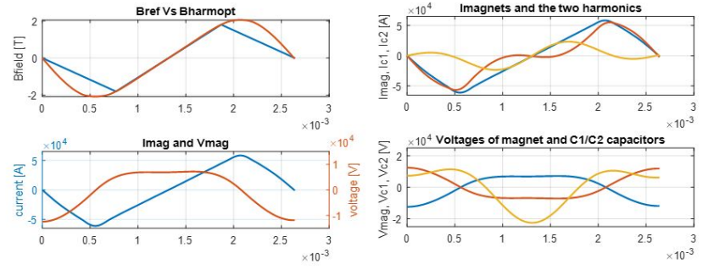
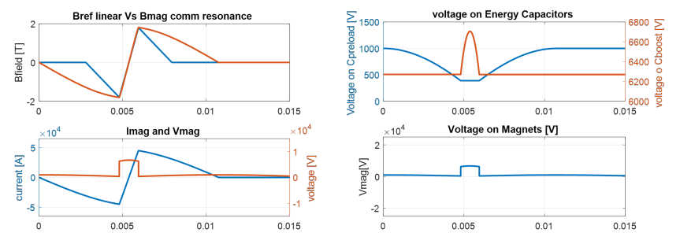
Powering circuit topology
Resonant power converters are employed for energizing dipole and quadrupole magnets.
Switched resonance retained.
Easier to divide in smaller units and put in series.
Cheaper storage energy
Can be controlled without additional HW )to be demonstrated.
More expensive in switching devices

Slide 12
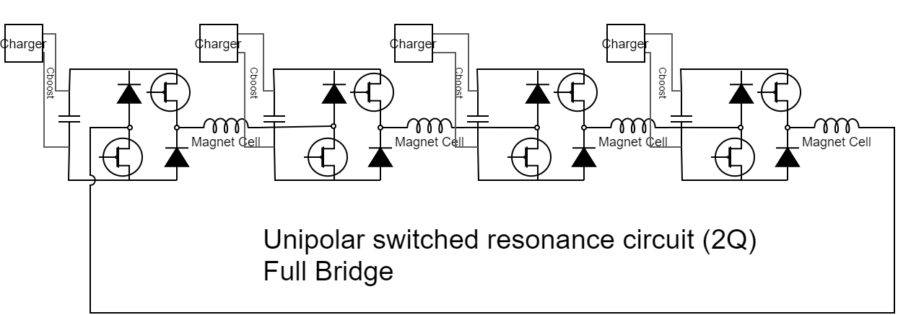
Powering circuit topology
Switched resonance retained.
Easier to divide in smaller units and put in series.
Cheaper storage energy
Can be controlled without additional HW )to be demonstrated.
More expensive in switching devices
Hundreds of smaller power cells connected in series

Slide 13
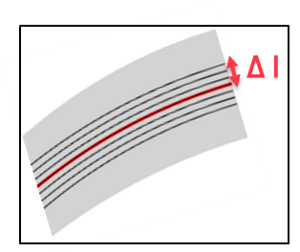
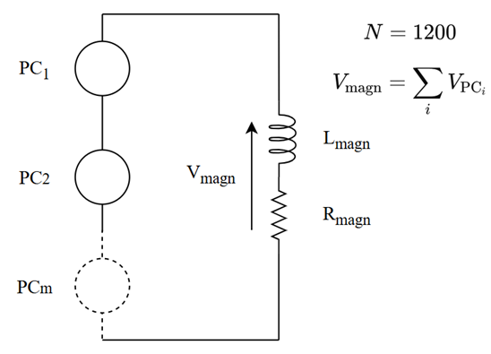
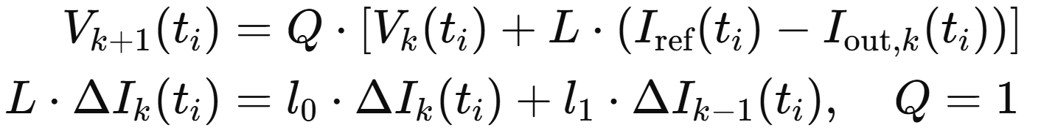







The control problem
We need to demonstrate that we can control the current / field shapes with a reasonably accuracy with the resonance only approach. Two issues to solve:
Repeatability
Control strategy
To meet repeatability requirements, ΔI must remain below 100 ppm in ~ 95% of cases. In the worst-case scenario (when σ_{Ĩ}(t) is maximum), the condition 2·σ_{max} < 100 ppm must be satisfied
Repeatability of the charger most critical
Monte Carlo simulation
ILC works well in simulation

Slide 14



The first real tests
What: a 40 power cells powering system with 40 inductors controlled by a cots demonstrator pcb (Tensy 4.1 microcontroller).
Why: demonstrate that the principle of series connected resonant cells is valid. Demonstrate that we can achieve control performances using the ILC.
How: The power cells have a power ratio of 10k with respect to the real ones. are built using PCB. The inductors will be build on purpose using stacked sheets 0.35mm with airgap of 1mm
How Much: 2.5k for the inductors + 5k for the power cells and the Tensy 4.1.

Slide 15




The first real tests
Capacitors
Power Cell
Charger
Switching devices
Power Cell
Inductor
Controller
Initital charge
Current pulse
Voltage discharge and losses
Re-charge of losses before next pulse
Work in Progress

Slide 16
Conclusions and critical outcomes
Resistive magnets
  Generic: we haven’t got any construction expert audit the design hypothesis.
  EM design: gap harmonics needs to be better assessed, esp. in quads.
  Losses: methodology still to be validate for Iron.
  Construction: verify 0.35 mm laminations; standard in machines.
  Cost: build a (scaled) prototype to refine estimates.
Power converters
  Topology: reatability is essential. To be proved
  Ratings: define current/voltage limits for series/parallel devices. If the performances are not confirmed cost could explode
  Control: ILC promising in sims; accuracy may be too small; 40-cell board gives qualitative insight only.
  Cost: dominated by power stack; test full-size IGBTs/IGCTs/diodes for RBSOA at low duty/low f_sw.
  EMC: high dV/dt → capacitive ground currents; assess impact on magnet current path.

Slide 17
Conclusions and future activities
Resistive Magnets
  Field quality (quads/dipoles): include shim effects → simulation
  Materials: validate PoMaRCS loss model → test
  Full-power dipole & quadrupole: build and test → test
Circuits
  System integration: analyze cable layout → simulation
  Dynamics/EMC: model parasitics; quantify ground returns → simulation
Power Converters
  40-cell PCB: complete and test → test
  Full-power cell: build, map SOA, refine costs → test
Global
  200-cell demo (~1000× power): include dipole & quad; measure field/control → test

Slide 18



TRL Drives the R&D (courtesy of Luca Bottura)
Fast Powering system
Resonating PC + hundreds of connected cells + p2p control. Altogether is totally new. Not sure it’ll work as needed!

