Slide 1
KAON levy hbt with phenix
Day of Femtoscopy
03. 11. 2025.

Slide 2
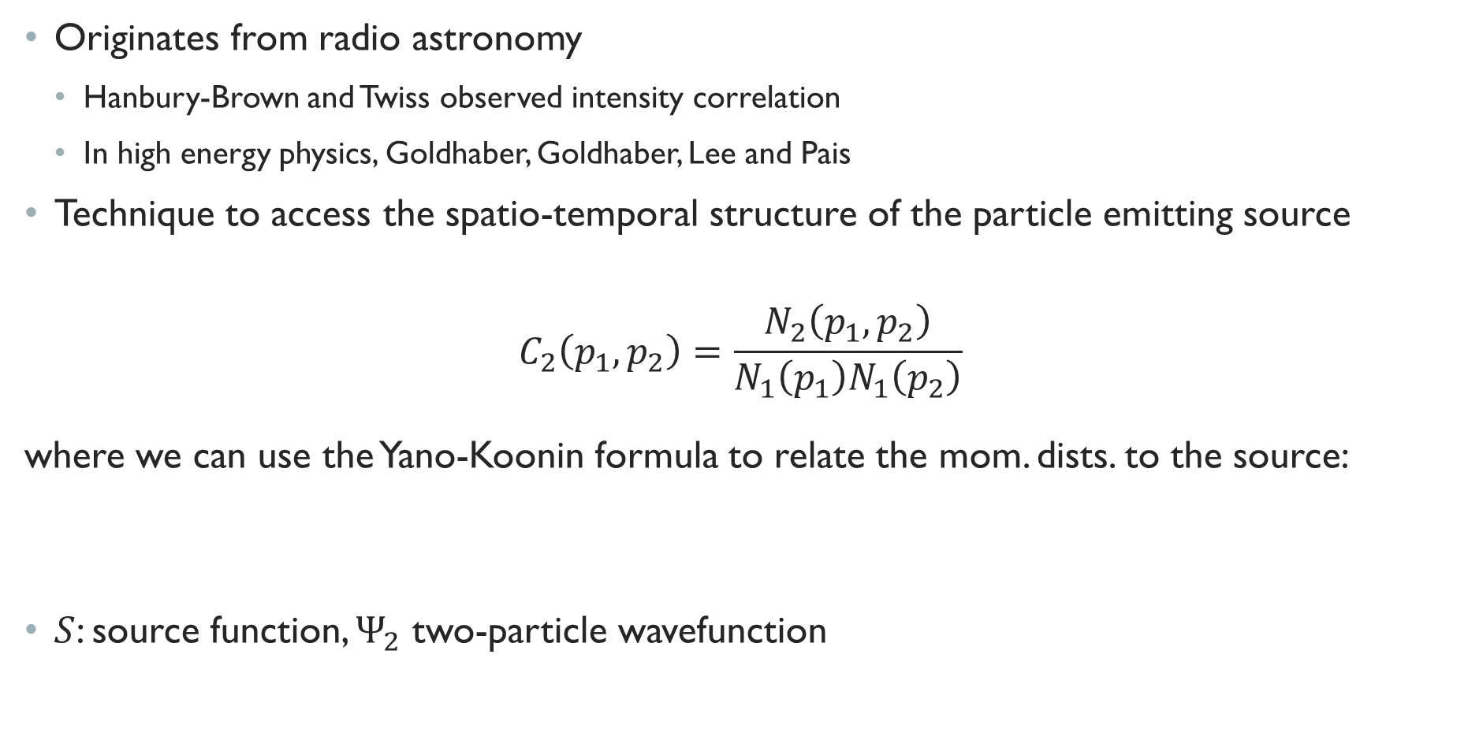
introduction
Originates from radio astronomy
Hanbury-Brown and Twiss observed intensity correlation
In high energy physics, Goldhaber, Goldhaber, Lee and Pais
Technique to access the spatio-temporal structure of the particle emitting source
$$C_{2}\left(p_{1},p_{2}\right)=\frac{N_{2}\left(p_{1},p_{2}\right)}{N_{1}\left(p_{1}\right)N_{1}\left(p_{2}\right)}$$
where we can use the Yano-Koonin formula to relate the mom. dists. to the source:
$S$: source function, $Ψ_{2}$ two-particle wavefunction
$$N_{2}\left(p_{1},p_{2}\right)=∫dx_{1}dx_{2}S\left(x_{1},p_{1}\right)S\left(x_{2},p_{2}\right){\left|Ψ_{2}\left(x_{1},x_{2}\right)\right|}^{2}$$

Slide 3
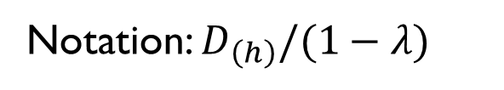
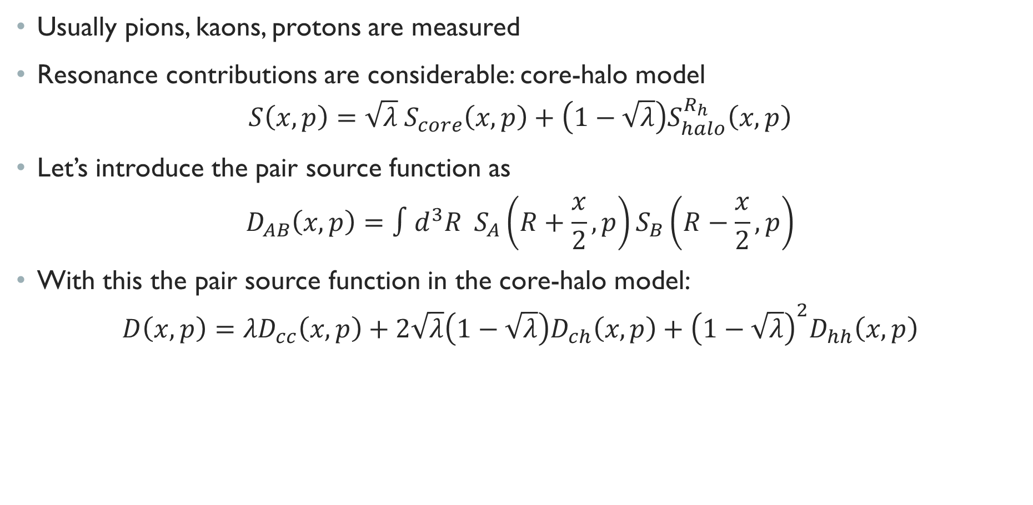
Femtoscopy – the core-halo model
Usually pions, kaons, protons are measured
Resonance contributions are considerable: core-halo model
$$S\left(x,p\right)=\sqrt{λ} S_{core}\left(x,p\right)+\left(1−\sqrt{λ}\right)S_{halo}^{R_{h}}\left(x,p\right)$$
Let’s introduce the pair source function as
$$D_{AB}\left(x,p\right)=∫d^{3}R S_{A}\left(R+\frac{x}{2},p\right)S_{B}\left(R−\frac{x}{2},p\right)$$
With this the pair source function in the core-halo model:
$$D\left(x,p\right)=λD_{cc}\left(x,p\right)+2\sqrt{λ}\left(1−\sqrt{λ}\right)D_{ch}\left(x,p\right)+{\left(1−\sqrt{λ}\right)}^{2}D_{hh}\left(x,p\right)$$
Notation: $D_{\left(h\right)}/(1−λ)$

Slide 4
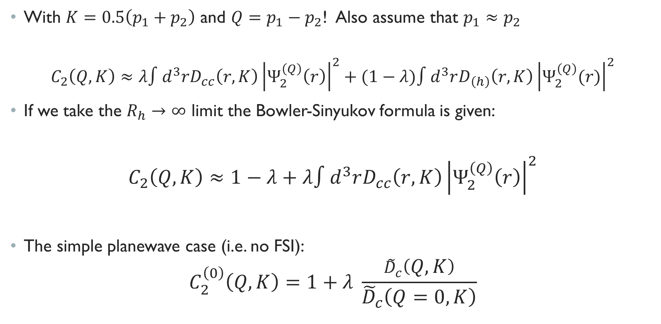
Femtoscopy – general form
With $K=0.5\left(p_{1}+p_{2}\right)$ and $Q=p_{1}−p_{2}$! Also assume that $p_{1}≈p_{2}$
$$C_{2}\left(Q,K\right)≈λ∫d^{3}rD_{cc}\left(r,K\right){\left|Ψ_{2}^{\left(Q\right)}\left(r\right)\right|}^{2}+(1−λ)∫d^{3}rD_{\left(h\right)}\left(r,K\right){\left|Ψ_{2}^{\left(Q\right)}(r)\right|}^{2}$$
If we take the $R_{h}→∞$ limit the Bowler-Sinyukov formula is given:
$$C_{2}\left(Q,K\right)≈1−λ+λ∫d^{3}rD_{cc}\left(r,K\right){\left|Ψ_{2}^{\left(Q\right)}\left(r\right)\right|}^{2}$$
The simple planewave case (i.e. no FSI):
$$C_{2}^{\left(0\right)}\left(Q,K\right)=1+λ \frac{{\tilde{D}}_{c}\left(Q,K\right)}{{\tilde{D}}_{c}\left(Q=0,K\right)}$$

Slide 5
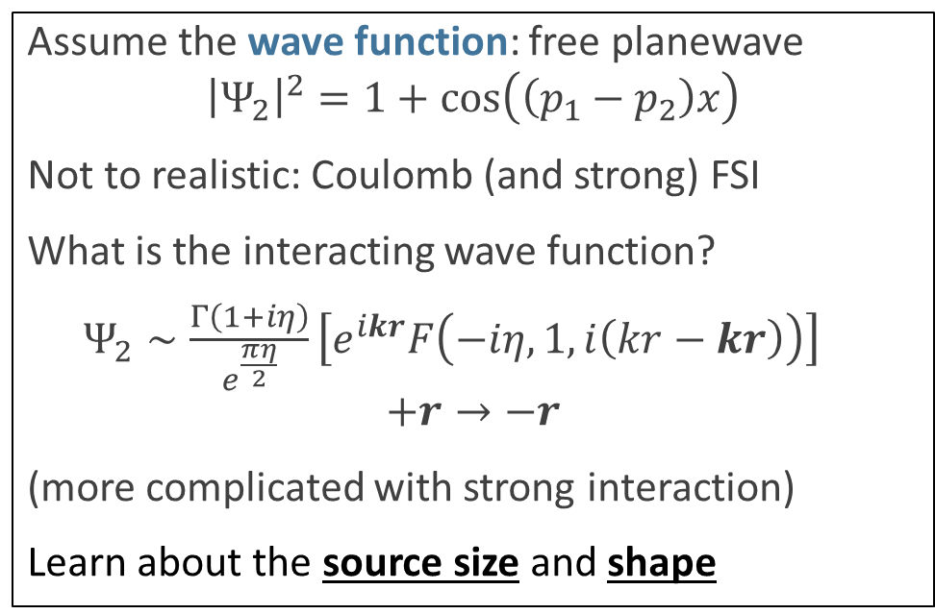
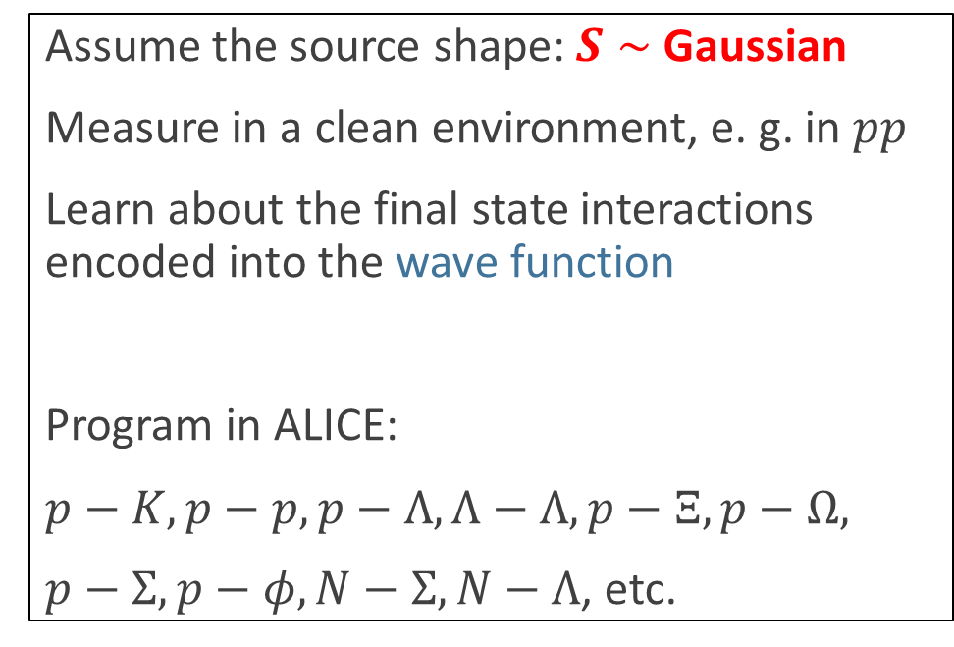
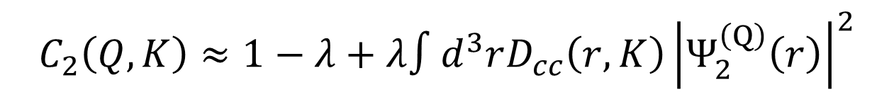
Femtoscopy – two approaches
Femtoscopy – general form
$$C_{2}\left(Q,K\right)≈1−λ+λ∫d^{3}rD_{cc}\left(r,K\right){\left|Ψ_{2}^{\left(Q\right)}\left(r\right)\right|}^{2}$$
Assume the source shape: $S∼$ Gaussian
Measure in a clean environment, e. g. in $pp$
Learn about the final state interactions encoded into the wave function
Program in ALICE:
$p−K, p−p, p−Λ, Λ−Λ, p−Ξ, p−Ω,$
$p−Σ, p−φ, N−Σ, N−Λ$, etc.
Assume the wave function: free planewave
$${\left|Ψ_{2}\right|}^{2}=1+\cos\left(\left(p_{1}−p_{2}\right)x\right)$$
Not to realistic: Coulomb (and strong) FSI
What is the interacting wave function?
$Ψ_{2}∼\frac{Γ\left(1+iη\right)}{e^{\frac{πη}{2}}}\left[e^{ikr}F\left(−iη,1,i\left(kr−kr\right)\right)\right]$ $$+r→−r$$
(more complicated with strong interaction)
Learn about the source size and shape

Slide 6
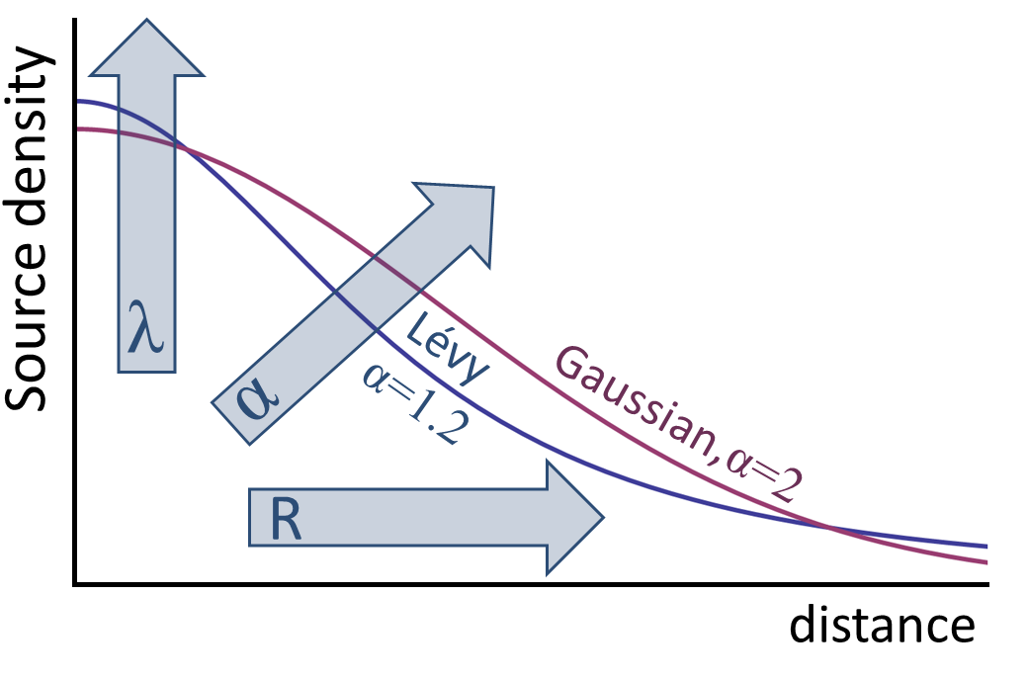
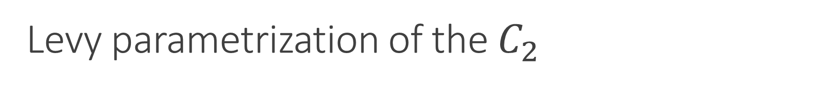
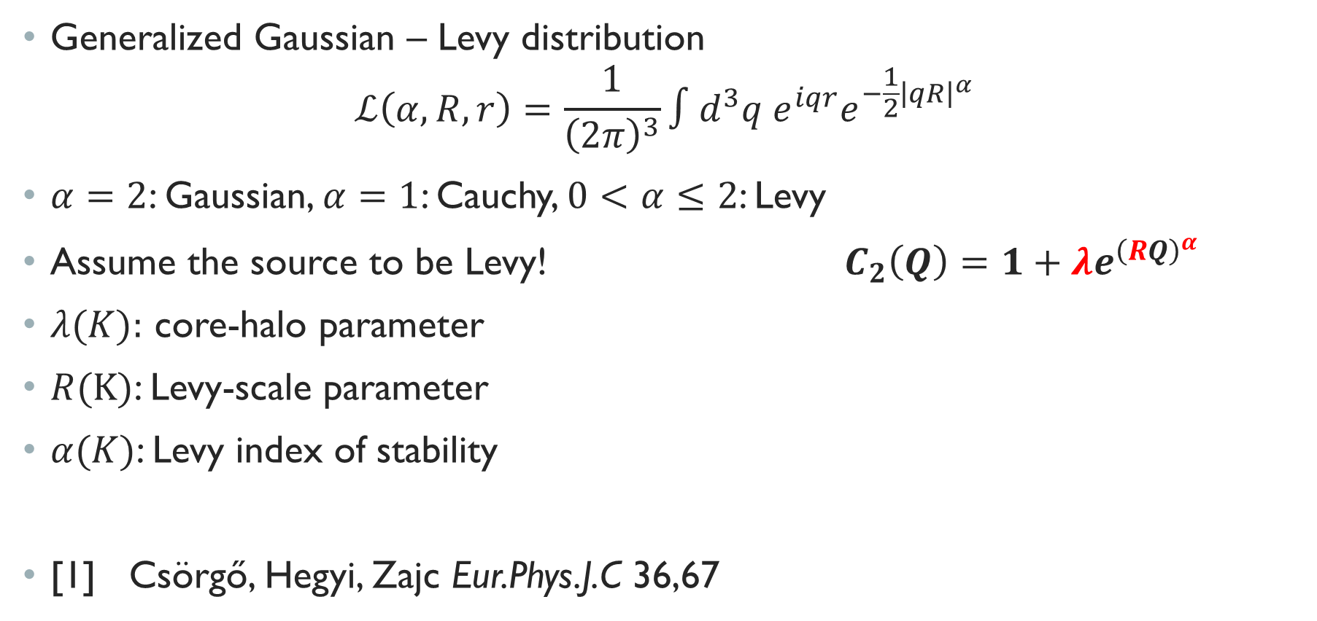
Levy parametrization of the $C_{2}$
Generalized Gaussian – Levy distribution
$$ℒ\left(α,R,r\right)=\frac{1}{{\left(2π\right)}^{3}}∫d^{3}q e^{iqr}e^{−\frac{1}{2}{\left|qR\right|}^{α}}$$
$α=2$: Gaussian, $α=1$: Cauchy, $0<α≤2$: Levy
Assume the source to be Levy! $C_{2}\left(Q\right)=1+λe^{{\left(RQ\right)}^{α}}$
$λ(K):$ core-halo parameter
$R(K)$: Levy-scale parameter
$α(K)$: Levy index of stability
[1] Csörgő, Hegyi, Zajc Eur.Phys.J.C 36,67

Slide 7
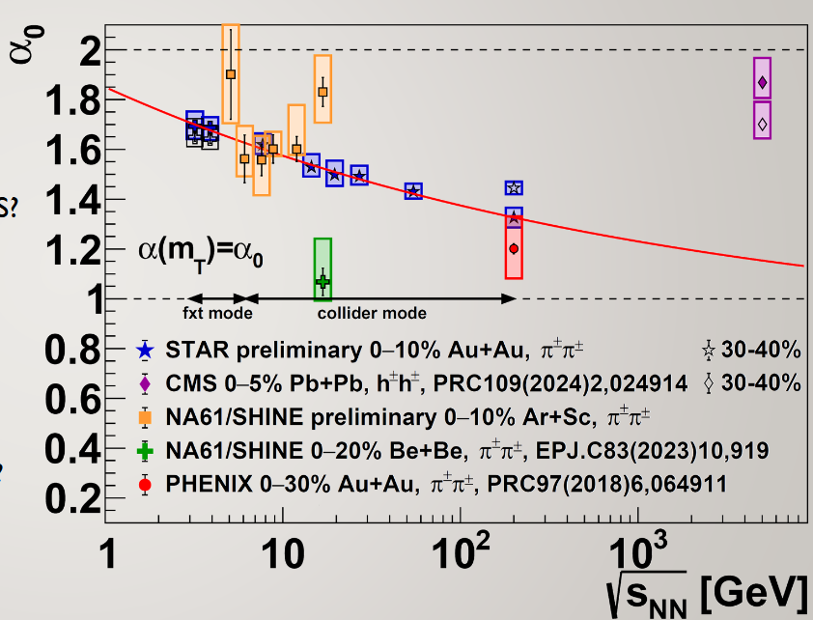
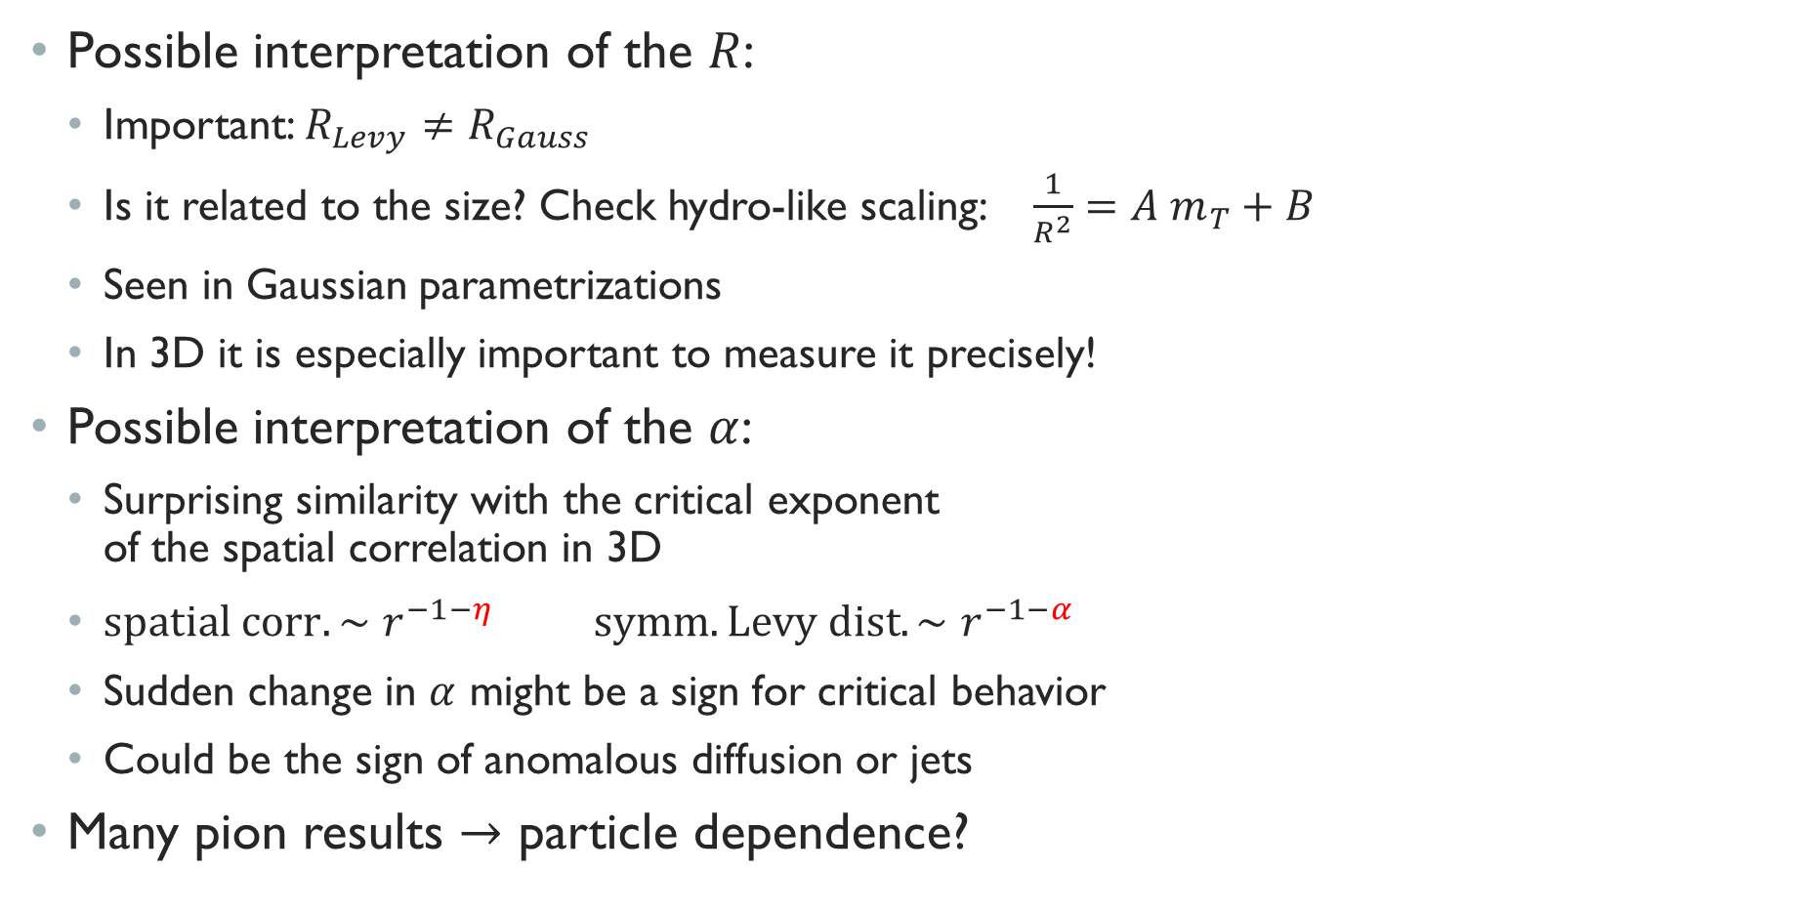
Physics in the parameters
Possible interpretation of the $R$:
Important: $R_{Levy}≠R_{Gauss}$
Is it related to the size? Check hydro-like scaling: $\frac{1}{R^{2}}=A m_{T}+B$
Seen in Gaussian parametrizations
In 3D it is especially important to measure it precisely!
Possible interpretation of the $α$:
Surprising similarity with the critical exponent of the spatial correlation in 3D
$spatial corr. ∼r^{−1−η} symm. Levy dist. ∼r^{−1−α}$
Sudden change in $α$ might be a sign for critical behavior
Could be the sign of anomalous diffusion or jets
Many pion results $→$ particle dependence?

Slide 8
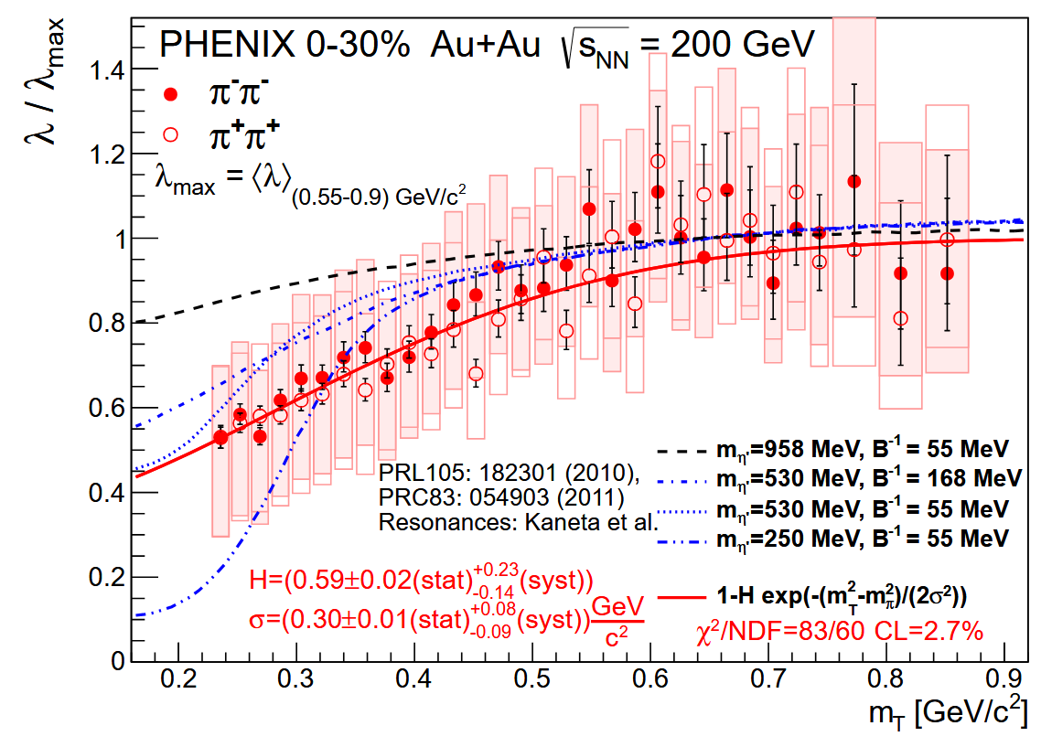
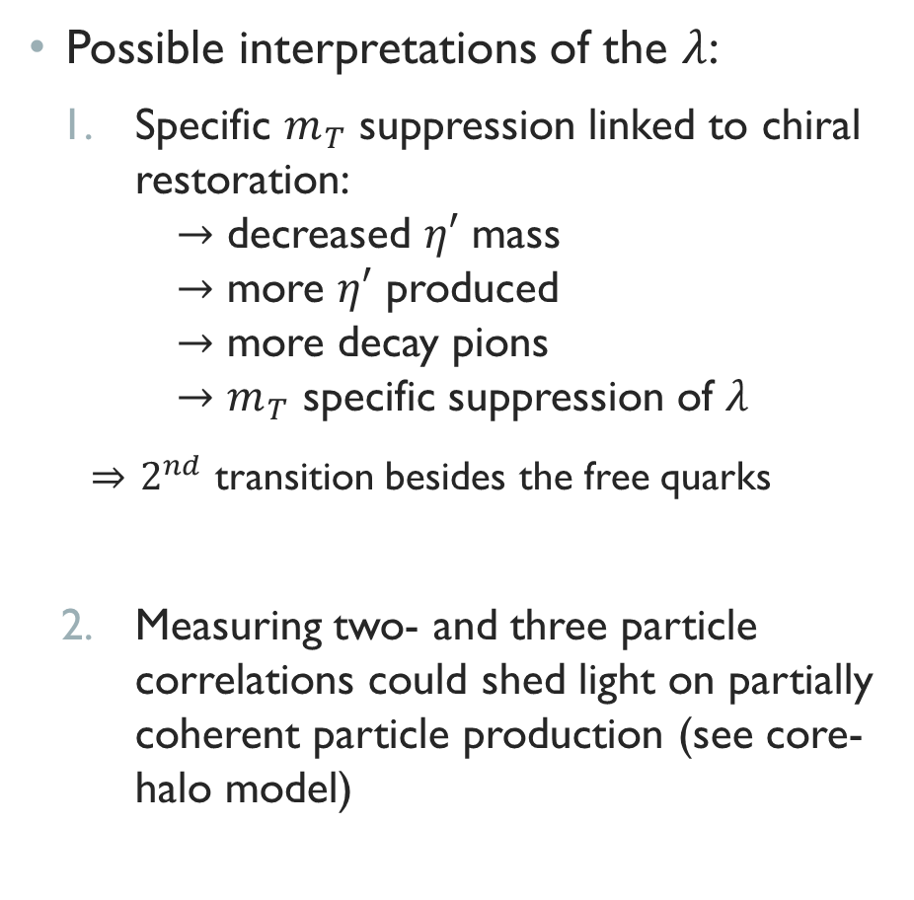
Physics in the parameters
Possible interpretations of the $λ$:
Specific $m_{T}$ suppression linked to chiral restoration: $→$ decreased $η′$ mass $→$ more $η′$ produced $→$ more decay pions $→$ $m_{T}$ specific suppression of $λ$
$⇒$ $2^{nd}$ transition besides the free quarks
Measuring two- and three particle correlations could shed light on partially coherent particle production (see core-halo model)
PHENIX, Phys.Rev.C 108, 4
MEASURE HBT WITH THE PROPER PARAMETRIZATION

Slide 9
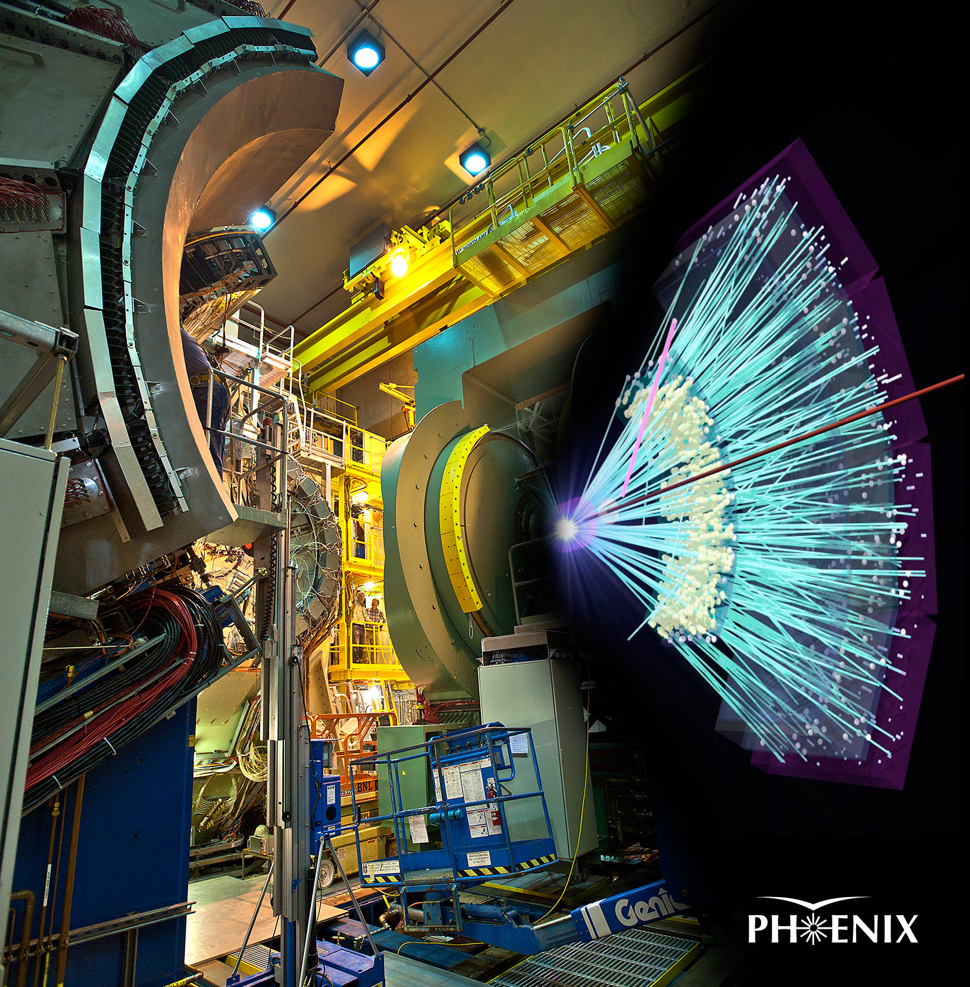
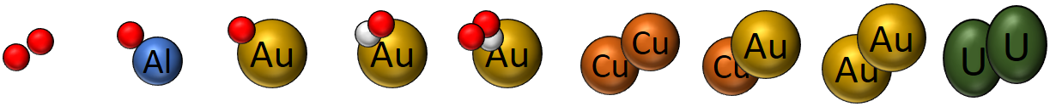
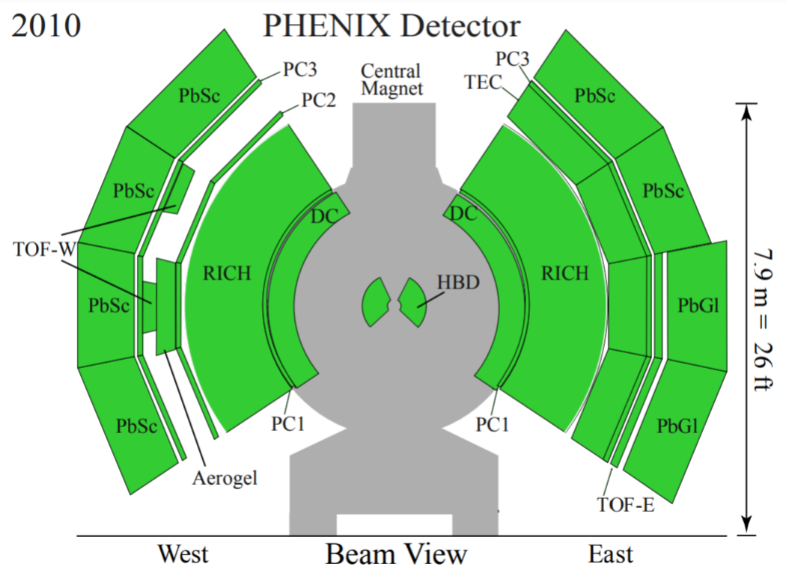
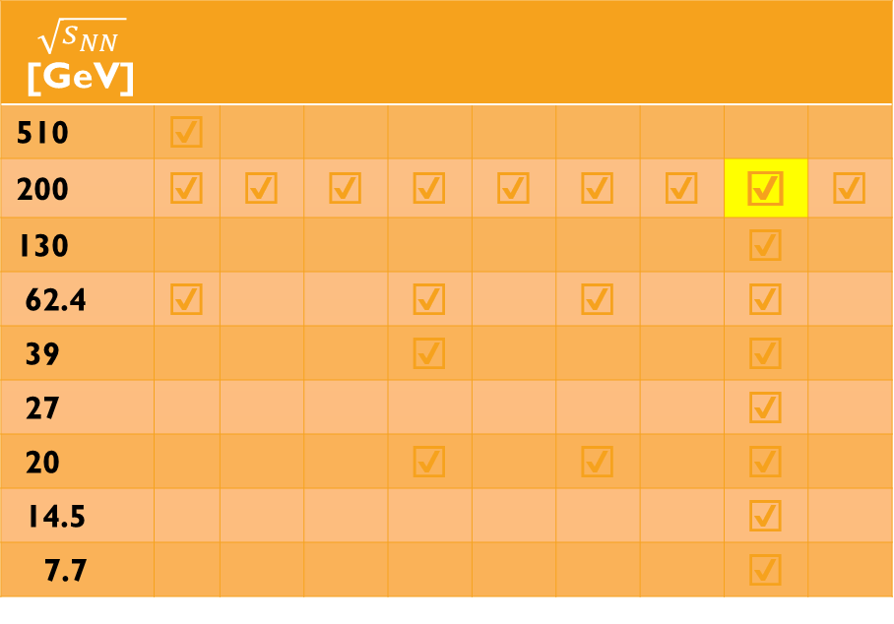

The PHENIX and the BES
Collision energies: 7.7 to 200 GeV
20-400 MeV in $μ_{B}$, 140-170 MeV in $T$
This talk: 200 GeV Au+Au
$$\sqrt{s_{NN }}$$ [GeV]
510 | ☑
200 | ☑ | ☑ | ☑ | ☑ | ☑ | ☑ | ☑ | ☑ | ☑
130 |  |  |  |  |  |  |  | ☑
62.4 | ☑ |  |  | ☑ |  | ☑ |  | ☑
39 |  |  |  | ☑ |  |  |  | ☑
27 |  |  |  |  |  |  |  | ☑
20 |  |  |  | ☑ |  | ☑ |  | ☑
14.5 |  |  |  |  |  |  |  | ☑
7.7 |  |  |  |  |  |  |  | ☑

Slide 10
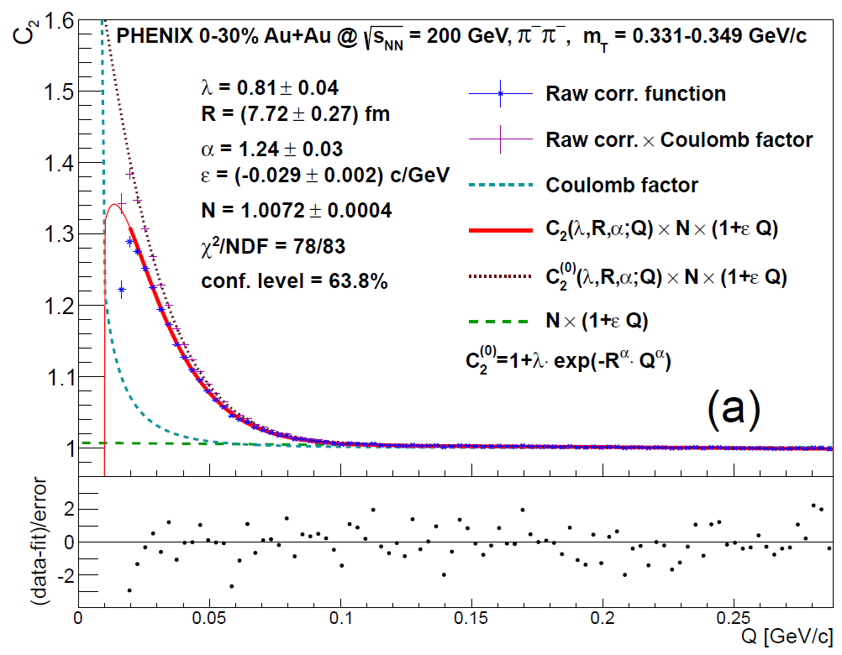
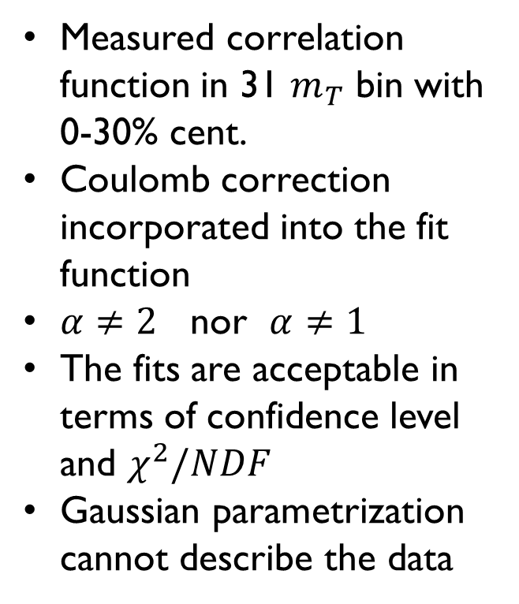
The first results – PHENIX 0-30% Au+Au
Measured correlation function in 31 $m_{T}$ bin with 0-30% cent.
Coulomb correction incorporated into the fit function
$α≠2$ nor $α≠1$
The fits are acceptable in terms of confidence level and $χ^{2}/NDF$
Gaussian parametrization cannot describe the data

Slide 11
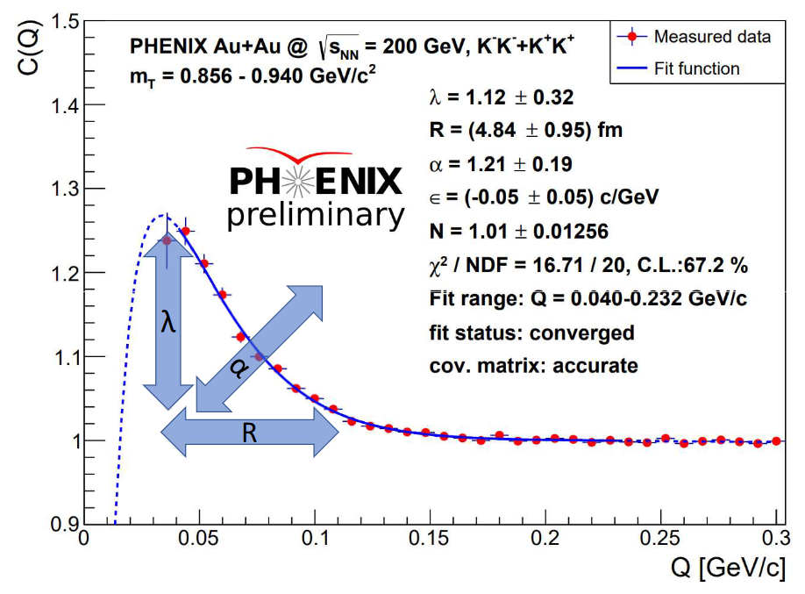
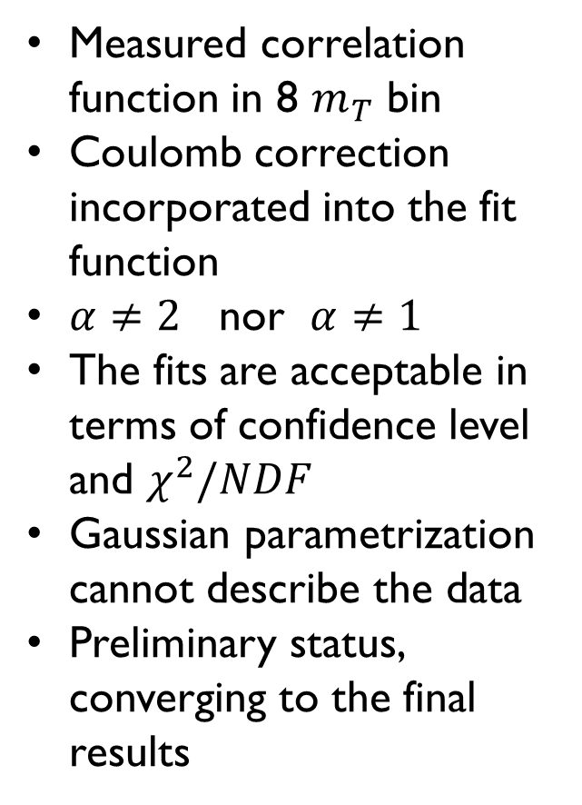
PHENIX minbias K-k correlation
Measured correlation function in 8 $m_{T}$ bin
Coulomb correction incorporated into the fit function
$α≠2$ nor $α≠1$
The fits are acceptable in terms of confidence level and $χ^{2}/NDF$
Gaussian parametrization cannot describe the data
Preliminary status, converging to the final results

Slide 12
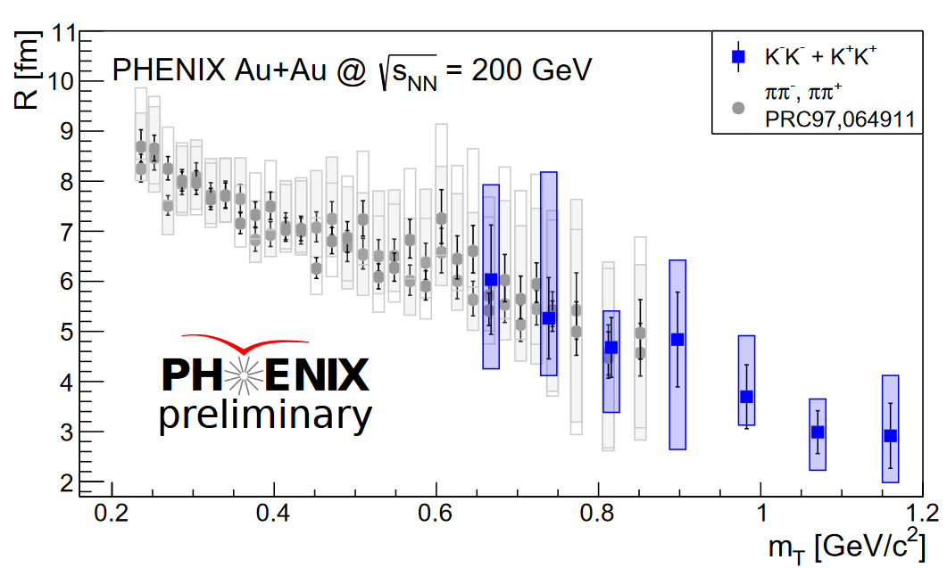
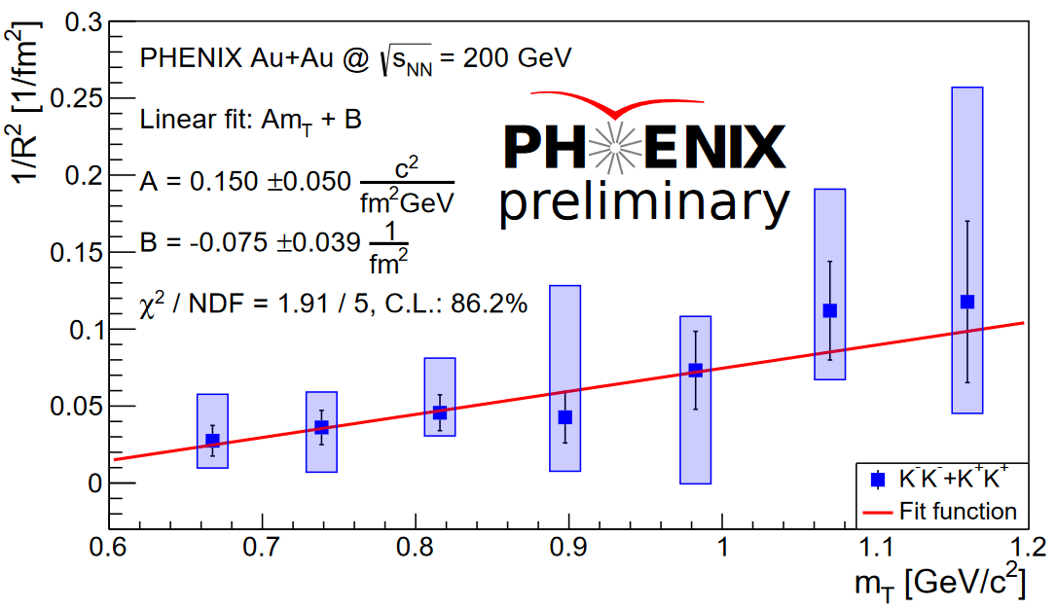
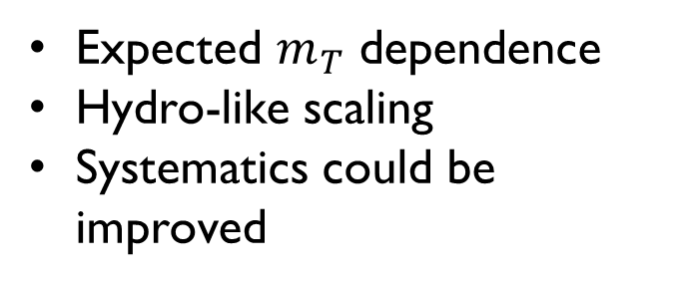
Preliminary – $R\left(m_{T}\right)$
Expected $m_{T}$ dependence
Hydro-like scaling
Systematics could be improved
Excellent agreement with earlier results

Slide 13
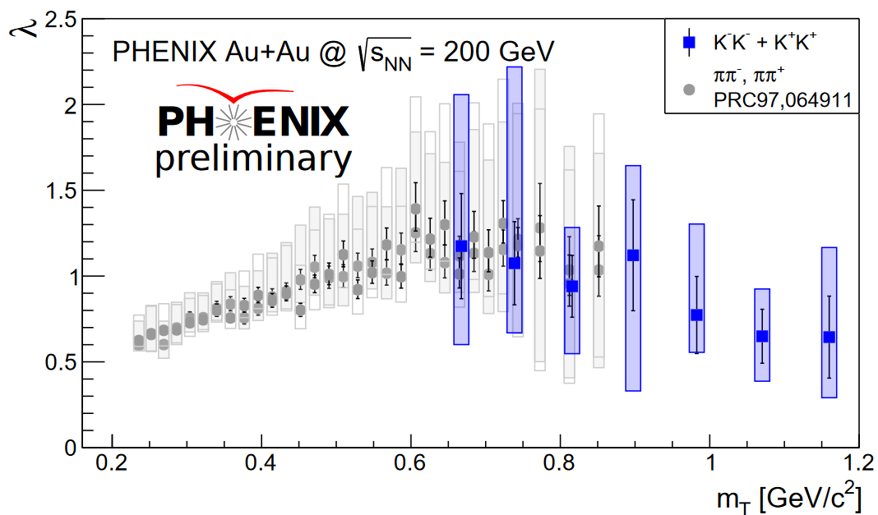
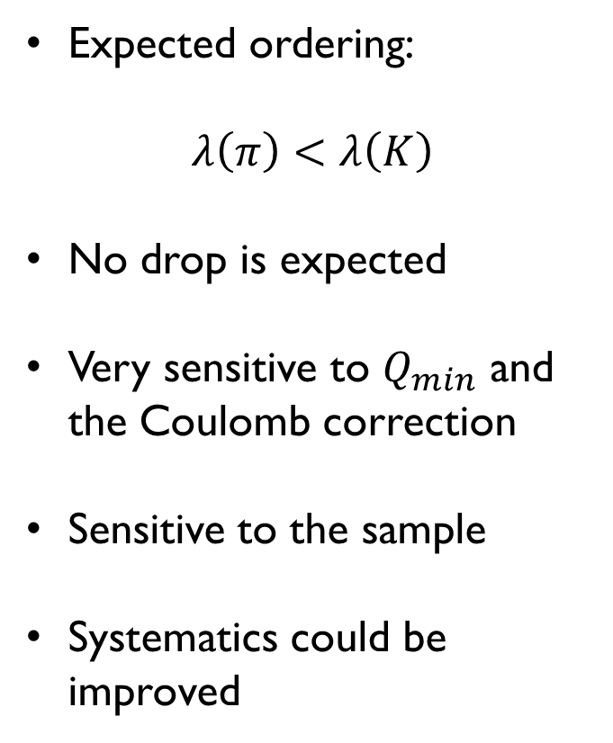
Preliminary – $λ\left(m_{T}\right)$
Expected ordering:
$$λ\left(π\right)<λ\left(K\right)$$
No drop is expected
Very sensitive to $Q_{min}$ and the Coulomb correction
Sensitive to the sample
Systematics could be improved
Excellent agreement with earlier results

Slide 14
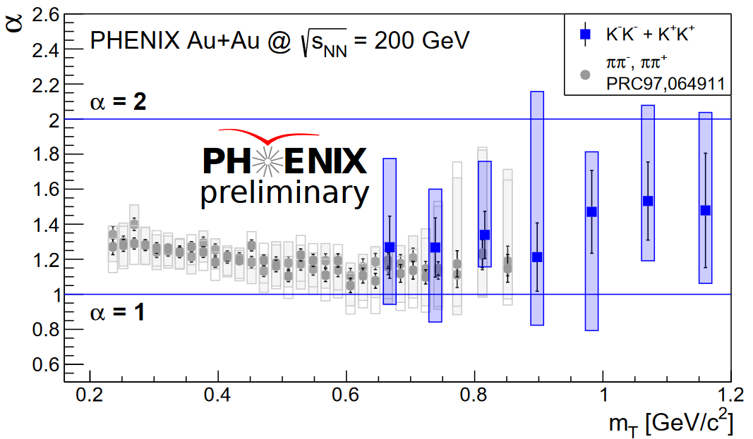
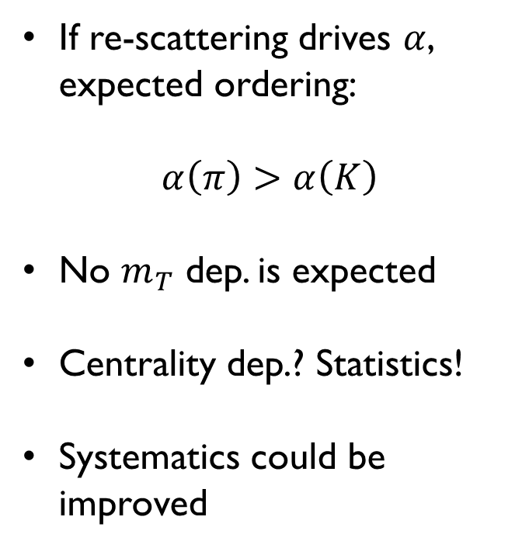
Preliminary – $α\left(m_{T}\right)$
If re-scattering drives $α$, expected ordering:
$$α\left(π\right)>α\left(K\right)$$
No $m_{T}$ dep. is expected
Centrality dep.? Statistics!
Systematics could be improved
Excellent agreement with earlier results

Slide 15
Thank you for your attention!

Slide 16
references
[1] Csörgő, Hegyi, Zajc Eur. Phys. J. C 36,67
[2] Nagy, Purzsa, Csanad, Kincses Eur. Phys. J. C 83, 1015 (2023)
[3] PHENIX Coll. Phys. Rev. C 97 (2018) 6, 064911
[4] PHENIX Coll. Phys. Rev. C 110 (2024) 6, 6

