Slide 1

Lévy source parameters from EPOS with CRAB
Szilágyi Máté
Eötvös Loránd University (ELTE)
Days of Femtoscopy 2025. 11.04. Gyöngyös

Slide 2
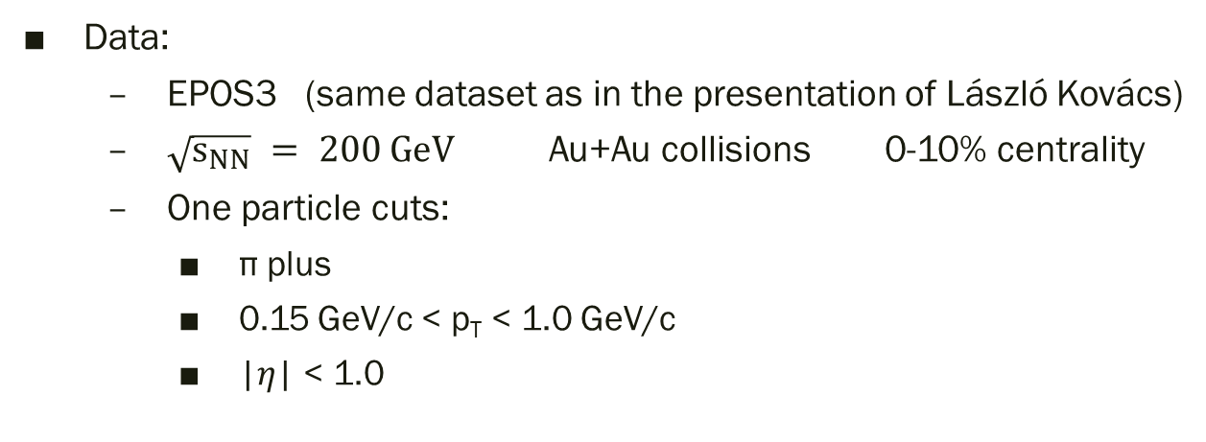
Introduction
Method
Fitting the source function event by event
Averaging the parameters
EPOS3 data
Lévy scale parameters
Add Bose-Einstien correlations with CRAB
Fitting the 3D correlation function
Data:
EPOS3 (same dataset as in the presentation of László Kovács)
$\sqrt{s_{NN}} = 200 GeV$ Au+Au collisions 0-10% centrality
One particle cuts:
π plus
0.15 GeV/c < p_{T} < 1.0 GeV/c
|𝜂| < 1.0

Slide 3
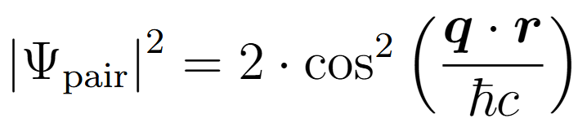
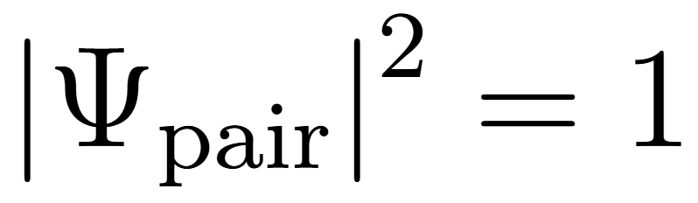
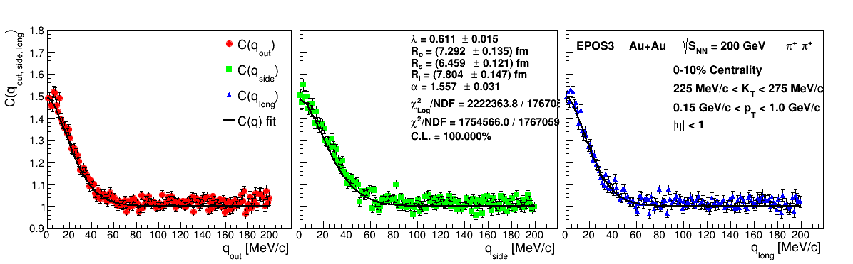
How CRAB works?
Loads particles with similar impact parameters in mixed events
Chooses a particle pair
From a given average transverse momentum bin: K_{min} < K_{T} < K_{max}
Calculates the correlation
Nominator A(q) ->
Denominator B(q) ->
3D q binning

Slide 4

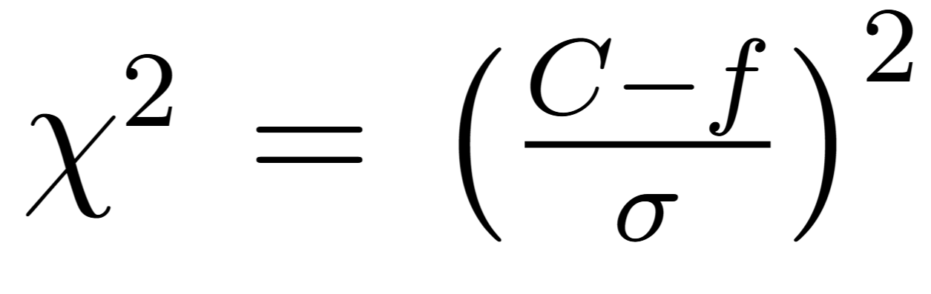
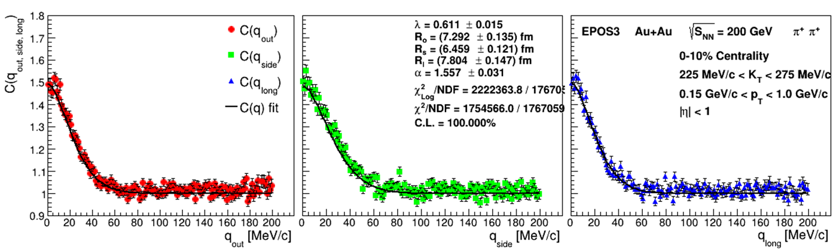
Fitting the corr. function
Fitting a 3D Lévy-stable distribution:
Using log-likelyhood error function:
Error calculated by basic chi²

Slide 5
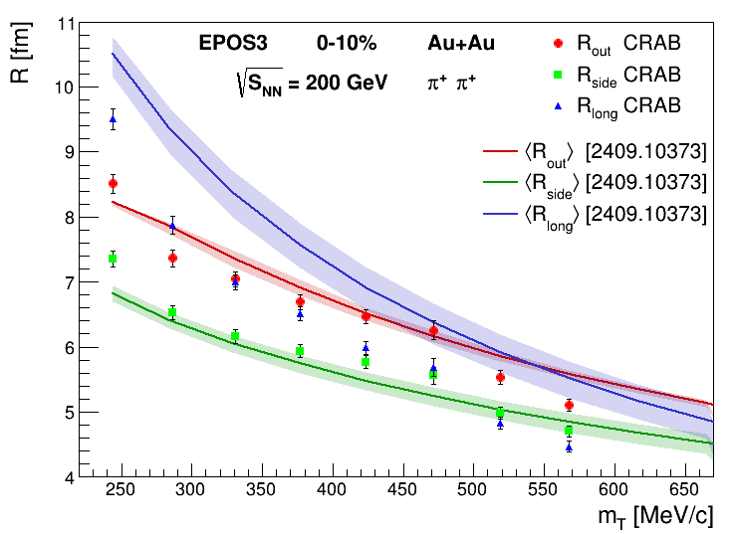
R parameter

Slide 6
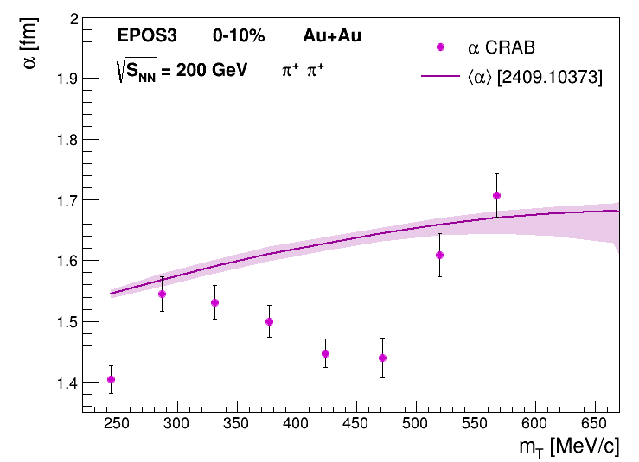
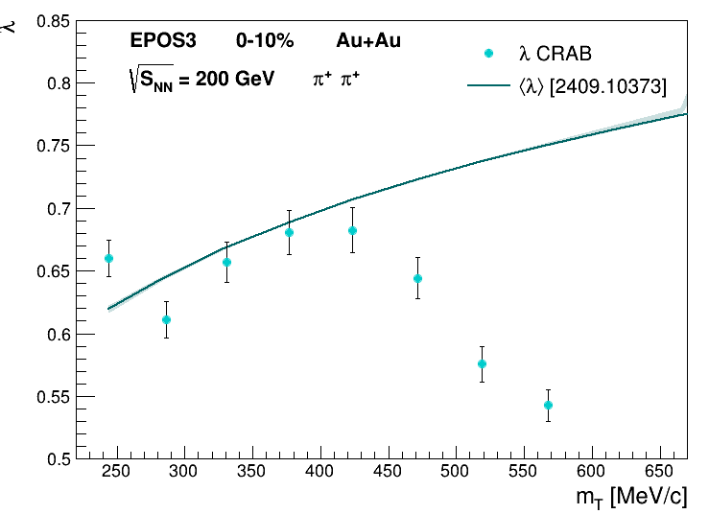
Alpha, Lambda
Correlations and anti-correlations between parameters
Where does this waving trend come from?
Mixed events?
Some specific CRAB setting?

Slide 7
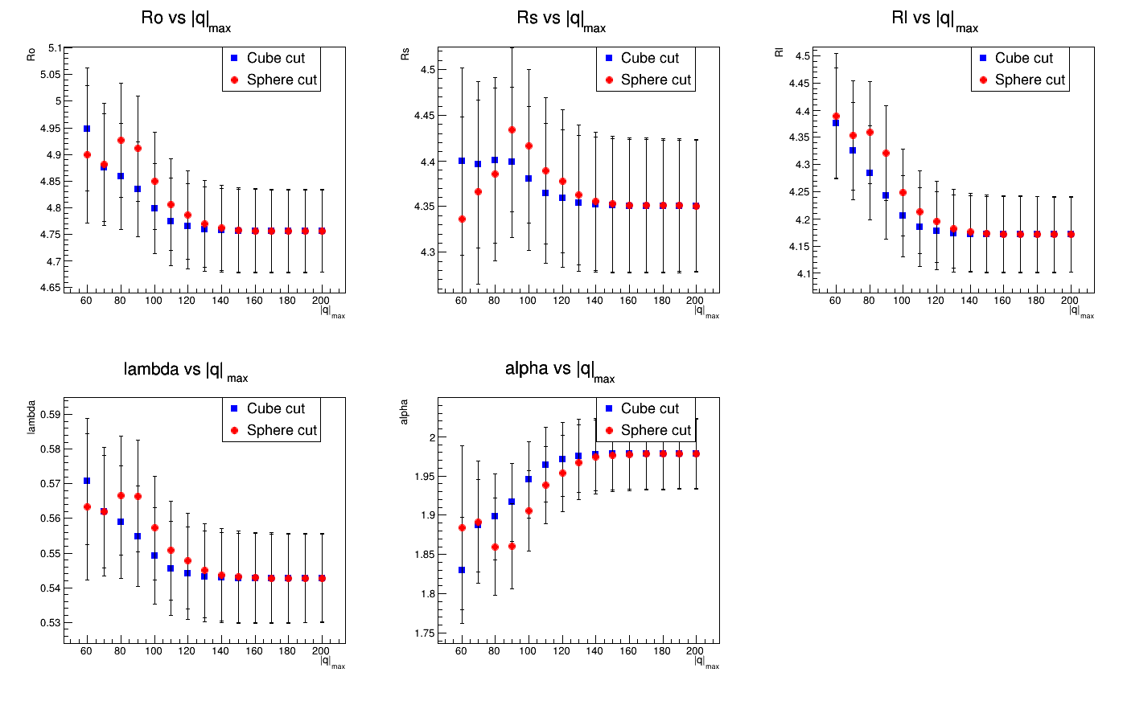
Fit-limit dependence
525 MeV/c < K_{T} < 575 MeV/c

Slide 8
Thank you for your attention!
Any questions?

