Slide 2











High Field Magnets news, actions and special topics
Ezio Todesco
On behalf of HFM collaboration
Thanks to B. Auchmann, A. Milanese

Slide 3
Contents
Recall of mandate, structure and ESPP documents
Revised targets for FCC-hh in Nb₃Sn, options, and some special topics
Outlook on HTS

Slide 4
Mandate of HFM
Mandate of HFM was revised in January 2024 towards a more directed R&D for FCC-hh
In particular the concept of “finding the limit” is removed – impossible to make a TDR without a baseline, but with ranges – on the other hand, we are ready to change the baseline if needed
2023
Design and demonstrate a full-size Nb3Sn accelerator magnet to proof the maturity of the most advanced technologies today, based on the HL-LHC design, i.e., 12 T magnets, and applying all the lessons learned from the US LHC Accelerator Research programme (LARP), the US High-Luminosity LHC Accelerator Upgrade project (AUP) and the HL-LHC project
Explore the limitations of the LTS state-of-the-art technology and push Nb3Sn magnet technology to its practical limits in terms of ultimate performance, towards the 16 T target targeted by the FCC-hh
Explore the capabilities and limitations of state-of-the-art HTS
2024
Develop an Nb₃Sn accelerator dipole with 14 T operational field for FCC-hh, giving an energy of 85 TeV c.o.m., with a focus on sustainability, cost versus performance, and large scale production
Explore the HTS magnet technologies for accelerator applications in the range from 14 T up to 20 T
Promote the required developments for superconductors
Highlight the innovative of high field magnets developments, both for particle physics instruments different from FCC, and for societal applications

Slide 5
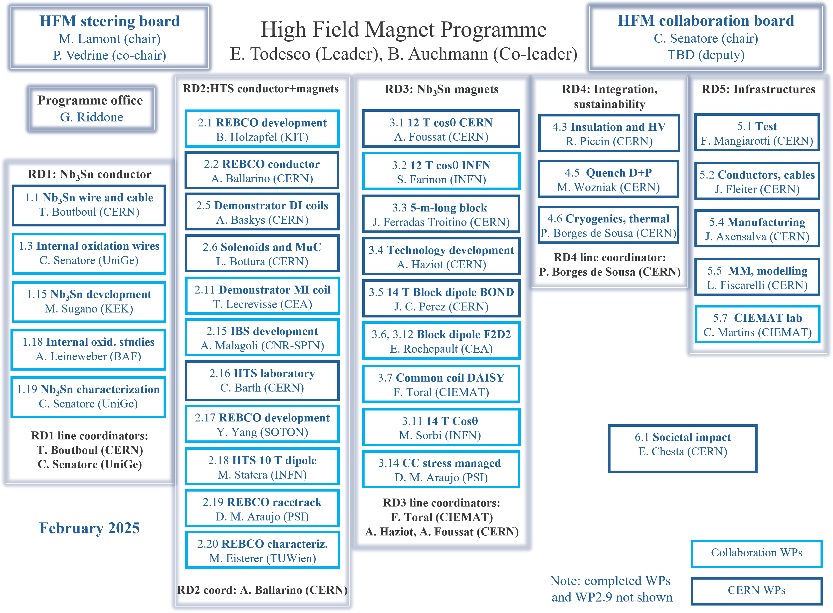
11 collaborating institutes
33 workpackages, half from CERN
HFM forum
HFM WG
www.cern.ch/hfm
Five RD lines
Nb₃Sn conductor
Nb₃Sn magnets
HTS
Integration & sust.
Infrastructures
Plus societal impact
Each collaboration has a CERN technical coordinator

Slide 6
Budget
Budget is of the order of 180 MCHF (CERN material) for the 2021-2035
This is used for CERN WPs to pay material and M4P (fellow, students, associates, FSU)
This is used for collaboration WPs to pay material for collaborations, and monetary contribution
This is complemented by 40 MCHF of in kind from collaborations
Note that only active collaborations are estimated, therefore this number is expected to grow with time
See talk of G. Riddone

Slide 7
The ESPP documents
European Strategy Update was anticipated by one year, and 2025 has seen a major effort to prepare the documents
We contributed to the FCC document with the revised baseline for FCC-hh ESSP document 247 page 533-546
We wrote a specific document for the HFM program ESPP document
Both presented in Venice, 2025 and published
A Physics Briefing Book summarizing all documents has been published
It contains two sections concerning HFM in the chapter accelerator technology
The baseline for FCC-hh (pp. 171-183)
A dedicated section on the magnets (pp. 179-181)
https://cds.cern.ch/record/2944678

Slide 8
Contents
Mandate, structure and ESPP documents
Revised targets for FCC-hh in Nb₃Sn, options, and some special topics
Outlook on HTS

Slide 9
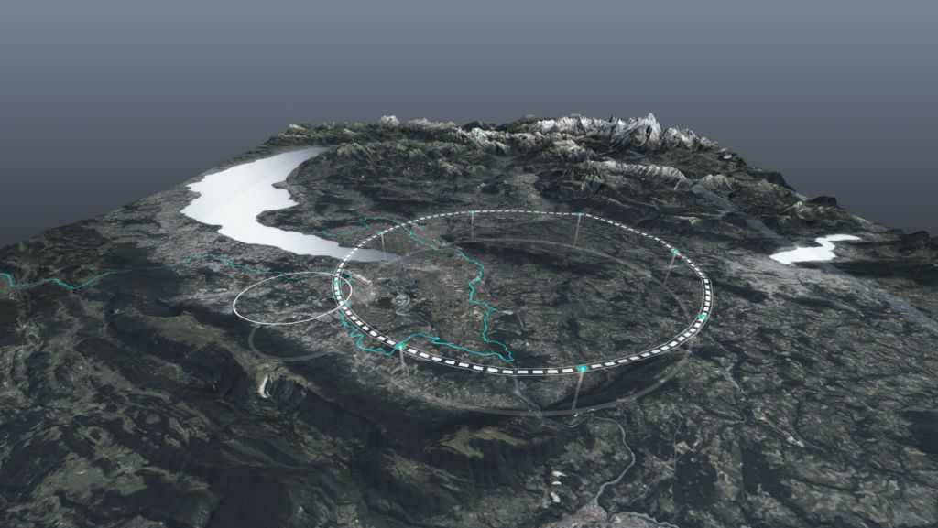
Main novelties of the strategy update: baseline
Baseline for FCC-hh: from 100 Tev - 16 T, to 85 TeV - 14 T
1.9 K and Nb₃Sn are kept as baseline
Main advantages
The magnet is at 80% of short sample with HL-LHC conductor
Stress limits <150 MPa rather than <200 MPa
Conductor is available 1200 A/mm² at 16 T and 4.2 K
Synchrotron radiation scales with E⁴: so 15% less energy gives 50% less synchrotron radiation
Another relevant element is that we made a clarification between baseline (this slide) and options (see next slide for Nb₃Sn)
The HTS option has a 14 T target, but with possibilities of going up to 20 T
This would give 120 T, i.e. four times the synchrotron radiation – however we keep it as a long term strategic target
Finally, we updated the timelines without the constraint of having operation in 2070 (see slides 16 and 21)
It is very difficult to make a R&D program with 2070 as target date …
FCC-hh parameters | CDR 2019 | 2024-Nb₃Sn
Dipole field (T) | 16.0 | 14.0
Temperature (K) | 1.9 | 1.9
Tunnel length (km) | 100 | 90.7
Arc length (km) | 82.0 | 76.9
Arc filling factor (adim) | 0.80 | 0.83
Energy c.o.m (TeV) | 100 | 85
Non Cu jc 16 T 4.2 K | 1500 | 1200
Loadline margin | 86% | 80%

Slide 10
Main novelties of the strategy update: options
If in the future Nb₃Sn can achieve 1500 A/mm² (original target of FCC-hh), with same price, we can reduce the conductor mass by 30%
Conductor is a driving factor of the dipole cost (order of 50% under some hypothesis)
This option can be injected in the designs that are presently developed at any time
This option has been introduced in 2024, when the target for the conductor has been lowered
We could use Nb-Ti in the low field area (nb-Ti / Nb₃Sn hybrid option)
This can reduce the Nb₃Sn conductor mass by 50% (more in the next slides)
This option has been proposed/rediscovered in 2024 by CIEMAT
We could consider 4.5 K operation with the same design for 1.9 K
This reduce the total energy consumption by 30%, but this would exclude the hybrid Nb-Ti/Nb₃Sn and strongly reduce the margin (more in the next slides)
This option has been proposed in 2024, after seeing that MQXFB always reach operational current also at 4.5 K
We could consider 12 T operational field to reduce the conductor mass, cost and challenges
This would reduce the magnet cost by 20%
Several demonstrators are being built as intermediate step
This option has been proposed in 2020

Slide 11
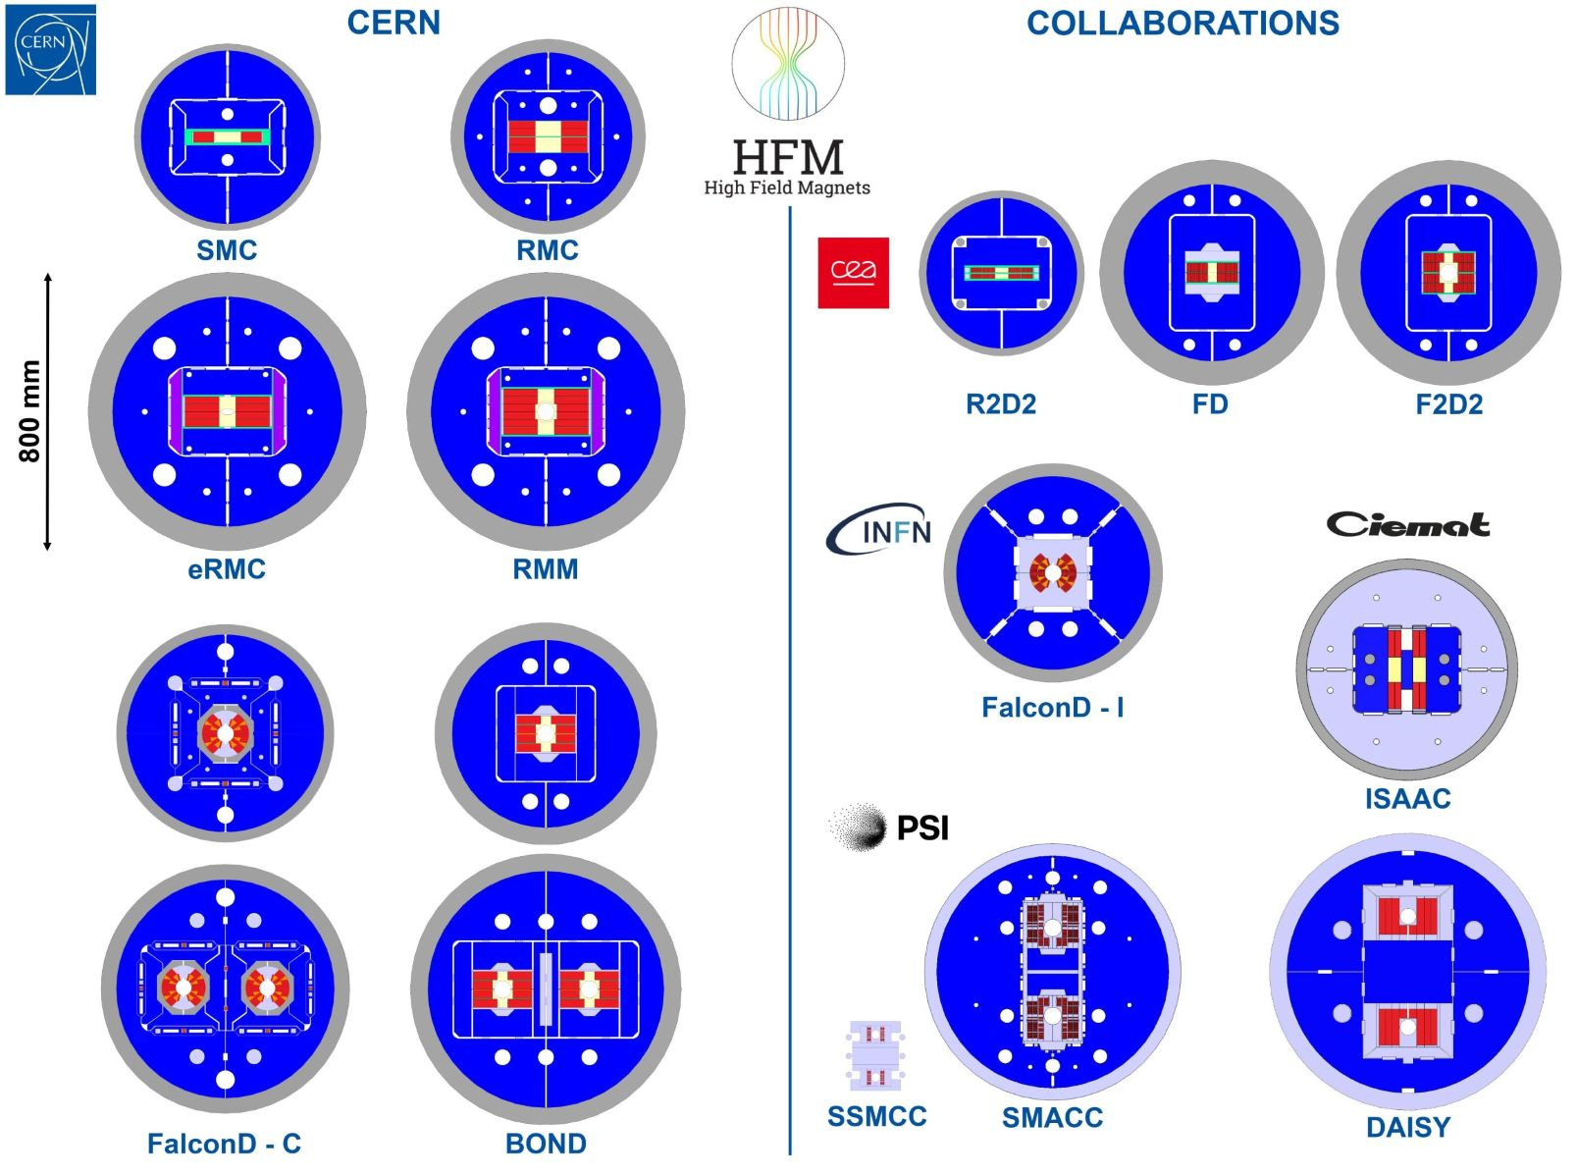

HFM Nb₃Sn zoo
Block demonstrators
(12 T)
Block 14 T
current grading
Done
2025
Block demonstrators
(>14 T)
Cosθ 12 T
option
Done
2025
Common coil
Demonstrator
(12 T)
2026
2026
Common coil
14 T
Cosθ 12 T
option
Done
SMCC demonstrator
(5 T)
Stress managed
Common coil 14 T
Block 14 T

Slide 12
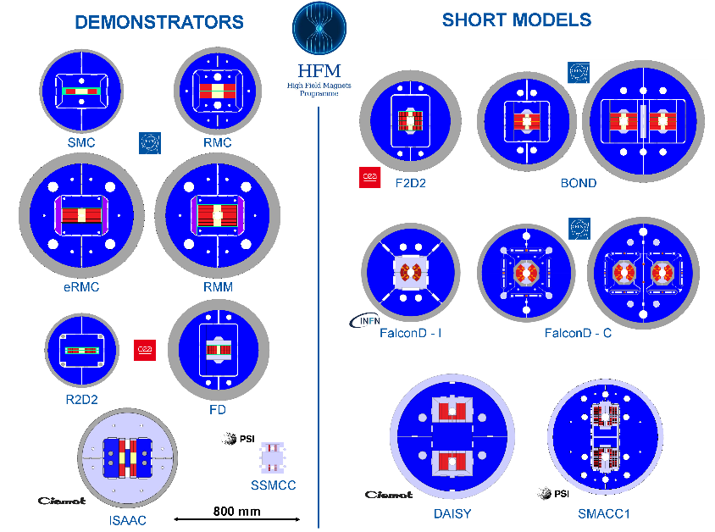
HFM Nb₃Sn zoo
We rearranged the global view of the designs separating
Demonstrators (magnet without all features needed for operation)
short models (magnet that if scaled to long lengths can satisfy all operation requirements

Slide 13
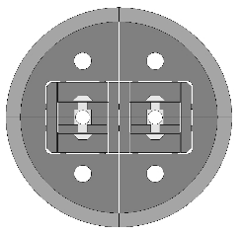
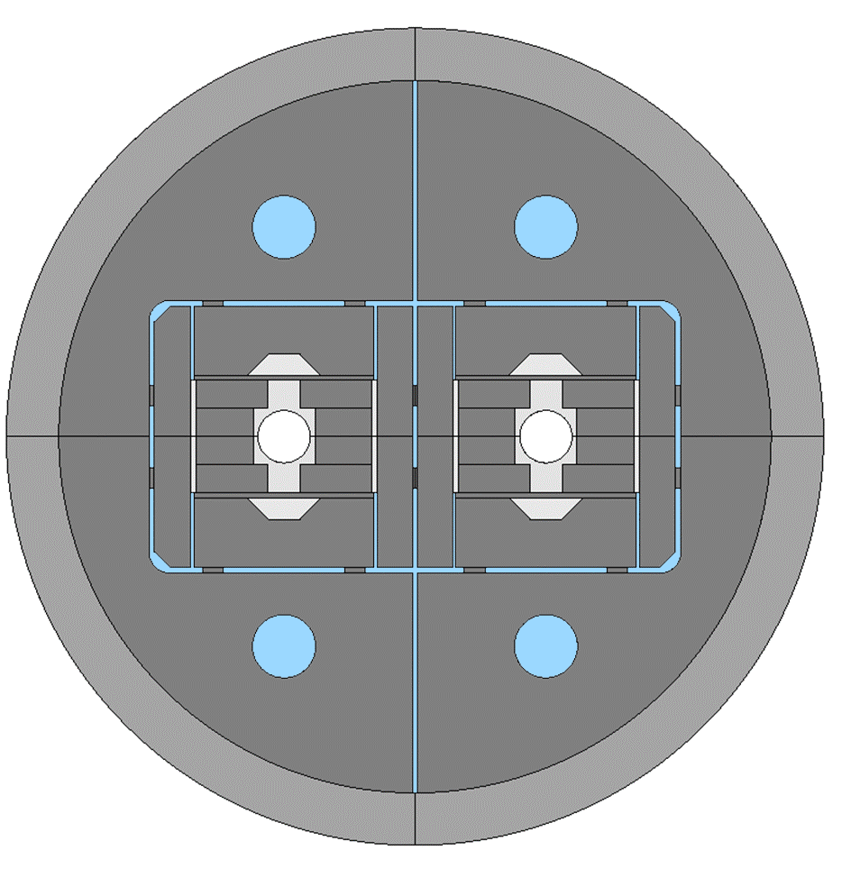
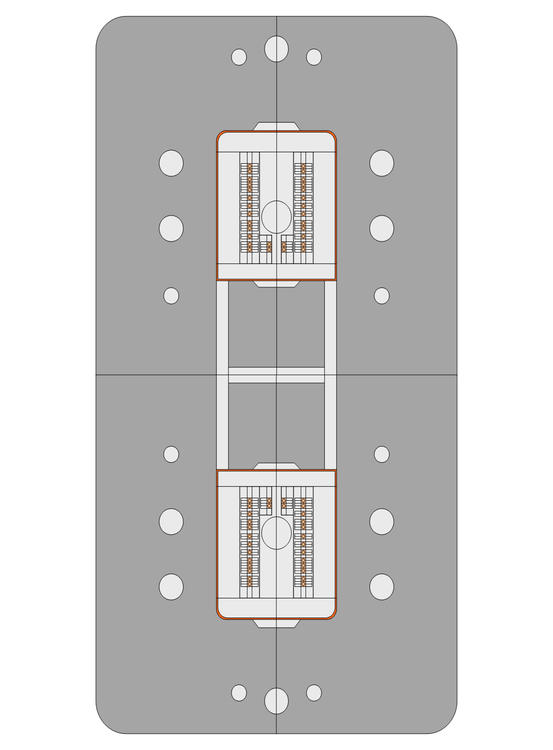
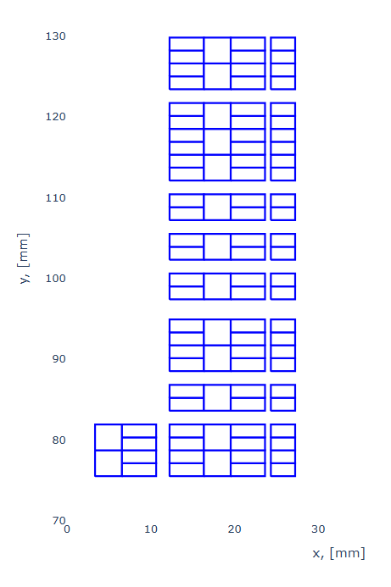

The 4.5 K option
The 4.5 K option is challenging but offers some opportunities
Lower consumption of the magnet (total reduction of energy consumption of about 30%) – and a factor two less on the magnet consuption
Challenges
The temperature margin is reduced by a factor two (4.5 K to about 2 K)
Having a variation of temperature along the machine of the order of 0.5 K, the margin could be too small
Moreover, the option considers a conduction cooled forced flow “dry magnet” (see P. Borges de Sousa at HFM forum https://indico.cern.ch/event/1449712/ )
This would reduce He inventory from 800 to 400 tons and reduce the logistics
Challenge: magnet insulation becomes more complex
PSI is manufacturing a SubSMACC to be tested in 2026 to be cooled via conduction (22 mm aperture)
Conclusion: we carefully study this option but it looks challenging
Note also that 400 tons of He cost is order of 50 MCHF, so neglibile
One could consider also 4.5 K with a magnet immersed in LHe
Magnet immersed in LHE (right) and cooled via forced flow (left)
P. Borges de Sousa
SubSMACC cooled via forced flow
D. Araujo et al.

Slide 14
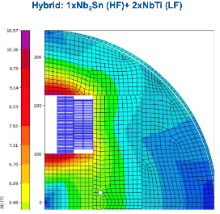

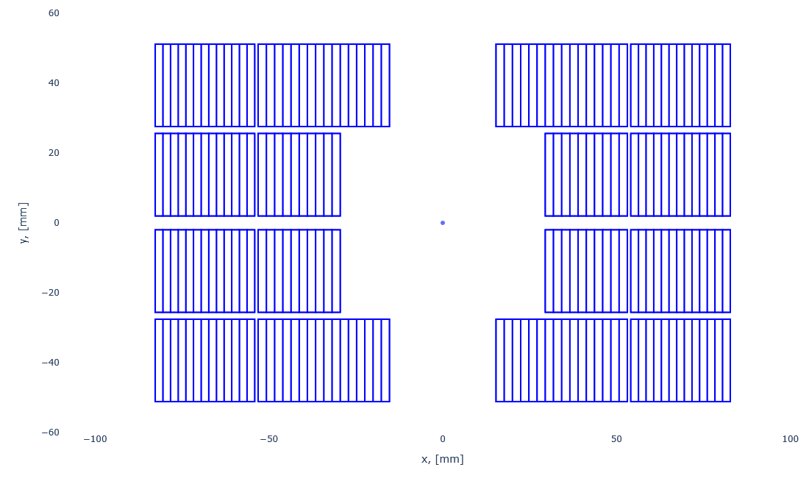
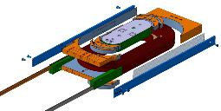

Nb₃Sn/Nb-Ti hybrid option
Nb-Ti/Nb₃Sn were proposed for HE-LHC 15 and 20 T conceptual design and long time ago E. Todesco et al, IEEE TAS 24 (2014)
Nb-Ti/Nb₃Sn were used in LPF3 by the IHEP colleagues, reaching 12.5 T in a common coil demonstrator C. Wang et al., SUST 36 (2023)
For the 14 T case, half of the coil can be in Nb-Ti !
See F. Toral (DAISY) at ASC 24: IEEE TAS 35 (2025) https://ieeexplore.ieee.org/document/10859164
See A. Haziot at HFM forum (BONDh), https://indico.cern.ch/event/1524821/
See D. Araujo at HFM forum (SMACC), https://indico.cern.ch/event/1581999/
Moreover, the finer filaments of Nb-Ti give lower losses (30% reduction in hysteresis losses)
If operate at 4.5 K, the reduction of Nb₃Sn is only 1/5
If we go at 4.5 K and 12 T, the reduction of Nb₃Sn is 1/3
CERN plans to explore this technology in a SMC
Conceptual design ongoing, first test in 2026
Hybrid Nb₃Sn / Nb-Ti DAISY 12 T dipole
[F. Toral, et al.]
Nb₃Sn
NbTi
Hybrid Nb₃Sn / Nb-Ti BONDh 14 T dipole [A. Haziot, et al.]

Slide 15

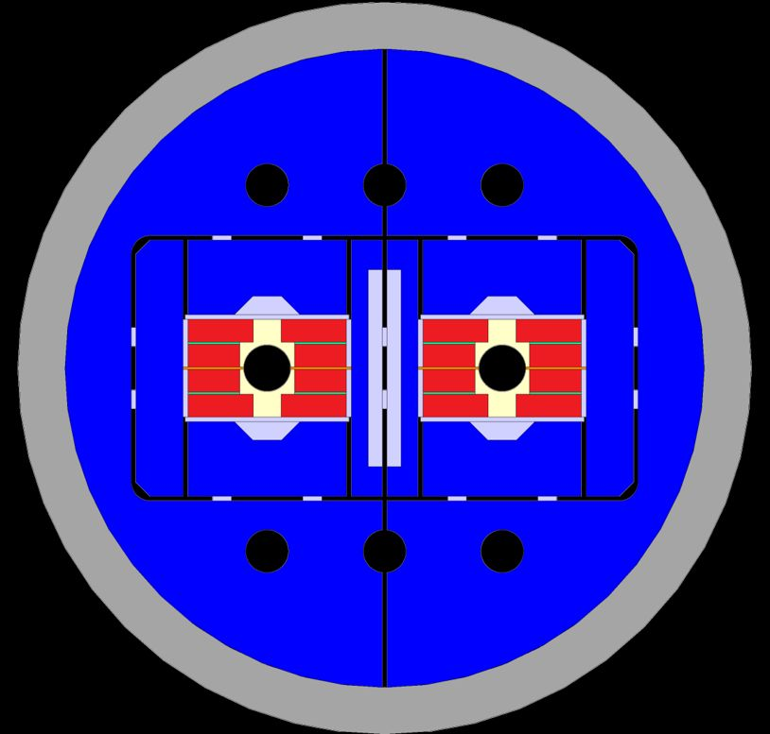
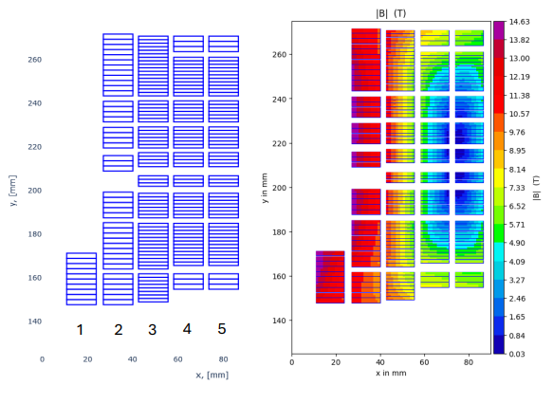
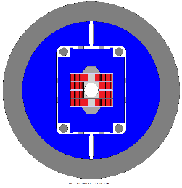
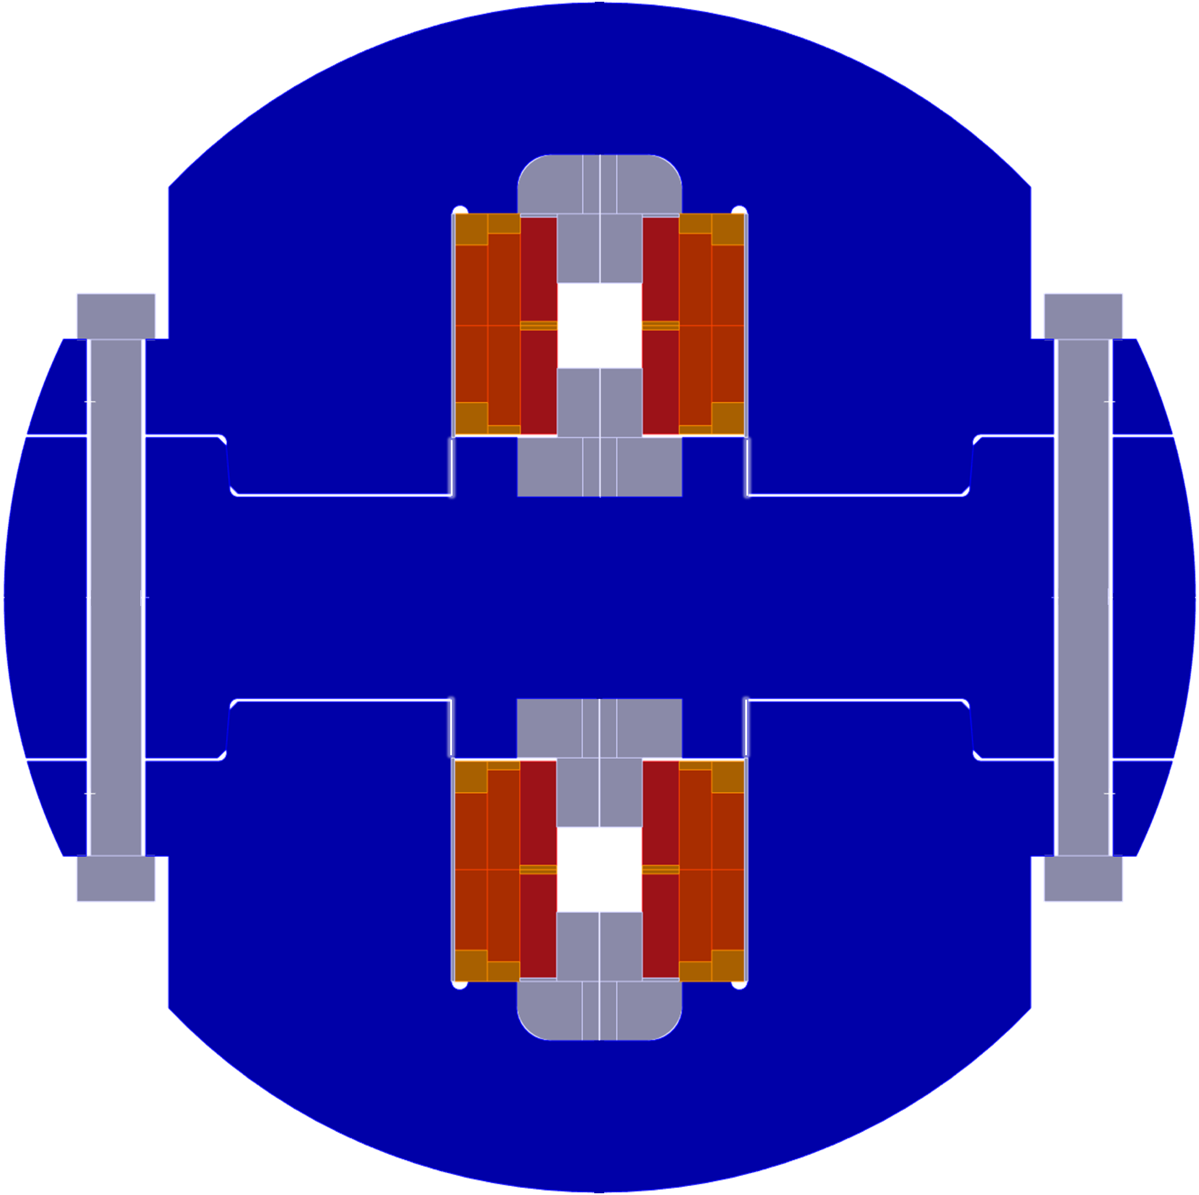
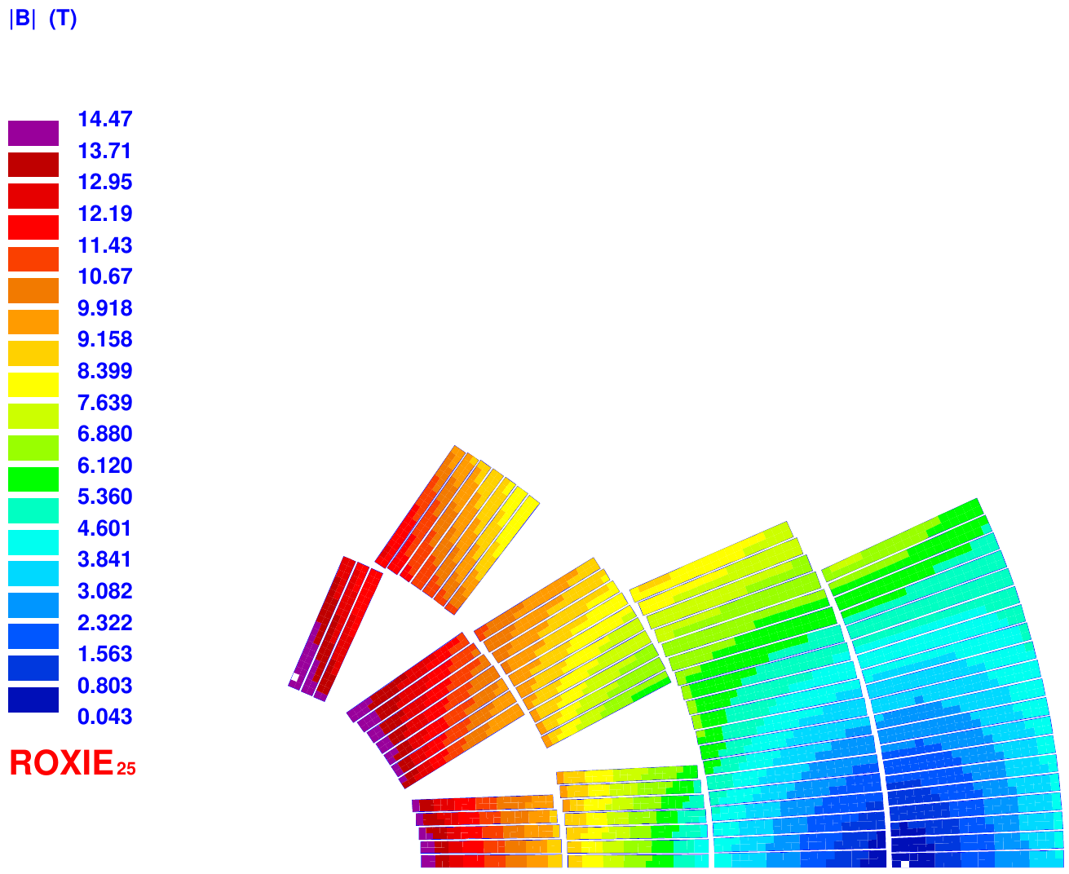




Nb₃Sn/Nb-Ti hybrid option
We had a brainstorming about the present hybrid designs of CIEMAT, PSI and CERN https://indico.cern.ch/event/1595880/
INFN is also considering a 4 layers with Nb-Ti in the outer
Designs are quite similar, with a 350 A/mm² overall current density
PSI is considering a grading also in current, reaching 500 A/mm²
CEA keeps the baseline of the Nb₃Sn grading

Slide 16
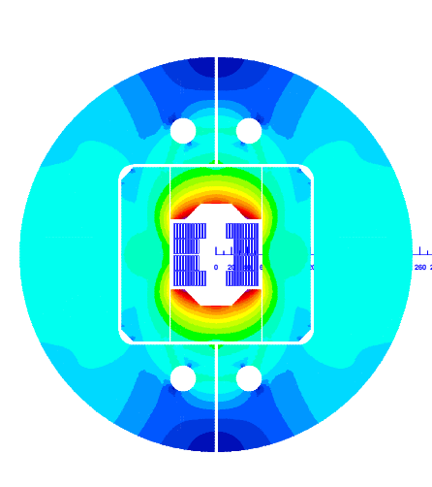
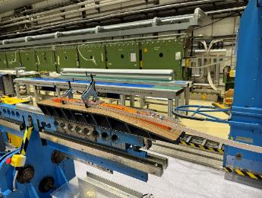
Too many designs ? And when going long ?
LDG REVIEW Nb₃Sn COMMENTS
Down-select 12-14 T Nb₃Sn dipole designs now and engage coordinated development of the baseline design with the collaborating labs
Accelerate the demonstration of full-length magnets
In March we had an LDG review on the program
Reviewers: H. ten Kate and Ph. Lebrun
Two main comments for Nb₃Sn
The requirement of down-selection now it is not wise, collaboration are manufacturing magnets: we have to wait for the results
The requirement on accelerating demonstration of full-length magnets has been addressed
CERN is launching a 4-m-long block coil to be tested vertically to prove the scaling of block coil to intermediate lengths
CERN could also launch a 4-m-long racetrack for common coil
The block coil with flared ends, based on HD2 concept [J. C. Perez, et al.]
5-m-long block dipole BONDM
[J. Ferradas, et al.]
CERN winding tests with portal winding machine for long block coils.

Slide 17
Another new element: the timeline for Nb₃Sn
Now-2035: select a magnet design and launch a demonstrator program to scale up to 4 m, check reproducibility, performance, …
2035-2042: scaling to 15 m with industry involvement and preseries magnets
2042-2050: production and installation
5-m-long prototypes
(>5 each type)
Industrialization (pre-series magnets)
4-m-long demonstrators
(block and racetrack)
Short model program on two selected designs
(>5 each type)
15 m long prototypes (>5 each type)
Production and test
Selection of final design
to start long magnets
Ongoing
12 T and 14 T short models
(7 designs, 1 or 2 of each type)
First selection
of design
Tender
for the series
Installation and commissioning
`25
`26
`27
`28
`29
`30
`31
`32
`33
`34
`35
`36
`37
`38
`39
`40
`41
`42
`43
`44
`45
`46
`47
`48
`49
`50
`51
`52
`53
`54
RunIII
HL-LHC RunIV
HL-LHC RunV
Nb₃Sn accelerated timeline for FCC-hh [ESPP document]

Slide 18
Too many designs ?
Coming back on the point of too many designs
Main part of mastering Nb₃Sn is coil manufacturing
A key to the success to the FCC-hh is that several laboratories master Nb3Sn technology
CERN is mastering this with several programs (up to 14-16 T)
CEA has mastered the full manufacturing cycle via two SMC (11 T) and R2D2 (test soon)
PSI has mastered the full manufacturing via a CCT (10 T) and a stress managed magnet (6 T)
ASG/INFN is starting now and should complete in 2026
CIEMAT will produce coils in 2026
Ideas are circulating and being exchanged
Asymmetric common coil proposed by PSI, and adopted by CIEMAT
Hybrid design proposed by CIEMAT (and IHEP …), and adopted by CERN and PSI
This is a very important exchange that is within the guideline of the program
To avoid that HFM is just distributing money and requirements, but to produce a global coordinated effort in R&D
The R2D2 coil (E. Rochepault, et al.)

Slide 19
Another development: wax impregnation
Wax impregnation has been proved to reduce (eliminate) training in stress managed magnets as CCT
Proof in PSI A. Brem et al., IEEE TAS 34 (2024) 7700105, doi: 10.1109/TASC.2023.3338588.
Recent proof in LBNL: CCT5-w
CERN is building the first non stress managed magnet (SMC) wax impregnated
Test will be in November
Will it have the same effect ?
11 T
wax
10 T
9 T
CTD 101K
8 T
7 T
CCT5w in LBNL (D. Arbaleaz, at HFM forum)

Slide 20
Contents
Mandate, structure and ESPP documents
Revised targets for FCC-hh in Nb₃Sn, options, and some special topics
Outlook on HTS

Slide 21
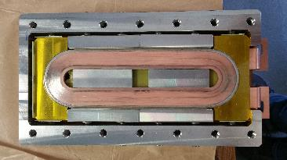
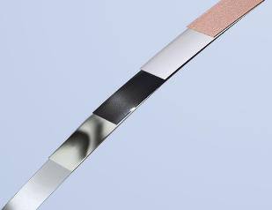
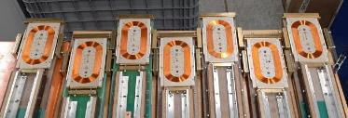
The HTS path
HFM also includes as a R&D target dipoles based on HTS in the 14 -20 T range, that could operate at higher temperatures and at fields >15 T
HTS has a huge potential and a large momentum from the fusion community
Even though high field solenoids have been successfully built, many challenges have still to be solved for the applications to high field dipoles, protection above all
Is the 20 T target still valid for FCC-hh? 120 TeV means 4 times more synchrotron radiation w.r.t. 85 TeV (with same beam parameters), and power consumption now is critical
FCC-hh parameters | 2024-Nb₃Sn | 2024-HTS
Dipole field (T) | 14.0 | 14-20
Temperature (K) | 1.9 | 4.5-20
Tunnel length (km) | 90.7 | 90.7
Energy c.o.m (TeV) | 85 | 85-120
Non Cu jc 16 T 4.2 K | 1200 | TBD
Loadline margin | 80% | TBD
MI racetrack coil [T. Lecrevisse, et al. ]
HTS tape developed in ARIES and Bruker
ReBCO racetracks [A. Ballarino, et al.]

Slide 22
Timeline for HTS
Target: by 2035 a proof of a short model dipole with all features for FCC
Aperture, field ≥14T, field quality, protection, …
Ten years look a lot, but if you look back …
This timeline, if all proofs are positive, could give FCC-hh operation in 2060
FEASIBILITY
Reproducibility and first scaling in length
Selection of cable and
insulation technology
SCOPING
Short model ≥14 T
FINAL PROTOTYPES
CONSTRUCTION (ends 2060)
CANAVASSING
Demonstrators to select cable
and design
Proof of short model
with all requirements
Proof of reproducibility
and first long magnets
PRE_SERIES AND INDUSTRIALZATION
`25
`26
`27
`28
`29
`30
`31
`32
`33
`34
`35
`36
`37
`38
`39
`40
`41
`42
`43
`44
`45
`46
`47
`48
`49
`50
`51
`52
`53
`54
RunIII
HL-LHC RunIV
HL-LHC RunV
HTS timeline for FCC-hh [August 2023, B. Auchmann, et al.]

Slide 23
HTS for accelerator dipoles: advancement in the last ten years
Apertures
C1, C2, C3: 65 mm
Feather2, cosθ: 40 mm
IHEP: 20 mm
Cables
Bin5 (BSCCO): Rutherford
Feather2, Cosθ: Roebel
IHEP, CERN 2025: tapes
CEA 2025: MI tapes
Design
Feather2: aligned block
C1, C2, C3, Bin5: CCT
IHEP: racetracks with gap

Slide 24
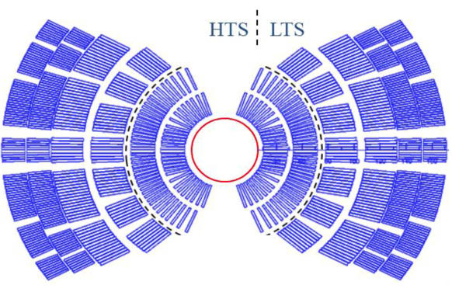
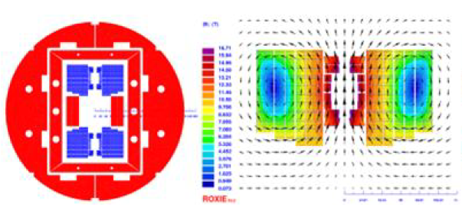
HTS program: hybrid LTS/HTS or all HTS ?
Both IHEP and US-MDP have a program that is relying on hybrid Nb₃Sn and HTS
IHEP present target: 11 T in Nb₃Sn, 7 in HTS
They recently achieved the target on both HTS and LTS separately, but when powering together the HTS degraded
US MDP target: 20 T with stress managed designs
5 T reached with ReBCO C3 CCT dipole, and test in Nb₃Sn outsert is coming soon
HFM strategy is to go for a all HTS, ramping up in field
Approximate steps 5 T, 9 T, 14 T
Common coil geometry is strongly preferred by all labs
Hybrid design for 20 T magnet
[P. Ferracin, et al, IEEE TAS 33 (2023) 4002007
and 4LOr1B-01]
Hybrid design for 20 T magnet
[Q. Xu, et al, CEPC design report, pg 749]

Slide 25
HTS program: tapes
Roebel cable was the Eucard2 workhorse, but it has been abandoned
Today, the community is working with tapes, or with cables with a circular geometry (CORC® or CORC like)
HFM is mainly investing on ReBCO
We carefully follow BSSCO development and advancement in the US (talk at HFM forum of T. Shen, https://indico.cern.ch/event/1510468/ )
We have a WP on IBS (CNR SPIN), and we follow the advancements in China
Three different paths are being taken by CEA, CERN and PSI for the first demonstrators
CEA: metal insulated tapes – wide experience of CEA with this technology, an impressive literature has been produced – the program has reached >5 T in racetrack (no aperture), and is going to test 600 mm long coils (Narsil)
CERN: insulated tapes, with Cu – the program has reached >5 T in racetrack, and is ramping towards 9 T soon
PSI: soldered stacks of tapes, with stress managed common coil platform also used for Nb₃Sn

Slide 26
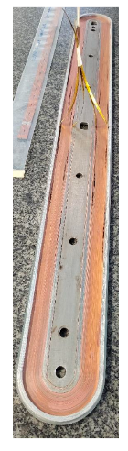


HTS program: synergies
LDG REVIEW HTS COMMENTS
Set up a task force to accelerate the R&D on ReBCO, aiming at demonstrating principle solutions for a 10-20 kA accelerator magnet conductor and quench protection of long HTS coils
HTS today is a more difficult environment to apply the collaborative paradigm
Lot of emphasis coming from fusion, with private investements, start-ups … this field is growing very very rapidly with a lot of expectations
HFM management is encouraging sharing of results and strategies in a early stage – this is the way of accelerating the R&D (HL-LHC/LARP/AUP paradigm)
I wish to organize a brainstorming on the dimensions of the coils that we are manufacturing today
And the path in field/length/ aperture that is planned, in PSI, at CERN and in CEA
100 mm long ReBCO racetracks [A. Ballarino, et al.]
600 mm long MI racetrack coil
[T. Lecrevisse, et al. ]
180 mm long MI racetrack coil [T. Lecrevisse, et al. ]

Slide 27
Some questions about physics
How to make the scale up of the demonstrators to short models ?
Several parameters: field, aperture, length …
How about cable geometries
Can we exclude that simple tapes cannot be used to manufacture a accelerator magnet ?
Protection seems today the main critical aspect
What is the driving parameter ?
Stored energy ? (hard to believe to me – it should be an intensive quantity, not an extensive)
Field square , i.e. magnetic pressure ?
Energy density on the coil ?

Slide 28
Conclusions
The new baseline for FCC-hh is more compatible with all constraints
85 TeV is a good bargain: 15% less energy, bringing 50% less synchrotron radiation, plus ..
… a 14 T Nb₃Sn magnet feasible with HL-LHC conductor, and 150 MPa stress rather than 200 MPa
… and at 14 T half of the coil can be in Nb-Ti ! Considerable cost reduction – we just need 30% reduction of present HL-LHC strand cost to fit the FCC targets
Options are being considered
Hybrid Nb-Ti/Nb₃Sn to reduce cost, 4.5 K to bring energy saving, 12 T to reduce costs
Several designs for Nb₃Sn are being explored (block, cosθ, common coil, stresss managed) and first results will come in 2026
HTS efforts are focussed on ReBCO, and all-HTS; first results are available on racetracks
Common coil design is the workhorse for the moment, but other designs are being explored

Slide 30
Some references
Talks at FCC week
E. Todesco, Overview of LTS HFM magnet and conductor activities. indico.cern.ch/event/1549746
A. Ballarino Progress towards HTS HFM magnet and conductor strategy indico.cern.ch/event/1408515/contributions/6513891
A. Verweij Protection of LTS and HTS magnets and circuits for FCC-hh. indico.cern.ch/event/1408515/contributions/6513888
Q. Xu HTS magnet R&D for next-generation accelerators at IHEP
P. Ferracin Status of US MDP indico.cern.ch/event/1408515/contributions/6513892
E. Rochepault Status of HFM development at CEA indico.cern.ch/event/1408515/contributions/6513893
F. Toral Status of HFM development at CIEMAT indico.cern.ch/event/1408515/contributions/6513896
A. Pampaloni Status of HFM development at INFN indico.cern.ch/event/1408515/contributions/6513894
B. Auchmann Status of HFM development at PSI indico.cern.ch/event/1408515/contributions/6513895
L. Delprat FCC-hh cryogenics update for 1.9 K and 4.5 K options indico.cern.ch/event/1408515/contributions/6499564
P. Tavares Coutinho Borges De Sousa Cryogenic baseline and advancements on the 4.5 K option for FCC-hh using Nb3Sn magnets indico.cern.ch/event/1408515/contributions/6513882
HFM forum: https://hfm.web.cern.ch/hfm-forum
HFM talks at conferences and meetings: https://indico.cern.ch/category/19189/
For the updated baseline of FCC-hh, my plenary at ASC 10.1109/TASC.2025.3558196

Slide 31



Timeline for HL-LHC
All development and production in labs (4 different ones: BNL, FNAL, LBNL, CERN)
Design study HiLumi
MQXFB production and test (10 magnets)
HL-LHC
project
MQXFB
prototypes
(2 each type)
LARP
approval
Selection of aperture
and cable
MQXF short models (7) ……..
MQXFA production and test (20 magnets)
Demonstrators (TQ, HQ, LQ) including scaling to 4 m, plus first MQXF in the US
MQXFA
prototypes
(2 each type)
`00
`01
`02
`03
`04
`05
06
`07
`08
`09
`10
`11
`12
`13
`14
`15
`16
`17
`18
`19
`20
`21
`22
`23
`24
`25
`26
`27
`28
`29
LHC RunI
LHC RunII
LHC RunIII

Slide 32
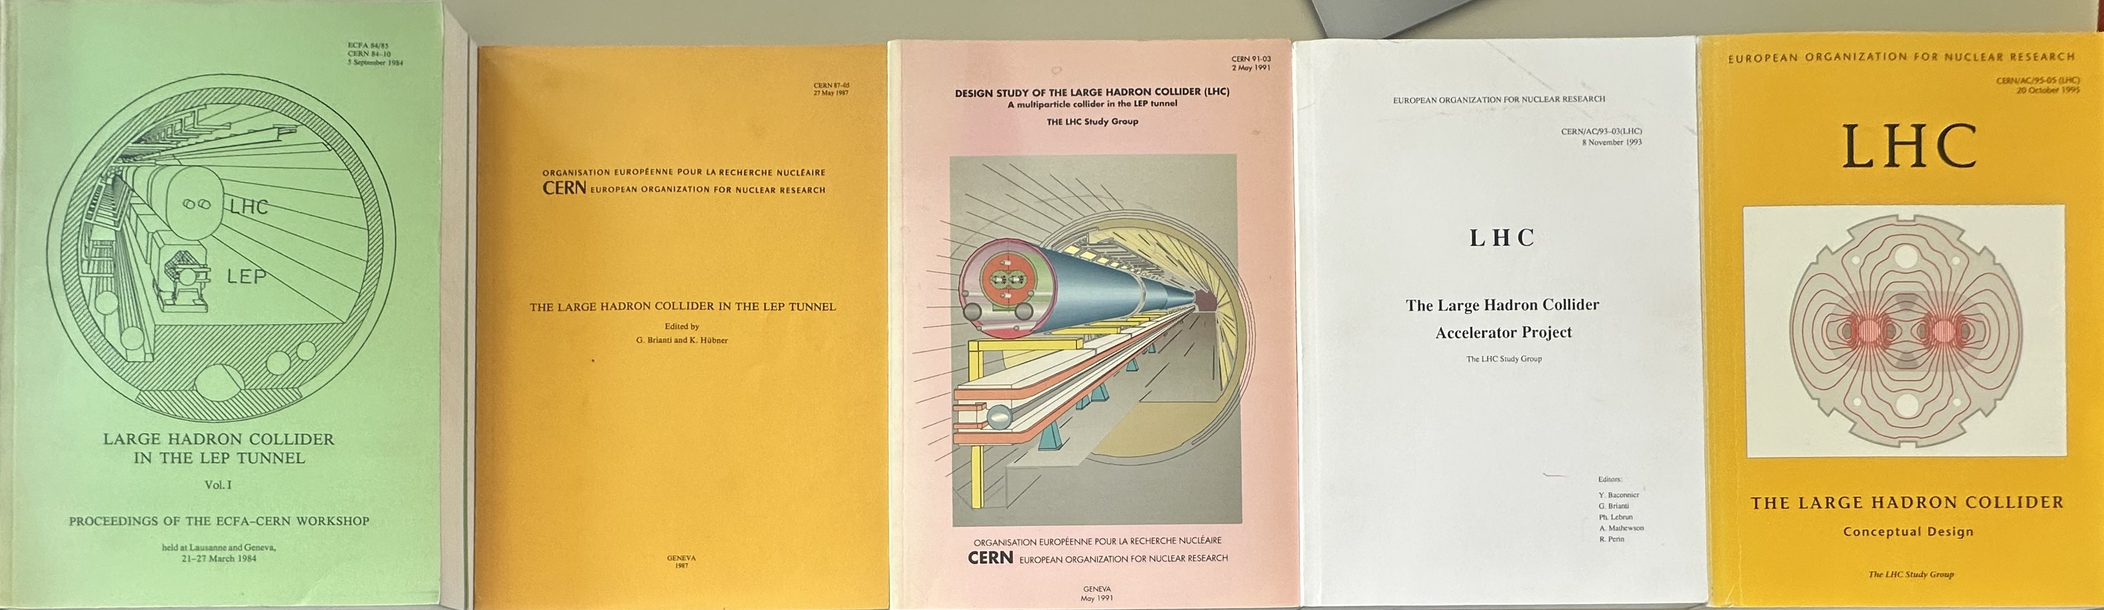
Timeline for LHC
Initial development in industry and institutes (mature technology) - approval based on a 10 m long magnet
Reduction of field from initial 10 T to 8.3 T
Short model at CERN from 1995
Design changes up to the very end of prototypes
Installation
LHC approved
Production
(1200)
Scaling to 10 m in industry (6 magnets)
Scaling to 10 m in industry
56 mm aperture (5 magnets)
LHC in the LEP tunnel first proposal:
8 TeV, 10 T
Preserie
(30)
Field reduction:
10 T to 8.6 T
Aperture increase:
50 mm to 56 mm
SSC canceled
Final prototypes
(6 magnets)
Short models
Field reduction:
8.65 T to 8.33 T
Collar material change:
Al to SS
CERN final short models (30)
`79
`80
`81
`82
`83
`84
85
`86
`87
`88
`89
`90
`91
`92
`93
`94
`95
`96
`97
`98
`99
`00
`01
`02
`03
`04
`05
`06
`07
`08
LEP operation
Thanks to L. Rossi for comments

