Slide 1

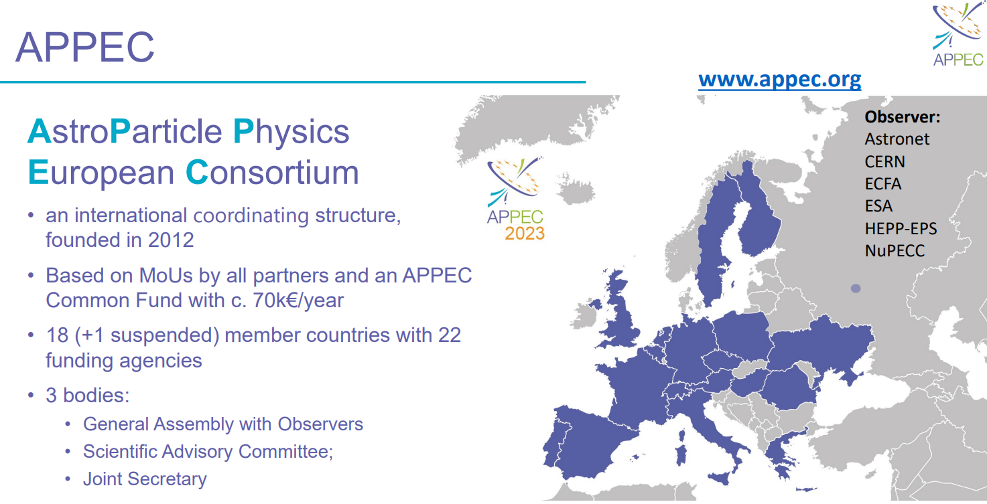

Slide 2
APPEC
ASTROPARTICLE PHYSICS EUROPEAN CONSORTIUM
Provide a discussion forum for the coordination of European Astroparticle Physics and express collective views on astroparticle physics in international fora.
Develop and update long term strategies (e.g. roadmap for European Astroparticle physics) and participate in European scientific strategy such as the European Strategy Session of CERN Council and ESFRI.
Develop closer relationships with organizations involved in Astroparticle Physics research

Slide 3
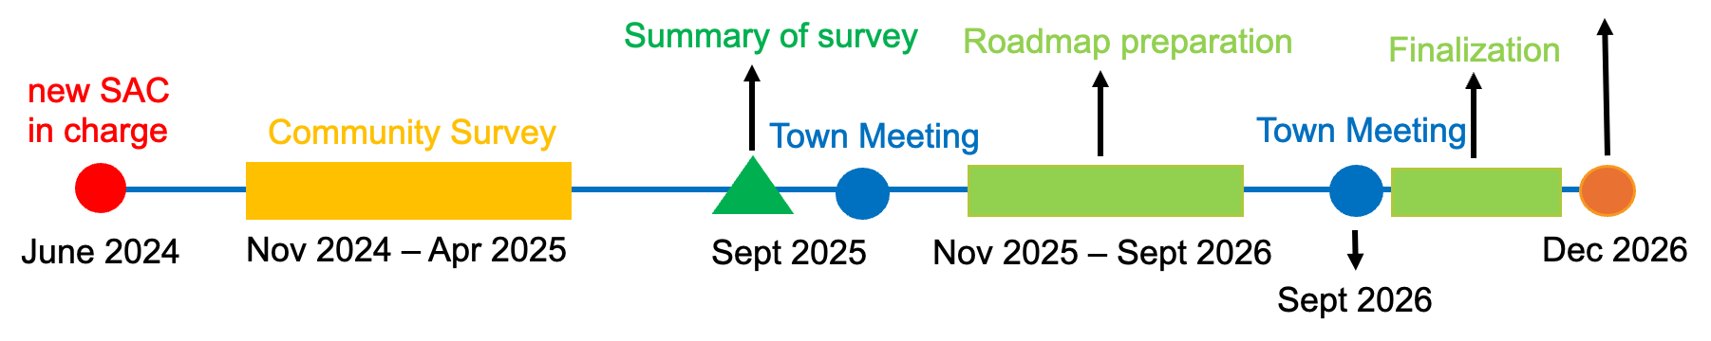

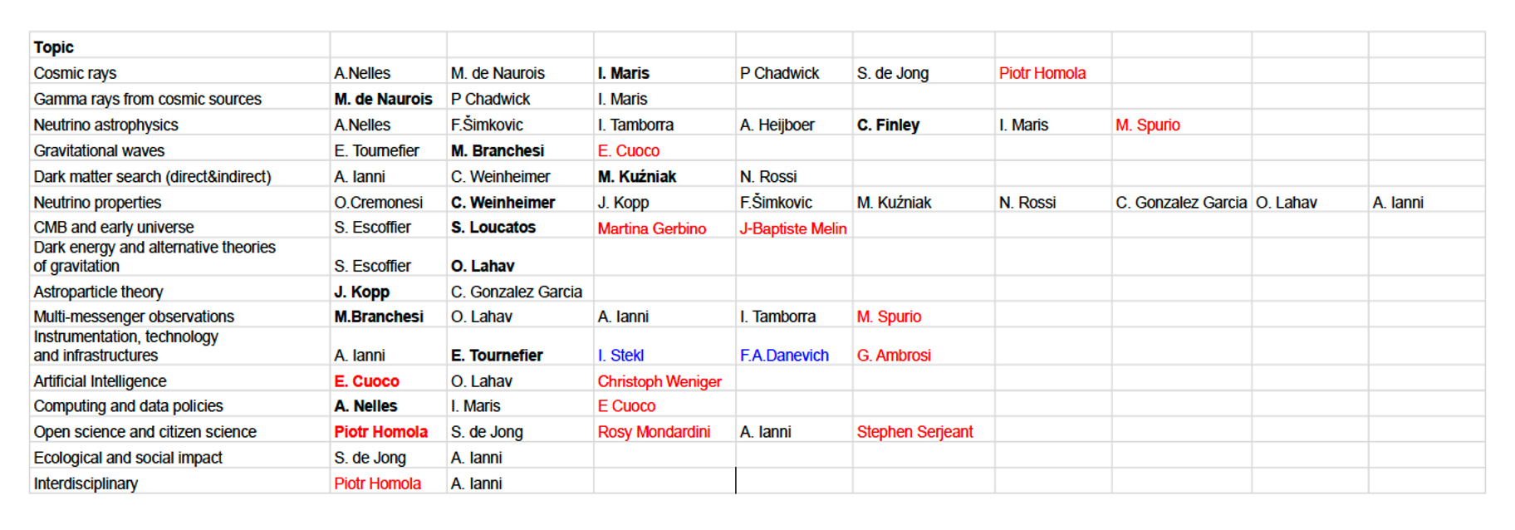
Timeline to elaborate the European AstroParticle Physics Strategy 2027-2036
SCIENTIFIC ADVISORY COMMITTEE +
16 topics addressed by 23 members:
A. Ianni (chair) and M. de Nuarois (deputy chair)
1 secretary (N. Rossi).
8 external members and 2 GA members.

Slide 4
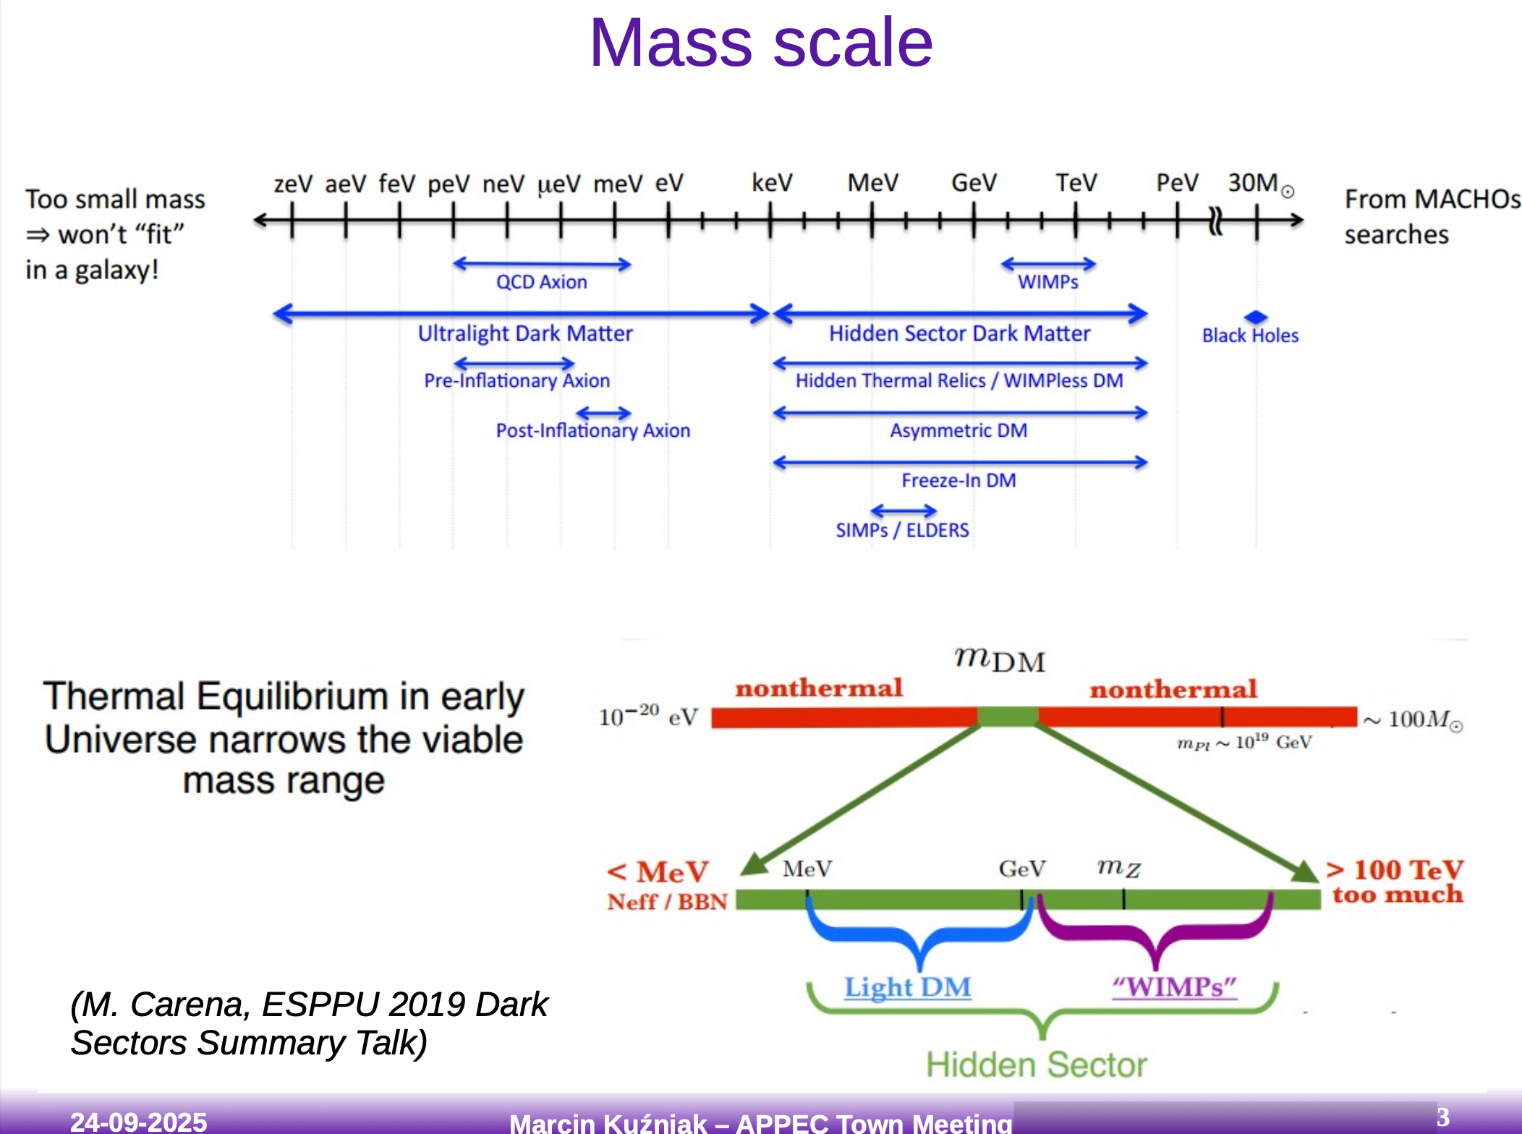
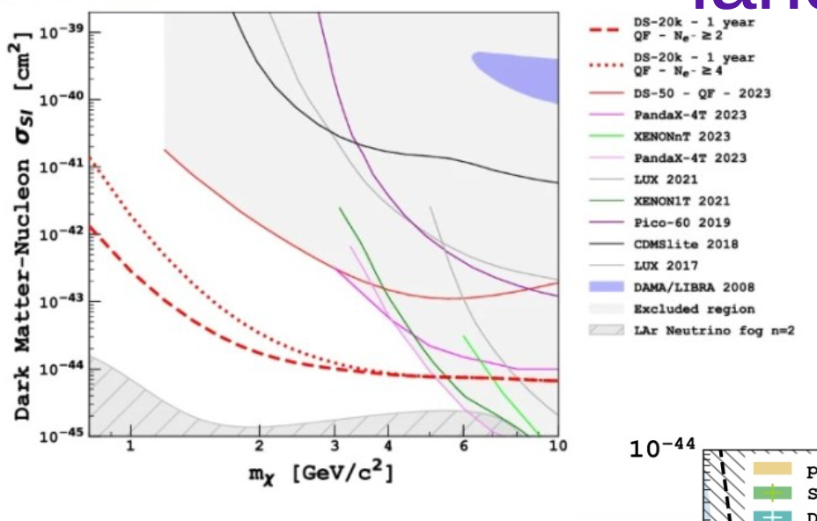
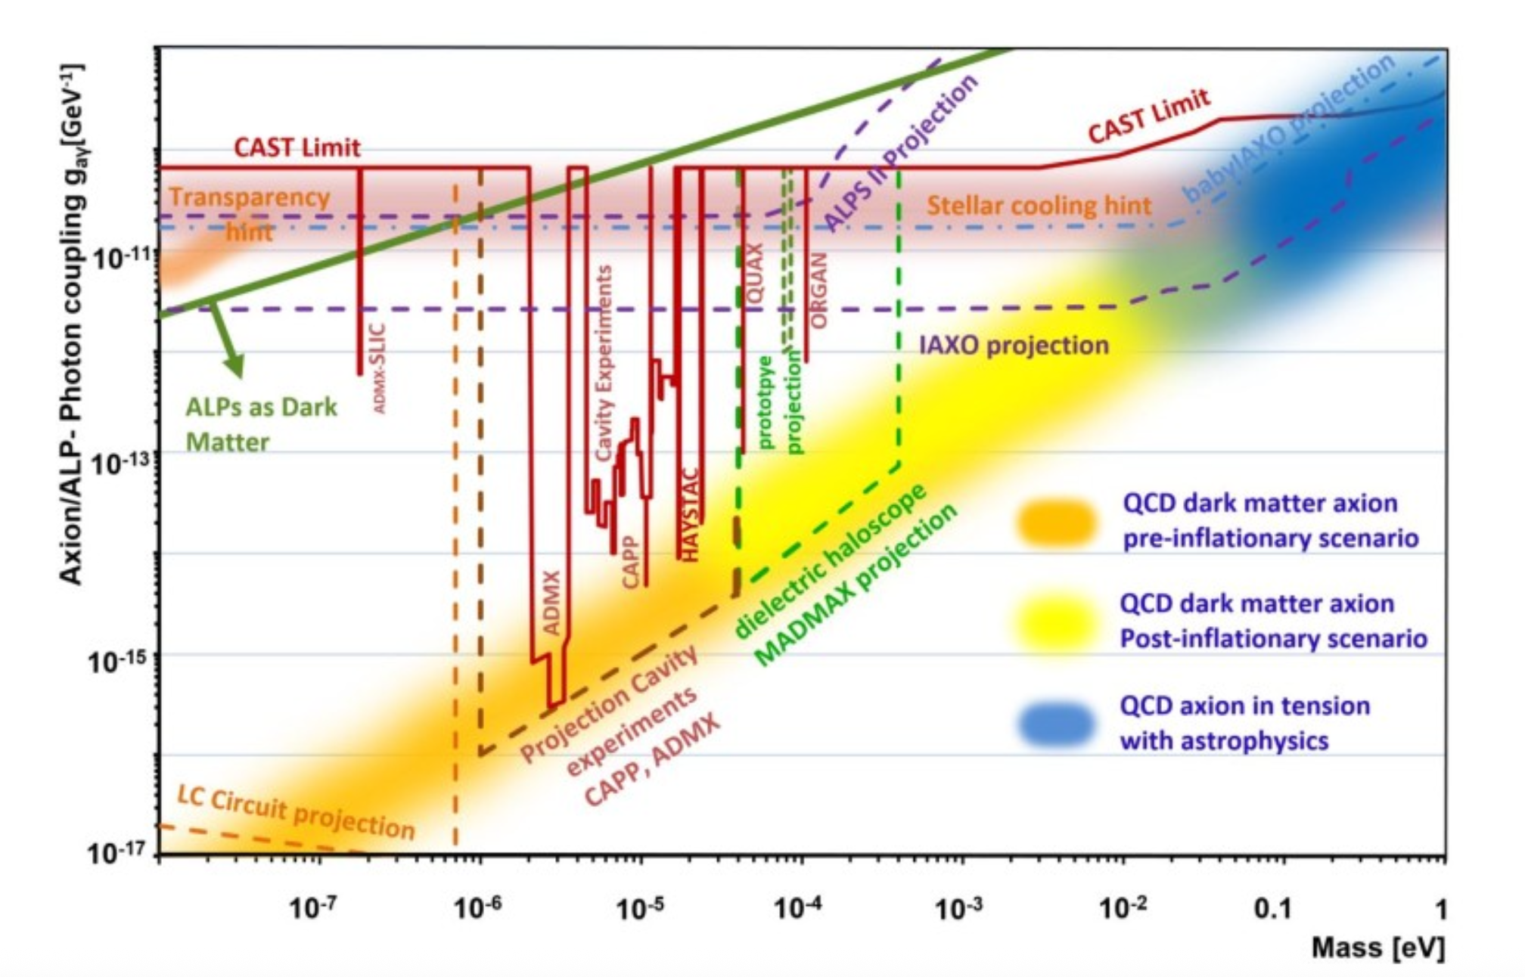
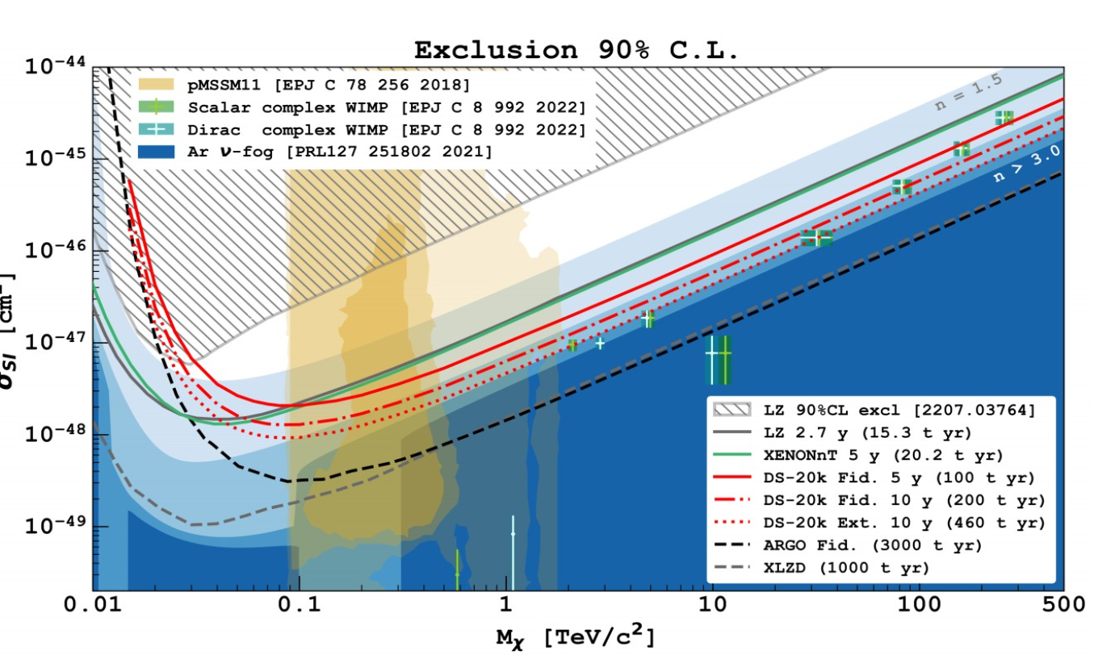
DARK MATTER
+
indirect detection
+
accelerator searches
Among the top scientific questions in Fundamental Physics.
Diverse as astronomical observations (from radio to gamma radiation).
In discovery phase: guaranteed signal in a given range? Differences in size and resources depending on the frequency. Need of R&D and new technologies.
Works and discussions to define a common strategy (in various bandwidths) for the next decade.

Slide 5
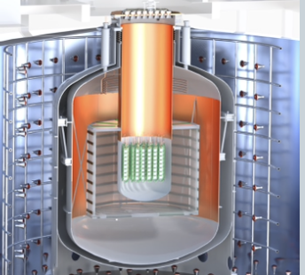
NEUTRINO PROPERTIES
NEUTRINOLESS DOUBLE BETA DECAY
LEGEND-1000 - 1000 kg 76Ge-enriched HPGe detectors based on LEGEND-200 with much lower background. background [selected by US downselect, DOE & Europe summit and on German RI prioritization short list].
CUPID - 450 kg of Li2MoO4 cryobolometer crystals, 240 kg 100Mo) using CUORE cryostat, with light and heat read-out, heat readout, lower bg [selected by DOE & Europe summit].
NEXT-HD - 1 t HP-TPC with 136Xe-enriched xenon gas with identification capabilities (two electron vertex, Ba tagging).
XLZD - a 60 (80) t multipurpose liquid natural xenon observatory, dark matter detector with competitive sensitivity.
BETA DECAY
- KATRIN+ (first R&D phase): cover fully inverted neutrino mass ordering and finally normal neutrino mass ordering: reuse KATRIN setup to a big part, enhance to differential spectral measurement, atomic tritium source (R&D with Project 8).
R&D projects: EC - 163Ho cryogenic bolometers (ECHo, HOLMES), 3H beta spectroscopy (Project 8,QNTM, Ptolemy)
CP-VIOLATION AND NEUTRINO MASS PARAMETERS
HyperKamiokande - 188 kton fiducial water Cherenkov detector + 295km baseline neutrino beam. Data taking in 2028.
DUNE - 40+ kton fiducial liquid Argon detector + 1300 km baseline neutrino beam. Data taking in 2030+.
JUNO - 20 kton liquid scintillator reactor neutrino experiment. Taking data since 2025.
IceCUBE/KM3NeT (DeepCore/PINGU, ORCA). Taking data.
Guaranteed signal (in the simplest scenarios). Discoveries expected in the period 2027-2036.
Ultra-low background required and very low signals (very large detectors). R&D needed to reach the lowest sensitivities needed to find the expected signals.

Slide 6
MULTIMESSENGER
Multi-Messenger(MM) is not so new:
Transient events: merger of compact objects (GW170817), supernovae (SN1987A), AGN flares (TXS 0506+056).
Steady sources: active galaxy (NGC 1068), solar neutrinos.
Multi-messenger/multi-wavelength for galactic and extragalactic sources in cosmic-rays and diffuse backgrounds.
Multi-messenger as multi-probe: combination of different messenger results (e.g cosmology).
What is new in MM:
next-generation GW and neutrino observatories will turn rare multi-messenger events into routine (hundreds/ year).
main current and ongoing projects: LIGO, Virgo, Kagra, Super-Kamiokande, SNO+, JUNO, KM3NeT, Ice-Cube, Vera Rubin, VLT-ESO, Swift, FERMI, SVOM, Einstein Probe, CTAO.
main future projects: ET, LISA, Hyper-Kamiokande, DUNE, massive dark matter detectors ,THESEUS, newASTROGAM, ELT, WST, SKA.
Define a strategy to optimize the limited observational resources: Wide-FoV instruments (e.g. Vera Rubin, WST), high energy all-sky satellites (Theseus,newASTROGAM), sensitive instruments,…
Identify missing instruments, optimize sky coverage, time schedule in the short and long term, enhance coordination (with space observatories).
Develop multi-messenger platform (in collaboration with LSST, …) in an European research infrastructure (Horizon- project ACME).

Slide 7
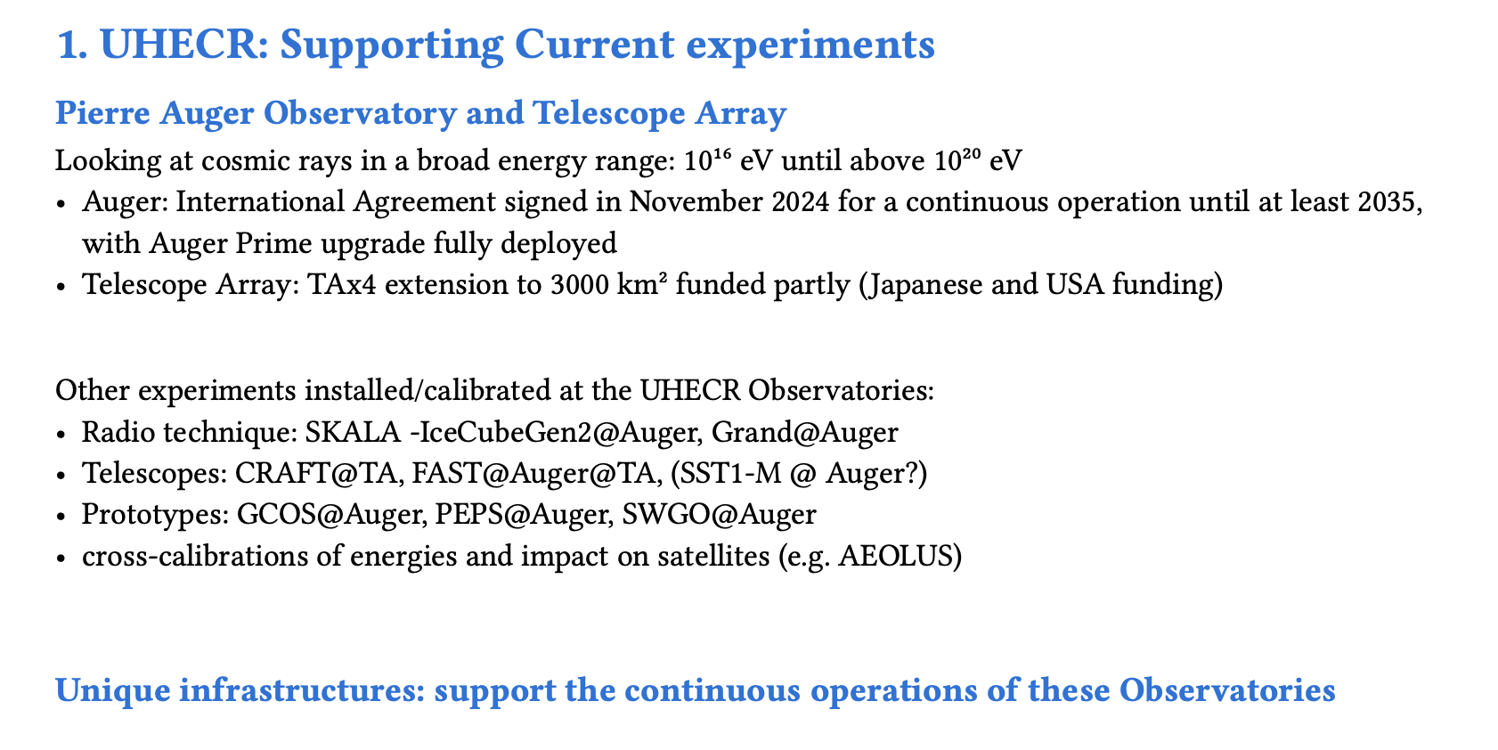
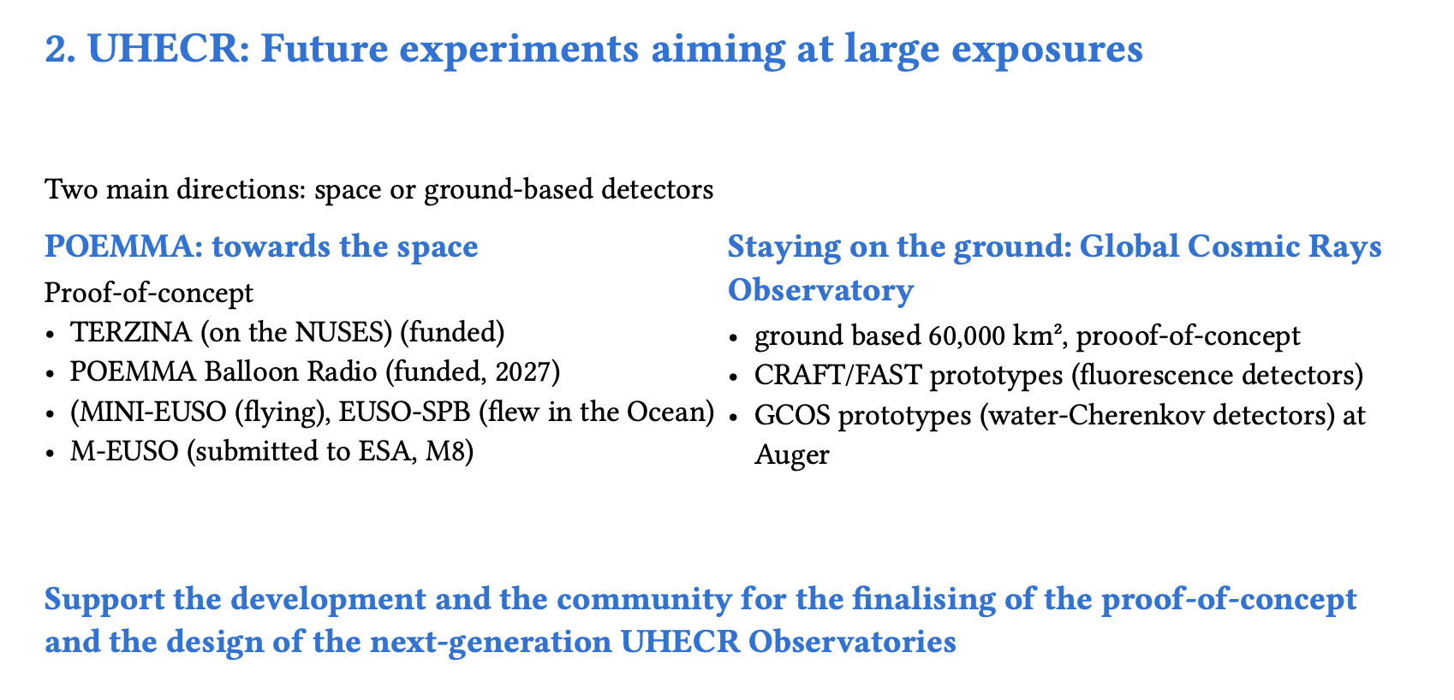
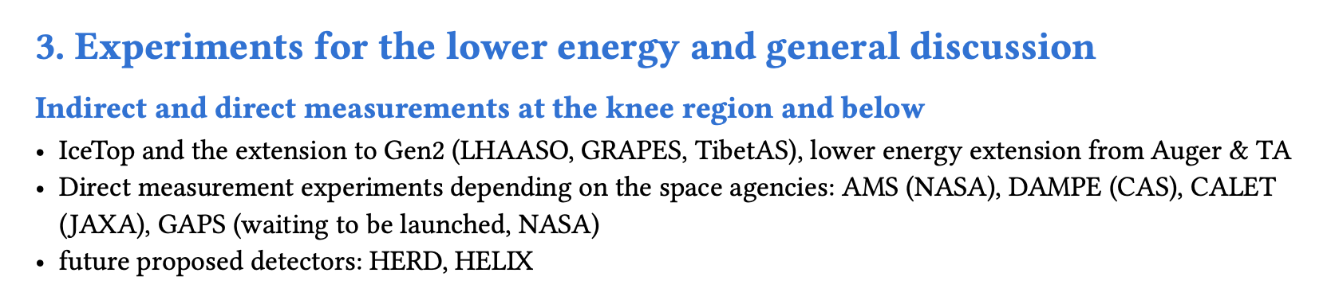
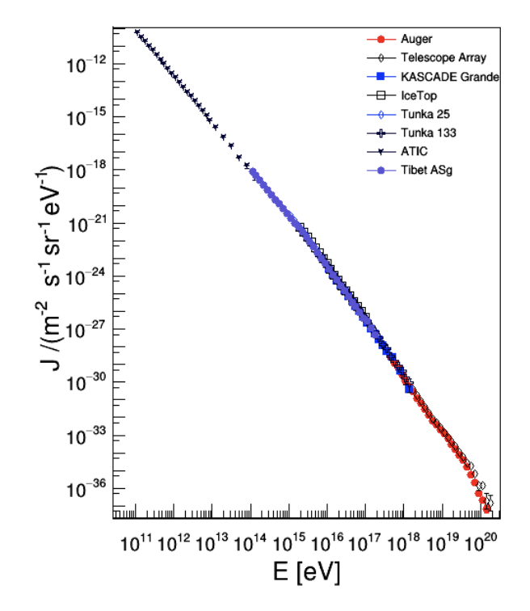
COSMIC RAYS
Mature plan with modest budget. Member of the multimessenger squad.
Importance of supporting R&D, particularly in radio.

Slide 8
GAMMA RAYS
Cherenkov Telescope Array Observatory (CTAO), from 20 GeV to 300 TeV, https://www.ctao.org. Two sites (Spain and Chile), ERIC approved in 2025, funding for alpha configuration, and now telescopes need to be built. Scientific operation expected before 2030. Discussions about how to best/quick build it, and secure funding for long-term operations.
Southern Wide-field Gamma-ray Observatory (SWGO), from 100 GeV to PeV, https://www.swgo.org. Prototypes of the water Cherenkov detectors being constructed and will soon be deployed to demonstrate the observatory’s technological and scientific potential. Scientific operation could happen in early 2030s, but project is not yet funded.
Most formidable player (outside Europe): Large High Altitude Air Shower Observatory (LHAASO) - cosmic rays and gamma rays from 100s GeV to multiPeV - and its extension Large Atmospheric Cherenkov Telescope Array (LACT),
Missions:
MeV Gamma-Ray Missions, from 100 keV to 3 GeV, ESA M8 proposal newASTROGRAM. Technology ready (Compton scattering + pair creation). Proposal to M8 call in May 2025.
GeV Gamma-Ray Missions - FermiLAT (no successor). While FermiLAT/GBM instruments were built with large European participation, the actual operation is mostly run by USA (NASA). Funding situation for Fermi (2026+) unclear.
Mature Plan. Significant delays in delivery instruments and science.
Large number of instruments in a large energy range in operation. USA funding situation?.

Slide 9
NEUTRINO ASTROPHYSICS
Small number of detections since the first extragalactic neutrinos observed by IceCube in 2013. Recent highlights: first detection of neutrinos in the MW by IceCube (Science 2023) and highest energy neutrino ~ 200 PeV by KM3NeT (Nature 2025). Neutrino observatories:
KM3NeT (to be completed in 2030?)
IceCube-Gen2 (IceCube upgrade scheduled in 2025) funding is not secured.
P-ONE deployment of several strings in this decade.
Complementarity with other observatories and experiments:
Radio antennas (RNO-G with 35 antennas, GRAND-Proto with 300 antennas in 200 km3) - 2026-2031.
- Pierre Auger Observatory for ultrahigh energy neutrinos.
Hyper-Kamiokande and JUNO and DUNE for (difuse) supernova and solar neutrinos.
Partially built with delays. More than one site operative.
Complete the experiments as initially planned, with timely budget and operation.
Coordination within neutrino observatories. Progress needed in multi-messenger strategy.

Slide 10
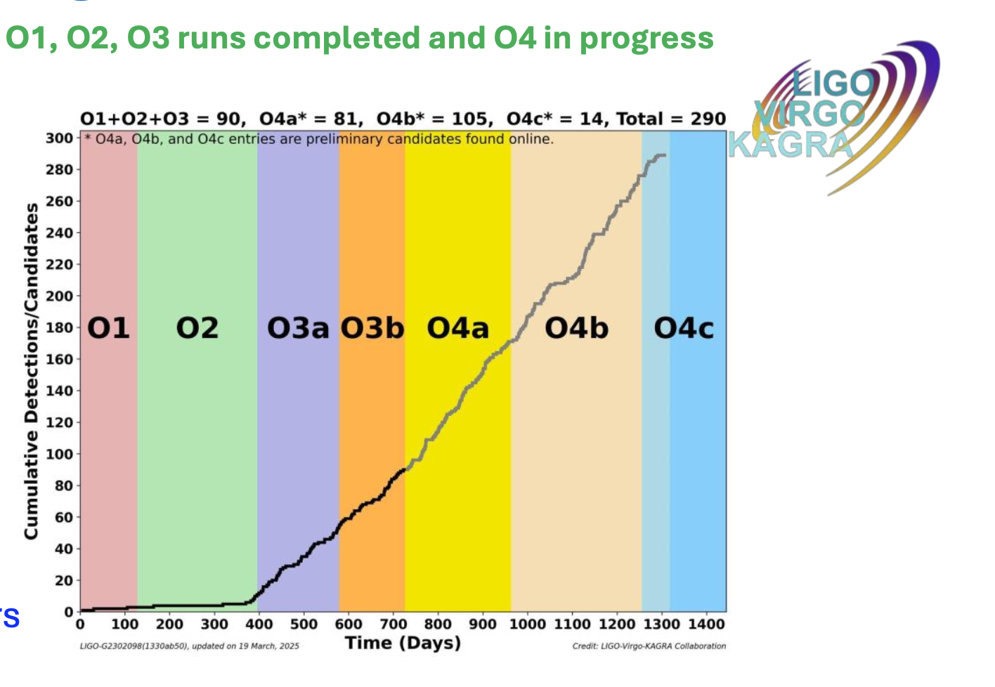
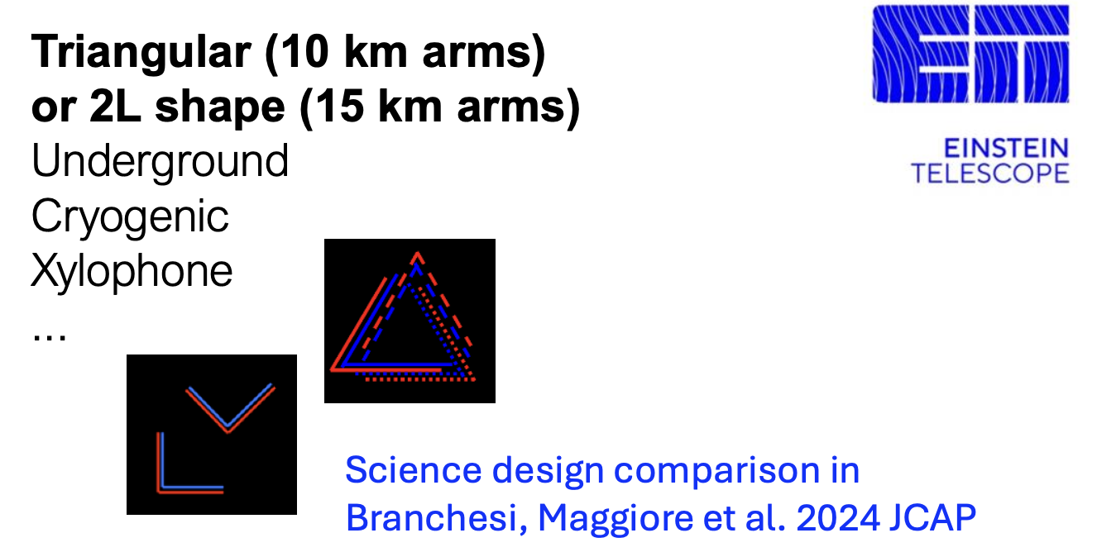
GRAVITATIONAL WAVES
The Virgo GW (in O4 observing run) upgrades (O5, 2030) will be critical
to keep Europe at the forefront of GW astronomy:
as observatory enabling new and impactful discoveries.
advancing key technologies and building expertise for ET
Einstein Telescope (ET) stands out as the most indicated next-generation
infrastructure to be included in the roadmap. It is of interest not only to the
GW community but also to a broader range of astroparticle scientists.
                Currently: design comparison between triangular and 2L shape configurations
                ET requires extensive R&D efforts in key technologies. Major challenge will
                be access to the low-frequency range (cryogenic). Development of a specific
                data analysis and MDC roadmap.
LISA raises great expectations (launch planned for 2035) - new observational band at low frequencies 0.1 mHz and 1 Hz.
ET - Next generation infrastructure to host such a large scientific and technological endeavour.
ET - Extensive R&D efforts in key technologies.
ET - Highlight roadmap of R&D activities for ET (crystals, vacuum, … ) across Europe - message to funding agencies.(D´Hondt)
ET - Data analysis challenges require a plan for computing & software technologies development

Slide 11
ASTROPARTICLE THEORY
Understanding neutrino properties: matrix elements for 0ν2β decay using modern nuclear physics methods, neutrino–nucleus interactions from low-energy nuclear processes up to the highest energies relevant to neutrino telescopes, interpretation of data, breaking degeneracies between SM and BSM effects.
Exploring the dark matter landscape: cast a broad net (many different DM candidates, WIMPs remain an interesting candidate, connections with other areas as extended Higgs sectors, strong CP problem, MeV-scale experiments, dark sector searches, cosmology, …, signal + background (!) Predictions, new detection concepts, understanding the DM production mechanism, understanding the DM distribution in the Milky Way.
Understanding extreme astrophysical environments: neutron Stars, Supernovae, and their surroundings sources of UHE CRs, UHE neutrinos. Requires an interdisciplinary effort: nuclear and hadron physics (EoS of neutron stars, etc.), neutrino physics (oscillations of SN neutrinos, high-E ν sources), GW (signal predictions, interpretation of observations), new physics in these objects.
Improving GW signal predictions: improved template banks (post-Newtonian dynamics using method from particle physics), numerical GR, signals from the early Universe, signatures of physics beyond the SM), more efficient calculations (new theoretical methods, AI-assisted methods),…
Interpreting cosmological data: relating new data (DESI, Euclid, …) to underlying particle physics models, interplay between different observations, connections between cosmology, astrophysics, particle physics, understanding anomalies (e.g. H0 tension) either within the SM or beyond

