Slide 1




Connecting CERN with Brazilian Electronics Companies
Raphaël Berberat

Slide 2
Introduction to the BE-CEM-EPR Electronics Service
BE-CEM-EPR section offer an Electronics Service providing CERN-wide support in the domain of Printed Circuit Boards (PCB) and Electronic Module Assembly
The main activities of the service are:
CERN Altium & Cadence Libraries: creation and maintenance
Layout design for electronics boards and crates
Manufacturing of bare PCB internally at CERN or by subcontracting
Mechanical parts production in collaboration with Mechanical and Materials Engineering (MME) Group
Assembly and integration of electronic modules, internally or by subcontracting
Electronics components procurement for CERN users
&
Radiation tests campaigns for electronics components for the qualification of components candidate for the electronics installed in the CERN accelerators’ radiation environment, representing approx. 400 kCHF per year.
  These test campaigns are done internally at CERN High energy AcceleRator Mixed field/facility (CHARM) and at CERN Cobalt-60 (CC60) facility. Both CHARM and CC60 are under EPR section responsibility
  But also externally at Paul Scherrer Institute in Villigen, Switzerland
2

Slide 3
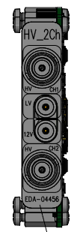
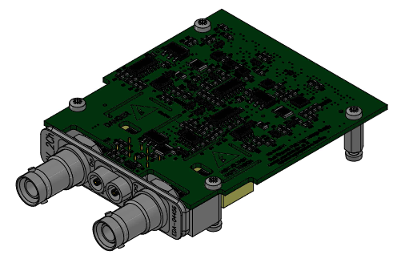
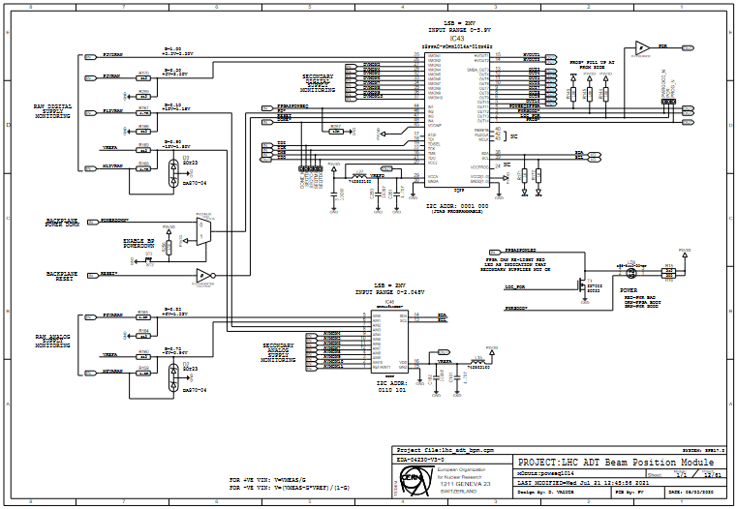
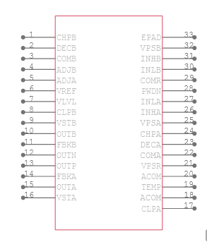

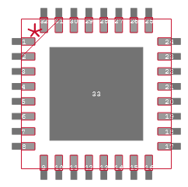
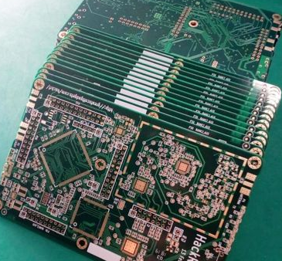
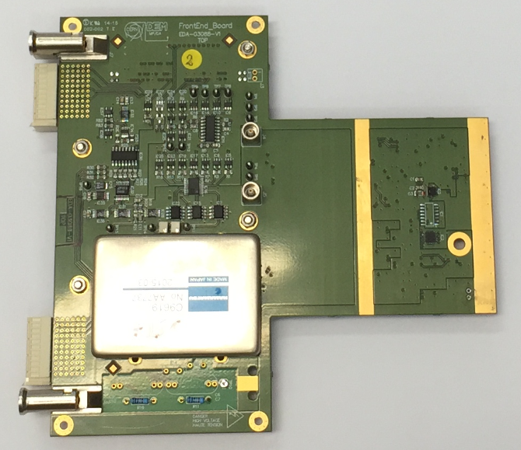
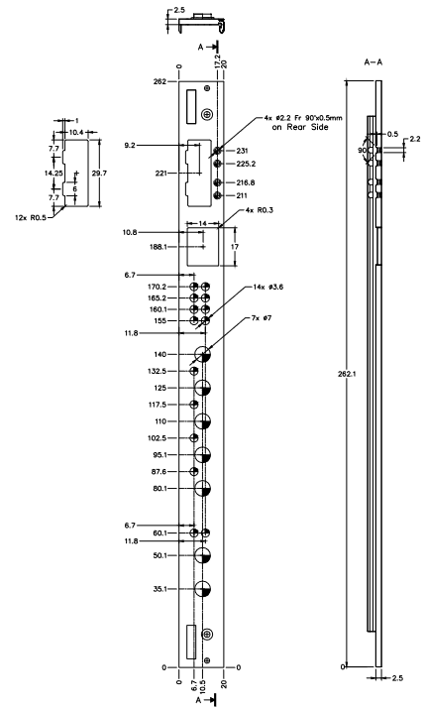

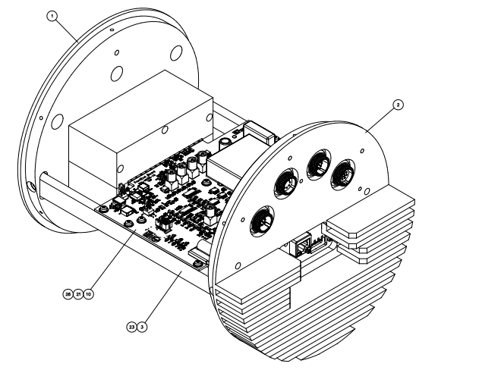
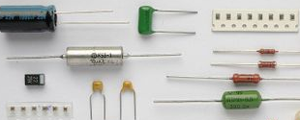
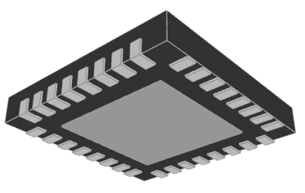
Introduction to the BE-CEM-EPR Electronics Service
Engineers develop
We deliver
We take care of all processes involved prior and during electronic production
BE-CEM-EPR Electronics Service
Schematic Libraries
PCB Libraries
Layout and integration
PCB and components procurement
PCB assembly
Mechanical production in collaboration with EN-MME
3D Model
3

Slide 4
Introduction to the BE-CEM-EPR Electronics Service
A team of 18 members coming from the industry and composed of 8 CERN employees and 10 members of external contractors
2 Engineers specialized in production processes, dedicated to design reviews
for the jobs done in our Design Office, subcontractor validation and planning follow-up
2 Engineers & Technicians specialized in PCB assembly and special repair
2 ADMIN students, working on bare PCB subcontracting activities, cost invoicing and KPI
2 Early-Career Professionals (ORIGIN) program members, real work opportunity in a technical or administrative field
&
5 contractor technicians for the design of standard and special PCB layouts
2 contractor technicians specialized in CAD libraries (free of charge for all CERN users)
3 contractor technical assistants for ordering components and assembly, which is a real advantage for users of the service when producing more than 10 units (free of charge)
4

Slide 5
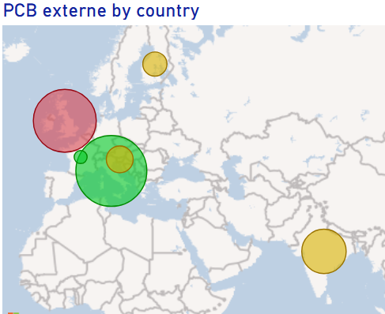
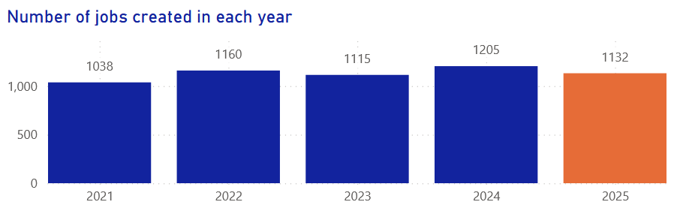
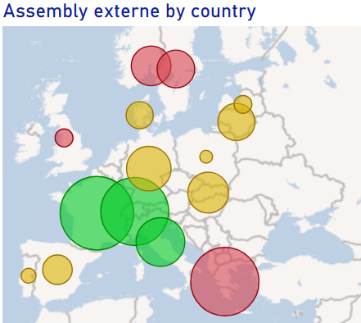
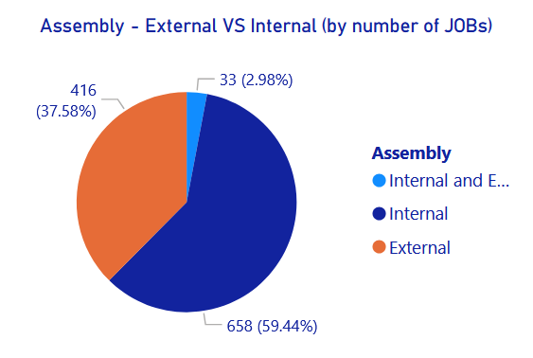
Introduction to the BE-CEM-EPR Electronics Service
Working with 21 Member States - Associate Member States and Associate Member States in the pre-stage to Membership
5

Slide 6
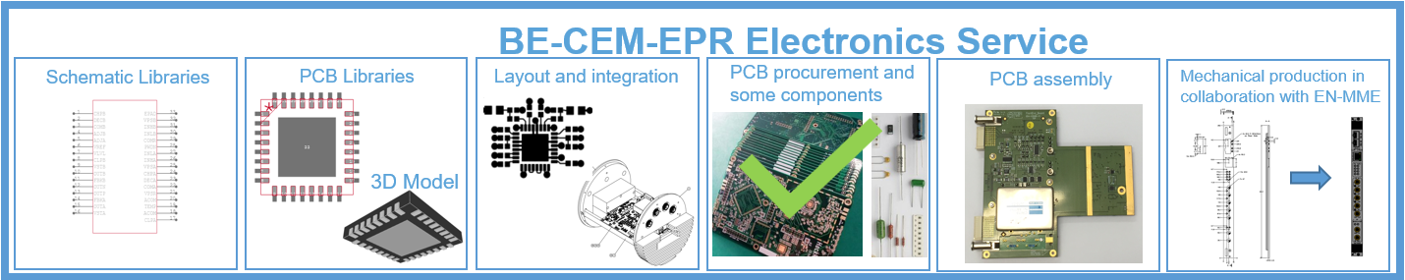
BE-CEM-EPR Electronics Service procurement strategy for bare PCB
One of the most expensive single parts of an assembly
A defective PCB may result in the complete loss of components
Defects in PCB may be hidden and introduce reliability problems during operation and/or for safety of critical equipment
The PCB must withstand the assembly process (RoHS, High Tg) and CERN safety rules (halogen-free base material)
As compared to “off the shelf “ components, each PCB is a new product made in limited quantity and each production may be impacted by technical issues during the complex manufacturing processes
  Selection of PCB supplier is critical
6

Slide 7
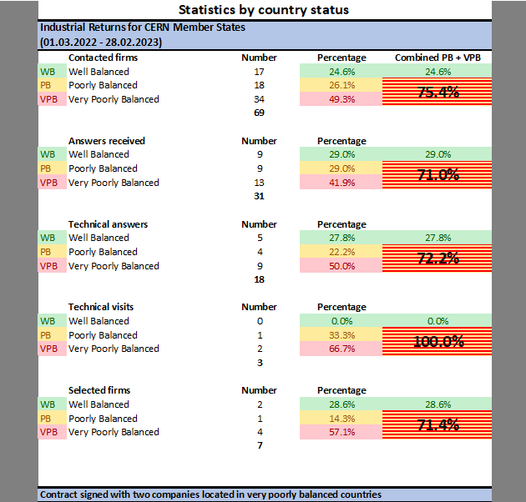
BE-CEM-EPR Electronics Service procurement strategy for bare PCB
Creation of Open Contracts with validated firms in CERN Member states
Market Survey (MS) sent (in July 2022) to 69 firms in 23 Member States
  31 answers received
  13 companies declined and 18 sent technical answers
  7 selected based on their replies to the Technical Questionnaire
  3 technical audits done on companies' production plants
  7 short listed after technical audits
Invitation to Tender (IT) sent to the 7 firms
  Based on a list of samples of representative PCB designs produced in the past years
  A pricing model was part of the deliverable (to guarantee that the costs of the future orders will comply with those announced for the Invitation to Tender)
→ 2 contracts established in July 2023 and for 3 years with two companies with two times one year possible extension if contract amount not reach
7

Slide 8
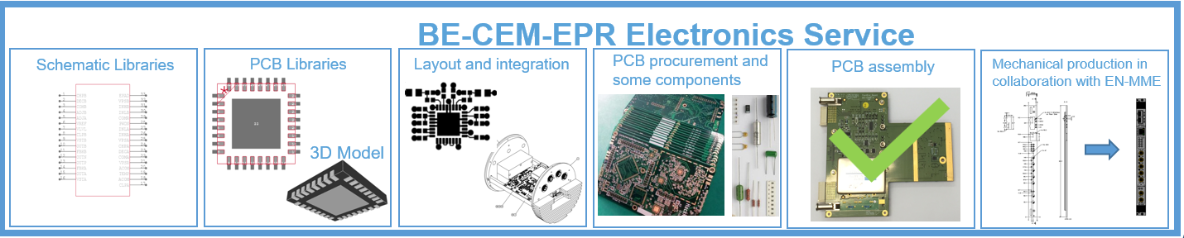
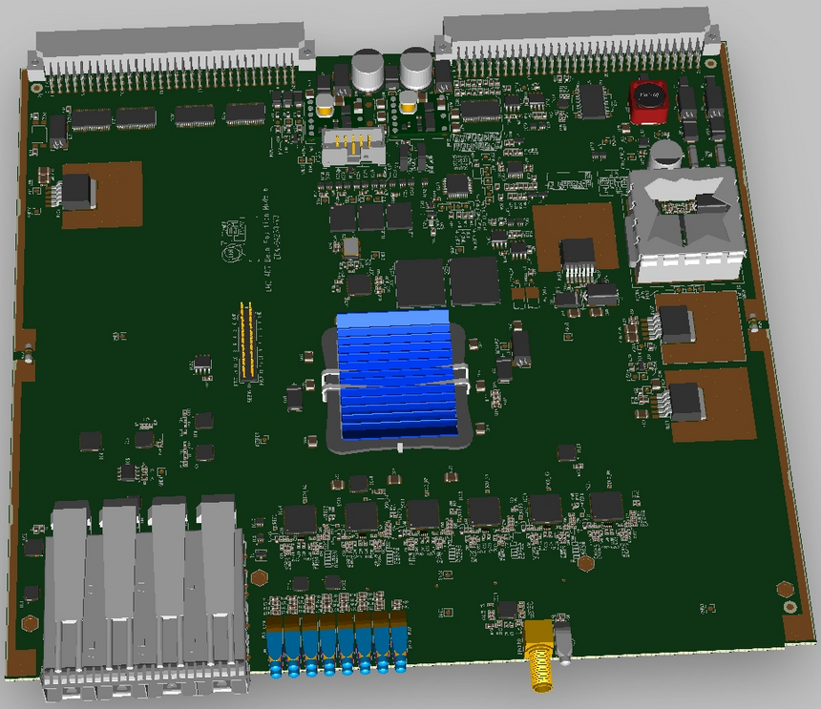
BE-CEM-EPR Electronics Service procurement strategy for electronics assembly
  3 categories of assemblies
    Simple: through hole components, low density
    Intermediate: Through hole and simple SMD components
    Complex: BGA, QFN, LGA packages
  Each category has its assembly requirements, leading to
  different processes and equipment
  A firm equipped for the assembly of complex boards
  will not be competitive for simple ones
  Urgent projects often require proximity to the firm
  Too varied to establish a standard pricing model and create an Open Contract. An Open Contract requires a pricing model to guarantee the best cost at any time and for any project. For assembly, a price model is not easy to establish or will be too expensive
LHC ADT Beam Position Module
8

Slide 9
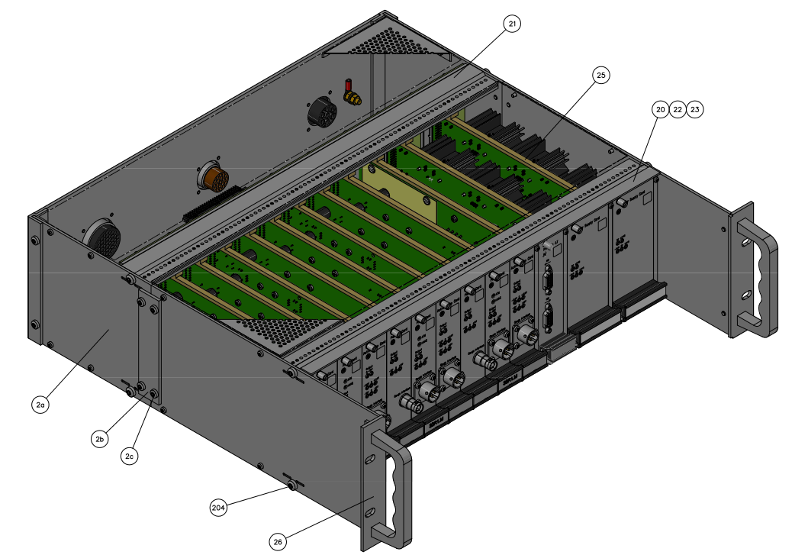
BE-CEM-EPR Electronics Service procurement strategy for electronics assembly
ISO 9001:2015 certified company
In a CERN Member State or Associate Member States
All process steps shall be done in-house, no subcontracting allowed
Companies accepting kitting (bare PCB and components)
Industrial cleaning process in-house is mandatory
Vapour phase oven is a real advantage
AOI inspection is mandatory
Assembly processes according to J-STD-001 and IPC/JEDEC-J-STD-033
Acceptance of electronic assemblies in compliance with IPC-A-610 and IPC-A-620
  Class 1 -- General Electronic Products
  Includes products suitable for applications where the major requirement is function of the completed assembly.
  Class 2 -- Dedicated Service Electronic Products
  Includes products where continued performance and extended life is required, and for which uninterrupted service is desired but not critical.
  Typically the end-use environment would not cause failures.
  Class 3 -- High Performance Electronic Products
  Includes products where continued high performance or performance-on-demand is critical, equipment downtime cannot be tolerated, end-use environment may be uncommonly harsh, and the equipment must function when required, such as life support or other critical systems.
9

Slide 10
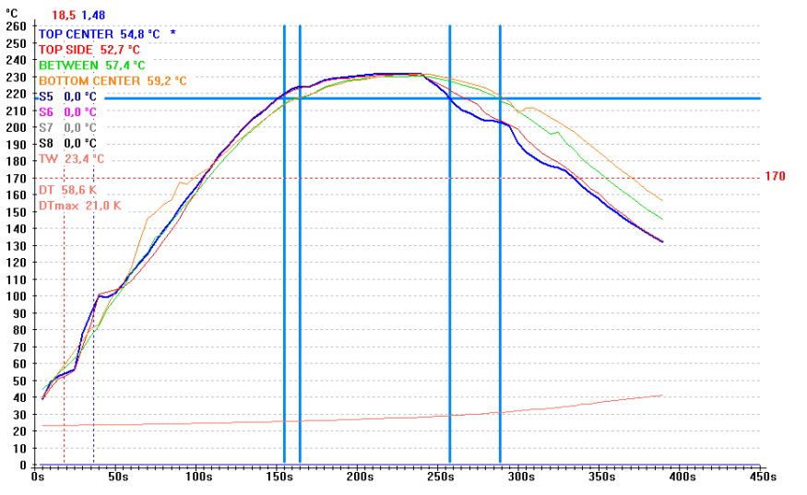
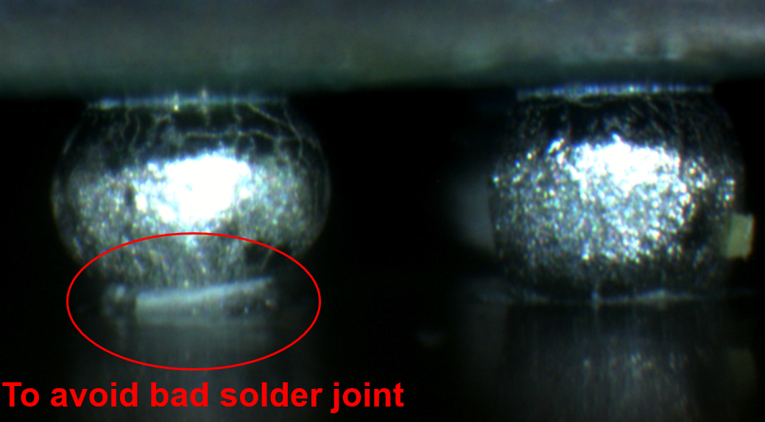
Electronic Assembly Requirements
Measurement of thermal
profile for reflow process validation prior production
Mandatory for “complex” assemblies
When BGA, LGA and specific components are on present on board to be assembled
Thermal parameters defined in our documentation
Measured using real PCB & dummy components
Critical for high quality assemblies
10

Slide 11
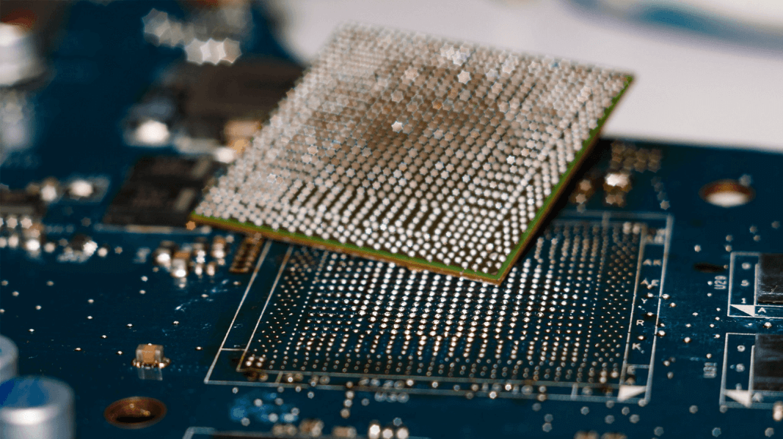
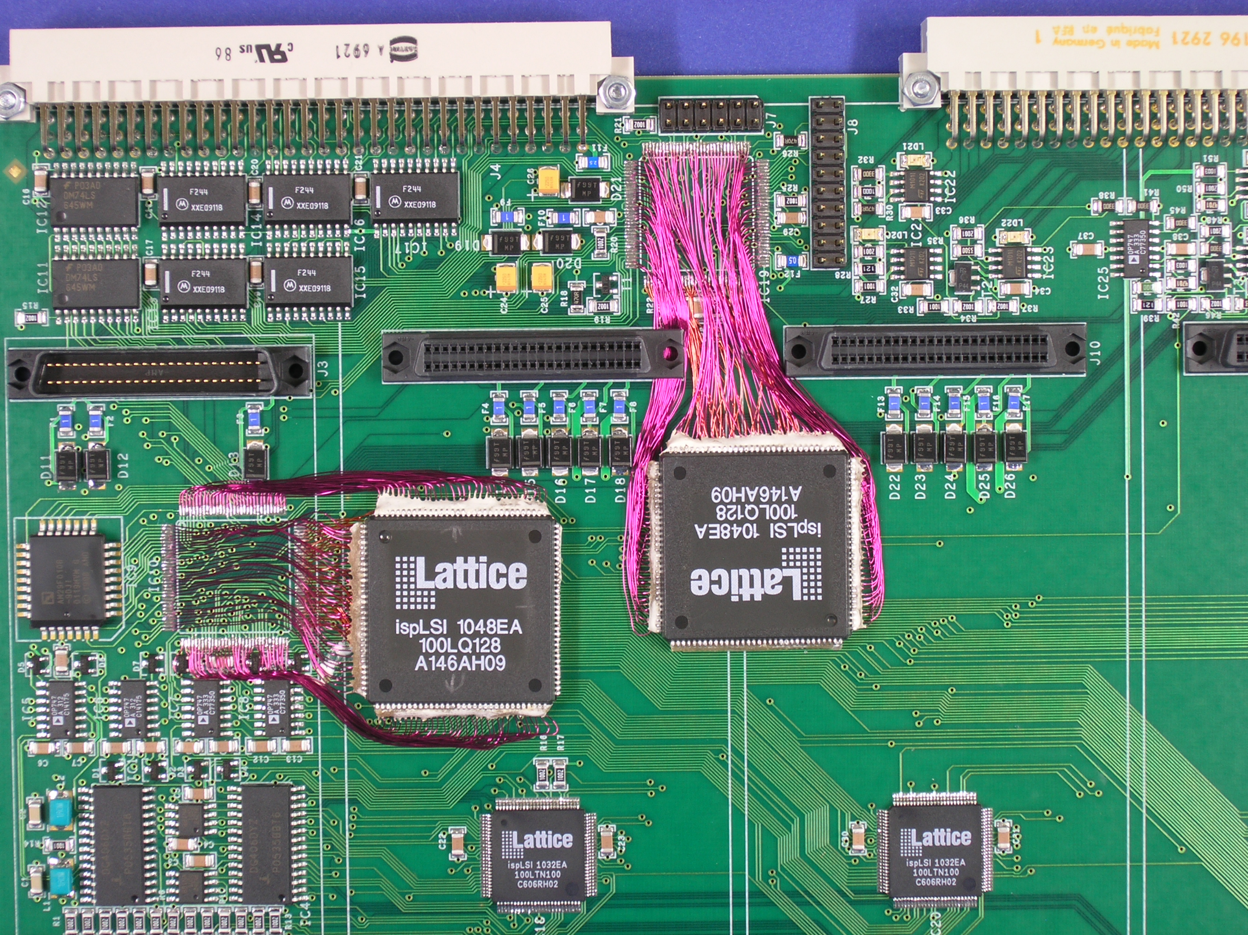
BE-CEM-EPR Electronics Assembly Workshop
Prototypes → in general 10 PCB or 10 panels
Same rules as when outsourced
Impossible-to-subcontract assemblies
→ The lead-time may be long due to limited resources
Repair/rework of almost any component type
Board/assembly modification
On-demand PCBA cleaning
11

Slide 12

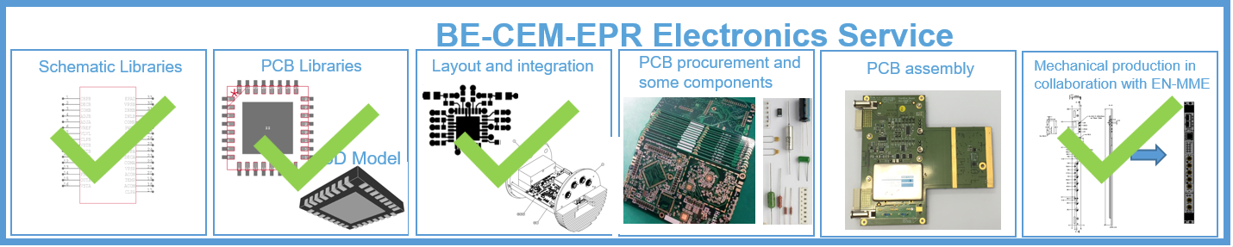
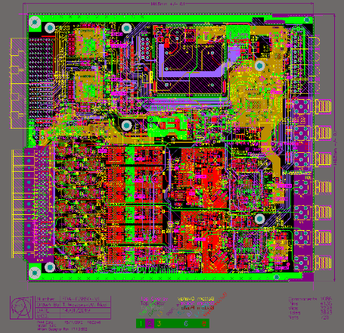
Layout design for electronics boards and crates

Slide 13

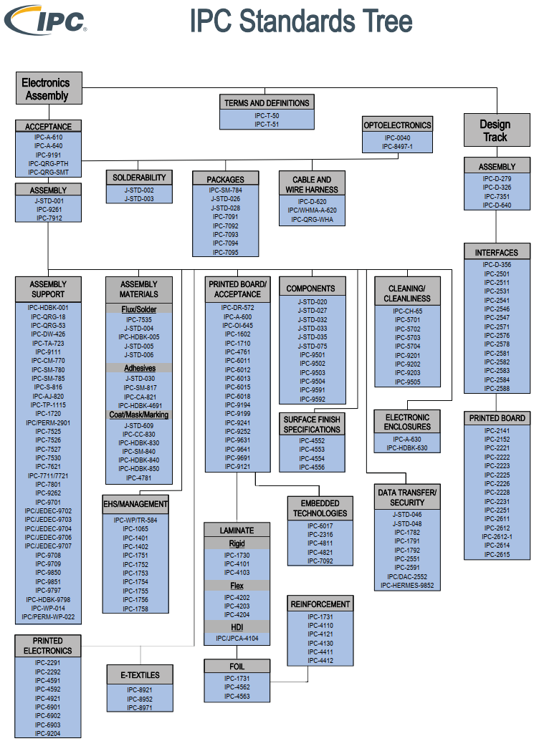
Design for eXcellence in BE-CEM-EPR design office
Where is Design for eXcellence defined?
From IPC worldwide recognised standards. (Institute for Interconnecting and Packaging Electronic Circuits)
CERN is IPC member and CERN library owns several standards available for users
BE-CEM-EPR has the main standards on site in building 107 accessible to team members
13
Notes:
From IPC standards. (Institute for Interconnecting and Packaging Electronic Circuits), which will help to increase high-quality products through proven and worldwide recognised standards, certification, education and training
CERN is IPC member and CERN library owns several standards available for users
BE-CEM-EPR has the main standards on site in building 107 accessible to team members as all designs and electronics assemblies are done according to the most important IPC standards, class 3 acceptance criterias
This presentation will give an overview of the important topics to address when developing and designing a new project and taking care of Design for eXcellence

Slide 14
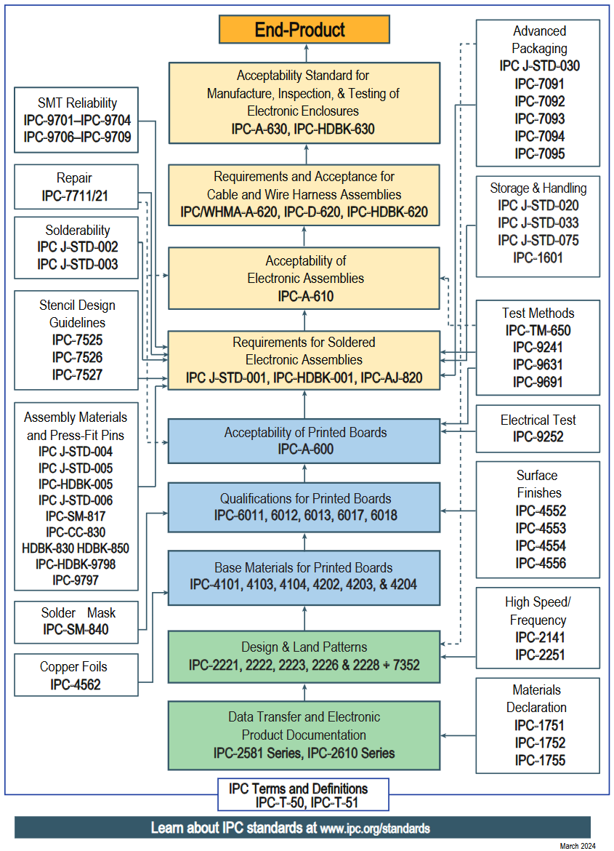
Applying Design for eXcellence
What EPR Electronics Service team is taking care when your designs are going through our processes?
During CAD library creation and during design layout
During PCB manufacturing
During components assembly
During quality assurance
Important parameters to be specified by engineers before starting a new development and design:
  Application environment (electro-magnetic, high voltage, high-current, vacuum, humidity, cryogenic, radiation)
  Signal characterisation (High-speed, controlled impedances, differential)
  Mechanical constraints (external dimension, final integration)
  End use (prototype, long term service, quick fix, test bench)
14

Slide 15

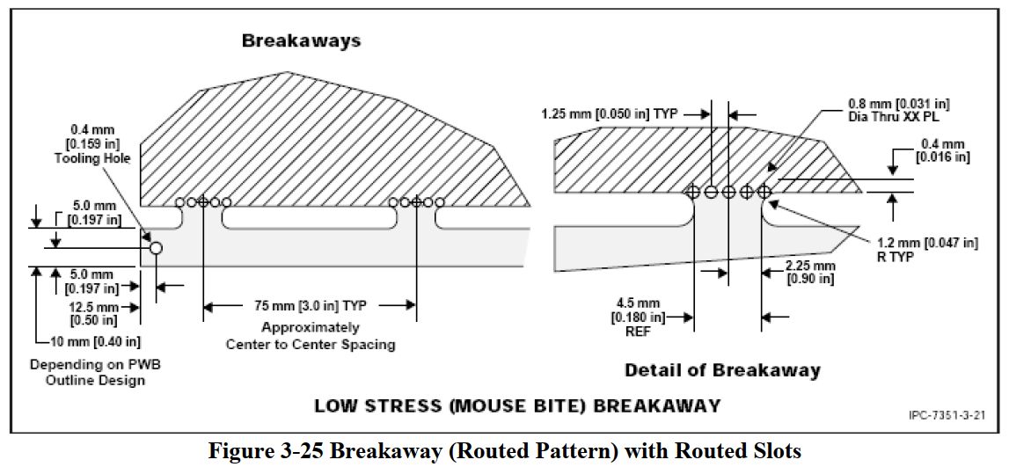
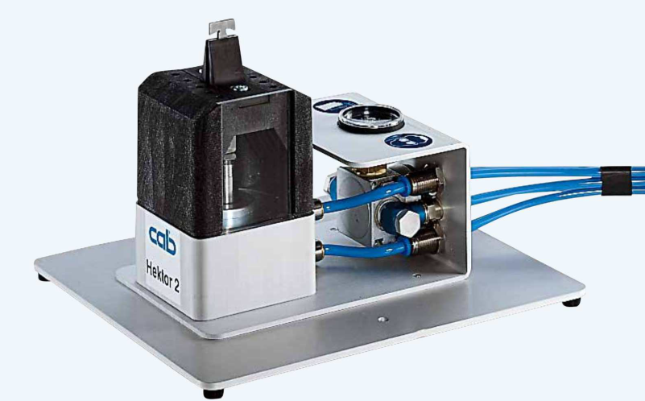
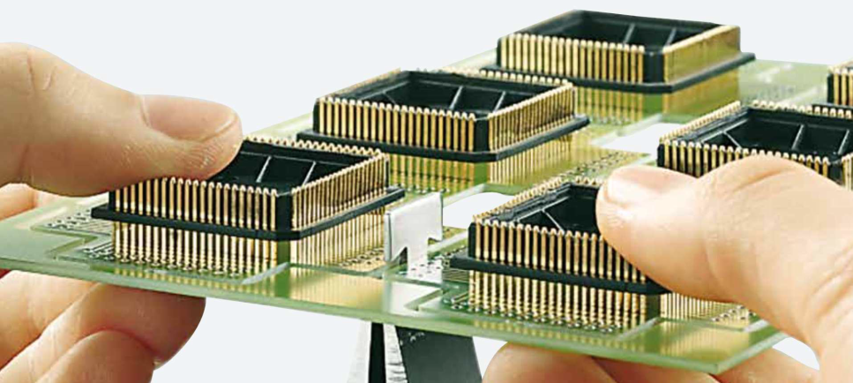
Cut-out (aka Mouse Bites or Tabs)
Used to panelise boards in a panel.
A dedicated tool shall be used (do never cut Mouse-Bite by hands!) or any Dremel-like tool.
We do not recommend V-Cut using pizza-cut tool for panelization. Several possible damages on PCB if fine-tuning of the tooling is not done properly
05/11/2025
15

Slide 16
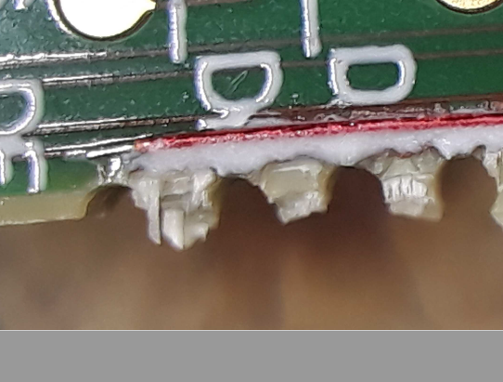
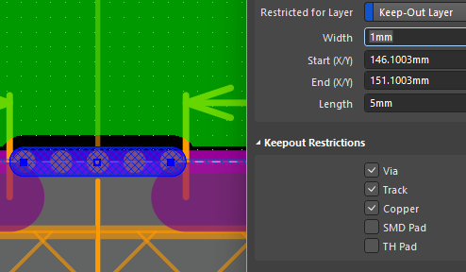
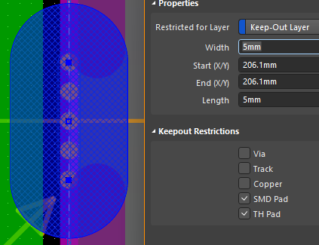
Cut-out (Mouse Bites or Tabs)
Distance between two cut-outs, 50mm to 70mm recommended, up to 90mm but for specific production
Must be 1mm from copper lines or plans and 5mm minimum from components
If these limits are not respected, we may face possible issues
16

Slide 17
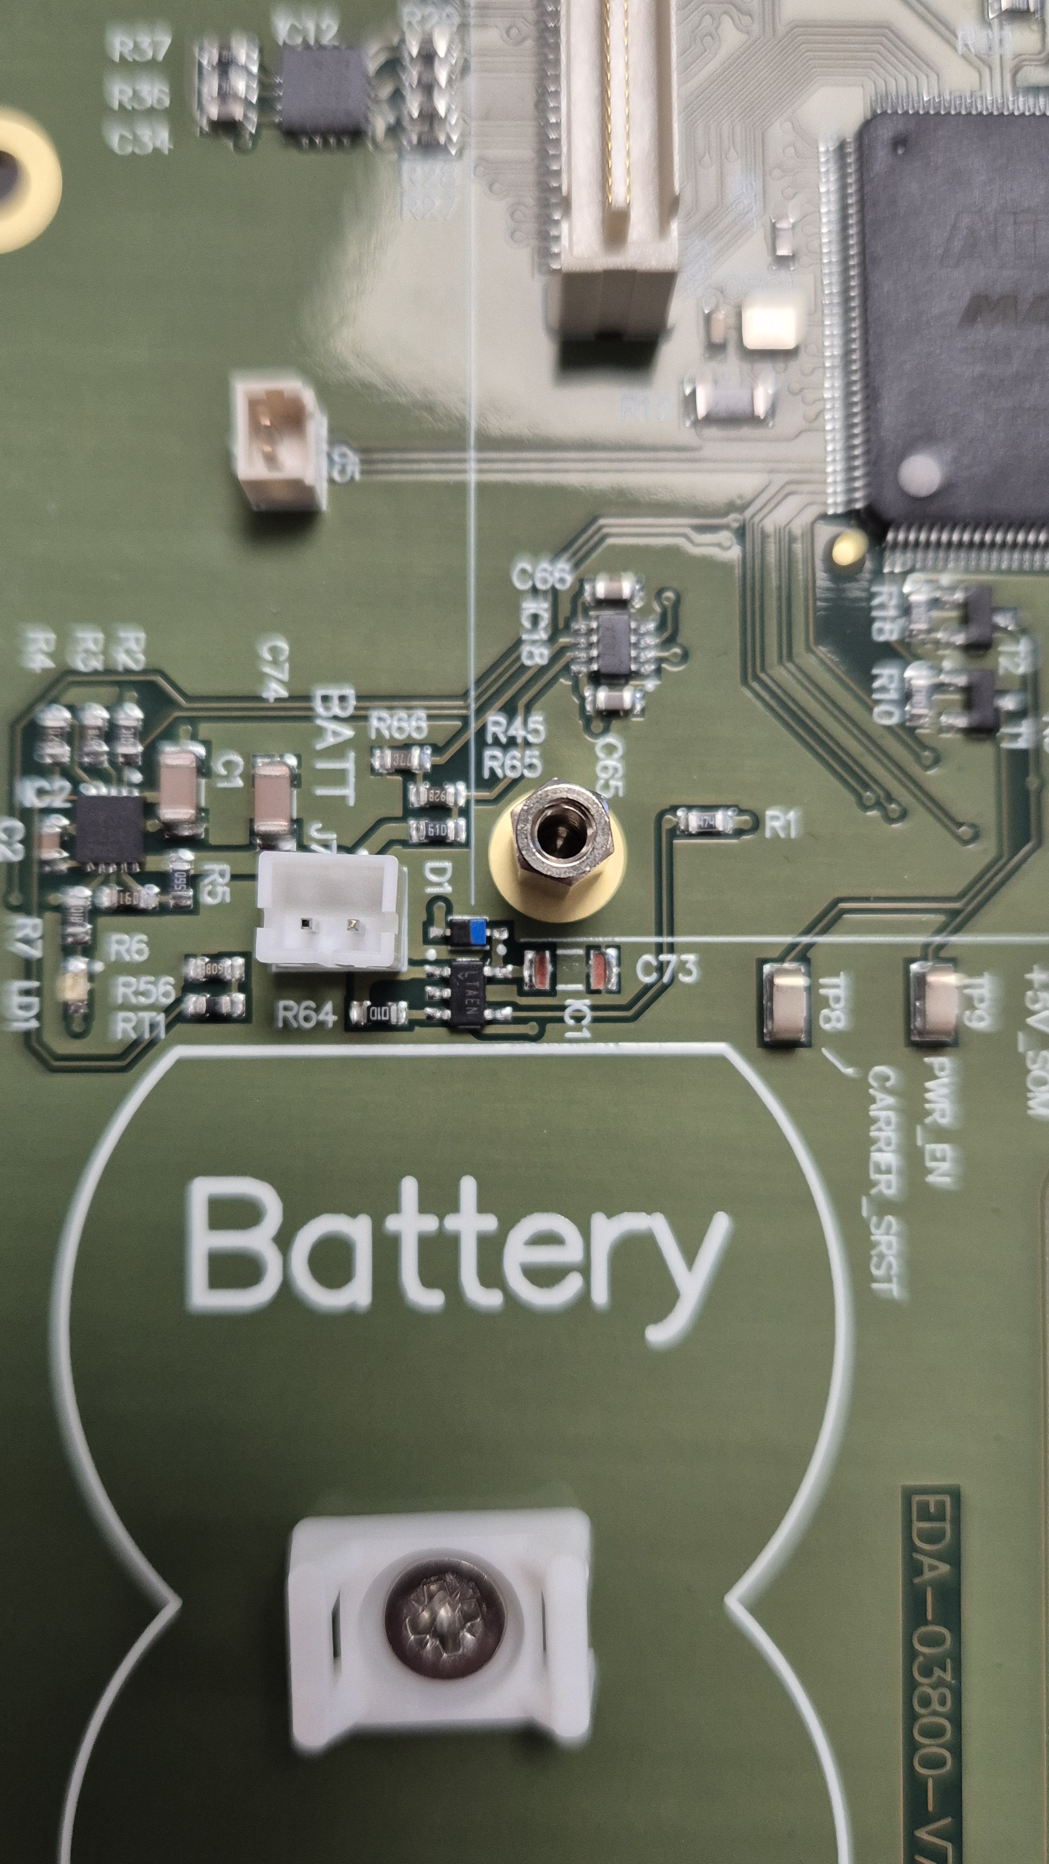
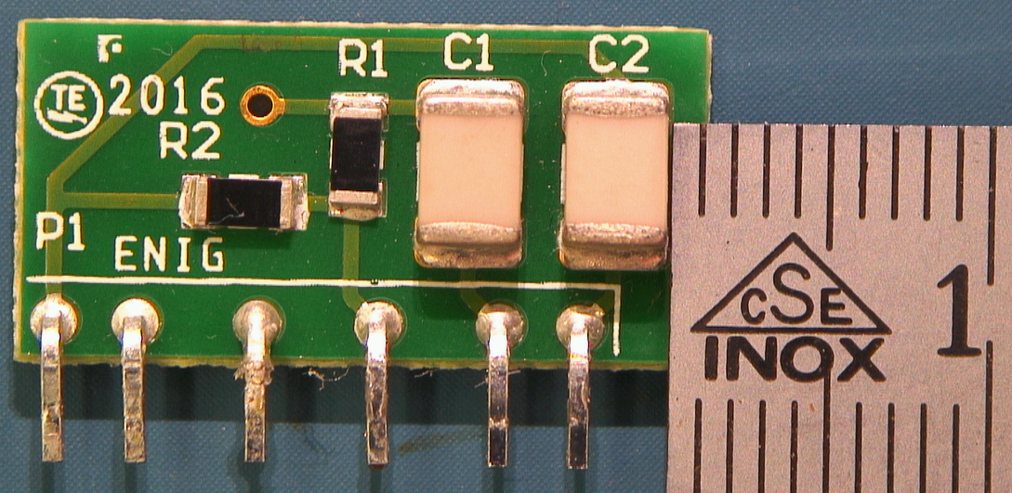
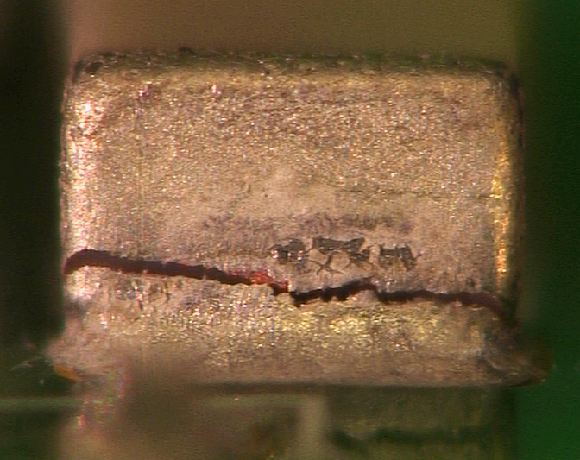
Design: mechanical considerations
Mechanical fixtures such as screws, spacers shall be kept at least 5mm away from any components to avoid potential damages
While it is not recommended to use V-score, failing to ensure 5mm clearance with parts and solder joints can lead to disaster (30% failure in the case shown on the right)
17
Notes:
Mechanical fixtures such as screws, spacers and alike shall be kept at least 5mm away from any part package or solder joint to avoid potential damages
When technical edges or panel are used, the same 5mm rule applies for the placement of the tabs; in addition, mouse bites design for the tabs are preferred to help limiting the mechanical load experienced by the PCB during singulation
While it is not recommended to use so-called V-score, failing to ensure 5mm clearance with parts and solder joints in these cases can lead to disaster (30% failure in the case shown on the right)

Slide 18
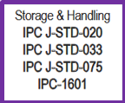
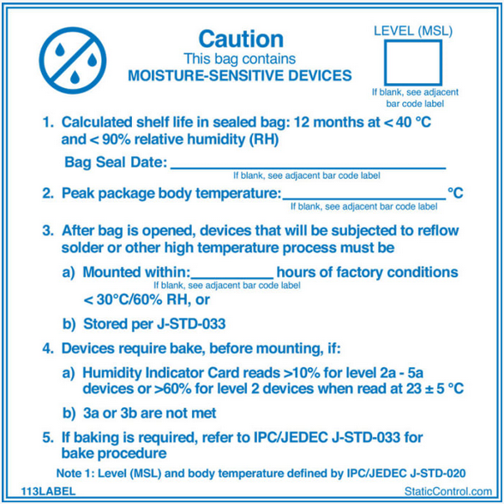
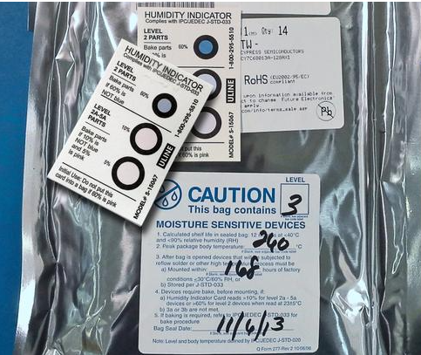
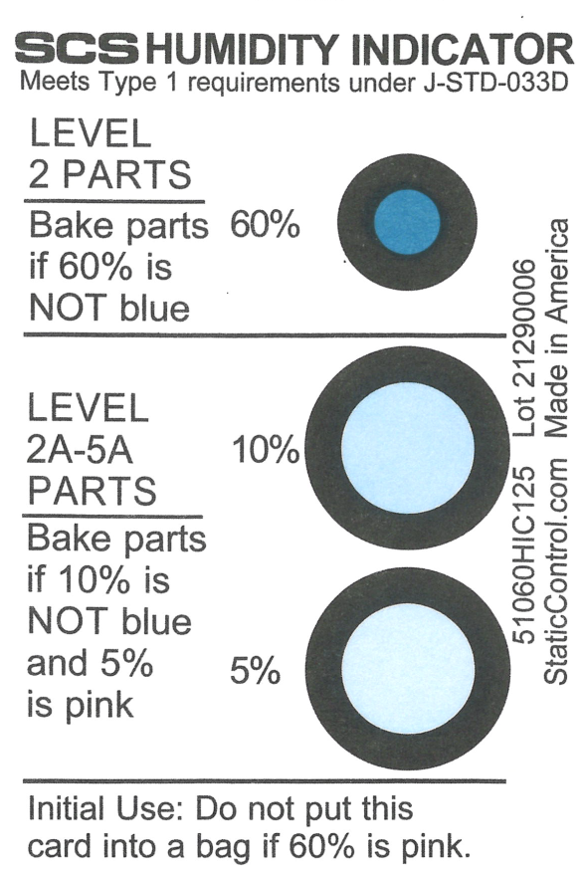

Components selection
Moisture Sensitivity Levels (MSL) requirement
  List MSL>3 in the BOM and in the manufacturing files
  Do not open the sealed bags before production
  Follow the manufacturer’s instructions on the labels of the bags before the production
  After production, bake parts, count the remaining parts and re-seal the bag, using:
    New humidity indicators
    New desiccant bag
    Correctly use the MSL sticker
MSL level of the part
Expected lifetime of the sealing
Bag seal date
Component max temp.
Time within assembly or new mandatory baking
Humidity sensor
New baking mandatory if humidity sensor color present
18
Notes:
Moisture Sensitivity Levels (MSL) requirement
List important information to respect (eg MSL>4) at the BOM and at the manufacturing files
Do not open the sealed bags before production
Follow the manufacturer’s instructions on the labels of the bags before the production
After the production, re-seal the bag before storing, using new humidity indicators inside the bag and indicate the necessary information for the sealing

Slide 19
DOCUMENTATION QUALITY
The perfect set of PCB manufacturing files is composed of:
    Technical specification listing all important parameters of a PCB and reference of all applicable standards and base material criteria
    Panel Gerber file: stencil manufacturing/pick and place
    Drilling and milling files for individual PCB and panel
    Gerber files for PCB production
    Stack-up files for internal layers and copper thicknesses
The perfect set of assembly files is composed of:
    Solder paste Gerber file: stencil manufacturing
    Panel Gerber file: stencil manufacturing/pick and place
    SMD placement file: pick and place
    Bill Of Material (BOM): parts sourcing
    ASCII CAD file of project: machine programming and assembly documentation (ODB++ OK, IPC-2581 better than ODB++, GENCAD, Protel, Accel EDA/P-CAD ASCII)
    Complete parts placement file: AOI
19

Slide 20
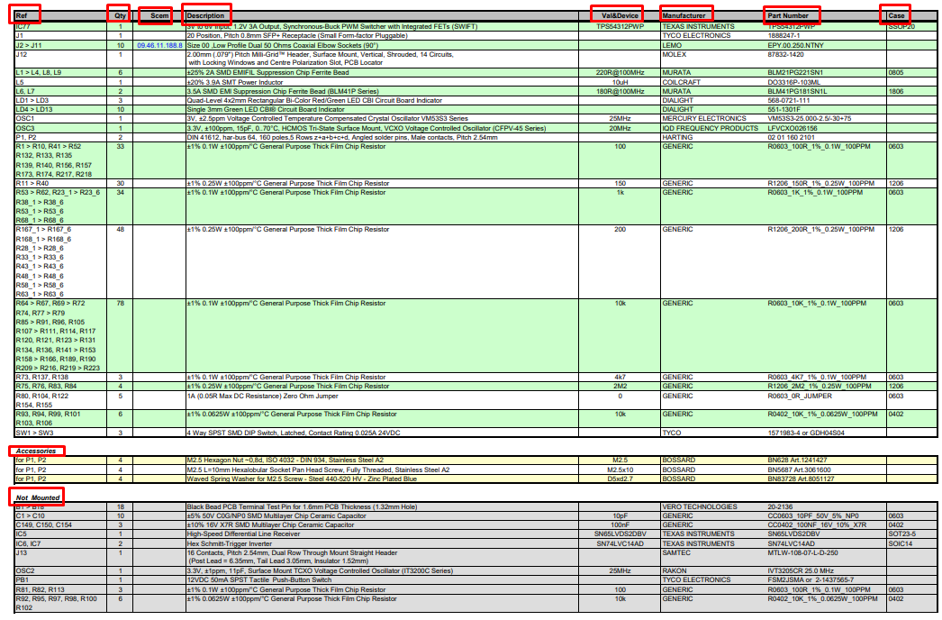
Manufacturing files
Bill Of Material (BOM)
  Column with designators, quantity, description, part numbers, packages
  Indicate all the specific (sensitivity, handling instructions, etc)
  Include mechanical parts e.g. screws, nuts, washers for connectors
  To ease assembly and optical inspection, mention the not-mounted parts
20

Slide 21
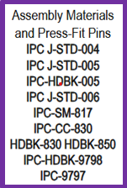
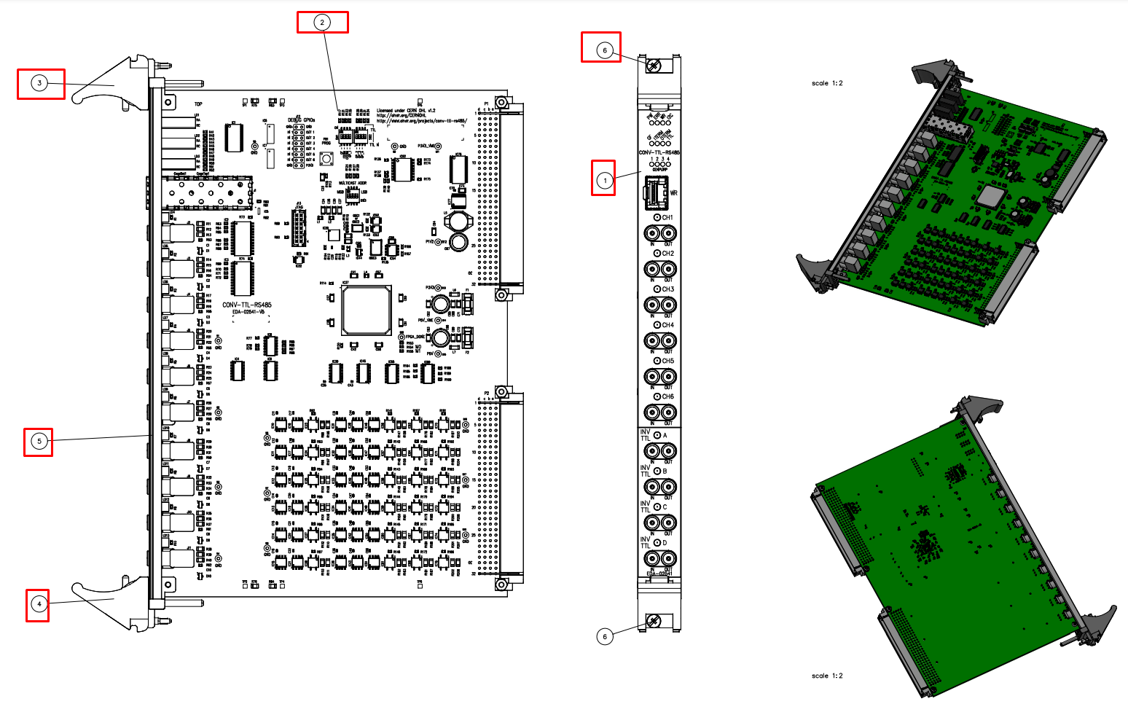
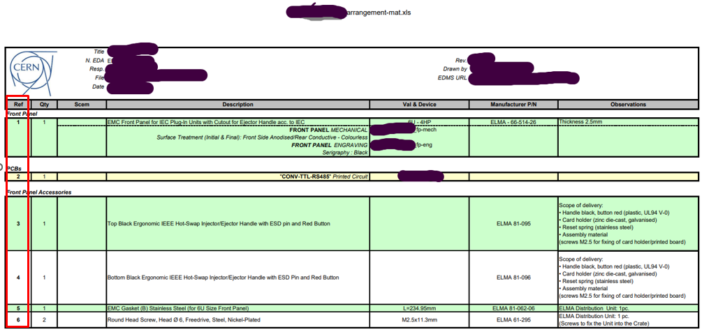
Manufacturing files
Bill Of Material (BOM) for Arrangement files
  Clear view of arrangement, indicate the reference number for all the parts
  Declare all the reference numbers in arrangement material list
21

Slide 22
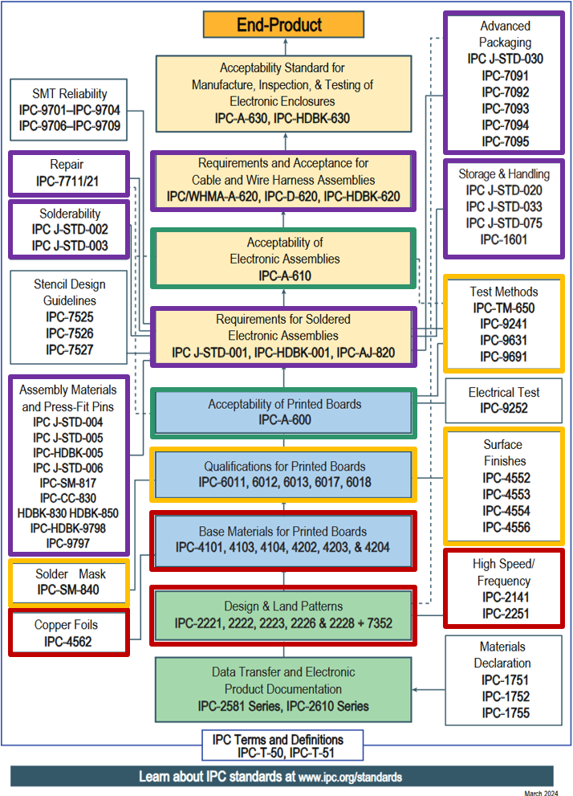


Summary
Design for eXcellence is a dedicated way of development that includes all specific parameters involved in the complete electronic domains
  Starting from Industrial standards for knowledge basics
  External parameters the projects should respect (high frequency, high-voltage, high-current)
  Schematics and components selection
  Layout rules for technical edges, cut-out, teardrops, stack-up, soldermask restriction
  PCB base material selection and surface finishing
  Copper balancing and components placement
  Assembly documentation
Electronics Service, is responsible to make the idea work, offering support for layout rules, production documents creation, components procurement in correct packaging, productions processes knowledge
Validated suppliers for sub-contracted production by the electronics Service, with technical specification and quality requirements based on international standards
Engineers are responsible to develop electrical functions and to select the correct components to make their idea possible
22

Slide 23
Next step
If you are interested to work for CERN and for the Electronics Service, please provide:
  List of your production equipment in place in your production plant (manufacturer and reference)
    Solderpaste deposition (manufacturer and reference) and capability
    Pick & Place
    Reflow Oven (convection/vapor-phase)
    Wave soldering machine (standard/selective)
  Reference of your cleaning equipment and cleaning chemistry and process assessment/deployment data
  Thermal profiler reference (including calibration date)
  Dry cabinets (manufacturer and reference) and information in case of Nitrogen option
  AOI (manufacturer and reference) and capability
  Specific processes
    Pressfit tool (manufacturer and reference)
    Conformal coating (manufacturer, reference and type of coating)
  List of your key contact persons (Sales, Quality and Technical)
  And in any case, please register your company on CERN e-Procurement
23

Slide 24
RoHS regulation
Brazil CONAMA (National Environment Council) opened Public Consultation on the New Brazilian RoHS Regulation
  A public consultation is currently underway in Brazil regarding a proposed RoHS (Restriction of Hazardous Substances) regulation for electrical and electronic equipment. Inspired by the EU RoHS Directive, aims to restrict the use of certain hazardous substances in various electronic products.
  The consultation period is open until September 24, 2025.
What is the timeline to deploy the Brazilian RoHS regulation?
Are companies in the audience today already producing electronic modules compliant with EU RoHS?
24

Slide 25
Thank you for attention

