Slide 1
Update on FPGA Radiation Tolerance in CERN control equipment
Antonio Scialdone – CEM/EPR

Slide 2


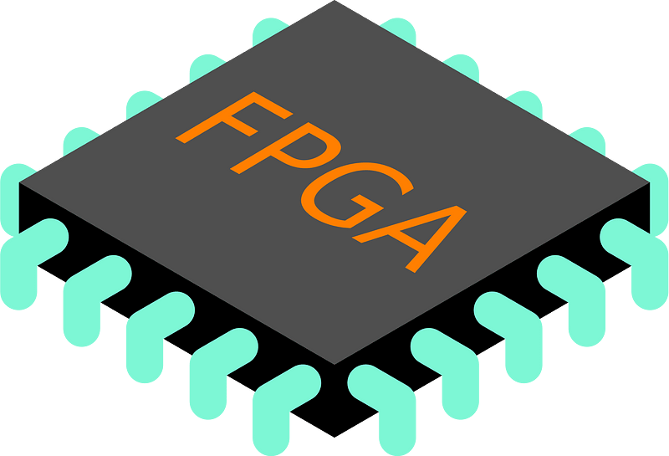
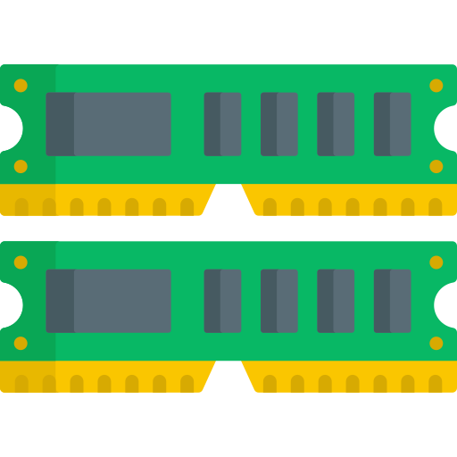




EPR activities and mission
Mission
Find radiation-tolerant building
blocks for the accelerator equipment
Tested devices
From discrete components like regulator,
to complex devices like FPGAs, MCUs and RFICs
Long history
Continuous testing activities
since 2008
Our contribution
Our results support other groups in
designing radiation-tolerant accelerator equipment
Scope of this talk
Address some concerns regarding possible failures reported by one user in one FPGA
Present challenges and solutions for FPGA batch qualification

Slide 3
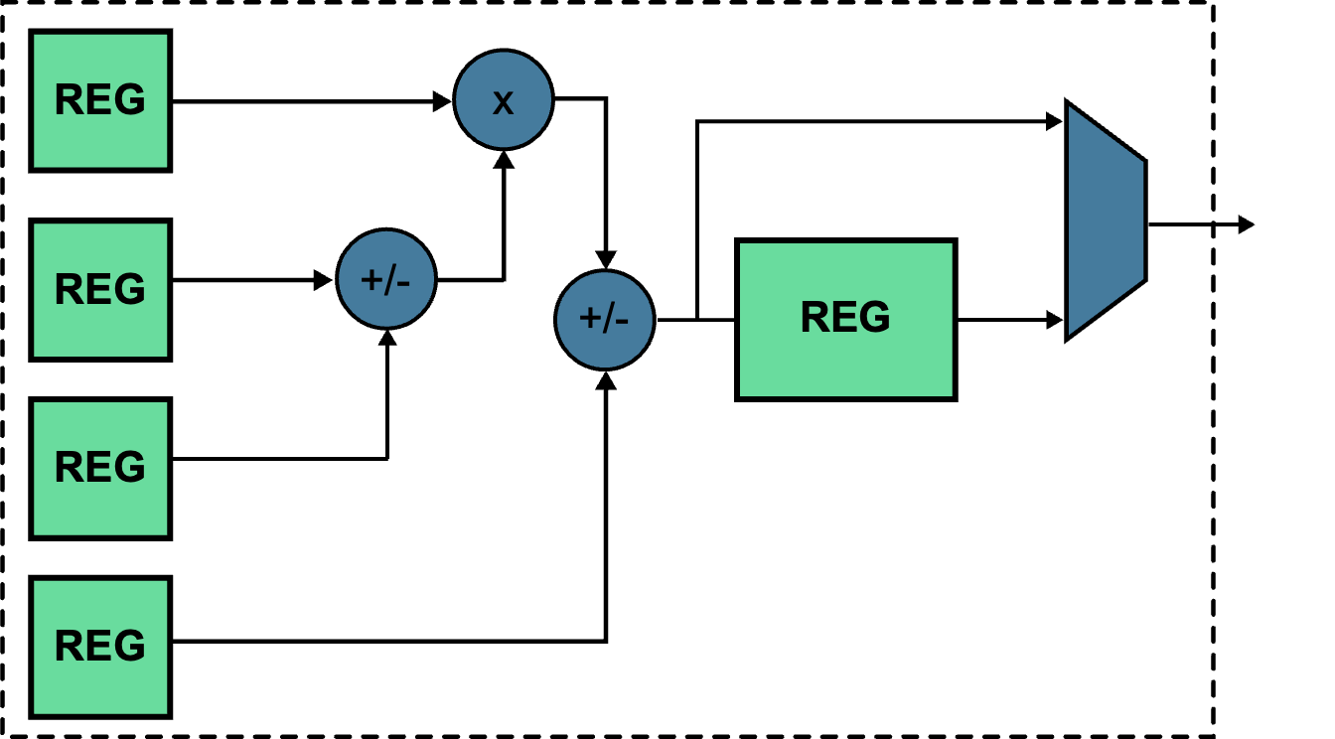
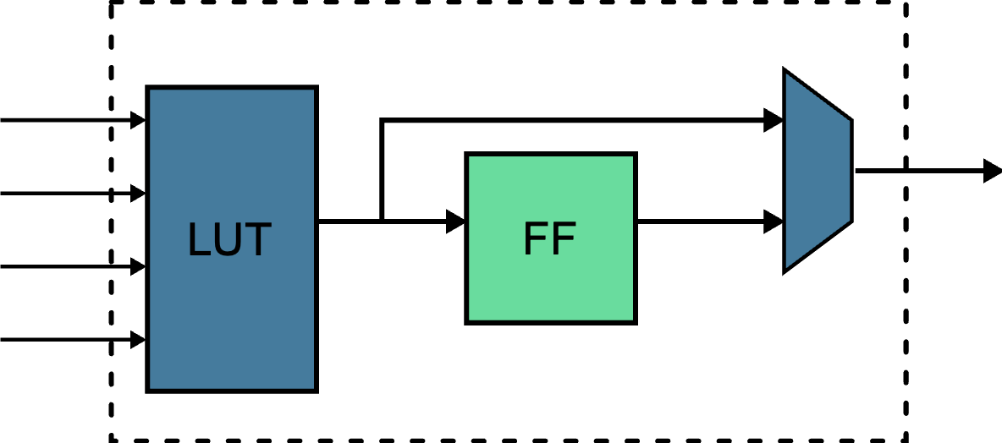



Radiation effects on FPGAs - Summary
Single event effects
Total Ionizing Dose
Single event transient/upset/functional interrupt (SET/SEU/SEFI)
  Wrong arithmetic result
  Wrong content in the storage element
  Wrong configuration memory
  Temporary loss of functionalities
Increase of propagation delay
  Loss of functionalities
  Loss of programmability
  Current consumption increase
$$t_{pd}$$
A
LUT
B
FF
OUT
C
FF
D
$$t_{pd}$$
FF
RST
PLL
CLK
FF
CLB
Sensitivity measured through a cross section of the event:
Measured as the dose absorbed when the failure is observed
  Example: Programmability loss after 50 Gy
$$σ_{SET/SEU/SEFI}=\frac{\# events}{total fluence} [cm^{2}/device]$$

Slide 4




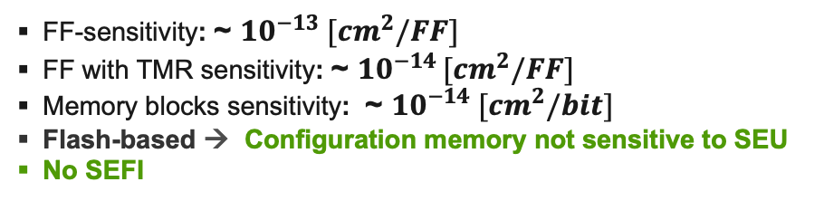
Use of FPGAs in CERN accelerator
ProASIC3 is currently the most used FPGA in accelerator equipment
  Selected for its radiation tolerance
Single event effects
Total Ionizing Dose
FF-sensitivity: ~ $10^{−13} [cm^{2}/FF]$
FF with TMR sensitivity: ~ $10^{−14 }[cm^{2}/FF]$
Memory blocks sensitivity: ~ $10^{−14} [cm^{2}/bit]$
Flash-based → Configuration memory not sensitive to SEU
No SEFI
Lifetime: ~ 500 Gy
  20% propagation delay increase at ~ 400 Gy
Programmability: < 50 Gy
Research for a new candidate was necessary due to:
  Low TID-robustness for the High-Lumi phase
  Unknown lifetime/availability (ProASIC3 was released in 2005!)

Slide 5
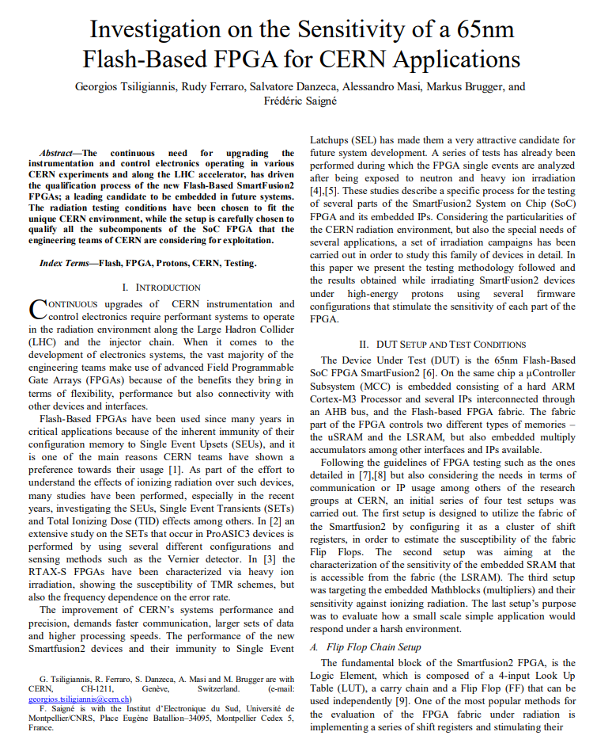
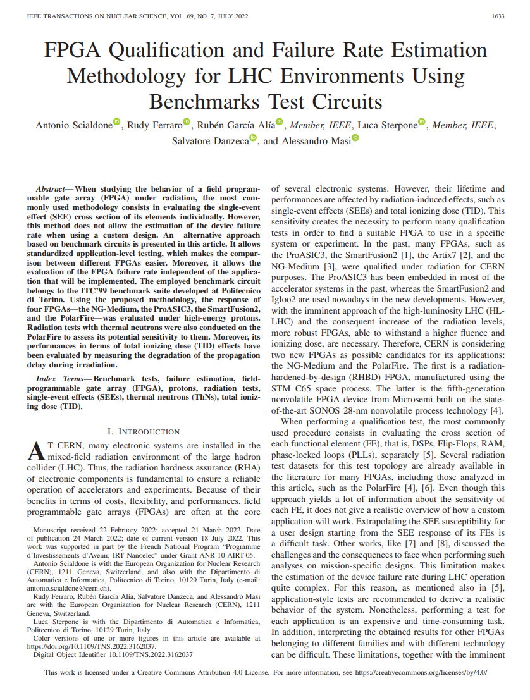
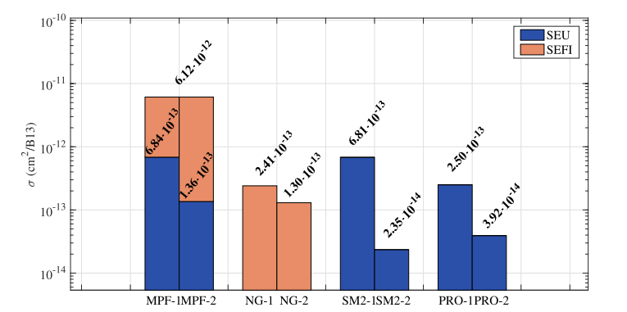
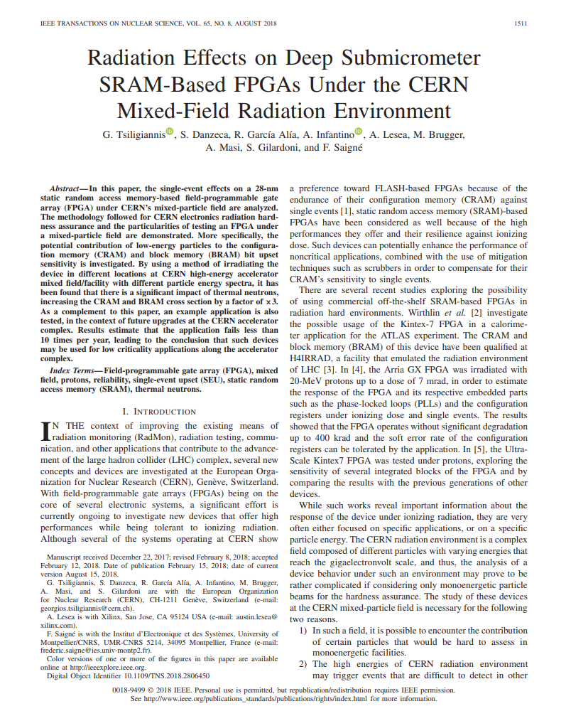
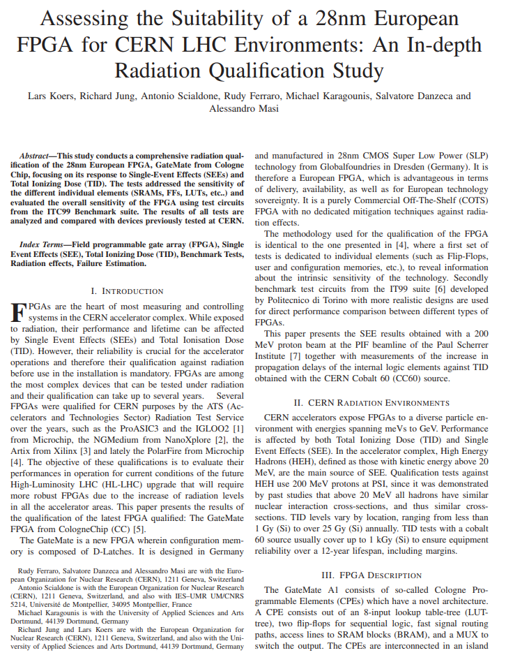
FPGA radiation testing in EPR section
Long track-record of FPGAs radiation testing in CEM-EPR
Continuous development/improvements of radiation test setups
  To improve visibility in the FPGA, and ease the test procedure
New methodology
  For comparing results across multiple FPGA families/technologies
Collaborations
  With industry, universities and other organizations

Slide 6







FPGA radiation testing in EPR section
Collaboration with ESA for access to NanoXplore FPGA
Collaboration with Polito for benchmark testing
SmartFusion2
ProASIC3
SmartFusion2
ProASIC3
NG-Medium - NX1H35AS
PolarFire - MPF300TS
GateMate FPGA
Collaboration with TESAT for heavy ion testing of the GateMate
Functional elements
Functional elements
Functional elements
Functional elements
Benchmark
Benchmark
Benchmark
2016
2019
2019
2020
2021
2021
2023
2011
2018
2019
2020
2020
2021
2022
2025
SF2 Functional elements
CERN Application
Benchmark
Functional elements
Functional elements and benchmark under Thermal Neutrons
Benchmark
Benchmark
Our findings led to the selection of the SmartFusion2/Igloo2 FPGA for the High-Lumi phase!

Slide 7
Candidate FPGA for the HL-LHC electronics
SmartFusion2/Igloo 2 FPGAs have been selected for systems during the HL-LHC phase
  Good robustness to TID ( between 500 and 700 Gy ) and SEE [1], [2], [3]
  Flash FPGA → Configuration memory resilient to SEU
  Included in the following projects (handled through EDA)
Group | System | EDA/Link | FPGA Part
TE-MPE | CIBU | EDA-04288-V4 | M2GL010-TQG144
TE-MPE | CIBFX | EDA-04838-V1 | M2GL010-TQG144
TE-MPE | CIBF | EDA-04711-V2 | M2GL010-TQG144
BE-CEM | DIOT System Board | EDA-04326-V4 | M2GL090T-FGG676I
TE-MPE | Universal Quench Detection System – VDP | EDA-04160-V1 | M2GL150-FC1152
TE-MPE | DQQDV | EDA-04864-V1 | M2GL060-FG484
TE-MPE | UCS EE Control Board | EDA-04820-V2 | M2GL060-FGG484I
TE-CRG | Beam Screen Heater | EDA-02782-V4 | *M2S010T-1FGG484
TE-CRG | Insulated Reprogrammable TT/ PT Card | EDA-03296-V5 | M2GL010T-1FGG484
TE-MPE | EE 13kA On/Off Control | EDA-03958-V1 | M2GL010-TQ144
TE-CRG | DIDO | EDA-04793-V2 | M2GL010T-1FGG484
TE-CRG | Dual Reprogrammable LT Conditioner | EDA-03632-V4 | M2GL010T-1FG G484
SY-SI | Rad Tol relay box | EDA-04898-V2 | M2GL060-FGG484I
BE-GM | WPS Conditioner | EDA-04908-V1 | A3PE1500-PQ208 (To be replaced by IGLOO2)
TE-MPE | DQQBS | EDA-04865-V1 | M2GL010-TQG144
*SmartFusion2

Slide 8
Candidate FPGA for the HL-LHC electronics
SmartFusion2/Igloo 2 FPGAs have been selected for systems during the HL-LHC phase
  Good robustness to TID ( between 500 and 700 Gy ) and SEE [1], [2], [3]
  Flash FPGA → Configuration memory resilient to SEU
  Included in the following projects (handled through EDA) – Some have already been tested under radiation
Group | System | EDA/Link | FPGA Part
TE-MPE | CIBU | EDA-04288-V4 | M2GL010-TQG144
TE-MPE | CIBFX | EDA-04838-V1 | M2GL010-TQG144
TE-MPE | CIBF | EDA-04711-V2 | M2GL010-TQG144
BE-CEM | DIOT System Board | EDA-04326-V4 | M2GL090T-FGG676I
TE-MPE | Universal Quench Detection System – VDP | EDA-04160-V1 | M2GL150-FC1152
TE-MPE | DQQDV | EDA-04864-V1 | M2GL060-FG484
TE-MPE | UCS EE Control Board | EDA-04820-V2 | M2GL060-FGG484I
TE-CRG | Beam Screen Heater | EDA-02782-V4 | *M2S010T-1FGG484
TE-CRG | Insulated Reprogrammable TT/ PT Card | EDA-03296-V5 | M2GL010T-1FGG484
TE-MPE | EE 13kA On/Off Control | EDA-03958-V1 | M2GL010-TQ144
TE-CRG | DIDO | EDA-04793-V2 | M2GL010T-1FGG484
TE-CRG | Dual Reprogrammable LT Conditioner | EDA-03632-V4 | M2GL010T-1FG G484
SY-SI | Rad Tol relay box | EDA-04898-V2 | M2GL060-FGG484I
BE-GM | WPS Conditioner | EDA-04908-V1 | A3PE1500-PQ208 (To be replaced by IGLOO2)
TE-MPE | DQQBS | EDA-04865-V1 | M2GL010-TQG144
Tested
Tested
Tested
Tested
Tested
Tested
Tested
Tested
*SmartFusion2

Slide 9
Candidate FPGA for the HL-LHC electronics
Possible SEFIs((?)) were reported during radiation tests of cryogenic equipment
System involved | FPGA part | SEFIs(?) observed
CIBU | IGLOO2 | No
DIOT System Board-V1
UCS EE Control Board
Insulated Reprogrammable TT | SmartFusion2 | Yes
Dual Reprogrammable LT Conditioner
Insulated Reprogrammable TT – Dual Reprogrammable LT Conditioner
 | IGLOO2
Beam Screen Heater / DIDO
DIDO
LT Conditioner / NanoFIP |  | No
Rad Tol relay box
DI/OT System Board |  | No
EPR Tests on SF2/IGLOO2 |  | No
Cryogenic tests
Results available: RADECS2018 [4] RADWG-2025 [5]
Observed behavior: all I/O going into high-Z state → Typical of FPGA in programming mode
We decided to investigate the reproducibility, the cross-section, and eventual mitigation technique

Slide 10
SmartFusion2 – IGLOO2 differences
Same FPGA fabric – but SmartFusion2 includes a Microcontroller Sub System (MSS) with ARM-Cortex M3
SmartFusion2
Igloo2
FPGA fabric
FPGA fabric
Microcontroller Sub System (MSS) with Cortex M-3
System controller
High Performance Memory Subsystem
System controller
System controller (available in both) provides functionalities like:
  Device programming → This could be the behavior of the SEFI observed during CRYO tests
  Cryptographic
  Zeroization service → This could be the behavior of the SEFI observed during CRYO tests
  Flash*Freeze Service
  Device and Design Information Services
The system controller can be suspended to prevent any activation under radiation (recommended from Microchip [ref] )
  Even though it is always active at power-up, going in reset after device initialization is complete
JTAG input signals are blocked from activating the system controller if TRST is GND [ref]

Slide 11
SF2/IGLOO2 radiation-tests settings
IP for additional features
Can be disabled
Should be kept low to prevent JTAG
to use the System controller
System involved | FPGA part | SEFIs observed | System controller | JTAG (TRST) Configuration
CIBU | IGLOO2 | No | Enabled | Pull-down
DIOT System Board-V1
UCS EE Control Board
Insulated Reprogrammable TT | SF2 | Yes | Enabled | Pull-down
Dual Reprogrammable LT Conditioner
Insulated Reprogrammable TT – Dual Reprogrammable LT Conditioner
 | IGLOO2
Beam Screen Heater / DIDO
DIDO
LT Conditioner / NanoFIP |  | No | Suspended | Pull-down
 |  |  | Enabled | Pull-down
Rad Tol relay box
DI/OT System Board | IGLOO2 | No | Enabled | Pull-down
EPR Tests on SF2/IGLOO2 | IGLOO2 | No | Enabled | Pull-down
Cryogenic tests
Other experiments were performed with the same settings of the CRYO tests
  Is the observed behavior due to a setup misconfiguration, or not visible in other tests due to insufficient testing?

Slide 12
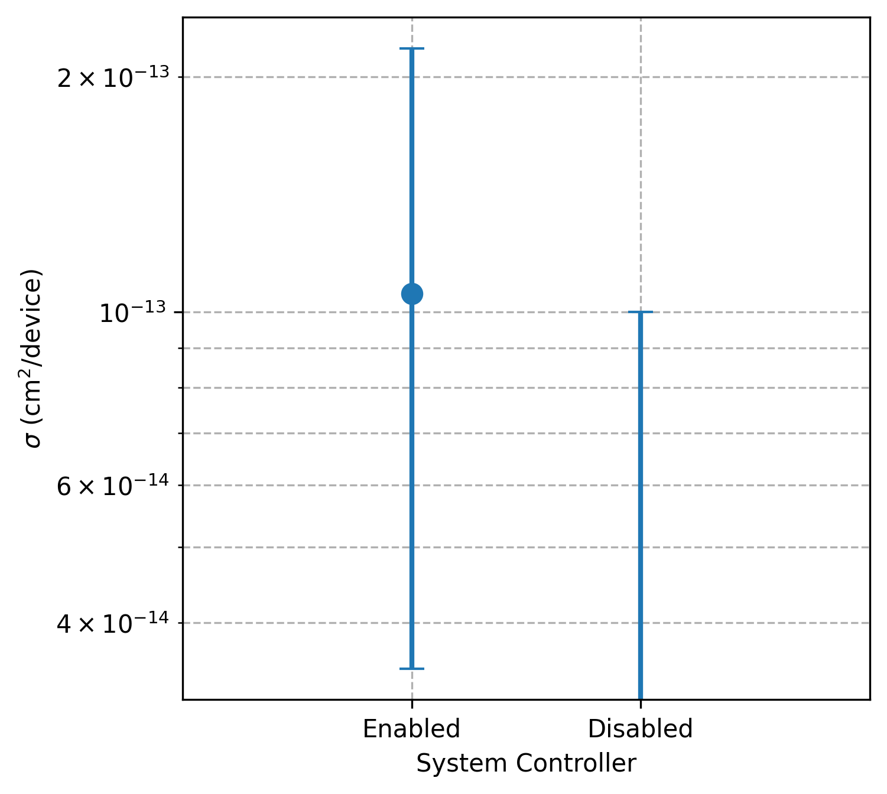
SF2/IGLOO2 radiation tests statistics
Gathered fluences and cross-sections of all the tests perform on the IGLOO2/SmartFusion2 FPGAs
  Combined all the tests according to the configuration settings of the system controller
Evaluated upper limits cross-sections with the 95% confidence interval [ref]
No “SEFI” observed in all the tests with suspended mode
DI/OT tests in 2025 significantly reduced the upper limit cross-section
  It fits (by far!) the requirements for DI/OT and all the projects qualified up to now!
DI/OT Failure rate example (Considering WPS + WIC)
Expected HL-LHC fluence: 1E11 HeH/year → Expected failures:
  < 0.21 (if Enabled mode)
  < 0.01 (if Suspended mode)
2x upper limit
reduction
with new DIOT qualification
For more critical systems, lower upper-limit cross-section are necessary
→ This will be achieved with next year system production qualification of DQQDL and UCS

Slide 13
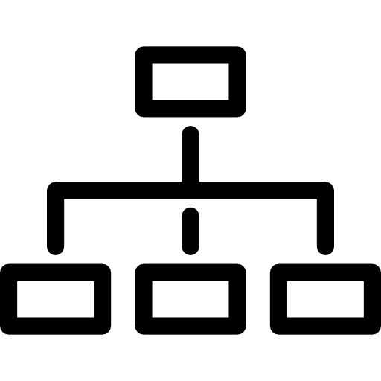




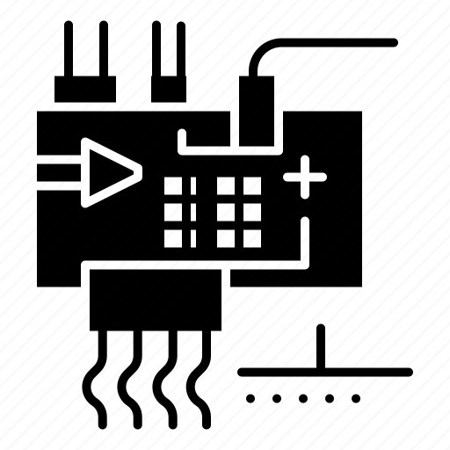


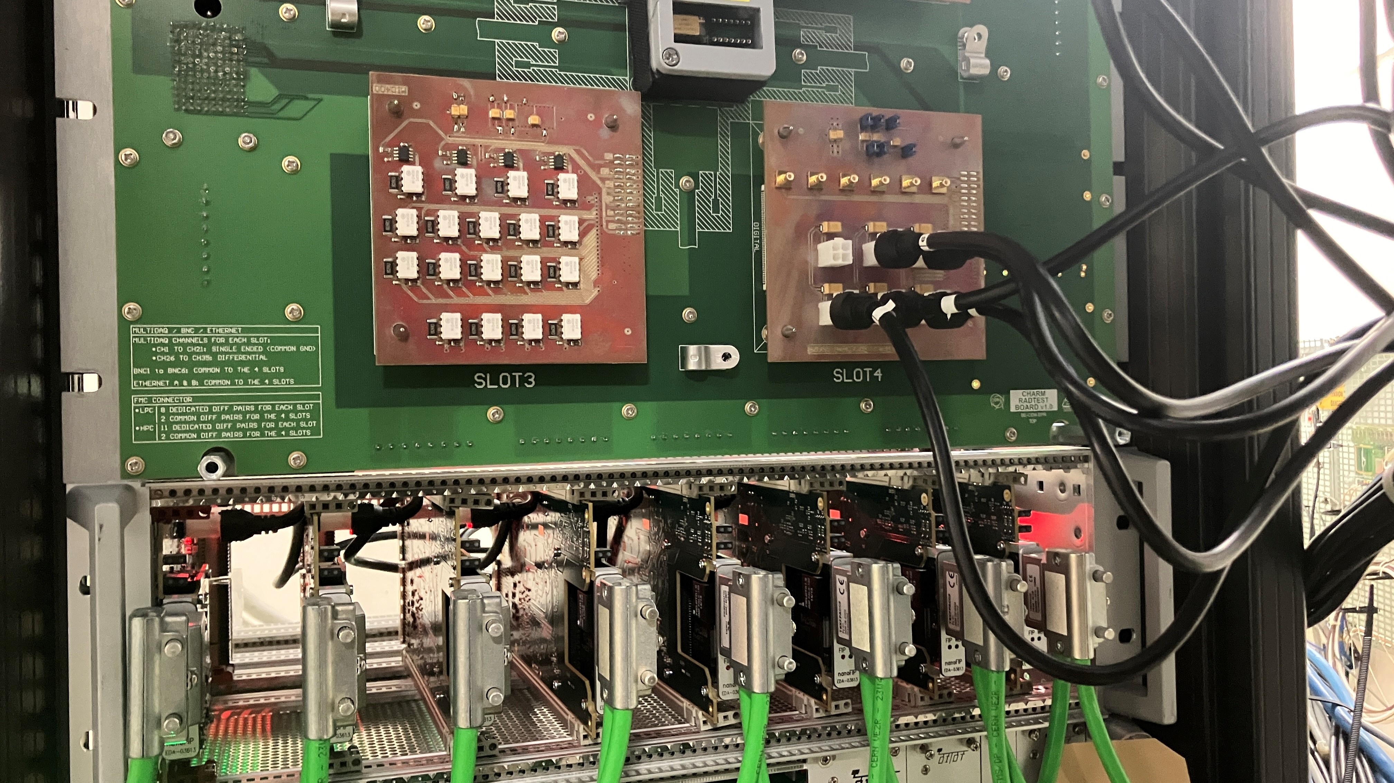
Possible strategy for FPGA qualification
Systems must undergo the RHA procedure prior to installation
  Phase 6 foresees component-level batch qualification
Current challenge:
    Many FPGA size/packages used by different projects
    Test board (for different packages) should be developed
    Components might arrive in different lots → Testing of each LOT
    Would require testing for package, for lot, for each user!
Time
Phase 0
Functional Description / Blocks
Phase 1
Radiation Environment
Phase 2
System / Components Description
β
Phase 3
Exploratory COTS Component Radiation Test
Phase 4
System-Level Prototype Radiation Test
Phase
Radiation Test Request Document
β
Phase 5
Production batches Component Radiation Qualification
Phase 6
System-Level Radiation Qualification Test
Component Radiation Test Reports
System Radiation Test Report
Component Radiation Qualification Reports
Phase 7
Final Summary Installation Approval
Radiation Qualification Request Document
Phase 8
Operation Follow up
System Radiation Qualification Report
Project Radiation Hardness Assurance Validation (RHAPV) Document
Possible strategy for qualification:
  Batch qualification through the user-developed board
    Example - DI/OT qualification in collaboration with CEM-EDL: 8 boards tested in CHARM
  Tests should focus on design-agnostic failures → Must differentiate failures mechanisms
  Example - DI/OT qualification
  3 signals to differentiate:
    Communication / Hydra / FPGA failure
DIOT System Board used for batch testing the IGLOO2 in CHARM
Heartbeat communication
System board
Heartbeat
HYDRA
FMC nanoFIP
IGLOO2
Monitoring
Heartbeat
IGLOO2
HYDRA
Heartbeat IGLOO2

Slide 14
Thank you

