Slide 1
SEL Qualification Methodology for ATS Rad-Tol Control Systems: A Large-Sample Testing Approach
Rudy Ferraro (BE-CEM-EPR),
Alessandro Zimmaro (BE-CEM-EPR),
Giorgio Scognamiglio (BE-CEM-EPR),
Gilles Foucard (BE-CEM-EPR)
R2EWG Workshop – 20th November, 2025

Slide 2
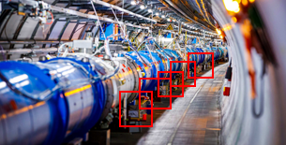
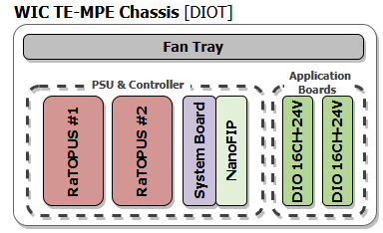
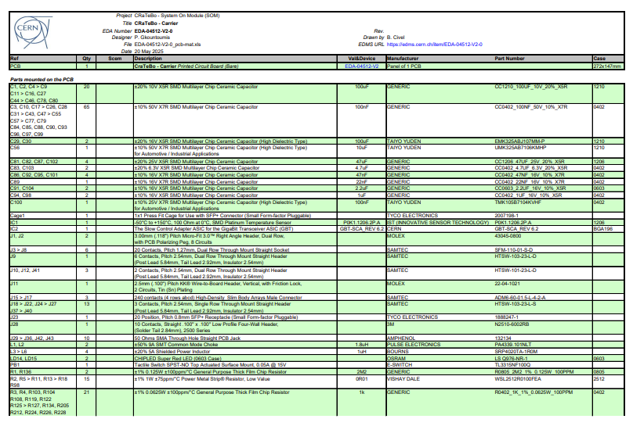
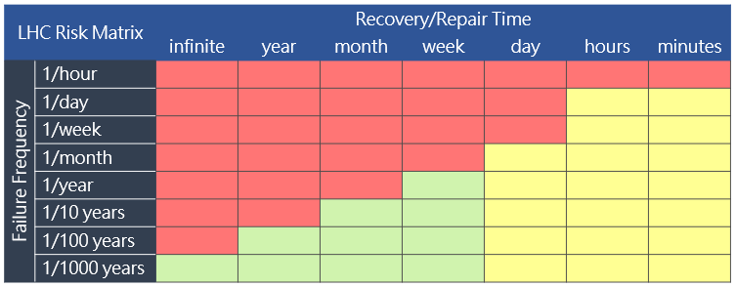
SEE Qualification Requirements Analysis
Destructive Single Event Effects (Latchups, Burnouts) affect drastically the AVAILABILITY of the LHC
The proper calculation of the part cross-section requirements for qualification is fundamental to ensure it will fit the project annual failure target
EPR Radiation Test Services provides now the support for the full analysis of the project radiation qualification requirements!
See detailed methodology in February RadWG dedicated presentation
System locations
Radiation Locations (DS, UJs, RRs)
Number of systems
Radiation Levels
Chassis Target Failure Cross-Section
Calculation of the full chassis cross-section from locations, radiation levels, number of systems & target failure rate
BOMs
FLUKA Simulations
BatMON/RadMON Radiation Monitoring
System-Composition
Board(s) Target Failure Cross-Section
Propagation of the chassis target cross-section to board target cross-section, considering redundancy configuration & number of boards
Chassis Architecture
Redundancies
Bill of Materials (EDAs)
Part Radiation Effects Analysis
Biasing Conditions Analysis
Component Target Cross-Section
Propagation of the board target cross-section to part target cross-section, considering Radiation Sensitivity, biasing conditions & number of devices
Target Failure Rate
Target Maximum Failure rate according to risk analysis
Calculation of number of test samples to use to comply with the propagated part target cross-section considering the Facility test fluences capabilities
Most common Requests
Radiation-Qualification Test Conditions
Machine Protection
Machine Performance
R. Ferraro - SEL Qualification Methodology for ATS Rad-Tol Control Systems

Slide 3
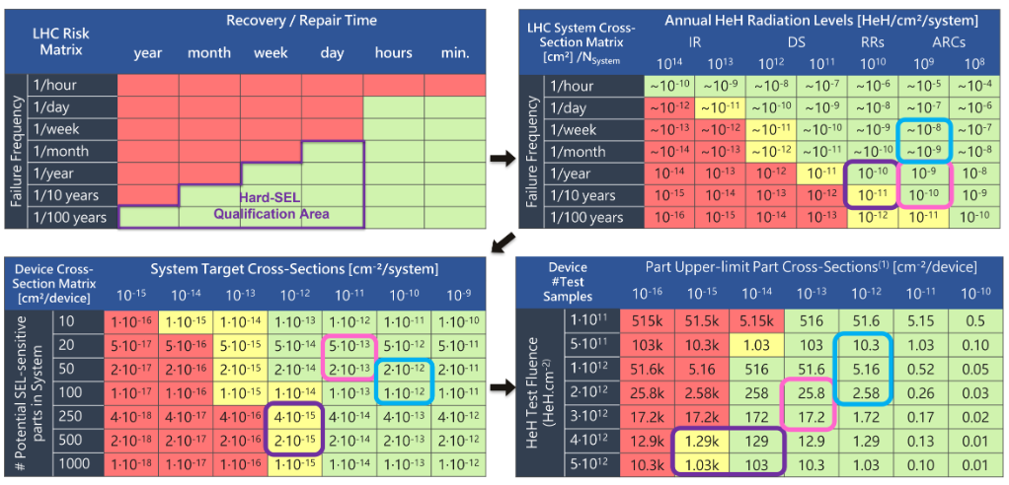
LHC SEL Qualification Matrices
DIOT - WPS [TE-MPE]
DIOT - WIC [TE-MPE]
UCS [TE-MPE]
Considering a minimum time to repair of about a day or less for a system experiencing an SEL, the target annual failure rate for a system installation goes from 1 per month to 1 / 100 years depending on the system criticality.
This target is provided by the user according to the reliability analysis and budget for his project
Usually, it is between 1 to 0.1 failure per year for radiation tolerant systems.
R. Ferraro - SEL Qualification Methodology for ATS Rad-Tol Control Systems

Slide 4
LHC SEL Qualification Matrices
DIOT - WPS [TE-MPE]
DIOT - WIC [TE-MPE]
UCS [TE-MPE]
Combined with the estimated radiation levels the system will be exposed to in operation, it is possible to calculate the failure cross-section for the entire installation.
The system-cross section is then calculated by simply dividing by the number of systems in the installation.
R. Ferraro - SEL Qualification Methodology for ATS Rad-Tol Control Systems

Slide 5
LHC SEL Qualification Matrices
DIOT - WPS [TE-MPE]
DIOT - WIC [TE-MPE]
UCS [TE-MPE]
Then a rough estimation of the part cross-sections can be done by dividing the target system cross-section by the number of parts potentially SEL sensitive
Those are the requirements to fulfill during the SEL qualification procedure
R. Ferraro - SEL Qualification Methodology for ATS Rad-Tol Control Systems

Slide 6
LHC SEL Qualification Matrices
DIOT - WPS [TE-MPE]
DIOT - WIC [TE-MPE]
UCS [TE-MPE]
- 1 week in MONTRAC
- 1 run at PSI
1 week in CHARM R13
Finally depending on the target part cross-section and the test fluence we can calculate the upper limit number of test samples required based on the Poisson process and considering all source of uncertainty [Ferraro. 2025]
R. Ferraro - SEL Qualification Methodology for ATS Rad-Tol Control Systems

Slide 7
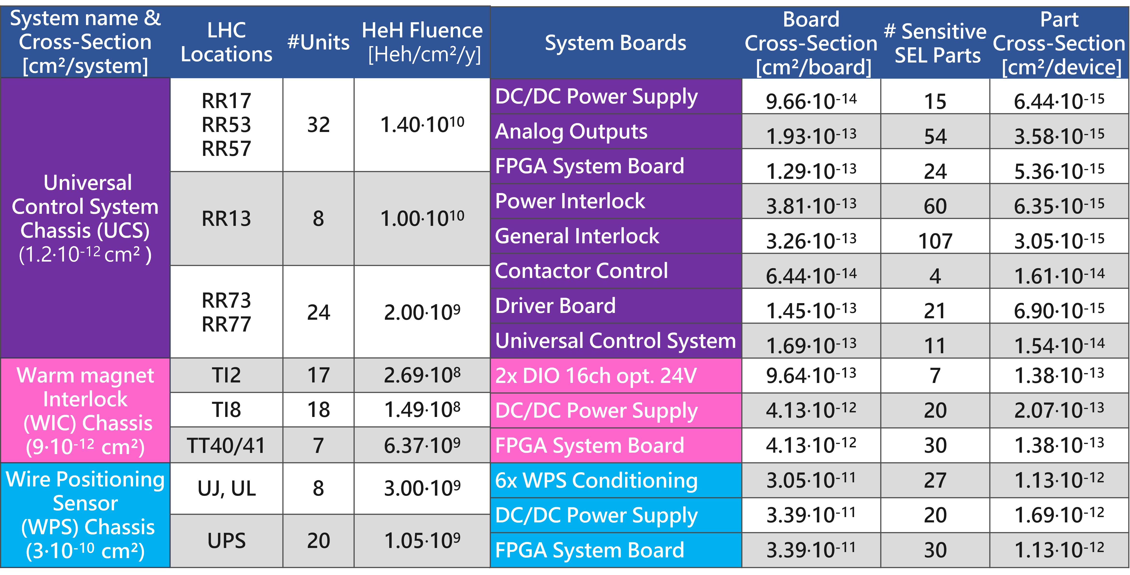
2024-2025 SEL Qualification Requirements
400 Test Samples
- 1 Week in R13
- 4 Weeks in Montrac
Minimum 10 Test samples for CHARM/PSI
Less than 5 test samples required for CHARM/PSI
R. Ferraro - SEL Qualification Methodology for ATS Rad-Tol Control Systems

Slide 8
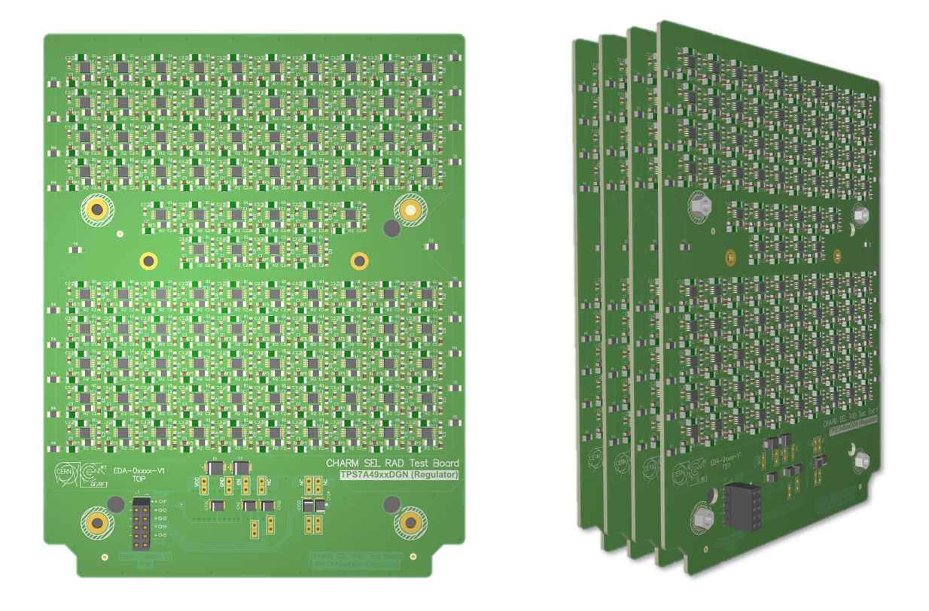
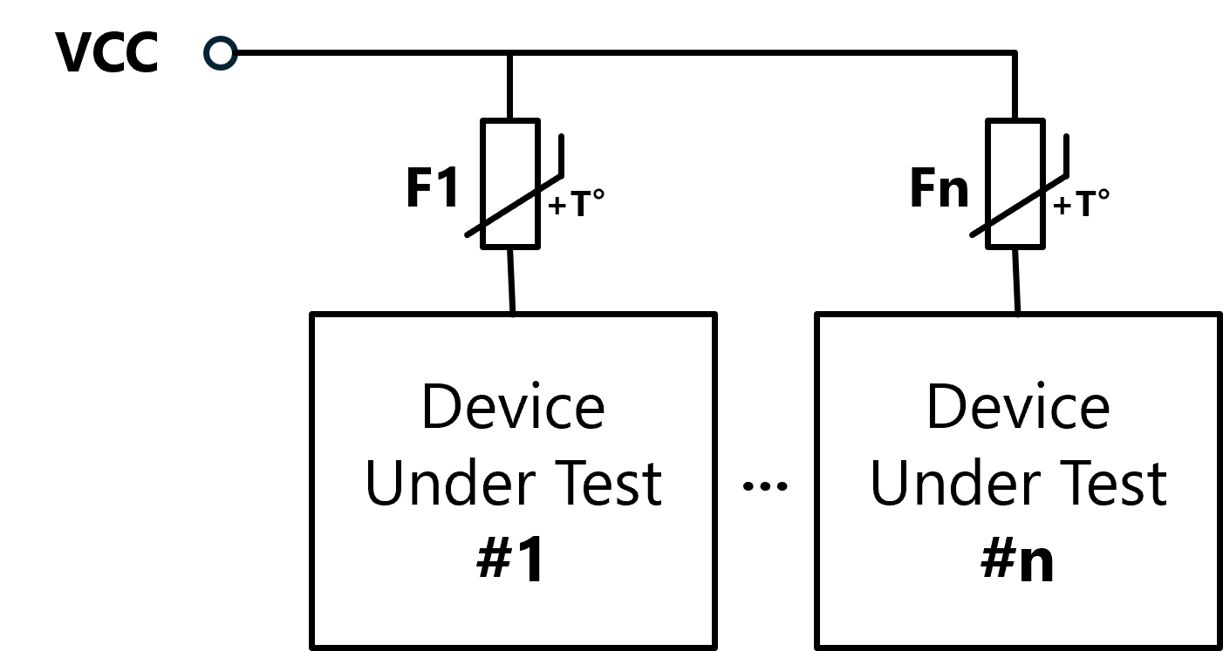
Dedicated SEL Test Boards Design
Specific SEL Test board were designed to host the hundred of samples required for qualification:
Compatible with our newly developed test platform
From 50 to 100 samples per test board depending on package size
6 Power channels per test board
Stackable (stack of 6 boards tested in 2025)
One self-resettable PPTC fuse per DUT per Power channels
R. Ferraro - SEL Qualification Methodology for ATS Rad-Tol Control Systems

Slide 9
Why use PPTC Fuses?
Several constrains for large batch testing:
  Being able to test 100+ samples
  Avoid to have 1 damaged part draining all current / disturbing the whole test after an SEL
  Simplicity: Ideally only the power supply to be provided
  Different solutions:
    Relays: (-) Requires individual control, or (-) IC-based control, (-) are bulky
    Blow-up fuses: (+) No control required, (-) one-time use: would blow also on non-destructive SELs, (-) require fine-tuning the current value
    Anti SEL circuitry: Like opamp-based comparator: (+) fast, (+) can be rearmed automatically, (+) threshold can be adjusted, (-) expensive, (-) can suffer from radiation effect, (-) relatively bulky
    PPTC: “Polymeric Positive Temperature Coefficient” (PPTC): (+) self-resettable, (+) very compact (0805/0603 formats), (+) slow (allows peaks to be easily capture), (+) broad range of time/current characteristics: easy to find single part fitting many tests
R. Ferraro - SEL Qualification Methodology for ATS Rad-Tol Control Systems

Slide 10
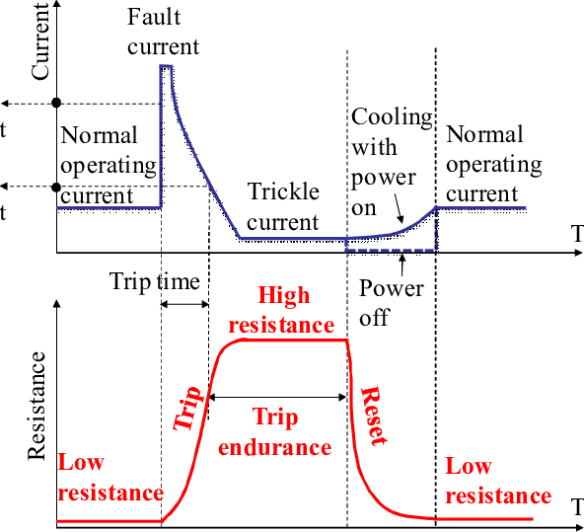
PPTC Working Principle:
Low resistance path at nominal current
At higher current the PPTC heats up (trip step) and the resistance increases drastically, inducing high drop voltage on the powered device
Stabilizes at a holding current, corresponding to a balance point between remaining current consumption, the corresponding dropped voltage, the dissipated power and temperature (holding current is a known parameter)
If the SEL/Short circuit is cleared (with a power cycle or self-cleared) the PPTC cool down and its resistance goes back to low level
[Cheng 2012]
R. Ferraro - SEL Qualification Methodology for ATS Rad-Tol Control Systems

Slide 11
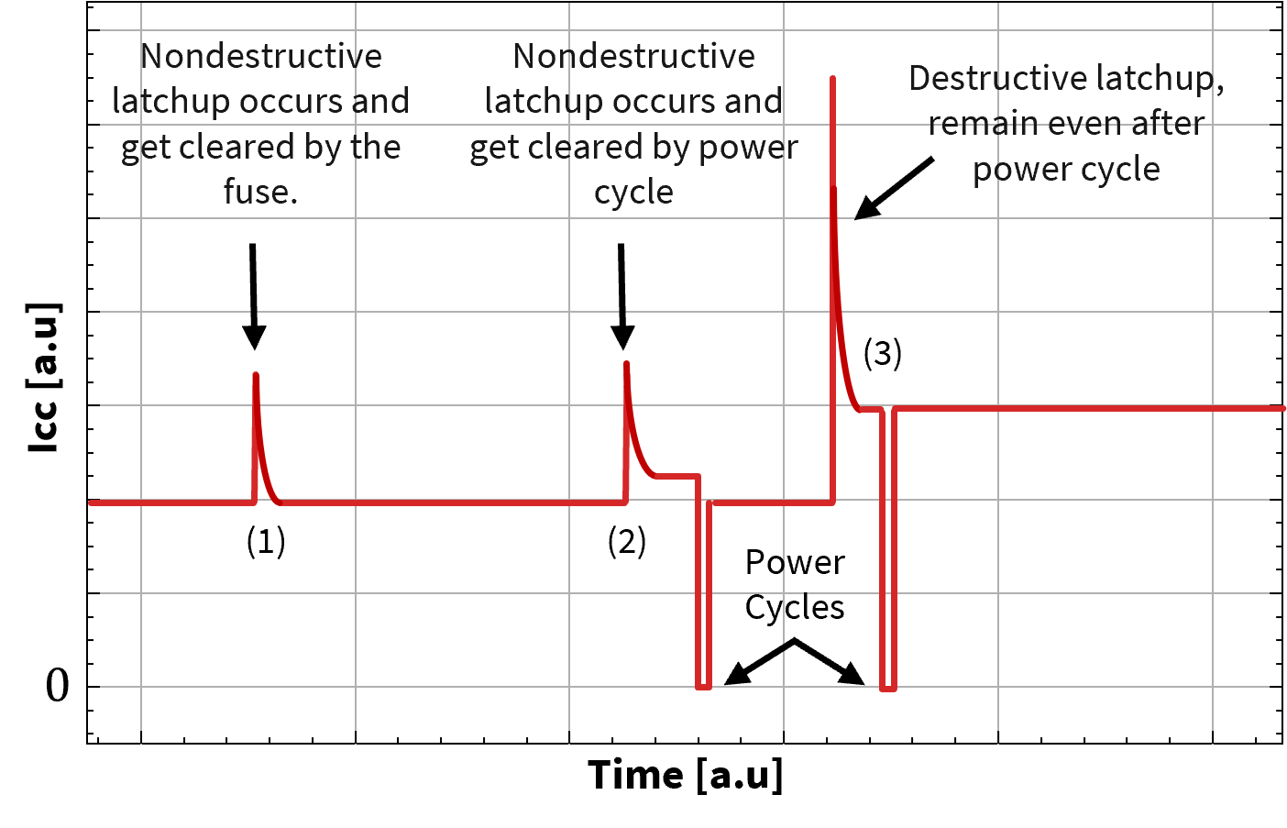
PPTC Fuse behavior on SEL
Different behavior can occur dependent on SEL nature:
Self-Cleared SEL: SEL occurs and is cleared directly by the fuse due to the current limitation. The affected device recovers functionality.
SEL cleared by Power Cycle: an SEL occurs, the fuses trips and limit the current but the SEL is still present and there is a remaining holding current whose value depends on power going through the fuse. A power cycle allows to clear the SEL, and the device recovers functionality.
Destructive SEL: Same as (2) but after power cycle the holding current is still present, the device is permanently damaged and is no longer functional.
Hold current
Hold current
R. Ferraro - SEL Qualification Methodology for ATS Rad-Tol Control Systems

Slide 12
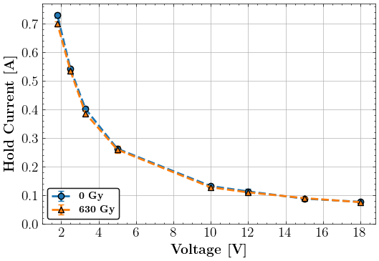
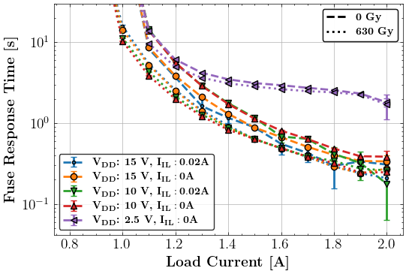
PPTC Fuse Radiation-Tolerance
Very important to verify that the fuse characteristics remains stable/known during irradiation:
Hold Current vs Voltage
Fuse Response time (90%) vs Current load/consumption
No radiation-effect visible.
The “Hold Current vs Voltage” characteristics let us know which current step to look for during the tests
R. Ferraro - SEL Qualification Methodology for ATS Rad-Tol Control Systems

Slide 13
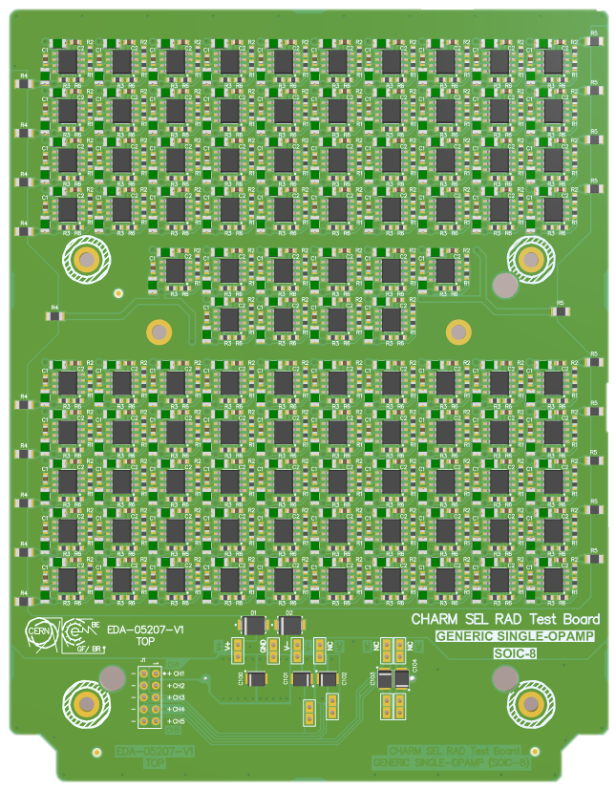
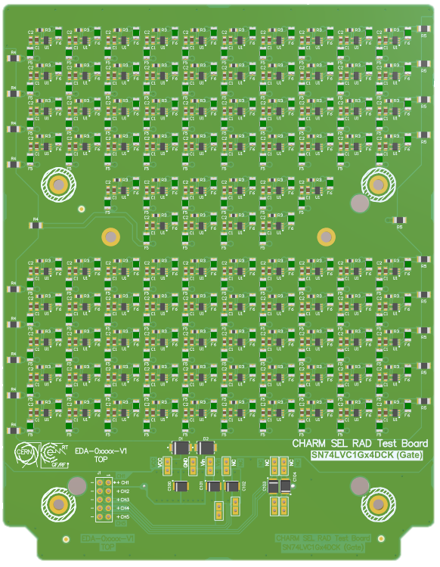
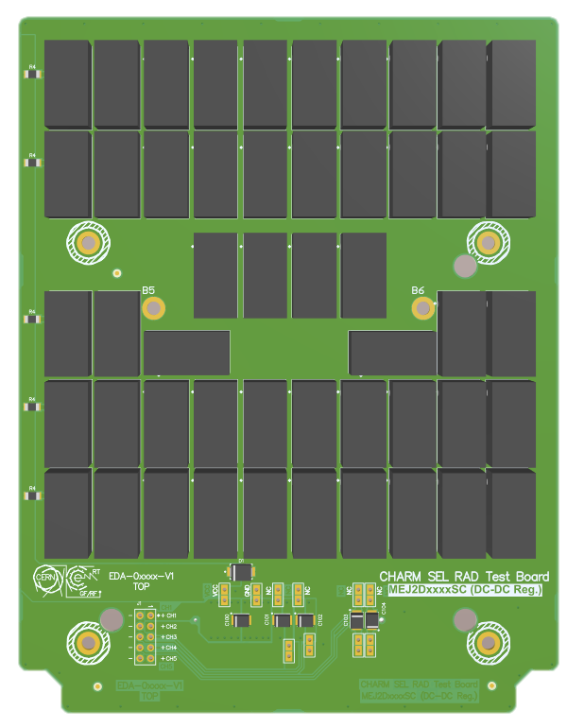
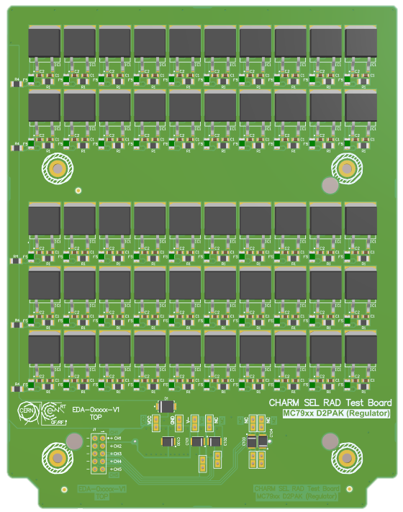
SEL Test Board Examples:
41 SEL Test board designed in 2025 !
Dual Opamps
Logic Gates
DCDC Converters
Voltage Regulators
100 samples
100 samples
50 samples
50 samples
R. Ferraro - SEL Qualification Methodology for ATS Rad-Tol Control Systems

Slide 14
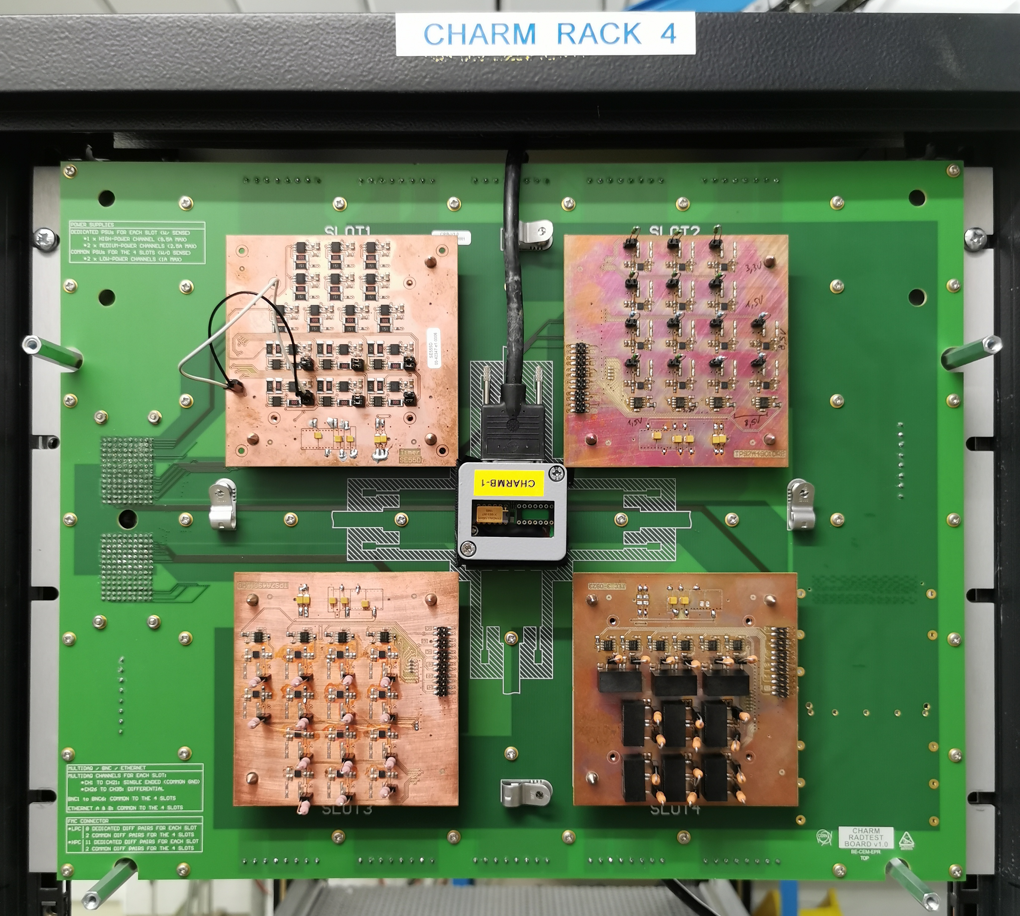
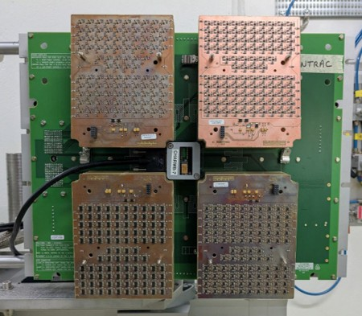
Type of Tests
Cumulative Tests Boards (Rack or G0 only)
High-density SEL tests board (Rack or MONTRAC)
Between 9 and 40 samples per board
Real-Time full device characterization against TID + DD
SEL Upper-limit cross-sections:
  R13: Up to 5E-14 cm²/device per week
Hundred of samples per board (stackable)
Only SEL characterization (powering only provided)
No characteristic monitoring
SEL Upper-limit cross-sections with 400 test samples:
  R13 Up to 2E-15 cm²/device per week
  MONTRAC: Up to 1E-14 cm²/device per week
  x 25
R. Ferraro - SEL Qualification Methodology for ATS Rad-Tol Control Systems

Slide 15
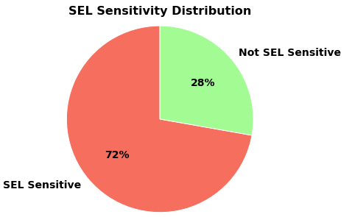
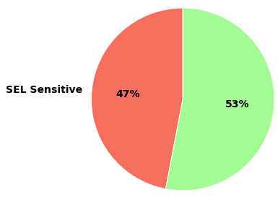
Proportion of SEL Sensitive Parts in 2025 Projects:
[TE-MPE] DQQDL
[TE-MPE] UCS
29 lots for SEL Tests
39 P/N for SEL Tests
(Procurement still ongoing)
A significant proportion of used devices are potentially SEL sensitive
Their proper qualification is fundamental to assess the SEL risk in operation
For DQQDL and UCS, SEL sensitive parts requires at least two tests (one cumulative and one large batch SEL)
The MONTRAC SEL-Only location allows parallelizing SEL tests with cumulative ones in R13
R. Ferraro - SEL Qualification Methodology for ATS Rad-Tol Control Systems

Slide 16
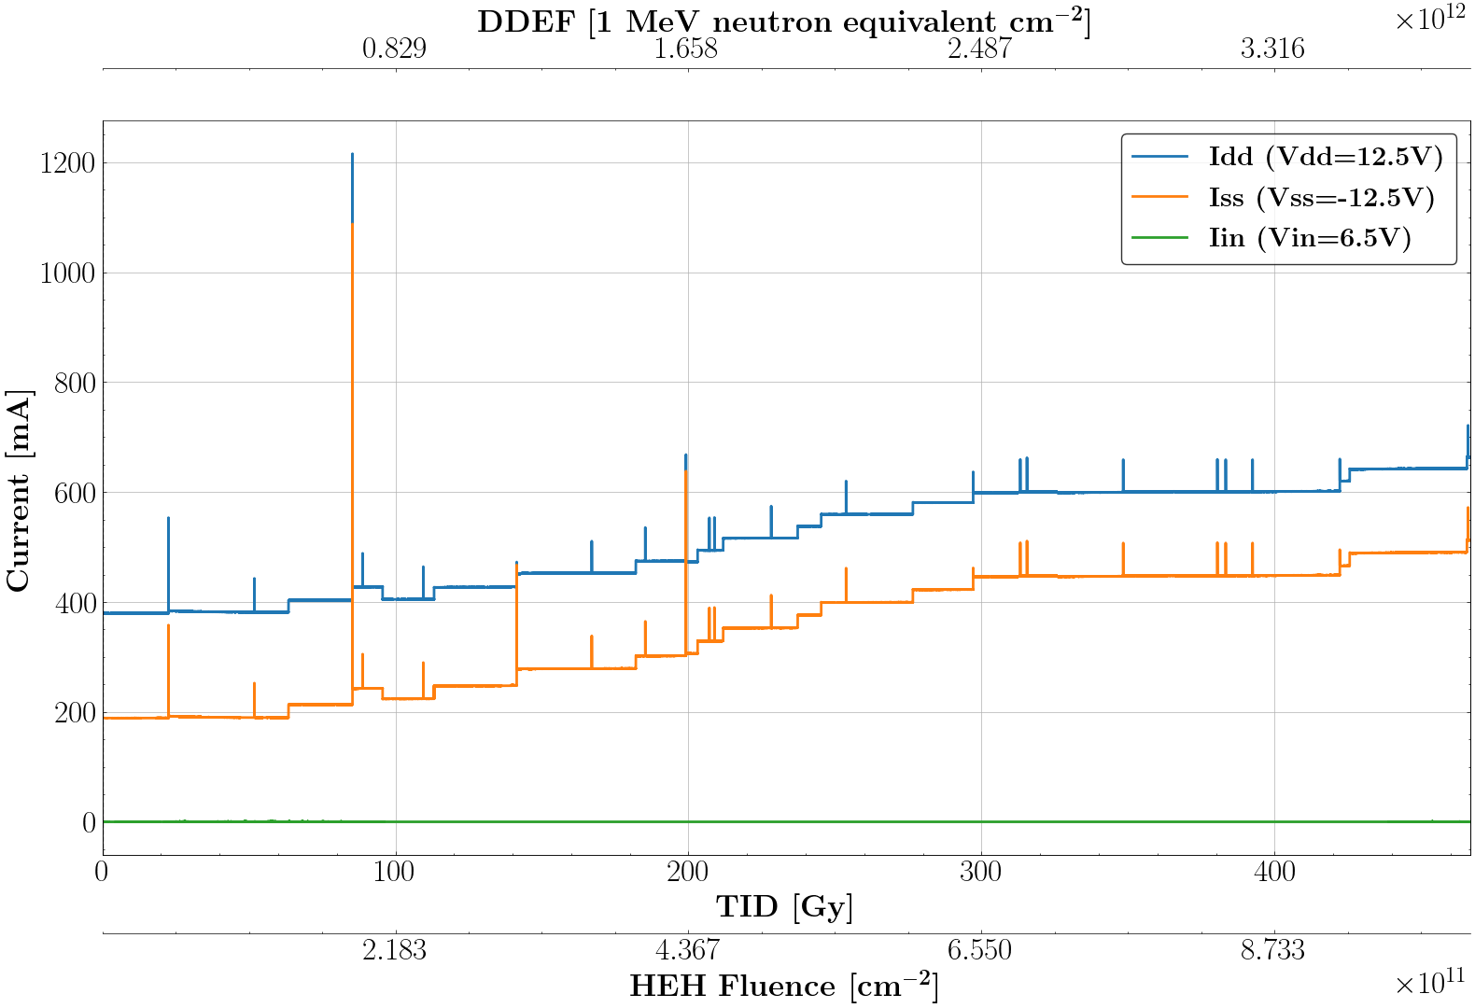
Example of observed SELs: Infamous OPA2192
Results of OP2192 presented already multiple times [100 samples]
All 3 types of events observed
About 50% of events were destructive
The rest is mainly self cleared events
SEL cross-section:
  UL: 2.10 e-13 cm²/device
  LL: 5.618e-13 cm² /device
As mentioned in many previous presentation, such low cross-section is hardly visible with low number of samples, but would be a real threat in operation for many projects, which justify the required careful estimation of the radiation design requirements.
R. Ferraro - SEL Qualification Methodology for ATS Rad-Tol Control Systems

Slide 17
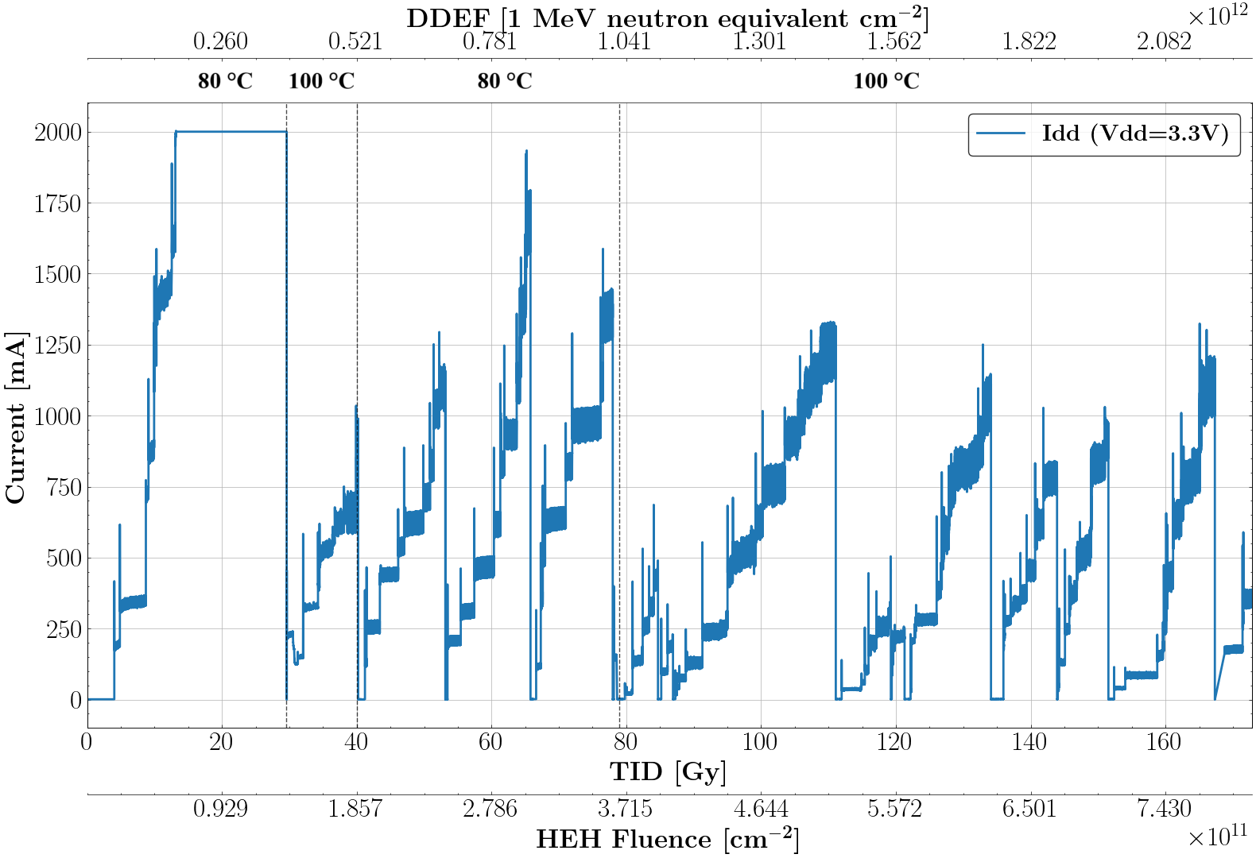
Example of observed SELs: AT25EU0081A-SSUN
SPI Flash Memory [100 Samples]:
103 Type 2 SEL observed (cleared on power cycle)
Events regularly cleared all at once, once a day with a power cycle
SEL cross-section:
  UL: 2.21 e-12 cm²/device
  LL: 8.61 e-13 cm²/device
R. Ferraro - SEL Qualification Methodology for ATS Rad-Tol Control Systems

Slide 18
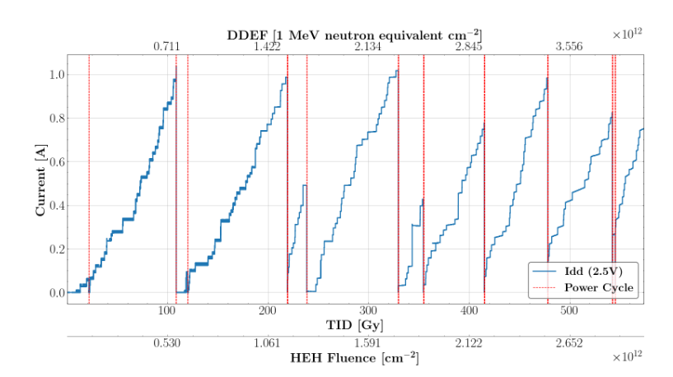
Example of observed SELs: 24AA025E48-I/SN
I2C EEPROM [100 Samples]
217 micro-latchups observed, 0 destructive ones
All observed events were between 20 and 40 mA, and below the fuse tripping levels, they can be considered as micro-latchup”
Observed micro-SEL cross-section:
  UL: 2.38 E-13 cm²/device
  LL: 1.20 E-13 cm²/device
SEL cross-section
  UL: 3.03 E-15 cm²/device
No destructive events should be expected in operation for the majority of locations
EEPROM unavailability due to micro-latchups should be expected, can be cleared on power cycle
Not a problem for many systems which uses the EEPROM as ID read only on boot, but to be carefully considered
R. Ferraro - SEL Qualification Methodology for ATS Rad-Tol Control Systems

Slide 19
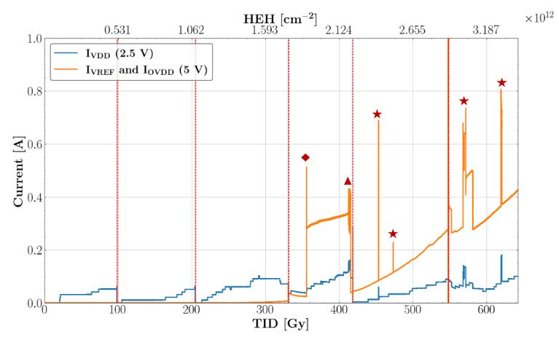
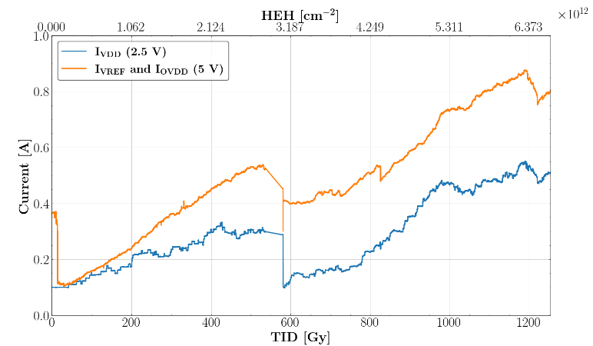
Example of observed SELs: LTC2377 ADC
DQQL Qualification lot [400 samples]: Two voltage configurations tested:
VDD = 2.5 V, VREF = 5.00 V, VODD = 5V
VDD = 2.5 V, VREF = 2.50 V, VODD = 2.50 V
5 SEL observed, 1 was destructive.
  UL: 4.42 E-14 & LL: 1.77 E-14 cm²/device
0 SEL observed
  UL: 1.3 E-15 cm²/device – 33 times lower
Voltage configuration played a crucial role in the ADC’s SEL response
R. Ferraro - SEL Qualification Methodology for ATS Rad-Tol Control Systems

Slide 20
0 Events Large batch Test Results
P/N | Voltages | #Samples | Fluence(HeH/cm²) | #Events | Upper Limit Cross-section (cm²/device)
MC7805ABD2TG | Vin = 10 | 150 | 3.04E+12 | 0 | 4.36 E-15
MC7905ACD2T | Vin = - 10 V | 250 | 1.08E+13 | 0 | 5.46 E-15
MEJ2D1215SC | Vin = 12 V | 200 | 2.53E12 | 0 | 2.98 E-15
OPA333AIDBVT | V+/- = 5 V | 400 | 4.5E+12 | 0 | 2.05 E-15
REF5045AID | Vcc = 5 V | 400 | 3.04E+12 | 0 | 3.03 E-15
SN74LVC16T245DGG | Vcc = 5 V | 400 | 3.07E+12 | 0 | 4.01 E-15
SN74LVC1G04DCK | Vcc = 5 V | 400 | 7.44E+12 | 0 | 1.24 E-15
SN74LVC1G08DCK | Vcc = 5 V | 400 | 4.10E+12 | 0 | 2.25 E-15
SN74LVC1G17DCK | Vcc = 5 V | 400 | 2.37E+12 | 0 | 3.89 E-15
SN74LVC1G32DCK | Vcc = 5 V | 400 | 2.64E+12 | 0 | 3.48 E-15
THS4281DBVT | V+/- = 5 V | 400 | 3.36E+12 | 0 | 2.75 E-15
THS4521ID | V+/- = 5 V | 200 | 4.21E+12 | 0 | 4.38 E-15
TPS7A3001DGN | Vcc = - 15 V | 400 | 2.87E+12 | 0 | 3.21 E-15
TPS7A4501DCQ | Vcc = 12 V | 400 | 4.32E+12 | 0 | 2.13 E-15
TPS7A4901DGN | Vcc = 15 V | 400 | 4.58E+12 | 0 | 2.02 E-15
TL1431ACL3T | Vcc = 33 V | 200 | 2.41E+12 | 0 | 7.65 E-15
R. Ferraro - SEL Qualification Methodology for ATS Rad-Tol Control Systems

Slide 21
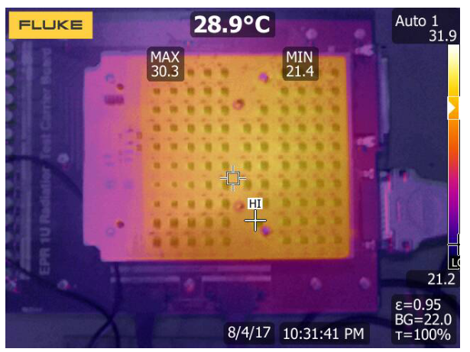
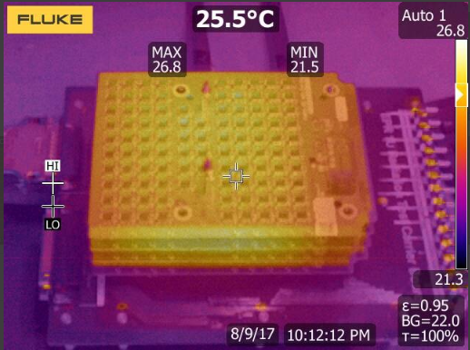
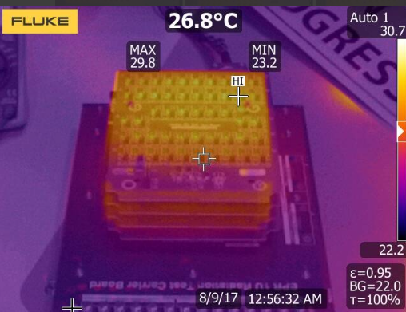
Temperature plays a crucial role in SEL sensitivity
SEL phenomenon is extremely dependent on device temperature, the sensitivity can easily increase of one order of magnitude at high temperature and fall below Radiation Design Requirements
During all the tests the DUT temperatures were measured with a thermal camera at provided test biasing conditions both on the individual board and with the full stack, before and after irradiation:
The device temperature should be provided in the radiation test request documents by the user to guarantee the representativity of the tests. A simple approximation could be the ambient temperature expected inside the chassis or ideally prototype thermal measurements.
R. Ferraro - SEL Qualification Methodology for ATS Rad-Tol Control Systems

Slide 22
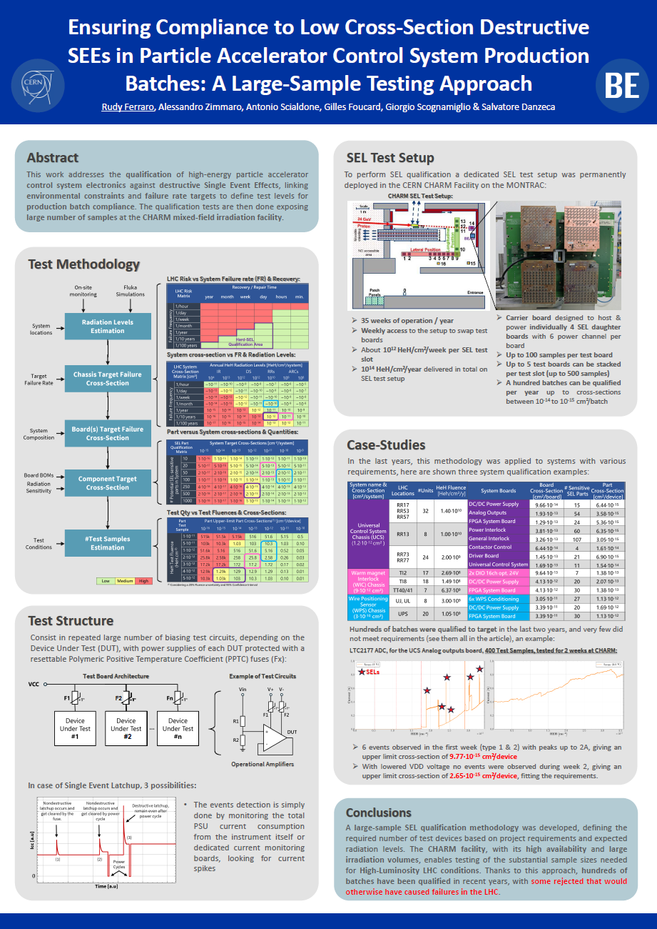
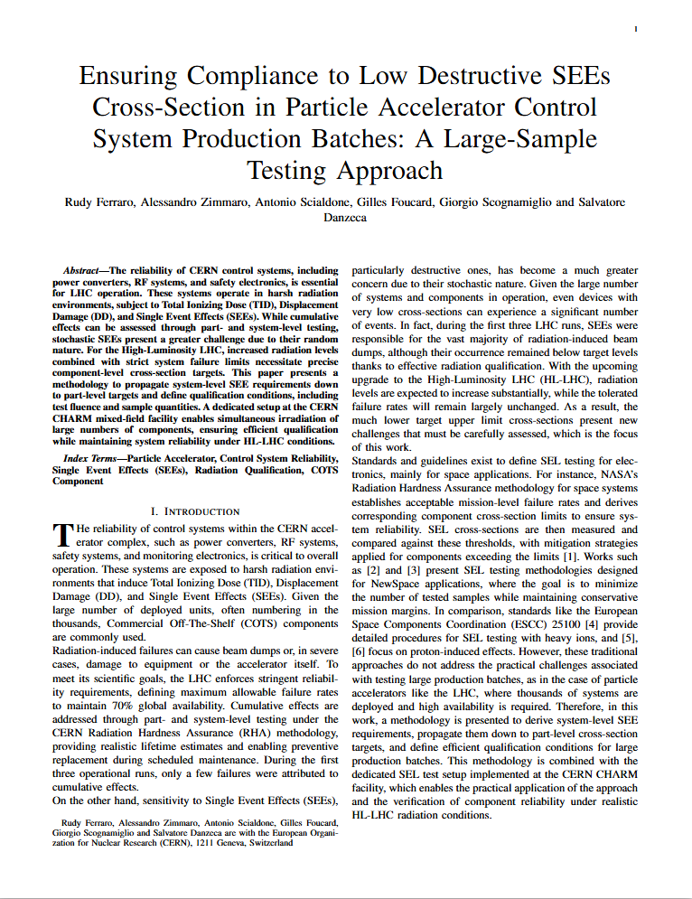
Work Presented at NSREC2025!
Work presented at NSREC 2025 with very good feedbacks from community:
IEEE journal submission under review.
R. Ferraro - SEL Qualification Methodology for ATS Rad-Tol Control Systems

Slide 23
Conclusions
A complete SEL qualification methodology was developed and implemented since 3 years
This methodology allows to derivate from operational inputs (number of systems, radiation levels, target failure rate) the target device cross-section for batch qualification
For critical projects very low cross-sections (in the range of 1E-15 cm²/device) were identified
To reach such low levels dedicated SEL test boards have to be designed giving the possibility to reach those target SEL cross-section by irradiating very large batches of test samples (up to thousand per week at CHARM)
About 40 production batches were qualified in 2025 to such low numbers
Several part numbers or operational conditions were discarded to be use in operation thanks to test, avoiding future failures in operation
Newly deployed dedicated SEL test location in CHARM (MONTRAC) allowed parallelizing many SEL tests to be able to cope with the very high number of devices to be qualified this year
Many more parts are expected to be tested in 2026 to such low cross-sections
R. Ferraro - SEL Qualification Methodology for ATS Rad-Tol Control Systems

Slide 24
Thank you for your attention!

Slide 25
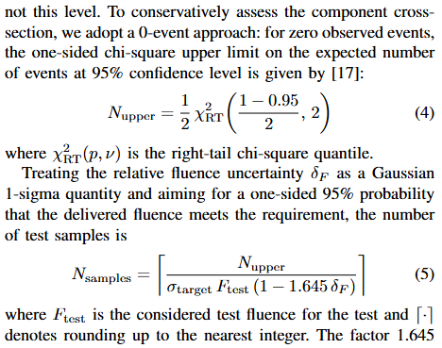
Test Sample Quantity Calculations:
R. Ferraro - SEL Qualification Methodology for ATS Rad-Tol Control Systems

