Slide 1
New AD E-Cooler: Electron gun test results
G. Khatri | SY-BI
15 Oct 2025,

Slide 2
Outline
Gun requirements/specs
Versions (design/production) and timeline
What was tested ?
Test outcome of the first gun (v4) and decision to make v5
Test outcome after modifications: gun v4.2
Results summary
Conclusion

Slide 3
Requirements/Specs for the new Gun
Func. Specs Gun/Coll:
EDMS 3077160
By operation:
Electron beam energy 27 keV
Electron beam intensity 2.4 A
Reliability demonstration of stable DC e-beam for at least 24 hours
Axial magnetic field of 2400 Gauss
Space charge limited operation (perveance >= 2.1 uAV^{-3/2})
By construction:
1” Cathode @ uniform temperature 1000 ℃ (hot)
High voltage holding 27 kV DC @ hot cathode (35 kV dry test for cold cathode)
Electron (total*) loss < 300 uA (present AD e-cooler and 1992 paper, mostly defined by collector efficiency)
Ceramic resistance > 1 Gohm @ hot cathode, i.e. loss in ceramic I =V/R = 27 kV/1G = 27 uA (i.e. < 27 uA)
Dissipated power in ceramic P = V²/R < 0.73 W (more heating-> more current->more heating….thermal run away+outgassing) … thx Jean !!!
NB:
Total electron losses = e-beam loss + R_{water} loss + R_{ceramic} loss
What if R_{ceramic} = 1 Mohm ?
Loss in ceramic = 27mA
Diss. power = 730 W

Slide 4
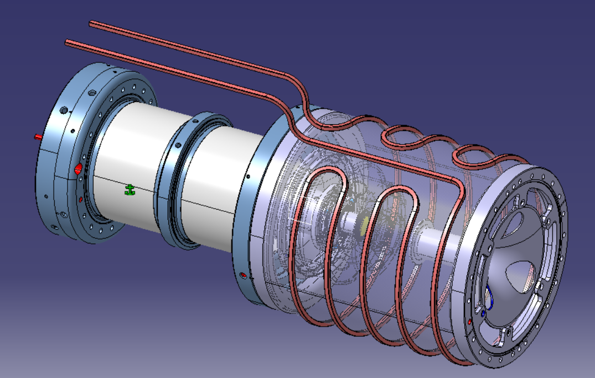
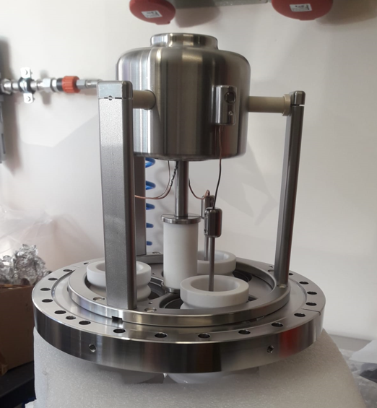
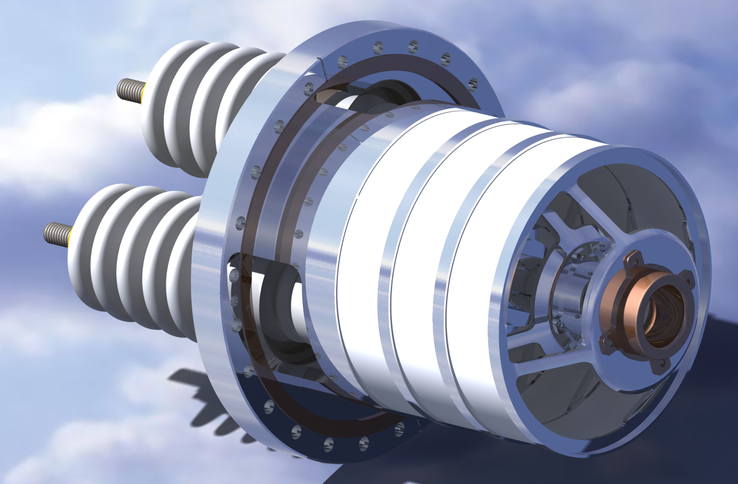
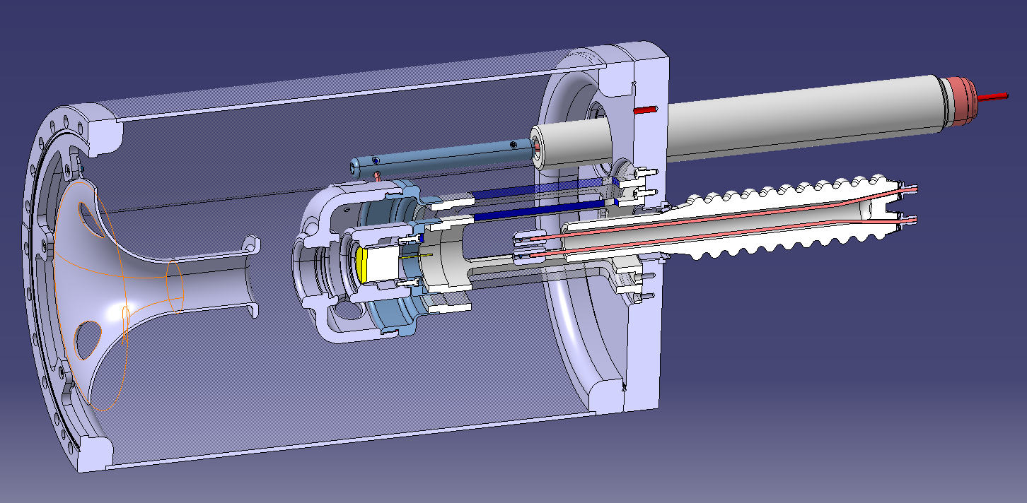

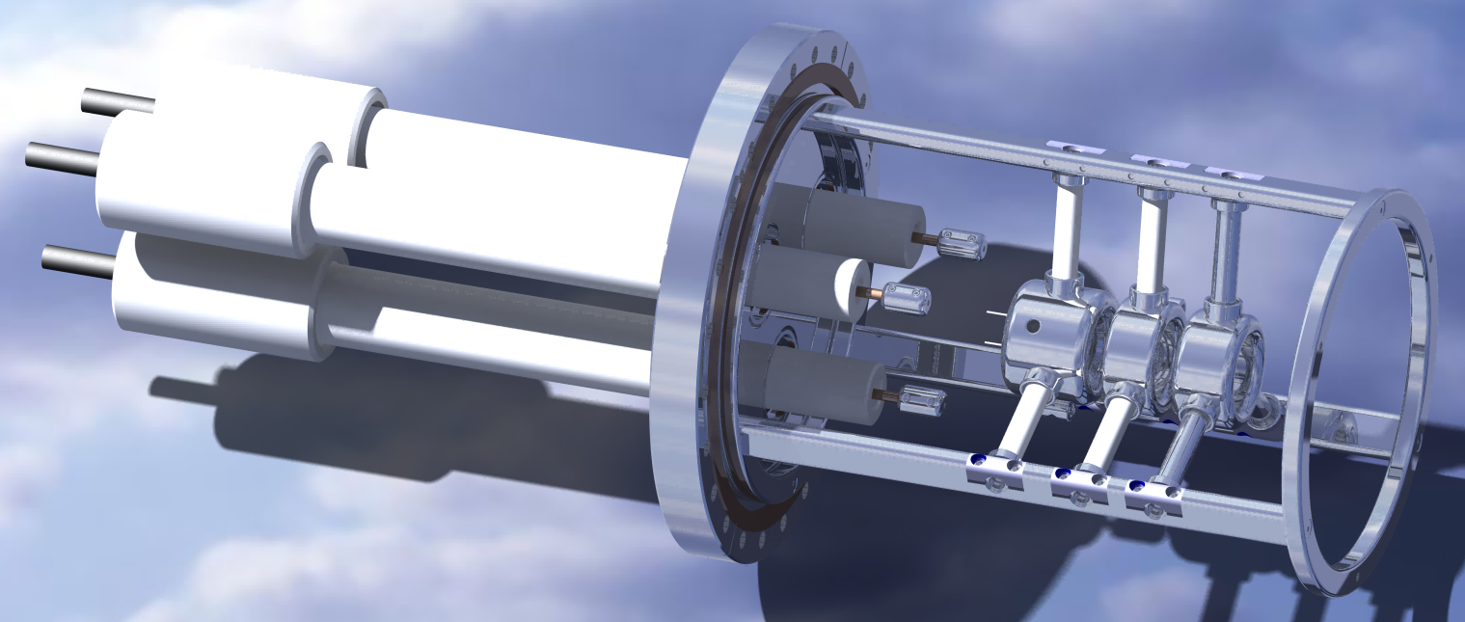
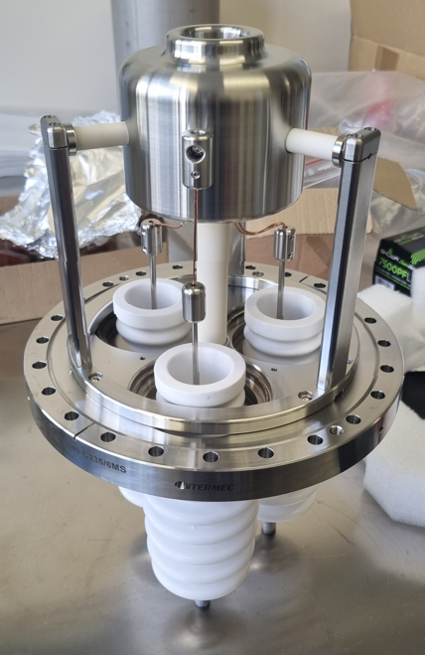
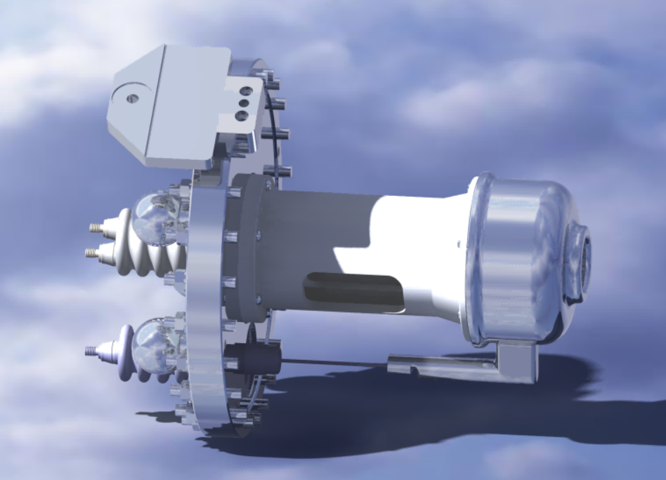
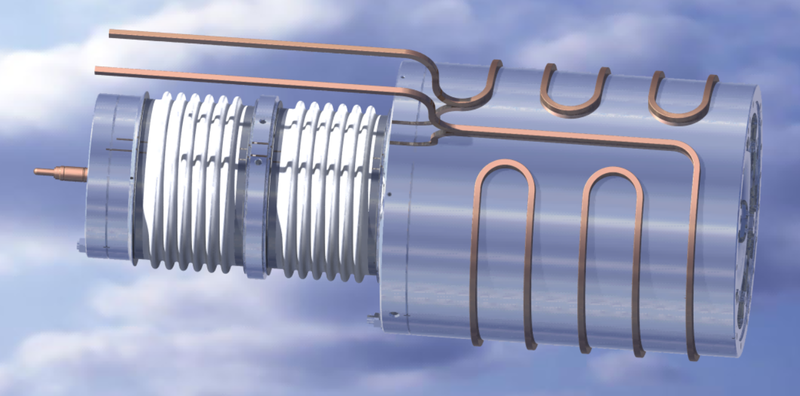
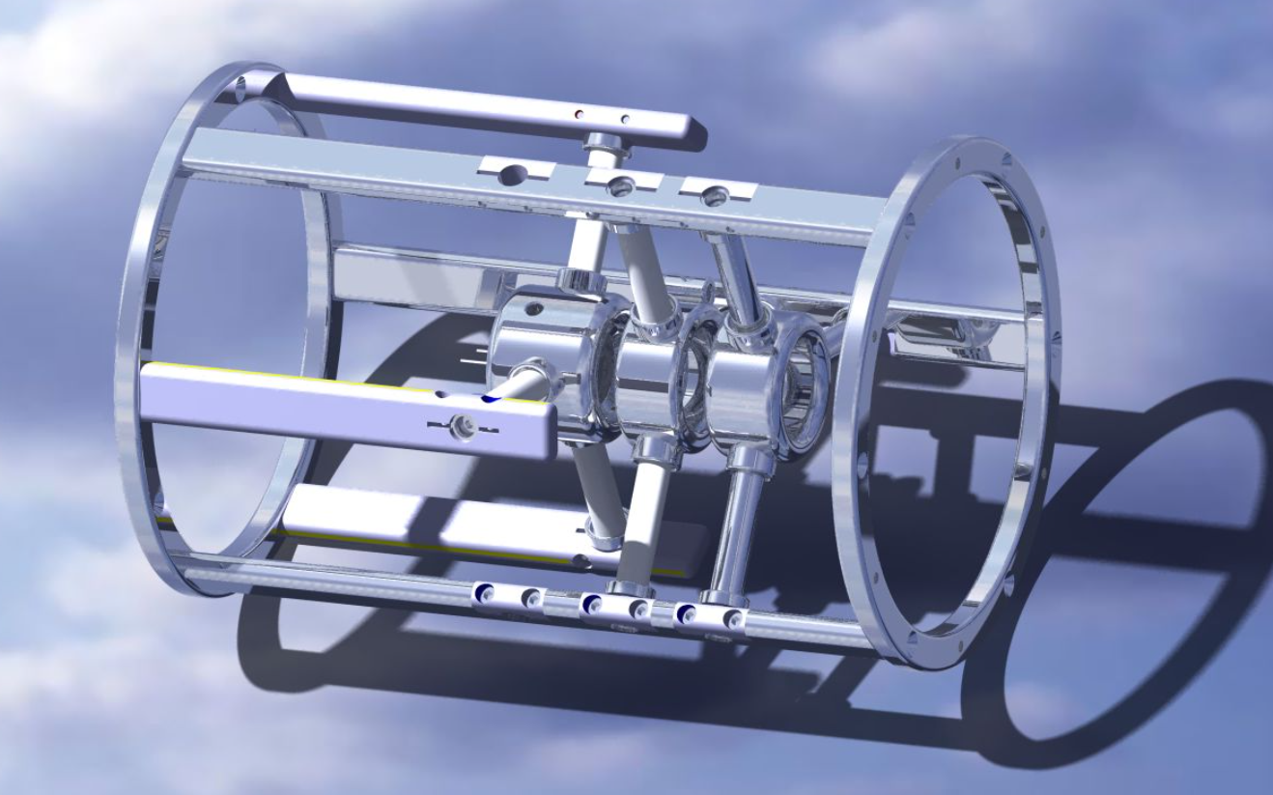
Gun design history and timeline (work of J. Cenede, SY-BI-XEI)
68 kV@3.5A => 27 kV@2.4A
Collector V1
HV tests
V4.2.1 – V4.2.2 – V4.2.3
MACOR – SHAPAL – AL2O3
V5
2025
V1
2021
V3
2023
V2
V3.2
V4
2024
V5.2
V2.2
EN-MME

Slide 5
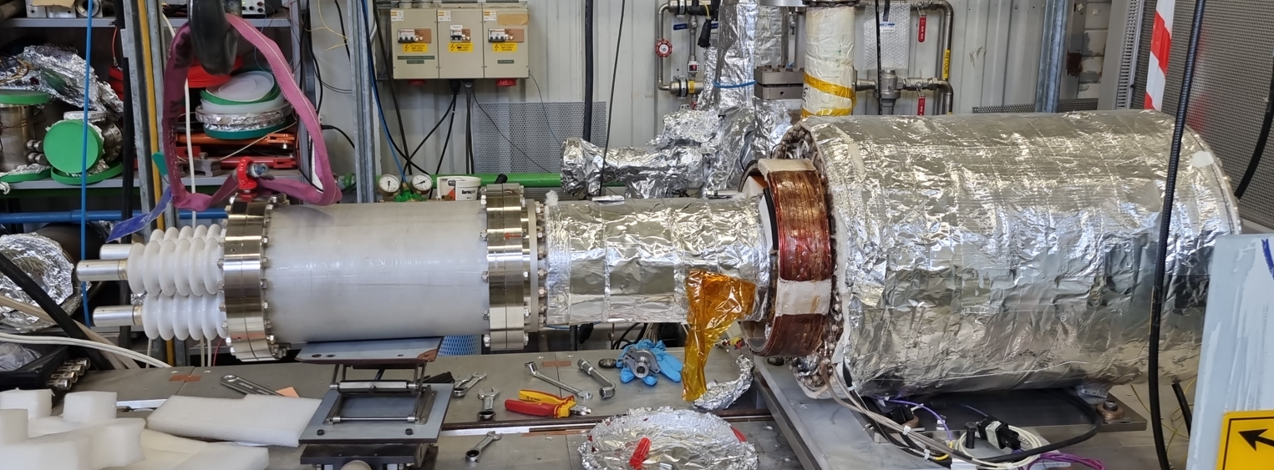
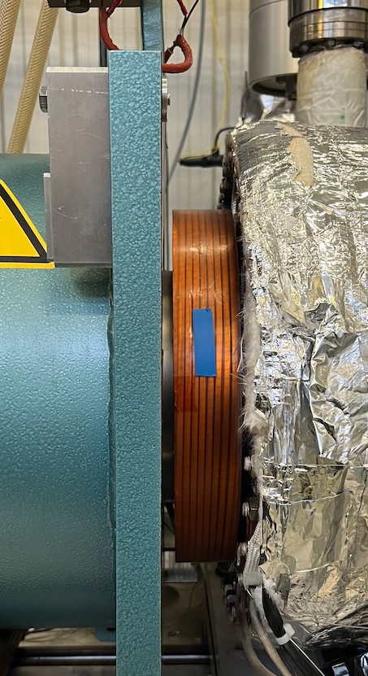
What was tested ?
New BBC coil
New collector
Proto gun
V4 (ALUMINA)
V4.2.1
(MACOR + Tantalum)
V4.2.2
(SHAPAL + Tantalum)
V4.2.3
(ALUMINA + Tantalum)
Oct 2023 – Dec 2023
Sep 2024
Jan 2025
Jun 2025 – today
Reminder: original goal was 68kV, then 27 kV => a cheap/quick prototype for test to validate new electrode shapes, not final gun !
Jean, Alex

Slide 6
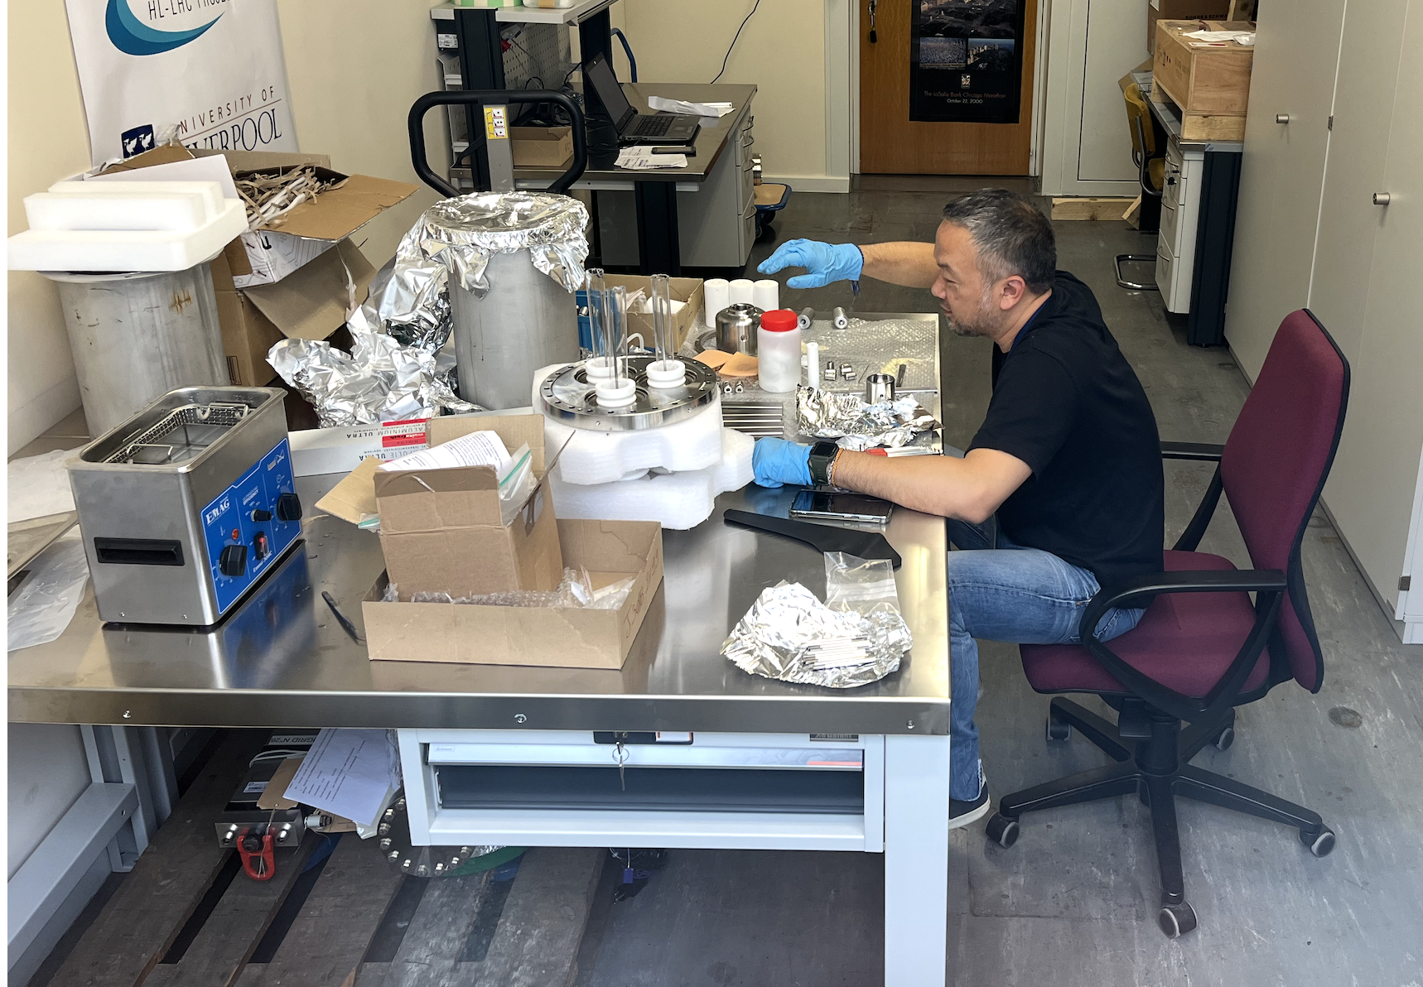
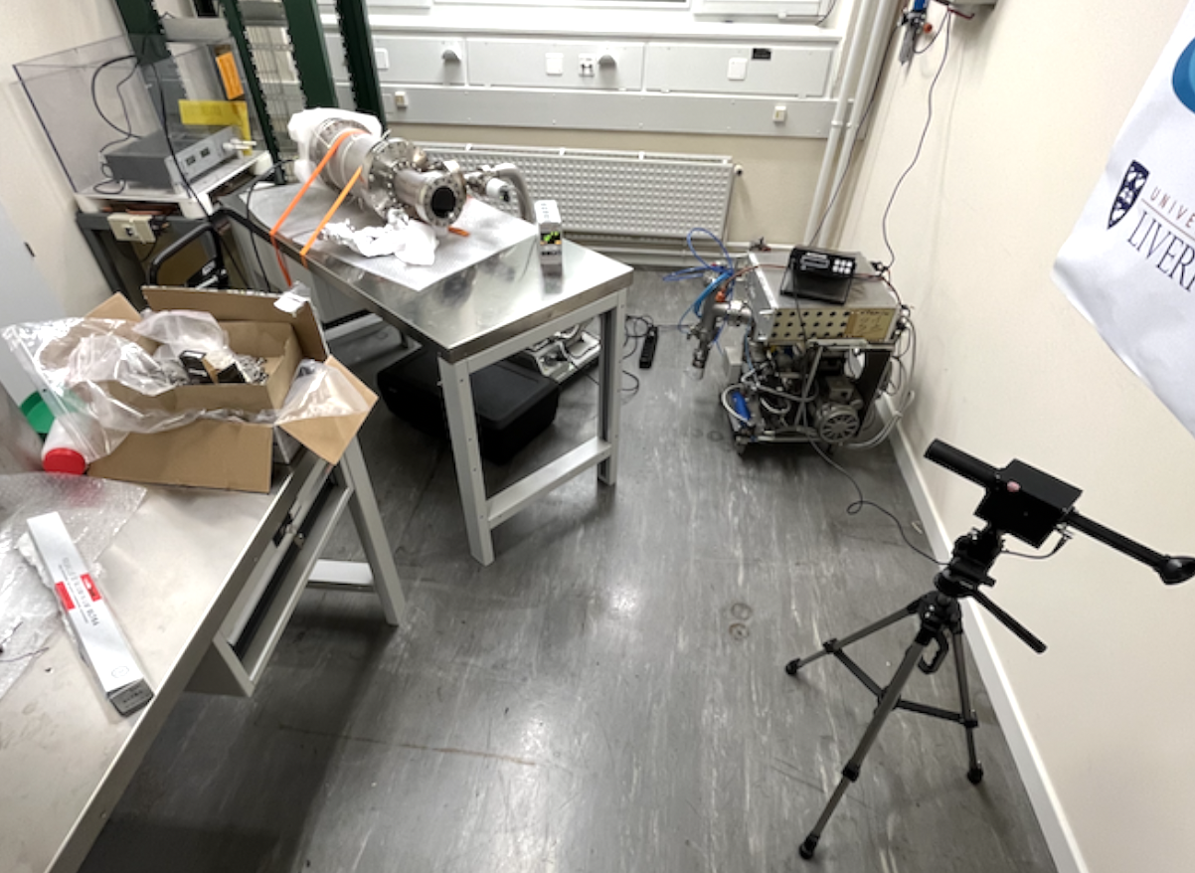
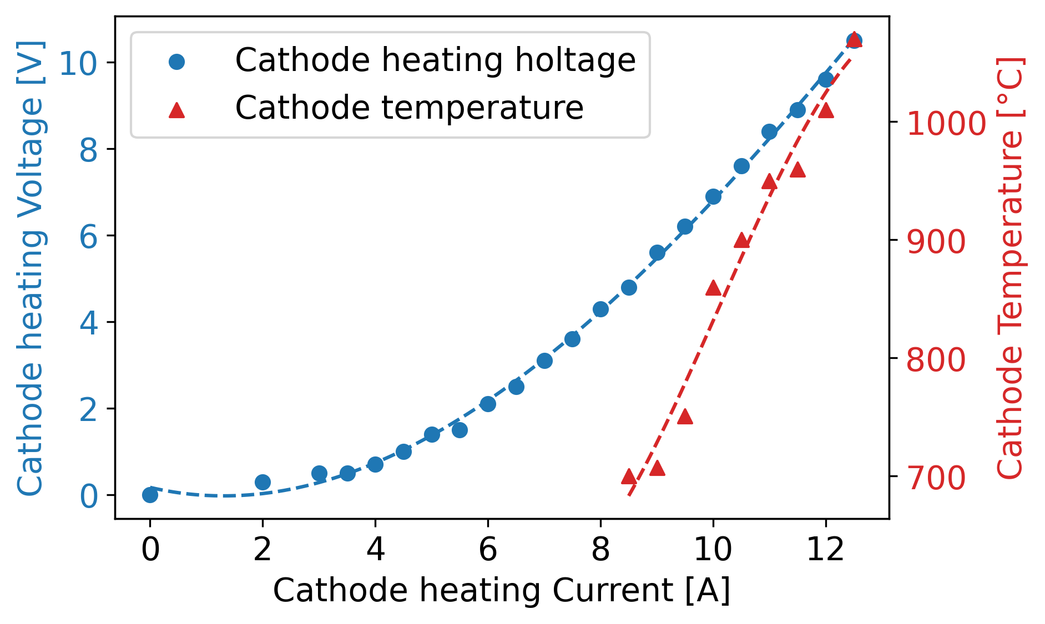
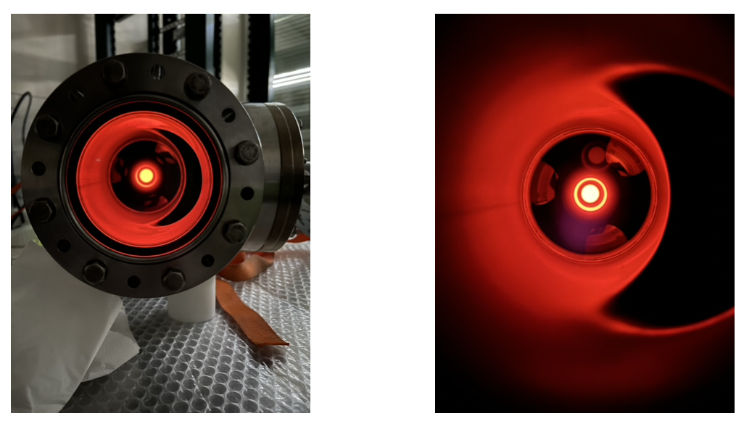
Gun v4: cathode heating test in lab b.8 (Jean, Gunn)
See logbook entry
30 kV @ 20 ℃ ok
cathode @ 1000 ℃ ok
Ceramic didn’t break (contrary to EN-MME simulations)

Slide 7
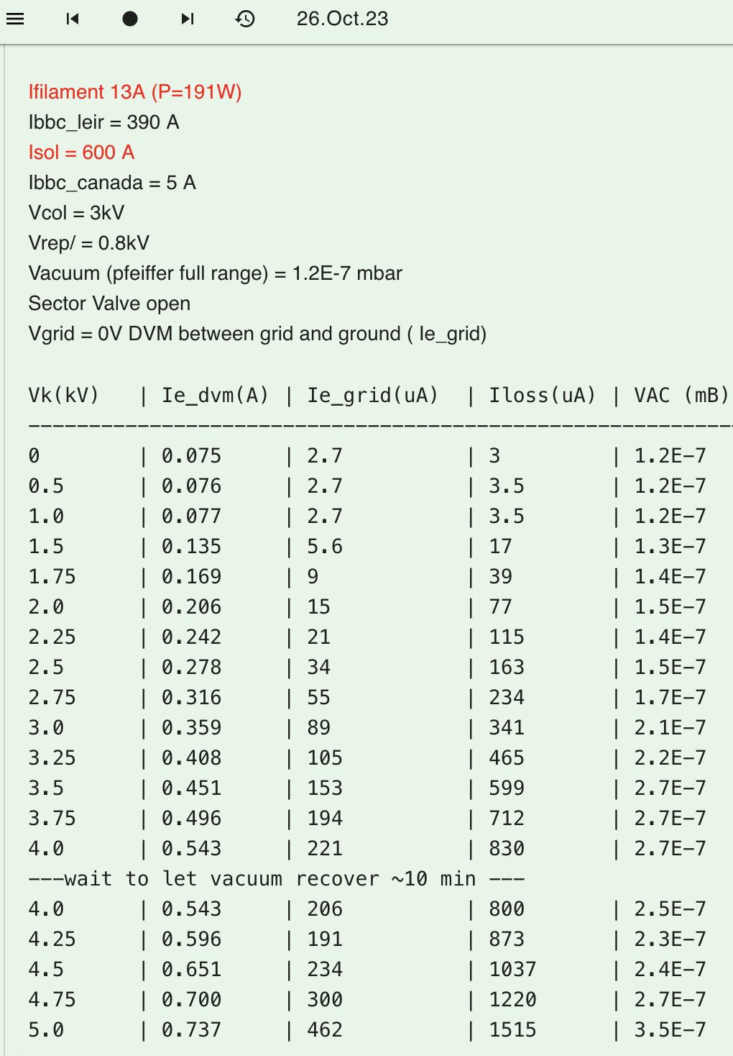
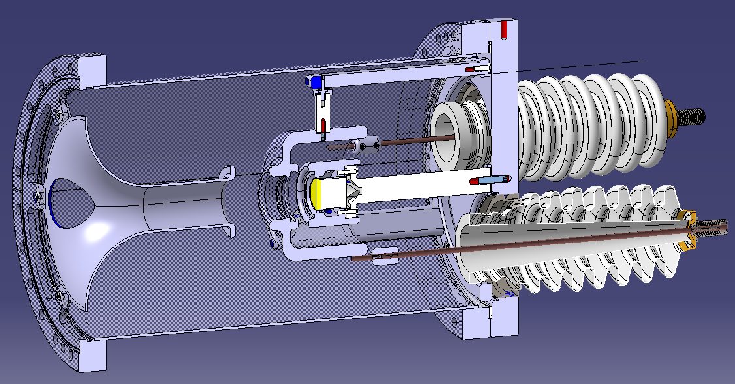
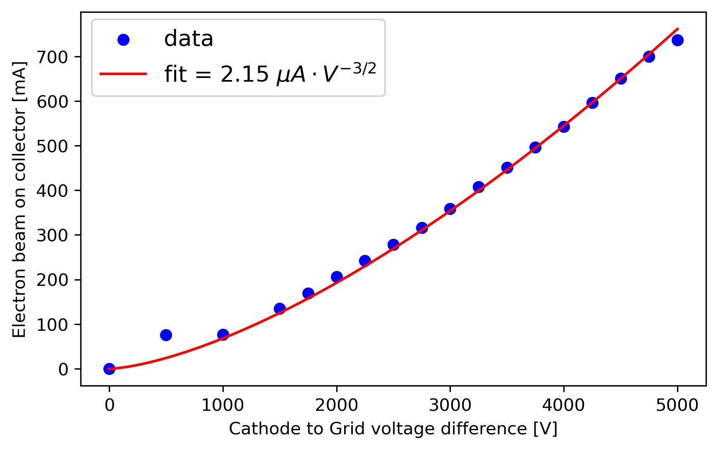
Gun v4: first electron beam extracted on ECTS
See logbook entry
anode
cathode
HV feedthroughs
grid
Perveance ok (up to 5 keV, 700 mA)
X e-loss + leakage = 2 mA
X vacuum = 3.5E-7 mbar
X B-field = 900 Gauss (600 A)
X cathode @ 1100 ℃ (I_{fill} = 13 A)
Jean, Alex, Gerard

Slide 8
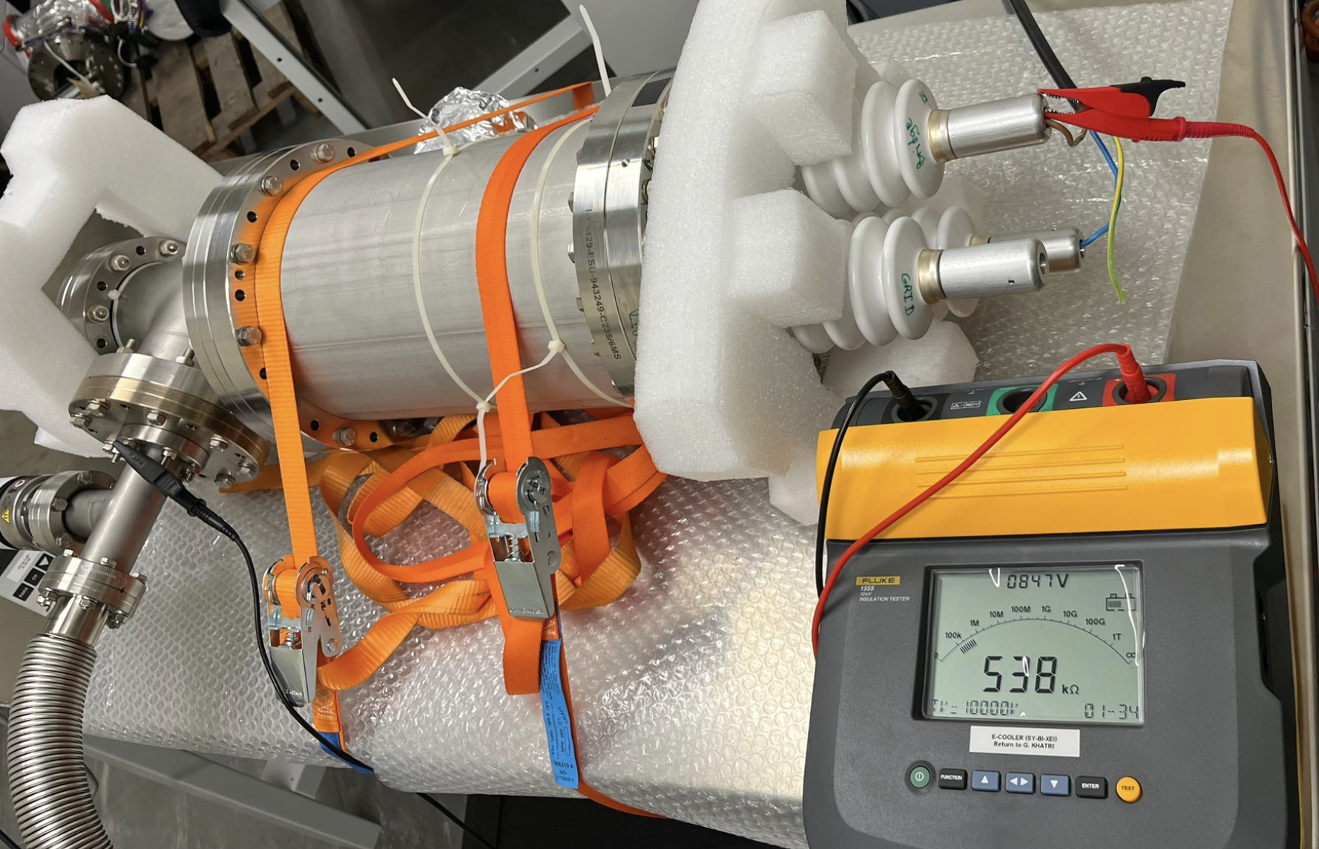
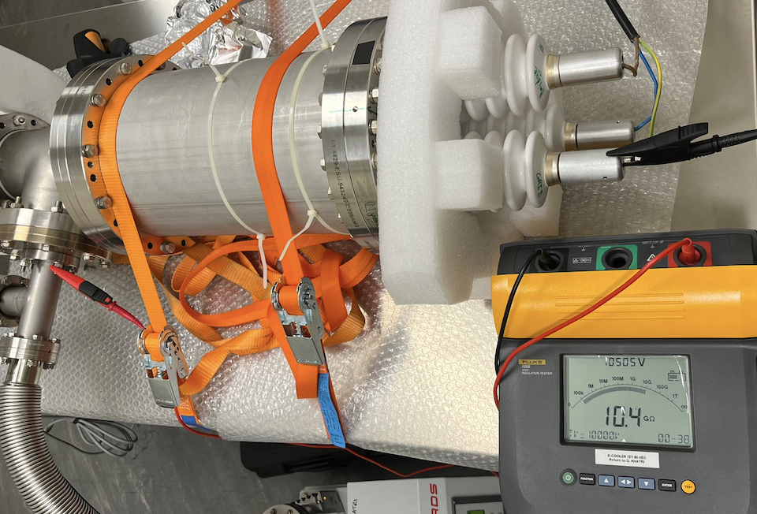
Gun v4: what did we learn ?
Ceramic too hot => low electrical resistance => large leakage currents
    Cathode to ground: 540 kΩ hot. (> 1 TΩ when cold).
    Grid to ground: 10.4 MΩ hot. (> 1 TΩ when cold).
    Solution: ceramic out if vacuum, away from cathode
Cathode losing heat (radiative & conductive)
    Heat cathode > 1000℃ to keep emission up.
    Solution: tantalum thermal shield (uniform T, low heat loss)
Beam scalloping (oscillation) in low B-field (900 Gauss)
    According to CST sim., scalloping is reduced >1200 Gauss
    Solution: increase B field (expansion solenoid)
Gunn

Slide 9
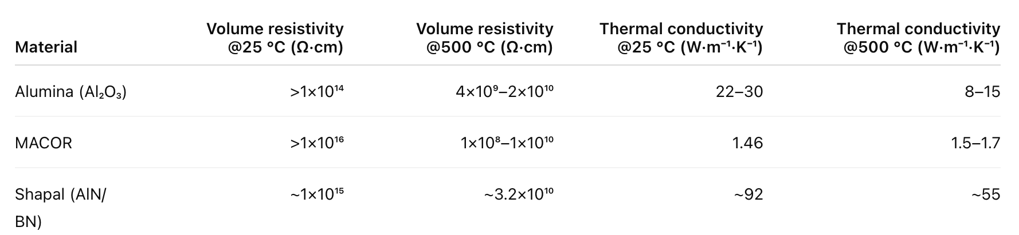
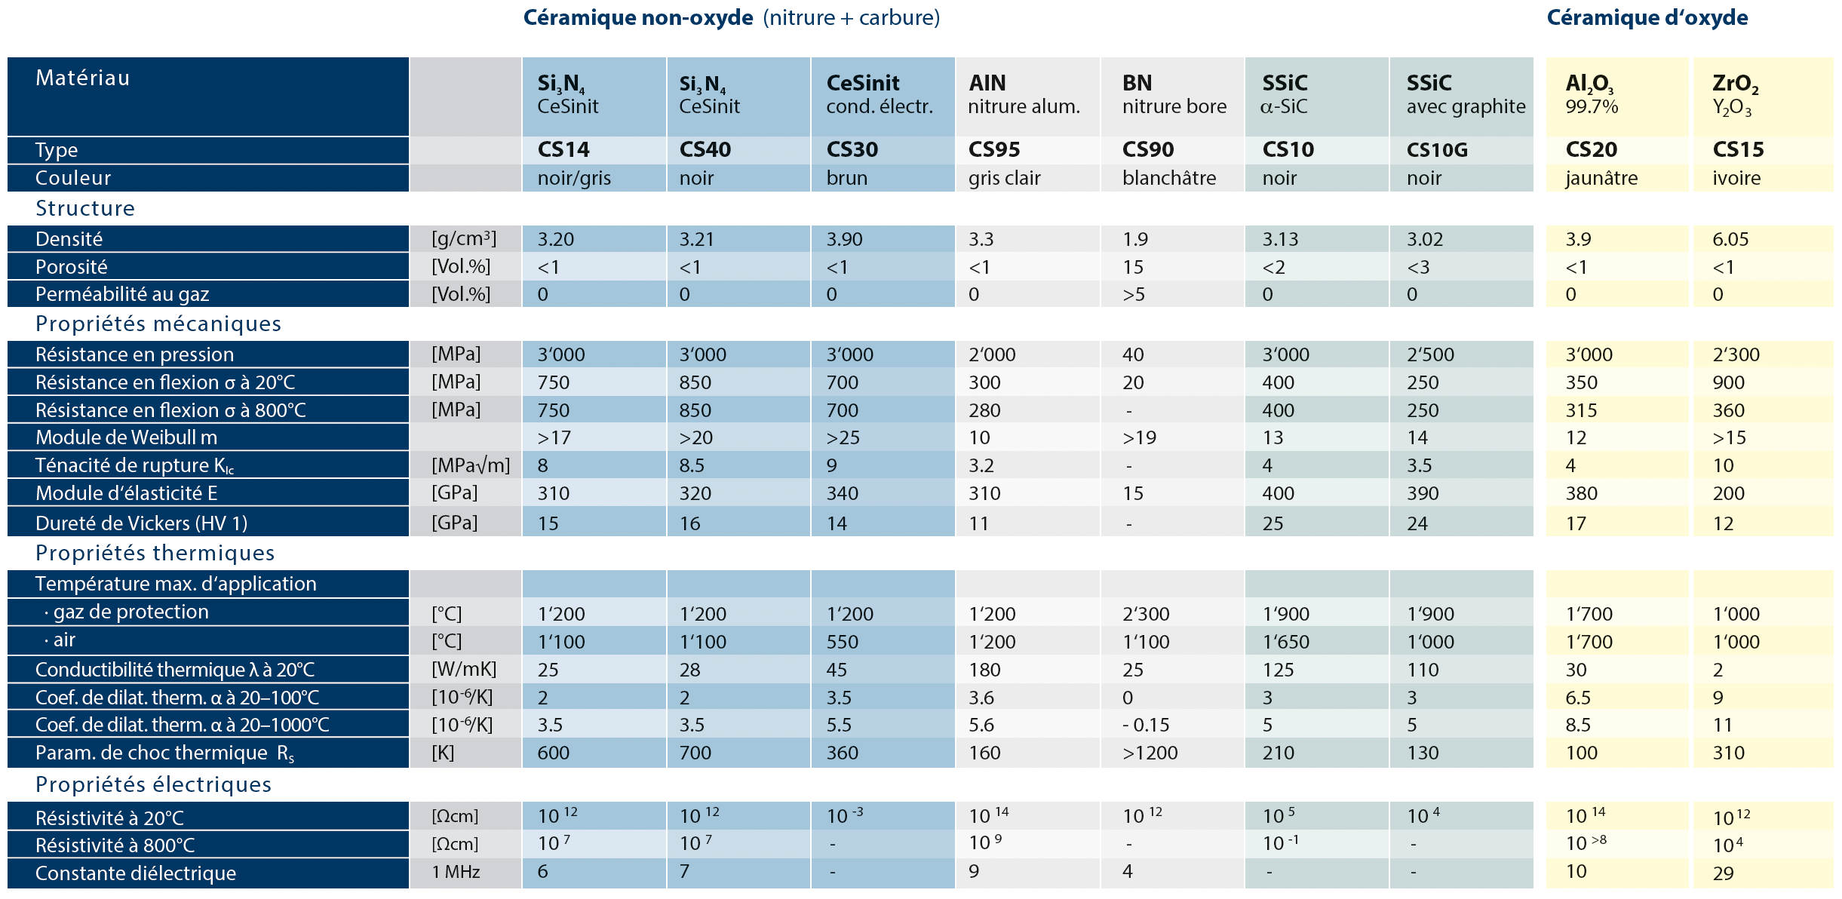
Ceramic properties (ele. Res. & the. Cond.) @25 C vs 500/800 C
Jean said: be careful of ceramic resistance when hot !

Slide 10
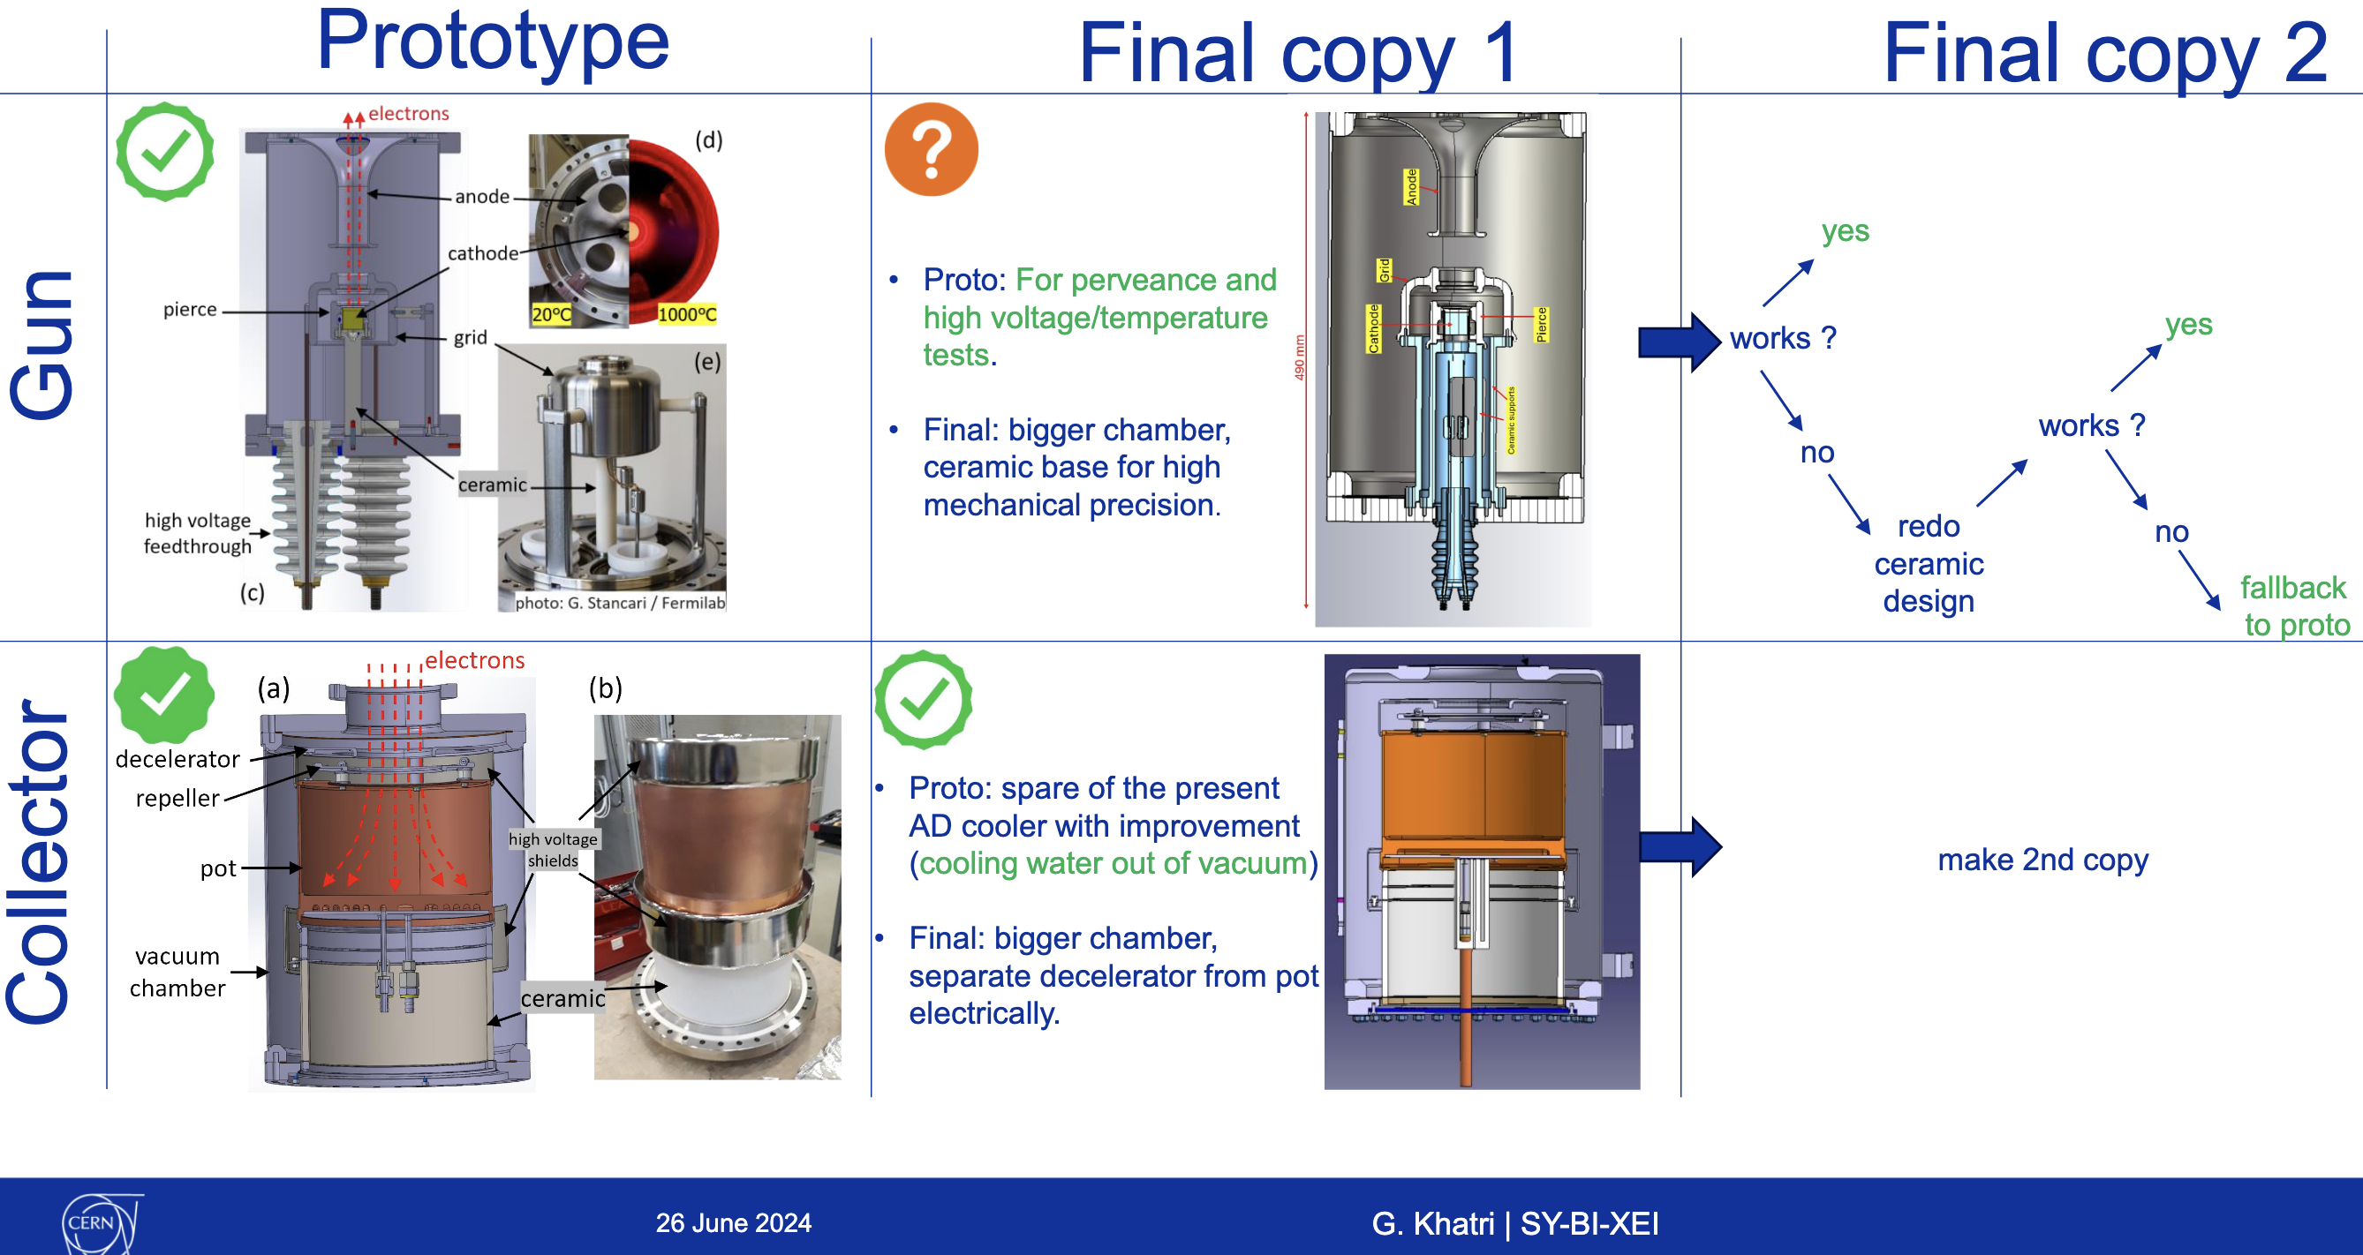
GO/No-go decision June-2024, time pressure to deliver a working gun by LS3
NB: LS3 delay was announced in Sep 2024
See indico meeting 26 June 2024 & EDMS minutes
Jean suggested to go for Russian design, safe solution, Gun v5 was born, Gunn=>Gun v5.2
See follow up meetings on gun v5 on indico category between July 2024 – Feb 2025 & handover to EN-MME
J. Cenede

Slide 11
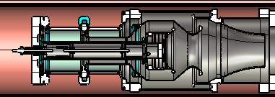
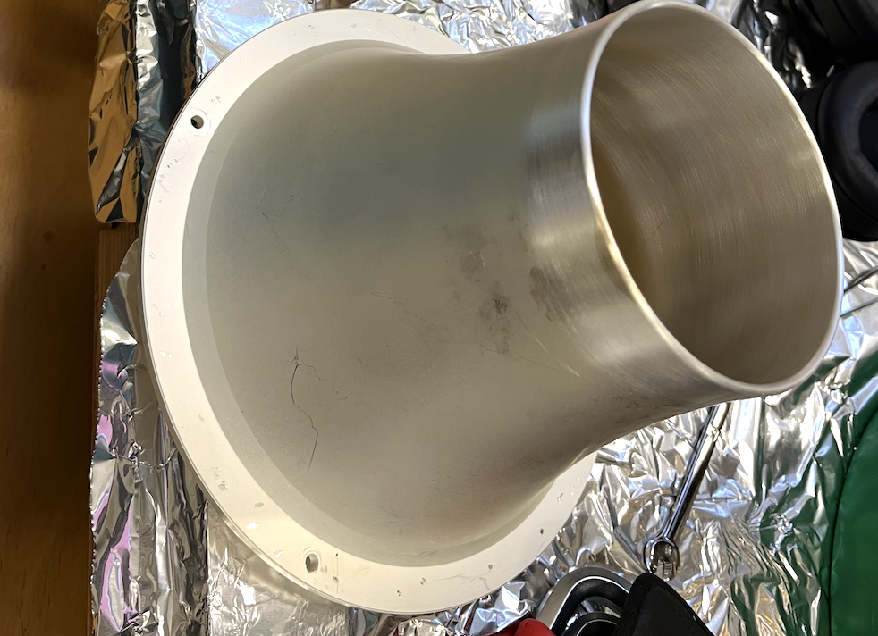
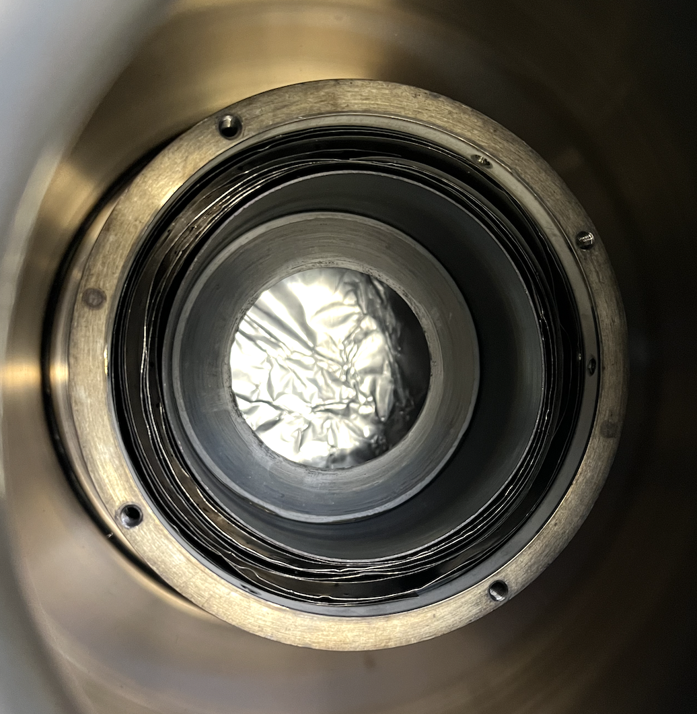
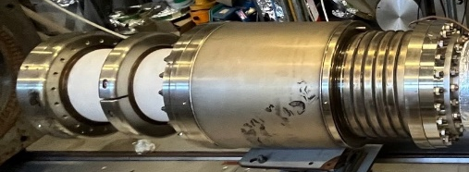
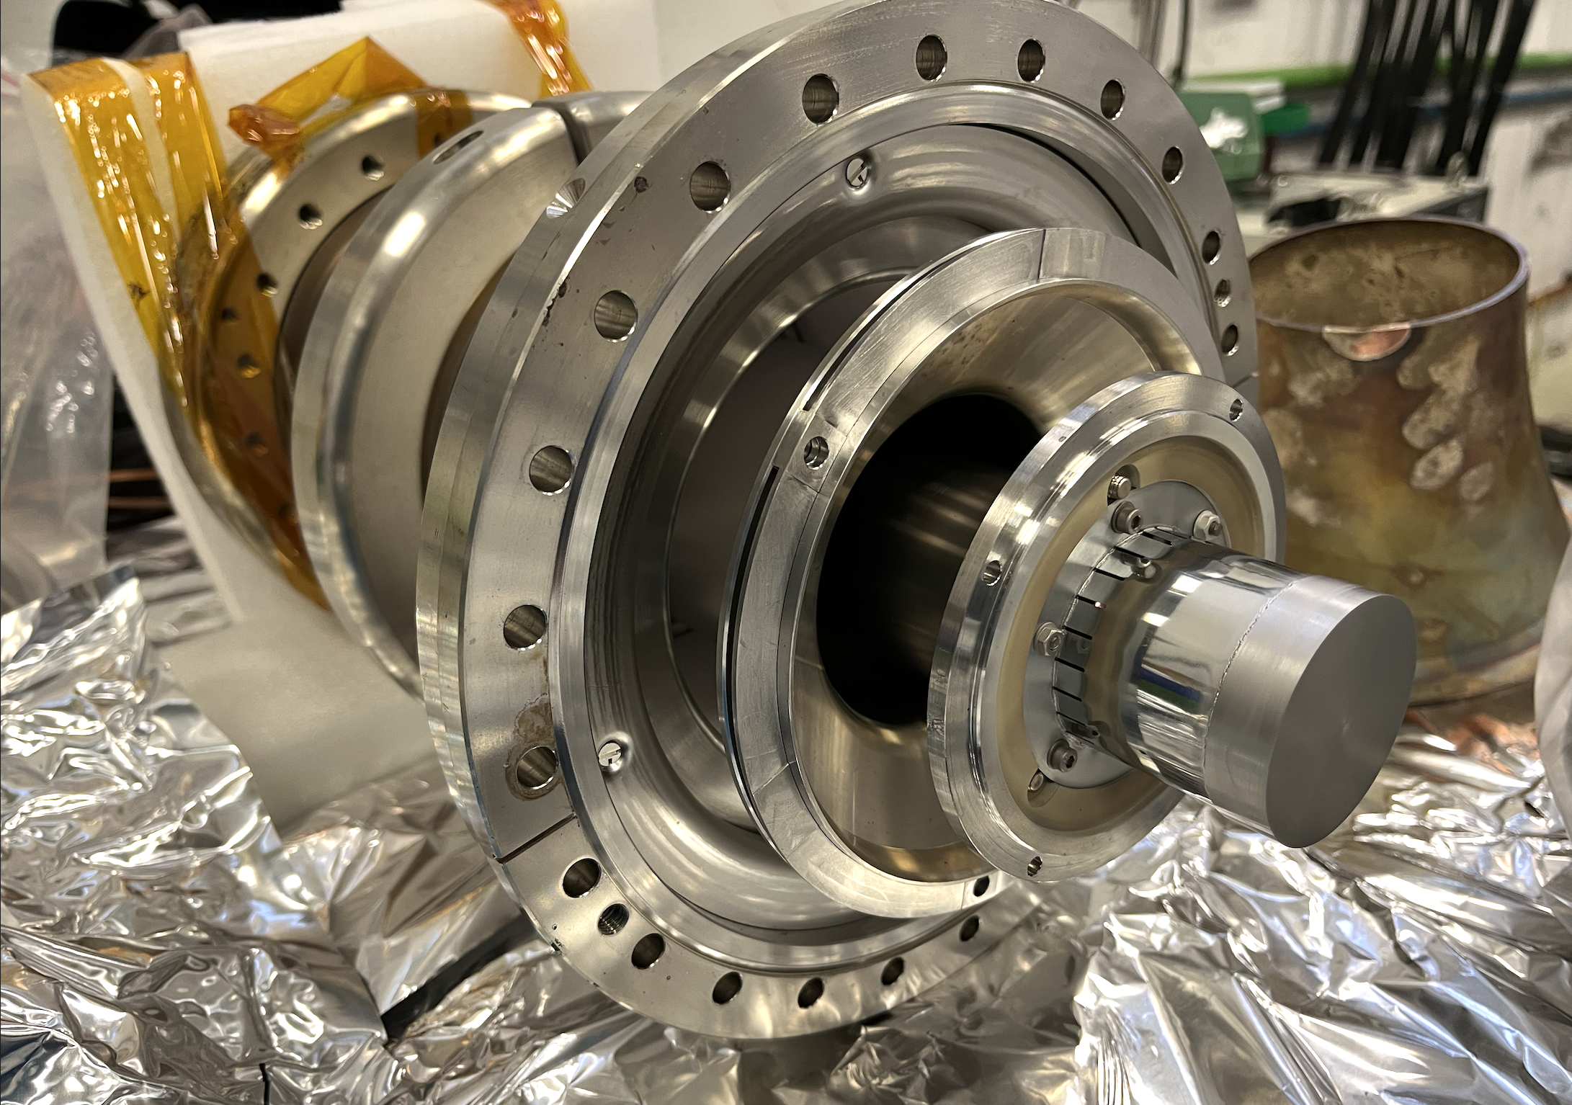
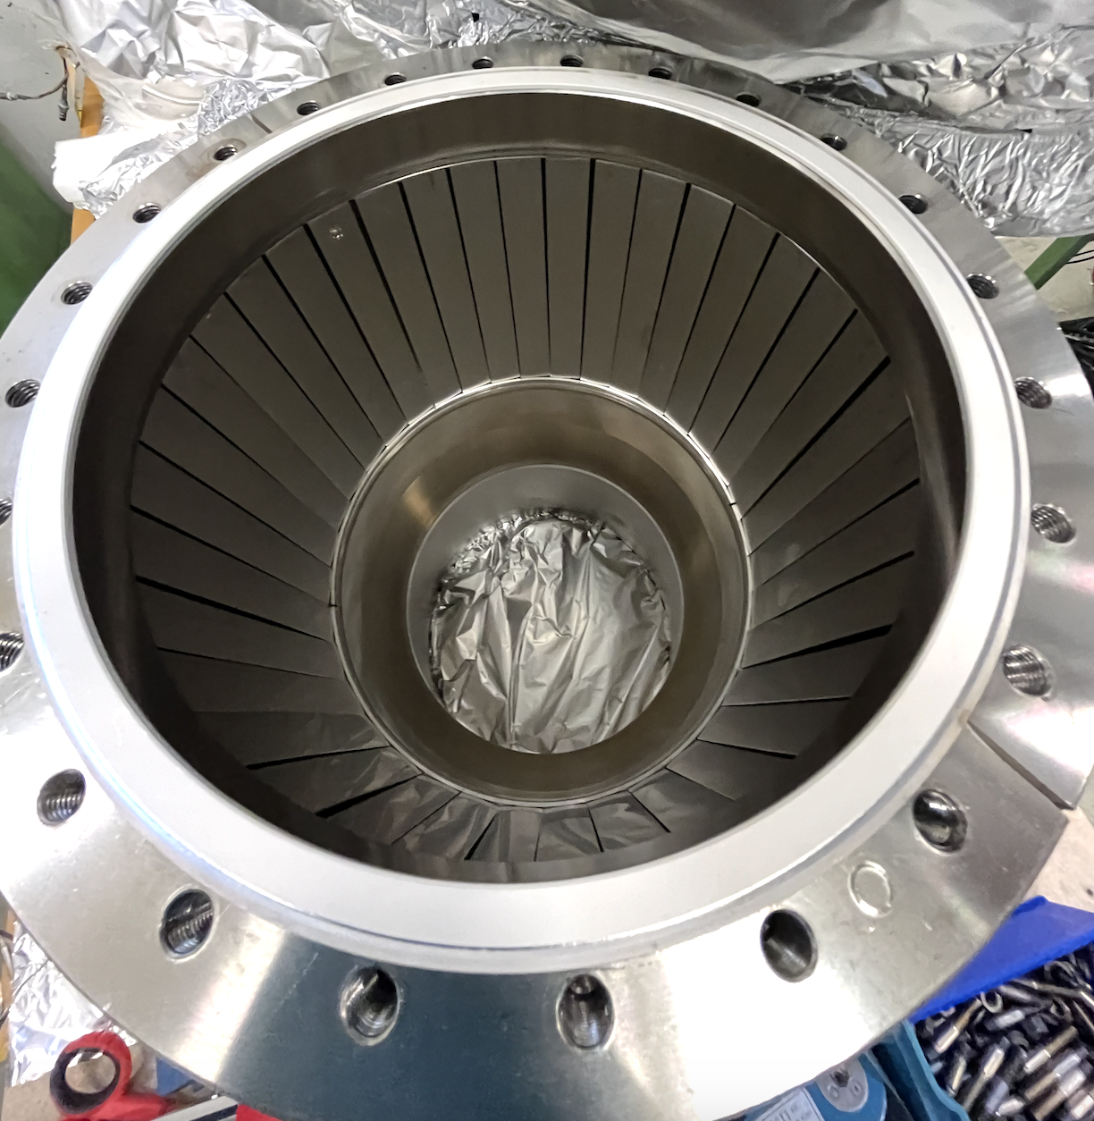
Postmortem of Russian gun design
J. Cenede
Russians had thought through about the thermal management very carefully !
Silver coated anode (thermal emissivity is about 10 times lower than that of ss
ceramic
cathode
Cooling water
on the outside of anode
chamber
Tantalum foils for radiative heat shield
inside hollow pierce electrode
Cathode is far from ceramic, large ceramic tube air side,
cathode inside chamber that has metal strips for thermal shield, cooling water behind
old AD e-cooler gun, NIM A, 1995, I. N. Meshkov

Slide 12
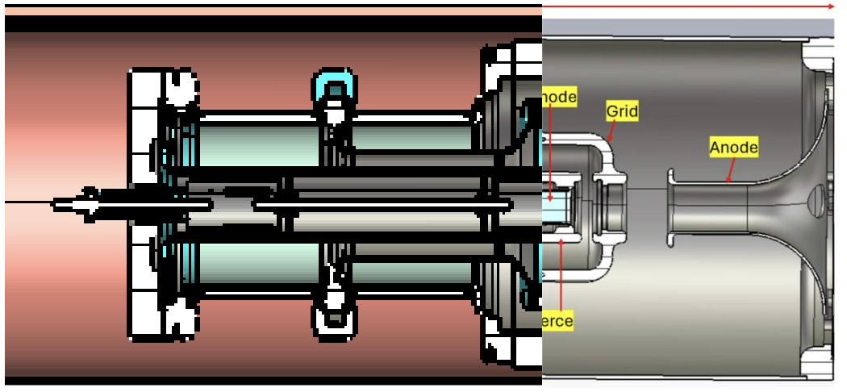
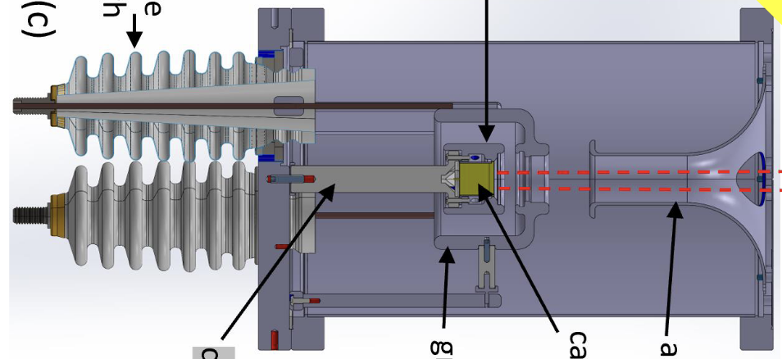
Russian + Gun v4 = Gun v5.2
Ceramic resistance tested
+
Final gun based on
known working solutions
(high confidence)
but of course, needs to be tested
Electrode shape (perveance) tested

Slide 13
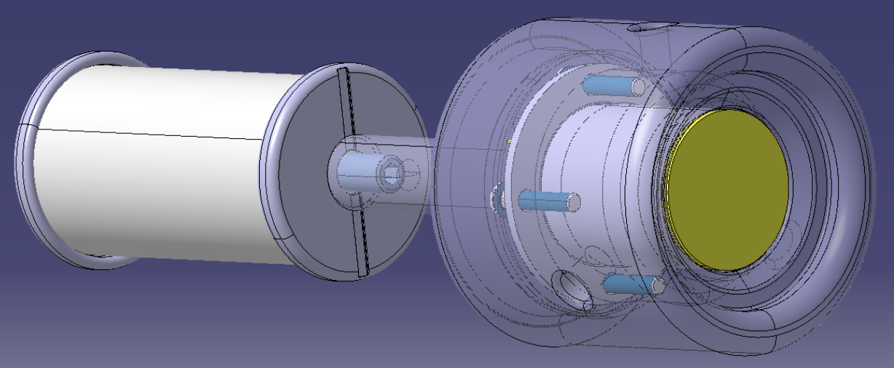
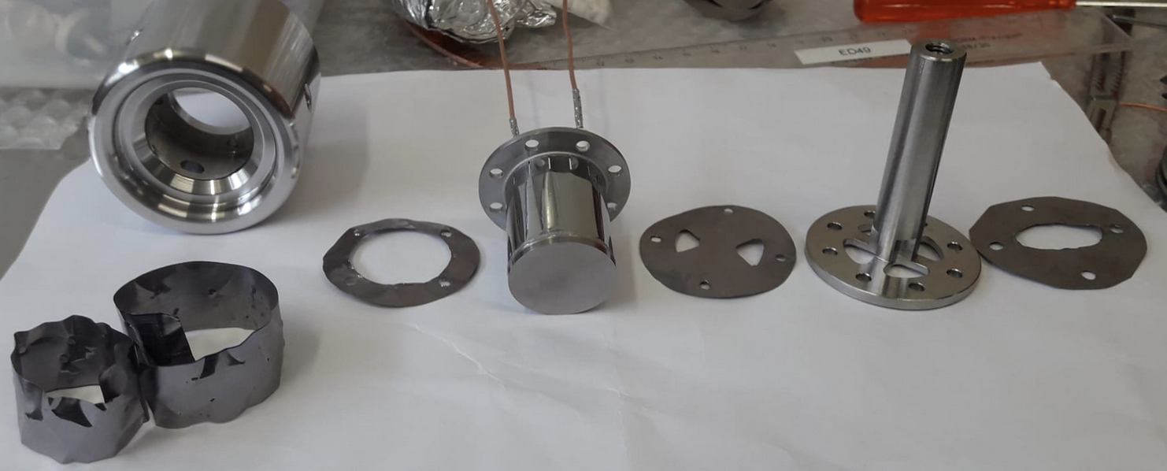
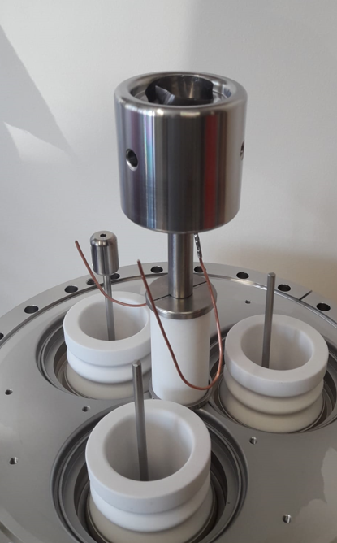
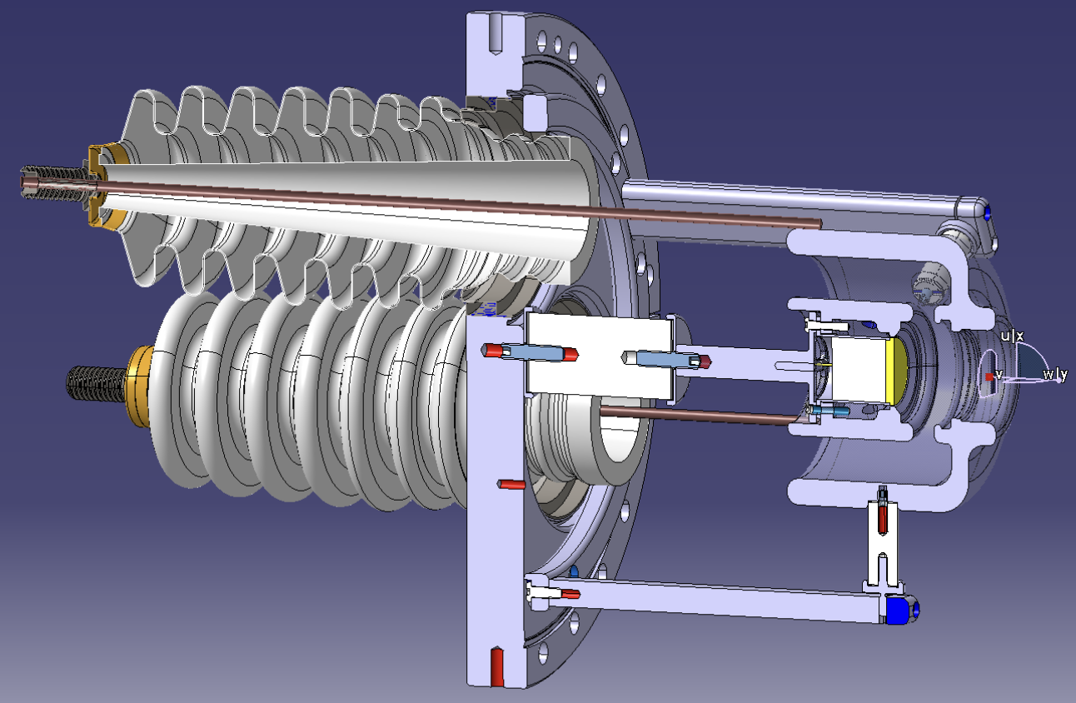
Quick fix (bricolage) in Gun v4 for further tests – Gun v4.2 was born
From the lessons learned + Russian gun inspiration: keep the ceramic temperature low by
    increase distance from cathode (12 cm => 6 cm)
    add tantalum shield around cathode

Slide 14
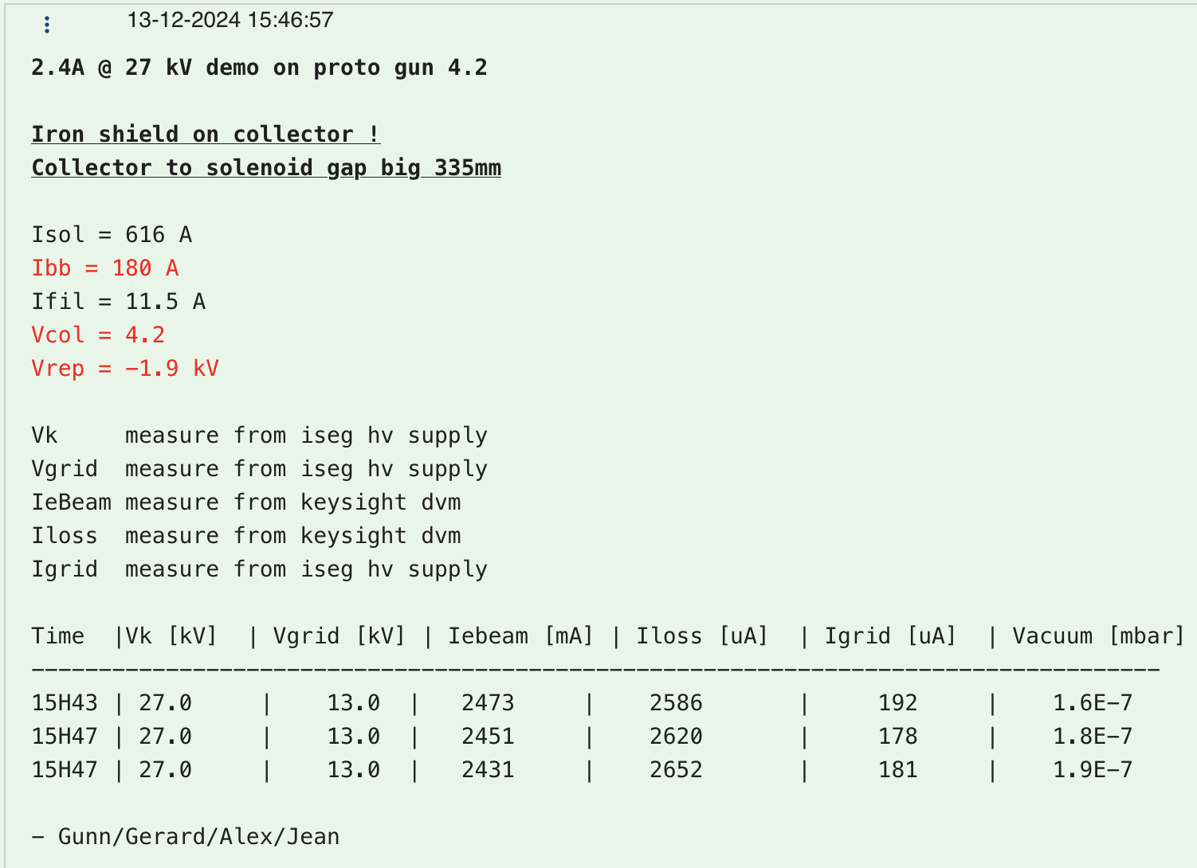
Gun v4.2.1 (Macor) results
 | 20 ℃ | 1000 ℃
Cathode to GND | > TOhm | 30 GOhm
GRID to GND | > TOhm | 7 GOhm
2.47 A @ 27 keV
But:
perveance 1.6 instead of 2.1
only for 5 minutes
E-loss = 2.5 mA
Vacuum 2E-7 mbar
Filament @ 950 ℃ (11.5 A)

Slide 15
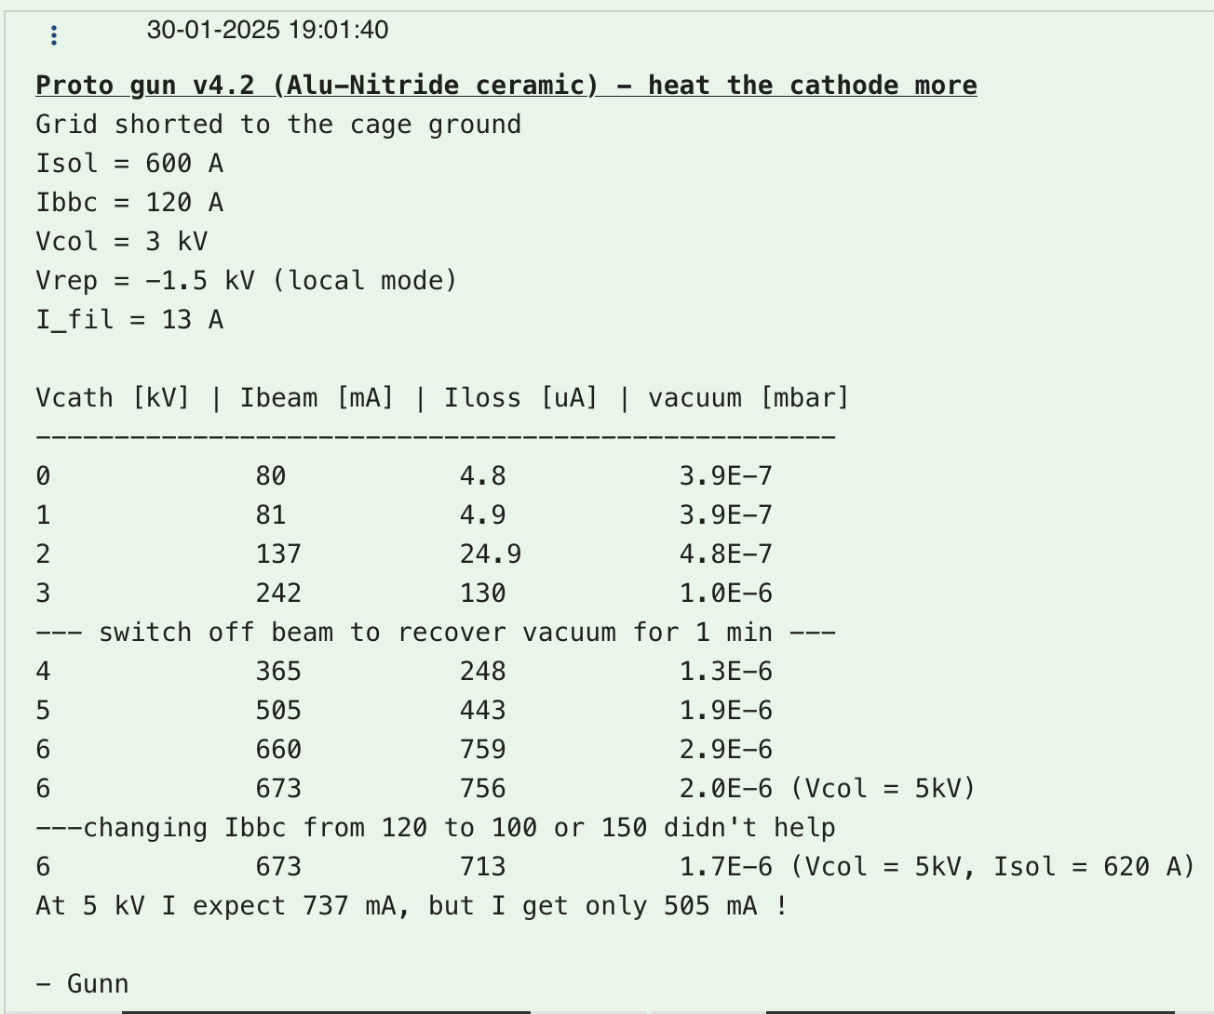
Gun v4.2.2 (Shapal) results
Logbook link
Many problems, was not clear:
Vacuum vented with Argon
Ion pump dead (only TMP)
Low perveance
Spark and could not reach 27 kV dry
Very bad vacuum (cathode supplier <1E-6 mbar)

Slide 16
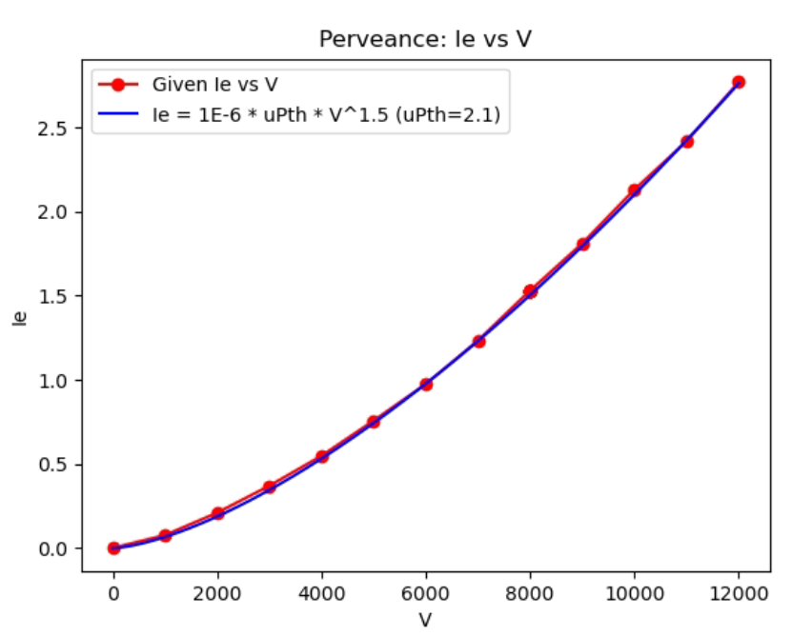
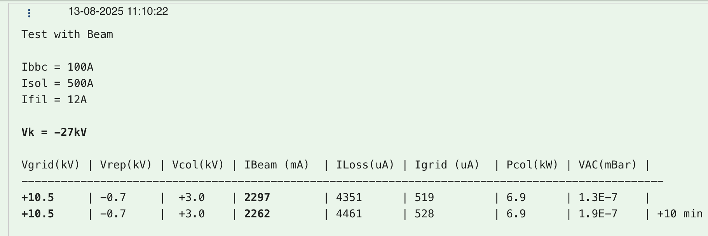
Gun v4.2.3 (Alumina) results
2.3 A @ 27 keV
perveance 2.1
Cathode @ 1000℃
But:
only for 10 minutes
E-loss = 4.3 mA
Vacuum 2E-7 mbar
Low perveance was just human error (Jean found it)
Credit: A. Frassier, J. Cenede

Slide 17
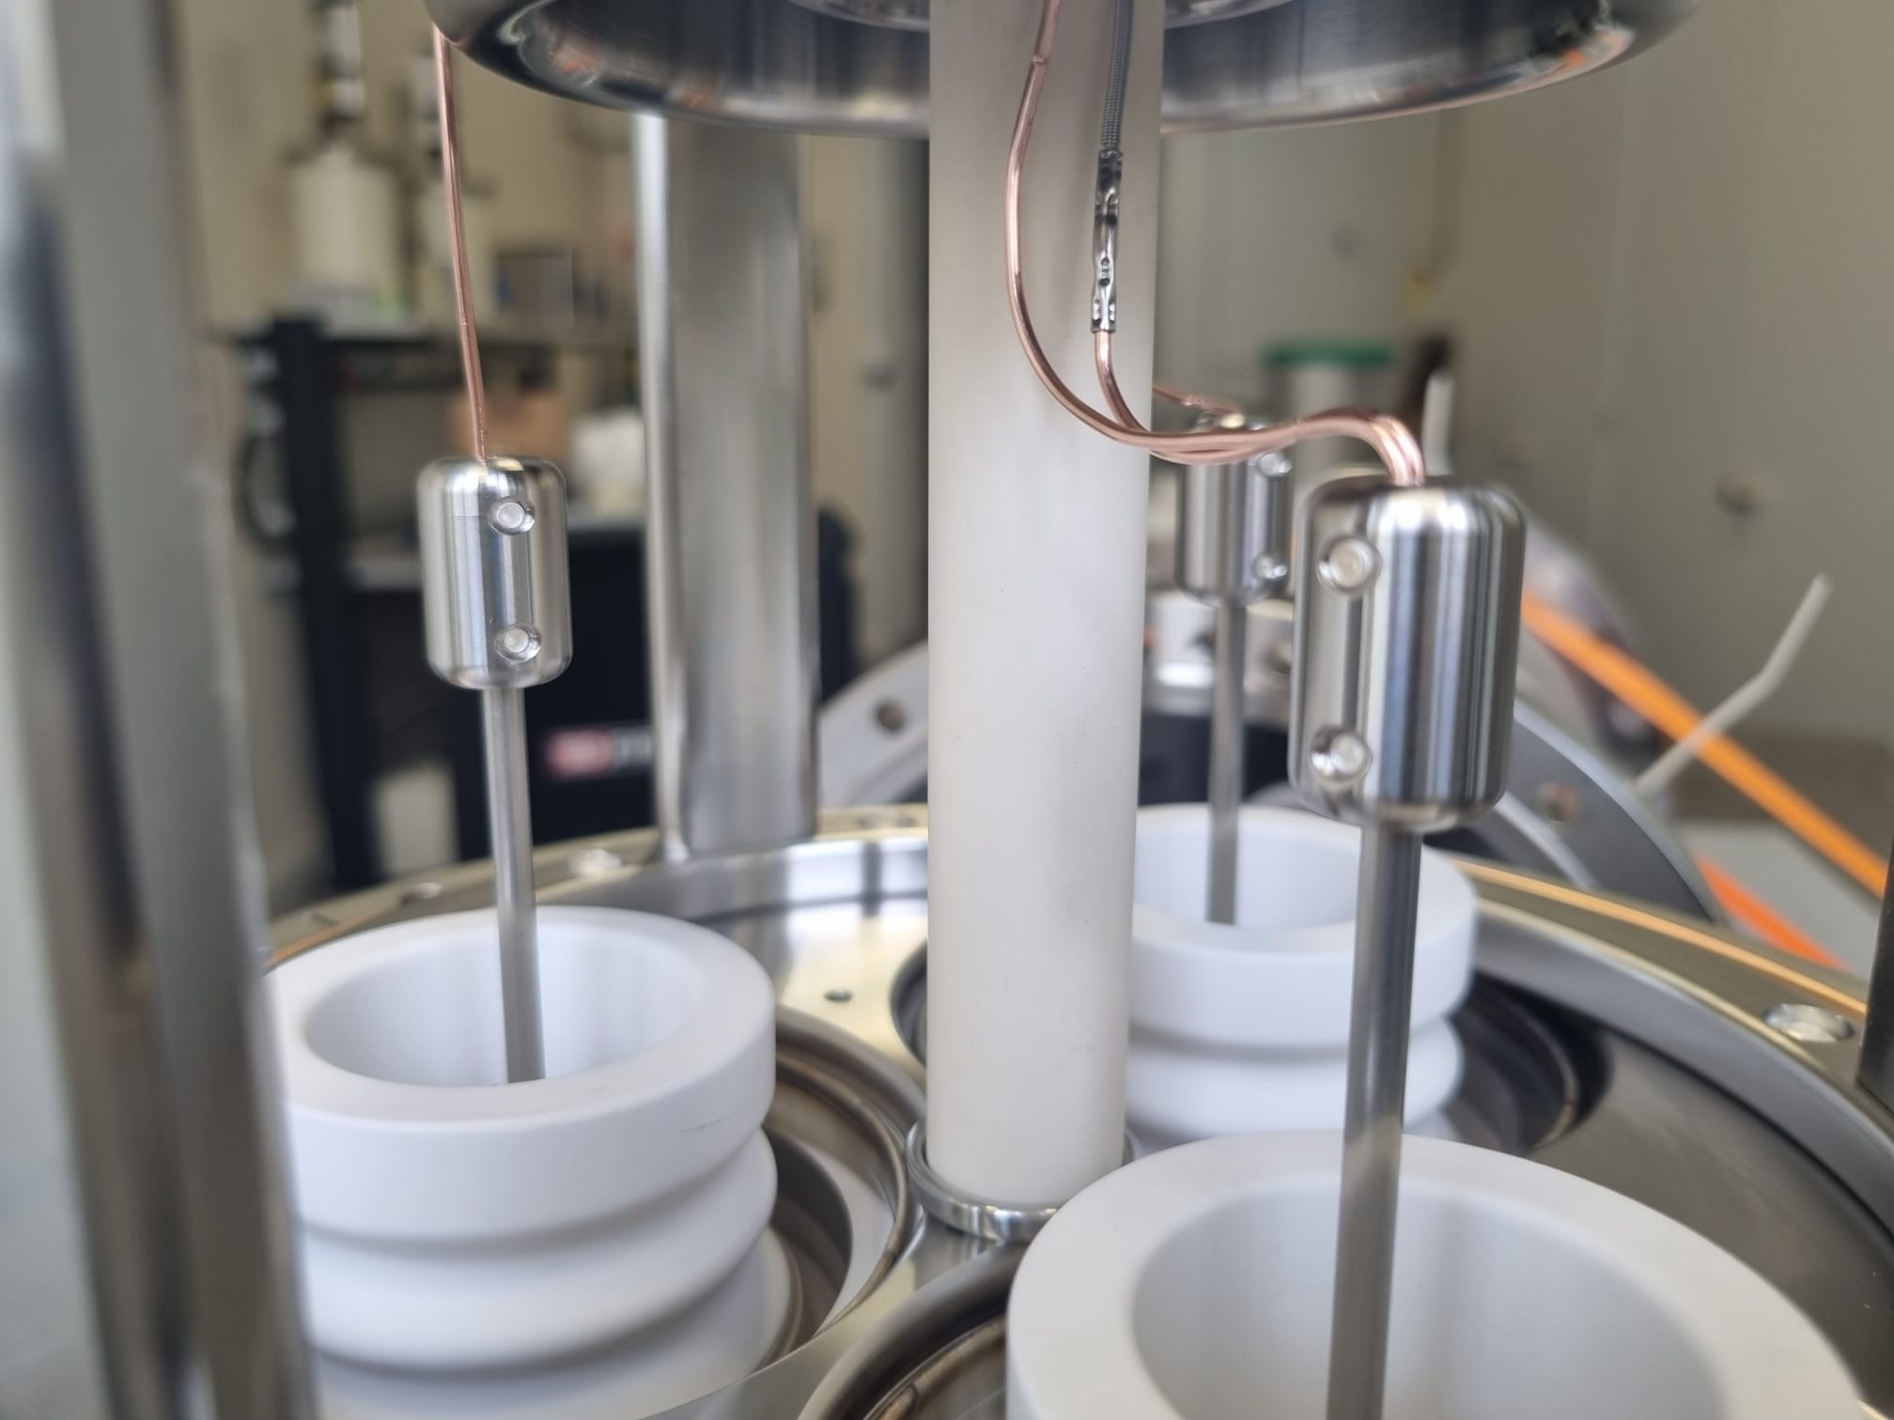
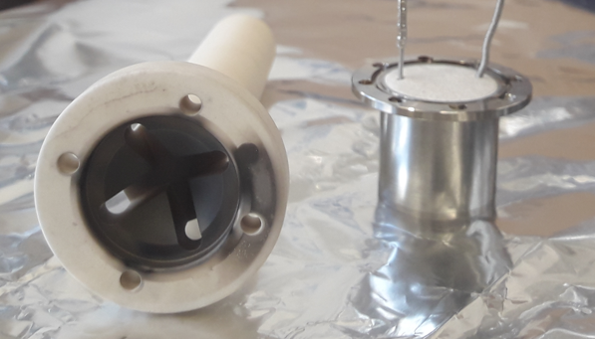
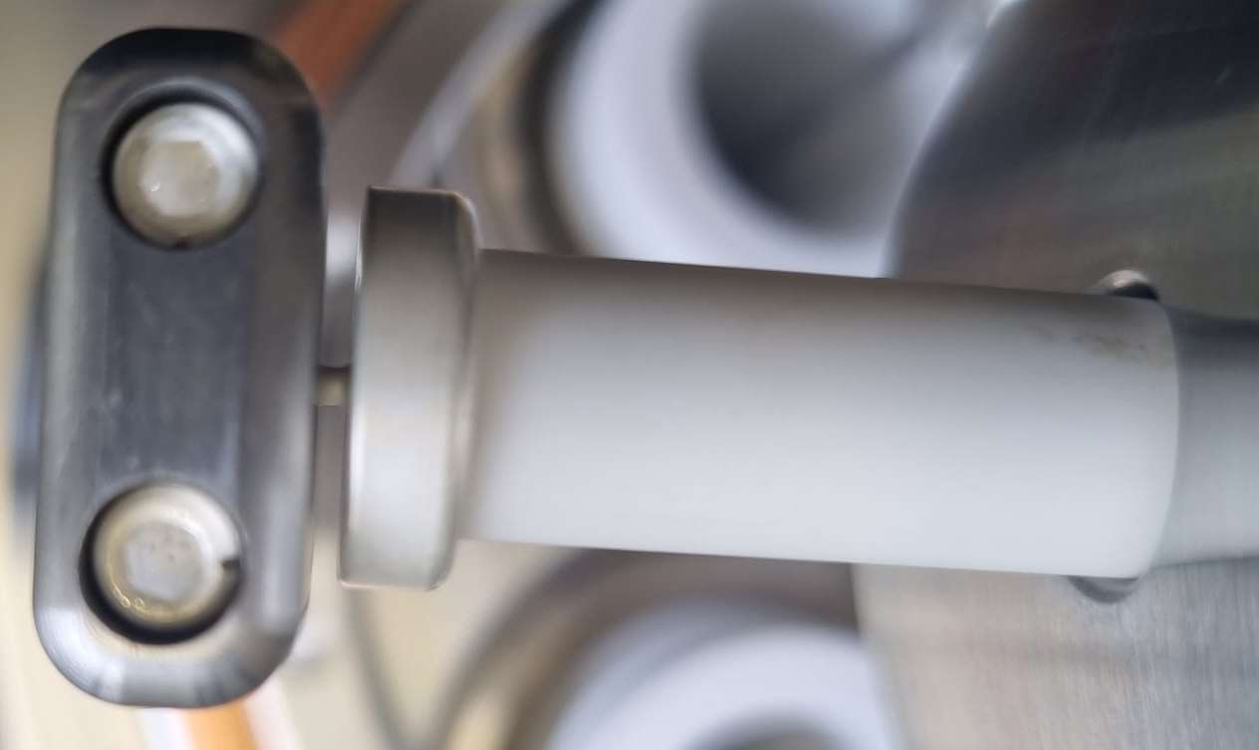
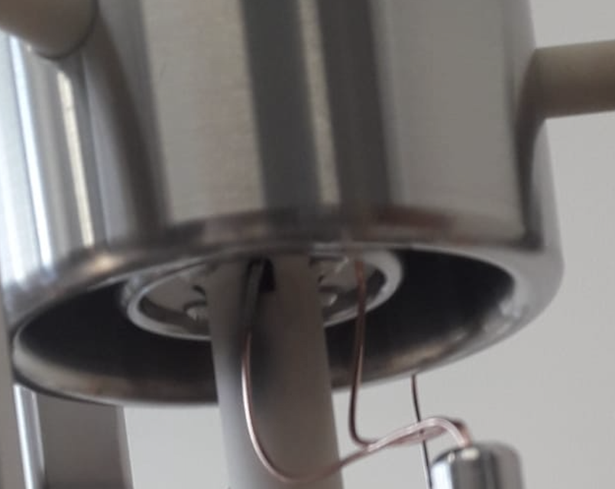
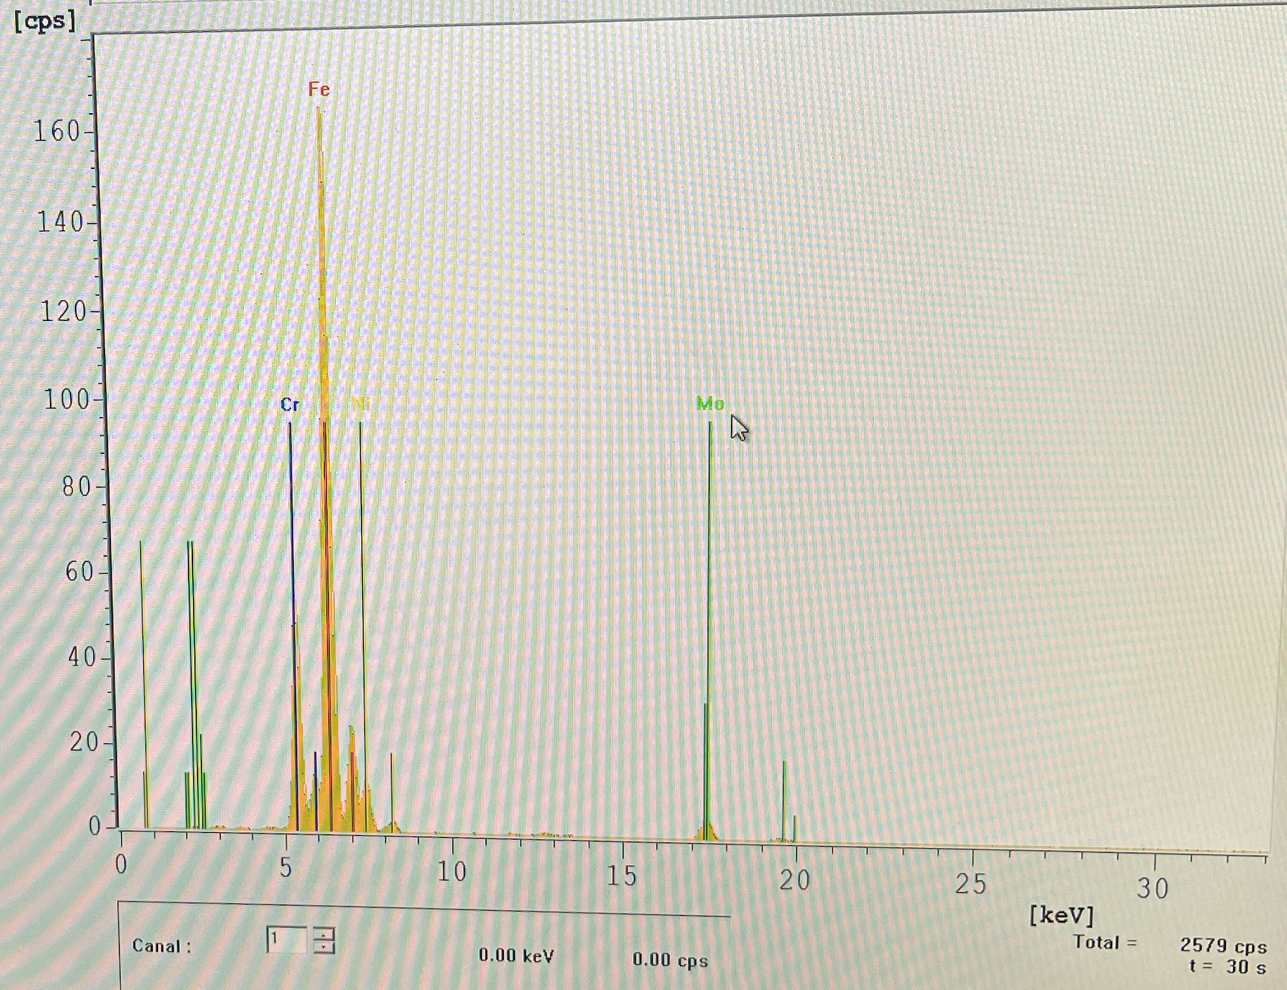
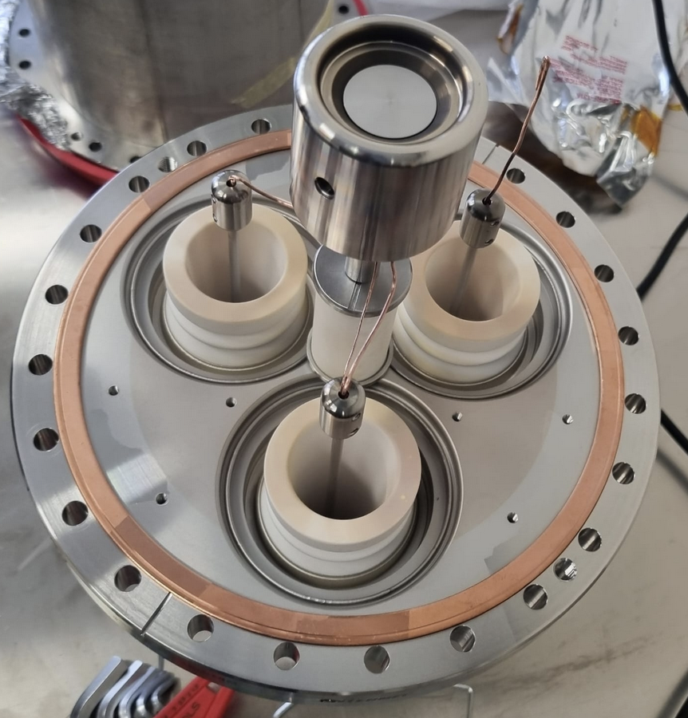
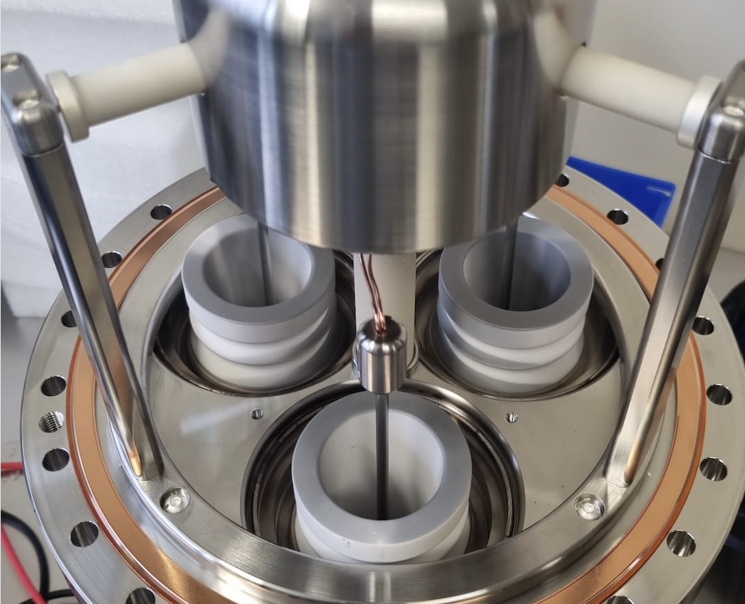
Other limitations of gun v4 (exposed ceramic)
Clean gun assembly before use.
Risk of contamination of ceramic when exposed directly to the ion path (sputtering)
Overheating of cathode caused Molybdenum evaporation
(17 A instead of 12 A)
Mechanical alignment not guaranteed in this design (said by EN-MME)
Pink residue possibly due to copper wire evaporation
Molybdenum (Mo)
Resistance at room temperature reduced from Tohm to 200 Gohm.
Never recovered even after cleaning !
Stainless steel
Image courtesy: Marc Thiebert (TE-VSC)

Slide 18
Results summary
Gun v | 27 keV | 2.4 A | e-loss <300 uA | 24h tested in DC | cathode @ 1000 C | B = 2400 Gauss | Perveance >2.1
4 | - | - | - | - | yes | - | yes
4.2.1 | yes | yes | - | - | - | - | -
4.2.2 | - | - | - | - | - | - | -
4.2.3 | yes | yes | - | - | yes | - | yes
Yes, the proto gun has demonstrated energy, intensity and perveance.
But to put in the machine, needs “yes” in every column !
Oh and the vacuum should be 1E-10 mbar at least for AD
(outgassing and ESD + SEY)
Note: e-loss = real e-beam loss + current in ceramic + current in collector water pipe

Slide 19
Conclusion
Being a new design (high perveance, high B-field, expansion), R&D was needed
The v4.2 gun is not ready for installation but can work if proved all the requirements
Proposed gun v5 has high confidence of working in new AD E-Cooler
Thank you, Alex, Jean, Gerard and Adriana for the collaboration
Special thanks to Jean for excellent work and his in-detail expertise for electron guns.

Slide 20
EXTRA slides

Slide 21
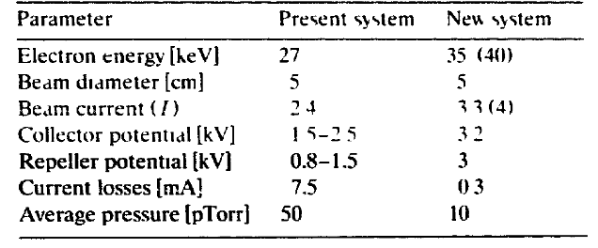
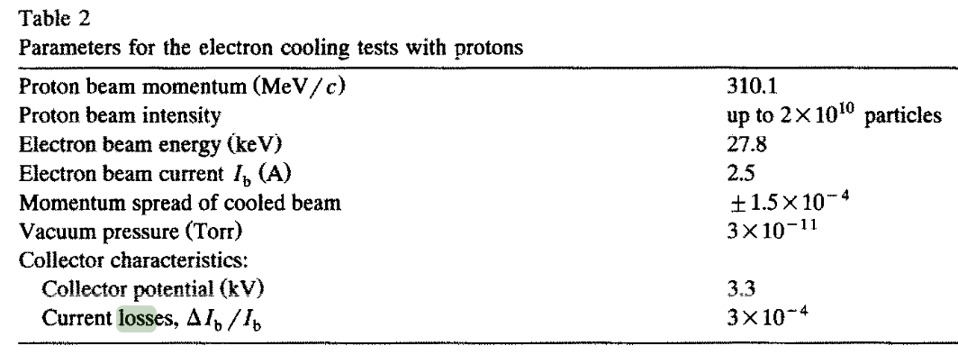
Links
Draft report on proto gun test results: EDMS 3225048
Gun/Collector specifications: EDMS 3077160
CST simulations of mechanical tolerances vs beam quality: Indico ECTS 6 March 2025
Old gun paper: old AD e-cooler gun, NIM A, 1995, I. N. Meshkov
Old collector paper: old AD collector, NIM A, 1992, J. Bosser

Slide 22
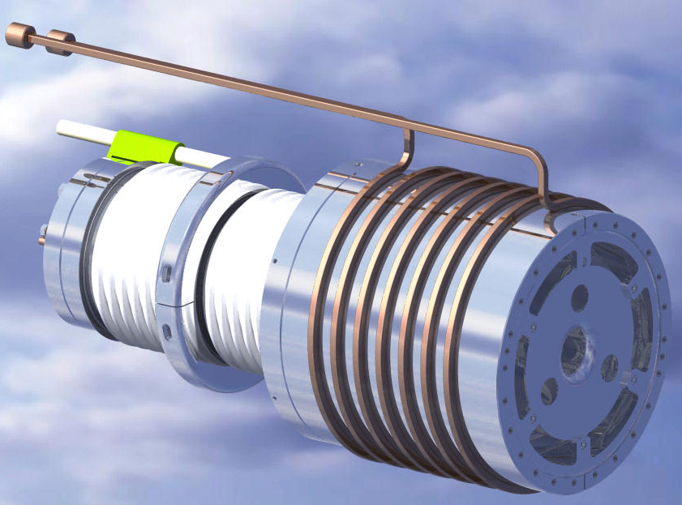
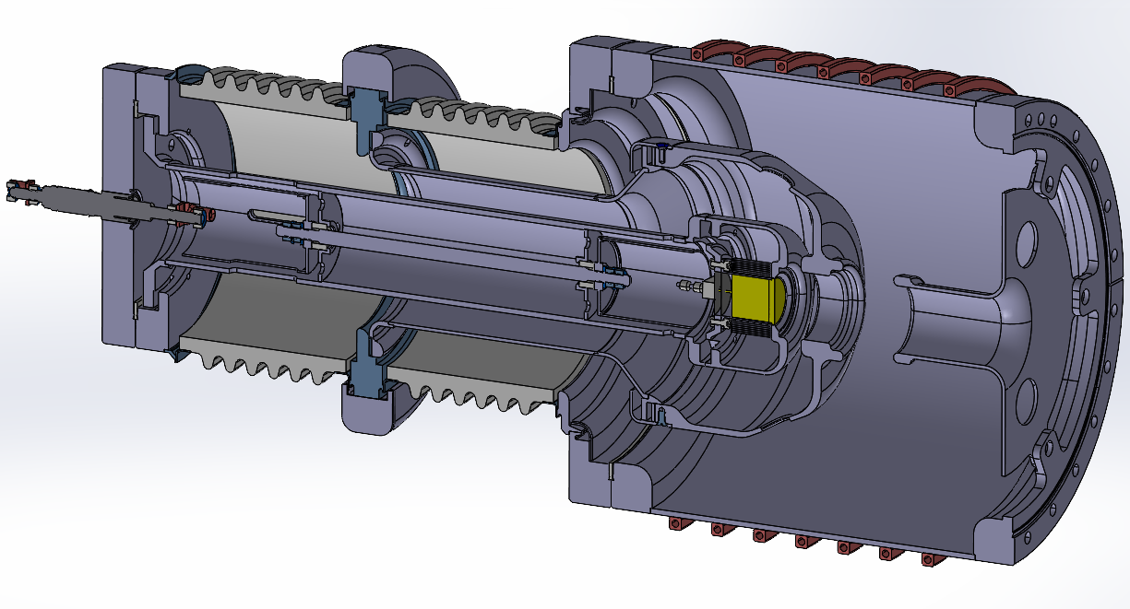
Gun v5.2 vs Russian gun
(a)
(b)
present AD gun
(Russian design)
HV insulation
ceramics
U_{grid}
vacuum chamber
with cooling water
on the exterior
cathode
Tantalum
foils
grid
Wehnelt
anode
U_{cath}
(d)
gun v5
(c)
design by J. Cenede

Slide 23

Thermo mechanical sim by EN-MME
See indico meeting

