Slide 1
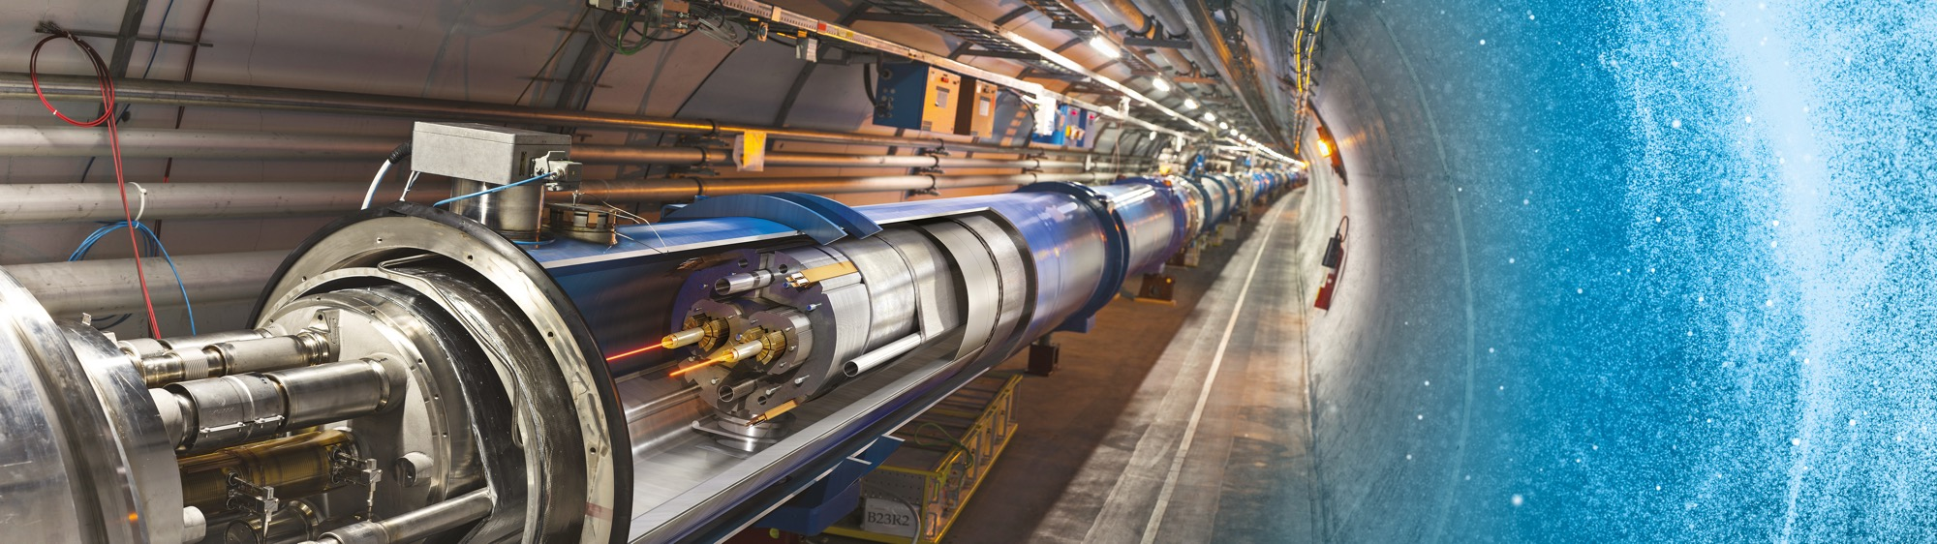
Upcoming Tenders at CERN
Industry Webinar
Jessica Stearns Metcalfe
IPT-PI 27 November 2025

Slide 2
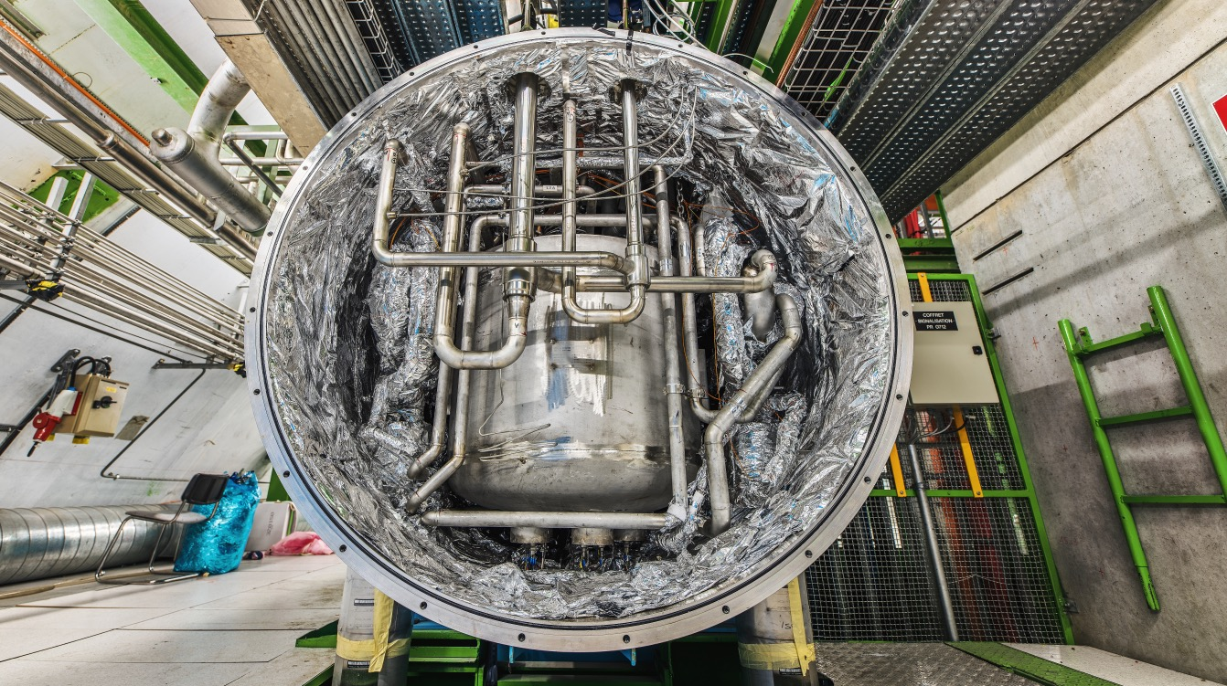
Cooling & Ventilation,
Cryogenics

Slide 3
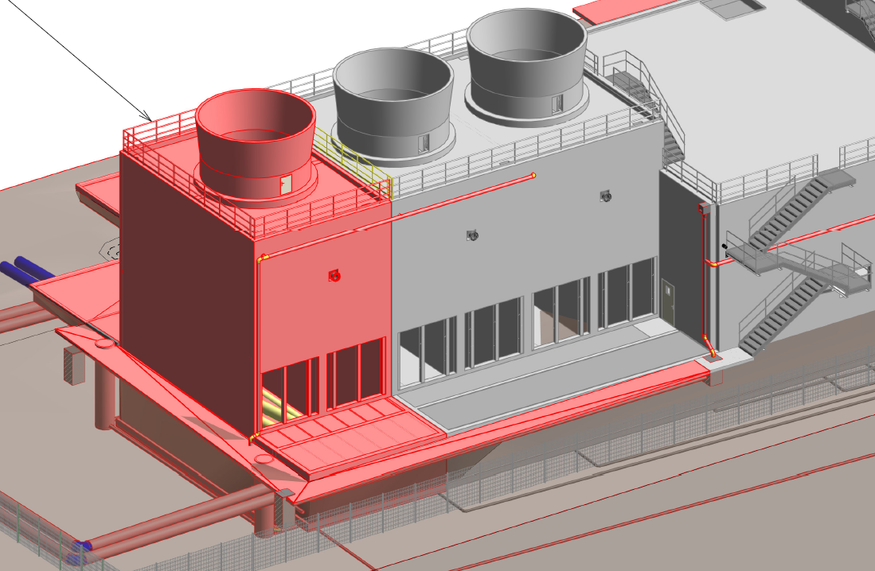
NA-CONS: CT2 cooling upgrade and consolidation
Description & Specific Condition :
Design, supply, installation, testing and commissioning of the 5th cooling tower cell in CT2.
To meet the requirements of the additional load required by the new users that will be installed as part of the NA-CONS project, a 5th cooling tower cell will be added to CT2. This Invitation to Tender will cover the equipment to be installed in the cell, as well as consolidation works to the pumping station.
Start of the Contract: Q2 2027
Procurement Code: 01 03 03 00
Cost Range : 400k - 1.5M CHF
Planning: MS: Q4 2026
IT: Q1 2027
Contact: laurentiu.vlasceanu@cern.ch
Notes:
In Prevessin – part of the North Area consolidation project.

Slide 4
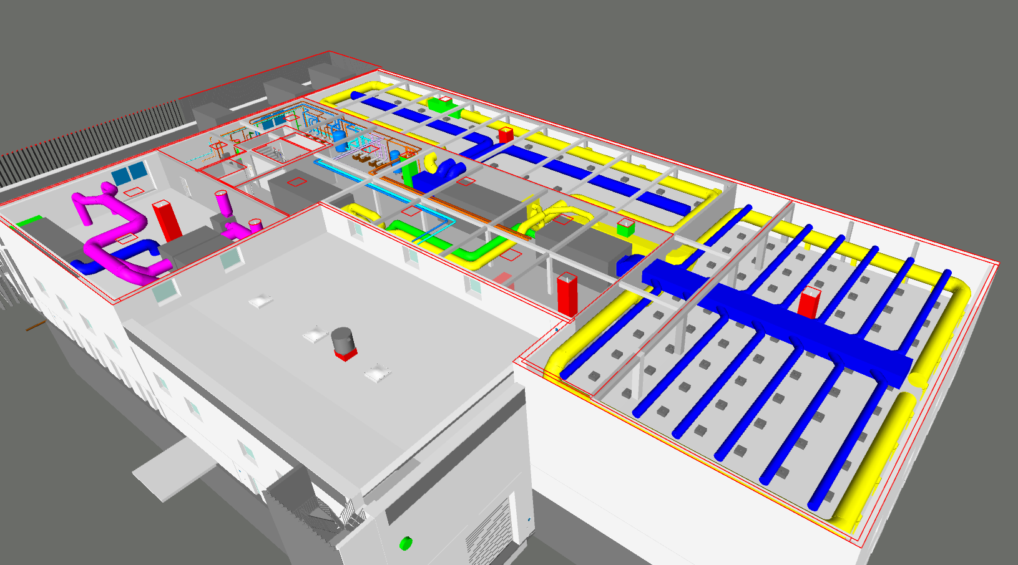
SRF/SA18 Cooling and ventilation systems (MS-5136)
Description & Specific Condition :
Design, supply, installation, test and commissioning of all the HVAC systems and the air treatment system in the new building SA18 at Point 1.8 of the LHC.
Key conditions:
Experience in the installation of HVAC systems of similar size and complexity.
Experience in the installation of air treatment systems with wet scrubbers.
Experience in the execution of similar projects in accordance with applicable regulations.
Start of the Contract: Q2 2026
Procurement Code: 01 03 00 00
Cost Range : 5 MCHF ⬄ 10 MCHF
Planning: MS: Q1 2026
IT: Q1 2026
Contact: theodoros.aivaliotis@cern.ch

Slide 5
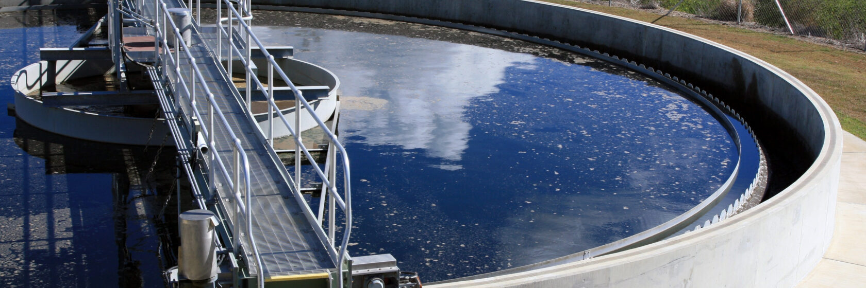
SA18 Wastewater treatment plant (MS-5135)
Description & Specific Condition :
Manufacture, delivery and installation of one wastewater treatment plant based on concentration of waste by vacuum distillation.
The plant will comprise one vacuum distillation unit with capacity up to 6 m3 per day and capable of processing water based acidic effluents arriving from the nearby surface treatment workshop and scrubbers. The plant shall have its own control system interlocked with the surface treatment workshop.
Start of the Contract: Q1 2027
Procurement Code: 09 02 02 01 (Chemical decontamination equipment)
Cost Range : 400k - 1.5M CHF
Planning: MS: Q1 2026
IT: Q3 2026
Contact: Leonel.ferreira@cern.ch
Notes:
Ellie
Part of SA18? New RF Facility?

Slide 6
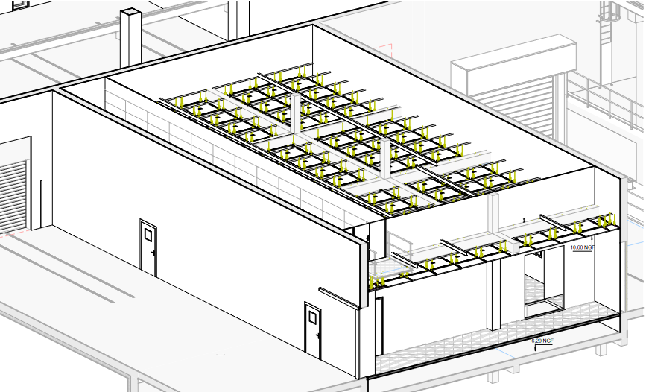
SRF/SA18 Cleanrooms construction (MS-5136/EN)
Description & Specific Condition :
Supply of the HVAC systems, Low Voltage (LV) installation, lighting installation, safety systems, process fluids and IT network installation of the cleanrooms.
Key conditions:
Experience in the construction of laminar flow ISO Class 4 cleanrooms and mixed flow ISO 8 cleanrooms of similar size and complexity.
Experience in the execution of similar projects in accordance with the applicable regulations.
Start of the Contract: Q3 2026
Procurement Code: 01 03 00 00
Cost Range : 5 MCHF ⬄ 10 MCHF
Planning: MS: Q1 2026
IT: Q1 2026
Contact: theodoros.aivaliotis@cern.ch

Slide 7
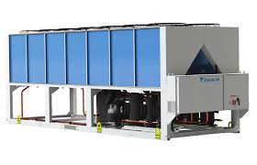
SRF/SA18 Natural refrigerant heat pumps/chillers
Description & Specific Condition :
Supply of the Air Source Heat Pumps (ASHPs), which will generate heating and cooling water for the new building SA18 at Point 1.8 of the LHC.
Key conditions:
Experience in the supply of units of similar cooling and heating capacities.
Utilisation of a natural refrigerant with very low GWP.
Energy performance validated in accordance to EN14511.
Start of the Contract: Q3 2026
Procurement Code: 01 03 01 03
Cost Range : 400k - 1.5M CHF
Planning: MS: Q1 2026
IT: Q1 2026
Contact: theodoros.aivaliotis@cern.ch
Notes:
Floris ?

Slide 8
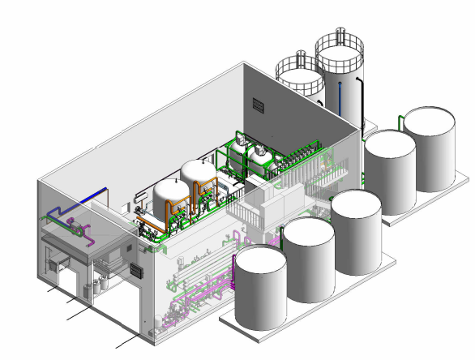
Water treatment plant in point 1
Description & Specific Condition :
Design, supply, installation, test and commissioning of a water treatment plant including :
Filtration: multimedia filters, ultrafiltration.
Softeners.
Reverse osmosis.
Tanks and piping.
Power and control cubicles.
Cost Range : 1.5 MCHF ⬄ 5 MCHF
Planning: MS: Q1 2027 IT: Q3 2027
Contact: serge.deleval@cern.ch
8

Slide 9
UHV all metal angle valves (MS-5128)
Description & Specific Condition :
Supply of UHV all metal angle valves, including compatibility, spare parts and repairs on existing equipment including:
Compatibility, spare parts and repairs on existing equipment;
Special valves according to specifications, i.e. special flanges, asymmetric valve bodies, improved actuations may be required;
All metal angle valves shall guaranty extreme reliability and durability (several decades with only minor and basic on-site preventive maintenance).
Cost Range : 400k - 1.5M CHF
Planning: MS: Q1 2026 IT: Q1 2026
Contact: ja.ferreira@cern.ch @cern.ch
9
Notes:
UHV: ultra-high vacuum
Just the supply

Slide 10
UHV all metal gate valves (MS-5132)
Description & Specific Condition :
Supply of UHV all metal gate valves with and without RF contacts including compatibility, spare parts and repairs on existing equipment including:
Compatibility, spare parts and repairs on existing equipment;
Special executions according to specifications, i.e. flanges, a-symmetric valve bodies and improved actuations;
The valves shall have an extreme reliability and durability and their functionality guaranteed for several decades with only minor and basic on-site preventive maintenance possibilities;
The Contract will include the refurbishment of existing radioactive all metal gate valves with and without RF shielding at the Contractor's premises.
Cost Range : 400k - 1.5M CHF
Planning: MS: Q1 2026 IT: Q1 2026
Contact: ja.ferreira@cern.ch @cern.ch
10
Notes:
UHV: ultra high vacuum
Just the supply

Slide 11
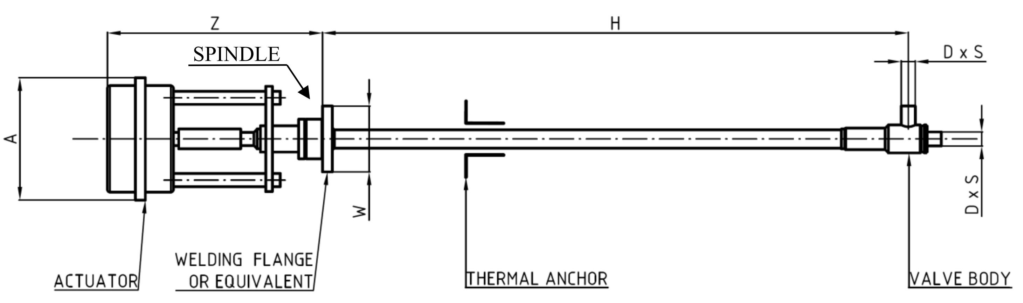
Cryogenic Valves (MS-5125/TE/HL-LHC)
Procurement Code: 06 02 03 04 (Cryogenic valves)
Cost Range : 750k – 1500k CHF
Planning: MS : already dispatched (Q4 2025)
IT: January 2026
Contract start: Q1 2026
Scope:
Approximately 300 bellows-sealed cryogenic control valves
Ranging from DN4 to DN125
Featuring high rangeability characteristics for operation with helium at temperatures from 1.8 K to 300 K and pressures from 0.01 bar(a) to 25 bar(a)
Eligible Firm Profile
Interested firms shall have competence and experience in the design, manufacturing, assembly and test of cryogenic control valves; specifically for bellows-sealed cryogenic control valves with orifice sizes from DN4 to DN125, suitable for operation with helium at temperatures from 1.8 K to 300 K and pressures from 0.01 bar(a) to 25 bar(a), and equipped with control flow plugs with equal-percentage characteristics and a rangeability of at least 1:100
Contact: Olivier.Pirotte@cern.ch
Notes:
Fully funded by CERN
MS is currently published
DN is the size of the pipe
Bar(a) = absolute bar
300 K = is ambient temperature

Slide 12
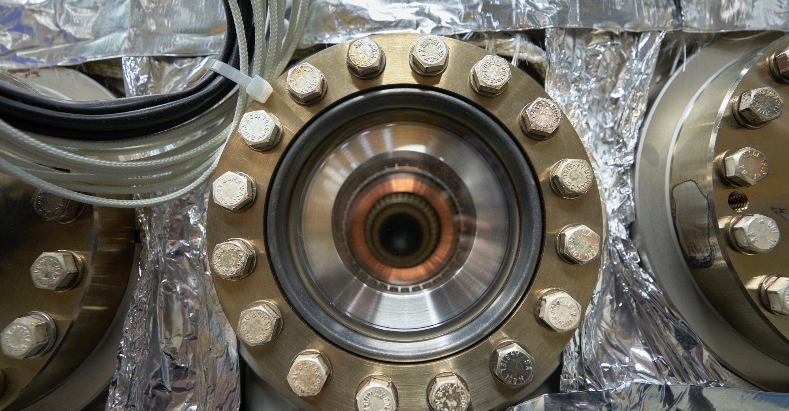
Electrical Engineering, Magnets

Slide 13
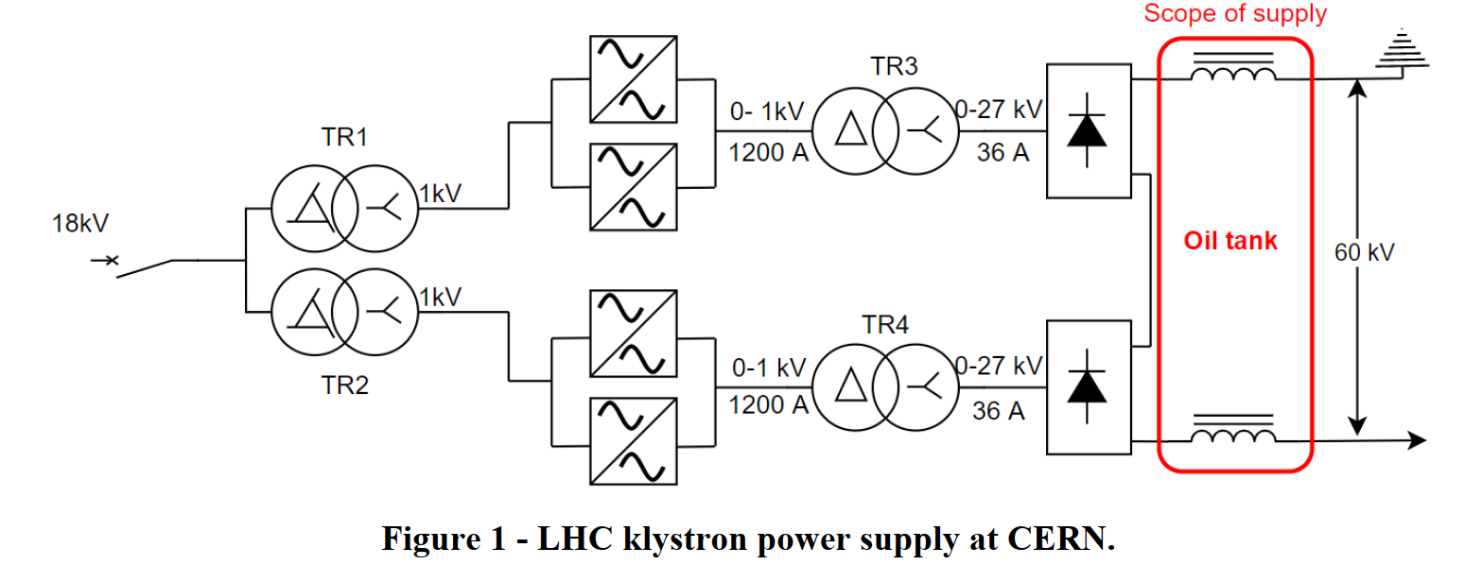
Supply of oil-tanks for oil-immersed high voltage
filter chokes (MS-5106/EN)
Description & Specific Condition :
Supply of six high voltage oil tanks for oil-immersed filter chokes.
Main characteristics of the oil-tanks:
• Construction: welded with a bolted lid;
• Cooling method: Oil-Natural, Air-Natural (ONAN);
• Expected power losses: less than 15kW;
• Permanent operation and storage in outdoor conditions (-25 °C to + 45 °C);
• Oil type: Mineral oil;
• Approximate dimensions (L x W x H, mm): 2000 x 1400 x 1500 (without conservator and radiators);
• Minimum equipment: bare tank / radiators / conservator.
The Supply shall be delivered to CERN within five months of notification of the Contract by CERN.
Procurement Code: 02010500 - Special transformer
Cost Range : 400k - 1.5M CHF
Planning: MS: published IT: Q1 2026
Contact: stephane.joffe@cern.ch
Notes:
Anthony

Slide 14
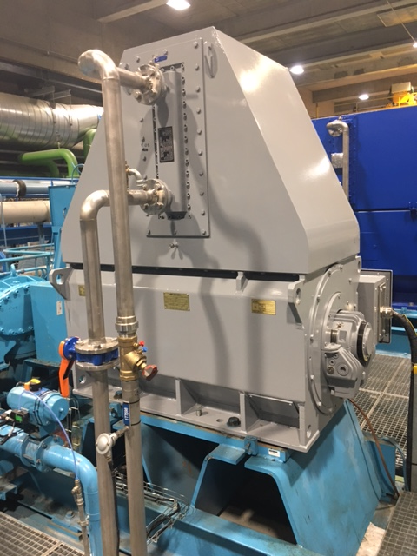
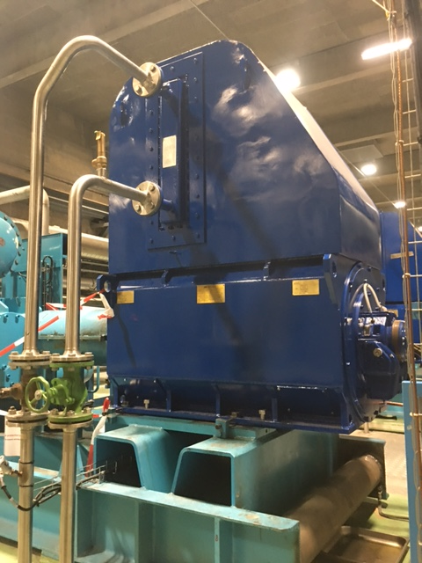
Electrical motor overhaul (DO-34739/TE/CRG)
Procurement Code: 02 09 01 00 (Alternating current motors)
Cost Range : 200k – 400k CHF
Planning: DO : Q4 2025
Contract start: Q1 2026
Scope:
Overhaul of 75 low-voltage (400 V) and 70 medium-voltage (3.3 kV) electrical motors
In accordance with IEC 60034 standards.
Eligible Firm Profile
Interested firms shall have proven experience and competence in overhauling in accordance with IEC 60034 standards. They shall be equipped with proper electrical testing tools and benches, a painting facility, an oven, a balancing system, etc.
Contact: Nicolas.Bonetti@cern.ch
Notes:
Alvaro
Motors for compressors – these will be shipped to the contractor who will do the overhaul and ship back to CERN.

Slide 15
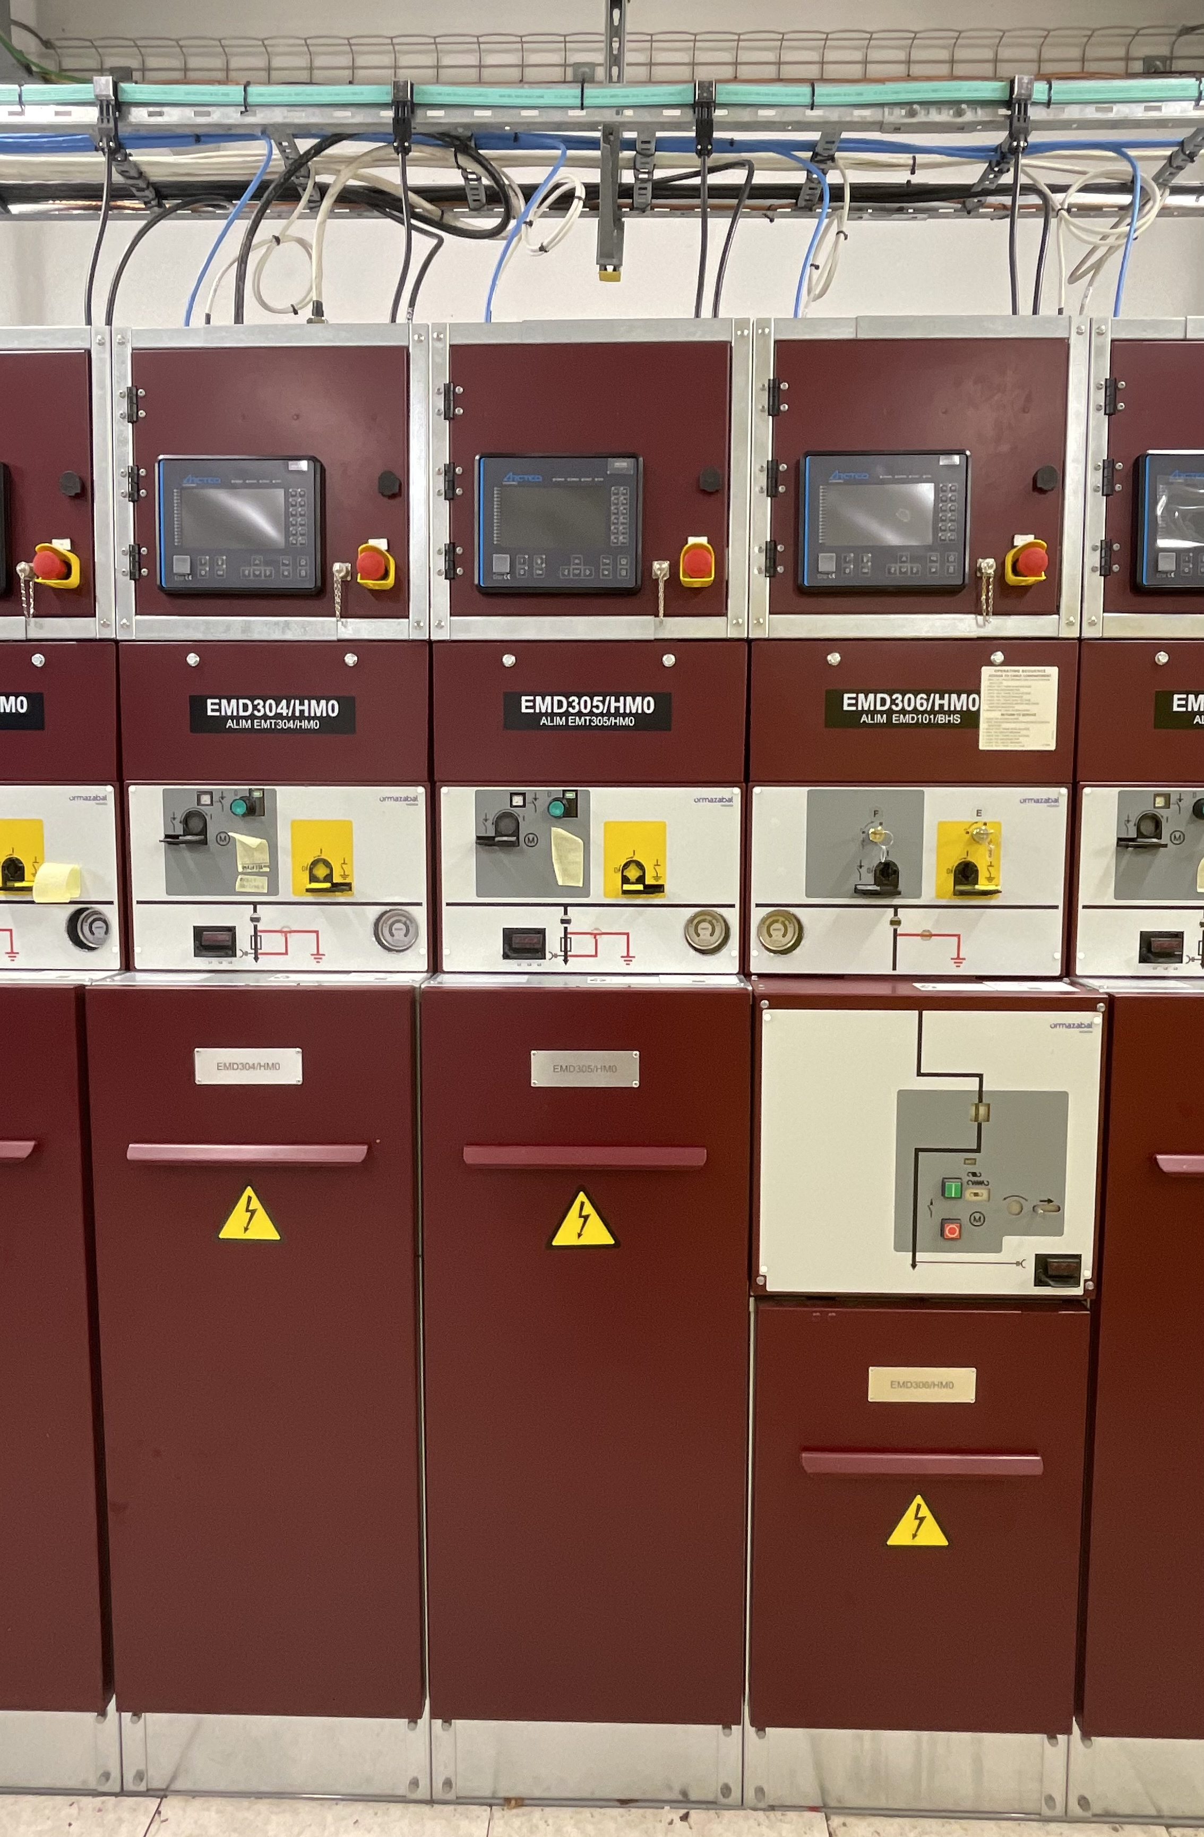
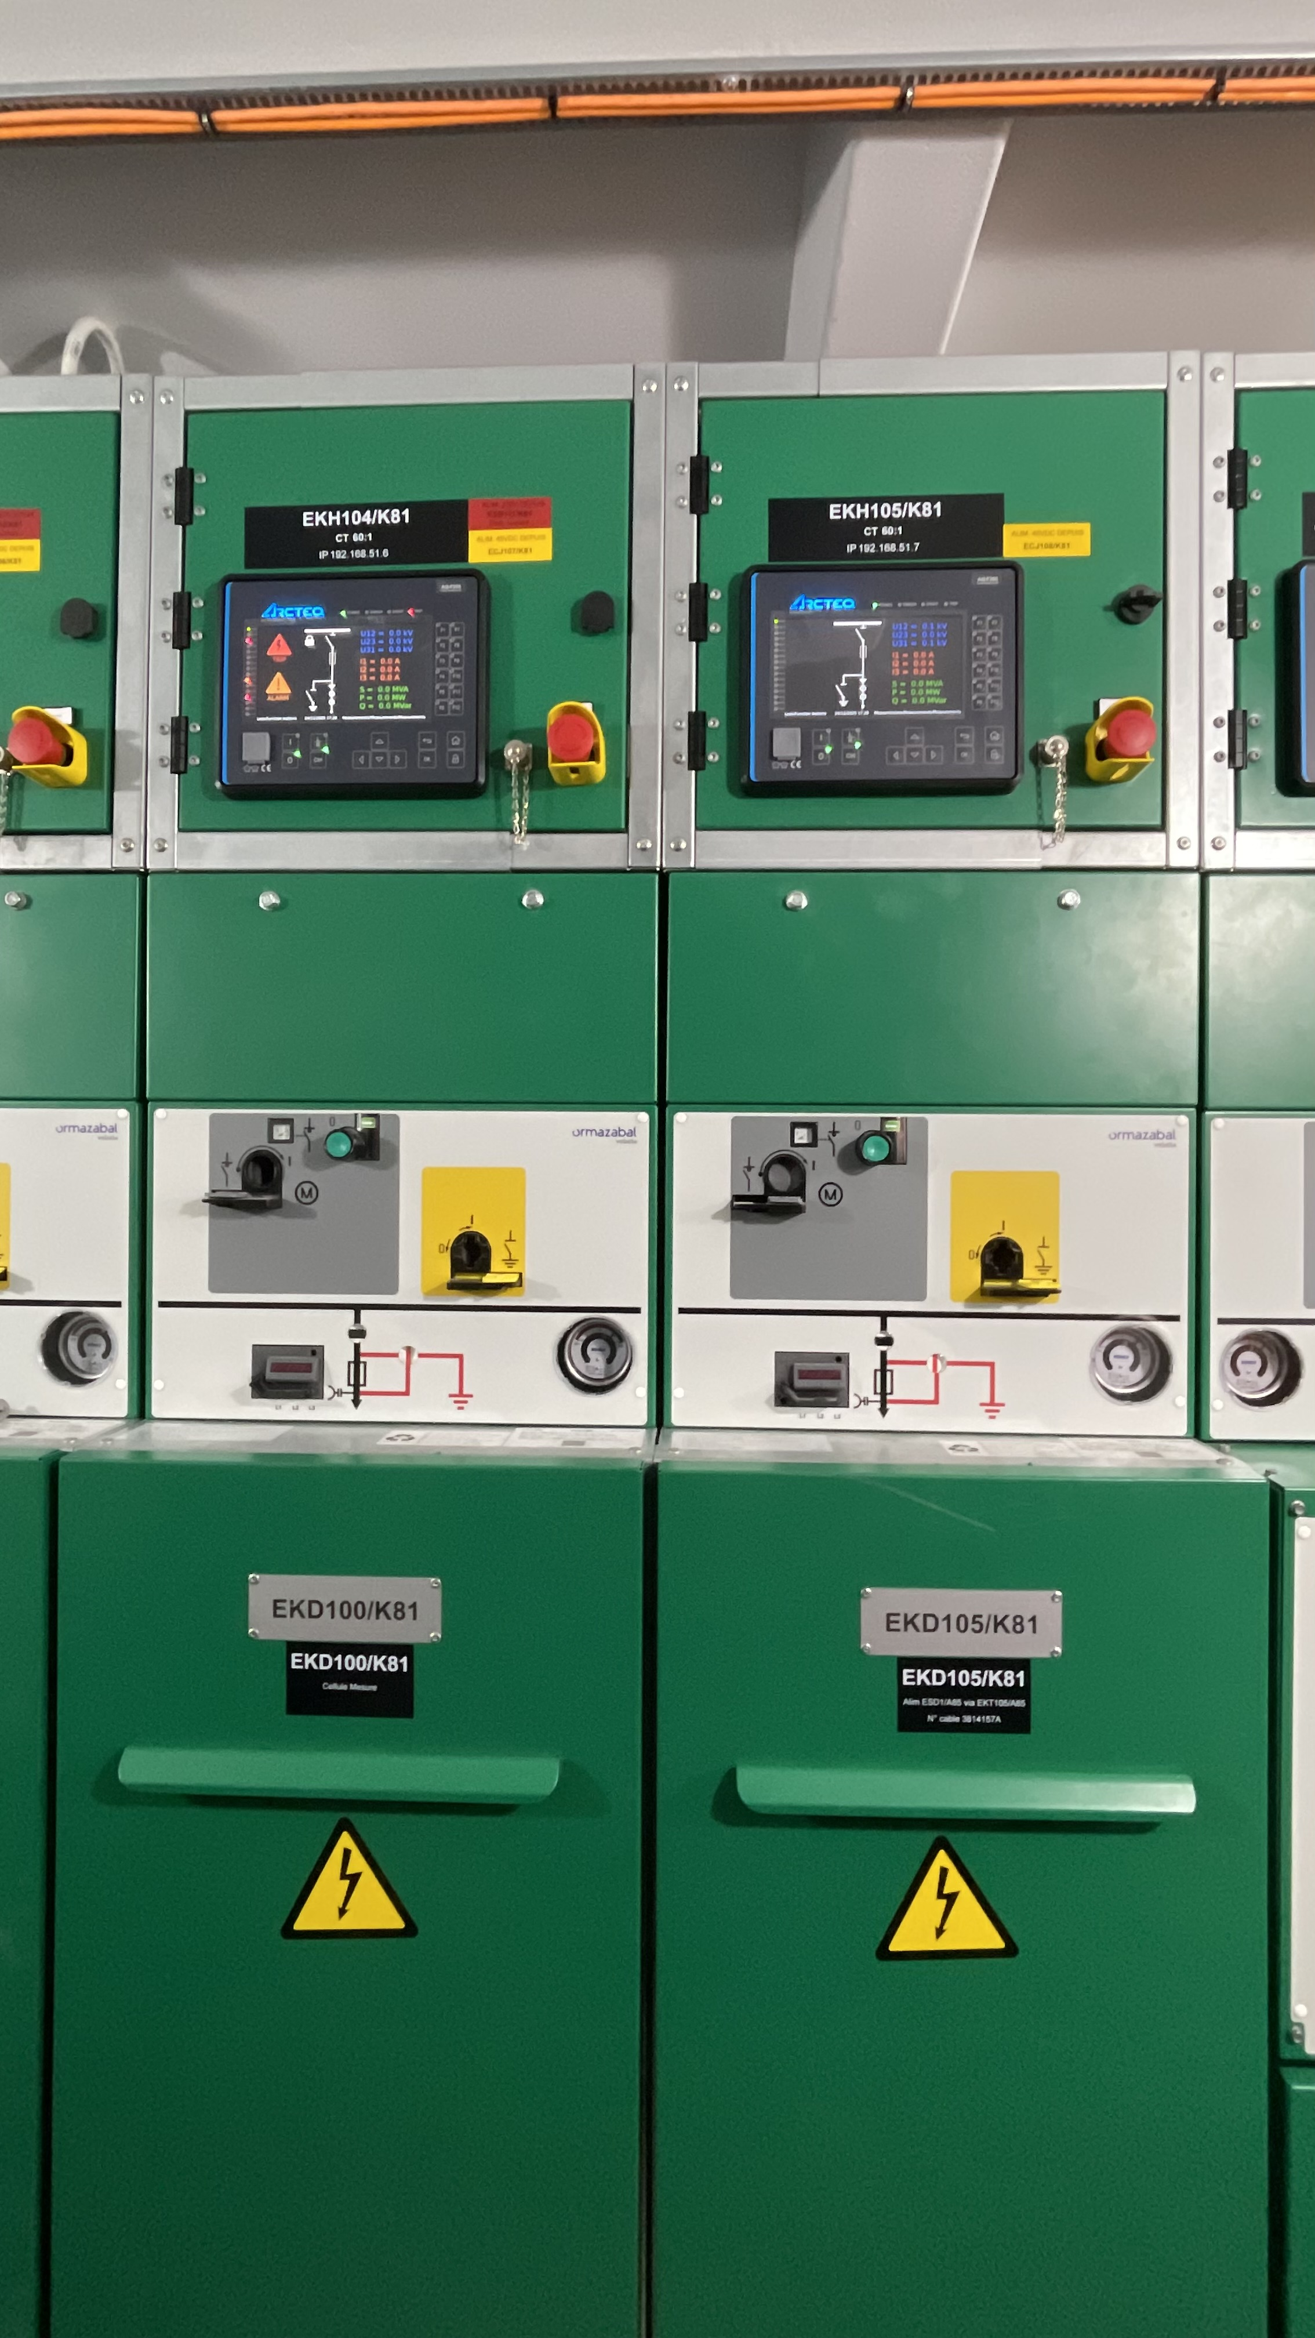
Supply of Medium voltage secondary distribution switchgears
(MS-5155/EN)
Procurement Code: 02020200 - High Voltage (HV) switchboards (1 000 < U <= 50 000 V)
Cost Range : 400k – 1.5M CHF
Planning: MS : Q4 2025
IT : Q1 2026
Contract start: Q2 2026
Scope:
Blanket contract (5 years) for the supply of about 50 cubicles for indoor switchgear with highest system voltage of 24 kV and minimum short circuit current withstand 20 kA
Eligible Firm Profile
Interested firms shall have a proven experience and competence in the fields of engineering, manufacturing, installation, commissioning and maintenance services for electrical distribution switchgear. The company shall design and manufacture metal clad compact medium voltage switchgear with a voltage rating up to 24 kV or higher.
Contact: Giuseppe.Cappai@cern.ch

Slide 16

Supply of 240km of Round Scintillating Plastic Fibres (MS-5142/EP)
Description & Specific Condition :
Scope:
240 km of round scintillating plastic fibres, including samples;
Testing;
Quality documentation.
Main requirements:
fibres shall have a round section of D = 1.5 mm diameter;
Bending radius: 300 mm without performance loss;
Peak emission around 530 nm;
Intrinsic scintillation yields above 6000 photons/MeV;
Radiation tolerance.
Eligible firm profile: Proven competence and experience in scintillating plastic fibres production.
Procurement Code: 07030201 – Scintillating Fibres
Cost Range : 400k - 1.5M CHF
Planning: MS: Q4 2025 IT: Q1 2026
Contact: matteo.Salomoni@cern.ch
Notes:
nm= nano meters
MeV=mega-electro-volts

Slide 17
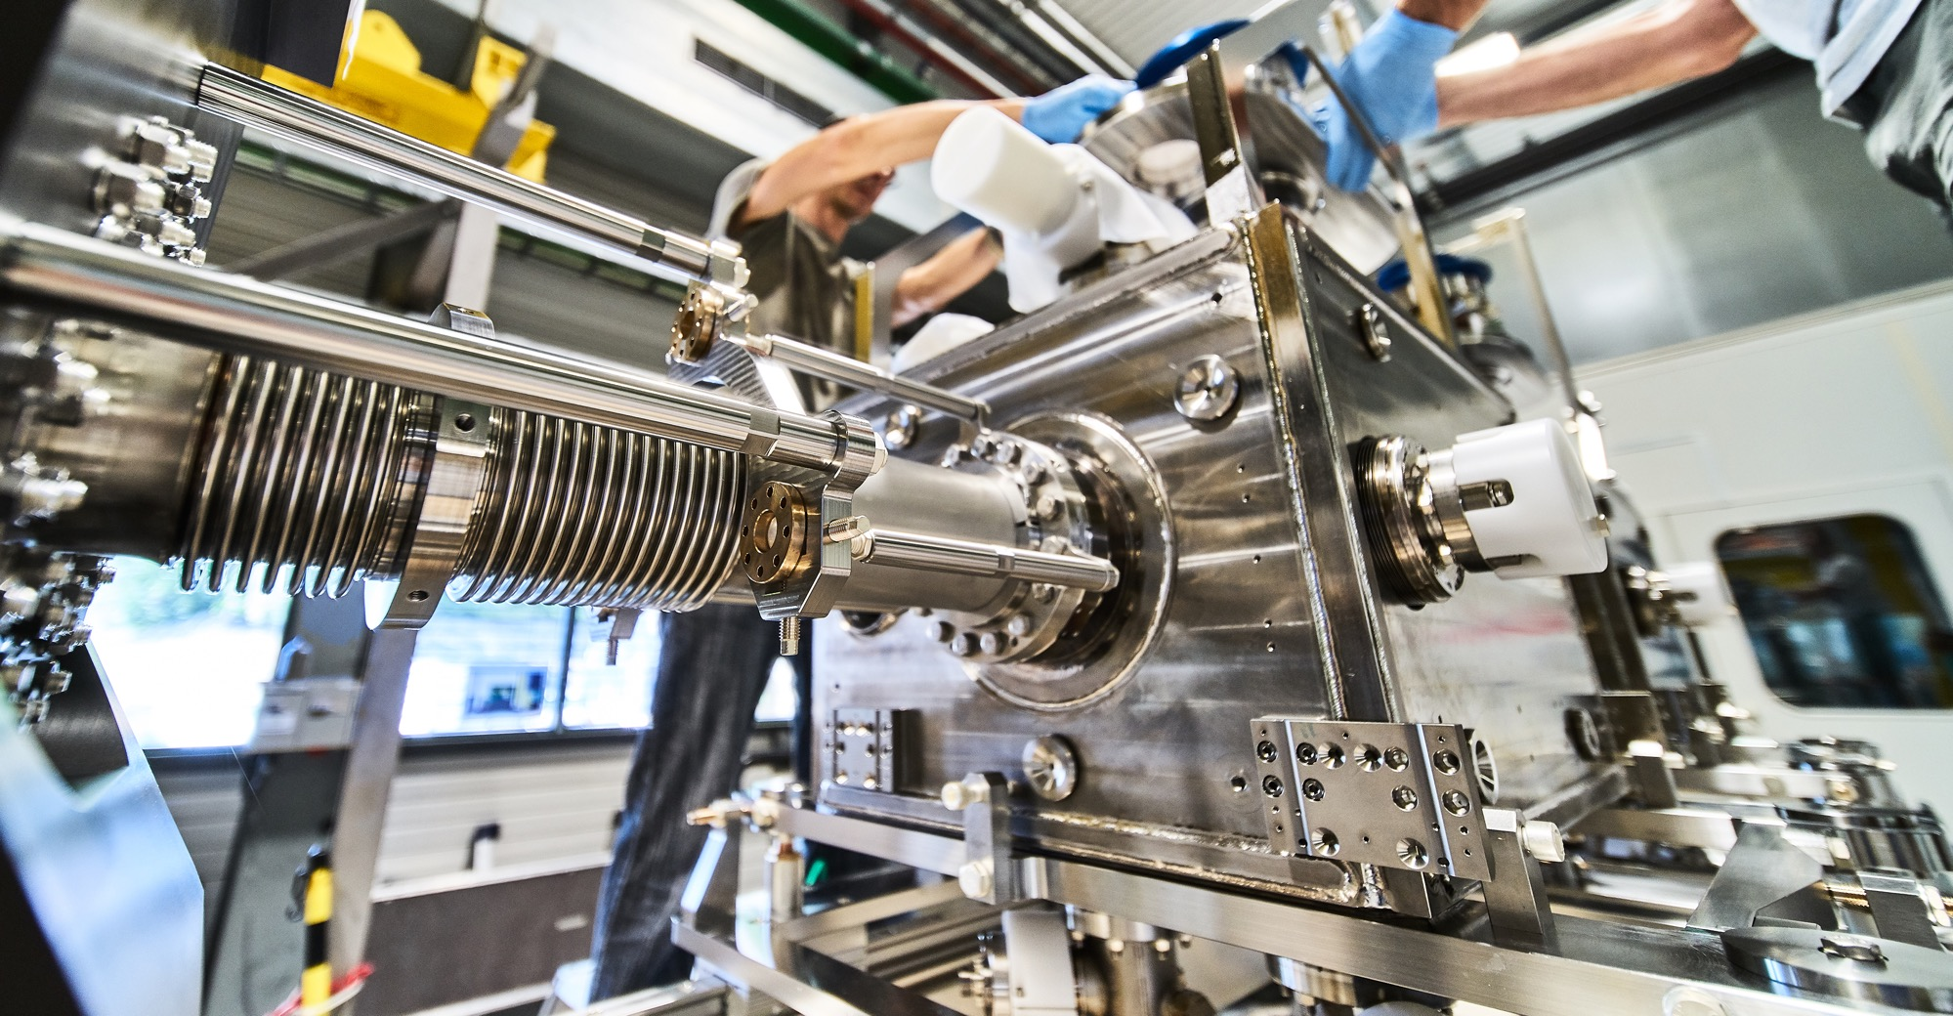
Mechanical Engineering, Raw Materials

Slide 18
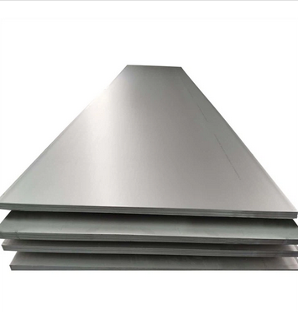
Stainless-steel sheets and plates EN 1.4429 AISI 316LN for Ultra-High Vacuum applications (MS-5056/SCE)
Procurement Code: 05 01 01 02 (Stainless Steel)
Cost Range : 1,5M – 5M CHF
Planning: MS : published
IT: Q4 2025
Contract start: Q1 2026
Scope:
Supply of 80T stainless steel sheets and plates;
EN 1.4429 AISI 316LN (Electroslag Remelting ESR)
Duration: 5 years
Eligible Firm Profile: Interested firms shall have proven experience and competence in metallurgy, manufacturing, forging and testing of the above-mentioned material.
Contact: Leila.akhouay@cern.ch
Notes:
Simon – Stores contracts

Slide 19
Stainless-steel sheets and plates EN 1.4306 AISI 304L for High Vacuum applications (MS-5054/SCE)
Procurement Code: 05 01 01 02 (Stainless Steel)
Cost Range : 400K – 1,5M CHF
Planning: MS : published
IT: Q4 2025
Contract start: Q1 2026
Scope:
Supply of 70T stainless steel sheets and plates;
EN 1.4306 AISI 304L
Duration: 5 years
Eligible Firm Profile: Interested firms shall have proven experience and competence in metallurgy, manufacturing, forging and testing of the above-mentioned material.
Contact: Leila.akhouay@cern.ch
Notes:
Simon – stores contracts

Slide 20
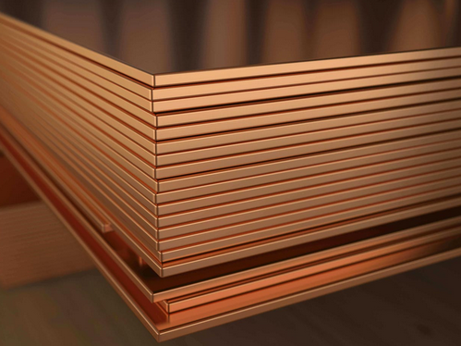
Cu-OFE (Oxygen-Free Copper) sheets and plates for Ultra-High Vacuum applications (MS-5057/SCE)
Procurement Code: 05 01 01 03 (Copper)
Cost Range : 400K – 1,5M CHF
Planning: MS : Q4 2025
IT: Q1 2026
Contract start: Q2 2026
Scope:
Supply of 50T Oxygen- Free Electronic copper (UNS C10100) Grade 1, according to ASTM B224 with a maximum oxygen content of 5ppm
Duration: 5 years
Eligible Firm Profile: Interested firms shall have proven experience and competence in metallurgy, manufacturing, forging and testing of the above-mentioned material.
Contact: Leila.akhouay@cern.ch
Notes:
Simon – stores contracts

Slide 21
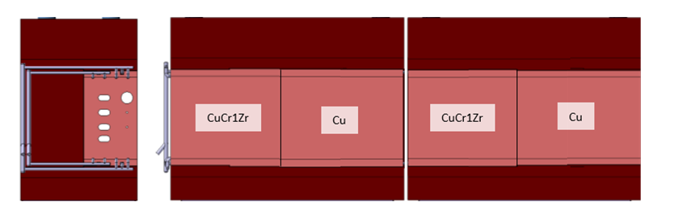
CuCr1Zr blanks for XTAX (MS-5074/BE)
Procurement Code: 05 01 03 03 (Copper, copper alloys)
Cost Range : 400K – 1,5M CHF
Planning: MS : Q4 2025
IT: Q1 2026
Contract start: Q1 2026
Scope:
Supply of forged CuCr1Zr blanks in various shapes and sizes
Material: CuCr1Zr CW106C according to EN 12420, multi-directional forged, solution annealed, and precipitation hardened. Delivered in temper H120 (according to EN 12167).
Overall tolerances: ISO2768 – cL
Delivery by July 2026
Eligible Firm Profile:
Interested firms shall have proven experience and competence in forging, machining, and material testing.
6x DIMENSIONS : 300x810x420 mm³
2x DIMENSIONS : 800x810x420mm³
1x DIMENSIONS : 300x800x170mm³
Contact: miguel.lino@cern.ch
Notes:
Copper chromium zirconium - CuCr1Zr - blanks for XTAX experiment target attenuator experimental areas in the North Area
Linked to next slide for the cast iron blocks
CW106C different name to CuCR1Zr that is according to EN12420 with the named surface treatment requirements

Slide 22
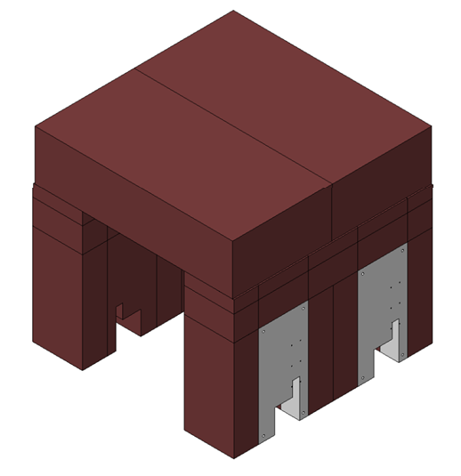
Cast Iron for XTAX (MS-5075/BE)
Procurement Code: 05 01 04 01 (Cast iron, steel)
Cost Range : 1,5M CHF – 5M CHF
Planning: MS : Q4 2025
IT: Q1 2026
Contract start: Q3 2026
Delivery by end 2027
Quantity | Overall dimensions (mm³)
6 | 1620 x 1030 x 500
2 | 1620 x 800 x 720
6 | 390 x 1080 x 500
2 | 390 x 1080 x 800
6 | 820 x 1080 x 500
2 | 820 x 1080 x 800
3 | 780 x 1080 x 500
1 | 780 x 1080 x 800
6 | 1615 x 490 x 927
6 | 1615 x 300 x 419
6 | 1615 x 800 x 295
2 | 1610 x 490 x 918
2 | 1610 x 700 x 300
2 | 1610 x 800 x 412
2 | 1615 x 800 x 419
2 | 1615 x 800 x 295
Scope:
Supply of 190 T of Cast Iron Blocks machined in various shapes and sizes.
Main materials: Nodular Iron GJS – 400-18U-RT, acc. to EN 1563
Paint: Primer anti-radiation: Inorganic zinc silicate; 2nd layer epoxy coat; (3rd layer red 3005)
Overall tolerances: ISO2768 - cL
Eligible Firm Profile:
Interested firms shall have proven experience and competence in casting, machining, and material testing.
Contact: miguel.lino@cern.ch
Notes:
XTAX – experimental target attenuator experimental areas
190 tons

Slide 23
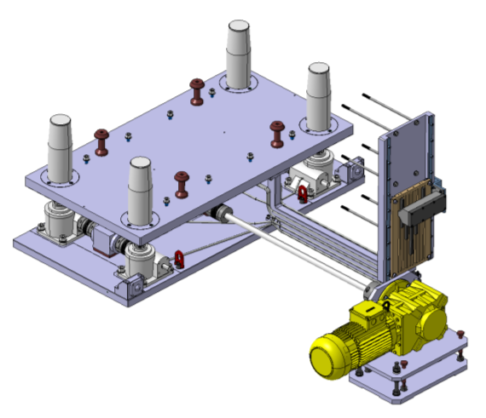
Tables for XTAX (MS-5076/BE)
Procurement Code: 05 01 01 04 (Aluminium, aluminium alloys)
05 01 01 02 (Stainless steel)
Cost Range : 400K – 1,5M CHF
Planning: MS : Q1 2026
IT: Q2 2026
Contract start: Q3 2026, delivery by May 2027
QTY: 8; DIMENSIONS: 1616 x 780 x 832 mm³
QTY: 1; DIMENSIONS: 3200 x 780 x 832 mm³ (non motorized)
Scope:
Supply of alignment tables which are a Z displacement (300 mm) device, designed to support and lift 15T of operational load with all controls and driving systems placed outside the table footprint.
Stroke: +/-150 mm; Operational Load 15 T; Speed: 100 mm/min
Each table is equipped with a manual alignment system on its base providing 5 DOF with the following specifications:
Resolution: 0.1mm; Stroke: y: +/- 5 mm; Z: +/- 3mm; Rx: +/- 7 mrad; Ry: +/- 7 mrad; Rz: +/- 7 mrad
Main materials: AL EN AW6082, Stainless Steel A4, Stainless Steel 304
General machining tolerances ISO2768 – mk
All components must be radiation hard > 100kGy in 20 Yrs.
Eligible Firm Profile
Interested firms shall have proven experience and competence in machining, precision assembly, and metrology and material testing.
Contact: miguel.lino@cern.ch
Notes:
Alvaro
Mrad = miliradiance
100kGy = kilogray (measurement of radiation dose)

Slide 24
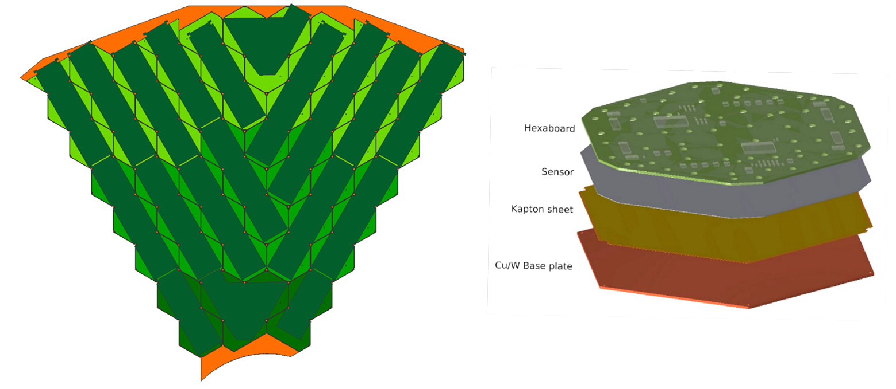
Polyimide-Coated Copper Foils (DO-34890/EP/CMS)
Procurement Code: 05 01 01 00 (Metallic plates, sheets and strip)
Cost Range : 200k – 400k CHF
Planning: DO : Dispatched
Contract start: Q1 2026
Scope:
12 950 polyimide-coated copper foils, covering 13 different geometries
Dimensions up to 188 mm × 167 mm and an 18 µm thick copper layer
CERN will use them for electrical isolation of silicon sensors in the CMS High Granularity Calorimeter
Eligible Firm Profile
Interested firms shall have competence and experience in manufacturing similar polyimide-coated copper foils.
Contact: erik.butz@cern.ch
Notes:
Launched on Friday (November 20th) but still available to send if any firms are interest

Slide 25
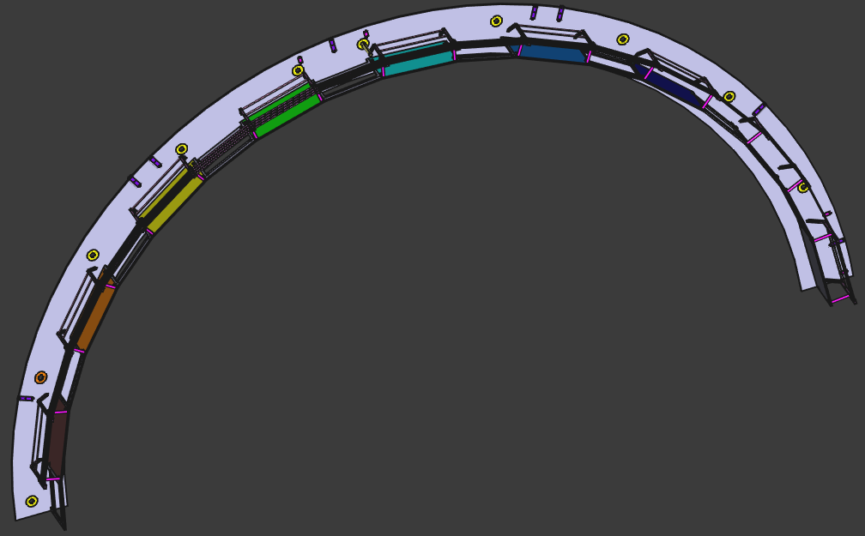
20 Carbon-Fibre Patch-Panel Crowns (DO-34982/EP/CMS)
Procurement Code: 05 04 05 02 (Composite materials)
Cost Range : 200k – 400k CHF
Planning: DO : Q4 2025
Contract start: Q1 2026
Scope:
20 identical Patch-Panel Crowns
Made in carbon-fibre, with semi-circular shape, 2 m diameter
Main semi-circular element, 4 mm thick and flat, with an inner radius of 960 mm and an outer radius of 1 095 mm
Eligible Firm Profile
Interested firms shall have competence and experience in producing similar parts (standard carbon material with epoxy matrix).
They shall also possess prepreg storage means, autoclave equipment and high precision CN machining equipment.
Contact: massimiliano.marchisone@cern.ch
Notes:
CMS experiment procurement

Slide 26
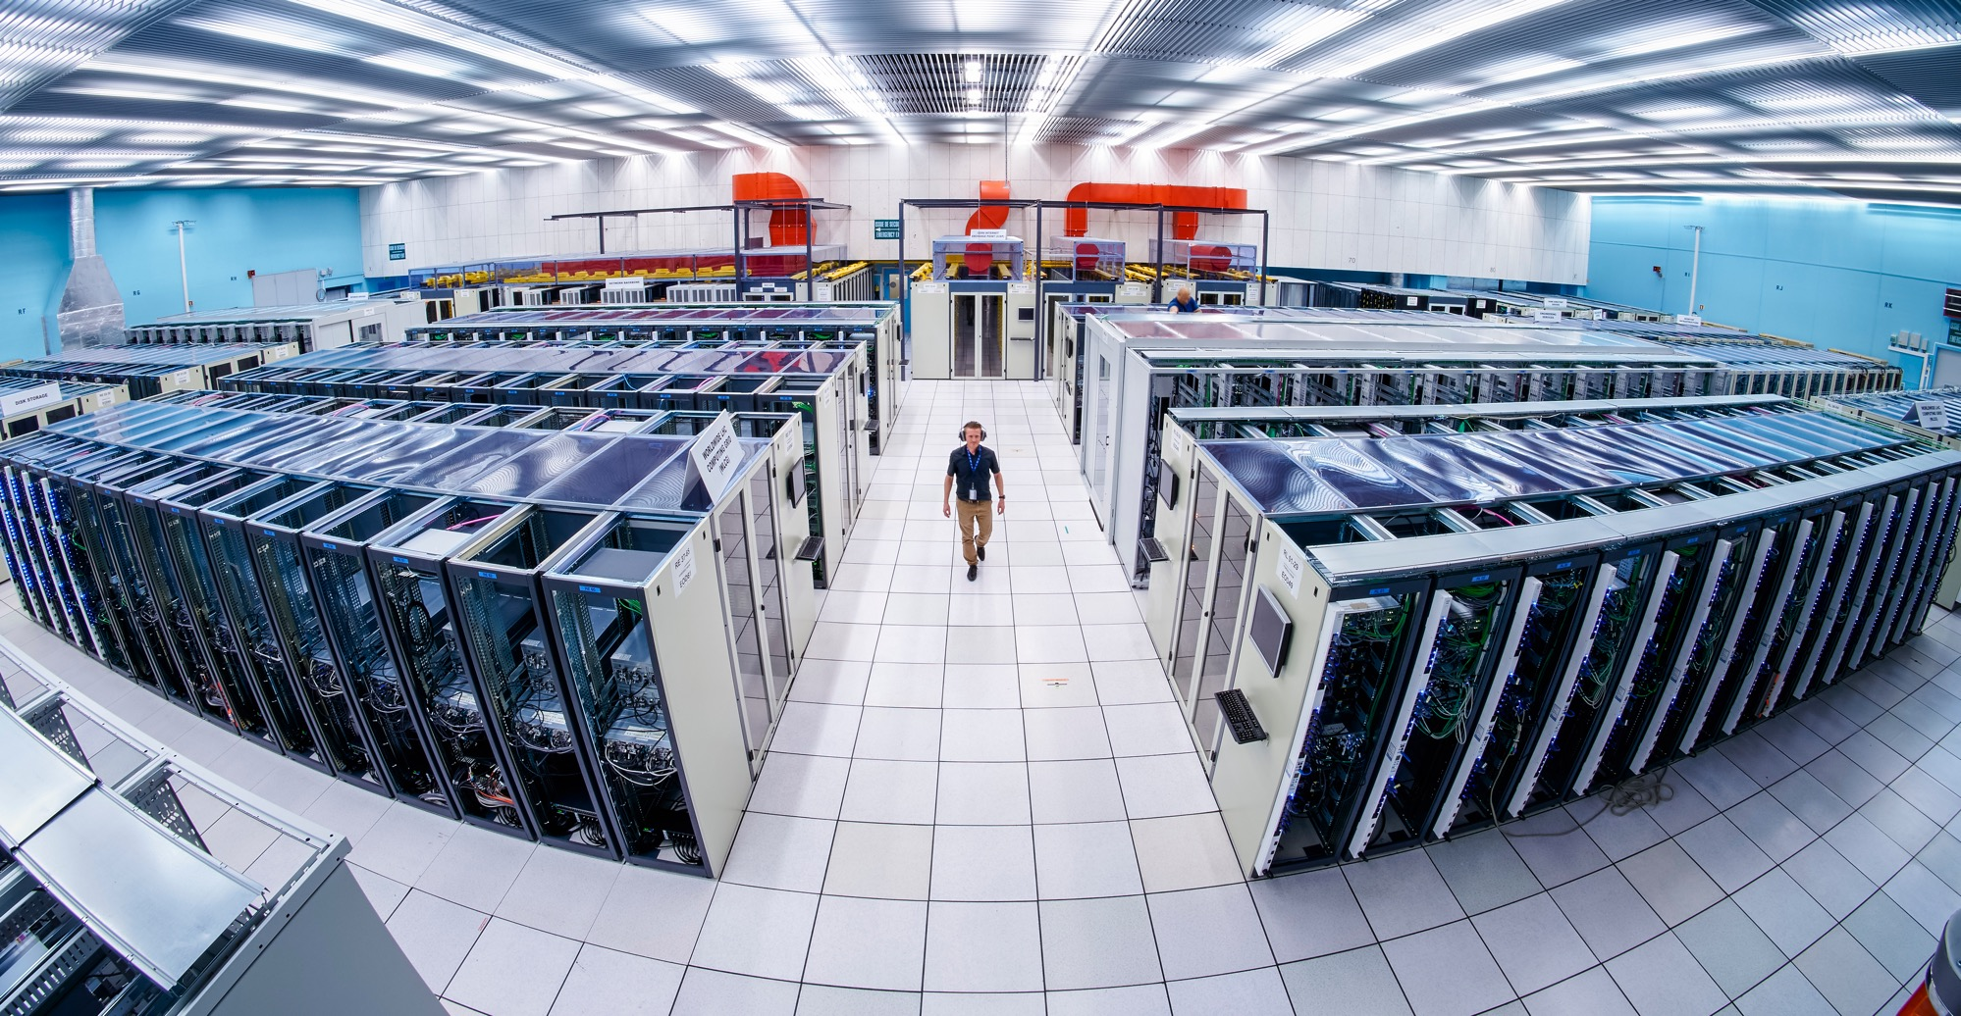
Information Technology

Slide 27
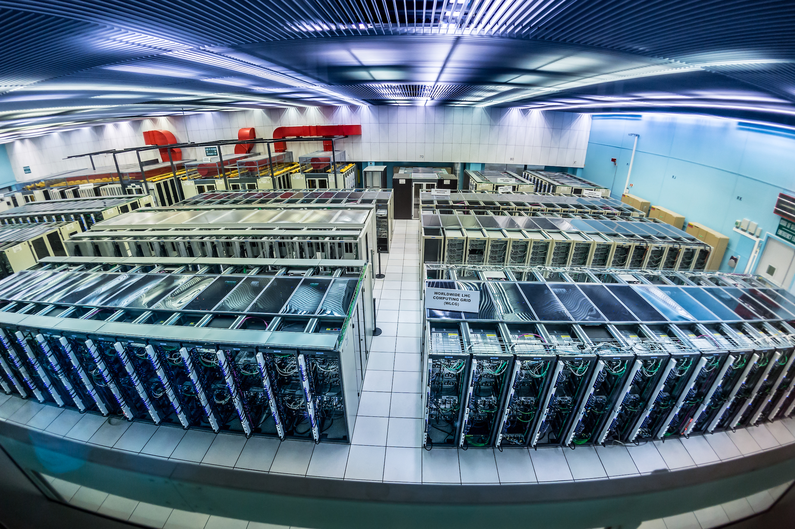
Supply of Water-Cooled Server Racks and Cooling Doors
(IT-5108/EP)
Procurement Code: 03040100 (Other components for racks)
Cost Range : 1.5M – 5M CHF
Planning: MS : published
IT: Q4 2025
Contract start: Q1 2026
Scope:
Supply and commissioning of 54 complete water-cooled racks as well as approximately 40 additional cooling doors for existing racks to house computing servers for the ATLAS experiment.
Eligible Firm Profile:
Interested firms shall have a proven experience and competence in designing and manufacturing computing racks and cooling doors.
Contact: Markus.Joos@cern.ch
Notes:
Case C
Thomas

Slide 28
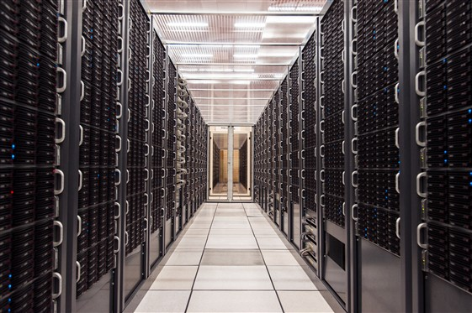
Supply of Servers for Physics Data Processing
Procurement Code: 04010300 (Servers)
Cost Range : 2.5M CHF
Planning: MS: Q4 2025
IT: Q1 2026
Contract Start: Q2 2026
Scope:
Supply of Servers for Physics Data Processing, Acquisition and Control. Servers are rack-mountable PC systems, or integrated systems such as blade servers for batch and interactive farms in the Computer Centre for physics data processing. Servers are to be optionally acquired fully assembled and installed in industry standard racks.
Eligible Firm Profile:
Interested firms shall have a proven experience and competence in the supply of Servers and Storage for Physics Data Processing, Acquisition and Control.
Contact: luca.atzori@cern.ch
Notes:
Case D (~5 % CERN contribution)
MS reference yet?

Slide 29
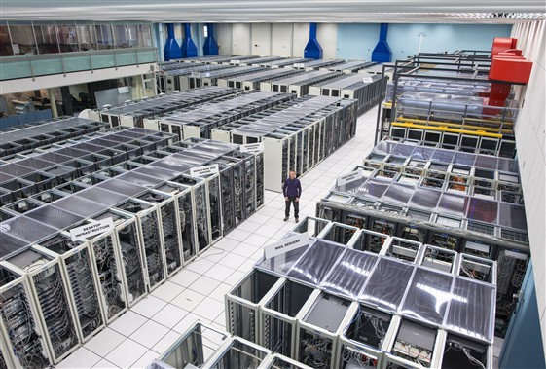
Supply of Storage for Physics Data Processing (MS-5157/IT)
Procurement Code: 04020400 (Storage expansion units)
Cost Range : 3M CHF
Planning: MS: Q4 2025
IT: Q1 2026
Contract Start: Q2 2026
Scope:
Supply of storage for physics data processing, acquisition and control. Disk storage configurations with hard disk drives and, to a smaller volume also solid state drives, mounted in external rack-mountable SAS JBOD expansion units directly attached to rack-mountable PC front-end server systems. Disk storage are to be optionally acquired fully assembled and installed in industry standard racks.
Eligible Firm Profile:
Interested firms shall have a proven experience and competence in the supply of servers and storage for physics data processing, acquisition and control.
Contact: luca.atzori@cern.ch

Slide 30
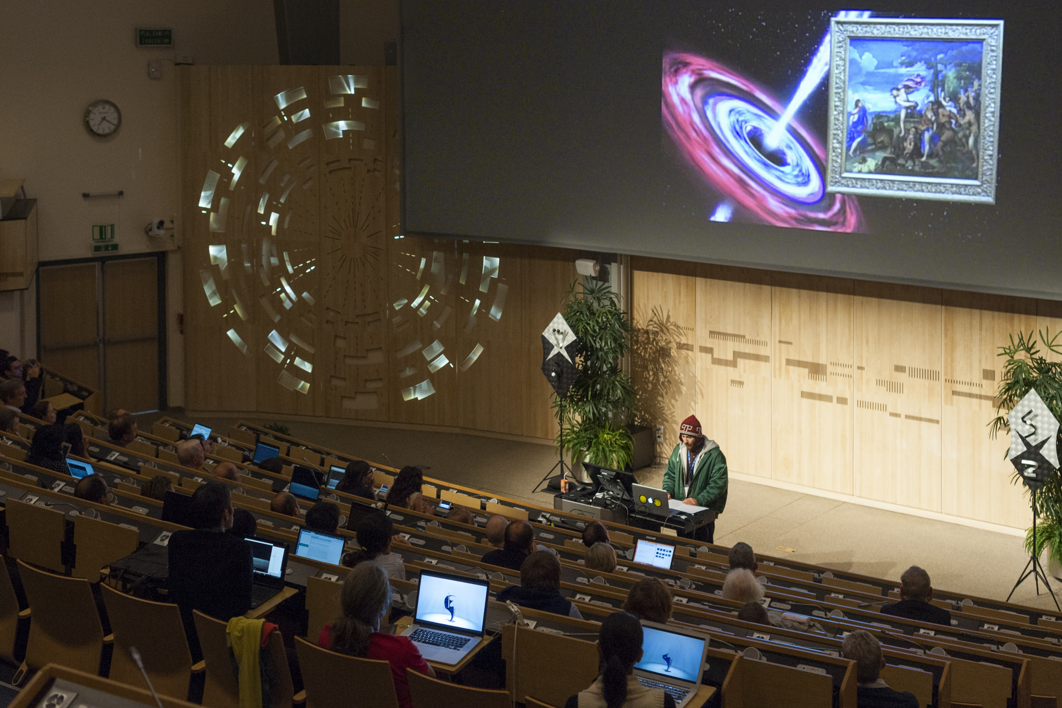
Supply and Installation of Audio-Visual and Lighting Equipment for the Globe Auditorium(MS-5143/IR)
Procurement Code: 04040700 (Audio-visual control systems), 04040600 (Audio devices), 04040900 (Lighting equipment for video), 08010502 (Video camera and video devices)
Cost Range : 800k-900k CHF
Planning: MS : Q4 2025
IT: Q1 2026
Contract start: Q2 2026
Scope:
Supply and installation of equipment for around 75 conference rooms including three auditoriums
Includes system schematics, rack layouts, cabling schedules, room layouts
Duration: One-year, blanket purchase contract renewable for up to two further periods on one year each.
Eligible Firm Profile:
Interested firms shall have a proven experience and competence in the domain of audiovisual supply and installation. The use of an acrobatic worker is required for certain components that require specialised access.
Contact: gilles.gautheron@cern.ch
Notes:
Thomas
MS realistically being published? There are three MS to publish before the 12th which seems ambitious

Slide 31
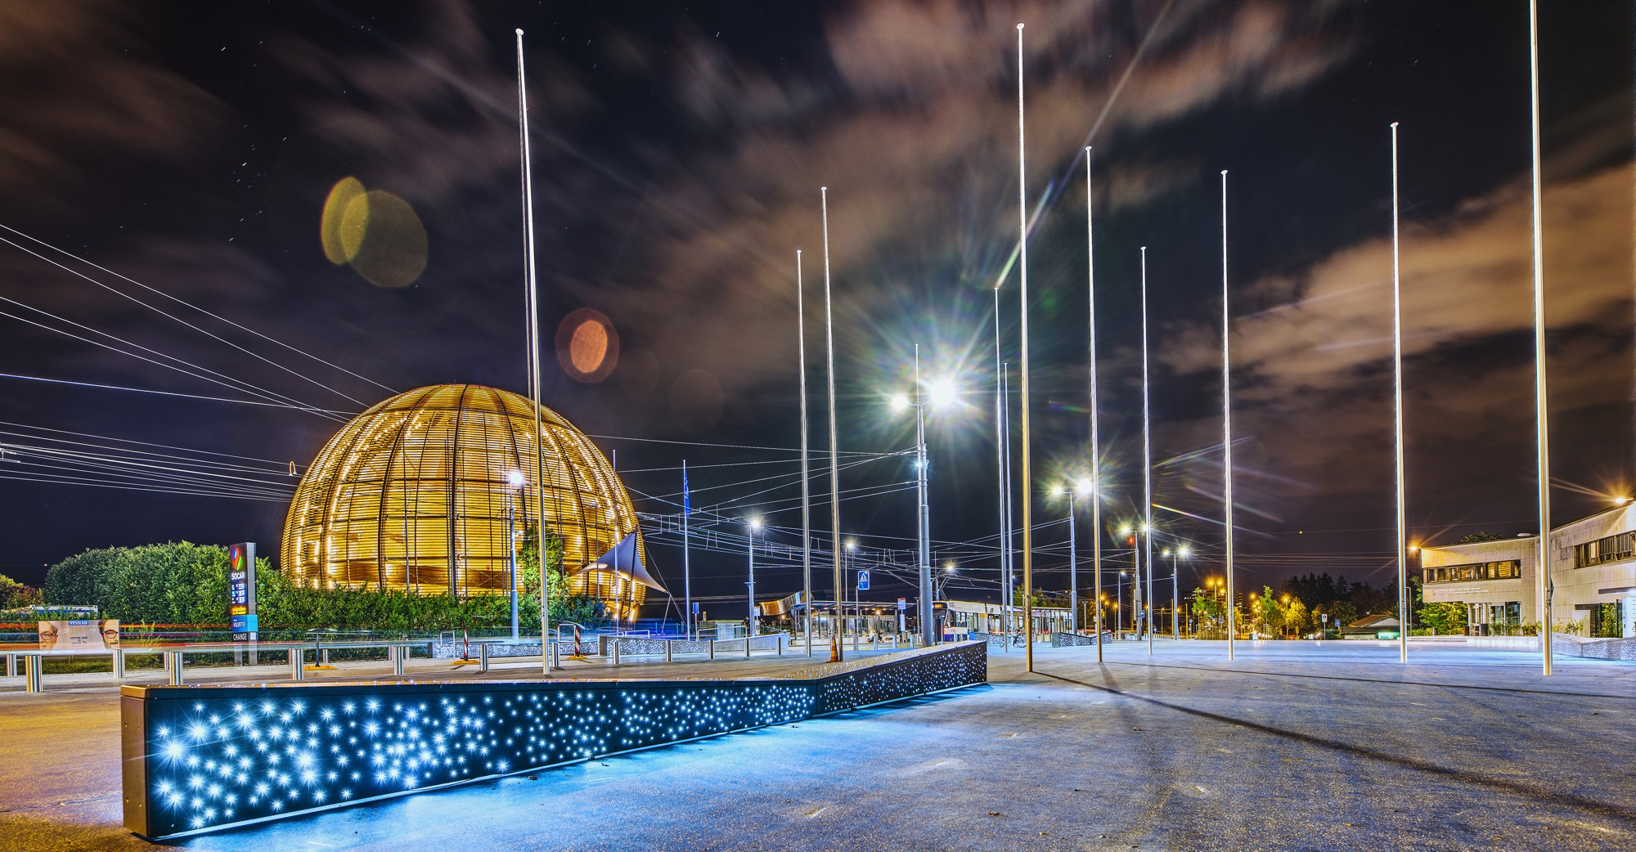
Health & Safety
Machines

Slide 32
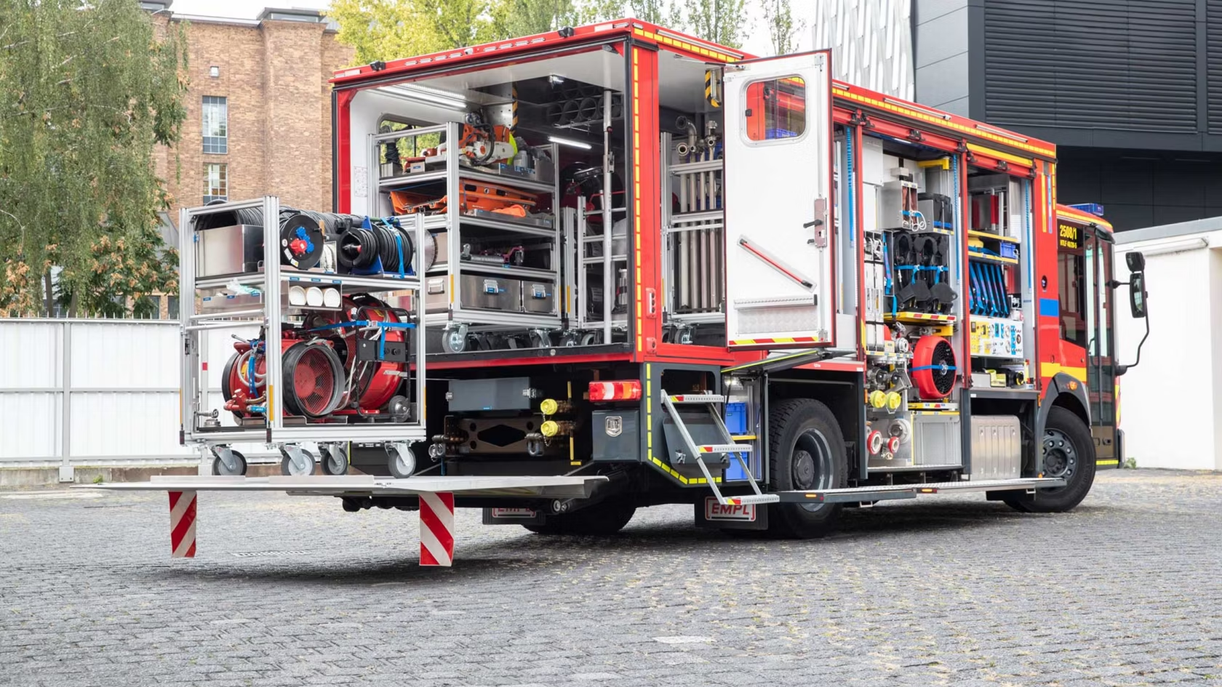
Supply of three utility vehicles (MS-5083/HSE)
Description & Specific Condition :
Three utility vehicles to be delivered over a three- year period (2026-2028)
  1x Flexi Unit in 2026
  1x Officer unit in 2027
  1x Flexi unit in 2028
Vehicles must be suited to transport fire and rescue equipment
Be equipped with an automatic gearbox
Procurement Code: 11 01 04 01 (Fire engines)
Cost Range : 400 kCHF - 1.5 MCHF
Planning: MS: published IT: Q4 2025
Contact: Miikka.Leinonen@cern.ch

Slide 33
Design, supply and installation of a high-pressure rinsing machine
Description & Specific Condition :
Supply of a high-pressure rinsing machine to perform waterjet impingement of internal surface of superconducting radio-frequency cavities
Operating in cleanroom conditions, under vacuum and under inert atmosphere
The Supply shall be based on a commercially available vacuum-steam sterilizer typically used by the pharmaceutical industry with modifications to fulfil the high-pressure rinsing stage.
To be installed in the new RF facility SA18
Procurement Code: 05030500 (surface treatment and cleaning equipment)
Cost Range : 400 kCHF - 1.5 MCHF
Planning: MS: published IT: Q2 2026
Contact: David.Smekens@cern.ch
Notes:
ME

Slide 34
SA18 Polishing Machines (MS-5134)
Description & Specific Condition:
Manufacture, delivery and installation of two electrochemical and chemical polishing facilities.
Each chemical/electrochemical polishing facility shall comprise a control system, one chemical plant to store, control working parameters and make the polishing fluid circulate through the handling machine and one handling machine to provide the necessary movements to the component to be processed (rotational (longitudinal and lateral axis) and translational) and keep the assembly leak tight.
Start of the Contract: Q1 2027
Procurement Code: 09 02 02 00 (Equipment related to chemicals)
Cost Range : 400k - 1.5M CHF
Planning: MS: Published
IT: Q2 2026
Contact: Leonel.ferreira@cern.ch
Notes:
Ellie

Slide 35
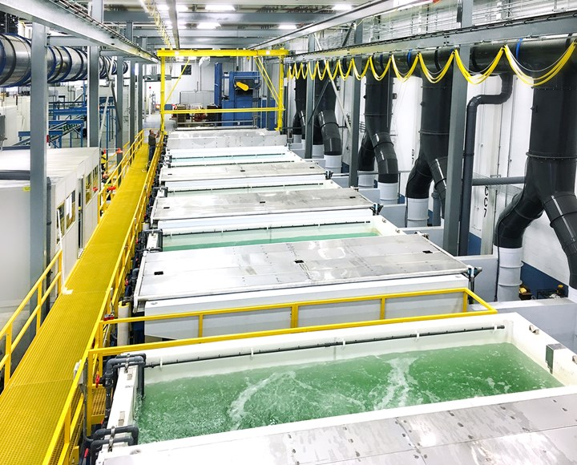
SA18 Surface treatment line (MS-5138)
Description & Specific Condition :
Manufacture, delivery and installation of a surface treatment line for the chemical and electrochemical preparation of copper and niobium parts.
The supply comprises eight fully equipped immersion tanks with capacities ranging up to six cubic meters and their respective control units; two pumping tanks with a capacity up to one cubic meter each; one retention structure with more than fifty square meters and a chemical compatible enclosure for the chemical storage area with a twenty square meters footprint.
Start of the Contract: Q1 2027
Contact: Leonel.ferreira@cern.ch
Procurement Code: 09 02 02 00 (Equipment related to chemicals)
Cost Range : 400k - 1.5M CHF
Planning: MS: Published IT: Q2 2026
Notes:
Ellie

Slide 36
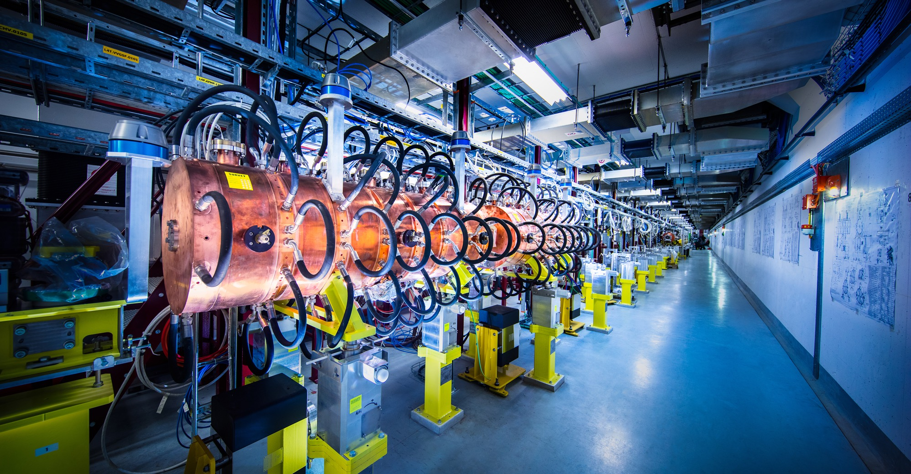
Electronics

Slide 37
CRP anode drilling and milling
Description & Specific Condition:
Supply of 700 large PCBs drilled and milled with high precision for the DUNE Charge Readout Planes (CRP) anode fabrication.
Drilling and milling of 700 PCB circuits, each being clad on both sides with a 35 µm copper layer having photolitographed strip patterns.
Each PCB is 3.4 meters long and 1.7 meters wide requiring high density of 2.4 mm holes (>130,000 holes per msq.). High precision on the dimensions and the absolute position of the holes is also required (50 microns).
Start of the Contract: Q2 2026
Procurement Code: 03 02 10 00 (Printed circuits)
Cost Range: 400k - 1.5M CHF
Planning: MS: Q1 2026
IT: Q2 2026
Contact: jeremie.alexandre.merlin@cern.ch
Notes:
Corinna

Slide 38
Construction,
Onsite & Offsite Services

Slide 39
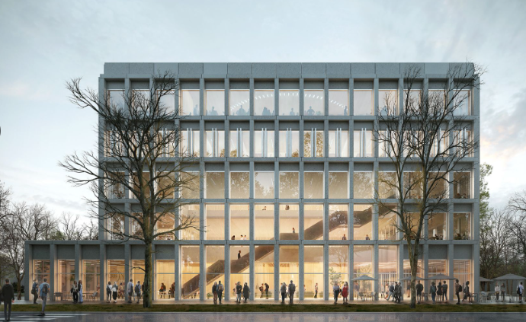
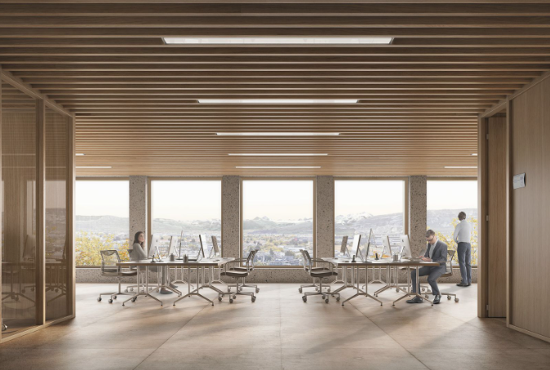
Construction of new Building 140 (MS-5104/SCE)
Description & Specific Conditions :
General contractor to construct new Building 140 on CERN’s Meyrin site in Switzerland.
Highly-performing mechanical, electrical, plumbing (MEP) and façade system to achieve recognised sustainability accreditation.
The building will provide a new council chamber, EP workshops, a learning centre and media facilities and will be constructed in two phases
Procurement code: 01 02 01 00/ 01/ 02
Cost Range : > 10M CHF
Planning: MS Published (MS-5104) / IT Q1 2026
Contact: baptiste.mercier@cern.ch
Notes:
recognised sustainability accreditation?
Check with Adam if he wants to present

Slide 40
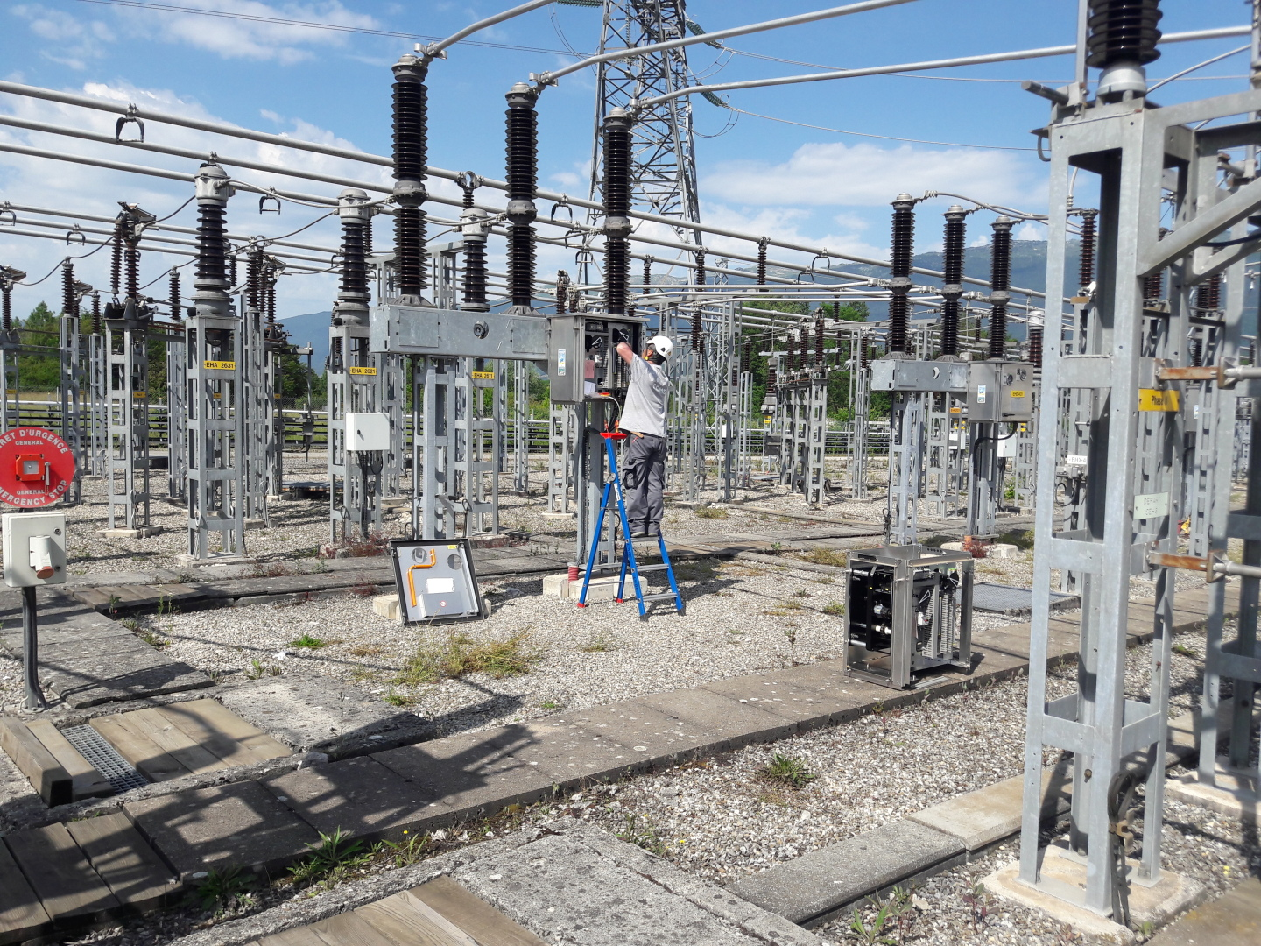
Maintenance, Consolidation and Upgrade of the High Voltage
Protection Relays at CERN (MS-5120/EN)
Procurement Code: 13030200 - Maintenance of high-voltage electrical boards
Cost Range : 0.4 – 1.5 M CHF
Planning: MS : Published
IT: Q4 2025
Contract start: Q2 2026
Scope:
Consolidation and Upgrade of the protection relays
Preventive and corrective maintenance of current protection relays
Duration: 3 years (+ 4 optional 1-y extension)
Eligible Firm Profile: Interested firms shall be able to demonstrate that it has competence for preventive maintenance and corrective maintenance of HV protection relays and shall be able to demonstrate that it has the needed equipment for testing the protection relays (secondary injection test equipment).
© CERN
Contact: joni.leppilahti@cern.ch

Slide 41
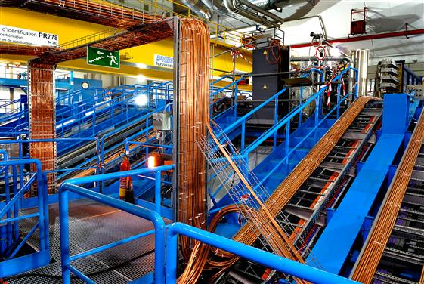
Electrical installation services at CERN (MS-5140/EN)
Procurement Code: 13 03 06 00 (Electrical installation works)
Cost Range : > 10M CHF
Planning: MS : Q4 2025
IT: Q1 2026
Contract start: Q2/Q3 2026
Scope:
Modifications to the electrical power distribution network
Cabling work
Minor electrical works
IT cabling
Work supervision
...
Duration: 3 years (+ optional 1-y extension)
Eligible Firm Profile: Interested firms shall have proven experience and competence in large electrical installation service contracts.
© CERN
Contact: Kamil.Zielinski@cern.ch
Notes:
© CERN Some rights reserved. This image is freely available for non-commercial use.

Slide 42
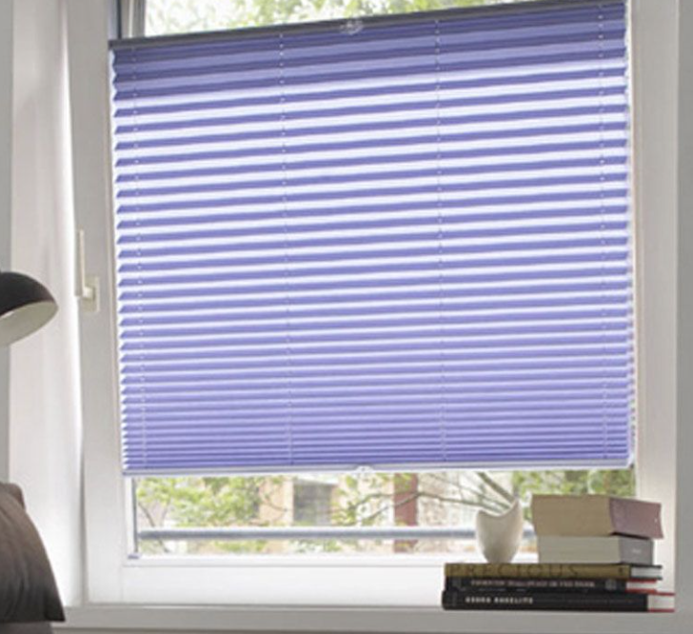
Supply, installation and maintenance of blinds (MS-5129/SCE)
Procurement Code: 01 02 03 05
Cost Range : 0.4 – 1.5 M CHF
Planning: MS: Q4 2025
IT: Q2 2026
Contract start: 1 August 2026
Scope: Supply, installation and maintenance of blinds and shutters on CERN surface buildings
Duration: 3 years (+ optional 2 x 2-y extensions)
Eligible Firm Profile: Interested firms shall have proven experience and competence in supply, installation and maintenance of blinds
Contact: samuel.adam@cern.ch
Notes:
© CERN Some rights reserved. This image is freely available for non-commercial use.

Slide 43
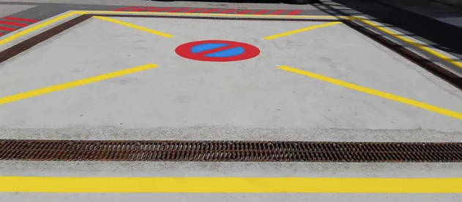
Road marking and signage on the CERN site (MS-5130/SCE)
Procurement Code: 01 01 03 07 (marking service)
01 01 03 08 (signage service)
Cost Range : 0.4 – 1.5 M CHF
Planning: MS: published
IT: Q4 2025
Contract start: 1 February 2026
Scope: Road marking, supply and installation of road signs according to French and Swiss standards
Duration: 3 years (+ optional 2 x 2-y extensions)
Eligible Firm Profile: Interested firms shall have proven experience and competence in road marking and installation of road signs
Contact: samuel.adam@cern.ch
Notes:
© CERN Some rights reserved. This image is freely available for non-commercial use.

Slide 44
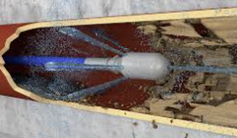
Drain networks control and cleaning in CERN TUNNELS
(MS-5133/SCE)
Procurement Code: 01 01 01 06 (Tunnel drainage maintenance service)
Cost Range : 0.4 – 1.5 M CHF
Planning: MS: published
IT: Q1 2026
Contract start: 1 June 2026
Scope: Camera inspection work, cleaning and minor repairs in the drainage networks in CERN tunnels
Duration: 3 years (+ optional 2 x 2-y extensions)
Eligible Firm Profile: Interested firms shall have proven experience and competence in drain networks control and cleaning
Contact: samuel.adam@cern.ch
Notes:
© CERN Some rights reserved. This image is freely available for non-commercial use.

Slide 45
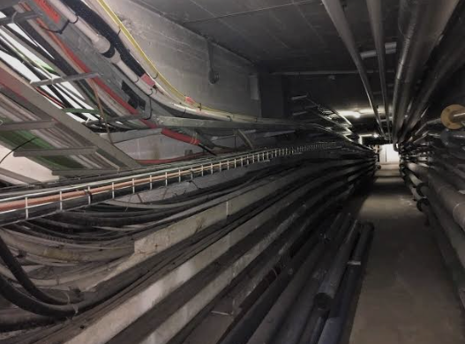
Engineering studies, supply and installation of piping and its accessories on the CERN site (MS-5137/SCE)
Procurement Code: 01 03 01 01
Cost Range : 1.5 – 5 M CHF
Planning: MS: Q4 2025
IT: Q2 2026
Contract start: 1 October 2026
Scope: Replacement of pipes and associated equipment, insulation for district heating network and HVAC consolidation. Work in confined spaces with specific welding processes related thereto.
Duration: 3 years (+ optional 2 x 2-y extensions)
Eligible Firm Profile: Interested firms shall have proven experience and competence in supply and installation of piping.
Contact: Gregoire.guillot@cern.ch
Notes:
© CERN Some rights reserved. This image is freely available for non-commercial use.

Slide 46
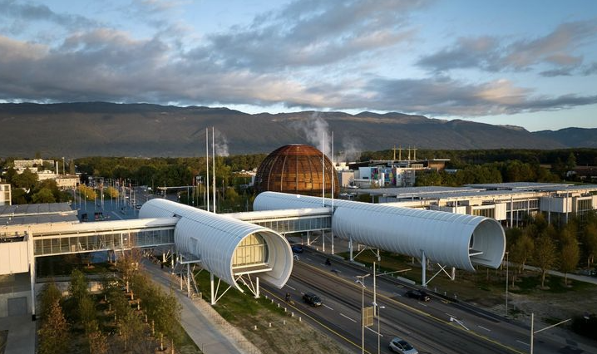
Technical maintenance of Science Gateway buildings (SGW)
(MS-5152/IR)
Procurement Code: 13 02 03 00 (maintenance and operation of heating
installations)
13 02 05 00 (HVAC maintenance and operation)
Cost Range : 0.4 – 1.5 M CHF
Planning: MS: Q4 2025
IT: Q2 2026
Contract start: 1 December 2026
Scope: Technical maintenance of SGW including preventive and corrective maintenance of:
HVAC equipment
Electrical installation
Building management system
Lifts, elevators and automatic doors
Duration: 3 years (+ optional 2 x 2-y extensions)
Eligible Firm Profile: Interested firms shall have proven experience and competence in building technical maintenance
Contact: pauline.emery@cern.ch
Notes:
© CERN Some rights reserved. This image is freely available for non-commercial use.

Slide 47

Small works for CERN’s green spaces
Procurement Code: 13 01 02 00 (Green spaces)
Cost Range : 200k – 400 KCHF for each DO (three in total)
Planning: DO: Q1 2026
Contract start: 1 April 2026
Scope: Small works for CERN’s green spaces including tree and agricultural work as well as landscaping work.
Duration: 3 years (+ optional 2 x 2-y extensions)
CERN intends to place three contracts:
- One for tree and agricultural work
- One for the French part and one for the Swiss part of CERN for landscaping work.
Eligible Firm Profile: Interested firms shall have proven experience and competence in maintenance of green spaces
Contact: Mathieu.fontaine@cern.ch
Notes:
© CERN Some rights reserved. This image is freely available for non-commercial use.

Slide 48
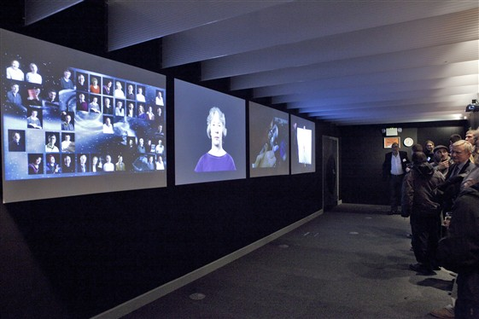
Multimedia content production (DO-34936/IT)
Procurement Code: 04 04 00 00 Audio-visual Equipment
Cost Range : 50k – 200k CHF
Planning: - DO launch Q1 2026
- Contract start: Q2 2026
Scope:
Provision of multimedia material (videos, animations) foreseen by the design of a new exhibition at CERN
© CERN
Contact: Antonella.Del.Rosso@cern.ch

Slide 49

Provision of insurance medicine services
Procurement Code: 10900600
Cost Range : 200k- 400 CHF CHF
Planning: - DO launch Q1 2026
- Contract start: Q3 2026
Scope:
Provision of insurance medicine services ("medecin conseil") for CERN and the Pension Fund
© CERN
Contact: Raphael.Otzenberger@cern.ch
Notes:
Check with Charles if he will present as its services

Slide 50
Thank you

