Slide 1
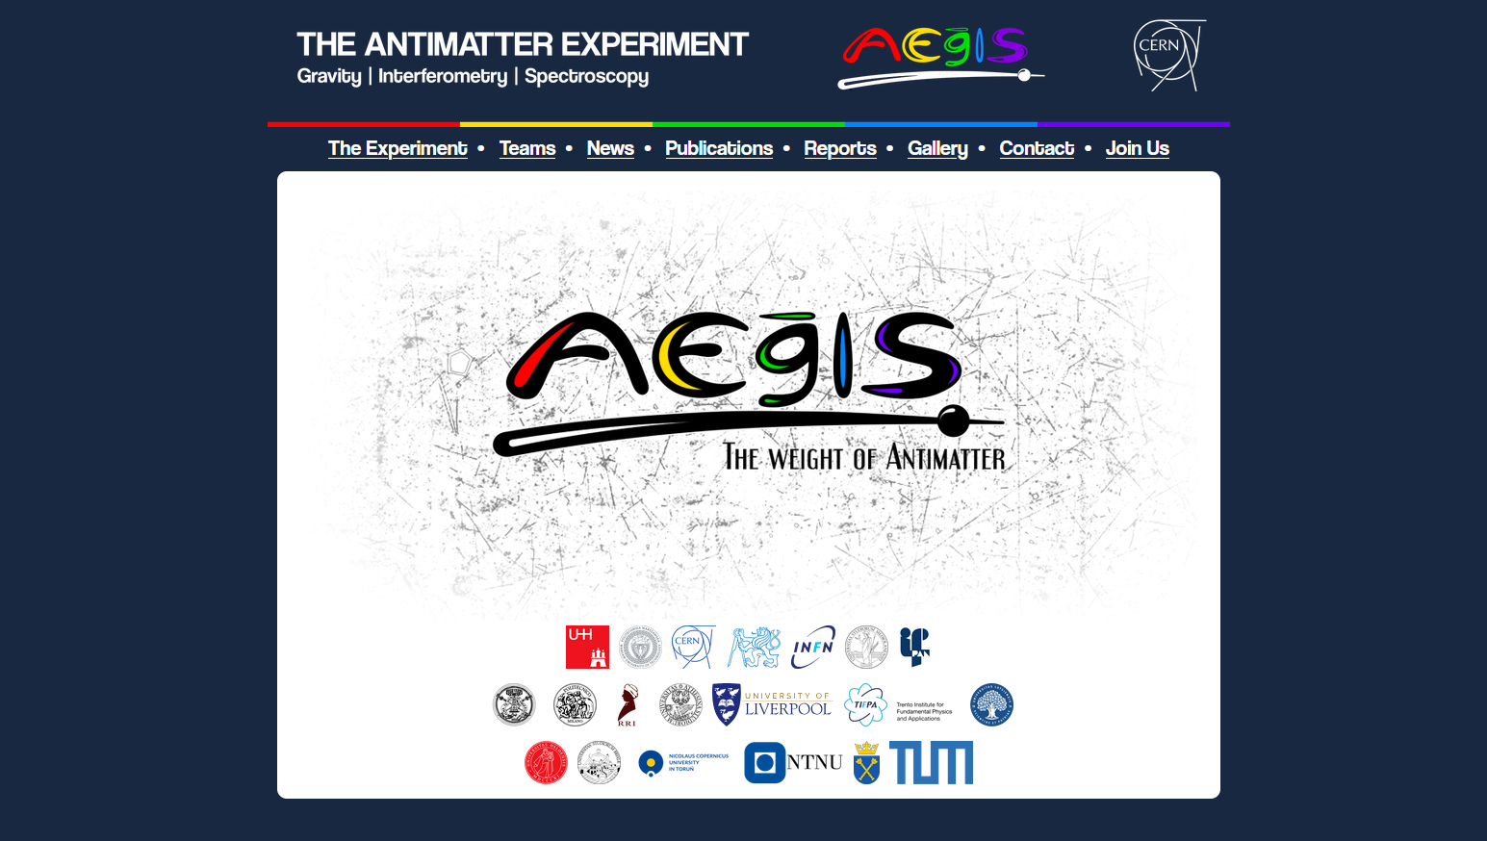
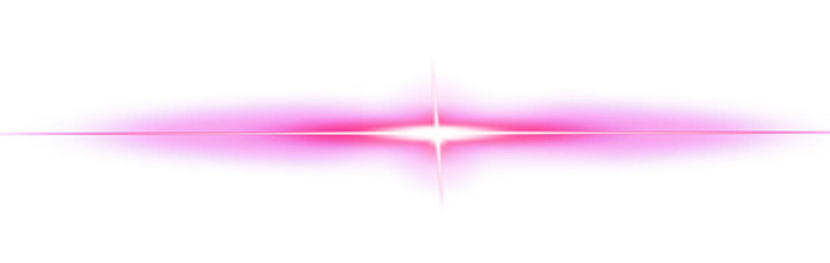
5 laser beams
≈500 million antiprotons
1 billion positrons
50 collaborators

Slide 2
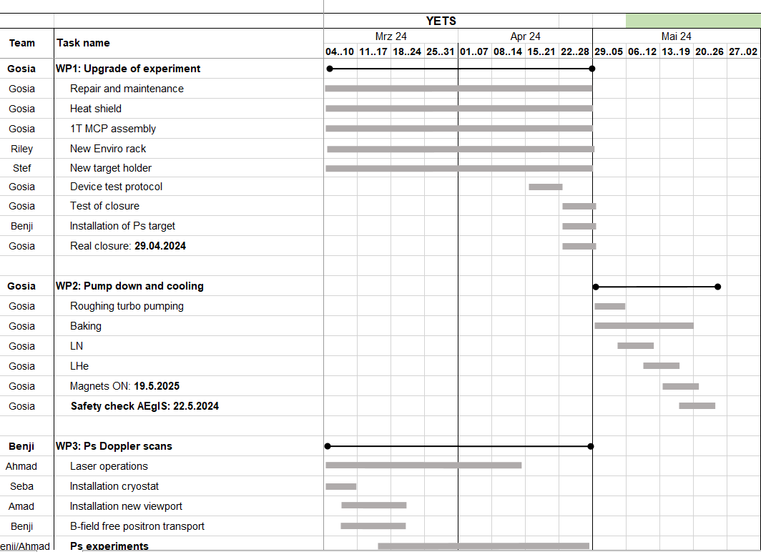
AEgIS 2025: Jan-May (+June +July)
Starting up
True transition of technical coordination – overall it went remarkably smooth
Huge success on the heat shield
Thanks to Stef, who designed and finished a new target holder from scratch (still … +1 month)
We missed an important WP: the anti-sun installation +1 month
Delay of 2 month - was well used for cryogenic Ps laser cooling experiments with a new Ps target and OPHANIM + pbar statistics

Slide 3
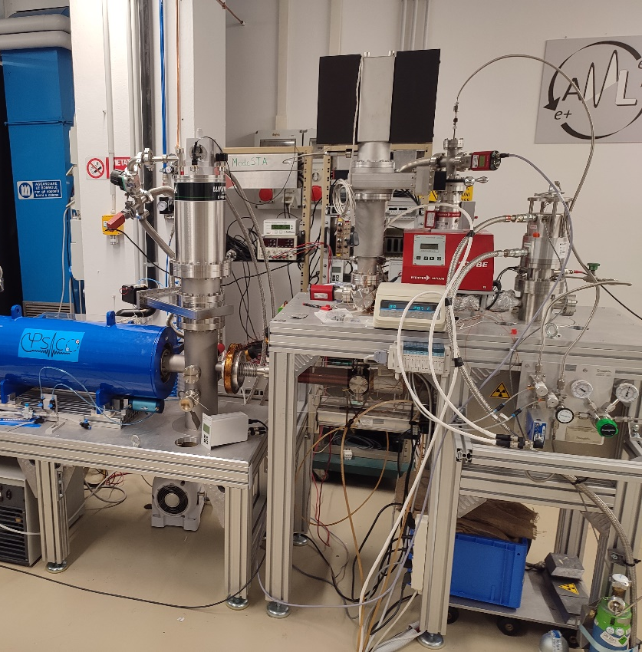
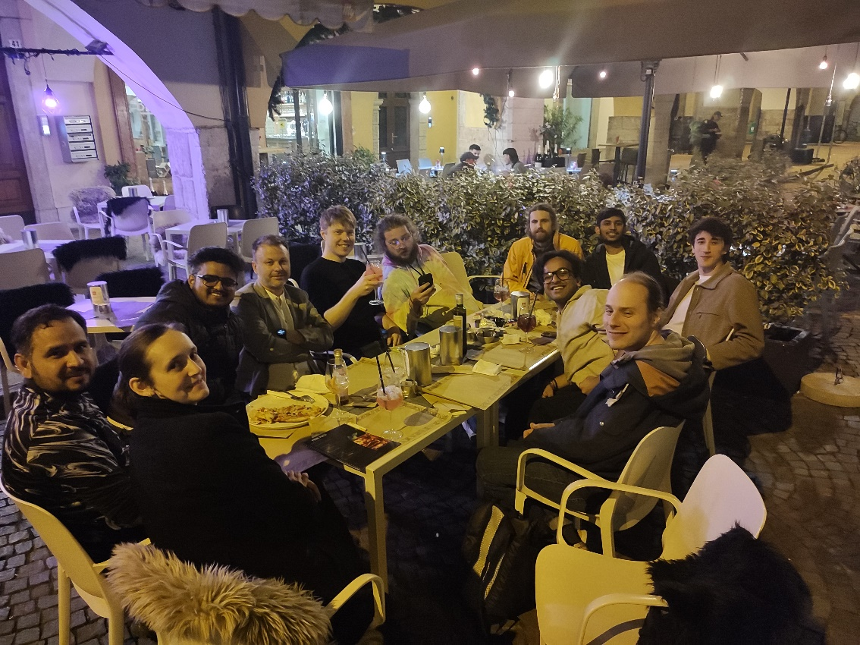
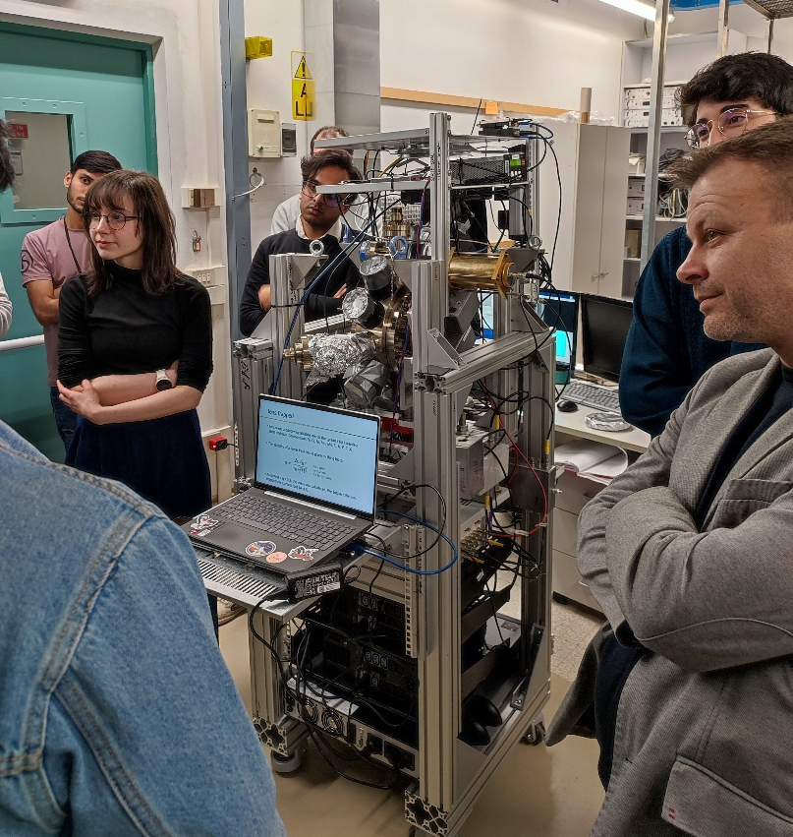
AEgIS 2025 – AEgIS Collaboration Meeting
April: Trento Collaboration Meeting

Slide 4
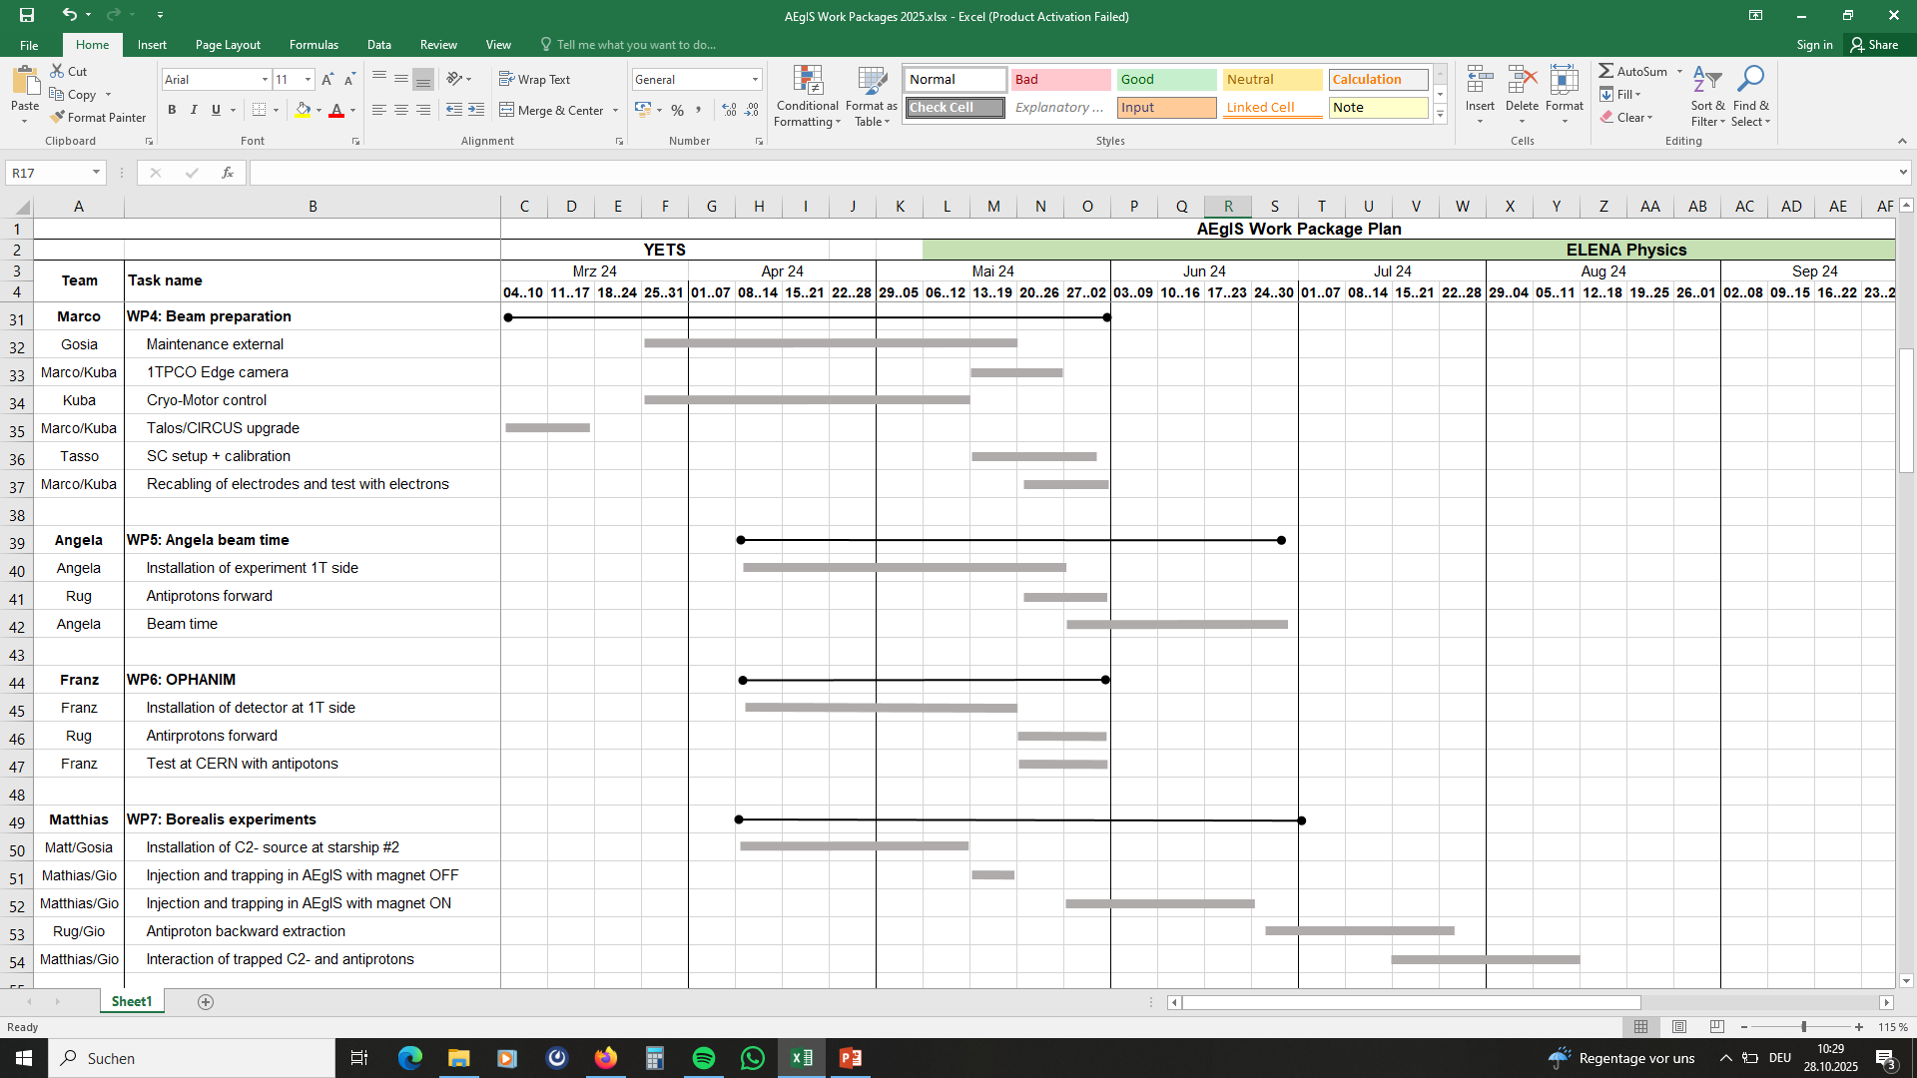
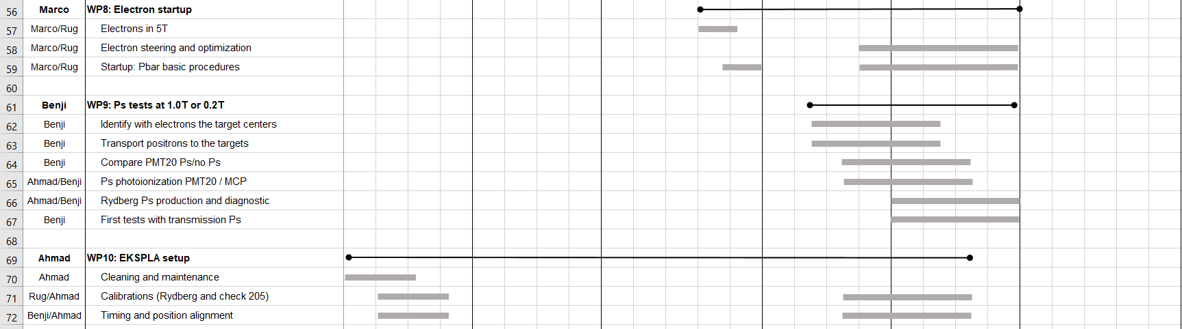
AEgIS 2025 – August speed run
August
CapbarA experiments
OPHANIM experiments with pbars
Commissioning of the BOREALIS source
Commissioning of PPT-chamber (FANTASIA)
Ps tests in 1T and 0.2T
Laser steering and testing in the 1T
Relocation of the Torun ion source to CERN

Slide 5
The MoirE Deflectometer for Universality and Symmetry of Antimatter (MEDUSA) Gravity Module
AEgIS 2025 – Partial warm-up
September
We diagnosed insufficient UHV vacuum in both the 1T/5T due to:
limited differential pumping during OPHANIM and CapbarA tests
procedural problem during cooldown with TP3
leaks in the antisun region
Installation and naming of the MEDUSA gravity module:
MoirE Deflectometer for Universality and Symmetry of Antimatter
We cleaned up to water evaporation!
Congratulation to the MEDUSA team!

Slide 6
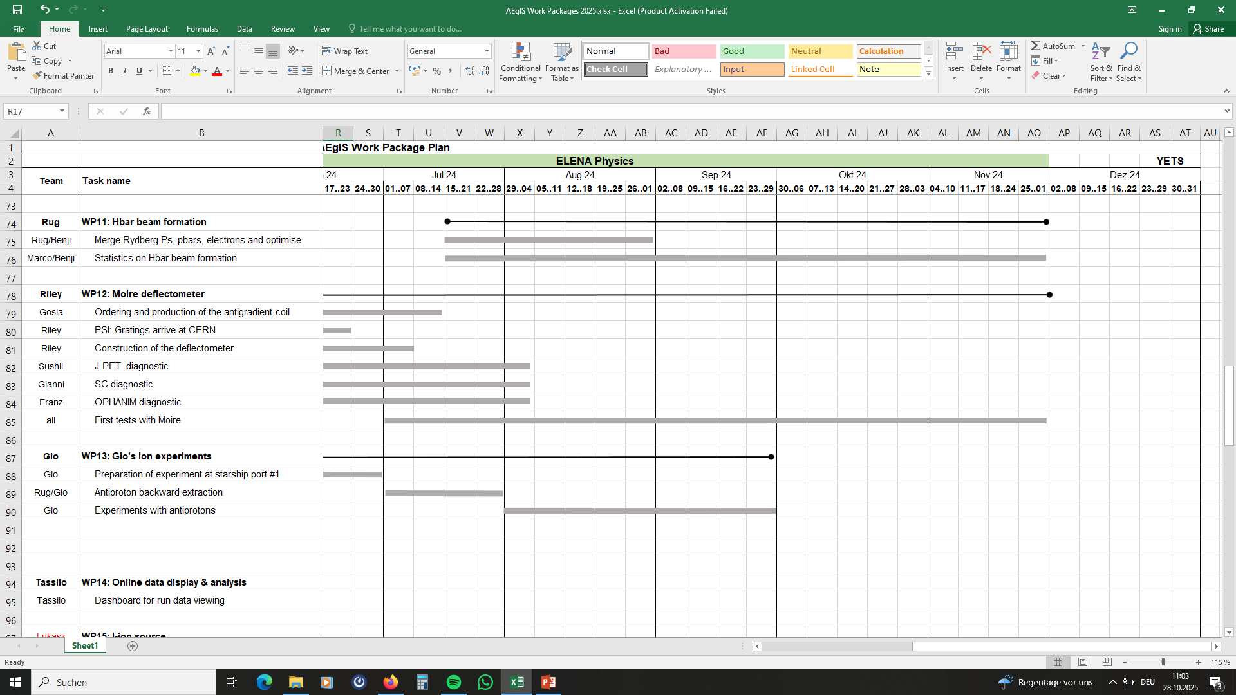
AEgIS 2025 – Final leap
Oct-Dec
No functioning Ps-target
Rapidly deteriorating UHV vacuum again (leak?)
First results with BOREALIS
Progress with FANTASIA
Commissioning of MEDUSA with antiprotons
A force measurement with MEDUSA on antiprotons
Development of procedures for an Hbar beam
Positron catching and cooling in 5T and transport to 1T
Three-body recombination

