Slide 1
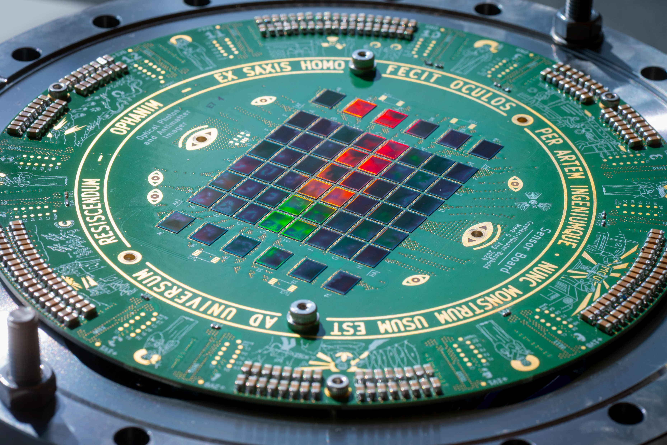
Progress of OPHANIM in 2025
Markus Münster & Michael Berghold
11. Dezember 2025

Slide 2
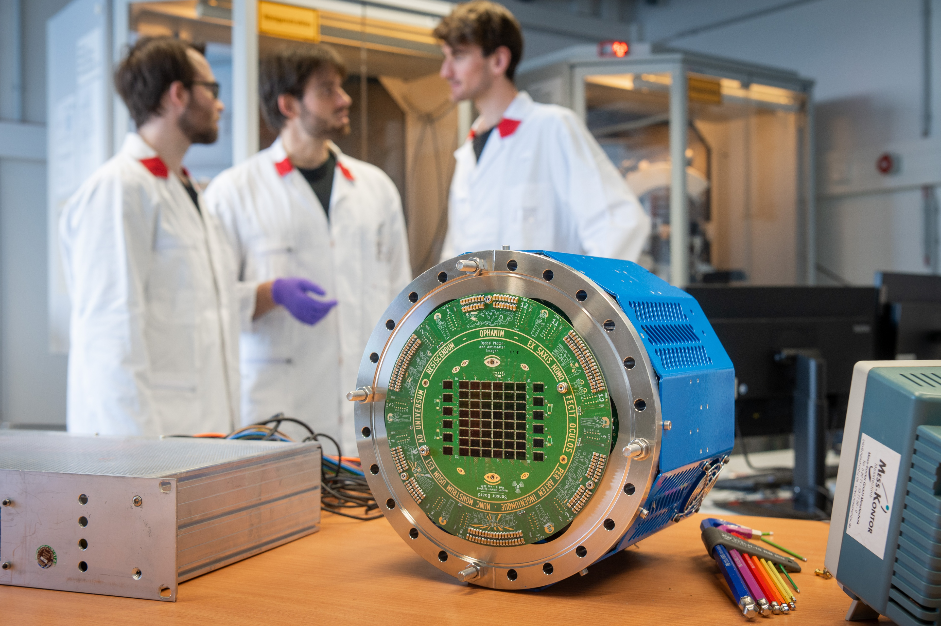
System Architecture
Limits of the System
First Pbars and Damage
Resolution Assessment
Pattern!

Slide 3
System Architecture
Limits of the System
First Pbars and Damage
Resolution Assessment
Pattern!

Slide 4
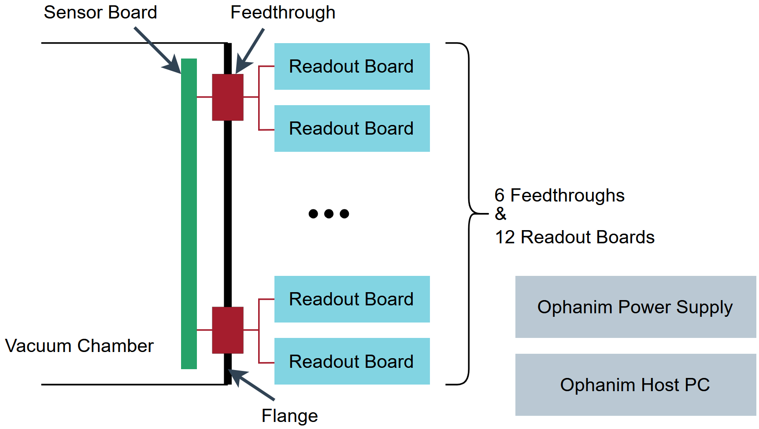
Hardware Overview
60 SONY IMX686 CMOS Sensors
➔ Total: 3850 MP
Notes:
Entire system developed and built by our Team consisting of Dr. FG, MB and me

Slide 5
Host Driver: Overview
Leave Standby = Sensor Board On + Set Sensor Config
Go To Standby = Sensor Board Off
After 2h
Timeout
1-2s
Turn Off RO Cards
After 10min Timeout or Automatic immediately
Setup
Arming for Transmission
Triggering
Data Reception
Post Acquisition Checks + Processing
Prepare for next Transmission
15-30s
1-2s
Depends on Exposure Time
Ca. 35-40s atm
10s Timeout
Link Health Monitoring

Slide 6
System Architecture
Limits of the System
First Pbars and Damage
Resolution Assessment
Pattern!

Slide 7
Trigger Mechanism
Option A
Trigger Signal via USB
Camera Controller
Option B
TTL Trigger Signal
GPIO Input
Rising Edge Detected
I2C Block
Set Start Register
Sensor
Introduce:
Delay
Jitter
Notes:
Along pipeline: delay, jitter → important to know to determine the time when the trigger is sent vs. all pixels of ophanim are active

Slide 8
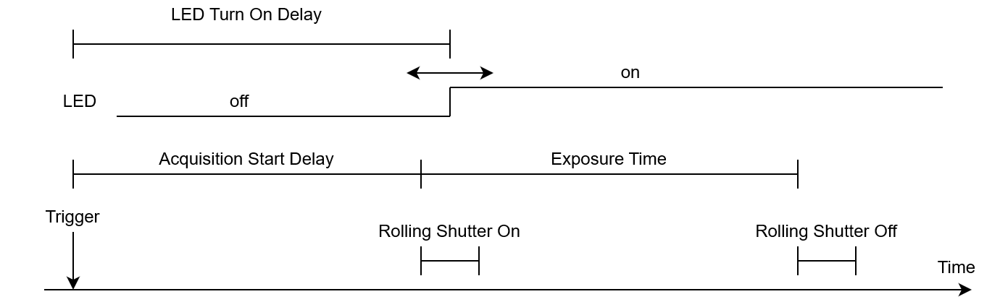
Trigger Performance Analysis
Procedure:
LED on before Exposure started ➔ Full Brightness
LED on after Exposure is finished ➔ Only Background
Notes:
LED Turn on delay: trigger to when Led is turned on
Rolling shutter
Only look at first block, remoive background and normalize from 0% to 100%
Want to measure acquisition start delay and its jitter

Slide 9
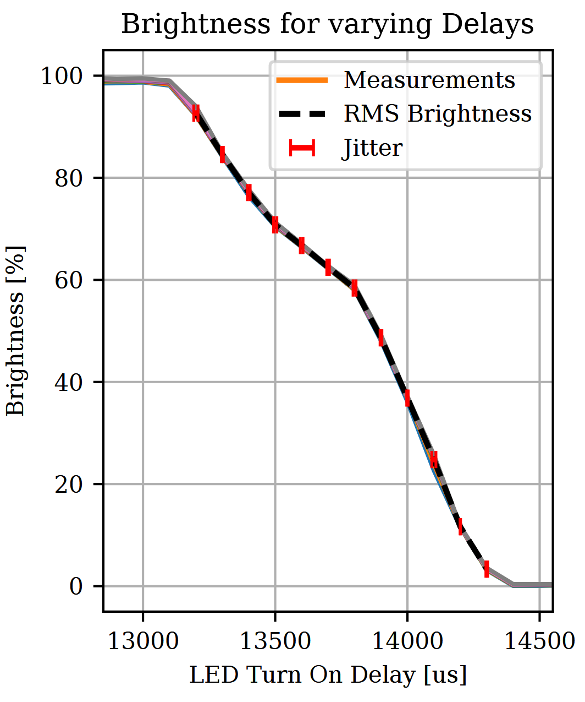
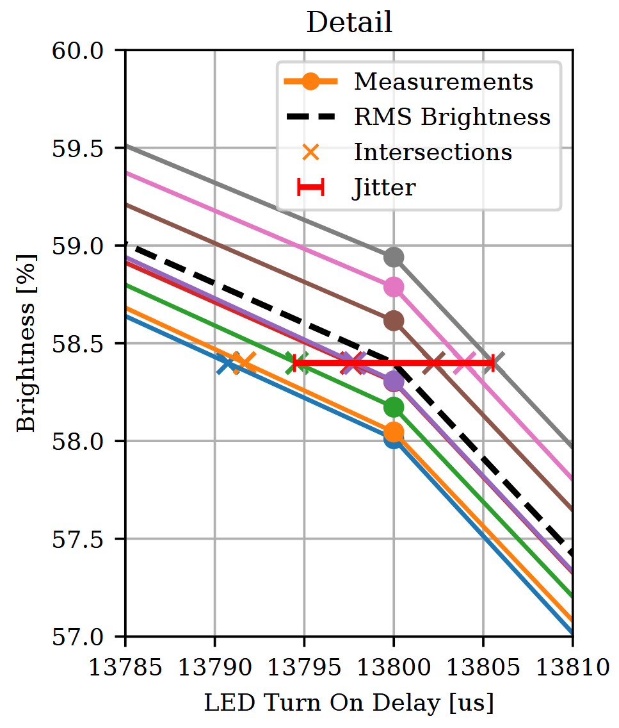

Trigger Performance Analysis
Linear Interpolation to invert the Function
Intersection: Time, at which Measurement crosses RMS Brightness
Jitter: Standard Deviation of Time Deltas
➔ Median Jitter: ±4.99 μs
I2C Bus Frequency: 100kHz
Notes:
- Brightness decline in between ca. 13000 and 14400 us, but not linear
Exposure: 1418.614 μs
Acquisition start delay is ca. 13000 ti 13100 us
For jitter: assumption
Mean
Look at detail

Slide 10
Trigger Performance Analysis
Turn on Delay smaller than 13100 μs
Jitter: ±4.99 μs
Rolling Shutter: ca. 542.4 ms
Trigger to be issued at least ca. 556 ms before incoming Particles are expected
For option A: Additional jitter of max. ±1ms due to USB Scheduling
Notes:
For exact turn on delay, more detailed scans would be necessary
Not necessary due to much longer rolling shutter
Engineers advice: assume 600 ms to be safe
542.415

Slide 11
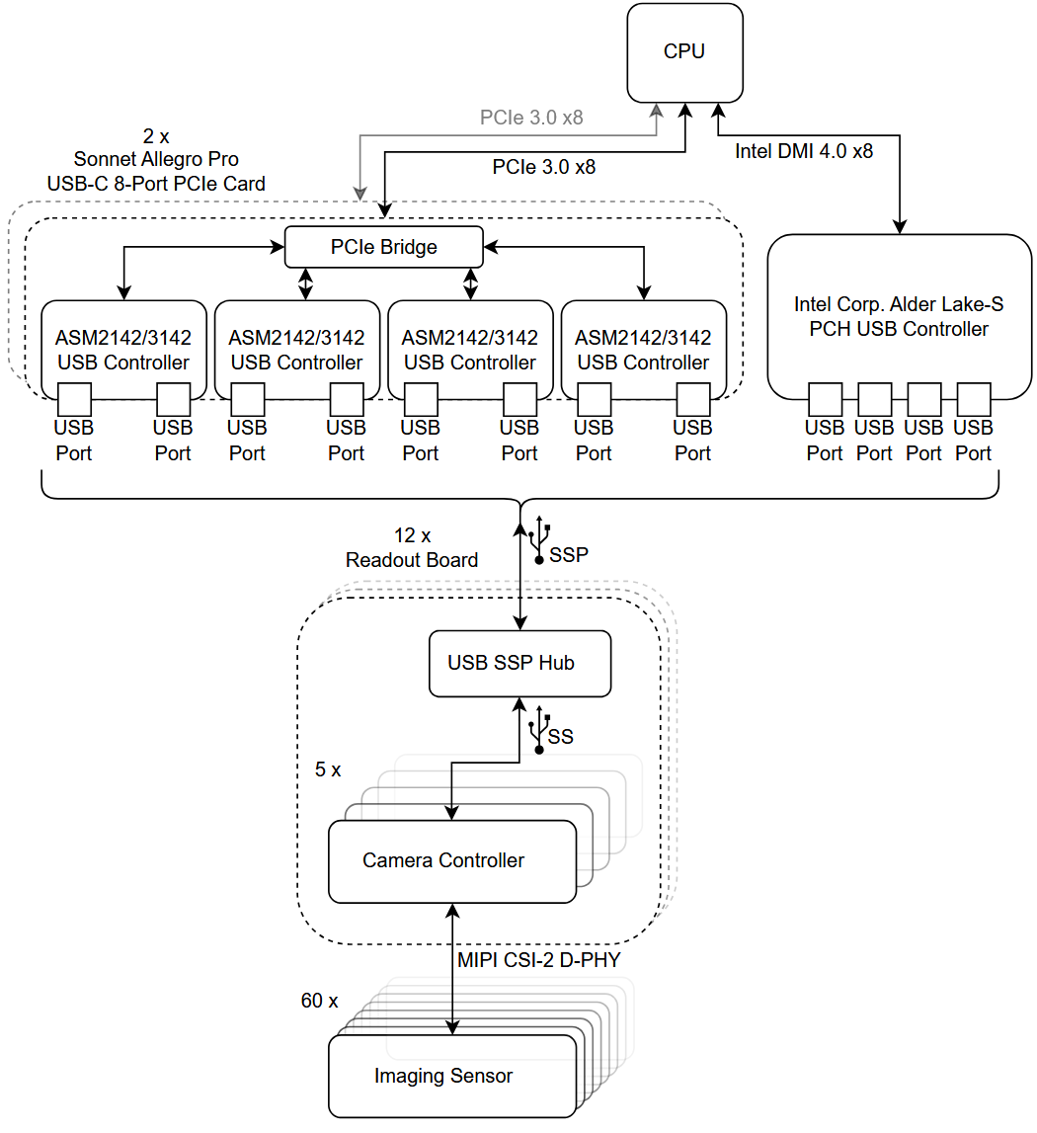
Bottleneck Analysis for Data Reception
Notes:
A lot of data in a short time
Investigate for bottlenecks to optimize throughput and avoid data loss
Go through components top to bottom

Slide 12
Ophanim Data Bus
20 Gbps in total
Sonnet Allegro PCIe Cards
SSP on each port simultaneously PROMISED
Link Bandwidths (actual Payload)
  8x SSP: 8x ca. 1.1 GB/s
  PCIe 3.0 x8: ca. 7.8 GB/s
Devices enumerate only as SS, not SSP
10 Gbps each
5 Gbps each
Notes:
Actually system of busses
Bottom to top
60 sensors connected to 60 camera controllers via MIPI CSI-2
Each five camera controllers on one RO card connected to a hub with a USB SS connection
12 RO cards have each one SSP upstream connection
Task: 12 SSP connections to host each, with full 10 Gbps bandwidth
On mother board: Intel PCH: up to 20 Gbps → can handle 2 SSP connection
Extra ports with 2 PCIe cards
Manufact. Promises full SSP bandwidth on all ports simultaneously
Scanning used components reveals: PCIe connection to weak
Attached devices do not enumerate as SSP dev. (commercial devices as well)

Slide 13
Bottleneck Analysis: PCIe
128 GT/s
➔ Much more performant than USB controller
Would bottleneck, if 2 SSP devices attached to any USB Controller
20 Gbps in total
Most performant USB configuration:
One Device per ASM2142/3142
Four Devices at Intel PCH USB Controller
PCIe 3.0 x8 performant enough
Notes:
Right: DMI overpowered compared to USB → no problem
PCIe x8 evenly split → each controller gets 2 lanes
Enough for one SSP device per controller (however, devices only go to SS anyways) → 8 RO cards attached to 8 controllers of PCIe cards → PCIe is performant enough to handle this
4 RO cards left connected to PCH controller
→ Experimentally proven to be most performant config, PCIe not a bottleneck

Slide 14
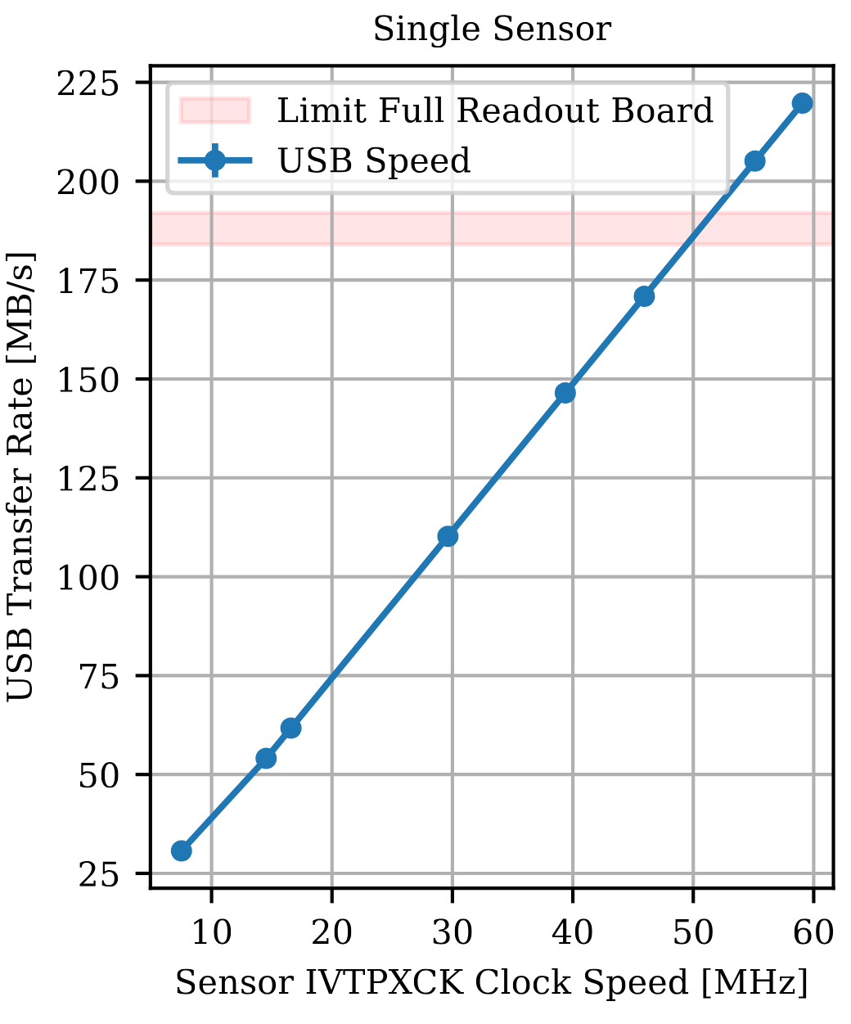
Bottleneck Analysis: USB
actual Payload
10 Gbps
⬄
920 to 960 MB/s
of usable Payload
→ Shared by 5 Devices
Only doable with USB controllers supporting SSP on all their used ports simultaneously
Ca. 730 MB/s on Hub ⬄ USB Controller Connection
Exceeding expected max. of SS (ca. 460 – 480 MB/s)
Can be achieved with entire detector with given hardware
Internal Sensor Clock Dictating the Pixel-Readout Frequency
Notes:
Actual payload speed → other only with special equipment
Single sensor, camera controller pair first
Data rate dictated by sensor settings → define “output rate” of sensor, everything else has to follow, as there is no memory to store the image data on the pipeline
Absolute limit for SSP → shared by 5 devices
Only doable with proper controller (PCH)
Below 40 MHz, green → achievable with given hardware with entire detector
Blue: limit for reliable transfer with entire detector: exceeds SS limits → even though RO cards connected to the PCIe cards are only enumerated as SS devices and PCH controller should not be able to handle data rate of 4x 730 MB/s

Slide 15
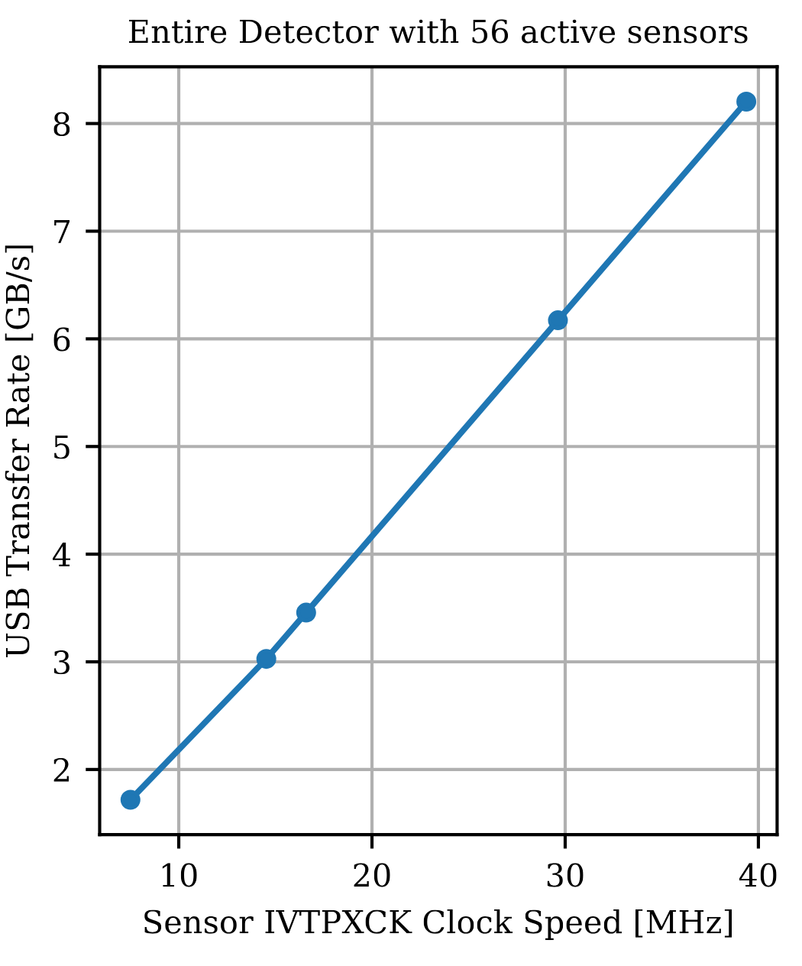
Bottleneck Analysis: USB
With better USB Controllers: at least 11.4 GB/s should be possible
Notes:
Green area translates into up 8.2 GB/s over entire ophanim detector
With all SSP capcable USB controllers: 45 MHz and up to 11.4 GB/s should be possible with entire detector

Slide 16
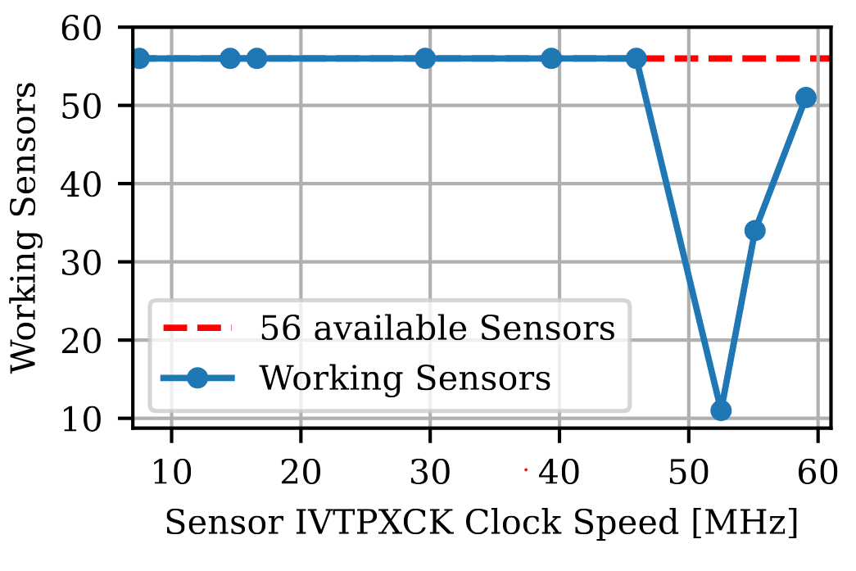
Bottleneck Analysis: MIPI CSI-2
Limit for reliable MIPI CSI-2 Link
➔ Shrinkage of Range of working Parameter Settings for the MIPI CSI-2 Link for high frequencies
Notes:
Scan all sensors on sensor board: some stop working at higher data rates
Working set of parameters for all sensors is harder and harder to find → anything above 45 MHz not reliable over entire sensor board, however, trend is not clear
Anyways above what USB can do

Slide 17
Bottleneck Analysis: Conclusion
Bottleneck: ASM2142/3142 USB Controllers
MIPI CSI-2 Link only allows slightly higher data rates

Slide 18
System Architecture
Limits of the System
First Pbars and Damage
Resolution Assessment
Pattern!

Slide 19
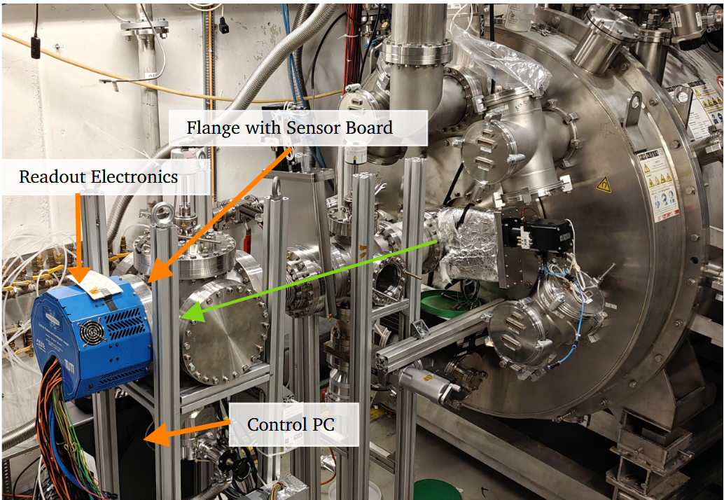

First $\overline{p}$ on Ophanim and Sensor Damage
Img of ophanim at anti-sun

Slide 20
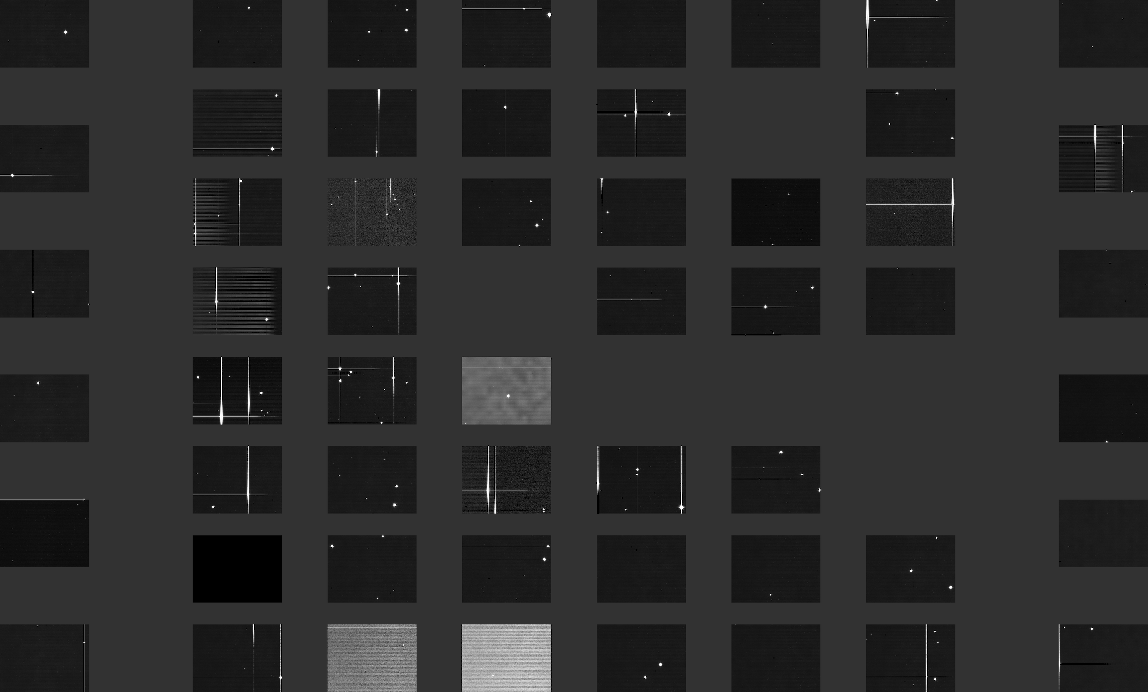
“Dark” Background Acquisition

Slide 21
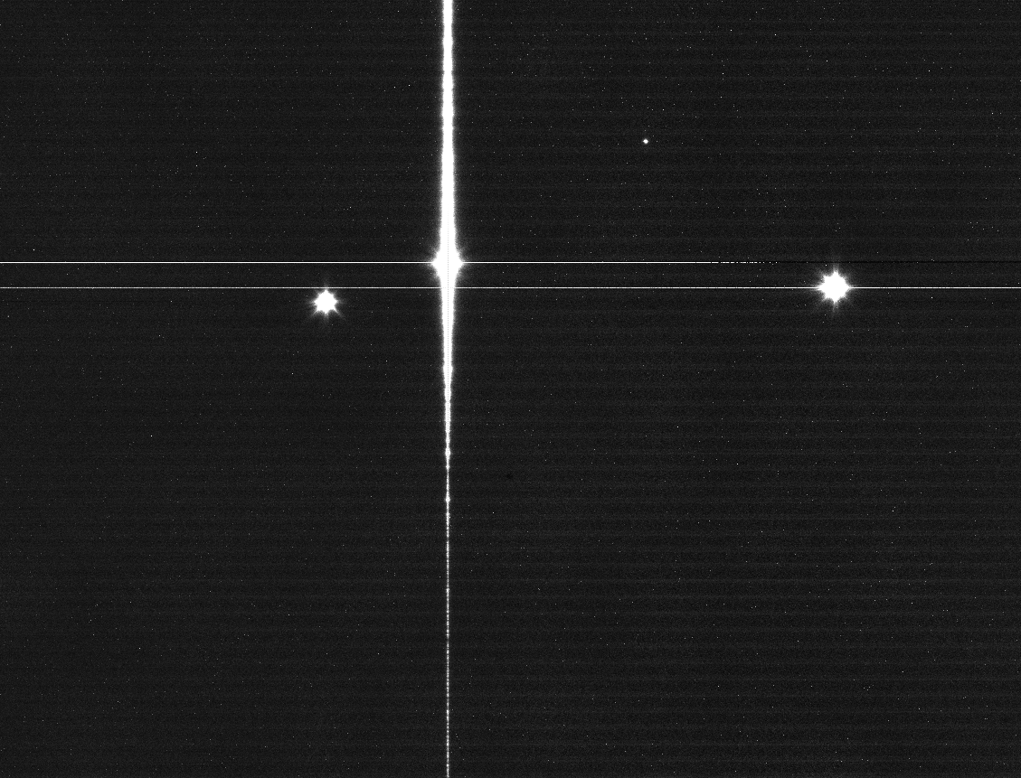
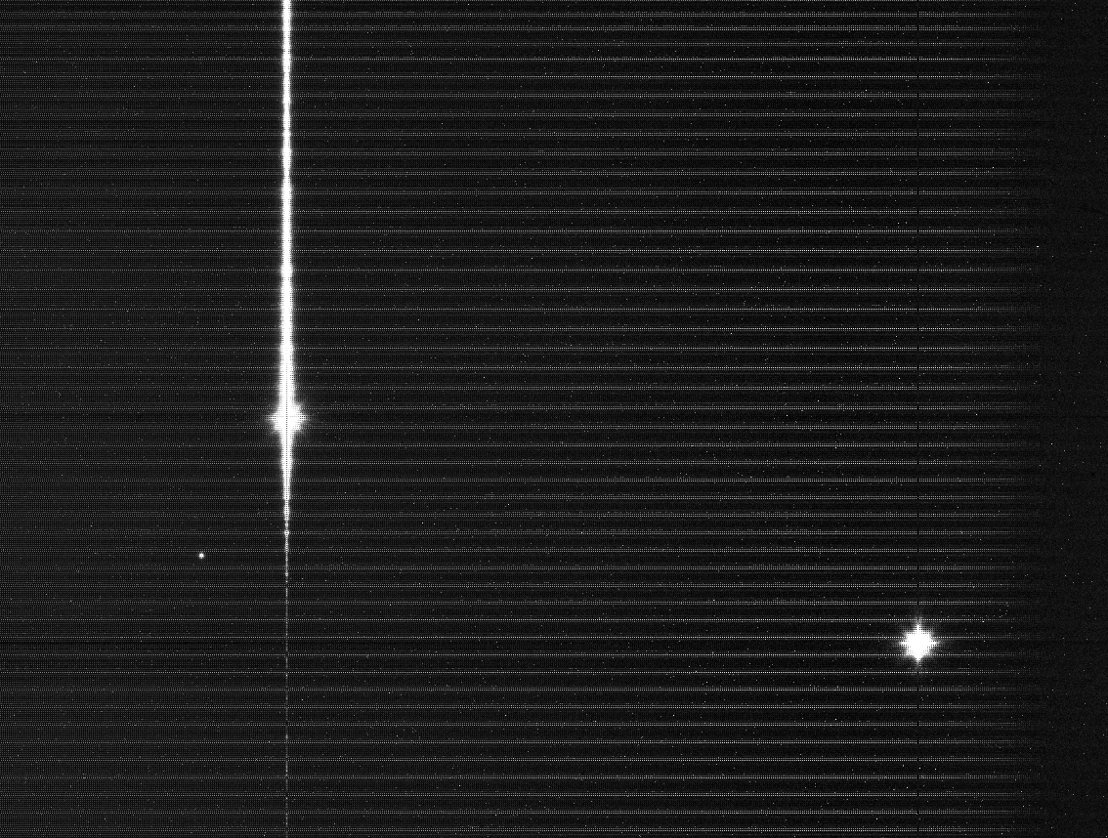
“Dark” Background Acquisition

Slide 22
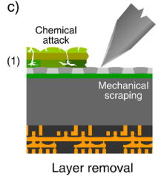
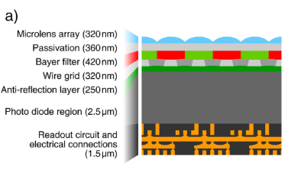
Under the hood…

Slide 23
Under the hood…

Slide 24
Under the hood…

Slide 25
Under the hood…

Slide 26
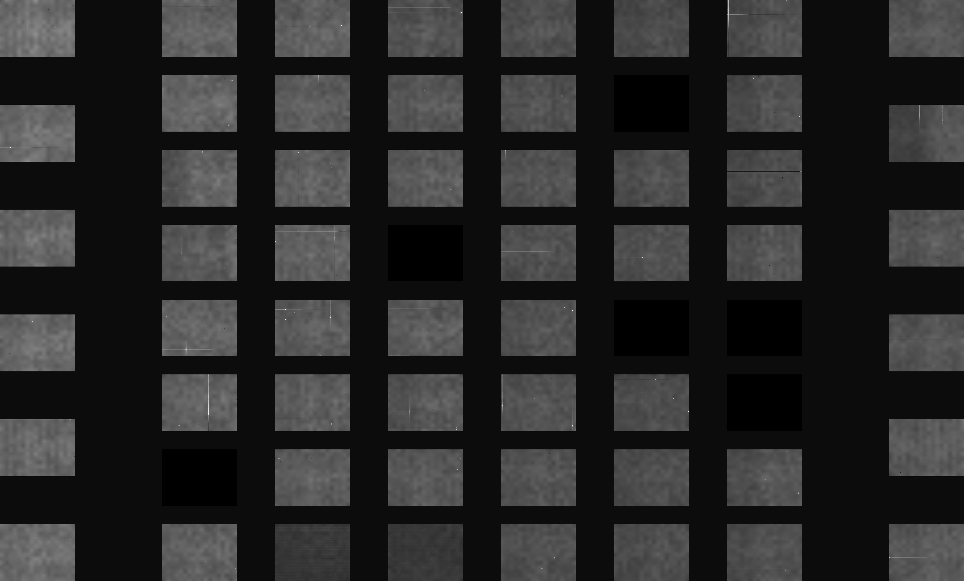
Optical Light Image

Slide 27
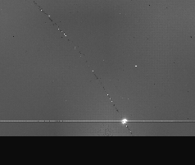
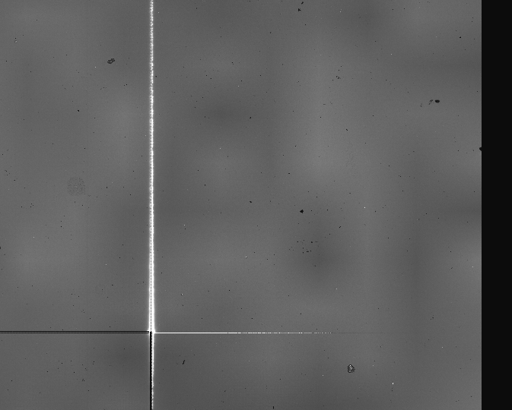
Optical Light Image
etc...

Slide 28
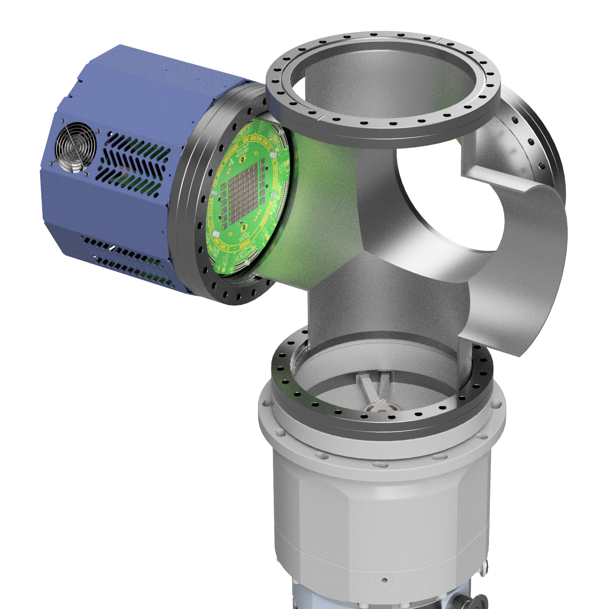
Our Theory
2025
The Timeline
May
OPAHNIM is delivered to CERN and installed in CF-Cross
No Damage visible at this point
June
specs of dust /
microscopic debris
July
Installation of OPHANIM onto
Anti-Sun
Extensive sensor damage as shown
August

Slide 29
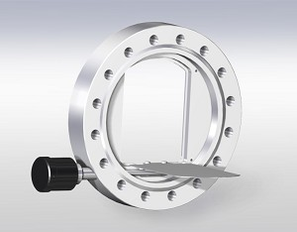
A Potential Solution?

Slide 30
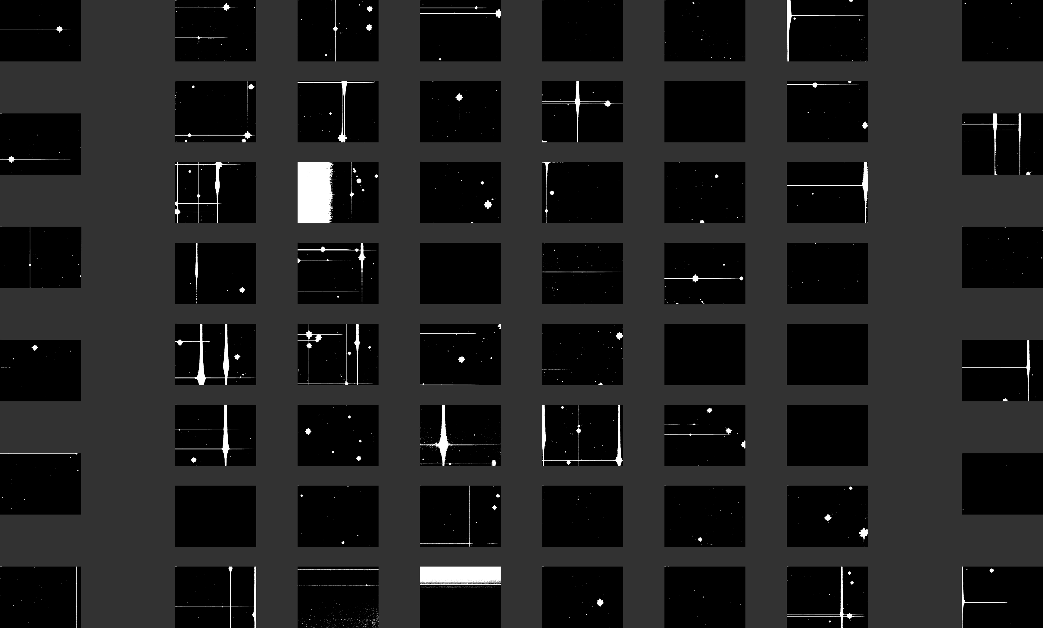
Dead Pixel Mask
Dead:
513 MPx
13.45 %

Slide 31
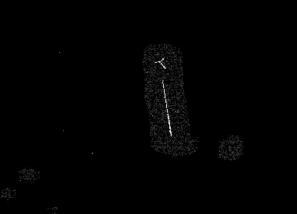

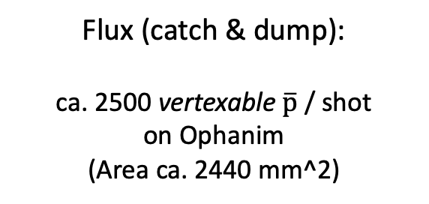
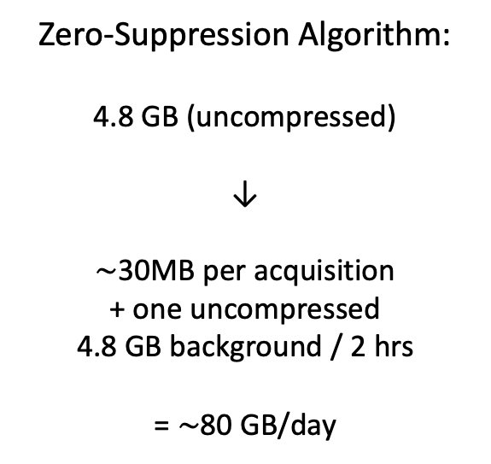
Finally: First $\overline{p}$ on Ophanim
Flux (catch & dump):
ca. 2500 vertexable $\overline{p}$ / shot
on Ophanim
(Area ca. 2440 mm^2)
Zero-Suppression Algorithm:
4.8 GB (uncompressed)
↓
$\sim$30MB per acquisition
+ one uncompressed
4.8 GB background / 2 hrs
= $\sim$80 GB/day

Slide 32
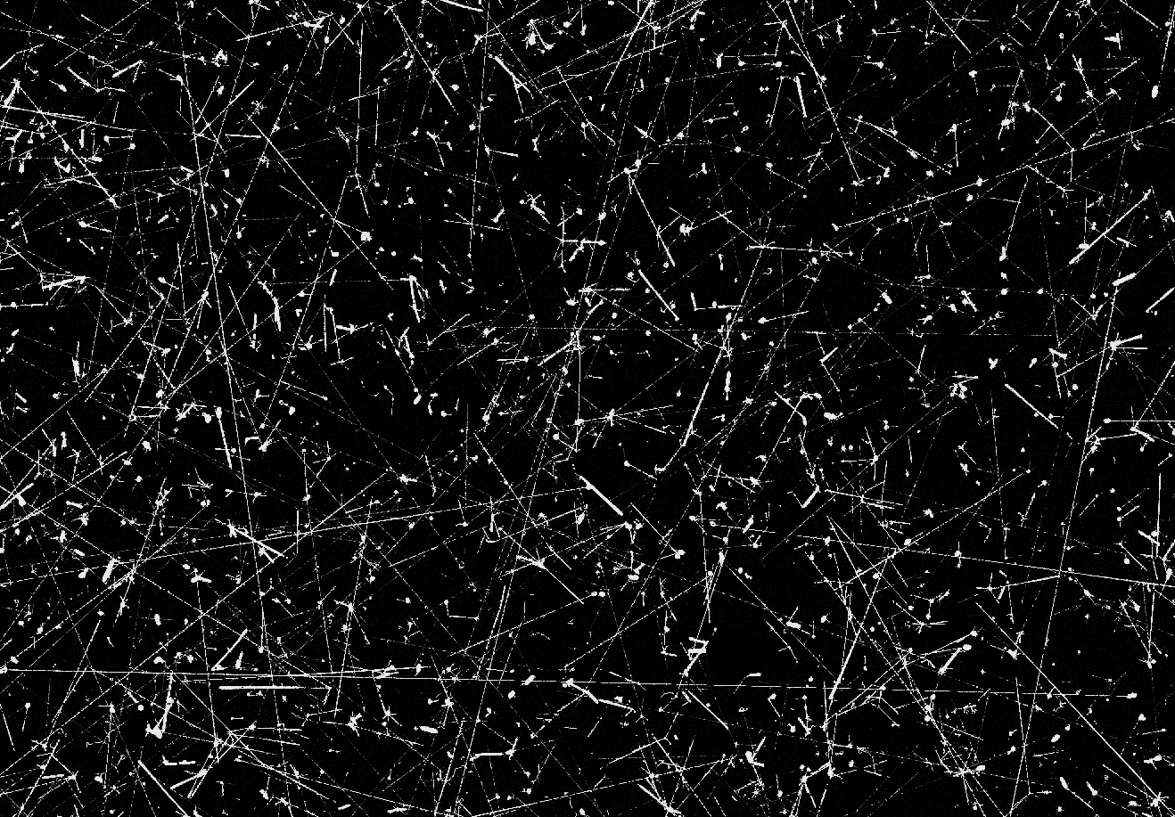
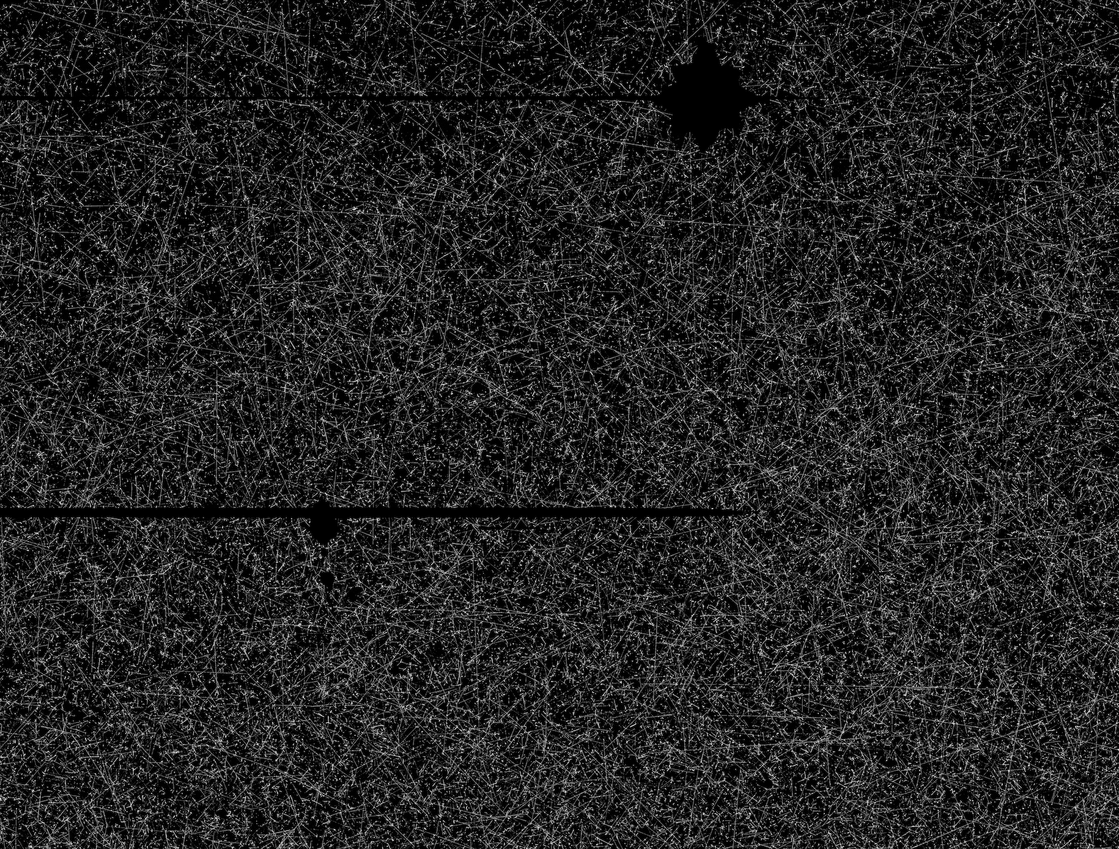
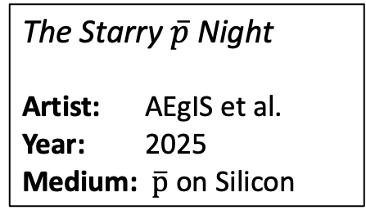
And now some more…
The Starry $\overline{p}$ Night
Artist: AEgIS et al.
Year: 2025
Medium: $\overline{p}$ on Silicon
In total (no catching):
ca. 300e6
vertexable Pbars collected
with / without degrader

Slide 33
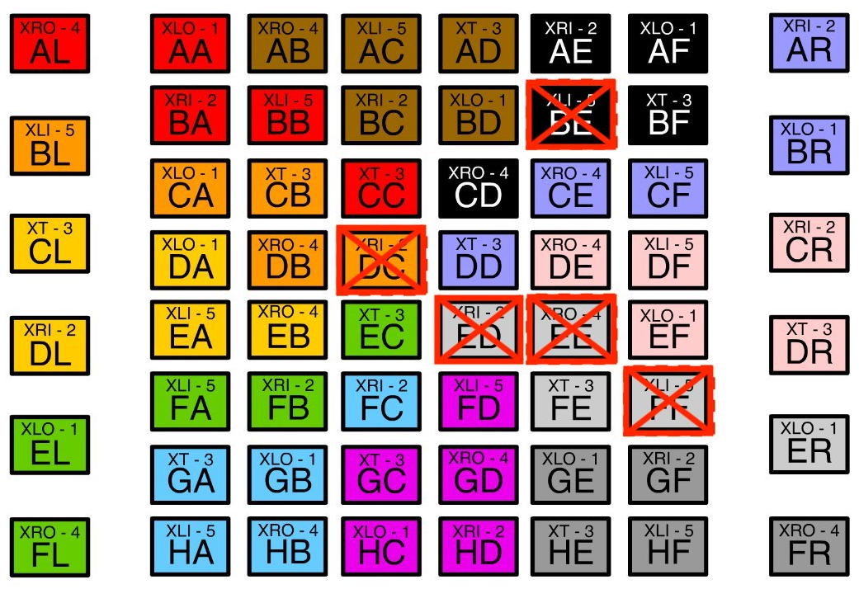
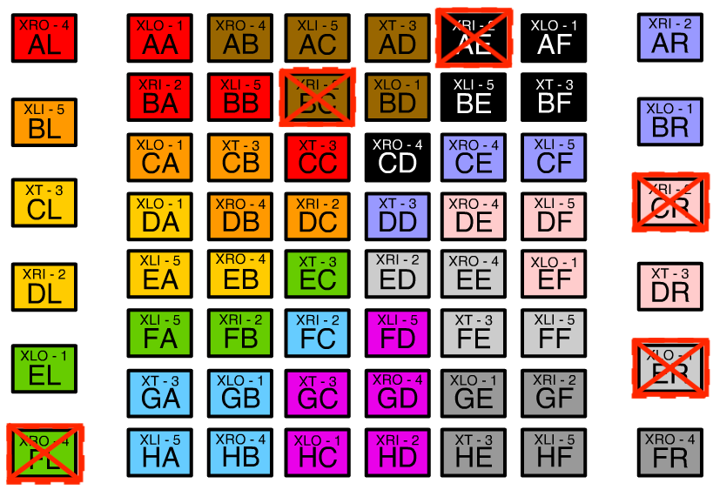
On the Ophanim Sensor Boards
Board No. 1
Board No. 2

Slide 34

On the Ophanim Sensor Boards
Five original Sensor PCBs (5k€ total):
Sensor Board Nr. 1: First to be installed at AEgIS
(6 Sensors defunct, remainder
significantly damaged)
Sensor Board Nr. 2: Currently installed at AEgIS
(5 Sensors defunct, remainder in perfect order)
Remaining Sensor Boards were needed to find process control & integration testing -> no longer available

Slide 35
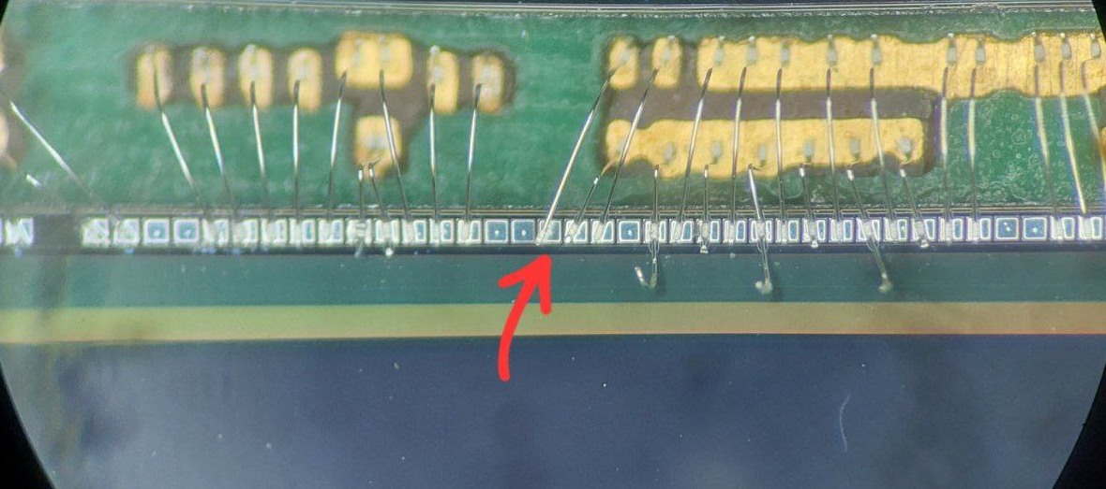

On the Ophanim Sensor Boards
Wires of
20 µm thickness
100 Bondwires
per Sensor
Special Thanks to
Herbert Schiffner

Slide 36
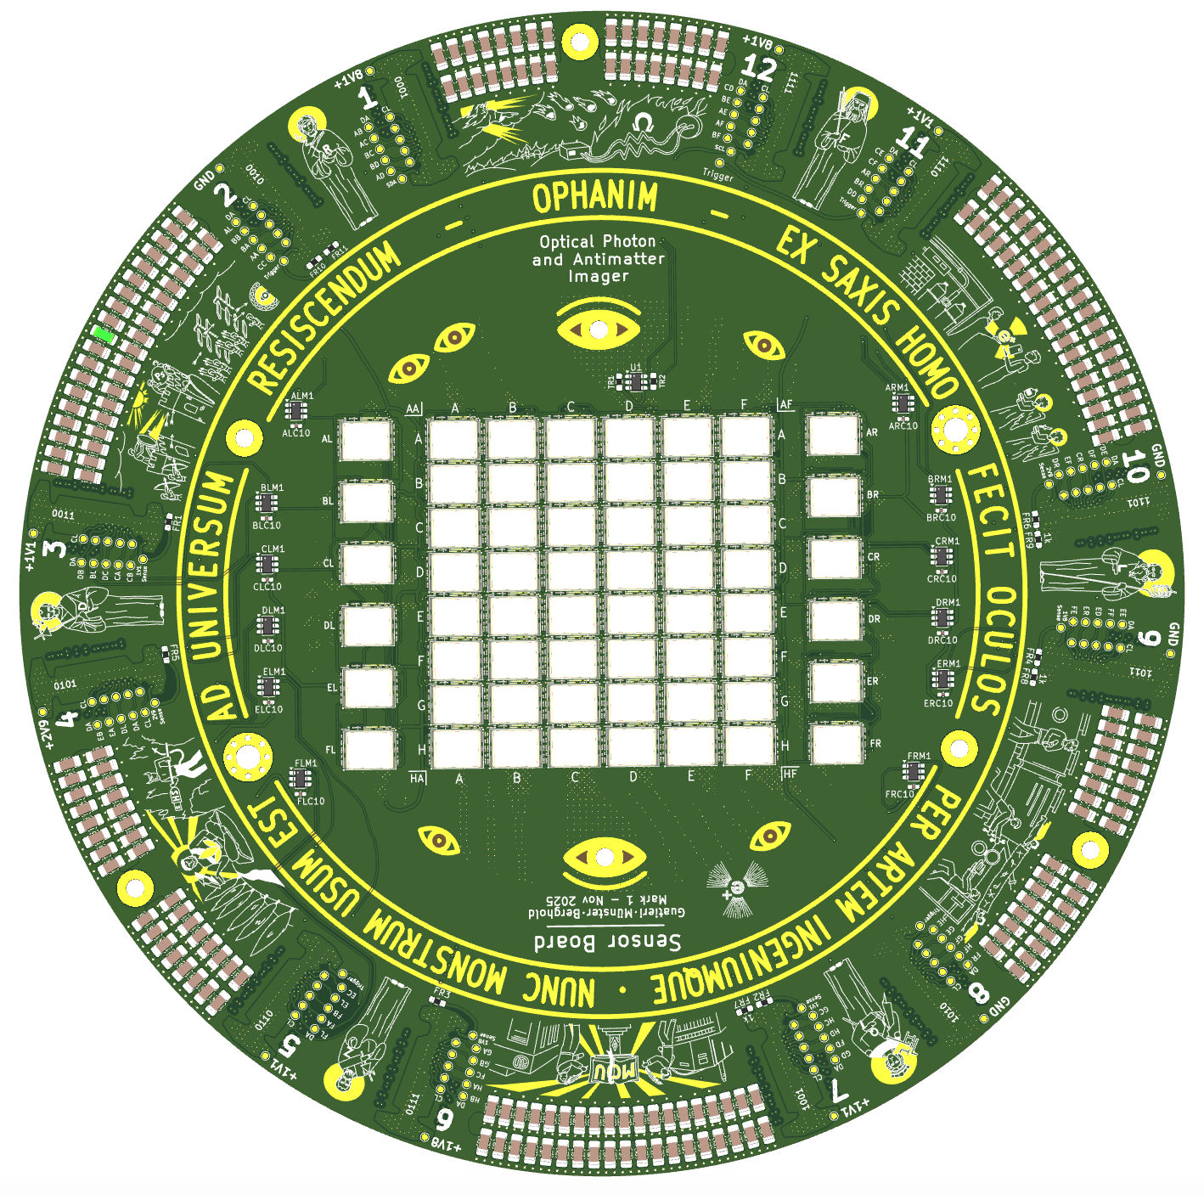
On the Ophanim Sensor Boards
5 More Sensor Boards currently in Production
Delivery in Feb. 2026
Already in contact with specialized wirebonding company
More advanced process and QA
Pricerange around 7.5 k€ for 3 Boards
V2

Slide 37
System Architecture
Limits of the System
First Pbars and Damage
Resolution Assessment
Pattern!

Slide 38
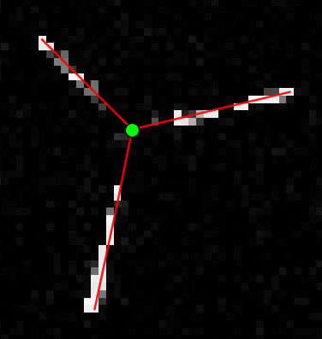
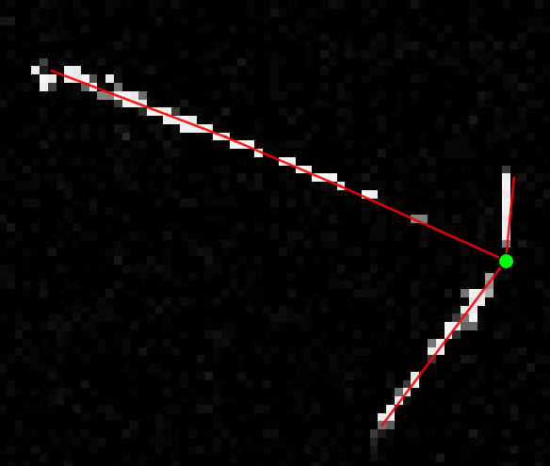
Vertexing Algorithms: SOLD2
Feature Extraction
Line Detection with SOLD2
Weighted Vertexing
SOLD2: Self-supervised Occlusion-aware Line Description and Detection (Pautrat et. al.)
Notes:
Self supervised:
Training on Synthetic data with known ground truth
Homography Adaptation on real images → Pseudo ground Truth
Training on real images using the pseudo ground truth

Slide 39
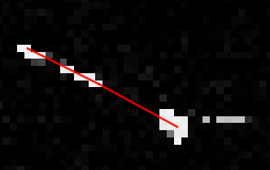
Vertexing Algorithms: SOLD2
Feature Extraction
Line Detector
→ Struggling with Dots
Line Detection with SOLD2
Weighted Vertexing
SOLD2: Self-supervised Occlusion-aware Line Description and Detection (Pautrat et. al.)
Notes:
Self supervised:
Training on Synthetic data with known ground truth
Homography Adaptation on real images → Pseudo ground Truth
Training on real images using the pseudo ground truth

Slide 40
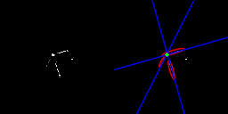
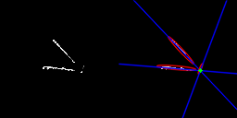
Vertexing Algorithms: ARIADNE
Feature Extraction
Ellipse Detection for Combination of Gaussian Mixture Model and Bayesian Information Criterion
Vertexing
Notes:
Aggregate Recomposition (divisive) with Integrated Analysis and Dimensionality (PCA)

Slide 41

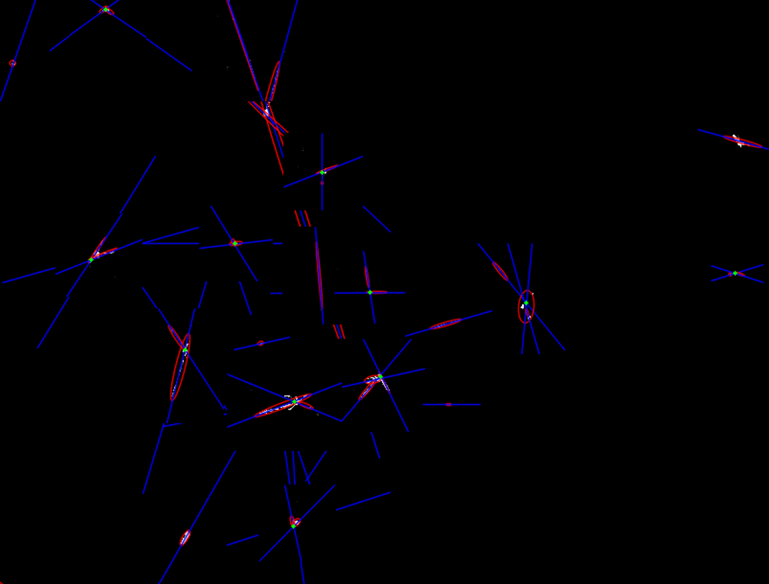
Vertexing Algorithms: ARIADNE

Slide 42


Quantifying the Resolution
Pbars
Recap of 2023

Slide 43
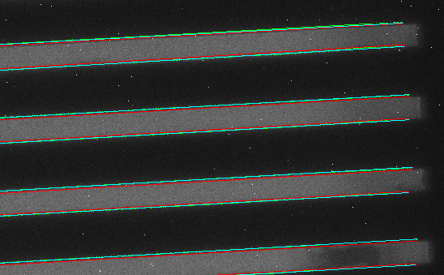
Quantifying the Resolution
Recap of 2023

Slide 44
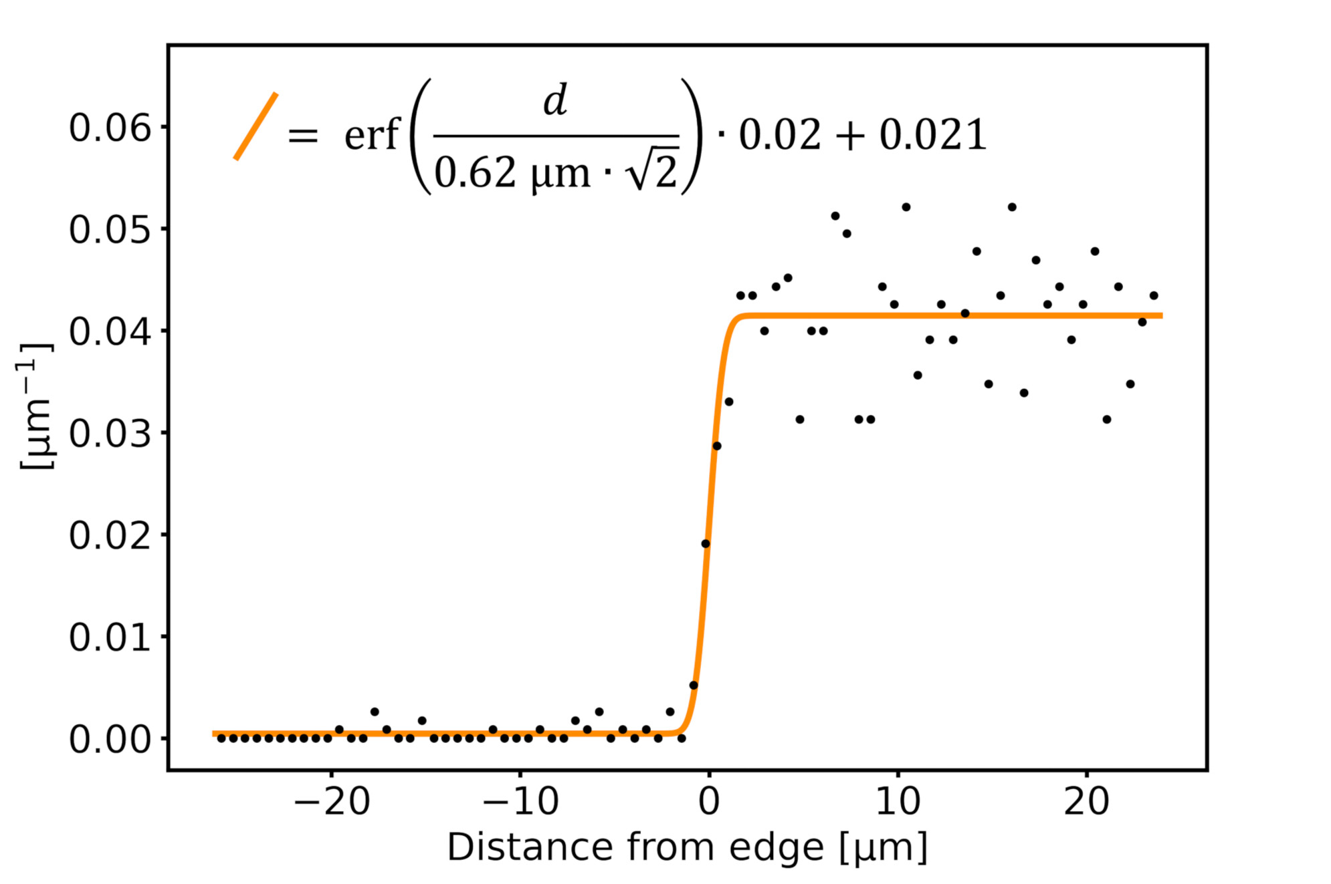
Quantifying the Resolution
Recap of 2023

Slide 45

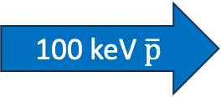

Quantifying the Resolution
Grid Image with $\overline{p}$ ?
100 keV $\overline{p}$

Slide 46
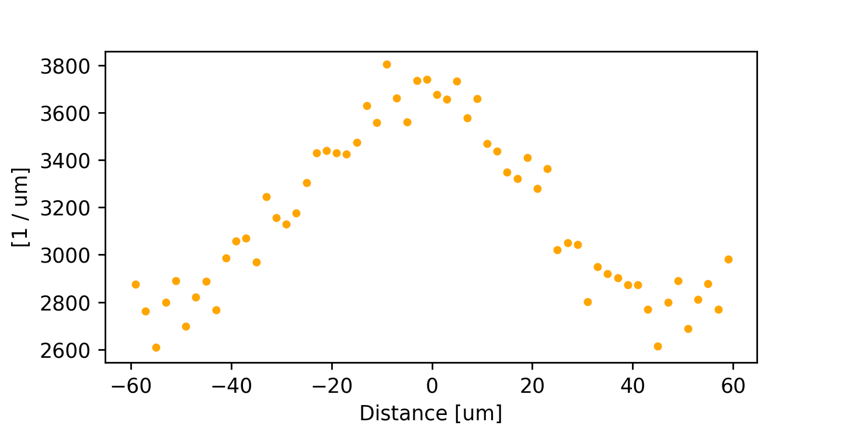
Quantifying the Resolution
Preliminary

Slide 47
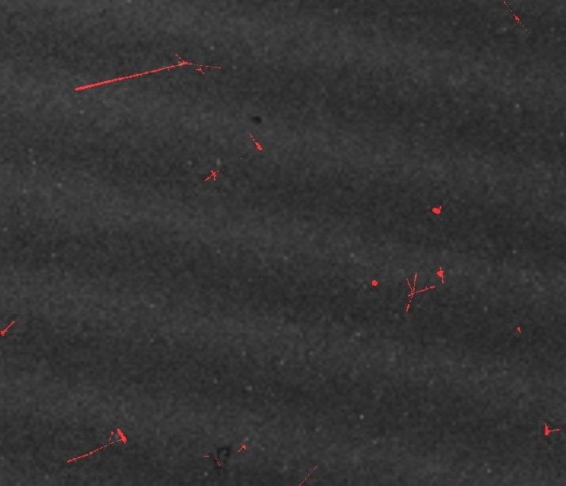
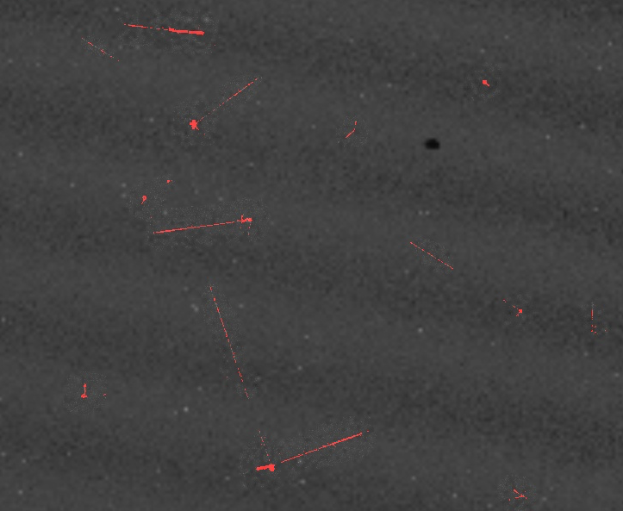
Quantifying the Resolution
Misalignment?
B-Field?

Slide 48
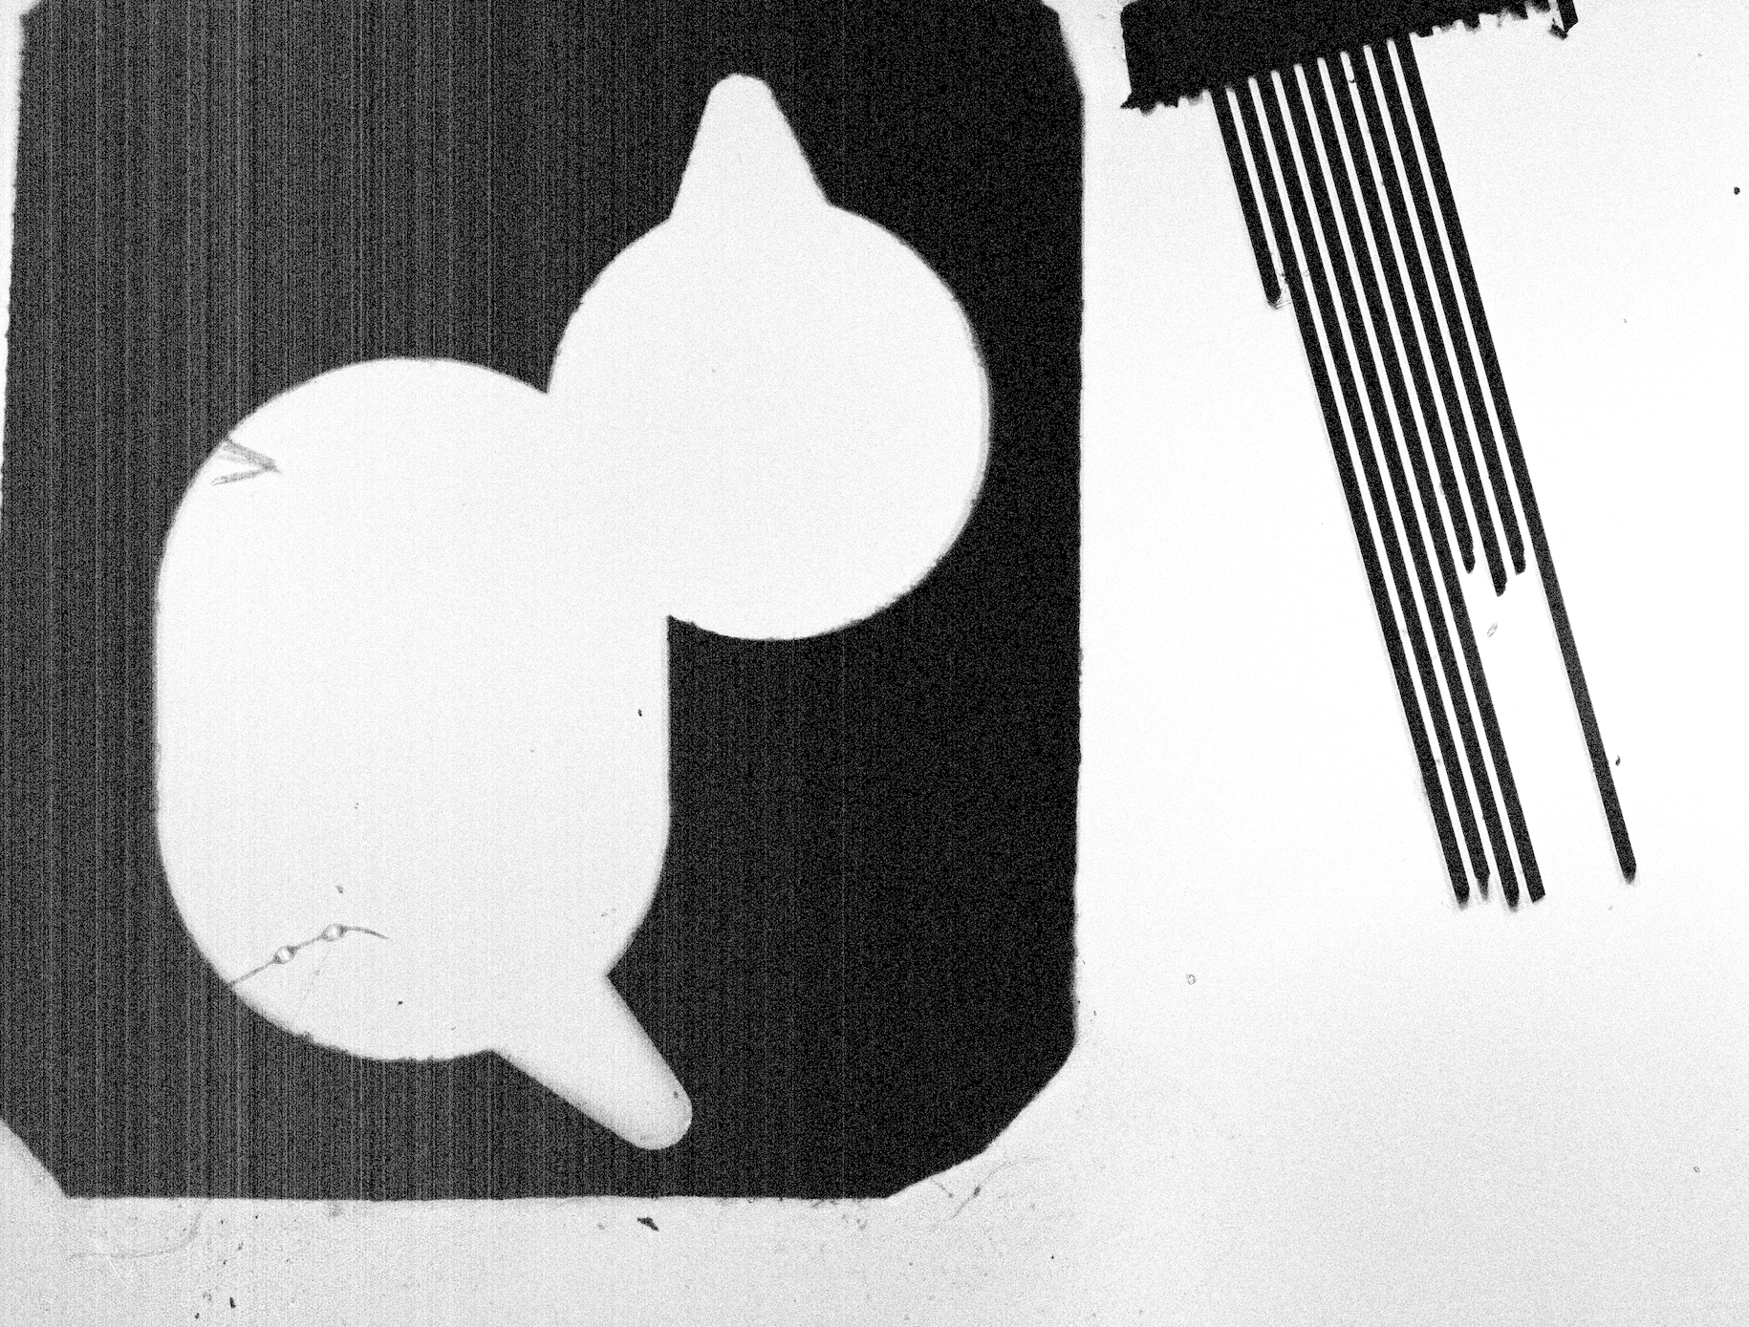
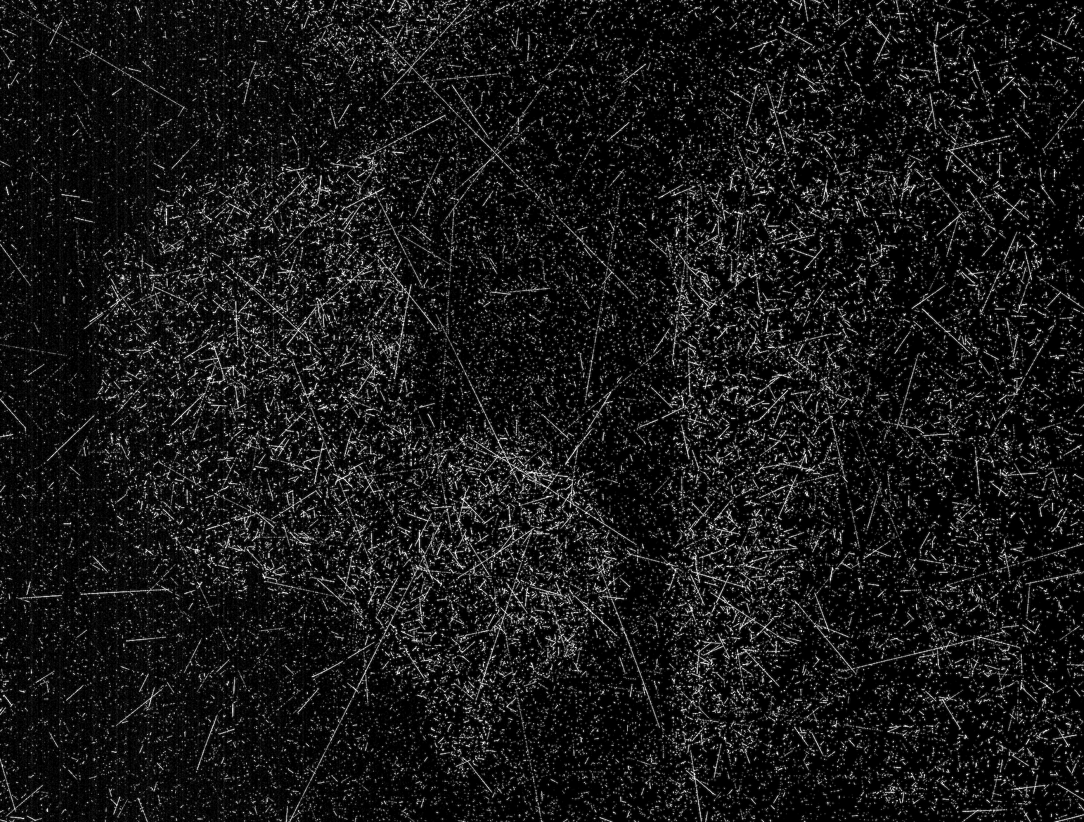
Quantifying the Resolution (IMX682)

Slide 49
Quantifying the Resolution (IMX682)
SOLD2
ARIADNE
Resolution = 4.9 µm
Resolution = 3 µm
☹
:/

Slide 50
System Architecture
Limits of the System
First Pbars and Damage
Resolution Assessment
Pattern!

Slide 51
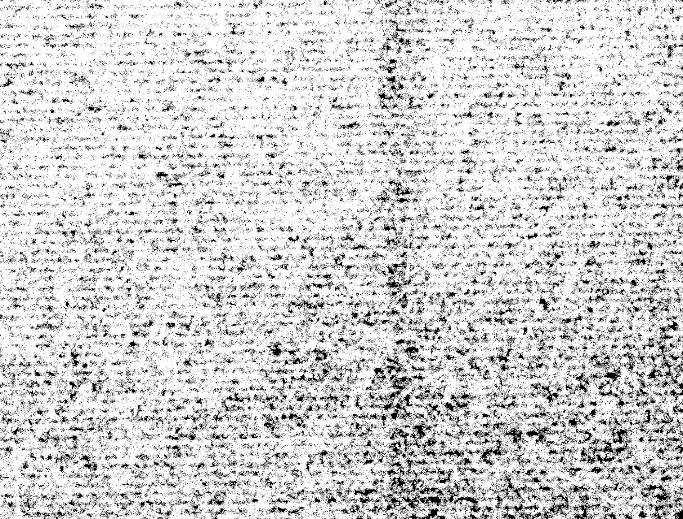
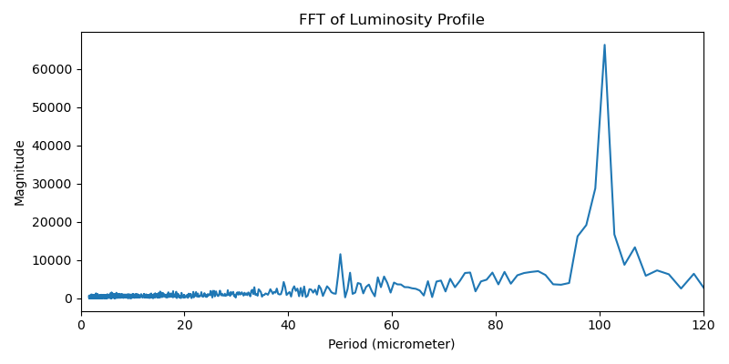
100keV Pbars from ELENA

Slide 52
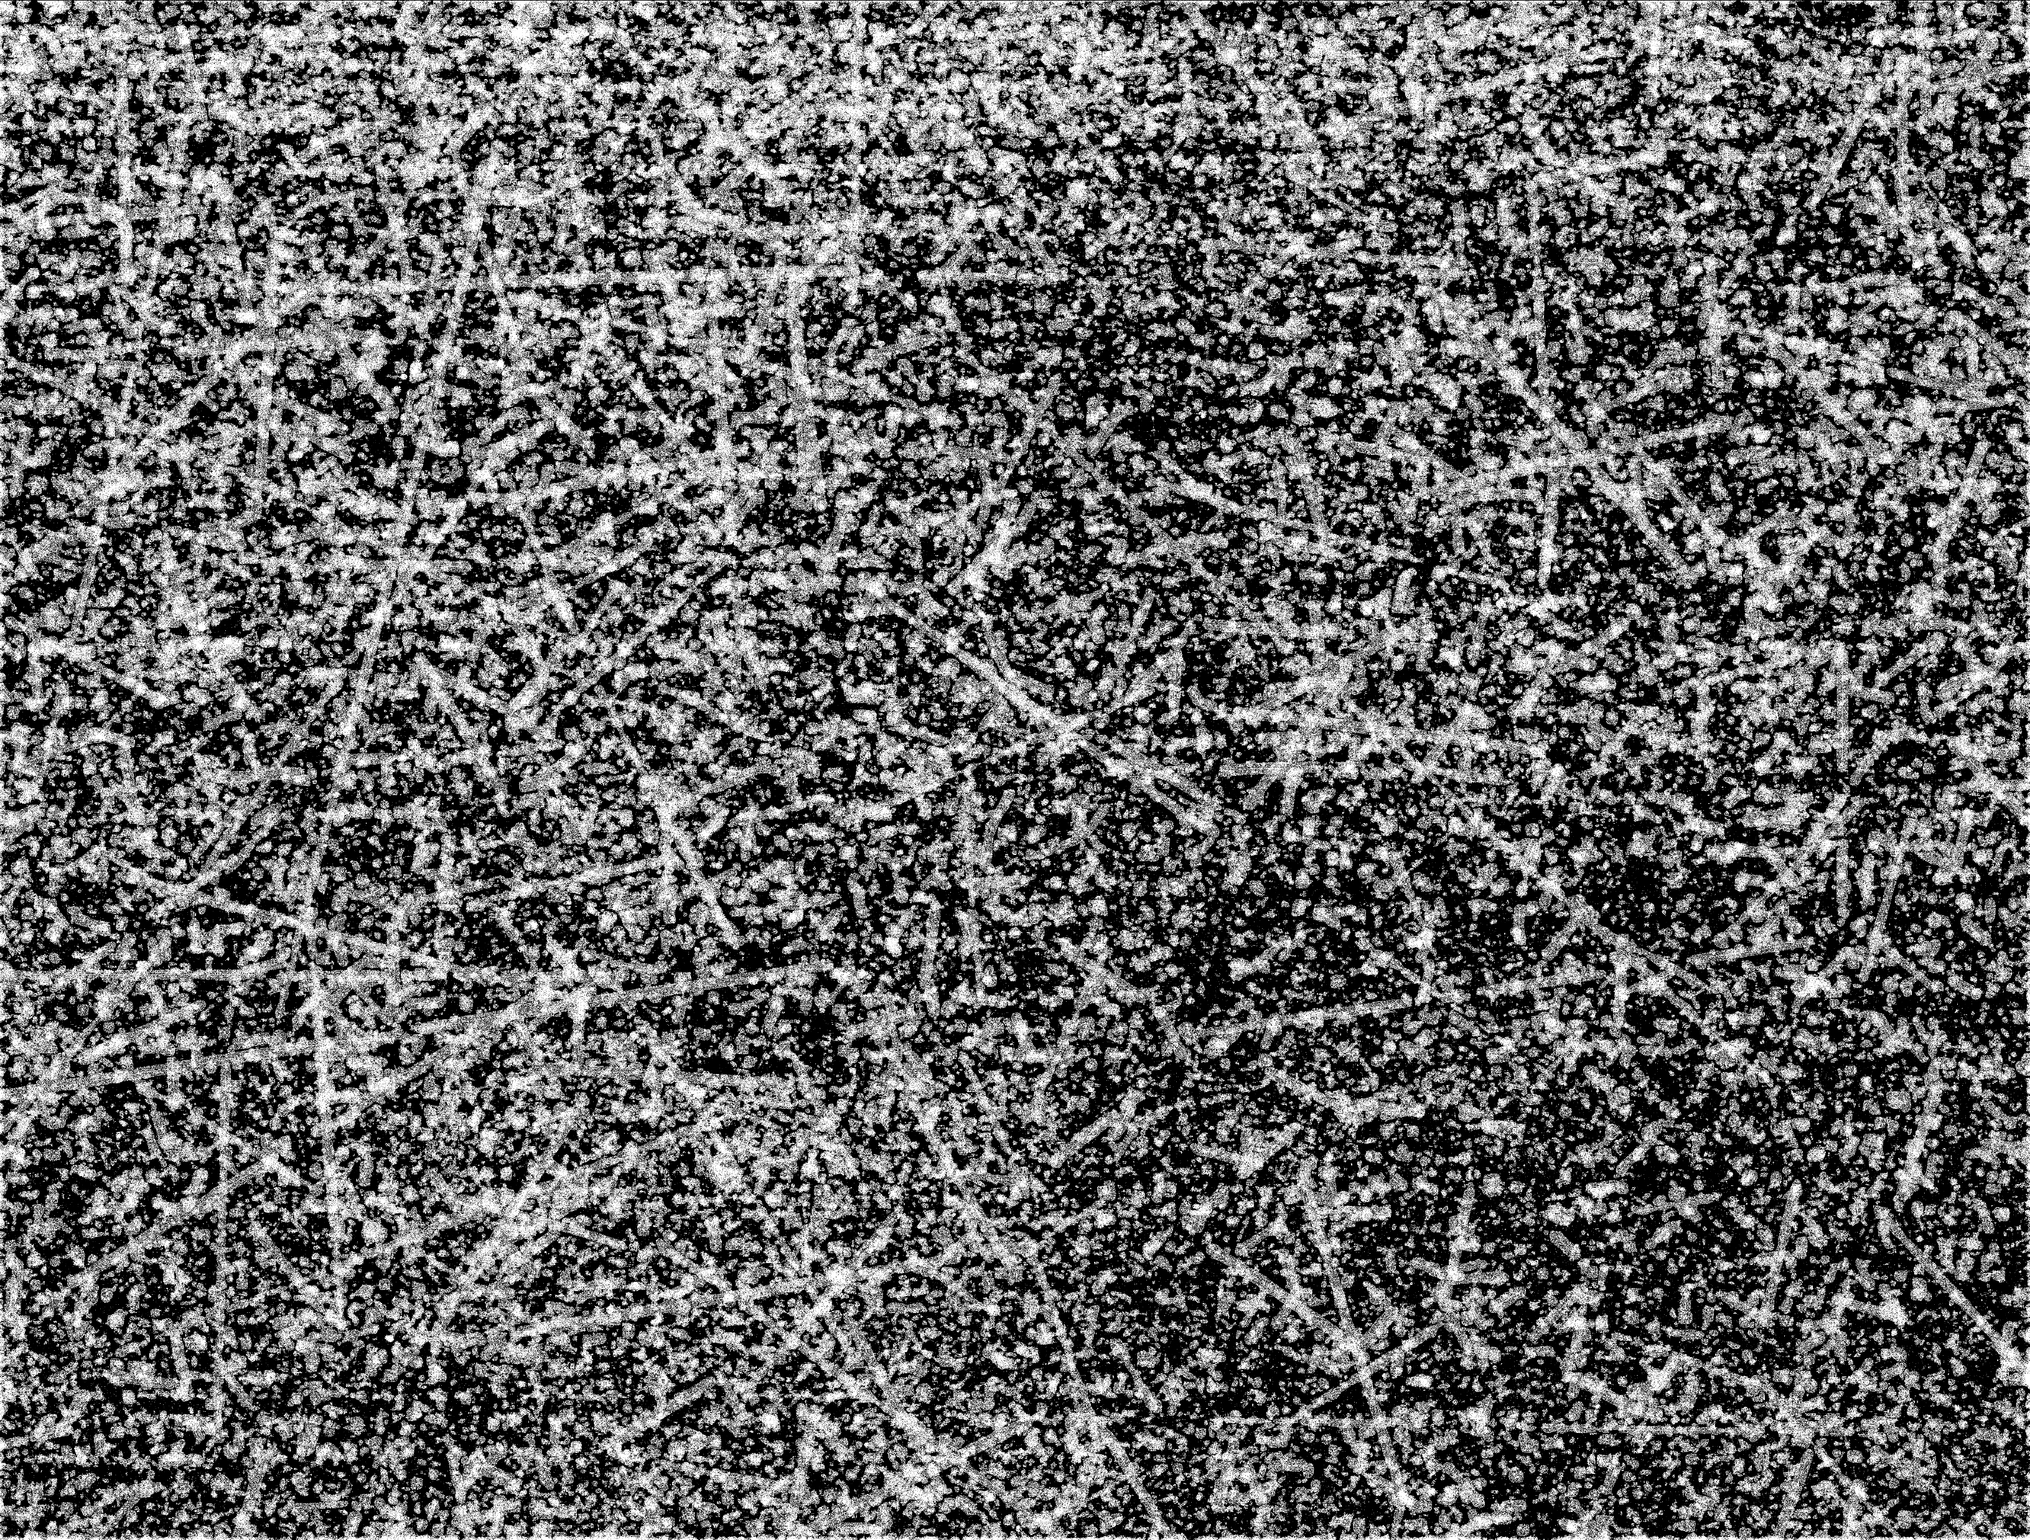
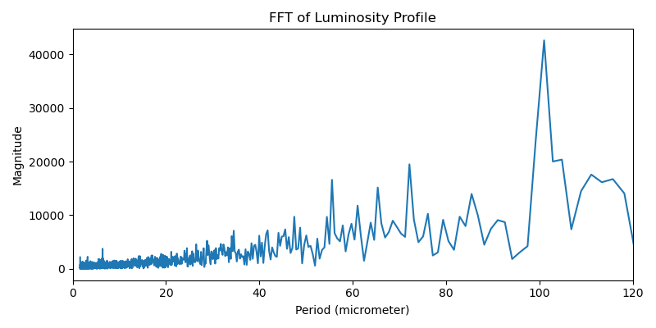
Non-monochromatic Pbars

Slide 53

Thank you for your attention
I am happy to answer any questions you may have
Notes:
Before any questions: thank Bergi and Francesco!

Slide 54
Vertexing Algorithms: ARIADNE
Feature Extraction
Ellipse Detection for Combination of Gaussian Mixture Model and Bayesian Information Criterion
Vertexing

Slide 55
Host Driver: Overview
Setup
Arming for Transmission
Triggering
Data Reception
Post Acquisition Checks + Processing
Prepare for next Transmission
Link Health Monitoring
→Libusb used for USB communication

Slide 56
3.5 Characterization
Power Rails:
  1.1V: 5 parallel MOSFETs
  1.8V: 2 parallel MOSFETs
  2.9V: single MOSFET
Allowed Currents: max. drain current for each IRF540N Power MOSFET: 110 A pulsed, 33 A continous (at 25°C)
Allowed Output Voltage Range: +/- 0.1 V compared to the nominal Value

Slide 57

Software Overview
Acquisition Driver manages
  Camera Controllers
  Sensors
  Data Reception
PSU Driver manages PSU
Notes:
Two main drivers
PSU driver
Connects to MCU of PSU
Reads various parameters of the power rails
Allows user and acquisition driver to control PSU
Acquisition driver
Connects to and manages the camera controllers
Attached sensors
Main: data reception
GUI for control and monitoring for user

Slide 58


Bottleneck Analysis: CPU & Driver
Ring Buffer for TRBs
Asynchronous Transfer Handling
Multithreaded Transfer Handling leveraging Libusb contexts
Queueing of multiple Transfers per Device simultaneously
Notes:
Cpu performance closely related to driver program
Linux USB stack with libusb
Firstt: async to be used → allows to queue multiple transfers in a non blocking manner
Transfer submitted → goes through stack and put into ring buffer of xHCI → multiple per deive have toi be queued here to ensure, that there is always a transfer ready to be filled with data
After transfer is finished, handled by cb of user space program → just copy data into memory buffer and resubmit transfer
Not enough with 60 devices! → multithreading

Slide 59

Bottleneck Analysis: CPU & Driver
Single Thread: CPU overwhelmed
  ➔ Data Loss
Notes:
Single thread: at 100% for long time; cannot keep up, data is lost, because ring buffer overwrites it

Slide 60

Bottleneck Analysis: CPU & Driver
Single Thread: CPU overwhelmed
  Data Loss
Solution: Multithreading by hacking Libusb’s context scheme
Notes:
Contexts are made for allowing multiple libusb based programs to run in parallel, not to run multiple contexts in the same program, but can be exploited for it
Each context has 2 or three devices, transfer submission and cb handling handled inside the same context inside the same thread → one thread only has to handle 2 or 3 devices
Cpu has 24 physical cores, with hyperthreading 48 → distributed devices as evenly as possible among all physical cores
Also using other helpers, like pinning threads to cores and giving them high priorities → plenty of cores are used and none ever exceeds usage of 60%

Slide 61

3.2 ADC Optimization
Circuit Design of Analog Inputs:
Signal
Multiplexer
ADC Input
Processor
optional

Slide 62


4.2 Mark 0
MIPI CSI-2 Connection to Sensors
Hub enumerates as SSP Hub
Devices Downstream of Hub do not enumerate as SS Devices

Slide 63

4.2 Mark 0
Camera Controllers can enumerate as SS Devices when hub is bypassed
No Devices Downstream of Hub enumerate as SS Devices
Hub ⬄ CX3: Mixed up USB SS RX/TX Connections → manual repair has no effect
Device Enumeration Behavior dependent on distance to hub
→ closer to hub ⬄“closer“ to SS
Wireshark: Hub Downstream Ports not enabled

Slide 64
4.2 Mark 0
Potential Causes
USB SSP Hub
Interconnect Hub ⬄ Device
Re-Design with:
different USB SSP Hub
Short and carefully routed SS Lanes

Slide 65


4.3 Mark 1
Bad: Stub Effect
Good: No Stubs

Slide 66
5.3.1 CPU & Driver
Additional Measures
Binding threads to cores (sched_setaffinity())
Assign high Priorities to threads (pthread_setschedparam())
Locking relevant Data structures into memory (mlock())
Notes:
Exposure: 1418.614 μs
Add estimation → explains why this is interesting!

Slide 67


6.2 Thermal Performance in UHV
Notes:
Exposure: 1418.614 μs
Add estimation → explains why this is interesting!

Slide 68


6.2 Thermal Performance in UHV
Measured with internal temperature sensors of SONY IMX686: ±3°C Accuracy

Slide 69


6.2 Thermal Performance in UHV
Only Passive Cooling
Water-Cooling
Notes:
Exposure: 1418.614 μs
Add estimation → explains why this is interesting!

