Slide 1
Borealis project
Anion
Scope, Results, Future
Kamila Kempny, Matthias Germann

Slide 2
Outline
Goal and scope of the project.
Progress over the last months.
Current state.
Future plans.

Slide 3
Goal and scope
The goal of the Borealis/Anion project is to
Inject,
trap,
and electron cool
negative ions in the AEgIS Penning-Malmberg trap.

Slide 4
Motivation
Trapping anions
Protonium
Antiprotonic atoms
Cold antihydrogen
Notes:
Why do we want to do that?

Slide 5
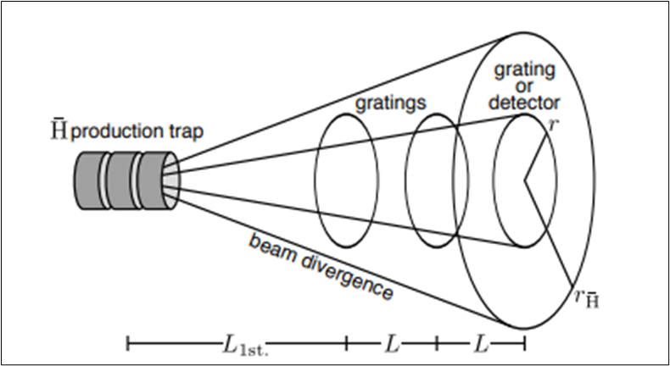
Motivation
Cooling
prepare cold anions through selective photodetachment
use as coolant for antiprotons (sympathetic cooling)
synthesize cold Hbar
Improved gravity measurement with boosted horizontal beam:
reduced emittance of Hbar beam:
higher flux reaching detector
slower Hbar beam:
larger vertical displacement due to gravity
Key for next-level gravity measurement.

Slide 6
Motivation
Antiprotonic atoms and molecules
anion as precursor for
controlled, in-trap synthesis
of antiprotonic atoms or ions.
Borealis anion source: enables injection of (almost) any anion species with gaseous neutral precursor.
Techniques for injection and trapping:
applicable to other sources as well → paving the way for iodine injection

Slide 7
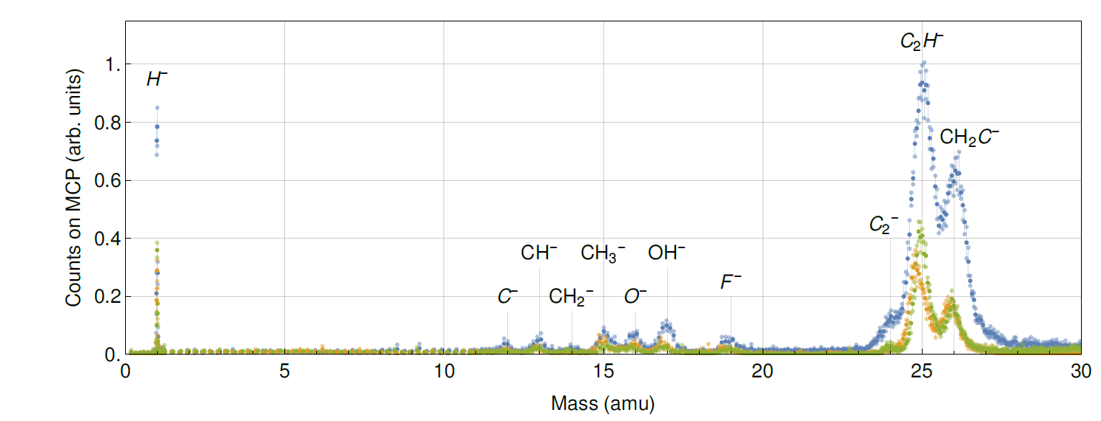
Motivation
Protonium
most fundamental antiprotonic atom
formation in traps and at low-energy → precision spectroscopy
QED and QCD studies in an exotic baryonic system
Protons needed for formation.
Borealis source lends itself as p-source.

Slide 8
Motivation
Trapping anions
Protonium
Antiprotonic atoms
Cold antihydrogen
➔ All major AEgIS activities benefit from successful trapping of anions.

Slide 9
Recent progress

Slide 10
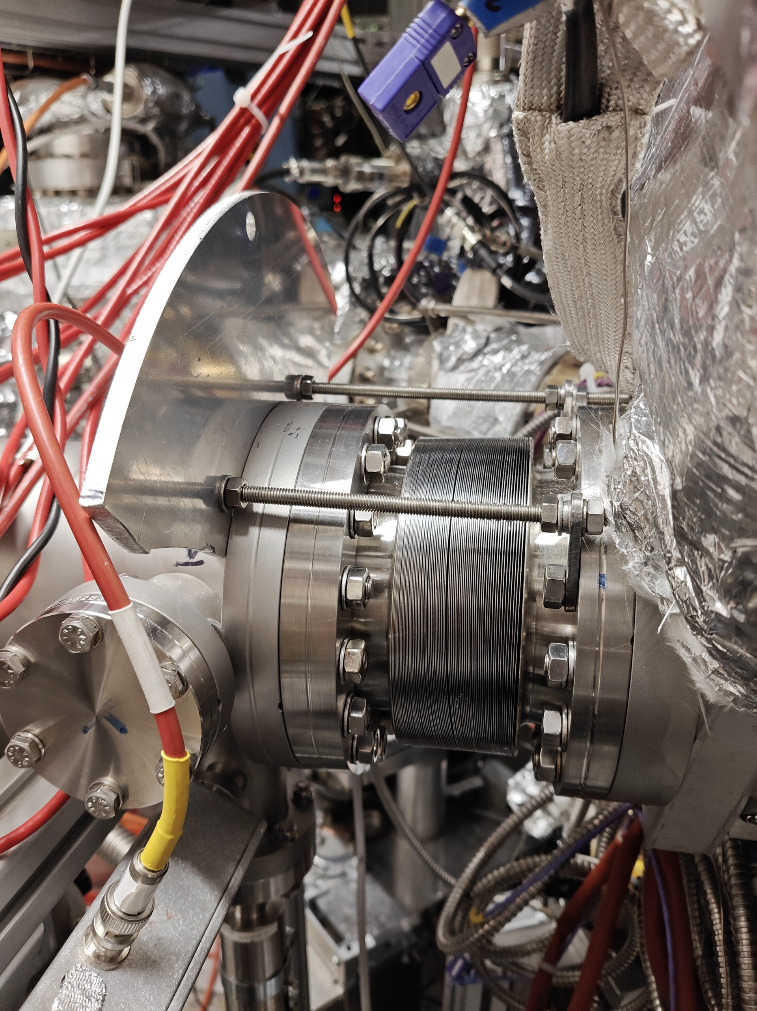
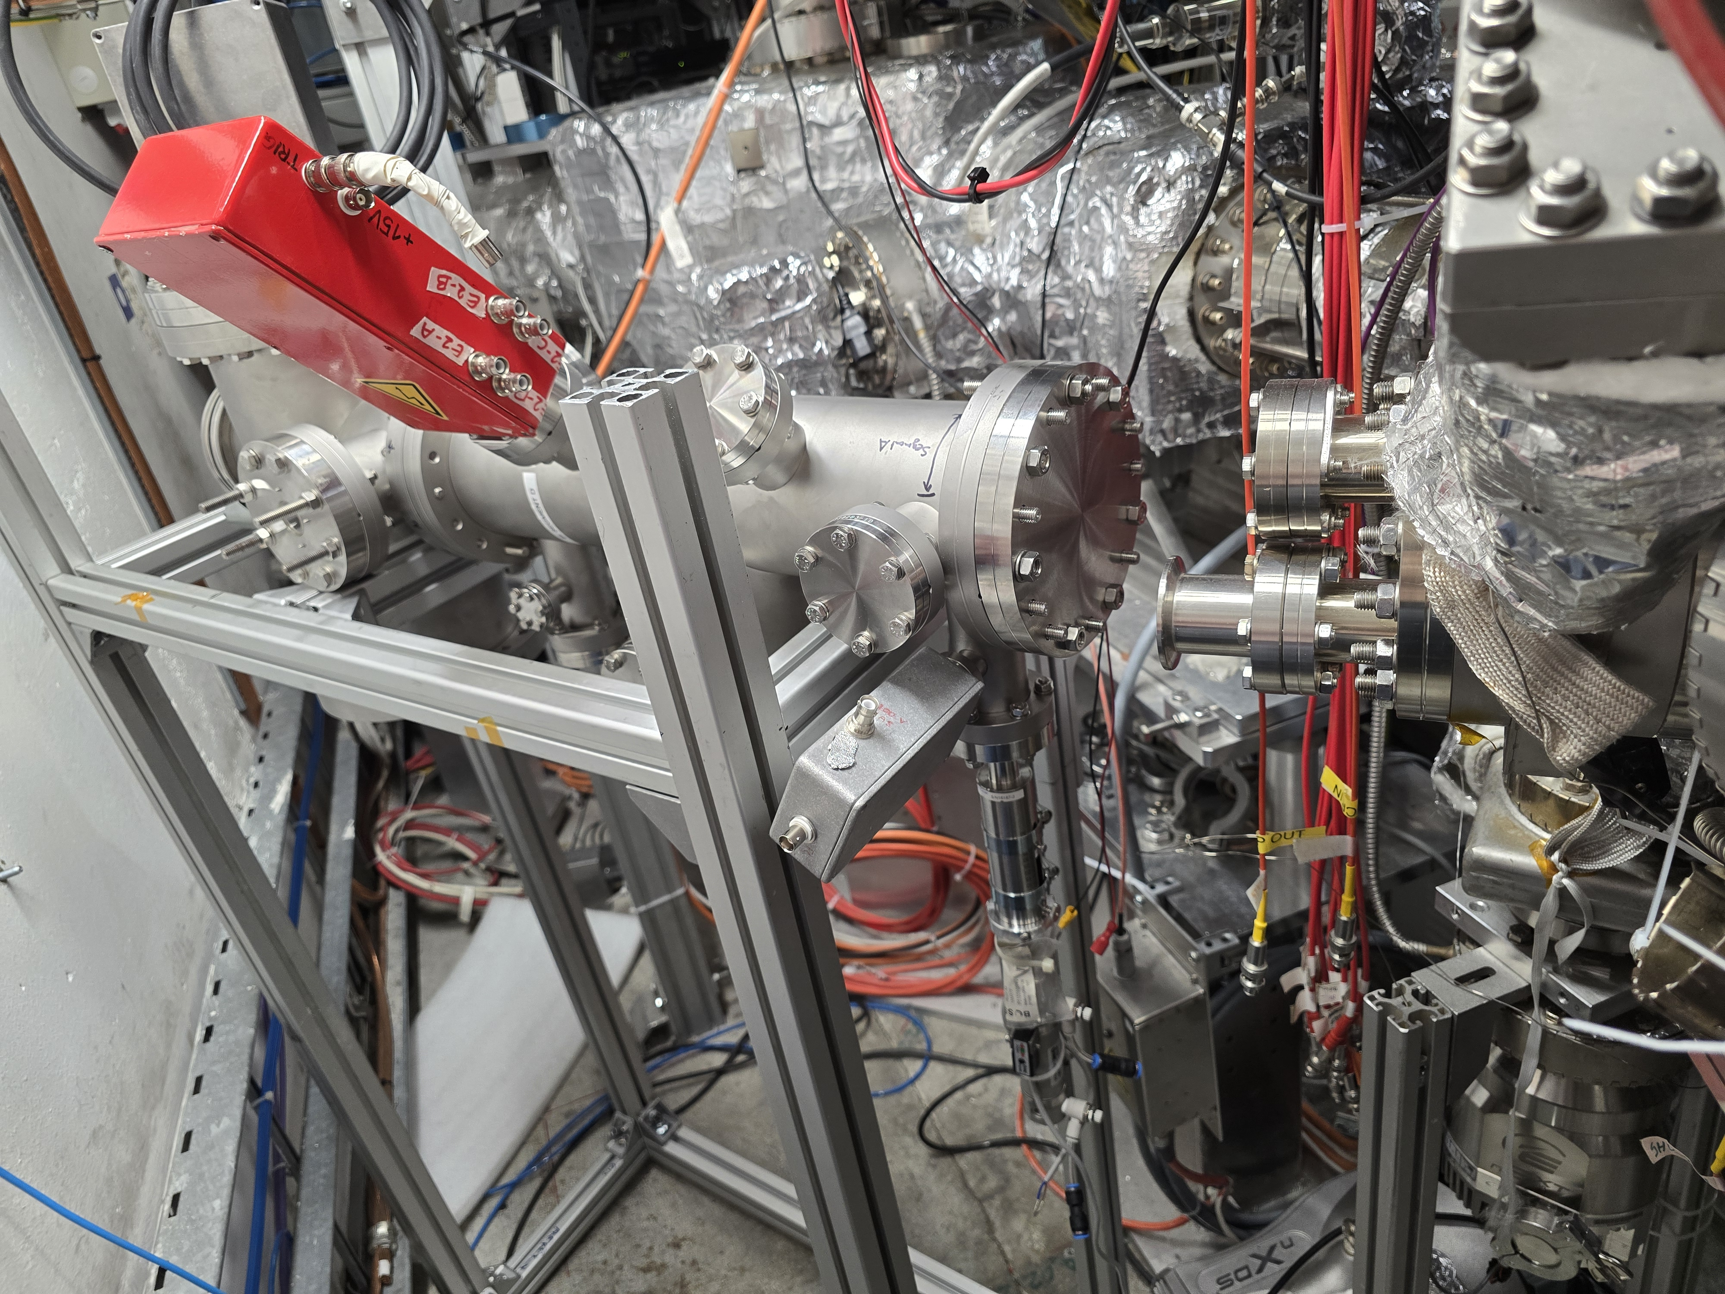
Mounting
April – the source was moved to its current position – behind the Starship
July – source mounted to the injection line
July-August – cabling of the Starship
August – optimisation of the parameters with the Faraday Cup

Slide 11
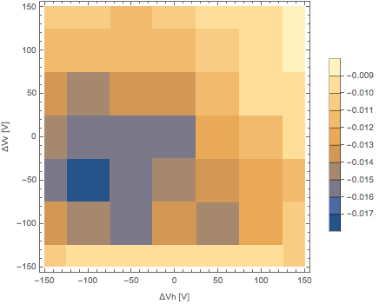
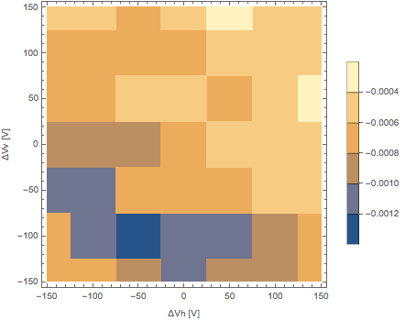
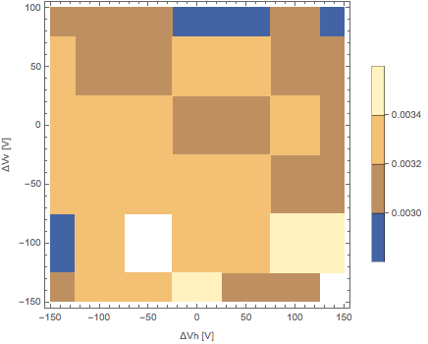
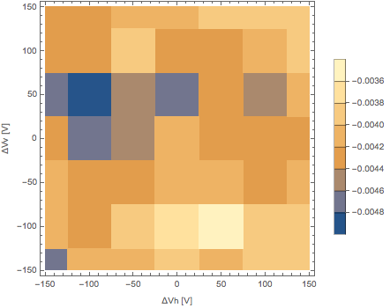
Impact of trap magnetic field on anion source
Shown: Faraday cup signal as a function of horizontal and vertical beam steering voltage.
2025-06-20
2025-07-08
2025-08-07
2025-08-28

Slide 12
Impact of trap magnetic field on anion source
Shown: Faraday cup signal as a function of horizontal and vertical beam steering voltage.
Clear peak
2025-06-20
2025-07-08
2025-08-07
2025-08-28
Structureless

Slide 13
Impact of trap magnetic field on anion source
Shown: Faraday cup signal as a function of horizontal and vertical beam steering voltage.
Clear peak
2025-06-20
Penning traps off
2025-07-08
Penning traps off
2025-08-07
Penning traps on
2025-08-28
Penning traps off
Structureless
➔ Magnetic field from Penning traps affects anion signal significantly.
Notes:
what you see here is the time-averaged FC signal as a function of the horizontal and vertical deflection voltage applied to the beam steering electrodes.

Slide 14
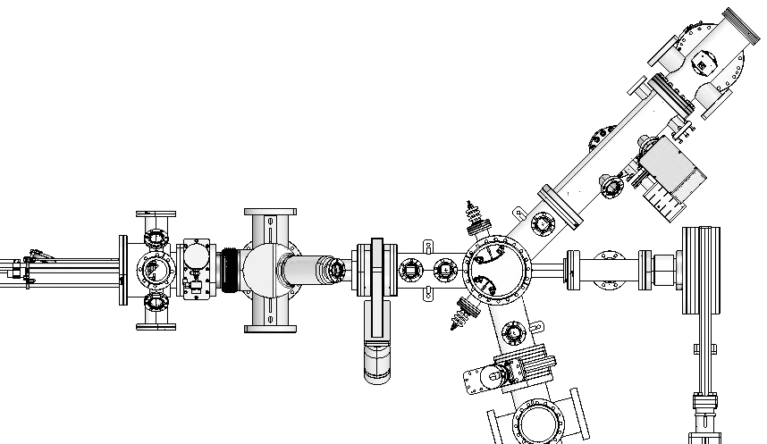
B-field with Penning traps on vs. off
15 G / 0.7 G
Radial field of 5 G
Ion beam deflected by 30 mm.
Skimmer diameter: 3mm
Beam blocked!
0G / 1G ⊗
Problematic!
5G / -0.5 G
⬅ to 5T Trap
to ELENA ➔
Hedgehog
Starship

Slide 15
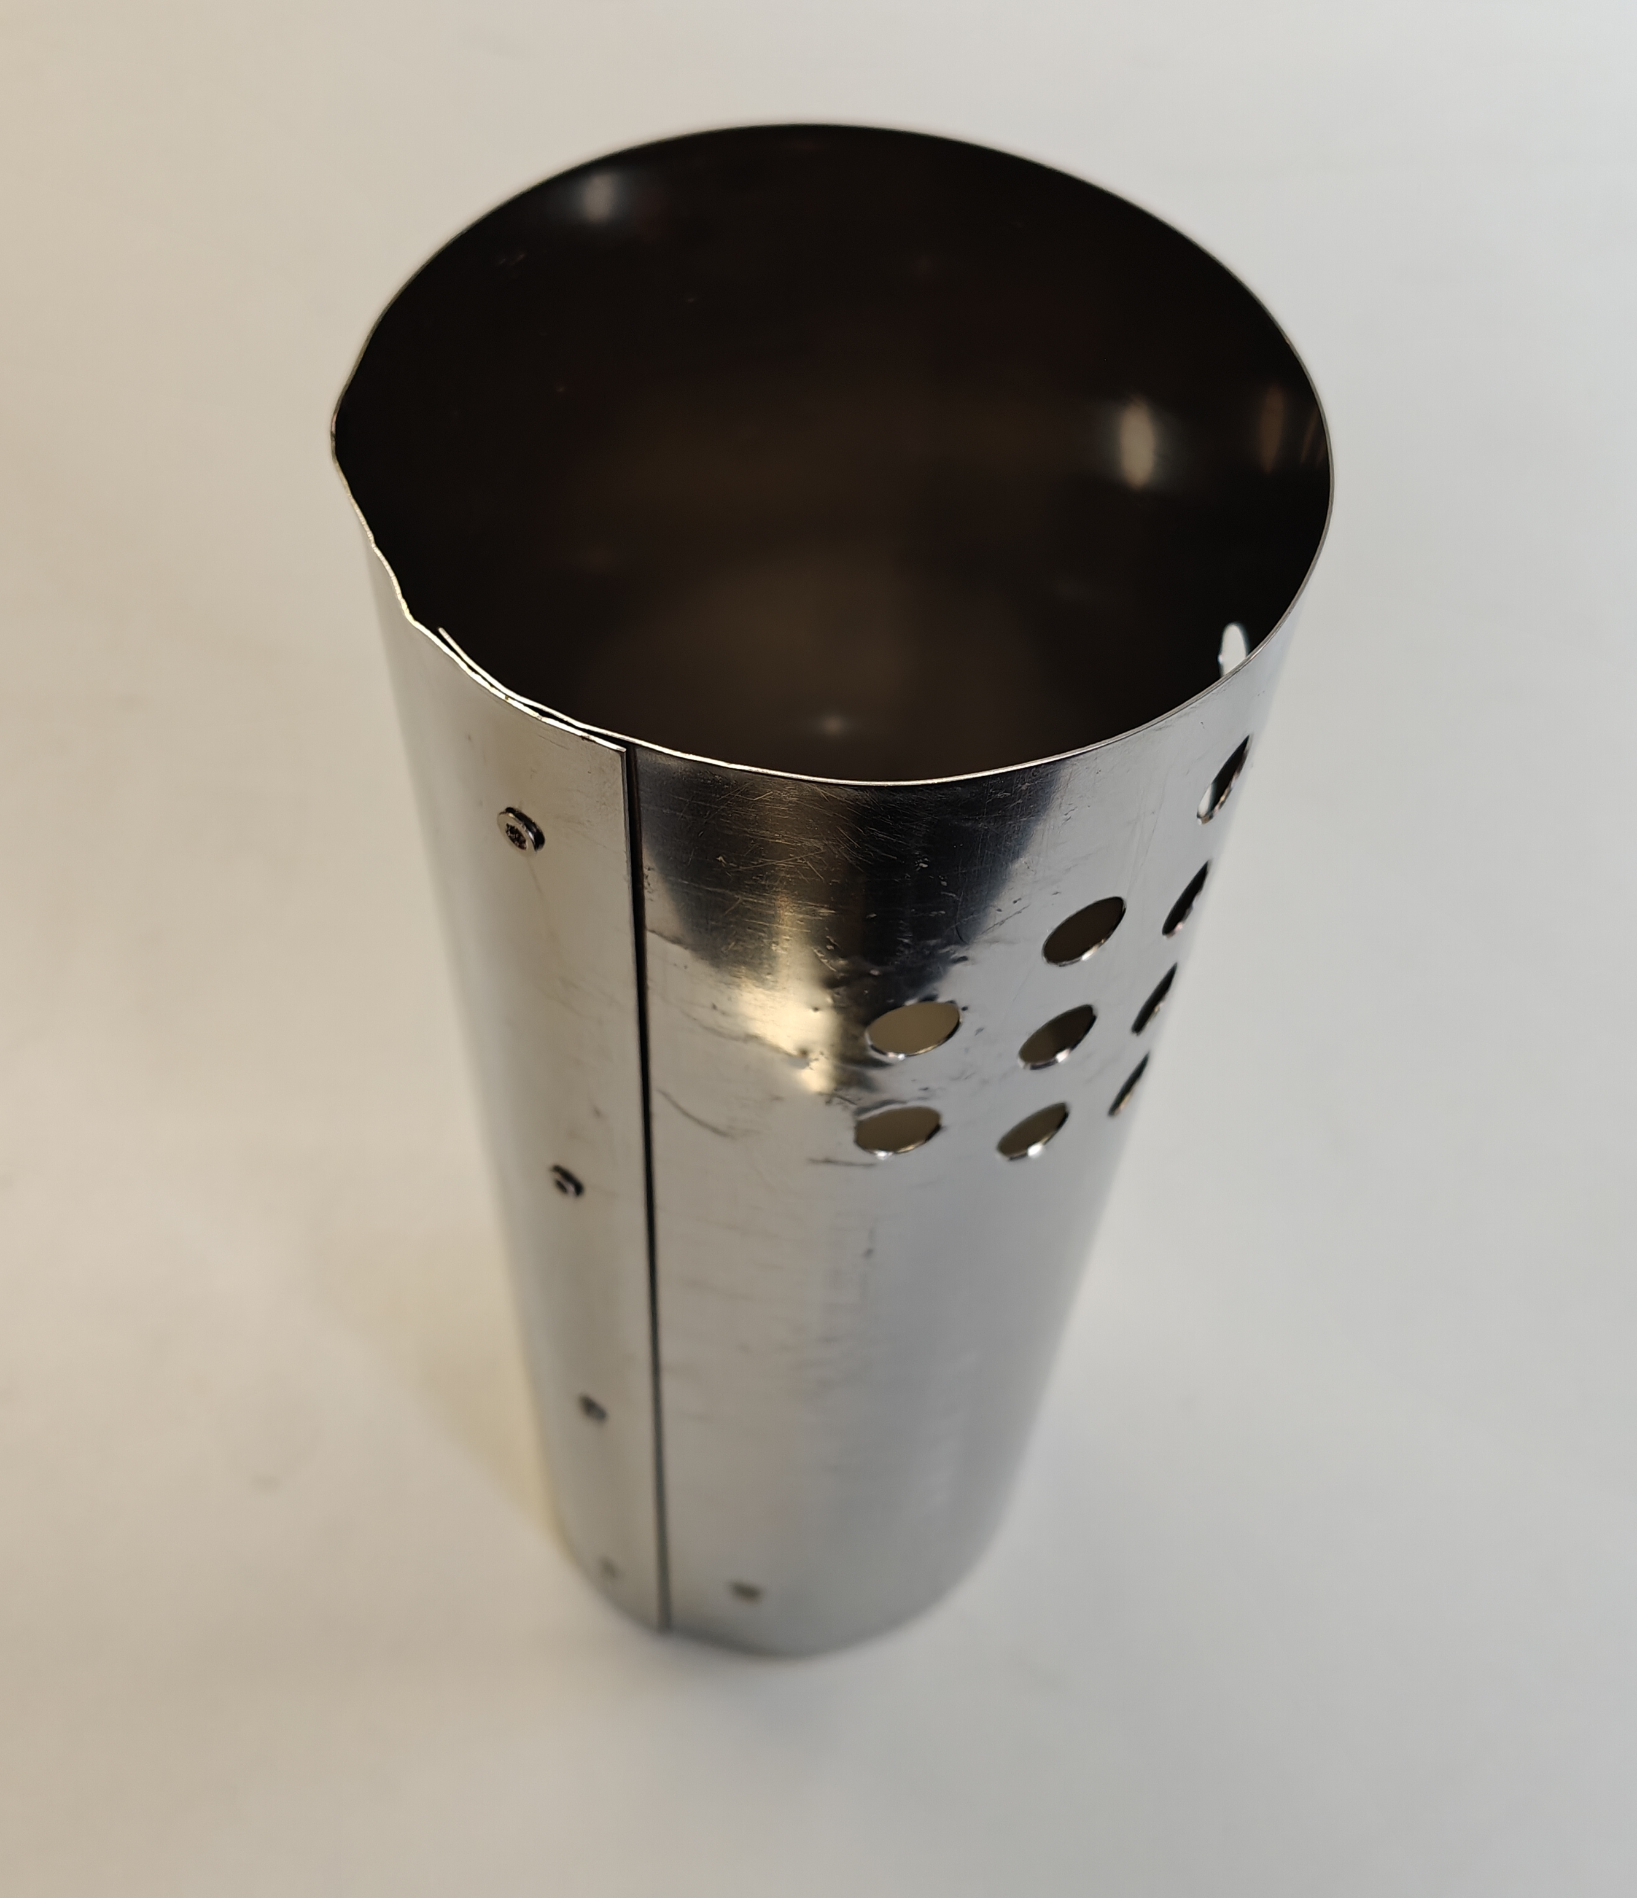
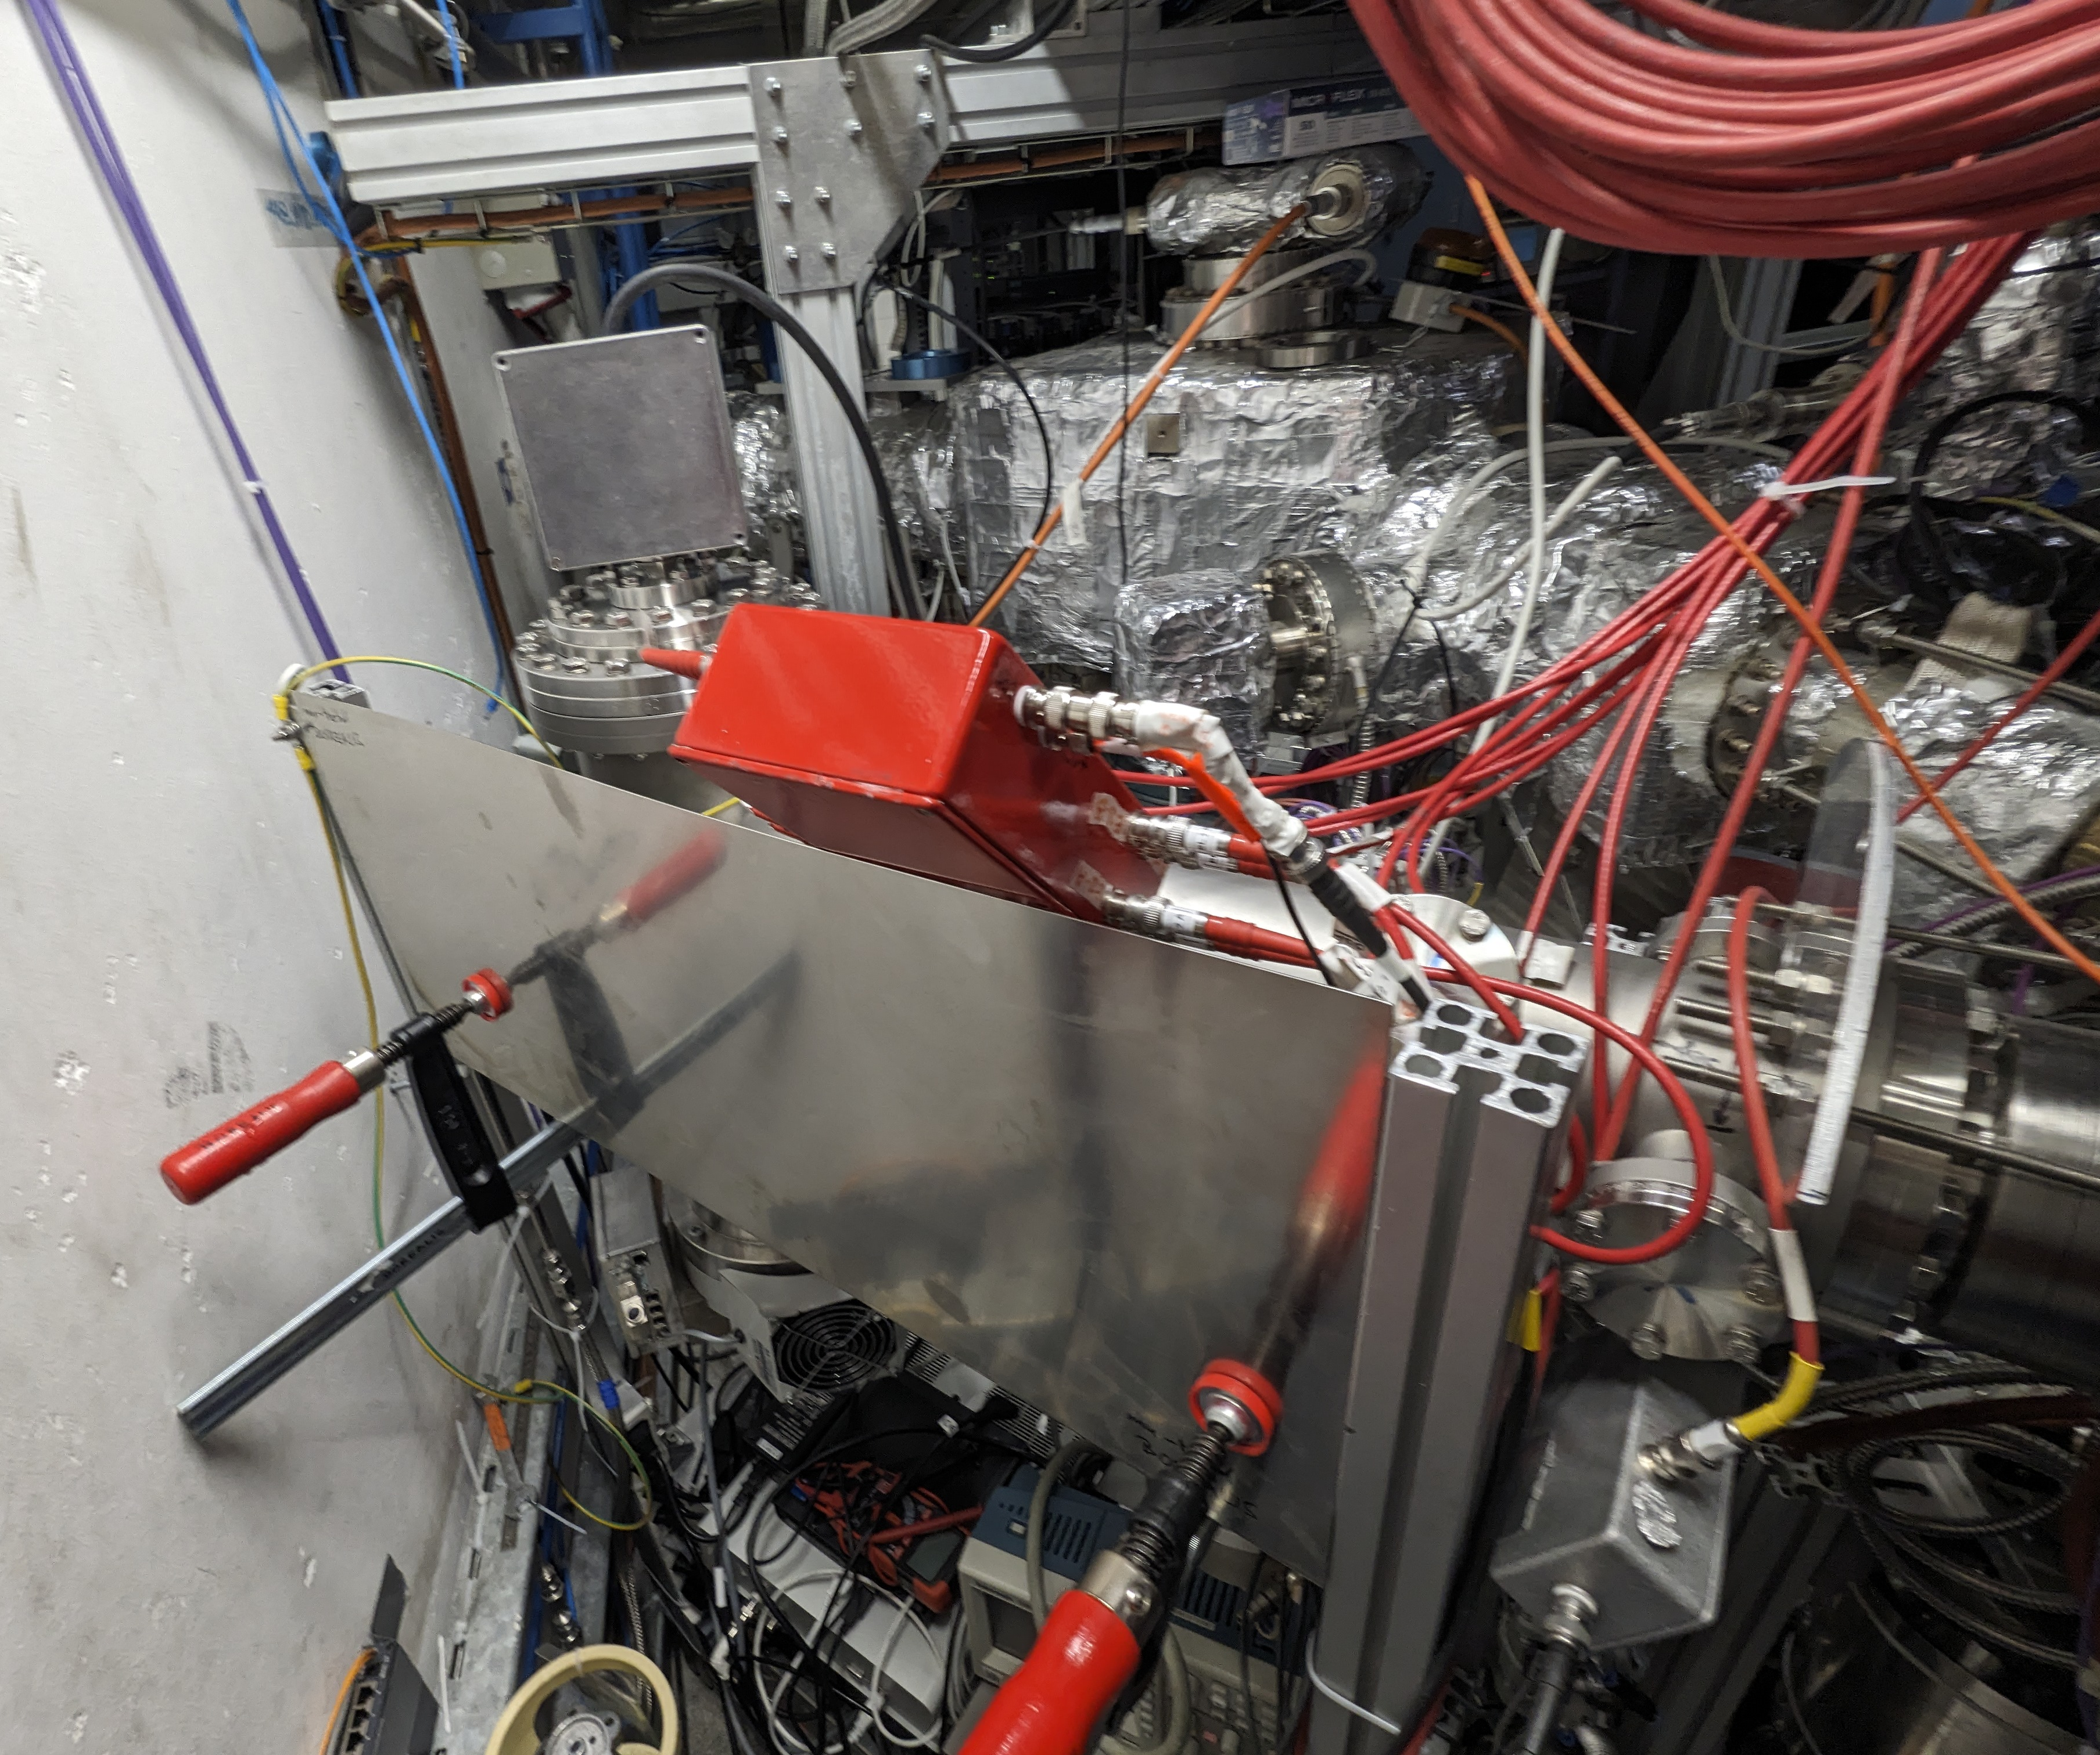
Magnetic field shielding
Openings for pumping (turbopump placed here)
Outer shield (plate)
Inner shield (before installation)

Slide 16
B-field with Penning traps on vs. off
+ with shielding
15 G / 0.7 G
3.2 G
FC signal with the shielding
0 G / 1 G ⊗
0 G
5 G / -0.5 G
0.9 G
⬅ to 5T Trap
to ELENA ➔
Hedgehog
Starship

Slide 17
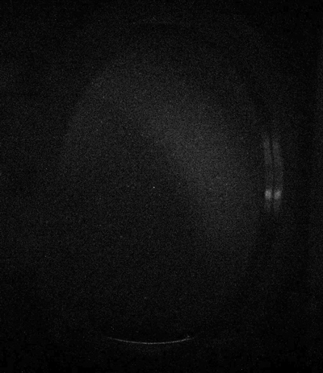
Ion injection on HedgeHog MCP
Ion beam on the HH MCP “sweeped” with the bender

Slide 18
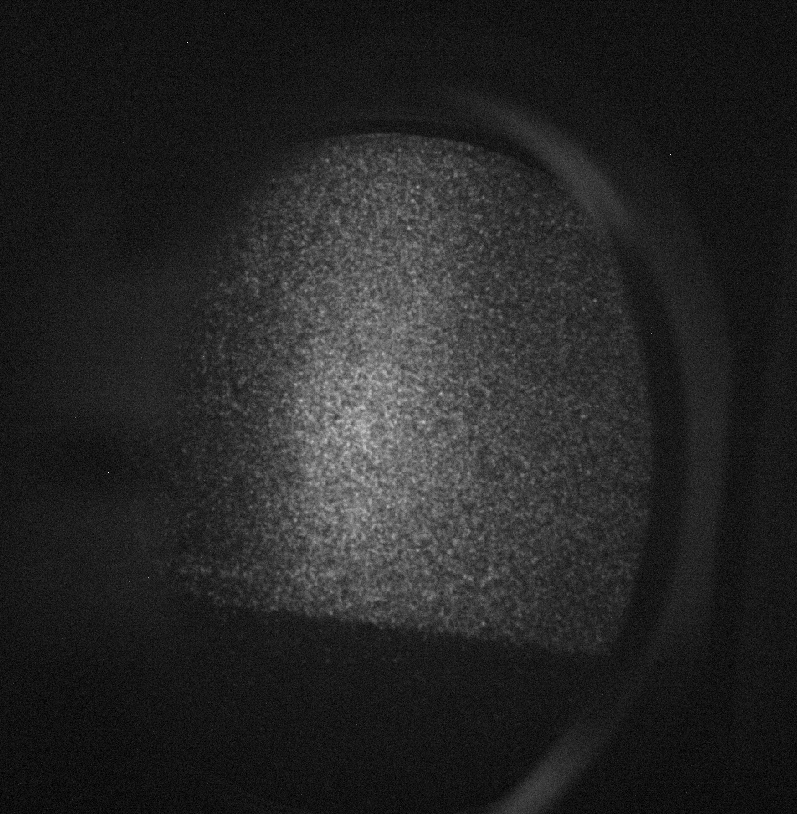
Ion injection on HedgeHog MCP
End of August – ion beam visible on the HH MCP!
Next – optimisation for the intensity and focus
Cut-off in the picture – problem with the MCP positioning (solved)

Slide 19

Injection towards 1T MCP
October:
  integration to the control system
  first injection towards 1T MCP
  Vacuum pollution issue – further tests postponed until the end of the beamtime.

Slide 20
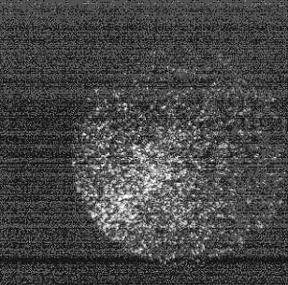
Ongoing campaign
Reproducible signal on the 1T MCP.
Beam characterisation:
  ToF spectroscopy
  Kinetic energy distribution
  Time distribution of the ion bunch
First trapping attempt?

Slide 21
How to go on?

Slide 22

Photodetachment cooling of anions
Planned joint project:

Slide 23
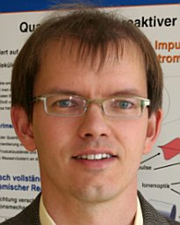
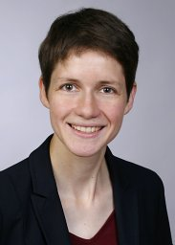
Photodetachment cooling of anions
Labs of Roland Wester and
Katrin Erath-Dulitz.
Experts on photodetachment (PD) cooling of anions:
demonstrated with OH– in 2023.
Contribution
Develop new cooling methods:
  sympathetic cooling of anions.
  PD cooling applicable at AEgIS.
Giovanni and me.
Knowledge of anions, AEgIS setup, atomic/molecular physics and laser spectroscopy.
Contribution
Trap anions at AEgIS.
Pre-cool with electrons.
Co-trap anions with antiprotons.
Together
Implement PD cooling developed in Innsbruck at AEgIS.

Slide 24
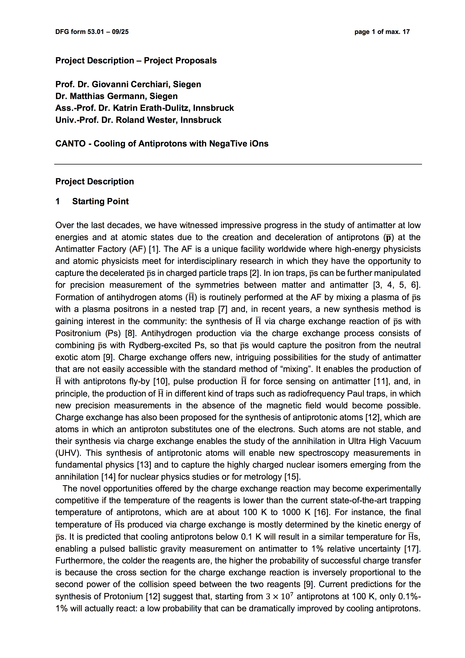
Photodetachment cooling of anions
Status
Grant proposal nearly finished.
To be submitted early 2026.
Funding
  DFG (Germany): Siegen/CERN
  FWF (Austria): Innsbruck
➔ Joint “WEAVE” project.

Slide 25
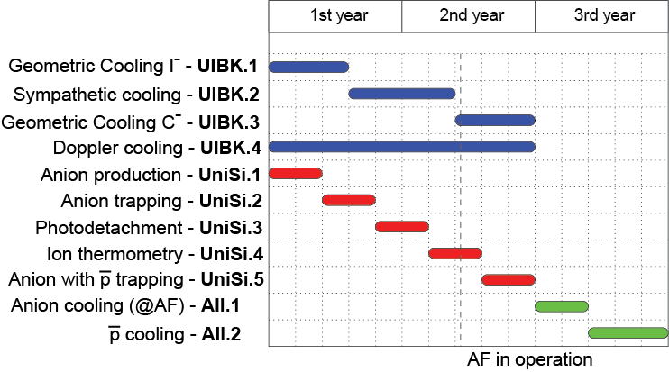
Photodetachment cooling of anions

Slide 26
Conclusions
Cold antiprotons – An ambitious but realistic goal!
Co-trapping of anions with antiprotons – Even more so!
Last months showed: This project can realistically be pushed!
But we need:
Funding – We are on that.
Support – We need the support from the collaboration!
➔ Focus for LS3.

