Slide 1
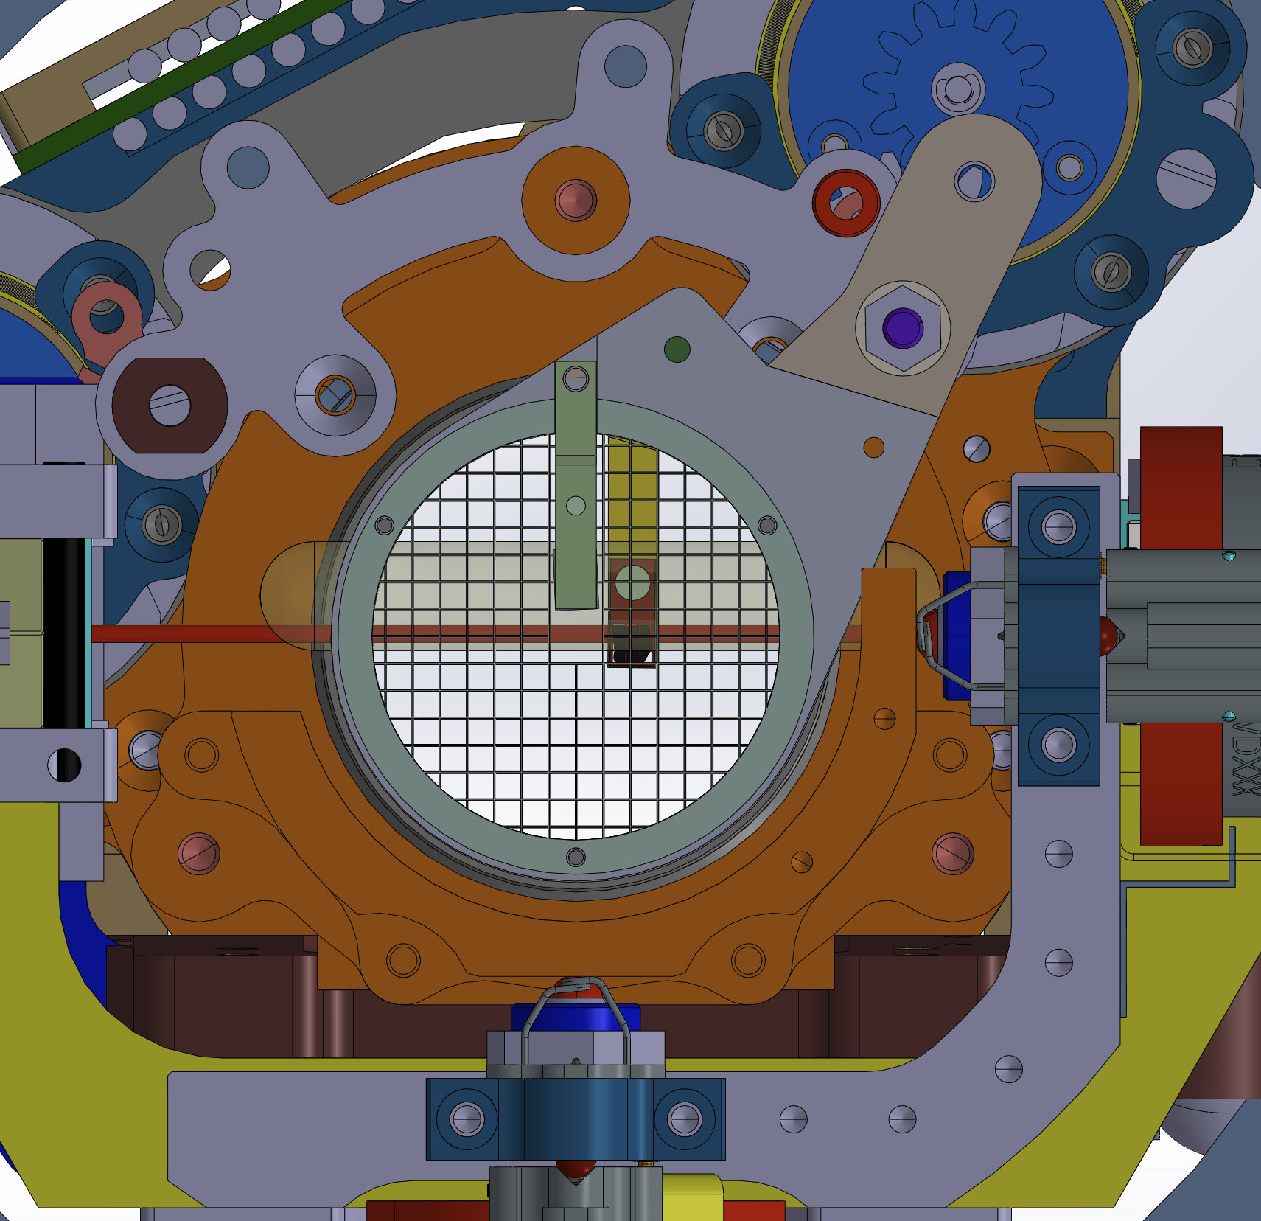
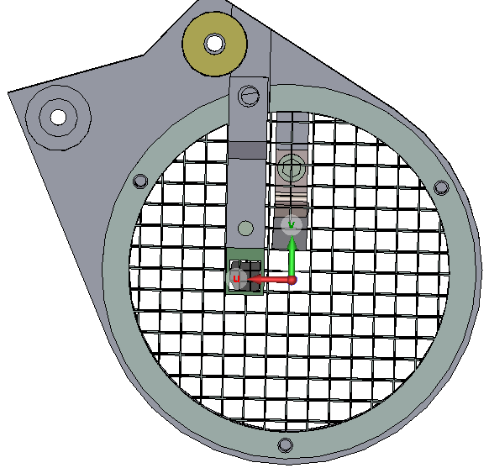
Ballistic transfer of antiprotons with reflection and transmission target - Updates
AEgIS collaboration meeting
CERN, December 2025
Bharat, Benji, Sruthy, Carsten and the AEgIS collaboration

Slide 2
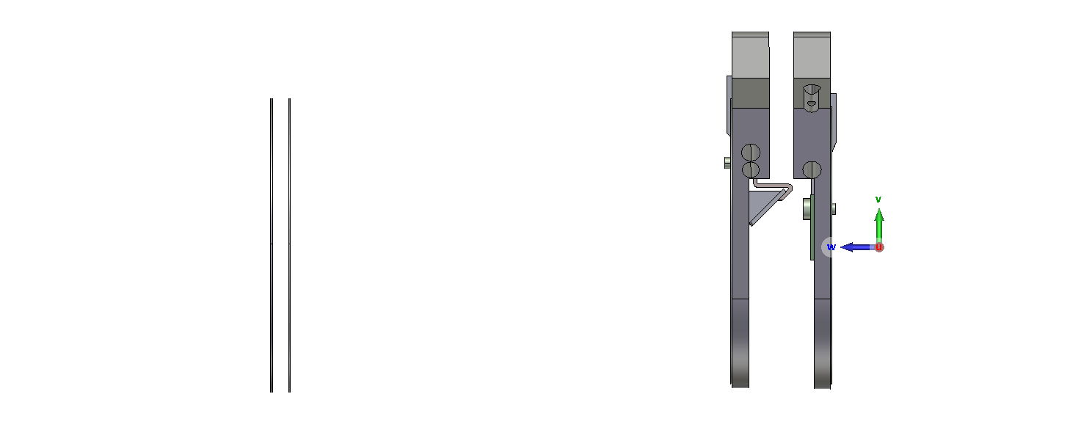
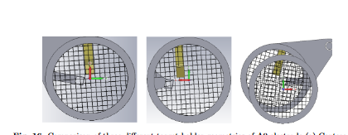
Target geometry- Current configuration
2mm
8mm
Centered
Off-centre
Transmission Centered
54mm
12mm
Current
Arrived at the current configuration with the previous comparison studies.

Slide 3
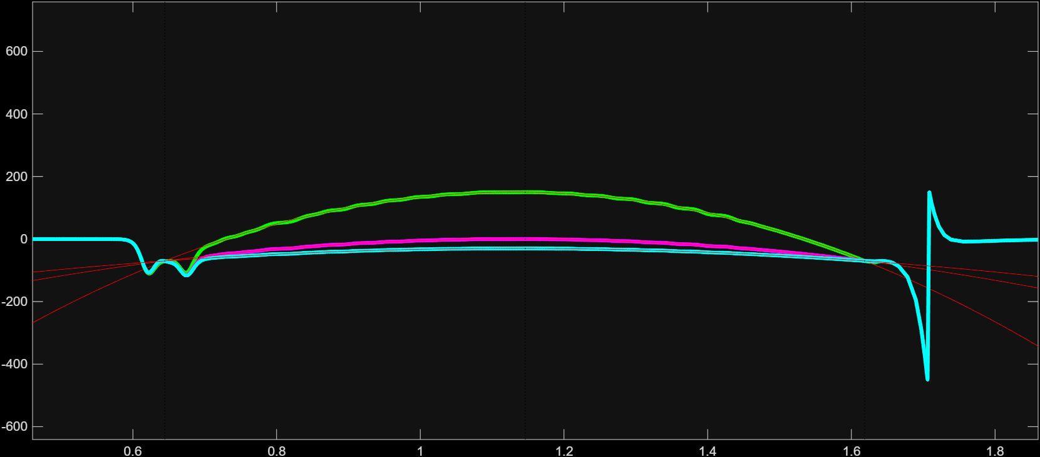
Parabolic potential well
150 V
0 V
-30 V
Vertex
Launch trap
Target
Varying the vertex of the parabola using the inverse solver.
More positive the vertex faster the transfer.

Slide 4
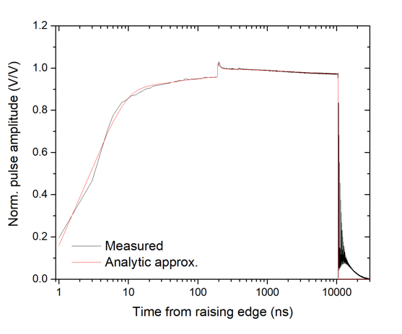
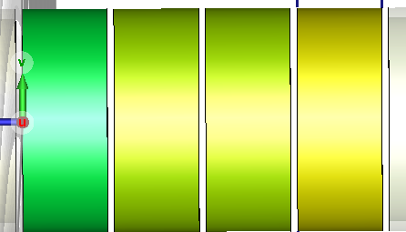
Pulsed P9 signal
Stored pbars
P6
P9
Credits: Ruggero
Pbars are pulsed and immediately launched with their initial distribution.
Particle transport is simulated using the ES-PIC solver in CST.

Slide 5
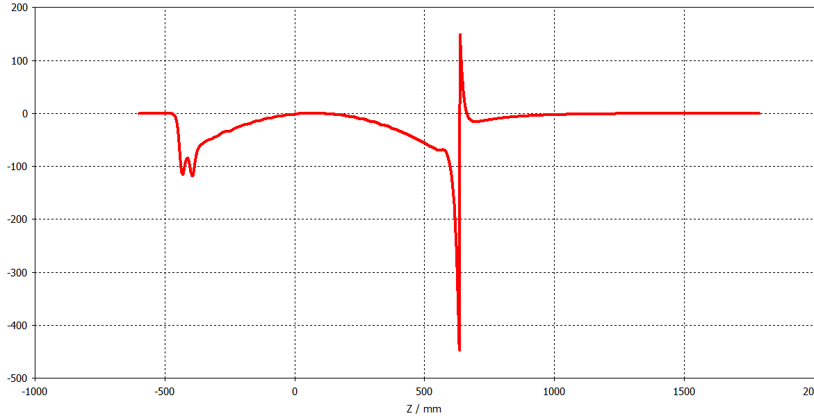
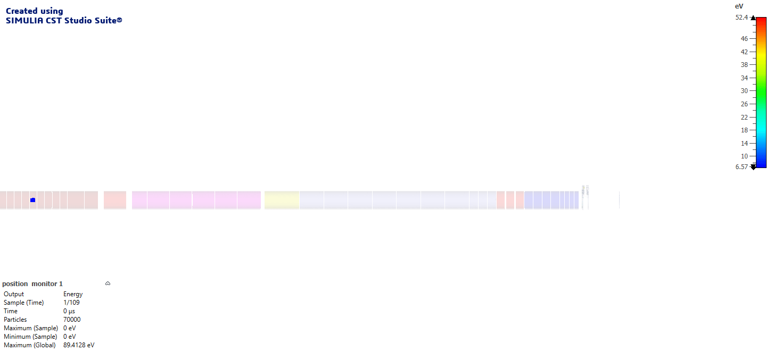
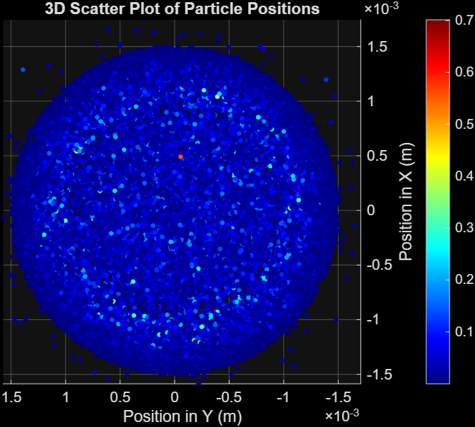
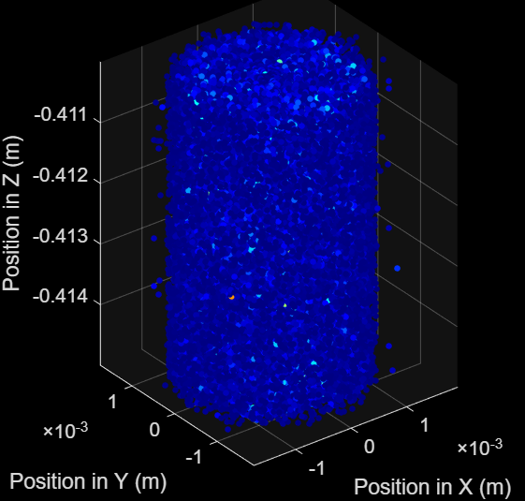
P6-P9 trap and parabolic potential
Source parameters
Density:2×10¹² m⁻³
Num of simulated pbars =70000
T_{tail}=500K, T_{core}=300K
Rmax=1.5mm
L=5mm
P6-P9 Launch Trap

Slide 6
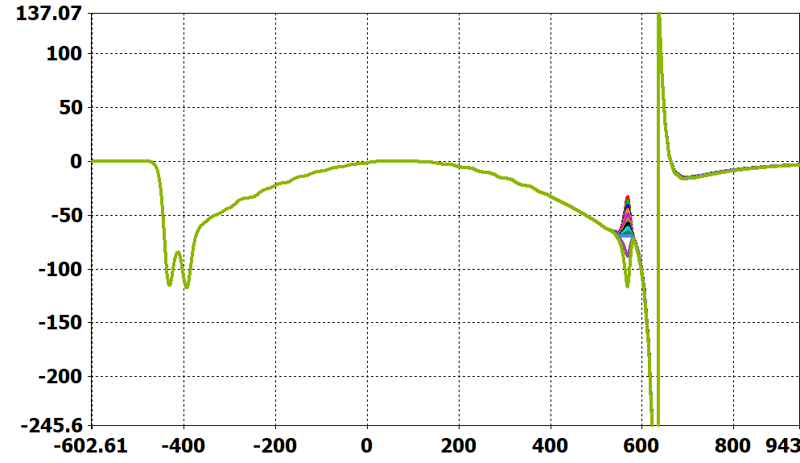
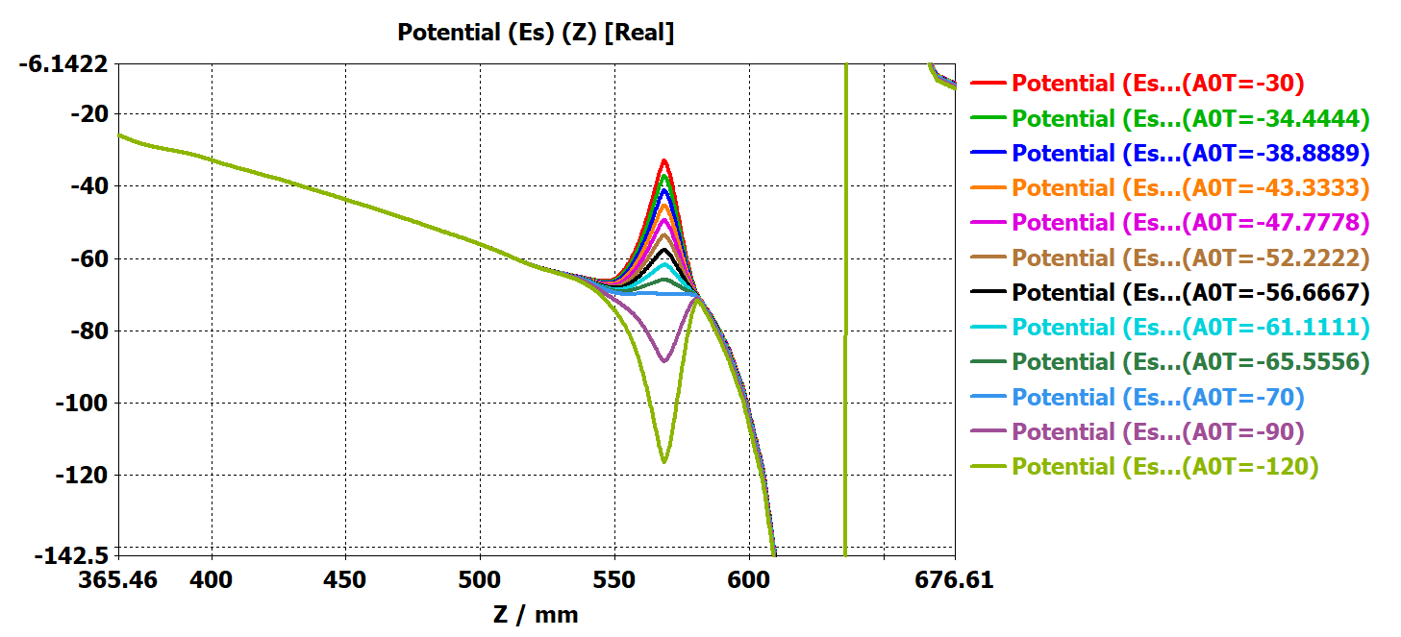
0V vertex
Axial potential profile
Controlling the transmission of pbars by varying A0T.

Slide 7
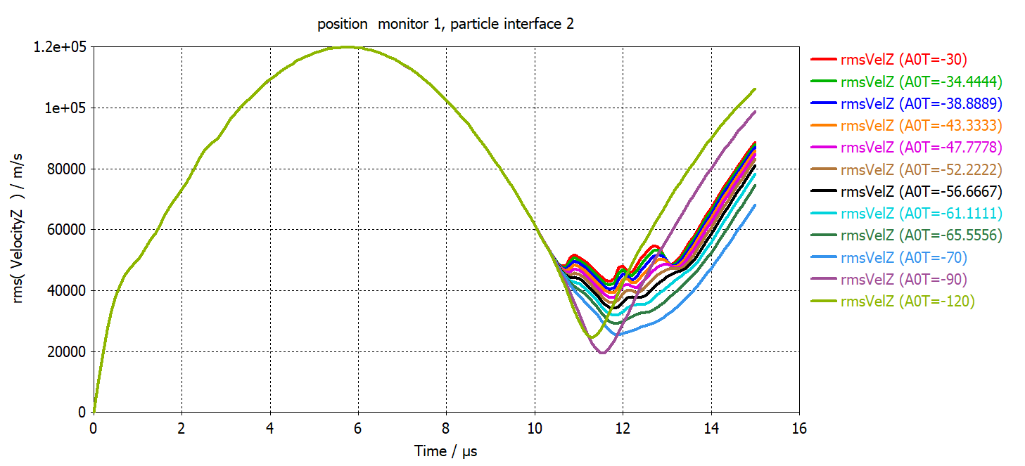
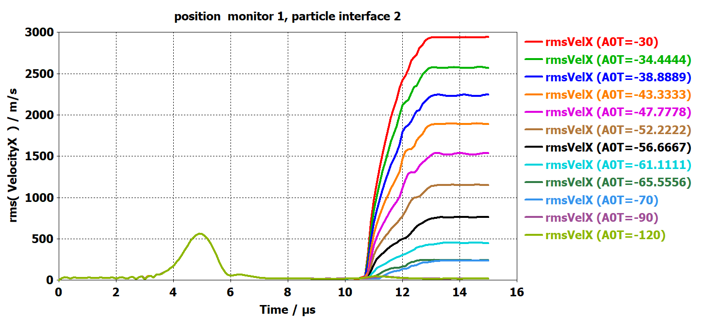
Axial and radial velocities at A0R=-70V
Vrms Z
Vrms X
The first reflection
The axial velocities is around 20000m/s for this parametric sweep.

Slide 8
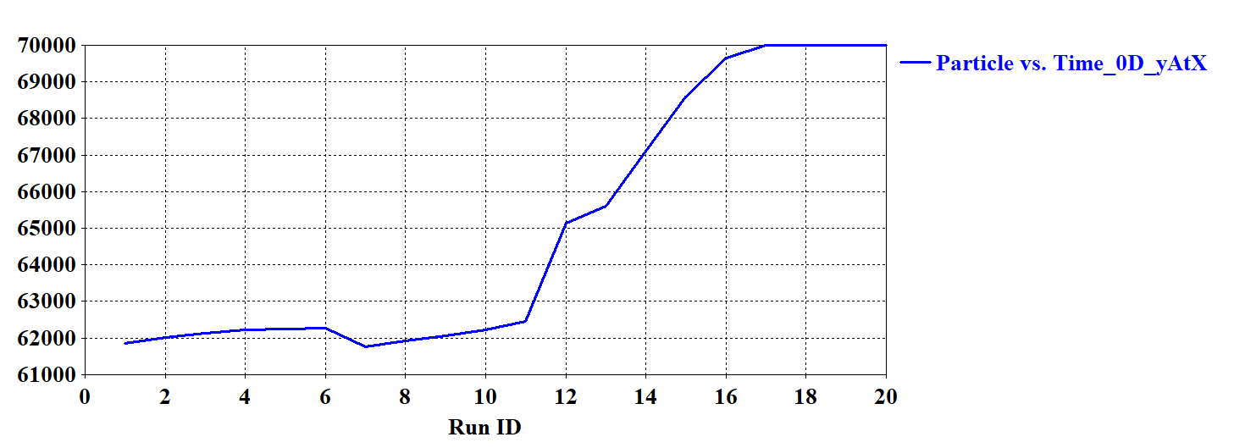
Parametric scan for A0R and A0T (0 V vertex)
A0R=-80V, A0T=-80V
SrNo | A0R | A0T
1 | -60V | -50V,-52V,-54V,-56V,-58V,-60V
2 | -70V | -60V,-62V,-64V,-66V,-68V,-70V
3 | -80V | -70V,-72V,-74V,-76V,-78V,-80V
4 | -90V | -80V,-82V,-84V,-86V,-88V,-90V
A0R=-80V
A0R=-60V
A0R=-70V
Loss curve
More parameter scan to find minimal axial velocity.

Slide 9
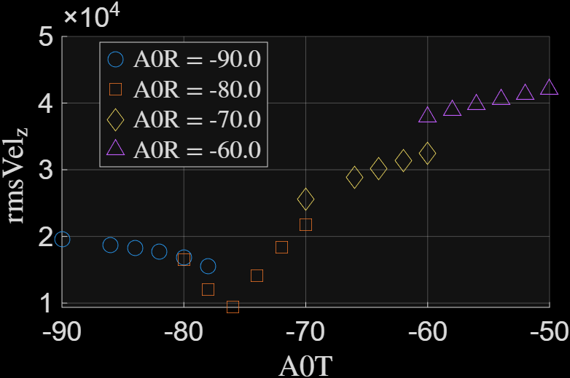
Effect of A0T on axial velocities of pbars for 0V vertex parabola
Vz≈10000m/s
The minimum axial velocity achieved is around 10000m/s! for the given transmission values.
Still haven’t found the A0T for the lowest Vz for the 0V setting .

Slide 10
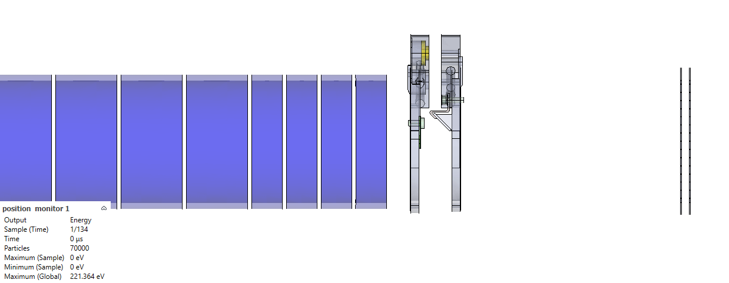
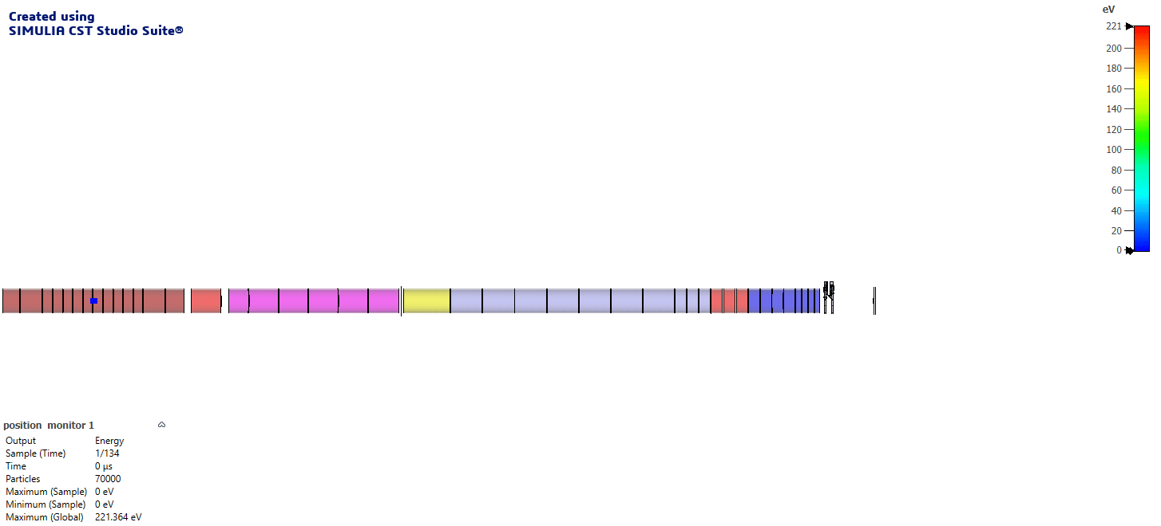
150V parabola vertex
A0T=-38V, A0R=-70V
150V
Deeper parabola faster transfer (150V, 7.6 μs), Flatter parabola slower transfer (0V, 12 μs).

Slide 11
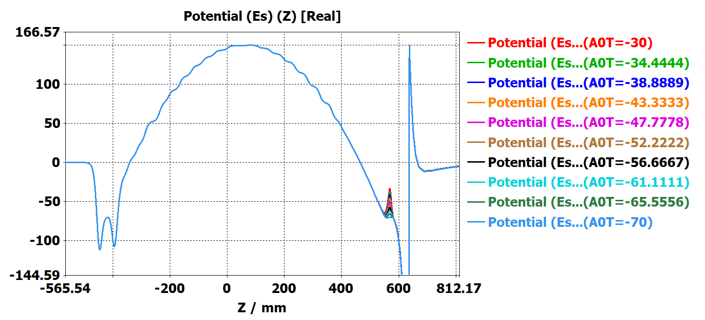
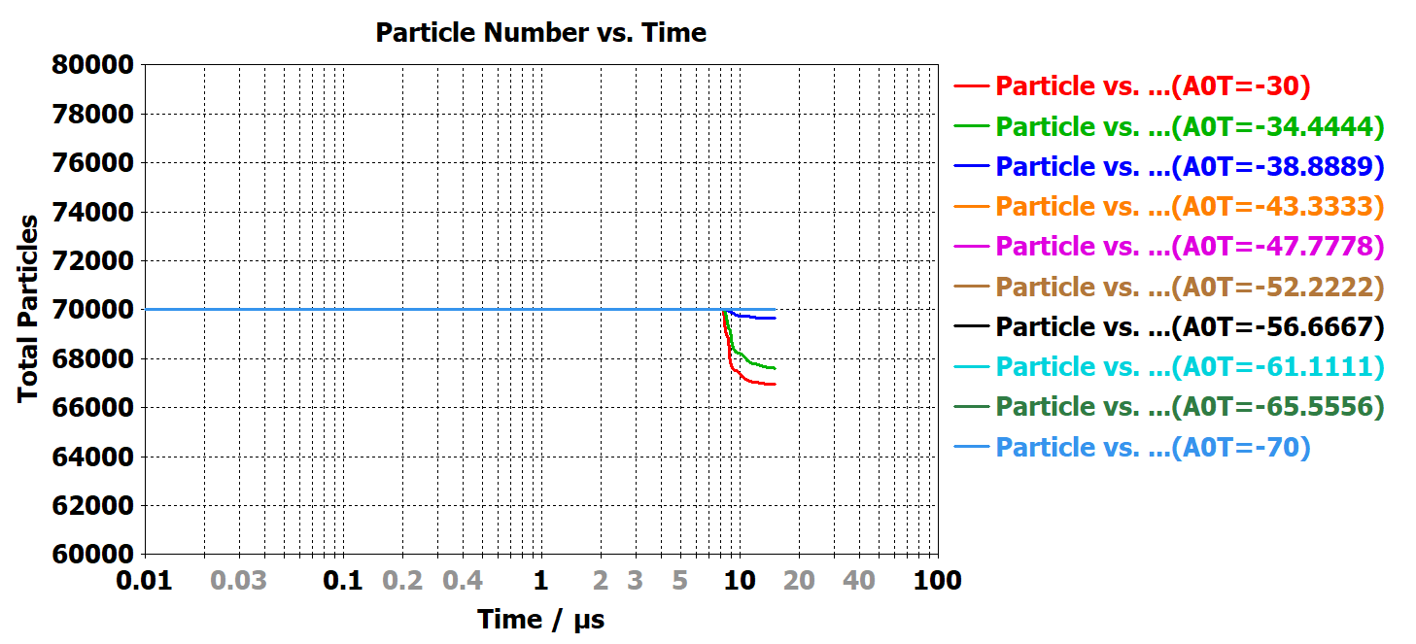
Particle loss curve for A0R=-70V and A0T=-30V to -70V
Values of A0T=-30V to -40V at A0R=-70V allows some transmission of pbars towards the reflection target.

Slide 12
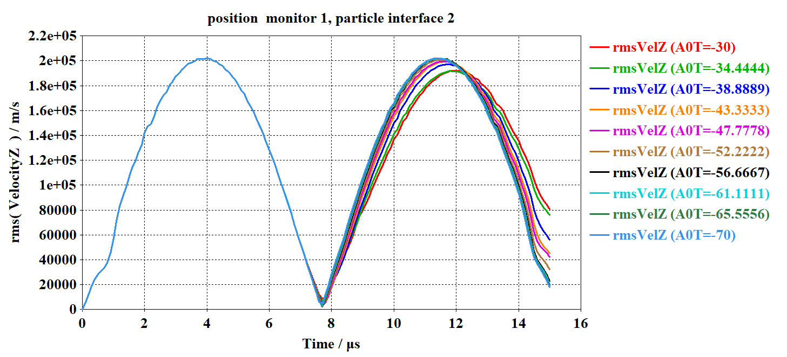
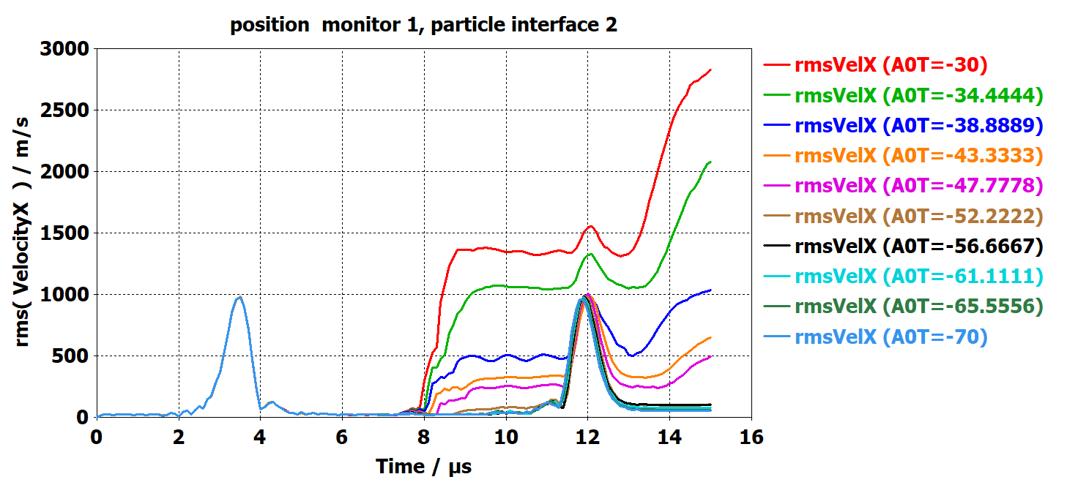
Axial and radial velocities 150V vertex
VrmsX
VrmsZ
The axial velocities of pbar reach < 2000m/s.
The radial velocities is around few 100’s m/s.

Slide 13
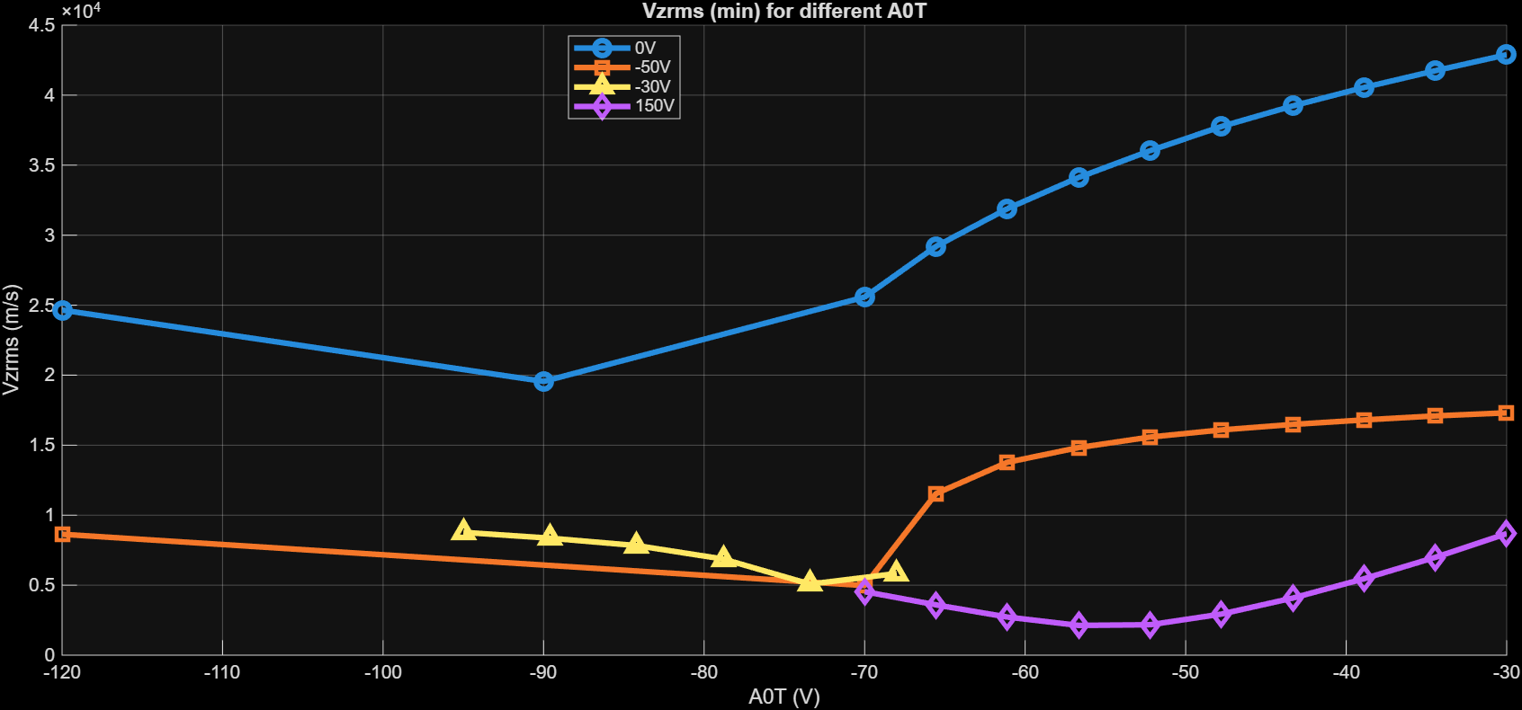
Comparison axial velocities for different parabolas (A0R=-70V)
Vz≈2500m/s
For a constant A0R=-70V parabola with 150V vertex gives the minimal VrmsZ.

Slide 14
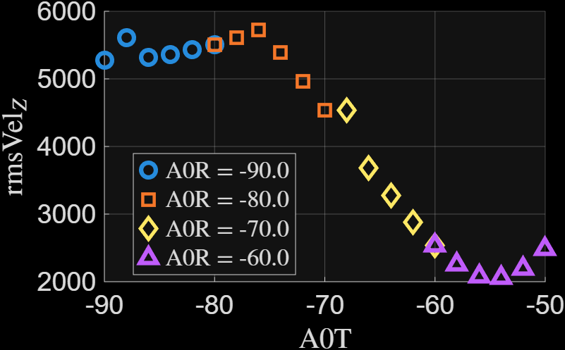
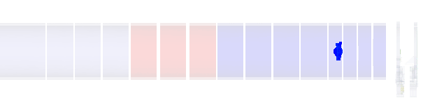
Parametric scan for A0R and A0T (150V vertex)
SrNo | A0R | A0T
1 | -60V | -50V,-52V,-54V,-56V,-58V,-60V
2 | -70V | -60V,-62V,-64V,-66V,-68V,-70V
3 | -80V | -70V,-72V,-74V,-76V,-78V,-80V
4 | -90V | -80V,-82V,-84V,-86V,-88V,-90V
A0T=-54V
A0R=-60V
Vrmz=2054m/s
A0T=A0R=-90V
The transmission values A0T >-40V no transmission takes place, but velocity is reduced.
Still need to scan higher values of A0T to allow some transmission towards reflection target.

Slide 15
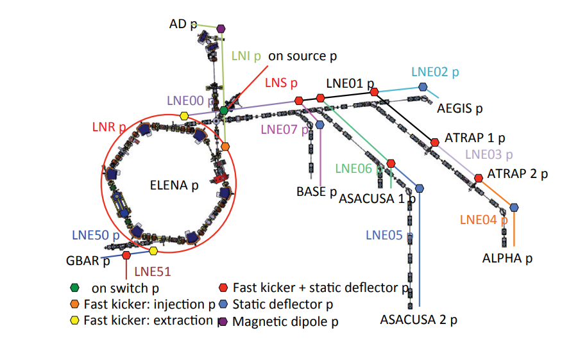
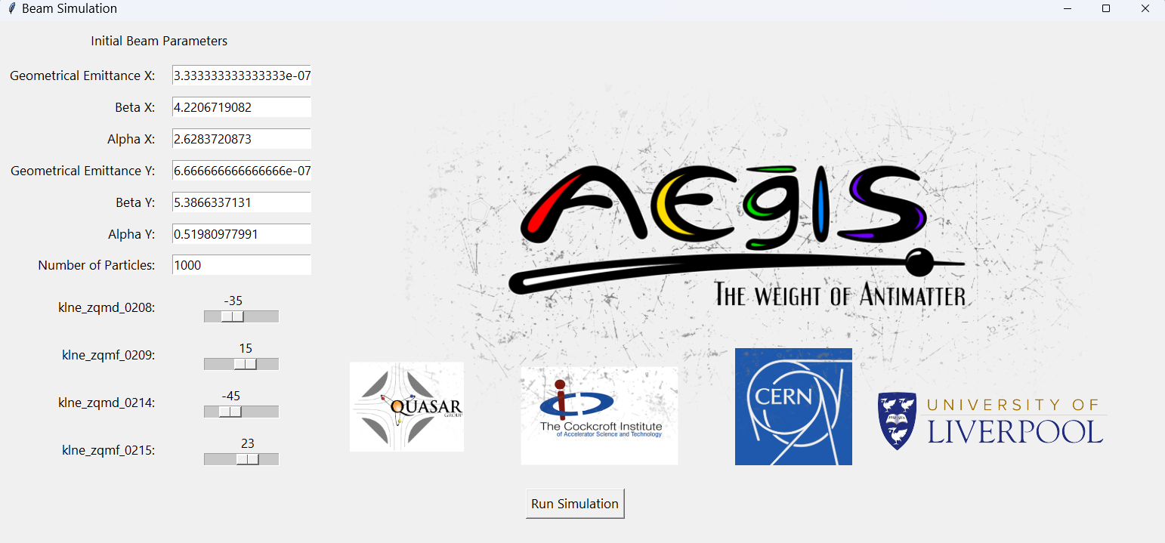
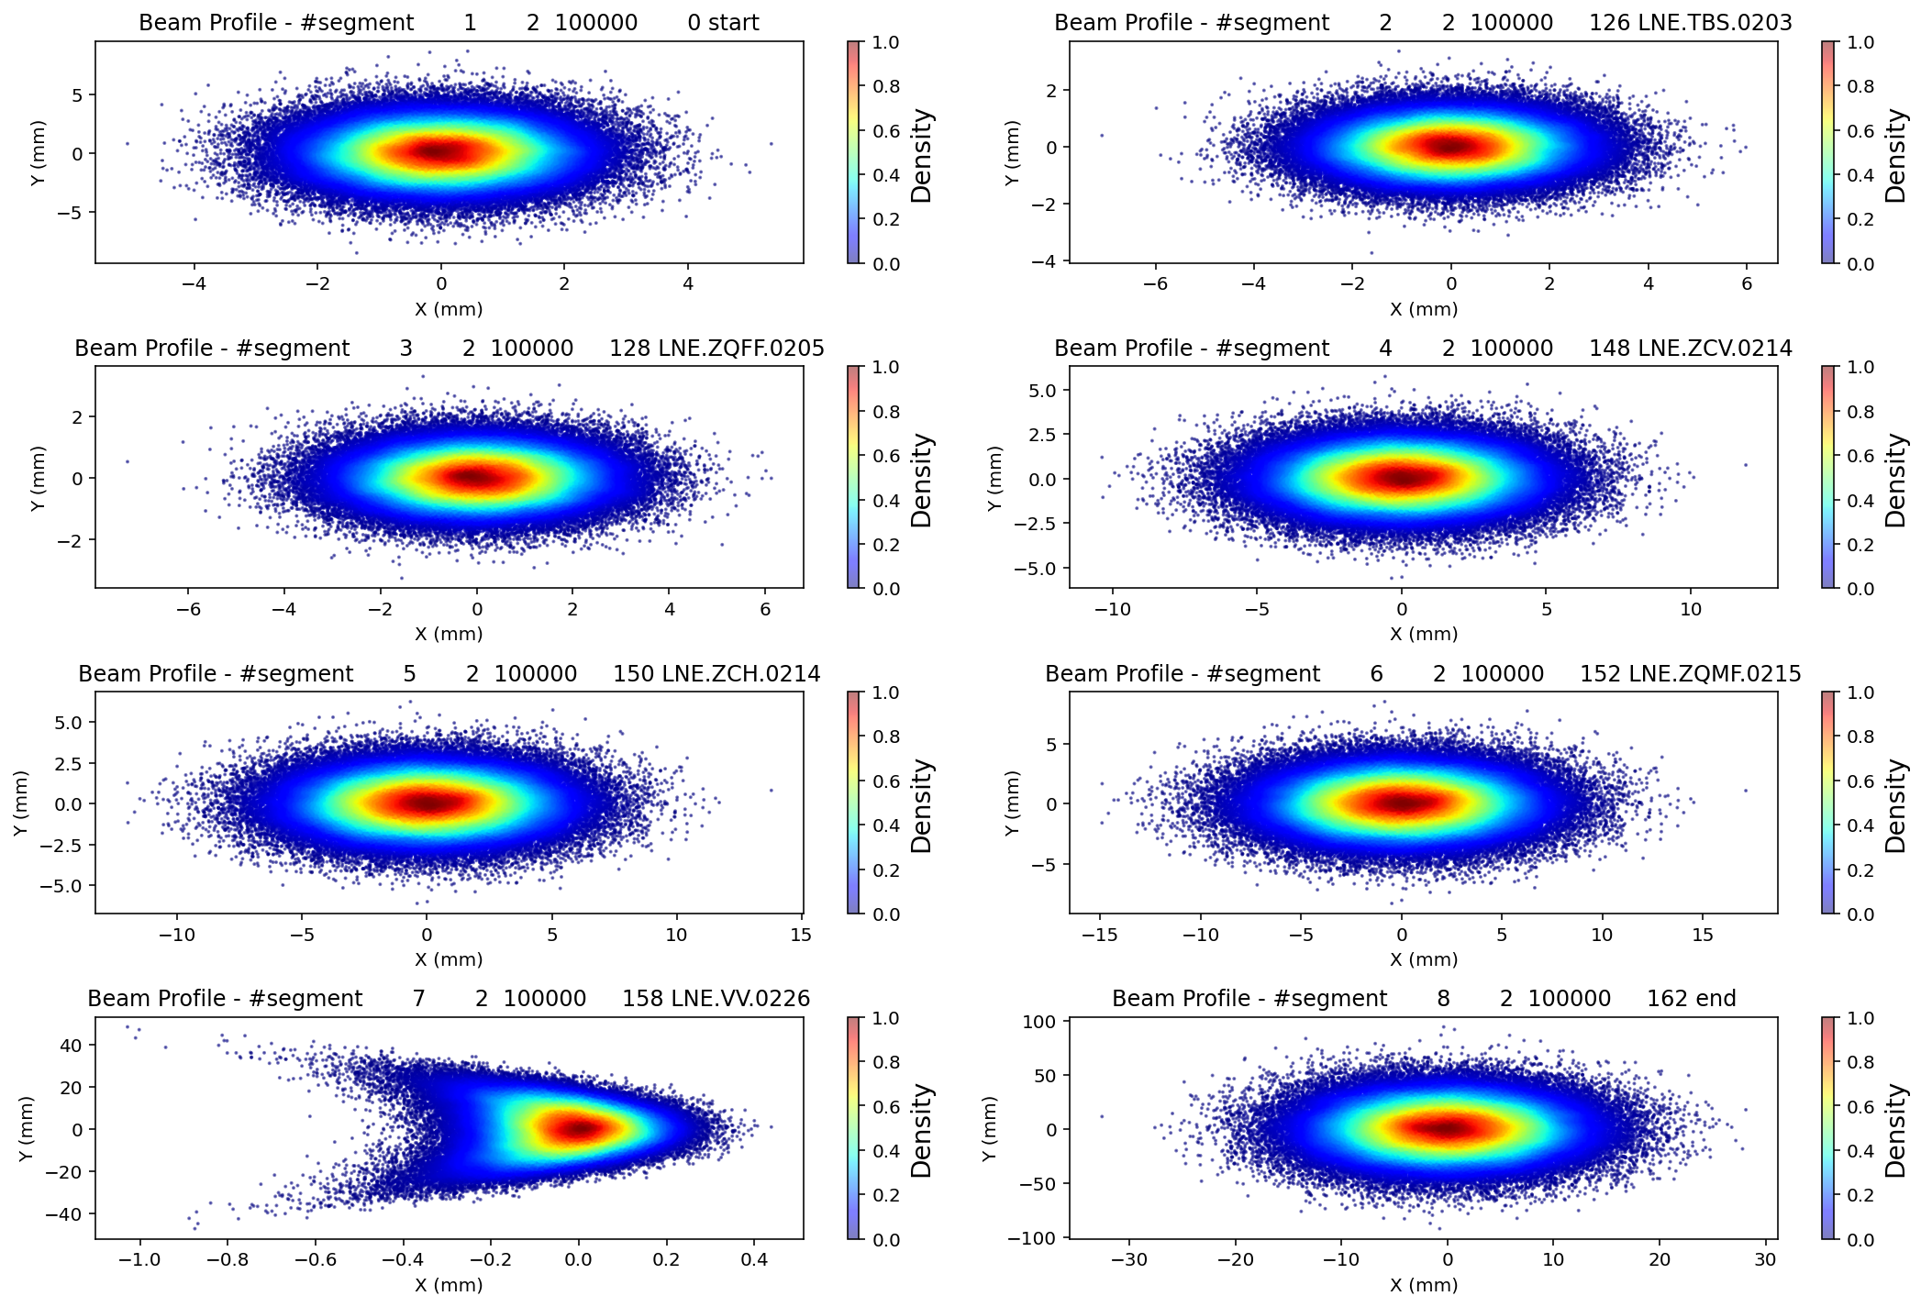
MADX ML model
Transport lines from ELENA to AEgIS
GUI based MAD-X model
Beam profiles at different locations
MADX model available on the transfer line from ELENA-AEgIS.

Slide 16
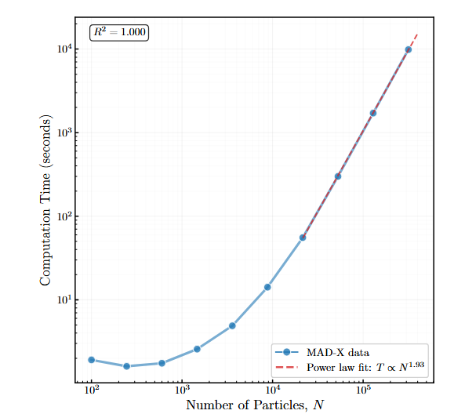
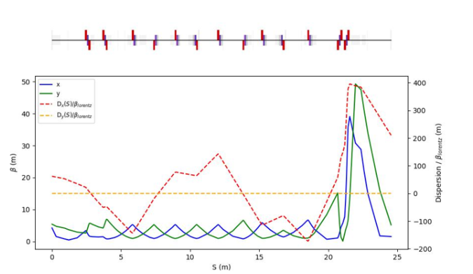
MADX ML model
Twiss plot
Credits: Alex Hill (UoL)

Slide 17
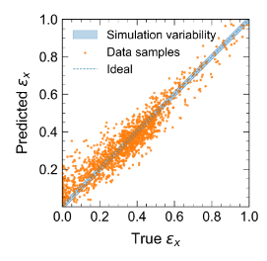
MADX ML model
Credits: Qiyuan Xu (UoL)
ML learning model takes 0.26ms compared to the MADX simulation model.

Slide 18
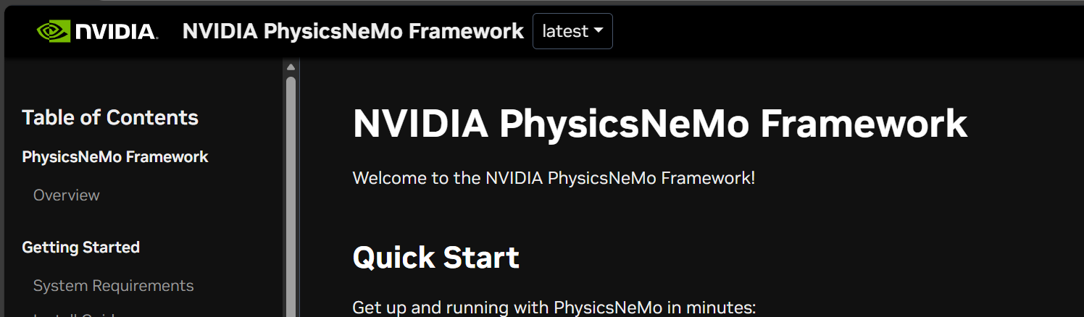
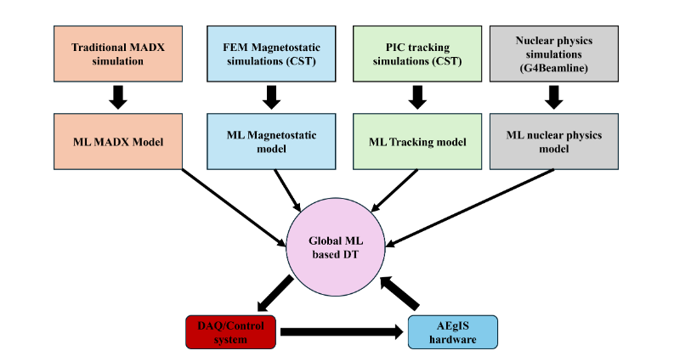
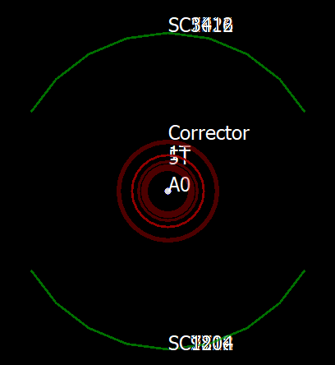
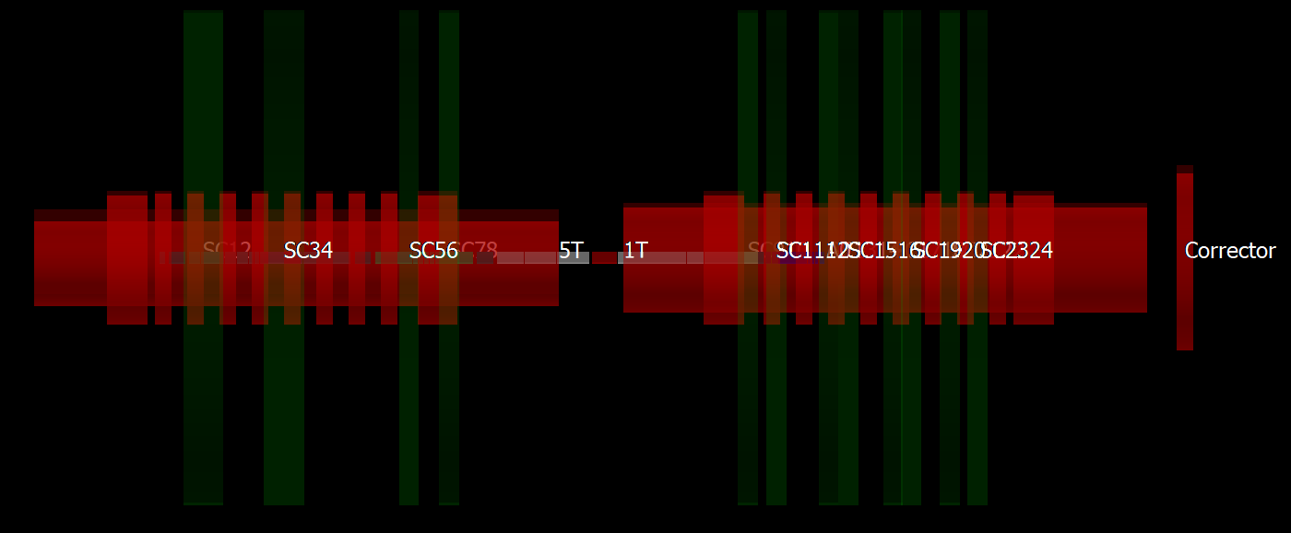
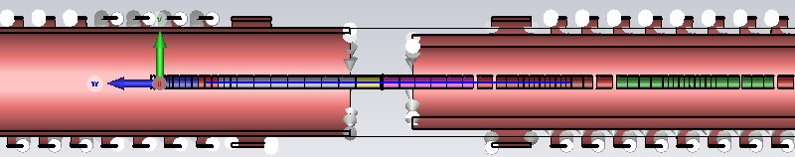
Towards Global Digital Twin model
Future goal towards the Digital Twin model of the AEgIS.

Slide 19
Conclusion and Future goals
The simulation studies indicate that steeper parabola leads to lower pbar energy spread in both axial and radial directions.
Continue working on further optimization of to find the minimal axial velocity setting under different conditions of pulse shape, space charge, plasma length, effect of pbar temperature etc.
Working on building the ML based model for G4 Beamline and MADX using NVIDIA’s Phys Nemo framework.

Slide 20
Extra slides

Slide 21
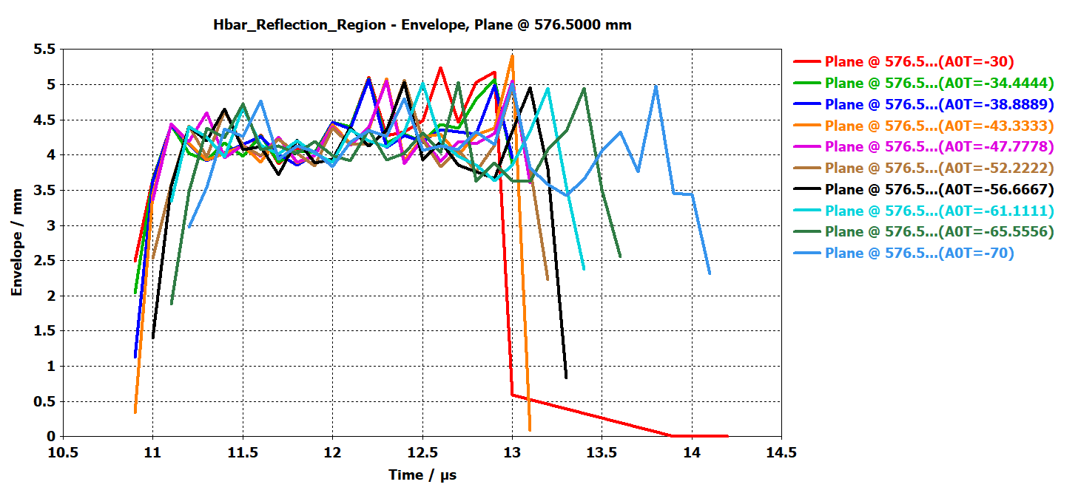
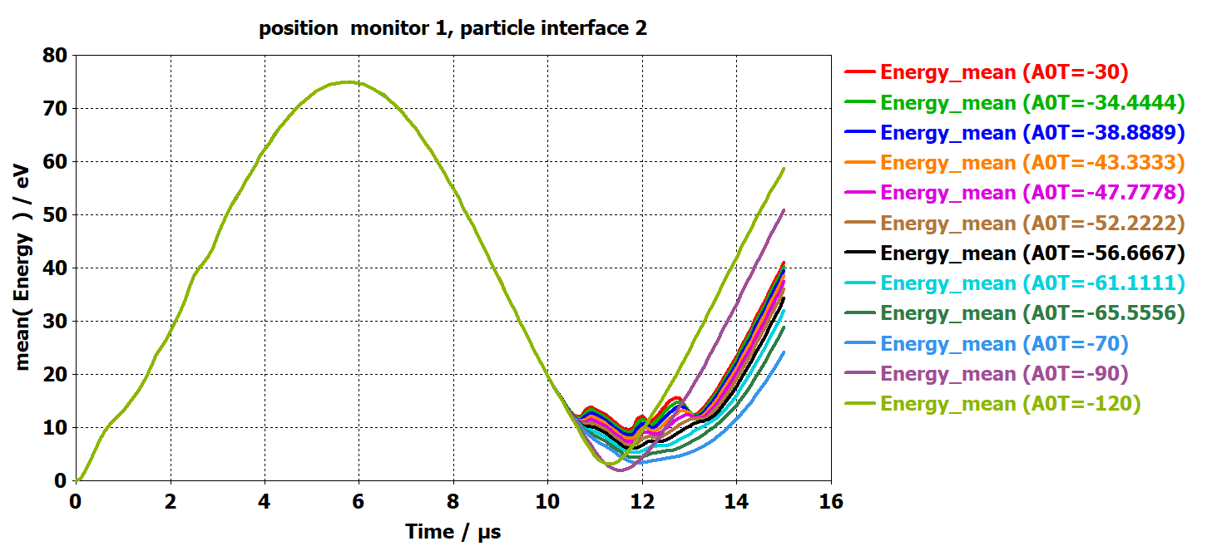
0V Parabola Effect of A0T

Slide 22
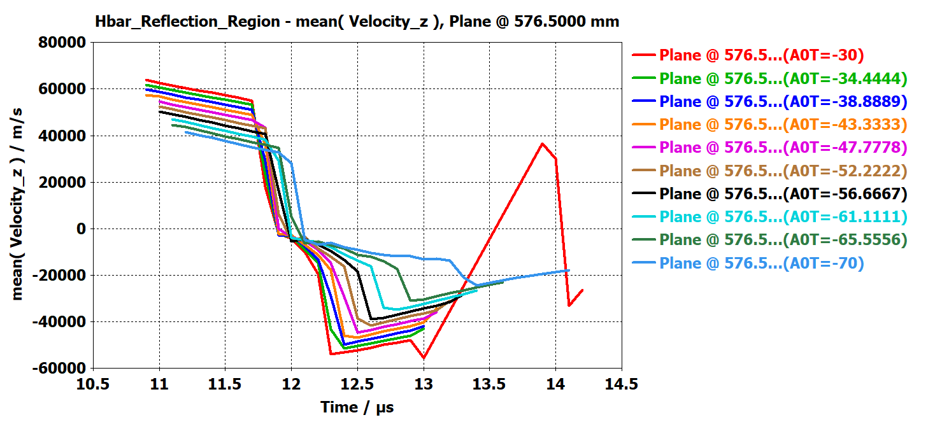
Mean velocity under reflection target

Slide 23
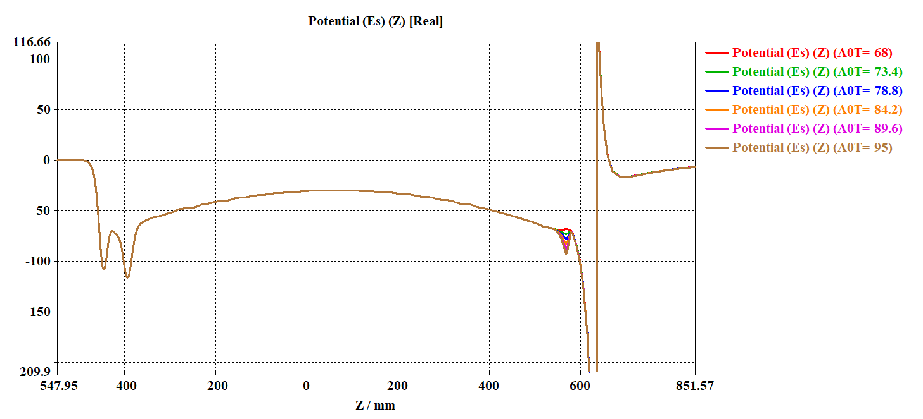
-30V Parabola

Slide 24
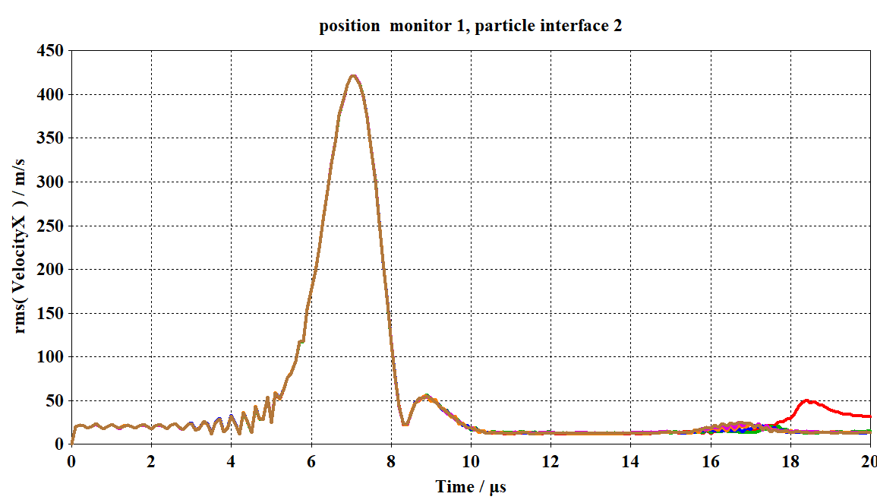
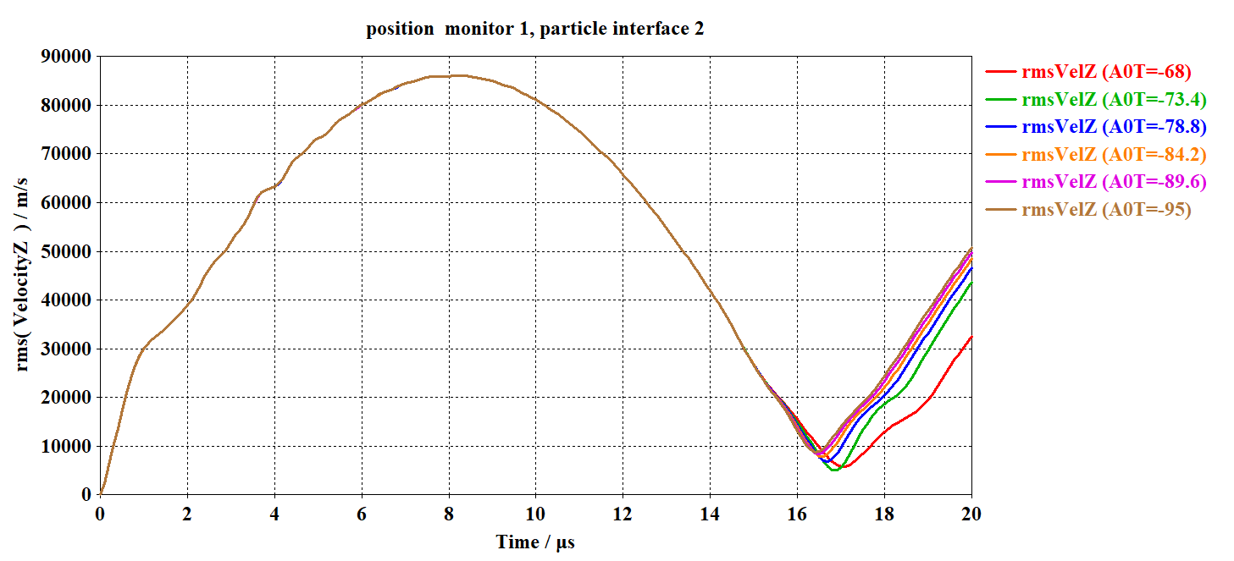
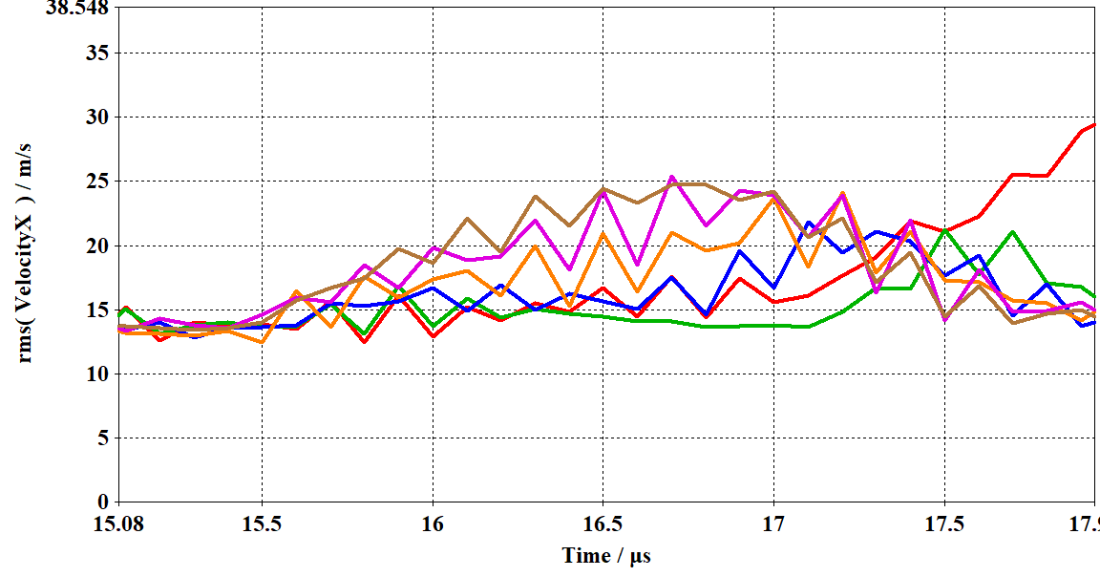
-30V Parabola

Slide 25
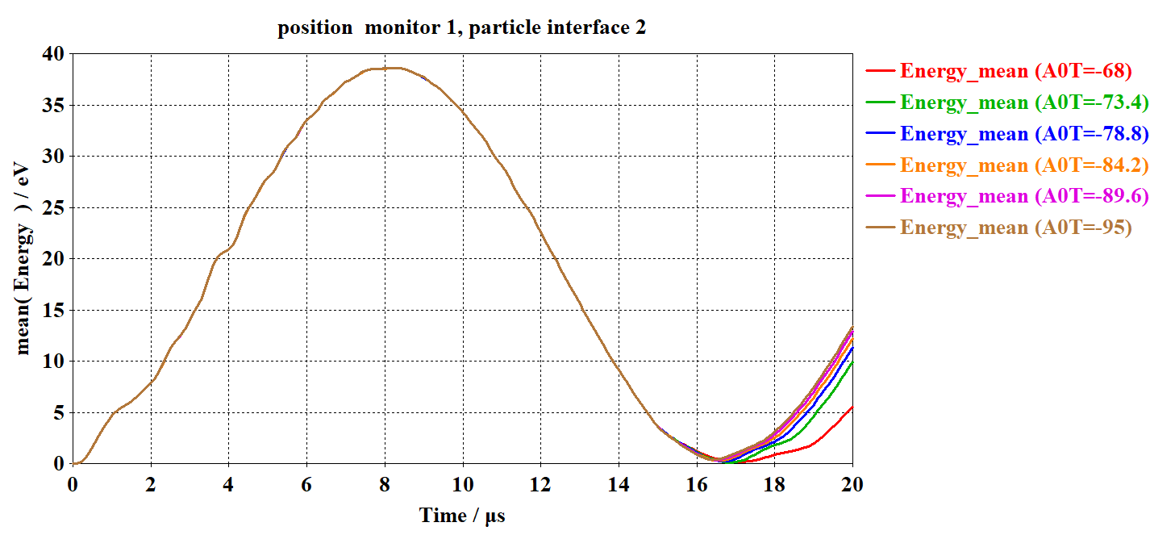
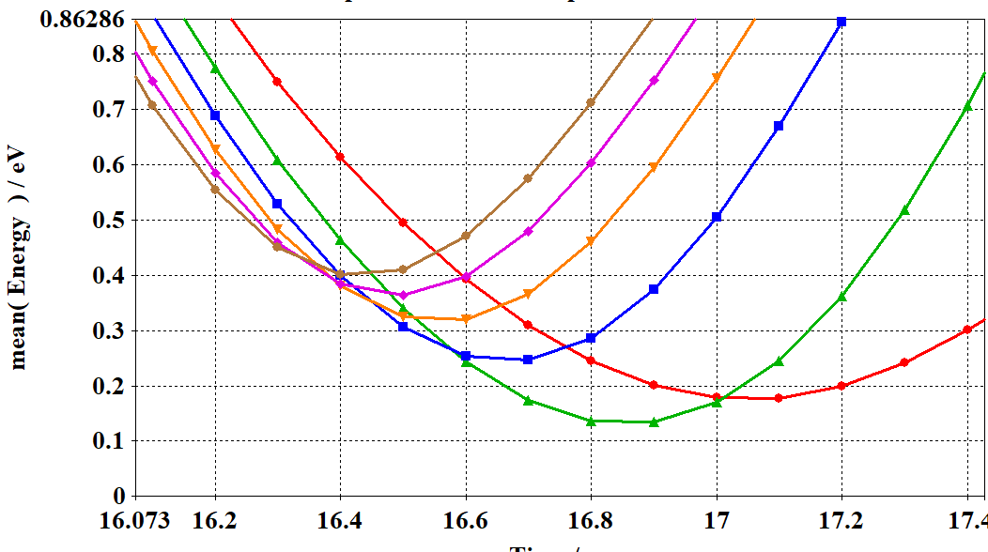
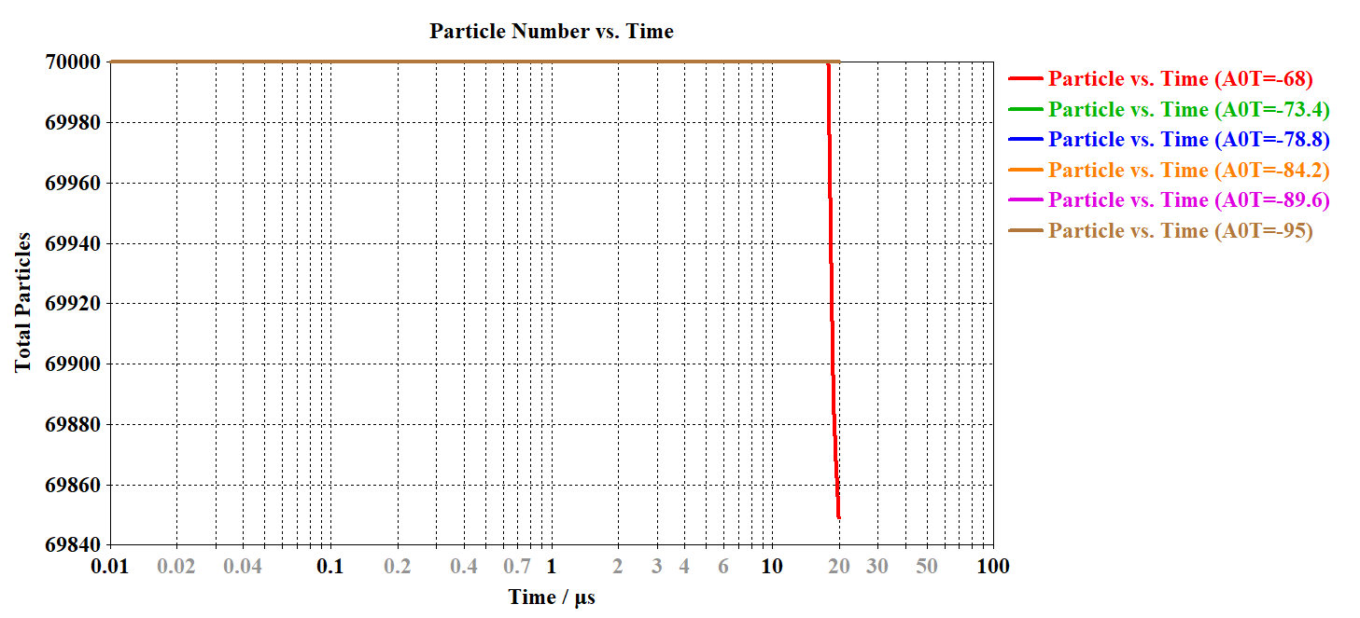
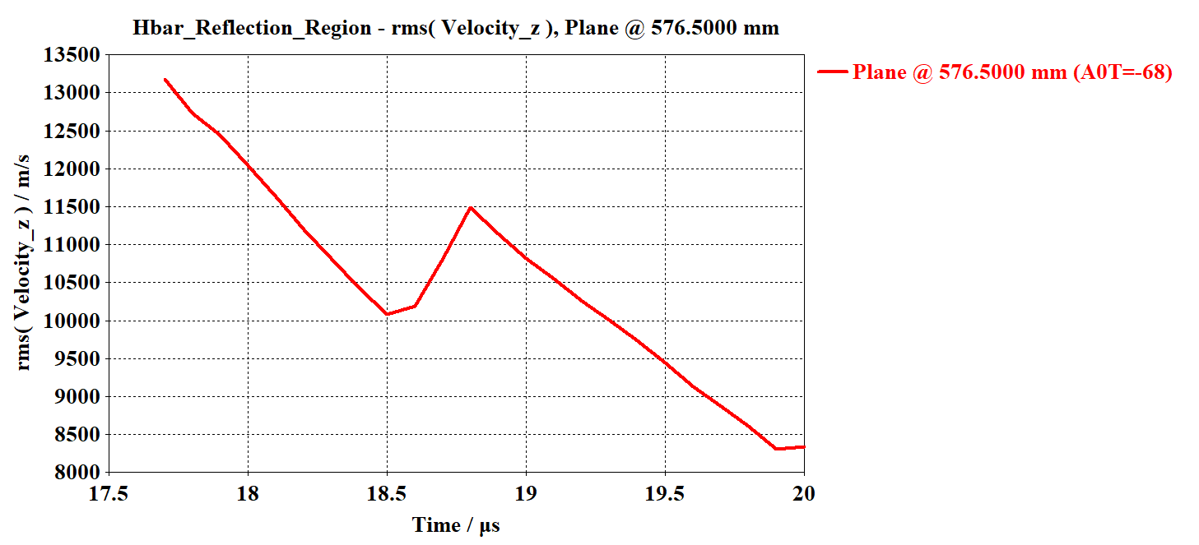
-30V Parabola

Slide 26
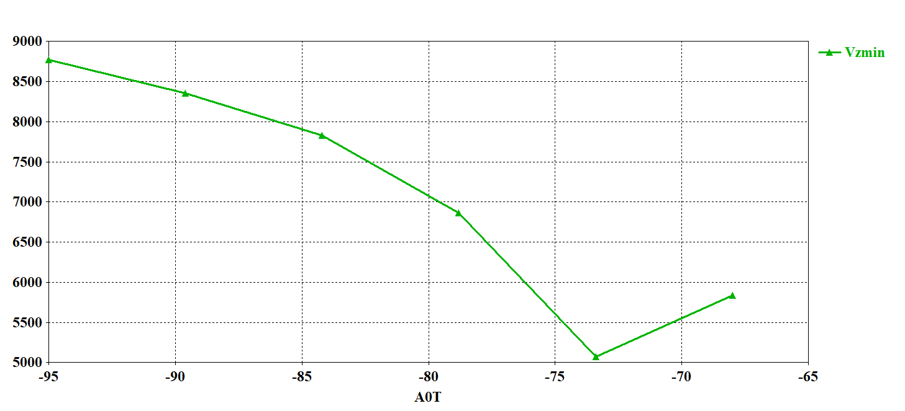
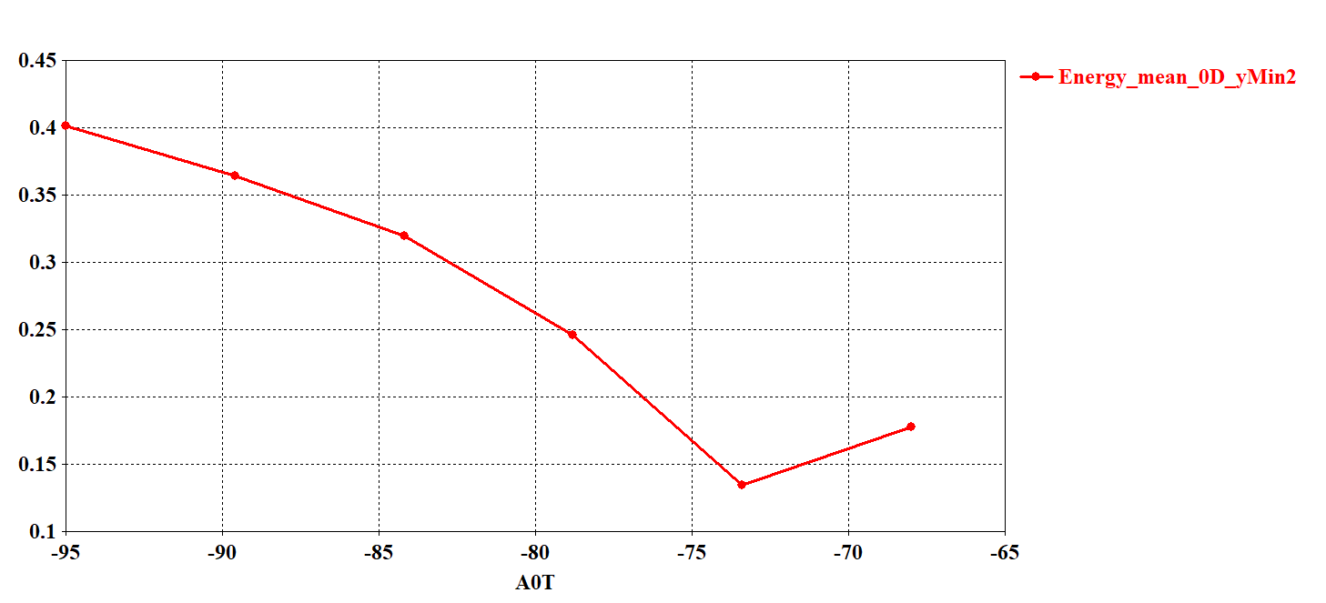
-30V Parabola

Slide 27



-50V Parabola

Slide 28


-50V Parabola

Slide 29




-50V Parabola

Slide 30


-50V Parabola

Slide 31



-50V Parabola
-30V Parabola
0V Parabola

Slide 32


150V Parabola

Slide 33




Slide 34





The ES-PIC simulations identified high-probability impact regions (using the feature particle monitor on solid) for antiprotons on the grid, allowing precise tuning of launch potentials and alignment parameters.

