Slide 1
Computational Accelerator Physics (CAP)
section meeting
Giovanni Iadarola
28 Nov 2025

Slide 2
Information
IPAC26
All our abstracts are GL-APPROVED
Department Head is reviewing them
Reminder to submit to IPAC by Dec 3
MERIT season starting (for staff)
Cannot to create the form in EDH in 2025, due to change of management
Will get to you to schedule the sessions
Fondue: today at 12:00!
02/12/2025: BE end of year meeting​
04/12/2025: ATS seminar on MAD-NG
04/12/2025: ABP Christmas party
05/12/2024: BE seminar on WAKIS

Slide 3
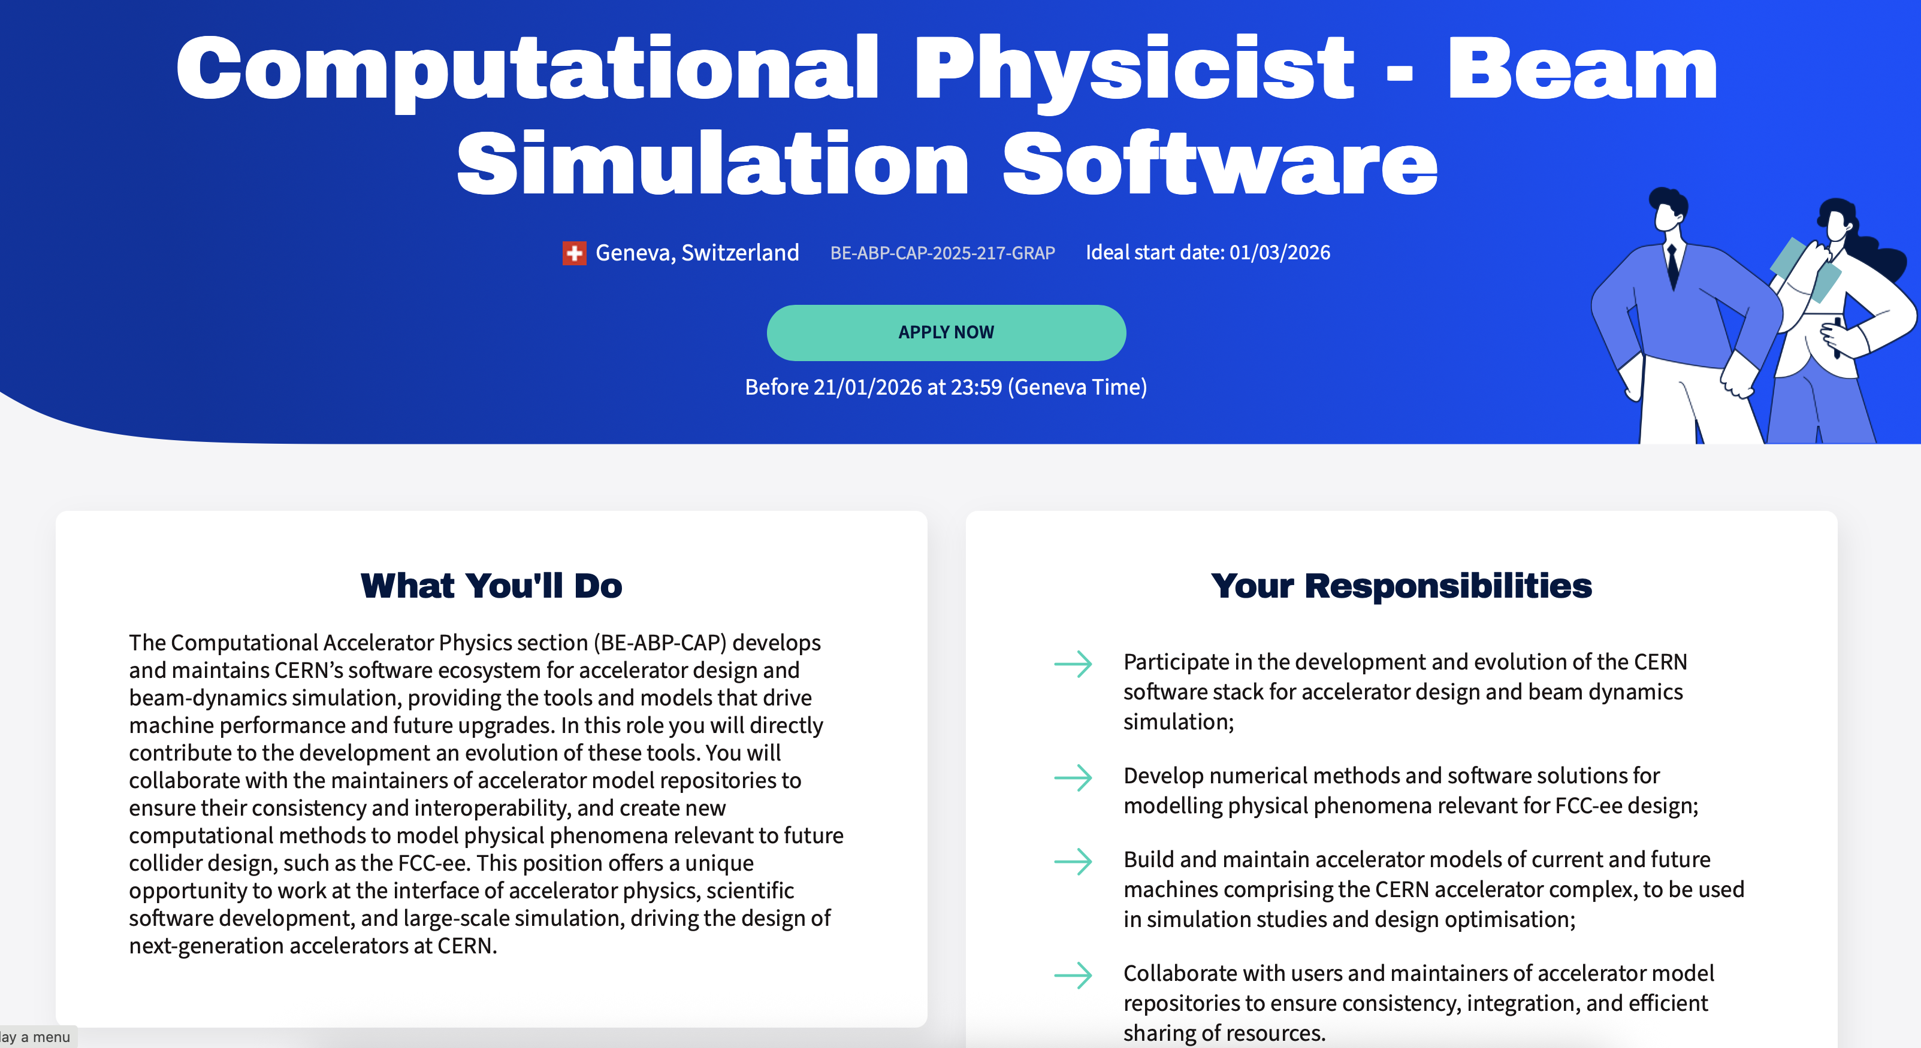
https://careers.cern/jobs/computational-physicist-beam-simulation-software/

