Slide 1
Design progress of the synchrotron radiation absorber for the FCc-ee
P. Krkotić, M. Ady, M. Bammer, G. De Gois Saretti, C. Garion, V. Giovinco, S. Grozavu, M. Morrone
28th of October / 107th Impedance Working Group Meeting

Slide 2
Outline
28th of October / 107th Impedance Working Group Meeting
P. Krkotić – Design Progress SRA FCC-ee
Synchrotron Radiation Absorber (SRA)
FCC-ee: Synchrotron Radiation
Beam Impedance Analysis
Summary and Next Steps
Optics Layouts Overview

Slide 3
Outline
28th of October / 107th Impedance Working Group Meeting
P. Krkotić – Design Progress SRA FCC-ee
FCC-ee: Synchrotron Radiation
Synchrotron Radiation Absorber (SRA)
Beam Impedance Analysis
Summary and Next Steps
Optics Layouts Overview

Slide 4
Outline
28th of October / 107th Impedance Working Group Meeting
P. Krkotić – Design Progress SRA FCC-ee
FCC-ee: Synchrotron Radiation
Synchrotron Radiation Absorber (SRA)
Beam Impedance Analysis
Summary and Next Steps
Optics Layouts Overview

Slide 5
Outline
28th of October / 107th Impedance Working Group Meeting
P. Krkotić – Design Progress SRA FCC-ee
FCC-ee: Synchrotron Radiation
Synchrotron Radiation Absorber (SRA)
Optics Layouts Overview
Beam Impedance Analysis
Summary and Next Steps

Slide 6
Outline
28th of October / 107th Impedance Working Group Meeting
P. Krkotić – Design Progress SRA FCC-ee
FCC-ee: Synchrotron Radiation
Synchrotron Radiation Absorber (SRA)
Optics Layouts Overview
Beam Impedance Analysis
Summary and Next Steps

Slide 7
Outline
28th of October / 107th Impedance Working Group Meeting
P. Krkotić – Design Progress SRA FCC-ee
FCC-ee: Synchrotron Radiation
Synchrotron Radiation Absorber (SRA)
Optics Layouts Overview
Beam Impedance Analysis
Summary and Next Steps

Slide 8
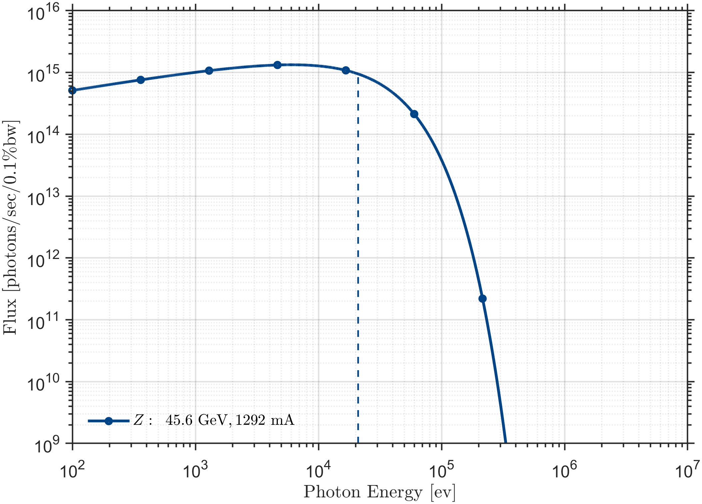
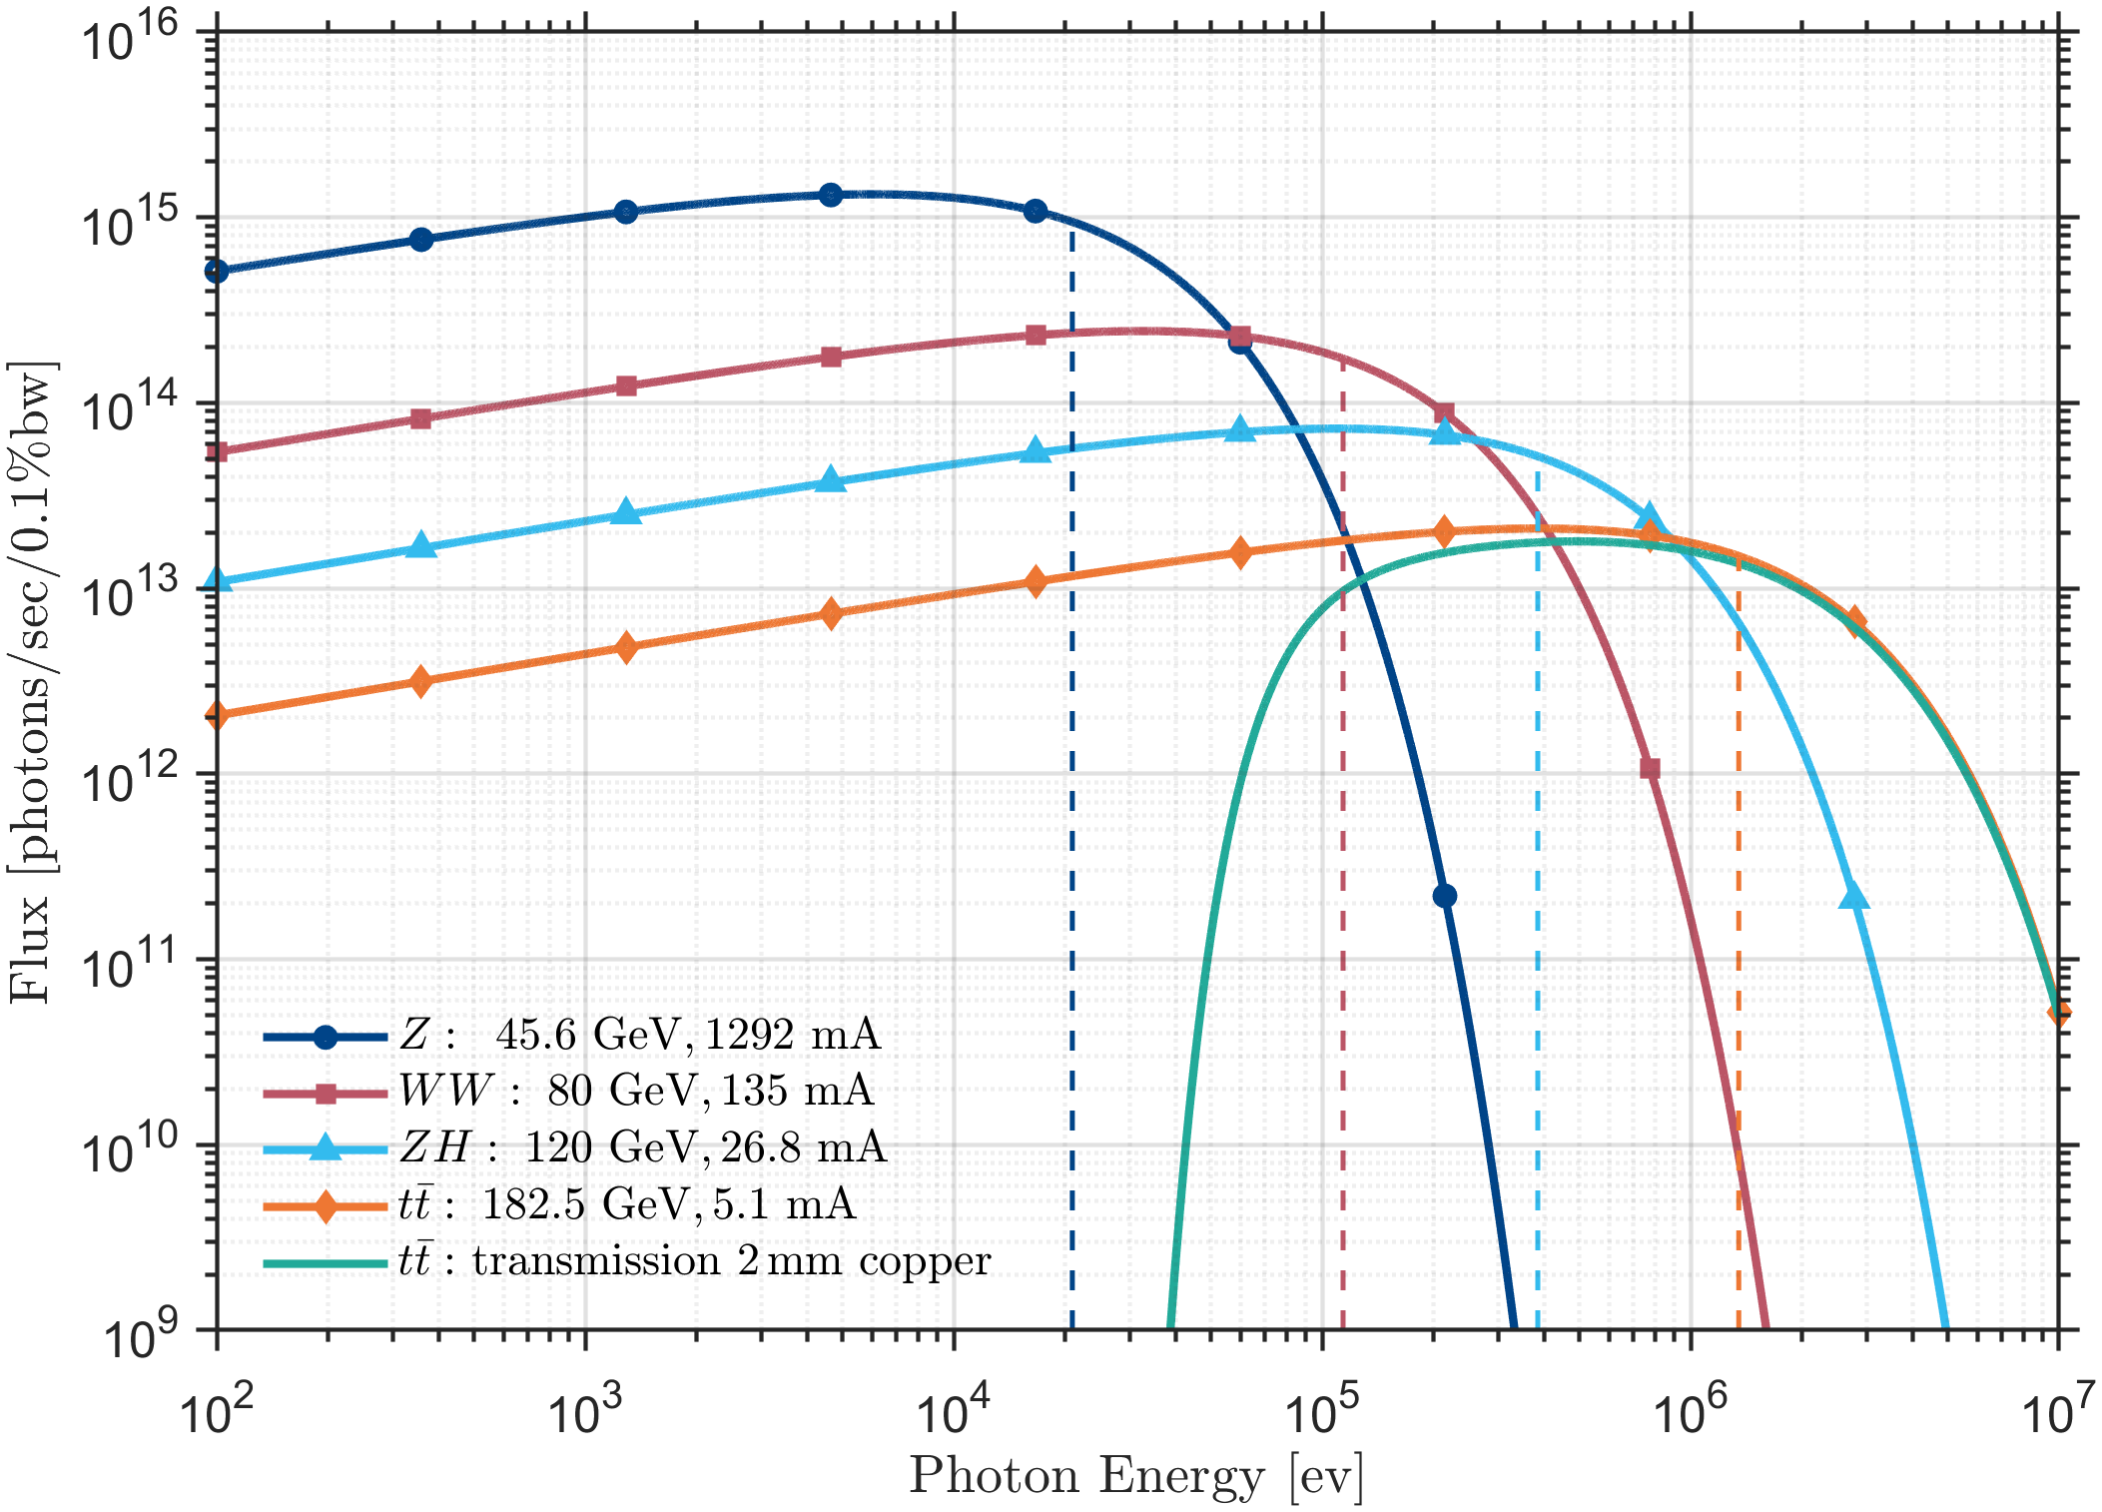
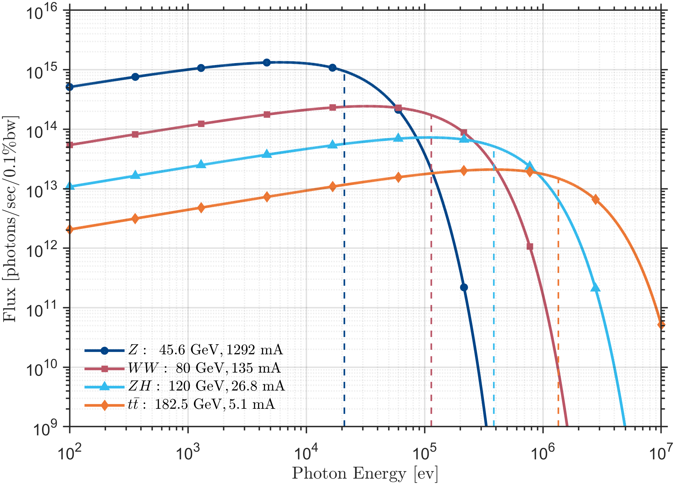
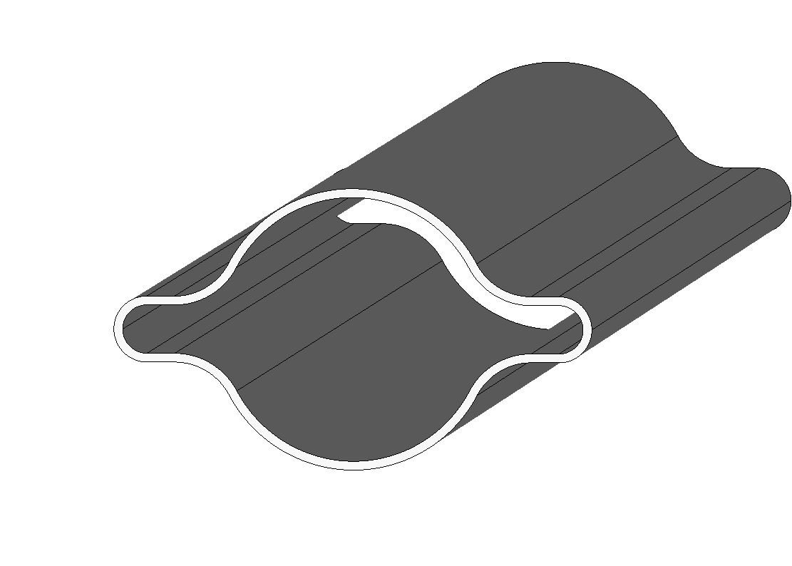
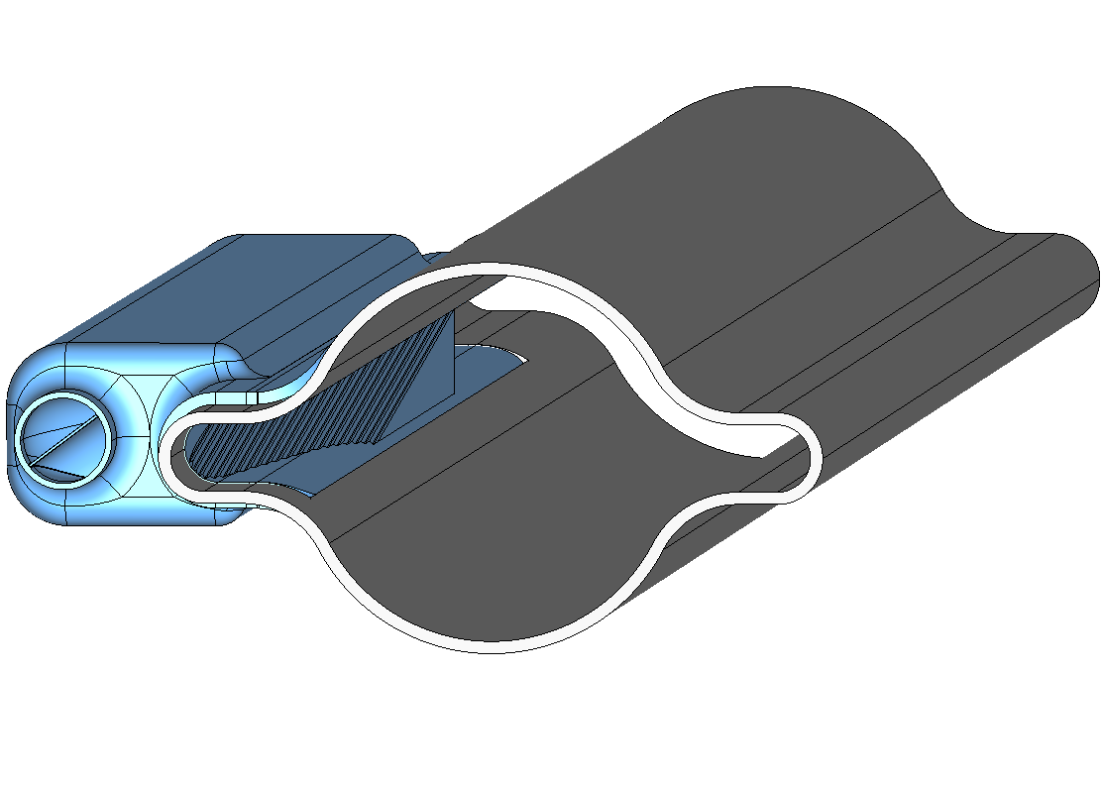
FCC-ee: Synchrotron Radiation
28th of October / 107th Impedance Working Group Meeting
P. Krkotić – Design Progress SRA FCC-ee
Highest surface
power density
Origin & impact on design
Highest penetration
into the material
synchrotron
radiation
vacuum chamber
electron beam
Running Mode | Z | WW | ZH | ttbar
Beam energy [GeV] | 45.6 | 80 | 120 | 182.5
Energy loss per turn [GeV] | 0.04 | 0.37 | 1.86 | 9.94
Synchrotron radiation power [MW] | 50 | 50 | 50 | 50
Beam current [mA] | 1294 | 135 | 26.8 | 5.1

Slide 9
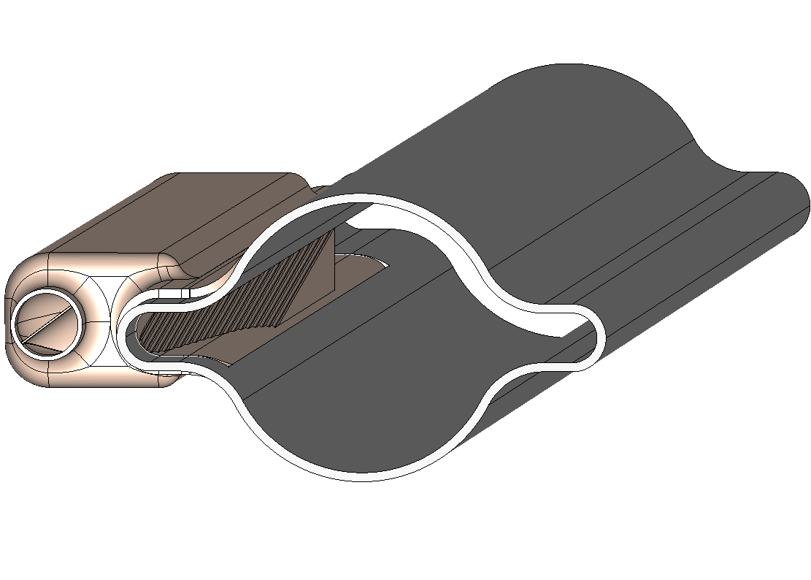
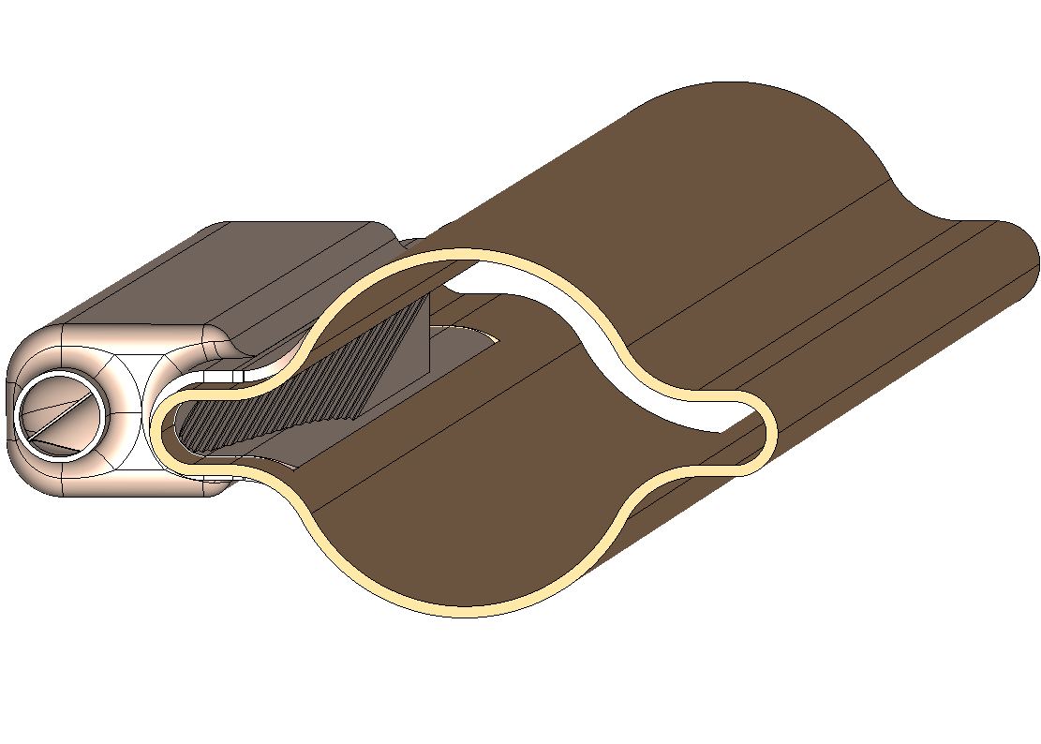
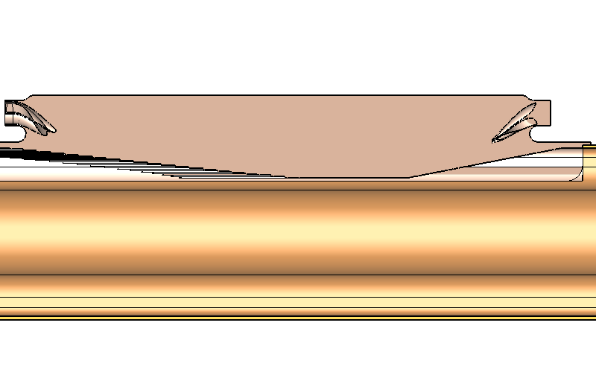
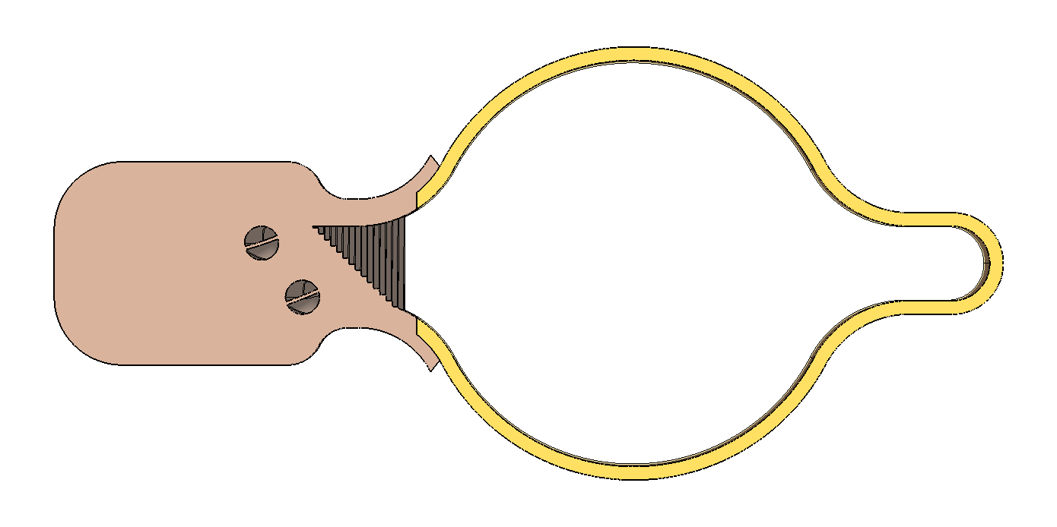
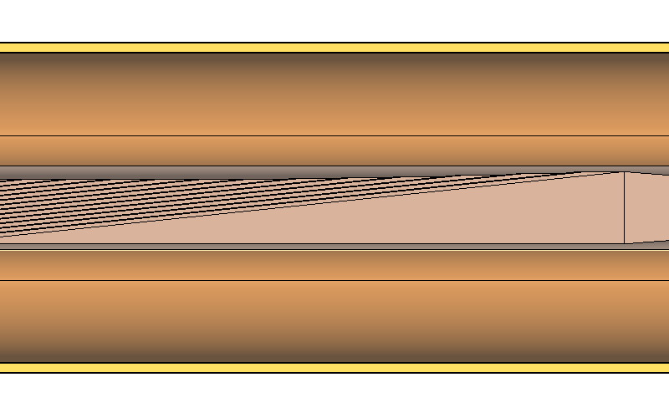
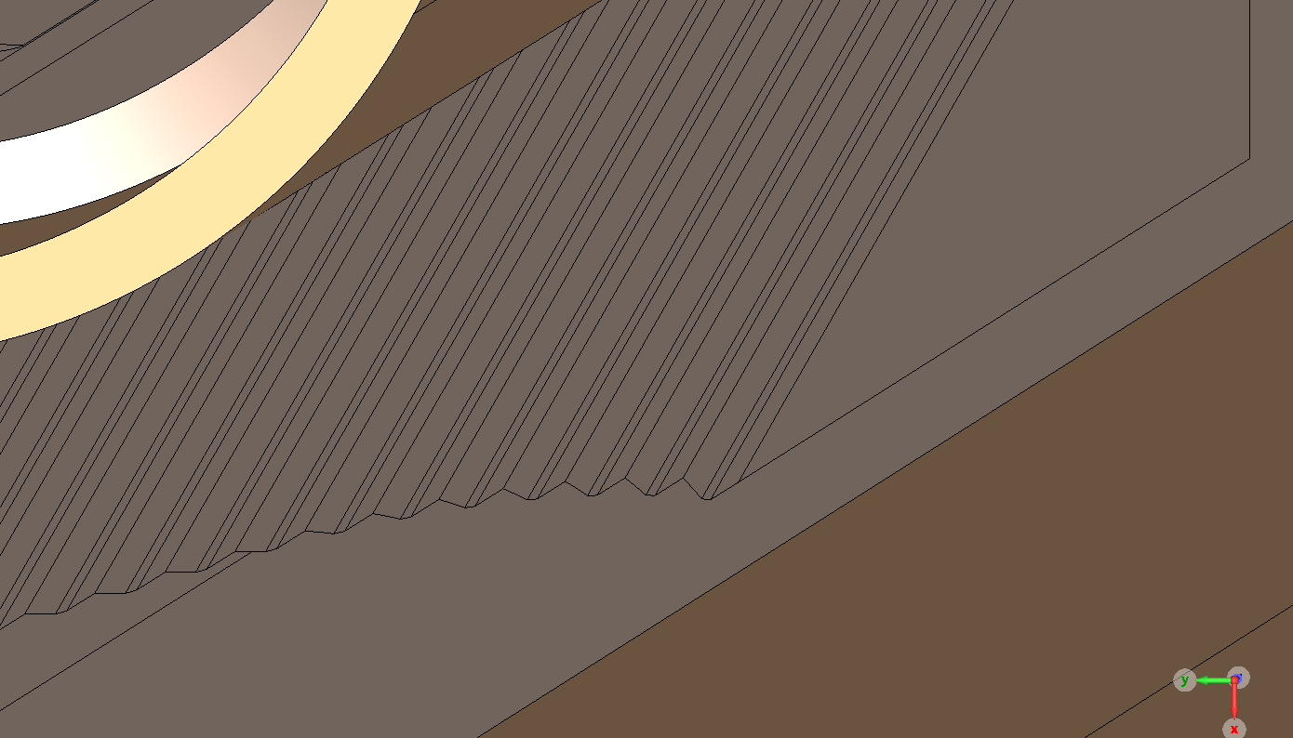
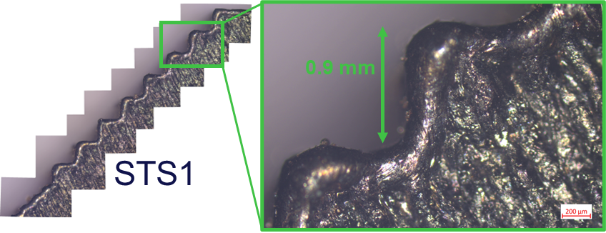
Synchrotron Radiation Absorber (SRA)
28th of October / 107th Impedance Working Group Meeting
P. Krkotić – Design Progress SRA FCC-ee
Conceptual Design
Material: CuCrZr (70–85% IACS)
Manufacturing: Powder Bed Fusion 3D printing
Design: slanted surface (45°), tilt (7°), taper-transition (15°)
Sawtooth: 0.9 mm step height
Integration: Laser welding
Cooling: water circuit
Placement: insight the winglet – dependence on
390 mm
vacuum chamber
Optics Layout
45°
7°
15°
S. Grozavu, Design, simulations and testing of the FCC–ee synchrotron radiation absorber, VSC Seminars, June, 2025
M. Bammer, Layer by Layer, FCC Week 2025, Vienna, May, 2025,
Sawtooth pattern

Slide 10
Optics Layout Overview
28th of October / 107th Impedance Working Group Meeting
P. Krkotić – Design Progress SRA FCC-ee
Optics Layout
Global Hybrid Correction
Local Chromatic Correction
Arc dipoles:
  2 magnet split
  12 m + {7.74 m, 9.19 m, 10.69 m}
  17 cm interconnection gap
Arc dipoles:
  3 magnet split
  9.06 m + 9.06 m + 9.06 m
  17 cm interconnection gap
1
2
3
4
5
6
7
8
9
10
11
12
13
14
15
16
17
18
19
20
21
22
23
24
25
26
27
28
29
30
GHC
Q
S
D
D
LCC
Q
S
D
D
D
M. A. Jebramcik, Status of the Optics used for comparison, 11th Meeting of the FCC-ee Layout and Optics Design

Slide 11
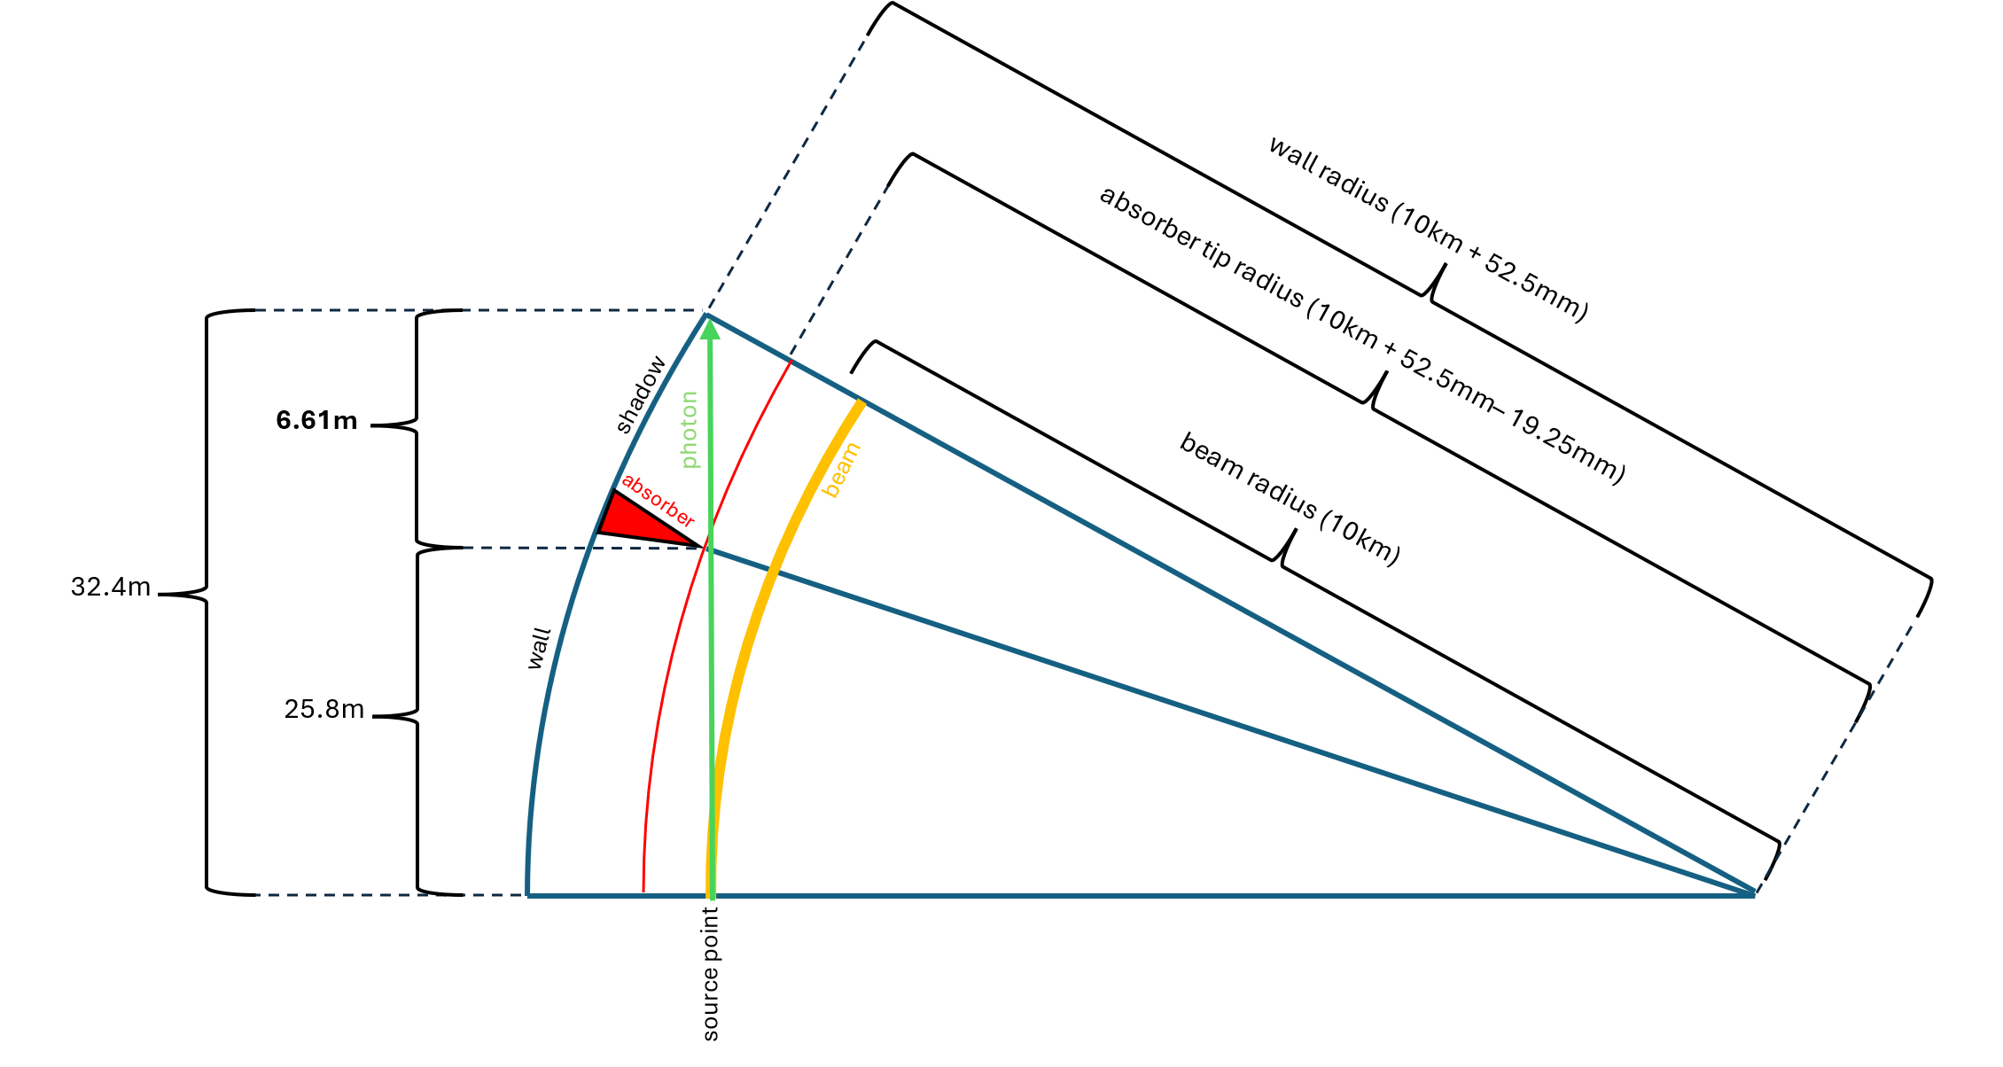
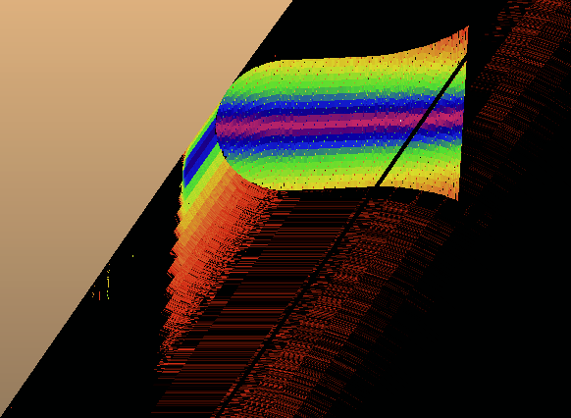
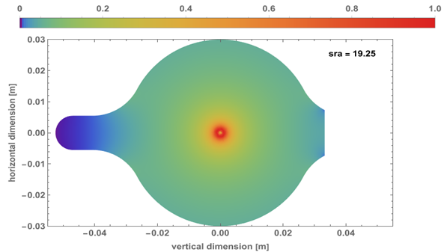
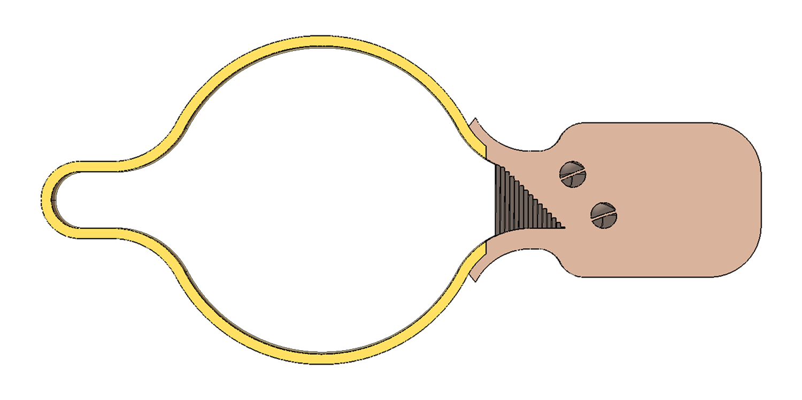
Optics Layout Overview
28th of October / 107th Impedance Working Group Meeting
P. Krkotić – Design Progress SRA FCC-ee
Global Hybrid Correction
– Absorber Placement
Arc dipoles:
  2 magnet split
  12 m + {7.74 m, 9.19 m, 10.69 m}
  17 cm interconnection gap
+ 0.75 mm
+ 4.00 mm
- 3.25 mm
Courtesy Marton Ady
Courtesy Marton Ady
GHC
Q
S
D
D
55 / 75 cm reserved for shielding
Synchrotron radiation absorber
M. Ady, Comparison criteria for GHC vs LCC:Vacuum, 8th Meeting of the FCC-ee Layout and Optics Design

Slide 12
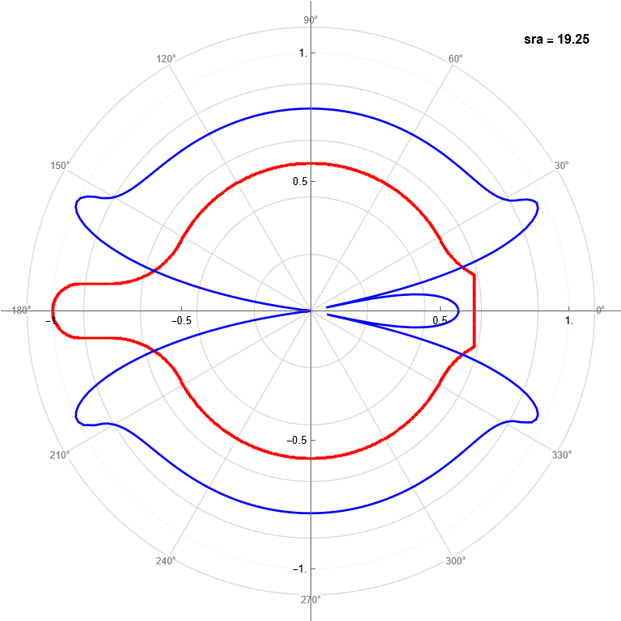
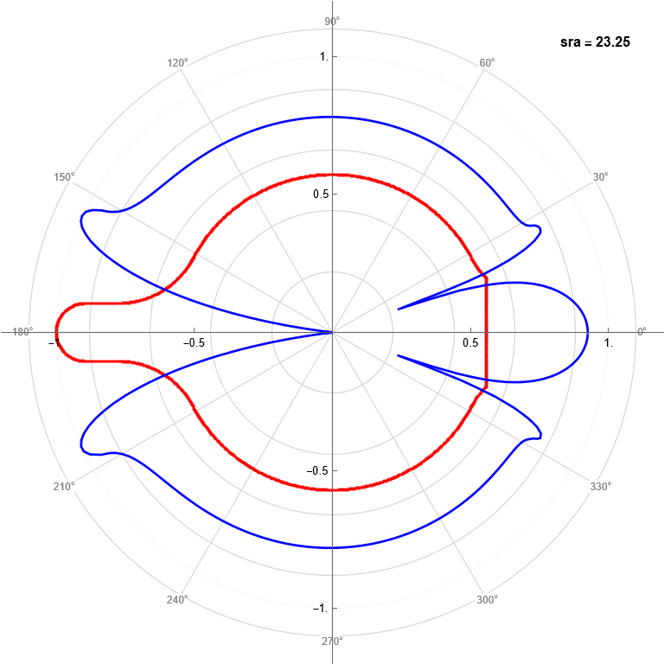
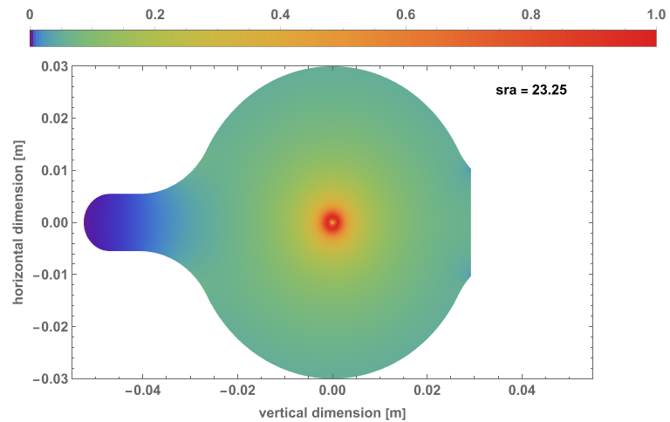
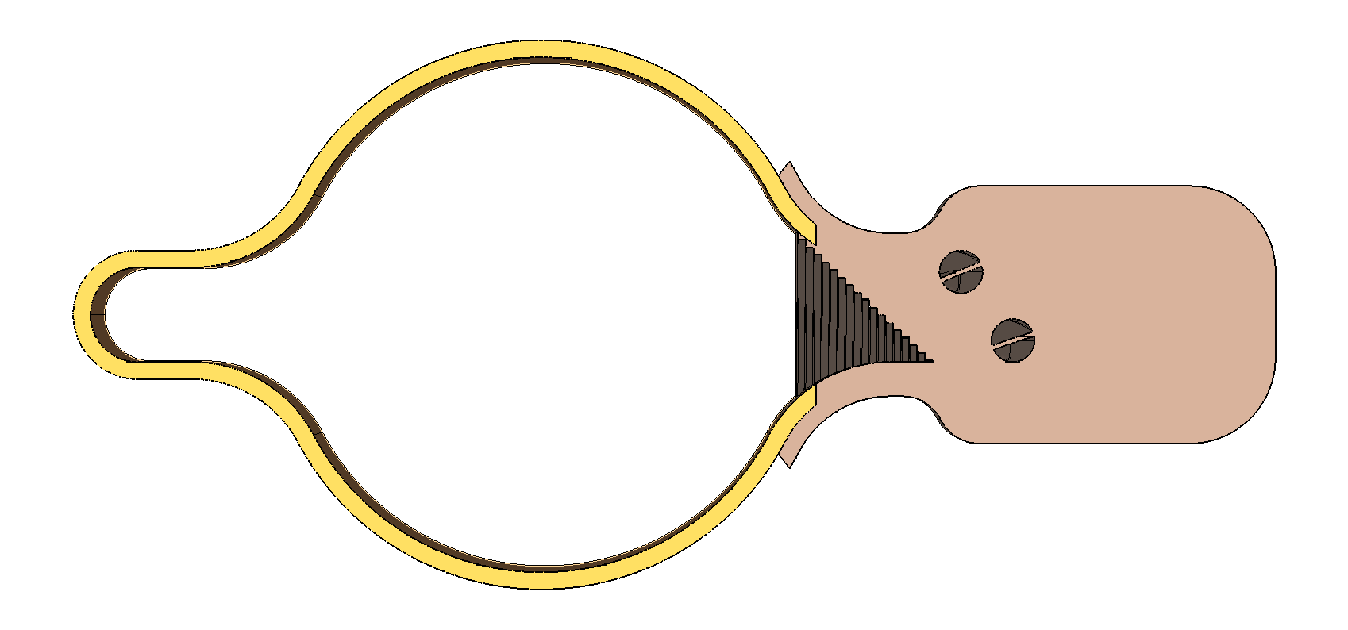
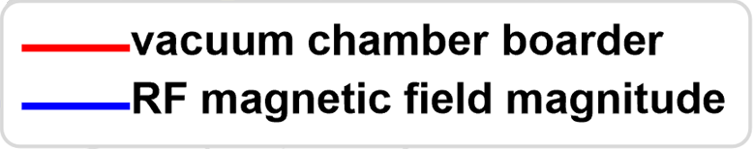
Surface Current Density
28th of October / 107th Impedance Working Group Meeting
P. Krkotić – Design Progress SRA FCC-ee
P. Krkotić, Investigation of Beam-Induced Heating in the FCC-ee Vacuum Chamber, EDMS Report 3352561, 2025

Slide 13
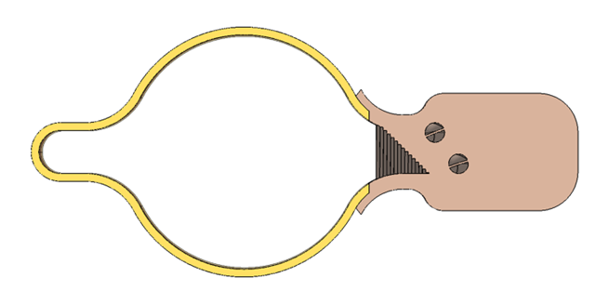
Optics Layout Overview
28th of October / 107th Impedance Working Group Meeting
P. Krkotić – Design Progress SRA FCC-ee
Global Hybrid Correction
– Absorber Placement
Arc dipoles:
  2 magnet split
  12 m + {7.74 m, 9.19 m, 10.69 m}
  17 cm interconnection gap
- 3.25 mm
+ 0.75 mm
Hybrid solution: 4+1
GHC
Q
S
D
D
55 / 75 cm reserved for shielding
Synchrotron radiation absorber
M. Ady, Comparison criteria for GHC vs LCC:Vacuum, 8th Meeting of the FCC-ee Layout and Optics Design

Slide 14
Optics Layout Overview
28th of October / 107th Impedance Working Group Meeting
P. Krkotić – Design Progress SRA FCC-ee
Local Chromatic Correction
– Absorber Placement
- 3.25 mm
Arc dipoles:
  3 magnet split
  9.06 m + 9.06 m + 9.06 m
  17 cm interconnection gap
LCC
Q
S
D
D
D
55 / 75 cm reserved for shielding
Synchrotron radiation absorber
M. Ady, Comparison criteria for GHC vs LCC:Vacuum, 8th Meeting of the FCC-ee Layout and Optics Design

Slide 15
Optics Layout Overview
28th of October / 107th Impedance Working Group Meeting
P. Krkotić – Design Progress SRA FCC-ee
Global Hybrid Correction
Local Chromatic Correction
Arc dipoles:
  2 magnet split
  12 m + {7.74 m, 9.19 m, 10.69 m}
  17 cm interconnection gap
  Quantity: 5680
Absorbers: 14200 / beam
  13064 – nominal position
  1136 – 4 mm closer towards beam
Arc dipoles:
  3 magnet split
  9.06 m + 9.06 m + 9.06 m
  17 cm interconnection gap
  Quantity: 6624
Absorbers: 13248 / beam
  13248 – nominal position
GHC
Q
S
D
D
LCC
Q
S
D
D
D
55 / 75 cm reserved for shielding
Synchrotron radiation absorber

Slide 16
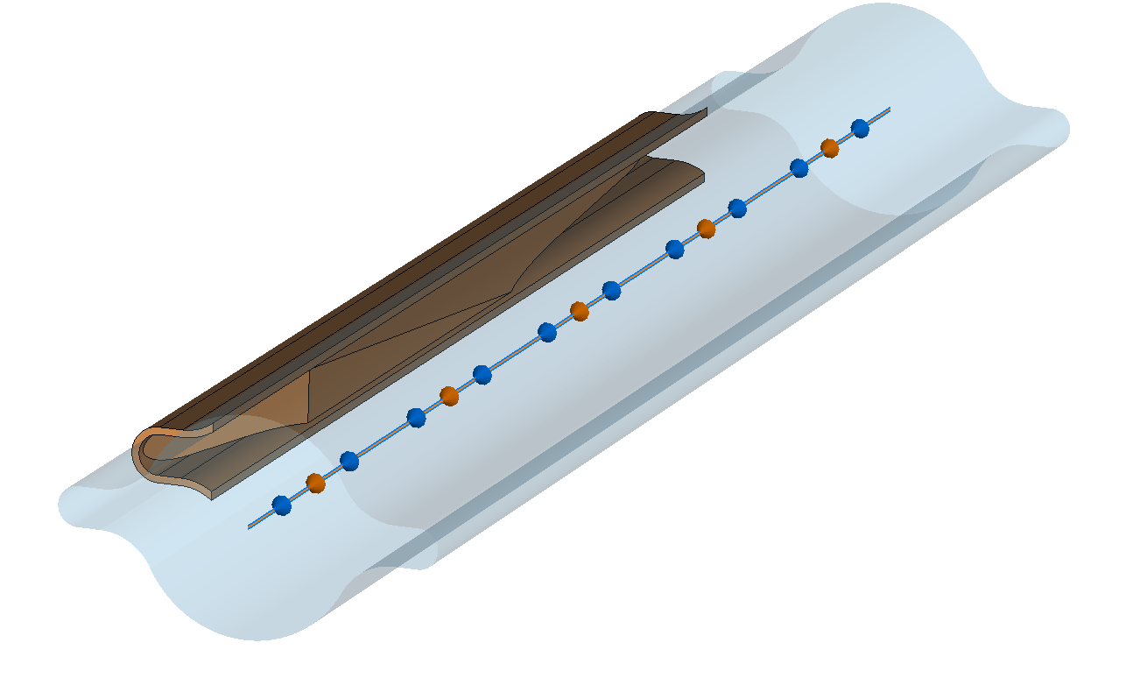
Beam Impedance Analysis
28th of October / 107th Impedance Working Group Meeting
P. Krkotić – Design Progress SRA FCC-ee
Numerical Model and Simulation Constraints
No symmetry – full 3D model
Gaussian bunch length σ_{z} = 5 mm (20 GHz) → 1.4 mm (70 GHz)
Low TM_{0,1} cut-off frequency: 3.8 GHz
Integration technique: Indirect interfaces
Mesh setup: Lines per sigma \ mesh cell geometry
CST model SRA nominal position

Slide 17
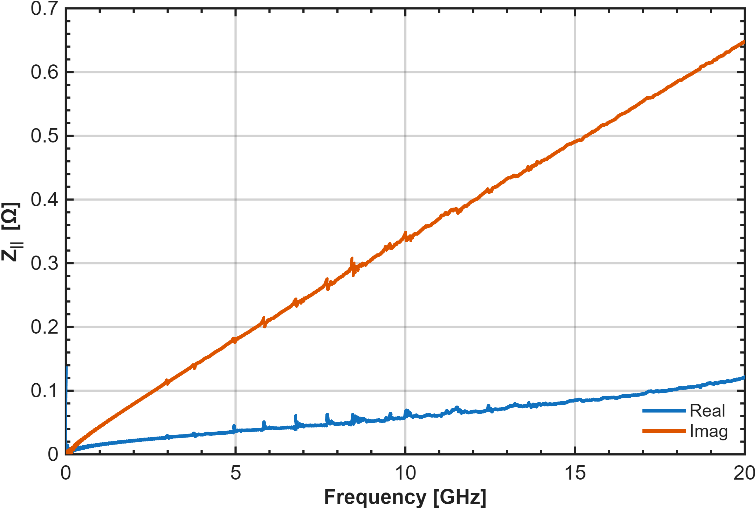
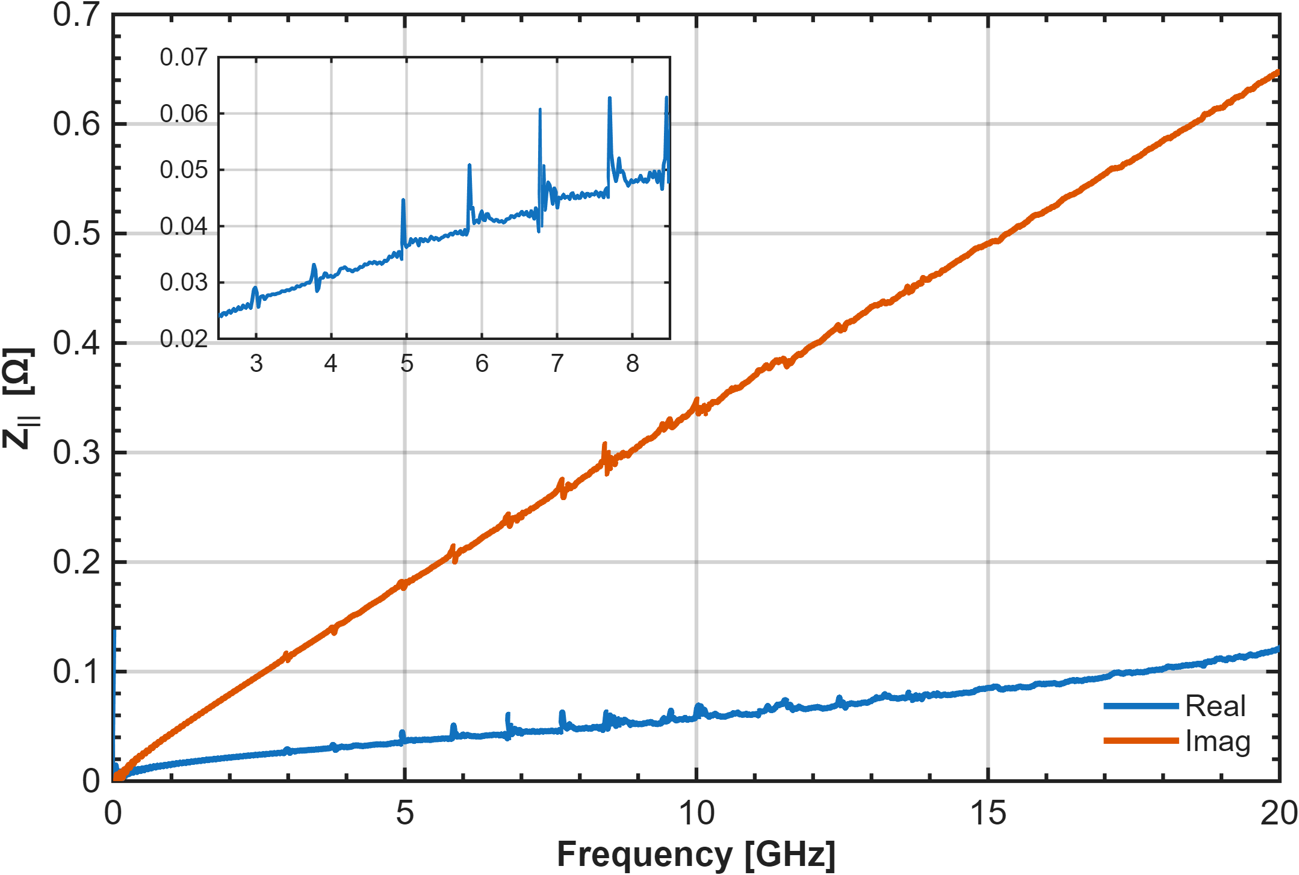
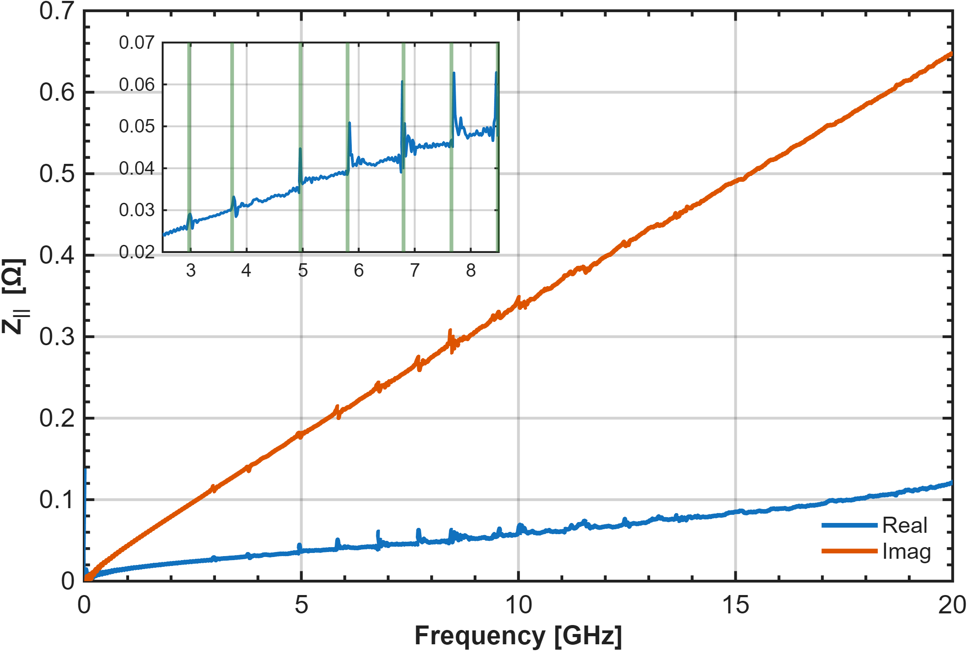
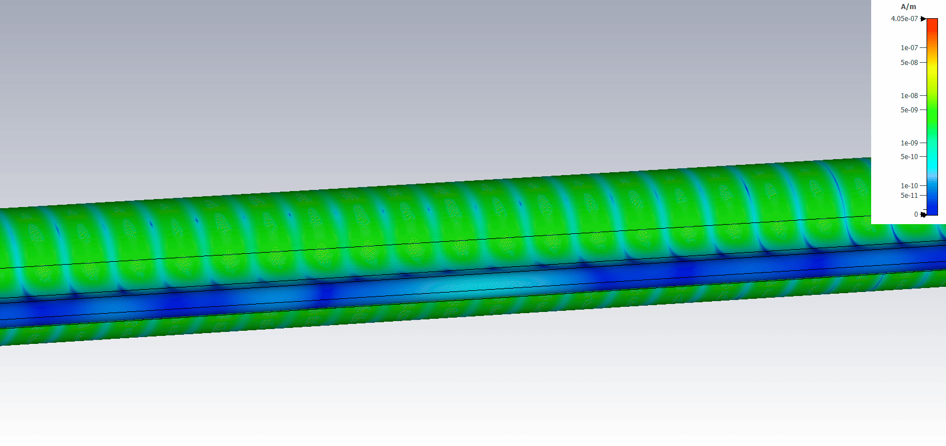
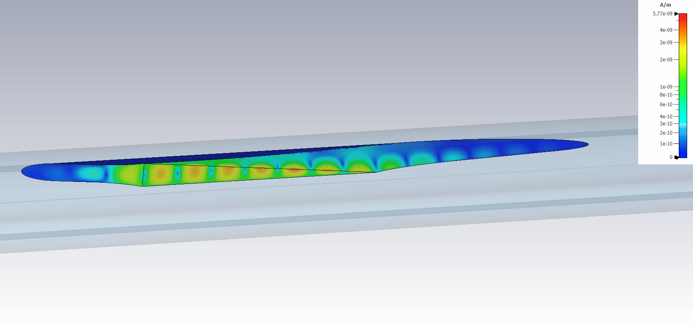
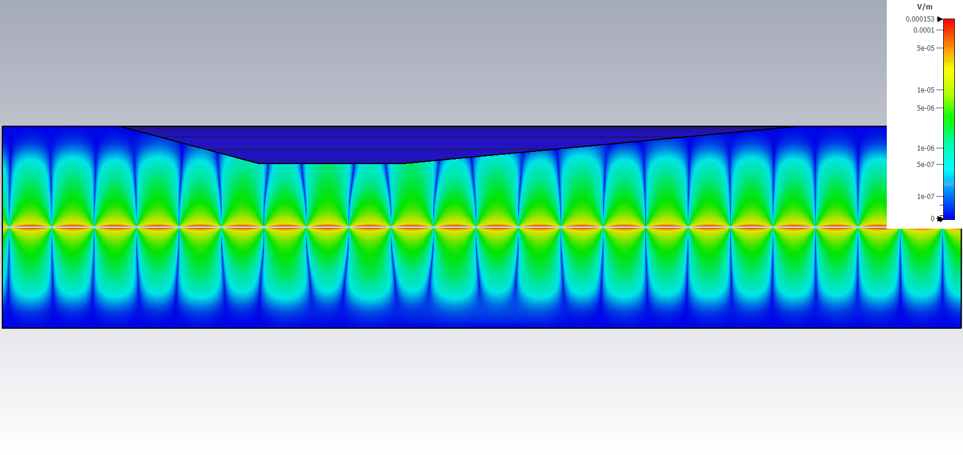
Beam Impedance Analysis
28th of October / 107th Impedance Working Group Meeting
P. Krkotić – Design Progress SRA FCC-ee
Preliminary – 125 M cells, 10 m wakelength
TE₁₁
TM₀₁
TE₂₁
TM₁₁
TE₃₁
TM₂₁
TE₁₂
Electric field– 6.7 GHz
CST model SRA nominal position
Surface current density – 6.7 GHz
Electric field top view cross-section – 6.7 GHz

Slide 18
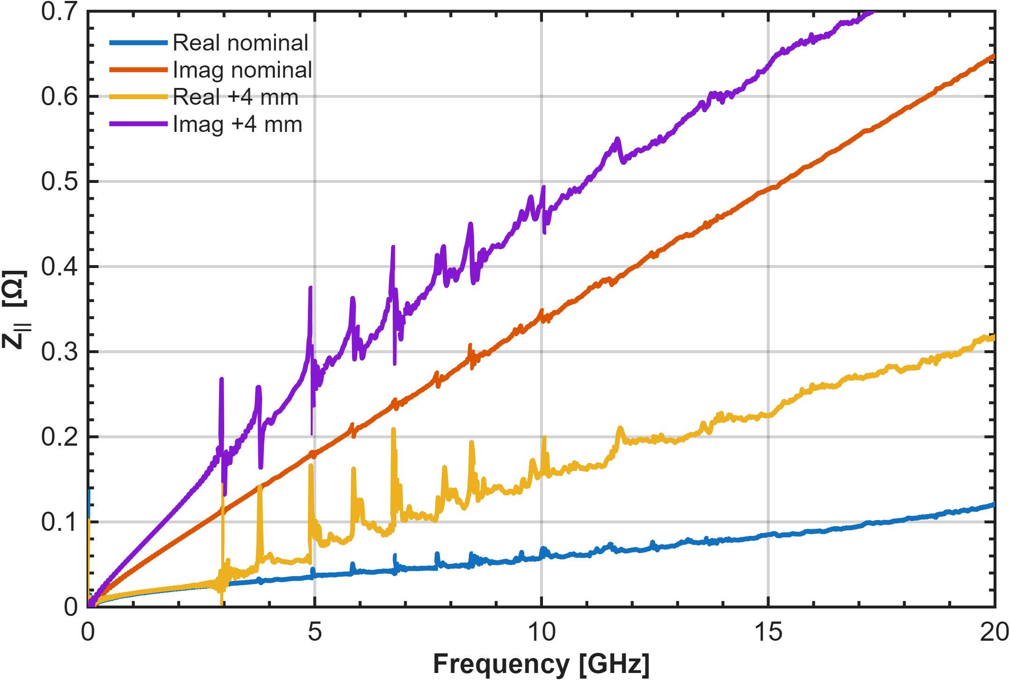
Beam Impedance Analysis
28th of October / 107th Impedance Working Group Meeting
P. Krkotić – Design Progress SRA FCC-ee
Preliminary – 125 M cells, 10 m wakelength
CST model SRA nominal position

Slide 19
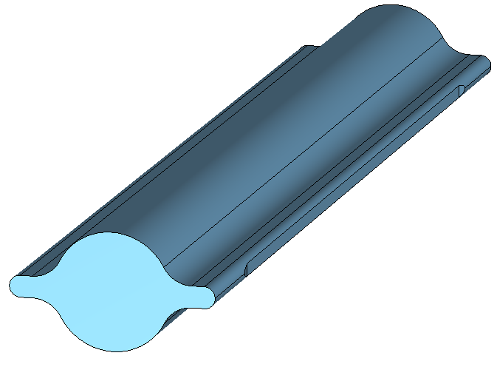
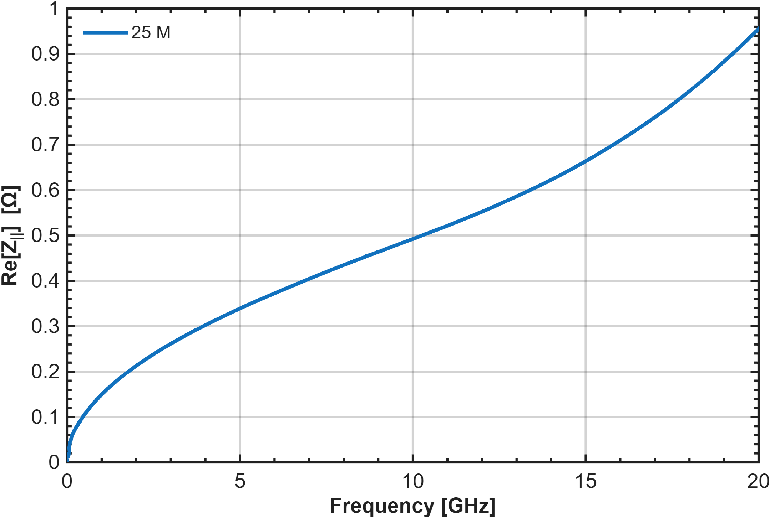
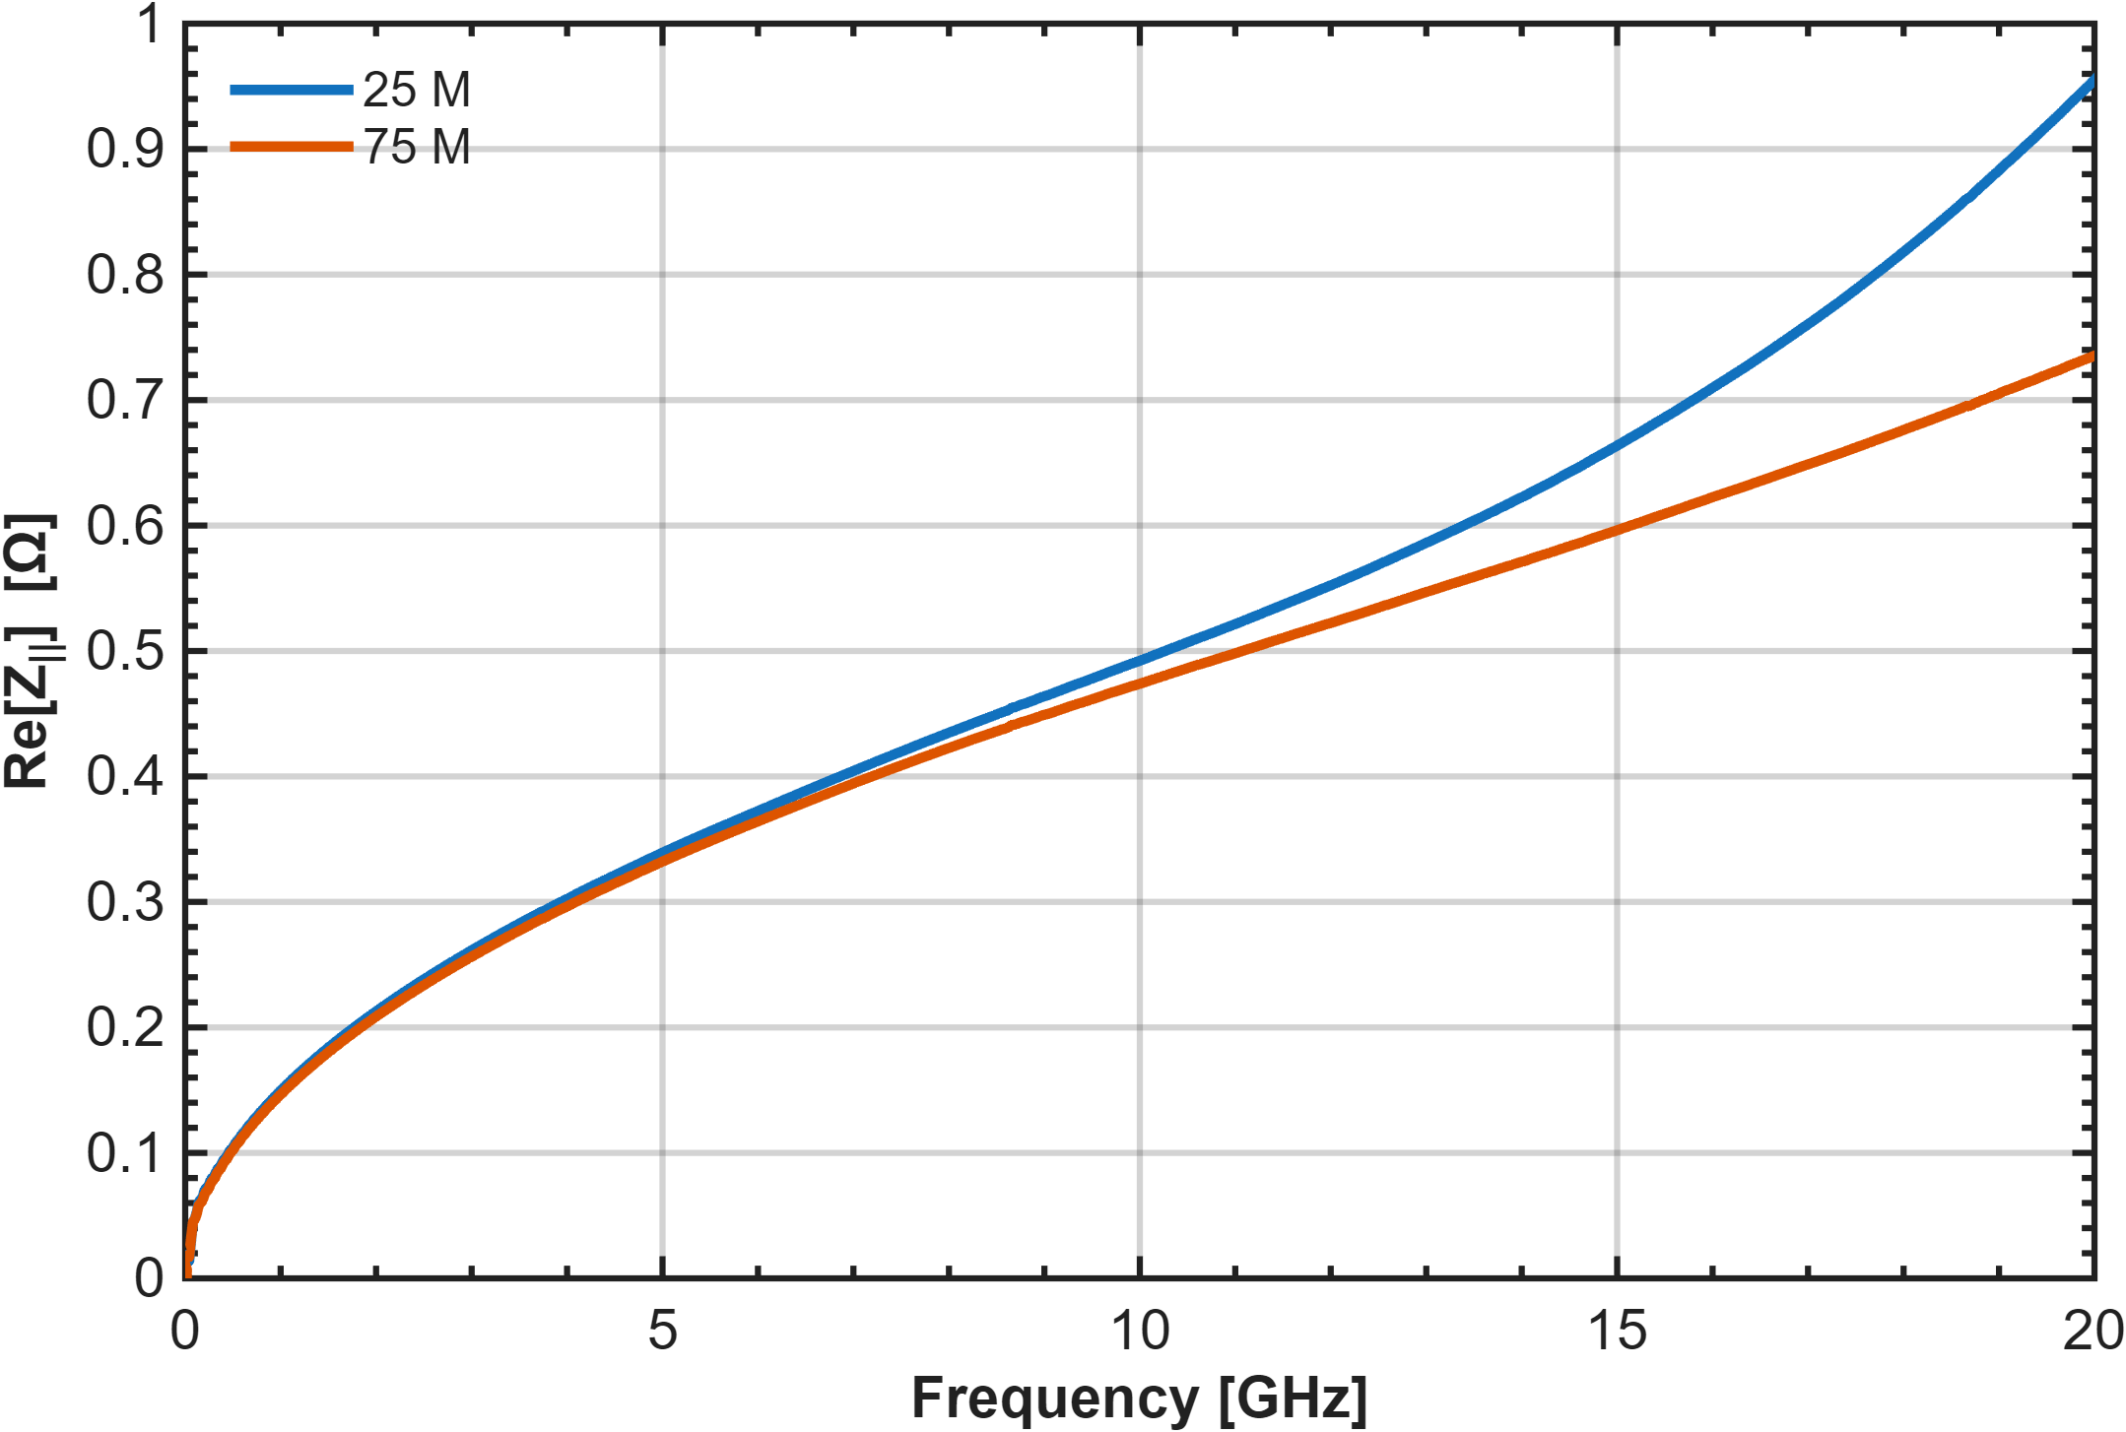
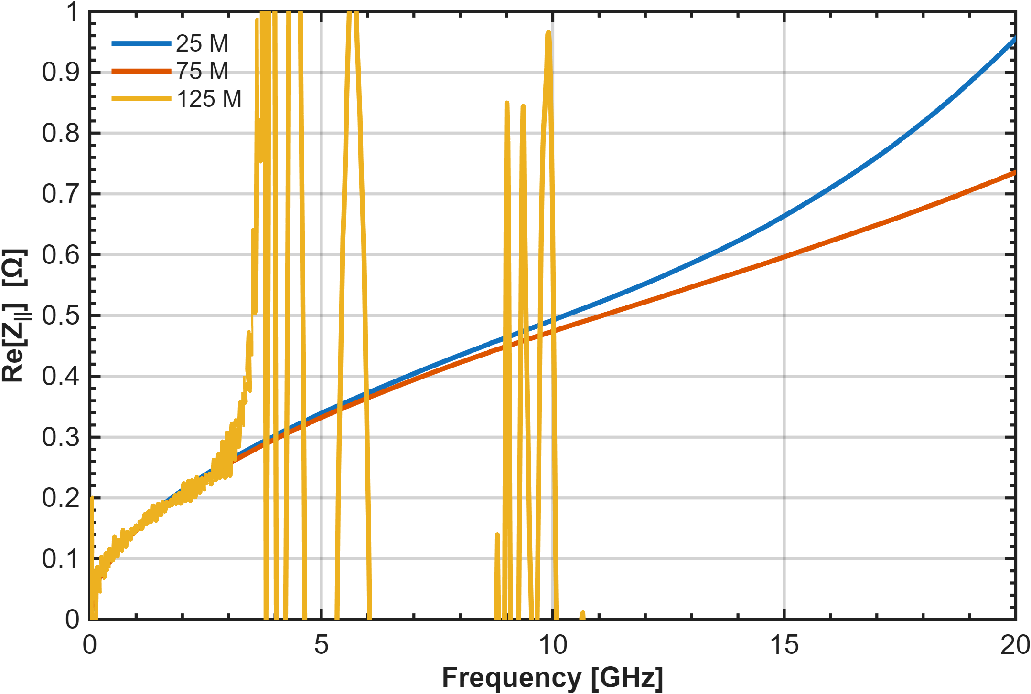
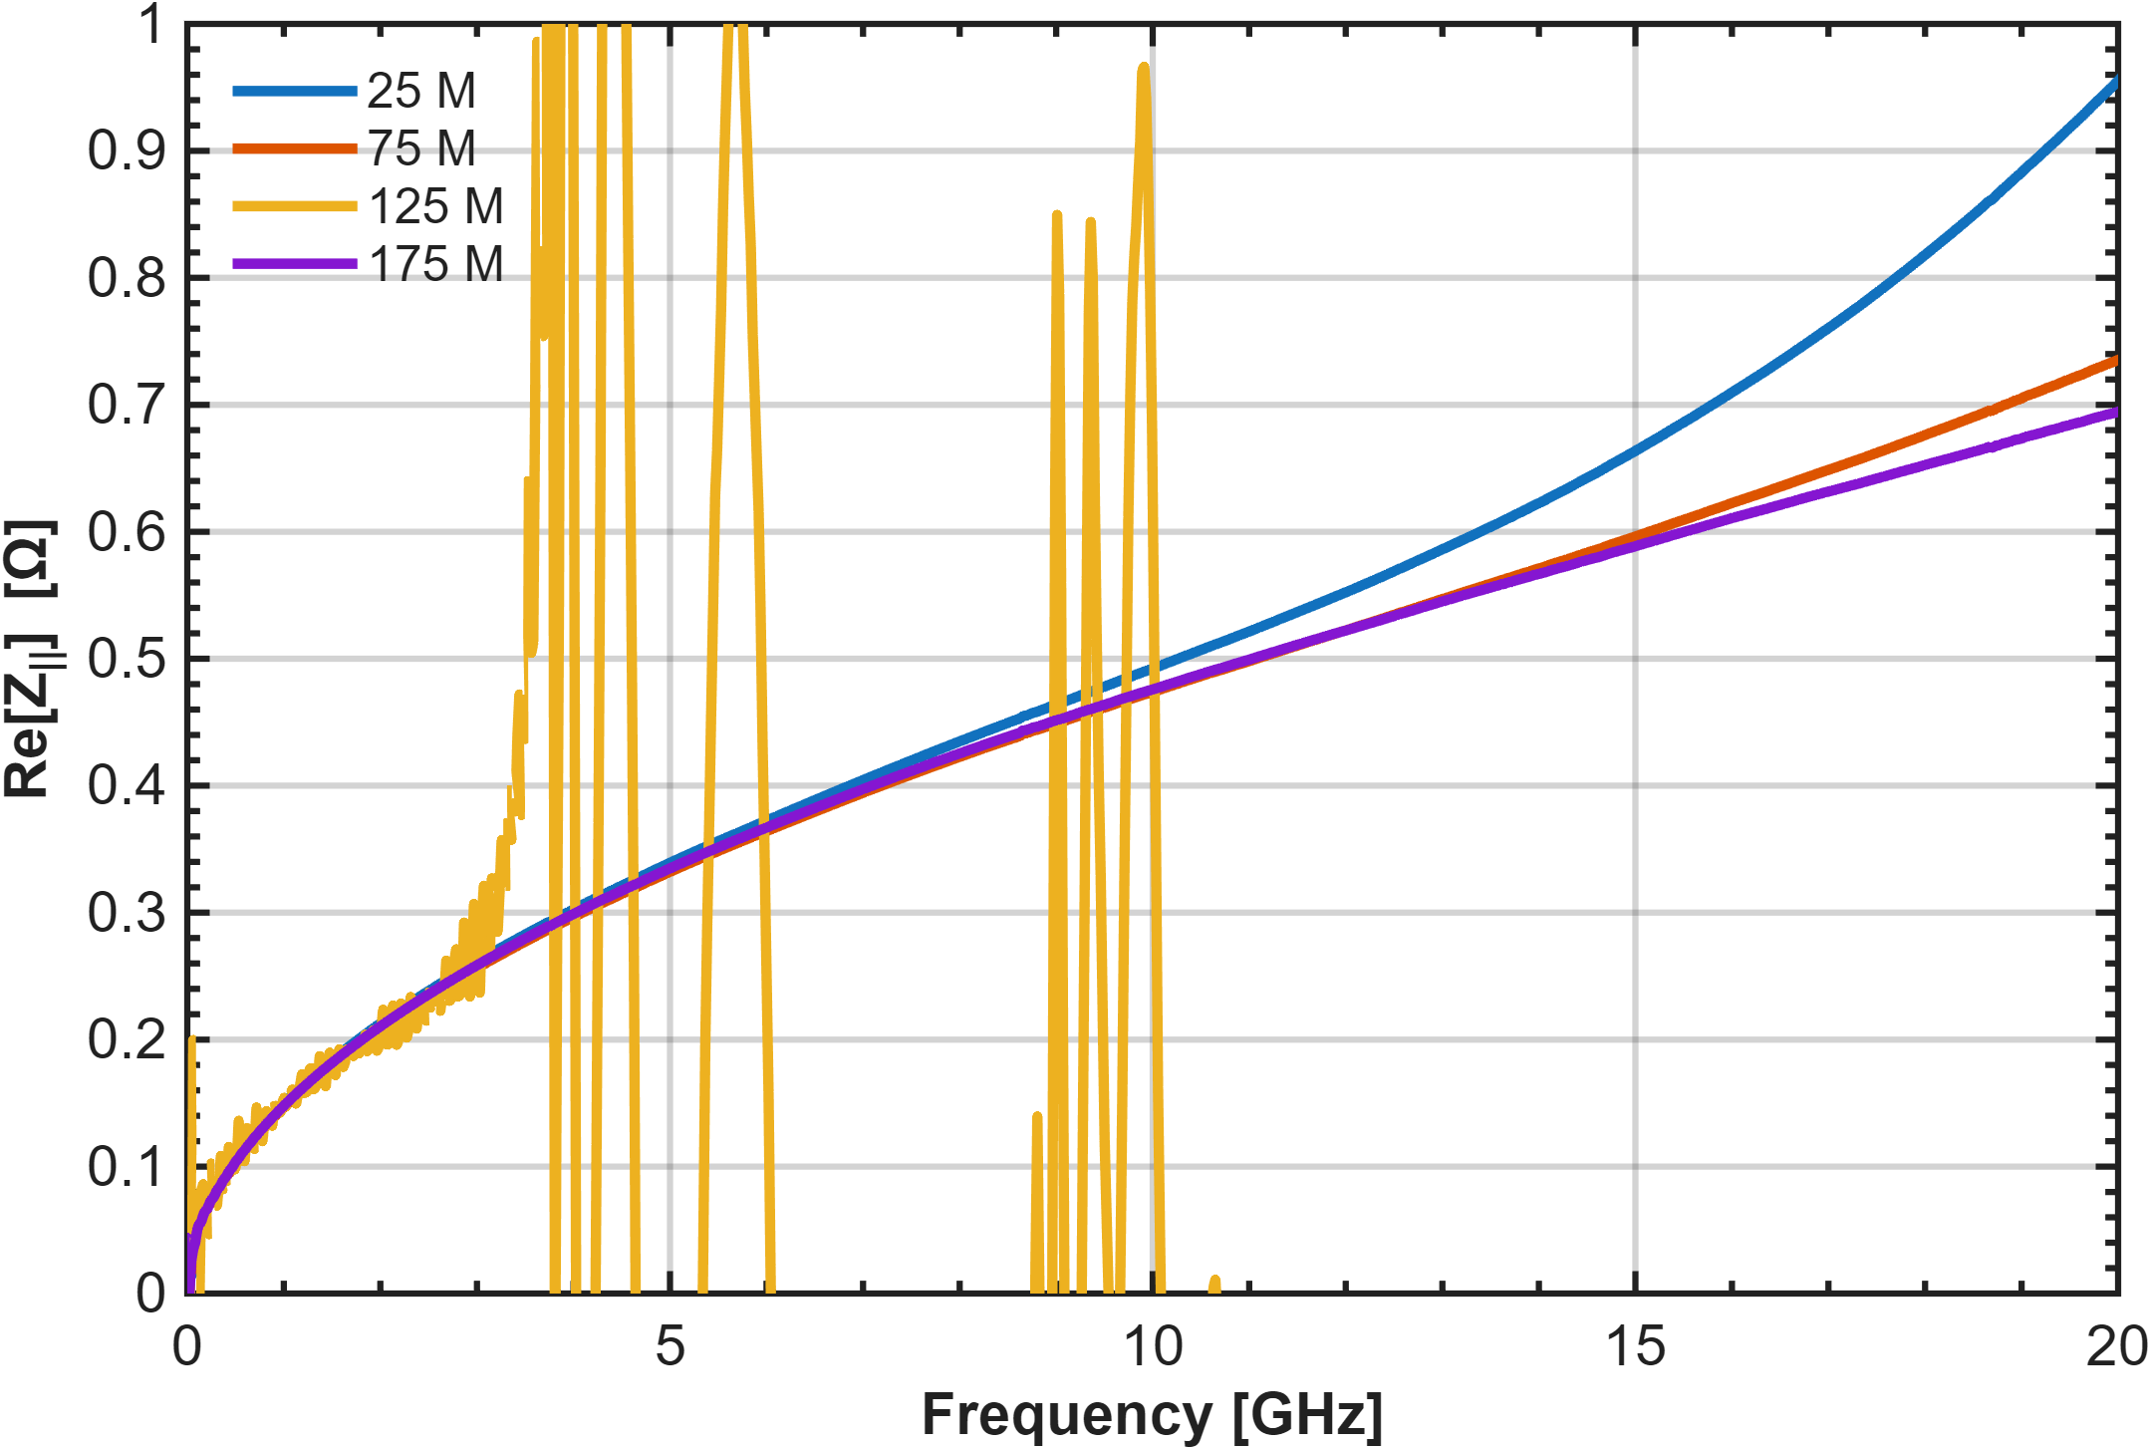
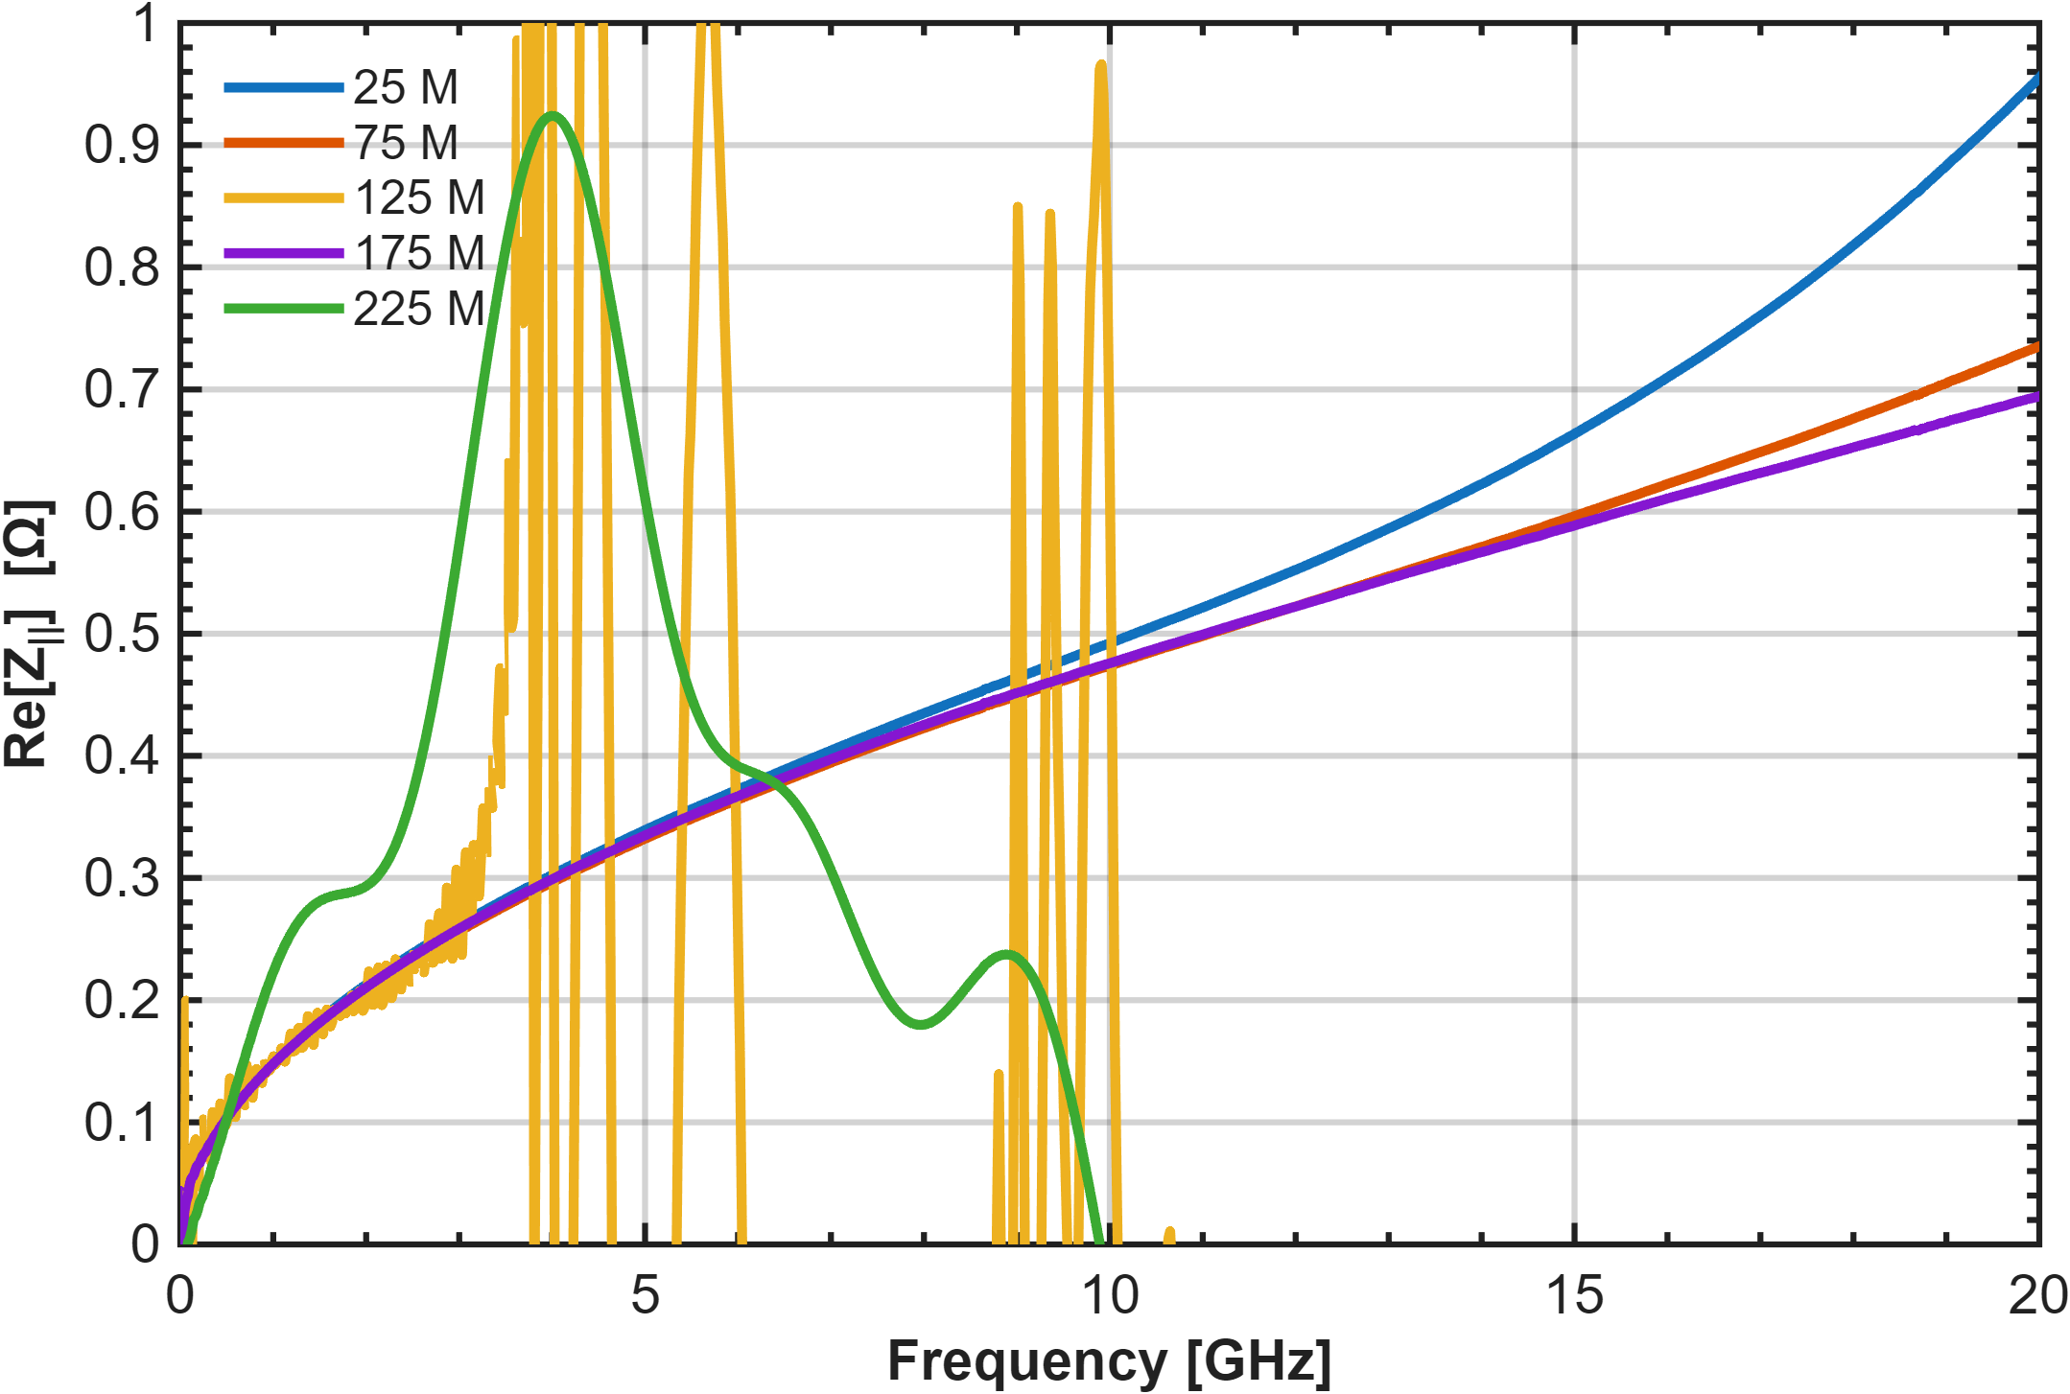
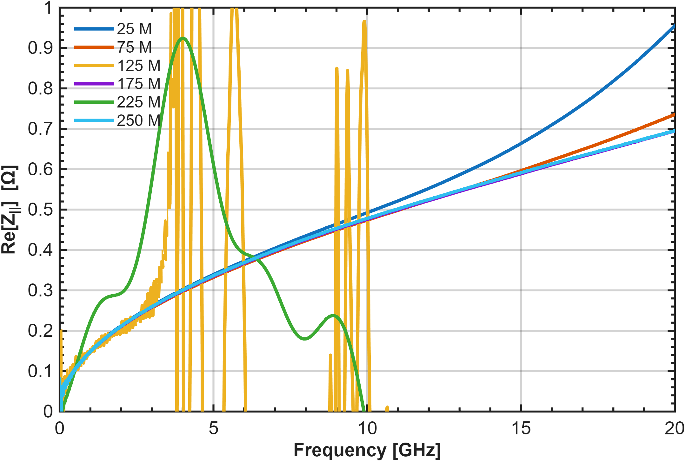
Beam Impedance Analysis
28th of October / 107th Impedance Working Group Meeting
P. Krkotić – Design Progress SRA FCC-ee
Peculiarities – convergence studies
Change in simulation time (nominal → +4 mm): ×20
Angle variation produces a similar trend
CST model testing phase
Similar effect observed in convergence study with Wakelength
$κ=5.77⋅{10}^{5}$
Wakelenght = 10 m

Slide 20
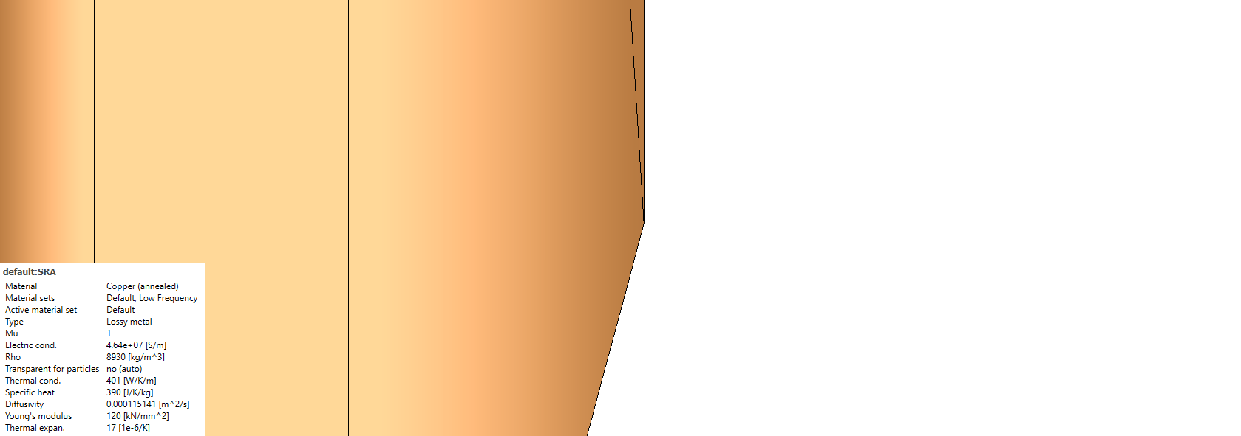
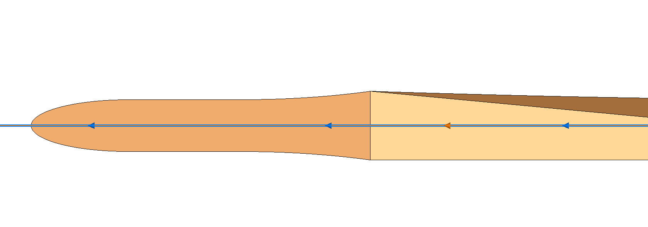
Summary
28th of October / 107th Impedance Working Group Meeting
P. Krkotić – Design Progress SRA FCC-ee
Impedance Factors
Optics Strategy Decisions - 2026
Material Properties
CuCrZr Conductivity < OFS copper
  → Increase in resistive wall
Geometry
Angles and roughness
  → Impedance dominated by geometry
Beam proximity
Breaking locally symmetry of the vacuum chamber
  → travelling wakes
    → perturbation into the vacuum chamber
    Novel simulation regime:
    Computationally demanding
    Many limitations
Input required by end of year for the optics report
Final decision enables improved impedance estimates
Next step: SRA placement studies for refinement including tolerances
Outlook
  Eigenmode open boundary
    Travelling wave measurement setup
      Design optimisation

Slide 21
Thank you for your attention.
28th of October / 107th Impedance Working Group Meeting
P. Krkotić – Design Progress SRA FCC-ee
14

Slide 22
