Slide 1
LHC Beam Wire Scanner impedance comment to ECR
M. Neroni, C. Vollinger, C. Zannini on behalf of the IWG
28th October 2025

Slide 2
Comment from the Impedance Working Group (IWG)
“IWG has no objections to the installation of the BWS prototype. Could you please add the comment below to the impedance box in 5.3, and the refer to the impedance table as provided in the 107th IWG meeting:
The newly developed linear BWS has been mitigated for impedance contribution, and the progressive work was discussed in several IWG meetings, concluded in IWG meeting #107 (indico 1603220), where the use of absorber material was decided. Estimated beam induced power is up to 8 W in the absorber coating with baseline HL-LHC beam, 1 ns bunch length and beam induced power on the wire is estimated to be max 20 mW.
It should be noted that a groove could be seen in the vacuum pipe directly connected to the BWS tank. Equipment owners explained that this groove is due to the selected weld type. For EM-fields, this groove presents a discontinuity going from initially dia 62 mm to dia 65 mm which could lead to a trapped mode in the frequency range of 3.5 GHz, i.e. far above the considered beam spectra (hence not critical yet). Such a resonant contribution could not be observed, instead the integration study showed that this mode is mitigated by the upstream and downstream large diameter vacuum pipes (dia 80 mm) which allow the mode to propagate. Equipment owner has been informed to avoid such a groove in future instrument developments, if possible.”

Slide 3
Impedance assessment overview
Element | LHC BWS-prototype (to be installed on beam 1 of RA47/C-05R4 section)
Component owner group | SY/BI
Impedance assessment method | Simulations | Measurements
Test location (if applicable)/method | CST simulations | pending
Date | September 24-October 25 | -
Conducted by | H. Bursali, C. Vollinger, J. Li, C. Zannini, C. Antuono, I. Karpov | -
Impedance references
Contribution to the machine overall effective longitudinal impedance (%) | 0.125
Contribution to the machine overall effective horizontal/vertical impedance (%) | 0.005/0.0013
Instability thresholds
Target intensity [e.g. 1x10¹¹ ppb*] | 2.3
Intensity threshold with/without the new or modified element in the longitudinal plane [e.g. 1x10¹¹ ppb*] | Unchanged (irrelevant impact) | -
Intensity threshold [e.g. 1x10¹¹ ppb*] or minimal octupolar current [A] with/without the new or modified element in the vertical plane | Unchanged (irrelevant impact) | -
Intensity threshold [e.g. 1x10¹¹ ppb*] or minimal octupolar current [A] with/without the new or modified element in the horizontal plane | Unchanged (irrelevant impact) | -
Beam induced power
Total induced power loss at target intensity [W] | Max. 8 W in absorbers, max. 20 mW on the wire.
Is the estimated power loss at target intensity acceptable? (answer to be given by equipment owner - power loss map to be provided on request) | Yes
Additional comment on the assessment
HL-LHC baseline beam has been considered (2.3e11 ppb, 1ns bunch length)

Slide 4
References to LHC BWS talks in IWG
93rd IWG – “Studies on new LHC wire scanners” by H. Bursali and W. Andreazza https://indico.cern.ch/event/1474515/
96th IWG – “Studies on BWSs for HL-LHC” by H. Bursali https://indico.cern.ch/event/1486663/
98th IWG – “Updates on the HL-LHC beam wire scanners” by H. Bursali and C. Antuono https://indico.cern.ch/event/1529313/
101st IWG – “HL-LHC Wire Scanner - coating material of RF absorbers” by H. Bursali https://indico.cern.ch/event/1568334/
105th IWG – “Power loss map in HL-LHC Wire Scanner” by H. Sullivan https://indico.cern.ch/event/1585850/

Slide 5
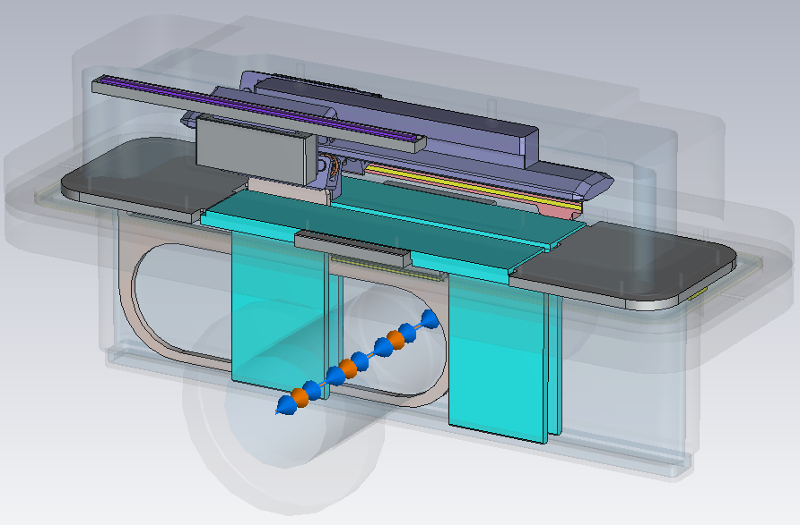
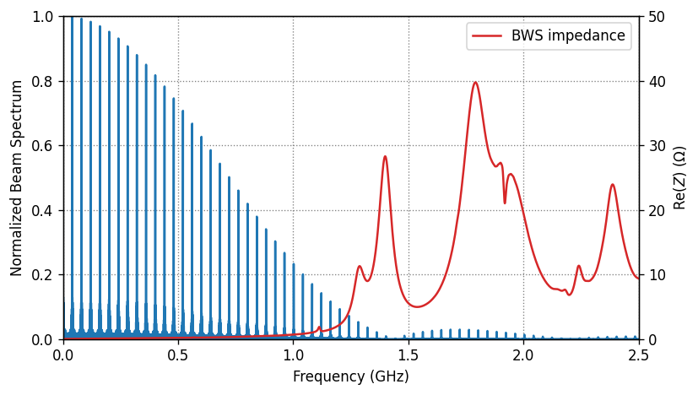
Recap on impedance study
Panels
RF absorbers
RF absorbers are alumina blocks with 50 Ω/sq titanium coating.
Estimated beam induces power with baseline HL-LHC beam, with 1 ns bunch length, up to 8 W.
Beam induced power on the wire estimated to be between 7 and 20 mW (J. Li, C. Antuono).

Slide 6
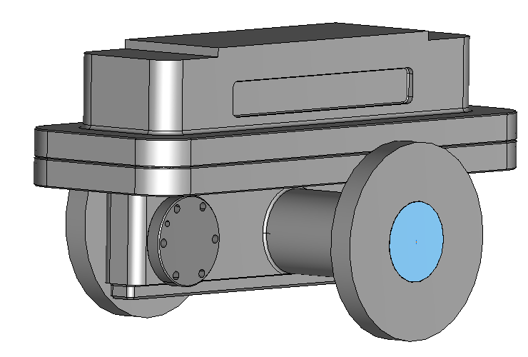
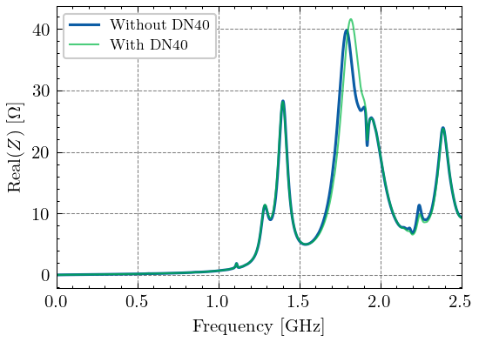
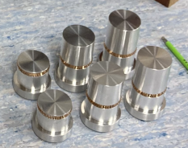
Recap on impedance study
Adding DN40 flange for possible feedthrough installation:
Negligible impact of DN40 flange on longitudinal impedance, no change is expected on the total power loss.
IWG recommends the use of a plug with RF contact if the flange remains unused.
From RF CAS hands-on:

Slide 7
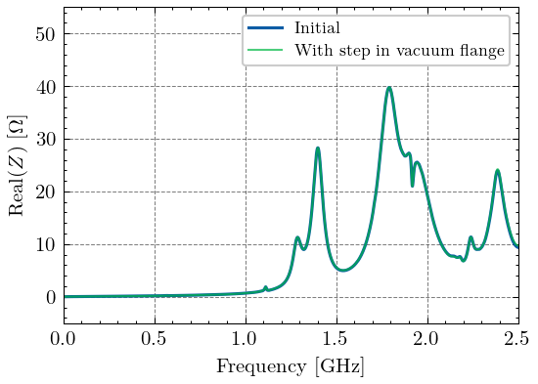
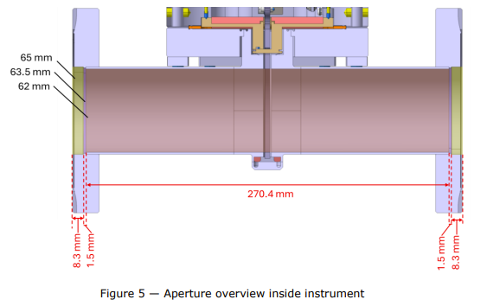

Integration of BWS prototype
Adding step in vacuum flange at the two ends of the device.
From ECR:
Step in vacuum flange is affecting higher frequency impedance behavior ➔ for 65 mm diameter, $f_{c_{TM010}}=3.5 GHz$.

Slide 8
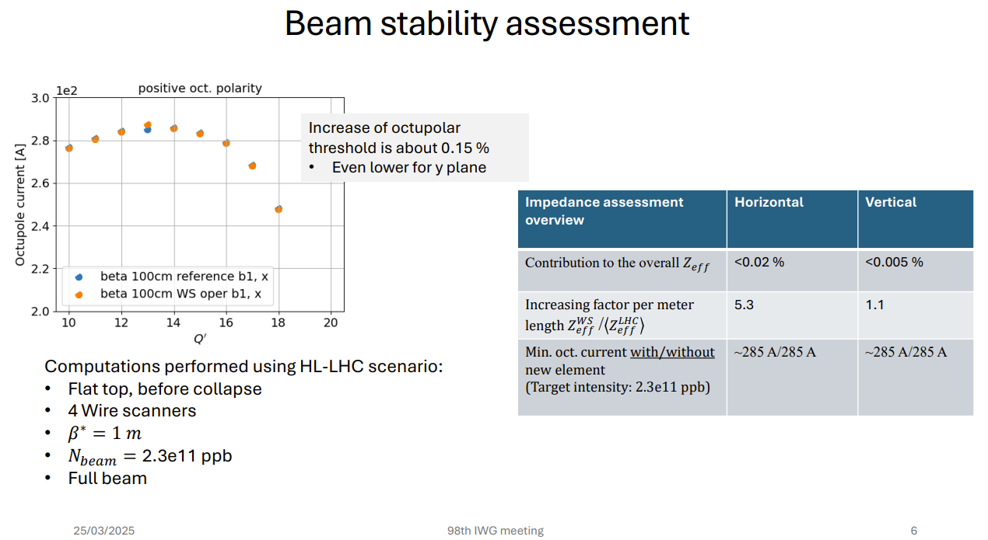

Considerations on impedance budget
Longitudinal stability assessment (I. Karpov):
Contribution to effective longitudinal impedance for one device → effective $ImZ/n=0.093$mΩ (TBC)
Contribution to the machine overall effective longitudinal impedance (%) → 0.125% (TBC)
Transverse stability assessment:
Courtesy of C. Antuono

