Slide 1
HL-LHC D2 Magnet Cryogenic Tests in SM18
Author: A. Lees (TE-CRG-ME) & Remi Mauny (TE-CRG-ML)
CERN - 19/11/2025

Slide 2






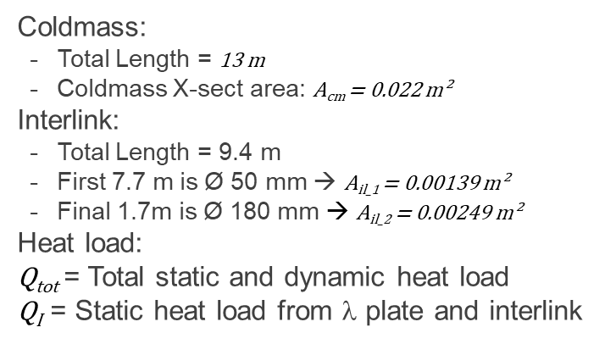





D2 Magnet 1.9 K Cooling Configuration
Due to the length and cooling power requirements of the D2 magnet, it was decided to uses a conduction based He-II / He-II Heat Exchanger (HX) in place of the bayonet heat exchanger used for the IT.
During the development of the system, the D2 interlink was added. While not cryogenically ideal, due to its location on the opposite side of the coldmass to the HX, analysis has been undertaken to validate its performance. See model below:
$$1.7 m$$
Coldmass:
Total Length = 13 m
Coldmass X-sect area: A_{cm} = 0.022 m²
Interlink:
Total Length = 9.4 m
First 7.7 m is Ø 50 mm → A_{il_1} = 0.00139 m²
Final 1.7m is Ø 180 mm → A_{il_2} = 0.00249 m²
Heat load:
Q_{tot} = Total static and dynamic heat load
$\text{Q}\text{I}$= Static heat load from λ plate and interlink
$$DFM$$
$$Q_{I}$$
$$p_{HX}; T_{sat}$$
$$p_{cm}$$
$$T_{0}=T_{sat}+{∆T}_{HX}$$
$$0.2 (Qtot−QI)$$
$$x$$
$$0.8 (Qtot−QI)$$
$$11.5 m$$
$$1.5 m$$
2

Slide 3
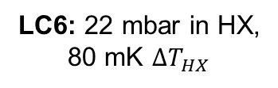
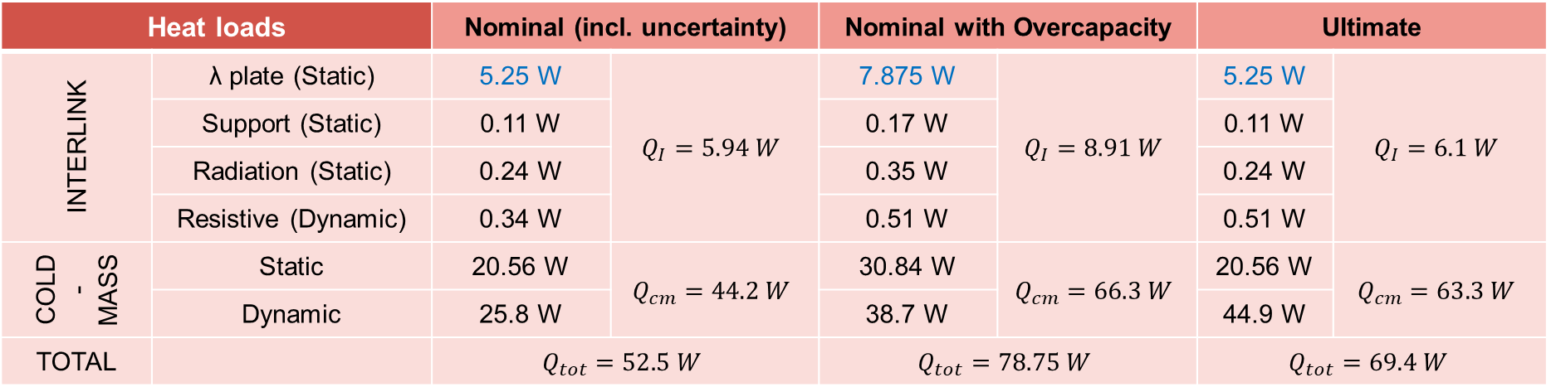
D2 Magnet Design Heat Loads & Load Cases
Heat loads |  | Nominal (incl. uncertainty) |  | Nominal with Overcapacity |  | Ultimate
INTERLINK | λ plate (Static) | 5.25 W | $$Q_{I}=5.94 W$$ | 7.875 W | $$Q_{I}=8.91 W$$ | 5.25 W | $$Q_{I}=6.1 W$$
 | Support (Static) | 0.11 W |  | 0.17 W |  | 0.11 W
 | Radiation (Static) | 0.24 W |  | 0.35 W |  | 0.24 W
 | Resistive (Dynamic) | 0.34 W |  | 0.51 W |  | 0.51 W
COLD-MASS | Static | 20.56 W | $$Q_{cm}=44.2 W$$ | 30.84 W | $$Q_{cm}=66.3 W$$ | 20.56 W | $$Q_{cm}=63.3 W$$
 | Dynamic | 25.8 W |  | 38.7 W |  | 44.9 W
TOTAL |  | $$Q_{tot}=52.5 W$$ |  | $$Q_{tot}=78.75 W$$ |  | $$Q_{tot}=69.4 W$$
LC1: Baseline Conditions
LC2: Baseline Conditions
LC3: Baseline Conditions
LC4: 30 mbar in HX
Design load case
LC5: 4 bar in coldmass
LC6: 22 mbar in HX, 80 mK ${∆T}_{HX}$
3

Slide 4
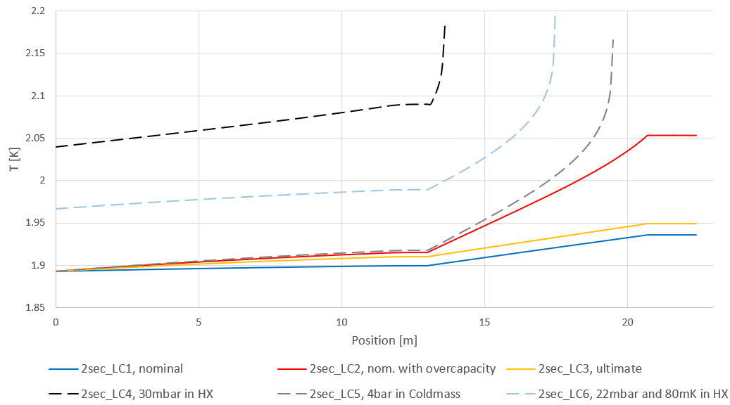

D2 Magnet Calculated Cooling Performance
He-II conditions are maintained throughout the Coldmass and Interlink for Design Loads (LC 1,2 and 3)
During degraded conditions He-II conditions are lost in the interlink → Conductor covered in He-I
D2 cold-mass
Interlink
ID=50 mm
ID=180 mm
λ plate
$$T_{λ}=2.165 K (@1.3 bar)$$
13
20.7
22.4
Baseline:
Degraded:
4

Slide 5
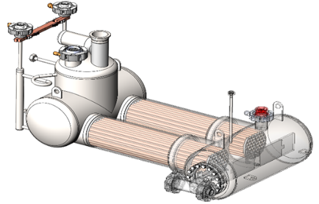
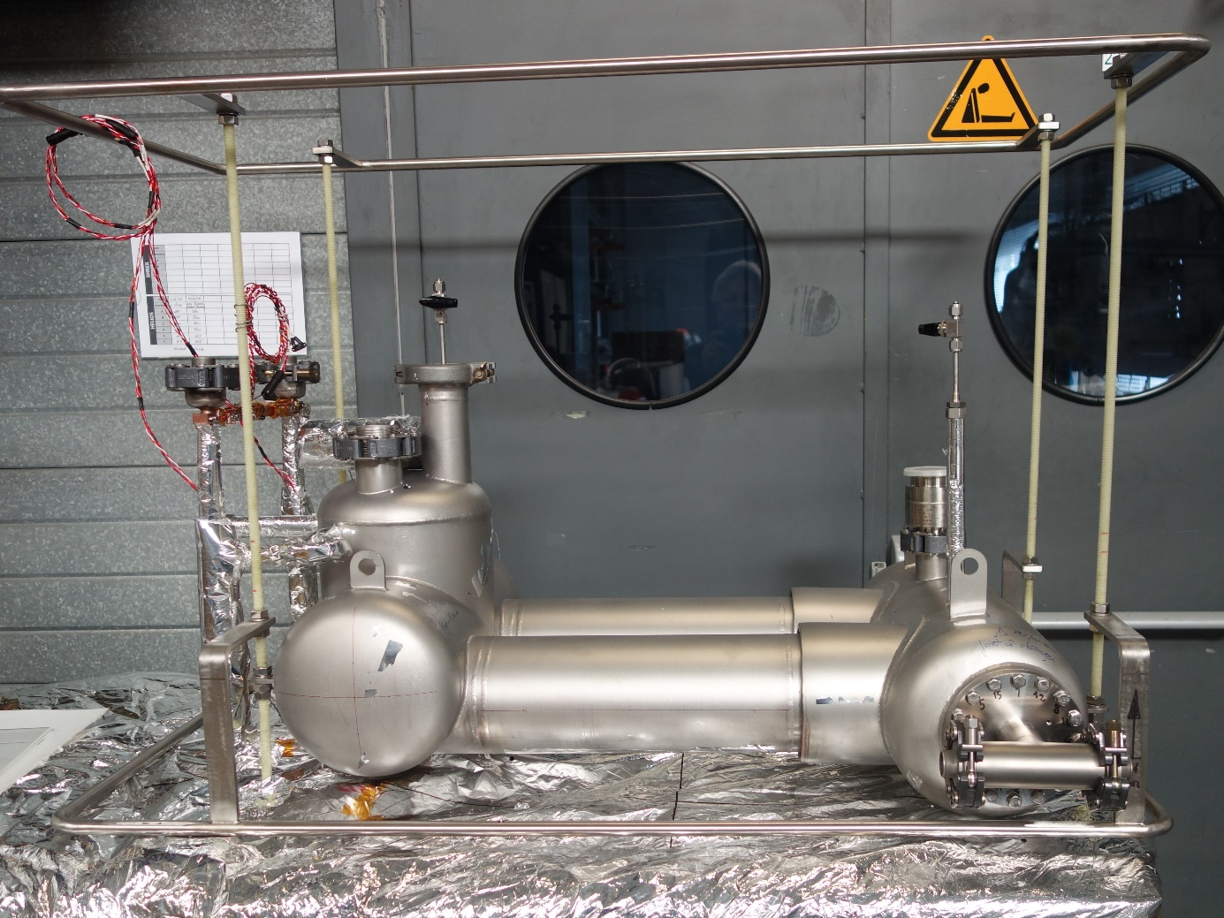
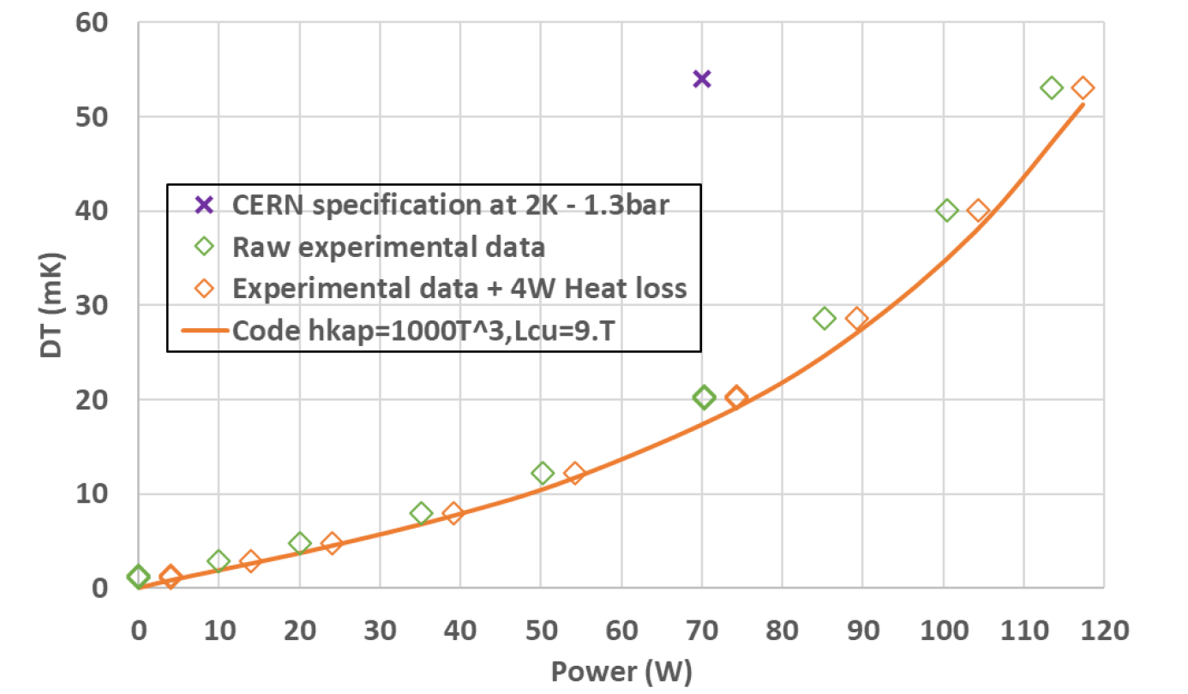
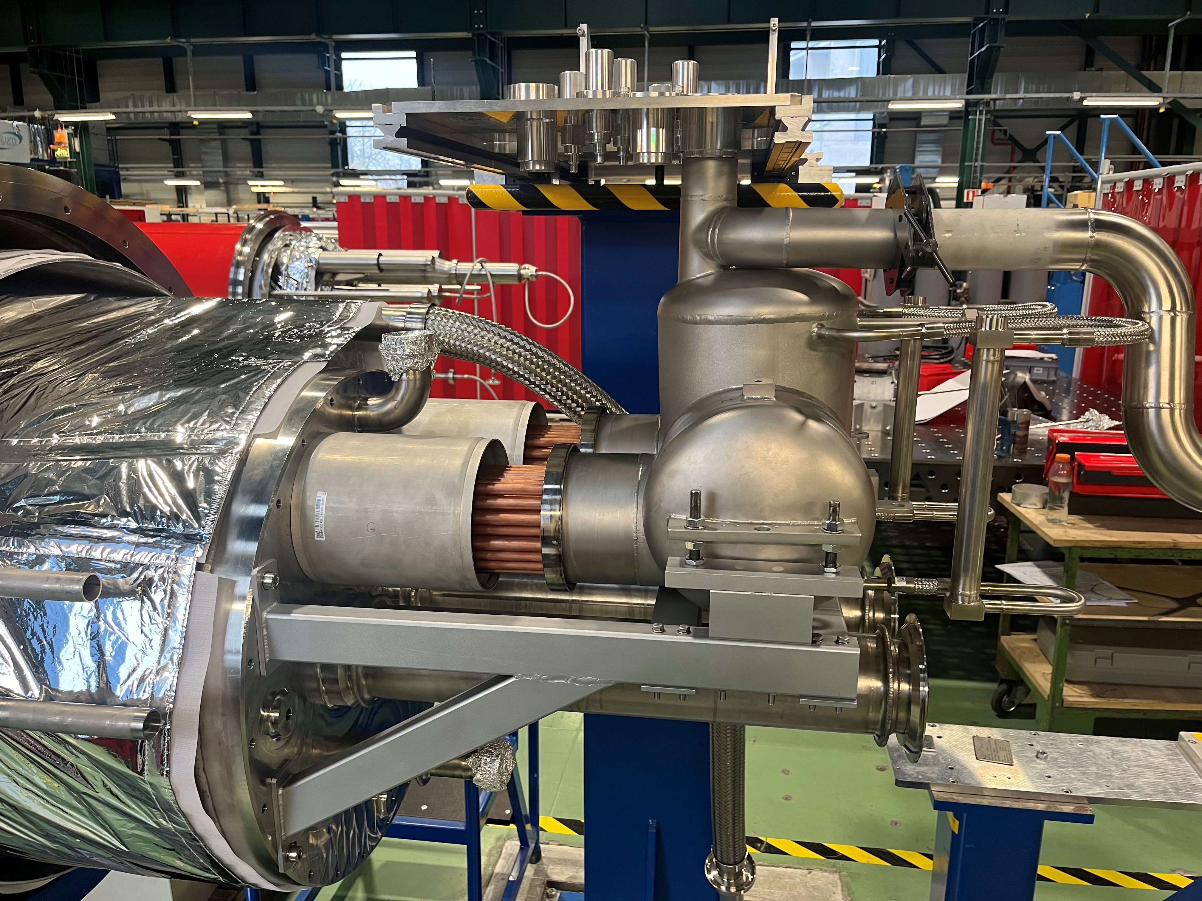
D2 HX Development with CEA Grenoble
He-II saturated bath
The HX was developed in collaboration with CEA Grenoble
Based on Two bundles of 52 copper tubes giving ≈ 2 m² exchange area
Testing was undertaken at 1.9 K:
Electric heater mounted in pressurized bath of test setup
ΔT between Pressurized and Saturated baths measured at different heater powers
CERN spec. of ΔT < 55 mK at 70 W was easily achieved
All HX were delivered during 2024 for installation in D2 coldmasses
He-II pressurized bath
Copper tubes
D2 HX – Test setup at CEA
D2 HX: CEA Test results – DT between baths against Power
D2 HX - Assembly to D2 coldmass in SMI2 by MSC-CMI

Slide 6
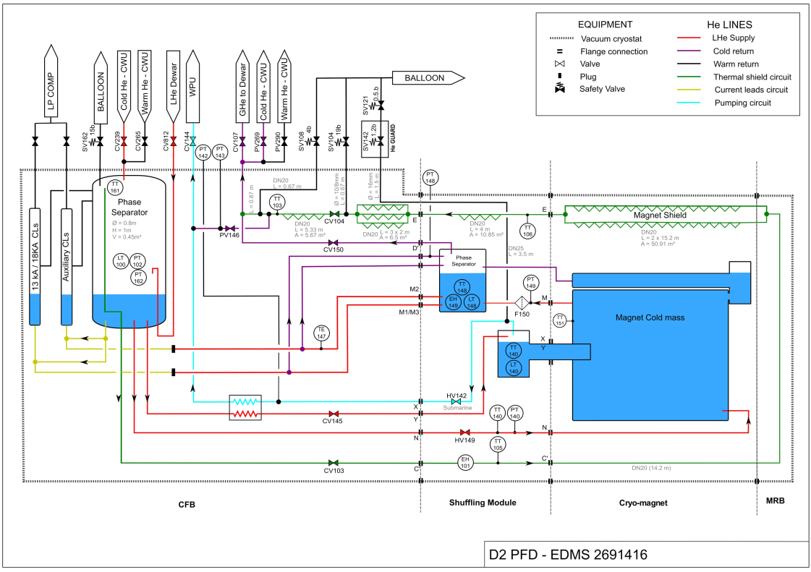
D2 Magnet and HX: Cryogenic Testing in SM18
The CFB in SM18 provide slightly different conditions than in the LHC tunnel:
Interlink and cold mass connected to shuffling module phase separator:
No Lambda plate
Additional He Volume
Additional heat load
Supply line connected directly to CFB phase separator:
Additional He Volume
Additional heat load

Slide 7
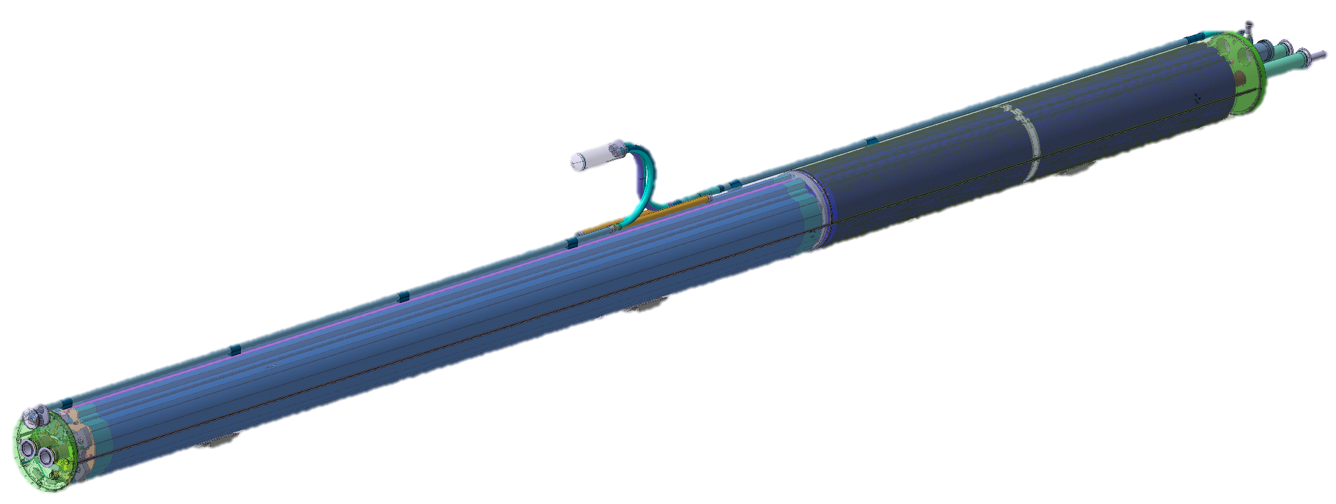
D2 Magnet and HX: Cryogenic Testing in SM18
Instrumentation used for the test:
HX saturated bath:
Level sensor (LT140) → Installed in the HX
Temperature sensor (TT810a) → Installed on level sensor
Pressure sensor (PT142) → Pumping pressure from test bench
D2 coldmass:
Temperature sensor → Cernox on coldmass
Warm-up heaters (applied heat load) → 2 x 100 W
Corrector package
Temperature Sensor
Magnet
He-II Heat
Exchanger
2.3 m
MBRD
Warm-up Heaters
(2 x 100 W)

Slide 8
D2 Magnet and HX: SM18 Results
Measurement of static heat load:
Between the 13th and 15th October Remi was able to measure the flow to the WPU with only this test bench in operation.
Heat Load:
Depending on heater power the WPU flow varies from 7.3 to 11 g/s:
This is equivalent to 167 to 254 W heat extraction
Removing the heater power gives average static heat load ≈ 145 W
By design static heat load of the magnet is < 21 W.
Assuming that the coldmass is to design the test bench is contributing ≈ 124 W of static heat load. Sources could be:
Inlet line estimated to be < 10 W
Shuffling module phase separator and its connections (supported by reports of slow cooldown of the phase separator to 1.9 K)
Poor operation of the sub-cooling HX creating flash during JT expansion
LHe Level in the HX:
As expected, if the copper tubes are fully submerged (level > 120 mm) further variation in level does not impact heat extraction.

Slide 9
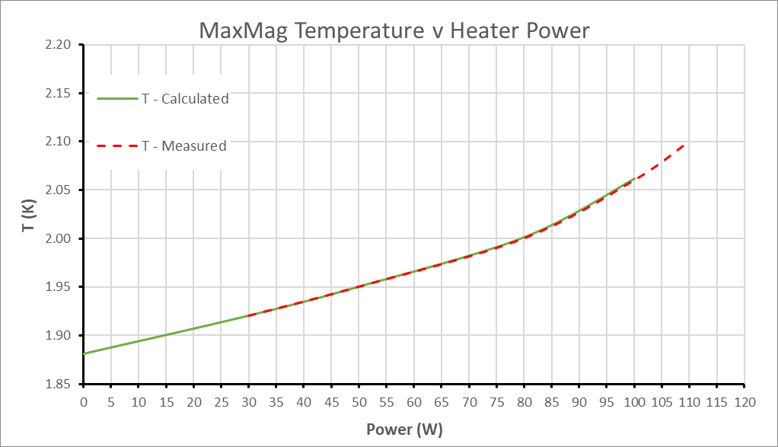
D2 Magnet and HX: SM18 Results
Cooling of D2 Coldmass:
If additional heat load comes mainly from the shuffling module it should not impact the temperature distribution along the coldmass during the test, only the total heat extracted by the heat exchanger.
By adjusting the application of heat load along the coldmass to incorporate:
110 W additional heat load at the start of the coldmass to represent the shuffling module
Static heat load of the coldmass amounting to 16 W (removing the lambda plate and 1 x CWT)
5 W additional heat load for the inlet pipe
The calculated coldmass temperature can be matched to that measured by correcting the ΔT across the HX
DT is greater than calculated by CEA due to the increased heat load across the HX
The parameters for superfluid helium were standard with m = 3

Slide 10
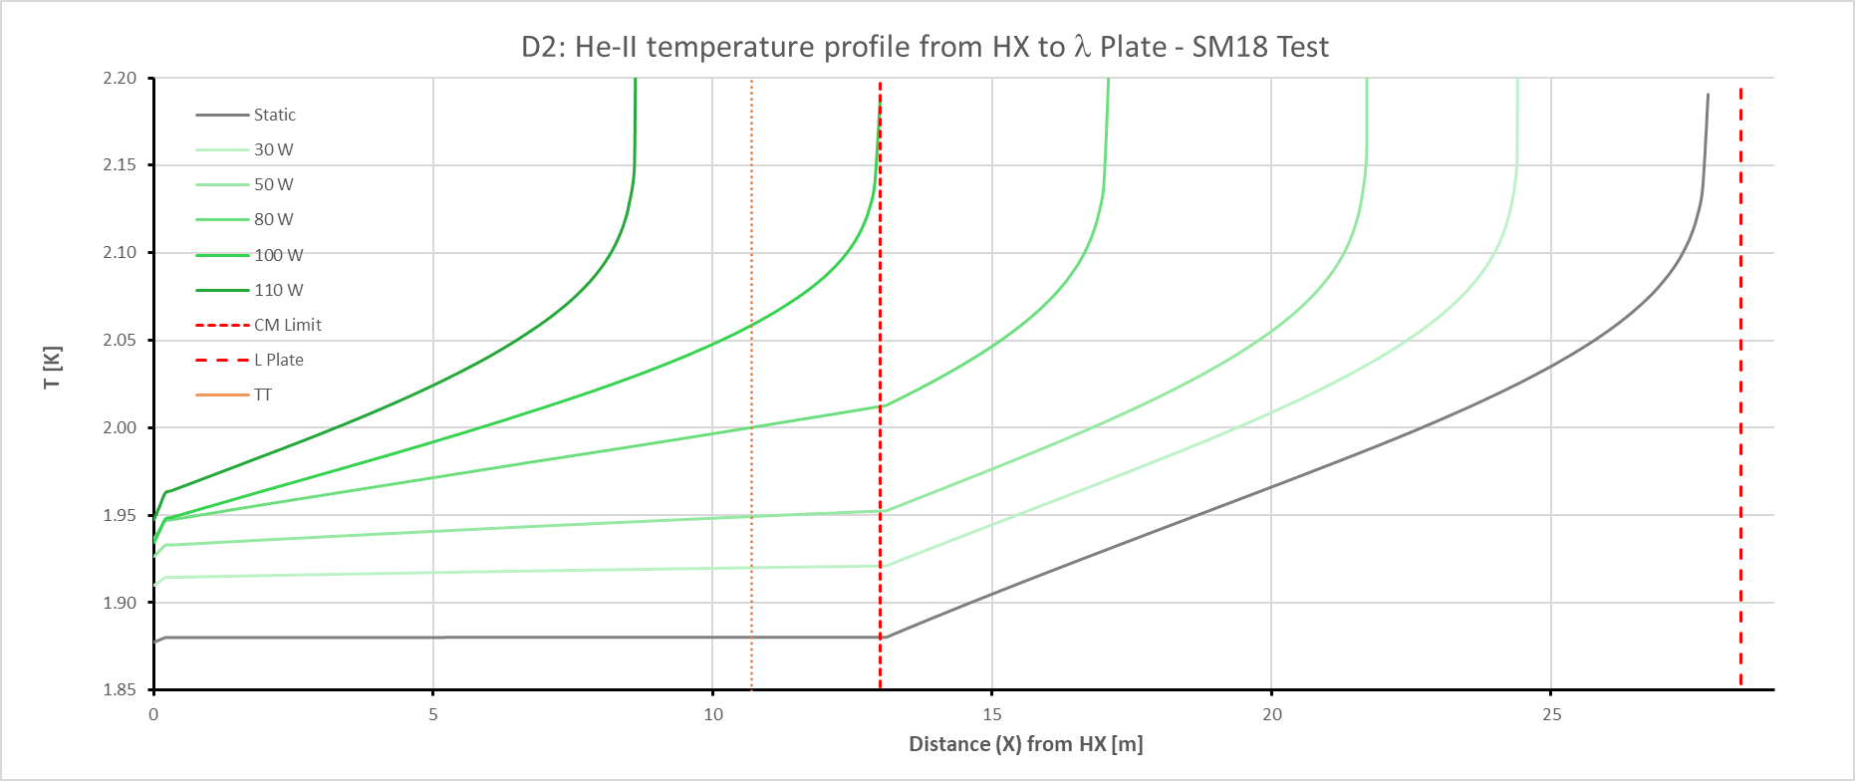
D2 Magnet and HX: SM18 Results
Cooling of D2 Coldmass:
The resulting temperature distribution along the cold mass dependent on heater power is shown below
He-II conditions are maintained in the coldmass until 110 W heater power
Due to the additional heat load of the test bench, it is unlikely that He-II conditions could be maintained through the interlink if it was installed
ΔT across the HX is as expected given the additional heat load
The HX is successfully extracting more than 250 W with the limitation in cooling being the He-II cross-section of the magnet
Interlink not included in test

Slide 11
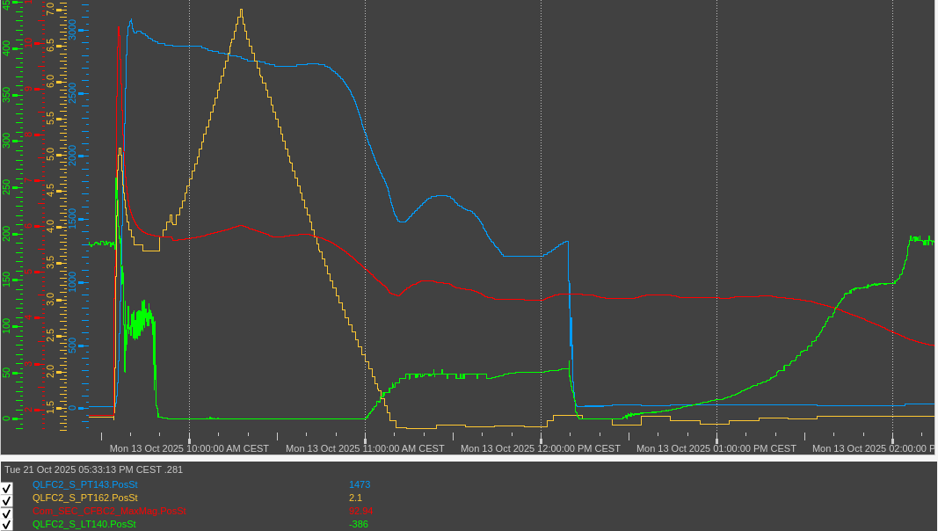
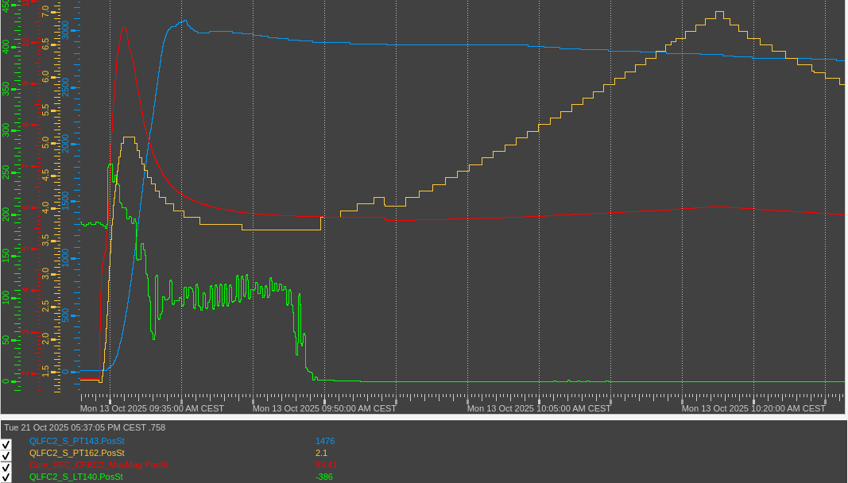
D2 Magnet and HX: SM18 Results
Quench recovery:
Pressure HX (PT142/143) rises from 18 mbar to 3000 mbar in 5 minutes → SV should be set at 1.7 barg!
LHe level (LT140) rises from 190 mm to 260 mm, and then stabilizes around 100 mm, before to drop at 0
Rise in level due to isochoric pressurisation within HX volume
Quench recovery time depended on global SM18-infra capacity & other tests in parallel → Not possible to judge the performance of the HX
ZOOM

Slide 12
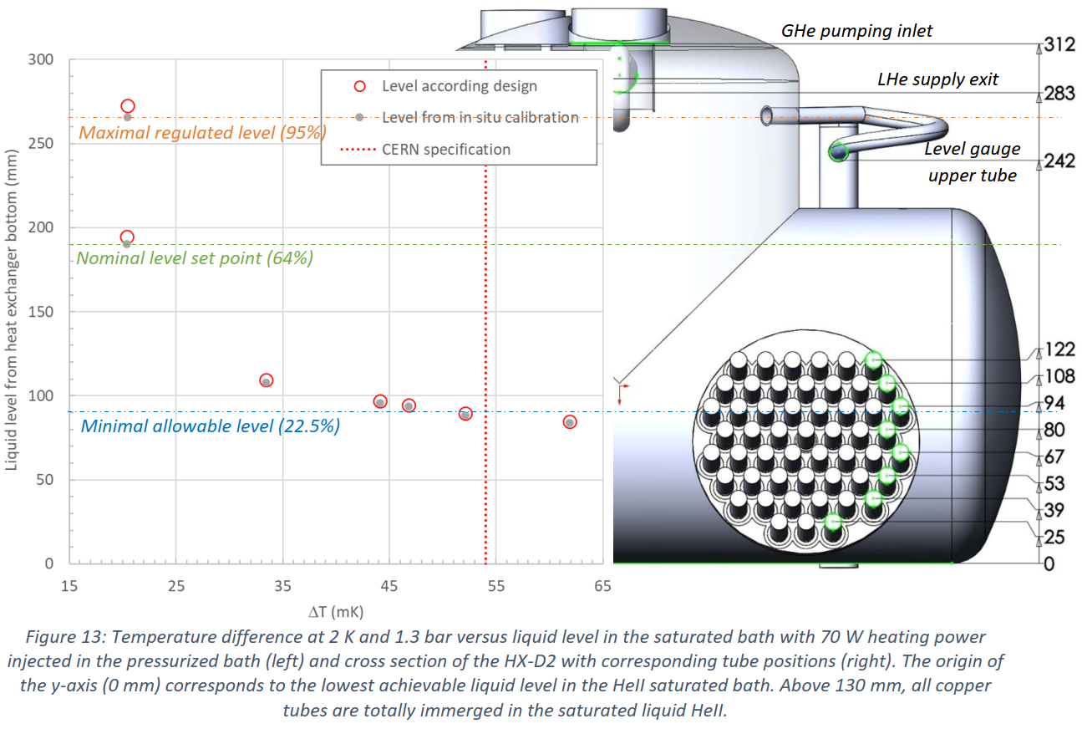
D2 Magnet and HX: SM18 Results
Effect of reduced LHe level in HX
As expected, the performance of the heat exchanger is negatively impacted once LHe level drops below 120 mm and the copper tubes start to become uncovered.

Slide 13
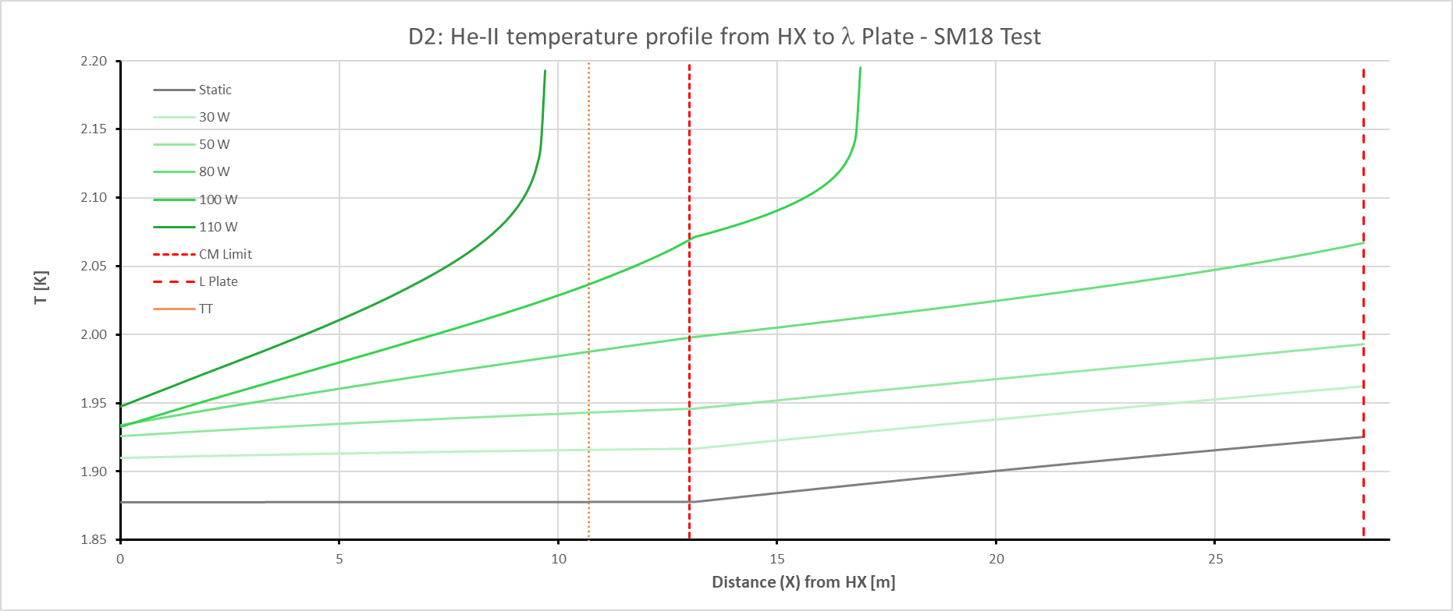
D2 Magnet and HX: SM18 Conclusions
Throughout testing the HX performed as expected, with no notable limitation on cooling or magnet performance.
Result indicate a significant contribution to heat load to 1.9 K from the test bench
Removing the estimated heat load from the test bench indicates:
He-II conditions maintained in the coldmass with dynamic heat loads up to 100 W.
He-II conditions maintained in the interlink with dynamic heat loads up to 80 W.
110 W estimated heat load from test bench removed

Slide 14
The End

Slide 15
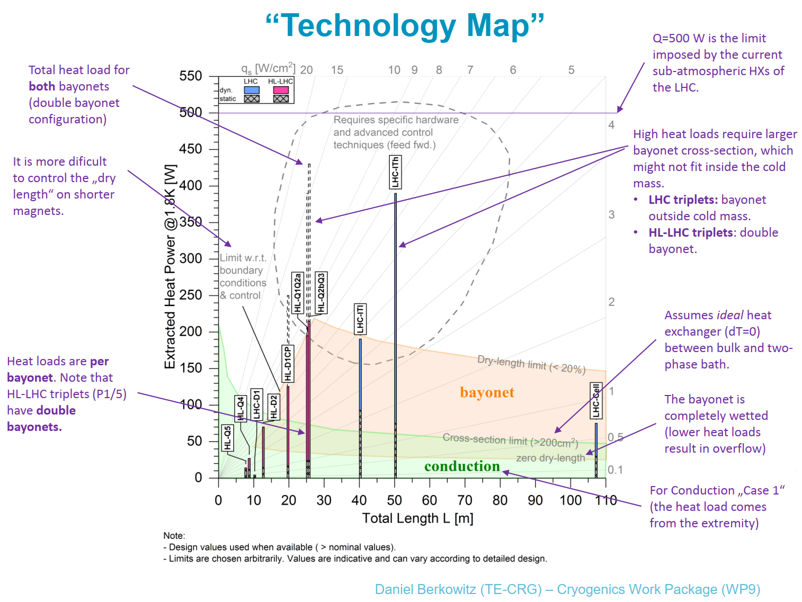

Slide 16
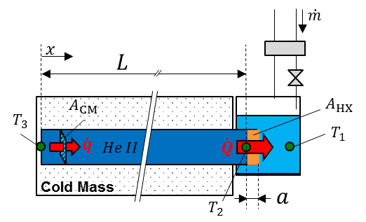
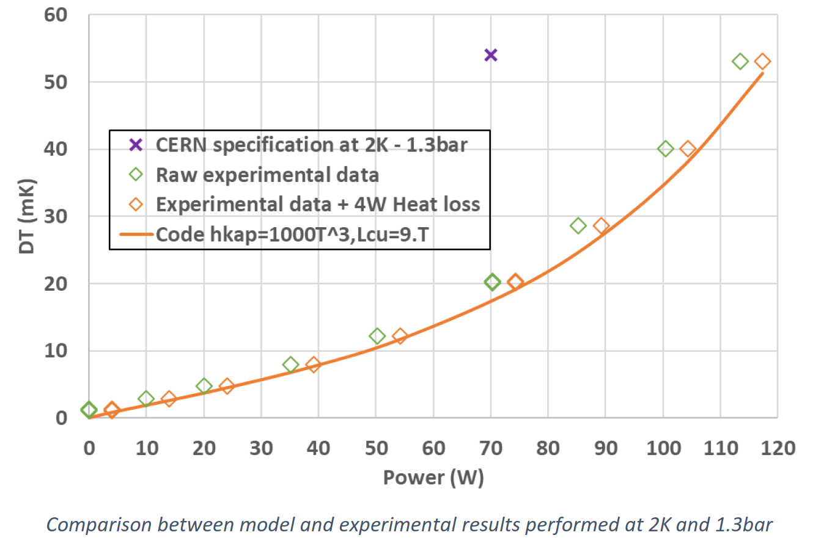


D2 Cooling limitation at 1.9 K
Two limitations to 1.9 K cooling capacity
Coldmass He-II Cross-section
He-II Heat Exchanger
To ensure He-II conditions over the 13.5 m length of the D2 Coldmass:
Min. 207 cm² He-II cross section to transfer heat.
HX Testing - Prototype Performance Margin:
Required to account for variation in Kapitza resistance of copper.
Margin will allow some increase in cooling capacity, so 74.25 W is acceptable.
He-II Cross-section is most limiting
Margin
13.5m

Slide 17
Nominal Static Heat Loads to 1.9 K
Nominal Static heat load was presented as 30.04 W at the Heat Load Review (April 2021)
Since this time the heat load from the Lambda Plate was reduced from 9 W to 5.25 W → Reducing the total static heat load to 26.51 W

Slide 18
P V Diagram for D2 HX Pressure Relief

