Slide 1
Magnetic measurements at 1.9 K on the LMBRD01 (D2 cold mass with MBRD2)
L. Fiscarelli, M. Pentella, G. Dima, G. Deferne, R. Beltron
Colleagues from the sections MQA, LMF, CMI
B. Caiffi, A. Pampaloni S. Farinon, A. Bersani from INFN Genova
19.11.2025

Slide 2
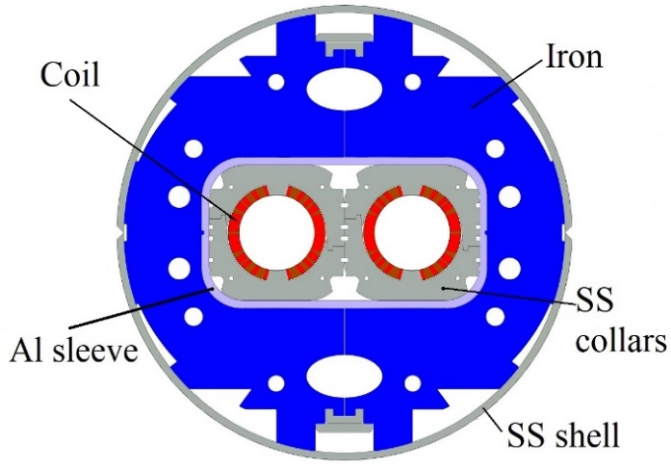
MBRD
  In industry at warm
  Rotating coil 750 mm – 11 positions
    Single apertures
    Two apertures in the sleeve
    Full magnet
  At CERN at warm
  Rotating coil 600 mm – 14 positions
    Magnet upon arrival
    Cold-mass
  At CERN at 1.9 K (with anticryostats)
  Rotating coil 1200 mm – 7 segments
    Machine cycles
    Stair-step
    Ramp-rate
  Stretched wire
    Nominal current (12330 A)
AP1 AP2

Slide 3
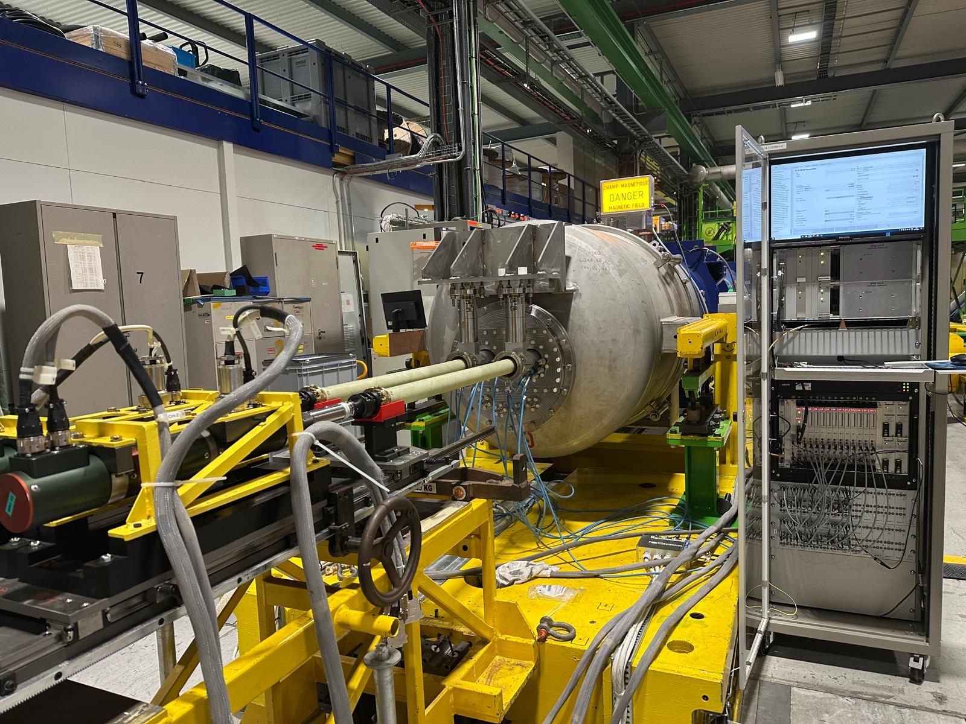
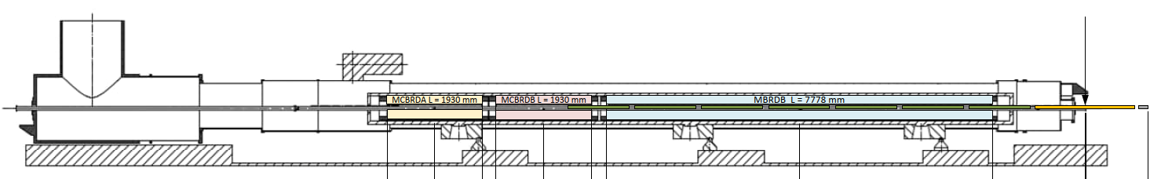
Setup with rotating coils in anticryostats
New anticryostats
  Acknowledgement to CMI
New rotating-coil shafts
  66-mm diameter
  7x1200-mm segments
  Parallel measurement of both apertures

Slide 4
Magnetic measurements at 1.9 K
TF
  Stretched wire
    At nominal (table)
  Rotating coils
    During ramp (plot)
Field quality
  Rotating coils
    At injection (table)
    At nominal (table)
    During ramp (plot)

Slide 5
Transfer function
12330 A | B1 (Tm) | Field direction* (mrad)
AP1 | 35.7709 | -0.85
AP2 | 35.7713 | 0.33
  Stretched wire
    At nominal
  Rotating coils
    Ramp from inj. to nom.
*Angle wrt gravity when cryo-assembly was tested

Slide 6
Field quality tables
AP1 |  |  |  |  |  | AP2
 | Injection |  | Nominal |  |  |  | Injection |  | Nominal
n | bn | an | bn | an |  | n | bn | an | bn | an
2 | 5.85 | 0.40 | -0.08 | 1.83 |  | 2 | -3.71 | 1.58 | 2.11 | 3.89
3 | -14.19 | -1.86 | 3.47 | -3.15 |  | 3 | -14.70 | -2.04 | 2.86 | -2.73
4 | -1.81 | -0.08 | -0.28 | -0.40 |  | 4 | 1.89 | 0.00 | 0.23 | 0.61
5 | 3.47 | -0.61 | 2.83 | -1.16 |  | 5 | 2.43 | -0.91 | 2.31 | -1.39
6 | 0.66 | -0.02 | 0.13 | -0.28 |  | 6 | -0.33 | 0.07 | -0.25 | -0.21
7 | 1.44 | -0.65 | 1.96 | -0.54 |  | 7 | 1.36 | -0.46 | 1.91 | -0.41
8 | 0.83 | -0.16 | 0.99 | -0.19 |  | 8 | -1.11 | -0.22 | -1.09 | -0.26
9 | 0.94 | -0.20 | 1.29 | -0.20 |  | 9 | 1.03 | -0.06 | 1.25 | -0.17
10 | 0.46 | 0.56 | 0.44 | 0.44 |  | 10 | -0.30 | 0.38 | -0.28 | 0.38
11 | -2.08 | -0.52 | -2.14 | -0.57 |  | 11 | -2.00 | 0.31 | -1.98 | 0.33
12 | 2.02 | 0.55 | 2.04 | 0.54 |  | 12 | -1.69 | 0.56 | -1.77 | 0.53
13 | -1.87 | -0.37 | -2.05 | -0.37 |  | 13 | -1.74 | 0.24 | -1.88 | 0.27
14 | 0.95 | 0.19 | 1.10 | 0.24 |  | 14 | -0.87 | 0.18 | -0.93 | 0.24
15 | -0.52 | 0.30 | -0.60 | 0.31 |  | 15 | -0.49 | 0.07 | -0.67 | 0.11
  Reference radius 35 mm

Slide 7
Field quality vs acceptance criteria
Acceptance criteria MBRD https://edms.cern.ch/document/2051868/1.39
 |  | Acceptance criteria |  |  | AP1 |  | AP2 |  |  | AP1 |  | AP2
n |  | |bn| | |an| |  | bn | an | bn | an |  | |∆bn| | |∆an| | |∆bn| | |∆an|
2 |  | 4.00 | 2.72 |  | -0.08 | 1.83 | 2.11 | 3.89 |  |  |  |  | 1.17
3 |  | 6.67 | 1.13 |  | 3.47 | -3.15 | 2.86 | -2.73 |  |  | 2.02 |  | 1.61
4 |  | 2.40 | 1.78 |  | -0.28 | -0.40 | 0.23 | 0.61
5 |  | 4.00 | 0.61 |  | 2.83 | -1.16 | 2.31 | -1.39 |  |  | 0.55 |  | 0.78
6 |  | 0.24 | 0.70 |  | 0.13 | -0.28 | -0.25 | -0.21 |  |  |  | 0.01
7 |  | 0.66 | 0.23 |  | 1.96 | -0.54 | 1.91 | -0.41 |  | 1.30 | 0.32 | 1.25 | 0.18
8 |  | 0.11 | 0.24 |  | 0.99 | -0.19 | -1.09 | -0.26 |  | 0.88 |  | 0.98 | 0.01
9 |  | 0.26 | 0.08 |  | 1.29 | -0.20 | 1.25 | -0.17 |  | 1.03 | 0.12 | 0.99 | 0.09
10 |  | 0.03 | 0.10 |  | 0.44 | 0.44 | -0.28 | 0.38 |  | 0.41 | 0.34 | 0.25 | 0.28
11 |  | 0.08 | 0.03 |  | -2.14 | -0.57 | -1.98 | 0.33 |  | 2.07 | 0.54 | 1.91 | 0.31
  Reference radius 35 mm

Slide 8
Multipoles vs current
  Reference radius 35 mm

Slide 9
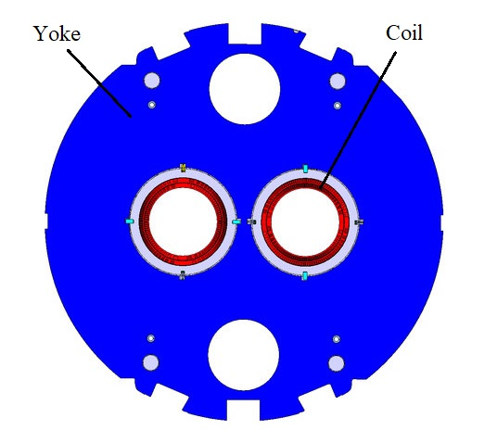
MCBRD’s
  Stretched wire
    At nominal 393 A
H
V
 | 393 A | B1 (Tm) | A1 (Tm)
MCBRDP4 | AP2_B_H | 5.0185 | -0.0134
 | AP1_B_V | 0.0286 | 5.0306
MCBRDP3b | AP1_A_H | 5.0202 | -0.0297
 | AP2_A_V | -0.0182 | -5.0032

Slide 10
Summary
Complete magnetic characterization available for the first series magnet
MBRD
  TF is larger (+2%) than the nominal 35.00 Tm and almost identical on the two apertures (current can be set lower)
  Correction applied on b3 and b5 is effective
  Field quality marginally outside the acceptance criteria
MCBRD’s
  Integral field at nominal with stretched wire for calibration of TF

