Slide 1




Displaced Vertex Finder on GPUs for LHCb
Applicant
Vladyslav Yankovskyi
Taras Shevchenko National University of Kyiv
Mentor
Andrii Usachov
VU Amsterdam and Nikhef

Slide 2

Motivation
The study of Long-Lived Particles can help in the search for the New Physics.
Their effective detection requires a special algorithm that quickly identifies the displaced vertices where these particles appear.
Main goal to find displaced multi-track vertices with anomalous topologies

Slide 3
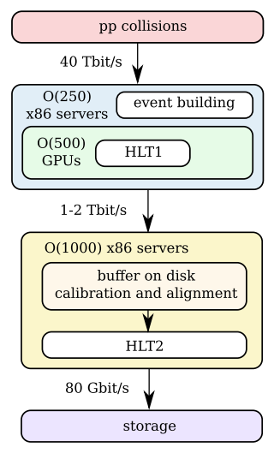
High-level triggers at LHCb
HLT1:
Performs fast track reconstruction
First fully GPU-based trigger
Implemented as an Allen application
HLT2:
Aligned and calibrated in near-realtime
Full particle identification
Track fitting

Slide 4
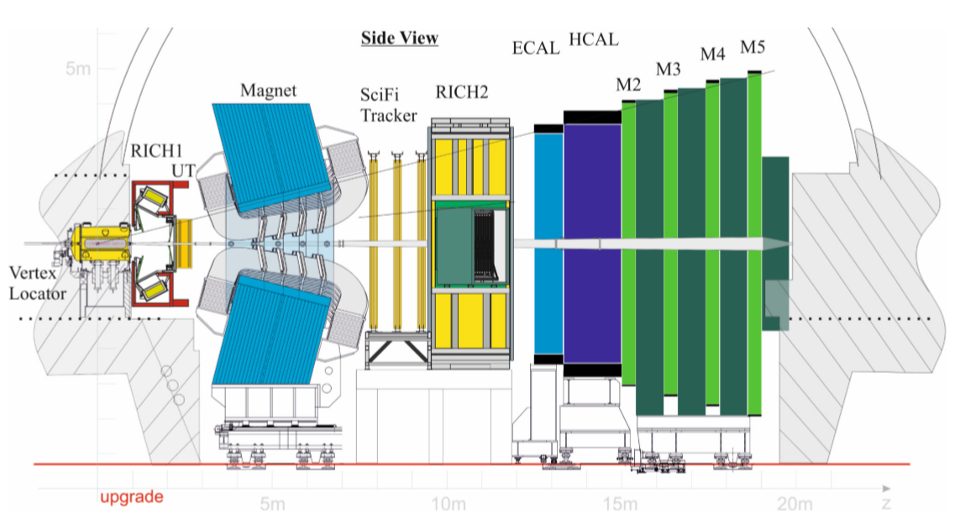
Generic vertex finder algorithm
VELO Detector
Beamline

Slide 5
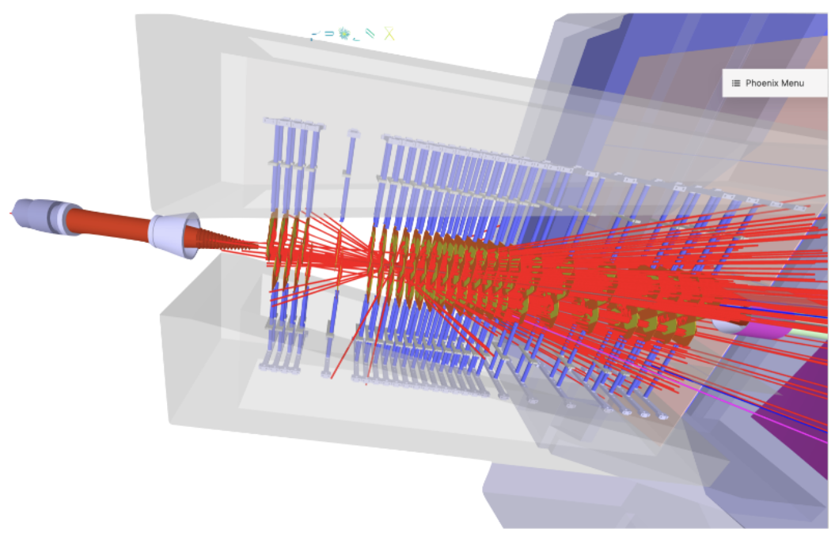
Generic vertex finder algorithm
About 80% of Velo tracks are associated with PV

Slide 6
Generic vertex finder algorithm
Beamline
Primary Vertices PV
Generic Displaced Vertices GDV
The main task of the project is to find Anomalous Vertices.
To do this, they must first be found from the Velo-tracks

Slide 7
Generic vertex finder algorithm
Search for vertices by pairs of tracks:
We look for the distance between each two
tracks in the event and if they are close
enough according to the χ² criterion,
we determine the Seed Vertex
χ²
Seed Vertex
Parameters of Seed Vertex:
X, Y, Z coordinate
Chi2 = χ2
nTracks = 2
Covariance Matrix

Slide 8
Generic vertex finder algorithm
Seed Vertex
Parameters of Seed Vertex:
X, Y, Z coordinate
Chi2 = Σ w*χ²
nTracks = 2 + nNew
Covariance Matrix
χ²
Add other tracks to vertex:
Check if there are other tracks that belong to the Seed Vertex by calculating the distance between them and χ²

Slide 9
Generic vertex finder algorithm
Merge vertices:
If two vertices are close enough to each
other, they can be treated as one vertex.
χ²
Seed Vertex
Parameters of Seed Vertex:
X, Y, Z coordinate
Chi2
nTracks = nV₁+nV₂+…
Covariance Matrix

Slide 10
Generic vertex finder algorithm
Merge vertices:
If two vertices are close enough to each
other, they can be treated as one vertex.
Parameters of Seed Vertex:
X, Y, Z coordinate
Chi2
nTracks = nV₁+nV₂+…
Covariance Matrix

Slide 11
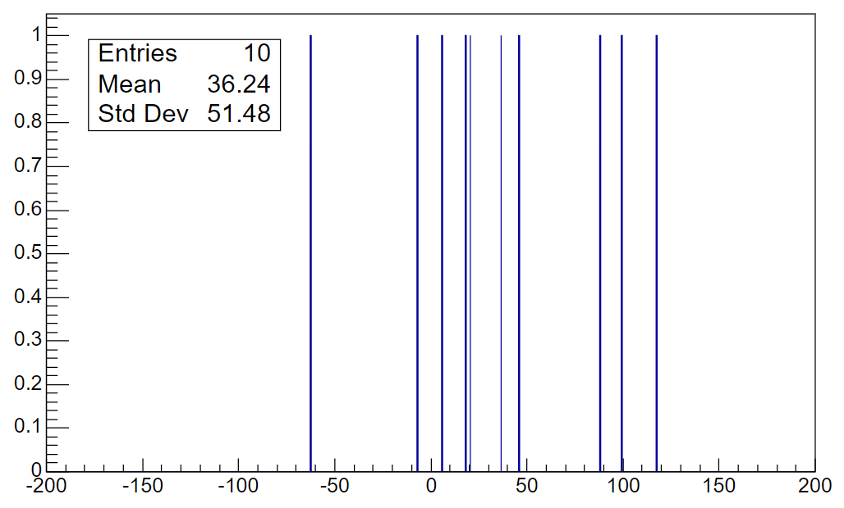
Results
PVFinder is implemented on the GPU
Its main function is to reconstruct the primary PV vertices
PV will be used as a reference for evaluating the effectiveness of the GVFinder algorithm
Z-coordinate of PVs

Slide 12
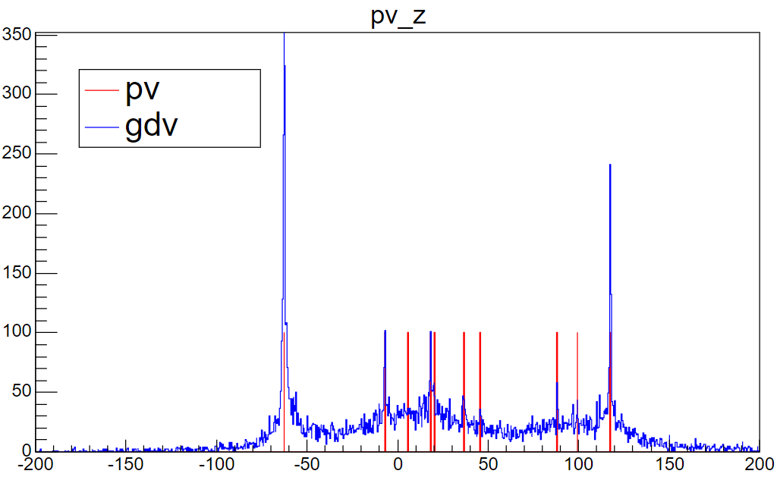
Results
The peaks on the histogram correspond to the positions of the PV
This is explained by the large number of tracks in PV and, accordingly, the large number of close vertices by pairs of these tracks.
Z-coordinate of GDVs by pairs of tracks

Slide 13
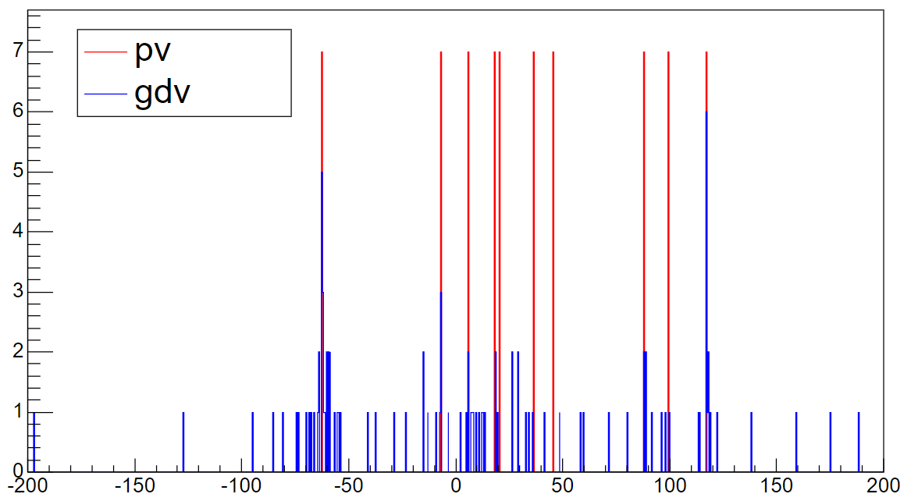
Results
For optimization purposes, it was decided to use each track in the event only once.
This requires the uniqueness of assigning a track to a vertex, which significantly speeds up the execution of the algorithm.
Z-coordinates of GDVs from pairs of tracks and PVs

Slide 14
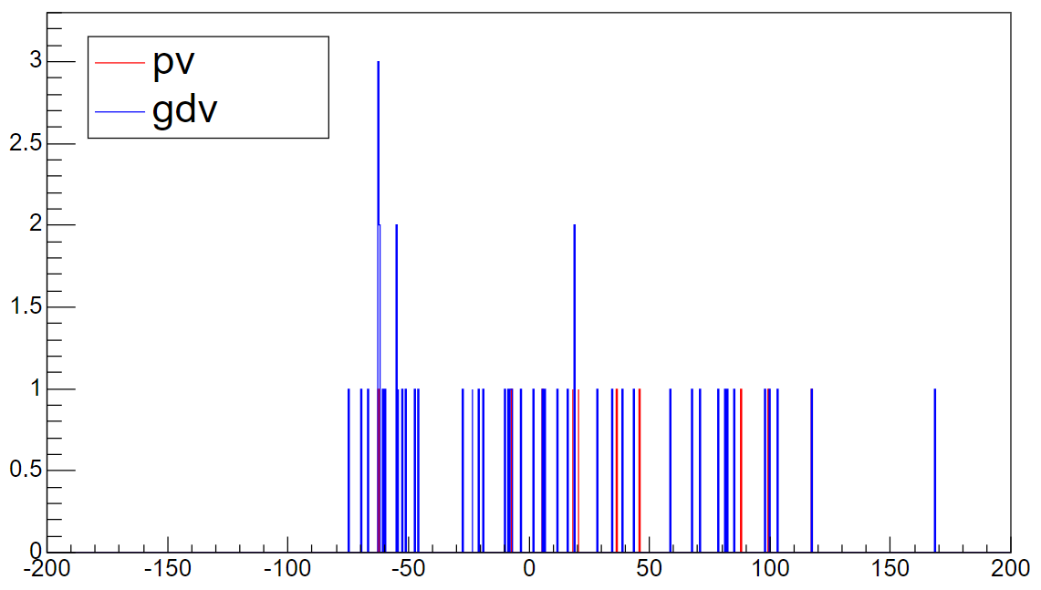
Results
Optimization:
Parameters of the maximum value χ².
Method for calculating the common coordinate.
Fitting parameters.
Z-coordinates of GDVs after merging and PVs

Slide 15
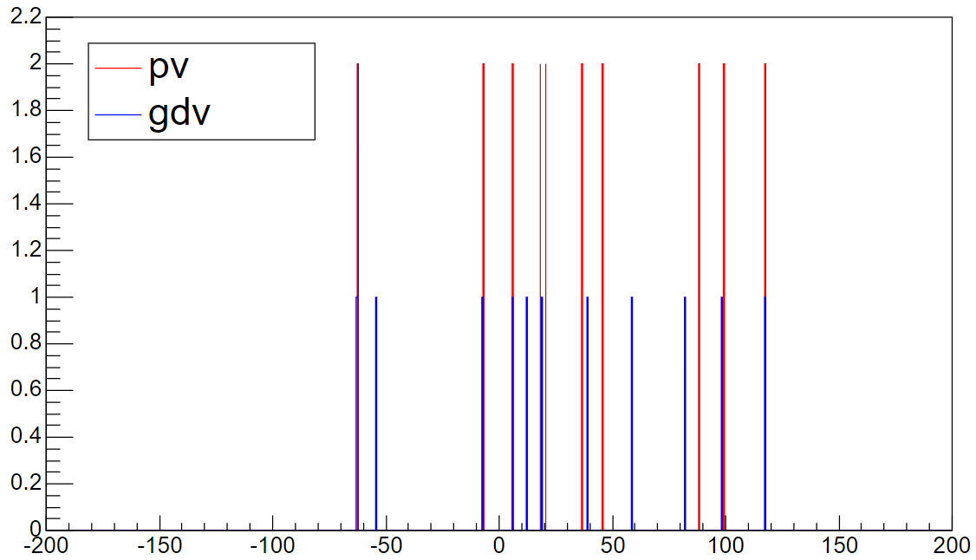
Results
Algorithm performance was evaluated by the accuracy of primary vertex determination.
Constraints:
Minimum number of tracks associated with a vertex
Maximum allowed distance ρ from the beam line.
Z-coordinates of GDVs with constraints on PV and PVs

Slide 16
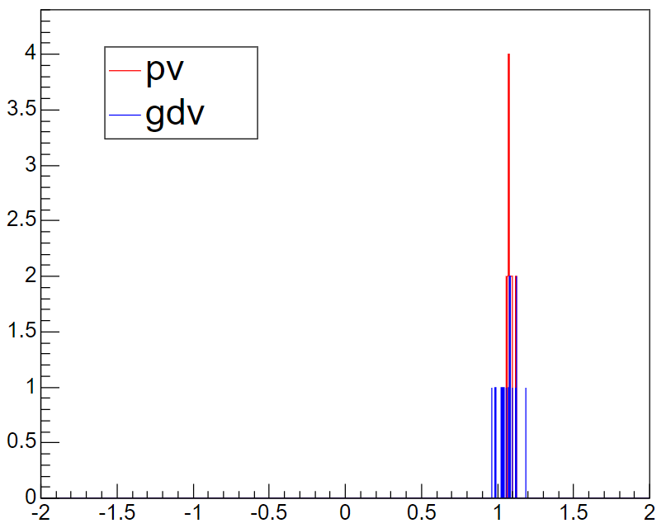
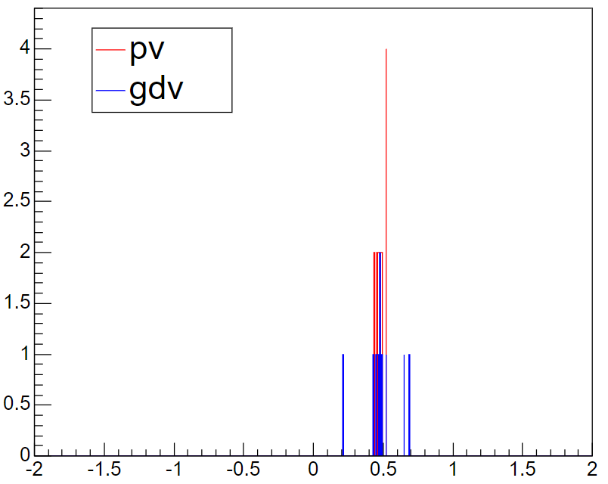
Results
X-coordinates (Right) and Y-coordinates (Left) of combined GDVs with angles on PV

Slide 17
Results
№ | Reference point (X, Y, Z) | Number of Tracks | Nearest point (X, Y, Z) | Number of Tracks | Distance, mm
1 | 1.074, 0.469, -62.512 | 57 | 1.084, 0.461, -62.560 | 24 | 0.050
2 | 1.060, 0.474, -7.098 | 25 | 0.985, 0.650, -7.413 | 12 | 0.368
3 | 1.079, 0.459, 5.690 | 12 | 1.025, 0.691, 5.765 | 16 | 0.250
4 | 1.094, 0.477, 18.392 | 22 | 1.058, 0.488, 19.172 | 20 | 0.782
5 | 1.089, 0.523, 20.433 | 13 | 1.125, 0.476, 12.306 | 4 | 8.127
6 | 1.072, 0.484, 36.430 | 18 | 0.964, 0.213, 39.056 | 4 | 2.642
7 | 1.067, 0.491, 45.693 | 12 | 1.184, 0.521, 58.693 | 4 | 13.001
8 | 1.121, 0.522, 88.154 | 16 | 1.096, 0.449, 82.091 | 8 | 6.063
9 | 1.119, 0.467, 99.589 | 13 | 1.117, 0.429, 98.287 | 4 | 1.303
10 | 1.074, 0.440, 117.542 | 28 | 1.076, 0.460, 117.504 | 28 | 0.043
Actual and found PVs, and the distance between them

Slide 18
Conclusions
Achievements:
The GVFinder algorithm and monitoring module have been developed
The algorithm has been implemented in Allen to run on both CPU and GPU
The accuracy of vertex reconstruction ranges from 0.05 mm to 2.64 mm

Slide 19
Conclusions
Achievements:
The GVFinder algorithm and monitoring module have been developed
The algorithm has been implemented in Allen to run on both CPU and GPU
The accuracy of vertex reconstruction ranges from 0.05 mm to 2.64 mm
Thank you for your attention!
Work is supported by US NAS and ONRG (IMPRESS-U)

Slide 20

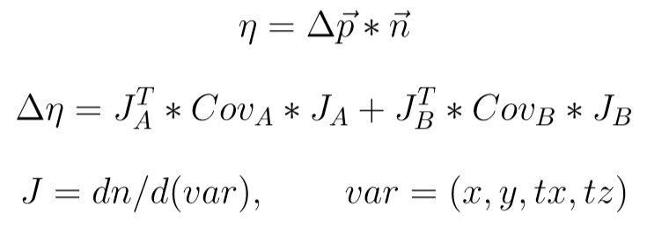
Backup
Vertex by pairs of tracks

Slide 21
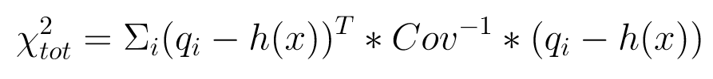
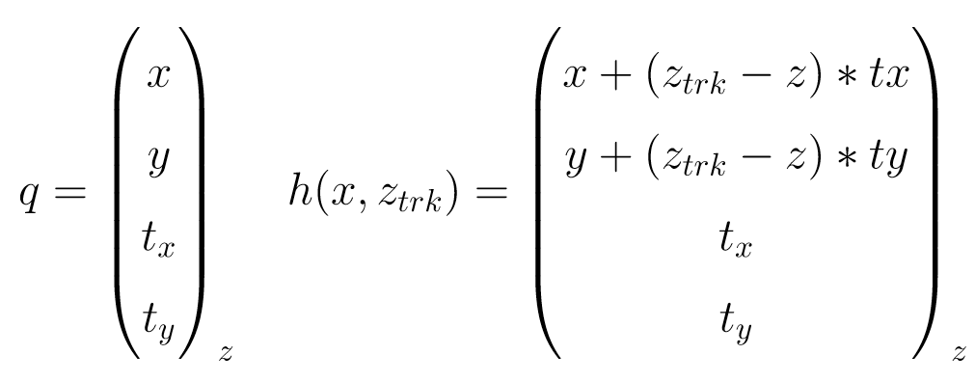

Backup
Adding tracks
Merging

Slide 22
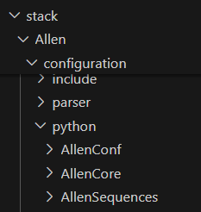
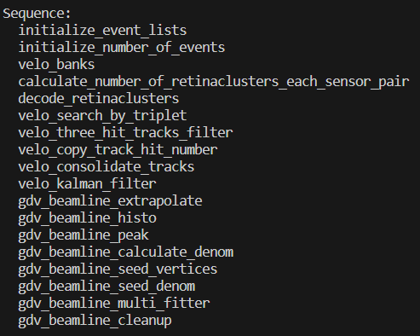
Backup

Slide 23
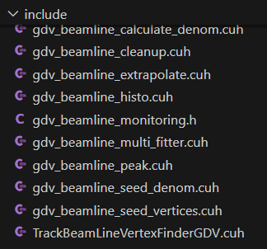
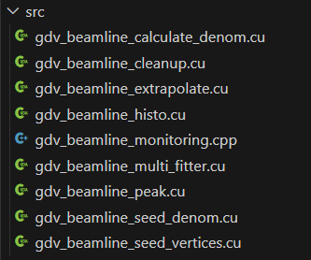
Backup

Slide 24
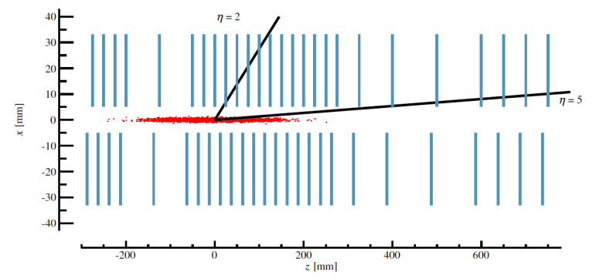
Backup

Slide 25
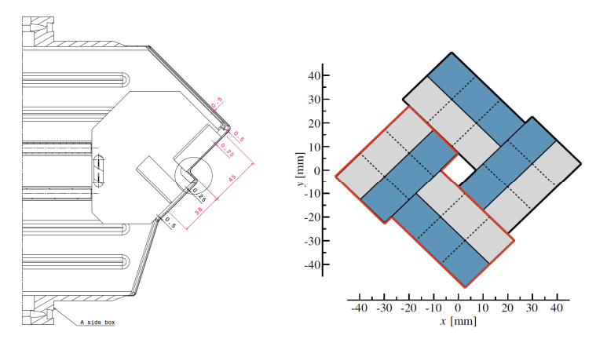
Backup

