Slide 1
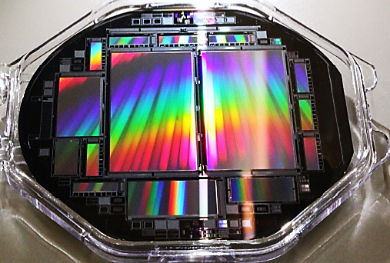
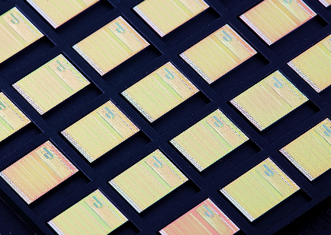
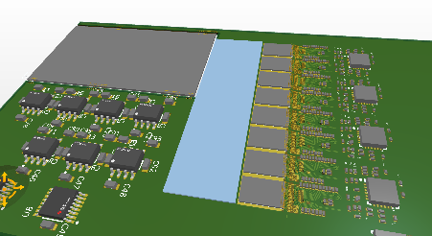
IMMPRINT detector system DPA Status
Semiconductor Laboratory of the Max Planck Society
Garching, 23.10.2025

Slide 2

Contents
Concept:
Status
Finalization of DPA concept
Thermal considerations

Slide 3
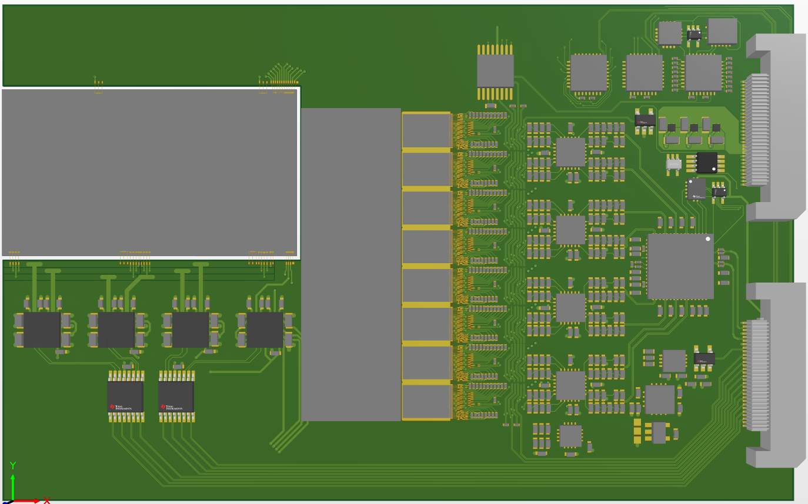
Hybrid layout status
CCD
SC interface & „glue“ logic
MC-ADC power
Layout finished
Last open ToDo-details were addressed
Clarification of last details w/ manufacturer
Ready for production in early November
Stack height ~ 0.45 mm
Integration of PCB on support
Φ - Driver
Pitchadapter (passive)
VERITAS 2.1 ICs (8x)
ADC driver
(Offset and gain)
MC-ADC

Slide 4
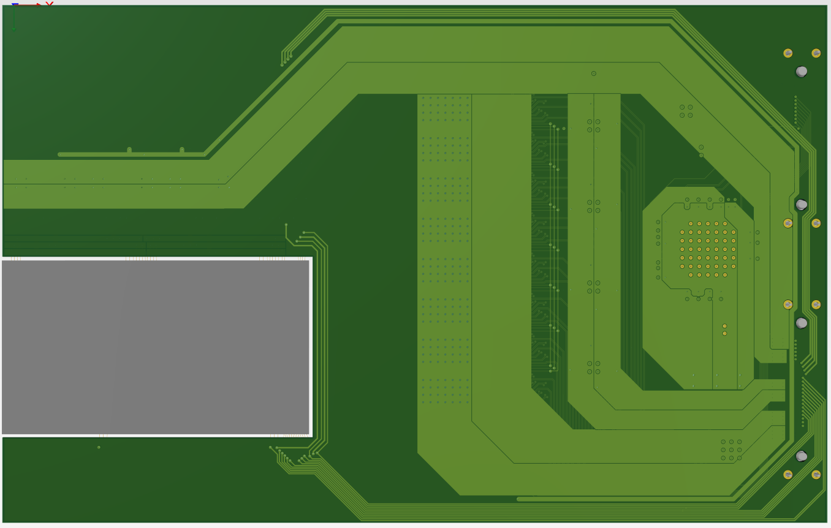
Hybrid layout status
Thermal vias
HV Bondpads placed
Thermal vias filled and covered
HV bondpads

Slide 5
Power estimate
Hybrid total:
CCD (worst case) : 1.5 W
CCD (realistic case) : 0.5 W
Φ pulsers ~ 1 W
ADC buffer ~ 0.8 W
VERITAS IC ~ 3.2 W
ADC + local LDO: 0.6 W + 0.4 W
Contingency (e.g. for glue logic): 0.5 W
Total: 8 W
0.4
W
1.5 W
3.2 W
0.6
W
0.8 W
1 W

Slide 6
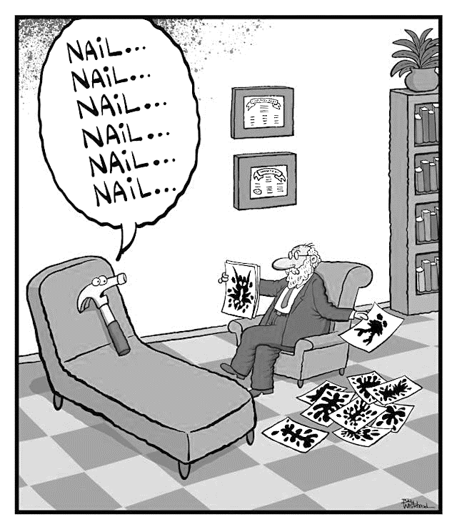
DPA concept
Functions of DPA support:
Mechanical support for Hybrid PCB
Mechanical support for CCD
Thermal interface for CCD and Hybrid PCB to Heatsink (heat removal)
Must allow integration of multiple DPAs in common stack
Must provide for small inter-plane distance, 10 mm or less
Must accommodate shield for FS region

Slide 7
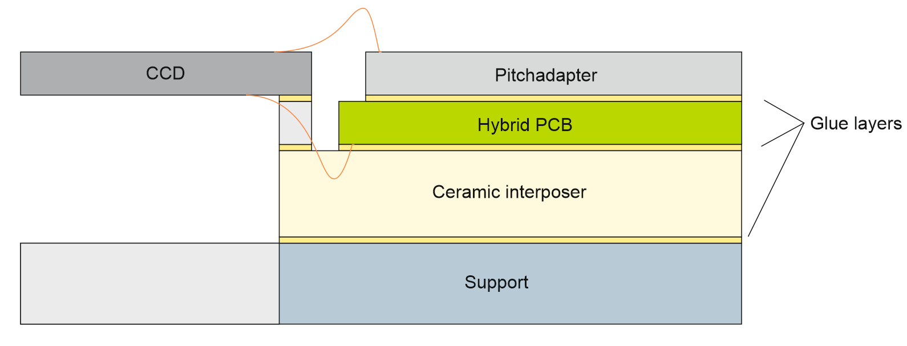
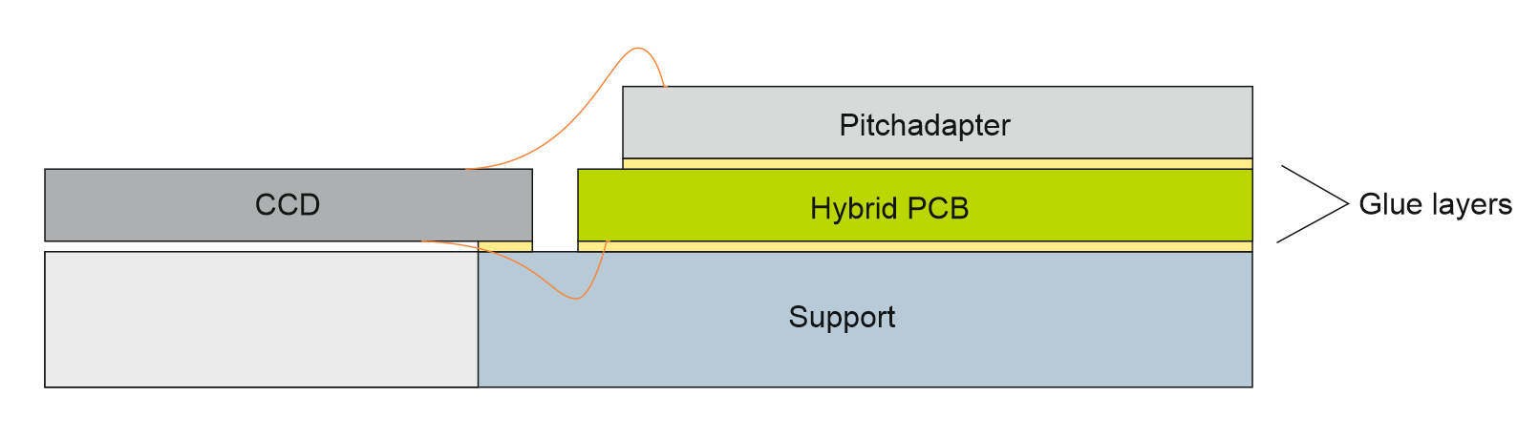
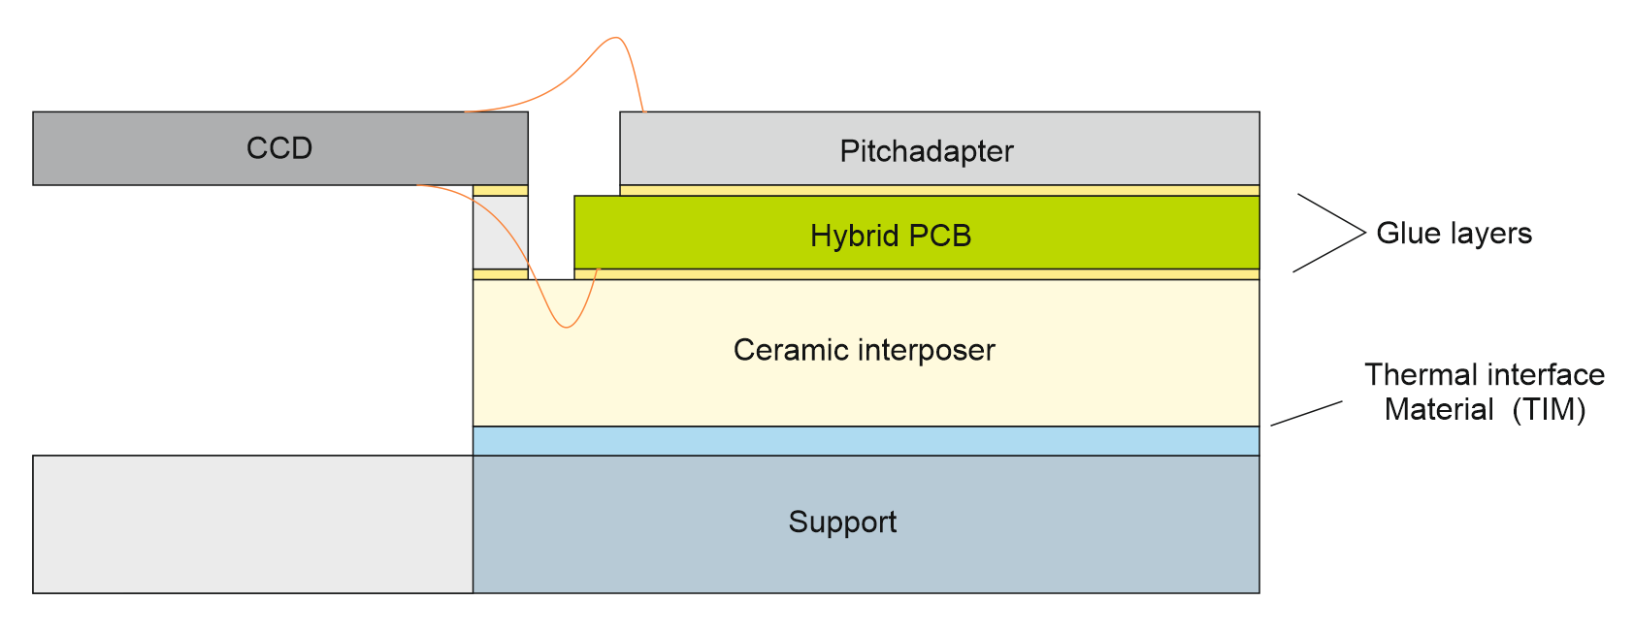
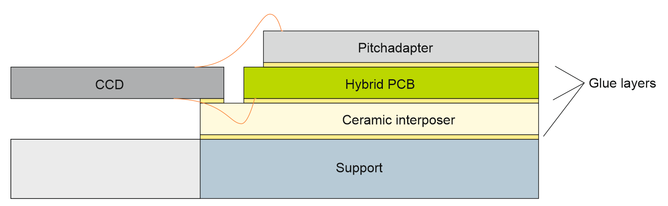
Vertical stackup
(Some options)

Slide 8
Configurations
Investigated configurations:
With and without thermal support ceramics
Molybdenum and Aluminum
Reduce thickness of support (limiting factor is connector)
Cooling from side and from back ( e.g. TPG heatsink)
Some stackup configurations already ruled out:
No additional spacer required for CCD (bonding step height of ~0.5 mm tolerable)
CCD / PCB / ceramic stack removable from support only if really necessary (e.g. if support complicated + expensive)

Slide 9
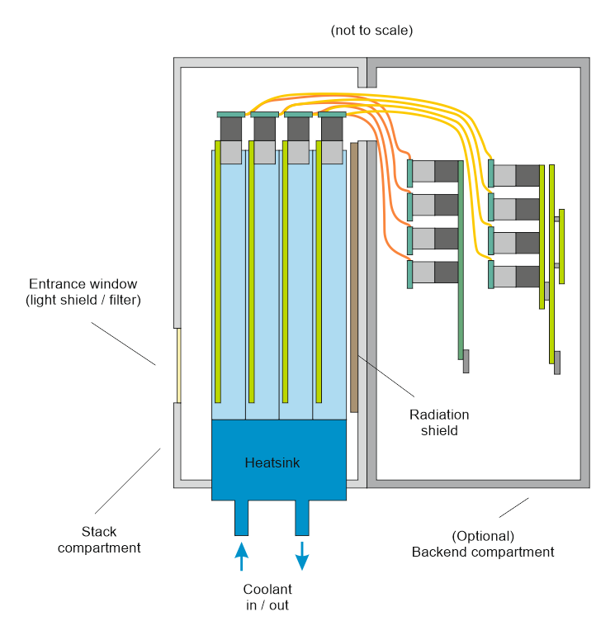
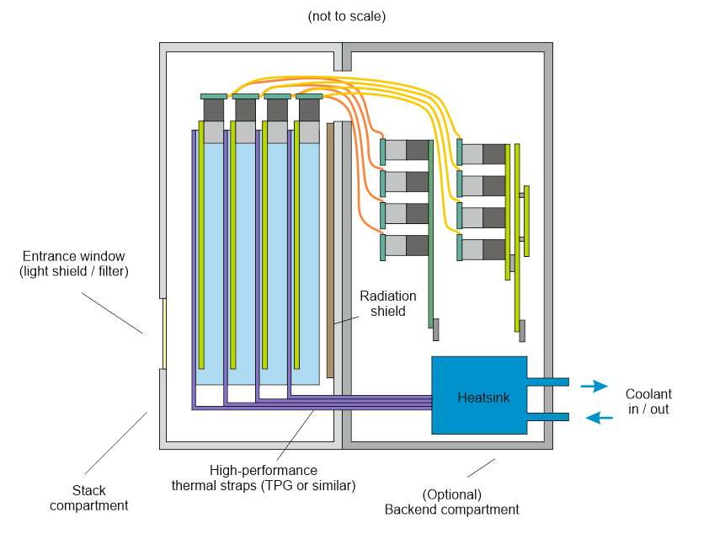
Configurations
Side coupling
(possible also on long edge (edge coupling, but casing more spacious)
Back coupling
(possible also on long edge, but casing more spacious)

Slide 10
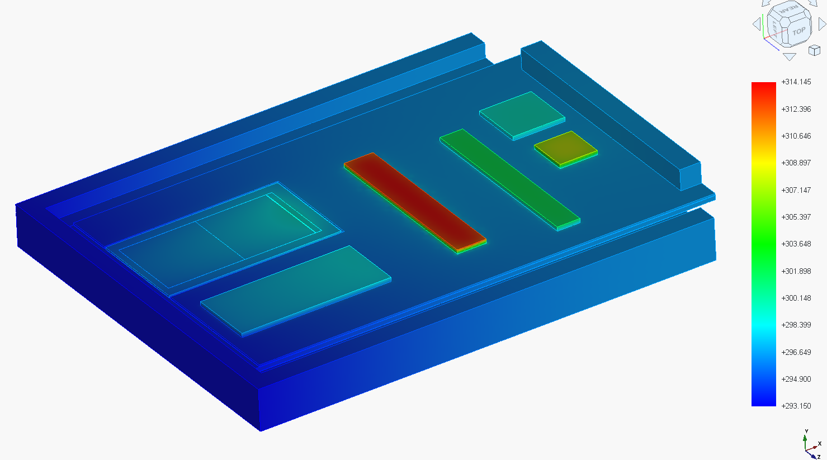
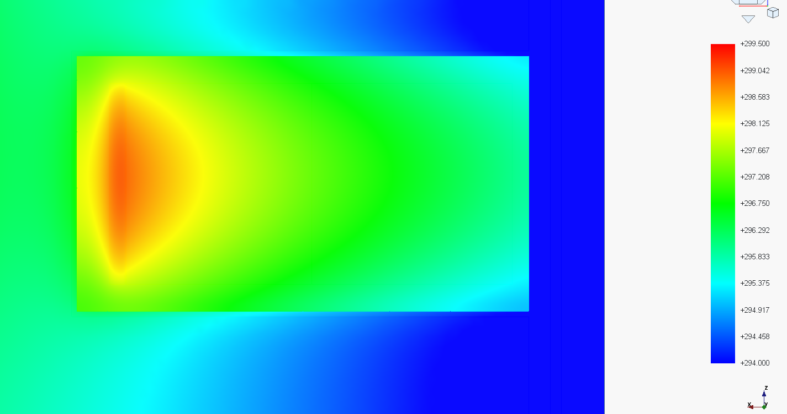
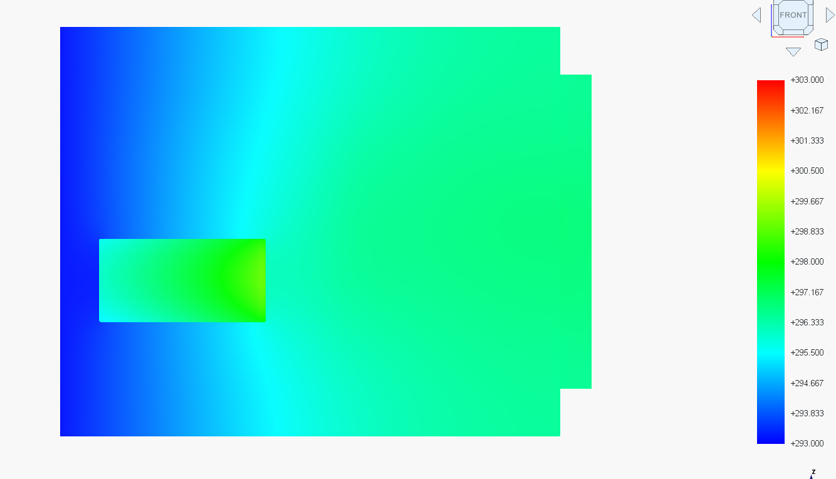
DPA concept
Configuration A: Baseline
Edge cooling @ 20°C
Bulk material Aluminum
1 mm ceramic interposer
Thickness 10 mm
Cavity 3.5 mm
Base 6.5 mm
Temp in °C | CDD | Hybrid
Temp max. | 26.5 | 23
Temp. min | 22 | 20
Gradient | 4.5 | 3

Slide 11
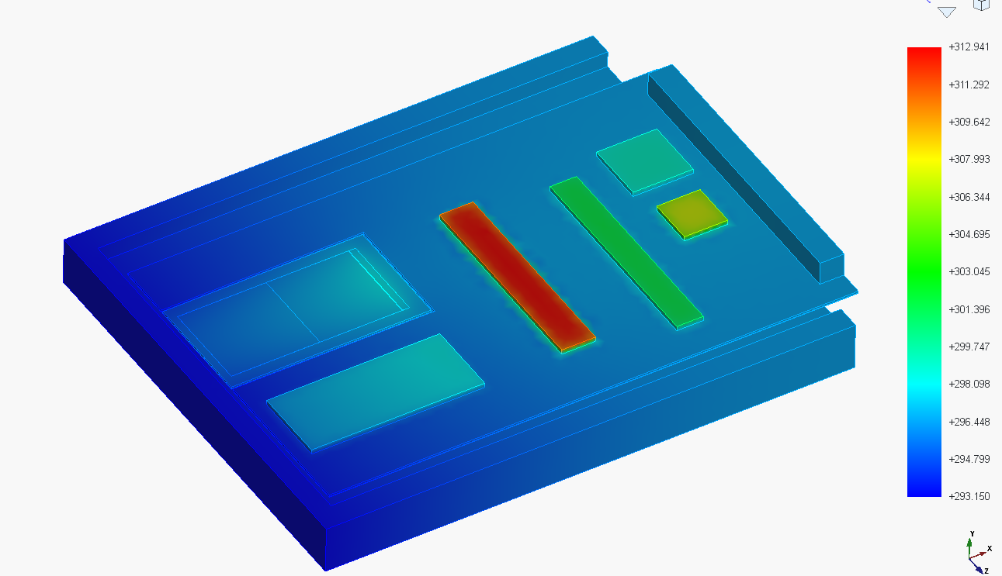

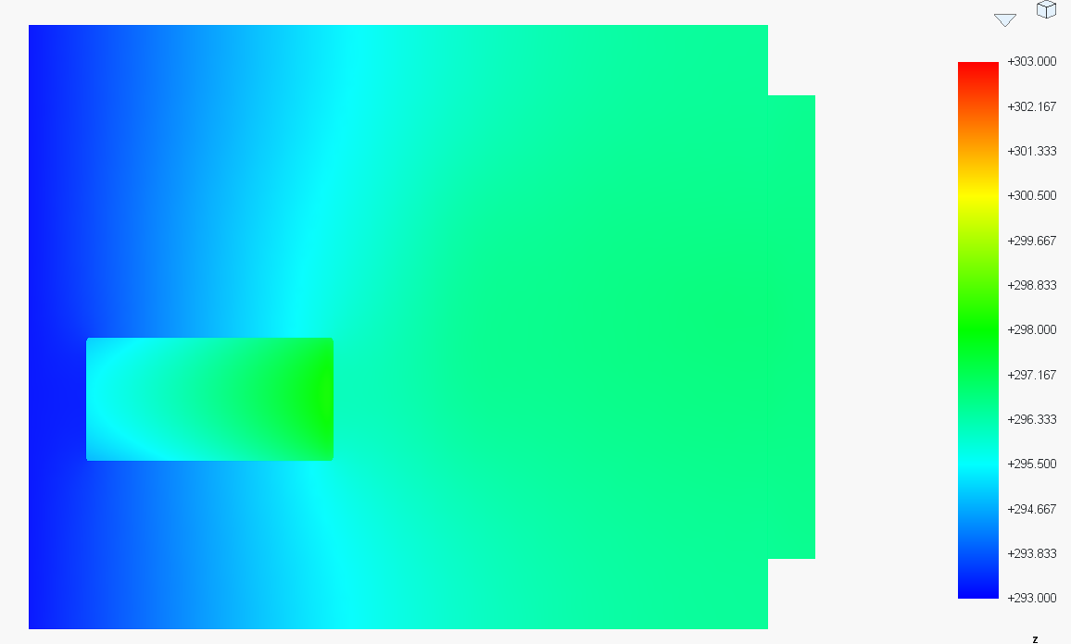
DPA concept
Configuration H: Baseline
Edge cooling @ 20°C
Bulk material Aluminum
No ceramic interposer
Thickness 10 mm
Cavity 3.5 mm
Base 6.5 mm
Temp in °C | CDD | Hybrid
Temp max. | 25 | 24
Temp. min | 22 | 20
Gradient | 3 | 4

Slide 12
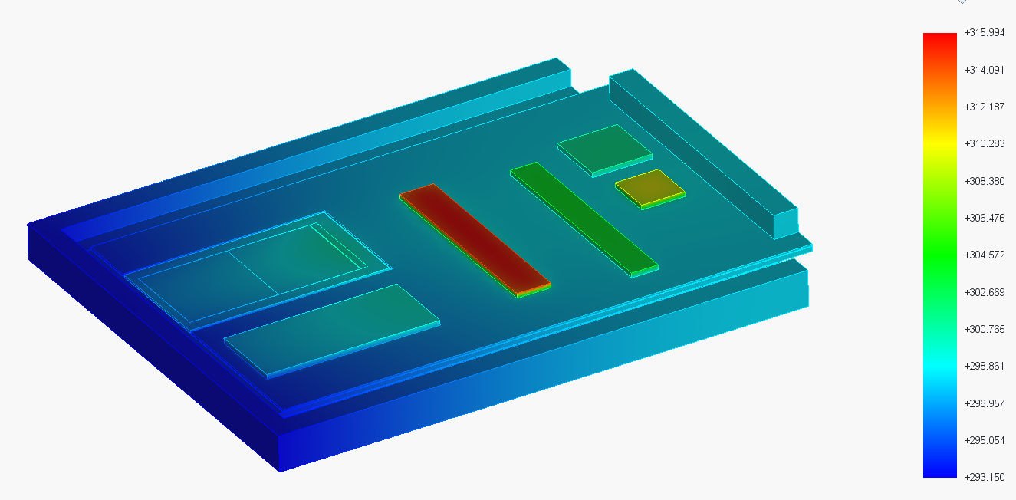
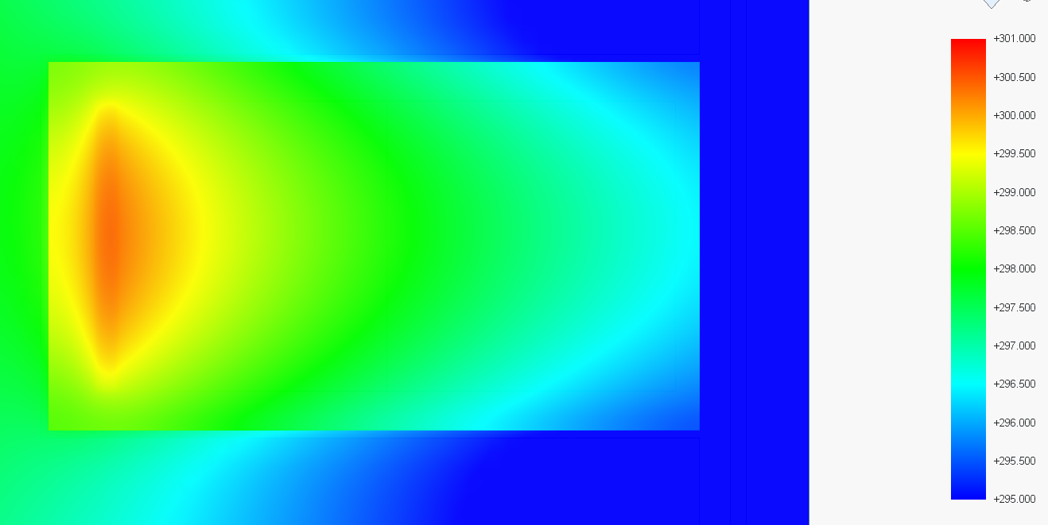
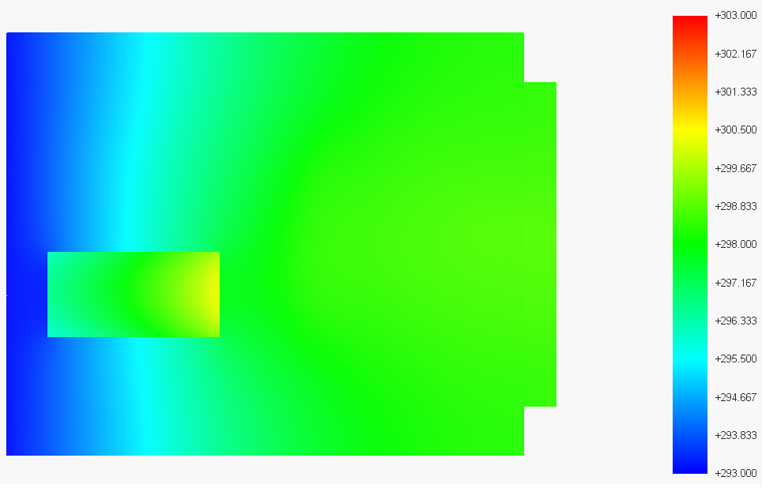
DPA concept
Configuration C: Thin bulk
Edge cooling @ 20°C
Bulk material Aluminum
1 mm ceramic interposer
Thickness 10 mm
Cavity 3.5 mm
Base 4 mm
Temp in °C | CDD | Hybrid
Temp max. | 27 | 25
Temp. min | 23 | 20
Gradient | 4 | 5

Slide 13
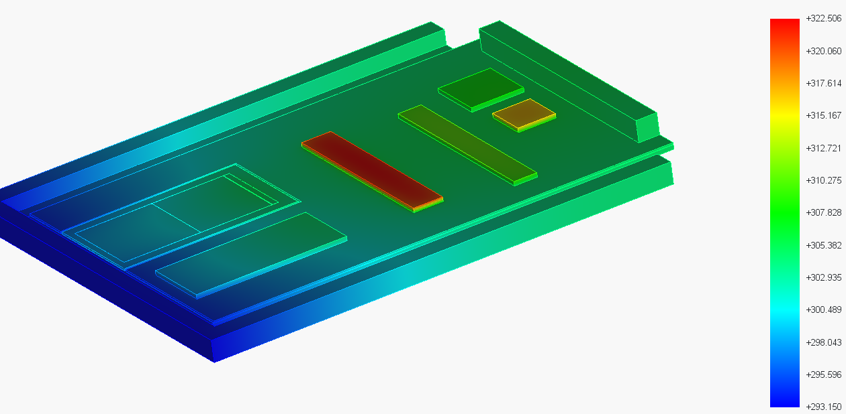
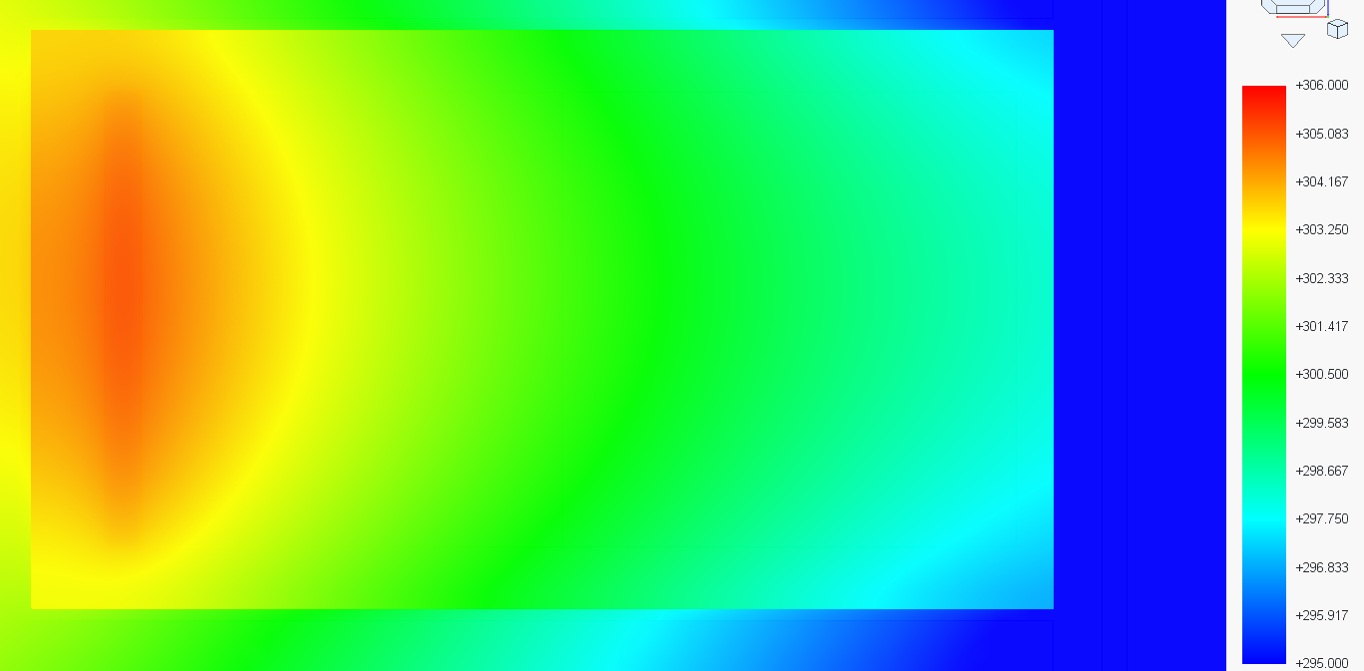
DPA concept
Configuration G: Ultra-Thin bulk
Edge cooling @ 20°C
Bulk material Aluminum
1 mm ceramic interposer
Thickness 5 mm
Cavity 3.5 mm
Base 1.5 mm
Temp in °C | CDD | Hybrid
Temp max. | 32 | 25
Temp. min. | 25 | 20
Gradient | 9 | 5

Slide 14
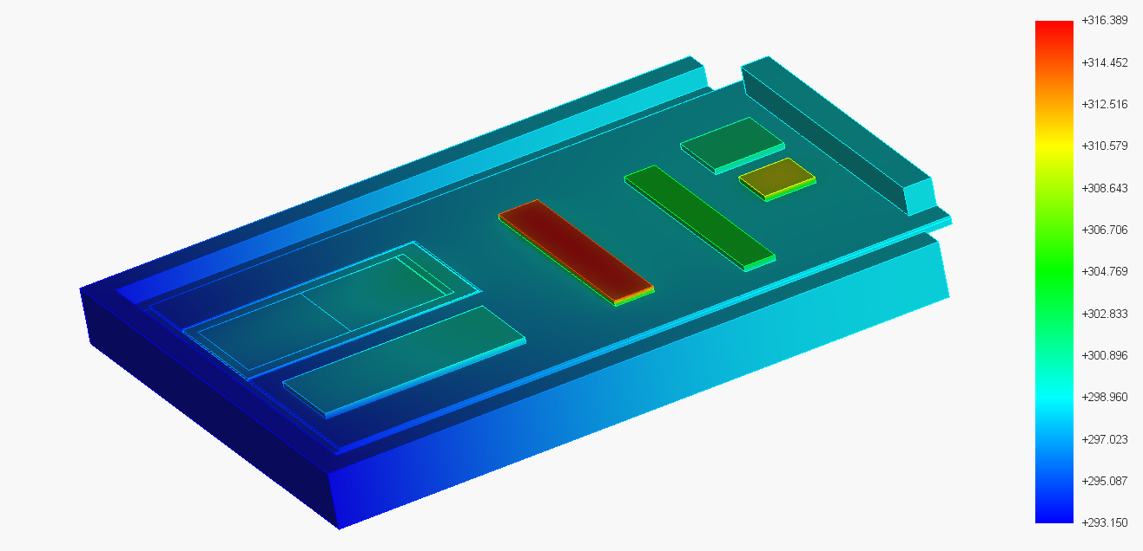
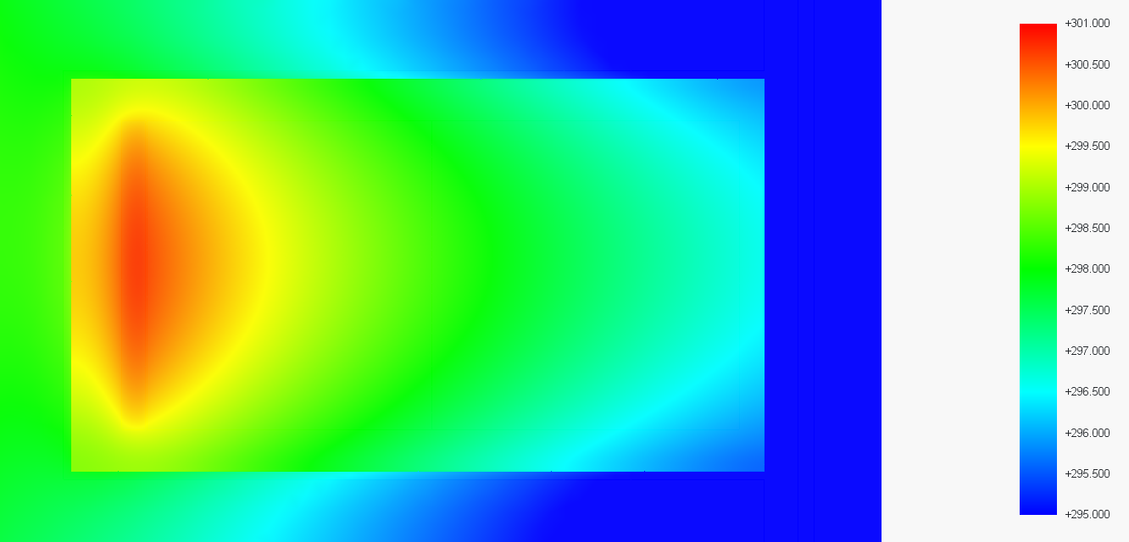
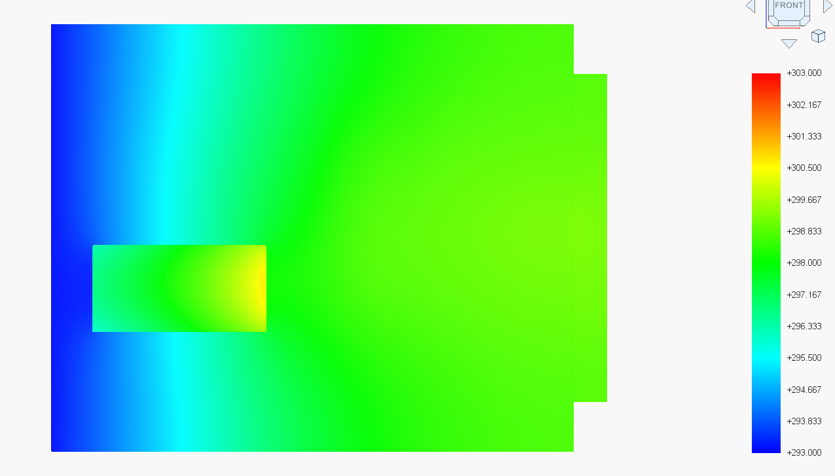
DPA concept
Configuration E: Molybdenum bulk
Edge cooling @ 20°C
Bulk material Molybdenum
1 mm ceramic interposer
Thickness 10 mm
Cavity 3.5 mm
Base 6,5 mm
Temp in °C | CDD | Hybrid
Temp max. | 27.5 | 26
Temp. min | 22.5 | 20
Gradient | 5 | 6

Slide 15
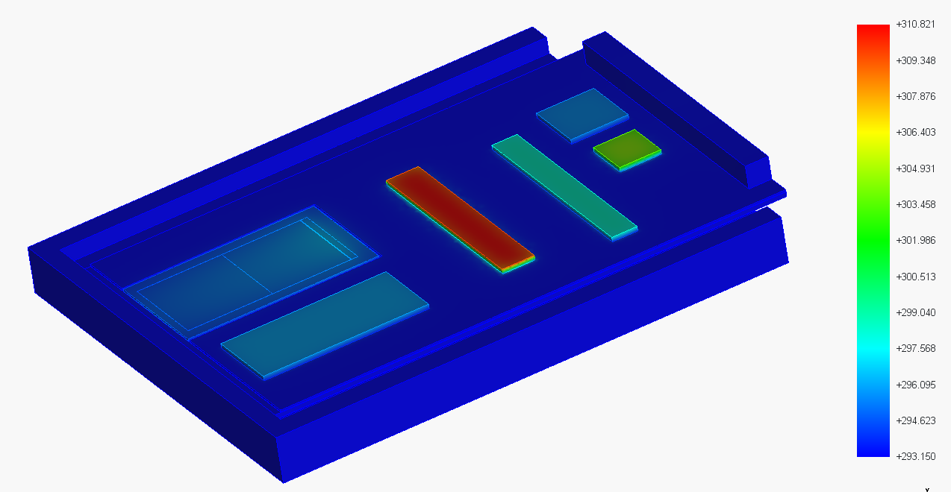
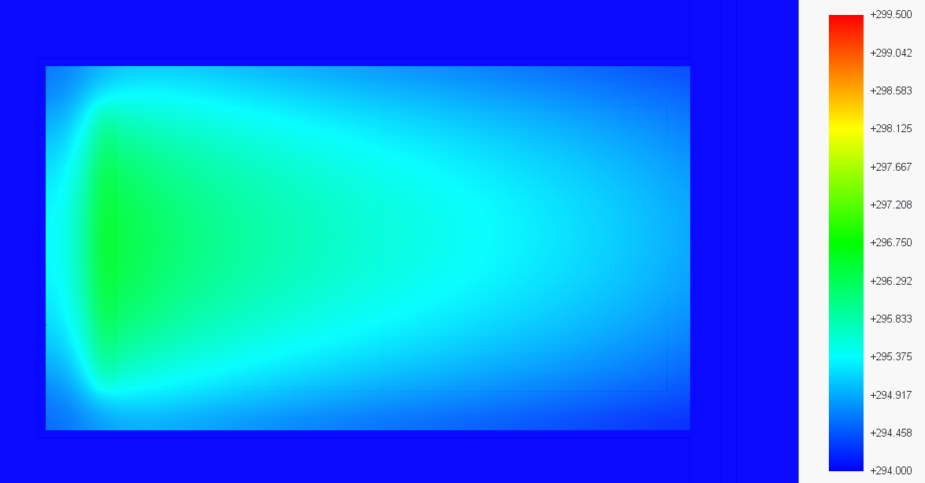
DPA concept
Configuration I: Back coupling
Edge cooling @ 20°C
Bulk material Aluminum
1 mm ceramic interposer
Thickness 10 mm
Cavity 3.5 mm
Base 6,5 mm
Temp in °C | CDD | Hybrid
Temp max. | 25 | 20
Temp. min | 21.5 | 20
Gradient | 4.5 | 0

Slide 16
DPA concept
Saves ~ 1°C in gradient
No ceramic interposer
Plus 0.5°C offset
Plus 2°C gradient
Evens out influence of hybrid / support gradient
Better for thinner supports
Molybdenum support
Standard
Back coupling
Thin
Plus 1°C offset
Plus 1°C gradient
Ultrathin
Plus 2°C offset
Plus 3°C gradient
Recommendation:
Molybdenum base material makes ceramic interposer obsolete (except for HV, to be checked)
Thin down Modlybdenum support to minimum tolerable for mechanical stability and filter accommodation
Use high performance thermal strap w/ high in-plane conductivity as interface for backside cooling (thickness to be evaluated)
Thin down Molybdenum support to minimum tolerable 4 mechanical stability
Maybe gain on inter-plane distance

Slide 17
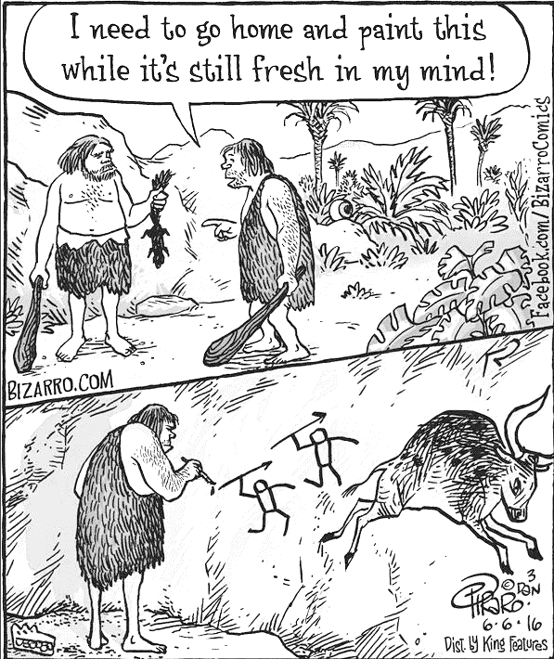
Next steps
Fabricate hybrids
Design of DSC (easy)
Design of ASC (harder)
Finalize mechanics:
Decide on Ceramics (yes/no, preference: No)
Decide on Thermal connection, evaluate TPG

