Slide 2
PS RF
With significant contributions from H. Damerau and M. Morvillo
Carlo Rossi – LIU 2011 Event – 25 November 2011

Slide 3
PS RF - Overview
The PS high level RF system
Issues in the PS longitudinal phase space
Implications for the hardware
The high level RF upgrade program (possible options)
What is already in the pipeline
Concluding remarks

Slide 4
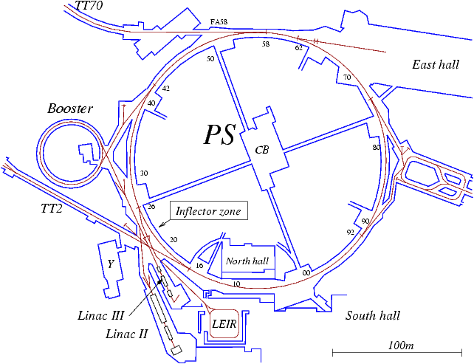
PS high level RF systems - overview
10 MHz system
56
51
13/20 MHz system
46
66
40 MHz system
76
77
80 MHz system
200 MHz system
36
78
80
81
86
88
89
91
96
92
11
8
6

Slide 5
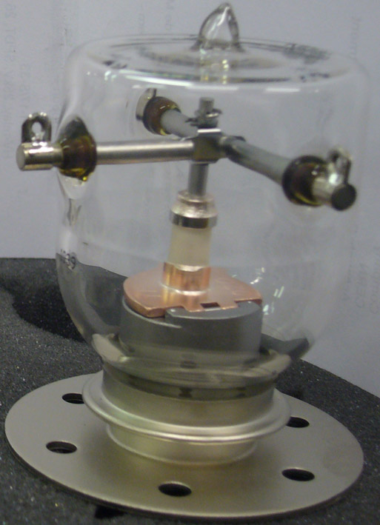
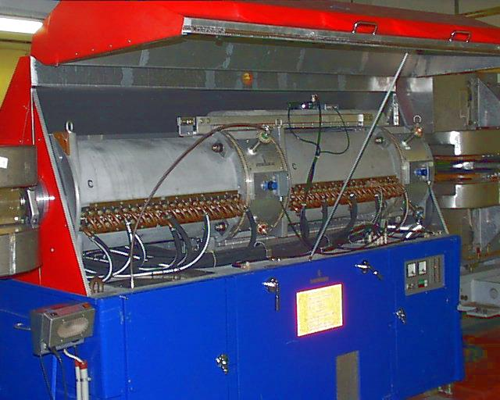
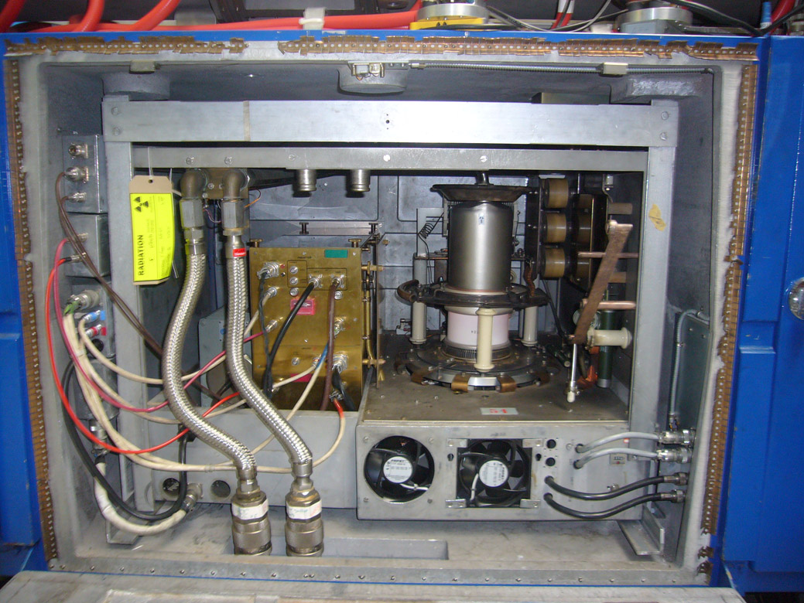
The 10 MHz system
Gap relay
Ferrite loaded cavity
Freq range 2.8 – 10 MHz
2 RF gaps / cavity
20 kV / cavity
Built in 1975, upgraded in 1988
RF amplifier adopting:
3 x YL1056 tubes in the feedback stage;
1 x RS1084 in the final stage.
Housed in the cavity base.

Slide 6
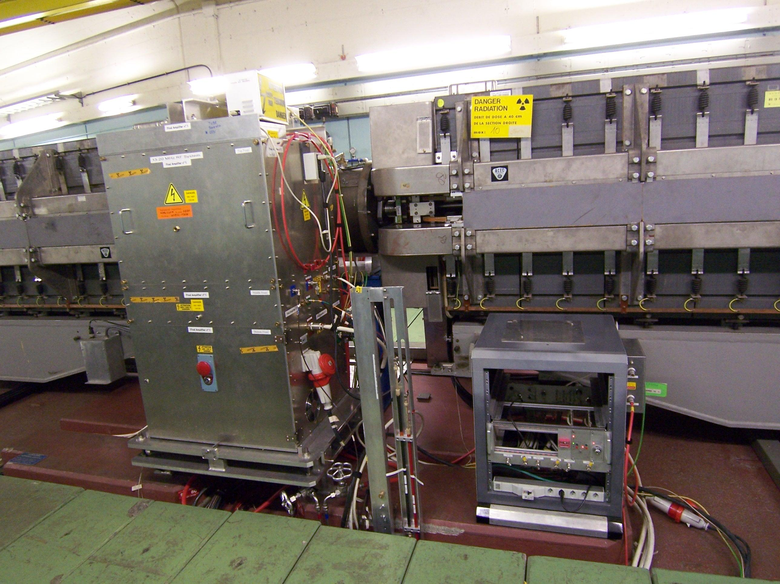
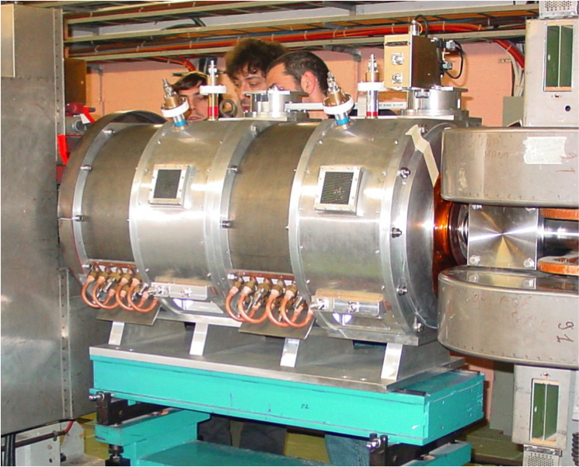
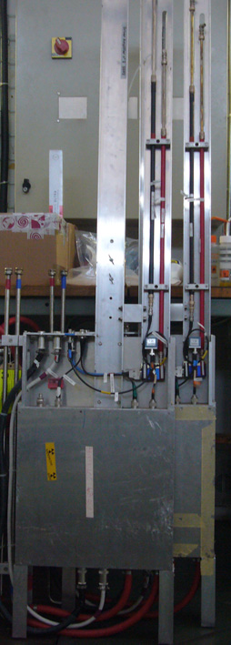
The 13/20 MHz system
Ferrite loaded cavity
Frequencies 13 or 20 MHz
2 RF gaps / cavity
20 kV / cavity peak
Built in 2002
Driver amplifier
Especially designed to slide in the gallery

Slide 7
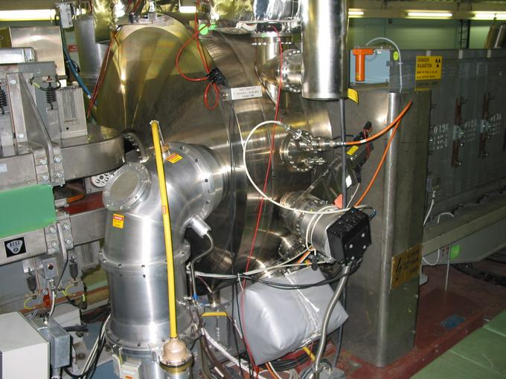
The 40 MHz system
Vacuum reentrant cavity
Frequency 40 MHz
1 RF gap / cavity
300 kV / cavity
Built in 1996

Slide 8
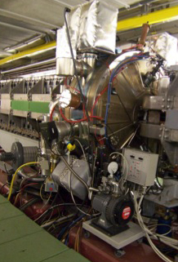
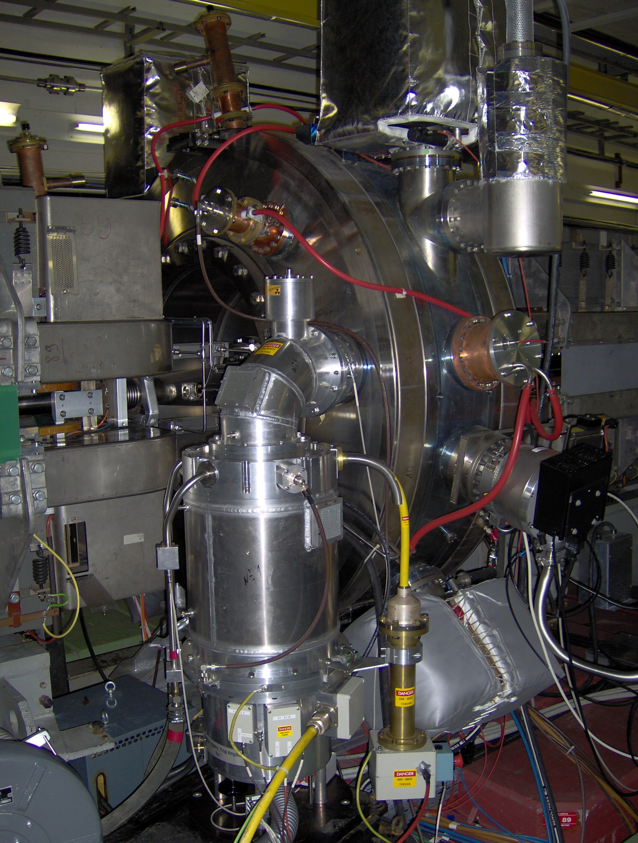
The 80 MHz system
Vacuum reentrant cavity
Frequency 80 MHz
1 RF gap / cavity
300 kV / cavity
Built in 1997

Slide 9
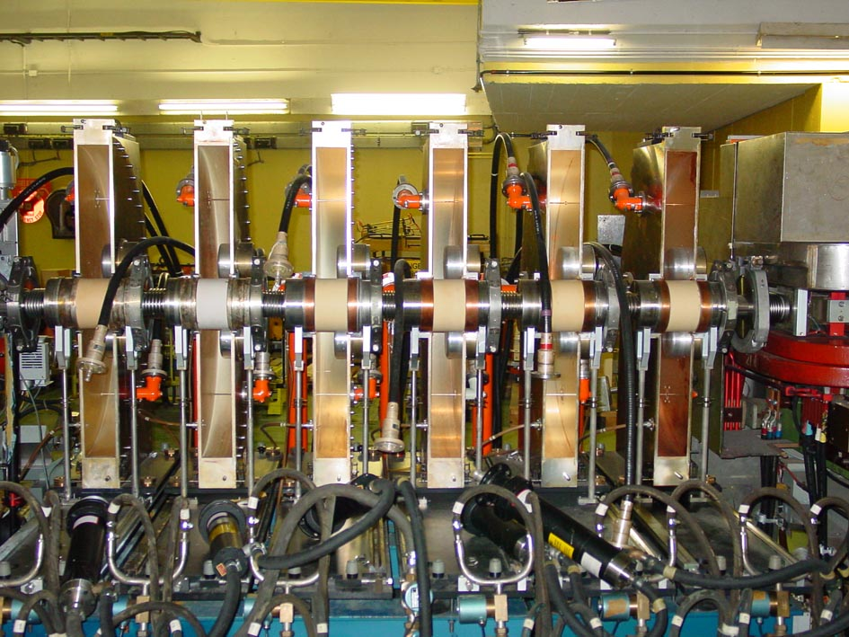
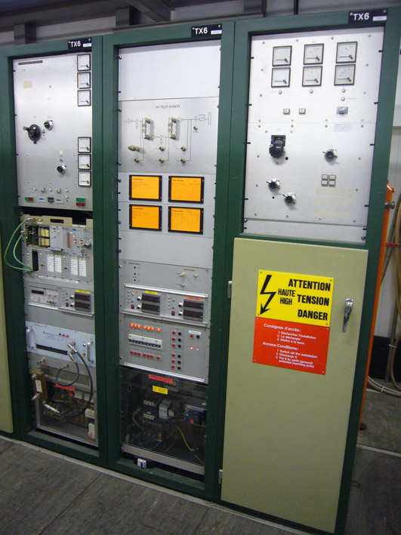
The 200 MHz system
Pill-box cavity
Frequency 200 MHz
1 RF gap / cavity
6 cavities
50 kV / cavity
Built in 1979
Amplifiers and HV power supplies partially renovated in 2005

Slide 10
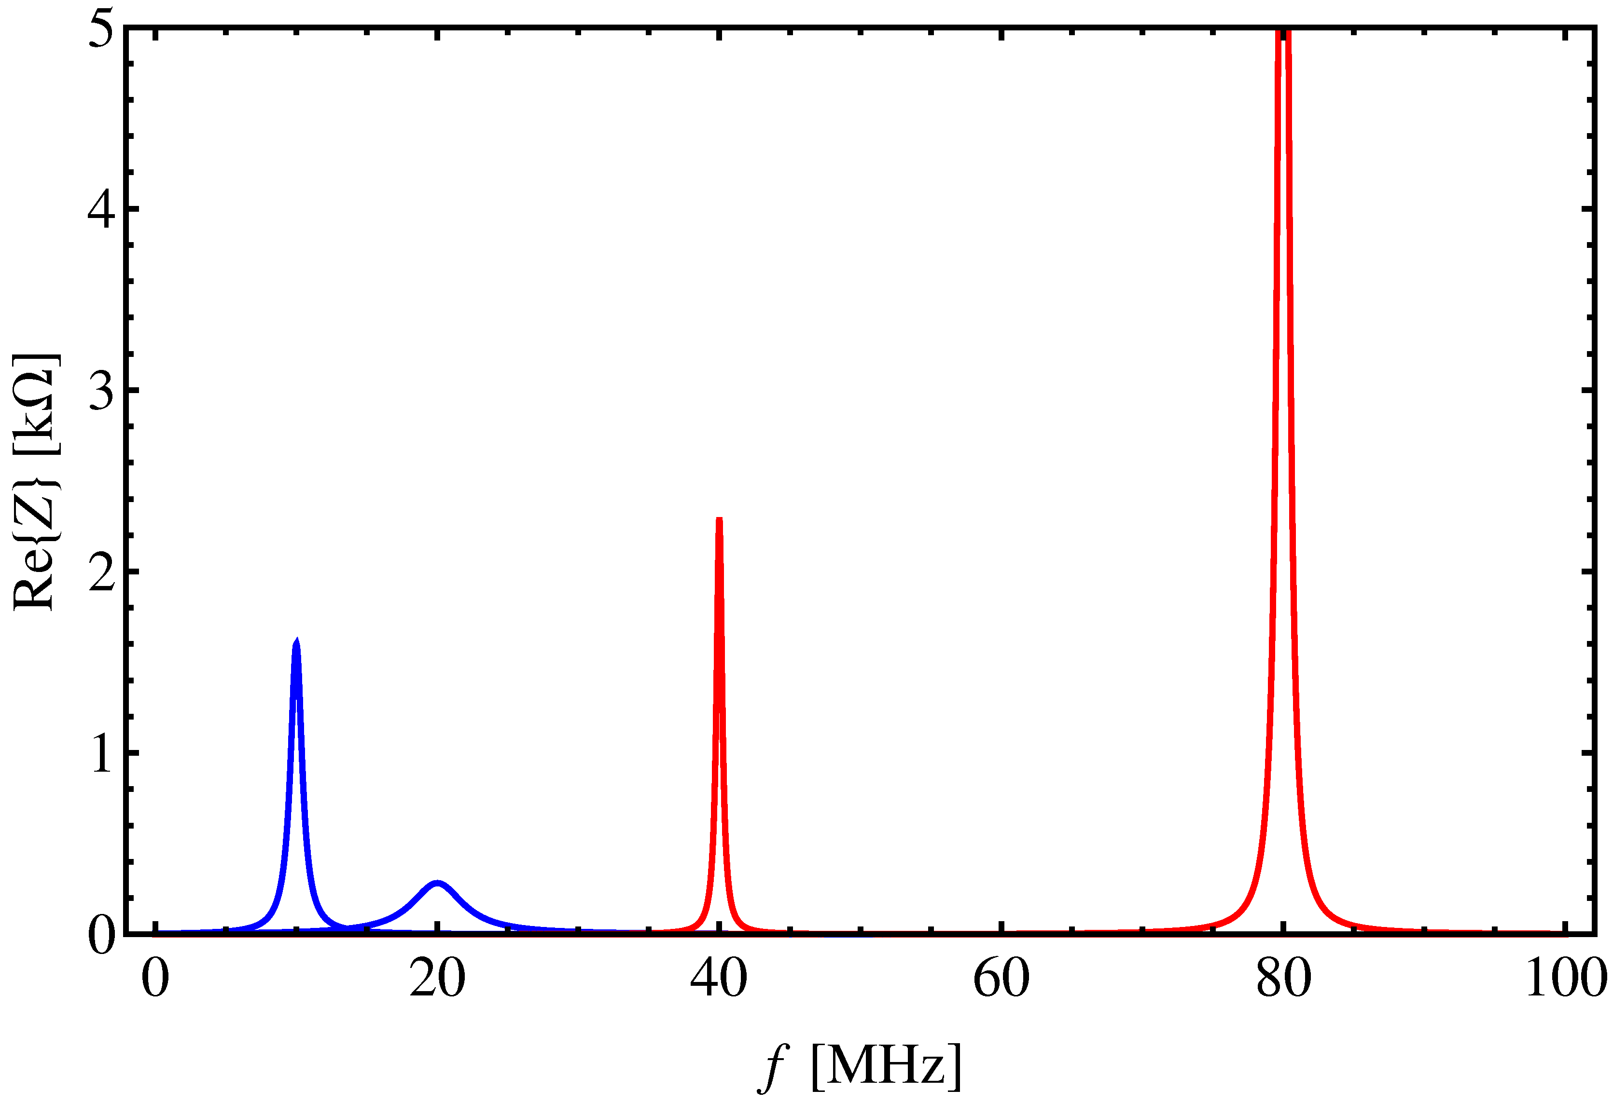
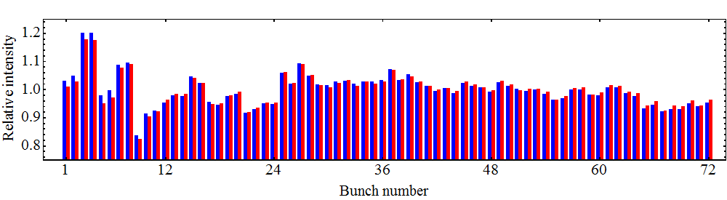
The PS Longitudinal phase space – CBI & TBL
LHC25, LHC50ns
80 MHz
10 x 10 MHz
h = 168
20 MHz, h = 42
40 MHz
h = 84
Bunch profile integral
Gauss fit integral
For more details see S. Hancock’s presentation, this LIU Event.

Slide 11
Possible remedies to PS longitudinal limitations
Main longitudinal limitations:
1. Coupled-bunch instabilities during acceleration and on flat-top
  New coupled-bunch feedback: based on 1-turn delay electronics
  Longitudinal kickers: 10 MHz RF cavities or dedicated wide-band cavity?
  Impedance reduction of all cavities, especially 2.8 – 10 MHz
2. Transient beam loading during bunch splitting manipulations
  Distributed issue: all RF systems for bunch splittings concerned
  10 MHz: new 1-turn delay feedback, new feedback amplifier or completely new amplifier?
  20 MHz: 1-turn delay feedback
  40 MHz: 1-turn delay feedback, new feedback amplifier?
  80 MHz: 1-turn delay feedback, new feedback amplifier, fast ferrite tuner?
H. Damerau’s presentation, LIU Event 2010.

Slide 12
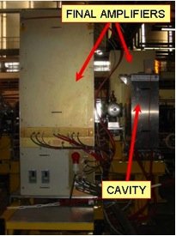
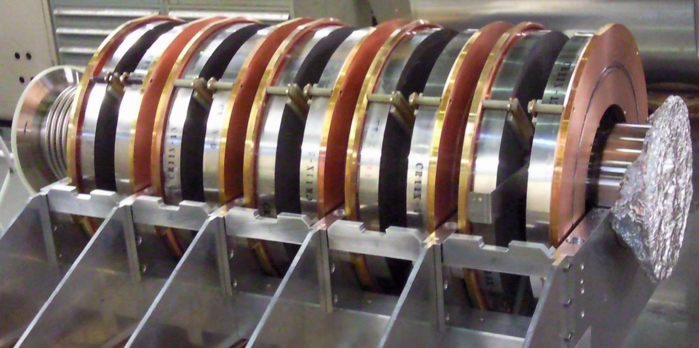
Some ideas for hardware developments
New 1-turn delay feedback around all systems would be beneficial for both CBI and TBL.
A dedicated wide band RF system using magnetic alloy rings in the resonator may result very effective in fighting CBI.
Prototype for PSBC04
RF cavity.
See M. Paoluzzi’s presentation, this LIU Event.
LEIR RF system operational since 2004, built in collaboration with KEK.

Slide 13
10 MHz developments
A new 1-turn delay feedback around the 10 MHz system is already in the pipeline.
If possible, an increase of the amplifier fast feedback beyond the present 26 dB could significantly reduce further the cavity impedance seen by the circulating beam.
Final amplifier
Feedback amplifier
(pre-driver + driver)

Slide 14
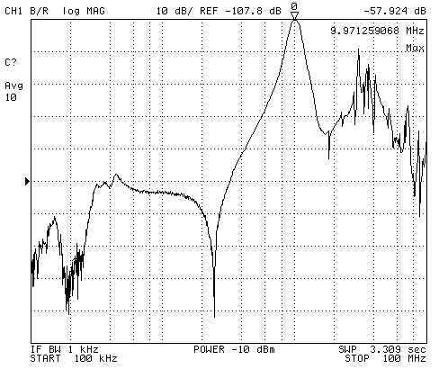
10 MHz developments – feedback increase limitations from the present architecture
Test performed in 2001 to replace the pre-driver stage with a solid state amplifier.

Slide 15
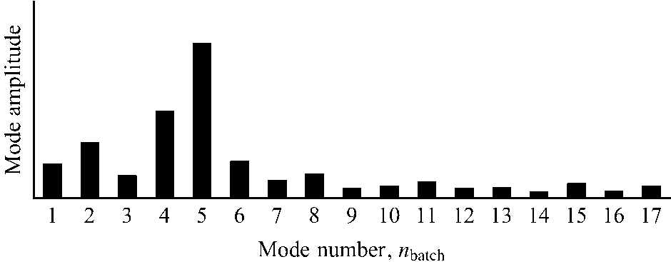
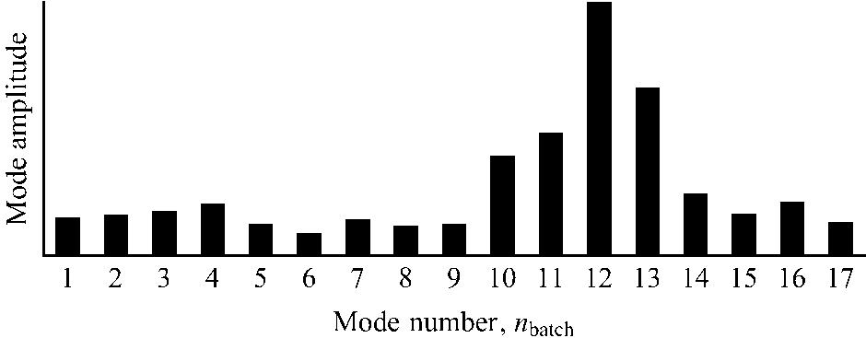
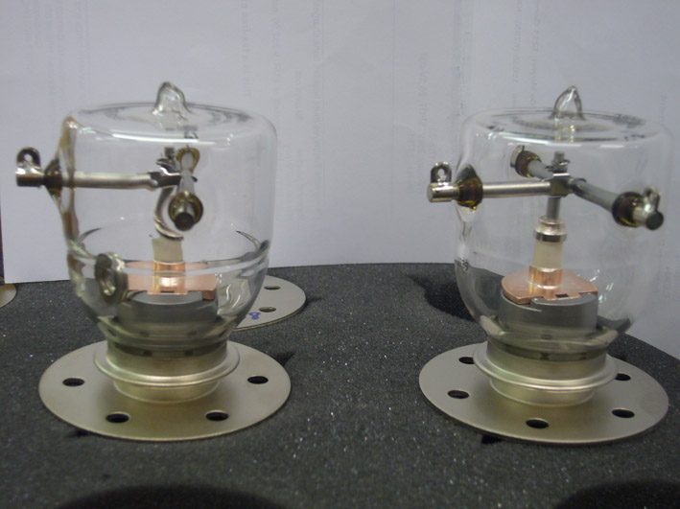
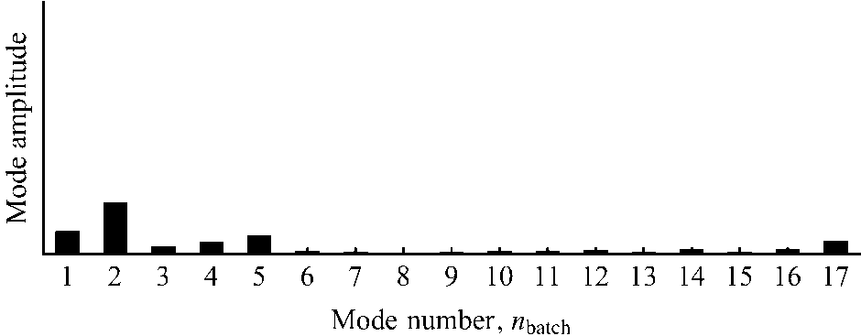
10 MHz developments – second gap relay installed in 2011
Both gap relays close
Only one relay closes
Modes appear at same frequency
With one gap relay closed and 8/10 cavities parked at h=6.5 the result is much more impressive.

Slide 16
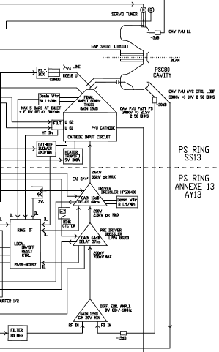
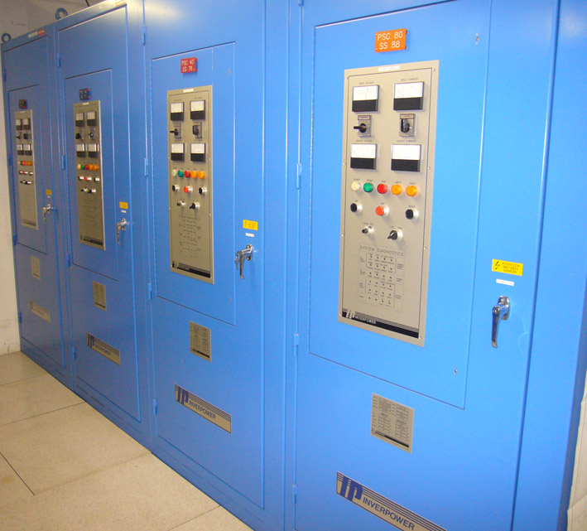
40/80 MHz developments – feedback increase
Long cable length from the cavity to the feedback amplifier and back to the final amplifier (120 ns) is a limit to push the feedback beyond the present performance (43 dB) .
A second limitation comes from the HV power supplies, already limiting the present performance of the system in the presence of high beam loading or cavity detuning.

Slide 17
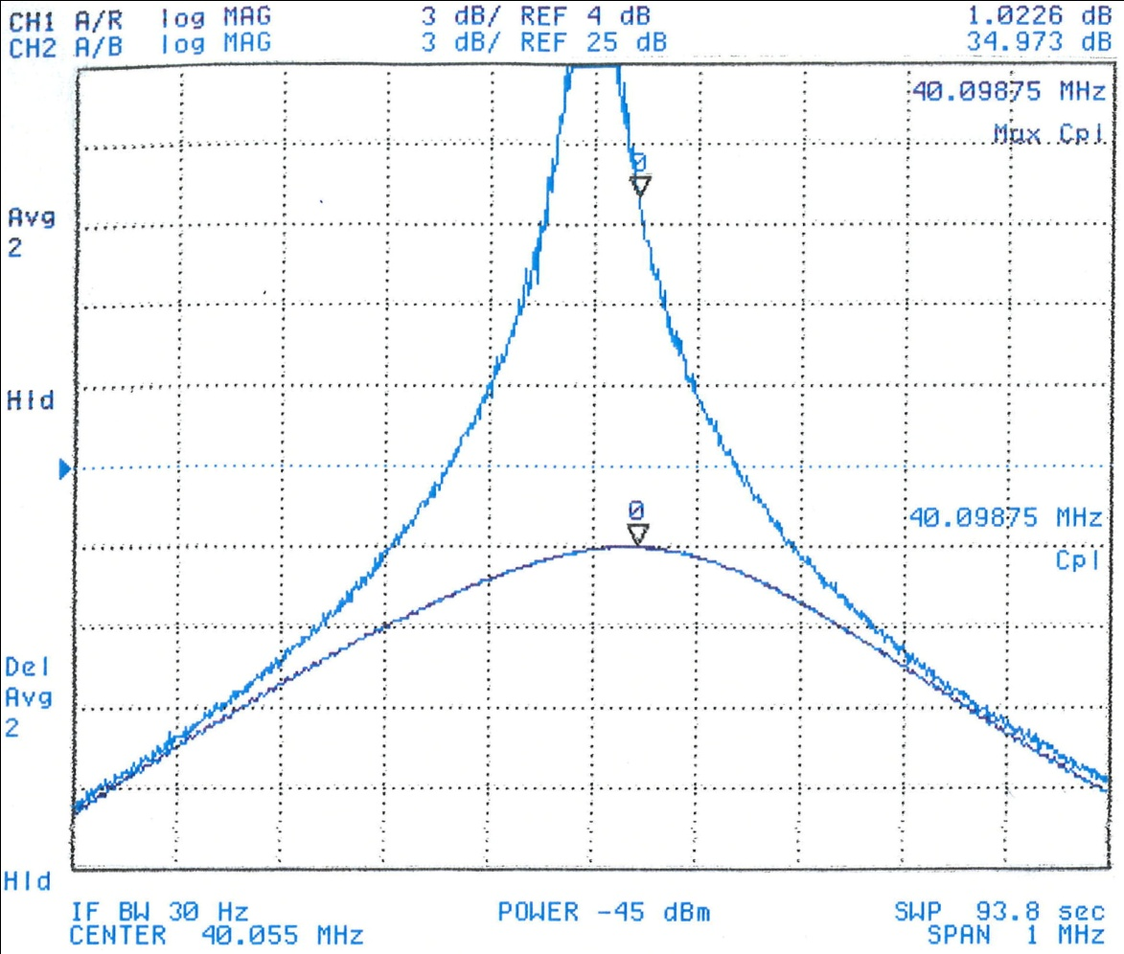
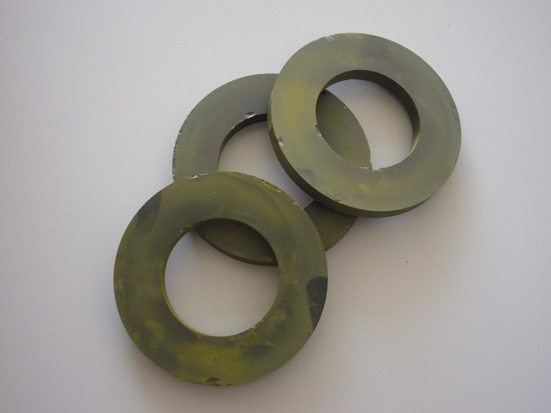
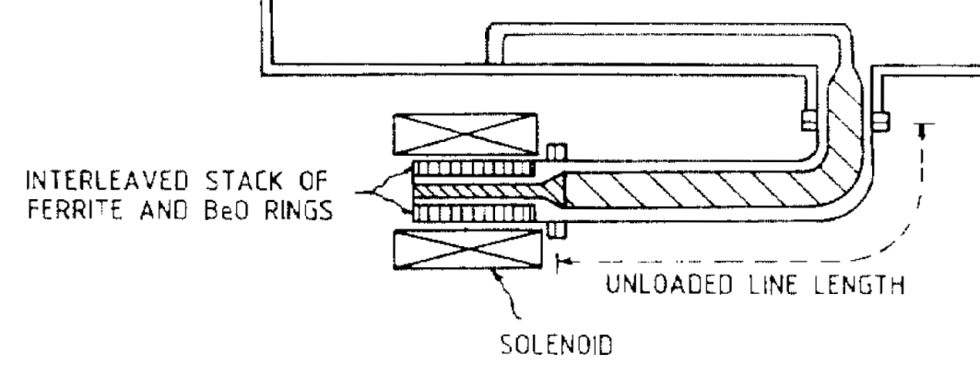
40/80 MHz developments – cavity detuning
Mechanical gap relay cannot be used in a pulse to pulse operation to reduce the cavity impedance seen by the beam (pneumatic actuator).
f_{rev}
Use perpendicularly biased ferrites to build a fast tuner.
By parking the cavities at an intermediate frequency (250 kHz off resonance) 2 to 4 dB could be gained in impedance reduction.

Slide 18
Some planning and what is already in the pipeline
Activity | Schedule | Status
LLRF studies | 05/2011 – 06/2012 | active
1-Turn delay feedback | 01/2012 – 12/2014 | active
Coupled bunch feedback | 06/2014 – 06/2016 | planned
HLRF studies | 05/2011 – 12/2012 | active
10 MHz system renovation | 01/2013 – 06/2018 | planned
Longitudinal kicker in the PS | 01/2014 – 12/2017 | planned
40/80 MHz feedback renovation | 06/2012 – 06/2017 | planned
Fast tuner for the 80 MHz system | 01/2012 – 12/2015 | active

Slide 19
Concluding remarks
The final choice among the possible optional developments will depend on experimental results from MD studies and operational decisions;
A prioritized list of interventions will be decided soon, depending on impact, available resources and possibility of success;
Aspects related to the maintenance of equipment and to the application of the ALARA principle will be a relevant factor in the decision process;
The R&D program will be anyway strongly dependent on available resources and on manpower, in particular.

