Slide 1
PSB to PS beam transfer
J. Borburgh,
W. Bartmann, S. Gilardoni, B. Balhan, D. Bodart, B. Goddard,
M. Hourican, A. Newborough, L. Sermeus, R. Steerenberg, S. Pittet, C. Yu
J. Borburgh, LIU day, 25 November 2011

Slide 2
Outline
Booster extraction
BT - line
BTP – line
PS injection
Summary
J. Borburgh, LIU day, 25 November 2011

Slide 3
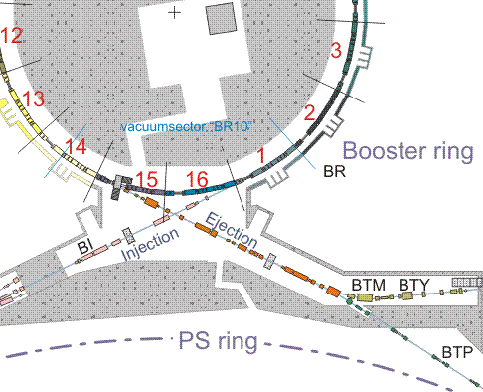
Beam transfer from PS Booster to PS
Extraction at PSB:
increase element strength to 2 GeV of extraction kickers and septa

Slide 4
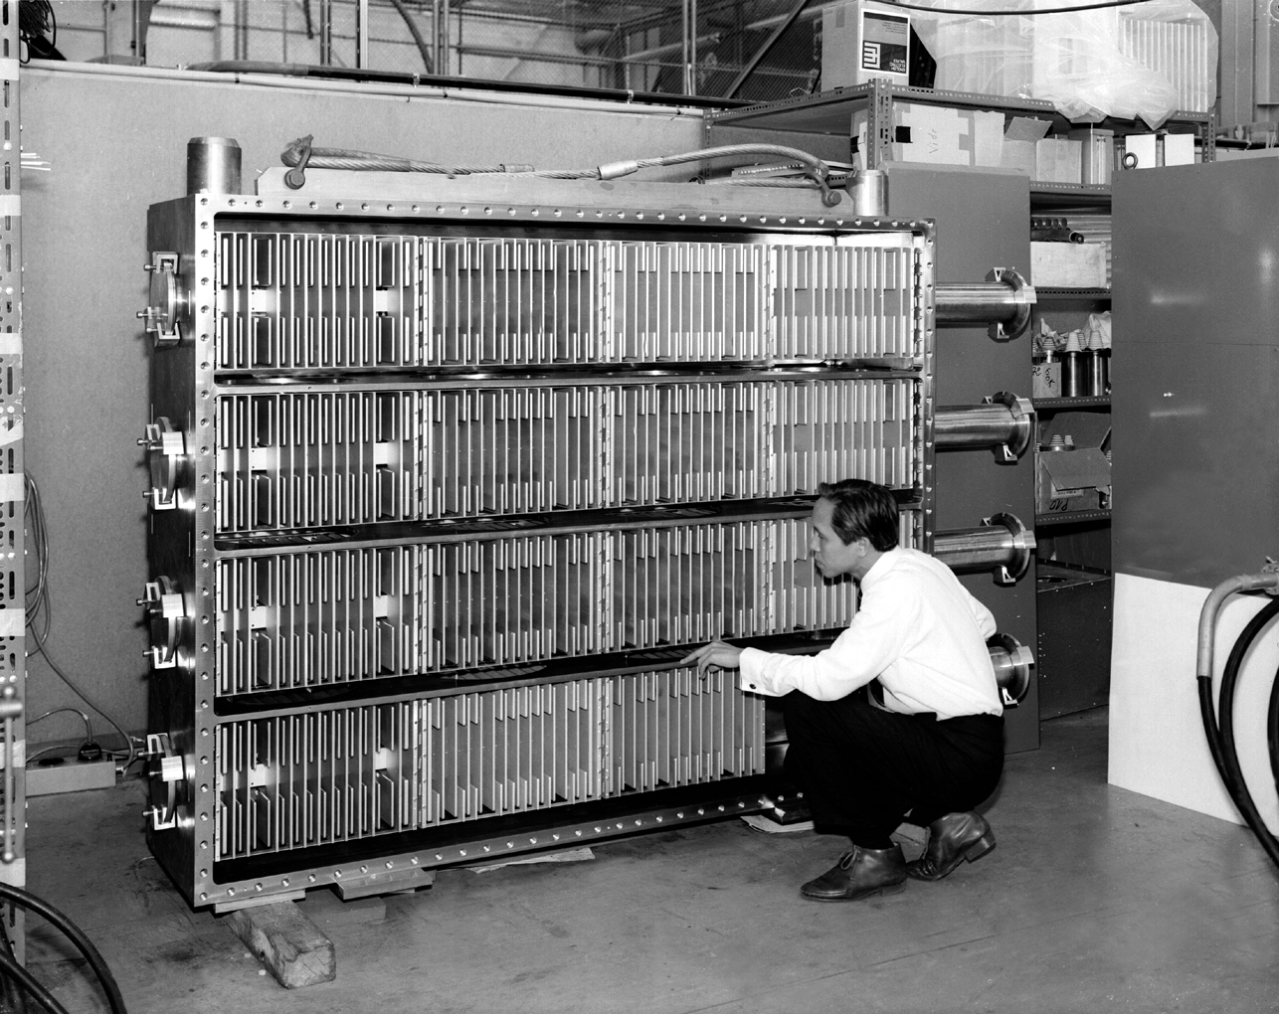
PSB extraction kickers KFA14L1
Magnets installed under vacuum.
4 delay line magnets in parallel (Z₀ = 25 Ω) per booster ring.
1 generator per booster ring.
Gas filled Pulse Forming Line rated at 60 kV.
V_{PFL} (@1.4 GeV): 42.5 kV
V_{PFL} (@2 GeV): 55 kV
At 2 GeV actual magnets would saturate.
  Conclusion:
    New extraction kickers required.

Slide 5
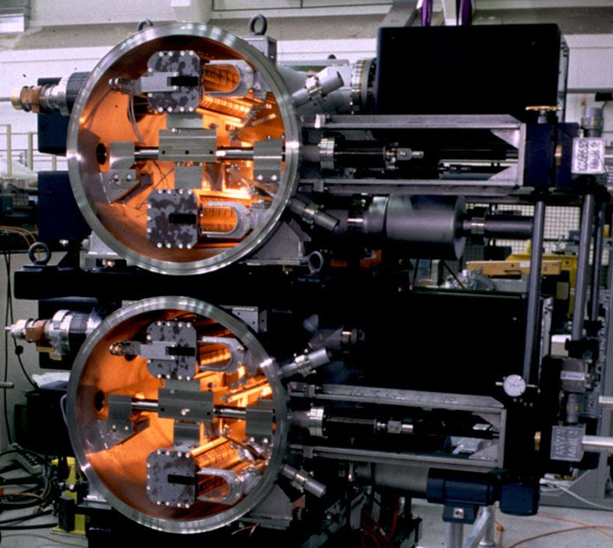
Booster Extraction septa (BE.SMH)
Under vacuum, laminated steel magnets; Strength increase obtained by increase of the nominal current. Modifications required to cooling and electrical connections.
 | 1.4 GeV | 2 GeV
B_{gap} (T) | 0.35 | 0.46
I_{nominal} (kA) | 7.2 | 9.4
Physical length (mm) | 1000 | 1000

Slide 6
Outline
Booster extraction
BT - line
BTP – line
PS injection
Summary
J. Borburgh, LIU day, 25 November 2011

Slide 7
BT recombination line
BT
Fundamental characteristics:
Presently the line can switch cycle to cycle (ppm) between 1.0 GeV to 1.4 Gev.
After the upgrade the line will be ppm between 1.4 GeV to 2.0 GeV.
No fundamental optics changes foreseen for the upgrade.
Modification of switching dipole BHZ 10 towards the BTP line.
Upgrade of recombination septa,
Kickers are already capable to deflect 2GeV beam.

Slide 8
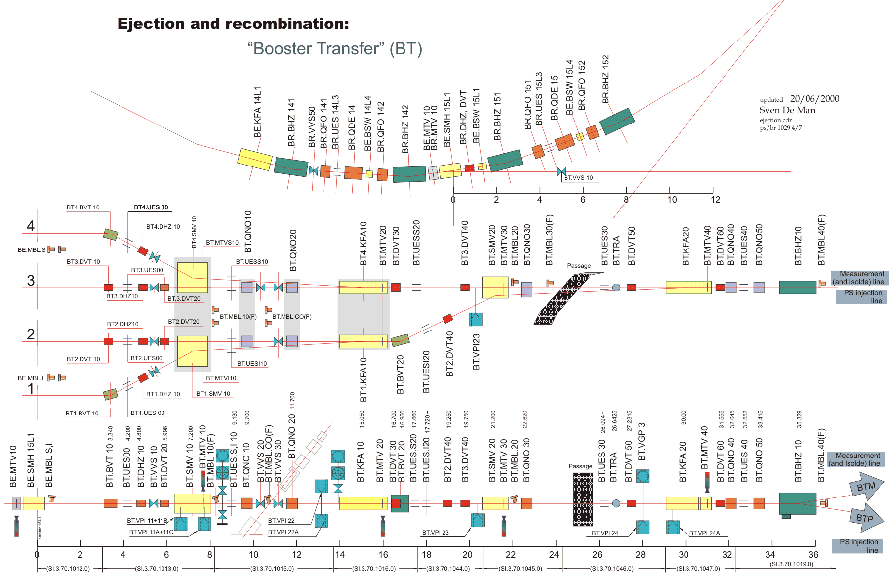
BT (booster recombination) line
Notes:
For the recombination kickers KFA 10 a spare will be built. Both the KFA10 as well as the KFA20 can handle 2 GeV beams.

Slide 9
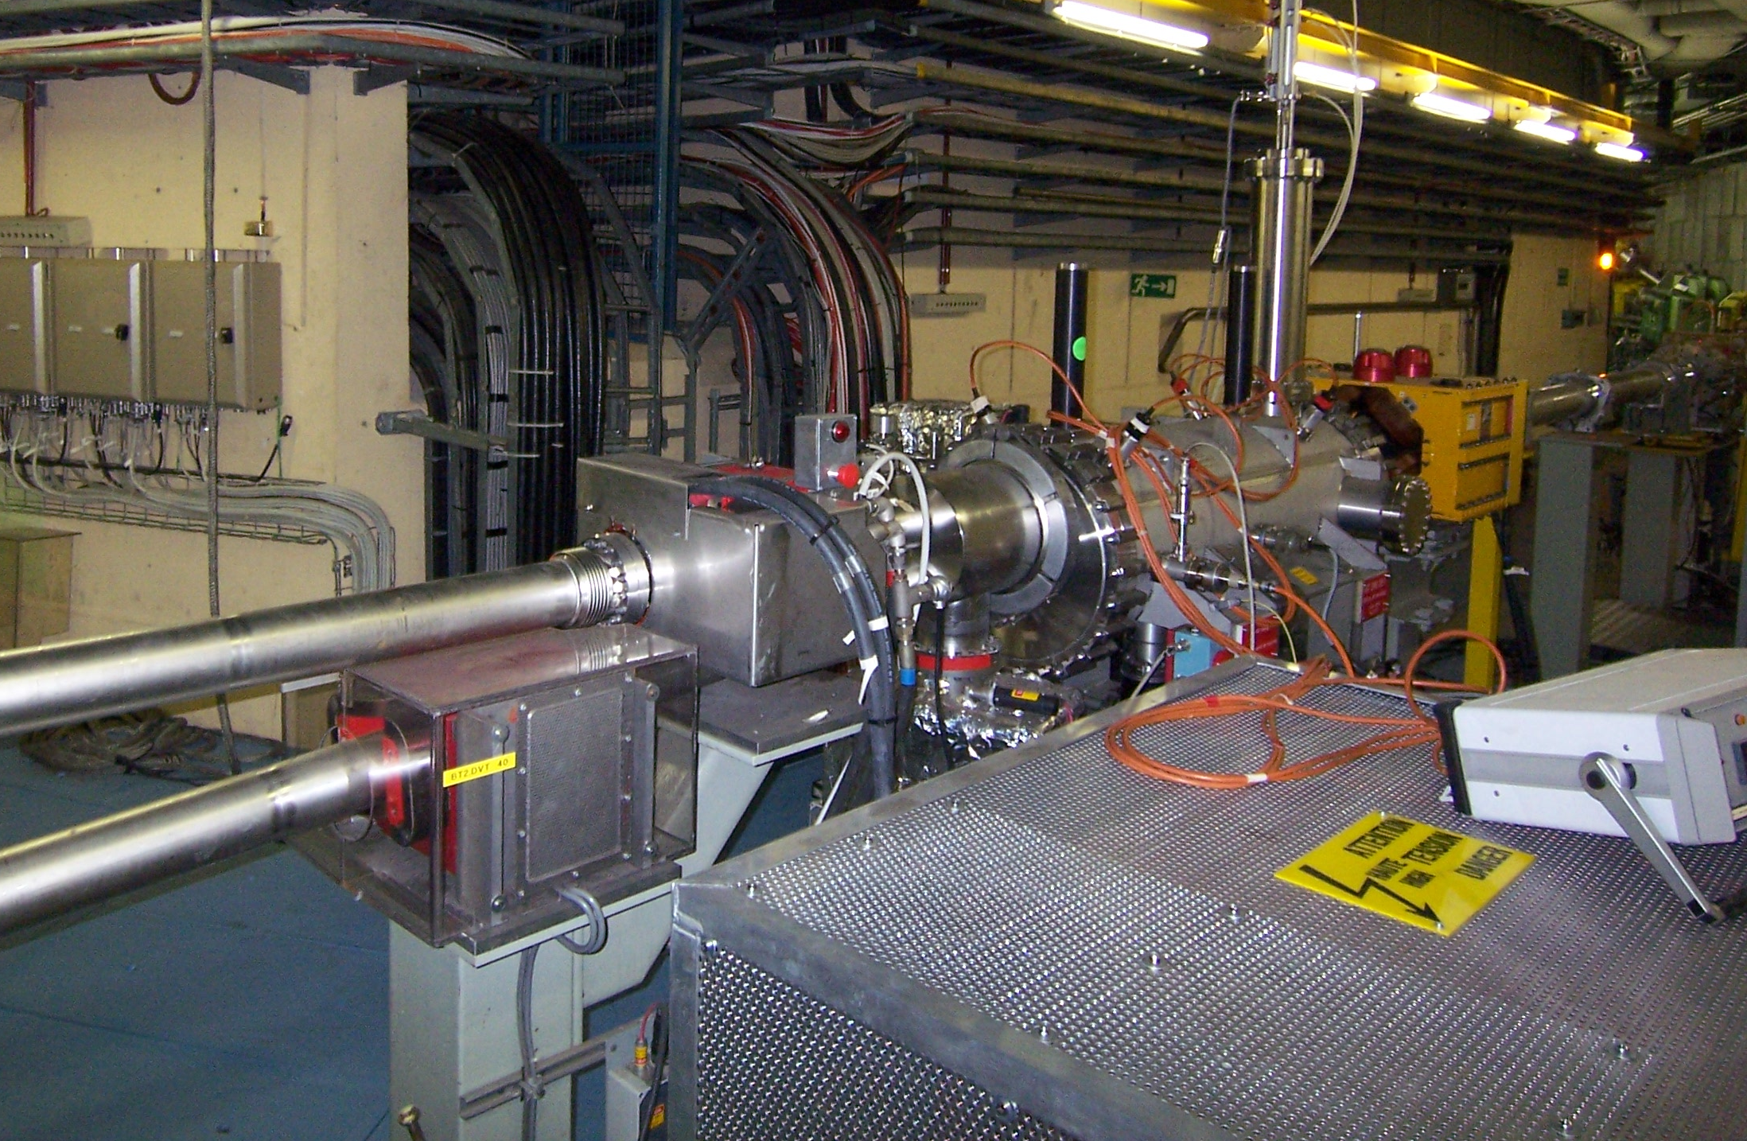
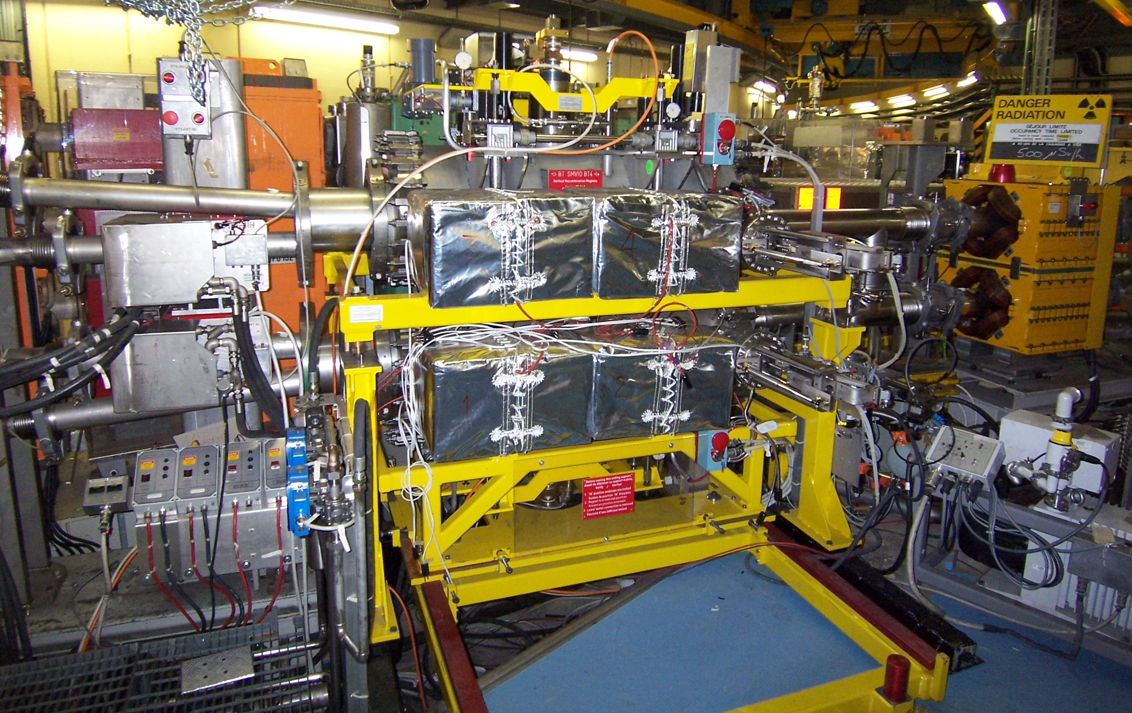
Recombination septa
Under vacuum magnetic septa. Increase in strength will be achieved mainly by increasing the length of the magnet. The vacuum vessel will remain unchanged.
 | Present 1.4 GeV | 2 GeV
B_{gap} (T) | 0.57 | 0.6
I_{nominal} (kA) | 27.3 | 28.6
Physical length (mm) | 1060 | 1300
Magnetic length (mm) | 997 | 1237

Slide 10
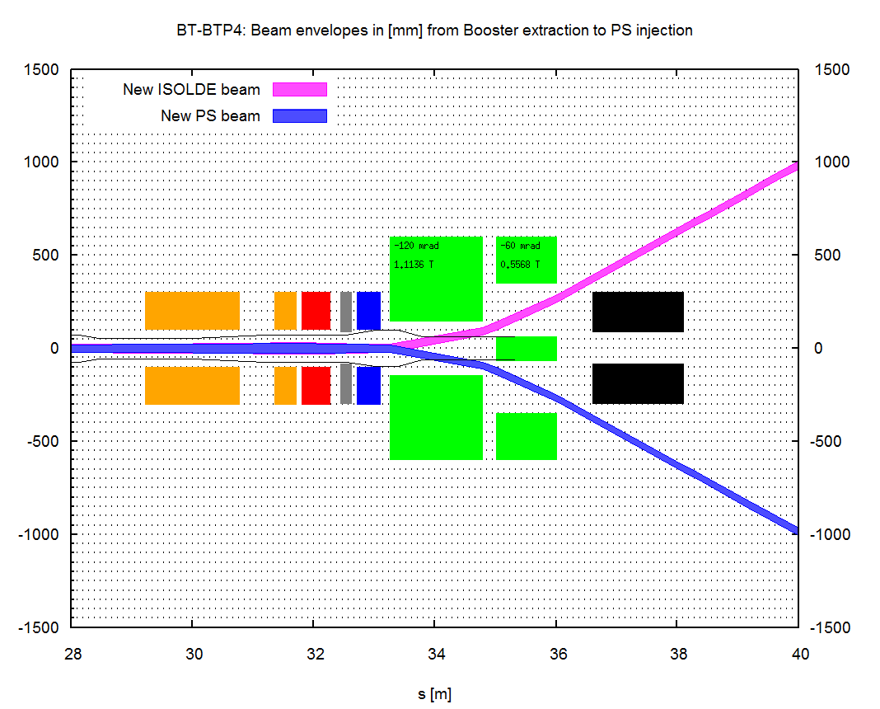
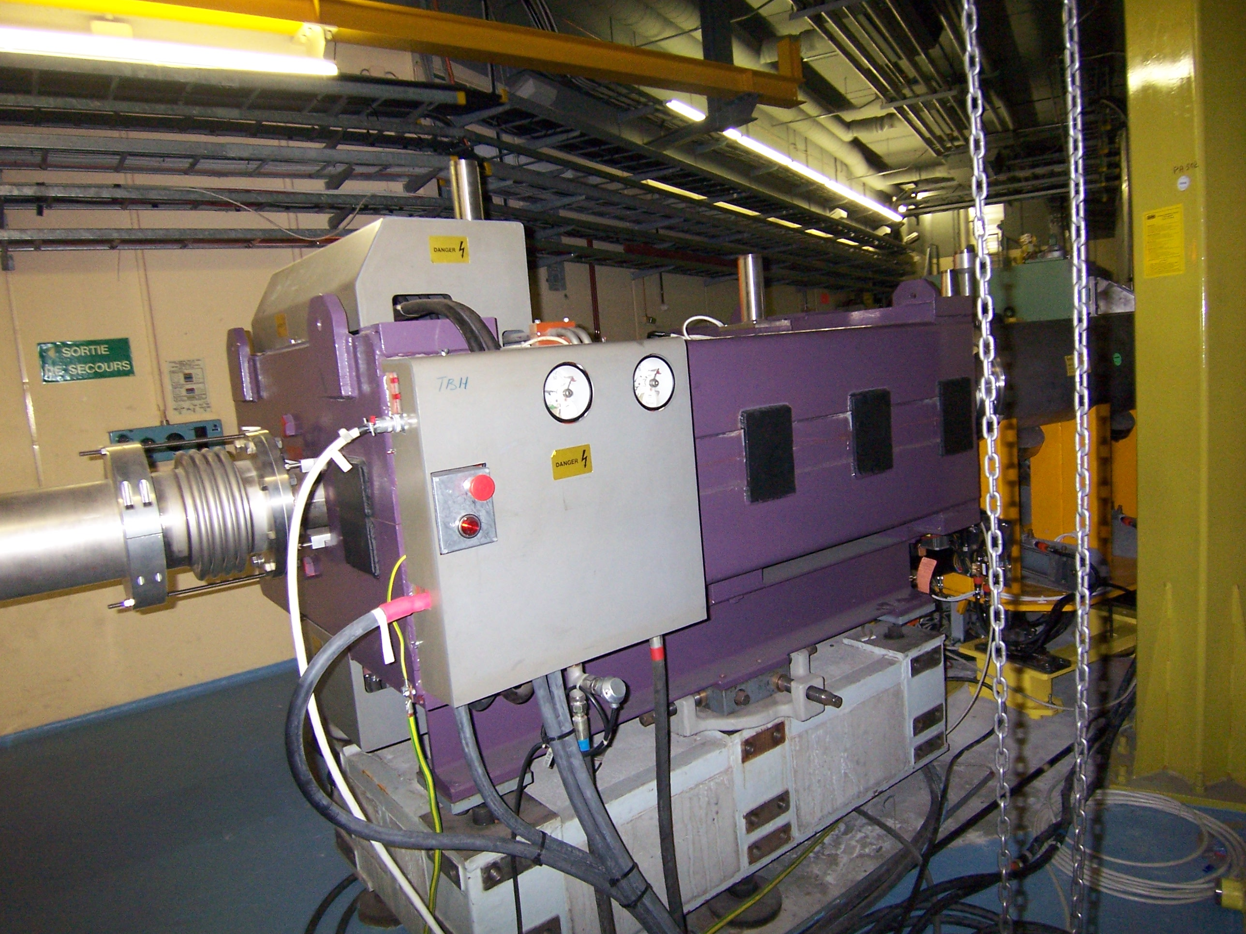
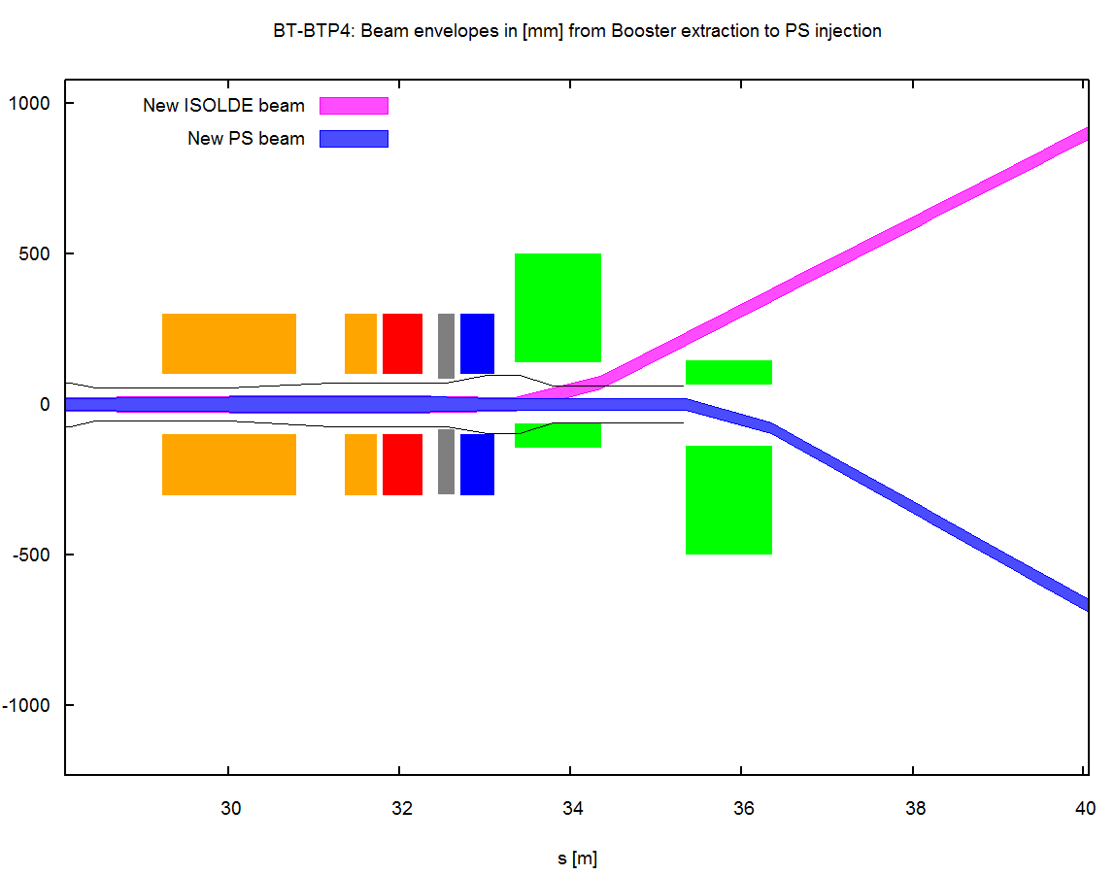
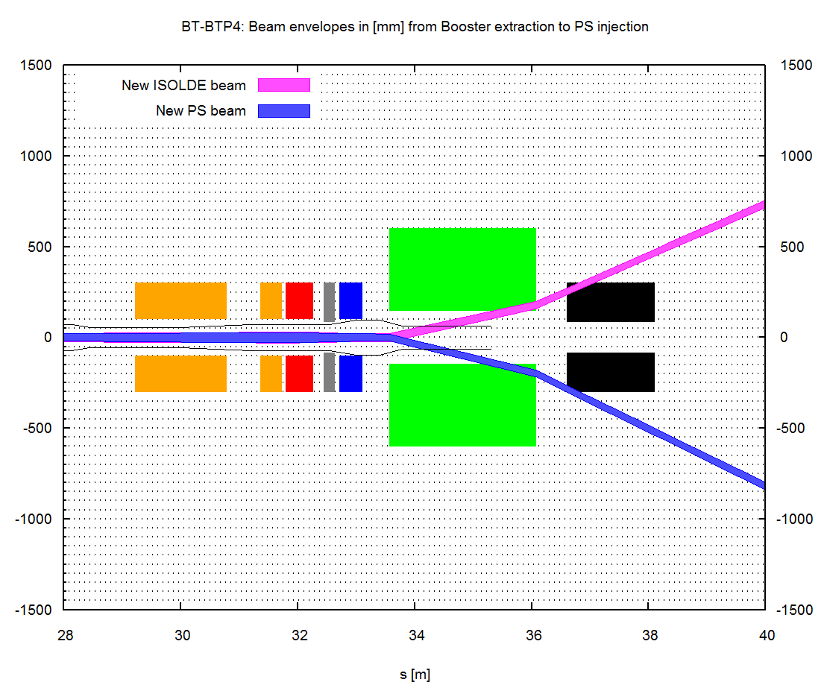
Switching dipole towards BTP line
3 solutions for BHZ 10 under investigation.

Slide 11
Outline
Booster extraction
BT - line
BTP – line
PS injection
Summary
J. Borburgh, LIU day, 25 November 2011

Slide 12
BTP (Booster to PS) line
Fundamental characteristics:
Presently a DC line.
Will become ppm between 1.4 GeV to 2.0 GeV
Optics will be adjusted as a function of beam type (LHC vs. High intensity)
New optics
avoids use of elements installed in the PS wall.
needs 1 additonal quadrupole on PS side
May include collimation to limit activation of PS injection septum

Slide 13
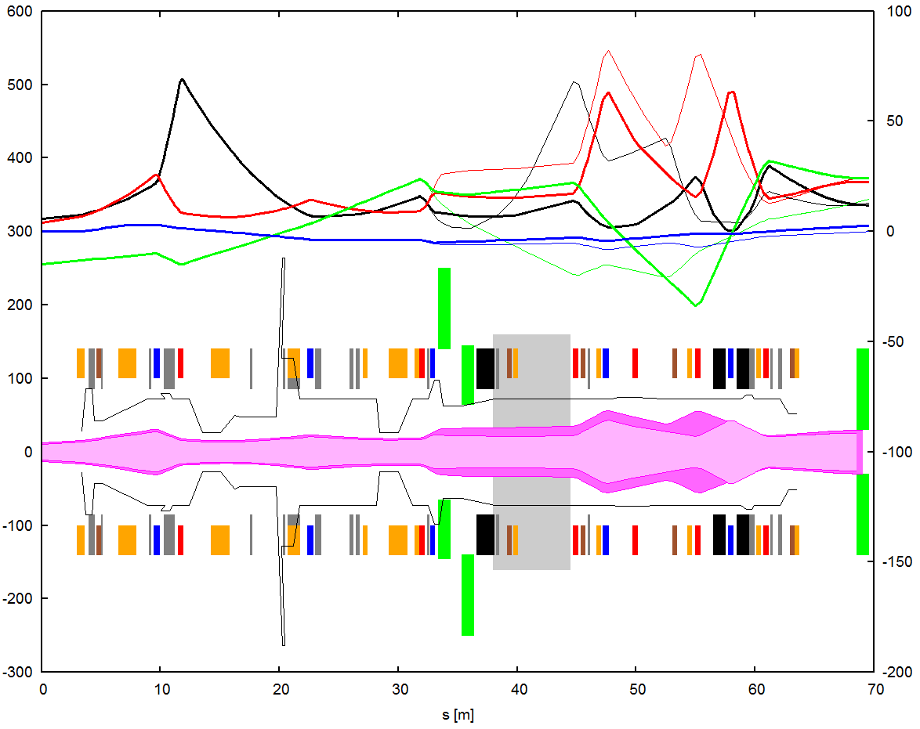
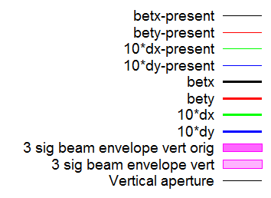
BTP line optics with matched optics (LHC)
Beta, Disp [m]
Note the vertical aperture limitation at PS injection
Y [mm]
Vertical beam size at SMH42 slightly smaller than present one but losses expected
ε_{n} (h/v) = 12/9 μm
Δp/p = 1.3e-3
BTP line optics for High Intensity beam profiles in vertical plane

Slide 14
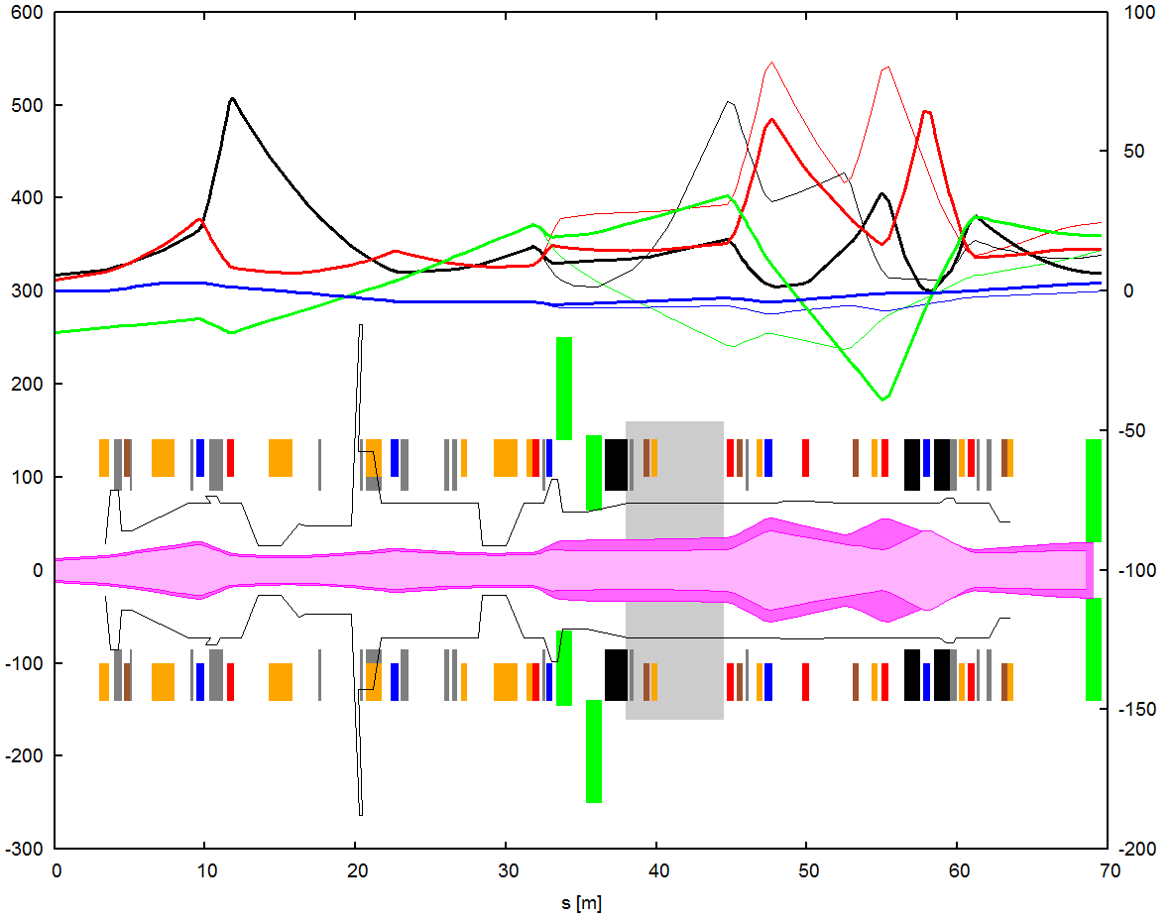
BTP line optics with reduced beam size at PS entrance
Beta, Disp [m]
BTP line with reduced beam size HI optics.
Y [mm]
Vertical beam size at SMH42 reduced w.r.t. to LHC and present settings
ε_{n} (h/v) = 12/9 μm
Δp/p = 1.3e-3
BTP line optics for High Intensity beam profiles in vertical plane

Slide 15
Principal characteristics BTP line
Transfer line LHC optics
  Horizontally matched
  Vertical dispersion mismatch reduced for BT1/2, same for BT3 and increased for BT4
  Envelopes and expected losses OK
Transfer line HI optics
  With LHC settings too big envelopes (also for 2 GeV beam)
  Optics detuned to squeeze HI beam into SMH42
  SMH42 losses should be significantly reduced
PS injection: looking into squeezing HI at injection.
  Low β insertion around septum using γ-jump quads not possible
  Low β insertion with QKE’s under study
Notes:
MD requested to validate LHC-beam injection using KFA 45 in short circuit mode.

Slide 16
Outline
Booster extraction
BT - line
BTP – line
PS injection
Summary
J. Borburgh, LIU day, 25 November 2011

Slide 17
PS injection
LHC beam injected using new septum and existing kicker
High Intensity beams injected using new septum, existing plus new kicker
PS injection optics, using 5 bumpers, KFA45 and KFA53.

Slide 18
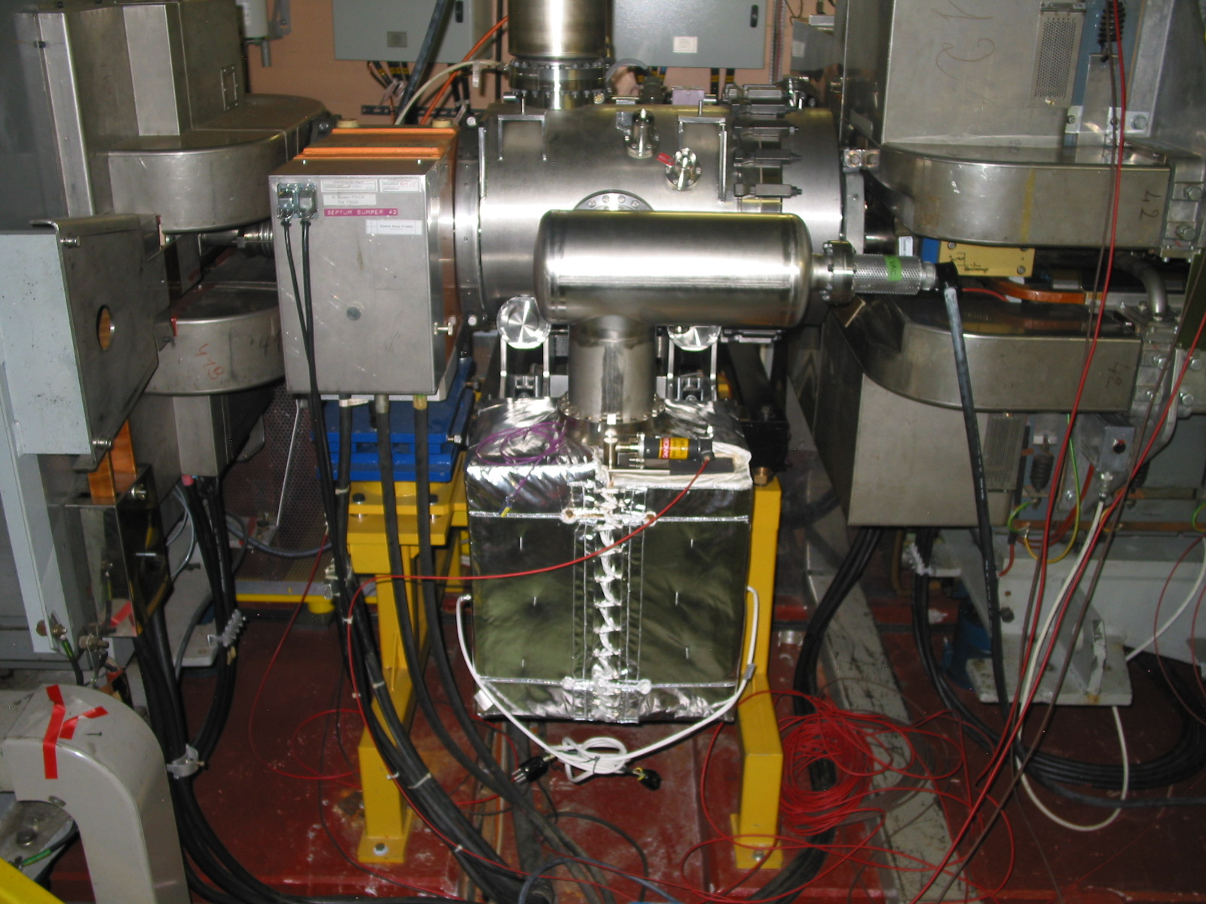
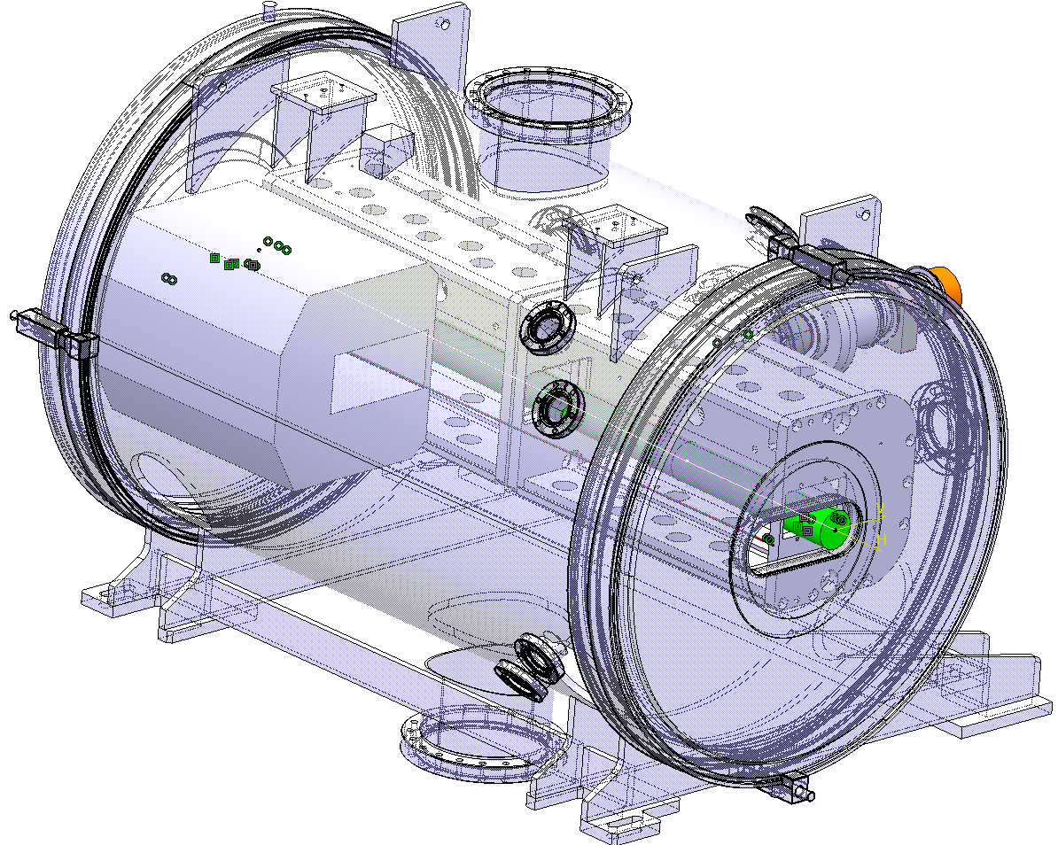
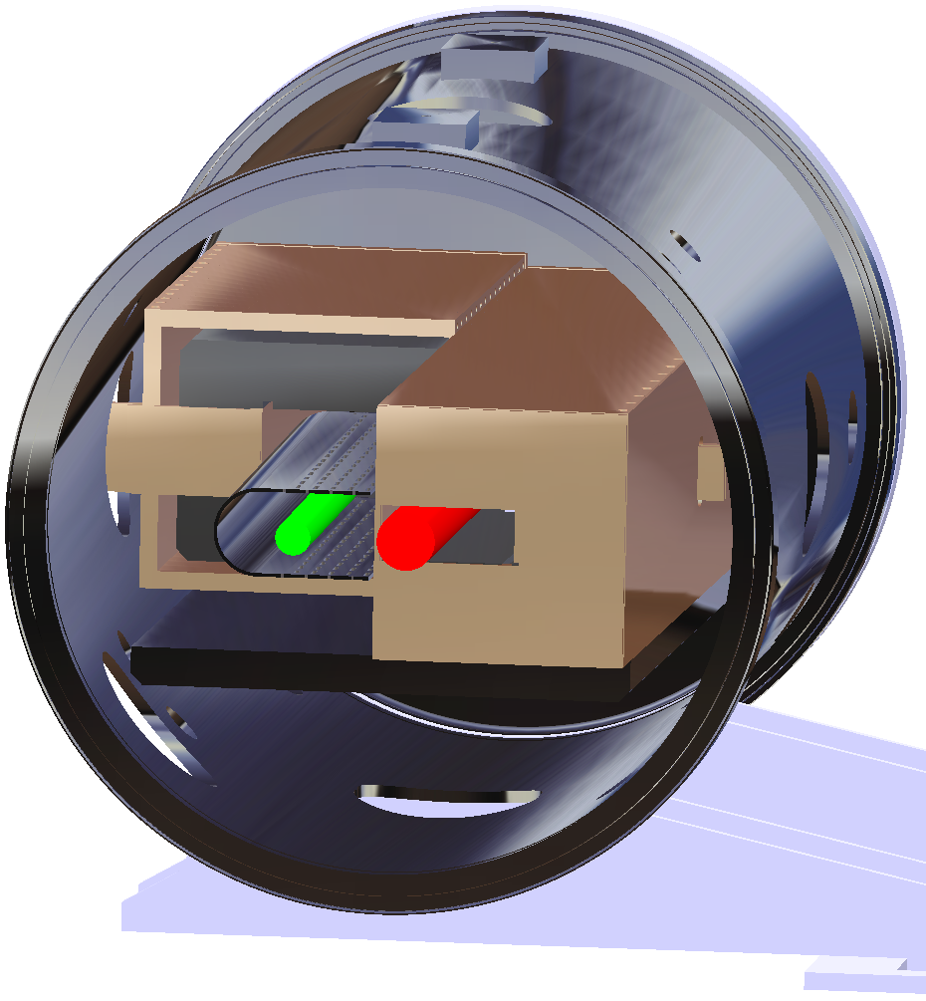
PS Injection septum 42
Concepts developed:
direct drive (left)
eddy current (right) variants
Less experience at CERN with eddy current devices, but possibly more robust (R&D required).
 | 1.4 GeV | 2 GeV
B_{gap} (T) | 0.7 | 0.7
I_{nominal} (kA) | 33.5 | 33.6
Physical length (mm) | 620 | 790

Slide 19
PS Injection bump
Strive for shorter injection bump to limit the continuous losses. Feasibility still to be investigated.
5 magnets will be needed instead of 4:
  4 outside vacuum multi-turn bumpers
  1 under vacuum single turn magnet installed in injection straight section
Delay in field between outside vacuum and under vacuum bumpers being investigated at present.
Tracking precision between different bumpers challenging for power supplies.

Slide 20
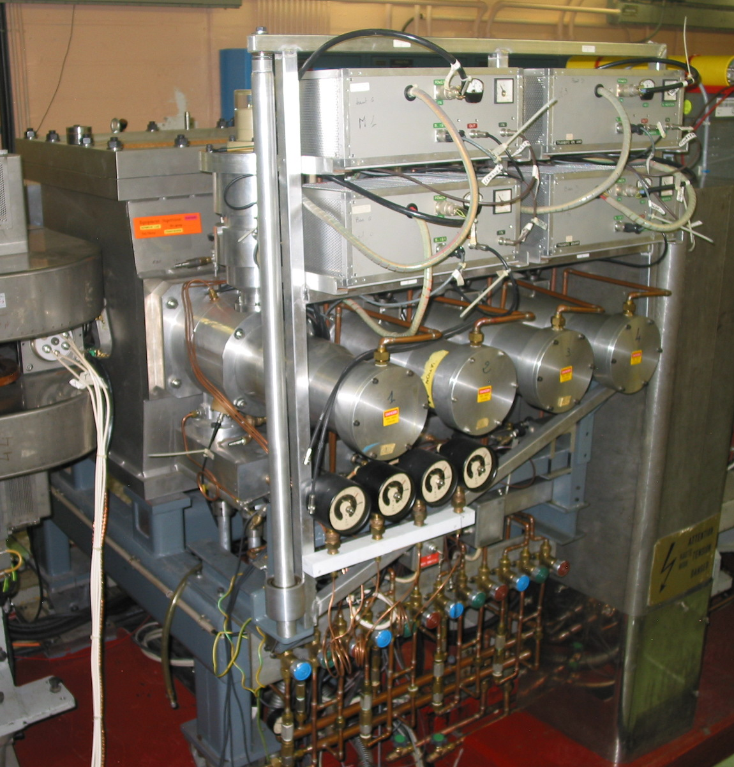
PS injection kickers KFA 45
4 kicker modules installed under vacuum.
Gas filled Pulse Forming Line rated at 80 kV.
Can be used in short circuit or terminated mode:
V_{PFL} (@1.4 GeV): 80 kV (limit of system);
V_{PFL} (@2 GeV): only in short circuit mode, 60 kV;
Drawbacks of short circuit mode:
    flattop ripple from ± 2 % to ± 3;
    post pulse ripple from ± 1.25 % to ± 1.5 %;
    rise time (2-98)% from 42 to 68 ns;
    fall time (98-2)% from 68 to 87 ns;

Slide 21
New to build PS injection kicker KFA 53
Additional short and fast kicker required.
Development will start next year.
 | nominal | maximum
Deflection angle [mrad] | 1.2 | 1.5
∫B.dl [mT.m] | 11.5 | 13.9
PFL voltage [kV] | 23.8 | 29.7
Magnet current [A] | 793 | 991
No of magnets | 4
Magnet impedance [Ω] | 30
Magnet gap (w×h) [mm²] | 140 × 59
Magnet length [mm] | 158

Slide 22
PS injection optics
Creation of a low β region at the injection septum to limit the continuous losses during injection being studied.
Study using QKE’s and verification of PS acceptance with 2 GeV beam injected.
PS injection region

Slide 23
Outline
Booster extraction
BT - line
BTP – line
PS injection
Summary
J. Borburgh, LIU day, 25 November 2011

Slide 24
Summary
Hardware to be modified is identified and its feasibility studied.
2 different optics of the transfer line are required for LHC (matched) and
High Intensity beams (reduced beam size at entrance of PS).
BTP line to be re-designed, taking into account new BHZ10 layout and
possibly collimation.
PS injection optics under study to create a low β insertion around septum.
Main challenges:
Injection septa (septum and bumper).
Injection bumper tracking precision (power convertors, magnets).
Additional PS injection kicker with high strength, very limited space and fast rise and fall time requirements.

