Slide 1
Beam Gymnastics and LLRF in the PS
S. Hancock
The remarkable versatility of the PS machine comes at the price of the complexity of its rf beam controls, which never cease to evolve. Historically, these systems have not only been maintained, but, to a large extent, have also been operated by the specialists who put them together. What impact will the LIU project have?

Slide 2
Overview
PS BEAM CONTROLS
Label | Harmonics | Source | Role
H8H16 | 8, 16 | DDS | General medium- and high-intensity beams (>1E11 ppb)
H16LI | 16 | DDS | Low-intensity beams, including LHC probe
HSWP | 8, 9, 11, 13, 15, 17, 20 | MHS | Antiproton production beam
H21, H84 | 7, 14, 21, 28, 42, 84, 168 | MHS | LHC-type multi- and single-bunch beams
H24, H169 | 12, 14, 16, 21, 24, 169 | MHS | Ion beams for LHC
___________>500 modules ¯¯¯¯¯¯¯¯¯¯¯
PS RF CAVITIES
Cavity | Quantity | Frequency Range | kV Max | Role
10 MHz | 10+1 | 2.8–10.1 MHz | 20 | Acceleration and rf gymnastics
13/20 MHz | 1+1 | Switched | 20 | Bunch splitting
40 MHz | 1+1 | Fixed | 300 | Bunch splitting and rotation
80 MHz | 2+1 | Fixed | 300 | Bunch rotation
200 MHz | 4+2 | Fixed | 30 | Controlled blow-up and recapture
__24¯¯

Slide 3
Basic Concepts
The multiplicity of different beam controls reflects their adaptation to different roles and beam intensities. It also affords some redundancy.
The versatility of the PS machine is due in large part to its 10 workhorse 10MHz cavities, which boast a large frequency range and which can be split into separate groups each with a different voltage and frequency programme on a fully PPM basis. This system alone allows up to three distinct harmonics to be active simultaneously during any given cycle.
The choice of beam control and the evolution of voltage and frequency programmes is driven by timing events. Hierarchical timing “trees” re-use generic multipulse events for different purposes on different cycles, greatly reducing the number of channels of controls hardware.

Slide 4
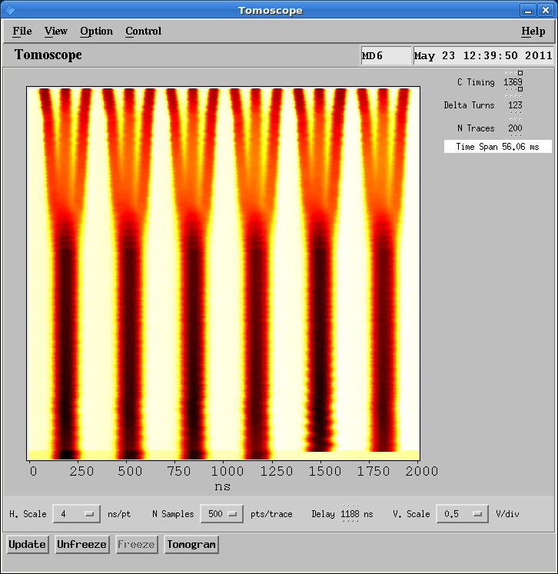
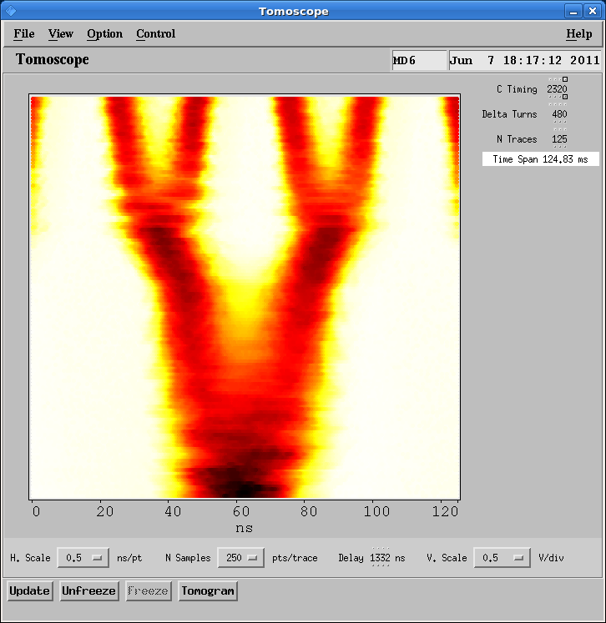
LHC Proton Gymnastics
Double-batch injection and triple splitting are performed with the 10MHz system, then, at top energy, the baton is passed to the HF cavities for further splitting and bunch rotation.

Slide 5
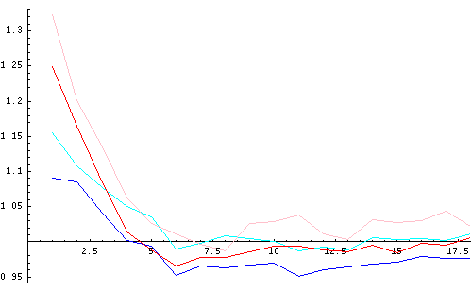
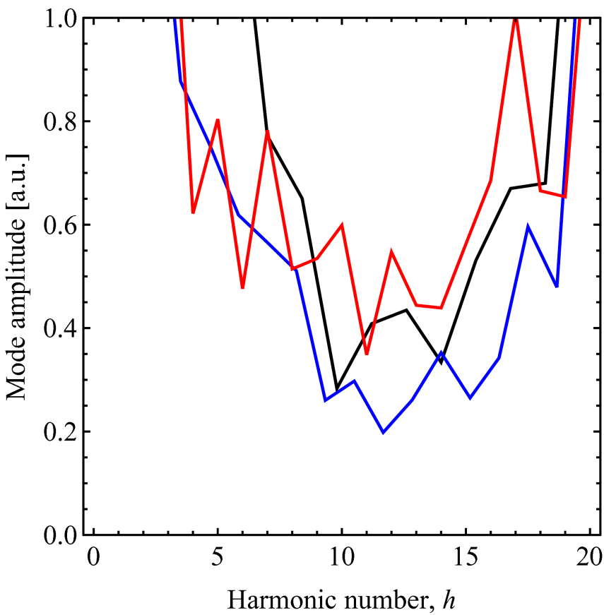
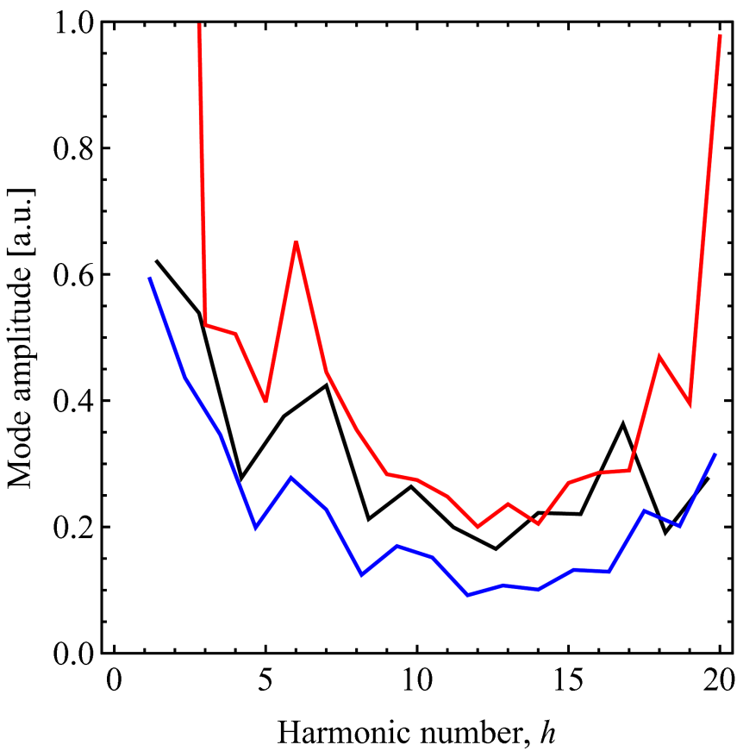
Limitations
Transient beam loading: the intensity asymmetry between bunch pairs in the first third of a batch is improved, but not eliminated, by reducing from two (pink, red) to one (cyan, blue) the number of 10MHz cavities at the handover.
Coupled-bunch instabilities: the mode spectrum during acceleration is different from that on the flat-top, while insensitivity to azimuthal filling indicates a wideband driving term – i.e., the 10MHz system itself. The existing feedback is at its limit and detuning unused cavities and re-installing the second gap relays provided only minimal benefit.
Increased longitudinal emittance improves stability but implies no spare 80MHz cavity and the benefit for the SPS is not yet clear.
Improved cavity feedback will be addressed in Carlo’s talk.
Bunch Pair Asymmetry
(50ns, Pre- and Post-rotation)
CBI Mode Spectra on the Flat-top (25ns)
5/7, 1.20 eVs 6/7, 1.20 eVs 7/7, 1.14 eVs
5/7, 0.94 eVs 6/7, 1.02 eVs 7/7, 0.95 eVs

Slide 6
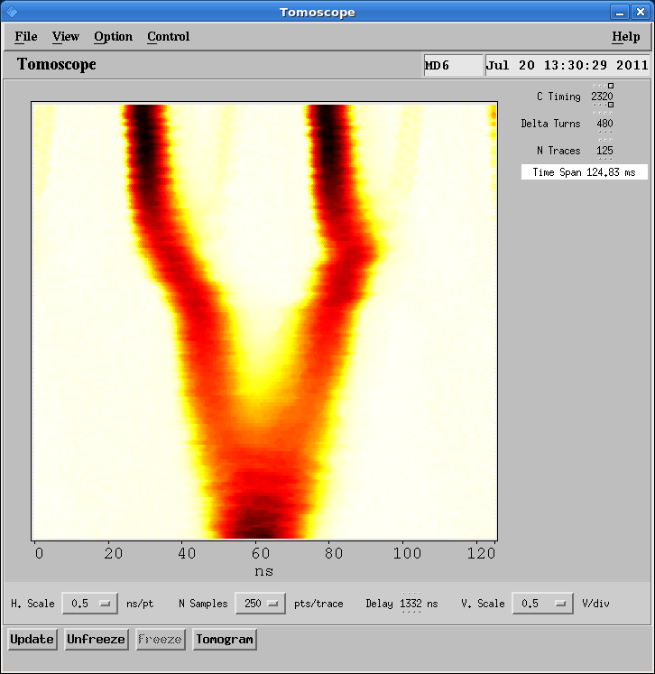
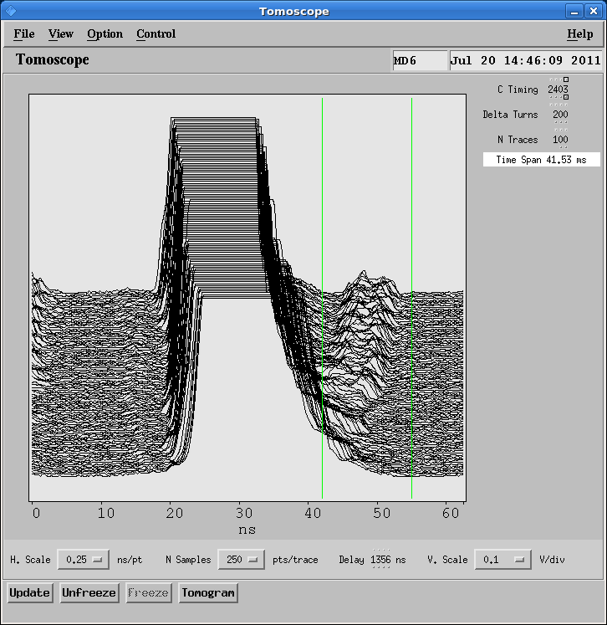
Future LHC Proton Gymnastics (1)
By biasing the final splitting, a satellite bunch is produced at the percent level of the main one. This ad hoc technique requires further optimization and more hardware to become fully operational.

Slide 7
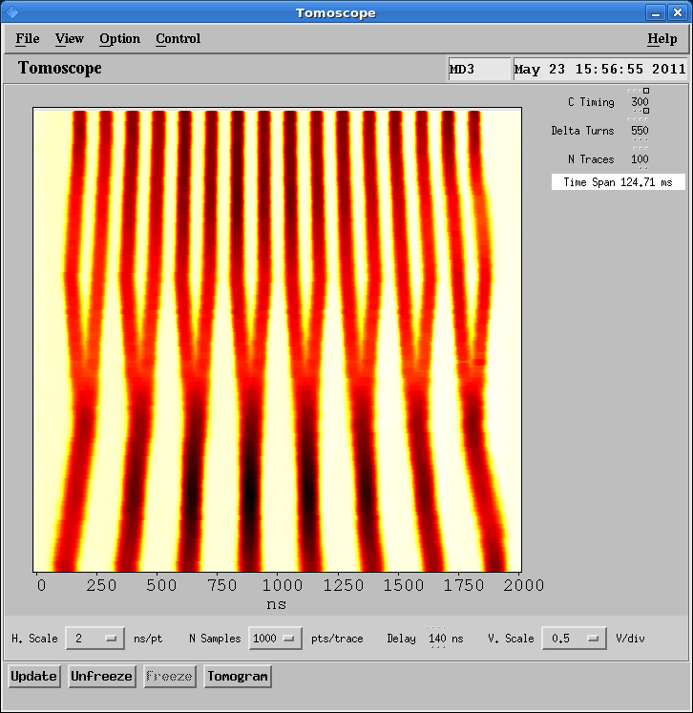
Future LHC Proton Gymnastics (2)
At the 2011 Chamonix Workshop, Carli suggested a batch compression scheme combined with bunch splitting to inject 8 bunches into h=8 and end up with 16 bunches on h=21. These are then be split as usual to produce a 25ns or 50ns bunch train. As the very first batch compression step from h=8→9 is not straightforward, a proof of principle was made with a special single-batch beam injected directly into h=9.
Double-batch injection would make maximum use of Booster rings. The number of h=21 bunches per ring would then be reduced from today’s 18/6=3 with triple splitting down to 16/8=2, with the potential of a commensurate increase in beam brightness.
There are outstanding technical issues.

Slide 8
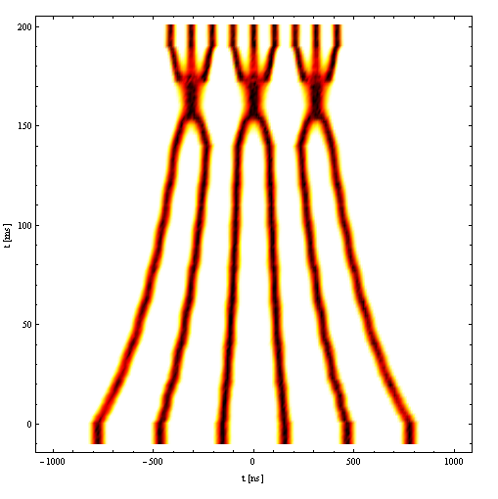
Future LHC Proton Gymnastics (3)
More recently, Garoby has addressed the issue of providing nominal luminosity after LS1 without increasing the total beam current in the LHC. In fact, the luminosity gains come from 7TeV with more squeezing, but the idea is not to compromise those gains by matching a factor of two reduction in bunch intensity by a similar reduction in transverse emittance when the 25ns variant replaces the 50ns one. The trick is to take 6 very low intensity (5E11 ppb) bunches in two Booster batches and, after acceleration to an intermediate energy, to batch compress and merge to obtain 3 half-intensity bunches back on h=7 ready for the entire triple splitting plus quadruple splitting and rotation gymnastics. The number of h=21 bunches per ring would be even further improved down to 9/6=1.5. More PS shots will be required because less than half that machine is filled, but the real challenge is to deliver 0.9μrad to the SPS and to achieve 1.25μrad at collision in the LHC.
Courtesy Damerau
Prepending a lengthy batch compression process (h=7→14 in steps of one) plus bunch merging (h=14→7) already goes well beyond the “complexity depth” that is achievable today, but the replacement of TG8 hardware by CTR-V during LS1 will permit more than the current limit of 8 timing events to be generated per multipulse channel. However, additional phase loop, radial loop and LO switchings will also be required.
Given that twice the number of PS shots will be needed to fill the LHC, it is important that the extra gymnastics can still be squeezed into a 3bp cycle.

Slide 9
Some Comments
Proper implementation of biased splitting to make enhanced satellites requires the scalar phase controls at 20 and 40MHz to be replaced by function generators. Although the new functions are readily calculated, the software interface and hardware to implement them are less obvious – particularly as the 40MHz is already piloted by an extraction bump compensation function.
All outstanding hardware (notably an arbitrary-harmonic injection bucket selector for the second batch) for the Carli scheme is already in preparation and is expected for 2012. This new hardware is also essential for the Garoby scheme.
Reconsidering the Carli scheme in the light of the half-intensity, half-emittance notions introduced by Garoby leads to yet another scheme. In terms of h=21 bunches per Booster ring the Carli scheme is only worse by 30%, so it becomes interesting if the Booster can deliver a 6.5E11 bunch from each ring within something close to the 0.75μrad demanded in the Garoby scheme. Double-batch injection of 8 such bunches into h=9 (or even h=10?) at 1.4GeV in the PS would be sufficient for the rest of the Carli scheme to proceed to h=21 in a relatively simple gymnastic. Acceleration and standard quadruple splitting would yield 64 bunches at 25ns spacing, 7E11 ppb, and approaching half-emittance. The point is this can be done in 2012, so the emittance conservation that is crucial to the Garoby scheme can be tested all the way to collision with meaningful luminosity in the LHC before LS1.
The Garoby scheme could also start from 8 bunches injected into h=9 and so deliver 48 instead of 36 bunches. (Presumably filling schemes exist for both with penalties only for extra filling time and more kicker spaces than for 72 bunches?)

