Slide 1
SPS Q20 – Low transition energy optics
H. Bartosik on behalf of LIU-SPS,
G. Arduini, T. Argyropoulos, E. Benedetto, C. Bhat, T. Bohl,S. Cettour Cave, K. Cornelis, H. Damerau, J. Esteban Muller, G. Franchetti, A. Guererro, W. Höfle, E. Métral, Y. Papaphilippou, G. Rumolo, B. Salvant, E. Shaposhnikova, R. Tomás, D. Valuch, G. Vanbavinckhove, J. Wenninger
and the whole OP group …

Slide 2
Outline
Introduction – why changing transition energy of SPS
Optics comparison
Implications of using low transition energy optics
Single bunch studies
Longitudinal beam characteristics
Future studies and next steps

Slide 3
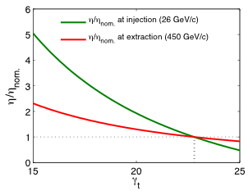


Introduction
Intensity limitations for LHC proton beams in the SPS due to:
  Transverse mode coupling instability (TMCI) at injection - single bunch instability in vertical plane for intensities above threshold of 1.6x10¹¹p/b (ε_{L}=0.35eVs, τ=3.8ns) and low ξ_{y}: N_{th}~ηε_{L}/β_{y} (for matched voltage)
  Loss of Landau damping due to longitudinal reactive impedance: N_{th}~ηε_{L}²τ
  E-cloud effects mainly for 25ns beam (for given longitudinal parameters: N_{th}~η)
Instability thresholds can be raised by increasing slip factor η
  Damping of instabilities due to faster synchrotron motion
  Factor of about 3 higher η can be reached at injection energy in the SPS by reducing transition energy γ_{t} by a few units
  Need to reduce the horizontal tune Q_{x}!
Slip factor relative to nominal optics

Slide 4
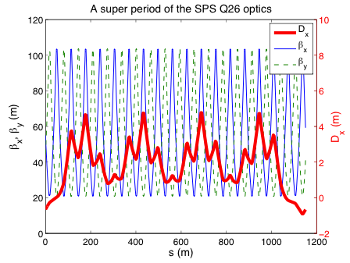
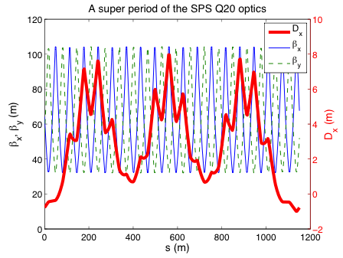
SPS optics comparison
Low γ_{t} optics by reducing (integer) tunes
  η increased by factor 2.85 at injection and 1.6 at top energy by changing γ_{t} from 22.8 (Q_{x}~26, nominal optics “Q26 optics”) to 18 (Q_{x}~20 → “Q20 optics”)
  Significantly increased dispersion in the arcs → lower γ_{t}
  No increase of maximal β-function values; minima increased from 20m to 30m
Dispersion in long straight sections similar to nominal optics
  By choosing phase advance of μ~3x2π per arc (instead of μ~4x2π )

Slide 5
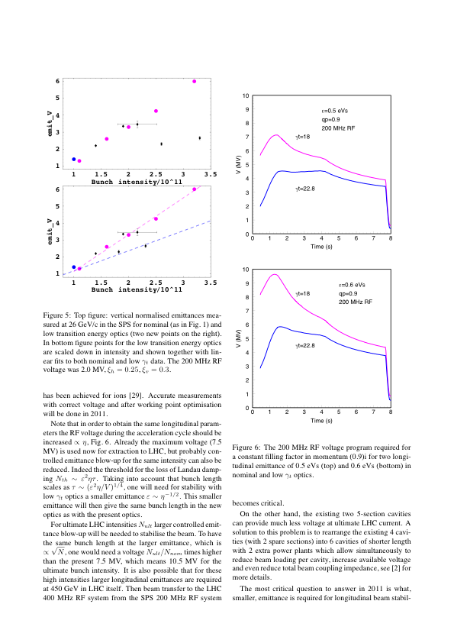
Implications of using Q20 optics
Available RF voltage and beam transfer to LHC
  Higher RF-voltage in Q20 needed (V~η) for same bucket area → better for beam loading
  RF-voltage limited to 7.5MV (already used in Q26 at flat top) → bunch length at extraction?
  For given longitudinal emittance → longer bunches at extraction (due to limited RF voltage → RF upgrade should help)
  For given bunch length at extraction → smaller longitudinal emittance but similar longitudinal stability in SPS since N_{th}~ε²ητ (however potentially unstable in LHC, to be seen)
  Also higher voltage of 800MHz Landau cavity needed!
Injection dogleg and beam dump
  Quads in injection region (LSS1) are misaligned to gain aperture for beam dump
  This creates non-closed orbit bump in Q20 optics which presently cannot be corrected at high energy → realign quadrupoles or install high energy orbit correctors
  Potential complication for extraction if not corrected (dispersion beating)
  Trajectory for high energy beam dump going off-center through main quadrupole → less kick downwards in Q20 optics (smaller quadrupole gradient) – but still within foreseen region!
Calculated voltage programs
Courtesy E. Shaposhnikova

Slide 6
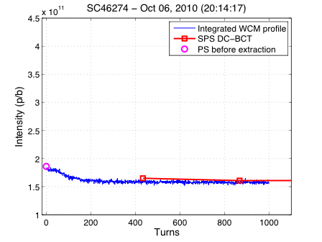
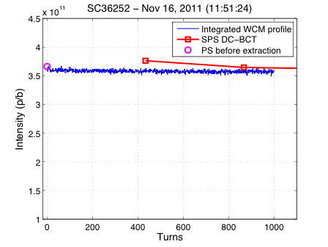
TMCI threshold in nominal optics compared to Q20
Nominal optics Q26
  Sharp losses after ~70 turns for low vertical chromaticity and injected intensity higher than 1.6x10¹¹p/b
  Clearly observed threshold for TMCI
  Higher intensity requires larger vertical chromaticity
Q20 optics
  Numerical simulation predict threshold at 3.2x10¹¹p/b (N_{th}~η/β_{y})
  No observation of TMCI up to 3.5x10¹¹p/b for low vertical chromaticity (ξ_{y}~0.03)
  Regime of higher intensity remains to be explored systematically

Slide 7
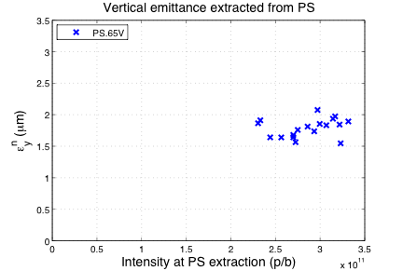
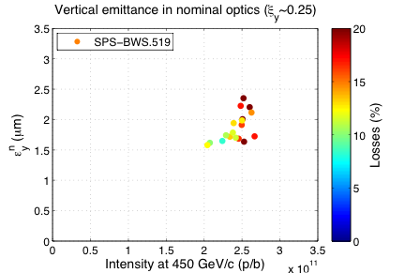
Q26 nominal SPS optics - single bunches
PS
SPS - Q26
Measurements during preparation for LHC high pile up single bunch MD
  ξ_{y}~0.25 as optimal value to reach around 2.5x10¹¹p/b with small emittance (total losses around 15%)
  Slightly higher intensity (2.8x10¹¹p/b) can be reached with chromaticity of ξ_{y}~0.4 however with emittance blowup (data not shown)
  Smaller chromaticity (ξ_{y}~0.1) leads to significant losses at injection due to TMCI (data not shown)

Slide 8
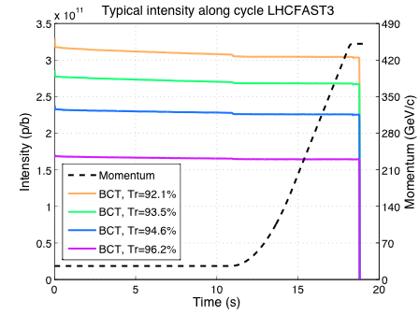
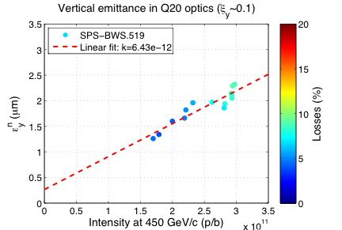
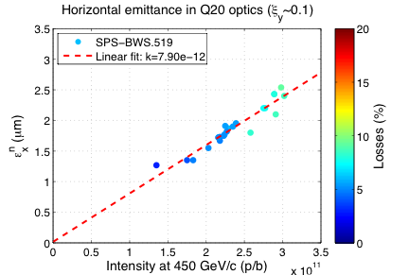
Q20 single bunch studies
SPS - Q20
SPS - Q20
Single bunch emittances vs. intensity
  Injected up to 3.3x10¹¹p/b and accelerated to flat top using nominal LHC magnetic cycle (long FB, slow ramp) and low chromaticity (ξ_{y}~0.1)
Linear increase of emittance with intensity
  losses at injection and along flat bottom increasing for intensity above 2x10¹¹p/b (working point optimization?)

Slide 9
Comparison of high intensity single bunches
SPS - Q20
SPS - Q26
Comparison Q20 – Q26
  Same fractional tunes in both optics (.13, .18)
  Low chromaticity (ξ_{y}~0.1) in Q20 cycle
  At least ξ_{y}~0.25 needed in Q26 to reach 2.5x10¹¹p/b – but still very high losses due to TMC instability
  Significantly smaller losses in Q20 (<10% even for 3.3x10¹¹p/b injected)
  Linear increase of emittance with intensity in Q20

Slide 10
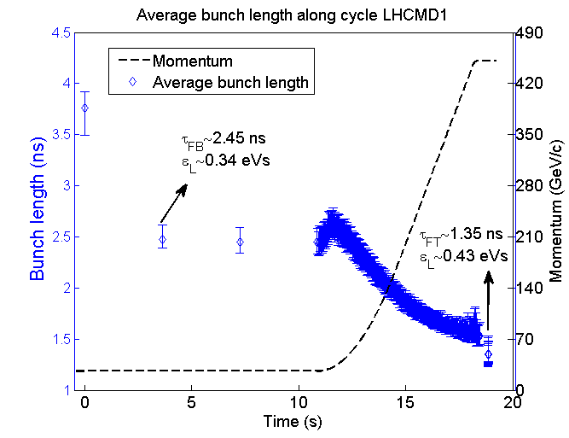
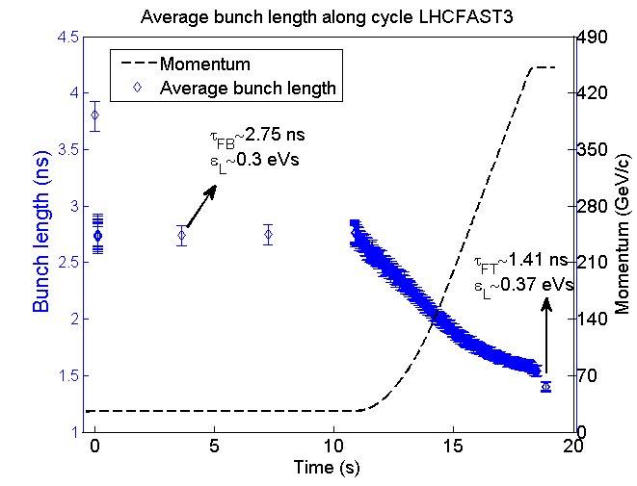
Longitudinal aspects – 50ns beam
Q26
Q20
Courtesy T. Argyropoulos
Example: 50ns LHC beam (1 batch) with 1.5x10¹¹p/b
  With 800MHz Landau cavity in bunch shortening mode (needed for stability in both optics)
  Without longitudinal emittance blow-up (used in routine operation for stabilizing beam)
  Unstable during ramp in Q26 for this intensity → emittance blow-up needed
  Stable in Q20 for this intensity (emittance blow-up needed for higher intensities)
  Longer bunches at extraction in Q20 due to limited RF-voltage

Slide 11
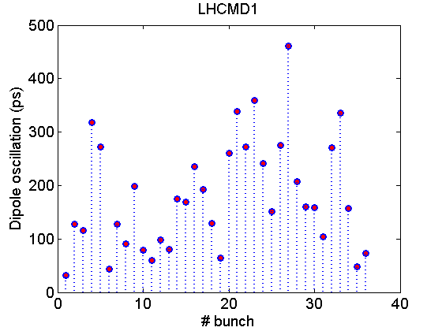
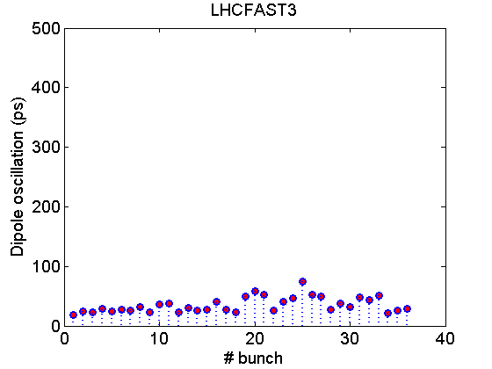
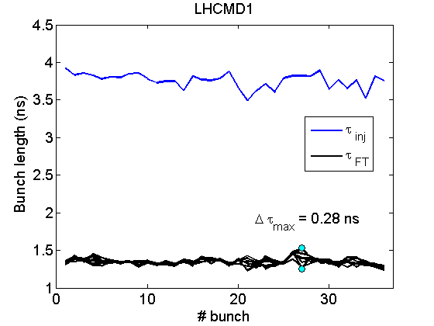
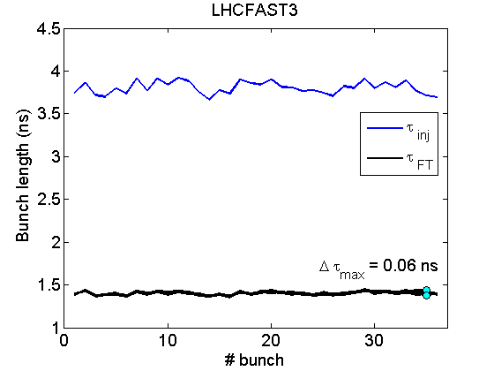
Longitudinal stability at flat top – 50ns beam
50ns beam at flat top (1 batch, 1.5x10¹¹p/b)
  Without controlled emittance blow-up
  800MHz cavity on
unstable in Q26
  Phase oscillations - dipole instability
  Bunch length oscillations – quadrupole instability
stable in Q20
  Small bunch length (emittance) - compatible with LHC bucket (margin for emittance blow-up)
  Smaller emittance sufficient for beam stability in SPS but could be too small for LHC for higher intensity (IBS, stability)
big dipole
oscillations
Only small dipole
oscillations
Q26
Q20
quadrupole
oscillations
no quadrupole
oscillations
Courtesy T. Argyropoulos

Slide 12
Next steps and future studies
Next step: Injection into LHC during MD
  Rematching the transfer-lines TI8 and TI2 to the new optics in the SPS → presently ongoing
  Study stability of beams with smaller longitudinal emittance in the LHC and acceptable losses due to longer bunches
Optimization left to be done
  RF settings
  Injection into Q20 optics → rematched optics of TT10 (and TT2) not employed yet
Future studies: split tunes
  Integer tune 20 in horizontal plane for lower transition energy
  Keeping the tune in the vertical plane close to 26 for smaller vertical beta function → further increase threshold for vertical instabilities such as TMCI (N_{th}~ηε_{L}/β_{y}), e-cloud, …
  Feasibility to be checked (potential conflict with LHC QPS) …

Slide 13
Summary
Changing optics to low transition energy as very promising option for high intensity LHC beams in the SPS
  Q20 optics without installation of new hardware
  Lower transition energy requires higher RF voltage – potential limitation for beam transfer to LHC (foreseen RF-upgrade should help)
Single bunch studies
  Huge increase of TMCI threshold at injection due to (almost) 3-fold increase of slip factor →TMCI threshold above 3.5x10¹¹p/b
  Single bunches with intensity up to 3x10¹¹p/b at flat top with emittances smaller than 2.5μm
Comparison of longitudinal characteristics of 50ns beam (1.5x10¹¹p/b)
  Nominal optics requires longitudinal emittance blowup in addition to 800MHz Landau cavity
  Beam stable with 800MHz Landau cavity with Q20 optics → no emittance blow-up needed for this intensity
  Longitudinal beam characteristics in Q20 optics compatible with LHC bucket
Major next step: injection into LHC

Slide 14
Thank you for your attention!

