Slide 1
SPS 200 MHz RF Upgrade
Eric Montesinos
On behalf of LIU-SPS 200 MHz Upgrade team

Slide 2
Contents
What ? Existing system
Why ? Motivations
How ? Technical choices
When ? Schedule
Who ? Persons involved

Slide 3
A bit of history
1975
1980
1985
1990
1995
2000
2005
2010
The SPS-RF started up in 1976 with two accelerating cavities
Since 1980, for the new role of SPS as proton-antiproton collider, there are four power plants operating @ 200 MHz
HVPS upgrade for
Pulse mode
1976
TWC#1 / TX1
TWC#2 / TX2
1978
TWC#3 / TX3
1979
TWC#4 / TX4
1980
TWC#1 / TX1+TX2
TWC#2 / TX3+TX4
TWC#3 / TX5+TX6
TWC#4 / TX7+TX8
Fire in BA3 HVPS TX#3
New RF power couplers
Configuration of one of the four
200 MHz power plant
Transmitter (TXA)
Coaxial transmission line
(feeder line)
125 to 160 meters
mW
Dummy load
Terminating loads
Power
combiner
Transmitter (TXB)
Accelerating cavity

Slide 4
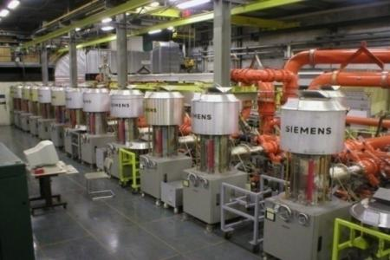
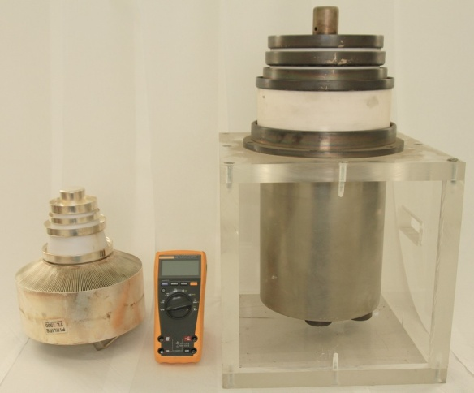
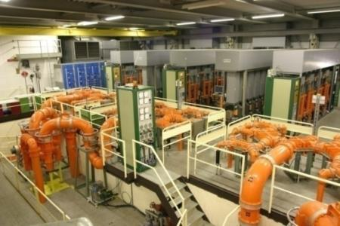

Existing amplifiers
20 x 135 kW RS2004
‘Siemens’ plant (1976 to 1979)
68 x 35 kW YL1530
‘Philips’ plant (1980)
20 x 135 kW RS2004
‘Siemens’ plant (1976 to 1979)
68 x 35 kW YL1530
‘Philips’ plant (1980)
RS2004
135’000 W
YL1530
35’000 W
GSM
1 W
700’000 W
700’000 W
700’000 W
700’000 W

Slide 5
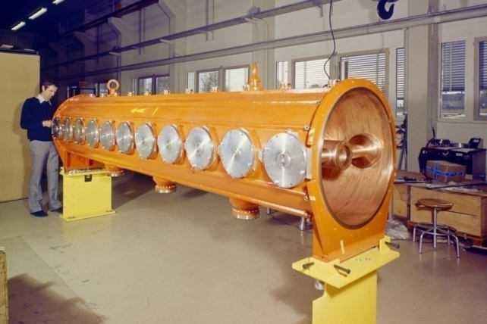
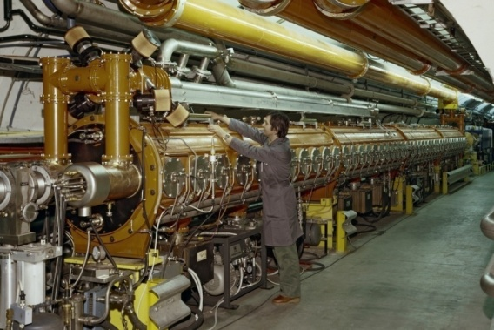
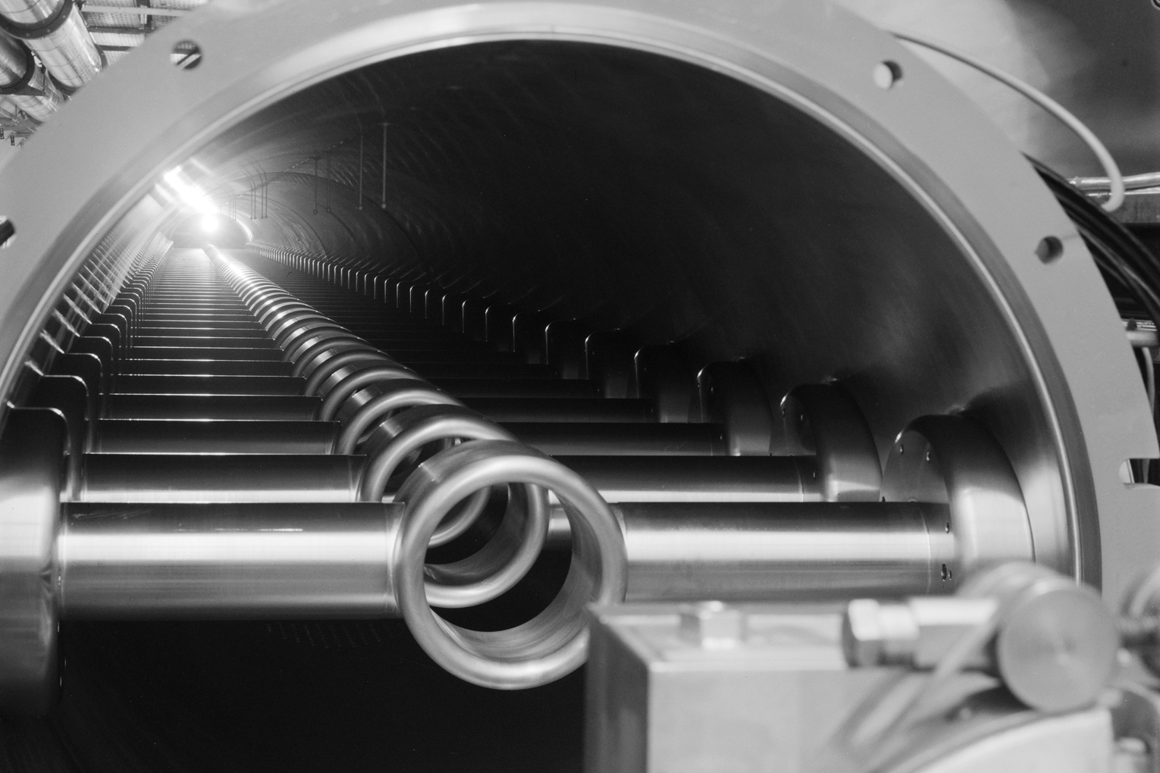
Travelling Wave Cavities:
2 x four sections & 2 x five sections
One four sections cavity
(four power couplers and two terminating power loads)
One section = 11 drift tubes

Slide 6
Cavities redistribution
2011 : 4 cavities (18 sections)
2 x 4 sections
2 x 5 sections
+ 3 spare sections
2018 : 6 cavities (20 sections)
4 x 3 sections
2 x 4 sections
+ 1 spare section

Slide 7
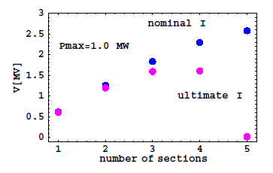
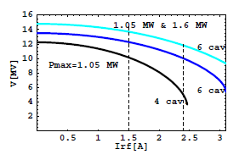
Motivations
Courtesy of Elena Shaposhnikova
With present 4 cavities configuration we will have difficulties at high intensity LHC beam in the SPS : IPAC11, Upgrade of the 200 MHz RF system in the CERN SPS
Increasing number of shorter cavities with 2 extra power plants should significantly improve the RF performance for higher LHC intensities
The best new compromise is 6 cavities:
  4 x 3 sections cavities with 1.0 MW
  2 x 4 sections cavities with 1.4 MW
Available RF voltage as a function of # section with 1.0 MW RF and with 1.5 A and 2.5 A Irf
Available RF voltage as a function of Irf

Slide 8
SPS 200 MHz RF system upgrade
Existing Amplifiers upgrade
New RF Amplifiers
New RF Building
LSS3 Tunnel integration
New RF Building
1 mW
1.7 MW
RF amplifier
Coaxial transmission line
150 meters
1 mW
1.7 MW
RF amplifier
Accelerating cavity
Accelerating cavity

Slide 9
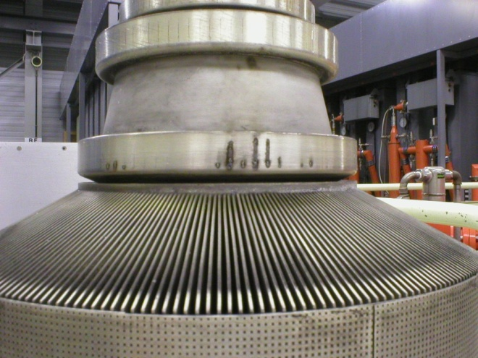
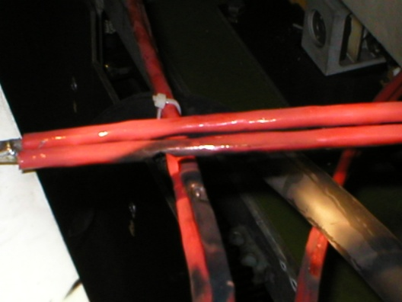
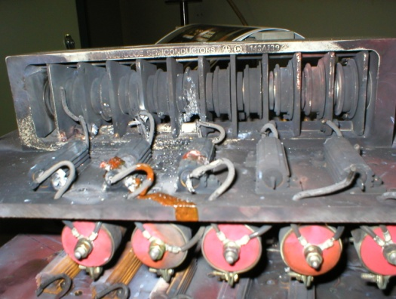
Existing amplifiers upgrade
Philips air cooling plant has to be modified to allow higher power
Siemens HVPS need a full re-cabling and an air cooling improvement
Be ready to pay for new tubes
Philips burnt tube because of lack of air cooling
Ratings | Present | Future
Pulsed 10 us/43 kHz | 700 kW | 1100 kW
Siemens HVPS damaged HV cabling and diode bridge
during high power tests

Slide 10
New 1.7 MW amplifier, i.e 1.4 MW cavity
Pulse mode: 1.7 MW max (10 µs / 43 kHz)
Average: 850 kW (thermal limitations)
A major improvement to existing systems will be to have individual SSA drivers per Final
Combiners and lines will be the same as with existing systems
Four contracts :
  Drivers (SSA)
  Finals (SSA or Tetrodes)
  Combiners (3 dB above 100 kW)
  Transmission lines (coaxial, 345 mm outer)
From Beam Control
Drivers
16 SSA
1/16 splitter
Final
16 PAs
1.7 MW
3 dB
combiners
and power loads
-0.6 dB total
1.5 MW
120 m and 180 m
Coaxial lines
-0.2 dB
To cavity input 120 m away
1.4 MW

Slide 11
Two new power amplifiers
16 x 138 kW Tetrodes, i.e 32 tetrodes
Qualified solution must have demonstrated to be reliable under scientific operation (not only broadcast operation)
Reliability and overall efficiency will be part of the adjudication
2 x 1.7 MW Klystron | 2 x 8 x 225 kW tetrodes Equivalent to ‘Siemens’
2 x 8 x 225 kW IOTs | 2 x 16 x 106 kW tetrodes Equivalent to ‘Philips’
2 x 4 x 450 kW Diacrodes | 2 x 2048 x 830 W SSA Equivalent to ‘SOLEIL’
16 x 128 x 910 W SSA, i.e. 4096 transistors
2 x 16 x 106 kW tetrodes Equivalent to ‘Philips’
2 x 2048 x 830 W SSA Equivalent to ‘SOLEIL’
128 x 910 W
SSA

Slide 12
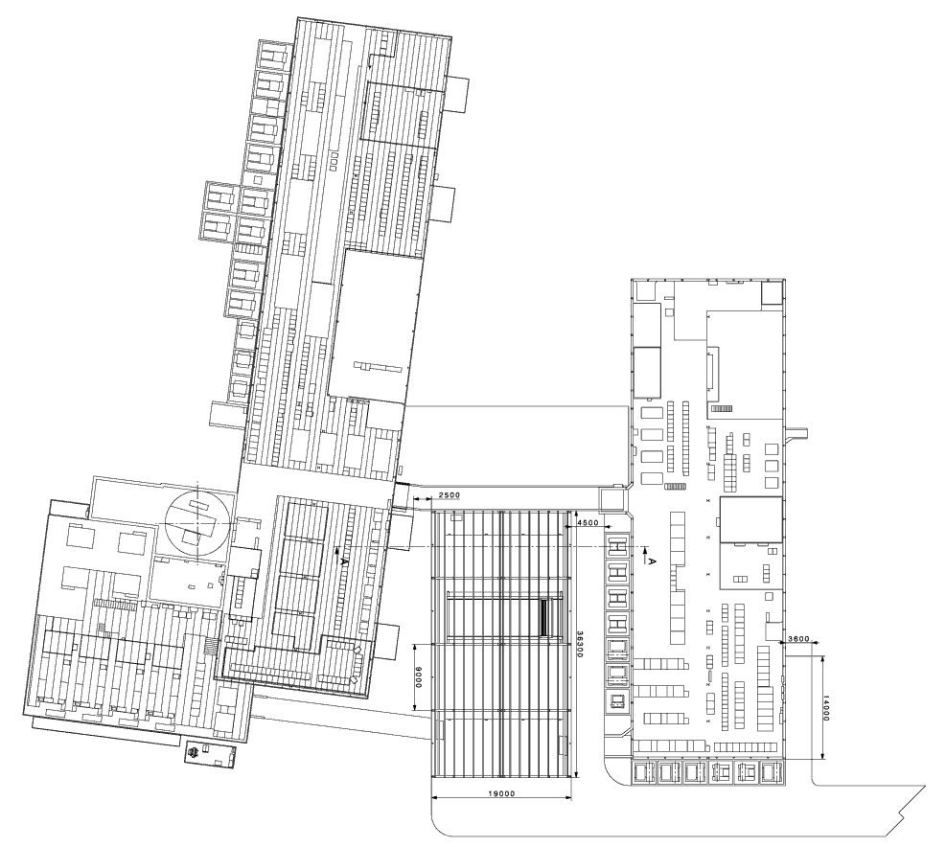
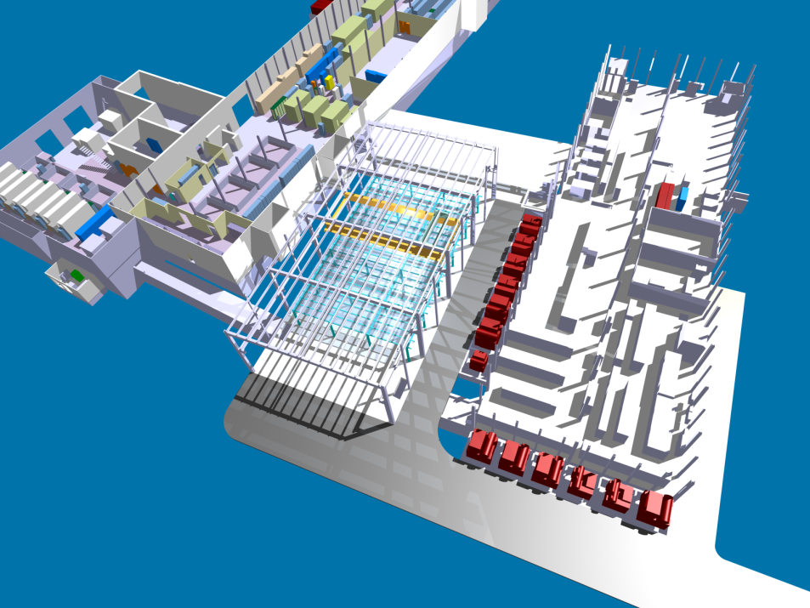
New RF building
Whatever the solution, SSA or Tetrodes, the same building
Best possible location is between BA3 and BB3
Maximum ‘RF’ foot print will be 2 x 450 m²
CCC
RF
workshop
BA3
Siemens
BB3
Philips
800 MHz
RF Faraday Cage
New RF plants

Slide 13
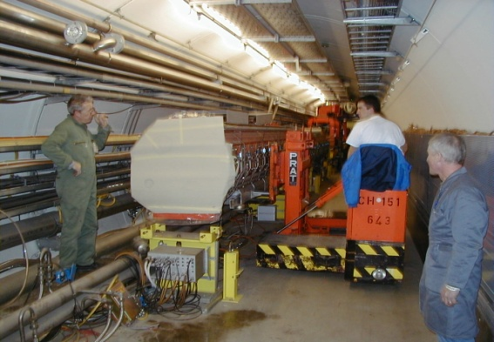
Cavities rearrangement
We already disassembled all cavities
(2001-2004 realignment campaign)
We know all needed specific tooling
It will be a huge challenge …

Slide 14
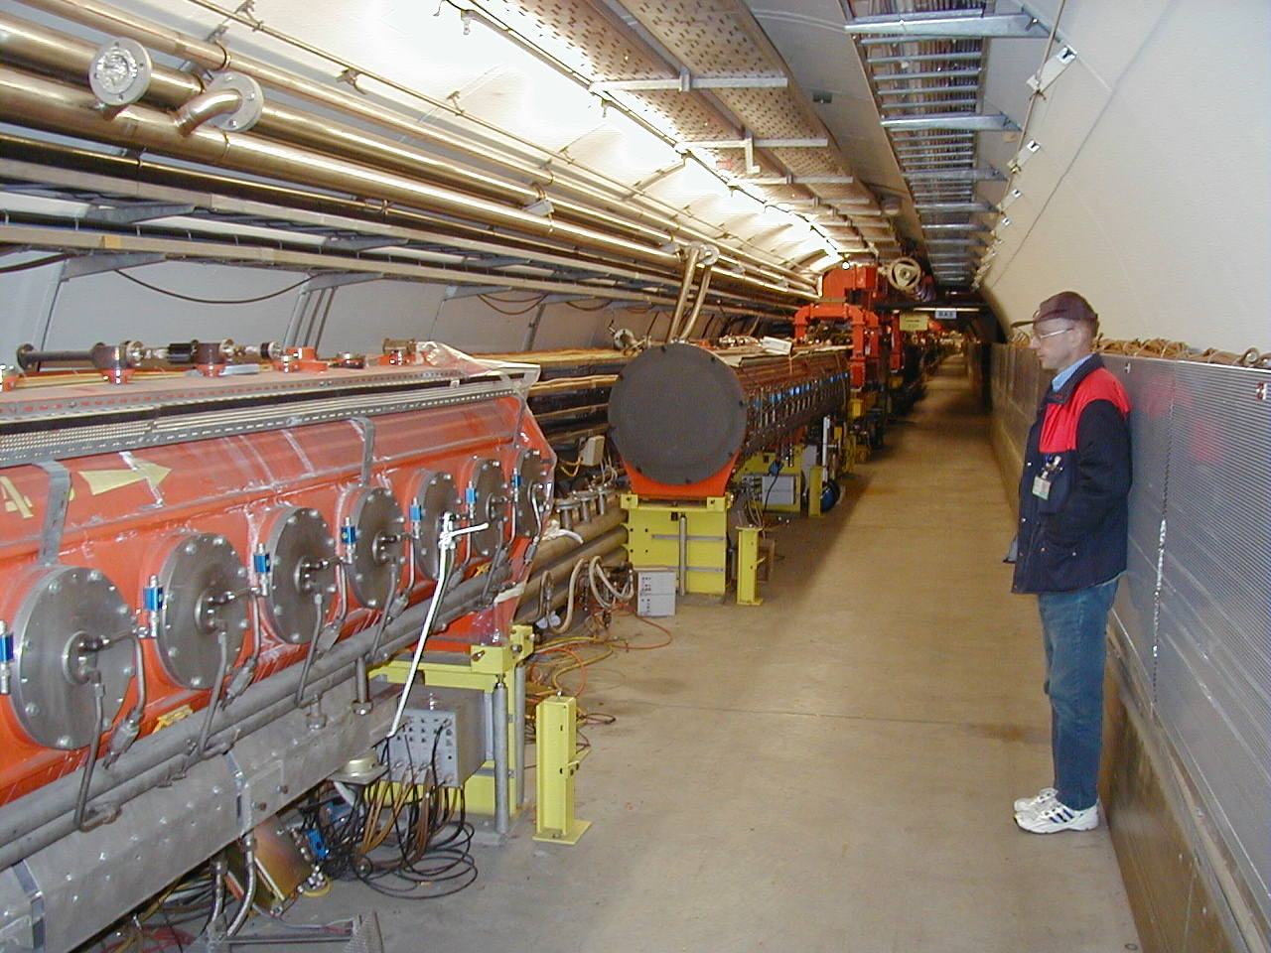
Cavities rearrangement
… even if this will be (very) stressing …
…we are confident we can do it, however…

Slide 15
LSS3 rearrangement

Slide 16
Key RF devices
Three spare sections : ~ 3.5 years
  Refurbishment (missing items)
  Power tests
New power couplers : ~ 5 years
  More power and shorter -> new design
  Prototyping and tests
  Series and pre-conditioning (x 30)
New amplifiers : ~ 5 years
  New building
  Construction of amplifiers
  Long duration tests
New LLRF : ~ 4 years
  Design
  Train onto a spare cavity in the new RF building
  Test onto an existing system prior to deployment
Impossible to re-arrange cavities within LS1
Only 5 pickups / 17 devices to be reinstalled

Slide 17

Schedule
6 months cavities re-arrangement
2 months RF Power conditioning
4 months LLRF commissioning
2011
2012
2013
2014
2015
2016
2017
2018
2019
Studies
Tendering
Construction
Installation
LLRF Design and proto
Commissioning
Start up
LLRF Tests
New RF Power Amplifiers and LLRF
LLRF Series
Studies
Construction
Cavities Pickups vacuumCV, EL
LSS3 Tunnel Integration
coaxial lines, Pickups
Spare sections
New power couplers
Studies
Authorizations
Construction
New RF Building
Services (CV, EL)
#2

Slide 18
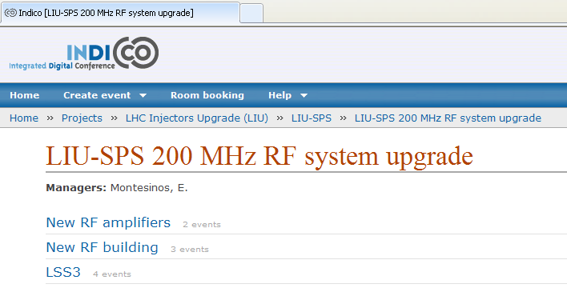
Persons involved
Dep-Group | Persons
BE-RF | Eric Montesinos, Thomas Bohl, Wolfgang Höfle, Urs Wehrle, Elena Shaposhnikova, Philippe Baudrenghien, SPS power team
BE-ABP | Patrick Bestmann, Yannis Papaphilippou
BE-ASR | Paula Carvalho Correia, Emmanuel Paulat
BE-BI | Christian Boccard, Patrick Odier
DGS-SEE | Guillaume Fontana, Cécile Pinto
EN-CV | Michel Obrecht, Mauro Nonis
EN-EL | Guillaume Gros, Joël Lahaye, Christophe Crombez
EN-HE | Caterina Bertone, Pascal Brunero, Serge Pelletier, Yann Seraphin
EN-MEF | Frédéric Galleazzi, Yvon Muttoni, David McFarlane
GS-SE | Luz-Anastasia Lopez-Hernandez, Evelyne Crocci-Torti, Antoine Kosmicki
TE-VSC | Paolo Chiggiato, Antonio Mongelluzzo
TE-MSC | Jérémie Bauche

