Slide 1
SPS collective effects and limitations
E. Shaposhnikova
for LIU-SPS
Beam Dynamics (SPSU - BD) Working Group
http://cern.ch/spsu/

Slide 2
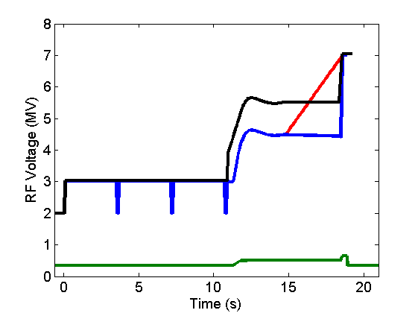
LHC beams in the SPS: acceleration from 26 to 450 GeV/c
add. emittance
blow-up MD
transfer to LHC
ultimate 25 ns
Maximum intensity achieved
(1-4 batches) at 450 GeV/c :
single bunch – 3.0x10¹¹
50 ns beam (2011)
- 1.8x10¹¹ p/b (not stabilized), beam losses ~ 10%
25 ns beam (2010): injected 1.9x10¹¹ p/b, losses ~ 20-30% (more for more batches)
200 MHz
nominal 25 ns
ultimate 50 ns
800 MHz

Slide 3
SPS beams in 2011
.
Beam parameters |  | SPS at 450 GeV/c (stable beam)
 |  | LHC | LHC | FT | indiv
bunch spacing | ns | 25 | 50 | 5 | 23040
bunch intensity | 10¹¹ | 1.2 | 1.6 | 0.1 | 3.0
number of bunches |  | 4x72 | 4x36 | 2x2100 | 1
total intensity | 10¹³ | 3.5 | 2.3 | 4.2 | 0.04
long. emittance | eVs | 0.7 | 0.5 | 0.8 | 0.4
norm. h/v emittance | μm | 2.5/3.0 | 2.0/1.9 | 8/5 | 2.5*
* Q20 optics

Slide 4
Intensity and beam quality (BQM!) limitations
Single bunch effects
  space charge → working point optimisation (H. Bartosik et al. + study of G. Franchetti, GSI)
  TMCI (Transverse Mode Coupling Instability)
  loss of Landau damping
  longitudinal/microwave instability
Multi-bunch effects (total intensity or local density)
  e-cloud
  beam loss (many possible reasons) → PS-SPS beam transfer studies
  longitudinal coupled bunch instabilities
  beam loading in the 200 MHz and 800 MHz RF systems
  heating of machine elements (MKE, MKDV kickers, …)
  vacuum (beam dump and MKDV outgassing), ZS septum sparking

Slide 5
Intensity limitations for 25 ns beam - 2011
intensity /bunch | Origin | Leads to | Present/future cures/measures
0.2x10¹¹ | loss of Landau damping / longitudinal multi bunch instability due to longitudinal impedance | - beam loss during ramp - bunch variation @450GeV/c | FB, FF, longitud. damper - 800 MHz RF system - emit. blow-up → RF
0.5x10¹¹ | e-cloud due to the StSt vacuum chamber (δ_{SEY}=2.5, 1.3 is critical for SPS) | - dynamic pressure rise transv. (V) emit. blow-up instabilities - beam losses | - scrubbing run (δ→1.6) - high chrom. (0.2/0.4) transv. damper (H) (50/75 ns spacing) - a-C coating (δ→1.0)
>1.2x10¹¹ | beam loading / ecloud / impedance / space charge (?) | - flat bottom/capture beam loss (>5%) | - (lower chromaticity) WP, RF gymnastics collimation
1.5x10¹¹ | beam loading in 200 MHz RF system | voltage reduction on FT b-by-b phase modulation | Feedback & FF RF cavities shortening
1.6x10¹¹ | TMCI (transverse mode coupling instability) due to transverse impedance | beam losses emittance blow-up | - higher chromaticity high voltage - transverse high bw FB

Slide 6
Cures
Understanding the limitations: MD studies, simulations, calculations
Impedance identification and reduction (MKE kickers, MKDV, 200 MHz RF)
Low γ_{t} (Q20 optics) → talk of H. Bartosik
e-cloud mitigation → talk of M. Taborelli
Upgrade of the 200 MHz RF system → talk of E. Montesinos
Landau cavities (800 MHz RF system)
Controlled longitudinal emittance blow-up
High bandwidth transverse feedback (e-cloud, TMCI)

Slide 7
Single bunch: transverse emittance versus intensity
injected emittance is increasing with intensity (~ 30%)
emittance blow-up in SPS above 2x10¹¹, more in H-plane

Slide 8
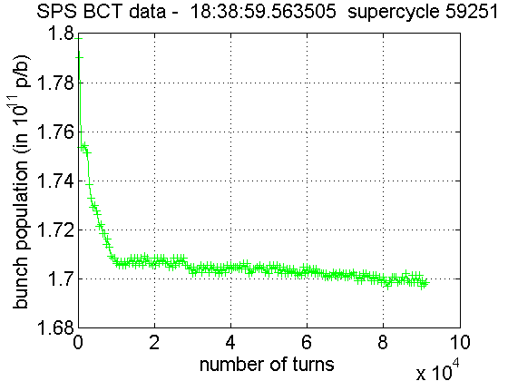
Transverse Mode Coupling Instability
Measurements (B. Salvant et al.): threshold @26 GeV/c - 1.6x10¹¹ for ξ_{V} =0 (ε_{L} = 0.35 eVs, τ=3.8 ns); (2.25-3.3)x10¹¹ for ξ_{V} in range 0-0.3, ξ_{H}=0.25
Threshold scales (matched V) ~ ε_{L}η, where η = 1/γ²-1/γ_{t}²
Cures:
  high ξ_{V} , ε_{L} and η → lower γ_{t}
  (Q20 optics!)
  impedance reduction… but
  ~30% of transverse SPS impedance
  is still unknown → ongoing work
  (B. Salvant et al.)
  transverse wide-band FB
  (W. Hofle et al. with LARP)

Slide 9
SPS impedance
Reduce known high impedance → loss of Landau damping, heating
  MKE: serigraphy – the last after LS1 (M. Barnes et al.)
  Transverse impedance issue. New design (B. Goddard)?
  MKDV, MKDH: complete transition pieces between magnet and tank
  (heating, outgassing)
  800 MHz TW cavities: active damping → new FB and FF (2014?)
  200 MHz TW cavities: reduction by 20% due to modifications
Search for unknown impedances:
  transverse (broad-band and narrow-band)
  longitudinal (narrow-band?)

Slide 10
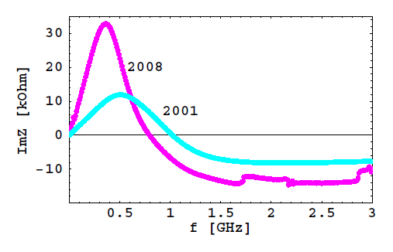
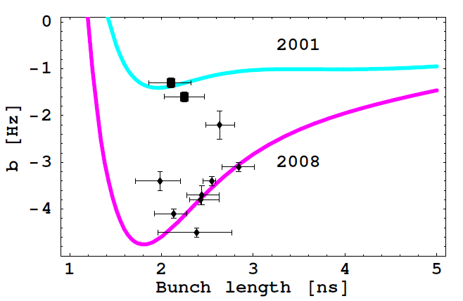
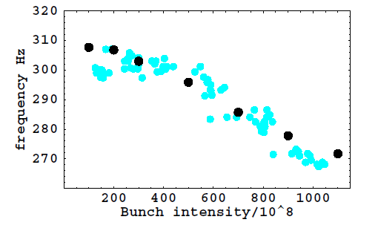
Longitudinal impedance: reactive part
Kickers - main contribution to ImZ → loss of Landau damping
Not much room for extra impedance ,
Similar for resistive impedance (stable phase shift measurements)
all kickers
(data - B. Salvant)
Quadrupole
synchrotron frequency shift
slope b
simulations
measurements

Slide 11
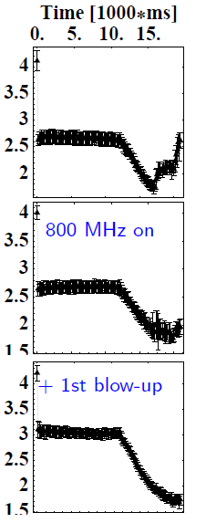
Longitudinal multi-bunch instability and its cures
Threshold: reduces with energy ~1/E,
single batch (25 ns spacing) with 2x10¹⁰p/b is unstable at the end of the ramp, beam is lost at nominal intensity
Possible source: fundamental /HOMs
of 200 MHz or 800 MHz RF systems
Cures:
- FB, FF, longitudinal damper for 200 MHz
800 MHz RF system in bunch shortening mode through the cycle, V₈₀₀ ~ 0.1 V₂₀₀,
V₈₀₀ ~ 0.15 V₂₀₀ in the last MD
- controlled longitudinal emittance blow-up (0.35 → 0.42 eVs → 0.65 eVs)
Bunch length [ns] during the cycle
T. Bohl et al.

Slide 12
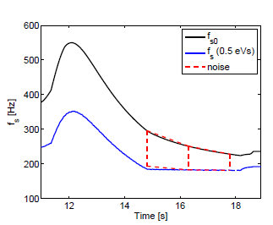
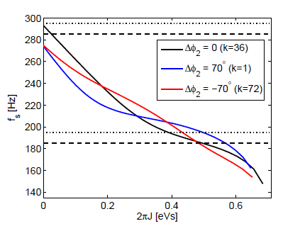
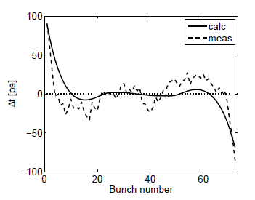

Emittance blow-up by band-limited noise: intensity effects
synchrotron frequency spread during the cycle
synchrotron frequency distribution
T. Argyropoulos et al., HB2010
Synchrotron frequency distribution is modified by potential well distortion and beam loading (depending on bunch position in the batch) effects
bunch positions

Slide 13
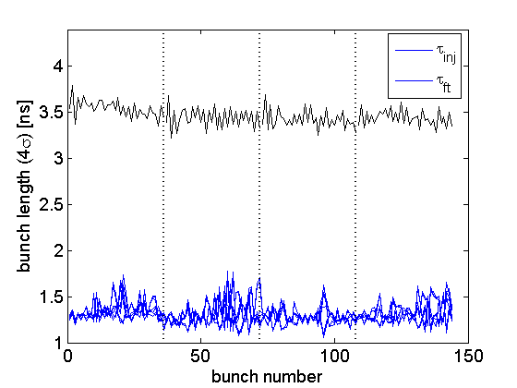
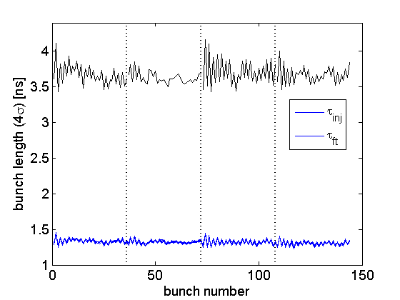
Longitudinal multi-bunch instability due to loss of Landau damping
Short PS bunches
Long PS bunches
T. Argyropoulous et al.

Slide 14
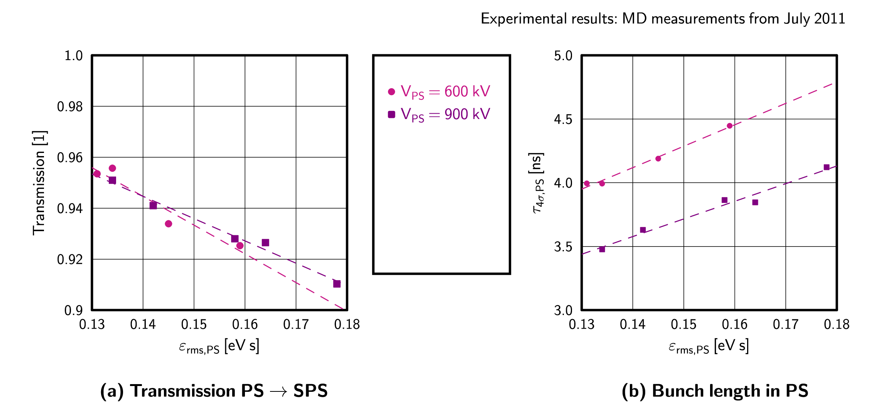
PS-SPS transfer: capture loss - measurements
.
used in simulations (next slide)
H. Damerau et al.

Slide 15
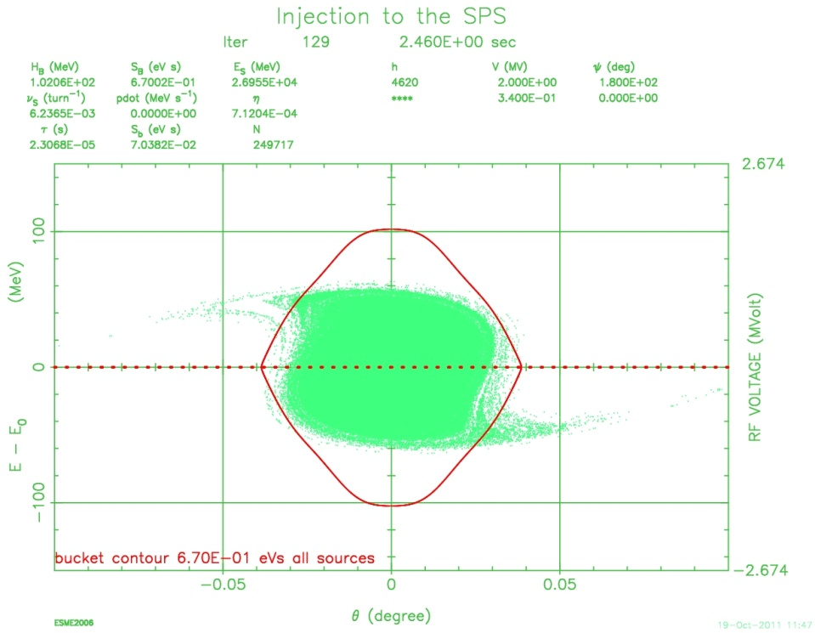
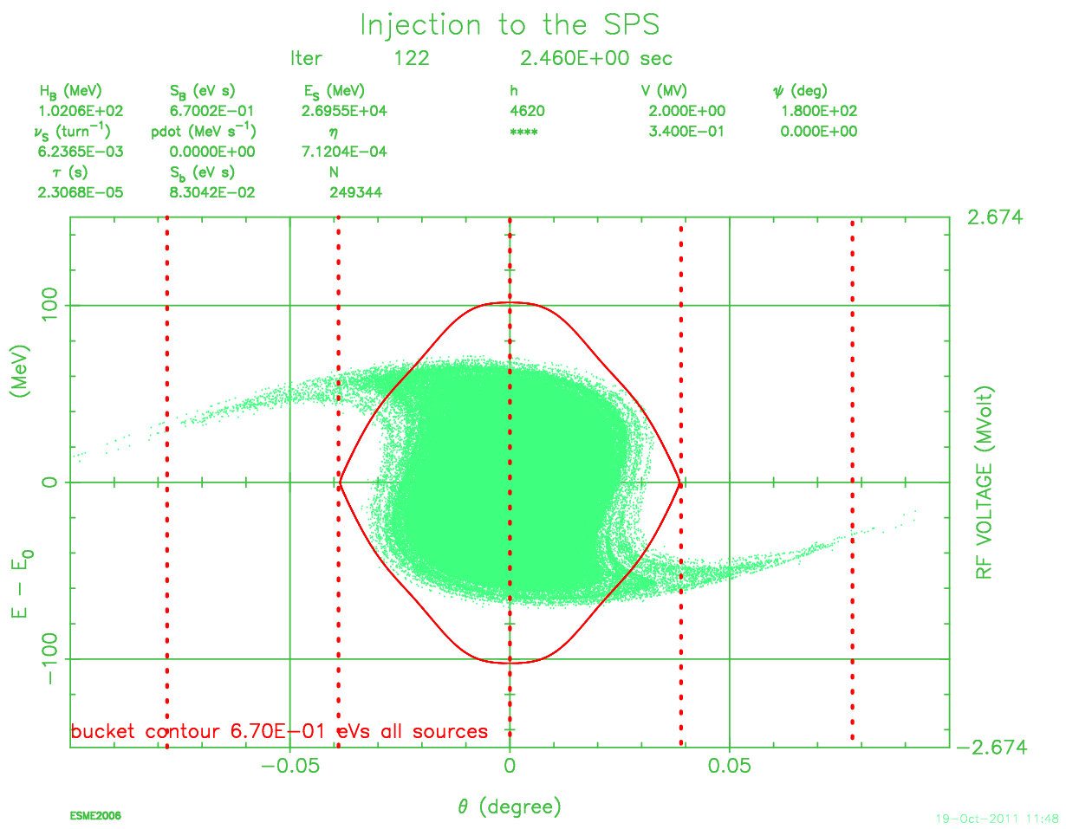
PS-SPS transfer: capture loss - simulations
long (nominal) PS bunches (600 kV)
short PS bunches (900 kV)
PS RF gymnastics simulated with measured particle distribution (H. Timko)
→ Measured SPS transmission is reproduced with 20% emittance blow-up!
different bunch lengths but similar emittances; SPS: V = 2 MV
no intensity effects, beam loading or injection phase errors

Slide 16
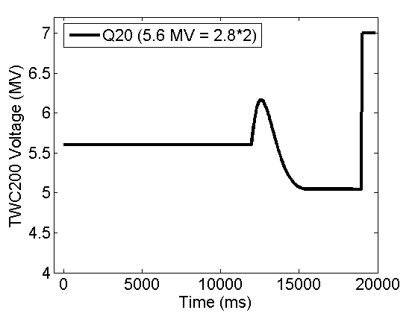
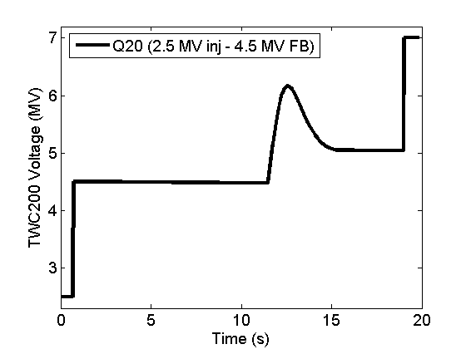
Low γ_{t} (Q20) optics
For the same longitudinal parameters required V ~ η
- limit at 450 GeV/c to 7.5 MV
→ 200 MHz RF upgrade
→ more 800 MHz voltage also
V scaled
from Q26
Emittance blow-up for the same intensity can also be reduced: loss of Landau damping N_{th}~ ε² η τ. Since τ ~ (ε² η/V)^{1/4} → ε ~ η^{-1/2} and τ = const for V=const.
matched V at injection

Slide 17
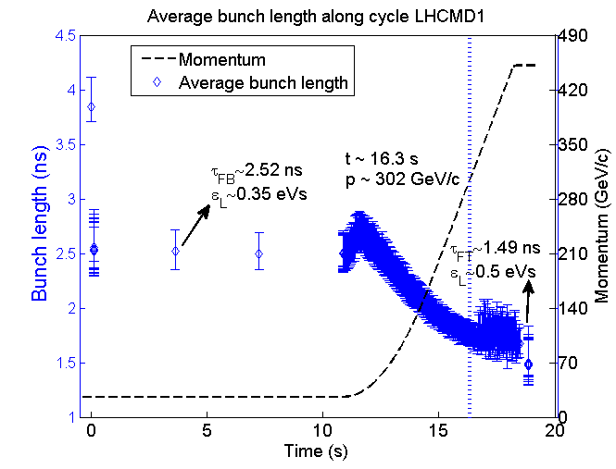
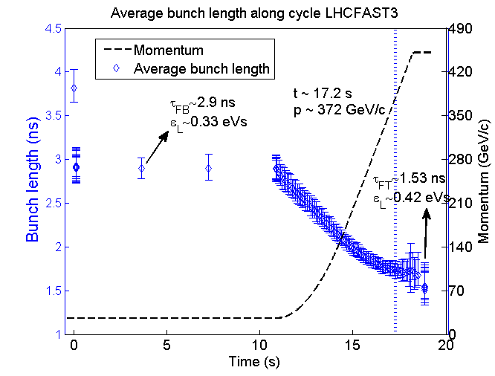
Q26/Q20 comparison
50 ns beam (1.9x10¹¹ p/b)
Q26
Q20
800 MHz needed for both cycles
In Q20 instability starts later but controlled
emittance blow-up (smaller) is still required
Losses ~ (8 – 9)%
T. Argyropoulos et al.
MD Nov. 2011
Q26 – 1.49 ns
Q20 – 1.53 ns

Slide 18
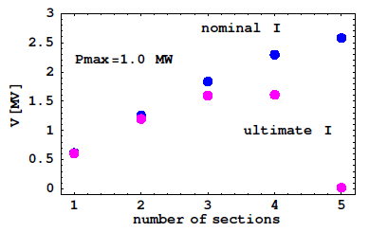
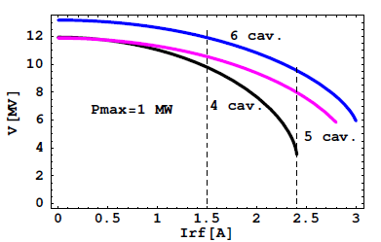
200 MHz TW RF system upgrade
Voltage/cavity on Flat Top
.
Now: 2x4+2x5 sections
Power/cavity (E. Montesinos):
- 1.05 MW pulsed
5-section cavities are useless for ultimate intensities and 1 MW limit
7.5 MV used @450 GeV for beam transfer to LHC → more V needed for higher intensities (larger emittance)
→ Rearrange 4 cavities (+ 2 spares) into 6 shorter cavities of 2x4+4x3 sections with 2 extra power plants to
  reduce beam loading/cavity and beam coupling impedance (~L²)
  restore voltage for ultimate beam
  more voltage for Q20 optics
Total voltage on Flat Top
τ = const
nominal
ultimate

Slide 19
Summary
High bunch intensities were achieved in 2011 for 50 ns beam
Beam loss is important limitation for high intensity beams
More MD time needed for optimisation of high intensity and high brightness beams
Cures for longitudinal instability (800 MHz and emittance blow-up) are limited – need additional improvements (e.g. Q20, impedance reduction)
MKE kickers give dominant contribution to longitudinal broad-band impedance, improvement is expected after LS1
Q20 optics is a very promising solution for beam stability, need more optimisation, transfer to LHC should be studied

Slide 20
Acknowledgments:
SPSU-BD SG: G. Arduini, H. Bartosik, C. Bhat, A. Burov, F. Caspers, E. Metral, Y. Pappaphilipou, G. Rumolo, B. Salvant, M. Taborelli +…
BE/RF: T. Argyropoulos, T. Bohl, H. Damerau, W. Hofle, S. Hancock, E. Montesinos, J. F. E. Muller, G. Papotti (OP), H. Timko, J. Tuckmantel, U. Wehrle +…
LIU: R. Garoby, B. Goddard + LIU-SPS
PS & PSB teams and SPS OP shifts for help in MDs

