Slide 1
e-cloud in SPS
Present situation of the development of mitigation methods
-MD 2011 results (clearing electrodes, half coated chambers, Q20/Q26)
-Carbon coating of dipoles
-Plans
Taborelli Mauro. LIU Day, 25/11/2011

Slide 2
Summary of previous measurements of electron cloud monitors (ECM) in SPS MD for various SEY (StSt, a-C, DLC..)

Slide 3
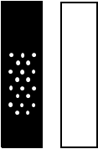
ECM for MD in 2011: two configurations in SPS
Clearing
electrode
(StSt)
StSt8
Carbon coated
3y in SPS
Carbon/StSt
Half coated H
MD w19
MD w21
Do clearing electrodes work up to nominal B-fields ?
Carbon coated
hollow cathode
StSt 9
Carbon coated
3y in SPS
Carbon/StSt
Half coated V
MD w33
MD w35
Would it be sufficient to coat half of the pipe or insert a coated “gutter” ?

Slide 4
25 ns, half carbon-coated vs StSt
MD
Half coated V
Half coated V
StSt9
Int e-cloud/int BCT
At 25 ns the half coated has only 10 times lower current (500 times lower for 50 ns) than StSt, whereas a full carbon coating has at least 1000 times lower current
Conditioning has a similar slope for both (6.5 hours, 3 batches x 72b)

Slide 5
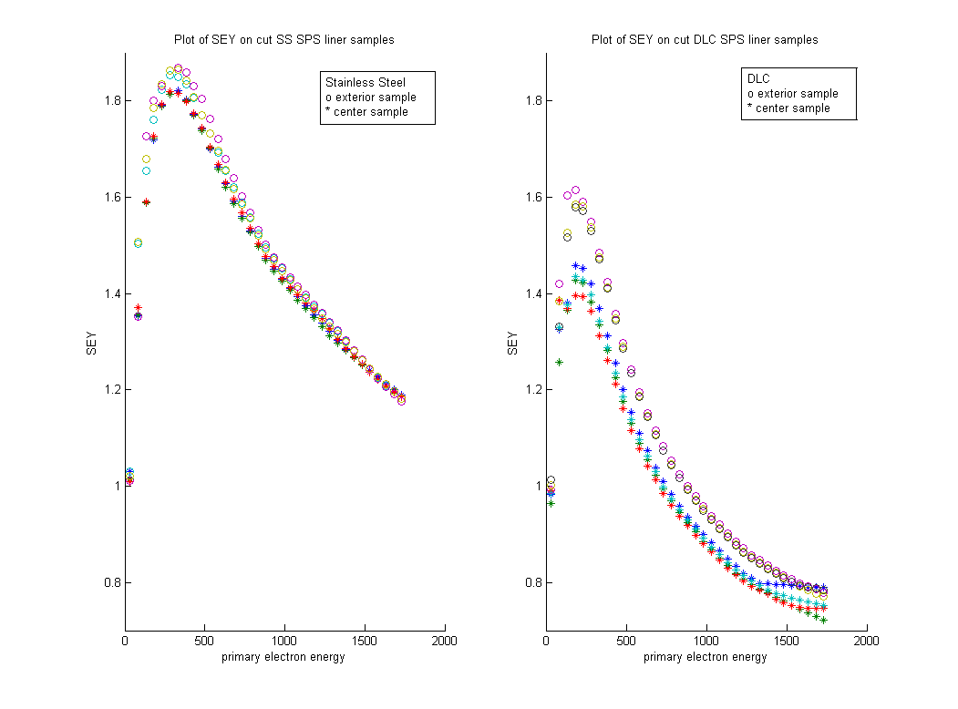
Half-coated vertical : predicted effect by simulations of G.Rumolo (uncoated part δmax=1.8)
G.Rumolo
The result from the MD fits with the prediction of the simulation if we assume an SEY around 1 and a reflection or a zero energy reflection above 0.5
1.8
1.6
1.4
1.2
1
0.8
StSt liner extracted from SPS:
1.8 is realistic
SEY
0 500 1000 1500 2000 Energy[eV]

Slide 6
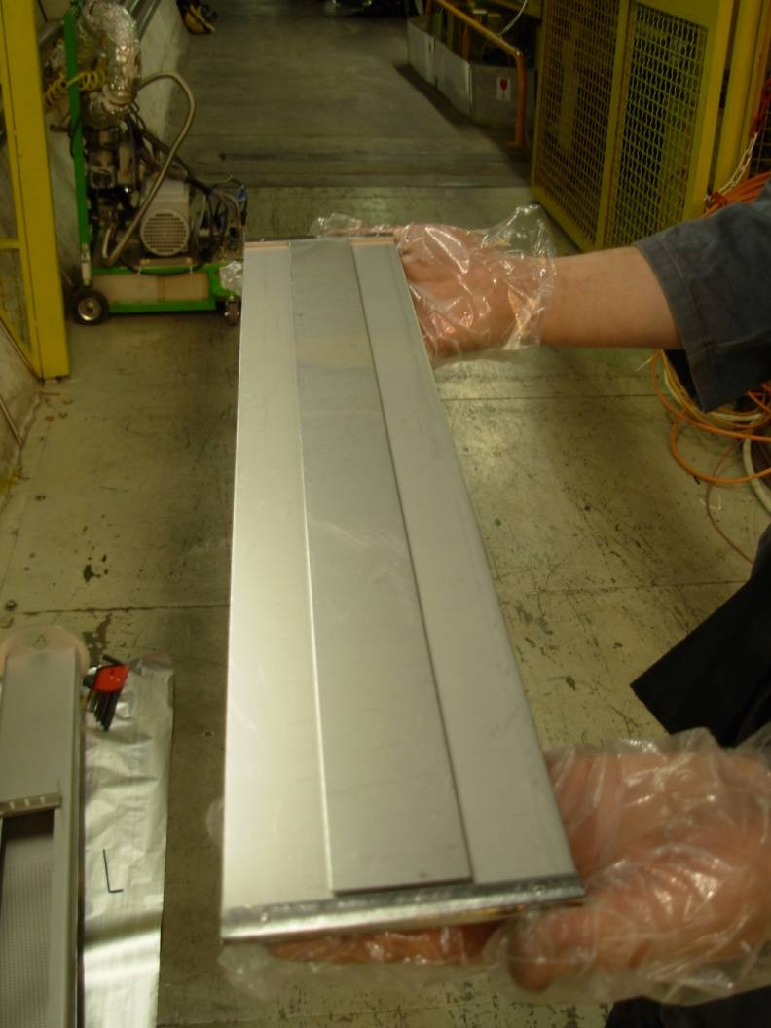
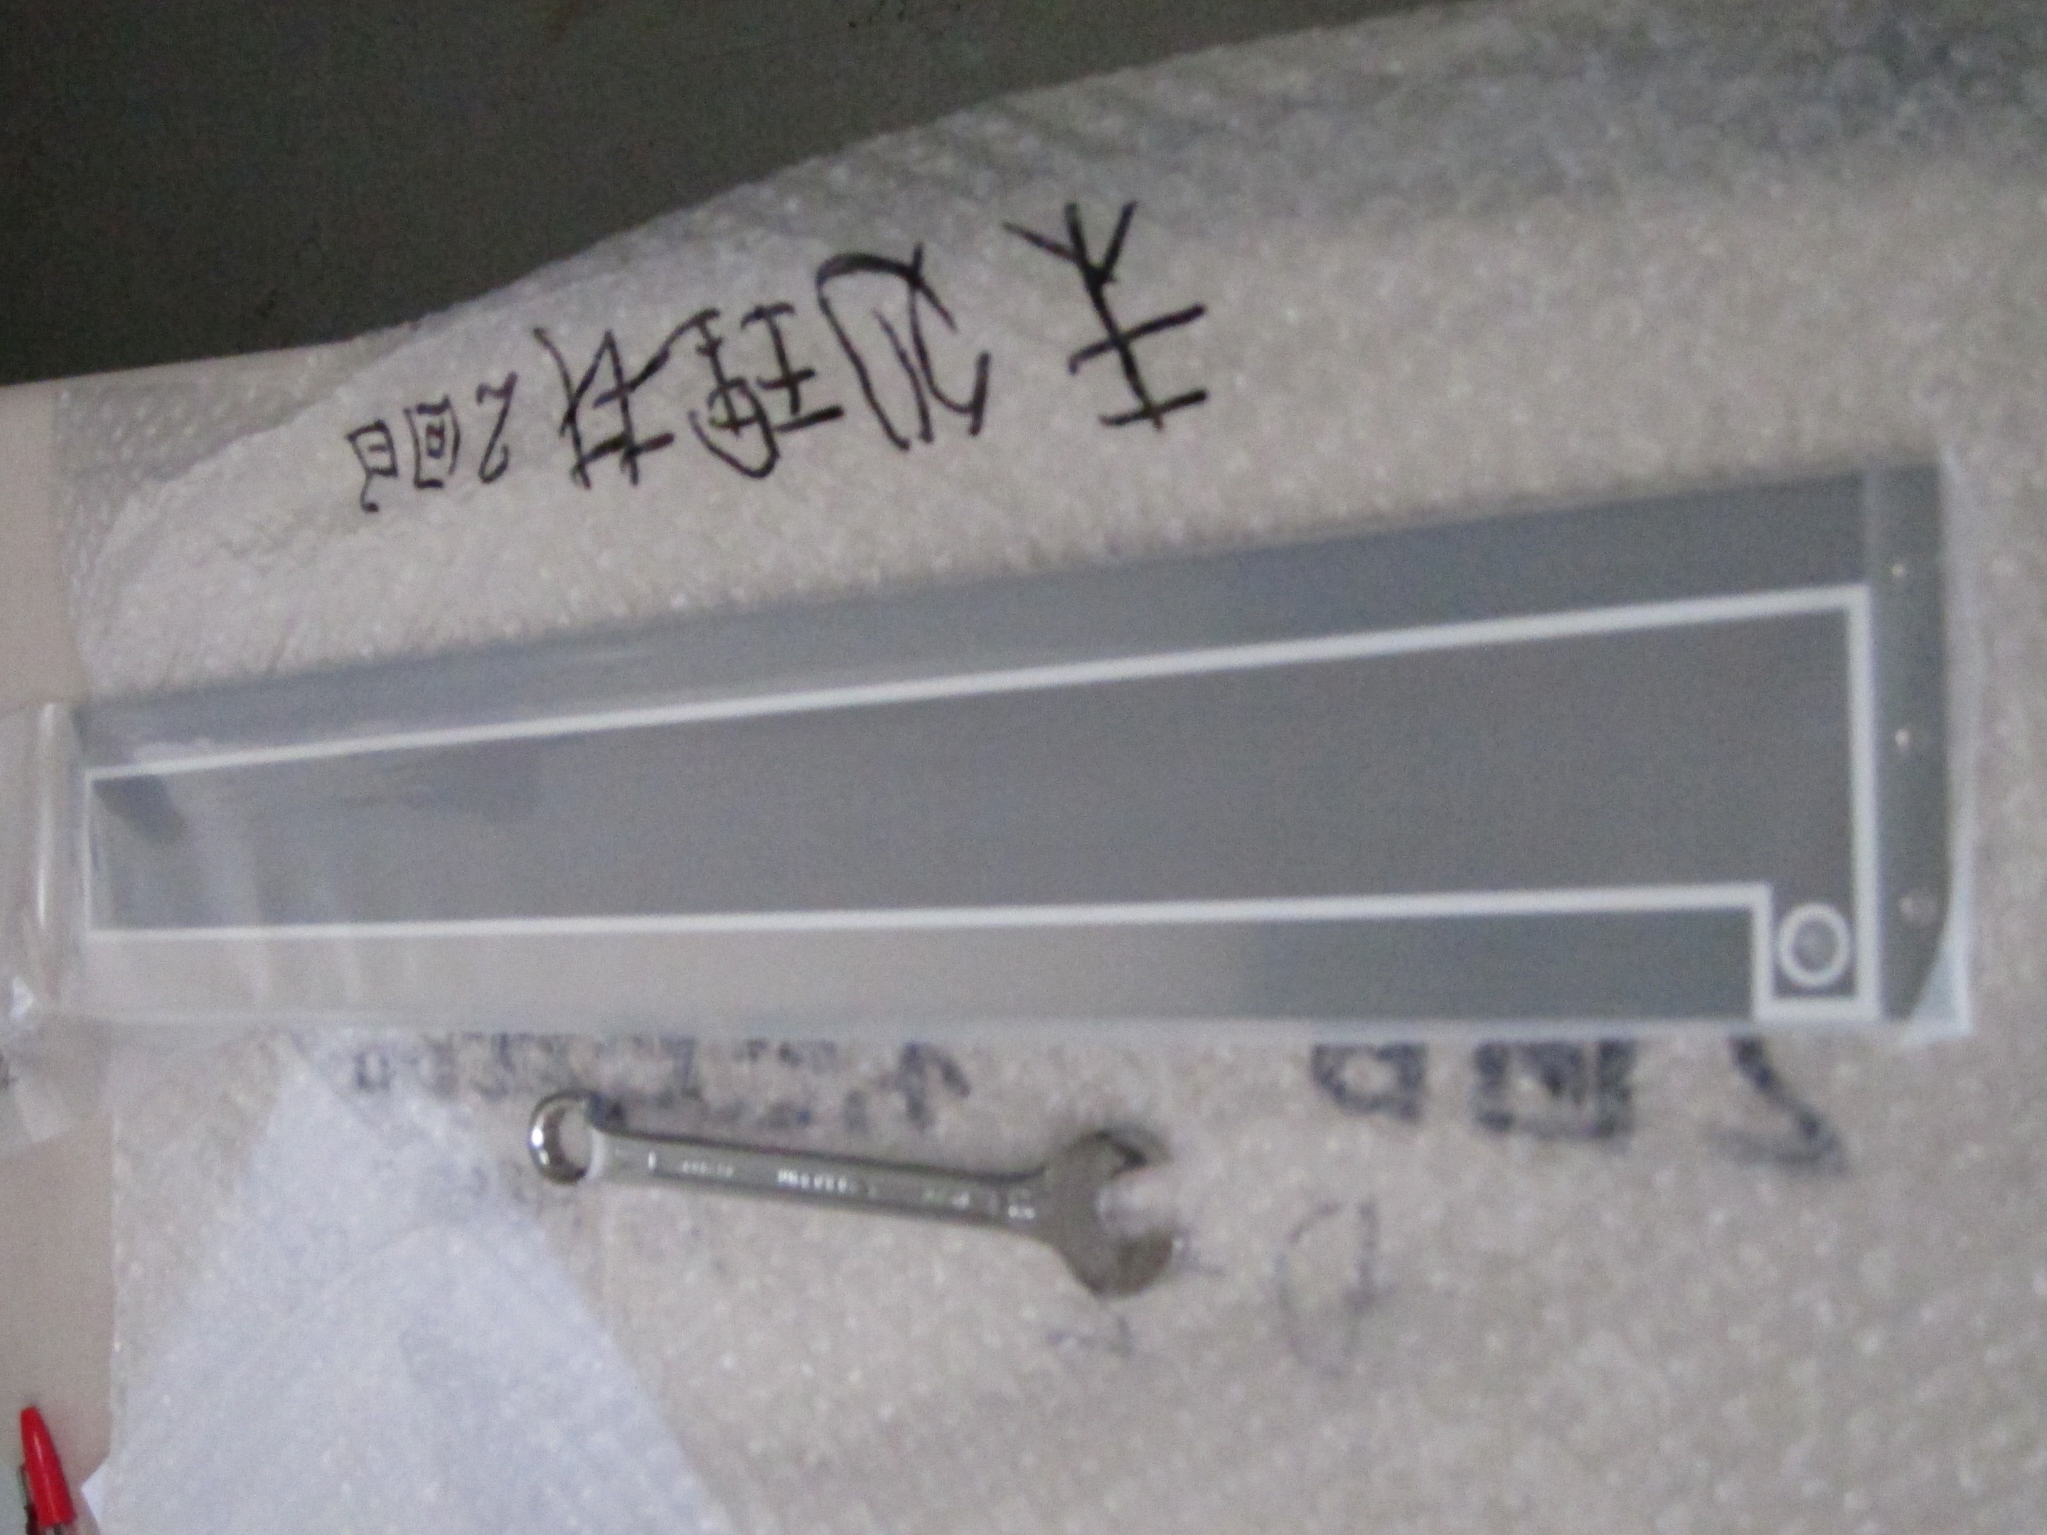
Clearing electrode (StSt)
From KEK (Y. Suetsugu) to CERN
W
Al₂O₃
2011 , StSt
alumina plasma spray, to be tested in 2012

Slide 7
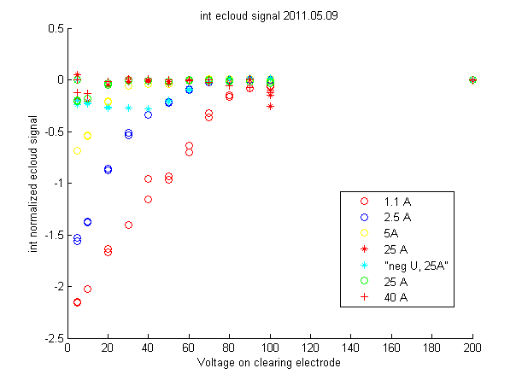
Clearing electrodes: as a function of voltage for different B fields, 25 ns
o 1.1A
o 2.5A
o 5A
* 25A
* 40A
+ -25A
o 25A
+ 25A, 450Gev
26GeV
3 batches
Int e-cloud/int FBCT
0 20 40 60 80 100 120 140 160 180 200
Voltage on the electrode [V]
◊Effective suppression at all tested B fields with low voltage <100V
◊NB: the effect on pressure is almost invisible (the electrode is short 0.4 m) compared to the conductance of the pipe

Slide 8
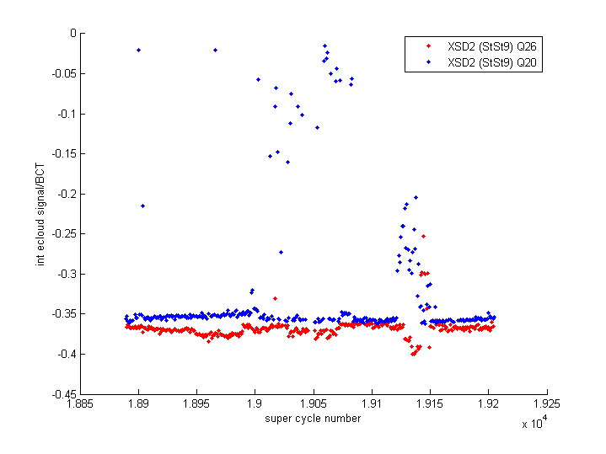
Comparison of e-cloud in Q20/Q26 settings in e-cloud monitor
50 ns
3 batches Q26 + 2 batches Q20
25 ns
2 batches Q26 + 2 batches Q20
0
-0.05
-0.1
-0.15
-0.2
-0.25
-0.3
-0.35
-0.4
Int e-cloud/int BCT
Int e-cloud/int BCT
1.885 1.89 1.895 1.90 1.905 1.91 1.915 1.92 1.925
super cycle number
No significant difference in the measured e-cloud current between the two settings neither at 50 ns nor at 25 ns

Slide 9
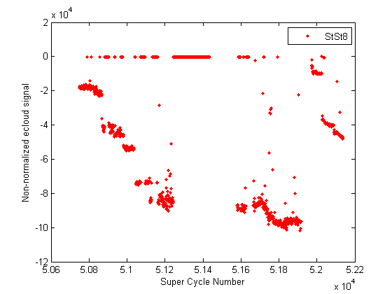
Emittance effect on e-cloud: 50 ns, StSt ECM
1.4p/b
Inj Eh= 3
Inj Ev=2.6
1x36
2x36
4x36
1.6p/b
Inj Eh= 2
Inj Ev=1.9
3x36
4x36
1.35p/b
Inj Eh= 1.6-1.7
Inj Ev=1.6-1.8
4x36
From G.Rumolo
Lower emittance at equal intensity leads to larger e-cloud current
- Should we redo it by disentangling vertical and horizontal emittance effect?

Slide 10
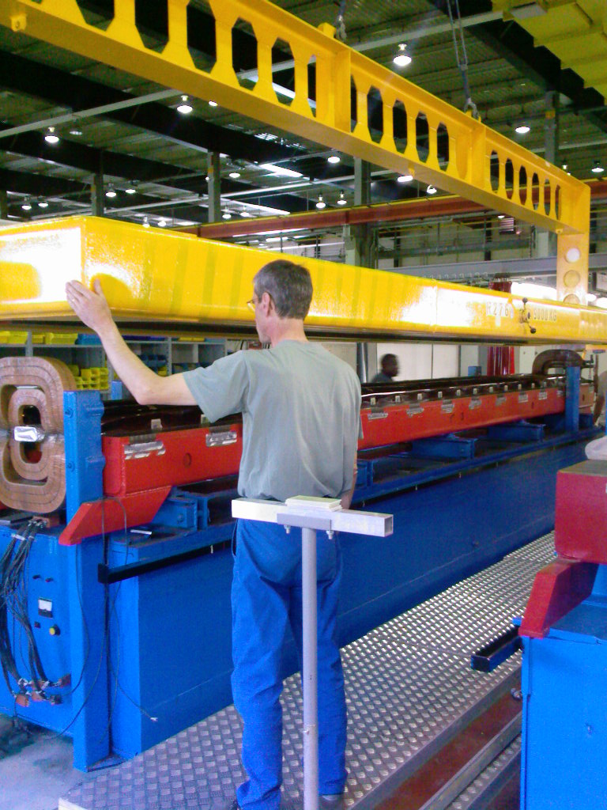
Coatings of SPS dipole chambers
MBB chambers (disassembling/assembling the dipole-yoke):
We have the technology to coat 7m chambers in “magnetron” (new cathode being rebuilt), 3 dipoles already in SPS since 1 year
MBA chambers (disassembling/assembling the dipole-yoke):
-Same technology as MBB, 1 prototype in MBA in progress (next week)
NB: at present we do not have a technique for
magnetic measurements in coated pipes, which
avoids damaging the coating!

Slide 11
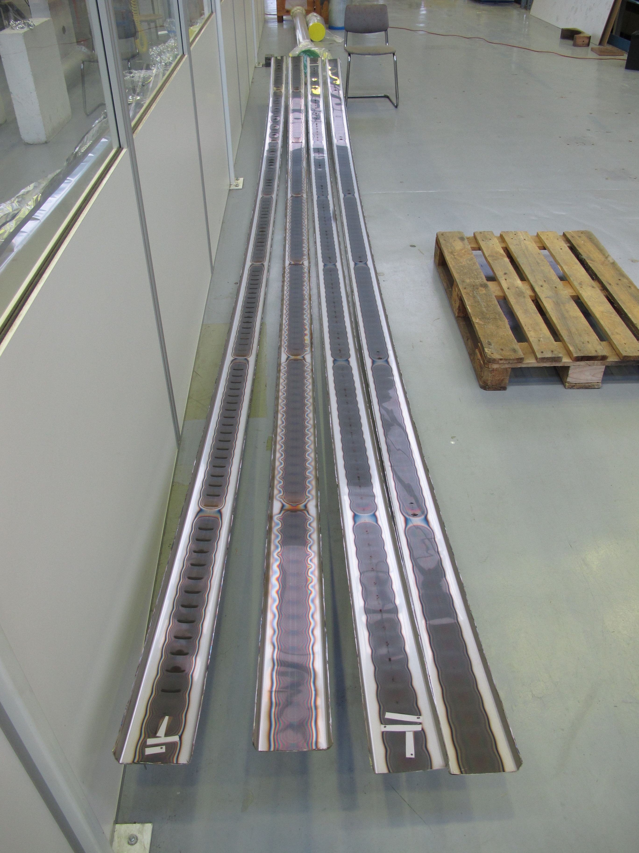
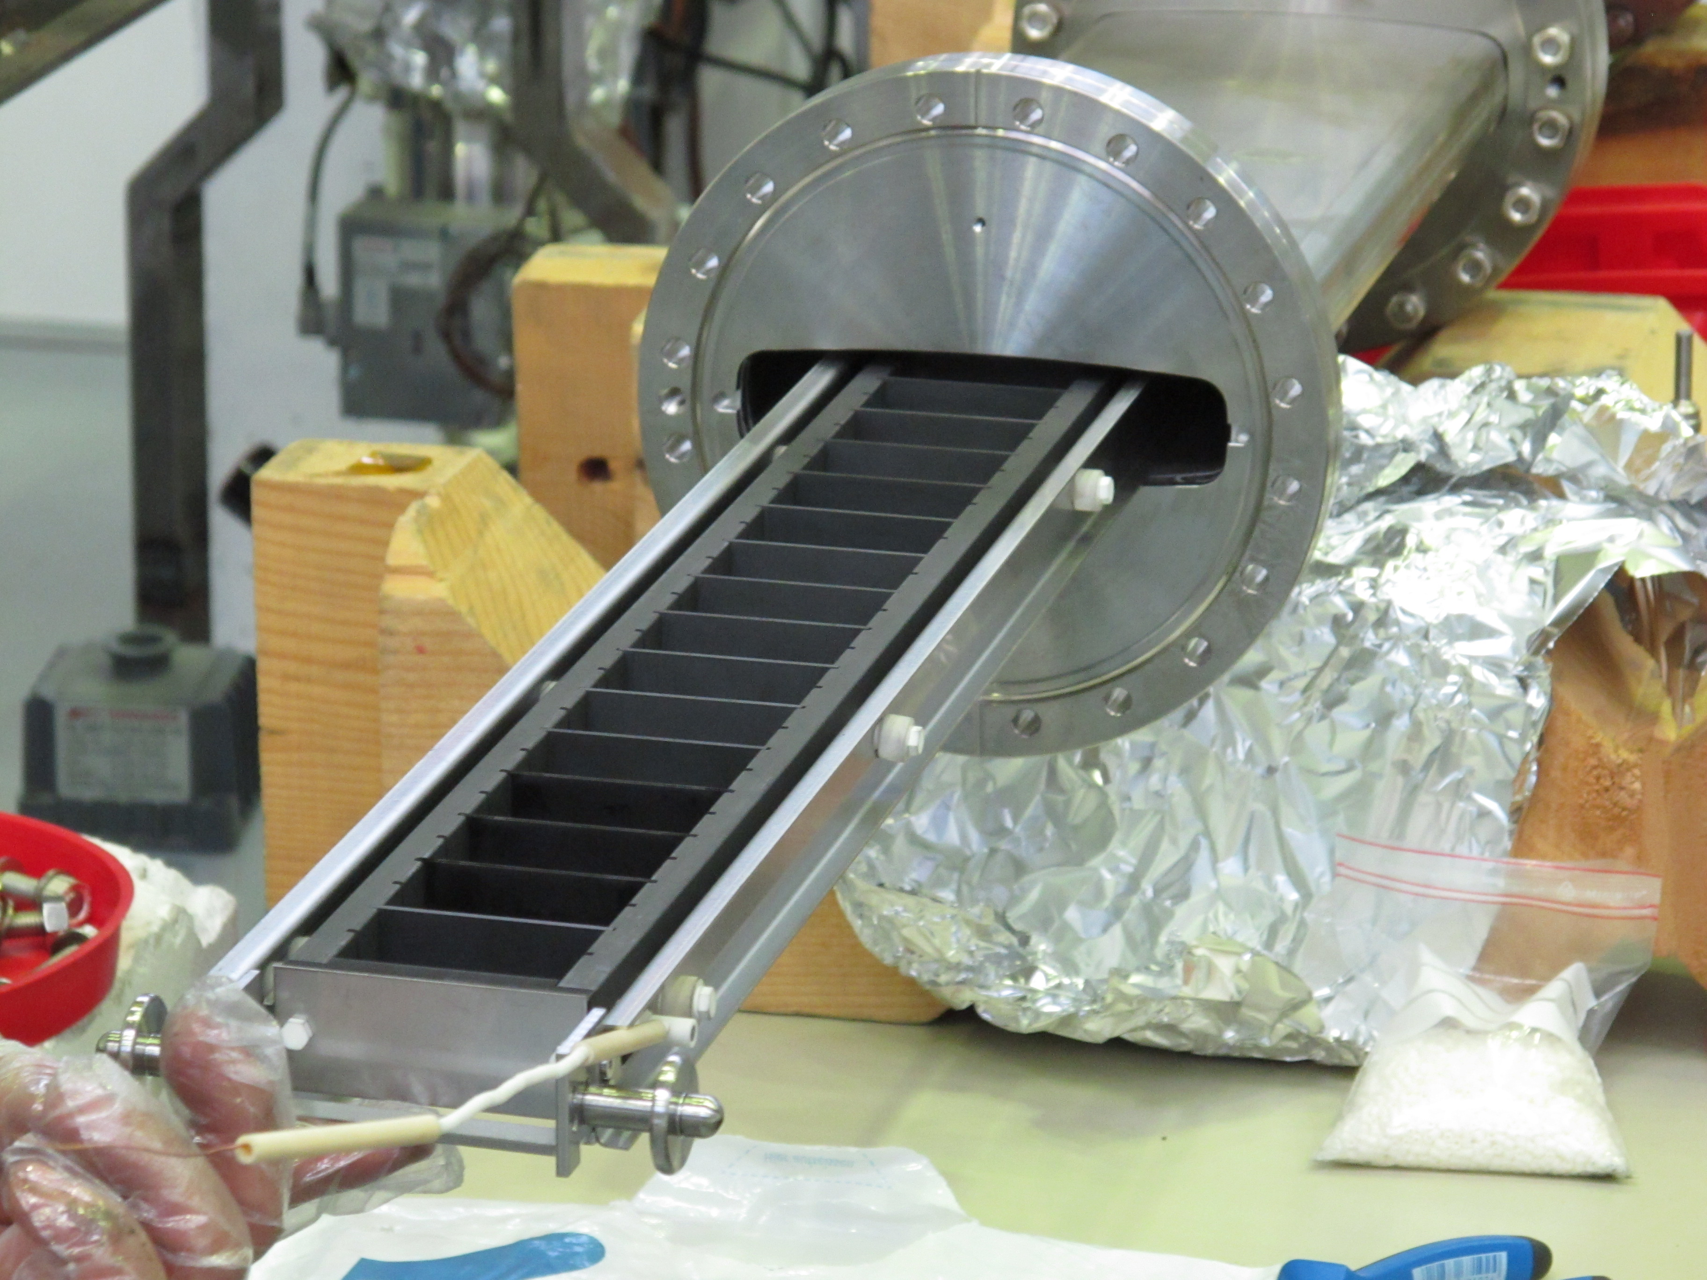
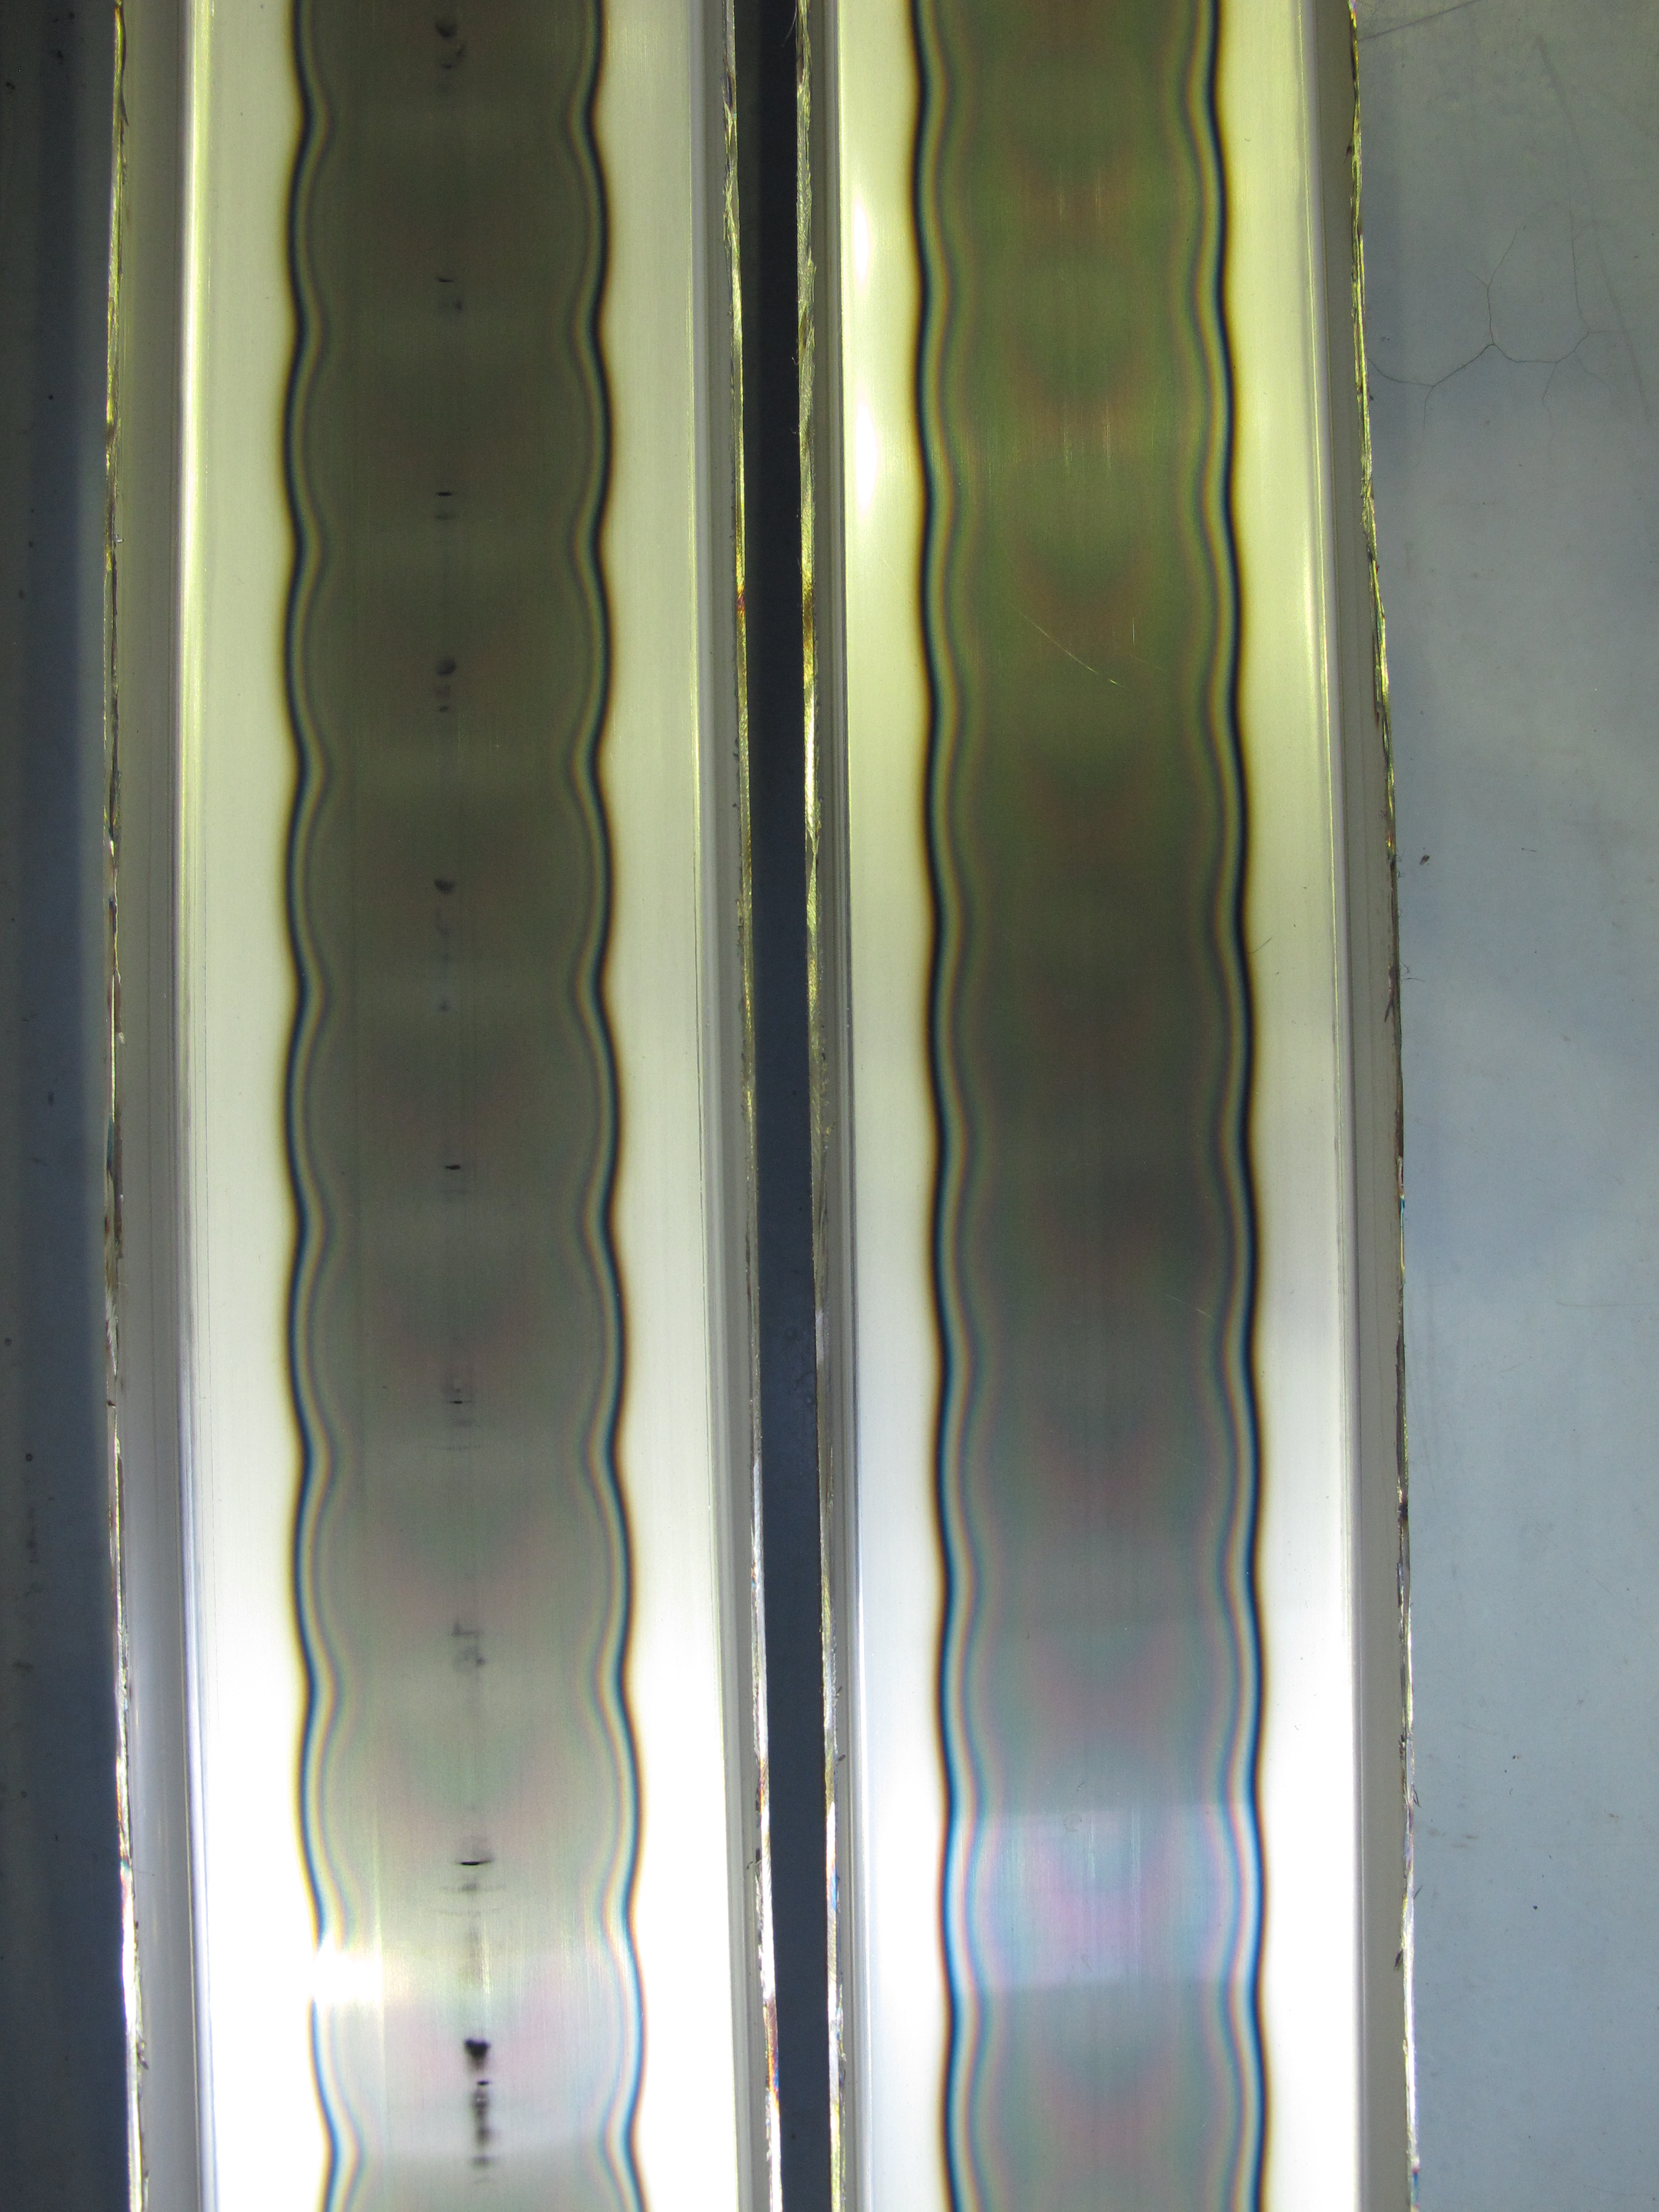
Coatings in dipole
MBB in dipole (without disassembling):
We have the technology to coat 7m chambers in “hollow cathode” (2 prototype tubes)
MBA in dipole (without disassembling):
Same technology as MBB, cathode under construction (March 2012)

Slide 12
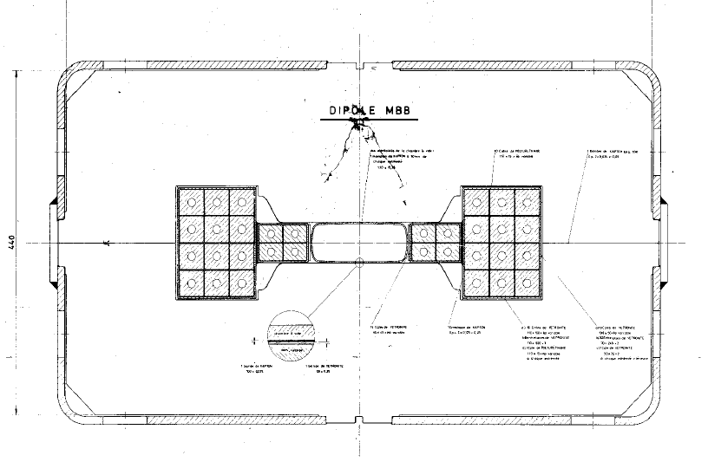
Direct measurement of e-cloud and pressure in dipoles
20 mm
40 mm
20 mm+1mm
grid for RF screening
Insert a screened pick-up electrode directly in the dipole by drilling a hole in the yoke: local measurement of e-cloud and pressure
Calculations (J.Bauche) confirm that the effect of two symmetric holes on the magnetic length can be compensated by shims

Slide 13
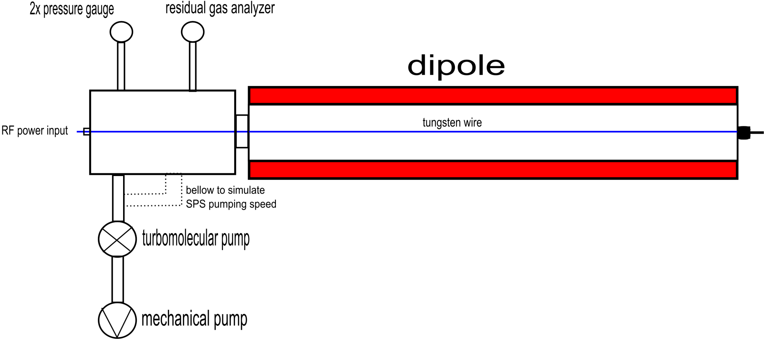
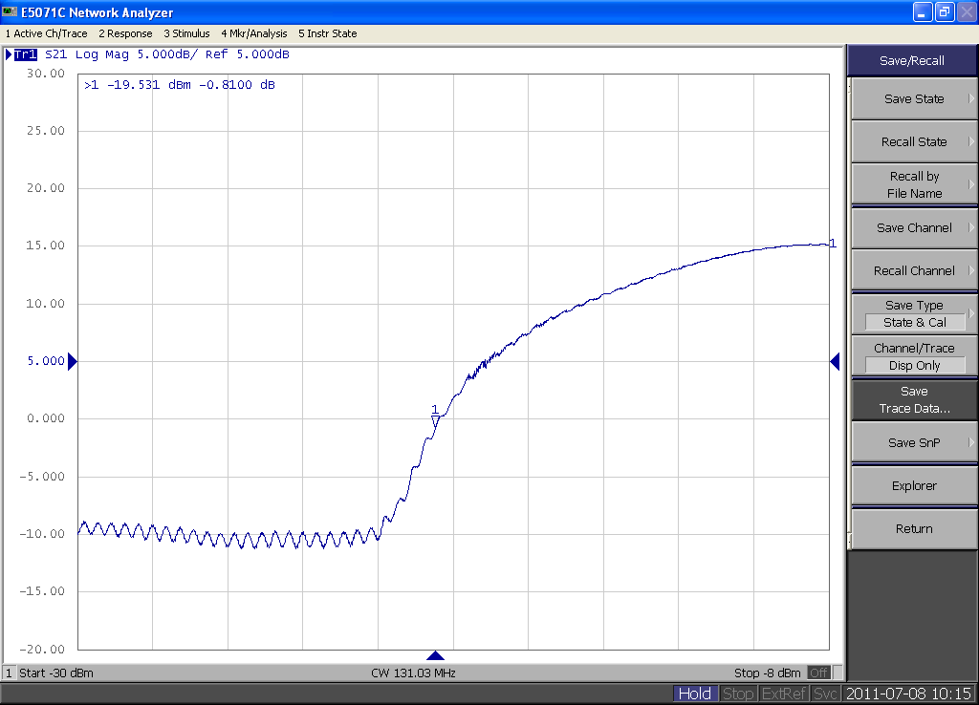
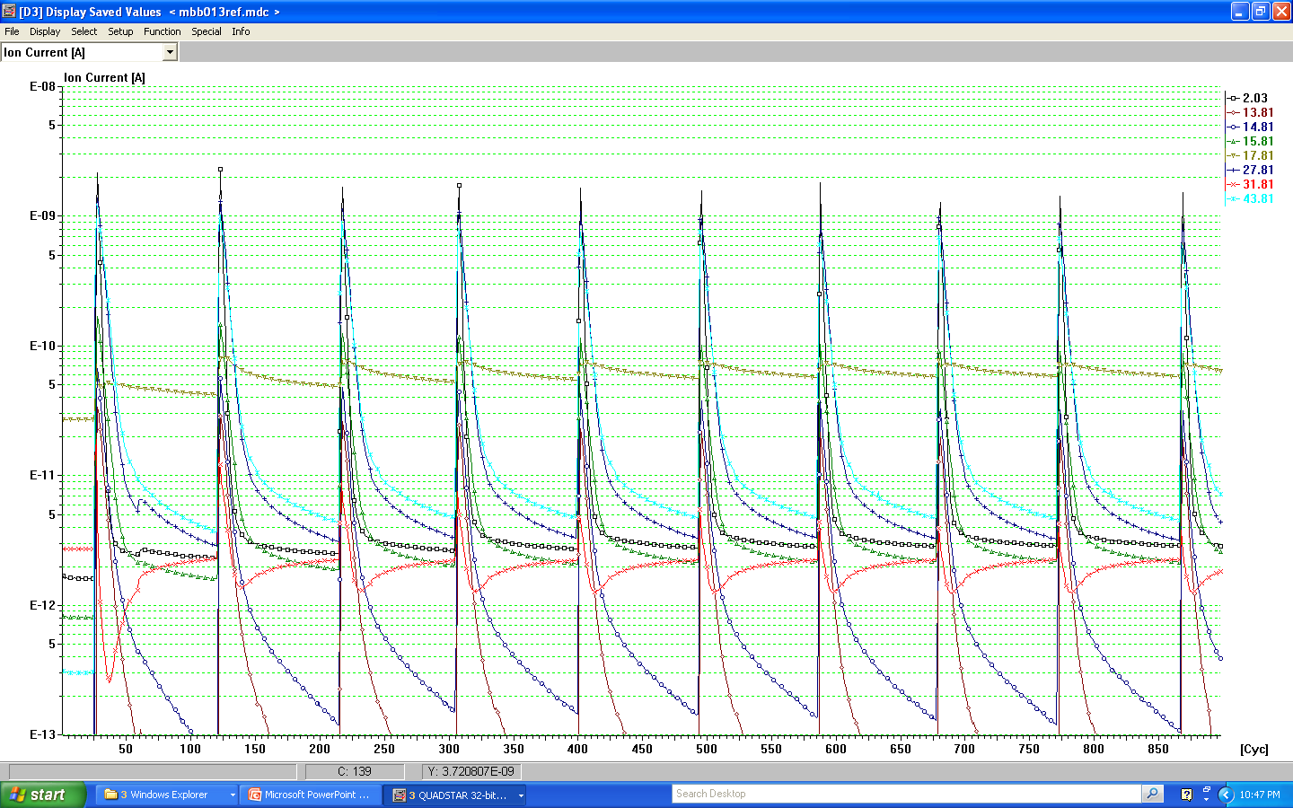
Diagnostics in the lab: Multipactor in StSt dipole
M.Holz
RF diagnostics: reflected power
Pressure rise diagnostics: RGA signal
reflected
pressure
Power in
M.Holz
Time

Slide 14
Planning
Plan for winter 2011-12 TS
Insert in SPS a half cell (or part of it) with carbon coated chambers in magnetron
Clearing electrode in alumina plasma-spray
By mid 2012
Complete the half-cell and add a second half-cell coated in “hollow cathode”
Equip it with more detailed pressure diagnostics
Insert pick-up diagnostics in dipoles (1 coated + 1 uncoated)
Plan for LS1
- Insert 2 cells with coating

Slide 15
All this would not have been possible without the contributions of :
J.Bauche
P.Costa Pinto,
F.Caspers,
P.Edwards,
M.Holz,
D.Holzer,
M.Jimenez,
L.Leggiero,
M.Mensi,
H.Neupert,
G.Rumolo,
E.Shaposhnikova,
C.Yin-Vallgren
…….

Slide 16
Measurements of currents in electron cloud monitors
B-field (0.12 T = field of SPS at injection)
Coated liner
proton
beam
magnet chamber
e-cloud current
48 strips spaced 1.5 mm

Slide 17
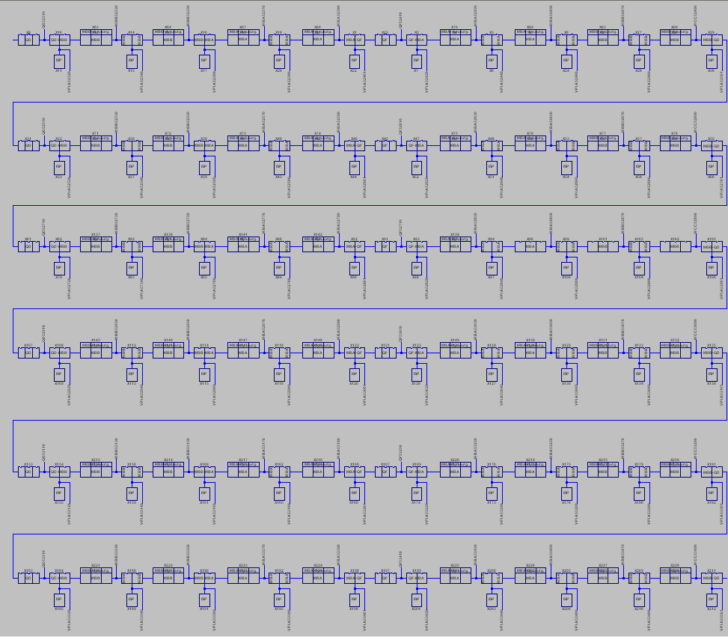
Pressure calculation
Assumptions:
only StSt dipole have dynamic outgassing
pumping speed of ion pumps is the nomimal one
Result of the analytical calculation:
The dynamic pressure rise in the coated dipoles is between 3 and 5 times lower than in StSt
We never observed this!
Coated
dipoles
without
dyn. outgassing
Entire layout: 6 full cells
Measured p
D.Holzer

Slide 18
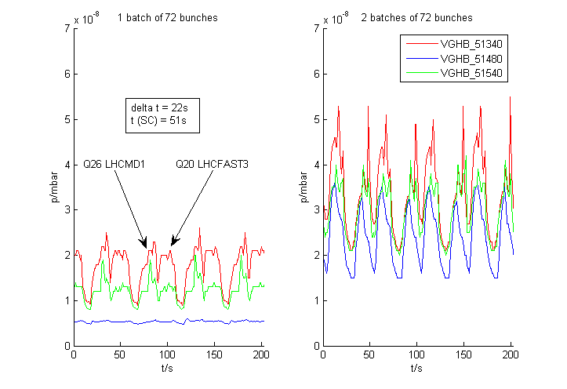
Pressure measurements between coated/uncoated MBB dipoles
1 and 2 batches, 25 ns, 2011
Uncoated
carbon coated

Slide 19
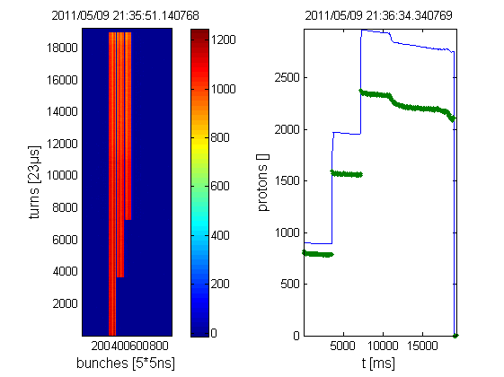
Residual gas analyser installed in SPS (MD May 2011) close to ECM
Beam on: 25 ns, 3 batches, 72bunches, 450 GeV
Gas ratios typical for particle induced desorption: no change for water and p dominated by CO and H₂. (approximate calibration of RGA)

