Slide 1
THE
LHC INJECTORS UPGRADE (“LIU”) PROJECT
R. Garoby for the LIU Project Team
LIU-2011 November 25, 2011 CERN

Slide 2
Introduction
Project Management
Anticipated Performance Goals
Planning
Summary

Slide 3
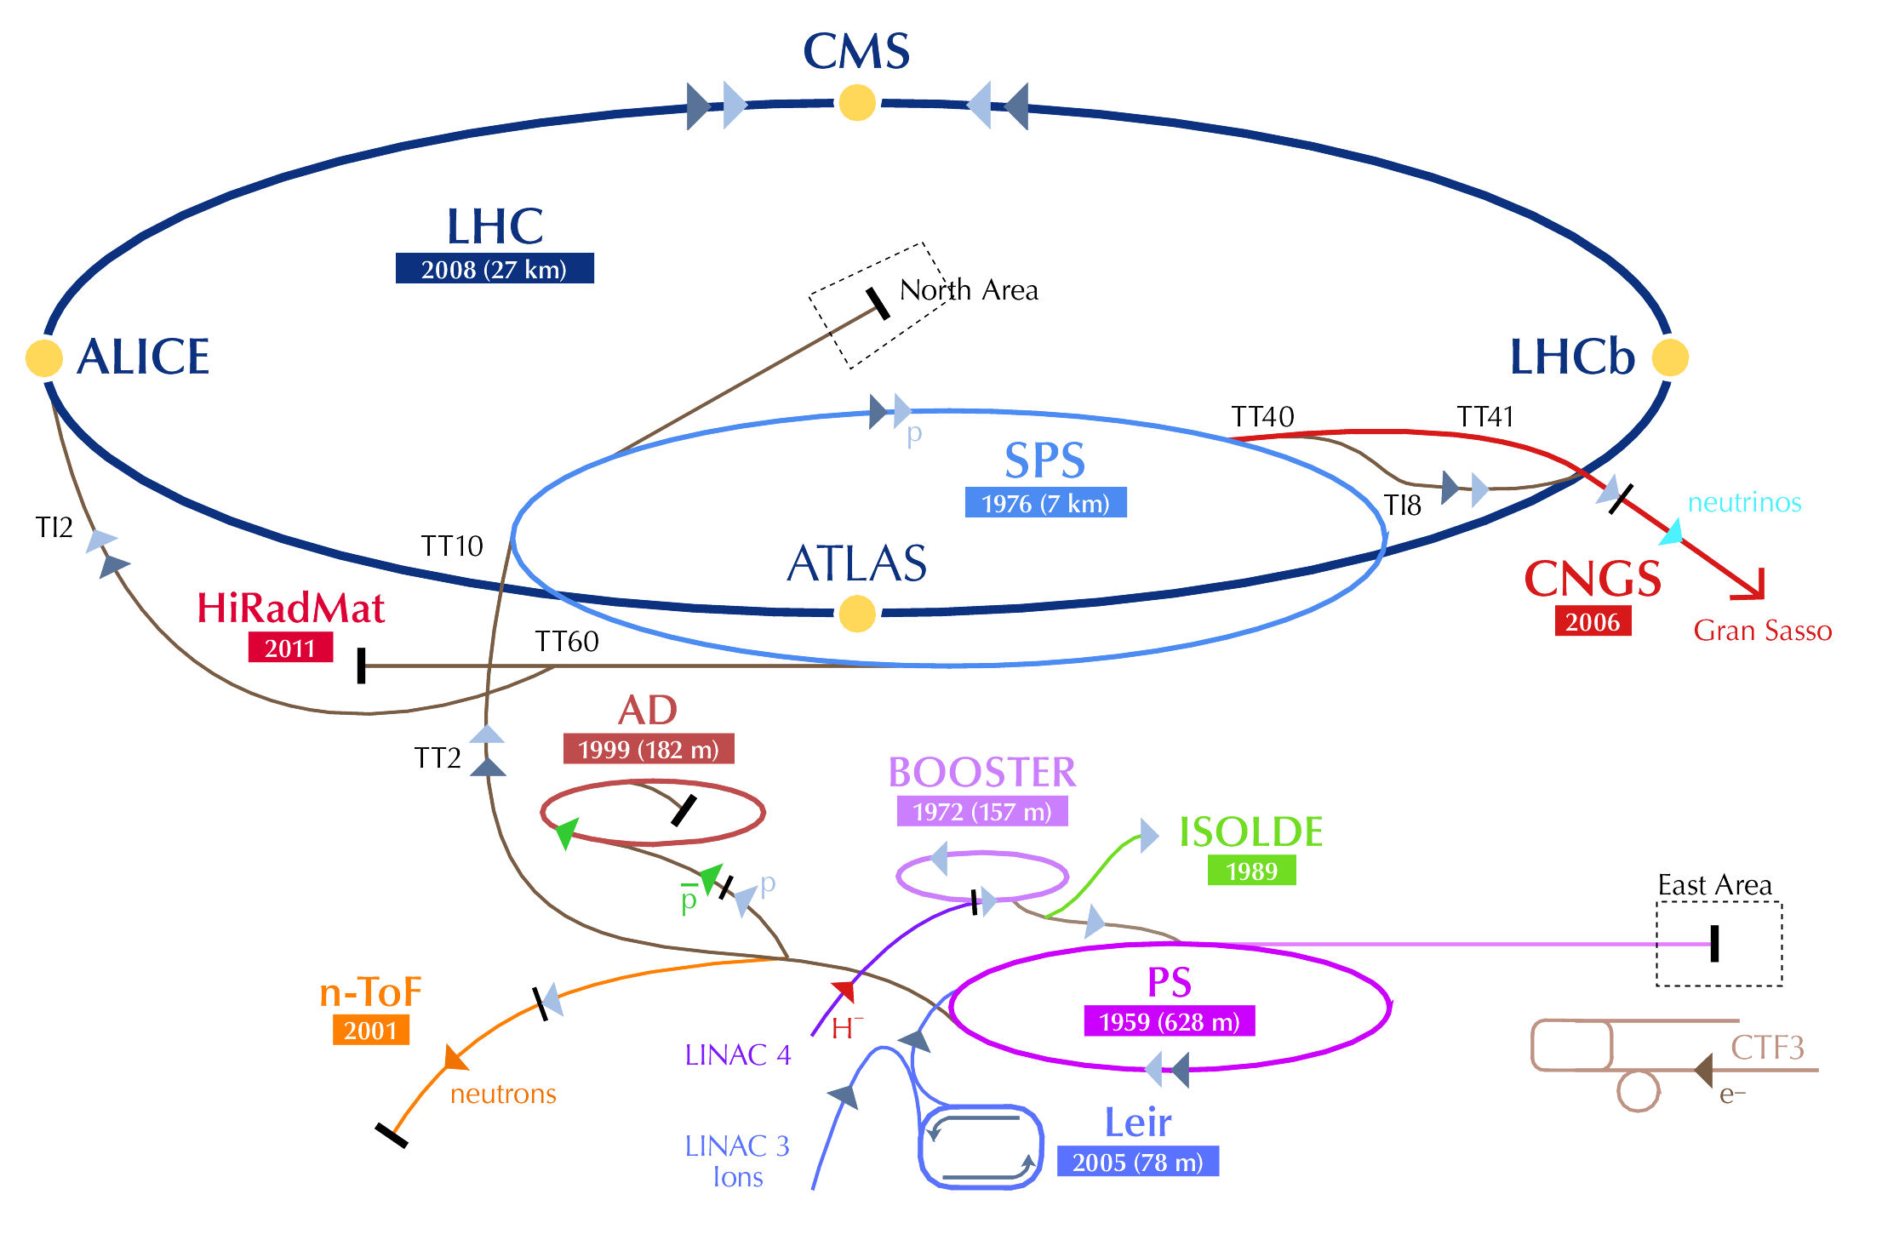
Goals & Means
Mandate
“The LHC Injectors Upgrade should plan for delivering reliably to the LHC the beams required for reaching the goals of the HL-LHC. This includes LINAC4, the PS booster, the PS, the SPS, as well as the heavy ion chain…”
Implementation
The LIU Project will:
  Analyze the status of the injectors and the HL-LHC requirements,
  Propose an upgrade path for the injectors, exploiting the work done by the Task Forces on the „PSB energy upgrade“ and „SPS upgrade“ and by the Working Group on the SPS upgrade,
  Organize the upgrades (WBS with resources and planning) and take care of their implementation,
  Take care of hardware and beam commissioning.

Slide 4
Basic Principles
To increase performance (soon extended for heavy ions)
Brightness ä
Increase injection energy in the PSB from 50 to 160 MeV, Linac4 (160 MeV H⁻) to replace Linac2 (50 MeV H⁺)
Increase injection energy in the PS from 1.4 to 2 GeV, increasing the field in the PSB magnets, replacing power supply and changing transfer equipment
Upgrade the PSB , PS and SPS to make them capable to accelerate and manipulate a higher brightness beam (feedbacks, cures against electron clouds, hardware modifications to reduce impedance…)
To increase reliability and lifetime (until ~2030!)
(tightly interleaved with consolidation)
Upgrade/replace ageing equipment (power supplies, magnets, RF…)
Procure spares
Improve radioprotection measures (shielding, ventilation…)

Slide 5
Baseline Upgrade Actions
PSB/PS/SPS | Management
 | Beam dynamics
 | Magnets
 | RF systems
 | Power converters
 | Beam instrumentation
 | Beam intercepting devices
 | Vacuum
 | Injection system
 | Ejection system and transfer line to PS/SPS/LHC
 | Controls
 | Electrical systems
 | Cooling and ventilation
 | Installation, transport and handling
 | Civil Engineering
 | Radioprotection
 | Machine interlocks
 | Alarms
 | Access system
 | Survey
 | Commissioning
 | Dismantling
Construction of LINAC4
All equipment and service groups are involved!
Upgrades of PSB,
PS and SPS
«Typical» list
of Work Units
+ Consolidation…

Slide 6
Introduction
Project Management
Anticipated Performance Goals
Planning
Summary

Slide 7
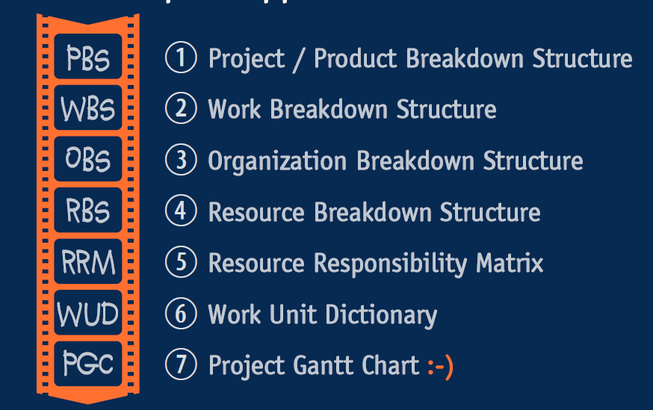
LIU Project Mandate (continued)
…
The project co-ordinator will have the responsibility for the project management (WBS, technical co-ordination and integration, manpower and budget agreement with the departments as well as budget and timescale control). They will report on a regular basis to the Director of Accelerators and Technology. The executive role for manpower and budget for the projects/studies remains with the technical groups in the departments.
LIU Project Planning and Costing
Source: Project Management case study
– P. Bonnal, M. Meddahi

Slide 8
Project Organization Breakdown Structure
Director of Accelerators and technology - Steve Myers
LIU Project team
Roland Garoby (Project Leader) - Malika Meddahi (Deputy) - Brennan Goddard (LIU-SPS machine coordinator) - Simone Gilardoni (LIU-PS machine coordinator) - Klaus Hanke (LIU-PSB machine coordinator) - Maurizio Vretenar (Linac4 Project Leader)- Laurette Ponce (Project Safety Officer)-Django Manglunki (LIU-Ion chain coordinator)
LIU-PSB coordination team
K.Hanke – Activity leader
B.Mikulec – Deputy
V.Raginel – Scientific secretary
https://espace.cern.ch/liu-project/liu-psb/
LIU- PS coordination team
S.Gilardoni – Activity Leader
H. Damerau– Deputy and Scientific secretary
https://espace.cern.ch/liu-project/liu-ps/
LIU-SPS coordination team
B.Goddard
E.Shaposhnikova – Deputy
G.Rumulo – Scientific secretary
https://espace.cern.ch/liu-project/liu-sps/default.aspx
LIU-Project Safety coordination
L. Ponce
Linac4 Project
M.Vretenar
http://linac4-project.web.cern.ch/linac4-project/
LIU Administrative Support: Cécile Noels, Nadine Audrey. Project Support: Pierre Bonnal, Sylvain Weisz, Tadeusz Kurtyka - EVM coordinators: De Jonghe, Benoît Daudin

Slide 9
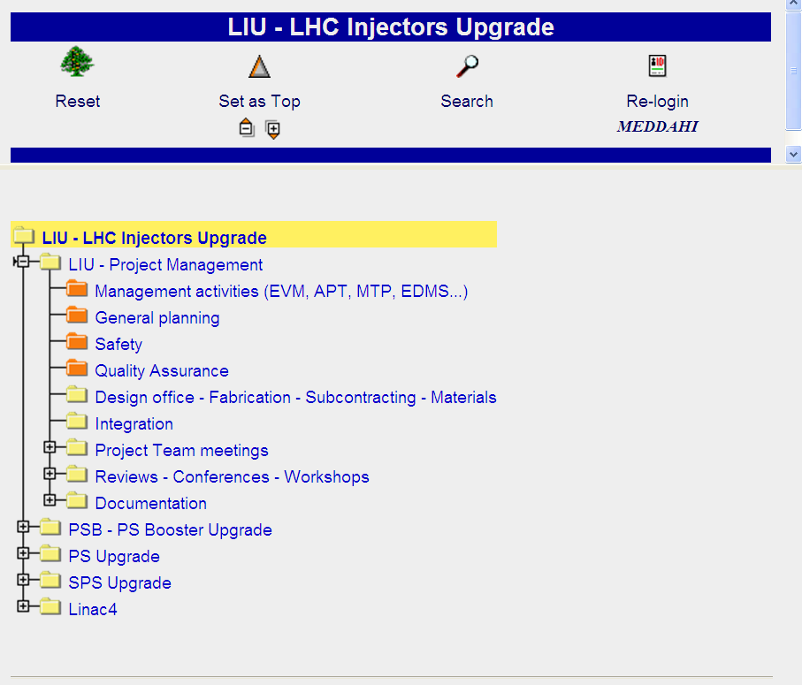
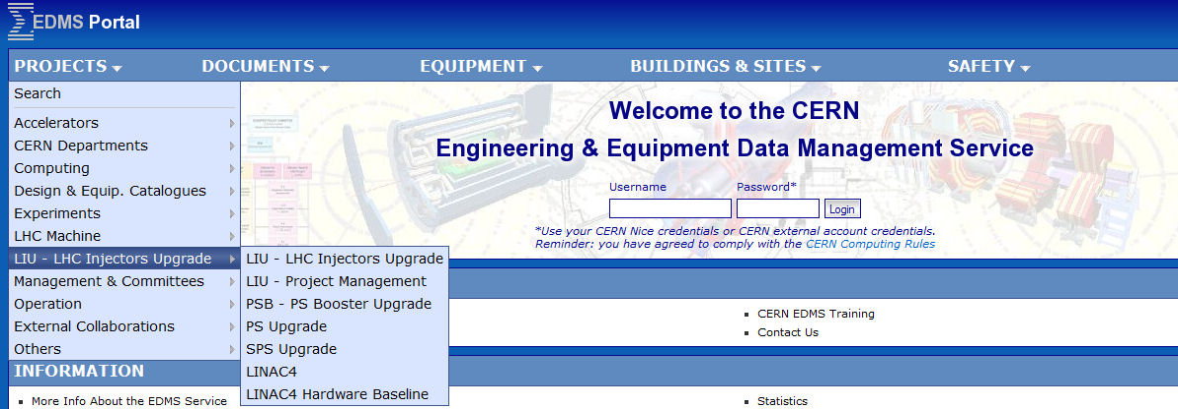
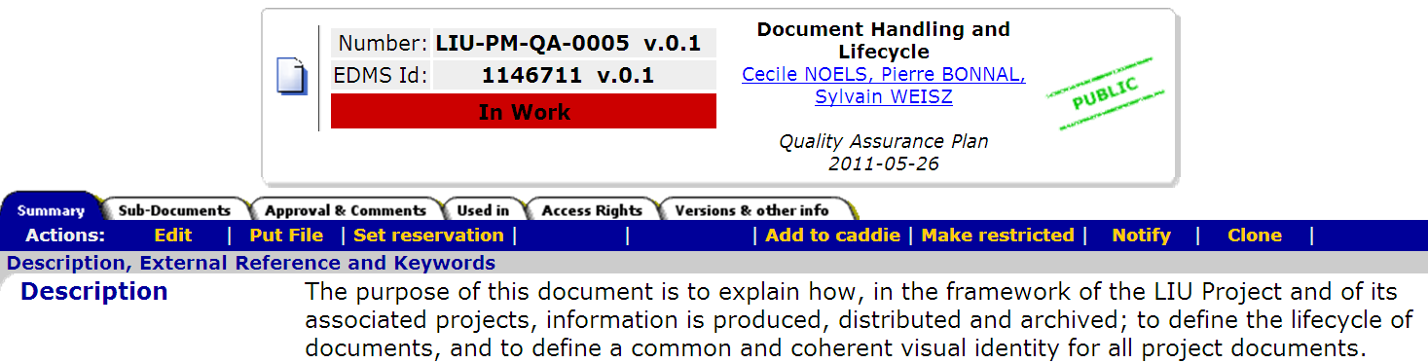
Quality Control
https://edms.cern.ch/ - by EDMS team and Project Support Office
Templates and document handling and lifetime
Indico

Slide 10
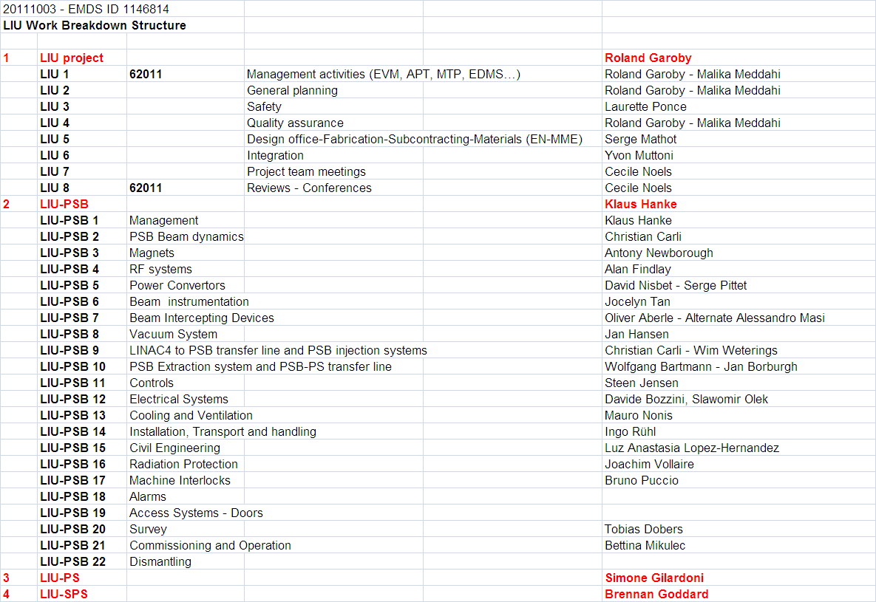
Work Breakdown Structure

Slide 11
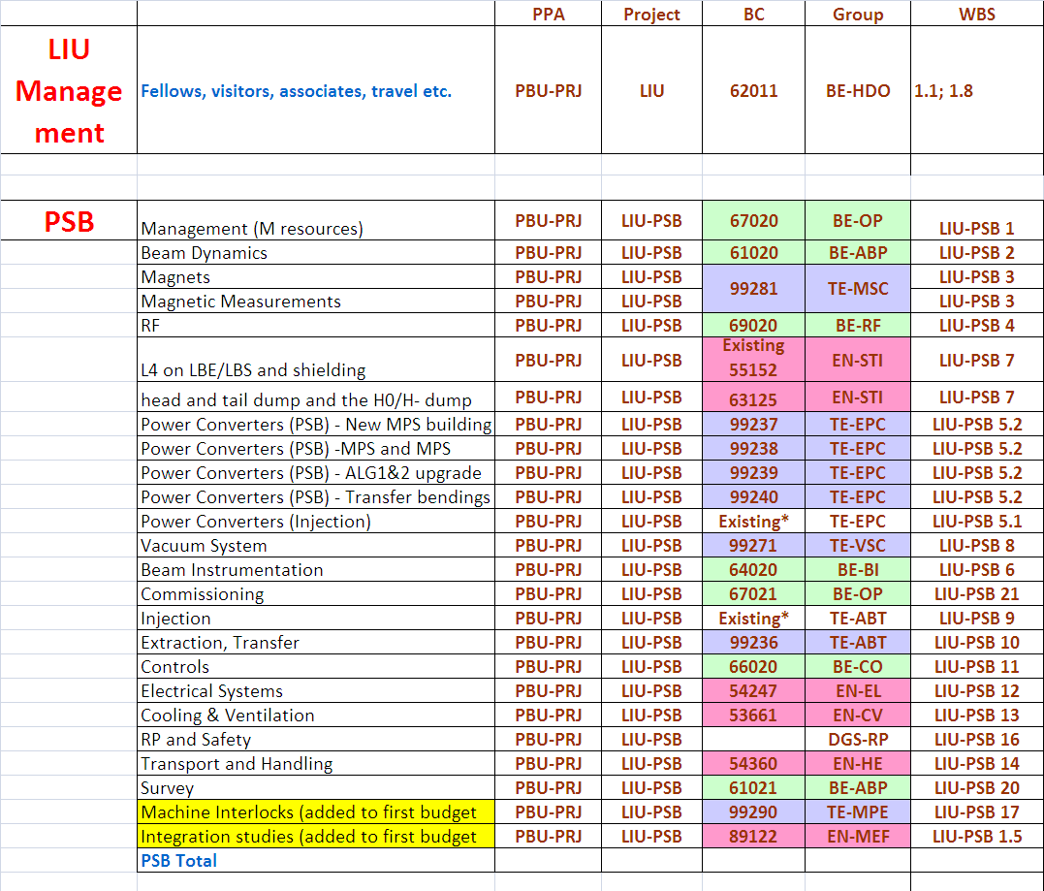
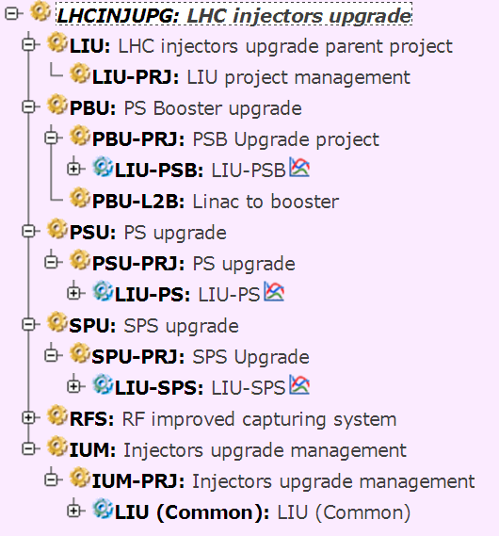
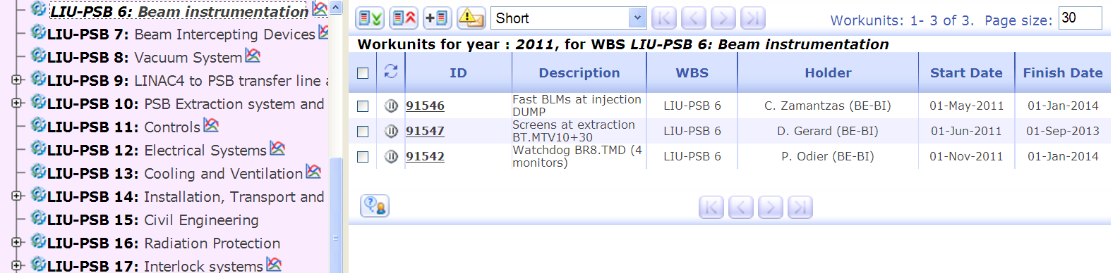
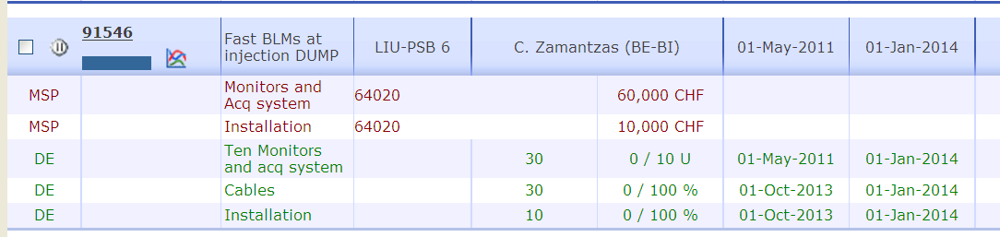
Budget Control – (APT by J. De Jonghe, B. Daudin)
WUs dictionary defined for all LIU machines - resources, schedule and deliverables
WORK IN PROGRESS

Slide 12
Introduction
Project Management
Anticipated Performance Goals
Planning
Summary

Slide 13
Basic assumptions
Beam parameters are given at injection in LHC: beam loss and blow-up inside the LHC are not accounted for.
All necessary improvements are implemented in the injectors (Linac4, PSB to PS transfer at 2 GeV, coupled bunch instabilities suppressed, e-cloud suppressed, hardware upgraded…)
Estimated beam degradation in the accelerator chain (based on observations in 2010):
  PS: 5 % beam loss, 5 % transverse blow-up
  SPS: 10 % beam loss, 5 % transverse blow-up.
RF gymnastics being kept, imperfections are unchanged:
  +-10 % fluctuation of all bunch parameters within a given PS bunch train.
  Traces of ghost/satellite bunches.

Slide 14
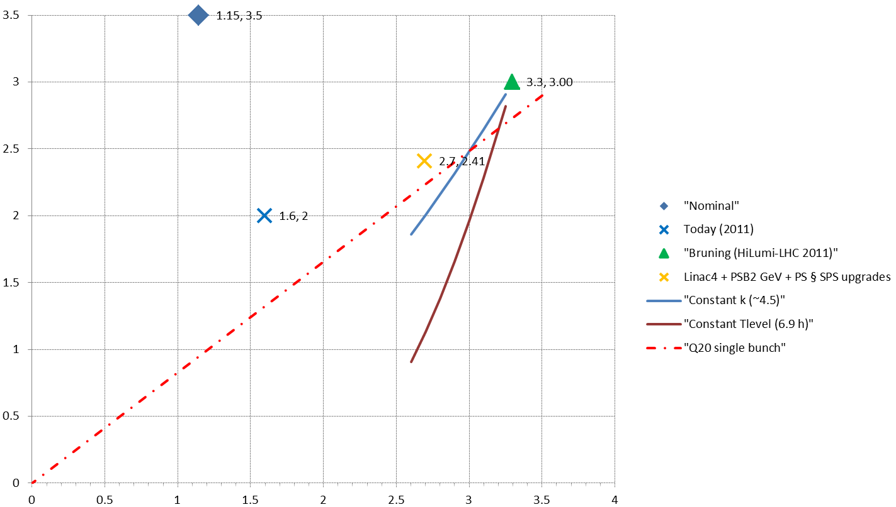
Beam parameters at LHC injection [50 ns]
HL-LHC requirement at 7 TeV
Nominal performance
Anticipated performanceafter LIU
Today (2011)
H/V transverse emittances [mm.mrad]
Constant transverse density
(Space charge)
SPS single bunch limit
Bunch intensity within constant longitudinal emittance [x10¹¹ p/b]

Slide 15
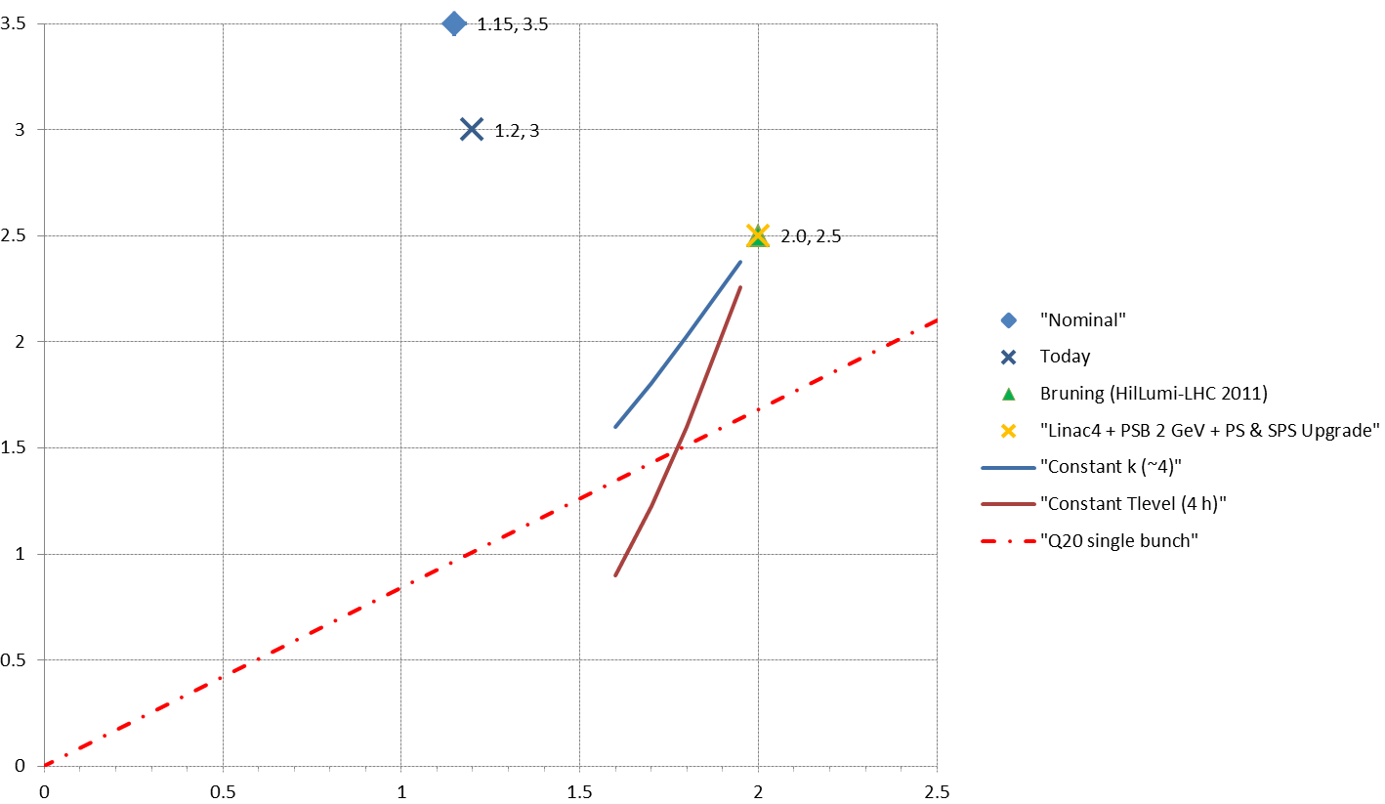
Beam parameters at LHC injection [25 ns]
Anticipated performanceafter LIU
Nominal performance
HL-LHC requirement at 7 TeV
Today (2011)
H/V transverse emittances [mm.mrad]
Constant transverse density
(Space charge)
SPS single bunch limit
Bunch intensity within constant longitudinal emittance [x10¹¹ p/b]

Slide 16
Introduction
Project Management
Anticipated Performance Goals
Planning
Summary

Slide 17
Comments
LIU performance goals in terms of beam characteristics at injection in the LHC have to meet the needs of HL-LHC and to be feasible... Subject of active interactions between HL-LHC and LIU teams (2nd joint «Brainstorming» session on January 24, 2012).
MDs until the end of 2012 will help refine the knowledge and understanding of the injectors and check the potential of upgrades.
End 2012/beginning 2013, the performance goals of the LIU project will be specified and the precise list of hardware modifications with their specifications will be issued.

Slide 18
Planning
 | Linac4 | PS injector, PS and SPS | Beam characteristics at LHC injection
2011 - 2012 | Continuation of construction… | Beam studies § simulations Investigation of RCS option Hardware prototyping Test of new beam gymnastics Design § construction of equipment TDR | 25 ns, 1.2 10¹¹p/b, ~3 mm.mrad 50 ns, 1.7 10¹¹p/b, ∼2 mm.mrad
2013 – 2014 (Long Shutdown 1) | Linac4 beam commissioning | Modifications and installation of some prototypes in PSB, PS and SPS Design § construction of equipment
2015 - 2017 | Progressive increase of Linac4 beam current | Implementation of new PS beam gymnastics… PSB modification and connection to Linac4 during extentended winter shutdown If/when Linac4 connected: progressive increase of PSB brightness with benefits for PS and SPS. Equipment design § construction for PSB, PS and SPS Beam studies | Possibly smaller emittance (25 ns) with new PS beam gymnastics… Limited gain from Linac4 proper (pending PSB, PS and SPS hardware upgrades)
2018 (Long Shutdown 2) |  | Extensive installations in PSB, PS and SPS Hardware commissioning
2019 –2021 |  | Beam commissioning | After ~1 year of operation: beam characteristics for HL-LHC…

Slide 19
Introduction
Project Management
Anticipated Performance Goals
Planning
Summary

Slide 20
Summary
The goal of the LIU project is to make the LHC injector complex capable to reliably deliver the higher performance proton and ion beams required for High Luminosity in LHC until later than 2030.
Performance for other users will at least be preserved and generally benefit (e.g. high intensity).
More MDs will take place in 2012 to finalize the hardware modifications and their precise specifications.
The implementation of hardware modifications will finish during LS2.
All equipment and service groups are concerned!

Slide 21
THANK YOU
FOR YOUR ATTENTION!

Slide 22
Reference

Slide 23
Why is today’s beam better than nominal?
Simple! No more blow-up along the accelerators cascade…
PSB:
  Improved (achromatic) optics in the Linac2 to PSB transfer line since 2005 [http://khanke.home.cern.ch/khanke/papers/2006/ab_note_2006_001.pdf]
PS:
  Injection trajectories
  Working point along the whole cycle
  Transition
PS to SPS:
  Transverse matching with better optics in TT2-TT10
  WARNING: NO MARGIN LEFT!

