Slide 2
LIU-PSB Overview
K. Hanke for the LIU-PSB Working Group
K. Hanke, LIU-2011, 25 Nov 2011

Slide 3
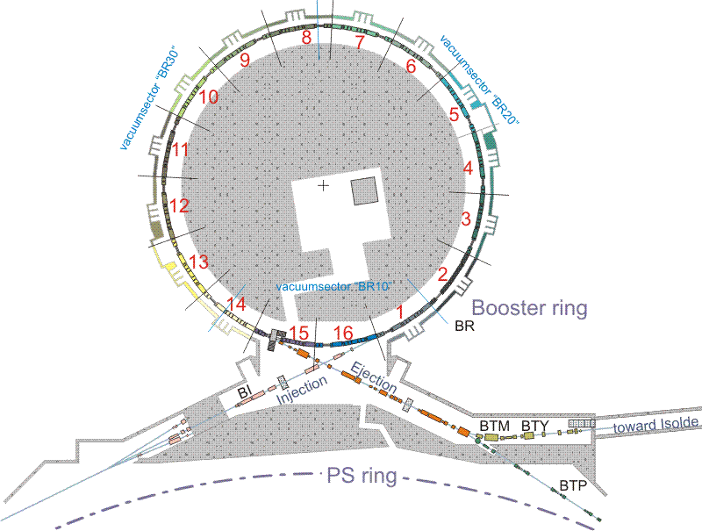
Scope of LIU-PSB
upgrade of the injection
from 50 MeV protons to
160 MeV H- and increased
intensity
re-build injection line for
160 MeV
replace injection septum by
stripping foil
injection bumps
diagnostics
…
upgrade of rings and
extraction / transfer from
1.4 GeV to 2.0 GeV and
increased intensity
replace main power supply,
number of smaller power
supplies, magnets, kickers,
etc.

Slide 4
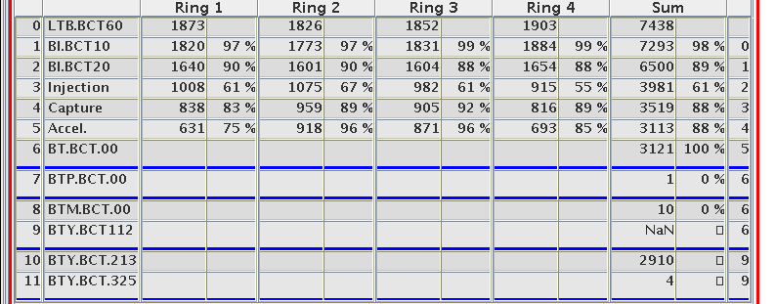
Upgrade of the Injection for Linac4
Why re-building the injection region?
increased energy from 50 MeV to 160 MeV with Linac4
reduce space-charge effects at PSB injection
injection of H- ions rather than protons
significantly reduce injection losses (at the moment about 50% of the beam is lost on the injection septum!)
more flexibility in tailoring emittances by transverse phase space painting

Slide 5
Present Multiturn Injection
horiz. beam momentum
septum
closed orbit at injection (t₁)
2
1
7
3
horiz. co-ordinate
4
5
6
PSB closed orbit
as this process takes place, subsequent linac
beam “slices” are injected, with increasing
oscillation amplitude around the instantaneous
closed orbit (“horizontal stacking”)
beamlets are now “polygons”, as they
have undergone several cuts
they spiral up around the (moving)
closed orbit, leading to a density
distribution which is dense in the core
and less dense in the outer part
closed orbit
after one turn (t₂)
closed orbit after
second turn (t₃)
etc.

Slide 6
Charge Exchange Injection
more technical details:
→ review held 9-10 November, see
https://indico.cern.ch/conferenceTimeTable.py?confId=158153#20111109
→ talk by W. Weterings at this meeting

Slide 7
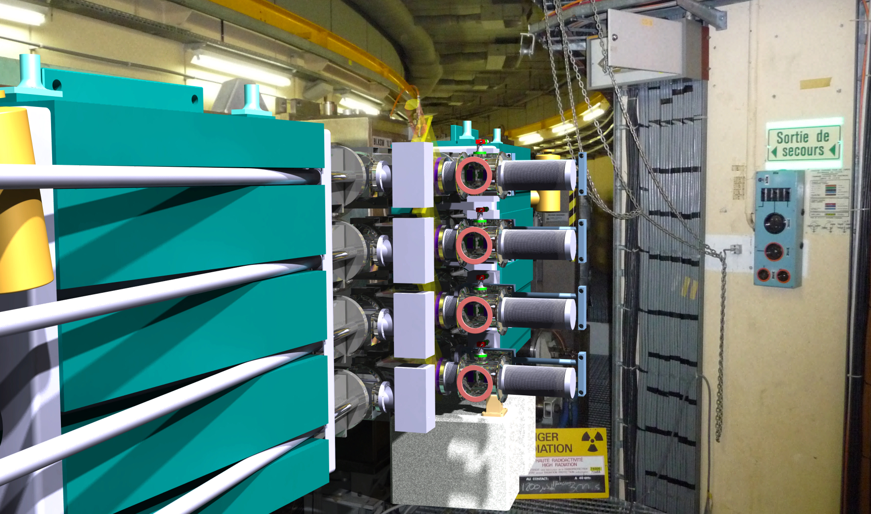
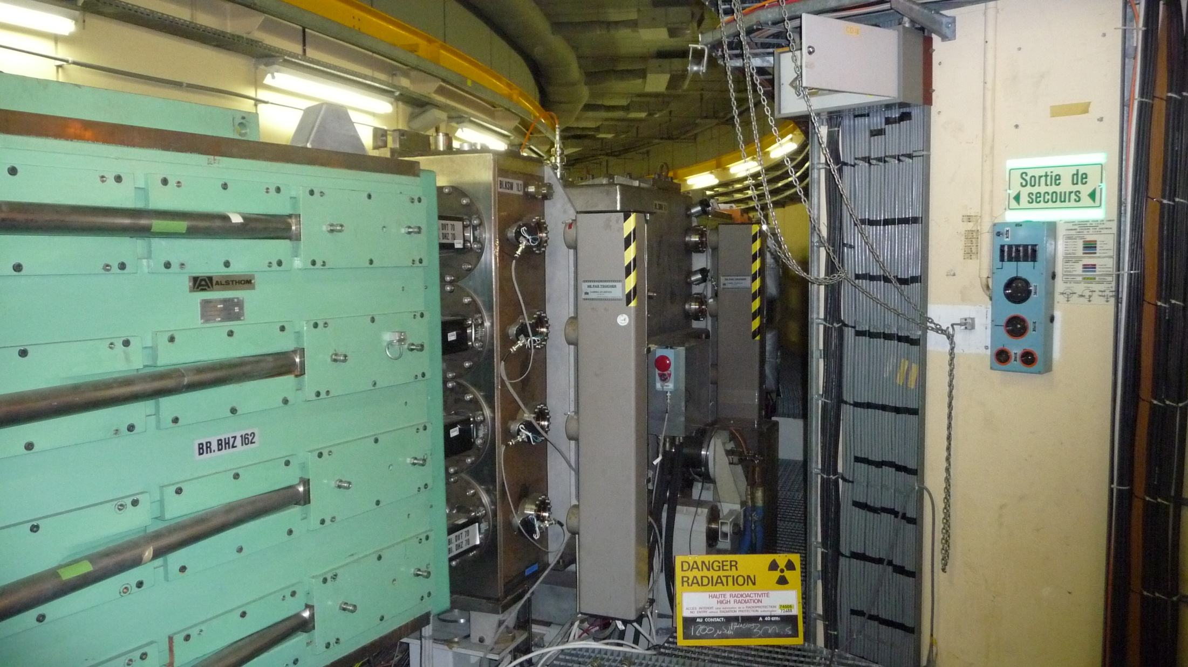
Present and Future Injection Region
B. Goddard, Review on PSB 160 MeV H⁻ Injection, 9-10 November 2011

Slide 8
Booster Injection: Planning
2013 |  |  |  |  |  |  |  |  |  |  |  | 2014 |  |  |  |  |  |  |  |  |  |  |  | 2015
1 | 2 | 3 | 4 | 5 | 6 | 7 | 8 | 9 | 10 | 11 | 12 | 1 | 2 | 3 | 4 | 5 | 6 | 7 | 8 | 9 | 10 | 11 | 12 | 1 | 2 | 3 | 4 | 5 | 6 | 7 | 8 | 9 | 10 | 11 | 12
long LHC injectors stop
 |  |  |  | Linac4 commissioning
 |  |  |  |  |  |  |  |  |  |  |  |  |  |  |  | Linac4 reliability run
 |  |  |  |  |  |  |  |  |  |  |  |  |  |  |  |  |  |  |  |  |  |  |  |  |  |  |  |  |  |  |  |  | potential
2016 |  |  |  |  |  |  |  |  |  |  |  | 2017 |  |  |  |  |  |  |  |  |  |  |  | 2018
1 | 2 | 3 | 4 | 5 | 6 | 7 | 8 | 9 | 10 | 11 | 12 | 1 | 2 | 3 | 4 | 5 | 6 | 7 | 8 | 9 | 10 | 11 | 12 | 1 | 2 | 3 | 4 | 5 | 6 | 7 | 8 | 9 | 10 | 11 | 12
 |  |  |  |  |  |  |  |  |  |  |  |  |  |  |  |  |  |  |  |  |  |  |  | long LHC injectors stop
slot |  |  |  |  |  |  |  |  | potential slot |  |  |  |  |  |  |  |  |  |  |  |  |  |  | present official slot for connection
Connection of Linac4 to the PSB during LS1 ruled out
Connect to the PSB during an intermediate length shut-down (2015/16 or 2016/17)
Connect to the PSB during LS2 (assumed 2018)
Depending on the physics results, there is still a (minor) possibility that LS1 could move

Slide 9
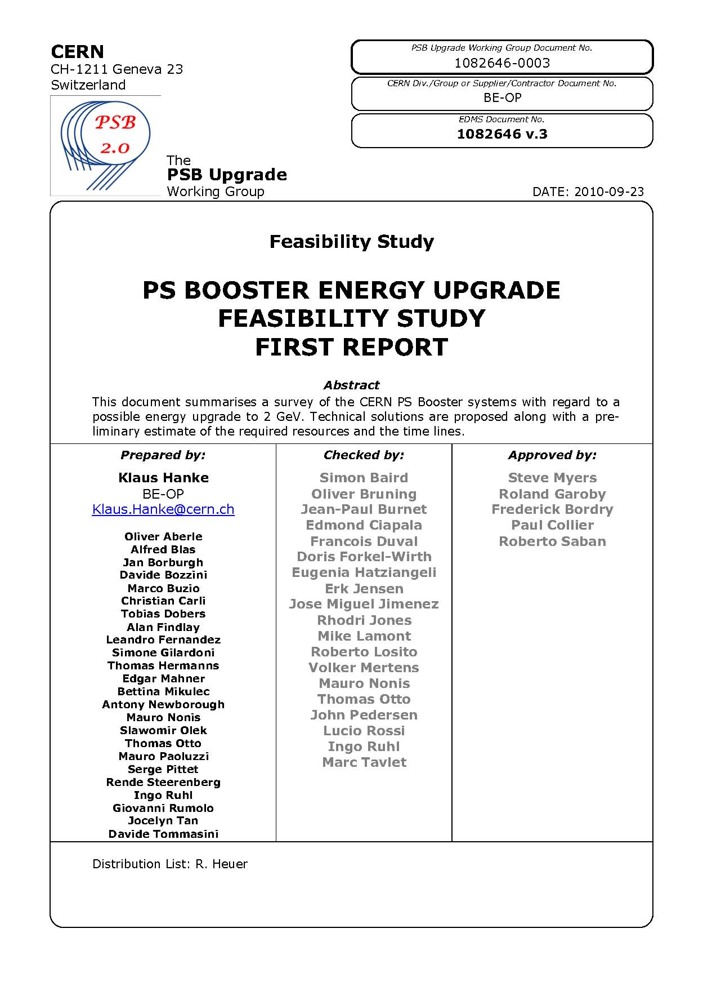
Upgrade of the Booster to 2 GeV
study launched following Chamonix 2010
→ feasibility, cost & time lines confirmed
RCS alternative studied following Chx. 2011
Booster option retained
3rd energy upgrade:
from 800 MeV to 1 GeV (1988)
from 1 GeV to 1.4 GeV (1999)
from 1.4 GeV to 2.0 GeV (LS2)
- no technical showstoppers identified
however a number of equipment and
systems need to be changed or upgraded
- high-impact items: MPS, RF, kickers, septa, …

Slide 10

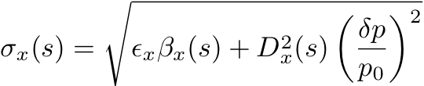



Expected Performance Gain with 2 GeV
injection at 2GeV lowers space charge effect by a factor (βγ²)_{2GeV}/(βγ²)_{1.4GeV}≈1.63
→can inject beams ~65% more intense keeping the same space charge tune spread as now
if we assume to conserve the longitudinal emittance (e.g., 1.3 eVs, LHC beam h=1), the bunch at 2GeV will be 33% shorter at the exit of the PSB, which would in principle limit the above gain to less than 40%; however, the PS bucket acceptance at injection also increases by 50%, which allows for injection of larger longitudinal emittances, recovering the desired gain (50% larger longitudinal emittance required)
larger transverse emittances acceptable at the PS injection, if the final transverse emittances to the LHC are the same? Unlikely, as the previously PSB specified transverse emittances have meanwhile become the “nominal” LHC emittances!
→ at least 65% intensity increase (within constant emittance) expected
1/βγ²
1/σ_{z}
1/ε

Slide 11
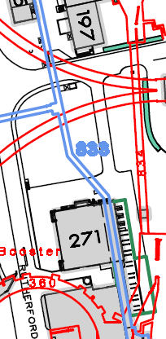
Booster 2 GeV Upgrade: Power
Main Power Supply
- present converter cannot deliver more than 1.4 GeV
- POPS-type converter proposed (capacitor bank)
- divide machine in 2 circuits (inner and outer rings)
- will make R 1+4 trim power supply obsolete
- new building needed
Other Power Supplies
- number of smaller converters to be changed
64 BHZ
Rings 1&4
GND
MPS A
2500V
5500A
QFO
600V
450A
128 QFO
Rings
1,2,3&4
Ring 1 B-filed
measurement
Reference
magnet
Ring 1&4
Reference
magnet
Ring 2&3
Ring 2 B-filed
measurement
MPS B
2500V
5500A
QDE
600V
450A
64 QDE
Rings
1,2,3&4
New MPSB
(2 GeV)
(26m x 16m)
GND
64 BHZ
Rings 2&3
S. Pittet
→ talk by S. Pittet at this meeting

Slide 12
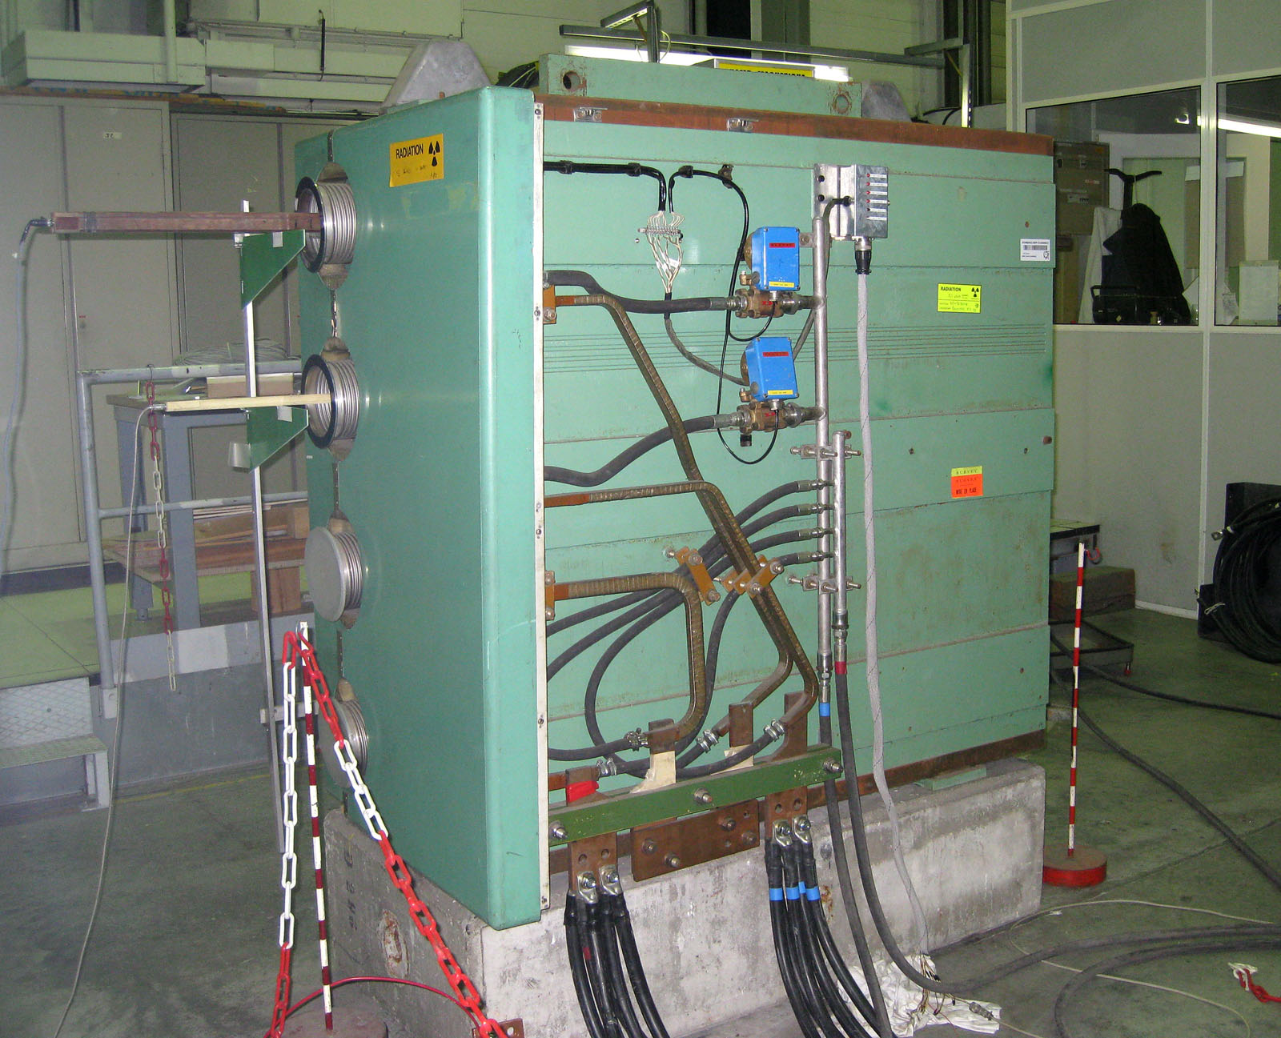
Booster 2 GeV Upgrade: Magnets, Dumps, Transfer
Magnets
- main dipoles can operate at 2 GeV with
some modifications (cooling, retaining plates)
- number of other magnets to be changed
Beam Intercepting Devices
- new dump and beam stopper being designed
- removal of the old and installation of the new
dump being studied for LS1
Extraction & Transfer
- number of septa/kickers cannot
operate at 2 GeV, notably extraction
kickers (BE.KFA) and recombination
septa (BT.SMV)
Booster main magnet undergoing tests for
operation at 2 GeV
A. Newborough, M. Buzio

Slide 13
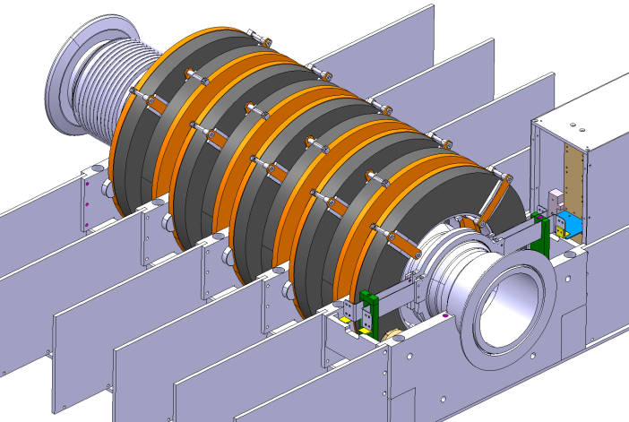
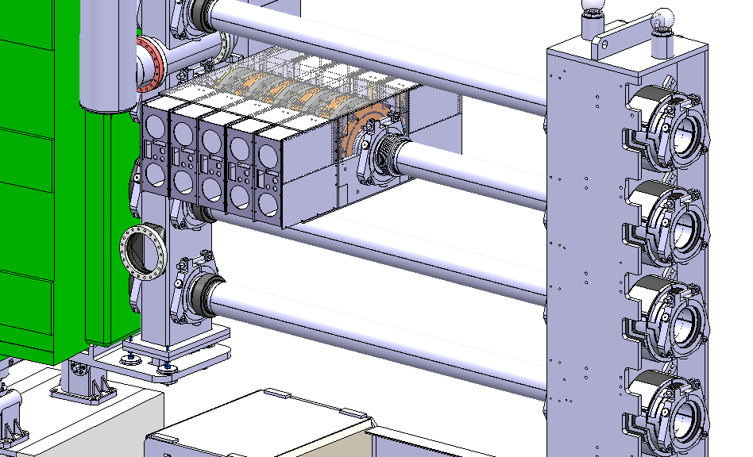
Booster 2 GeV Upgrade: RF System
complete upgrade of the Booster high-level
RF to new Finemet cavities
development of a prototype system (collaboration
with KEK-RF team)
installation in PSB during winter stop 2011-2012
approved by IEFC on 7 Oct. 2011
→ talk by M. Paoluzzi at this meeting
upgrade program for the LL RF
Finemet cavity test installation in the PSB
M. Paoluzzi

Slide 14
Other Items
 | Work-Package | Responsible | Unit
2. | Beam Dynamics | C. Carli | BE/ABP
3. | Magnets | D. Tommasini, A. Newborough | TE/MCS
4. | RF Systems | A. Findlay, M. Paoluzzi, M.E. Angoletta, A. Blas, A. Butterworth | BE/RF
5. | Power Converters | S. Pittet, D. Nisbet | TE/EPC
6. | Instrumentation | J. Tan | BE/BI
7. | Beam Intercepting Devices | O. Aberle, A. Massi | EN/STI
8. | Vacuum System | J. Hansen | TE/VSC
9. | L4-PSB Transfer and PSB Injection | W. Weterings, C. Carli | TE/ABT, BE/ABP
10. | PSB Extraction and PSB-PS Transfer | J. Borburgh, W.Bartmann | TE/ABT
11. | Controls | S. Jensen | BE/CO
12. | Electrical Systems | D. Bozzini, S. Olek | EN/EL
13. | Cooling and Ventilation | M. Nonis | EN/CV
14. | Installation, Transport and Handling | I. Ruehl, C. Bertone | EN/HE
15. | Civil Engineering | L.A. Lopez-Hernandez | GS/SE
16. | Radiation Protection | J. Vollaire | DGS/RP
17. | Interlock Systems | B. Puccio, P. Dahlen, B. Todd | TE/MPE
18. | Alarms |  | --/---
19. | Access Systems - Doors |  | --/---
20. | Survey | T. Dobers | BE/ABP
21. | Commissioning and Operation | B. Mikulec | BE/OP
22. | Dismantling |  | --/---
Cooling & Ventilation
- refurbishment of cooling station
and some distribution piping
- complete refurbishment of existing
ventilation plant keeping the same
functionalities
Electrical Systems
- re-design of the system has started
Other items:
- beam instrumentation, transport, controls,
interlocks, design office, vacuum, etc. etc.
for the full picture see
https://espace.cern.ch/liu-project/liu-psb/default.aspx

Slide 15
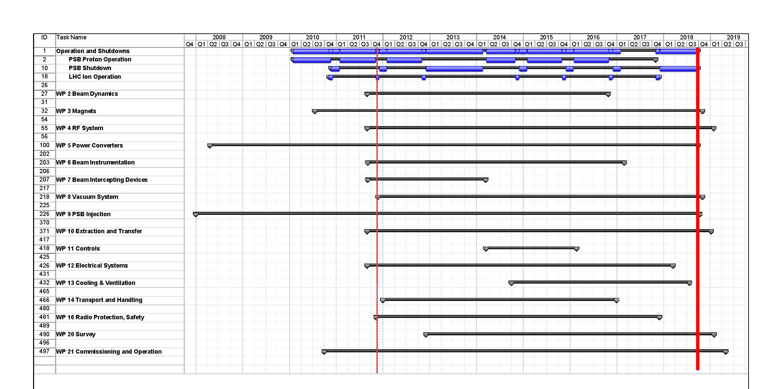
Time Lines
Linac4 connection possible as from end 2015, constrained by LHC stops
full upgrade including 2 GeV to be completed during LS2

Slide 16
Next Steps
TDR to be written
Ongoing MD activity during the next years
Some work during coming winter stops (removal ion distributor,
Finemet test installation, …)
Some work to be done during LS1: change of the Booster dump, renovation
of handling equipment, …)
Most work in LS2 (complete hardware upgrade); if Linac4 connection could be
advanced, this would reduce the stress on the intervening groups and on the
recommissioning, and is therefore the preferred scenario
If Linac4 and the 2 GeV upgrade will coincide in LS2, we will have a lot to do
→ We will come out of LS2 with a new Booster

