Slide 1
LIU-SPS sub-project
B.Goddard
On behalf of LIU-SPS project team

Slide 2
Contents
LIU-SPS challenges and objectives
Present limitations and motivation for upgrade
Main upgrade topics
  RF systems
  ecloud mitigation
  Beam loss control and machine protection
  Beam instrumentation
  Other systems/topics
Project organisation and planning
Remaining unresolved questions

Slide 3
LIU-SPS scope
TT20
(SPS NA)
SPS for LHC beams
From: injection septum in SPS
To: injection septum in LHC
(includes TI 2 and TI 8)
BA2
BA3
BA4
BA1
ECA4
BA5
TT40
TT66
(HiRadMat)
BA7
TI2
(LHC)
ECA5
TT60
BA6
TT41
(CNGS)
TT10
(PS)
TI8
(LHC)

Slide 4
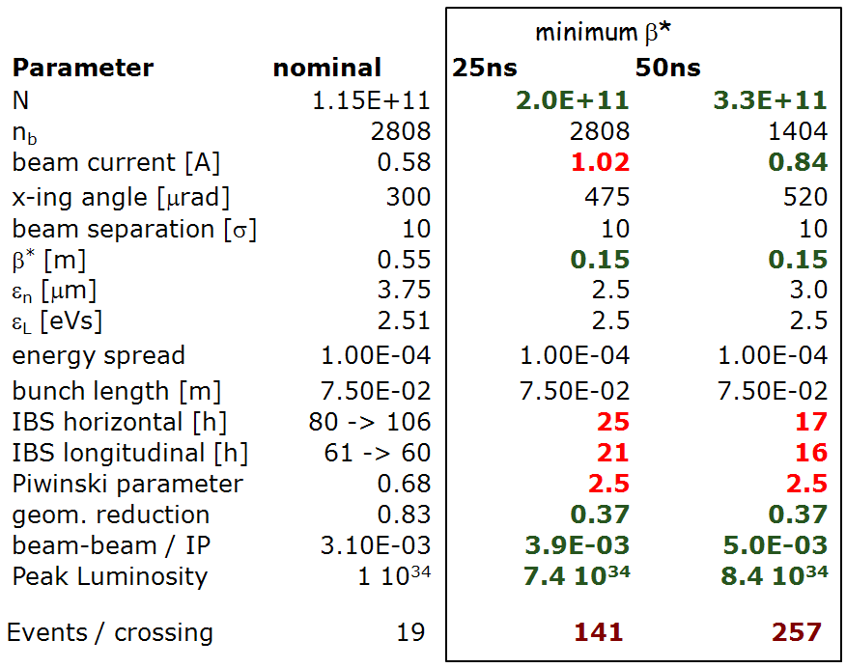
Requirements from HL-LHC
Target: 250-300 fb⁻¹ per year
at LHC collision!
Reminder: 2011 = 5.6 fb⁻¹ with 3.5 x10³³ cm⁻²s⁻¹

Slide 5
Main challenges and limits
Beam quality to LHC
  Preservation of transverse emittance from PS into LHC
  Limitations, instabilities
Beam loading and high power for RF system
Electron cloud induced effects
  Mitigation measures to apply
Beam loss control and robustness of machine protection devices
Beam instrumentation
“Operational” limitations: beam heating, ZS sparking, vacuum, dump, ...

Slide 6
Beam quality to LHC
LHC is requesting smallest emittance, and higher intensities.
  2.2e11 p+/b in 2.5 μm for 25 ns, 288b
  3.6e11 p+/b in 3.0 μm for 50 ns, 144b
Need large improvement, c.f. (already excellent!) 2011 performance
Ecloud, instabilities and beam losses becoming critical
  ecloud mitigation
  Potential gains from lower γ_{T} (Q20)?
  High bandwidth damper (TMCI, ECI, general)
  Impedance campaign to continue
 |  | Present 25 ns | Required 25 ns |  | present 50 ns | Required 50 ns
Ib [p+] |  | 1.10E+11 | 2.20E+11 |  | 1.60E+11 | 3.60E+11
Emitt [m.rad] |  | 3.00E-06 | 2.50E-06 |  | 2.00E-06 | 3.00E-06
Nb |  | 288 | 288 |  | 144 | 144
Spacing [ns] |  | 25 | 25 |  | 50 | 50
Bunch brightness [p+/m.rad] |  | 3.67E+16 | 8.80E+16 |  | 8.00E+16 | 1.20E+17
Beam brightness [p+/m.rad] |  | 1.06E+19 | 2.53E+19 |  | 1.15E+19 | 1.73E+19
Itot [p+] |  | 3.17E+13 | 6.34E+13 |  | 2.30E+13 | 5.18E+13
Irf [A] |  | 1.41 | 2.82 |  | 1.02 | 2.30
Brightness factor needed |  | 1.00 | 2.40 |  | 1.00 | 1.50
Intensity factor needed |  | 1.00 | 2.00 |  | 1.00 | 2.25
E.Shaposhnikova et al.

Slide 7
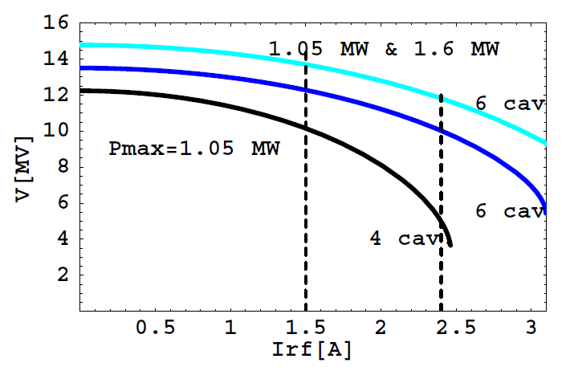
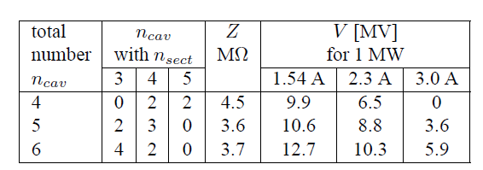
RF 200 MHz
Presently 18 sections arranged in 4 cavities (2x4, 2x5), each cavity with 700 kW
  Beam loading: limited to 1.5 A total RF current with 25 ns, or 1.2e11 p+/b
Using 2 spares, rearrange 20 sections into 6 cavities (4x3, 2x4), with 1000 and 1400 kW per cavity (in pulsed mode)
  Can then provide 10 MV at extraction for intensity up to 2.3e11 p+/b
Without this upgrade, will be limited to about 1.6e11 p+/b at 25 ns (even with pulsed power of 1 MW)
Rearrangement also reduces beam coupling impedance from 4.5 to 3.7 MΩ
Available RF voltage as a function of I_{rf}
25 ns: 1.2e11
1.8e11
2.3e11
E.Montesinos et al.

Slide 8
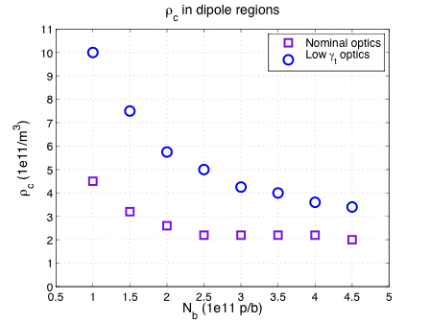
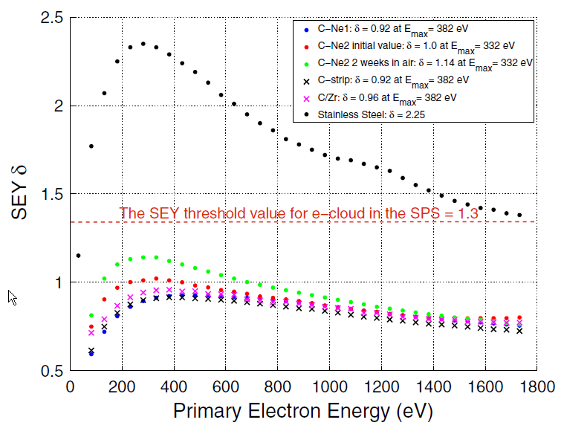
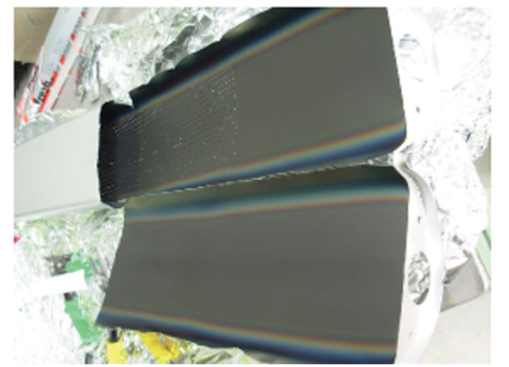
Ecloud mitigation
Critical ecloud e- densities
electron cloud strongly affects SPS beams
  Beam loss, vacuum, instabilities, incoherent emittance growth
Huge efforts in past decade to understand and investigate mitigations
Objective for end of 2012 is to decide on needed mitigation strategy
Possible feasible mitigations are:
  Amorphous carbon coating of all SPS dipoles and quadrupole chambers (need >90% of machine length treated). Reduces SEE yield below 1.0, and suppresses multipacting.
  Rely on scrubbing, as in LHC (possibly with enhanced techniques). Will be helped by improved vacuum sectorisation.
  High bandwidth damper to fight ecloud instability
SEY comparison
a-C coated liner
J.M.Jimenez, M.Taborelli et al.

Slide 9
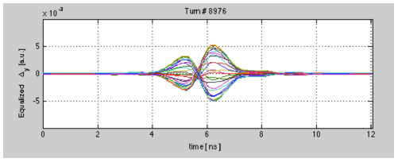
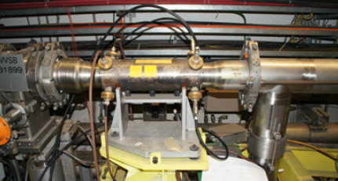
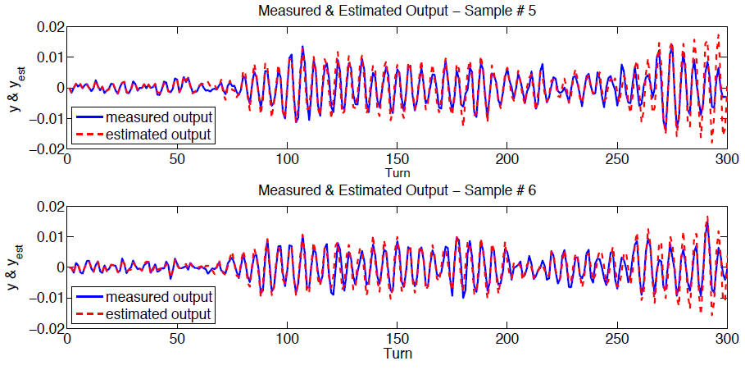
High bandwidth feedback
Head-tail type beam excitation
Intra-bunch GHz feedback system could help stabilise beam against ECI and TMCI
  Under development with LARP
  Start with vertical plane
  Could allow low chromaticity/higher intensities
High bandwidth pickup installed in SPS
  20-40 GS/sec sampling
  PU used to drive beam with different excitation functions (3.2/4 GS/sec) and measure response
Simulation and modelling effort
  Understanding MD data and specifying required performance (power, bandwidth) via reduced models and numerical simulations
Phased development
  Demonstrator (closed loop) for 2012
  Prototype ready for 2015
  Final system implemented in LS2
Wideband pickup in SPS LSS3
Measured and simulated response
W.Hoefle et al.

Slide 10
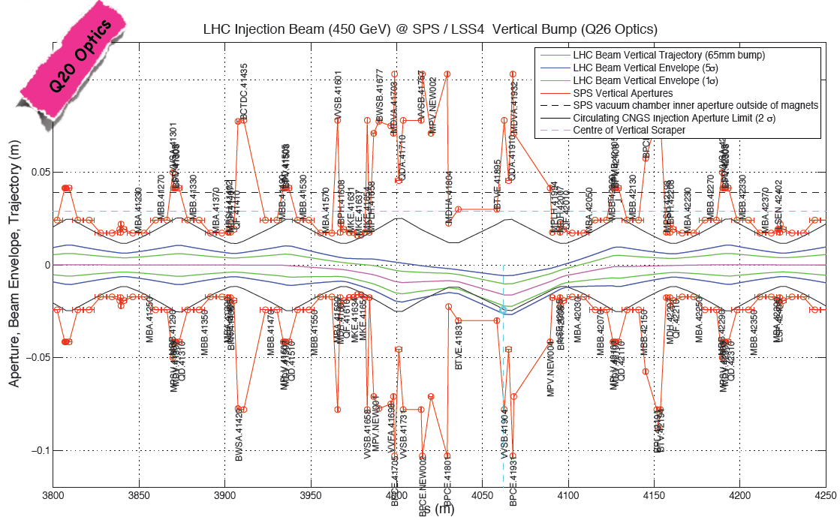
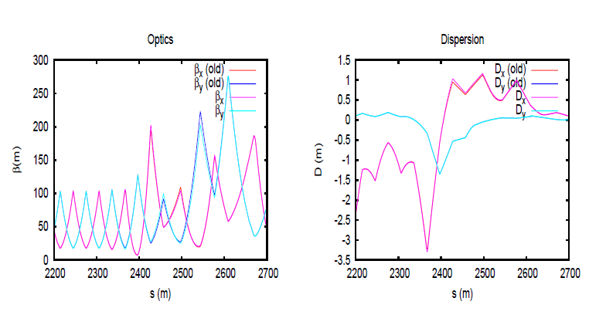
Beam loss and machine protection
New vertical bump for fixed LSS4 scraper
Scraper redesign with magnetic bump
  Under study for LSS4 re-using extraction bumpers, with fixed scraper blocks
Upgrade of TCDI collimators
  New locations further upstream to reduce cross talk with LHC, possible new design for robustness and protection
Upgrade of extraction protection devices
  To cope with higher beam intensity and smaller emittances
Beam loss, activation and component doses
  Beam loss inventories, FLUKA simulations and dose estimates
Machine protection and beam instrumentation improvements
  Interlocking elements, especially BLMs
TI 8 optics rematched for new TCDI locations
M.Meddahi et al.

Slide 11
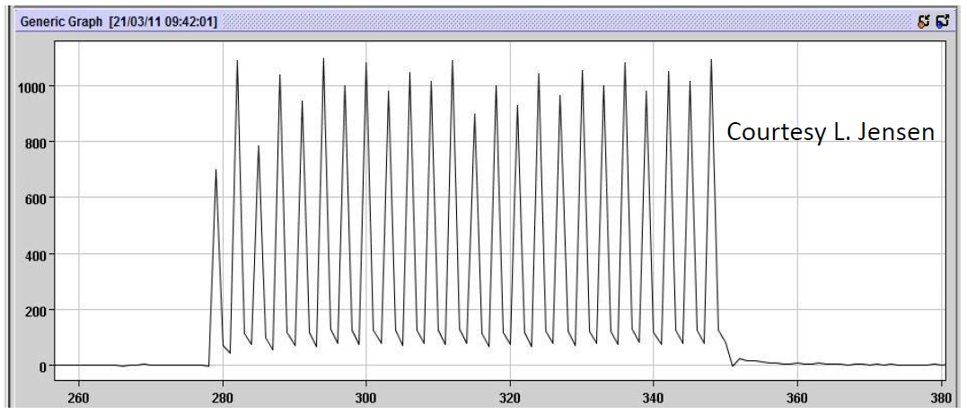
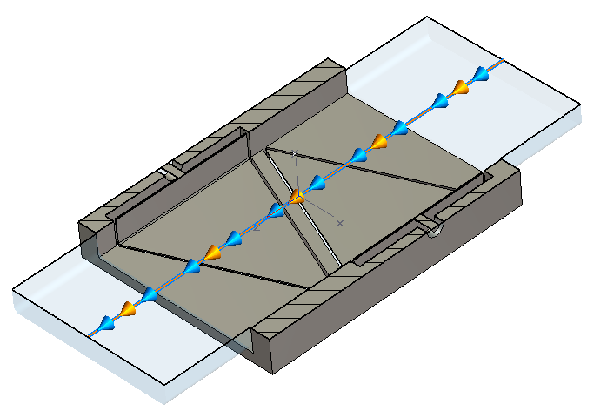
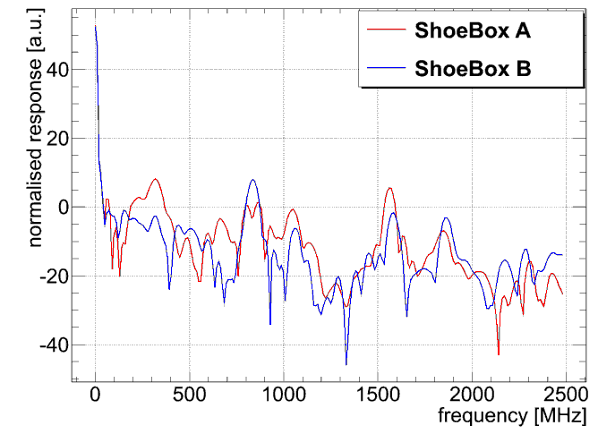
Beam instrumentation
FBCT response to 40 MHz bunch structure
New MOPOS system (already in CONS)
  Bunch-by-bunch, turn-by turn
New BLM system
  Upgrade electronics, acquisition to ‘LHC-like’
  Addition of fast (ns response) diamond BLMs
Improved wirescanners
  Key elements for beam optimisation and quality monitoring
  New prototype to install in SPS
Upgraded residual gas BGI monitor
  Continuous monitoring of beam size and possibly transverse beam quality
Improved FBCT and DCBCT
  FBCT SW and HW improvements to remove limitations and give turn-by-turn data
Tune, head-tail, matching monitor, ...
BPH PU
BPH frequency response
L.Jensen et al.

Slide 12
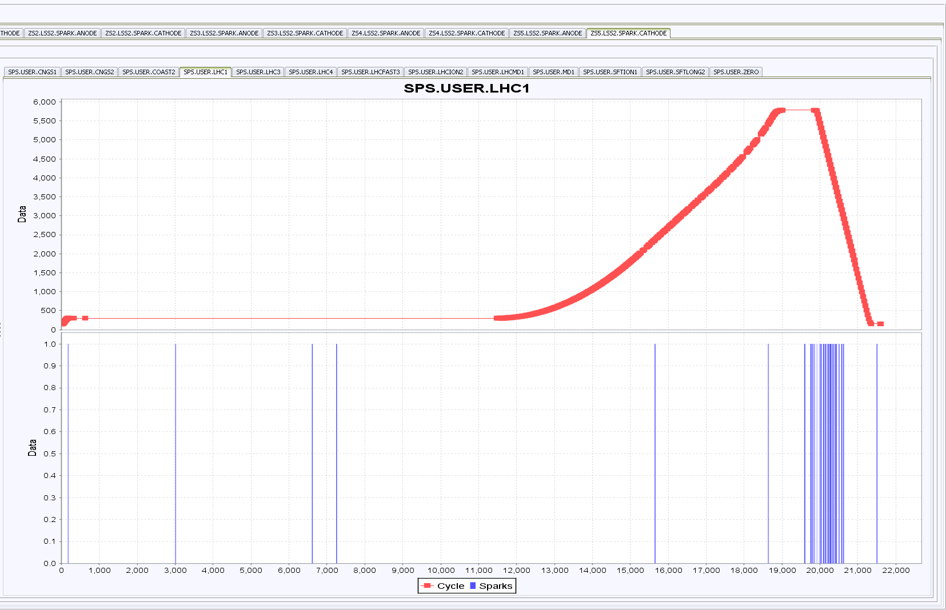
Operational limitations
MKE heating 25 ns beam
Heating of MKE extraction kickers
  Serigraphy reduces effect by factor of 3: final kicker to be equipped in LS1
  Possible new redesign possible with open C core kicker, with beam bumped in just before extraction
Sparking of ZS septa
  Modulation of main and ion trap voltage effective; SPS supercycle containing FT beam for North Area affected
Beam dump outgassing
  Limitation more for special modes like scrubbing
  Extra pumping and sectorisation being studied
  New dump design or relocation also possible
Vacuum sectorisation
  General improvement planned (scrubbing, kicker conditioning, dump outgassing)
ZS sparks in LHC cycle
K.Cornelis et al.

Slide 13
Other systems and teams
Many other systems and teams are heavily involved in LIU-SPS upgrade
  Vacuum (200 MHz, kickers, dump, BI, damper, sectorisation, ...)
  Controls (for BI, other FECs, data, SW, ..)
  Existing transverse damper system (new PUs, increased power?)
  OP (operational beams, applications, MD, ...)
  ABP (optics, apertures, Q20, collective effects, collimation, ...)
  Magnets (aC coating, Q20 implementation, scraper studies, ...)
  FLUKA (many energy deposition studies)
  Power convertors (new/upgraded convertors, stability improvements, ...)
  Cabling (everywhere)
  Cooling and ventilation (200 MHz)
  Design office (everywhere)
  Workshop
  Shutdown coordination
  Safety
  Consolidation
  Transport
  Survey
  Radioprotection
  …

Slide 14
Beam dynamics
Instabilities
Intensity limitation studies
Impedance
Longitudinal issues
Feedbacks
Simulations
Specifications
RF system upgrade
Wide bandwidth FB
e-cloud limits
Impedance upgrade
Instrumentation
e-cloud mitigation
Mitigation necessity
Surface treatments
Aging studies
Vacuum issues
Simulations
Specifications
Coating technology
Magnet chambers
Instrumentation
Beam loss, protection, TLs
Beam loss scenarios
Collimation studies
Scraper studies
Beam dump design
Extraction protection
TL and LHC injection protection
Specifications
Collimation system
Scraper upgrade
Beam dump
Instrumentation
Extraction diluters
TL protection devices
E.Shaposhnikova
J.M.Jimenez
M.Meddahi
Operational issues
Beam deployment
Radioprotection
General services
Powering
Layouts and DBs
Optics files
Integration
Planning
EVM, APT, MTP
Shutdown coordination
Surface space
Safety, risk
B.Goddard (deputy E.Shaposhnikova)
LIU-SPS coordination meeting
Hardware and other implementation workpackages
200 MHz RF
Magnet chamber e-cloud mitigation
Collimation system
Wide band feedback
Beam instrumentation (SPS and TLs)
RF low level control upgrade
ZS test area
Extraction diluters
Transfer line collimators
Scraper upgrade
Beam dump relocation/redesign
Further impedance reduction
New extraction kickers
ZS upgrade
Update layout and optics DB
Update of drawings

Slide 15
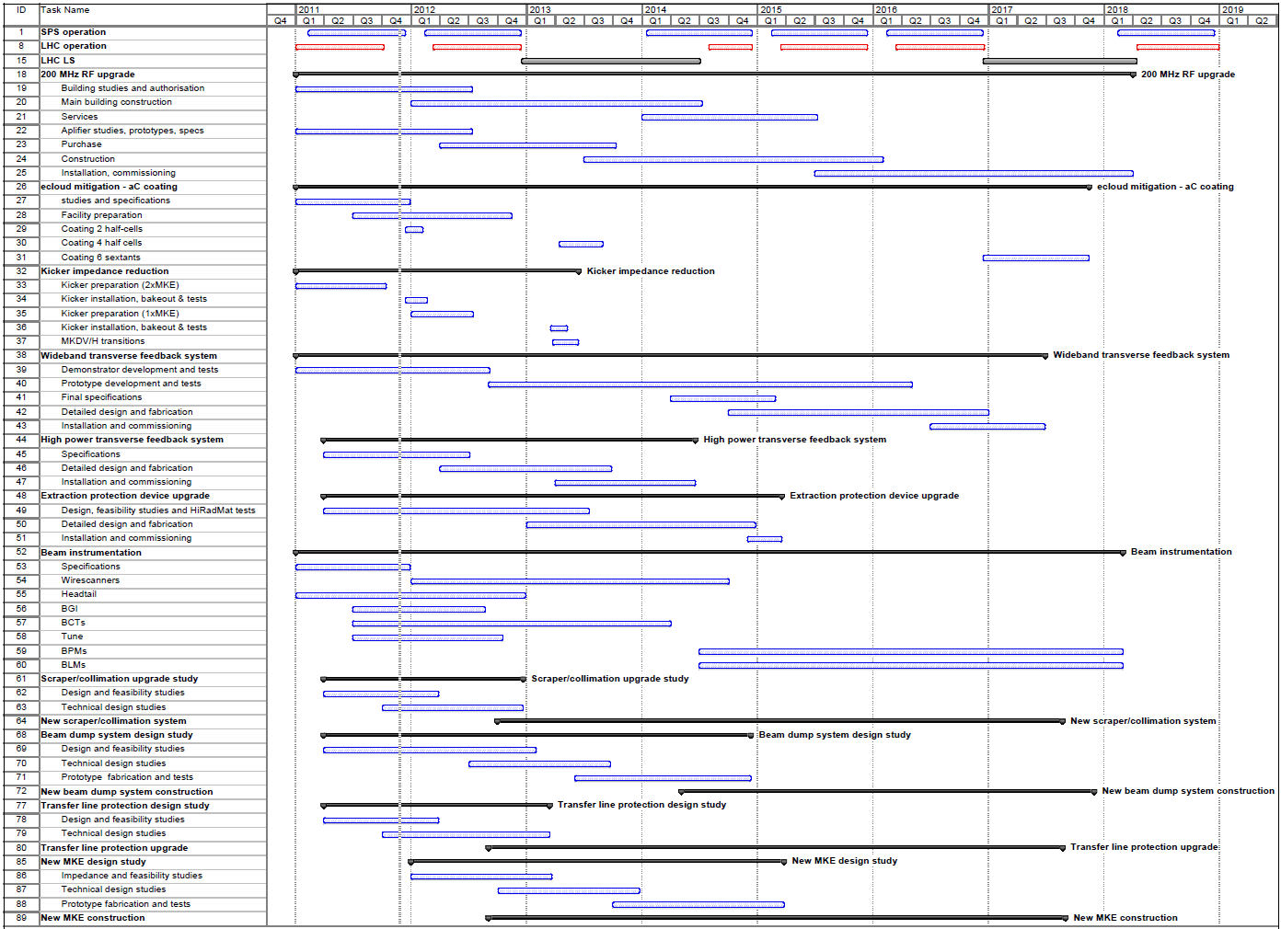
Planning

Slide 16
Activity status (snapshot)
Being implemented
  RF 200 MHz upgrade
  (some) beam instrumentation upgrades
  Vacuum sectorisation
  Kicker impedance reduction (MKE/MKDV)
Still being developed/prototyped
  (some) beam instrumentation upgrades
  aC coating of dipoles and other elements
  High bandwidth transverse feedback system
Still in conceptual study phase
  Upgraded transfer line collimators
  Upgraded extraction protection devices
  Upgrade of existing damper system
  New scraper concept
  New/relocated beam dump
  New extraction kicker concept

Slide 17
Unresolved questions
Ecloud mitigation – aC coating or scrubbing (+HBW damper)?
  Final answer MUST come at end 2012
  Plan 5 days “scrubbing run” early 2012 to investigate how far scrubbing can take us – will need high quality beams from PSB and PS
  Potential issue with aC of unexplained high vacuum pressure
Is Q20 a real operational alternative for after LS1?
  Need to still solve some issues
  Strong push for MD (again) for 2012
Is any further impedance reduction possible (or necessary?)
  New MKE a possibility, but very heavy activity
Is an external beam dump feasible?
  Study needs to be completed in 2012

Slide 18
Summary
SPS performance is already excellent for LHC beams
  50 ns: almost reaching LHC ultimate intensity, and already at 50% (!) above ultimate brightness
  25 ns: reached LHC nominal intensity, and already at 10-15% above nominal brightness
For HL-LHC era, requirements are challenging
  50 ns: need x2.3 present intensity, 50% above present brightness
  25 ns: need x2 present intensity, x2 present brightness
Work is well advanced for some systems, with others still ‘conceptual’
Main upgrade items will only be ready after LHC LS2, around 2019
Finally, thanks to all those who have worked directly and indirectly on the SPS over the years to put us in this strong position!

