Slide 2
Challenges in Beam Instrumentation
Rhodri Jones (BE/BI)
LIU-2011 Event, 25 November 2011, CERN

Slide 3
Introduction
BE-BI started a consolidation program for the beam instrumentation of the injector chain several years ago
The target at that time was to replace obsolete parts to ensure the availability of our systems in the coming years
These developments were not directly linked to performance issues or any requests for improvement
The LIU project now adds many new requirements
  Accurate, reliable measurement of emittance
    for more intense & smaller beams
    on a bunch by bunch basis
  Measurement of ghost & satellite populations
  Trajectory measurements in all machines
  Good localisation in time and space of beam losses
  ……

Slide 4
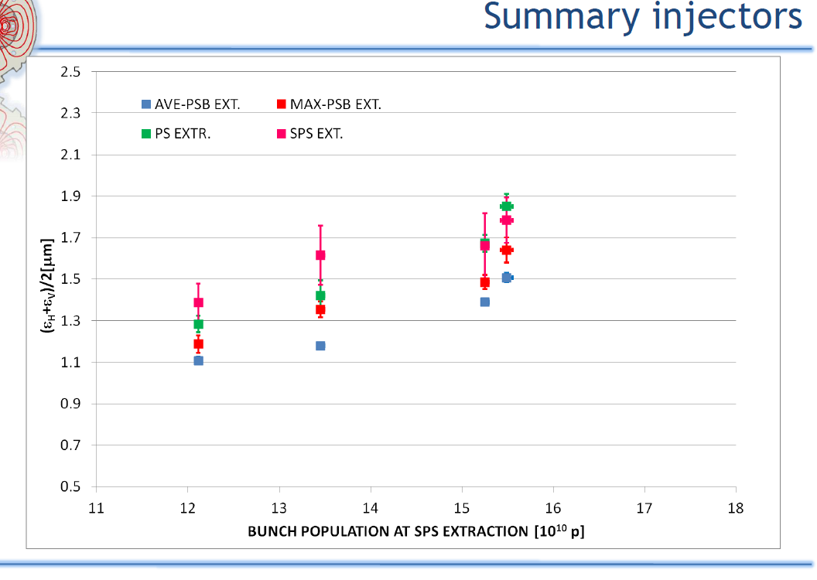
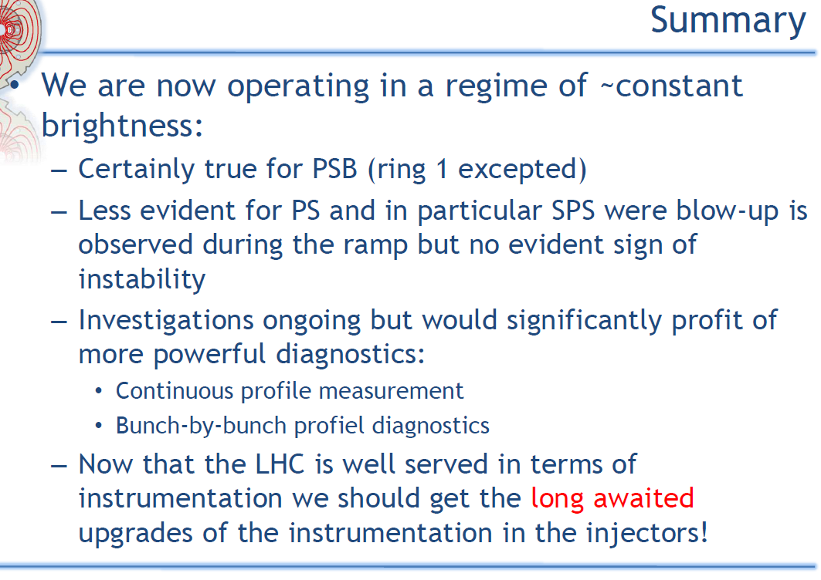
Measurement of Beam Size
Recent LMC summary on injector emittance measurements (G. Arduini)
Much work already done to calibrate, understand & optimise the existing wirescanner systems
For maybe first time emittance measurements between accelerators shows expected increase from one accelerator to the next
Error bars now small except for SPS at top energy
If smaller differences in emittances need to be determined for optimisation a reduction of systematic errors is required

Slide 5
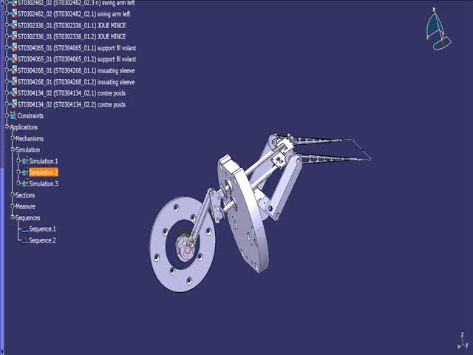
Current Wirescanner Limitations
Accuracy
Limited by complex mechanics needed for high speed
Fits on asymmetric tails/baseline on some users
Resolution
Small beam size requires improved wire position resolution
Dynamic range
Settings depend on operator input
Rather low signal for pilot beams
Scan speed
Limited operationally to 15 [m/s]
Premature bellow fatigue
5’000 scans in the PS (new bellows being tested)
Fast acquisition for bunch by bunch
LHC type being tested in the SPS at the moment
Unavailable for PSB and PS (frev variation)

Slide 6
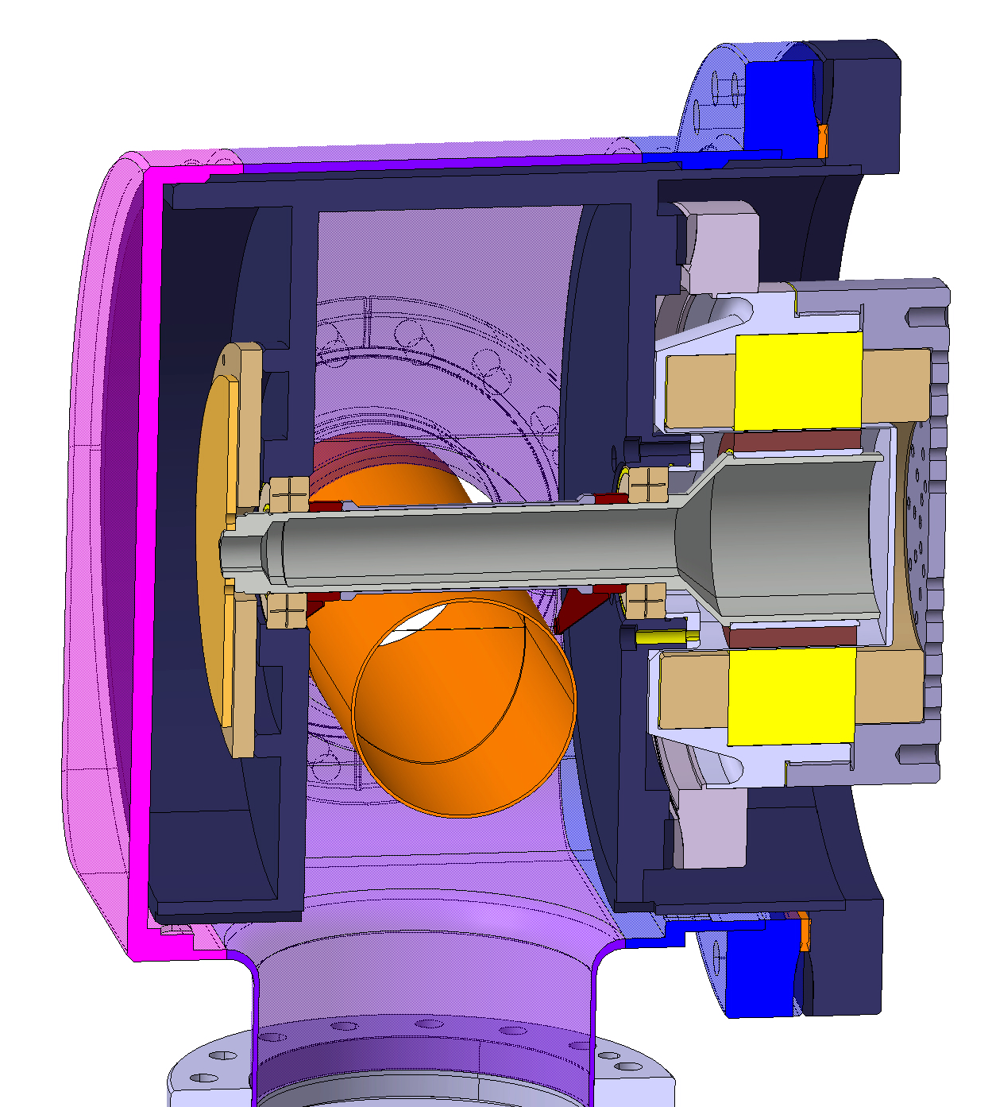
R&D on a New CERN Vacuum Wire Scanner
Vacuum chamber
Optical Disc in vacuum
Optical Fiber
Rotor in vacuum
Shaft
Fork
Resolver
Beam
Motor Stator
Wire
Vacuum pipe
Schematic
Bearings
3D Mockup

Slide 7
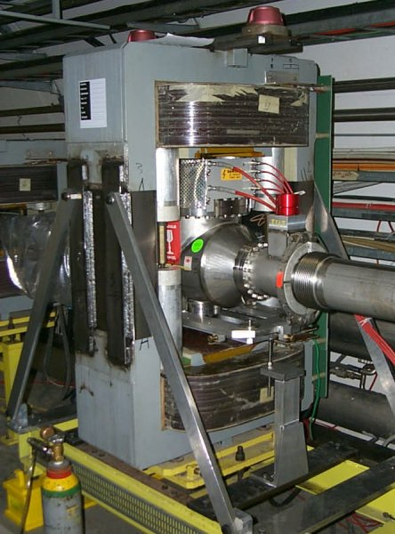
Continuous Beam Size Measurement
Rest Gas Ionisation Monitors

Slide 8
Continuous Beam Size Measurement
Rest Gas Ionisation Monitors
SPS System
Prototype to be refurbished with LHC type optical readout system
Aim to test in 2012
Look at possibility to develop similar system for the PS and possibly PSB
Challenge
To understand & optimise the system for different particle energies
To make this a compact instrument for PS / PSB
Beam size shrinks as
beam is accelerated
Fast extraction
Injection
Slow extraction
3D
Image
Beam Size
Time

Slide 9
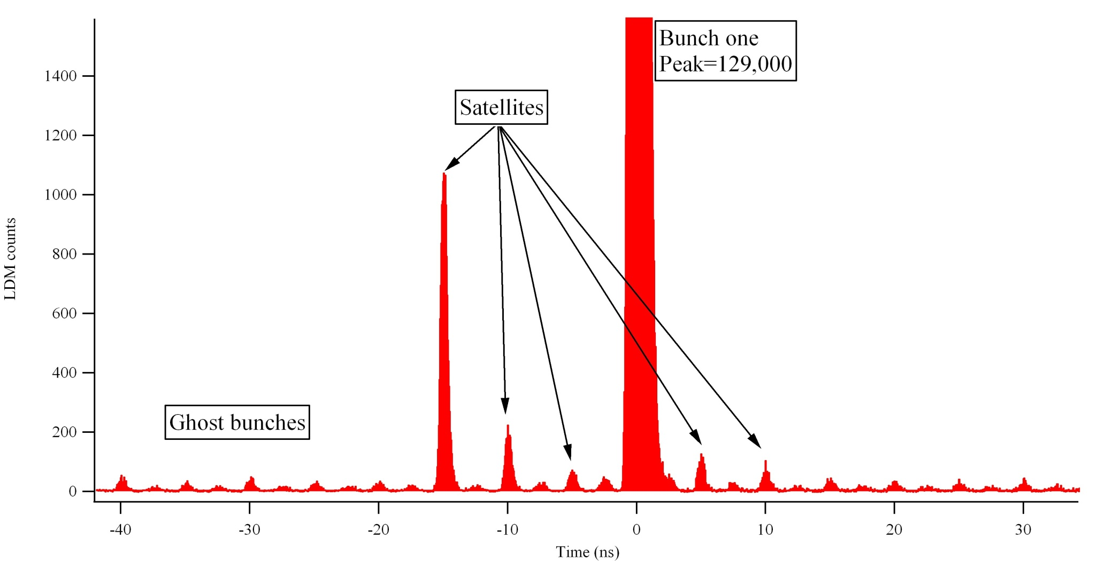
Measurement of Satellites
LHC
Longitudinal Density Monitor using synchrotron light & photon counting techniques gives dynamic range of 10⁵ with integration over a few minutes
Where do they come from?
Injectors
Do not benefit from synchrotron light (apart from SPS above 400GeV)
Are not colliders & hence require fast measurements
Challenge
Find technique to allow monitoring of populations at % level within 200 turns
Would allow further RF optimisation for minimisation
OR RF tuning to create desired satellites (main v satellite for ALICE)

Slide 10
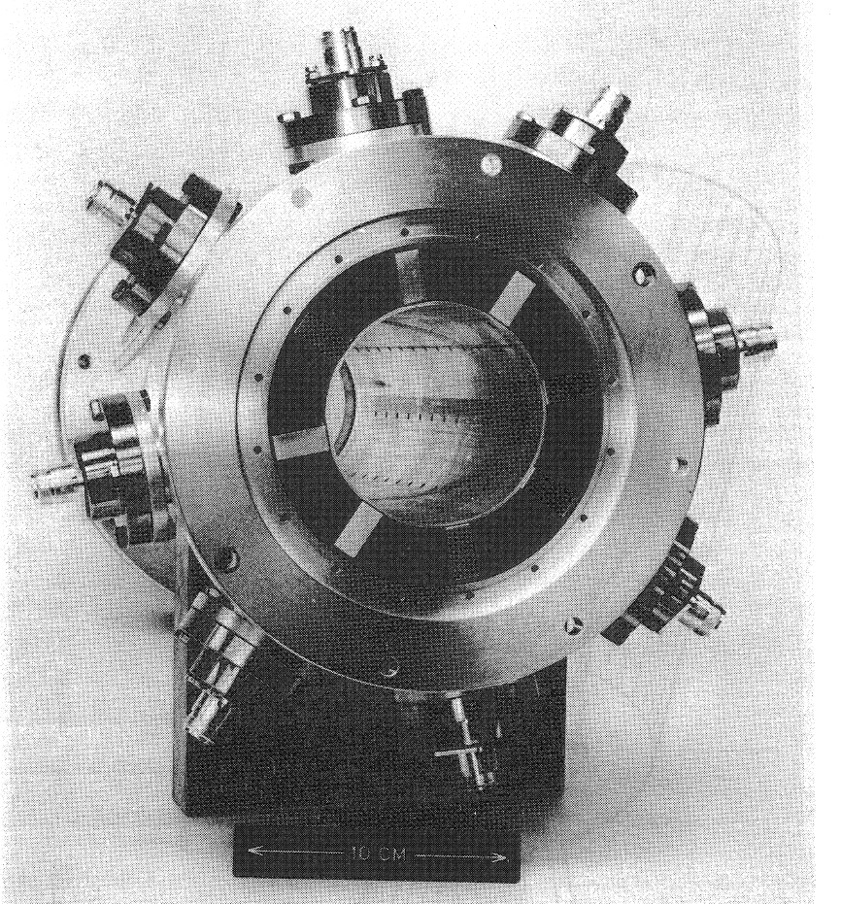
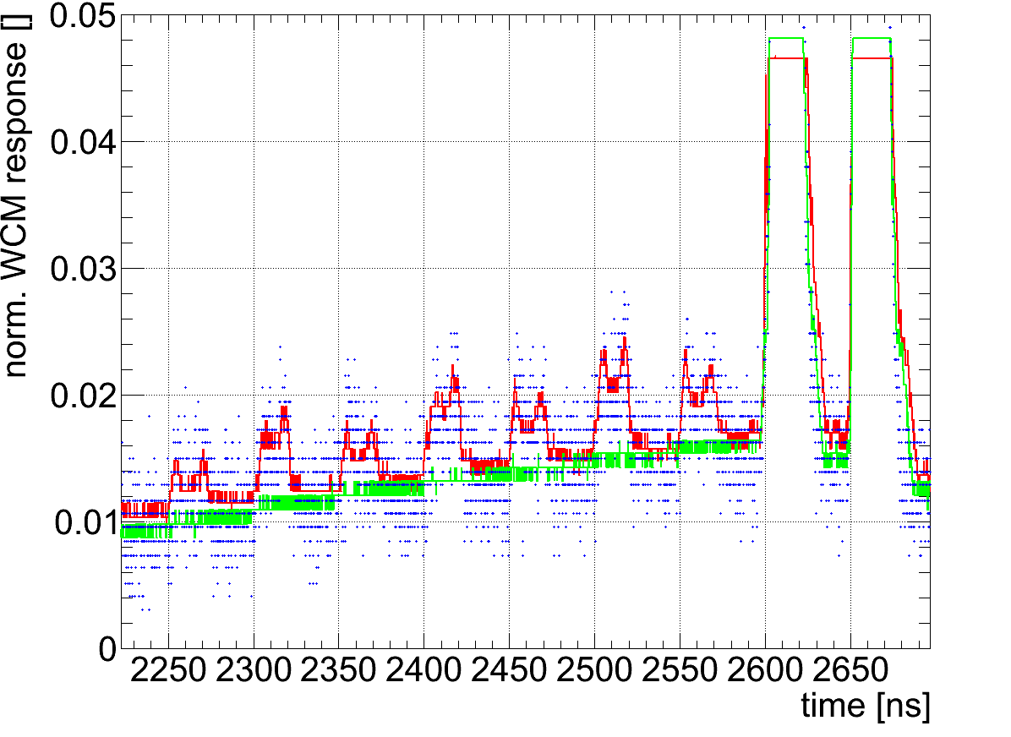
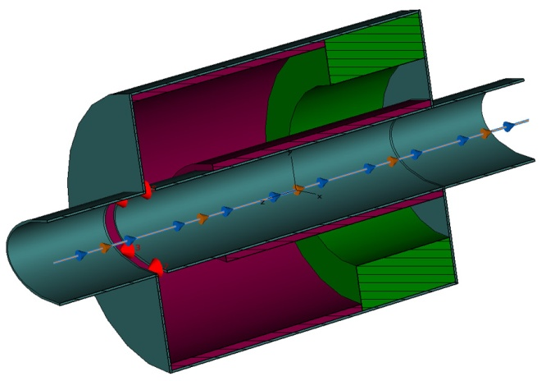
Measurement of Satellites
Best Candidate
Upgrade of the existing PS electromagnetic wall current monitor for improved pick-up response
Use of fast sampling oscilloscopes combined with significant post processing
  compensate for reflections, pick-ups response, droop etc.
Similar solution should also work in SPS
Main bunches
full-range scope signal
saturated scope signal
“satellite free” reference
Difficult to distinguish
Satellites between main bunches
50 ns satellites
~1.5% w.r.t.
main bunch
New PS Wall Current Monitor

Slide 11
Measurement of Satellites
Other Possibilities – using optical means
OTR in PS to SPS transfer lines
  Use photomultiplier to give time structure in single pass
Upgrade of the existing SPS synchrotron light monitor
  Synchrotron Light only available above ~400 GeV for protons
  Needs substantial refurbishing before it is operational again
  Can equip with
    CCD camera for transverse measurements
    Photomultiplier for longitudinal measurements

Slide 12
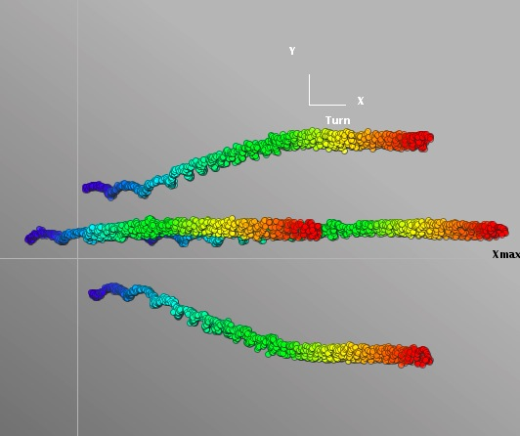
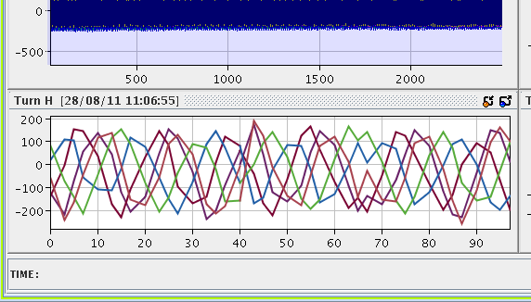
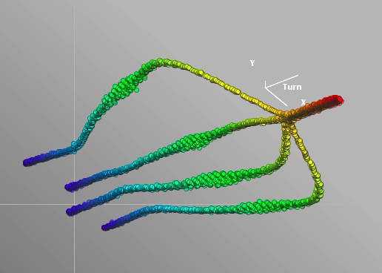
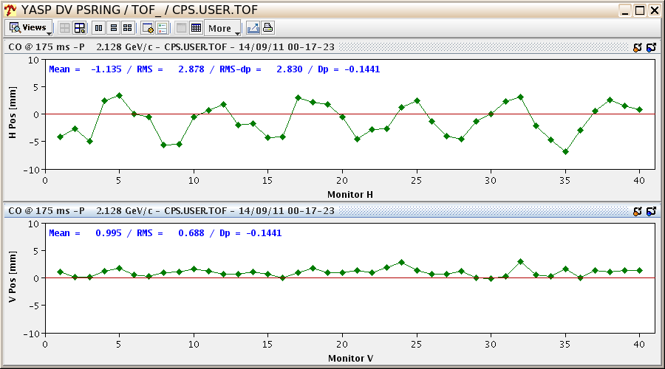
BPM System Upgrades - PS
PS System recently upgraded
Now allows bunch by bunch and turn by turn measurements
Vital for phase space visualisation and optimisation of critical processes
MTE islands lost!
(X/X’ 3D plot)
Trajectories at injection
There is a problem…
MTE islands
(X/X’ 3D plot)
Trajectories used for the steering
(YASP plot)

Slide 13
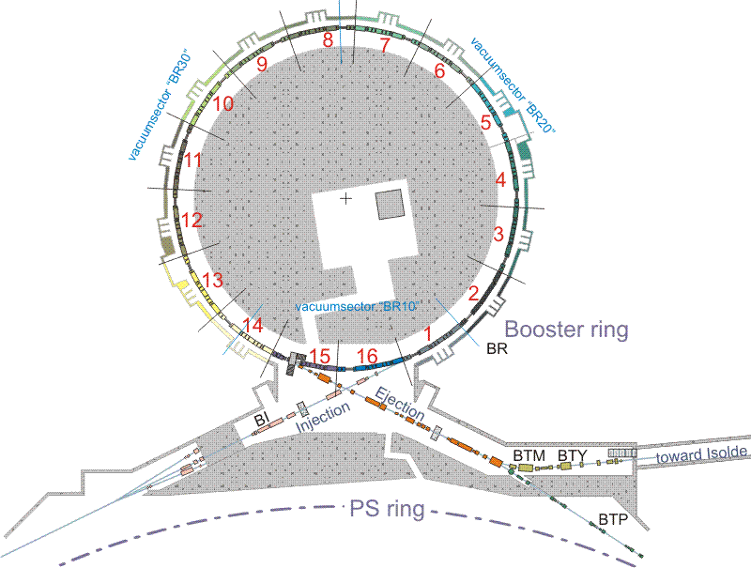
BPM System Upgrades - PSB
Requirements – most coming from connection of LINAC4:
  Bump closure measurement at injection
  Injection steering
  Injection trajectories turn-by-turn over the first ~100-1000 turns
  Resolution / absolute precision : 0.2 mm / 0.3 mm
  Frequency span : 1MHz
  Intensity range 5E9-2E13
STATUS : The present ORBIT measurement is obsolete and measures only one ring at a time
BI group proposal :
Keep monitors
New Front-end electronics
New Cables to BOR
Data processing :
  complete trajectories,
  orbit,
  same as PS, or in-house based on FMC
Every ring to get own acquisition (no multiplexing)
16 dual-plane PUs per ring
Total : 64 PUs

Slide 14
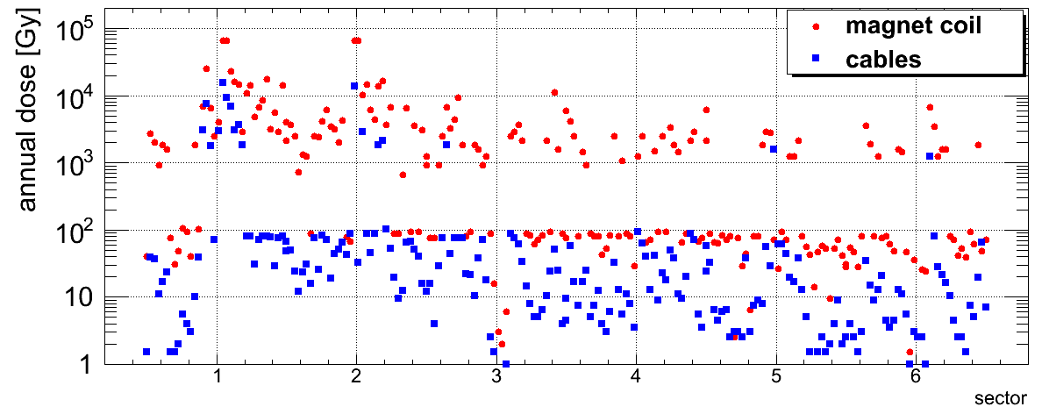
BPM System Upgrades - SPS
Why the Upgrade?
Actual SPS-MOPOS electronic system is:
  Obsolete
  Limited in accuracy
  Noisy for low intensity beams
  Shows filling pattern dependency
  Requires yearly in-situ calibration due to lack of on-line calibration system
Challenges
Elimination of coax cables
Move to fibre-optics (as for LHC)
Development of radation tolerant front-end electronics
Logistics
Installation of fibre-optic network in the SPS tunnel
  Allows system to be tested in parallel to exisiting system
  But implies addition of further cabling in an already crowded tunnel

Slide 15
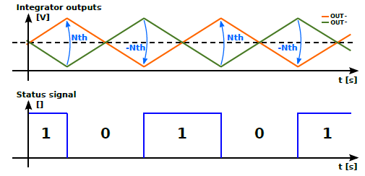
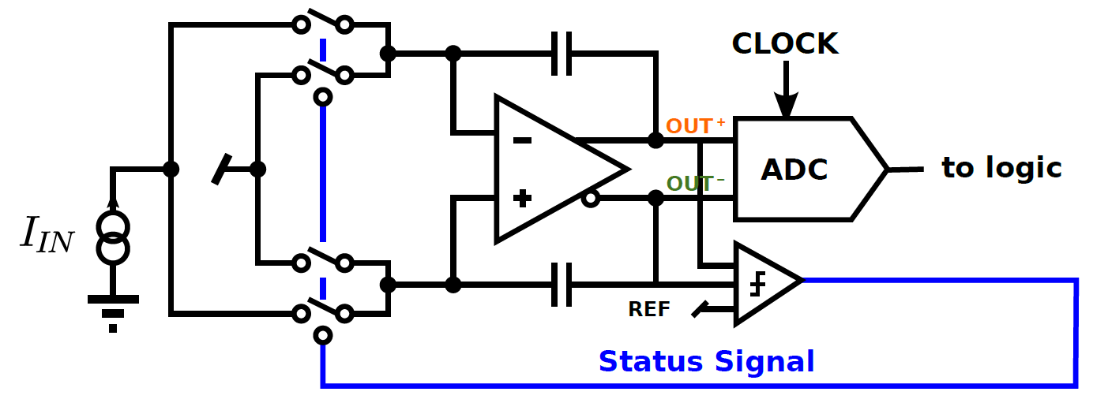
BLM System Upgrade
Objective: Replace obsolete system and upgrade performance for LIU
Challenge:
7 orders of magnitude dynamic range for 2ms integration window – 1nA to 200mA
9 orders of magnitude dynamic range for 1s integration window – 1pA to 200mA
Plan:
New system based on experience of successful LHC implementation
Single electronic system capable of taking input from different monitor types
  LHC type ionisation chambers or smaller version - little ionisation chamber (LIC)
Develop for LINAC4 & extend to cover whole injector complex
Add fast detectors (ACEM, Cerenkov or diamond) for bunch resolved measurements
Input switch
Fully differential Integrator

Slide 16
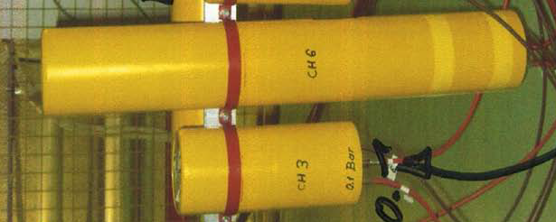
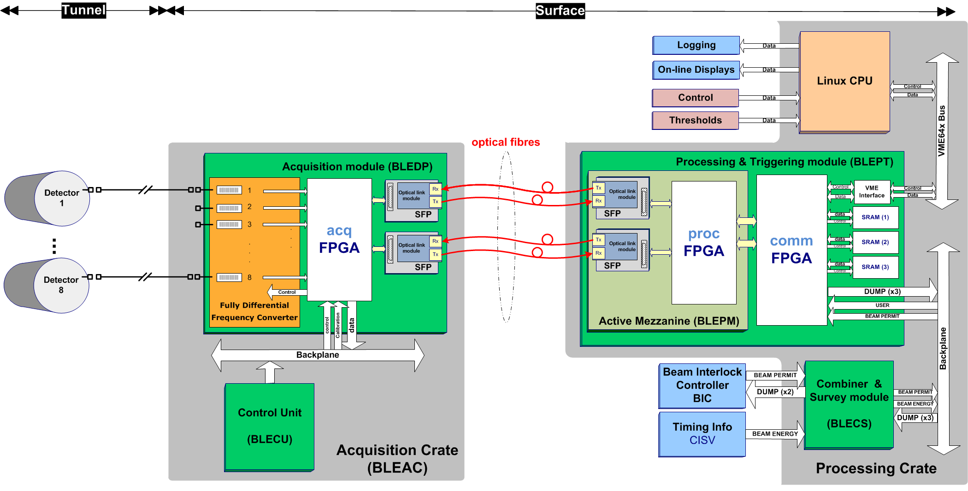
BLM System Upgrade
Schematic Overview of Acquisition System

Slide 17
Summary
The majority of Beam Instrumentation systems in the injectors have, or will, undergo significant upgrades in the coming years
This will be a combination of
Consolidation of old, obsolete or radiation damaged equipment
Fast BCT electronics standardised all over the PS complex
New Fast BCT and DCCT in the SPS
SEM electronics upgraded everywhere
Renovation of the controls infrastructure
Upgrades linked to enhanced performance required by the LIU project
A new PSB and SPS orbit and trajectory system
A new PSB, PS and SPS BLM system
New WCM in the PS for longitudinal density distribution measurement
New ionisation profile measurement system in the SPS
In addition there is much R&D to further improve beam instrumentation
Development of fast, accurate vacuum wire scanners
Study of feasibility of ionisation profile measurements in the PSB & PS
…………

