Slide 2
PSB RF
Renovation and upgrade plans
M.Paoluzzi BE/RF
25 November 2011

Slide 3
Summary
Existing RF systems.
Foreseen consolidation / upgrade.
New technology for C02 and C04.
Advantages / Risks.
5-cells Finemet® cavity prototype.
Foreseen tests.
Planning.

Slide 4
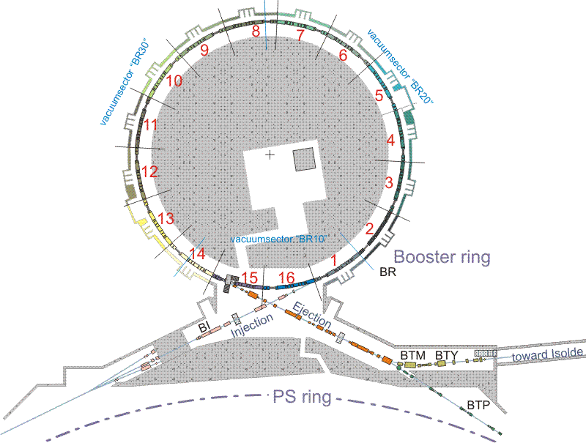
Existing RF systems
Three systems are presently installed in the machine:
C02
    Frequency range 0.6 (*1.0) – 1.8 MHz
    Gap Voltage 8 kV
    Installed in sections 7L1 and 10L1
C04
    Frequency range 1.2 (*2.0) – 3.8 MHz
    Gap Voltage 8 kV
    Installed in section 13L1
* Frequency with injection from LINAC4
C16
    Frequency range 6.0 – 16 MHz
    Gap Voltage 6 kV
    Installed in section 5L1

Slide 5
Foreseen consolidation/upgrade
In the ring:
  Keep the cavities
  Keep the C02 and C16 final amplifiers
  Redesign the C04 final amplifier to:
        Increase the mean available RF power
        Increase the available RF current for beam loading compensation.
        Deal with the foreseen 2 GeV energy upgrade.
  Replace all the irradiated cables.
    On the surface:
  Replace the interlock system with modern PLC.
  Replace the interfaces with the control system (G64!!!).
  Move the AVC and Tuning loops to the new digital beam control electronics.
  Implement new protections.
  Replace the 6 kV - 8 kV Anode HV power supplies and grid bias supplies.
  Install new stabilized tubes filament heaters.
  Replace tuning supplies.

Slide 6
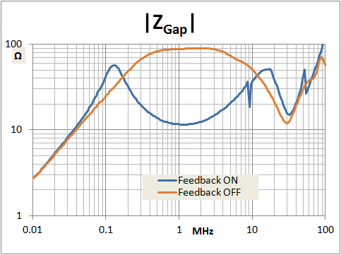
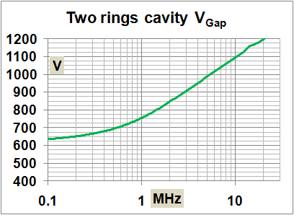
New technology for C02 and C04.
A substantial improvement could be achieved using wideband (0.6MHz to 4MHz) , Finemet® loaded cavities.
        Finemet exhibits wideband response
A basic cell configuration composed of one gap and two cores gives many advantages:
Full exploitation of the Finemet® wideband response.
Power requirements in the range of compact solid-state amplifiers.
Fast RF feedback feasible to reduce the gap impedance and compensate the beam induced voltage.
Gap voltage compatible with solid-state gap shorting devices.
C_{P} mostly depends on geometry and drives the high frequency response. The capacitive effect is enhanced by the final stage output capacitance.
  R_{P} and L_{P} drive
  the low frequency response. They and are mostly dependent on Finemet® Characteristics.
2-Rings cavity
Size compatible
with PSB.
V_{Gap}>700 V_{Peak}
Freq > 600 KHz
P = 2 x 670 W
Length =13 cm
In the available space a substantial voltage increase can be achieved or hot spares can be installed.

Slide 7
Advantages / Risks
Advantages
Single system to cover C02 and C04 frequency range.
Modular system.
Solid-state amplifier.
Multi harmonic operation.
No tuning.
Substantial increase of installed RF voltage (up to 300%).
Increased system reliability (hot back-up by on line spare cells).
    Risks:
New technology.
New configuration
Completely new design.
Different beam compensation scheme.
…?
Tests with beam absolutely needed.

Slide 8
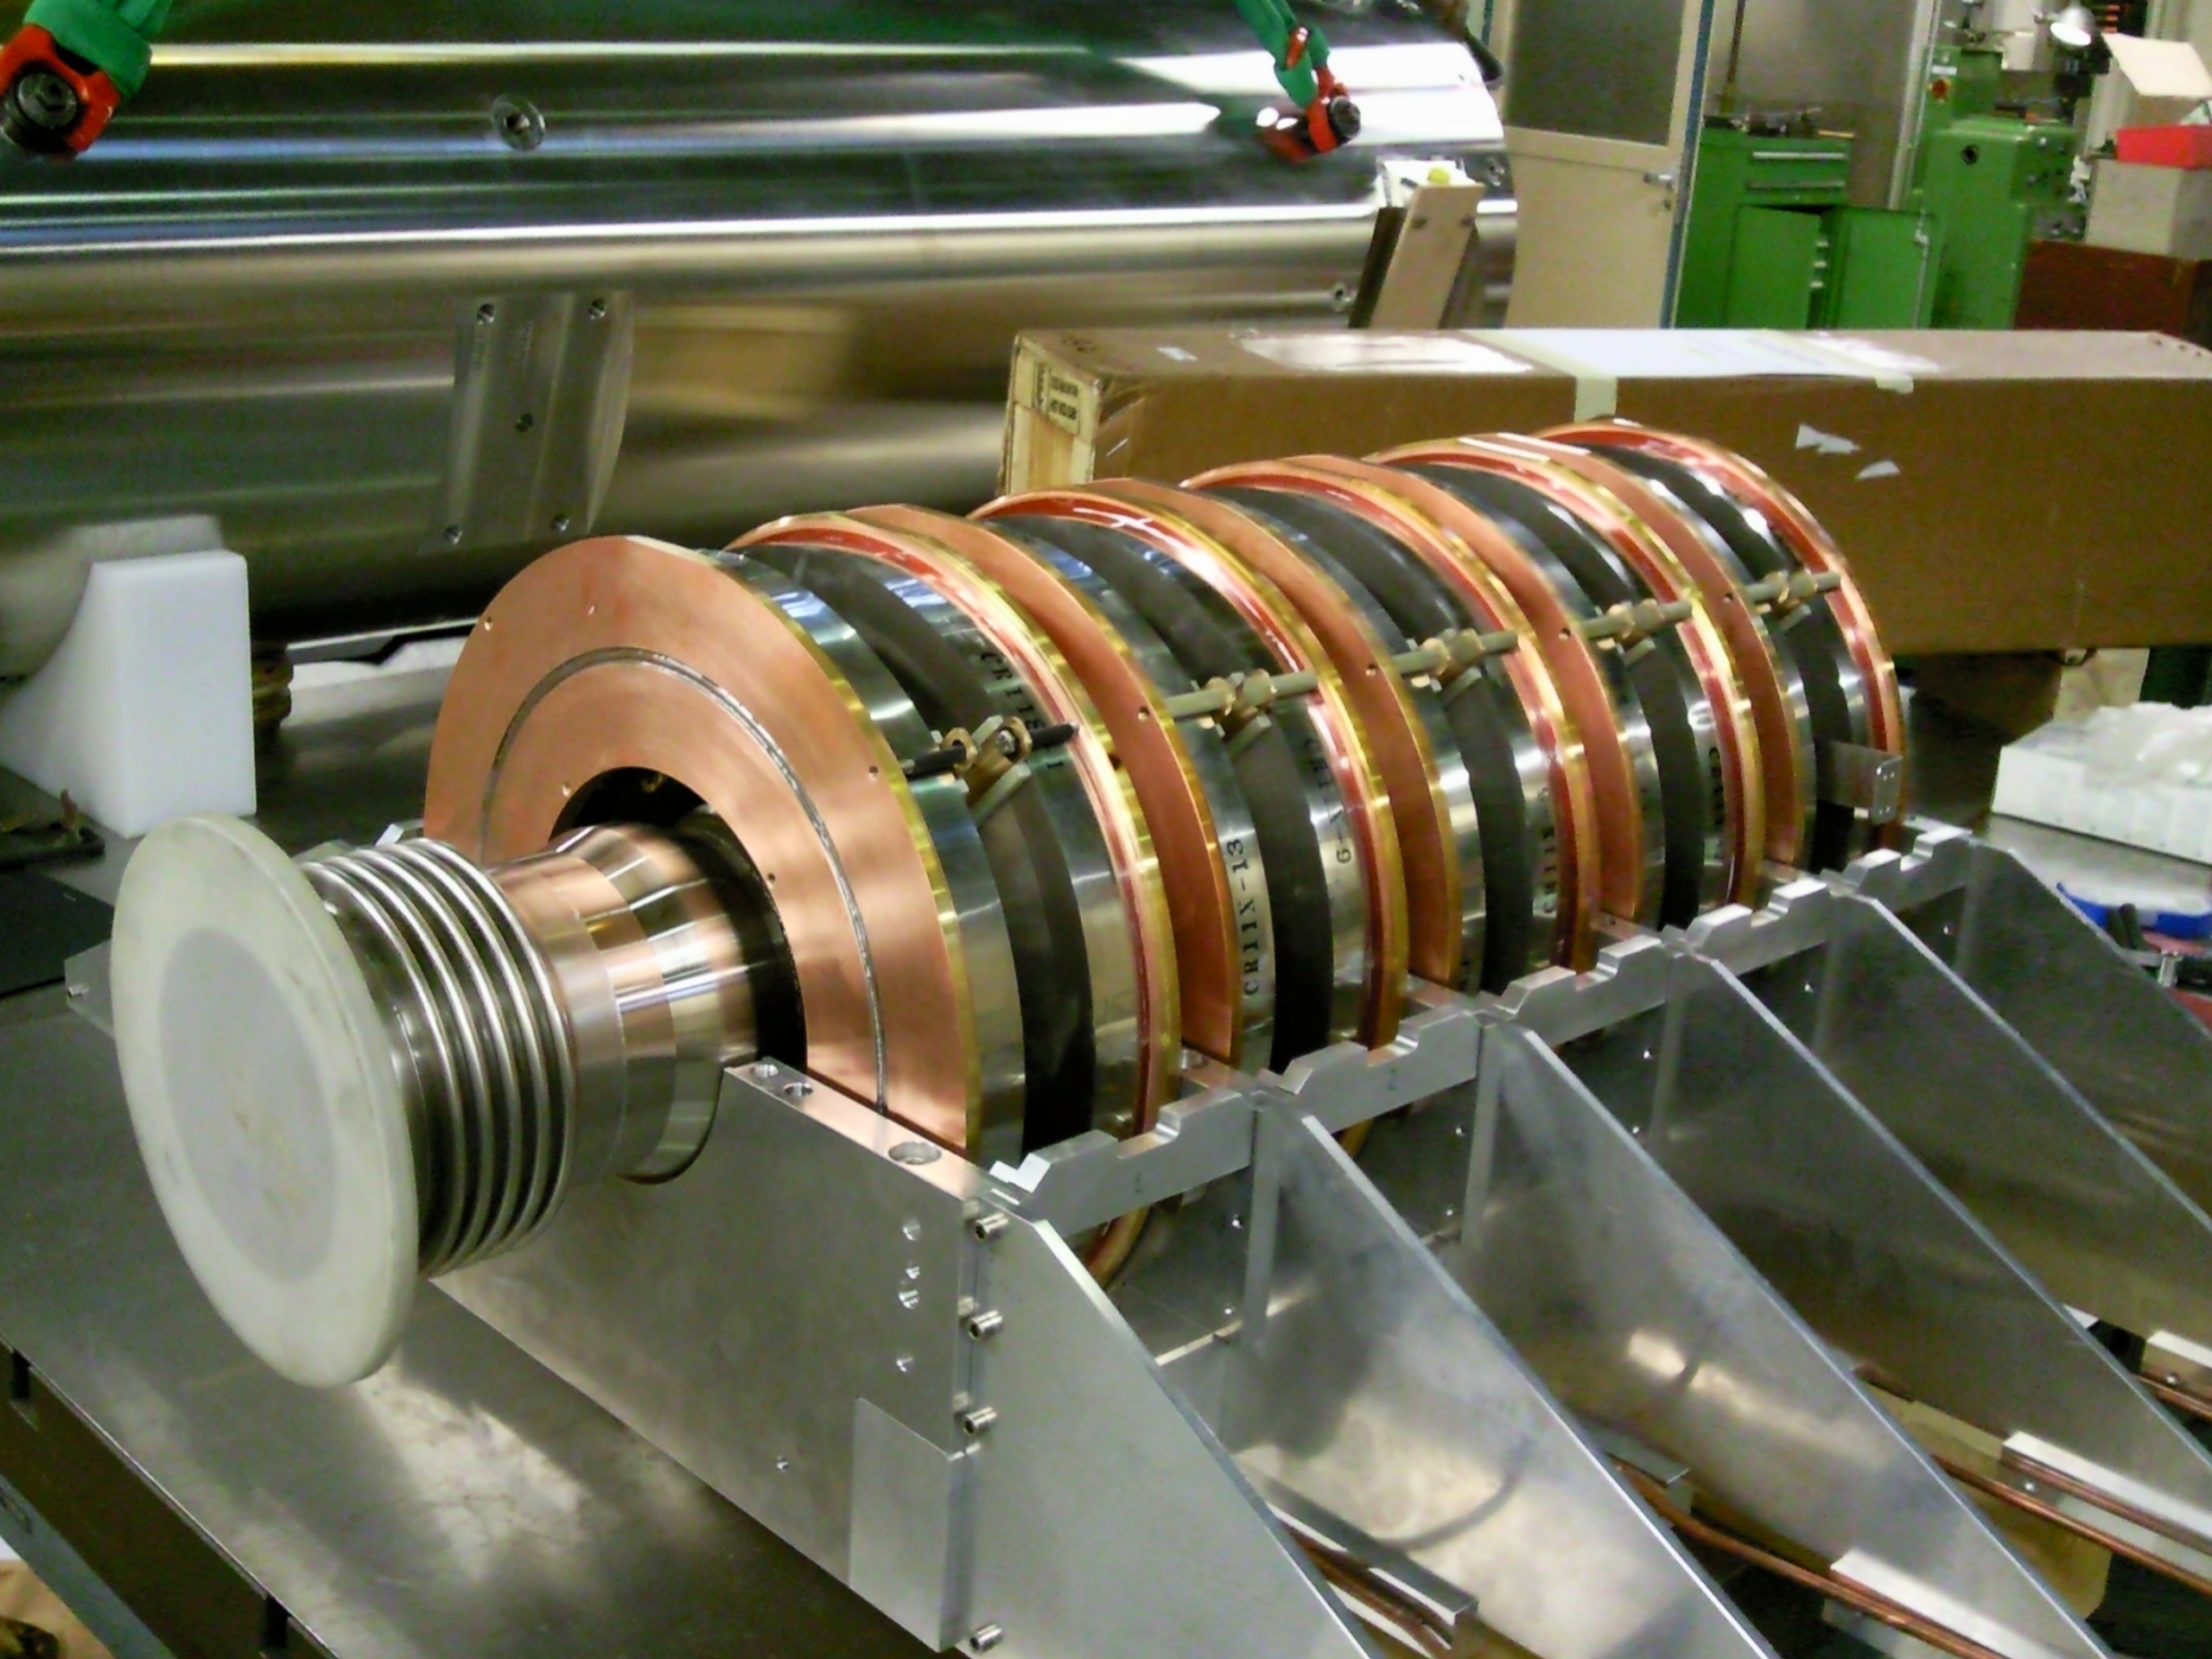
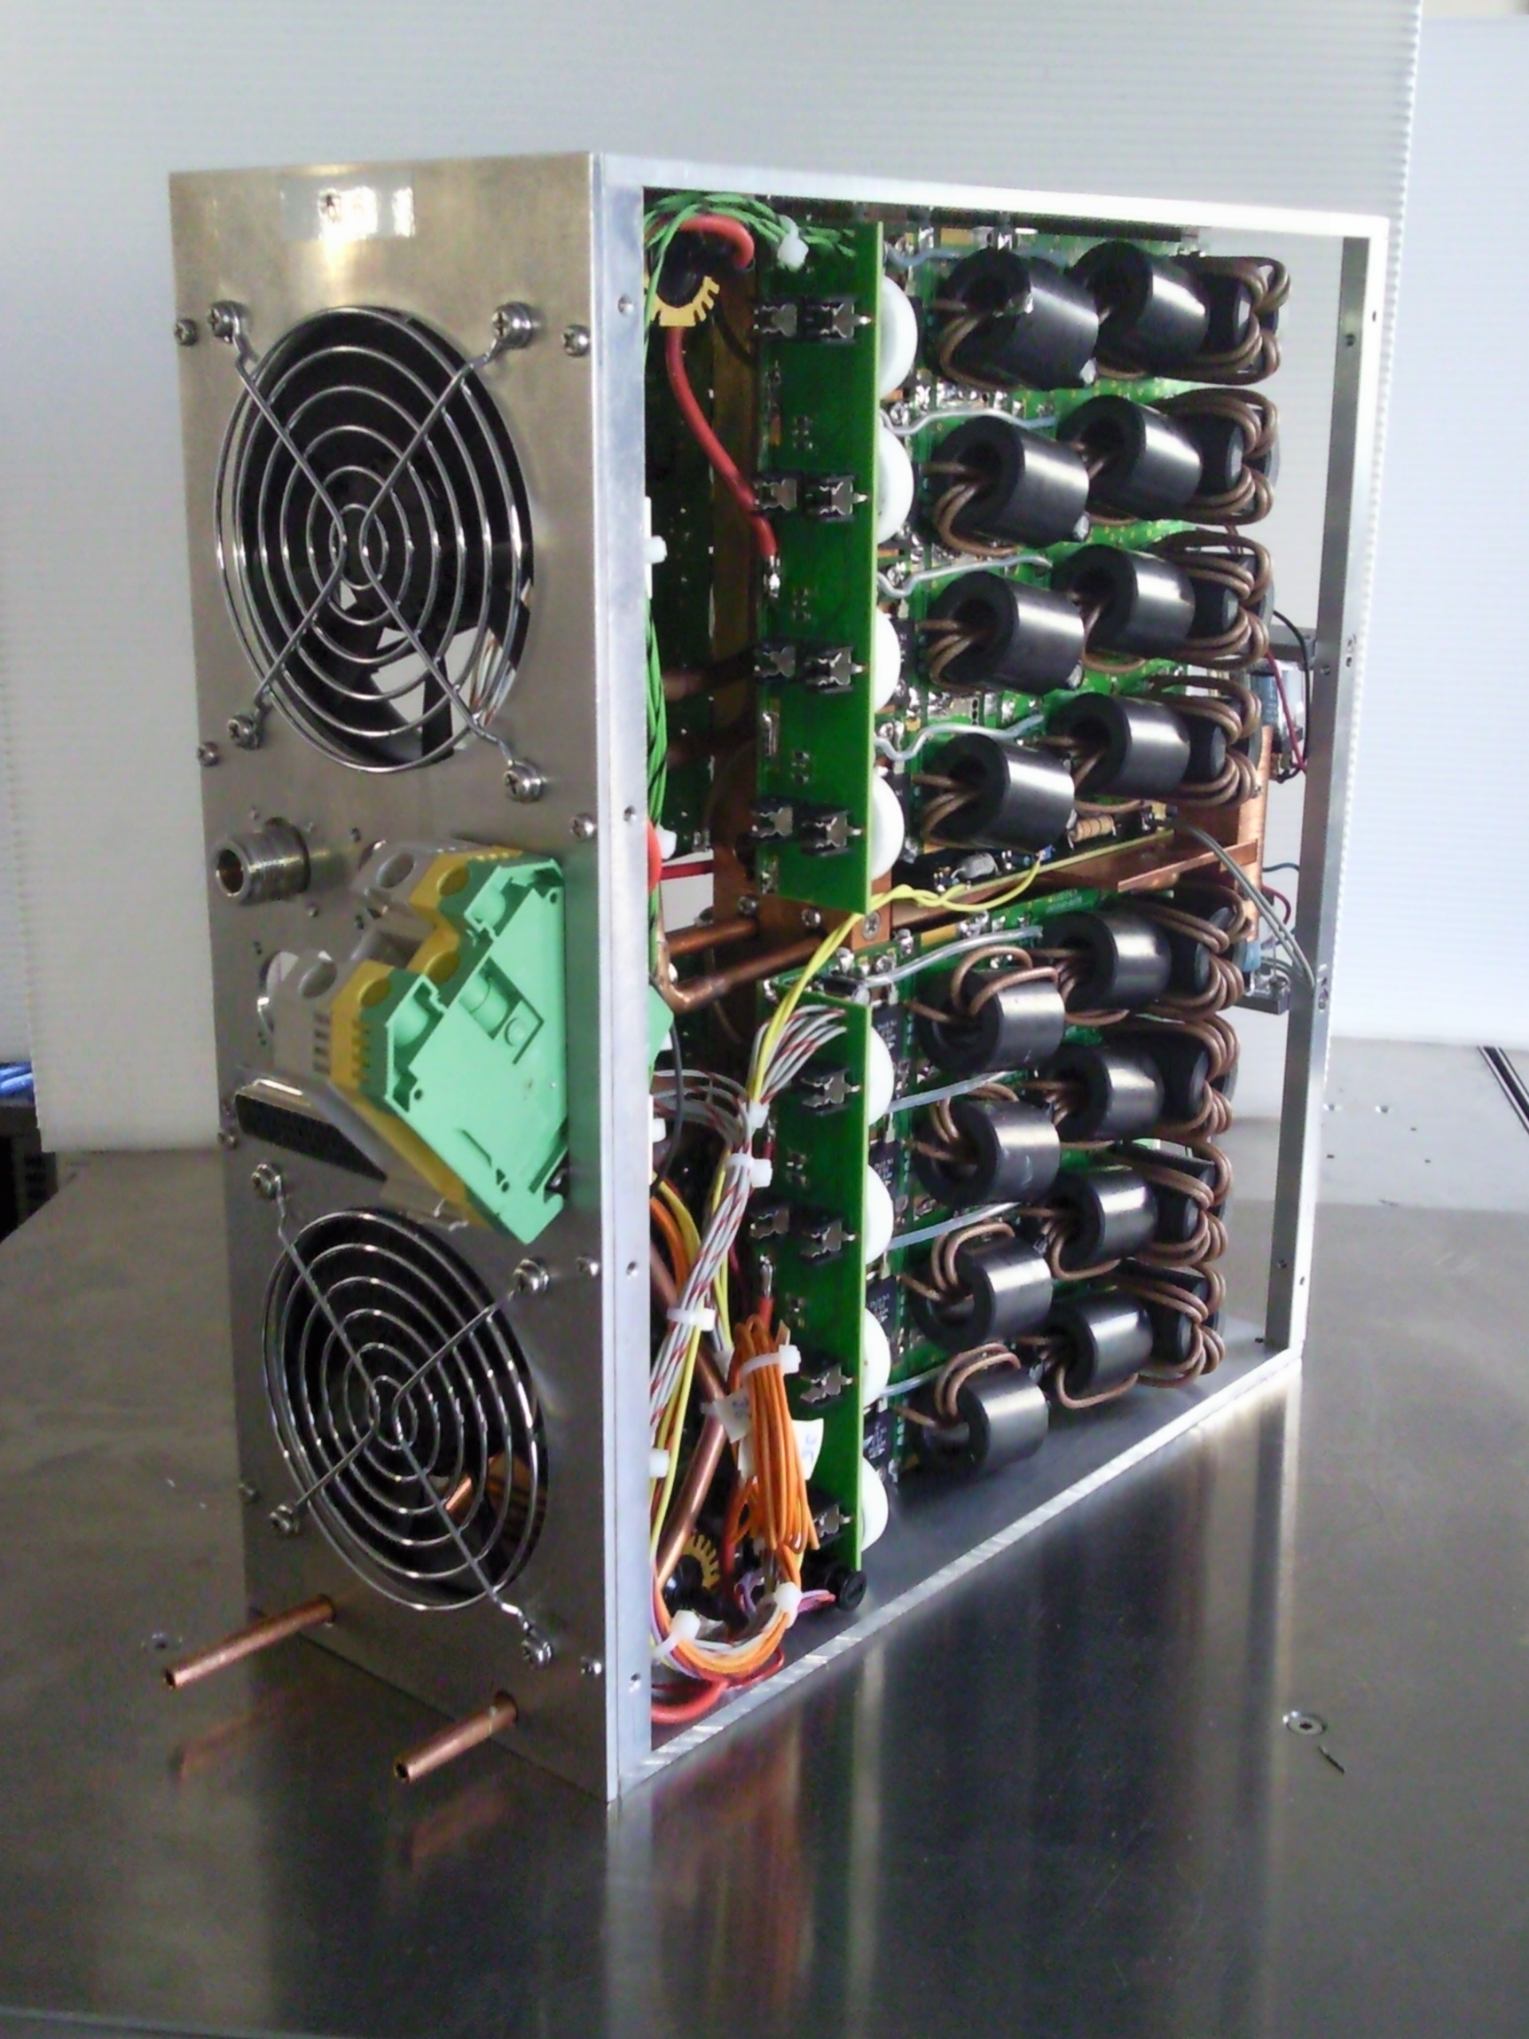
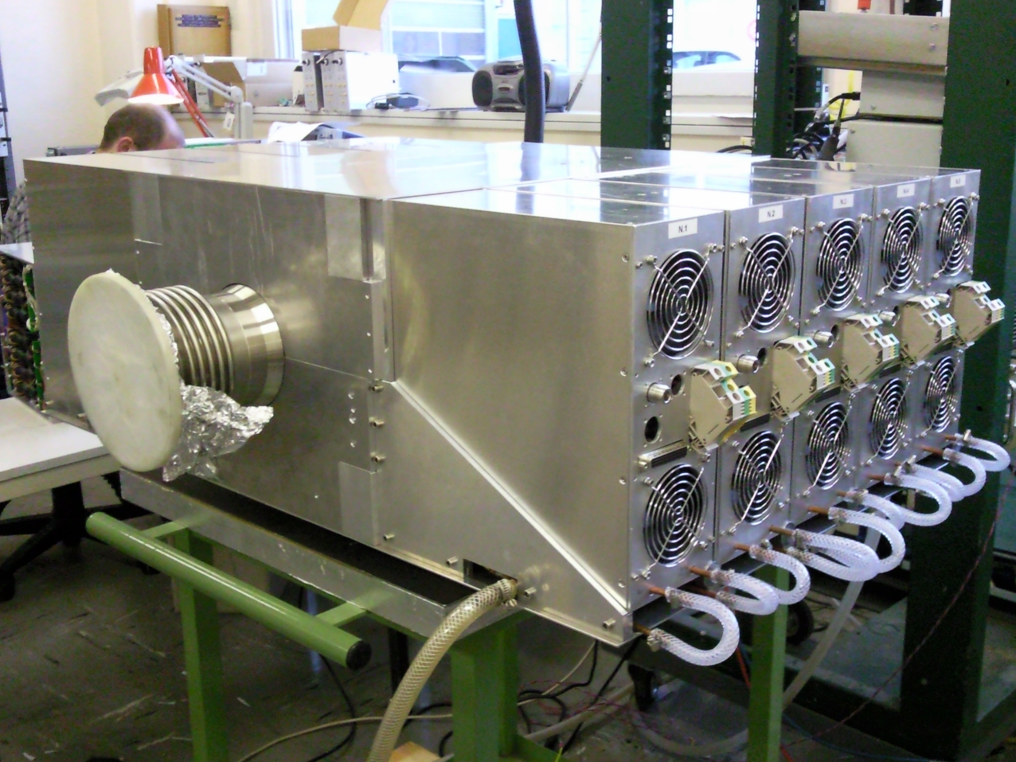
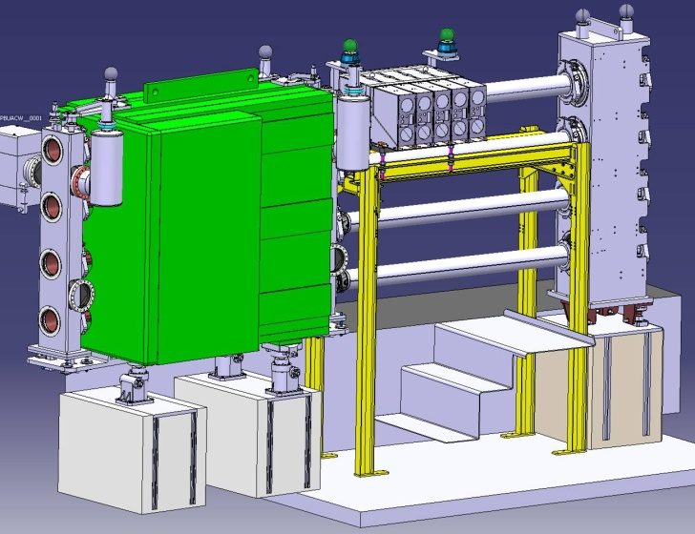
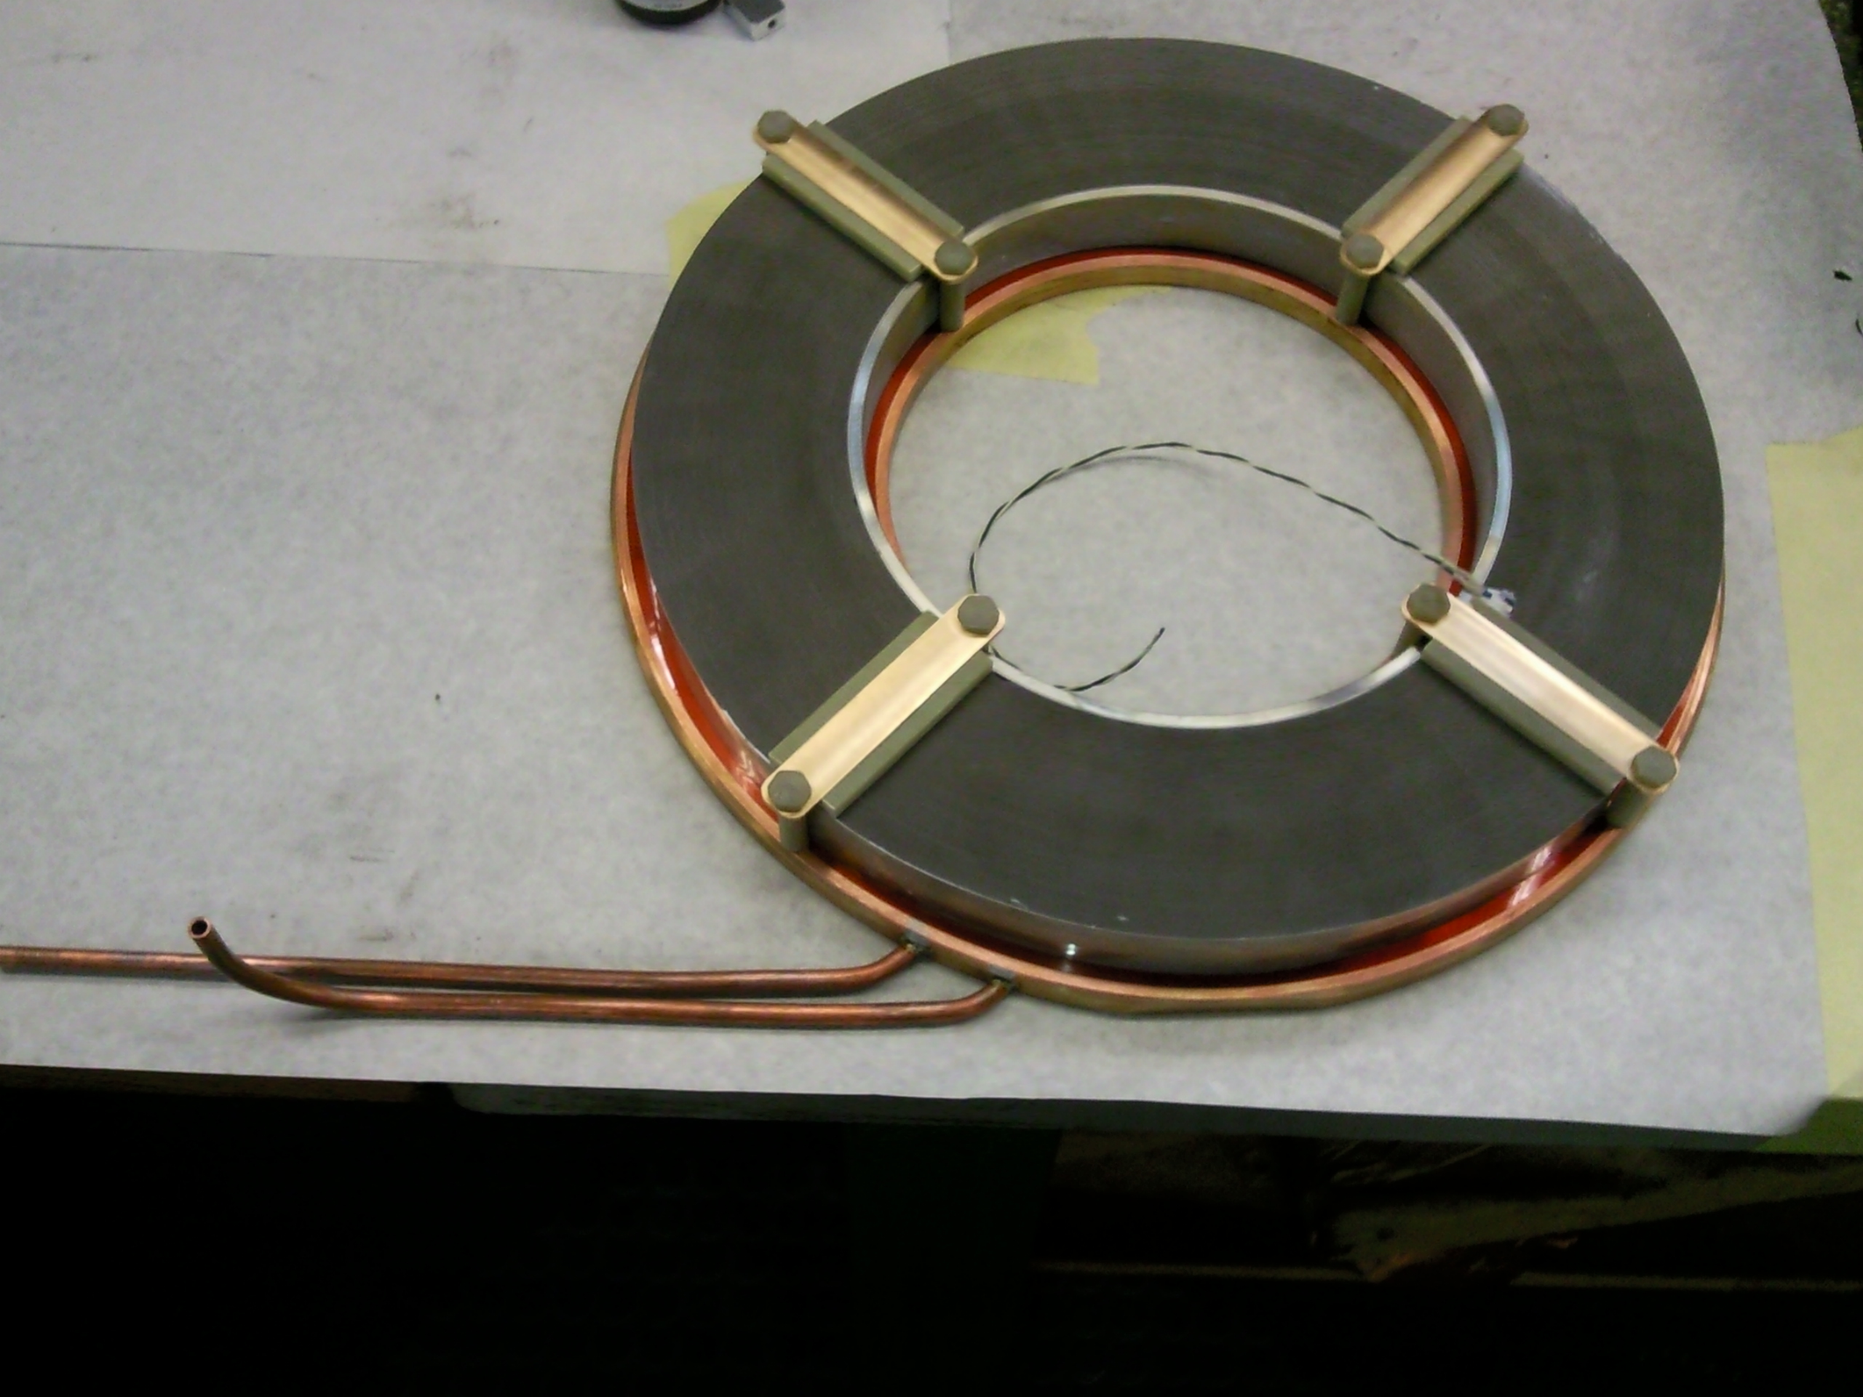
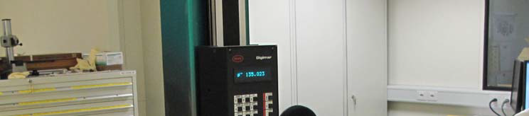
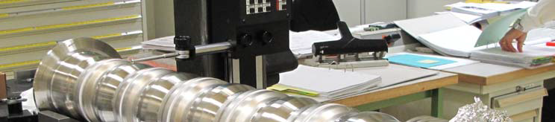
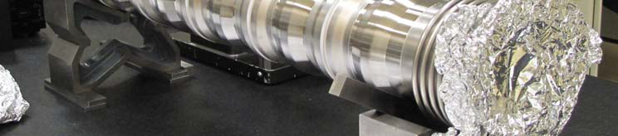
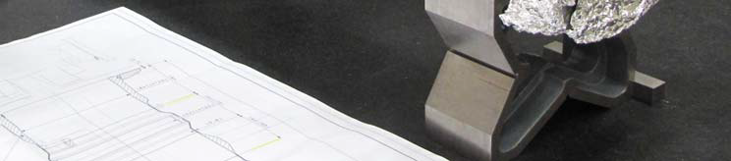
5-cells Finemet® cavity prototype
5-cells open cavity.
Solid-State amp.
Full assembly.
Installation layout in PSB 6L1.
Vacuum chamber.
Finemet® on a
cooling ring.

Slide 9
Foreseen tests
  PPM operation.
  Each gap equipped with shorting relays.
  Dedicated beam control low level electronics available.
Beam test required to study:
  Operation with wideband cavities.
  Beam loading compensation.
  Beam instabilities build-up.
  Amplifier reliability.
  … and much more!
Beam will be initially accelerated with the existing system to study the beam induced voltage and compensation effectiveness (RF feedback).
The new Finemet® system will then be used for acceleration using it ether in parallel with the existing one or alone.

Slide 10
Planning
Finemet®
2011 Design, produce and install in 6L1 a test cavity (5 cells, 3 kV).
2012 Beam test on dedicated users and MDs.
2013 - 2014 13 cells, 8 kV installed in 6L1.
2015 Beam test on dedicated users and MDs.
Parallel activities
C02 and C04 standard
2011 Design an upgraded C04 final amplifier and renovate test place.
2012 – 2014
C04 tests in the test place.
C02 and C04 tuning and filament supplies studies.
2015 Specification of items for C02 and C04 consolidation.
Parallel activities
C16
2012 - 2014
C16 Tuning and filament supplies studies.
2015 Specification of items for consolidation.
`
Depending on test results
2016 - ? Production of cells to fully equip the PSB with wideband cavities instead of C02 and C04!
Procurement of power supplies, ITL, new cables installation, etc.
2016 - ? Production of C04 upgraded amplifiers.
Procurement of power supplies, ITL, new cables installation, etc. for C02 and C04 consolidation
2016 - ? Procurement of power supplies, ITL, new cables installation, etc. for C16 consolidation
LS 2 Wideband cavities installation or C02 and C04 consolidation + C16 consolidation

