Slide 2
PSB
Main Power Supply
Serge Pittet
Jean-Paul Burnet, Karsten Kahle, Fulvio Boattini, Max Chamiot-Clerc
TE-EPC Serge PITTET
LIU-2011 Event, 25/11/2011

Slide 3
Overview of the existing Booster MPS system.
The 2GeV requirements.
LIU baseline: The “POPS” style alternative.
Technical alternatives.

Slide 4
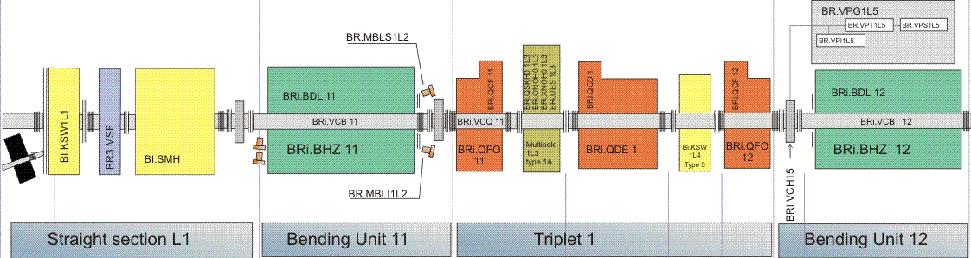
Booster MPS load characteristic
16 periods, 4 rings
 | Magnets quantity | Total resistance [mOhms] | Total inductance [mH]
Dipoles outer ring | 64 | 172 | 64
Focusing quadrupoles | 128 | 74 | 8
Reference magnet | 4 | 10 | 4
Defocusing quadrupoles | 64 | 51 | 6
Dipoles inner ring | 64 | 172 | 64
Total | 324 | 479 | 146

Slide 5
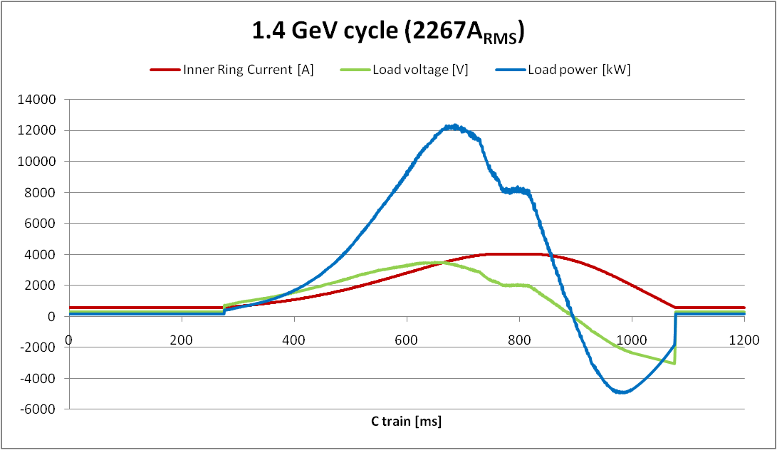
Booster MPS circuit
1.4GeV margins:
MPS voltage: -2%
MPS peak current: -2%
MPS rms current: 3%
TRIM A peak current: 40%
TRIM Q peak current: 0%
TRIM A
1900V
50A_{pk}
30A_{RMS}
64 BHZ
Ring 1&4
MPS
3600V
4000A_{pk}
2300A_{RMS}
QFO
520V
300A_{pk}
200A_{RMS}
128 QFO
Ring
1,2,3&4
Reference
magnet
GND
QDE
520V
300A_{pk}
200A_{RMS}
64 QDE
Ring
1,2,3&4
64 BHZ
Ring 2&3

Slide 6
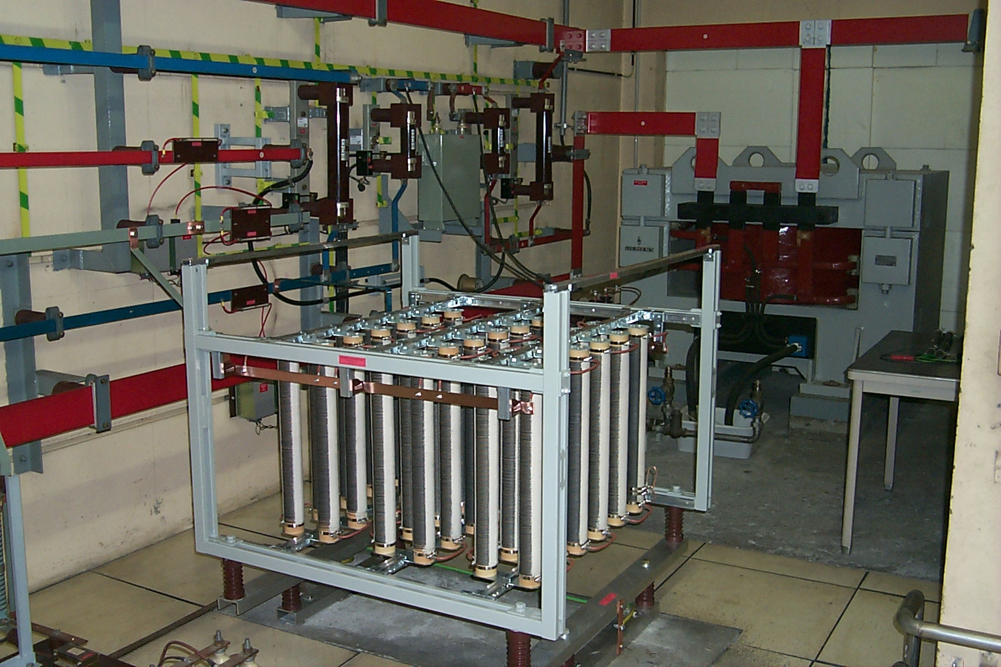
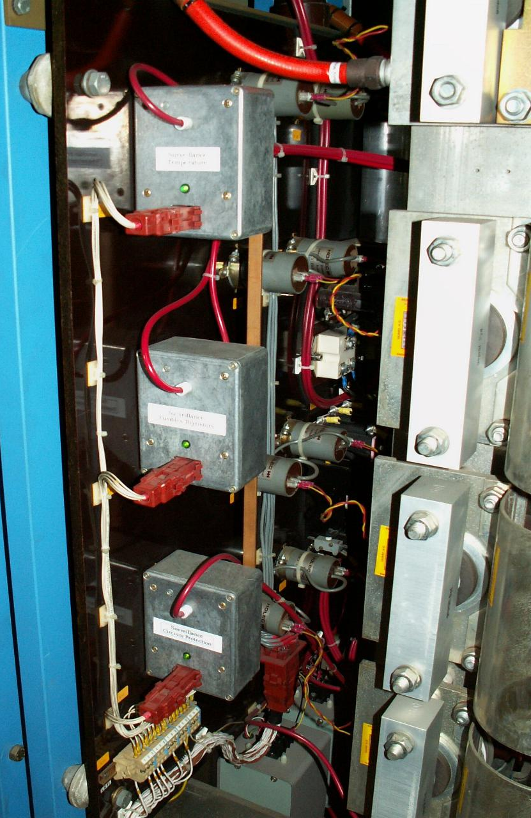
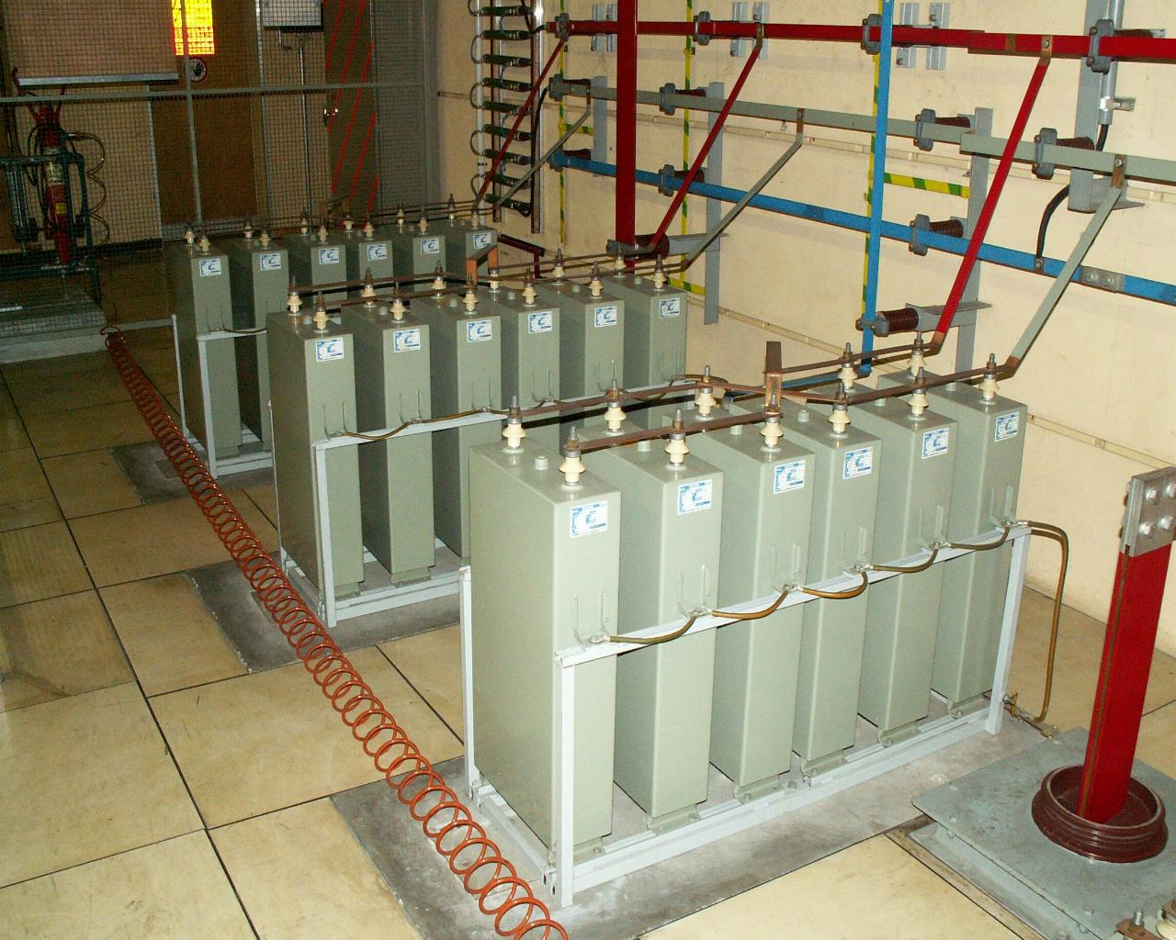
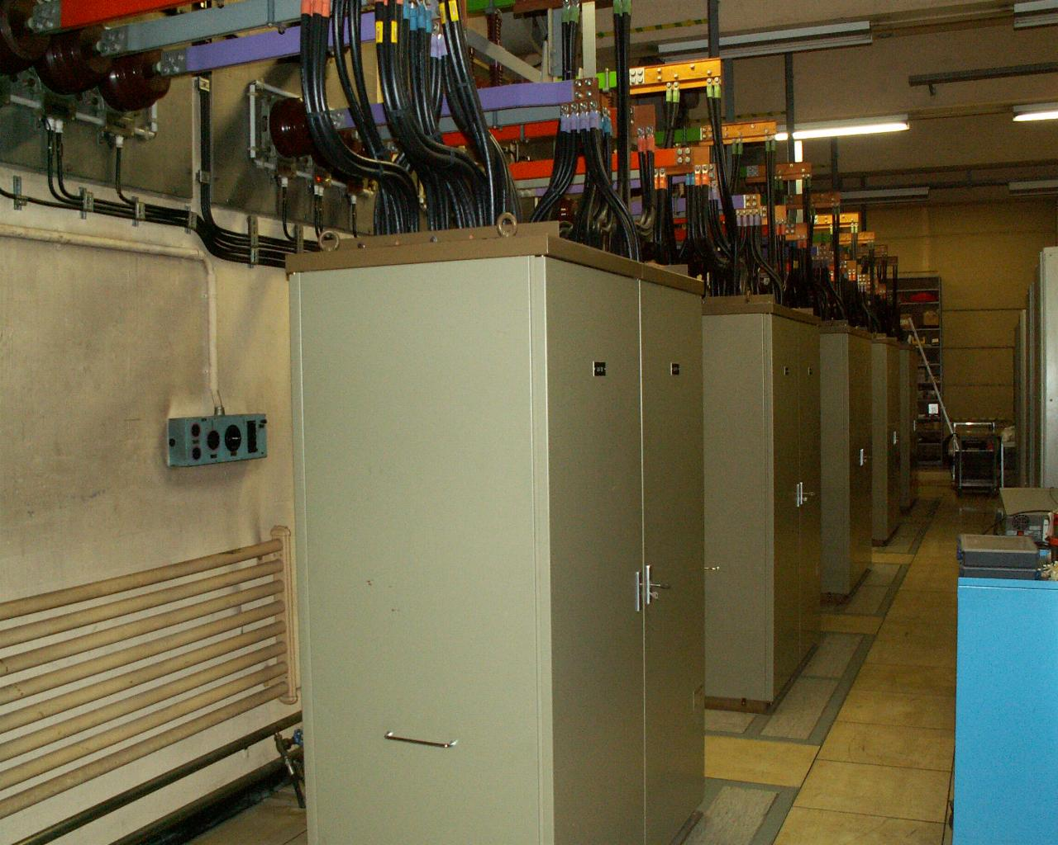
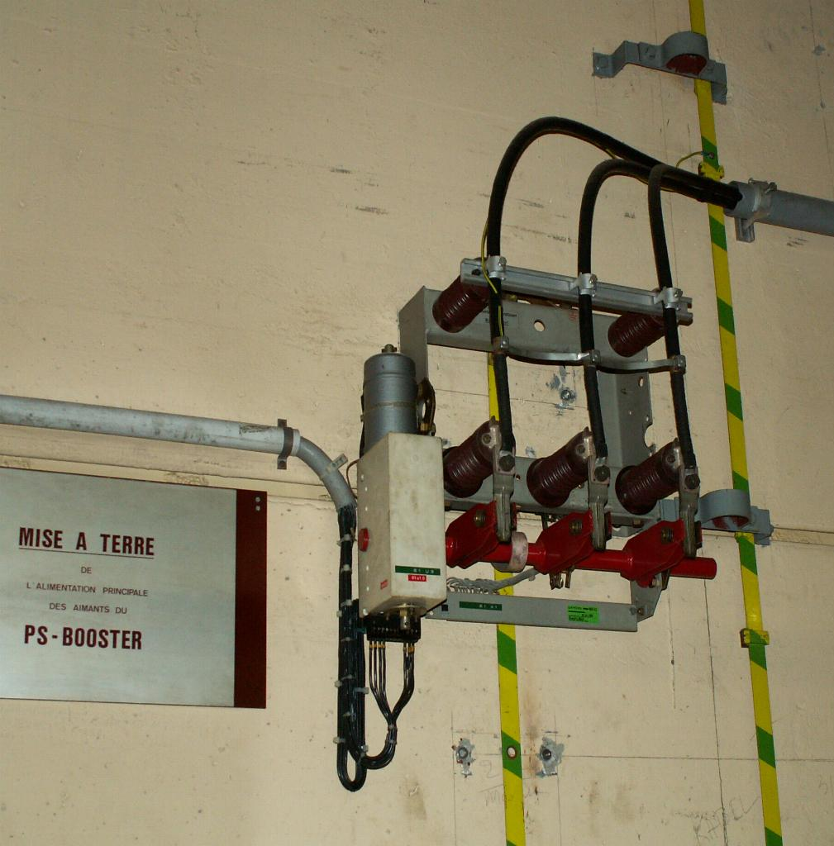
Booster MPS: the eighties

Slide 7
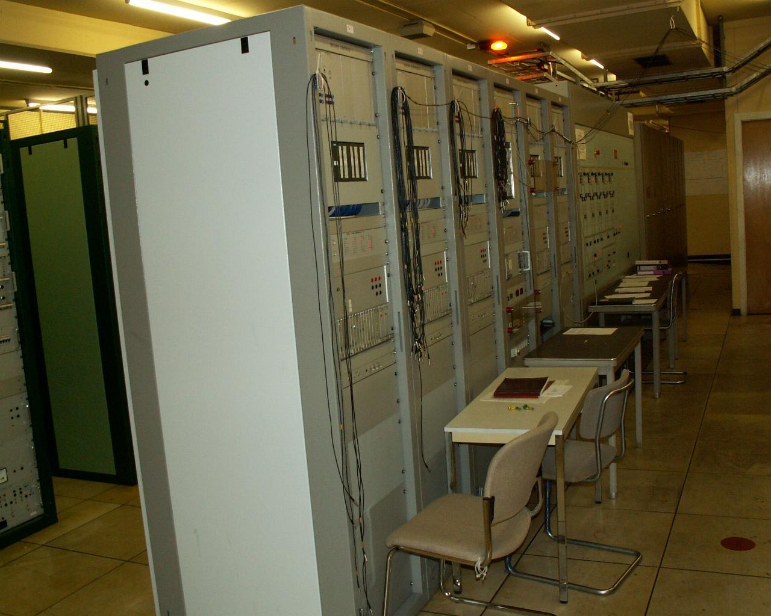
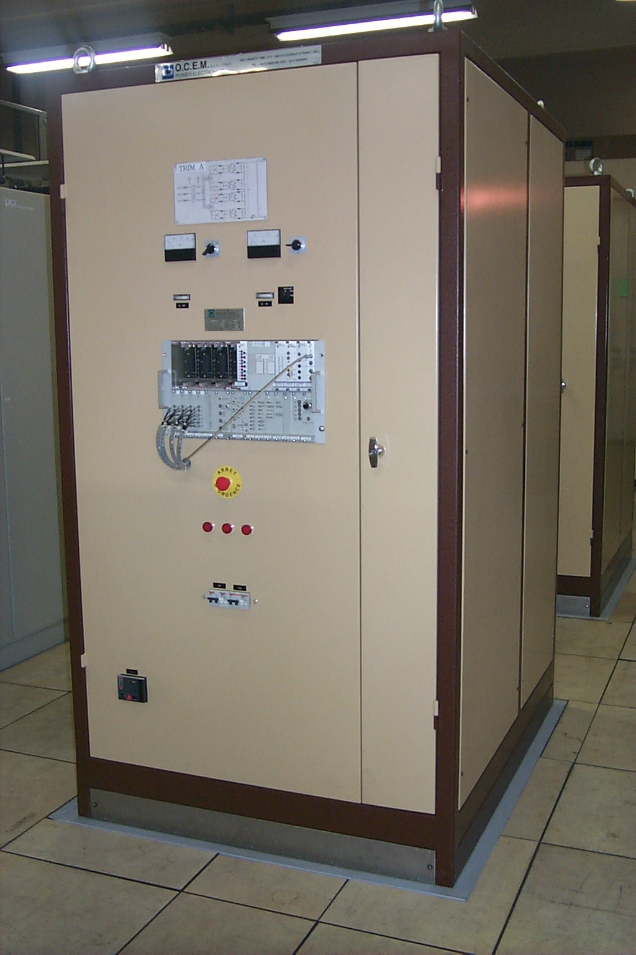
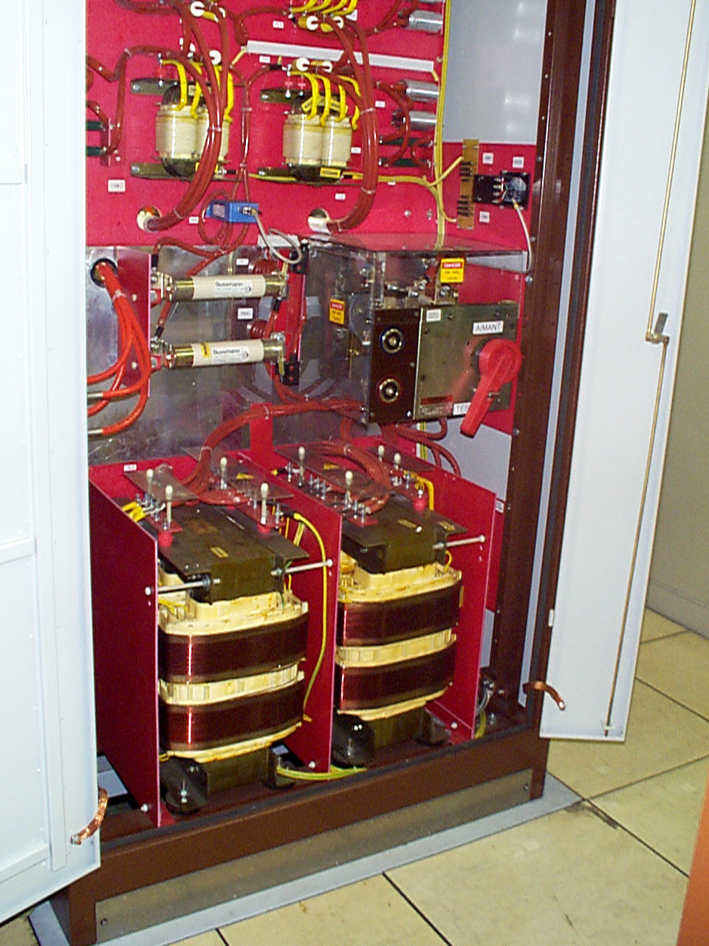
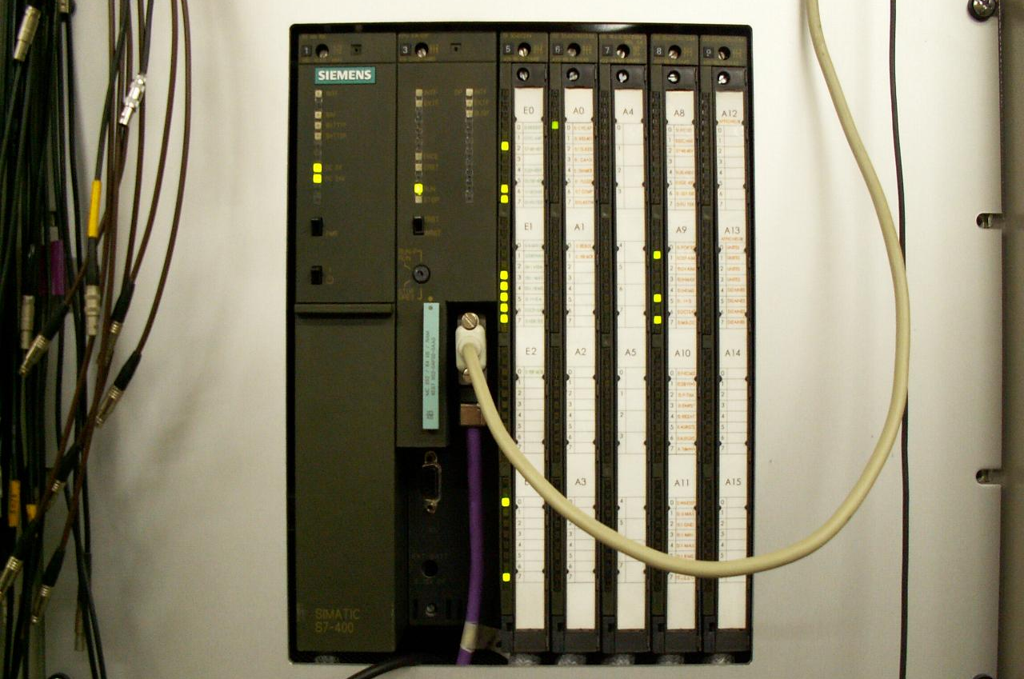
Booster MPS: 1998 consolidation
Automation & firing Trims

Slide 8
Overview of the existing Booster MPS system.
The 2GeV requirements.
LIU baseline: The “POPS” style alternative.
Technical alternatives.

Slide 9
LIU project scaling factors
From 1.4Gev to 2 GeV.
Considering some saturation effect, margin for B-field regulation and operation.
Power dissipation in the magnets with today’s ramp rate
Power dissipation in the magnets with existing MPS at maximal ramp rate.
New magnets and/or new MPS needed in any case
B-field: x1.3
Peak Current: x1.4
Power: x2
Far from design margins (20-30%)…
Power: x1.8
Better but not enough…

Slide 10
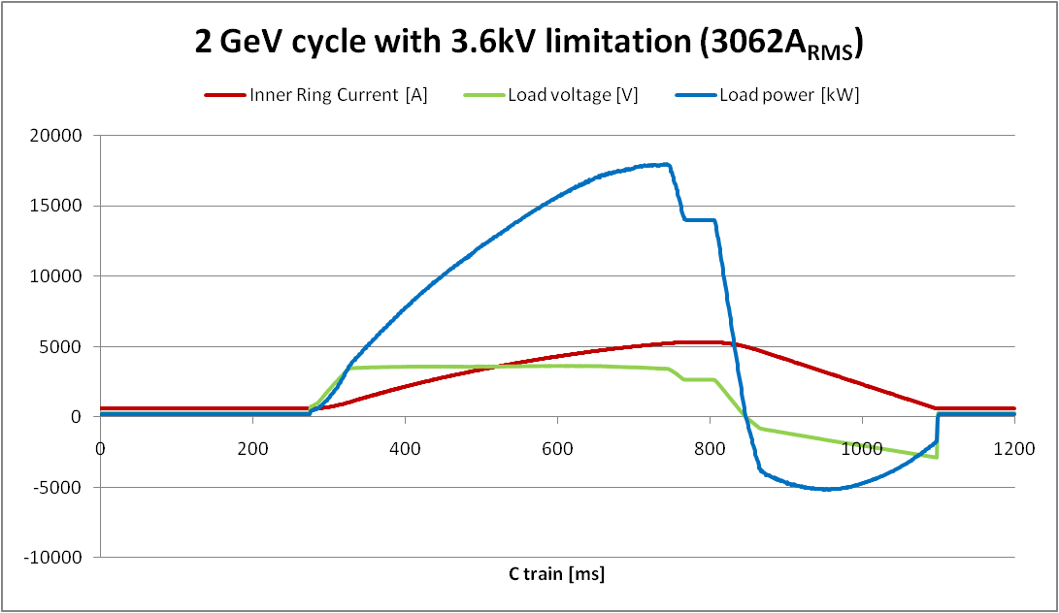
The existing Booster MPS at 2 GeV
Upgrade scaling on one cycle
MPS peak current: +30%
MPS rms current: +35%
18kV apparent power: +77%
18kV peak power: +45%
TRIM A peak current: +540%
TRIM Q peak current: +40%
TRIM A
1900V
270A_{pk}
64 BHZ
Ring 1&4
MPS
3600V
5300A_{pk}
QFO
520V
420A_{pk}
128 QFO
Ring 1,2,3&4
Reference
magnet
GND
QDE
520V
420A_{pk}
64 QDE
Ring 1,2,3&4
64 BHZ
Ring 2&3

Slide 11
Impact on the 18kV Meyrin network
Fast transients with 2GeV cycle which can not be compensated by Meyrin SVC.
50% increase of active power, 30% increase of reactive power

Slide 12
Overview of the existing Booster MPS system.
The 2GeV requirements.
LIU baseline: The “POPS” style alternative.
Technical alternatives.

Slide 13
“POPS” basic principles
The energy to be transferred to the magnets is stored in capacitors.
DC/DC converters transfer the power from the storage capacitors to the magnets.
Four flying capacitors banks are not connected directly to the mains. They are charged via the magnets.
Only two AC/DC converters (called chargers) are connected to the mains and supply the losses of the system.
Power to the magnets:
Chargers
+50MW peak
Power from the mains
10MW
Flying capacitors

Slide 14
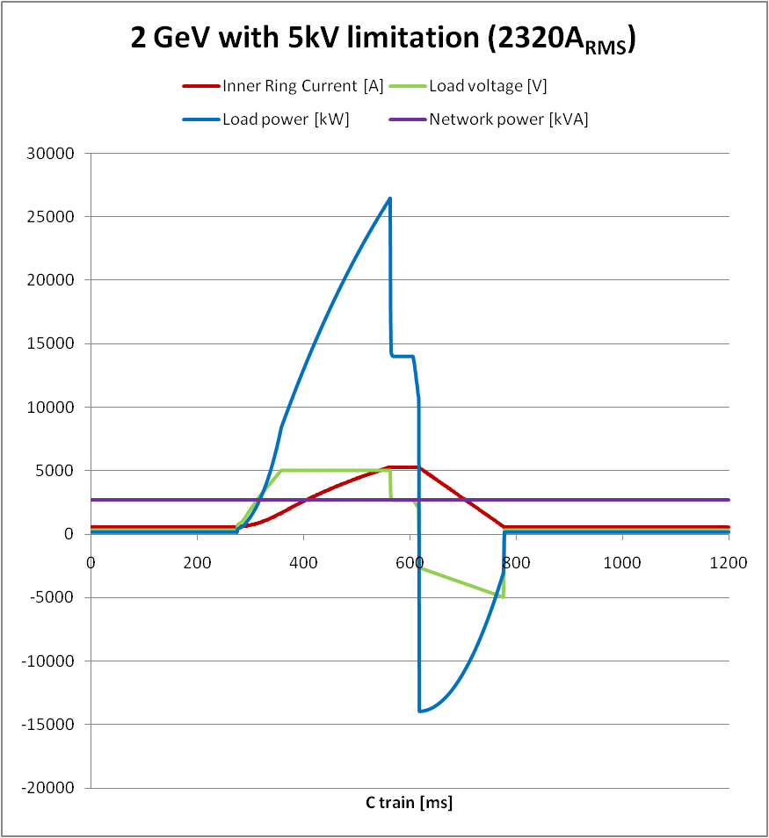
LIU Baseline: Fast cycle
Upgrade scaling on one cycle
MPS peak current: +30%
MPS rms current: +3%
18kV apparent power: -26%
18kV peak power: -78%

Slide 15
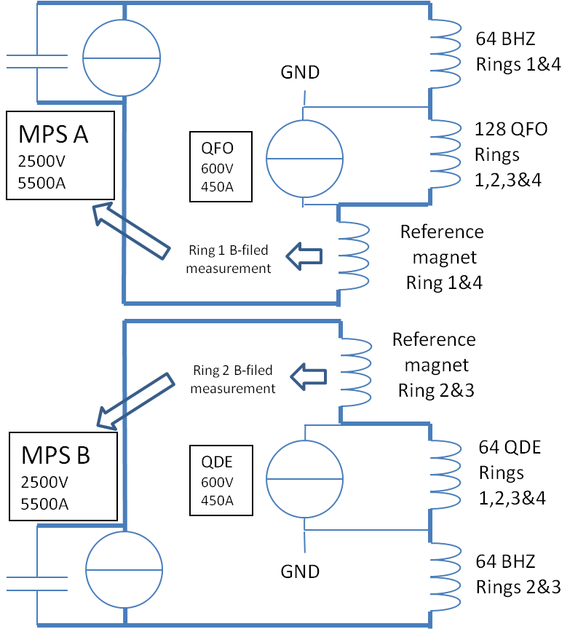
LIU-PSB 5.2 WU– MPS power converter
physics |  | LS1 |  | physics |  |  | LS2 | physics
2011 | 2012 | 2013 | 2014 | 2015 | 2016 | 2017 | 2018 | 2019
Alternative with new magnet studied
Design baseline confirmed and refined
Specification ready for submission
Market survey and call for tender completed
Converter manufactured and installed
Converter system commissioned
Converter commissioned and ready for operation
Benefits
Overall voltage available increases and would allow a reduction of the RMS current using a faster ramping.
The capacitor bank totally absorbs the peak power on the 18kV network. Meyrin SVC would then become optional.
Spare sharing between MPS A and B and eventually with POPS.
Only a few new cables needed between the reference magnet (BCER) and the MPS.
New B-field regulation to minimize eddy currents and saturation effects impact at higher current and acceleration rate.
Drawbacks
Cost.

Slide 16
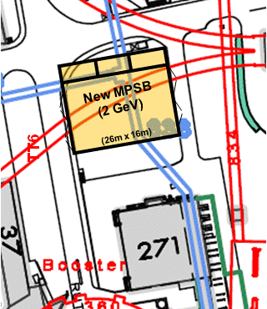
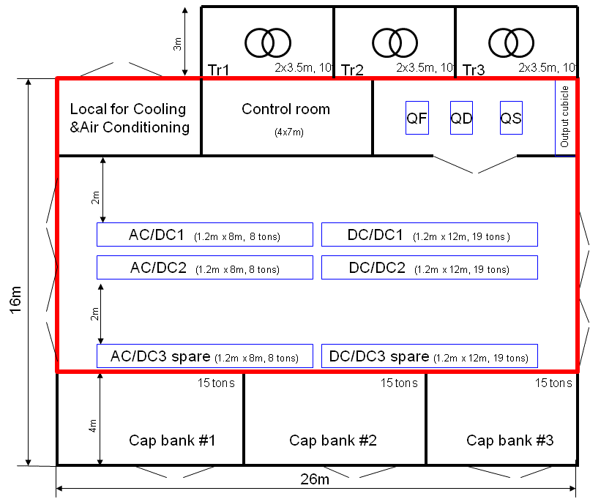
LIU-PSB 5.2 WU– MPS civil engineering
physics |  | LS1 |  | physics |  |  | LS2 | physics
2011 | 2012 | 2013 | 2014 | 2015 | 2016 | 2017 | 2018 | 2019
Civil engineering pre-study completed
Civil engineering designed
Civil engineering heavy workload done
Building infrastructure & services ready
With this new building:
We can install and commission during Booster operation.
We have a backup power supply during the first years.
Easy connection to existing cables and cooling services.

Slide 17
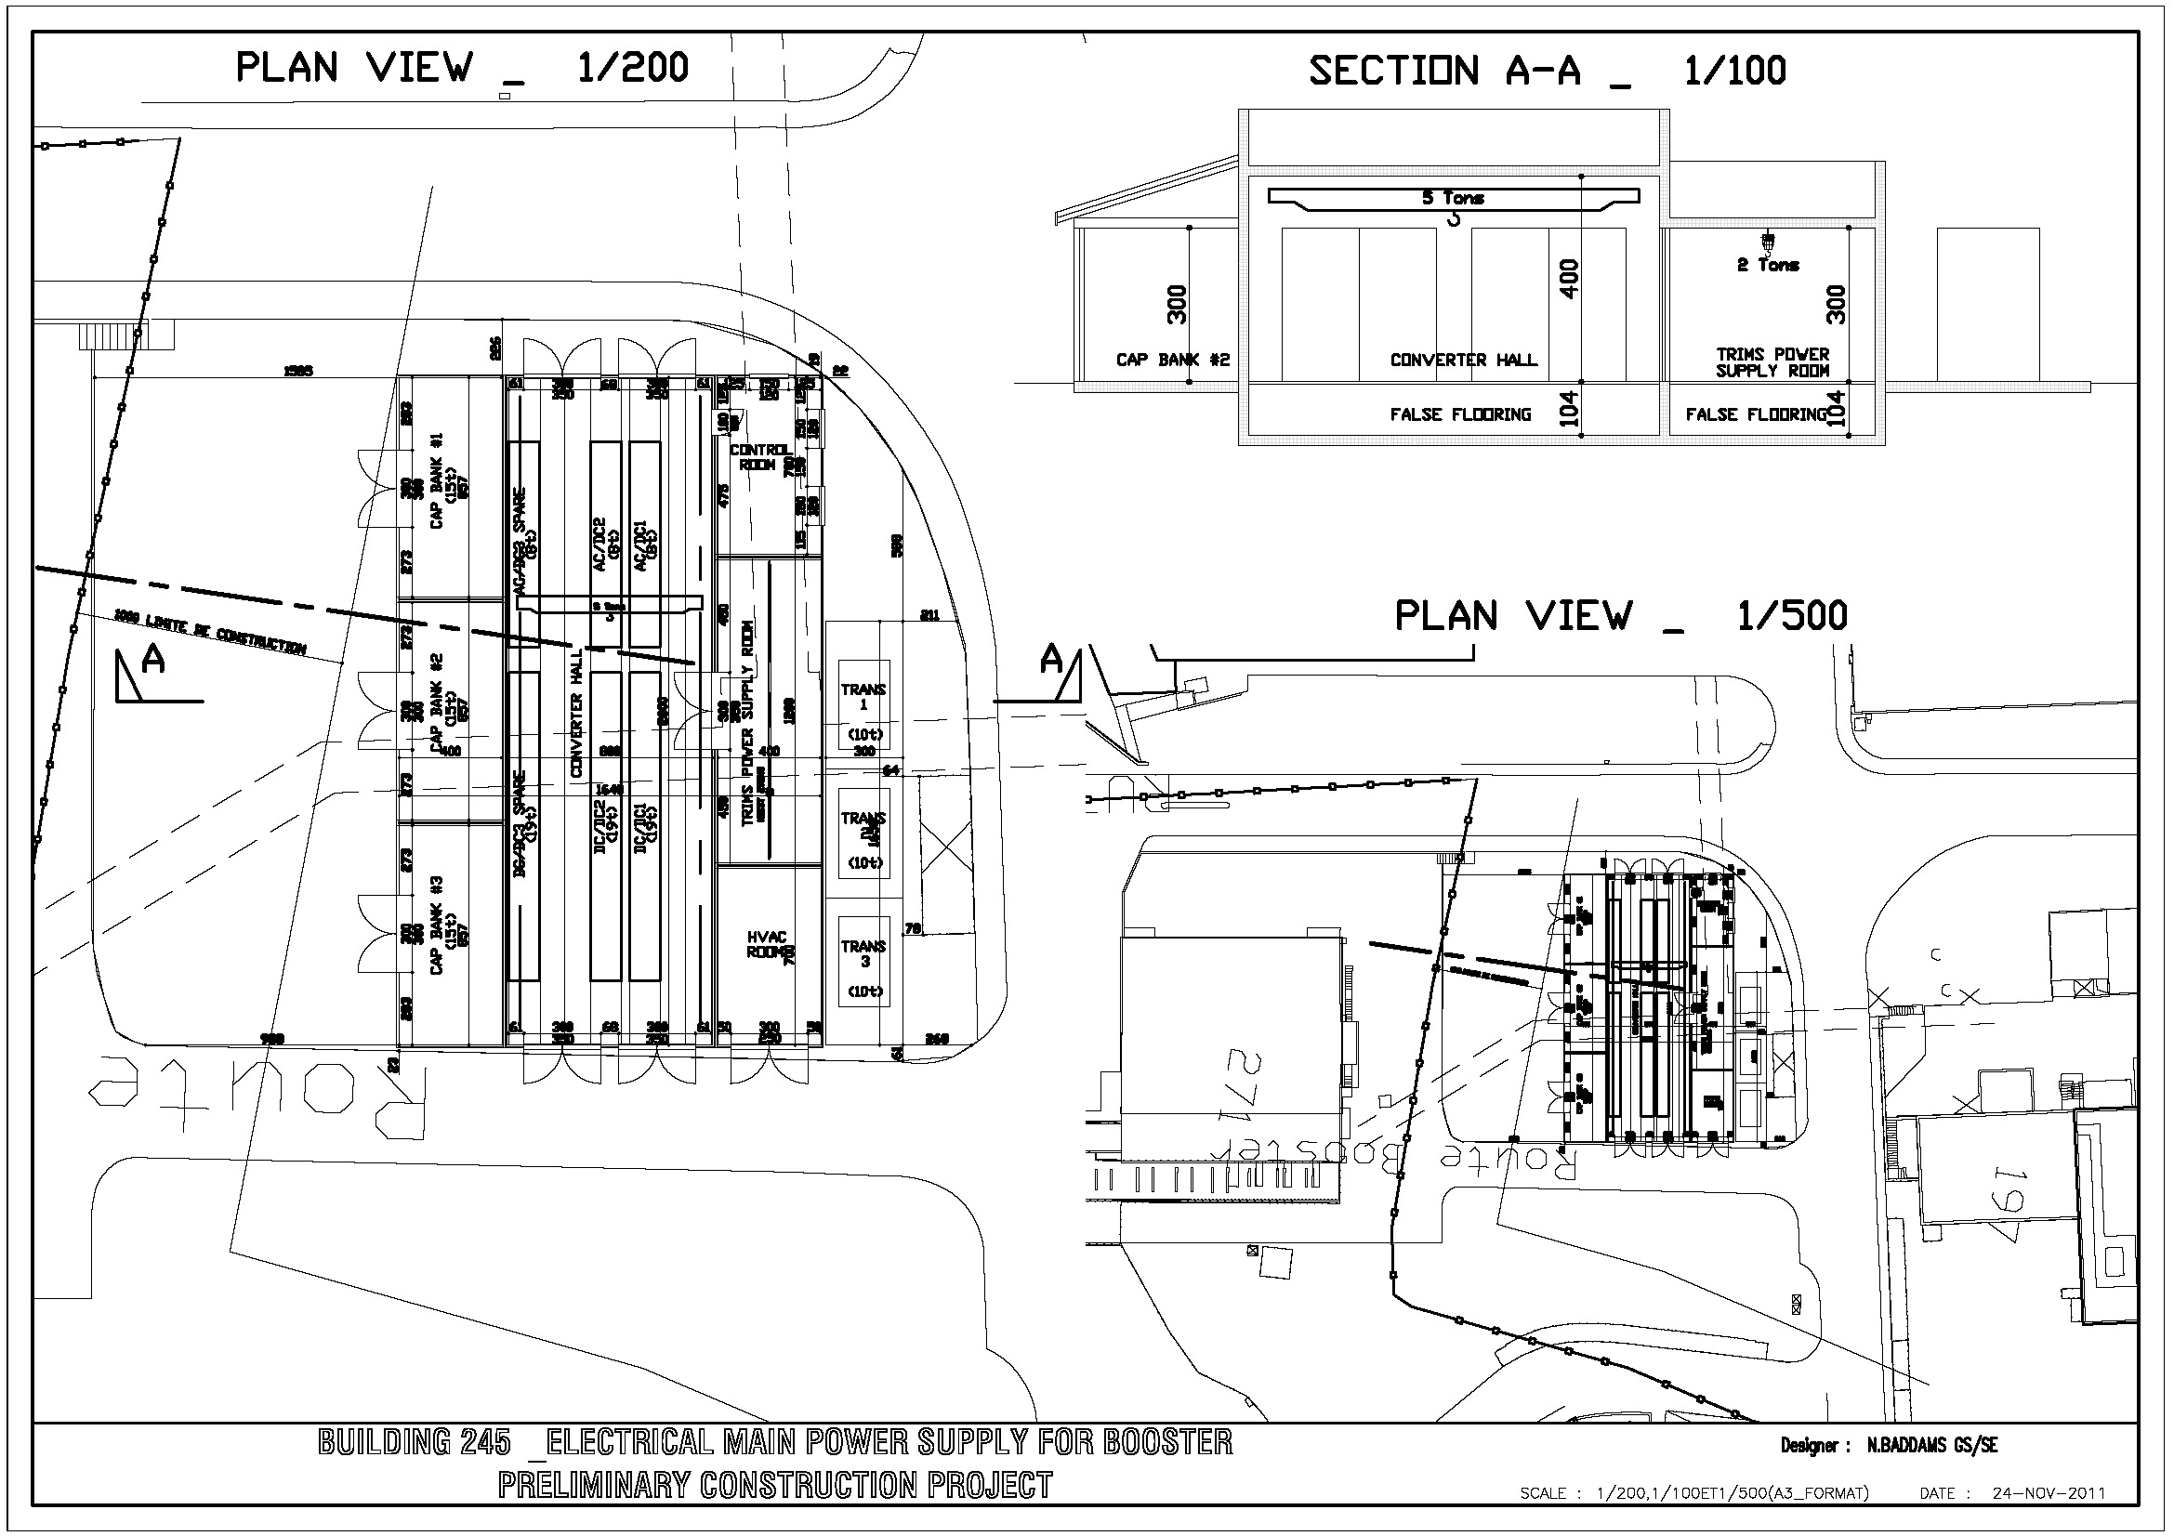
Building 245 - Preliminary Drawing
Designed by Nigel Baddams

Slide 18
Overview of the existing Booster MPS system.
The 2GeV requirements.
LIU baseline: The “POPS” style alternative.
Technical alternatives.

Slide 19
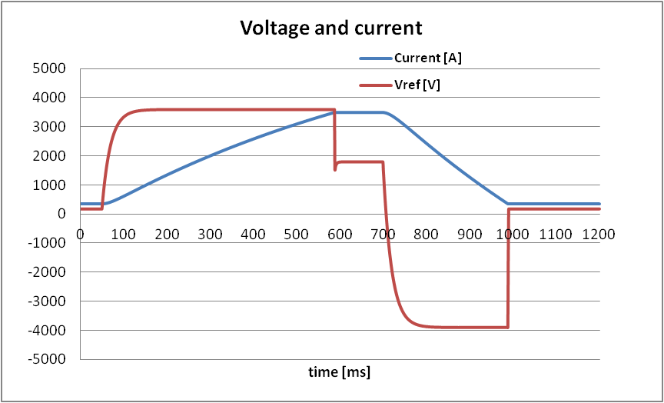
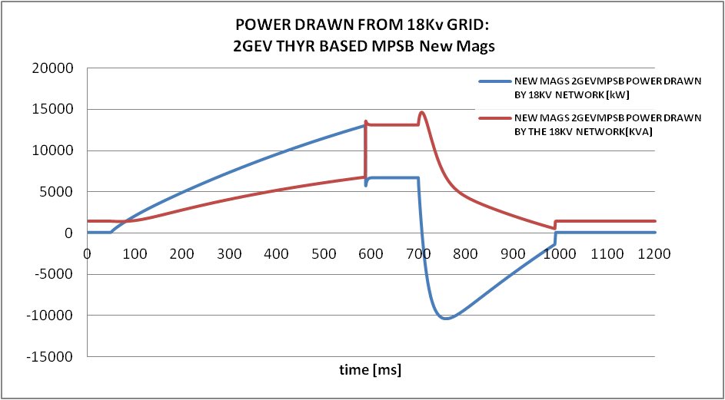
Existing MPS with new magnets
Preliminary design of the magnets by TE-MSC: R=0.52Ohm, L=0.42H, Inom@2GeV=3500A.
Simulation shows that the existing MPS could be reused (consolidation sill needed!).
Stress on the meyrin 18kV network similar to what is measured today at 1.4GeV.

Slide 20

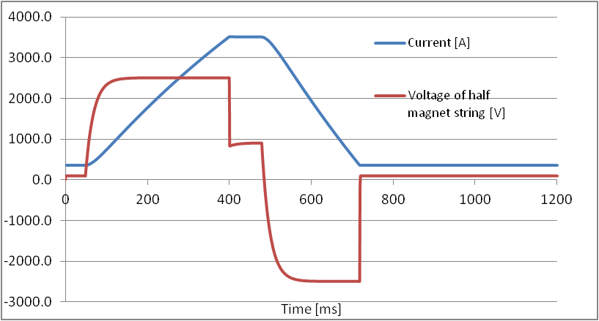
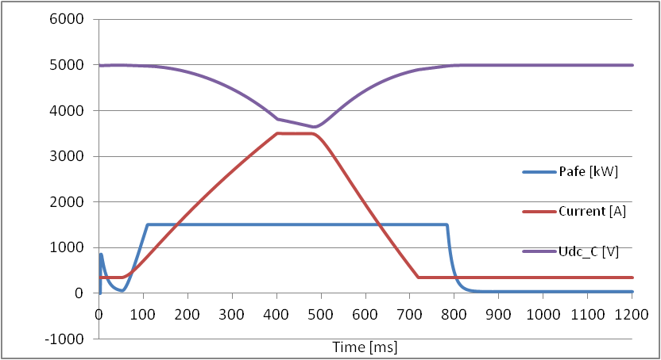
New MPS with new magnets
Allows fast cycle and significant reduction of the RMS current in the magnets.
Cost of an adapted POPS style MPS to be compared to the consolidation cost of the existing one.

Slide 21
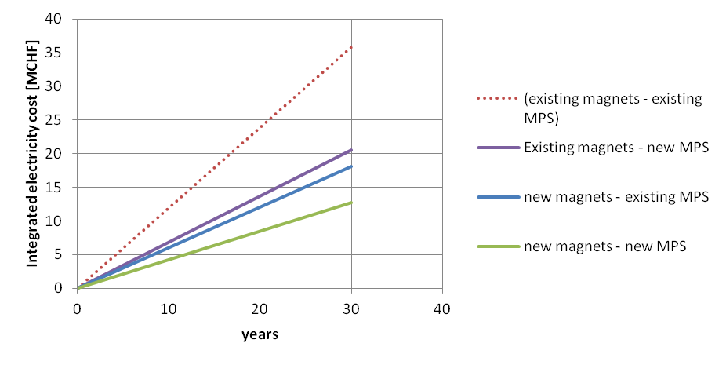
Comments on Power Consumption
Values plotted below are based on the existing magnets, 5000 hours of operation per year and 0.051CHF/kWh (average price in 2010).
In any cases several MCHF would be saved on a new supply and/or on electricity consumption with new magnets.
Does not include a foreseeable increase of the price per kWh.

