Slide 1
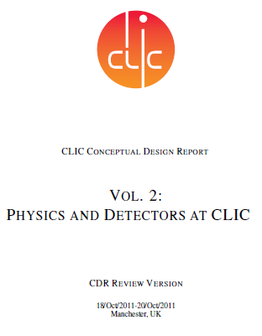
Physics and detectors at CLIC
– a multi-TeV e⁺e⁻ linear collider
Erik van der Kraaij
on behalf of
CLIC physics & detectors study group
Conceptual Design Report
Conceptual Design Report
Conceptual Design Report
Vol. 1:
ACCELERATOR AND
TECHNICAL SYSTEMS
Vol.2:
PHYSICS AND DETECTORS AT CLIC
Vol. 3:
SUMMARY, COST AND STRATEGY

Slide 2
Outline
Physics motivation
Accelerator design
  e⁺e- collisions, yet not LEP-like
Detector designs
  For unprecedented requirements
Particle Flow – imaging calorimetry
  How to cope with background

Slide 3
CLIC physics
Z → μ⁺μ⁻
Precision measurements of new particles discovered at LHC:
Higgs, SUSY, …
Discrimination between
competing models
Discovery of new physics
at TeV scale
hZ
ttbar
hνν
susy Sparticles
e⁺e⁻ collisions up to √s = 3 TeV
Must be linear – too much synchroton radiation in storage rings.

Slide 4
Higgs production
s-channel ~ 1/s
t-channel ~ log (s)
√s = 3 TeV: WW fusion crosssection ~2x higher than max of higgsstrahlung
M_{h} = 120 GeV

Slide 5
Higgs observables (M_{h} = 120 GeV)
g_{HWW} g_{HZZ} g_{Hbb} g_{Hcc} g_{Hττ} g_{Htt}
with 500 fb⁻¹ at √s = 500 GeV, except g_{Htt} which is at √s = 800 GeV with 1 ab⁻¹.
with 2 ab⁻¹ at √s = 3 TeV, as shown below. These are pure statistical errors.
  g_{Hμμ} measurement can be improved
Example of CDR benchmark
channels

Slide 6
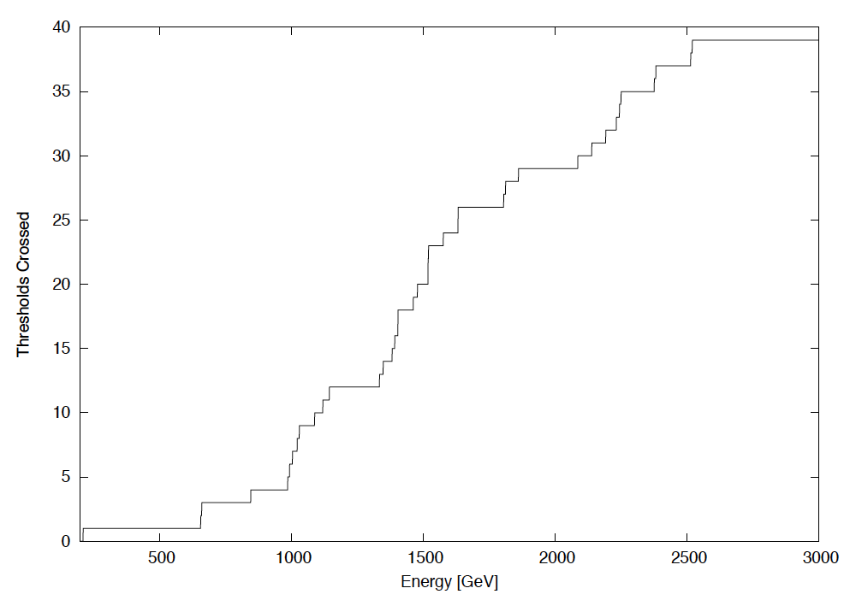
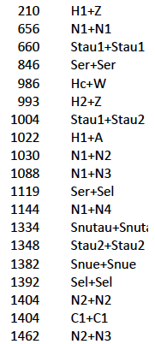
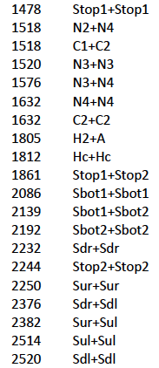
Thresholds crossed as a function of energy
Assume LHC is fully explored – Many of the possible particles in
the CLIC range will be discovered
→ Design according to expected physics

Slide 7
Outline
Physics motivation
Accelerator design
  e⁺e- collisions, yet not LEP-like
Detector designs
  For unprecedented requirements
Particle Flow – imaging calorimetry
  How to cope with background

Slide 8
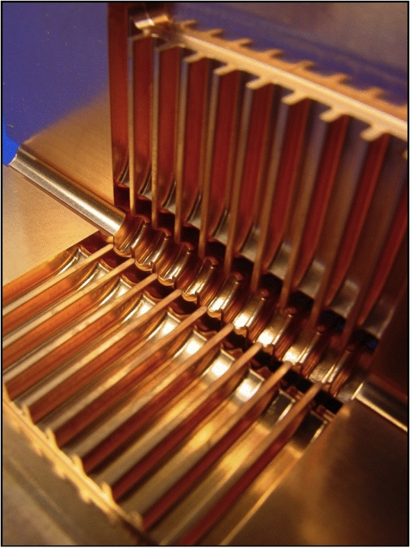
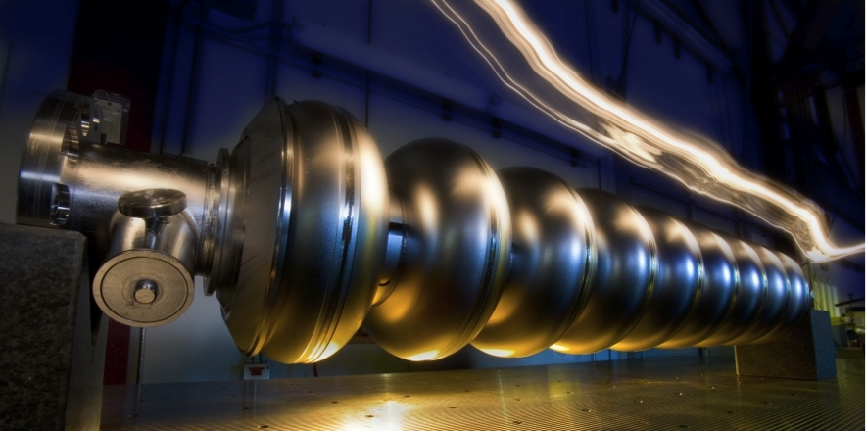
ILC and CLIC
linear colliders producing e⁺e⁻ collisions
ILC
CLIC
Based on superconducting RF cavities
Gradient 32 MV/m
Energy: 500 GeV, upgradeable to 1 TeV
(+ lower energies: Higgs, ttbar,…)
Detector studies 0.5 – 1.0 TeV
Based on 2-beam, normal conducting, acceleration structure
Gradient 100 MV/m
Energy: 3 TeV, though will probably start at lower energy (~0.5 TeV)
Detector study focuses on 3 TeV
Luminosities: few 10³⁴ cm⁻²s⁻¹
Notes:
Superconducting accelerating structures
Very low losses – High efficiency
Long pulse trains: good for detectors and feedback
Low peak power
Lower frequencies
BUT: lower gradient: 31.5 MV/m (ILC design value)
limited by: pulsed surf. heating, RF breakdown, structure damage

Slide 9
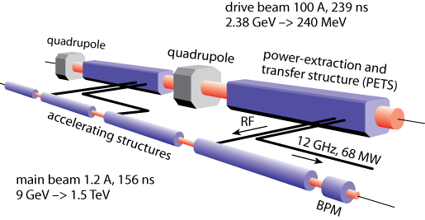
CLIC acceleration
No individual RF power sources
Two Beam Scheme:
Drive Beam supplies RF power
12 GHz bunch structure
low energy (2.4 GeV - 240 MeV)
high current (100A)
Main beam for physics
high energy (9 GeV – 1.5 TeV)
current 1.2 A
Like a HV transformer - transformer ‘core’:
  Waveguides with RF waves
Notes:
12 GHz is a higher frequency than the 0.5ns between BXs.
Time needed between the BXs, not to have them interfere & for the RF to come back to nominal.
The RFs cannot continuously be operated, hence the ‘long’ deadtime between trains.

Slide 10
CLIC 3 TeV machine layout
Drive Beam Generation Complex
48.3 km
Main Beam Generation Complex

Slide 11
CLIC energy staging
Linac 1
I.P.
Linac 2
Lower energies would require only 1 drive beam generation complex
0.5 TeV Stage
Injector
Complex
4 km
4 km
~14 km
Linac 1
I.P.
Linac 2
1-2 TeV Stage
Injector
Complex
7.0-14 km
7.0-14 km
~20-34 km
Linac 1
3 TeV Stage
I.P.
Linac 2
Injector
Complex
20.8 km
3 km
3 km
20.8 km
48.2 km
Notes:
Lower E complex can run most of the time will rest is being built.
First stages only require one drive beam complex → saves money
BDS length remains the same
Turnaround magnets can be reused everytime

Slide 12
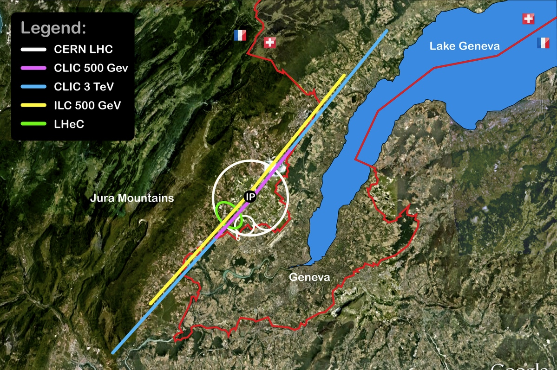
Possible construction location
J. Osborne
CERN GS-SE
Interaction region, caverns and surface installation, as foreseen in the CDR, at CERN Prevessin

Slide 13
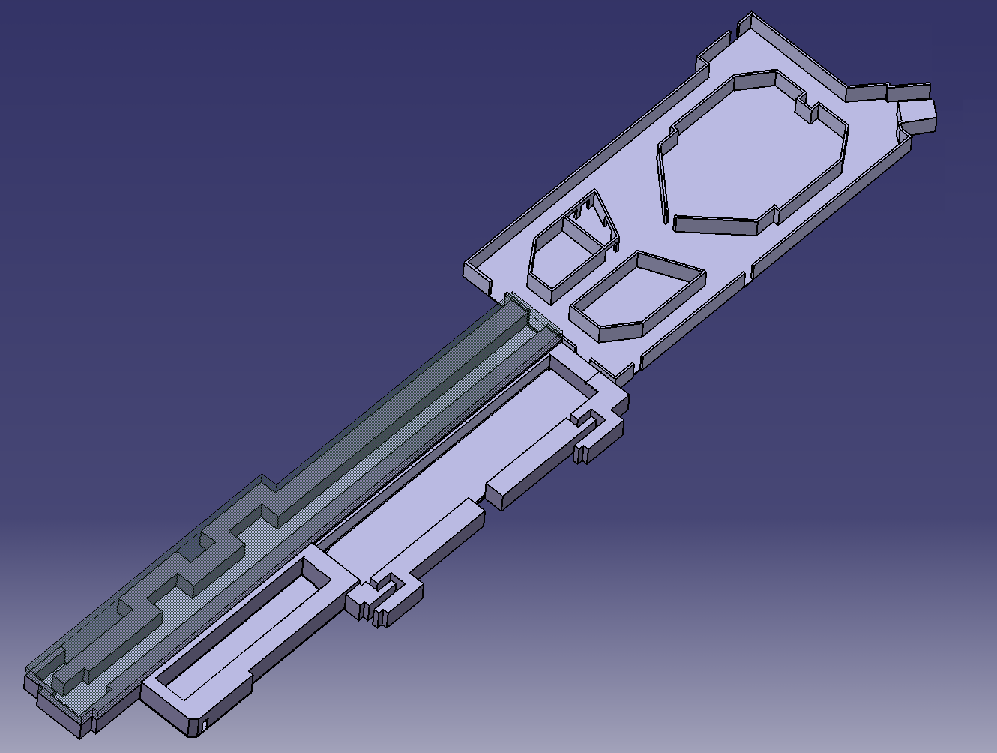
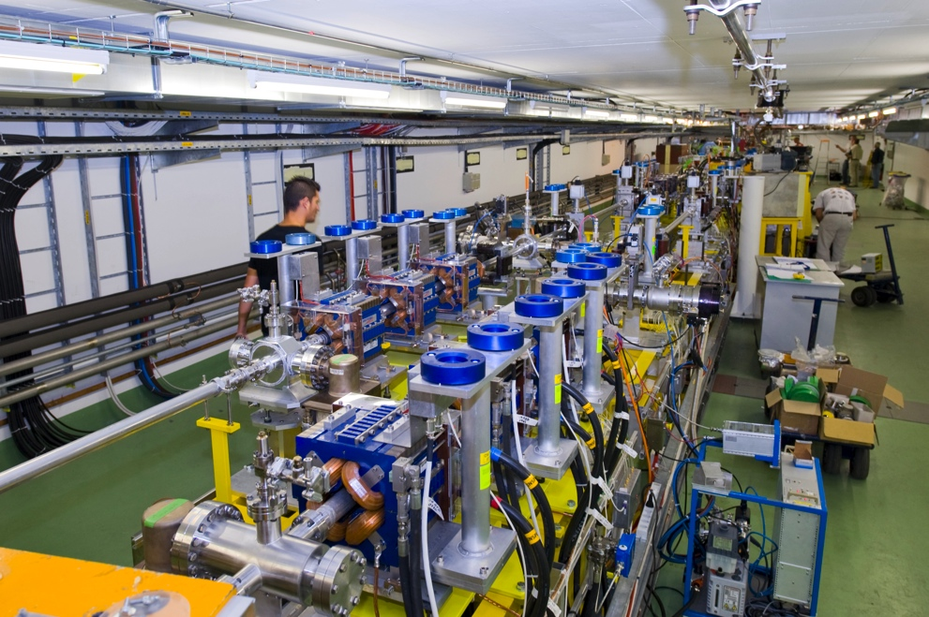
The CLIC Test Facility (CTF3)
Drive Beam generation.
fully loaded acceleration, beam intensity and bunch frequency multiplication x8
RF Power Production and test Power Structures
4 A – 1.2 ms
150 Mev
1.5 GHz bunch spacing
DELAY
LOOP
COMBINER
RING
DRIVE BEAM
LINAC
32 A – 140 ns
150 Mev
12 GHz bunch spacing
10 m
CLEX
CLIC Experimental Area
Demonstrate Two Beam Acceleration and test Accelerating Structures
Study deceleration
Notes:
Demonstrate Drive Beam generation
(fully loaded acceleration, beam intensity and bunch frequency multiplication x8)
Demonstrate RF Power Production and test Power Structures
Demonstrate Two Beam Acceleration and test Accelerating Structures

Slide 14
CLIC parameters
156 ns
20 ms
CLIC
CLIC: trains at 50 Hz, 1 train = 312 bunches, 0.5 ns apart
ILC: trains at 5 Hz , 1 train = 1300 bunches, 700 ns apart
 | LEP 2 | ILC 0.5 TeV | CLIC 3 TeV
L [cm⁻²s^{-1]}] | 5×10³¹ | 2×10³⁴ | 6×10³⁴
Crossing angle |  | 14 mrad | 20 mrad
BX separation | ~22 μs | 700 ns | 0.5 ns
# (γγ  hadrons) / BX | negligible | 0.2 | 3.2
#Incoherent pairs / BX | negligible | 1 × 10⁵ | 3 × 10⁵
Notes:
Occupancy = #hits / #readout-cells can reach large values
trigger-less readout of whole train
power pulsing of readout electronics,
to minimize material needed for cooling

Slide 15
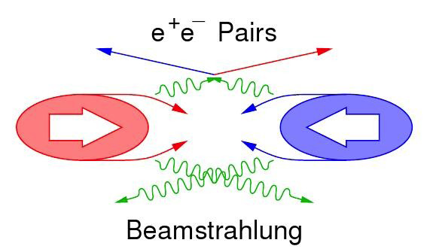
Beam-induced backgrounds
Need pile-up rejection
Need to include background in simulation
  Detector starts at θ>10 mrad

Slide 16
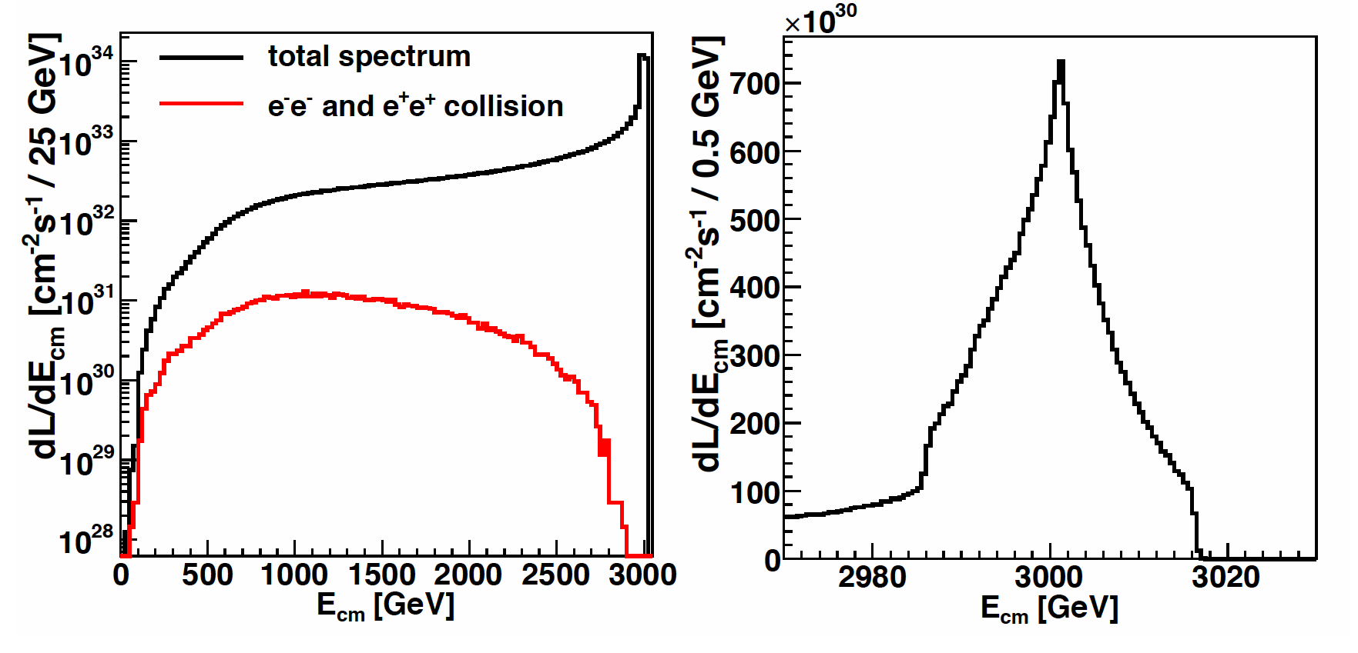
Luminosity spectrum
Includes beam energy spread and beamstrahlung
L_{tot} = 6 •10³⁴ cm⁻²s⁻¹ ; L_{0.01} = 2 •10³⁴ cm⁻²s⁻¹ (30% in “1% highest energy”)
√s is not known per event!
Much like the hadronic PDFs, need to fold in luminosity spectrum in simulation

Slide 17
Outline
Physics motivation
Accelerator design
  e⁺e- collisions, yet not LEP-like
Detector designs
  For unprecedented requirements
Particle Flow – imaging calorimetry
  How to cope with background

Slide 18
CLIC Detector Requirements (1/2)
High-resolution pixel detector to measure
displaced vertices
p = 1 GeV: σ_{d0}~20 μm (CMS: 90 μm)
p = 100 GeV: σ_{d0}~5 μm (CMS: ~10μm)
momentum resolution
p = 1 GeV: σ(p_{T})/p_{T} = 0.1% (CMS: 0.7%)
p = 100 GeV: σ(p_{T})/p_{T} = 0.2% (CMS: 1.5%)
Need very good jet-energy resolution
E = 10² – 10³ GeV:
σ(E_{j})/E_{j} ~ 4.0% – 3.5%
ATLAS ~ 8.0% – 4.0%
Notes:
2.5 σ W/Z separation requires σE/E=3.5%,
for Ej up to 1 TeV.

Slide 19
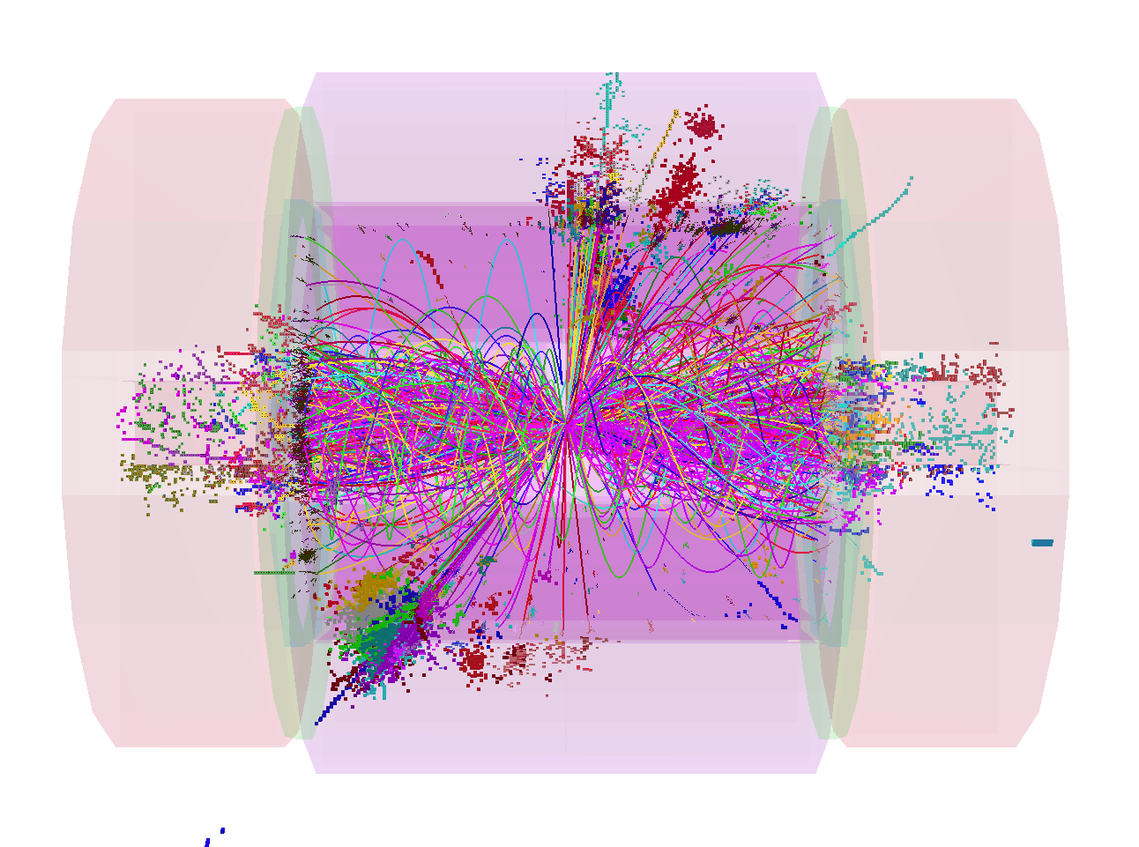
CLIC Detector Requirements (2/2)
Per bunch crossing: 3.2 γγ  hadrons events, 50 GeV visible energy
19 TeV dumped in the calorimeters per 156 ns bunch train.
Will have triggerless readout of full train. Need:
  Detector hit time-stamping
  Multi-hit storage/readout
  filtering algorithms at reconstruction level
8 jet final state
e⁺e⁻ → H⁺H⁻ → tbbt
+ 60 BX γγ → hadrons
1.4 TeV of background in reconstruction window
Notes:
See fig. 2.12 of CDR vol2.

Slide 20
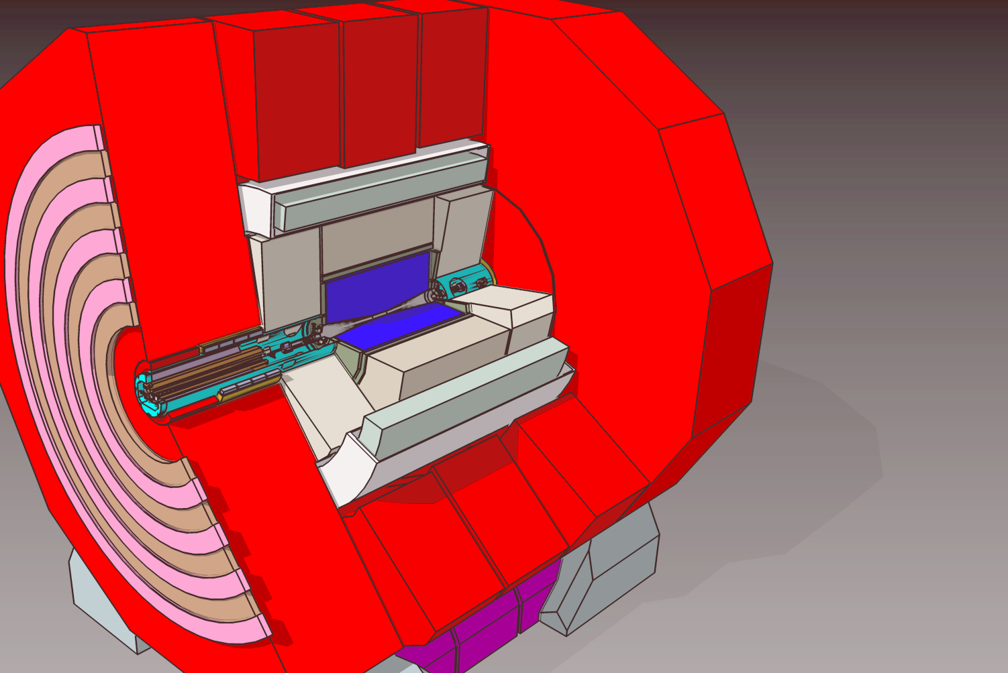
Two general purpose CLIC detector concepts
Based on validated ILC designs, adapted to CLIC energy and timing conditions:
  Denser barrel HCAL (Tungsten, 7.5 λ_{i})
  Redesign of vertex and forward detector regions (backgrounds)

Slide 21
Two general purpose CLIC detector concepts
CLIC_ILD
CLIC_SiD
3.4 m
2.7 m

Slide 22
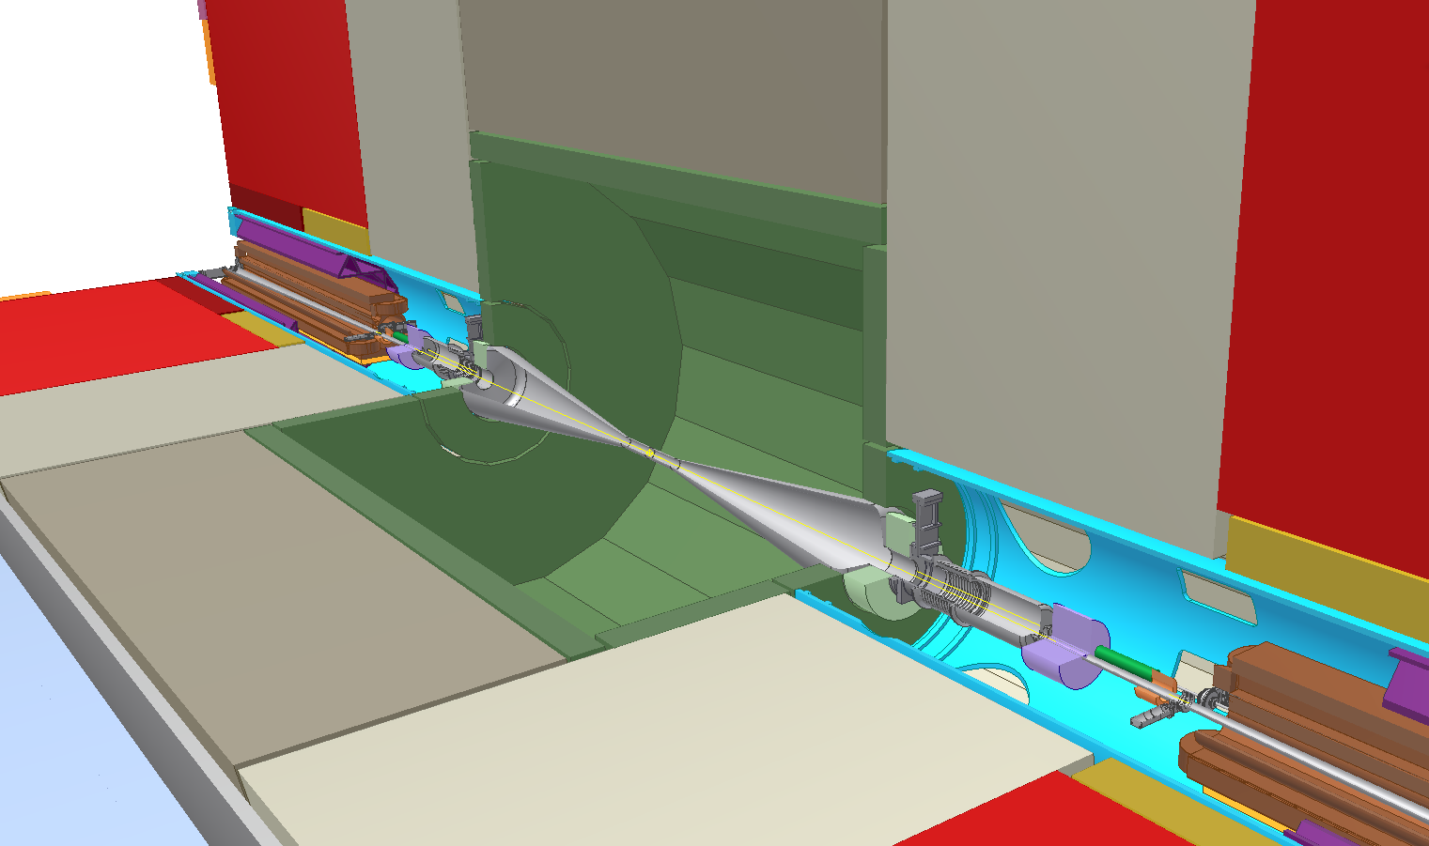
Very Forward Region
ECAL
Lumical
BPM
Spent beam
2.4 m
Beamcal
Kicker
QD0
Notes:
CLIC beam crossing angle is 20 mrad, (ILC: 14 mrad) => modifications of the design of the very forward region components:
LumiCal (40-100 mrad) : luminosity measurement
BeamCal (10- 40 mrad) : electron detection
Beam position monitor
Beam Kicker: intra train feedback
Final focus quadrupole: QD0
Anti-Solenoid: field compensation
Shielding masks: protect
upstream detectors and
BPM, Kicker, …

Slide 23
CLIC_SiD vertex detectors
CLIC_SiD
Beampipe
4 mm Fe
.5 mm Be
170 mm
830 mm
 | CLIC_SiD | CMS
Material X/X₀ (90º) | ~1.1% (5 layer) | ~10% (3 layer)
Pixel size | 20 x 20 μm² | 100 x 150 μm²
# pixels | 2.76 G | 66 M
Time resolution | 5-10 ns | <~25 ns
Power/pixel | <~0.2 μW | 28 μW
Very low duty cycle of CLIC machine: 156 ns train, 20 ms pause
All subdetectors will implement power pulsing schemes at 50 Hz, to reduce power consumption and thereby material in cooling systems

Slide 24
CLIC_ILD: TPC based tracking
Large TPC (329 < R < 1808 mm) for highly redundant continuous tracking (~ 200 measured points)
Particle ID through dE/dx
Little material in tracking volume (5% X₀); <25% X₀ in endcap
Complemented by silicon tracking system:
Independent tracking at low angles (FTD)
Silicon tracking layers surrounding TPC for timing and precision points (SIT, SET, ETD)
TPC acceptance down to 12⁰
(>10 measurement points)
SIT acceptance down to 25⁰
FTD acceptance down to 7⁰

Slide 25
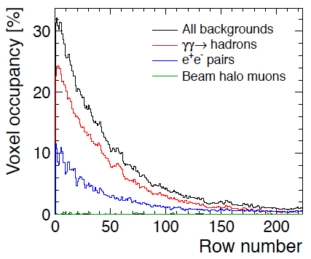
TPC occupancies
Full detector simulations:
High occupancies in the TPC, mostly due to γγ  hadrons.
Consider pixelized readout in this region or suppress the inner pad rows.
Requires technology/layout changes

Slide 26
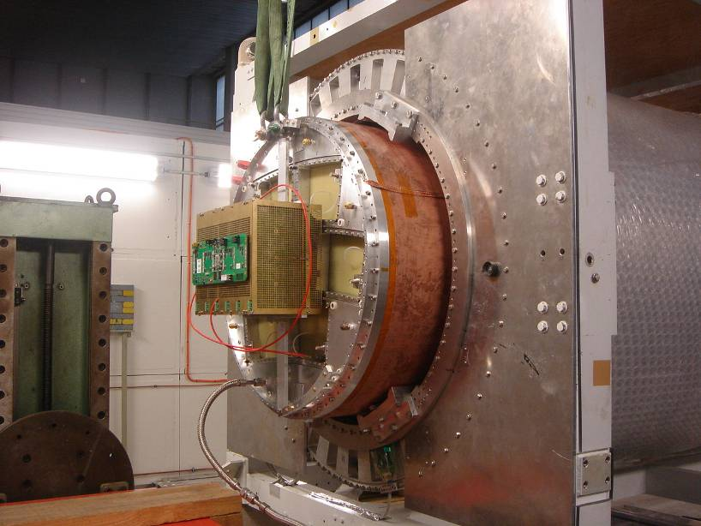
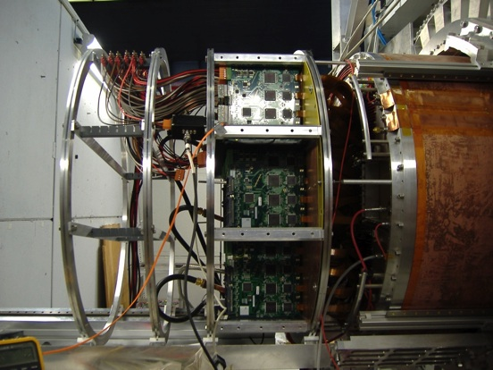
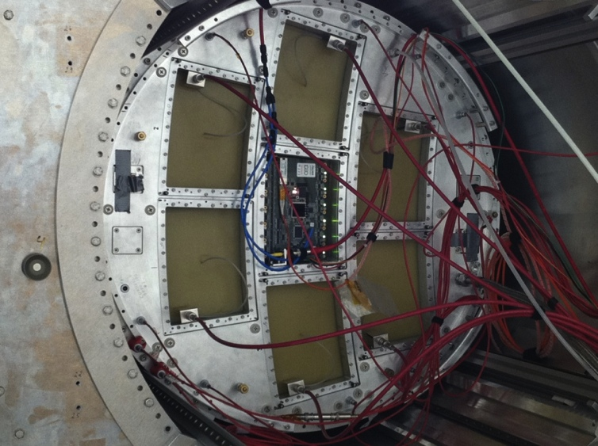
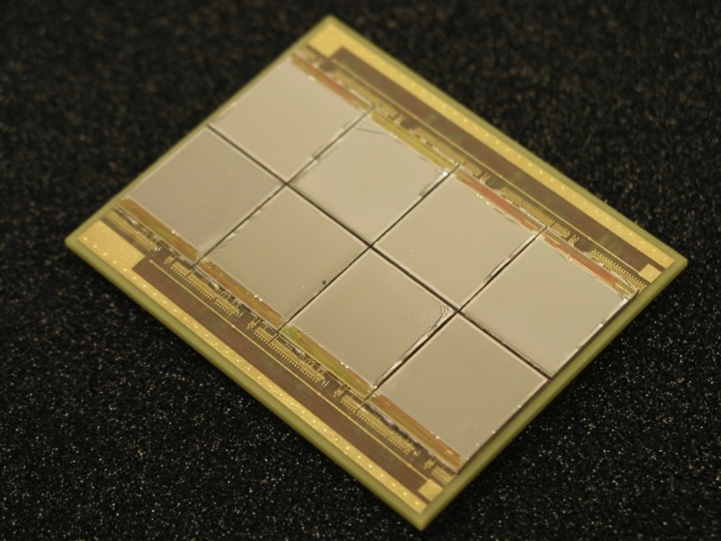
TPC beam tests at DESY with Large Prototype (2008-2011)
Micromegas (T2K readout) GEMs (Altro readout)
Integrated version
8-chip Ingrid module

Slide 27
CLIC_SiD: all-silicon tracker
Outer tracker barrel
1206 mm
Forward outer tracker
beam pipe
Vertex region

Slide 28
EM calorimetry
ECAL | CLIC_ILD, B = 4 T
Absorber/Active element | Tungsten / Si pads
Sampling layers | 20x 2.1 mm, 10x 4.2 mm
Cell size | 5.1 × 5.1 mm²
X₀ and λ_{I} | 23 and 1
Example – SiD approach:

Slide 29
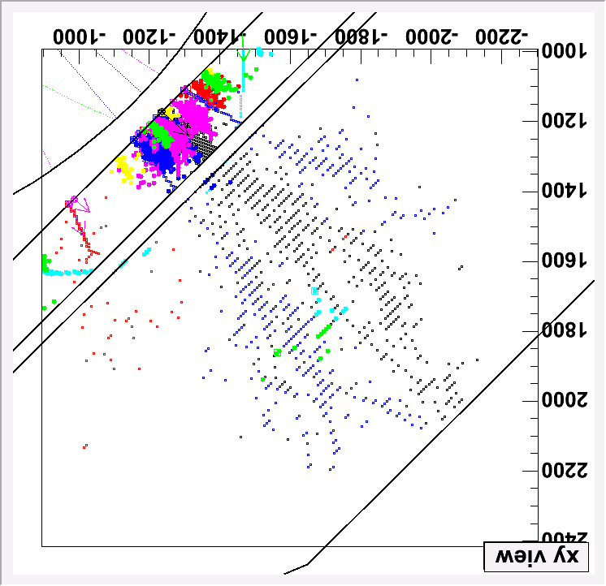
Hadronic calorimetry
HCAL | CLIC_ILD & CLIC_SiD
Absorber (Barrel/F) | Tungsten / Steel
Sampling layers (B/F) | 75x10 mm / 60x 20 mm
Cell size | 30 × 30 mm² (analog, e.g. SiPM)
λ_{I} | 7.5
← 10 × 10 mm²
(digital, e.g. RPC)

Slide 30
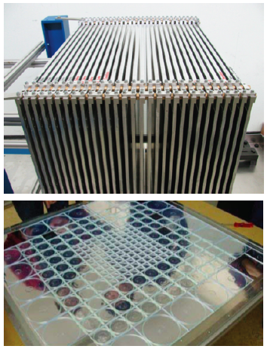
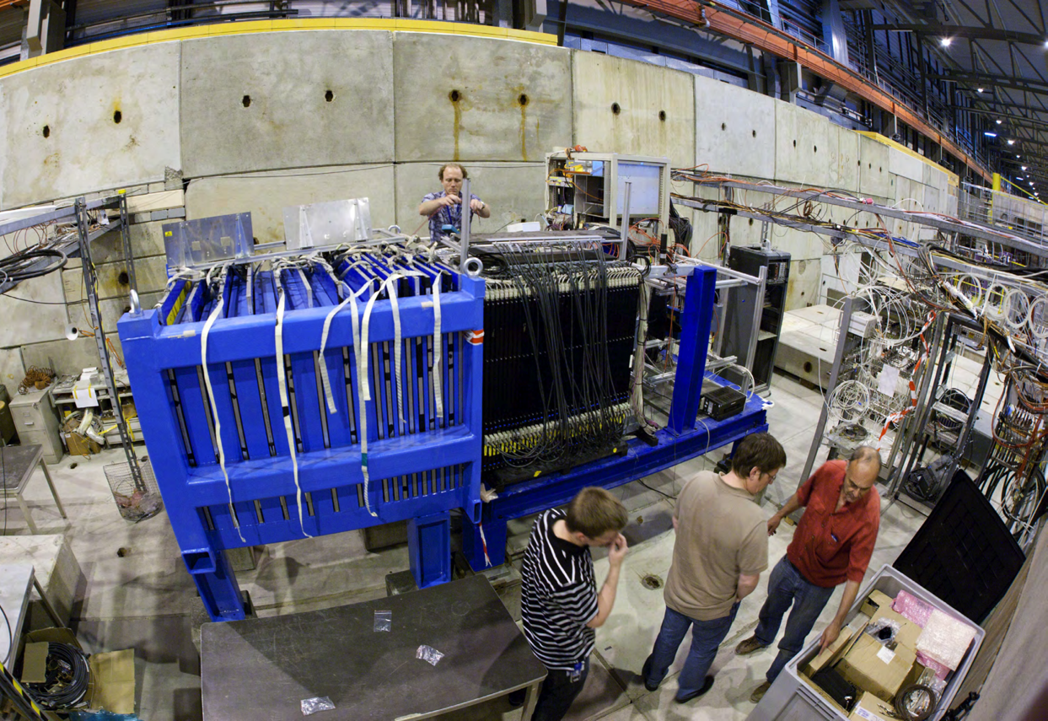
Tungsten HCAL prototype
Main purpose: Validation of Geant4 simulation for hadronic showers in tungsten
Data taken 2010/11 at CERN-PS/SPS, mixed beams 1 – 300 GeV
Scintillator tiles 3x3 cm² (in centre)
Read out by SiPM

Slide 31
SiPM analog HCAL testbeam
Time structure of shower:
10 GeV pion
First results demonstrate the importance of the high precision neutron tracking with QGSP_BERT_HP in Geant4 for the time evolution of hadronic showers in tungsten.
Notes:
“Mean time of first hit for 10 GeV 􀀀 as a function of radial distance from the shower core (a tile index of 10 corresponds to
approximately 30 cm). The data are compared with simulations using QGSP BERT and QGSP BERT HP. The error bars and the width of the area in the case of QGSP BERT HP simulations show the statistical error, while for QGSP BERT the errors are omitted for clarity.”
While QGSP BERT HP gives an excellent description of the data, QGSP BERT shows very
large discrepancies, with significantly overestimated late contributions at larger radii. This demonstrates the
importance of the high precision neutron tracking in Geant4 for a realistic reproduction of the time evolution
of hadronic showers in tungsten.
“simulated with the QGSP BERT and QGSP BERT HP physics lists [6]. The latter provides
additional high precision neutron tracking, and is expected to give an improved description of the shower
evolution in heavy absorbers, while the former is the list mostly used in the simulation of LHC detectors and
for linear collider optimization studies.”

Slide 32
RPC digital HCAL testbeam
120 GeV proton
With Fe, performed at Fermilab

Slide 33
Outline
Physics motivation
Accelerator design
  e⁺e- collisions, yet not LEP-like
Detector designs
  For unprecedented requirements
Particle Flow – imaging calorimetry
  How to cope with background

Slide 34
Particle Flow Calorimetry
γ
n
π⁺
E_{JET} = E_{ECAL} + E_{HCAL}
E_{JET} = E_{TRACK} + E_{γ} + E_{n}
  Measure charged particle energies (60% of jet) in tracker.
  Measure photon energies (30%) in ECAL
  σE/E < 20%/√E(GeV)
  Measure only neutral hadron energies (10%) in HCAL.

Slide 35
Time development in hadronic showers
In steel 90% of the energy is recorded within 6 ns (corrected for time-of-flight).
In tungsten only 82% of the energy is deposited within 25 ns.
  Response is slower due to the much larger component of the energy in nuclear fragments.
  Need to integrate over > 25 ns in the reconstruction, keeping out the pile-up hits…
Notes:
For the HCAL endcap with steel for the absorber material 90% of the energy is recorded within 6 ns (corrected for time-of-flight). For the tungsten absorber assumed for the HCAL barrel, only 82% of the energy is deposited within 25 ns. The calorimetric response of tungsten is slower than that of steel due to the much larger component of the energy in nuclear fragments.

Slide 36
Reconstruction timing strategy
….
….
Assume can identify t₀ of physics event in offline event filter
  define “reconstruction” window around t₀
  All hits and tracks in window are passed to reconstruction.
CLIC hardware
Requirements
- Achievable in the calorimeters with a sampling each
~25 ns
Subdetector | Reco Window | Hit Resolution
ECAL | 10 ns | 1 ns
HCAL Endcap | 10 ns | 1 ns
HCAL Barrel | 100 ns | 1 ns
Silicon Detectors | 10 ns | 10/√12
TPC (CLIC_ILD) | Entire train | n/a

Slide 37
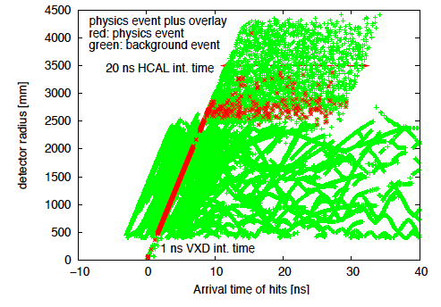
Reconstruction in time
After reconstruction have a list of Particle Flow Objects (PFOs)
Calculate energy weighted mean time of each cluster
  Obtain sub-ns resolution
  Use times to reject clusters
  and associated tracks
tCluster
Radius
Calorimeter
TPC
Si tracking/vertex
Time
Notes:
charged particles – mostly matched to clusters
photons – EM clusters
neutral hadrons – clusters
- High granularity calorimeter - even low energy clusters have many hits
- account for helical propagation time

Slide 38
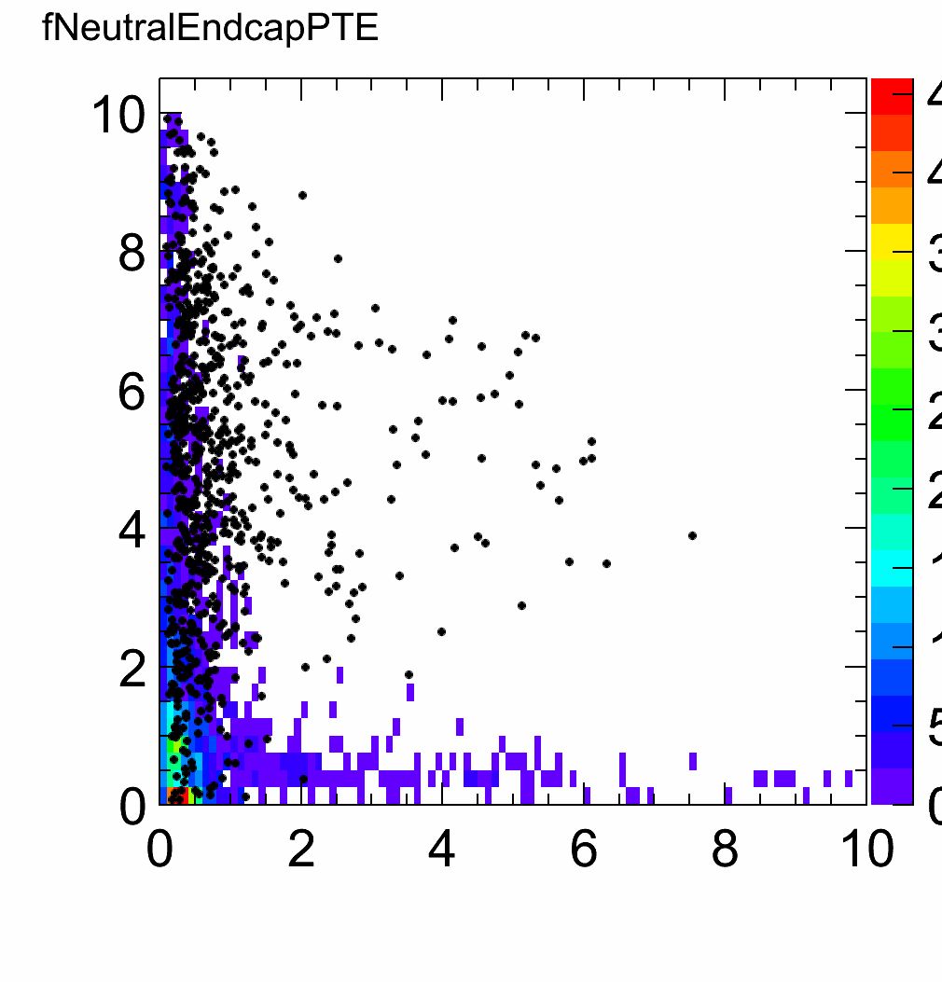
Reconstruction in time
After reconstruction have a list of Particle Flow Objects (PFOs)
Calculate energy weighted mean time of each cluster
  Obtain sub-ns resolution
  Use times to reject clusters
  and associated tracks
Neutral hadrons
Notes:
charged particles – mostly matched to clusters
photons – EM clusters
neutral hadrons – clusters
- High granularity calorimeter - even low energy clusters have many hits
- account for helical propagation time

Slide 39
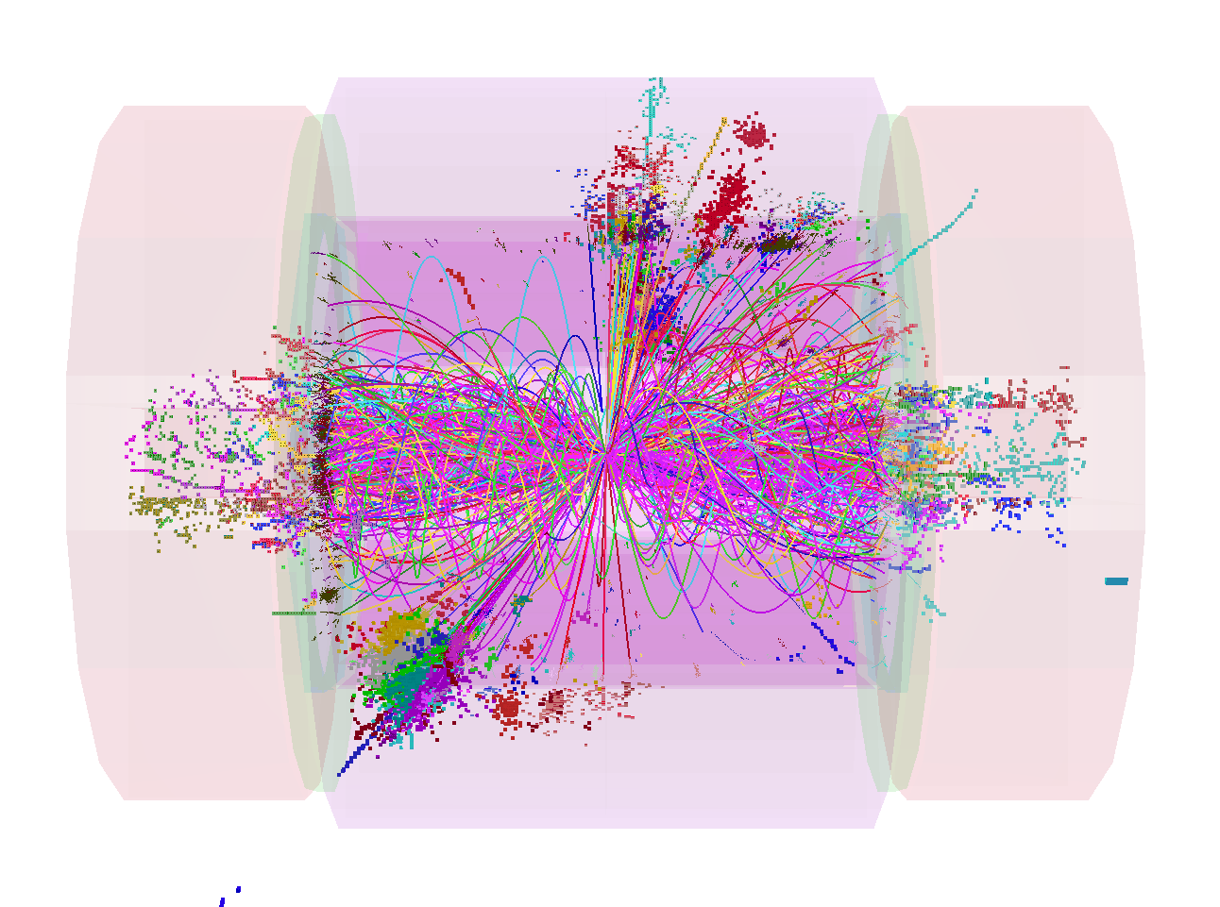
Impact of Timing Cuts
1.2 TeV background
√s = 3 TeV, 500 GeV di-jet event

Slide 40
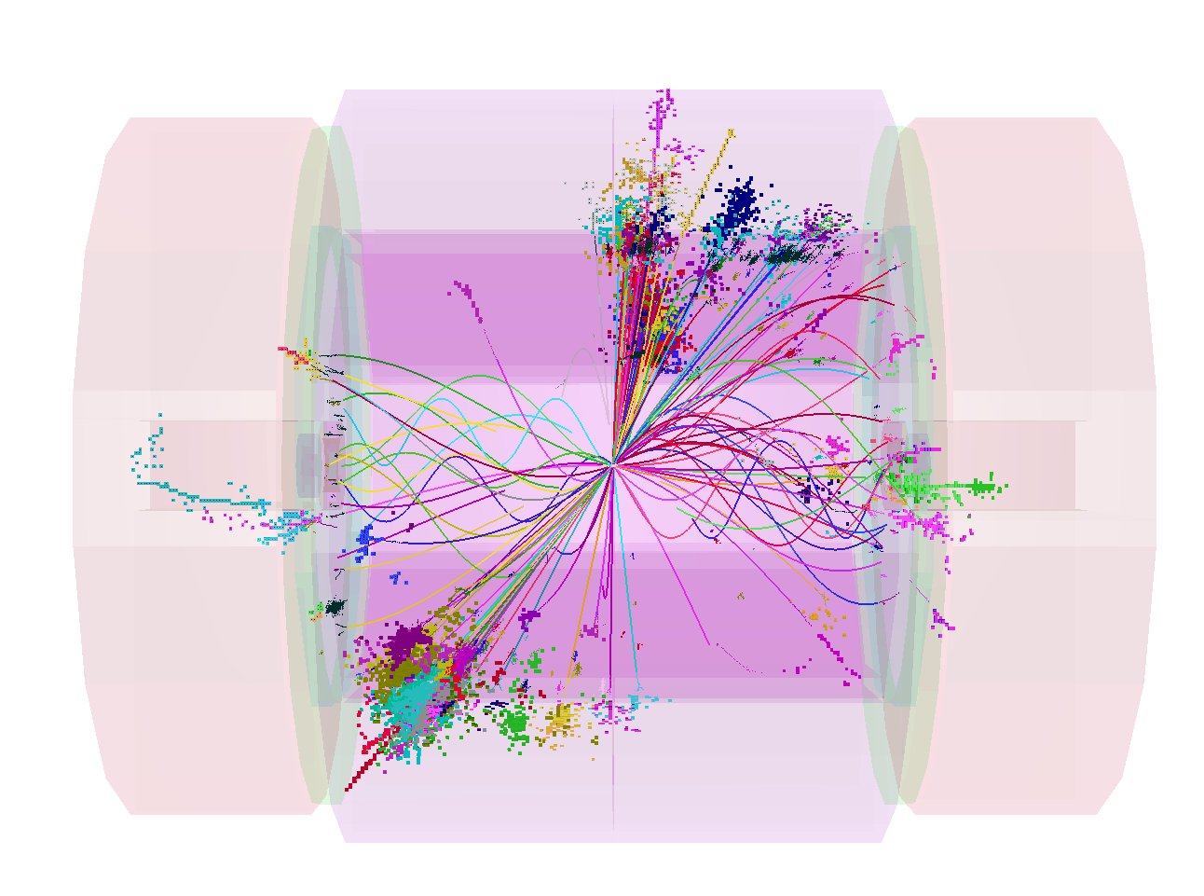
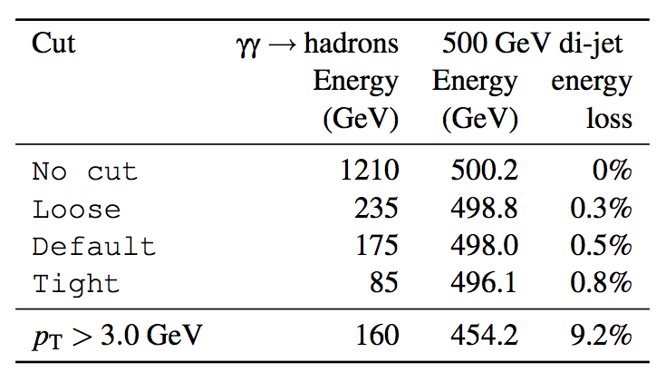
Impact of Timing Cuts
1.2 TeV
85 GeV
Reject 93 % of background energy and < 1% of physics event
  much more effective than simple p_{T} cut

Slide 41
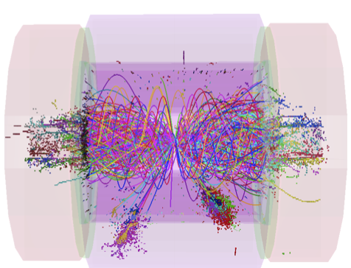
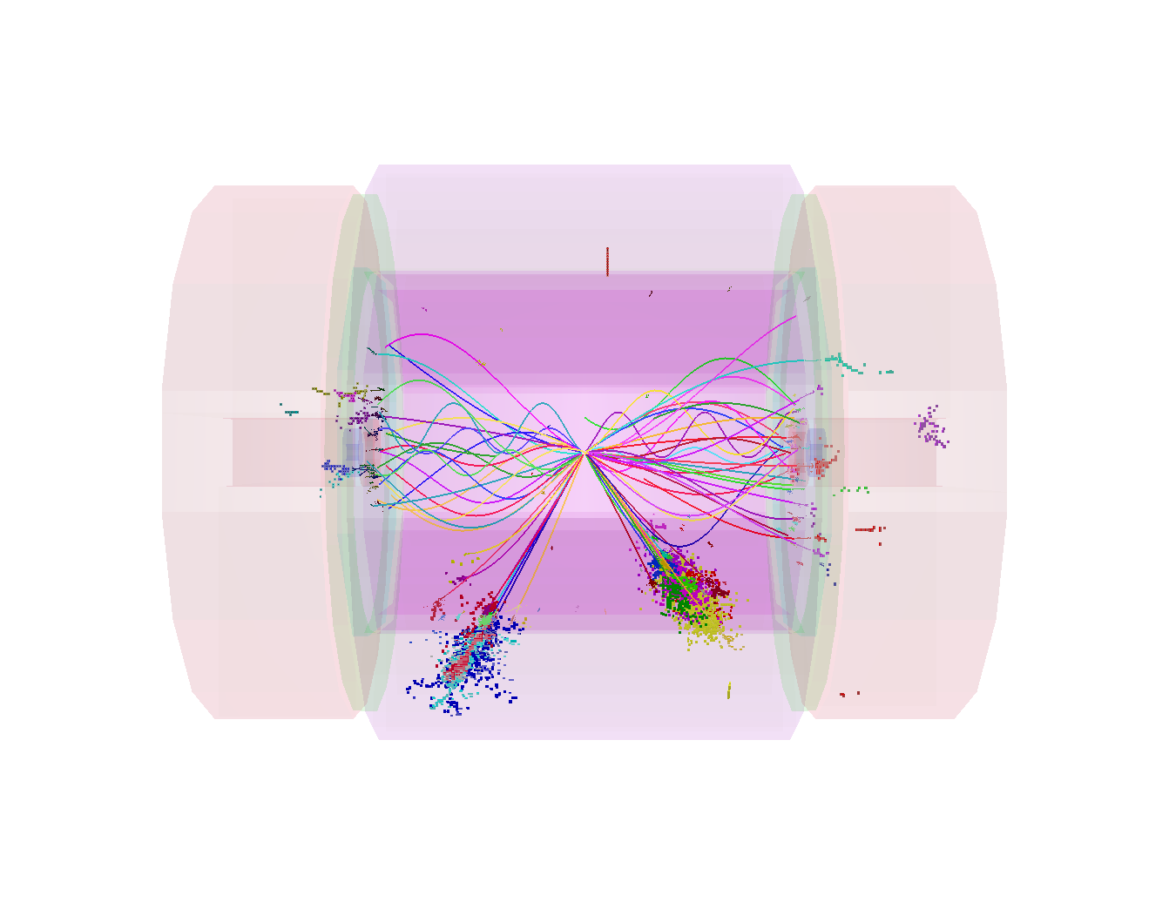
Jet Finding at CLIC
e.g.
timing
Using Durham k_{T} à la LEP
  Timing cuts are effective,
  but not sufficient
Notes:
At LEP, preferred jet-finding algorithm: Durham k_{T}
All particles in event clustered into the jets
not appropriate for CLIC
Events at CLIC
significant background from forward-peaked γγ → hadrons
events are often boosted along beam axis (beamstrahlung)
“hadron collider” type algorithms more appropriate
k_{T} algorithm at CLIC studied for benchmark physics analyses
invariant under longitudinal boosts
particles either combined with existing jet or beam axis
reduces sensitivity to γγ → hadrons

Slide 42
Jet Finding at CLIC
e.g.
timing
Using Durham k_{T} à la LEP
  Timing cuts are effective,
  but not sufficient
“hadron collider” k_{T} : R = 0.7
  Even less background,
  timing cuts hardly any effect
  for this topology
To tackle background:
timing cuts + jet finding
Notes:
At LEP, preferred jet-finding algorithm: Durham k_{T}
All particles in event clustered into the jets
not appropriate for CLIC
Events at CLIC
significant background from forward-peaked γγ → hadrons
events are often boosted along beam axis (beamstrahlung)
“hadron collider” type algorithms more appropriate
k_{T} algorithm at CLIC studied for benchmark physics analyses
invariant under longitudinal boosts
particles either combined with existing jet or beam axis
reduces sensitivity to γγ → hadrons

Slide 43
Test of di-jet mass reconstruction
Clear separation using di-jet
invariant masses:
Full Simulation with background
82 %
17 %

Slide 44
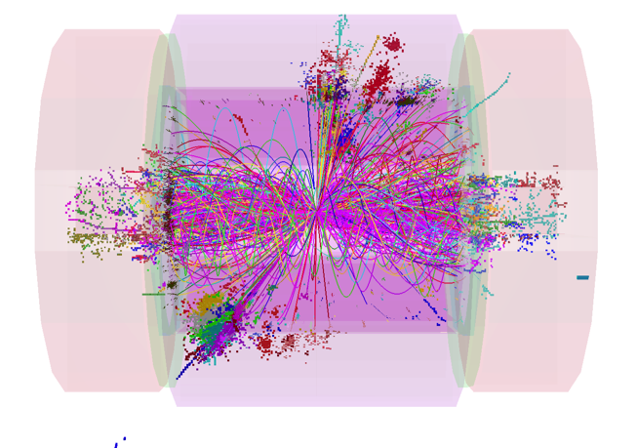
The 8 jet final state
M_{MC}
902.4
906.3
1.4 TeV of background
e⁺e⁻ → HA → bbbb
e⁺e⁻ → H⁺H⁻ → tbbt
Notes:
Testcase for almost everything:
Secondary vertices, high multiplicity of tracks, high multiplicity of jets, high energies.
Natural width of these particles is 6 GeV.

Slide 45
Top pairs at √s = 500 GeV
250 fb⁻¹
Unbinned maximum likelihood fit of mass distributions
Comparable to ILD LOI mass resolution
(0.11 GeV in all-hadronic final state)

Slide 46
More detector benchmark channels

Slide 47
Summary
CLIC CDR Volume 2 public and under review:https://edms.cern.ch/file/1160419/1/CLIC_CDR_Review_080911.pdf
Impact of background studied in detail
  Require high granularity in space and time
  Defines detector requirements and guides the future of ongoing R&D
With CDR achieved initial goal:
  Demonstrated ability to perform high precision physics in the CLIC machine environment
If you would like to give your support to the physics case and R&D towards a future linear collider based in CLIC technology, you are invited to sign up:
https://indico.cern.ch/conferenceDisplay.py?confId=136364
– Does not imply any formal commitment –

Slide 48
Backup slides
- accelerator

Slide 49
More physics potential studies

Slide 50
CLIC next phases
European Strategy
for Particle Physics
@ CERN Council
Final CLIC CDR and
feasibility established
2011-2016 – Goal: Develop a project implementation plan for a Linear Collider :
Addressing the key physics goals as emerging from the LHC data
With a well-defined scope (i.e. technical implementation and operation model,
energy and luminosity), cost and schedule
With a solid technical basis for the key elements of the machine and detector
Including the necessary preparation for siting the machine at CERN
Within a project governance structure as defined with international partners

Slide 51
CLIC next phases
European Strategy
for Particle Physics
@ CERN Council
Final CLIC CDR and
feasibility established
After 2016 – Project Implementation phase:
Including an initial project to lay the grounds for full construction (CLIC 0 – a significant part of the drive beam facility: prototypes of hardware components at real frequency, final validation of drive beam quality/main beam emittance preservation, facility for reception tests – and part of the final project)
Finalization of the CLIC technical design, taking into account the results of technical studies done in the previous phase, and final energy staging scenario based on the LHC Physics results, which should be fully available by the time
Further industrialization and pre-series production of large series components with validation facilities
2011-2016 – Goal: Develop a project implementation plan for a Linear Collider :
Addressing the key physics goals as emerging from the LHC data
With a well-defined scope (i.e. technical implementation and operation model,
energy and luminosity), cost and schedule
With a solid technical basis for the key elements of the machine and detector
Including the necessary preparation for siting the machine at CERN
Within a project governance structure as defined with international partners

Slide 52
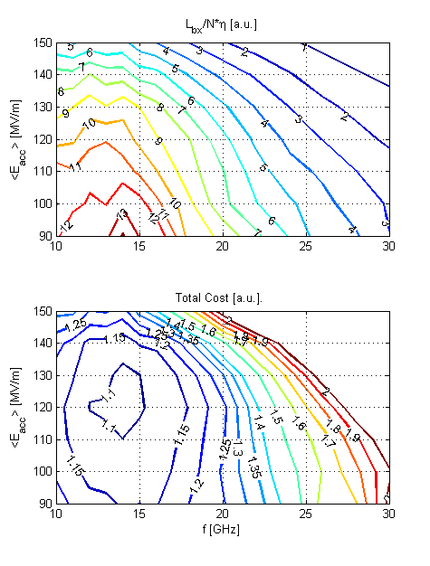
3TeV Parameter Optimisation
Optimisation:
Minimise cost for fixed luminosity L_{0.01}
Physics constraint
  L_{0.01}> 0.3 L
No constraints on background
  Regarded as perturbation

Slide 53
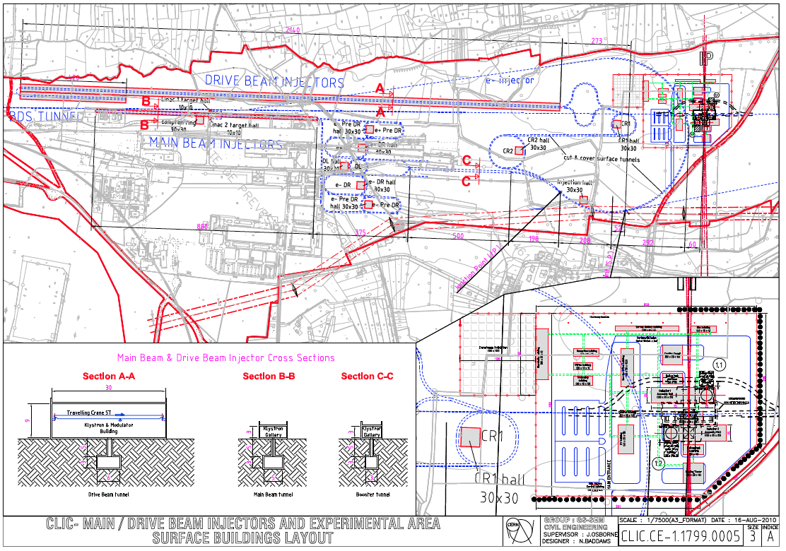
Injector complex & experimental area
Interaction region, caverns and surface installation, as foreseen in the CDR, at CERN Prevessin

Slide 54
Drive beam generation
CLIC RF Power Source Layout
Delay Loop × 2
gap creation, pulse compression & frequency multiplication
Drive Beam Accelerator
efficient acceleration in fully loaded linac
RF Transverse Deflectors
Combiner Ring × 3
pulse compression &
frequency multiplication
Combiner Ring × 4
pulse compression &
frequency multiplication
Drive Beam Decelerator Section (2 × 24 in total)
Power Extraction
Drive beam time structure - initial
Drive beam time structure - final
240 ns
240 ns
5.8 ms
140 ms train length - 24 × 24 sub-pulses
4.2 A - 2.4 GeV – 60 cm between bunches
24 pulses – 101 A – 2.5 cm between bunches
54

Slide 55
Concept of staging
Lower energy can run most of the time during construction of next stage.
0.5 TeV stage
Tot. length ~14 km
Notes:
Only at the higher energies will the second drive beam be needed.

Slide 56
Concept First Stage
Lower energy machine can run most of the time during the construction of the next stage.

Slide 57
Concept Second Stage
Physics results will determine the energies of the stages

Slide 58
Concept of staging
Only at the higher energies will the second drive beam generation complex be needed.

Slide 59
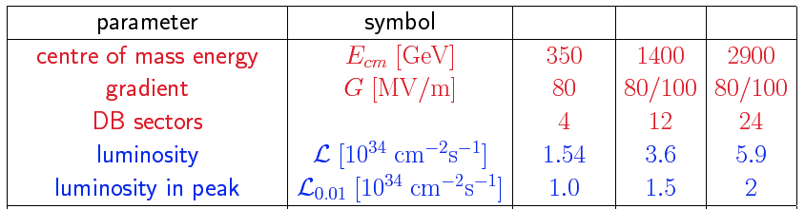
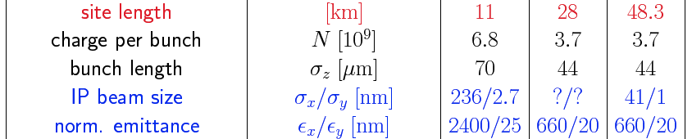
Potential New CLIC Staged Parameters
First stage ML structures are re-used
Notes:
First stage ML structures are re-used

Slide 60
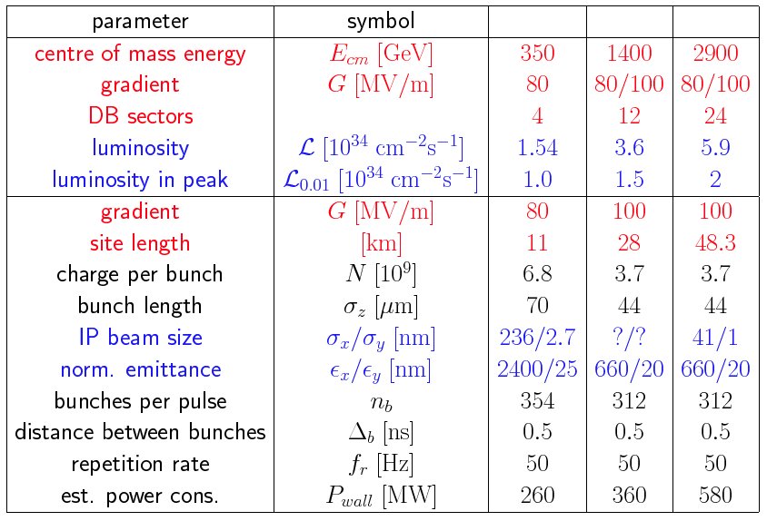
Potential New CLIC Staged Parameters
First stage ML structures are re-used
Notes:
First stage ML structures are re-used

Slide 61
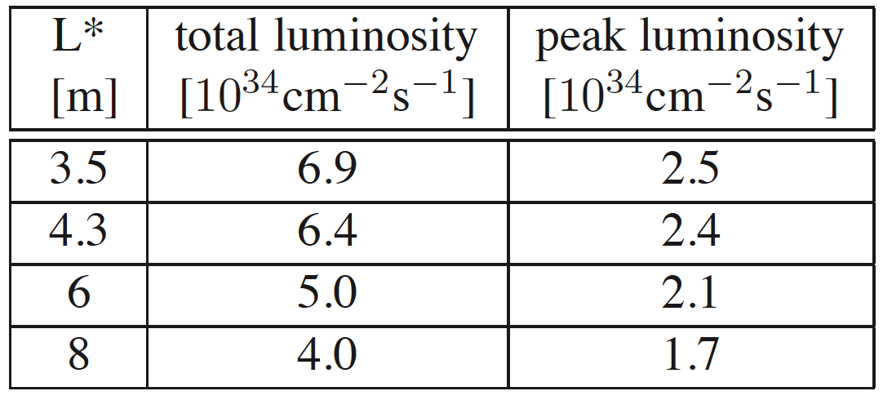
Choice of L*
Longer L* would be beneficial
detector design
  angular coverage
  shielding solenoid
final quadrupole stabilisation
But it reduces luminosity
-> use 3.5m/4.3m as a baseline
-> all studies performed at 3.5m, some at 4.3m
More effort in the future to understand
trade-off
Vol 1, 2.5.3.7
Luminosity includes 20% overhead for imperfections

Slide 62
Comparison CLIC vs LHC detector
In a nutshell:
CLIC detector:
High precision:
  Jet energy resolution
    => fine-grained calorimetry
  Momentum resolution
  Impact parameter resolution
Overlapping beam-induced background:
  High background rates, medium energies
  High occupancies
  Cannot use vertex separation
  Need very precise timing (1, 2, 5, 10ns)
No issue of radiation damage (10⁻⁴ LHC)
Beam crossings “sporadic”
No trigger, read-out of full 156 ns train
LHC detector:
Medium-high precision:
  Very precise ECAL (CMS)
  Very precise muon tracking (ATLAS)
Overlapping minimum-bias events:
  High background rates, high energies
  High occupancies
  Can use vertex separation in z
  Need precise time-stamping (25 ns)
Severe challenge of radiation damage
Continuous beam crossings
Trigger has to achieve huge data reduction

Slide 63
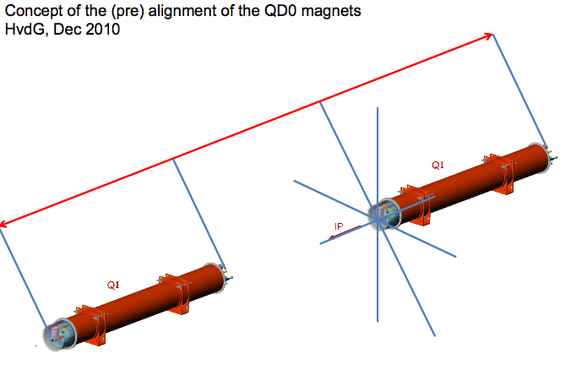
Nikhef: Alignment
Alignment of beamlines wrt each other
Based on RASNIK
In addition work on general alignment in CLIC and in CTF3

Slide 64
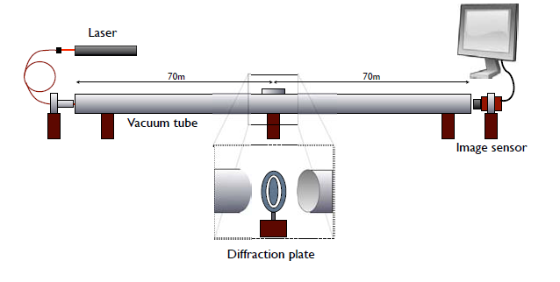
Nikhef collab. on pre-alignment
Objectives: provide transverse positional data on targets distributed over 100 m, with an uncertainty of measurement better than 5 μm
Concept: RASCLIC is a 3 point alignment, which consists of a monochromatic light source, a diffraction plate and a pixel image sensor.
The position of a diffraction pattern is monitored on the image sensor, which provides the relative position of the three components.
(M. Beker)

Slide 65
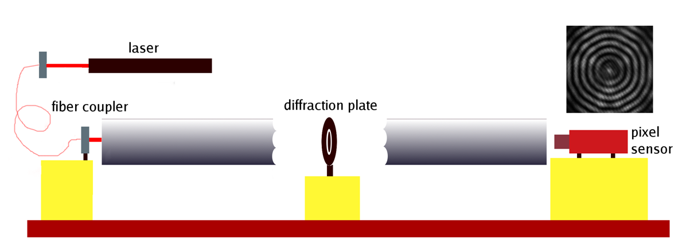
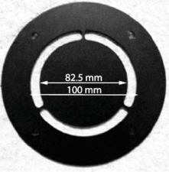
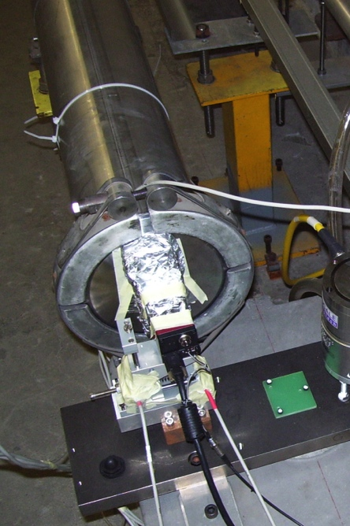
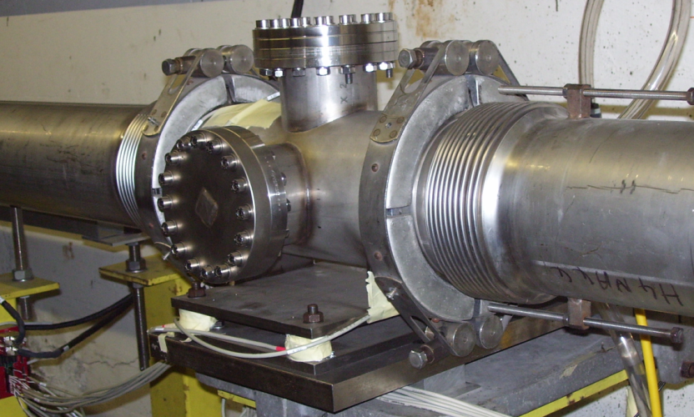
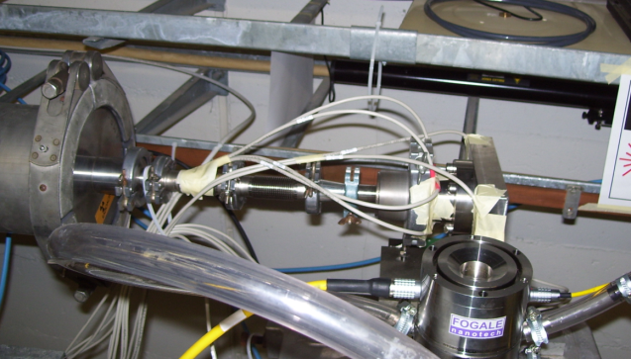
Nikhef collab. on pre-alignment
The concept was validated in an old tunnel named TT1 on 140 m.
A precision of 20 nm was reached
New agreement signed for improved and expanded system
(H. van der Graaf)

Slide 66
Backup slides
- CTF3

Slide 67
The CLIC Test Facility (CTF3)
Small scale version of the CLIC drive beam complex
Feasibility issues studied:
Drive beam generation
Beam driven RF power generation
Two beam acceleration & accelerating structures
Ultra low emittances & beam sizes
Alignment
Vertical stabilization
Operation and Machine Protection System
DELAY
LOOP
4 A – 1.2 ms
150 Mev
1.5 GHz bunch spacing
COMBINER
RING
DRIVE BEAM
LINAC
32 A – 140 ns
150 Mev
12 GHz bunch spacing
10 m
CLEX
CLIC Experimental Area
Notes:
Demonstrate Drive Beam generation
(fully loaded acceleration, beam intensity and bunch frequency multiplication x8)
Demonstrate RF Power Production and test Power Structures
Demonstrate Two Beam Acceleration and test Accelerating Structures

Slide 68
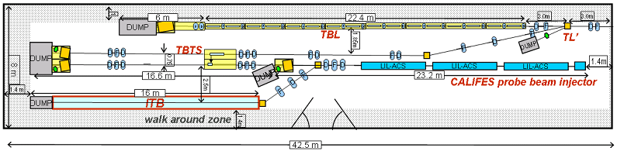
Drive Beam Deceleration and Module: CLEX
CLIC Decelerator sector: ~ 1 km, 90% of energy extracted
Two-beam Test Stand (TBTS):
Single PETS with beam
Accelerating structure with beam
  wake monitor
  kick on beam from break down
  Integration
Test Beam Line (TBL):
Drive beam transport (16 PETS)
  beam energy extraction and dispersion
  wakefield effects
Califes: Probe beam photo-injector
Beam energy 175 MeV

Slide 69

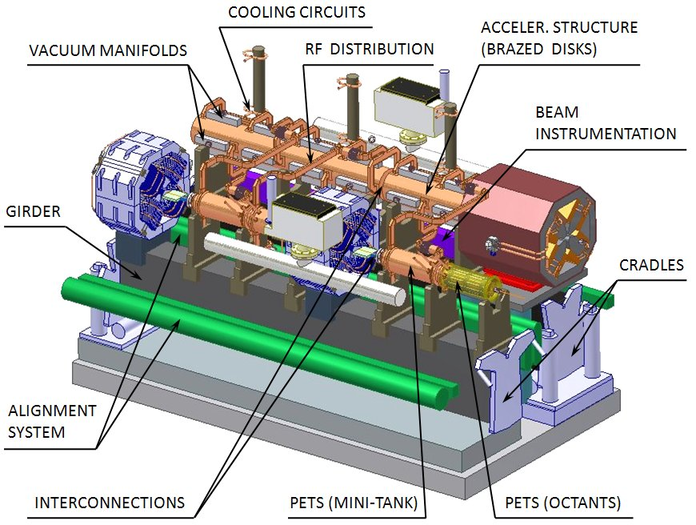
Two Beam Module
Integration aspects are important
  alignment
  vacuum
  transport
  cabling
  …
Beam tests of PETS are ongoing
accelerating structure installed
important goal 2010: two-beam acceleration with 100 MV/m
Some tests after 2010
e.g. wake monitors, design exists
Later full modules will be tested
G. Riddone et al.

Slide 70
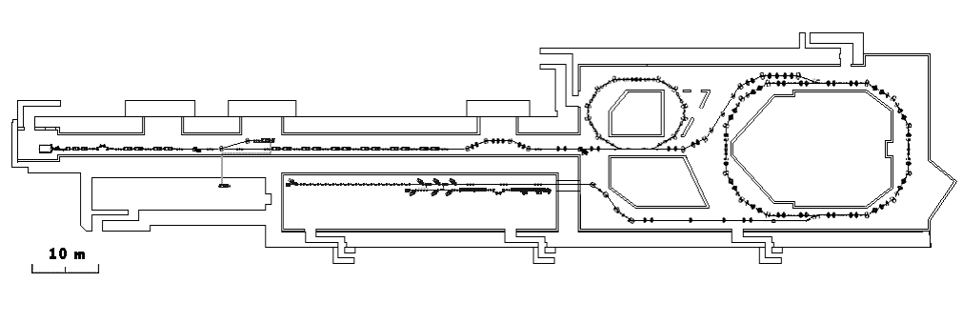
Two-Beam Acceleration: CLIC Test Facility (CTF3)
Demonstrate Drive Beam generation
(fully loaded acceleration, beam intensity and bunch frequency multiplication x8)
Demonstrate RF Power Production and test Power Structures
Demonstrate Two Beam Acceleration and test Accelerating Structures
PULSE COMPRESSION
FREQUENCY MULTIPLICATION
150 MeV e-linac
magnetic chicane
30 GHz test stand
3.5 A - 1.4 ms
Delay Loop
Combiner Ring
CLEX (CLIC Experimental Area)
TWO BEAM TEST STAND
PROBE BEAM
Test Beam Line
Photo injector tests,
laser
28 A - 140 ns
Infrastructure from LEP
total length about 140 m

Slide 71
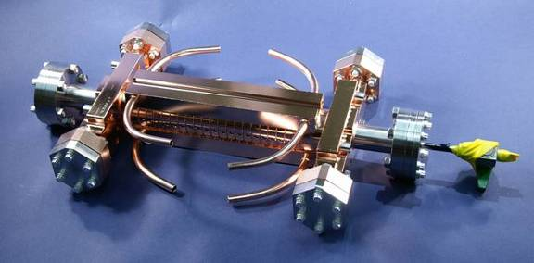
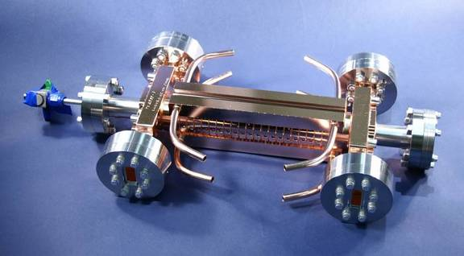
Accelerating Structure Results
RF breakdowns
can occur
=> no acceleration
and deflection
Goal: 3 10⁻⁷/m
breakdowns
at 100 MV/m loaded at 230 ns
T18 and TD18 structures built and tested at SLAC and KEK
T18 reached 95-105 MV/m
Damped TD18 reaches an
extrapolated 85 MV/m
  Second TD18 under test at KEK
  Pulsed surface heating expected to be above limit
CLIC prototypes with improved
design (TD24) will be tested this year
  expect similar or slightly better performances
S. Doebert et al.
Breakdown probability (1/m)
CLIC goal
Average unloaded gradient (MV/m)

Slide 72
Backup slides
- beamsthralung

Slide 73
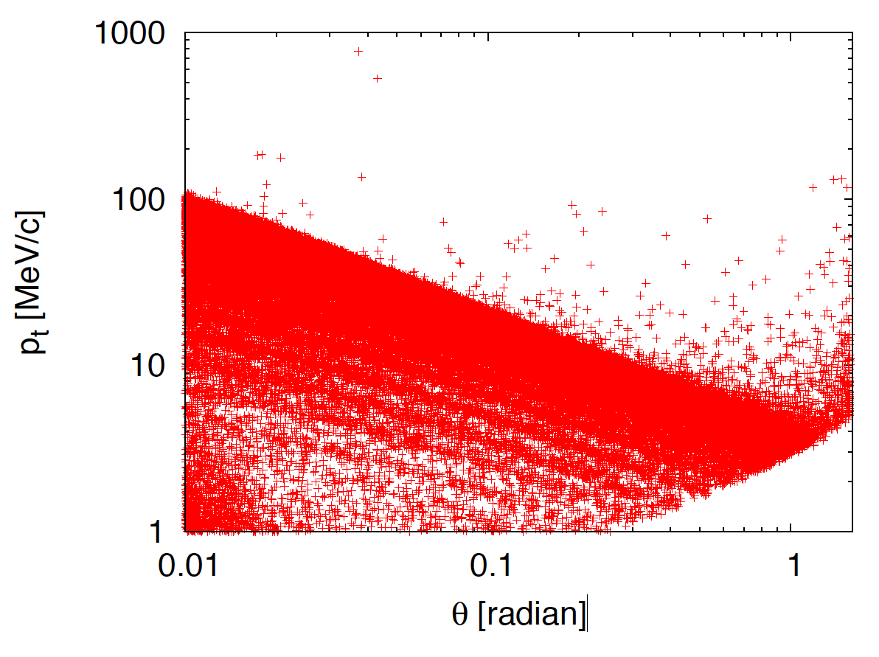
Incoherent Pairs
GUINEA-PIG used
Calculation with virtual photon
approximation (Q²_{max} choice confirmed by benchmarking Ph. Bambade et al.)
Beam size effect is included
300,000 particles produced
Average energy is 70 GeV
Strong deflection by the beam
smaller deflection observed with CAIN, under study
ϑ₀
r B_{z}

Slide 74

Hadronic Background
Based on equivalent photon approximation with
Q²_{max} =
max(1GeV²,(s/100)^{0.43})
3.2 events per bunch crossing
Events are simulated with PYTHIA 6.4.20
Benchmarked with SLAC generator (T. Barklow et al.)

Slide 75
Beam-induced backgrounds
Main backgrounds in detector:
  Incoherent pairs: 60 particles / BX
  γγ → hadrons: 54 particles / BX
Need pile-up rejection
Need to include background in simulation
  Detector starts at θ>10 mrad

Slide 76

Background Summary

Slide 77
CLIC detector
– very forward region
(closely linked to MDI)

Slide 78

Integration of QD0 magnets and IP Feedback systems

Slide 79

LumiCal
Measure luminosity using Bhabha events
(NB. luminosity spectrum measurement using large-angle Bhabha scattering, not treated here)
located at z=2.6 m
geometrical acceptance: 38 – 110 mrad
fiducial acceptance: 44 – 80 mrad
62 pb at 3 TeV
statistical accuracy
for 500 fb⁻¹: 1.8x10⁻⁴
Events
e⁺
e⁺
IP
e⁻
e⁻
Q, (rad)

Slide 80

LumiCal – preliminary design
(FCAL collaboration)
In CLIC_ILD:
located at z=2.6 m
total depth: 171 mm
inner radius: 100 mm
outer radius: 290 mm
40 layers:
3.5 mm W plates
320 mm Si sensors
550 mm connectivity
readout electronics
at outer radius

Slide 81
LumiCal – accuracy
(systematics!)
ILC at 500 GeV: requiring 0.1% accuracy
  high statistics physics channels at 500 GeV
  e.g. e⁺e⁻ -> WW or f f yield approx. 10⁶ events for 500 fb⁻¹
Statistical error 10⁻³
LumiCal accuracy should be the same or better
CLIC at 3 TeV: requiring 1% accuracy
    (e.g. 0.2 mrad or 0.5 mm accuracy on inner edge of LumiCal)
  decided in February 2009, at start of first simulations studies
  considered sufficient (?) w.r.t. statistics in typical physics processes
  considered realistic for CLIC (higher background!)

Slide 82

BeamCal
Tag h.e. electrons at small angles
(possibly used to give feedback to beam steering – not studied)
In CLIC_ILD:
located at z=3.1m
total depth: 260 mm (w/graphite)
inner radius: 32 mm
outer radius: 150 mm
40 layers:
3.5 mm W plates
+ sensors
incoming beam
spent beam
40 layers W-Si
10 cm graphite

Slide 83

BeamCal
A single h.e. electron and 10 BX of bg.
- Shown here: energy deposition in the 10th layer

Slide 84


Coil parameters
CLIC_SiD magnet parameters:
Conductor total length: 38 km
For details about transient behavior of the coil after a quench ->LCD Note 2011-007, B. Curé

Slide 85

Coil & Conductor
960 mm
487 mm
Cross section of the solenoid conductor and cut through the coil assembly

Slide 86

QD0 & Final focus stabilisation
Experiment side
Accelerator tunnel side
Final focus stabilisation to 0.15 nm ( f > 4 Hz) required
Achieved with combination of active and passive elements

Slide 87

Detector on IP – between 2 vertical walls
Shielding ring
chicanes
Vertical cut through the experiment

Slide 88

Ring chicane Shielding technique
3-D View
Side View
gap 50 mm
Mobile
rings
Fixed
rings

Slide 89

CLIC_ILD: Ring chicane and Coils

Slide 90
Backup slides
- detectors

Slide 91

Two detectors in Push-Pull
e⁻
e⁺
Notes:
Tunnel (and MDI) all the way up to the detector

Slide 92

CLIC Detector Concepts Overview
System | CLIC_ILD | CLIC_SID
VTX+Tracker | TPC, Radius=1.8m | Silicon, Radius=1.2m
ECAL | W/Si | W/Si
HCAL Barrel | W/Scint | W/Scint
HCAL Endcap | Steel/scint | Steel/Scint
Solenoid: B-Field | 4 T | 5 T

Slide 93
CLIC parameters
156 ns
20 ms
CLIC
CLIC: 1 train = 312 bunches, 0.5 ns apart trains at 50 Hz
ILC: 1 train = 1300 bunches, 700 ns apart trains at 5 Hz
 | LEP 2 | ILC 0.5 TeV | CLIC 3 TeV
L [cm⁻²s^{-1]}] | 5×10³¹ | 2×10³⁴ | 6×10³⁴
Crossing angle |  | 14 mrad | 20 mrad
BX separation | ~22 μs | 700 ns | 0.5 ns
IP size in x / y / z direction [nm] | 250 μm / 5 μm / 10 mm | 600nm / 6nm / 10mm | 45 nm / 1 nm / 40 μm
# (γγhadrons) / BX | negligible | 0.2 | 3.0
#Incoherent pairs / BX | negligible | 1 × 10⁵ | 3 × 10⁵
Notes:
Occupancy = #hits / #readout-cells can reach large values
trigger-less readout of whole train
power pulsing of readout electronics,
to minimize material needed for cooling

Slide 94
Optimization of interaction region
3 TeV
500 GeV
Direct hits from incoh. pairs for CLIC_ILD
3 TeV: High occupancy in inner-forward region, cut-off ~parabolic shape
500 GeV: situation similar, though lower rates
            place beam pipe outside high-occupancy region

Slide 95
Vertex detectors
CLIC_ILD
102 mm
255 mm
60 mm
CLIC_SiD
170 mm
830 mm
77 mm
 | CLIC_ILD | CLIC_SiD | CMS
Material X/X₀ (90º) | ~0.9% (3x2 layer) | ~1.1% (5 layer) | ~10% (3 layer)
Pixel size | 20 x 20 μm² | 20 x 20 μm² | 100 x 150 μm²
# pixels | 1.84 G | 2.76 G | 66 M
Time resolution | 5-10 ns | 5-10 ns | <~25 ns
Power/pixel | <~0.2 μW | <~0.2 μW | 28 μW

Slide 96

Cooling: P~500 W in vertex detectors
Forced air flow – may work in barrel region
  no extra material
  Up to 240 liter/s flow,
  ~40 km/h flow velocity
Water cooling – Sub-atmospheric pressure
  Can use thin PEEK pipes
  Need simulations to asses
  impact of material on performance
Micro-channel cooling – Integrate cooling channels in Si
  Could be solution for forward disks
  Connectors are major challenge
Nanoport connector
NA62 GTK
Top Sensor 200um
ASIC150um
A. Mapelli,
J. Buytaert
ASIC150um
Glue 50um
Connector
Bot Sensor 200um
Notes:
Need low-mass cooling solutions!

Slide 97
Power pulsing and power delivery
Very low duty cycle of CLIC machine: 156 ns train, 20 ms pause
All subdetectors will implement power pulsing schemes at 50 Hz, to reduce power consumption and thereby material in cooling systems
Efficient power delivery to front end → minimize cable volumes
Example: DC/DC step-down conversion (sLHC upgrades)
Example: Low drop-out regulators (LDO)
R&D needed to combine power pulsing with DC/DC or LDO and to minimize material + noise
≥ 5 mF
Power pulsing
in ASICs

Slide 98


Tracking System
Barrel Tracker | CLIC_ILD | CLIC_SiD
Technology | TPC+Silicon strips | Silicon strips
Inner radius | 329 | 230
Max. samples | 2(Si), 224(TPC),1(Si) | 5
Outer radius | 1808 | 1239
Max. Z | 2250 | 578 to 1536
Forward Tracker | CLIC_ILD | CLIC_SiD
Technology | Silicon strips | Silicon strips
Inner radius | 47 to 218 | 207 to 1162
Max. samples | 5 | 4
Outer radius | 320 | 1252
Max. Z | 1868 | 1556

Slide 99
Backup slides
- reconstruction

Slide 100


PandoraPFA
Topological Association Algorithms
Track-Cluster Association Algorithms
Reclustering Algorithms
Fragment Removal Algorithms
PFO Construction Algorithms
ConeClustering Algorithm
Cone
associations
Back-scattered tracks
Looping tracks
38 GeV
18 GeV
Cluster first
layer position
Projected track position
12 GeV
32 GeV
30 GeV Track
3 GeV
3 GeV
6 GeV
6 GeV
9 GeV
9 GeV
Layers in close
contact
Fraction of energy
in cone
Neutral hadron
Photon
Charged hadron

Slide 101
Jet Finding at CLIC
e.g.
  two jets + missing energy
TIGHT
timing
Using Durham k_{T} à la LEP
  Timing cuts are effective
  Yet all particles in event clustered into the jets
Notes:
At LEP, preferred jet-finding algorithm: Durham k_{T}
All particles in event clustered into the jets
not appropriate for CLIC
Events at CLIC
significant background from forward-peaked γγ → hadrons
events are often boosted along beam axis (beamstrahlung)
“hadron collider” type algorithms more appropriate
k_{T} algorithm at CLIC studied for benchmark physics analyses
invariant under longitudinal boosts
particles either combined with existing jet or beam axis
reduces sensitivity to γγ → hadrons

Slide 102
Jet Finding at CLIC
e.g.
  two jets + missing energy
TIGHT
timing
“hadron collider” k_{T} : R = 0.7
  much of background clustered with beam axis
  timing cuts do less work
  relative impact of timing and jet-finding depends on event topology
To tackle background: timing cuts + jet finding
Notes:
At LEP, preferred jet-finding algorithm: Durham k_{T}
All particles in event clustered into the jets
not appropriate for CLIC
Events at CLIC
significant background from forward-peaked γγ → hadrons
events are often boosted along beam axis (beamstrahlung)
“hadron collider” type algorithms more appropriate
k_{T} algorithm at CLIC studied for benchmark physics analyses
invariant under longitudinal boosts
particles either combined with existing jet or beam axis
reduces sensitivity to γγ → hadrons

Slide 103
Reconstruction in time
After reconstruction have a list of Particle Flow Objects (PFOs)
Calculate energy weighted mean time of each cluster
    sub-ns resolution
Use times to reject clusters
and associated tracks
Reject PFOs from background
  e.g. neutral hadrons in Endcap
Neutral hadrons
tCluster
Notes:
charged particles – mostly matched to clusters
photons – EM clusters
neutral hadrons – clusters
- High granularity calorimeter - even low energy clusters have many hits
- account for helical propagation time

Slide 104
Timing requirements in the pile-up
  integrate over > 20 BXs to accumulate calorimetric signals
  integrate over < 5 BXs for acceptable γγ → hadrons backgrounds
Radius
Calorimeter
TPC
Si tracking/vertex
Time
  The way out:
  Excellent time resolution
  High granularity calorimetry
  Sophisticated reconstruction

Slide 105



W/Z Separation
Separation calculated by applying optimal cut, minimising number of misidentified events.
For ideal Gaussian distributions, misidentification of 15.8% corresponds to 2σ separation.
If tails present in distribution, separation drops below 2σ even if main peaks remain 2σ apart.
Obtainable separation limited by natural width of W and Z to identification efficiency of 94%.

Slide 106


W/Z Separation
Separation between W and Z peaks with no background and with 60BX of background:

Slide 107
W/Z Separation
For ideal Gauss, misidentification of 15.8% corresponds to 2σ separation.
With tails in distribution, separation drops below 2σ even if main peaks remain 2σ apart.
Separation with & without background:

Slide 108

Default PFO Selection

Slide 109

Loose PFO Selection

Slide 110

Tight PFO Selection

Slide 111
Jet Finding at CLIC
At LEP, preferred jet-finding algorithm: Durham k_{T}
  All particles in event clustered into the jets
  not appropriate for CLIC
Events at CLIC
  significant background from forward-peaked γγ → hadrons
  events are often boosted along beam axis (beamstrahlung)
  “hadron collider” type algorithms more appropriate
k_{T} algorithm at CLIC studied for benchmark physics analyses
  invariant under longitudinal boosts
  particles either combined with existing jet or beam axis
    reduces sensitivity to γγ → hadrons
To tackle background: timing cuts + jet finding

Slide 112
Backup slides
- reconstruction resolutions

Slide 113
Transverse impact-parameter resolution
d₀: distance of closest approach to interaction point in R-phi plane
main benchmark parameter for vertex detector performance
Fast simulation: LiC detector toy tool, used for design optimisation
Full simulation: Geant4-based ILD/SiD frameworks, used for physics studies
Fig. 4.4a
Fig. 4.4b
CLIC_ILD:
Both full and fast simulation perform
simple Gaussian hit smearing
Full simulation without TPC information
  → Worse resolution for high momenta
CLIC_SiD:
Full simulation models clustering according
to parametrisation of KPiX readout chip
→ added realism leads to worse resolution
in full simulation, as expected

Slide 114
Dependence on single-point resolution
Fig. 4.5a
Fig. 4.5b
Varied single-point resolution by +- 50% (~ pixel sizes 10x10, 20x20, 30x30 μm²)
Observed change in d₀-resolution:
  +- 40% for p = 100 GeV
  +- 15% for p = 1 GeV
Resolution close to or better than target values for all cases
Pixel size is also constrained by:
  Expected background occupancy
  Ability to separate adjacent tracks in dense jets

Slide 115
Dependence on distance to IP
Fig. 4.6
Varied distance to interaction point, by changing radii of beam pipe and barrel vertex layers in CLIC_ILD model
Observed change in d₀-resolution:
  3.2% / mm for high momenta (parameter ‘a’)
  0.8% / mm for low momenta (parameter ‘b’)
Distance to interaction point is constrained by direct hits from incoherent pairs
(see André Sailer’s presentation on backgrounds)

Slide 116
Dependence on material
Fig. 4.7a
Fig. 4.7b
Very small amount of material in baseline designs
Realistic models for supports, cabling, cooling not available yet
Studied sensitivity of d₀ resolution for low momenta
on material in beampipe and silicon pixel layers of CLIC_ILD
Doubling beam-pipe thickness → ~20% worse resolution at 90º
Doubling material in silicon layers → ~20% worse resolution at 90º
Steeper slope in forward region

Slide 117
Tracking performance CLIC_ILD

Slide 118


Resolution vs. Jet Energy
Barrel region |cos θ| < 0.7, no background, no jet reconstruction:
At lower energies, CLIC_ILD benefits from its larger radius.
At higher energies, particle separation becomes more difficult; confusion term dominates energy resolution; particle flow can become energy flow. Both detectors show similar performance.

Slide 119


Resolution vs. Angle
No background, no jet reconstruction:
Resolution for CLIC_SiD is worse in the forward region, due to reduced angular coverage. There is no HCAL coverage below θ = 15.5°.
Resolution for CLIC_ILD dips in barrel/endcap overlap region, due to gap between ECAL barrel and endcap. Leakage effects due to this gap are more pronounced at higher energies.
Notes:
In barrel region, both detectors show only small variation with jet angle.

Slide 120


Timing Cuts
No background, no jet reconstruction:
Impact of CLICPfoSelector timing cuts on the physics event is studied by applying the cuts without overlaying any background.
Whilst timing cuts result in degradation of jet energy resolution for low energy jets, the impact is small for jets above 500GeV.

Slide 121
Backup slides
- occupancies

Slide 122
Occupancies in CLIC_ILD vertex region
Dominik – sep’11
Barrel cylinder layers
Forward disk layers
Direct hits from incoherent e⁺e⁻ pairs dominate
Up to 3x10⁻⁴ hits/mm^2/BX in barrel region → 1.9% train occupancy / pixel
Up to 5x10⁻⁴ hits/mm^2/BX in forward region → 2.9% train occupancy / pixel
(including factors for simulation uncertainty and clustering)
for comparison: ATLAS/CMS pixel occupancy ~0.1% / BX

Slide 123
Backgrounds in CLIC_ILD Calorimeters
Dominik – sep’11
ECAL Endcap layer 5-10 train occupancy:
HCAL Endcap layer 35-40 train occupancy:
5x5 mm² cells
3x3 cm² cells
Up to 50% train occupancy in ECAL Endcap, not including safety factors
Up to 1000% train occupancy in HCAL Endcap, not including safety factors
Need several readouts per train
May need even higher granularity
37 TeV energy release / train
→ challenge for (jet) reconstruction
Note: forward region not yet optimized
for backscatters into HCAL
Total energy release / train:

Slide 124
Calorimeter endcap occupancies
Full detector simulations:
layers 5 – 10
layers 35 - 45
High occupancy due to incoherent pairs in high-z region of HCAL endcap
Inadequate shielding from the very forward calorimetry region
Can be solved
Notes:
In the case of the ECAL the average is given for layers 5 – 10 which broadly correspond to maximum
energy deposit of typical EM showers. In the case of the HCAL the average is quoted for layers 35 – 45
where the maximum activity from the neutron background is observed.
However, the forward region of the
GEANT4 models of the CLIC_ILD and CLIC_SiD detector concepts were designed before the impact
of the scattered neutron background from the incoherent pairs interacting in the BeamCal was fully
understood. The level of background in the low radius region of the HCAL in the current detector
models is too high. However, there are a number of possible ways in which to reduce this component
of the background. These will be studied in the future and include: increased shielding between the
BeamCal and the inner regions of the HCAL; the possibility of using a different absorber which, unlike
plastic scintillator, is relatively insensitive to neutrons; and increasing the transverse segmentation to
resolve the occupancy issue.

Slide 125
Radiation exposure in silicon layers
NIEL:
Non-Ionizing Energy Loss (NIEL):
Displacement damage in silicon
Obtained from hit rates scaled with
tabulated damage factors
VTX barrel
Total Ionizing Dose (TID):
Obtained from simulated energy loss
in silicon layers
 | CLIC_ILD | LHC
NIEL VTX barrel [1-MeV-n_{eq}/yr] | 4x10¹⁰ | >~10¹⁴
NIEL FTD [1-MeV-n_{eq}/yr] | 5x10¹⁰
TID VTX barrel [Gy/yr] | 200 | >~ 10⁵
TID FTD [Gy/yr] | 180
TID:
FTD
→ Small expected radiation exposure,
compared to LHC experiments

Slide 126

Backgrounds in the calorimeters
Calorimeter backgrounds per bunch-train (3 TeV)
Calorimeter backgrounds per bunch-crossing are manageable,
~ 60 GeV
Hence want to integrate over as few as possible BXs
Tight timing requirements – O(ns) !
Detector | γγ→ hadrons
ECAL endcaps | 11 TeV
ECAL barrel | 1.5 TeV
HCAL endcaps | 6 TeV
HCAL barrel | 0.3 TeV
Total | 19 TeV
ECAL
….
….
0.5 ns

Slide 127
CLIC detector
– electronics

Slide 128
5 detector categories with similar readout specifications
Silicon pixel detectors
  Arrival time for 1 hit readout per train
  Zero suppression
Silicon strip detectors
  Arrival time for >1 hits per train
  Sampling of pulse at regular interval
  No zero suppression due to the large occupancies
TPC
  Analog pad readout for 1000 voxels per channel
Calorimeters
  Arrival time for >1 hits per train
  Sampling of pulse at regular interval
  Pulse heights higher than strip detectors → time resolution
  No zero suppression
Muon detectors
  Digital readout of > 1 hits per train with a multi-hit TDC
  Zero suppression

Slide 129

per train
Safety factor 5/2 for
incoherent pairs/γγ to hadrons, TPC no safety

Slide 130

Implementation Example: Analog Calo Readout

Slide 131

DAQ aspects

Slide 132
CLIC detector
– R&D

Slide 133
Hardware/engineering R&D
CERN LCD hardware/engineering R&D
(needed beyond ILC existing developments):
Vertex detector
  trade-off between pixel size, amount of material and timing resolution
Hadron calorimetry
  Tungsten-based HCAL (PFA calo, within CALICE)
Electronics
  Power pulsing for all sub-detectors (50 Hz)
  Fast readout with pulse-height + time + multi-hit in 156 ns
Solenoid coil
  Large high-field solenoid concept, reinforced conductor (CMS/ATLAS experience)
Overall engineering design and integration studies
  In view of sub-nm precision required for FF quadrupoles
  For heavier calorimeter, larger overall CLIC detector size etc.
In addition at CERN: TPC electronics development
(Timepix-2, S-ALTRO)

Slide 134


Pixel-detector technology options
20x20 μm² pixel sizes → need small feature sizes
Time-stamping ~5-10 ns → need high-resistivity sensor
0.1%-0.2% material/layer → allows for ~50 μm sensor + ~50 μm electronics
Read out full 156 ns bunch train, no trigger
Technology Options:
1) Hybrid
Thinned high-resistivity fully depleted sensors
Fast, low-power highly integrated readout chip
Low mass interconnects
2) Integrated technologies
Sensor and readout combined in one chip
Charge collection in epitaxial layer

Slide 135

Pixel-detector in hybrid technology
Timepix3 design
Thinned depleted high-resistivity sensors, ~50 um active width
Example: ALICE pixel upgrade → meet CLIC goals
Fast, low-power, highly integrated readout chips
Example: Timepix3 (2012) 130 nm IBM CMOS
  50x50 μm² pixels → needs further reduction (<~90 nm process)
  1.5 ns time resolution → exceeds CLIC goals
  P~350 mW/cm² → meets CLIC goals (with power pulsing)
Low-mass interconnects between sensor+readout
  cost driver → needs further R&D
Advantages:
Use industry-standard processes for readout
Factorize sensor and readout R&D
Drawbacks:
Higher material budget than integrated approach
Interconnects difficult/expensive
Handling/bonding of thinned structures difficult
110 μm
2x4 superpixel
220 μm
X. Llopart

Slide 136



Pixel-detector in integrated technology
Mimosa 26
Integrate sensor and readout in one chip
Signal collection through electron drift in epitaxial layer
Example: MIMOSA chip family, 0.35 μm CMOS process
50 μm total thickness → meets CLIC goal
<<1 μm depleted area → need to increase
100 μs readout time (rolling shutter) → need single-pixel r/o
18.4 μm pitch, σ_{SP}~4 μm → meets CLIC goal
P~250 mW/cm² → meets CLIC goal (with power pulsing)
Advantages:
Very low material budgets achievable
Very low power consumption possible
Drawbacks:
Custom-made processes (availability in 10 years?)
Difficult to get fast signal collection + good S/N
Fast readout not yet demonstrated
M. Winter
Epitaxial layer:
Low resistivity
High resistivity

Slide 137

Hardware R&D on the experiment
Power delivery, on/off at 50Hz, driven by front-end electronics
Final Focus: Active and passive stabilisation, alignment
Solenoid coil:
Reinforced conductor
tests. Materials
Calorimetry:
>1000 m2 cost-effective
silicon sensors; Integrated HCAL sensor planes
6 m
Pixel detector:
Integrated solid state sensors, deep submicron, small-pitch interconnect, low-mass cooling, ultra-thin materials
Main tracker
(silicon strip detectors 150 m2,
TPC gas detector)

Slide 138
RPC digital HCAL testbeam
32 GeV pion
With Fe, performed at Fermilab

Slide 139
Beam Halo Muons

Slide 140
Beam halo muons
Target muons/bunch crossing < 1
  muons per lost particle ~ 10⁻⁴
  allowed loss ~10⁻⁶
Muon spoilers gain factor 10, i.e. allowed loss ~10⁻⁵
  further reduction may be possible
Main halo generation is elastic beam-gas scattering in the BDS
  expected loss 7 10⁻⁸, i.e. 0.05 muons with no spoilers
  Other sources to be reviewed

Slide 141
Beam Halo muons
Most work for CDR concentrated on impact of γγ → hadrons
  Also looked at beam halo muons
Simulated events with entire bunch train of beam halo muons
  For study assumed a bad case: 5 muons/BX through detector
In 150 ns from start of bunchtrain:
  ECAL
    Total = 1.5 TeV (54k hits)
    Barrel = 0.8 TeV (18k)
    Endcap = 0.7 TeV (36k)
  HCAL
    Total = 10.8 TeV (128k hits)
    Barrel = 5.3 TeV (32k)
    Endcap = 5.5 TeV (96k)
For this very conservative
level of background:
12 TeV

Slide 142



Software Mitigation
Three steps of background reduction
  Initial reconstruction window of 10 ns (50 ns in HCAL barrel)
  Timing cuts at cluster level (TightPFOSelection)
  Build in beam halo muon rejection into particle flow reconstruction
For very conservative assumption of 5 muons per BX
Readout window
TightPFOSelection
+ dedicated reco. Alg.
2.2 TeV
420 GeV
30 GeV
Background rejection very effective due to high granularity calorimeters

Slide 143


Impact on Physics
Tested in by looking at W reconstruction in
  Sample of 500 GeV hadronic W decays
  Again very conservative assumptions (5 muons/BX)
Two effects observed
  Extra energy from clusters from beam halo muons: 30 GeV
  Energy of reconstructed jets also biased “pick” up hits from muons: 30 GeV
Readout window
TightPFOSelection + reco. alg.

Slide 144



Impact on W Reconstruction
Compare W mass reconstruction
  no background
  γγ → hadrons
  5 muons per BX (very conservative)
  1 muon per BX (conservative)
Worst case as pattern recognition not optimal
γγ → hadrons
muon halo (5/BX)
muon halo (1/BX)
Conclude: a beam halo muon background of 1 muon/BX is acceptable
  Machine background likely to be much lower than this

Slide 145
Backup slides
- physics examples

Slide 146
Susy
Search reach in the m_{A} − tan β plane for LHC and CLIC. The left-most coloured regions are current limits from the Tevatron with ∼7.5 fb⁻¹ of data at √s = 1.96 TeV and from ∼1 fb⁻¹ of LHC data at
√s = 7 TeV.
Black line is projection of search reach at LHC with √s = 14 TeV and 300 fb⁻¹ of luminosity.
Right-most red line is search reach of CLIC in the HA mode with s = 3 TeV.
Resolving SUSY breaking models and masses with CLIC: Shown are the nearly degenerate spectra of a mSUGRA model and a mGMSB model.
Assuming some of the SUSY masses are measured, with a spectrum of the type above predicted by the different models of Supersymmetry breaking, CLIC would be able to discern not only some of the slepton masses and the heavier charginos within the two models, but also the SUSY Higgs masses.
Notes:
Search reach in the mA − tan β plane for LHC and CLIC. The left-most coloured regions are
current limits from the Tevatron with ∼ 7.5 fb−1 of data at √s = 1.96 TeV and from ∼ 1 fb−1 of LHC
data at √s = 7 TeV. The black line is projection of search reach at LHC with √s = 14 TeV and 300 fb−1 √
of luminosity [78]. The right-most red line is search reach of CLIC in the HA mode with s = 3 TeV.
This search capacity extends well beyond the LHC. A linear collider at √s = 500 GeV can find heavy
Higgs mass eigenstates if their masses are below kinematic threshold of 250 GeV.
Resolving SUSY breaking models and masses with CLIC: Shown are the nearly degenerate spectra of a mSUGRA model and a mGMSB model. Assuming some of the SUSY particles masses are measured, with a spectrum of the type above predicted by the different models of Supersymmetry breaking, CLIC would be able to discern not only some of the slepton masses and the heavier charginos within the two models, but also the SUSY Higgs masses. For mSUGRA the soft masses are m0 = 175 GeV, m1/2 = 645 GeV, A0 = 0, with tan β = 10 and μ > 0. For mGMSB the number of messengers are nl = nq = 5, and ΛSUSY = 4·104 GeV, MMess = 1012 GeV, with tanβ = 10.

Slide 147
Heavy gauge boson
Observation of new gauge boson resonances in the μ⁺μ⁻ channel by auto-scan at 3 TeV. The two resonances are the Z_{1,2} predicted by the 4-site Higgsless model
Expected resolution with √s = 3 TeV and 1 ab⁻¹ on the “normalised” leptonic couplings of a 10 TeV Z′ in various models, assuming lepton universality. The couplings can be determined up to a twofold ambiguity.
  Z′ mass is assumed to be unknown.
  χ, η, φ refer to various linear combinations of U(1) subgroups of E6; the SSM has the same couplings as the SM Z; and, LR is U(1) surviving in Left-Right model.
Notes:
Fig. 1.15: Left: Observation of new gauge boson resonances in the μ+μ− channel by auto-scan at 3 TeV. The two resonances are the Z1,2 predicted by the 4-site Higgsless model of [64]. Right : Expected resolution at CLIC with √s = 3 TeV and L = 1 ab−1 on the “normalised” leptonic couplings of a 10 TeV Z′ in various models, assuming lepton universality. The couplings can be determined up to a twofold ambiguity. The mass of the Z′ is assumed to be unknown. χ, η, φ refer to various linear combinations of U(1) subgroups of E6; the SSM has the same couplings as the SM Z; and, LR is U(1) surviving in Left-Right model. The two fold ambiguity is due to the inability to distinguish (a,v) from (−a, −v).

