Slide 1

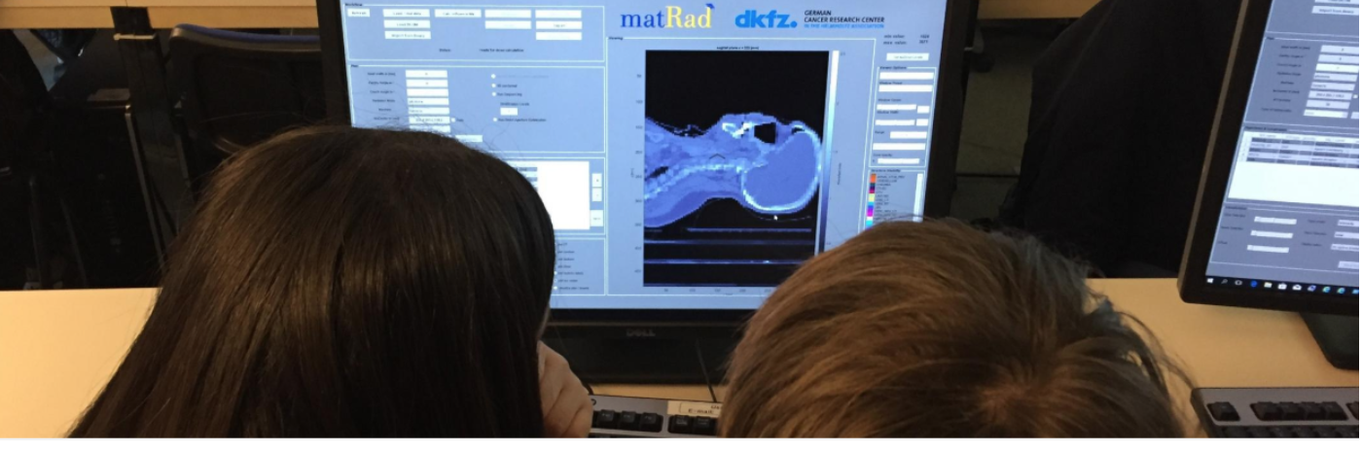

Particle Therapy MasterClass
educational outreach package
https://indico.cern.ch/event/840212/
Yiota Foka (GSI/CERN)
PTMC tutorial zoom-meeting
Thursday 11 February 2020 at 13:30 (Geneva Time)

Slide 2
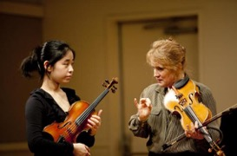
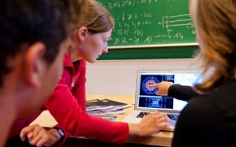
International MasterClasses
PTMC is integrated into the International MasterClasses project
https://physicsmasterclasses.org/index.php
The “International Masterclasses” IMC project
is an educational outreach activity that brings the excitement
of cutting-edge research methods into the classroom.
Offers to pupils hands-on experience with real data
Become “scientists for a day” !
Classes by masters, experts

Slide 3
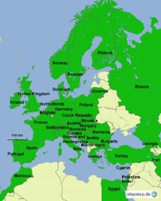
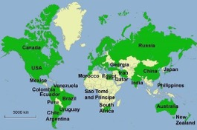

IMC Statistics 2019
Motivate the next generations of scientists !
7.3. - 16.4.2019
255 Institutes
54 countries involved
~ 15 000 students
Coord.: QuarkNet / TU Dresden
188 institutes (177)
266 LHC Masterclasses (257)
30 ATLAS W (35)
101 ATLAS Z (104)
64 CMS (58)
41 LHCb (39)
27 ALICE SP (18)
3 ALICE R_AA (3)
51 institutes (48)
54 LHC Masterclasses (50)
22 ATLAS (19)
32 CMS (31)
(Incl. TRIUMF program)
12 MINERvA Masterclasses
Flagship project of IPPOG, International Particle Physics Outreach Group https://ippog.org

Slide 4

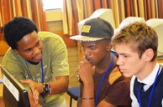
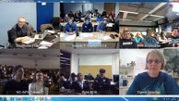
Concept and programme of an IMC day
Every year, during the months of
February-March
school-children (15-19 year old)
are invited to an institute of their area.
2-5 institutes per day performing the same programme
LOCAL TIME: ACTIVITY
8:30 - 9:00 Registration and Welcome
9:00 - 10:00 Introductory lectures
10:30 - 11:30 Visit of a lab or experiment
12:00 - 13:00 Lunch
13:00 - 15:00 Hands-on session
15:00 - 16:00 Discuss results locally
16:00 - 17:00 Video conference
The aim is to get insight into topics and methods of research

Slide 5
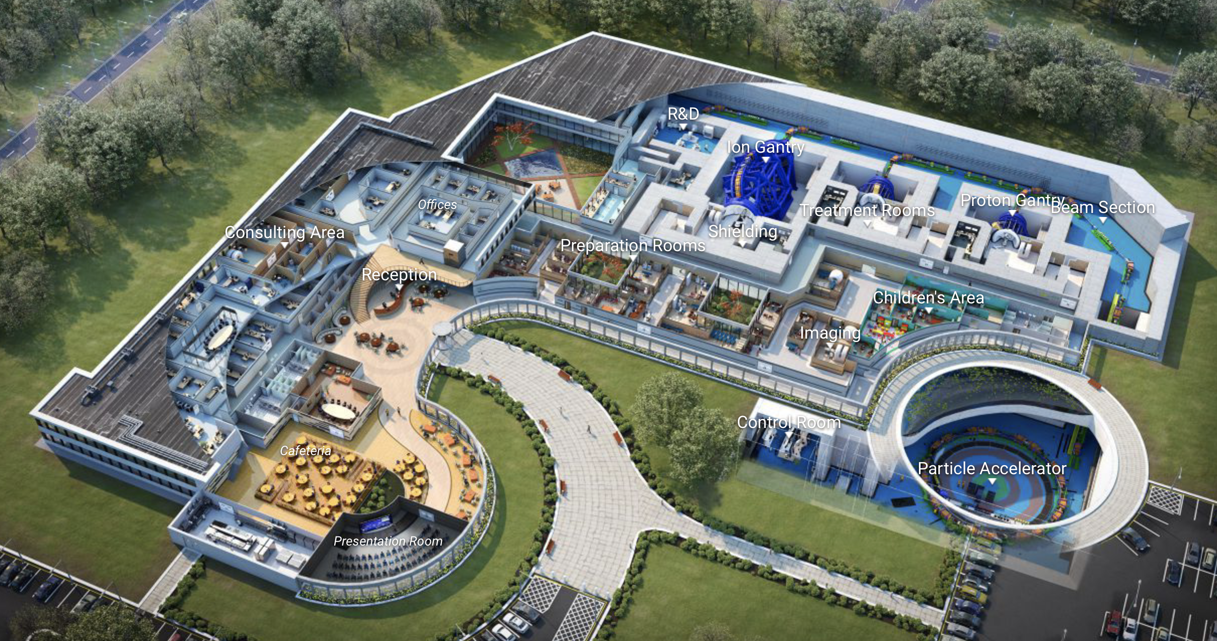
Particle Therapy Centre

Slide 6

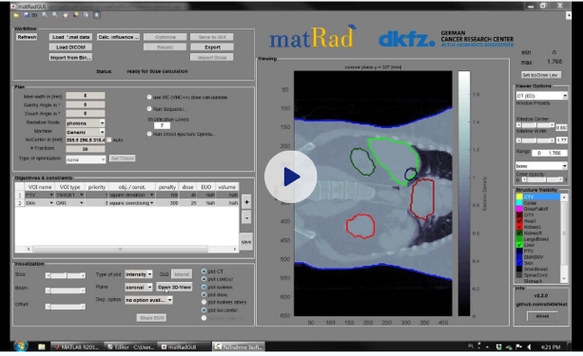
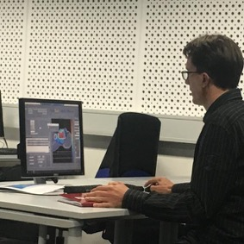
PTMC and Treatment Planning
Based on professional open source treatment planning: matRad
developed by Heidelberg DKFZ www.matrad.org
First contact proposed by C.G.
Simplified version by HD DKFZ

Slide 7
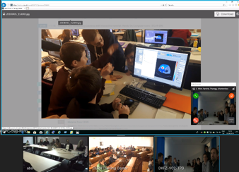
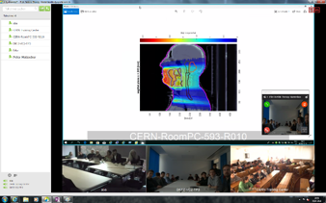

PTMC pilots in 2019
First test: locally at GSI on 7th February 2019
First pilot: CERN, DKFZ Heidelberg, GSI, 5th April 2019
Participation of CURIEosity Team from Crete
Survey: positive results from students
Hope and motivation to contribute
to the fight against cancer
CERN, DKFZ, GSI
Common discussion: intuitive, visual
comparisons of photons, protons, ions

Slide 8
Approval for IMC2020
PTMC in IMC 2020 and 2021
Publication CHEP in arxiv 6 may: https://arxiv.org/abs/2005.02215
IMC Steering Group: Presentation and Feedback
Material ready for IMC web: during summer 2019
In the IMC program for 2021
25 institutes registered and more interested
Uni Sarajevo: web pages
In Greece:
Veroia Library: whole greece
With the support of Aris Mamaras (AUTh)
Dates IMC2021: 11.2-27.3 2021
Switching to online/zoom sessions
MATERIAL and TRAINING:
- Material/methods for zoom/online sessions
- Training of tutors, support teams

Slide 9
PTMC in 2021
Every Friday at 13:30 we hold a "Helpdesk" for any questions and/or training.
The next ones are:
12th February: https://indico.cern.ch/event/1006829/ 19 February: https://indico.cern.ch/event/1006832/ 26 February: https://indico.cern.ch/event/1006833/

Slide 10
PTMC in 2021
Examples of a PTMC Session (9:00-16:00
and a Videoconference (16:00-17:00 CET)
EXAMPLE PTMC Session 9:00-16:00
https://indico.cern.ch/event/1002980/
EXAMPLE VIDEOCONFERENCE 16:00-17:00 Central European Time
https://indico.cern.ch/event/999420/

Slide 11
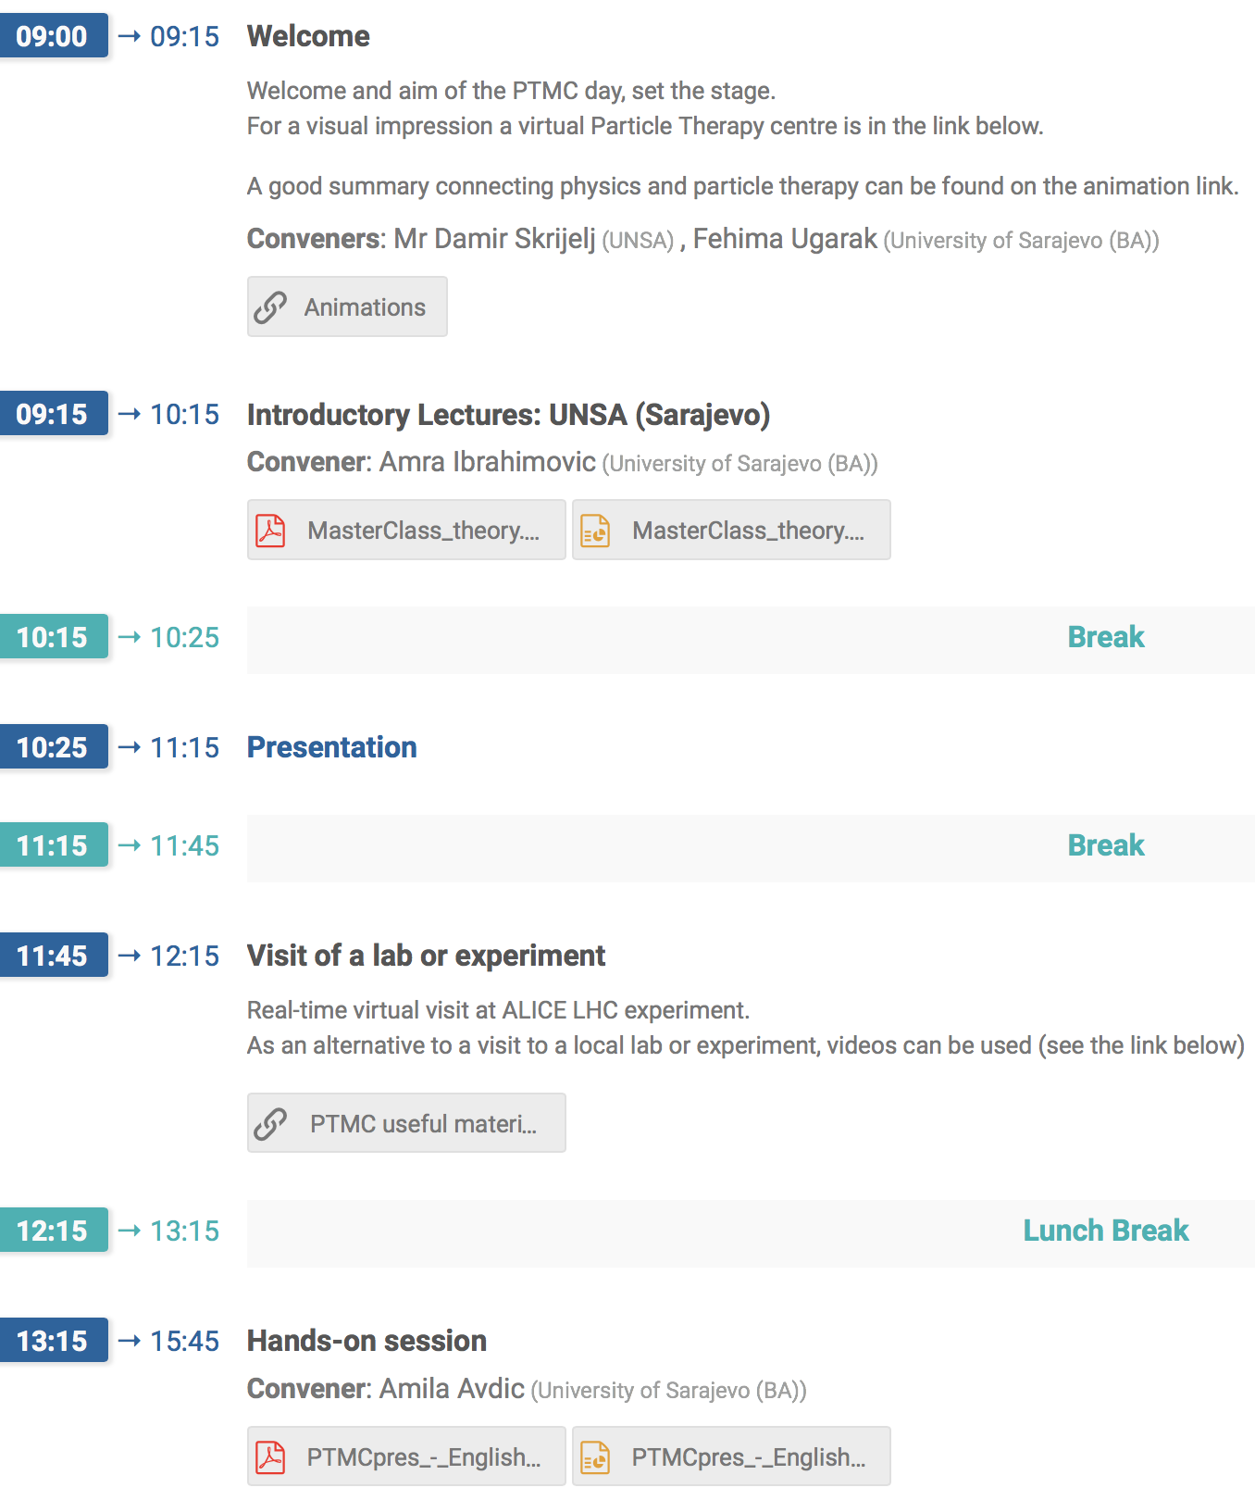
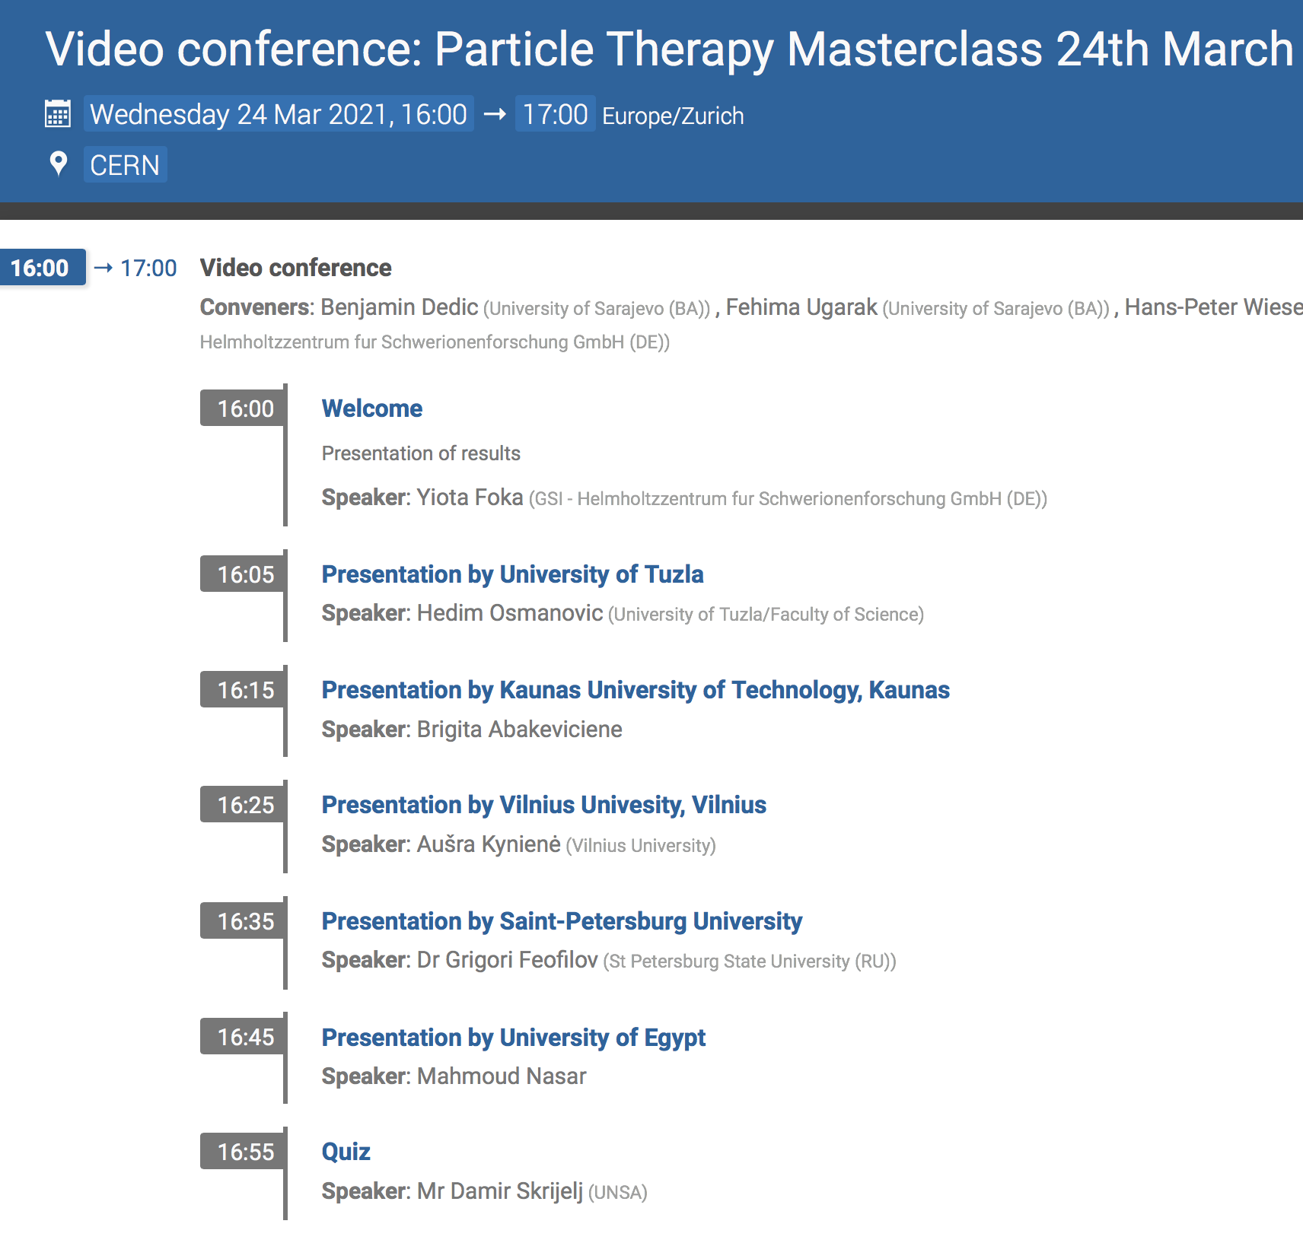
16:00-17:00 CET

Slide 12
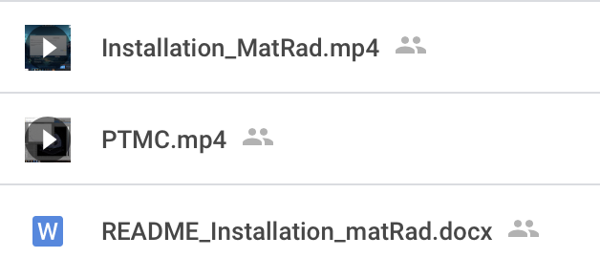
PTMC in a kit: Installation and Testing
The necessary material for installation and the hands-on,
including recording:
PTMC in a kit in ENGLISH (Spanish, Bosnian, Greek coming) https://drive.google.com/drive/folders/1jRnLf49N_yRoOGg8V8vwq3DIpnetWdF0

Slide 13
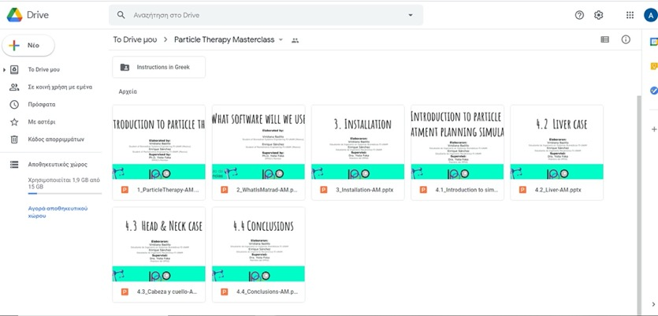

PTMC in a kit Installation and Testing
For fast installation and testing, instructions in google drive:
in English, Mexican/Spanish, Greek: by Aris Mamaras, Viridiana, Enrique
https://drive.google.com/drive/folders/1jRnLf49N_yRoOGg8V8vwq3DIpnetWdF0

Slide 14
PTMC material in web page
The PTMC web page https://indico.cern.ch/event/840212/overview
provides a lot of material :https://indico.cern.ch/event/840212/page/17998-materials
Instructions for tutors, moderators, necessary definitions:
https://indico.cern.ch/event/840212/page/17986-instructions
Presentations: https://indico.cern.ch/event/840212/page/17999-presentations
Animations: https://indico.cern.ch/event/840212/page/18000-animations

Slide 15
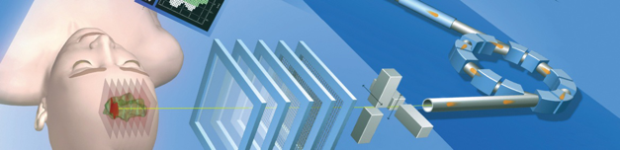
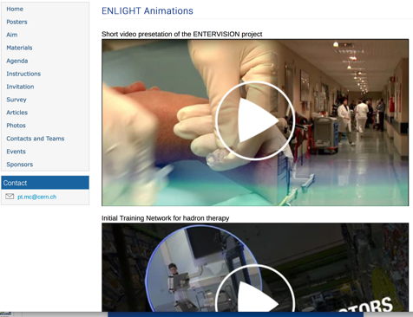
Particle Therapy MasterClass
Uni Sarajevo: web pages
https://indico.cern.ch/event/840212/
Material in the web
in several languages
Presentations
Posters
Animations (ENLIGHT, therapy centers)
Instructions
Workplan
Demos
https://videos.cern.ch/record/2690592
PR material:
articles
photos
events description

Slide 16
THE first and only… PTMC in IMC2020 in Mexico

Slide 17
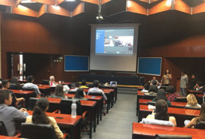
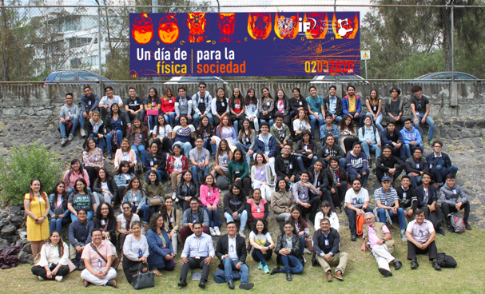
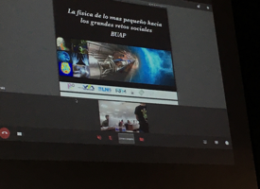



PTMC in MXC 2nd March 2020

Slide 18
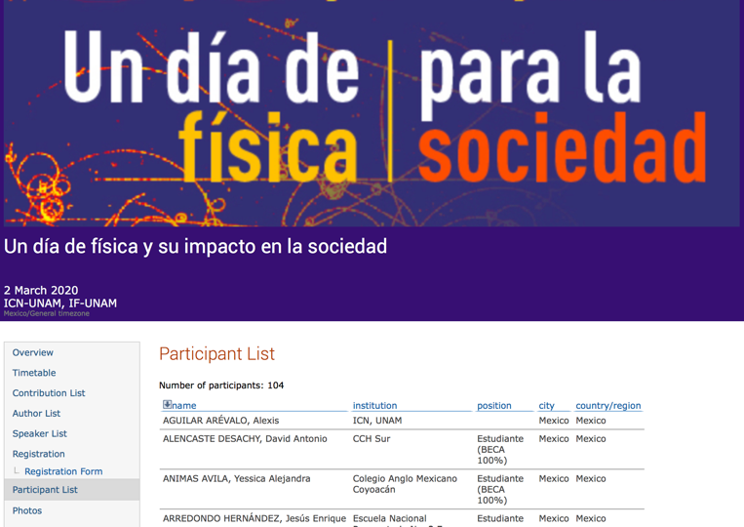
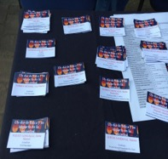
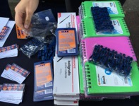
PTMC in MXC 2nd March 2020
Closed registration
reaching max capacity of
auditorium (100 students)
2x25 groups for hands-on

Slide 19
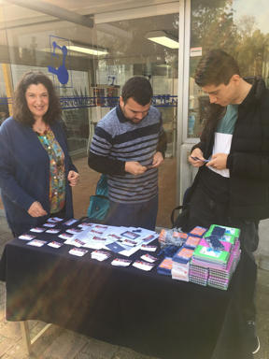
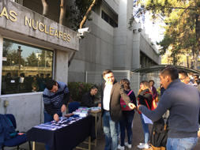
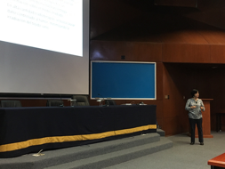
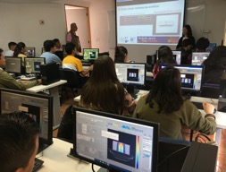
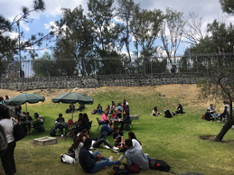



Slide 20
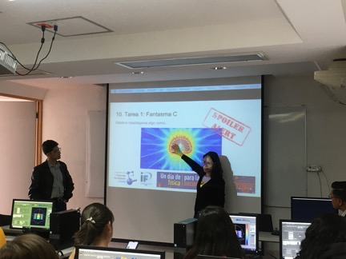
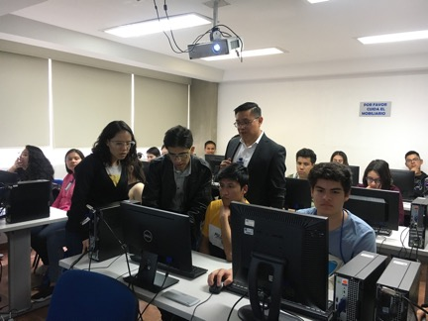
Hands-on: a strong experience
We could not see how physics relates with medicine
When listening at the lectures in the morning we could not believe that in the afternoon
we would be able to handle treatment planning and with such accurate results

Slide 21
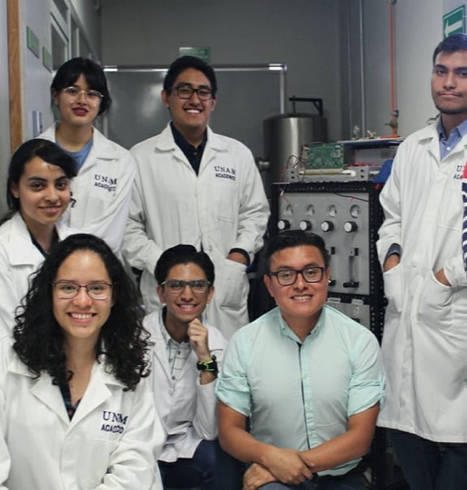

Attendees of IMC were attracted by Science, Technology, Engineering and Math careers. It was definitely our case
From participants to collaborators
It is inspiring to young students.
This could mean more professionals in STEM topics
Noteworthy fact:
now we collaborate in UNAM with our MC tutor
Antonio Ortiz Velasquez
.

Slide 22
PTMC Material can be used for different occasions

Slide 23
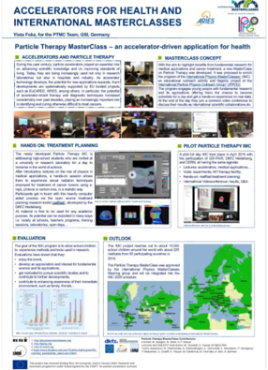
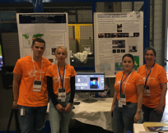
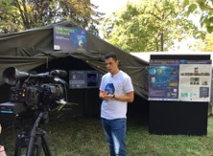
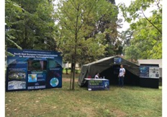
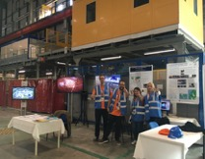
PTMC in Conferences, Open Days...
ENLIGHT, Caen, 2019
Open Days:
CERN and Montenegro 2019
23

Slide 24
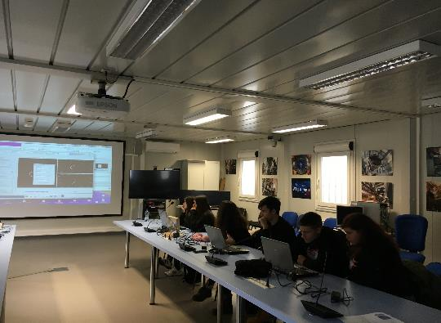
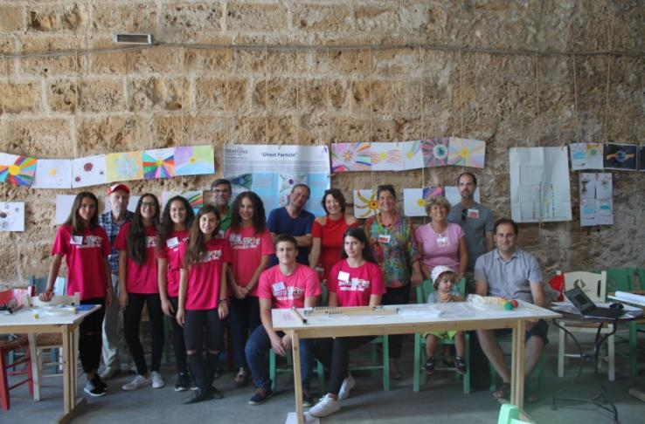
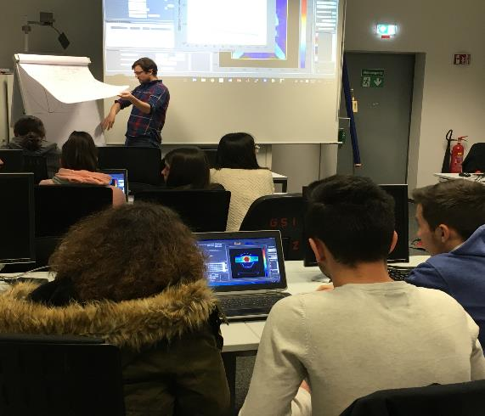
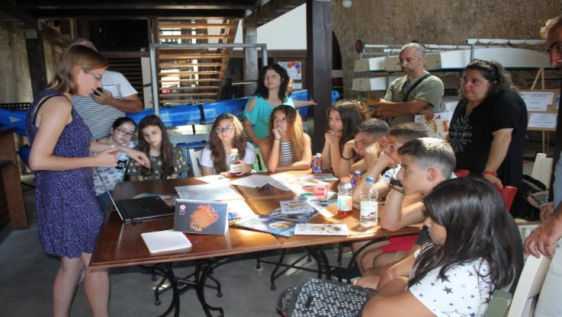
Experiences with CURIEocity team from Crete
… to CERN
From Crete
… to GSI
Yiota Foka
8

Slide 25

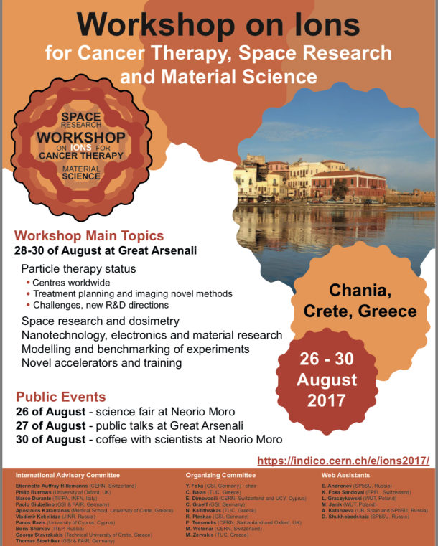
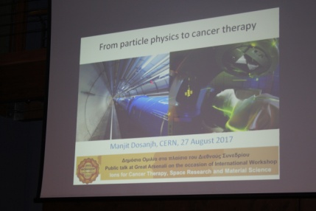

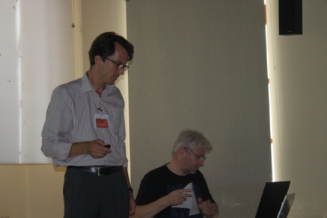
Ions for cancer therapy
Acknowledgements
BIOMAT and BIOPHYSICS
Focus on medical applications
Ideas and technologies for a next-generation facility
for medical research and therapy with ions
Yiota Foka
Archamps, 19 June 2018
6
Workshop and public events in Chania in 2017
Theme: benefits for society from fundamental research

Slide 26
