Slide 1
perfSONAR MDM updates:
New interface, new possibilities
Domenico Vicinanza
perfSONAR MDM Product Manager
domenico.vicinanza@dante.net

Slide 2
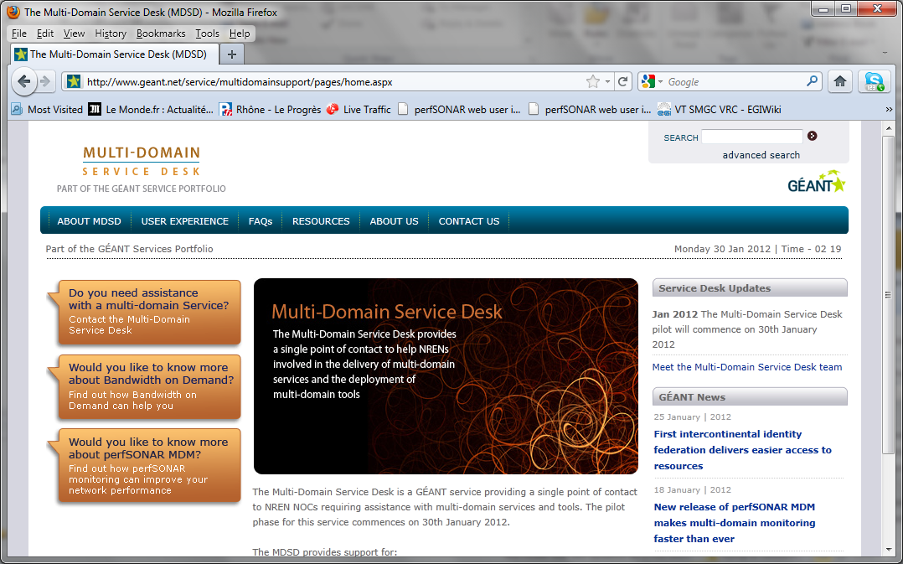
GÉANT Multi-Domain Service Desk http://mdsd.geant.net
perfSONAR MDM now officially supported by the GÉANT MDSD
MDSD is operational from 08:00 to 17:00 UK time, Monday to Friday.
Reachable by email mdsd@geant.net or telephone +44 1480 484697
http://mdsd.geant.net

Slide 3
Simplicity for concrete benefits:
Simplicity:
  Just four components to measure:
    Link utilisation, Input errors, Output drops
    OWD, Jitter, Packet Loss, Traceroute
    Bandwidth (on-demand and scheduled)
  No hardware-dependent software
  No need for GPS antenna
  New release, entirely package based, running on any standard RHEL, 32 or 64 bits server
  Debian to follow before March 2012

Slide 4
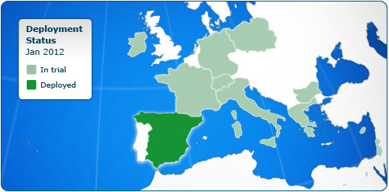
More NRENs are joining the pilot:
13 NRENs (Jan 2012)
4 NRENs will join next months – Other 10 targeted in the next months

Slide 5
Deployment (Tier1s)
Current Situation:
  The service is still offered as a managed service, just keep the machines switched on
In the future (terms still to be defined, input welcome):
  the model will change from managed to supported:
  The service desk will help updating and configuring the deployment
  The site will be able to intervene on the deployment, choosing what to measure, where to place the servers
  If required the Service Desk will take care of the complete deployment and configuration before handing the installation to the site perfectly working
  All the deployment will be package based (so the updates can be easily automated)

Slide 6
Deployment (Tier1s)
NDGF has been the first one to redeploy perfSONAR according to the new model
Some sites expressed a preference of running MDM
9 Tier1s have agreed to keep MDM servers up and running for the time being.

Slide 7
Deployment (NRENs and Tier2s)
A growing community of NRENs is joining perfSONAR MDM service
A growing community of Tier2s are deploying perfSONAR MDM
Some of them are already listed in the new interface
  Others will come soon (Turkey, Taiwan, Denmark, France, …)
Tests have been enabled from Tier1s to Tier2 and between Tier2s
(see next slides)

Slide 8
Deployment (Tier2 and NRENs)
As a consequence:
Possible integration of NREN and Tier2 monitoring infrastructures
Aggregation of network measurements across the T2-T2 path
(demo next LHCOPN meeting)

Slide 9
perfSONAR MDM as a natural choice for GÉANT Service Area
perfSONAR MDM is a natural choice for EU Tier2 part of the GÉANT( and Orient+) Service Area:
NREN
(MDM)
GÉANT
(MDM)
NREN
(MDM)
Tier2
Tier2
Orient+
(MDM)
Tier2

Slide 10
New web interface
perfSONAR MDM will have a new web interface
Experimental version available here (password protected): http://orval.grid.aau.dk:8080/perfsonar-ui-lhcopn/
A professional usability expert is working with the developer to make sure it satisfies commercial-grade usability requirements
It will be then presented to the NREN and LHCONE communities

Slide 11
Screenshots from the LHCOPN/LHCONE web interface

Slide 12
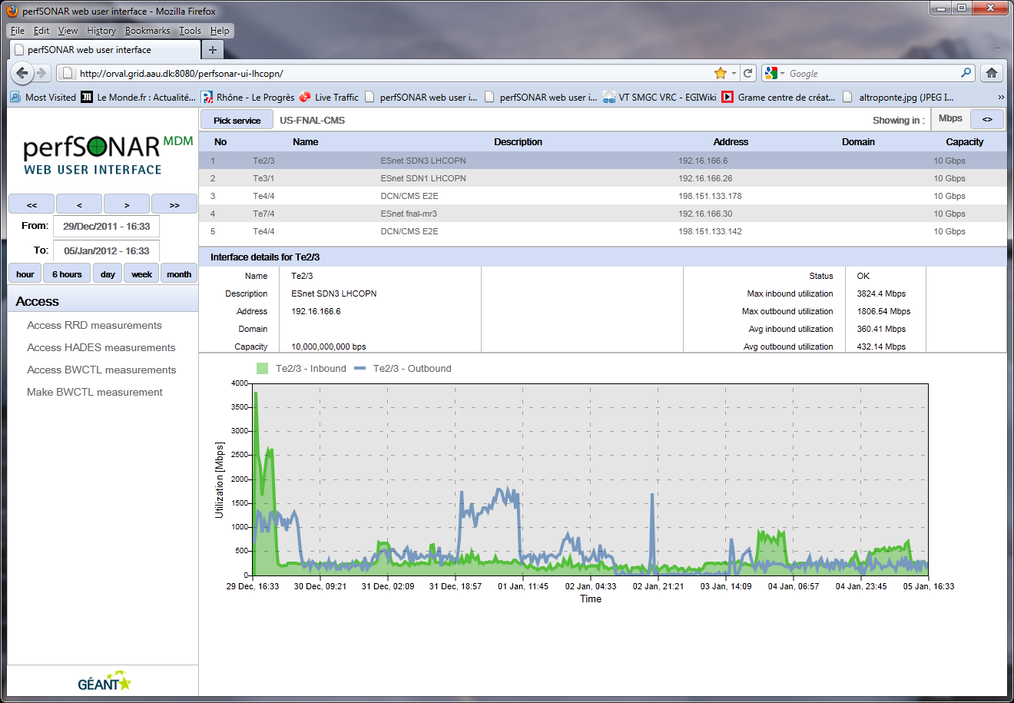
Link utilisation, input errors, output drops (RRD-MA)

Slide 13
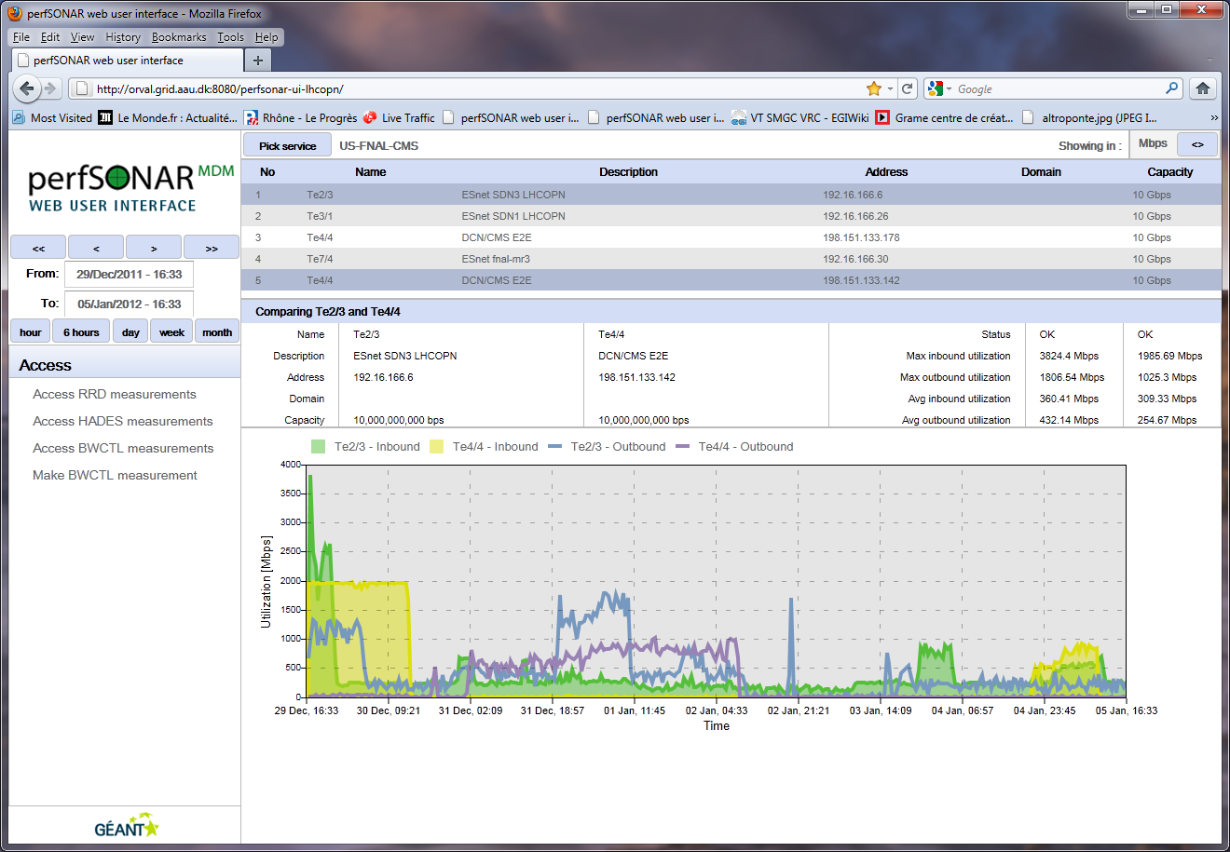
RRD-MA
Comparing two interfaces

Slide 14
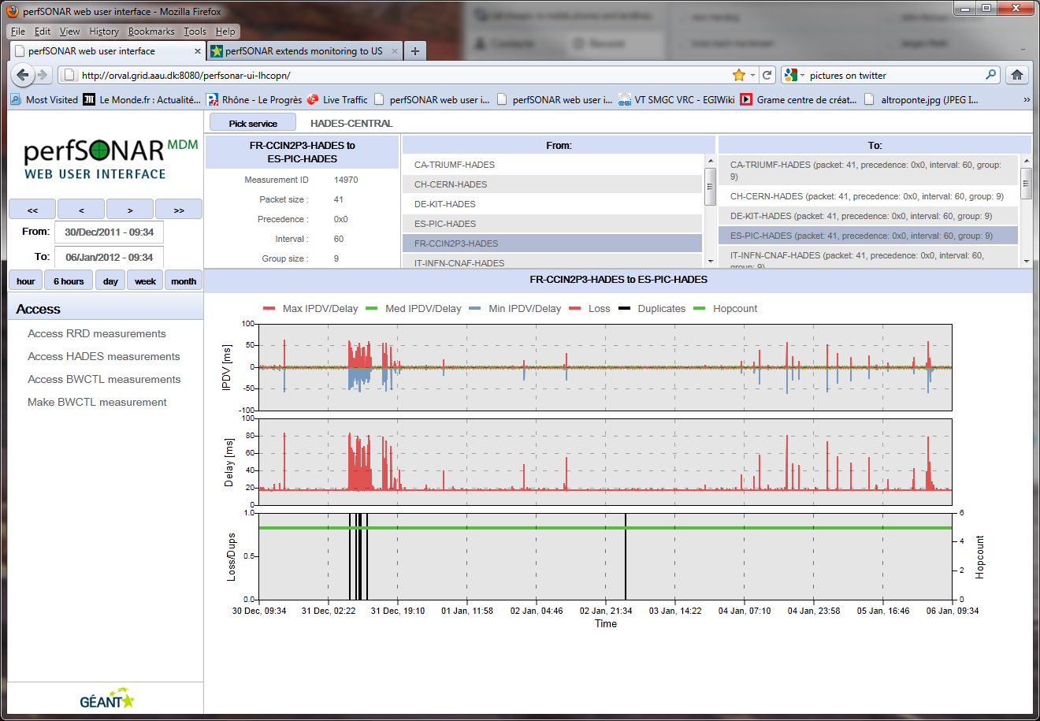
1Way Delay, Jitter, Packet Loss and Traceroute

Slide 15
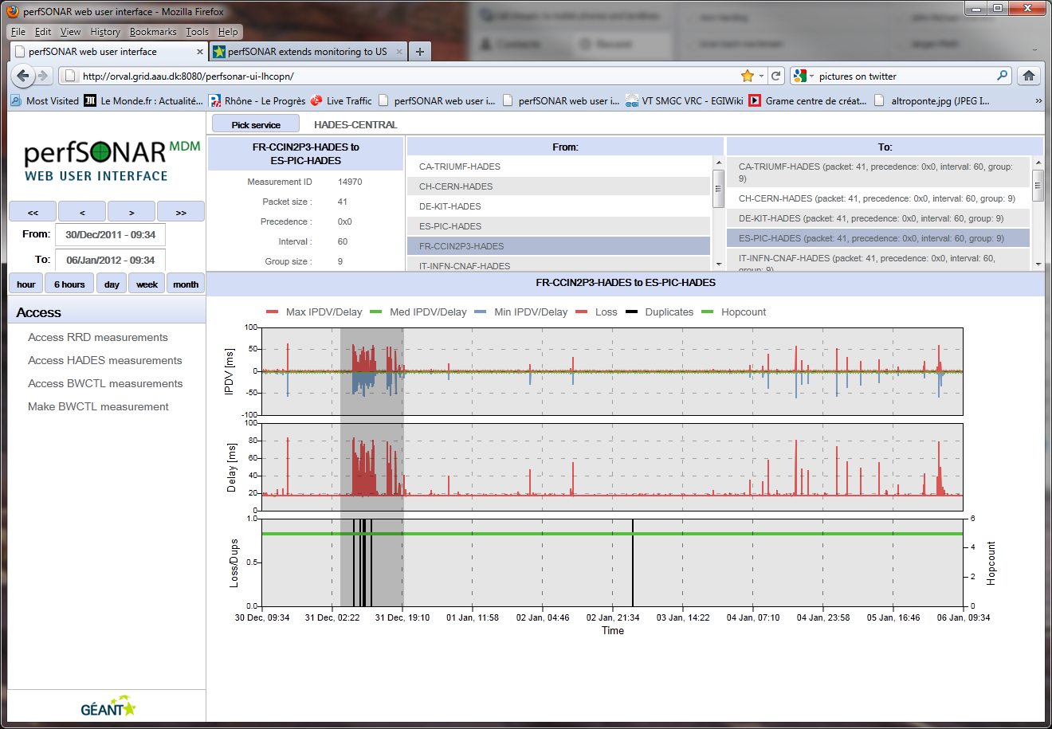
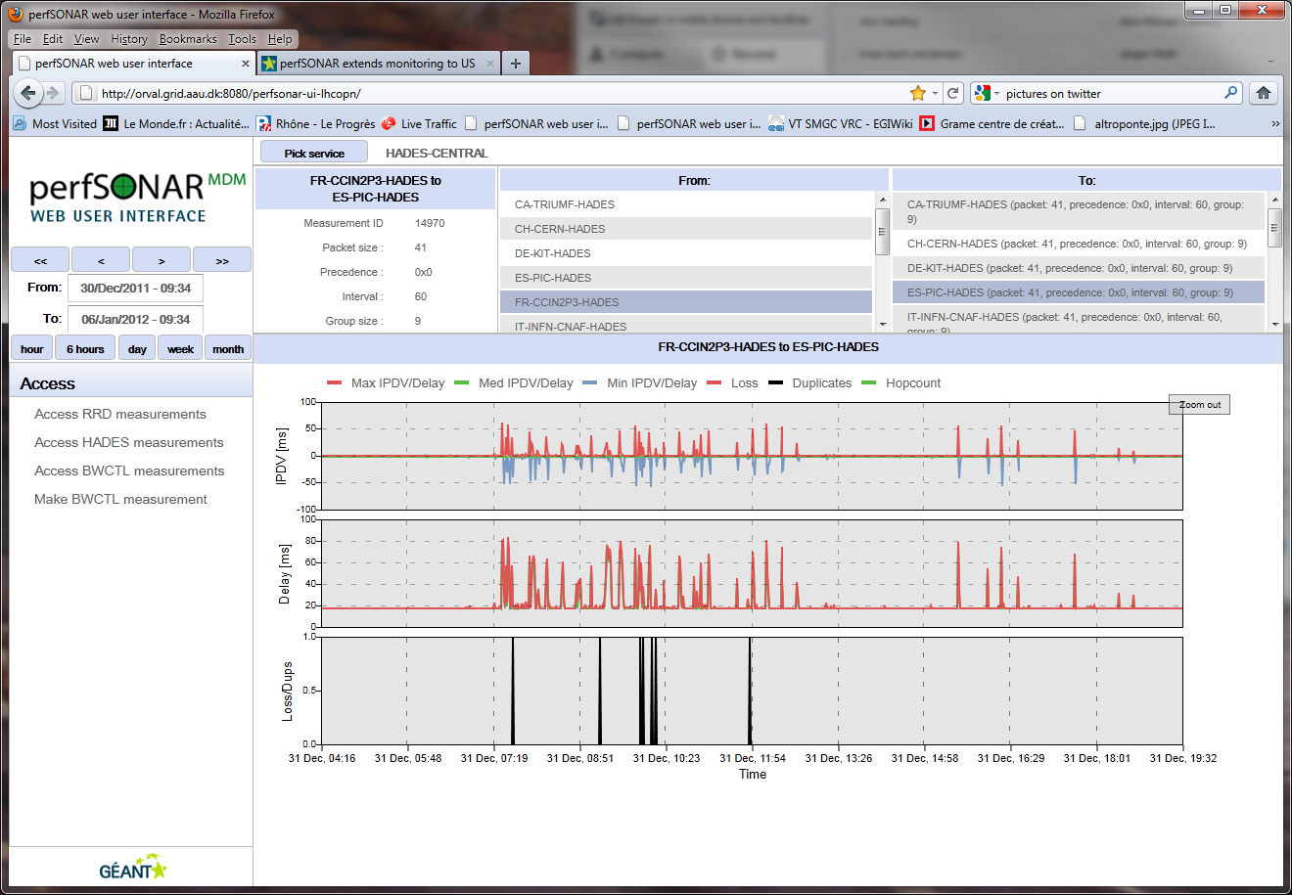
As usual you can select and magnify

Slide 16
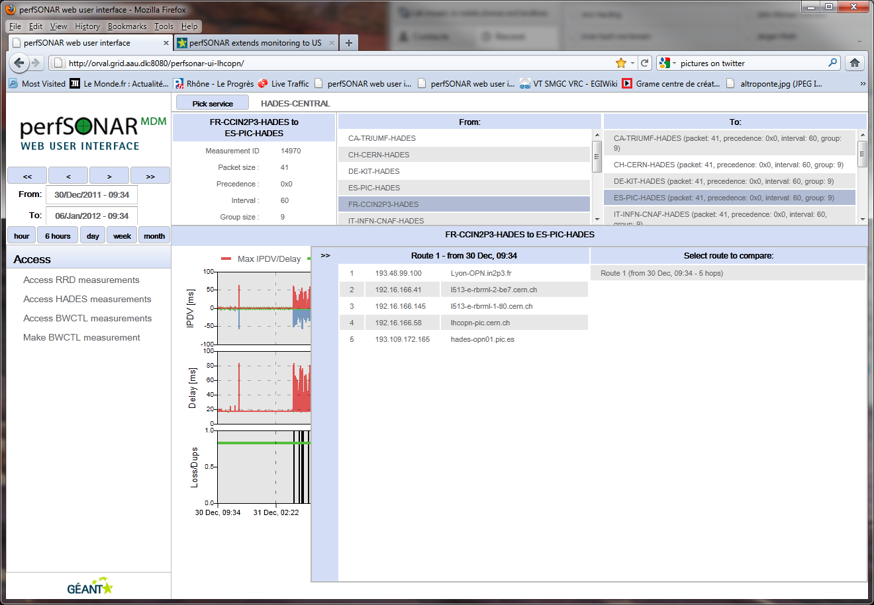
1Way Delay, Jitter, Packet Loss and Traceroute
Clicking on the hop counts graph you can get the traceroutes and compare them
Traceroute

Slide 17
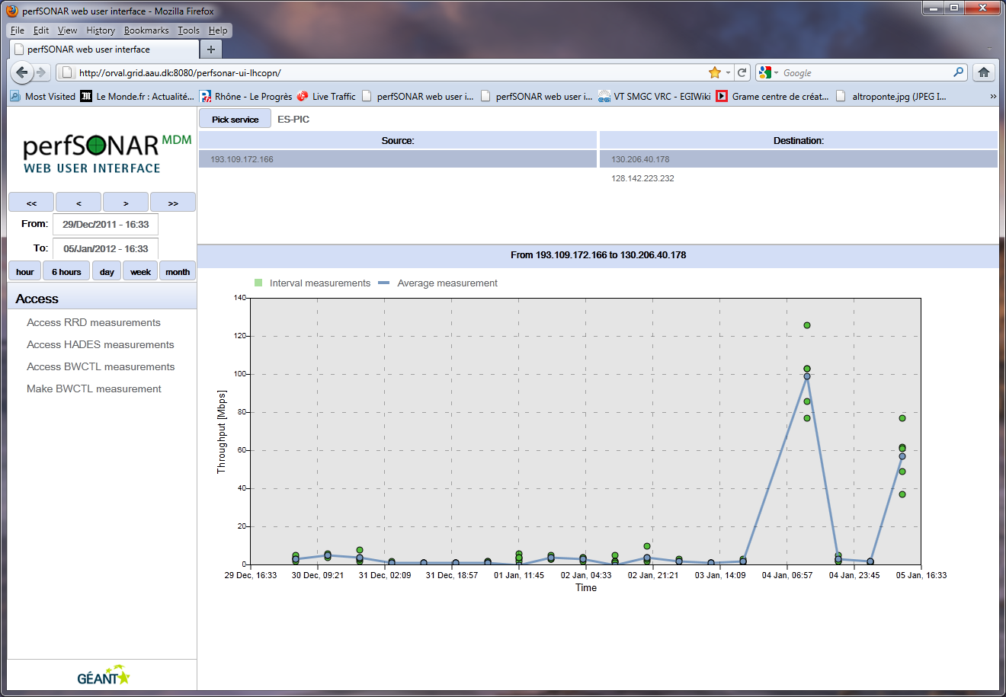
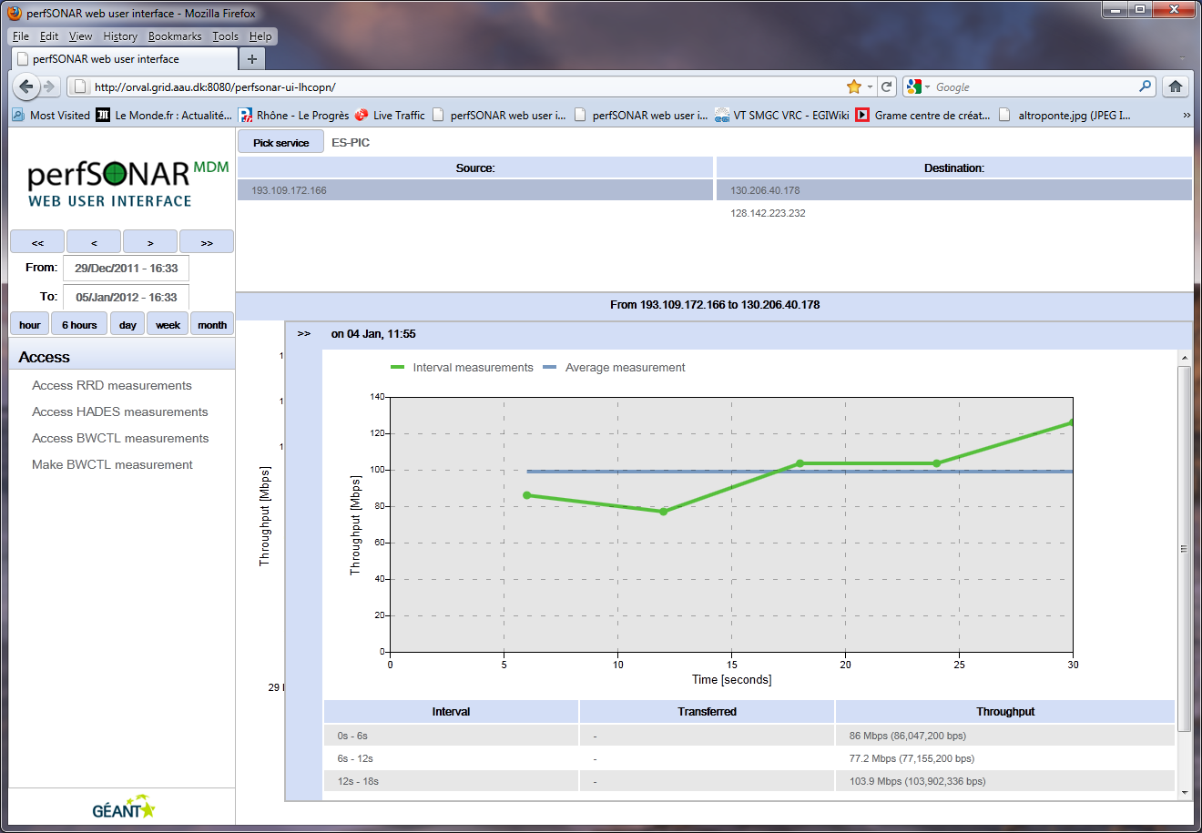
Accessing BWCTL Historic Measurements
Each dot is a measurement run.
Clicking on the dot a window displays the details

Slide 18
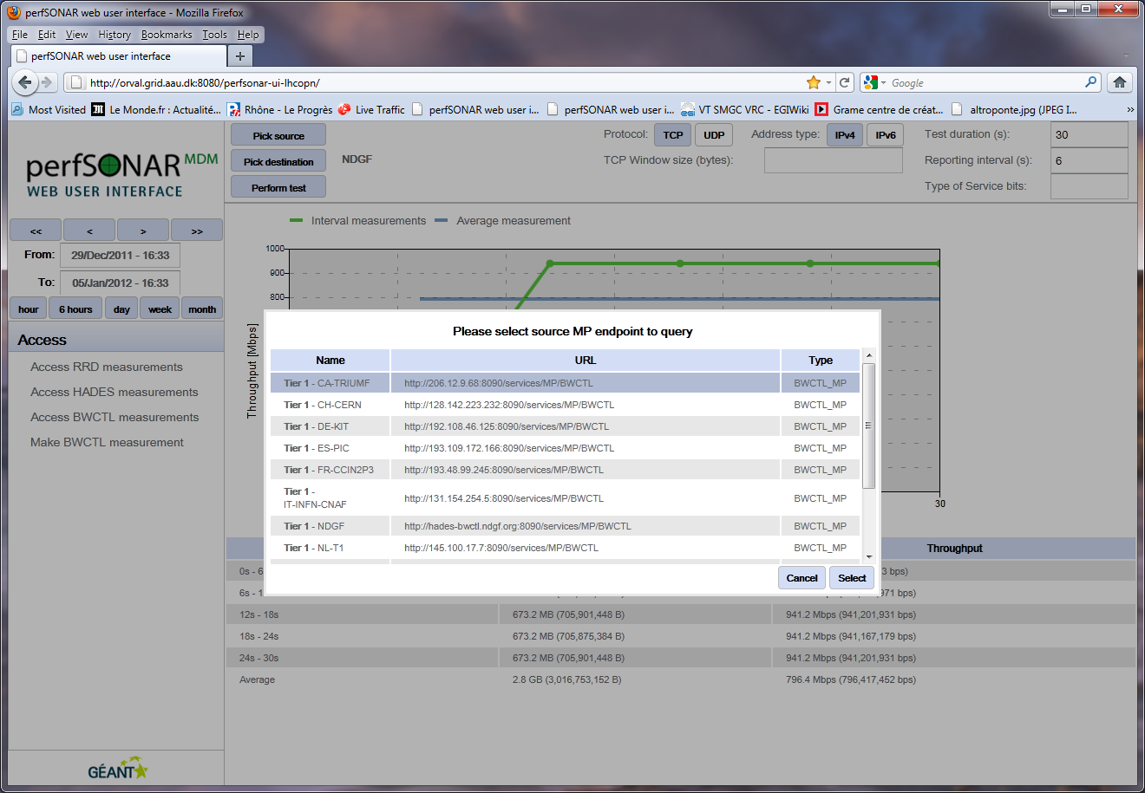
Making an on-demand BWCTL measurement…

Slide 19
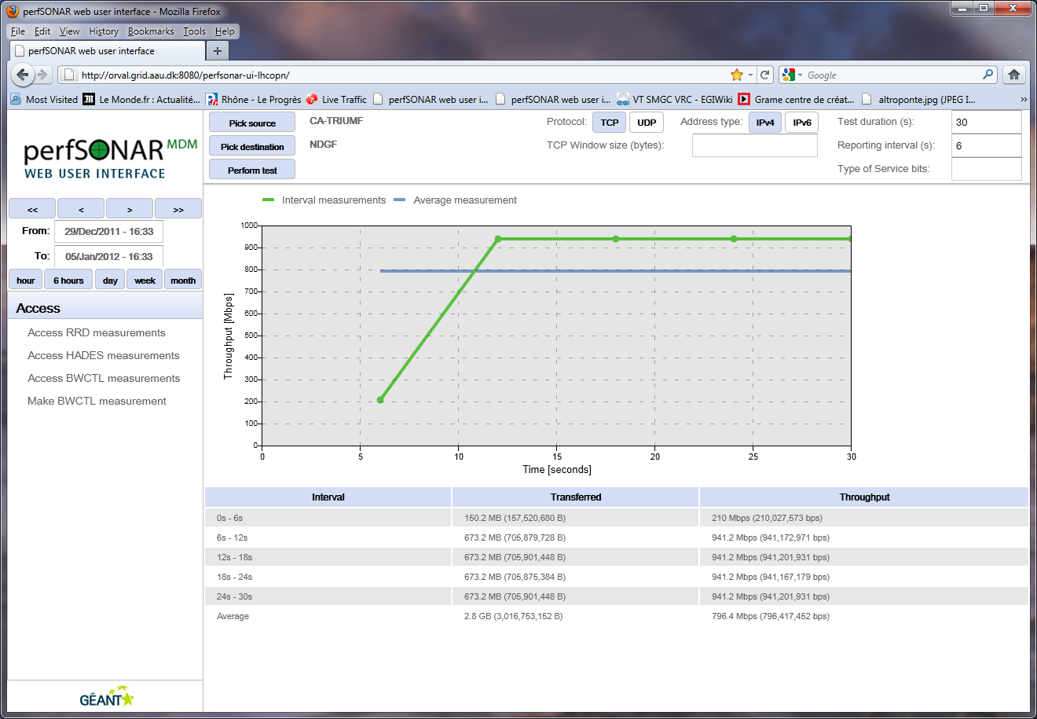
…and getting the results in two clicks from the web interface

Slide 20
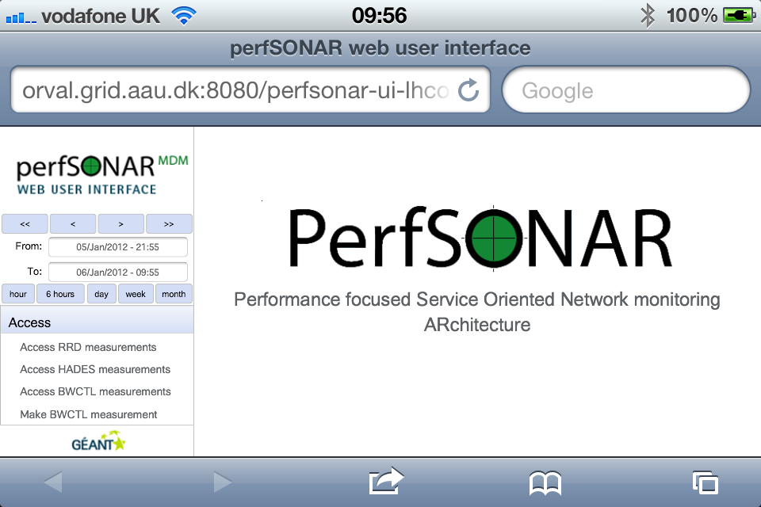
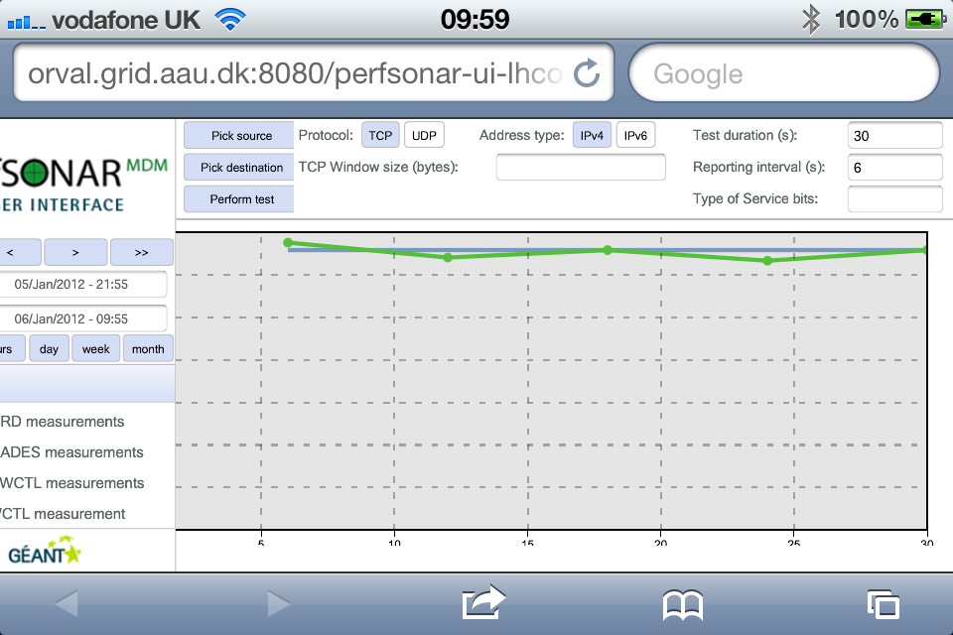
Interface accessible from mobile devices (with on-demand capabilities)
The interface on a smartphone (Apple iPhone)

Slide 21
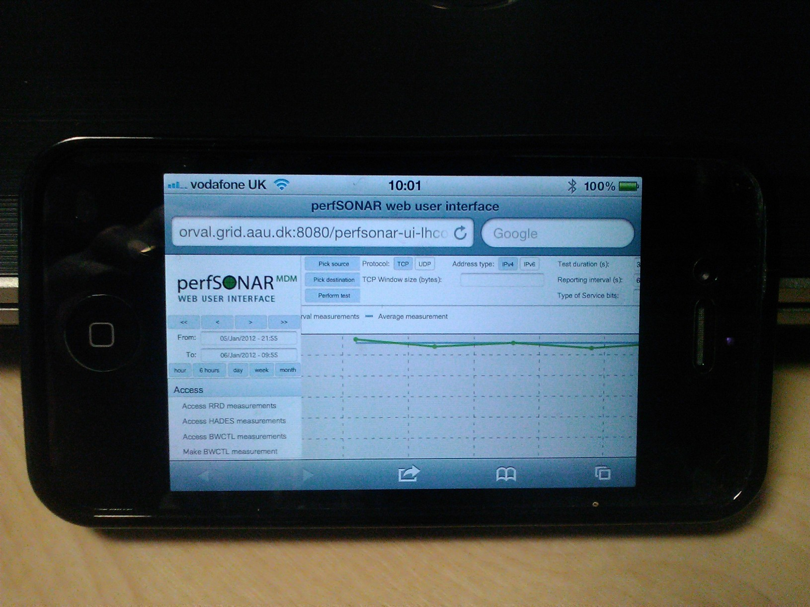
Troubleshooting on the move
The result of an
on-demand
Bandwidth test
run from an iPhone

Slide 22
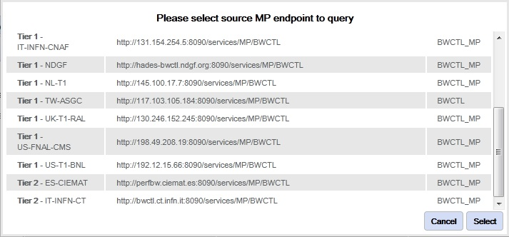
T1-T1, T1-T2 and T2-T2 monitoring from the same interface
Tier 1s
Tier 2s

Slide 23
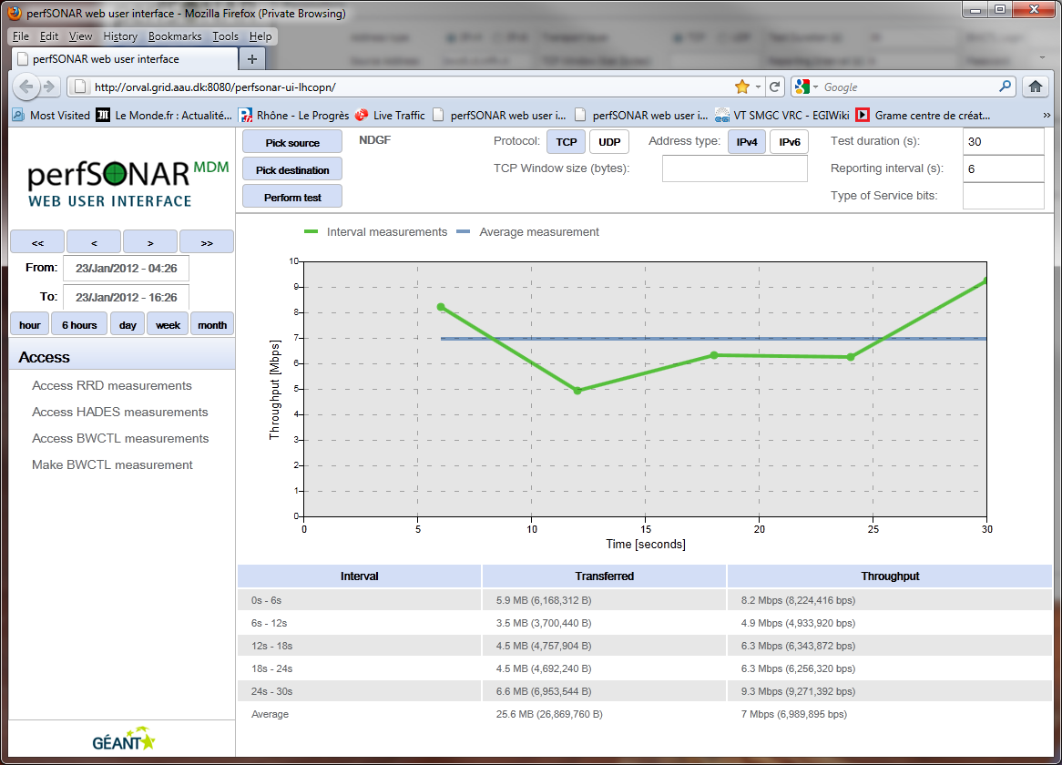
T1-T2 Measurements

Slide 24
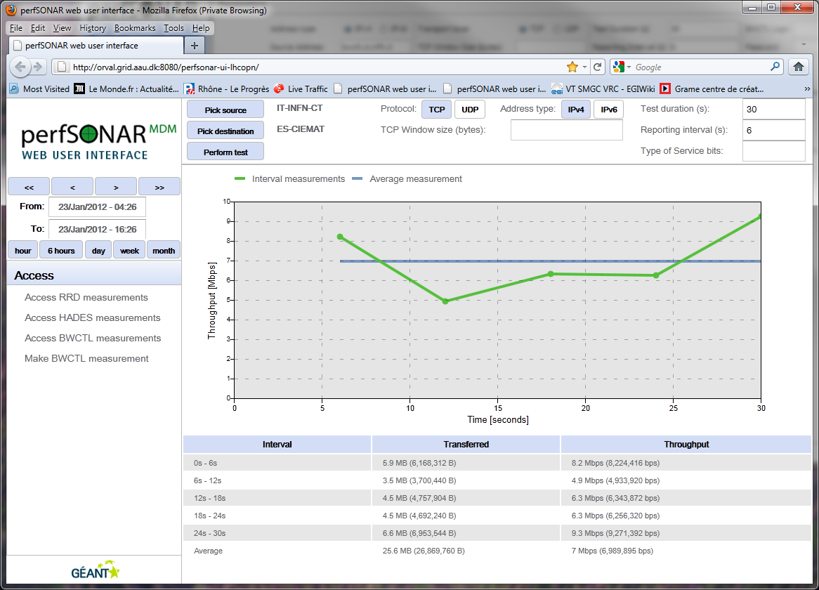
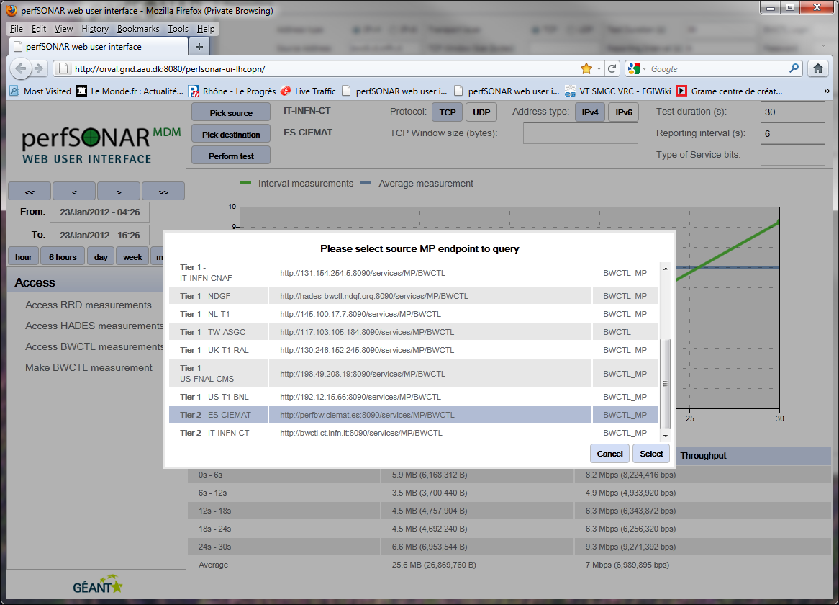
T2-T2 Measurements

Slide 25
New developments:
Integration of the new weather map

Slide 26
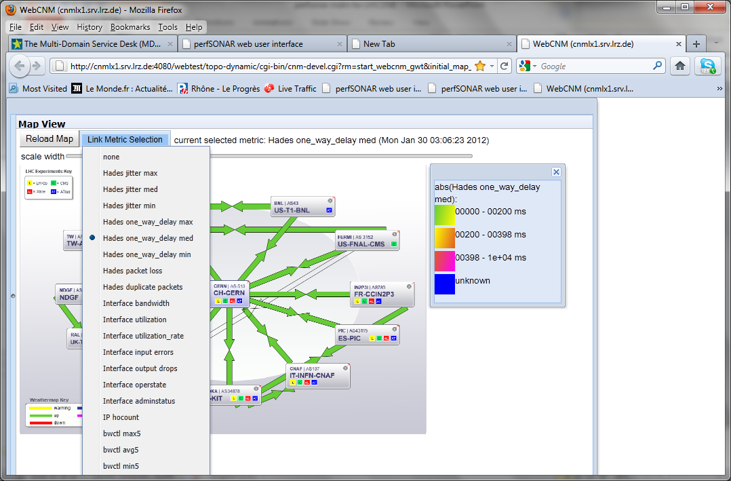
New weather map integration
19 perfSONAR parameters available

Slide 27
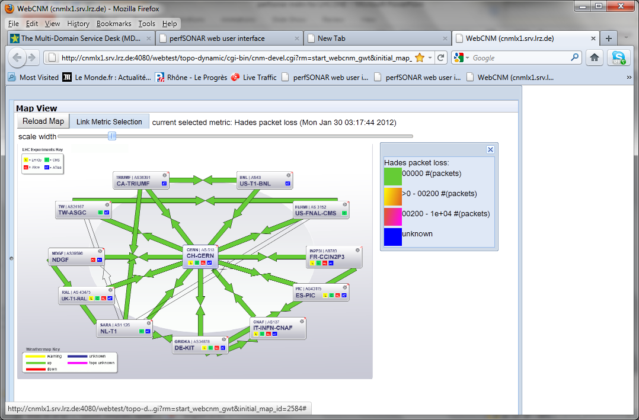
Weather map examples
(Packet loss)

Slide 28
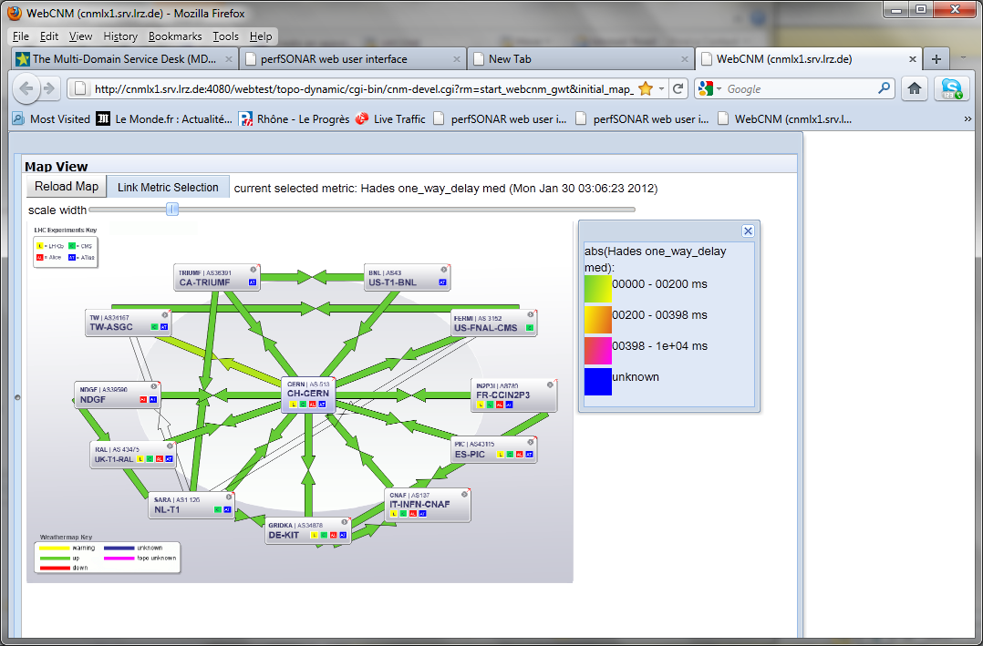
Weather map examples
(One-way delay)

Slide 29
Summarising:
4 good reasons to have perfSONAR MDM

Slide 30
Four good reasons to deploy perfSONAR MDM
Supported. perfSONAR MDM is supported by the Multi-Domain Service Desk (telephone and email) and deployment is assisted by a dedicated GEANT team.
  Support covers deployment, configuration and incident management.
  Support is coming from the same time zone
Accessible. Integrated web-based user interface
  shows from one single website all the metrics
  enabling engineers to run crucial performance tests from their mobile devices (i.e. smartphones)

Slide 31
Simple yet powerful.
  Simplified structure
  Simplified installation procedure
  No hardware dependencies.
  Training events for deployers.
Open and flexible.
  Active panel of real users
  Interoperability
  Growing community of NRENs and research projects in Europe, Latin America and Asia.

Slide 32
Questions?

Slide 33
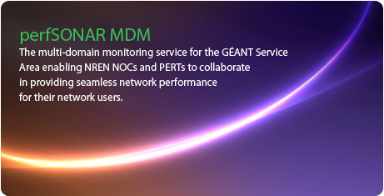

perfSONAR MDM in a nutshell
perfSONAR MDM (Multi-Domain-Monitoring) is the multi-domain monitoring service for the GÉANT Service Area (GSA)
Part of the GEANT portfolio
  officially supported, strong user focus
Based on the perfSONAR protocol
  Interoperable with hundreds of deployments around the world
(from the perfsonar.geant.net website)
(from the perfsonar.geant.net website)

Slide 34
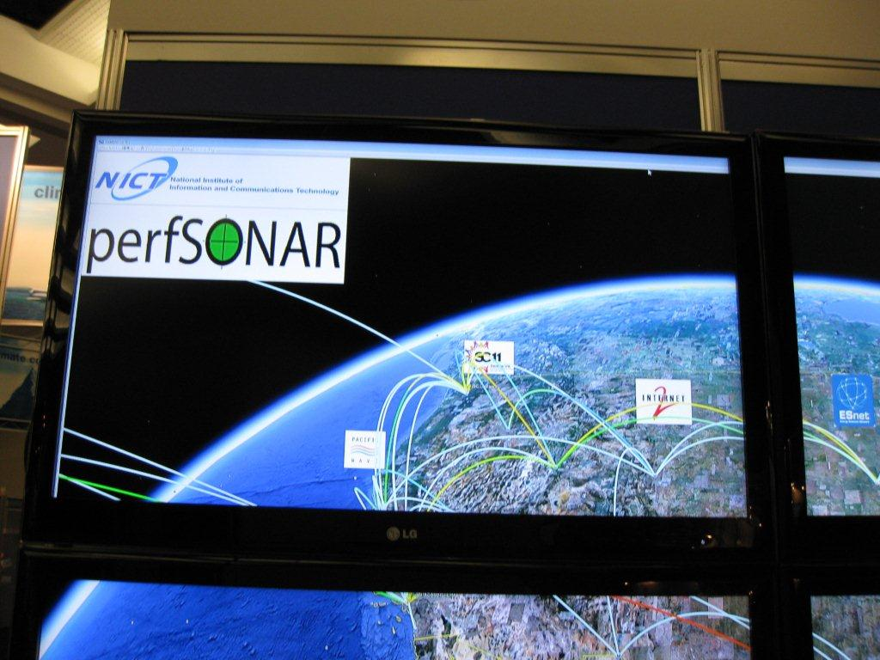
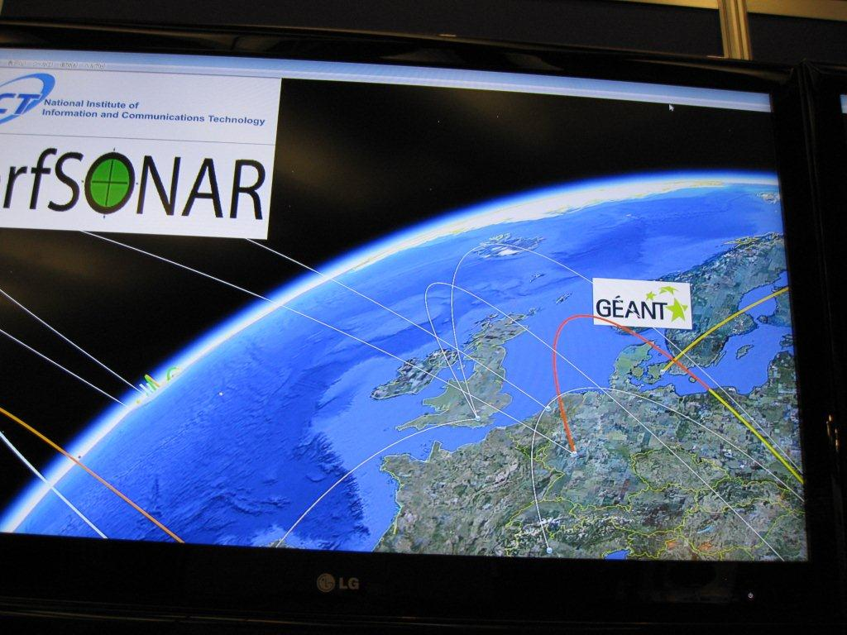
Used worldwide to display network performances
Growing community
  Liaising with user projects across the globe
Easy to integrate into other visualisation tools
Increasing number of organisations/events using perfSONAR to display network topology, utilisation, performances
(from the NICT booth at Supercomputing 2011, Seattle – Collaboration between GEANT and NICT)

Slide 35
A real answer to real use cases
Built around real use cases:
  Network performances and monitoring
  Circuit monitoring (both statically and dynamically provisioned)
  SLA verification
  Federated deployment facilitated by a dedicated deployment team
  Each NREN provides at least one MP (and possibly a MA)
  In turn it get access to GEANT and other participant NRENs MPs and MAs
Supported
  Through GEANT Multi-Domain Service Desk, started on 30 January
    Covering any installation, deployment problem

