Slide 1
Current Status: VRF solution for LHCONE
LHCONE
January 30, 2012
Eric Boyd, Internet2

Slide 2
LHCONE Goals
Ease of Connection
  Provide a collection of access locations that are effectively entry points into a network that is private to the LHC T1/2/3 sites.
  As soon as a T1/2/3 site is connected to LHCONE, it ought to be able to easily exchange data with any other T1/2/3 site over an infrastructure that is sized to accommodate that traffic.
  LHCONE must accommodate both IP connections and several variations of circuit-based connections.
  T1/2/3 sites may connect directly or via their network provider (e.g. National Research and Education Network (NREN), US Regional Optical Network (RON), ESnet, etc.).
Exploitation of Infrastructure
  Build on the familiar idea of exchange points
  Provide a mechanism to better utilize available transoceanic capacity.
Ease of Operation
  Provide an infrastructure with appropriate operations and monitoring systems to provide the high reliability (in the sense of low error rates) that is essential for the high bandwidth, high volume data transfers of the LHC community
  Provide a test and monitor infrastructure that can assist in ensuring that the paths from the T1/2/3 sites to LHCONE are also debugged and maintained in the low error rate state needed for LHC traffic

Slide 3
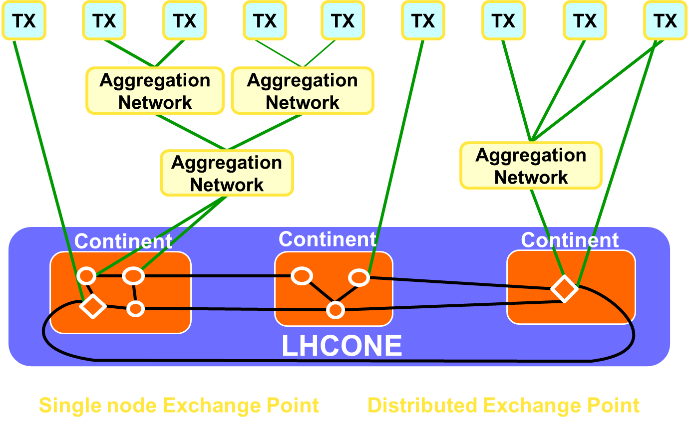
LHCONE High-level Architecture

Slide 4
LHCONE Design Considerations
LHCONE complements the LHCOPN by addressing a different set of data flows.
LHCONE enables high-volume data transport between T1s, T2s, and T3s.
LHCONE separates LHC-related large flows from the general purpose routed infrastructures of R&E networks.
LHCONE incorporates all viable national, regional and intercontinental ways of interconnecting Tier1s, Tier2s, and Tier 3s.
LHCONE uses an open and resilient architecture that works on a global scale.
LHCONE provides a secure environment for T1-T2, T2-T2, and T2-T3 data transport.
LHCONE provides connectivity directly to T1s, T2s, and T3s, and to various aggregation networks, such as the European NRENs, GÉANT, and North American RONs, Internet2, ESnet, CANARIE, etc., that may provide the direct connections to the T1s, T2s, and T3s.
LHCONE is designed for agility and expandability.
LHCONE allows for coordinating and optimizing transoceanic data flows, ensuring the optimal use of transoceanic links using multiple providers by the LHC community.

Slide 5
LHCONE Services
Multipoint Service (TODAY)
Point-to-Point Service (TOMORROW)
  With bandwidth guarantees
  Without bandwidth guarantees
Diagnostic Service (TOMORROW)

Slide 11
Current Status
The VRFs for Internet2, GEANT and ESnet are in place.
  Internet2’s VRF extends over its entire core.
  GEANT’s VRF extends over its entire core.
  ESnet’s VRF is partially implemented.
The VLANs to establish peerings across MAN LAN have been established and sent out.
  2002 Internet2-GEANT
  2003 Internet2-ESnet
  2004 GEANT-ESnet
Others can be set up as needed.
  The next diagrams show the current status and adding USLHCnet.

Slide 12
VRF Solution: Current Status

Slide 13
If USLHCnet adds a VRF …

Slide 14
Current Status
VLANs have not yet been assigned across WIX.
  That will happen immediately after this discussion.
As of Friday the 27th:
  Peering mesh between GEANT, ESnet and Internet2 have all been set up.
  There are probably not a lot of routes yet.
    Those will grow as sites start to participate in the VRF’s

Slide 15
Current Status - Policy
We need to discuss what sort of policies will be applied:
  There are BGP policies for traffic balancing.
  There are 4 Trans-Atlantic paths
    ACE/GEANT in NY and DC
    USLHCnet
    European circuit in Chicago
  These are not all equal bandwidth.
    There will need to be some traffic engineering between those paths.

Slide 16
Current Status - Issue
Would like the traffic passing through an exchange point to take the most direct path at the same time we minimize the number of peers with the VRFs.
Looking at this diagram again, we see that the data path is not optimal.

Slide 17
Sub-optimal Data Plane

Slide 18
Solution
To address this problem we are proposing separating the control plane (BGP) path from the data plane path.
By setting up a shared VLAN within the exchange point, 3rd party next hop routing is enabled.
  This will allow a VRF to better manage the traffic of direct connectors to an exchange point.
It will also require an address block for each exchange that can be used for the LHCONE participants.
  Can this be provided by CERN?

Slide 19
3rd Party Next Hop Routing

Slide 20
Adding USLHCnet

Slide 21
Next Step
The shared VLAN in MAN LAN and WIX could be set up at any time.
Seeking consensus from the LHCONE community prior to setting this up.

Slide 22
Discussion
What did we get right?
What did we get wrong?
What else needs to be included?

