Slide 1
BASIC SKETCH OF ACTIVITIES FOR THE CERN LHCB-RICH TEAM (2012 – 2017)
Team composition
Present activities and consolidation plans
RICH – CERN R&D and Upgrade activities
TORCH – EU Grant CERN activities
Conclusions

Slide 2
The CERN "RICH team“
sees its future activity split in three basic fields:
M&O and Consolidation of present detector;
R&D phase for the LHCb Upgrade;
Construction phase of LHCb.
As we all come from different groups - DT (2), ESE (1), LBD (1), LBO (2) - WPs will have to be produced with the adequate detail level and agreement of all parties.
Therefore, the scope of this is essentially to set the general picture and start the process of resources allocation.

Slide 3
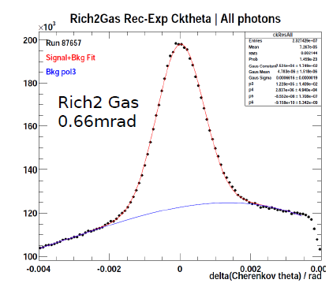
RICHes, present, consolidation and upgrade:
A word from the past
The CERN RICH team took full responsibility for the development, design, supervision, co-ordination, integration and installation of the present RICH 2 detector.
CERN played also a leading role in the development, test and construction of the current RICH photon detectors (HPDs).
At that time, however, it was clear that we would not have made it without some external collaborators, ex., Vessel design and construction and photo-detector boxes with their inner parts. All this has consequences on the CERN involvement in the present maintenance and consolidation activities.
This worked very well and RICH 2 is a stunning success!
MC expectation = 0.66 mrad !!

Slide 4
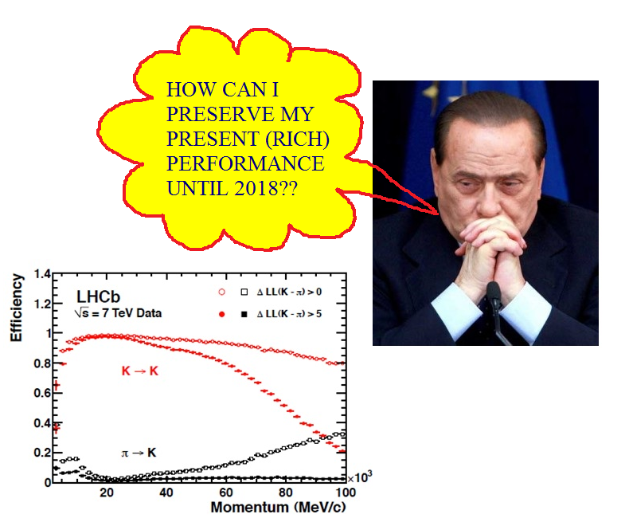
Present and consolidation
Preserving the present RICH performance until 2018
The CERN team is involved in major M&O and management activities.
Together with these, a major effort for consolidation is foreseen during the long shutdown; this is being studied in detail and a plan will be issued in the first half of 2012.
Some of these activities cover:
Project management;
HPDs program;
HV supply system and cabling;
Gas system and cooling;
RICH2 (and partially RICH1) opto-mechanics;
RICH2 vessel refurbishment of monitoring and calibration benches.

Slide 5
R&D and LHCB Upgrade I
The team believes that CERN should retain a leading role in the RICHes upgrade. Therefore and in spite of its shrinking size, it will keep part of the present main responsibilities for the R&D, construction and M&O of the upgraded LHCb. In particular:
Full responsibility for RICH2 opto-mechanics.
Specifically, supervision, co-ordination, general design and planning of the upgraded version for
whatever is inside vessel and photo-detector boxes, including mirror walls, photo-detector cages and columns and RICH2 (on-detector) cooling and gas systems;
in case RICH1 would be “rotated”, this could be extended to the RICH1 cages in close collaboration with the RICH1 responsible.
  1 appl. Fellow + 2 tech and 1 doct students (5 years programme)

Slide 6
R&D and LHCB Upgrade II
it would keep the supervision and the co-ordination of the R&D and construction of the electronics and electrical systems present in the boxes (to the GBT or so), only if PH/ESE would provide us with a "Ken-equivalent";
It would pursue the proof-of-principle for an HPD with external readout as backup to MAPMT, proviso electronics support in this direction;
  1 doct student (2 - 3 years programme)
if needed, it would design, test and modify accordingly the RICH2 optical system (trying to keep as much as possible of the present hardware).

Slide 7

R&D and LHCB Upgrade III
In conclusion, we think that in total, 1 appl. fellow, 2 doct. and 2 tech. students for the coming 5 years would be a minimum request to flank the present staff.
It makes 8 to 11 total men-year.
Total manpower rough cost: 600 kCHF to 800 kCHF for 5 years.
CERN contribution in the LHCb RICH present project is 13% of the total material funds.

Slide 8
TORCH R&D I:
Successful application made to the EU for an ERC Advanced Grant,
collaboration of CERN with Oxford and Bristol universities.
The project (and the grant) asks for the definition and construction of a working prototype, which should prove the principle, in collaboration with EU industry.
Funding over next 4 years includes a Doctoral/Technical student + an Applied Fellow
The CERN team is involved in the photo-detector and simulation studies and the opto-mechanical system.
Apart our personal (reduced) involvement, funds will come from the grant to cover for materials and “external” manpower. Any synergy towards the RICH upgrade activities will be stimulated.

Slide 9
TORCH R&D II:
We have requested from the EU-grant:
a technical/doctoral student specific for the photo-detector;
an applied fellow, for the overall R&D, tests and integration (quartz, quartz assembly and gluing, quartz support and general mechanical tooling, quartz lens and optical couplings).

Slide 10

We will come back for the LHCb RICH Construction phase in a couple of years.

Slide 11
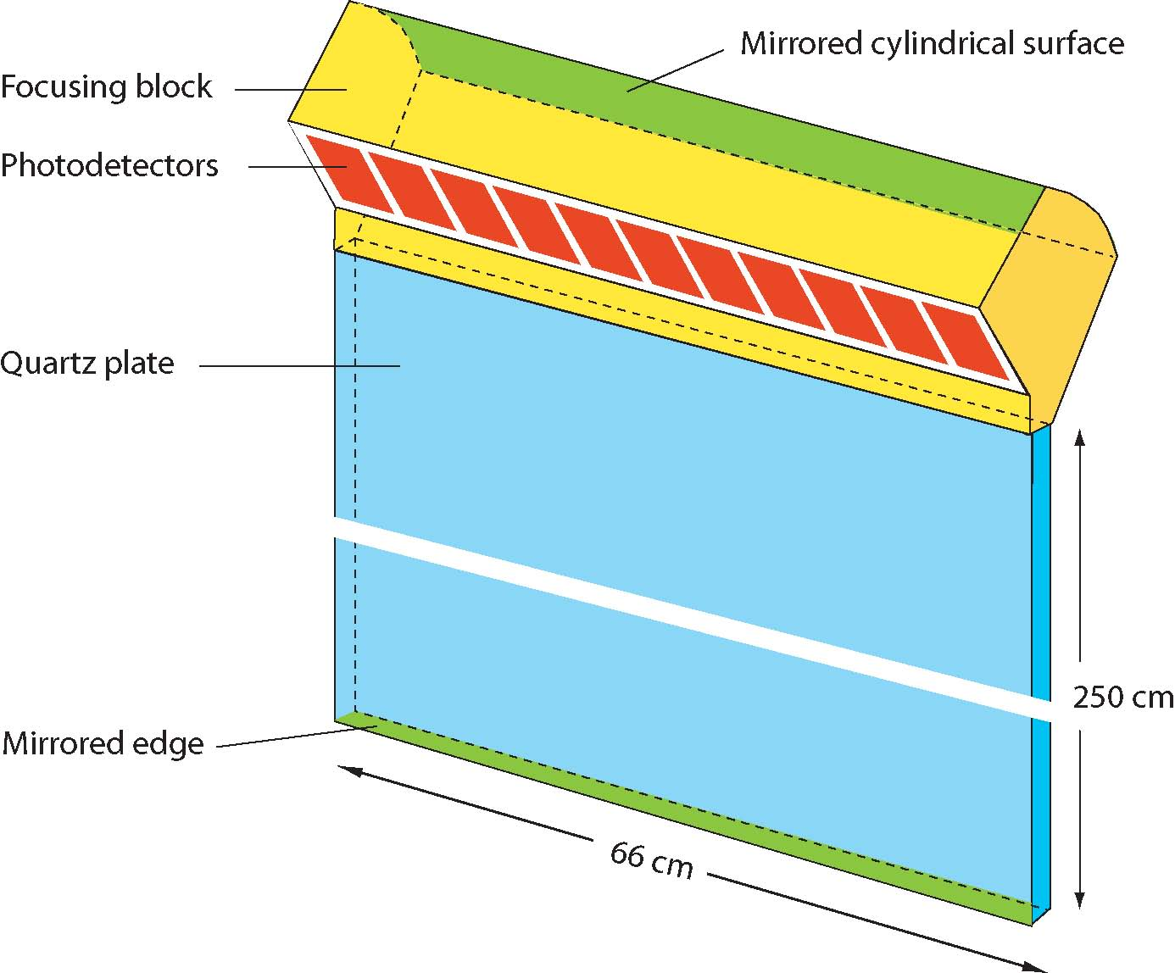
TORCH status
TORCH (Time Of internally Reflected
CHerenkov light) is a proposed
time-of-flight detector to replace the
aerogel in the LHCb upgrade
for low-momentum ID (p < 10 GeV)
Aims for 15 ps resolution per track
→ ~ 50 ps resolution/detected photon
Successful application made to the EU for an ERC Advanced Grant
collaboration of CERN with Oxford and Bristol universities
→ funding for the proof-of-principle R&D over next 4 years
including a Doctoral/Technical student + an Applied Fellow
CERN responsibility for the mechanics/optics (quartz radiator and focusing element) + participate in simulation & photon detector studies

Slide 12
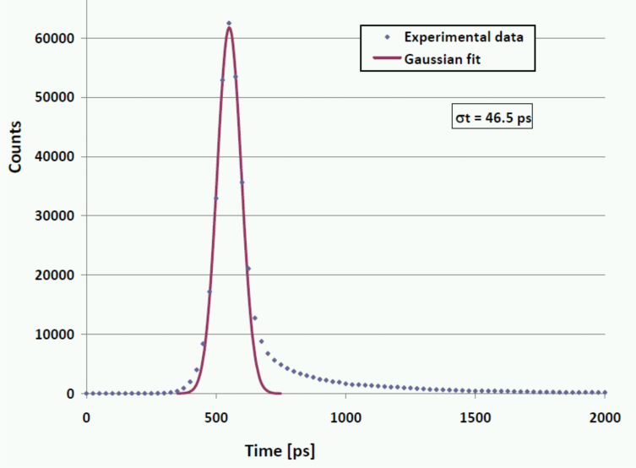
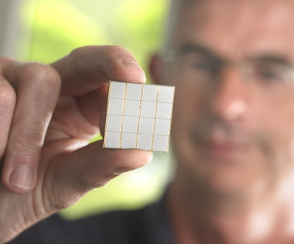
TORCH photon detectors
Baseline photon detector is
Micro-Channel Plate PM
Lab tests made of the Planacon (Burle/Phototonis) achieving <50 ps resolution for single photons
Issues to be addressed in R&D: increasing the granularity and lifetime
Interesting new development:
Digital Silicon PM (Philips)
Intrinsic granularity is excellent
(the APD cells are 60 μm in size)
Need to establish radiation tolerance
and improve readout dead-time
Possible synergy with other projects?
(eg scintillating fibres or axial-PET)

