Slide 1
SciFi Working Group
Carmelo D’Ambrosio, Gerard Decreuse, Rolf Lindner, Niko Neufeld, Eric Thomas

Slide 2
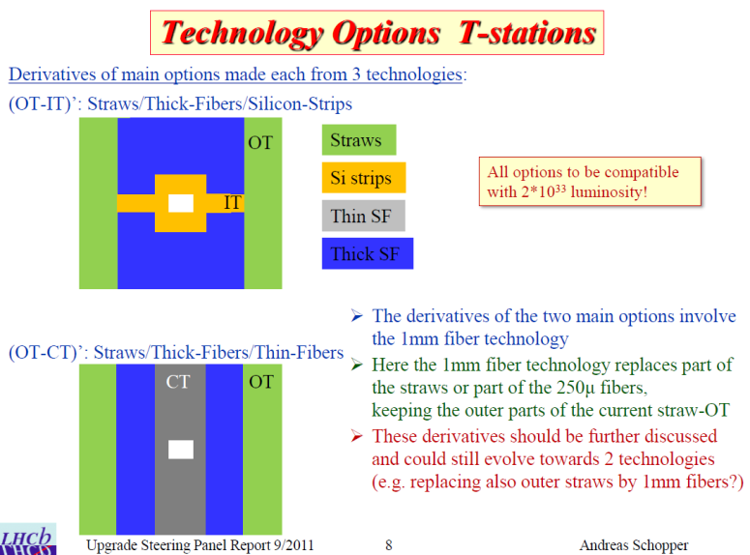
R&D Working group @ CERN
ITEP Victor Egorychev, Pavel Shatalov, Tengiz Kvaratskheliya
IHEP Iouri Guz
INR Evgeny Gushchin
Imperial College Andrey Golutvin, Trevor Savidge, Mitesh Patel
CERN Carmelo D’Ambrosio, Gerard Decreuse, Rolf Lindner, Niko Neufeld, Eric Thomas
Activities:
Module design R&D
Integration, global design, external constraints
and services
Radiation hardness of SiPM and Fibres
Construction of prototype module
development of tooling for prototyping / mass production
Construction of test setups (also for quality assurance in mass production)

Slide 3
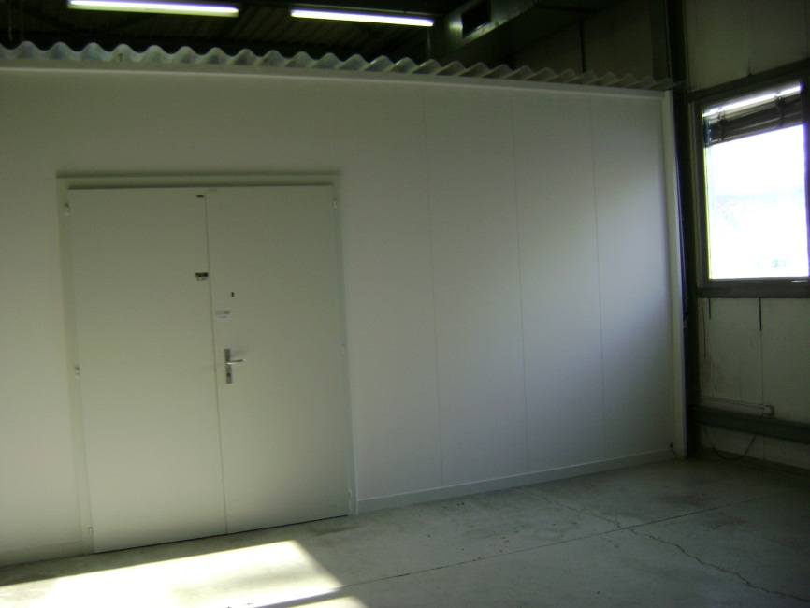
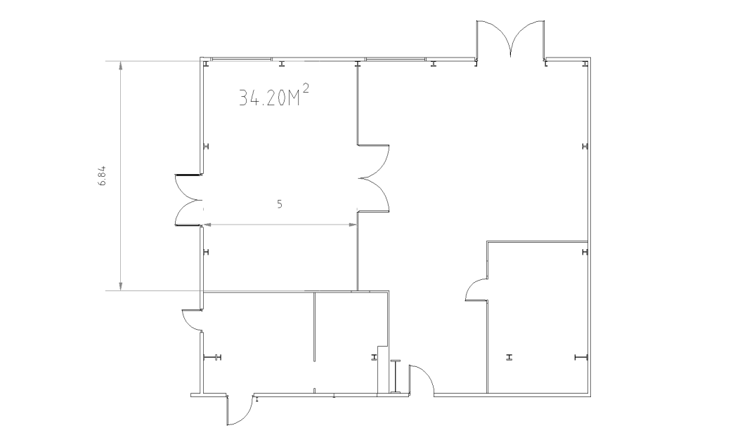
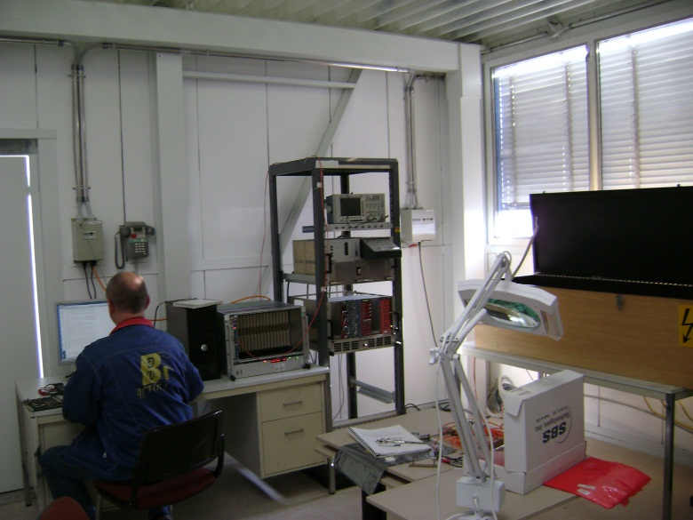
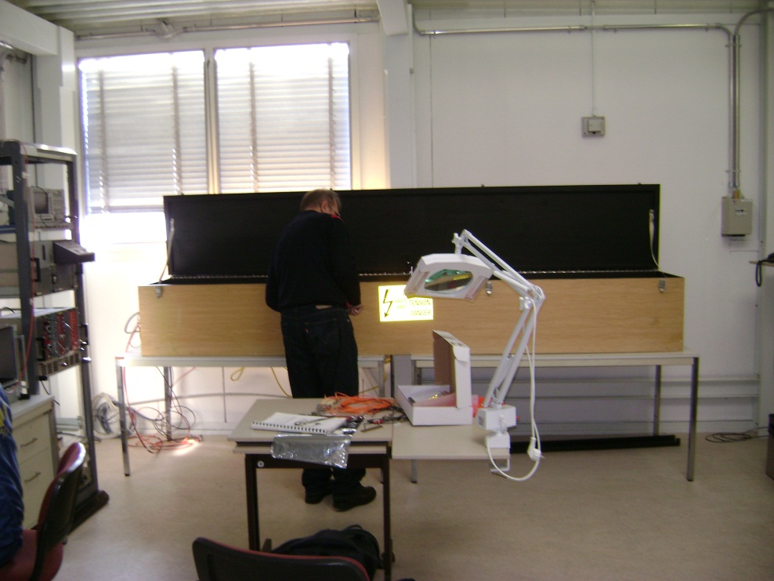
CERN: SciFi Lab in 156

Slide 4
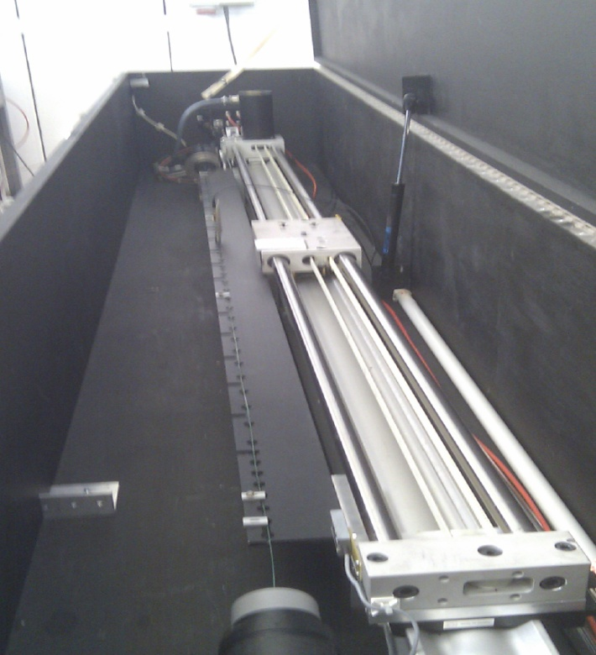
CERN: Optical Test bench
In kind contribution from Carmelo

Slide 5
Spending Profile
R&D phase 2012-2013-2014:
  30 kCHF (Subsistence)
  40 kCHF (Material: SIPM, Fibers, tooling, Test Beam …)
===========
70k CHF/y + 1 Doctoral Student / Fellow
Construction 2015-2016-2017
Total cost of the detector: ~6 MCHF (procurement only without construction costs)
Possible sharing with Ger, Ru (3), UK, CH, CERN
  10% x 6MCHF = 0.6 MCHF : 200 kCHF/y
  Subsistence and Material : 100 kCHF/y
============
300k CHF/y + 1 Doctoral Student / Fellow

