Slide 1
EPICS for CALET
May, 18, 2011
Y. Akaike

Slide 2
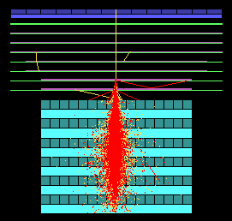
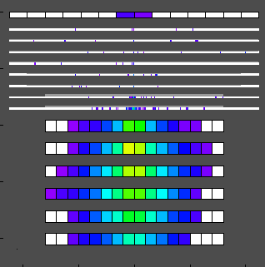
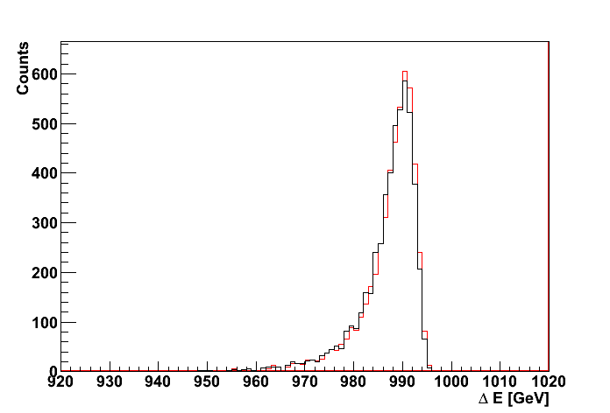
Outline
Download
Install
Event Generation
  Parameters
    config
    epicsfile
    param
    primary
    sepicsfile
    FirstInput
  UserInterface
    ephook.f
  Run
How to see events
  Geomview
Analysis Example
  Event viewer
  Create root
  Create histogram
Electron 1TeV
Deposit Energy

Slide 3
Download & Install
■ Environments for EPICS
- Linux, Mac
- Intel Fortran version >= 11.1
- 64 bit (recommended)
My laptop:
- Ubuntu10.10 64 bit
- Intel Fortran : 2011.3.174
■ Download
- Cosmos, EPICS
(http://cosmos.n.kanagawa-u.ac.jp)
- Geomview
you can install “yum” or “apt”
(export GEOMVIEW=/usr/bin/geomview)
■ How to install (detail, see manual)
Get the Cosmos & EPICS source code (http://cosmos.n.kanagawa-u.ac.jp/)
$ tar zxvf CosmosX.XX.tar.gz
$ tar zxvf EpicsX.XX.tar.gz
$ cd Cosmos
$ cp site.configPCLinuxIFC64 site.config
(bash) $ source Script/sevi.sh (tcsh) $ source Script/sevi
$ make
$ cd Epics
$ cp site.configPCLinuxIFC64 site.config
(bash) $source Script/sevi.sh (tcsh) $source Script/sevi
$ make

Slide 4
My sample program
Today, I give “calet20110518.tar.gz”
This is a sample program of EPICS and data analysis
This detector model has already released a few month ago.
Please decompress this file in EpicsX.XX/UserHook/

Slide 5
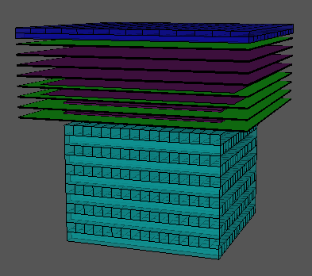
Detector Configuration
config
  Each updated config file of EPICS will be released from Japanese team.
  If you would like to create/change the configure, see manual in detail.
Check the config with Geomview
  $ cd EpicsX.XX/Util
  $ make –f drawConfig.mk
  $ ./drawconfig
  - Type “../UserHook/CALET/config”
  - Type “14” ⏎ “0␣6” ⏎⏎
  - Type “4” ⏎ “1” ⏎ “SCIN␣SciFi␣W␣PWO”
  - Type “1” ⏎⏎ ”0” ⏎
  $ cd Geomview
  $ ./dispconfigbygeomv
If it does not work, try the following
$ export GEOMVIEW=/usr/bin/geomview
$ ln –s /bin/tcsh /usr/local/bin/tcsh
(Type without SciFi)

Slide 6
Input Parameters
You may edit 4 files in EpicsX.XX/UserHook/CALET/
- primary
- kind of particle, energy
(cf. EpicsX.XX/Data/Primary/sample.d)
- sepicsfile
- incident point, direction
- num. of events to be generated
- random number seed
- epicsfile
- physical parameters (minimum energy, etc…)
- Trace (write trace or not)
- param
- chose hadron interaction model

Slide 7
User Interface of EPICS
In normal cases, you would simply modify the following parts of “ephook.f”
- ui1aev : Initialization for all events
- ui1ev : Initialization for 1 event
- userde : a particle losses energy in a component
- userbd : a particle crosses a component boundary
- ue1ev : End of 1 event.
- ueaev : End of all events
Initialize
ui1aev
Loop
Calculation
each event
ui1ev
userde
userbd
ue1ev
End of all
ui1aev

Slide 8
Event generation
■ Check parameters
param
- e- 1GeV
sepicsfile
“Nevent” 10
“Input P” ‘u+z’ (incident point)
“Xrange” (-22.4, 22.4)
“Yrange” (-22.4, 22.4)
“Zrange” (0,0) (on the top surface of detector)
“Input A” ‘cos 1’ (angular distribution)
“CosNormal” (0.9, 1) (the range of cosine of the angle)
epicsfile
“Trace” t (taking trace information)
($ mkdir /usr/”username”)
param
‘dpmjet3’
FirstKiss (1st line)
- ‘epicsfile’, ‘config’, ‘sepicsfile’, ‘param’
when you use “dpmjet3”, type the following to create tables. $ fordpmjet␣dummyconfig）

Slide 9
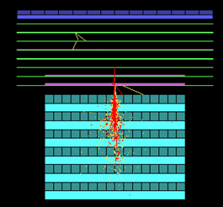
Event generation & see events
■ Event Generation
$ make
$ ./sepicsPCLinuxIFC64 < FirstInput > e-_1GeV.d
■ See Events by Geomview
$ cd EpicsX.XX/Util/Geomview
$ ./disptracebygeomv␣/tmp/”username”/trace1␣det
(after selecting the window of geomview) Type “aT”
You may change the color of material and particle traces
In “colormap” and “colortab” in Util/Geomview/

Slide 10
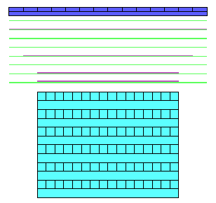
Output Data
■ see “e-_1GeV.d”
1: [#of event] [#of generated event]
2: [code] [subcode] [charge] [energy(GeV)]
3: [direction x] [y] [z] [position x] [y] [z] [collision point x] [y] [z]
4~: [cn] [dE] [dEeff]
last: 0␣0
In case of this sample program (ephook.f),
The event information is written when the shower
axis pass through the bottom layer of TASC.
# of event : the number of contained events
# of generated event : the number of generated events
code : particle id (ex. code=2:electron/positron)
subcode : math number (in case of electron, it is no means)
collision point : the first collision/conversion points (in case of electron, no means)
cn : component number
dE : real dE
dEeff : effective dE (in this sample, this is with Birk’s quenching effects)

Slide 11
How to Get Component Number and Each Dimension
$ cd EpicsX.XX/Util
$ make –f testCnf1.mk
$ echo ../UserHook/CALET/config | ./a.out > CALET.cnfg
Format of CALET.cnfg
[cn] [lebel] [shape] [media] [c] [de] [maxpath] / [x] [y] [z] [Lx] [Ly] [Lz]
- cn : component number
- media : SCIN, SciFi, W, PWO
- x,y,z : the coordination of the component
- Lx, Ly, Lz : the size of the component
- the other: you can ignore

Slide 12
Re-Generation events
■ Set parameters
param
- e- 1GeV
sepicsfile
“Nevent” 1000
epicsfile
“Trace” f (Disable taking trace information)
FirstKiss (1st line)
- ‘epicsfile’, ‘config’, ‘sepicsfile’, ‘param’
■ Event Generation
$ ./sepicsPCLinuxIFC64 < FirstInput > e-_1GeV_2.d

Slide 13
Analysis Example with ROOT
If you have installed ROOT, you may use my programs for analysis.
$ cd EpicsX.XX/UserHook/CALET/analysis
$ source bin/setenv.sh
$ make
Viewer of raw data
$ ./viewer ../e-_10GeV.d
Create root format
$ ./createroot ../e-_10GeV_.d e-_10GeV.root
Draw Histogram
$ ./histo_dEsum ../e-_1GeV_2.root

Slide 14
END

