Slide 1
Predicted CALET UH-Nuclei Abundances
Brian Flint Rauch
Washington University in St. Louis
CALET Meeting, Pisa
May 17, 2011

Slide 2
Steps in Calculation
Determination of rigidities seen in ISS orbit.
Estimation of integral CR-flux spectra.
High and Low energy regimes:
  Determination of thresholds.
  Determination of geometry factors.
Determination of CALET charge sensitivity range.
Prediction of abundances measured by CALET in 5 years.

Slide 3
ISS Orbit
Rigidity Cutoffs based on Smart, D.F. and Shea, M.A., 2009AdSpR..44.1107S

Slide 4
Weighted Rigidity Spectrum
Cutoff Rigidities from Epoch 1990 at 450 km on a 5° latitude × 15° longitude grid.
Orbit residence time based on an ISS inclination of 51.6° weighted for time in latitude bins and evenly sampling longitude bins.

Slide 5
Fe Integral Spectra Used for UH
Spectra have not been measured for UH GCRs, so the Fe spectrum is scaled by relative abundances.
Modulation seen by CALET is likely to be between Solar Minimum and Maximum, so calculations use averages.
Spectra 5 ≤ Z ≤ 32 from 2009ApJ...698.1666G

Slide 6
UH Charge Determination Regimes
At high enough energies charge can be determined based on trajectory corrected scintillator signal only.
This requires passage through the CHD and the top four fiber layers in the IMC, which gives a larger geometry factor, 0.44 m²-sr, than for the total instrument, 0.12 m²-sr.
  Particles with tracks through the calorimeter can have energy corrections that will improve resolution.
Lower energy particles require energy correction, and hence passage through the calorimeters.
CHD
IMC
TASC
Larger geometry factor calculated simply using formula in Sullivan, 1971NucIM..95....5S

Slide 7
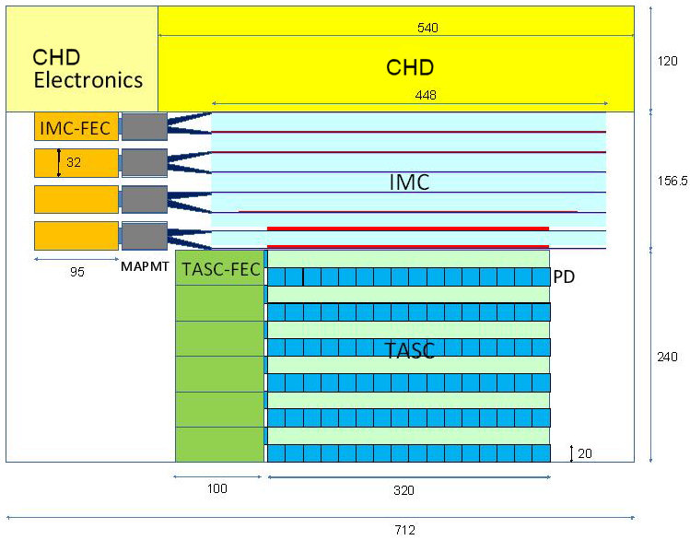
~70 deg

Slide 8
Impact of Differential Geometry Factors

Slide 9
High Energy Scintillator Resolution
Above a C1 threshold of ~5000 Fe-peak resolution does not vary with energy.
Charge determinations of UH GCRs can be made with scintillator signals alone.

Slide 10
Summary of measurable range
 | 1MIP | Fe (z=26) | Maximum
Scintillator EJ204 | 100% (no quenching) 300 p.e. | ～40%, S ~ Z^{1.72} 81,000 p.e.
PMT (gain: 5000) R7400 (at 400 V) | 240 fC | 64,000 fC | 375,000 fC 320,000 (linearity <2% )
CSA (C_{f} = 100 pF) : Charge Sensitive Amp. | 2.4 mV | 640 mV | 3,000 mV
ADC (16bits) | 32 counts | 8,600 counts | 32,768 counts
Scintillation yield is expected to be about 300 p.e. for a MIP with R7400 (QE ~30%) and EJ204.
The PMT gain and feedback capacitance of CSA are adjustable.
Data courtesy of Shoji Torii.

Slide 11
Maximum Resolved Charge
Signals derived for 0°, 30° and 45° incidence assuming S~Z^{1.7} * from Fe for:
  Scintillator (PE)
  PMT (fC)
  CSA (mV)
  ADC (counts)
The ADC appears to determine the maximum resolved charge: Z~45 at high incidence angles.
* 22nd ICRC, 1991, 2, 511

Slide 12
Interactions in CHD
Fraction of events that do not undergo nuclear interactions in passing through the CHD: ~2 cm of PVT plastic at an average incidence of 30° for 2.38 g/cm² areal density.

Slide 13
Estimated Abundances for 5 Years

Slide 14
Comparison with Existing Data

Slide 15
Conclusions
30≤Z≤40 charge range
  CALET should obtain numbers of events ~6-8x that of TIGER
  Comparable to numbers of events expected from Super-TIGER for 60 days at float
  CALET measurements will be cleaner since there will be smaller corrections for nuclear interactions
50≤Z≤56 charge range
  If the dynamic range is sufficient, CALET can make exploratory measurements with statistical precision of ~25-30% for even-Z nuclei
We conclude that UH-element abundances for 30≤Z≤40 on CALET are well worth doing. For 50≤Z≤56, the statistics are modest, but is still worth doing if the dynamic range is sufficient
Critical importance
  A trigger mode based on CHD and top layers of IMC
  Adequate dynamic range of the CHD PMT and signal processing chain

Slide 16
Backup Slides

Slide 17
High Energy Scintillator Resolution
Above a C1 threshold of ~5000 Fe-peak resolution does not vary with energy.
Charge determinations of UH GCRs can be made with scintillator signals alone.
TIGER analysis divided data into regions based on the threshold of its aerogel Cherenkov radiator (~2.5 GeV/nuc), shown in scatter plot on the left and giving the Above C0 (red) and Below C0 (blue) ranges in the plot on the right.

Slide 18
TIGER Kinetic Energy
C1 = 5000 for ~600 MeV/nucleon

Slide 19
Impact of Solar Modulation

Slide 20
Anticipated UH Charge Resolution
TIGER 2003 high energy scintillation peaks show separation for ₃₀Zn and above. CALET will have statistics to resolve more Z ≥ 30 peaks.

