Slide 1
CALET Simulation
17, May. 2011
Yosui Akaike
Waseda University
~Simulation & Modeling Meeting in INFN Pisa~

Slide 2
Outline
Detector Configuration
Trigger Condition
Detection Efficiency
Geometrical Factor
Energy Resolution
Particle Identification
  electrons/protons separation
  charge resolution of CHD and SciFi
Trigger Rate on ISS orbit

Slide 3
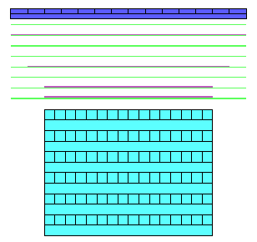
Baseline Configuration
The current detector model in our simulation is composed of active parts and major absorber parts of the calorimeter
  This model consists of;
    28 plastic scintillator paddles - 3.2 x 44.8 x 1.0 cm³
    7168 SciFi ‘s 0.1 x 44.8 x 0.1 cm³
    Tungsten plates
    44.8 x 44.8 x 0.07 cm³ x 3
    38.4 x 38.4 x 0.07 cm³ x 2
    32.0 x 32.0 x 0.35 cm³ x 2
    192 PWO logs 2.0 x 2.0 x 32.0 cm³
    no PMT, APD/PD, frames, cables, etc…
  No gaps between scintillators in
    CHD, IMC and TASC
  Tentative size of spaces are
  assigned between :
    CHD-IMC
    IMC-TASC
CHD
IMC
TASC
(Some results in this presentation are made
by different version models
which have SIA in substitution for CHD)

Slide 4
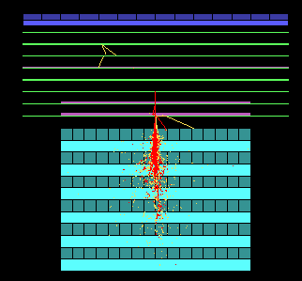
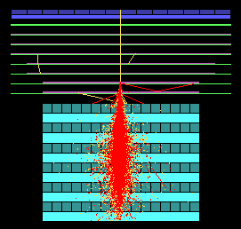
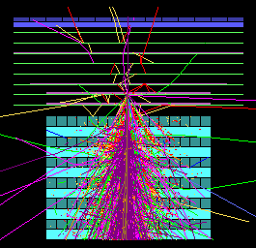

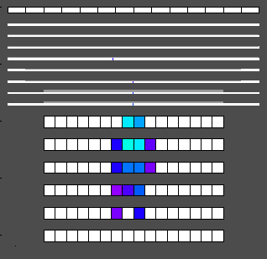
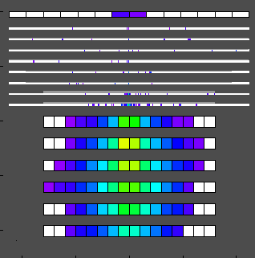
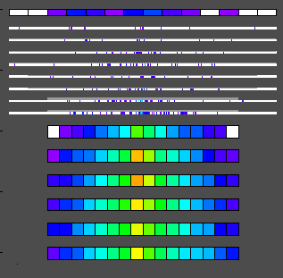
Shower Images
Gamma-ray 10GeV
Electron 1TeV
p 10TeV

Slide 5
Trigger system
In order to eliminate background events of low energy protons, trigger condition should be set to obtain only particles initiating the cascade shower. CALET is equipped with several trigger sources and three trigger modes
Trigger sources
  Sum of each 2 SciFi layers : 4 x 2 (X,Y) signals
  Sum of the top layer of TASC
  CHD
Trigger mode
  High energy shower
  (all particles > 10 GeV)
  Low energy shower
  (electrons > 1 GeV)
  Single (for calibration)
  (all particles)
IMC1+2
IMC3+4
IMC5+6
IMC7+8
TASC1
Trigger condition such as threshold for each trigger source should be optimized with simulation studies.

Slide 6
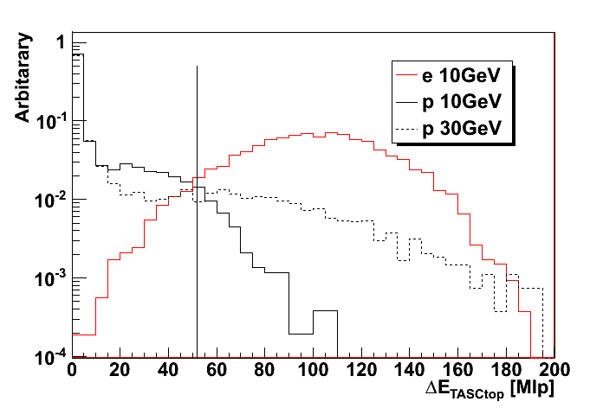
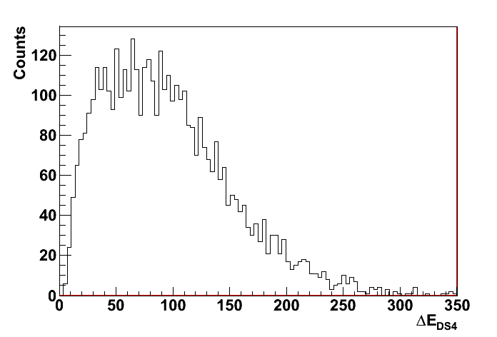
High Energy Shower Trigger
Target
  e > 10GeV
  γ > 10GeV
  p, nuclei > a several 10GeV
The distribution of MIPs at the top TASC layer
95%
Trigger Condition
  ① TASC1 > 55MIP
  ② IMC7+8 > 15MIP
p30GeV:15%
p10GeV:3.7%
The threshold of TASC1 is determined to detect 95% of the 10GeV electrons.
The threshold of IMC7+8 is determined to detect 98% of 10GeV gamma-rays, of which converted above IMC7. (Least 2 points (IMC7 and IMC8) are needed to reconstruct a tracking in IMC)
Non-showered events of proton and nuclei are rejected by these threshold.
IMC1+2, IMC3+4, IMC5+6 will be not used to;
①detect not only electrons but also gamma-rays.
②detect events incoming from the detector side.
The distribution of MIPs at IMC7+8, events which converted below IMC8 are ignored
γ ： 10GeV
15MIP
98%

Slide 7
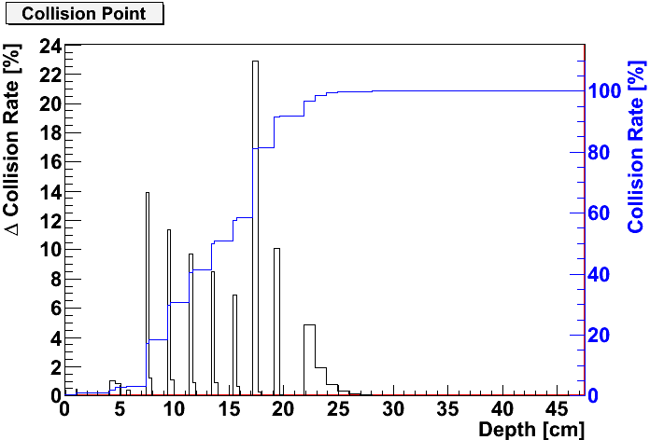
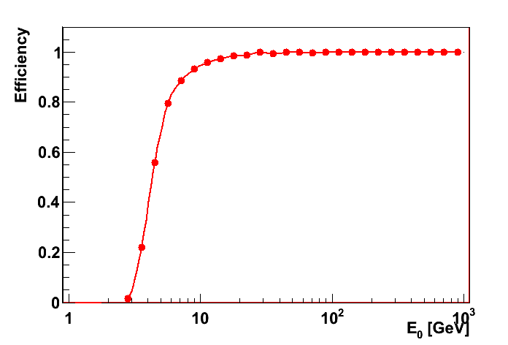
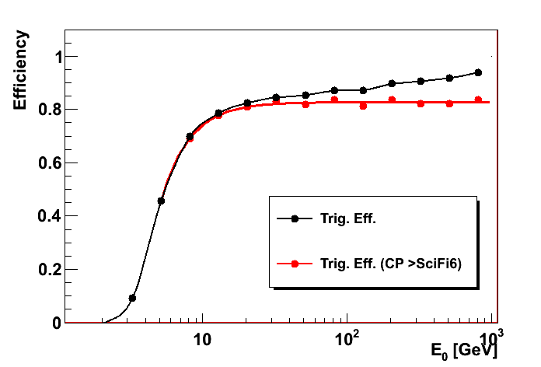
Detection Efficiency
First conversion points of gamma-rays
The detection efficiency of high energy shower trigger:
(electrons) 95%:10GeV, 99% >20GeV
(gamma-rays) ~ 80% > 10GeV
The ratio of the first conversion of gamma-rays above W6 is ~80%.
W6
W1
W2
W7
PWO
Detection efficiency of electrons
Detection efficiency of gamma-rays
― all triggered
― conversion points > W6

Slide 8
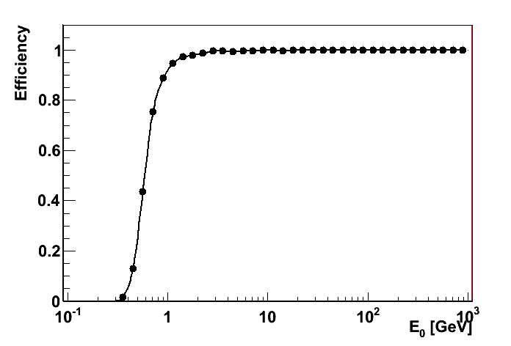
Low Energy Shower Trigger
Target
  e > 1GeV
Trigger Condition
  ① IMC1+2 > 0.7 x 2(layers) MIP
  ② IMC3+4 > 0.7 x 2 MIP
  ③ IMC5+6 > 0.7 x 2 MIP
  ④ IMC7+8 > 5 MIP
  ⑤ TASC1 > 7MIP
  (eff.95 of 1GeV electrons)
Detection efficiency of electrons
The thresholds of IMC1+2, IMC3+4, IMC5+6 are determined to detect a single track.
The thresholds of IMC7+8, TASC1 are determined to detect 95% of the 1GeV electrons
- the target is only electrons
- the flux in this energy region is very high,
⇒ IMC1+2, IMC3+4, IMC5+6 will be also used to detect only full-contained events.

Slide 9
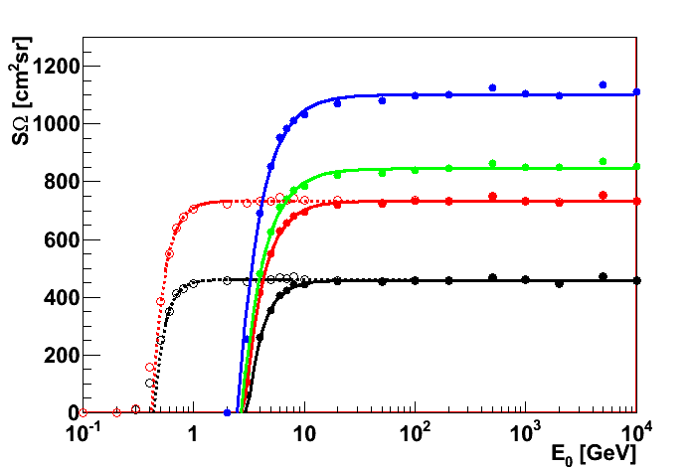
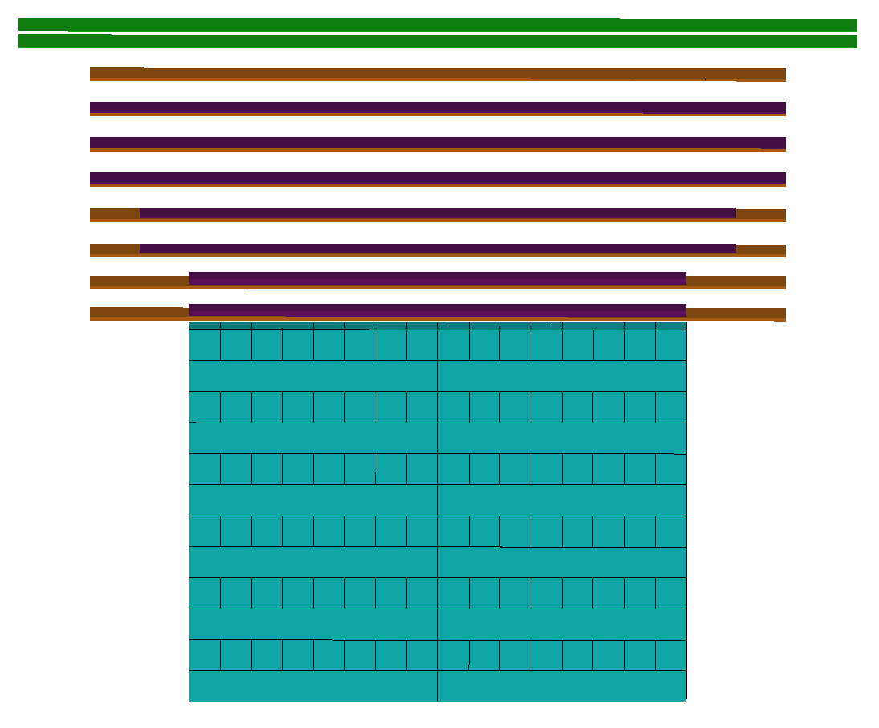
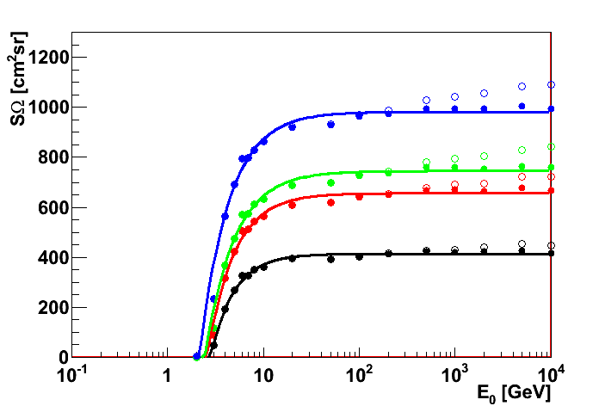
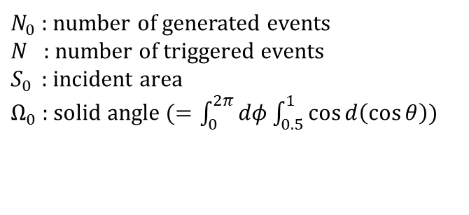

Geometrical Factor
$$SΩ=\frac{N}{N_{0}}⋅S_{0}⋅Ω_{0}$$
Electrons
$N_{0}$ : number of generated events
$N$ : number of triggered events
$S_{0 }$ : incident area
$Ω_{0}$ : solid angle ($=\int_{0}^{2π}{dφ}\int_{0.5}^{1}{\cos{d\left(\cos{θ}\right)}}$)
Classification by the shower axis geometry
①
②
Gamma-rays
③
④
>

Slide 10
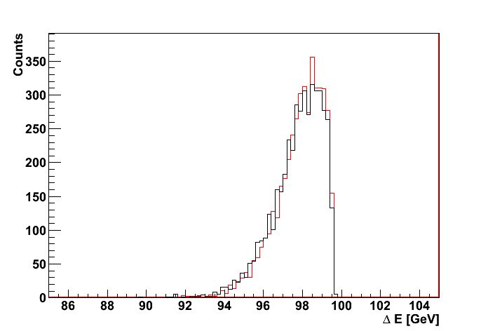
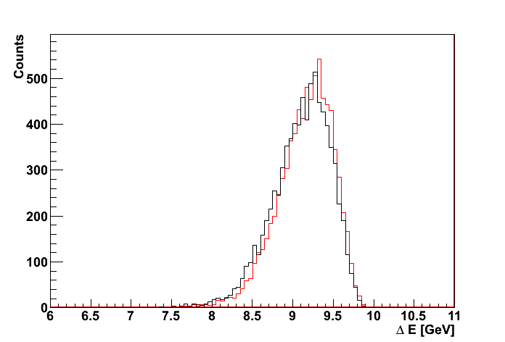
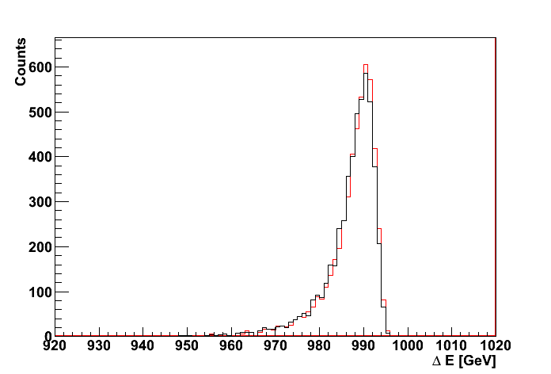
Deposit Energy
The incident energy of electrons and gamma-rays was estimated by the total deposit energy of IMC & TASC.
Gamma 100GeV
― TASC
― TASC+IMC
Electron 10 GeV
― TASC
― TASC+IMC
Electron 1TeV
― TASC
― TASC+IMC

Slide 11
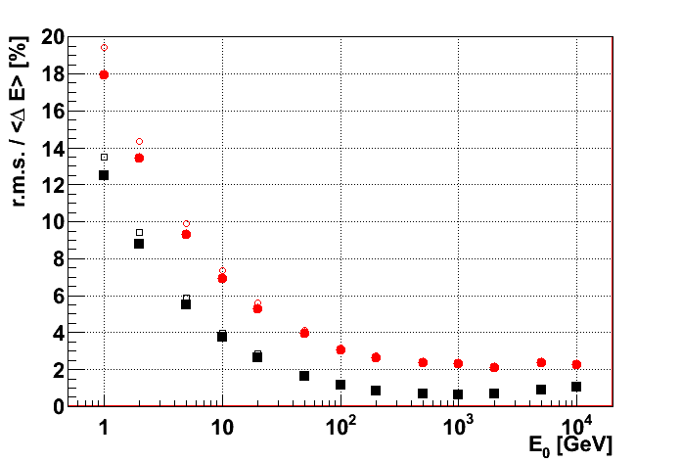
Energy Resolution
○：TASC (②③④)
□：TASC (①)
●：TASC+IMC (②③④)
■：TASC+IMC (①)
①: full-contained events
②~④ : partially contained events

Slide 12
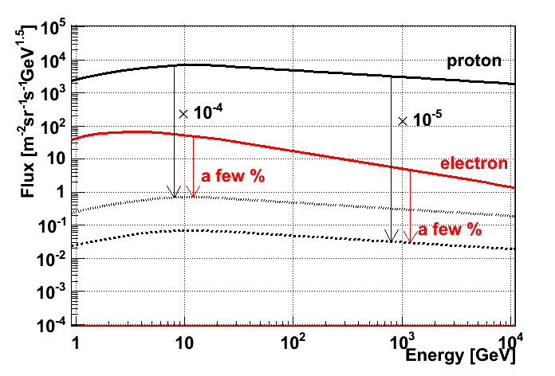
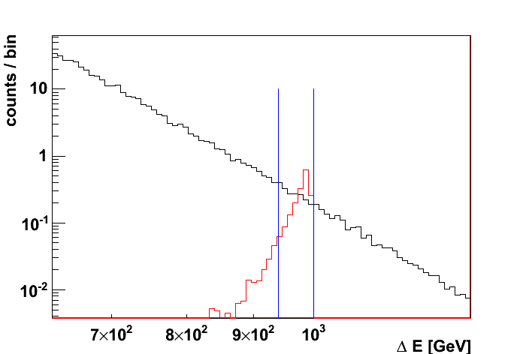
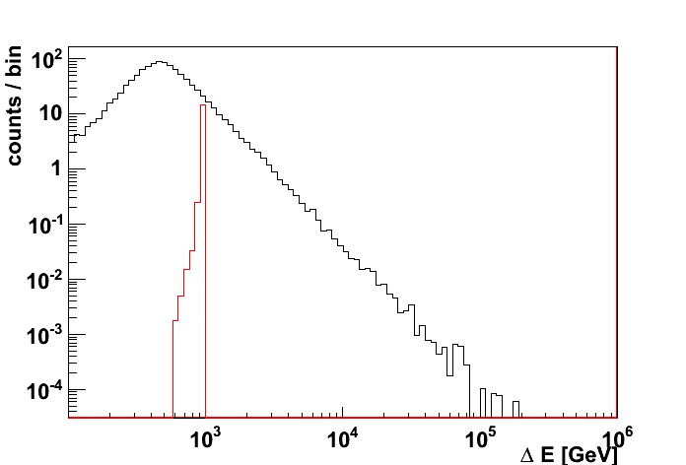
Electrons / Protons identification
Requirement of proton rejection power
e : p = 1 : 100 @10GeV
⇒ rejection power : ~10⁴
e : p = 1 : 1000 @1TeV
⇒ rejection power : ~10⁵
Estimation of the proton rejection power at TeV region
95%eff.
Electrons : 1TeV
Protons : 1~1000TeV (E^{-2.7}dE)
(Number of protons)
(generated) 1.6 x 10⁶
↓
(triggered) ~52000
↓
(energy bin) ~8700
― e
― p

Slide 13
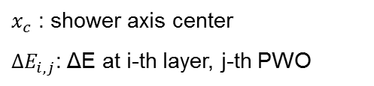
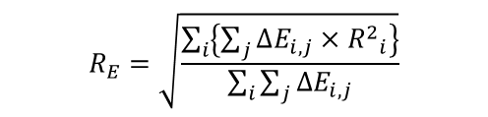
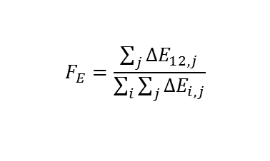
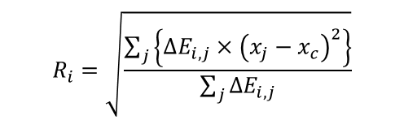
Electrons / Protons identification
Scatter plots for electrons and protons.
Classification by the shower axis geometry
(=F_{E})
①
②
③
④
(=R_{E})
>
$$R_{E}=\sqrt{\frac{\sum_{i}{\left\{\sum_{j}{∆E_{i, j}}×{R^{2}}_{i}^{}\right\}}}{\sum_{i}{\sum_{j}{∆E_{i, j}}}}}$$
$$R_{i}=\sqrt{\frac{\sum_{j}{\left\{∆E_{i,j}×{\left(x_{j}−x_{c}\right)}^{2}\right\}}}{\sum_{j}{∆E_{i,j}}}}$$
95% efficiency of electrons,
4 protons are contained.
⇒ Proton rejection power ：
~ 2.0 x 10⁵ (90%C.L.)
$$F_{E}=\frac{\sum_{j}{∆E_{12, j}}}{\sum_{i}{\sum_{j}{∆E_{i, j}}}}$$
$x_{c}$ : shower axis center
$∆E_{i, j}$: ΔE at i-th layer, j-th PWO

Slide 14
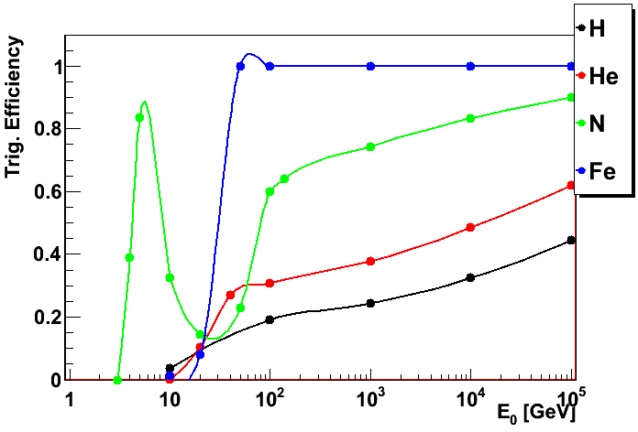
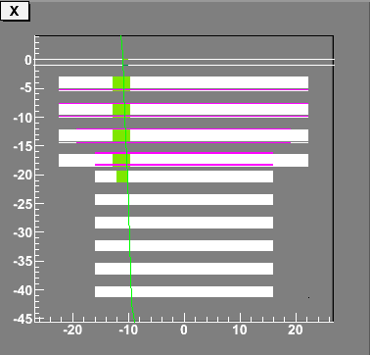
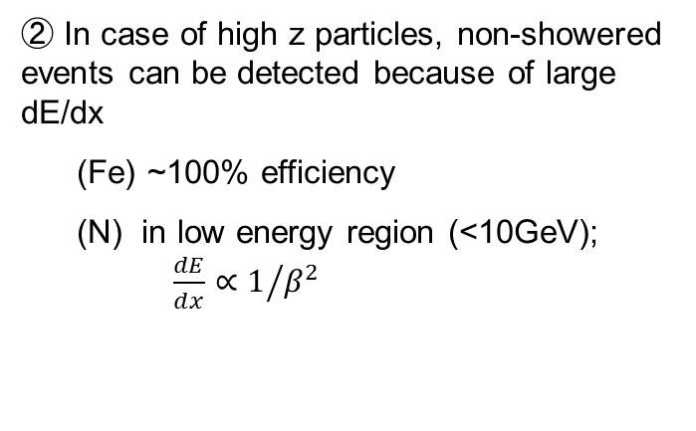
Detection efficiency of nuclei
Detection Efficiency
High energy shower trigger
・IMC7+8 > 15MIP
・TASC1 > 55MIP
②
②
①
① these increase is influence of the backscattering of the events of which the interaction occur in the lower layer of TASC.
② In case of high z particles, non-showered events can be detected because of large dE/dx
(Fe) ~100% efficiency
(N) in low energy region (<10GeV); ${\frac{dE}{dx}∝1}/{β^{2}}$
N 5GeV

Slide 15
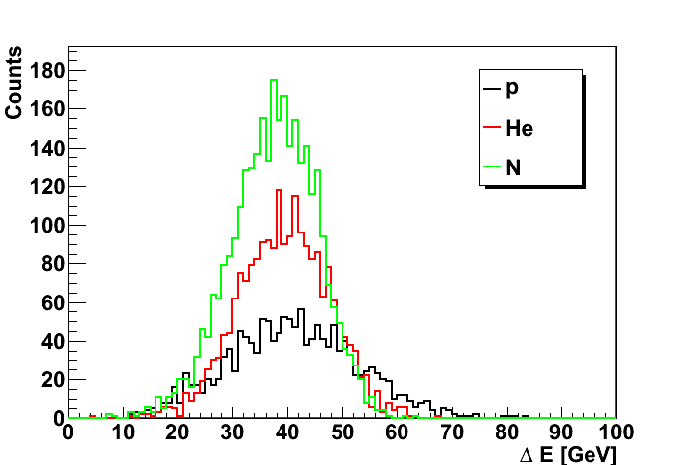
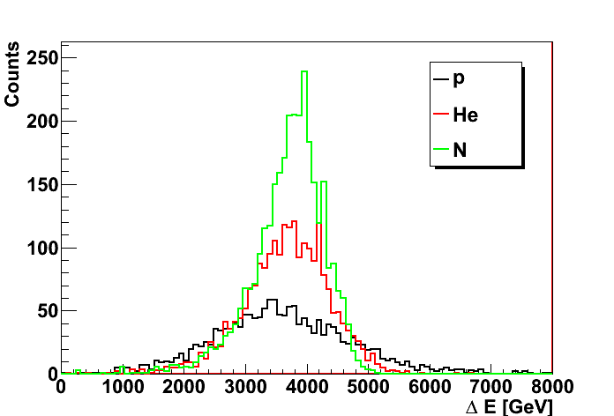
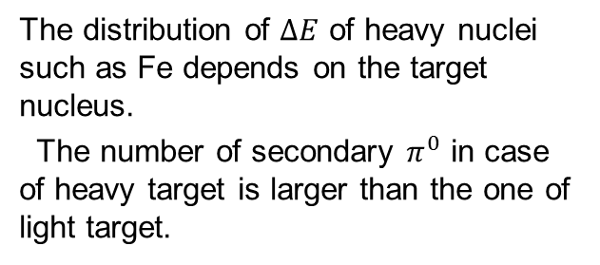
Deposit Energy of Nuclei
Incident energy of nuclei was measured by $∆E$ of TASC.
100GeV/A
10TeV/A
case of Fe
Fe 10TeV/A
The distribution of $∆E$ of heavy nuclei such as Fe depends on the target nucleus.
The number of secondary $π^{0}$ in case of heavy target is larger than the one of light target.
(Interaction model : DPMJET3)

Slide 16
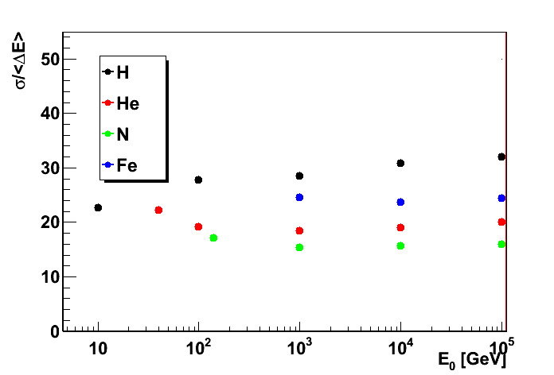
Energy resolution of nuclei
If we select events of which interaction occur above the top layer of TASC,
(Interaction model : DPMJET3)
r.m.s. / <ΔE>

Slide 17
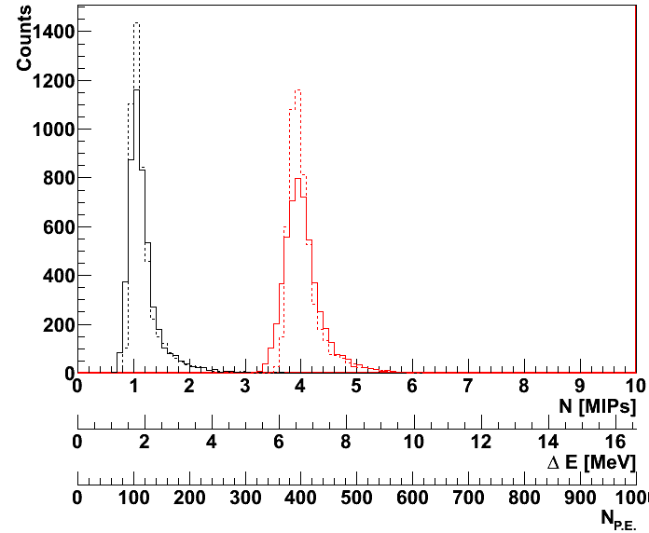
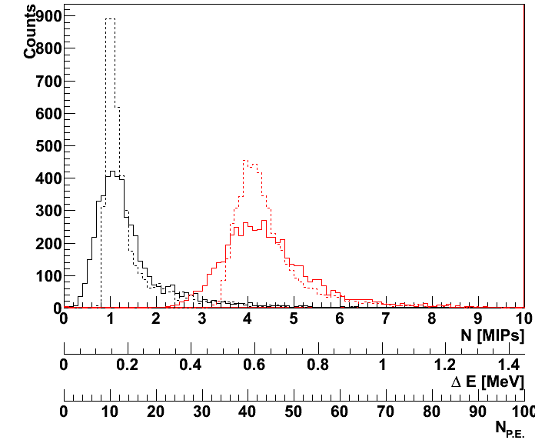
Charge resolution
The charge resolution of CHD and SciFi was estimated with;
- back-scattering
- quenching
The N_{p.e.} was calculated from the ΔE, assuming the following typical values;
  CHD : N_{photon}/MeV = 10000, N_{pe}/MIP = 100
  SciFi : N_{photon}/MeV = 10000, N_{pe}/MIP = 10
CHD
SciFi
--- p (ΔE)
― p (N_{P.E.})
--- He (ΔE)
― He (N_{P.E.})
--- p (ΔE)
― p (N_{P.E.})
--- He (ΔE)
― He (N_{P.E.})

Slide 18
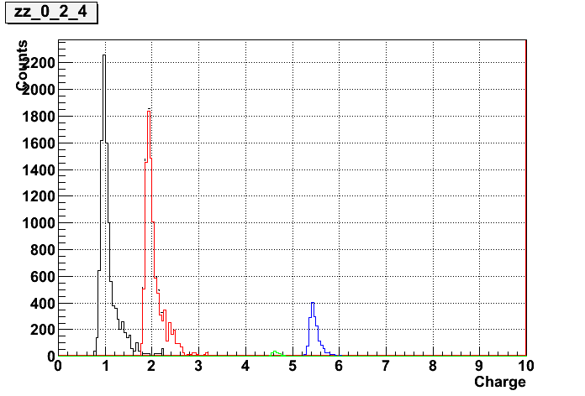
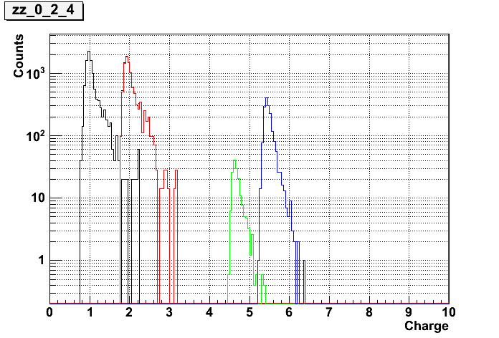
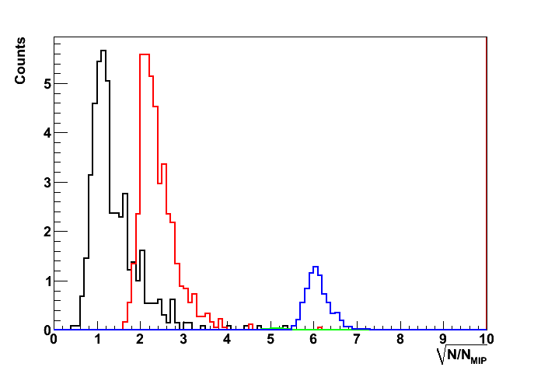
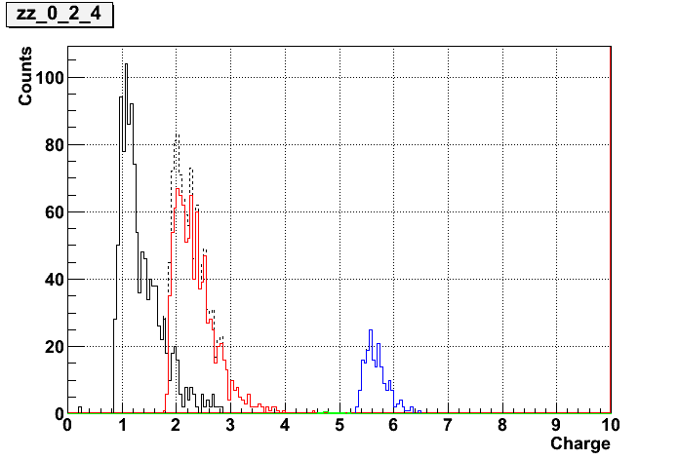
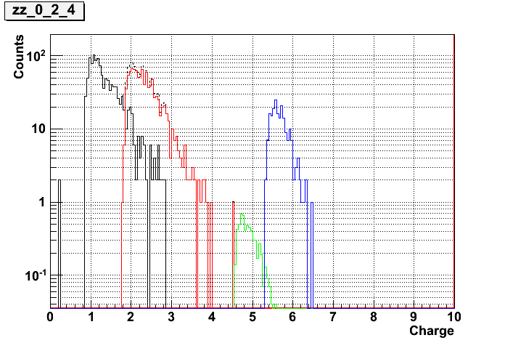
Charge resolution
The number of the incident particles to detector was estimated as SΩ~ 0.07m²sr.
Events which the first collision occur at the top layer of TASC was selected.
CHD : 1TeV/A (1year)
― p
― He
― B
― C
SciFi : 100TeV/A (5years)
― p
― He
― C
CHD : 10TeV/A (5year)

Slide 19
Estimation of the trigger rate on ISS orbit
The trigger rate on ISS is evaluated by estimation of cosmic ray flux including primary particles and albedo particles.
1. Estimated Flux on ISS Orbit (at an altitude of 400km)
primary cosmic rays are assumed by some satellite and balloon experiments
particle transportation in geomagnetism ・・・・・・ Cosmos, ATMNC3
(ATMNC3: Atmospheric Muon Neutrino Calculation code 3-dimensional version)
Model of geomagnetism --- IGRF2005
Model of atmosphere -----– US-standard1976
 | Geomag. | Atmos. | Heavy nuclei | Calc. time
Cosmos | ○ | ○ | ○ | △
ATMNC3 | ○ | ○ | △ | ○
(high energy shower trigger) primary: Cosmos, albedo: ATMNC3
(low energy shower trigger ) primary: ATMNC3, albedo: ATMNC3
Output : particle kind, energy, zenith angle
2. Trigger rate with detection efficiency
detector response : EPICS

Slide 20
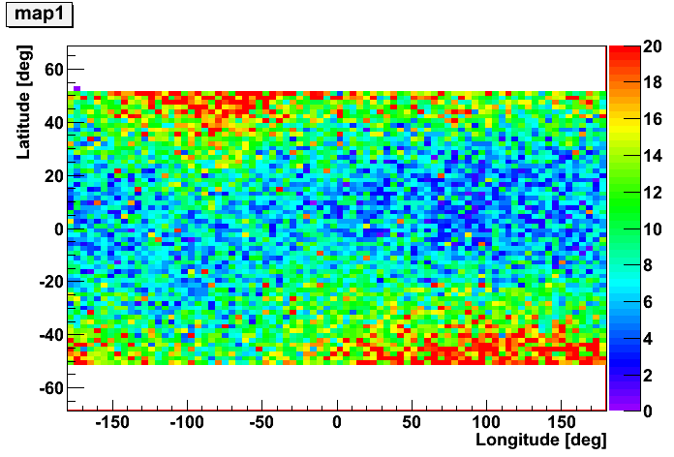
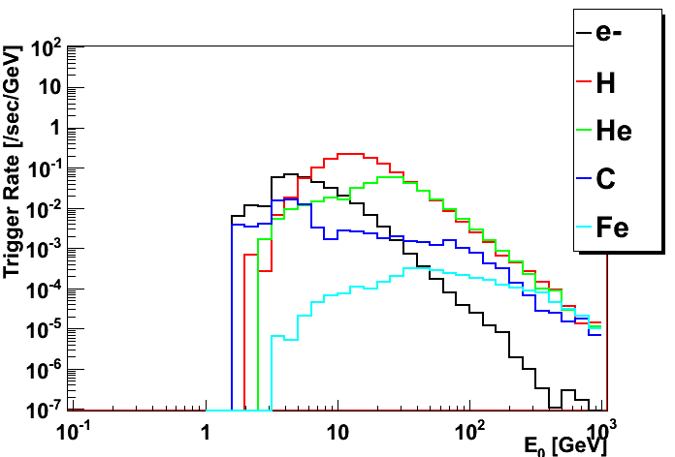
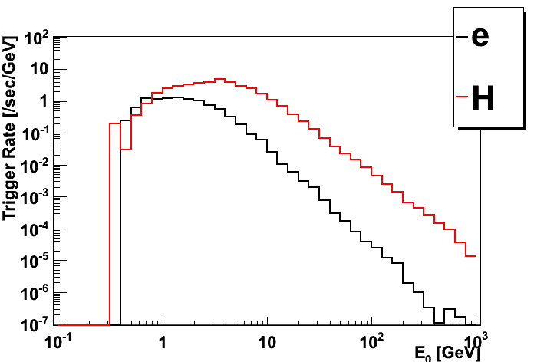
Trigger Rate on ISS orbit
The density map of trigger rate
(High Energy Shower Trigger)
Energy Spectra
(High Energy Shower Trigger)
Latitude[deg.]
Longitude[deg.]
(Low Energy Shower Trigger)
Average of trigger rate
(High) Ave. of orbit ：11.4Hz
e-:0.78, p:5.5, He:2.7,
C:0.47, Fe:0.11, the other:1.84
(Low) Ave. of 5 min. in highest latitude：108Hz
e-:8.3, p:74.8, the other：24.9

Slide 22
Prototype Detector for SPS beam test
layer
layer
(2-6)
(7,8)
x
for Shower trigger
r.l. :
(same as CALET)
Only longitudinal direction
layer
st
for Shower trigger
nd ~
r.l. :
(2/3 of CALET)
Only longitudinal direction

Slide 23
Example for events
Simulation electron
electron
posictron
Event viewer
particle density disclibed by Colors
the number is number of MIP
Number of MIP
Exp. Data electron

Slide 24
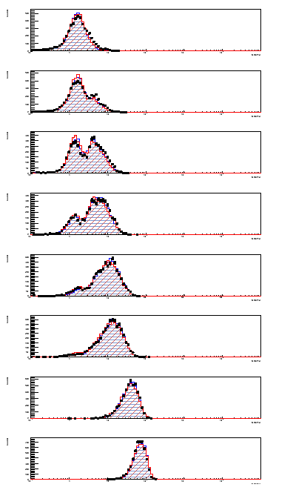
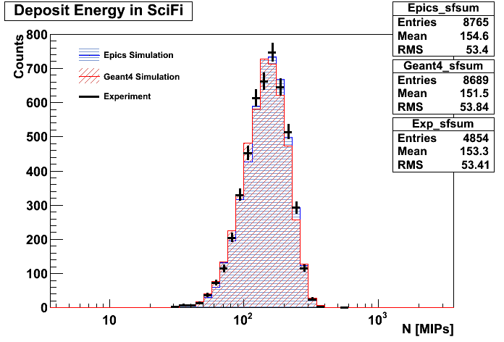
Energy Deposit in IMC
Vertical: event count
Horizontal：Energy Deposit [MIP]
（Horizontal axis is Log scale）
Each Layer
Positron 10GeV
・Energy deposit in sum of each layer
It could find the first interaction point by layer 1~6
・Sum of energy deposit in IMC
Layer 1
Layer 2
Single event
Shower event
Simulations & Exp. Data are consistent
Layer 3
Mean difference：
0.848%
Layer 4
Mean difference：
1.17%
Layer 5
All SciFi
Layer 6
Layer 7
Layer 8
Data : 215
~70 MIP
24
Notes:
24

Slide 25
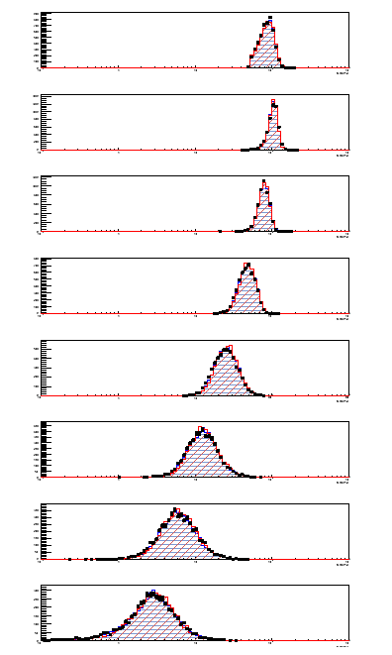
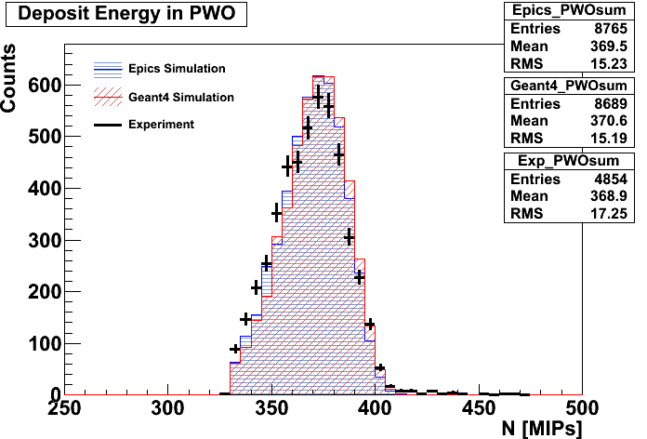
Energy Deposit in TASC
Vertical: event count
Horizontal：Energy Deposit [MIP]
（Horizontal axis is Log scale）
Positron 10GeV
・Energy deposit in sum of each layer
Using data → Layer1:PMT, Layer2~8:APD
Consistent in each TASC layer (PMT-MIP is calibrated with this data)
・Sum of energy deposit in TASC (without Layer 7)
Each Layer
Layer 1
Layer 2
~110 MIP
Simulations & Exp. Data are consistent
Layer 3
Layer 4
Mean difference：
0.163%
Mean defference：
0.461%
Layer 5
All PWO
Layer 6
Layer 7
Layer 8
Data : 215
25
Notes:
25

Slide 26
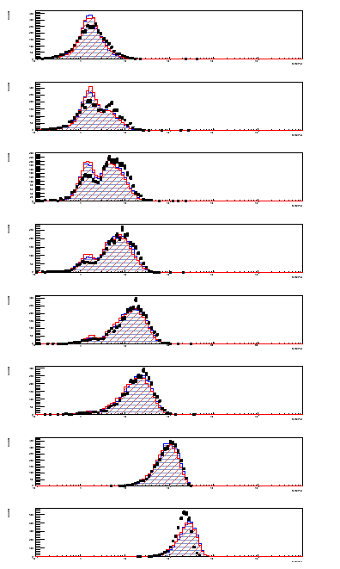


Energy Deposit in IMC
Vertical: event count
Horizontal：Energy Deposit [MIP]
（Horizontal axis is Log scale）
Positron 150GeV
・Energy deposit in sum of each layer
we can find the first interaction point by layer 1~5
・Sum of energy deposit in IMC
Each Layer
Layer 1
Layer 2
Simulations & Exp. Data are consistent
Single event
Shower event
(Mean value of Geant4 results has a tendency to be lower)
Layer 3
Mean diff：
1.70%
Layer 4
Mean diff：
6.88%
Layer 5
All SciFi
Layer 6
Layer 7
Layer 8
Data : 261&449
~280 MIP
26
Notes:
26

Slide 27


Energy Deposit in TASC
Vertical: event count
Horizontal：Energy Deposit [MIP]
（Horizontal axis is Log scale）
Positron 150GeV
・Energy deposit in sum of each layer
Using data → Layer1:PMT, Layer2~8:APD
Consistent in each TASC layer
・Sum of energy deposit in TASC (without Layer 7)
Each Layer
Layer 1
Layer 2
There’s a difference of distribution (Difference of mean value : ~ 1%)
Layer 3
~1400 MIP
Layer 4
Mean diff：
0.983%
Mean diff：
1.14%
Layer 5
All PWO
（without layer7）
Layer 6
APD disabled
Layer 7
Layer 8
Data : 449
27
Notes:
27

Slide 28

Energy Resolution
Energy Resolution in TASC
Define “Energy Resolution”, using histogram of energy deposit in TASC
Energy Resolution ： RMS_{TASC} / < E_{TASC} >
・ Simulation data have the same
tendency as Exp. data
In high energy region, resolution
degradation by shower leakage effects.
・ Resolution of Exp. data is lower
→ contaminant particles
→ multi-hit events
color ： Exp. & Geant4 & EPICS
Vertical axis ： Energy Resolution in TASC
Horizontal axis ： Energy of incident particles
preliminary
Shower leakage effects
28
Notes:
28

Slide 29





Lateral Spread
Lateral shower spread of IMC, TASC
(Positron 10GeV)
・For energy weighted spread of IMC, Using events of 1mm inner side of IMC layer 8.
・In IMC, simulation and exp. data have a similar distribution. (Difference of mean value : ~4%)
・In TASC, simulation and exp. data have a similar distribution.
(1cm edge : only 2 PWO logs in each layer)
IMC
[ Formula of Energy Weighted Spread R_{E} ]
Ex. TASC
TASC
Data : 451
29
Notes:
29

Slide 30


Lateral Spread
Lateral shower spread of IMC, TASC
(Positron 150GeV)
・For energy weighted spread of IMC, Using events of 1mm inner side of IMC layer 8.
・In IMC, simulation and exp. data have a similar distribution. (Difference of mean value : ~3%)
・In TASC, there is a little difference in distribution. (Diffirence of mean value : ~2%)
IMC
[ Formula of Energy Weighted Spread R_{E} ]
TASC
Ex. TASC
Data : 449
30
Notes:
30

Slide 31



Angular resolution （electron）
Distribution of the incoming direction deciding from reconstructed shower analysis
Shower core
IMC 1st layer
Anguler distribution（electron10GeV）
black：Simulation red：exp data
IMC8th layer
Example event （electron 10GeV）
Energy dependency of angular resolution
Notes:
31

Slide 32



e/p separation by IMC data
Distribution of shower spread (e10GeV and hadron 30GeV)
Weighted spread of shower particles
Deposit energy in i^{th} SciFi
Deposit energy in j^{th} SciFi
Core position of reconstructed shower
 | Electron selection | Hadrons rejection
Simulation | 91.2% | 98.9%
Exp. data | 88.2% | 98.4%
electron
Hadron
Notes:
32

Slide 33
END

