Slide 1
Simulation and Modeling Team Interface Meeting
S. Torii (Waseda U. & JAXA )
General introduction of CALET
CALET design: Frozen and Opened
Most of the design was frozen for PDR, Nov. 2010 except CHD. However
there is a little possibility to make a modification within a boundary of cost,
weight, schedule. The CHD design should be frozen by the end of June for the
“delta” PDR. The CDR is scheduled in Aug. (~ Dec.), 2011. This schedule depends
on the budget plan of JEM, which will be fixed in July, 2011.
Status and schedule of the CALET production/test
The BBMs of TASC, IMC, MDC were already made, and the STM of some critical
components will be made by Aug. 2011. The FM production will start after
CDR. Then, the test of FM will be done at CERN-SPS around the end off 2012.
CALET data structure : raw –calibrated –science variables
See for definition of the Data Level the draft of DPAP by Guzik and Wefel.
S&M Team should have a TIM with Data Analysis and Data Handling Team, and
we should discuss how is the data structure and the analysis tool in each level.
*) Japanese, JAXA, Team will have a responsibility the data structure up to Level 1.
Pisa 2011/5/17-18

Slide 2
CALET Team Organization |B
CALET Science Team
IEC (International Executive Committee)
JAXA
NASA
ASI
- Science Data Handling
- Science Analysis
- Science Publications
PI： S.Torii (JP)
Co-PI: J.Wefel (US)
Co-PI： P. Marrocchesi (IT)
JAXA
System & Hardware
Development
- Launch & Operation
NASA
- Technical Support
- ISS downlink
resources
ASI
Technical Support
Hardware Development
HV FM & CHD
Data Processing & Analysis Plan
will specifies all international collaboration such as Modeling, Analysis, Testing, Publication, etc.
Task Team1:
Data Handling &
Data Analysis
S.Torii /S.Ueno (JP)
T. Guzik (US)
P . Marrocchesi (IT)
and other members
Task Team2: Modeling & Simulation
K.Yoshida (JP)
Moiseev,/
J. Krizmanic (US)
P . Maestro (IT)
and other members.
Task Team3: Accelerator Calibration & other testing /Planning
T.Tamura (JP)
J. Mitchell (US)
O.Adriani /
P. Marrocchesi (IT)
and other members
Task Team4: Science Publication Policy
M. Mori (JP)
M.Cherry (US)
P. Marrocchesi (IT)
and other members
Public Outreach will be
coordinated by related agencies and Science Team.

Slide 3
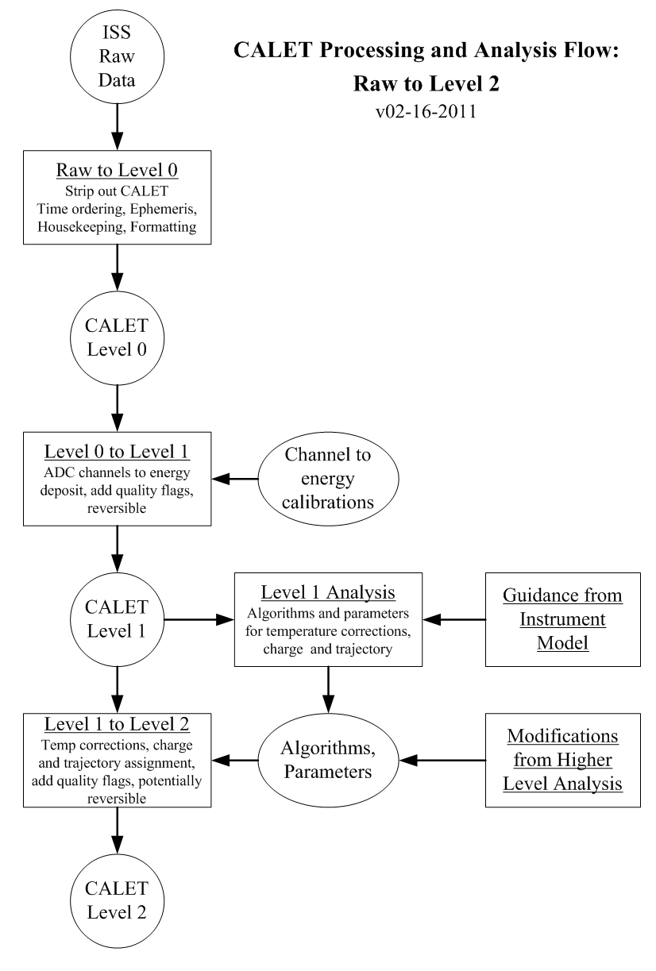
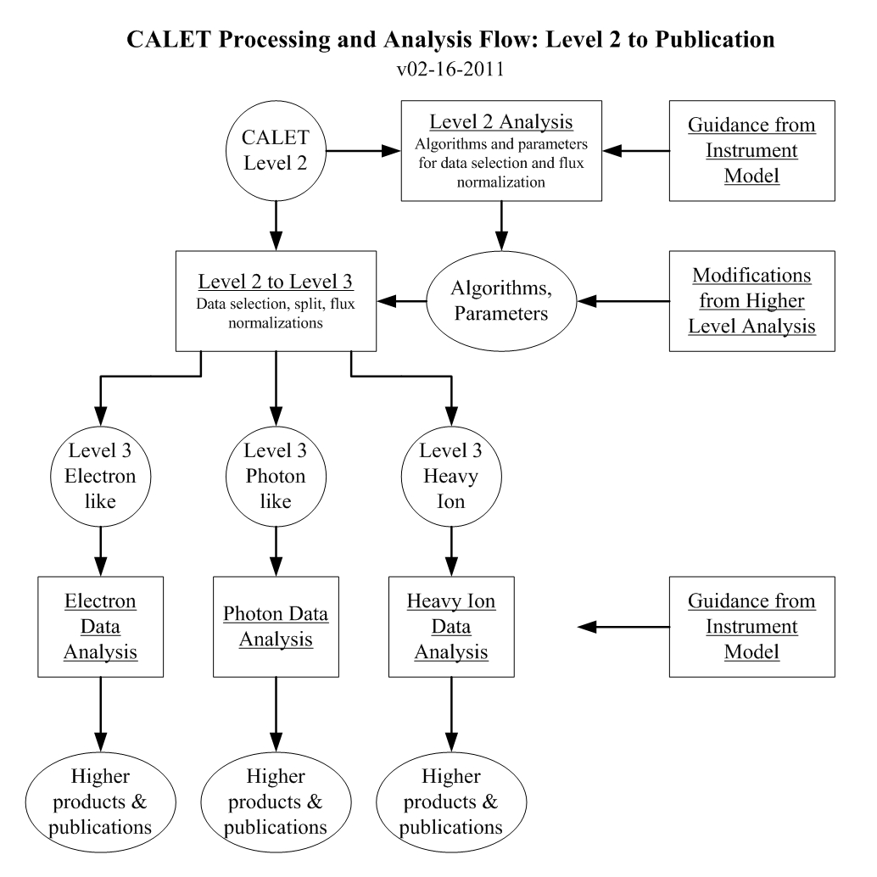

Slide 4
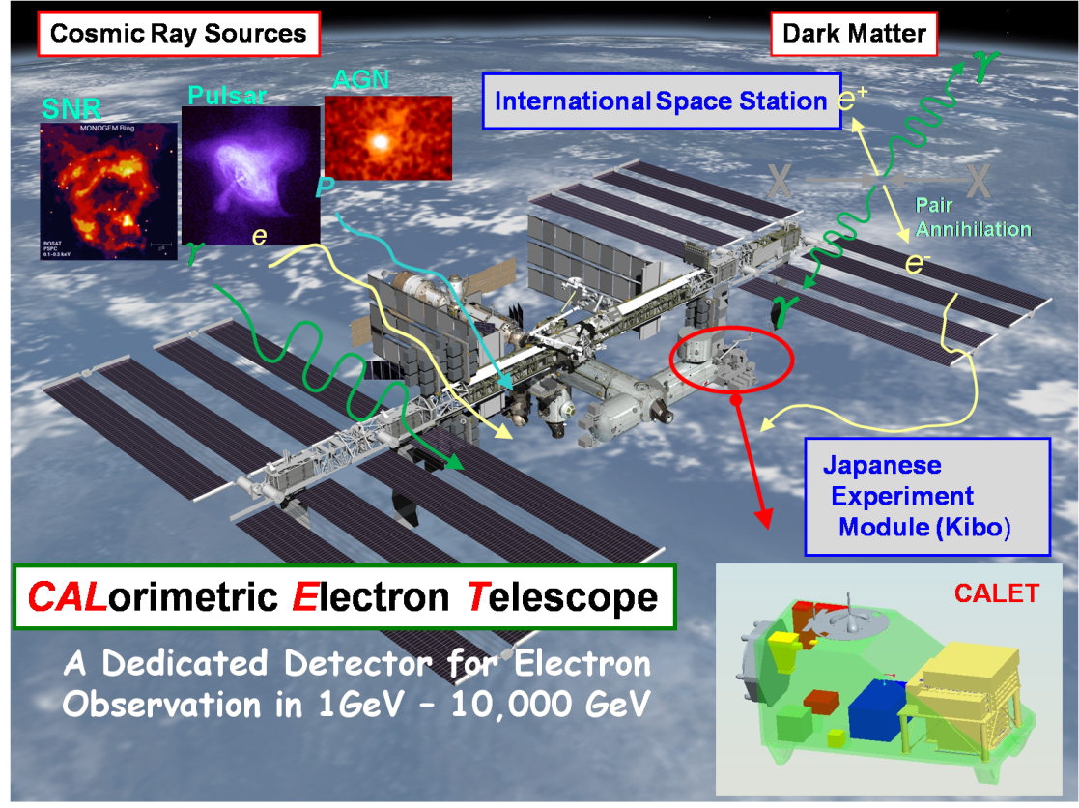
CALET Overview
Instrument
High Energy Electron and Gamma- Ray
Telescope Consisted of :
- Imaging Calorimeter (Particle ID, Direction)
Total Thickness of Tungsten (W) ： 3 X₀
Layer Number of Scifi Belts： 8 Layers ×2(X,Y)
- Total Absorption Calorimeter
(Energy Measurement, Particle ID)
PWO 20mmｘ19mmｘ326mm
Total Depth of PWO： 27 X₀ (24cm)
- Charge Detector (with Italy)
(Charge Measurement in Z=1-30)
Plastic Scintillator 32mmx450mmx10mm (TBD)
2 Layers with a coverage of 45 x45 cm²
Observation
Electrons : 1 GeV -20,000 GeV
Gamma-rays : 10 GeV -10,000 GeV (GRB > 1 GeV)
+ Gamma-ray Bursts : 7 keV-20 MeV
Protons, Heavy Nuclei:
several 10 GeV- 1000TeV ( per particle)
Solar Particles and Modulated Particles
in Solar System: 1 GeV-10 GeV (Electrons)
CHD
CHD ( Size wlll be modified )

Slide 5
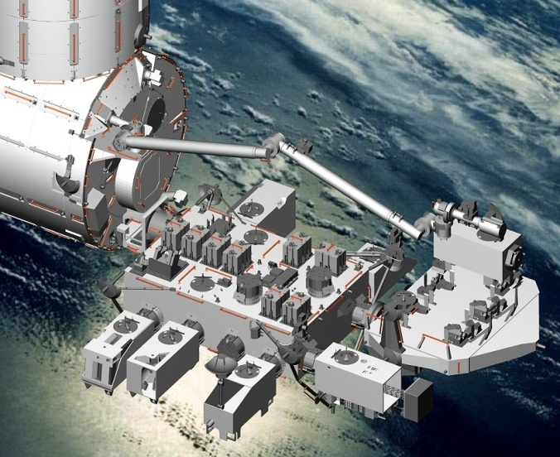
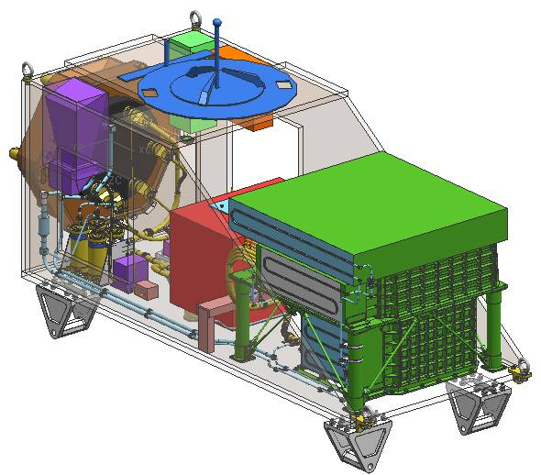
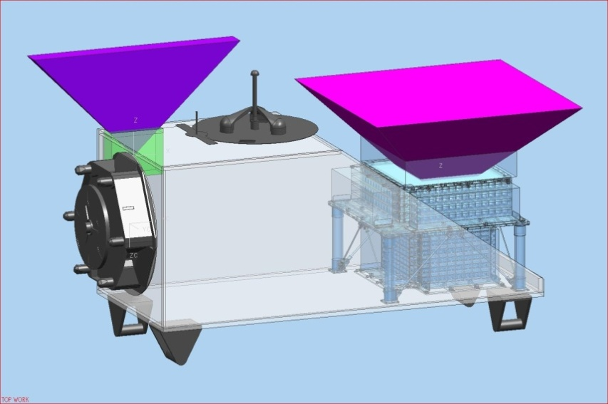
CALET System Design
The CALET mission instrument satisfies the requirements as a standard payload in size, weight, power, telemetry etc. for launching by HTV and for observation at JEM/EF.
JEM/EF & the CALET Port
CALET Payload
Star Tracker
Gamma-ray Burst Monitor
Calorimeter
＃９
Field of View (45 degrees from the zenith)
Mission Data Controller
Weight : 600kg
Power Consumption: 500 W

Slide 6
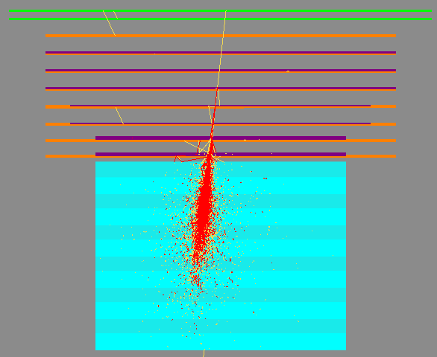
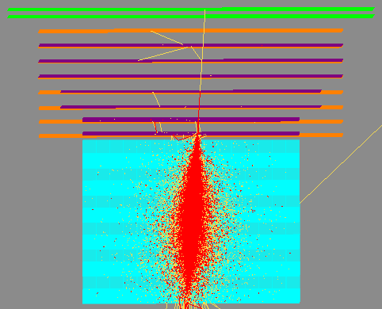
CALET Performance for Electron Observation
Electron 100 GeV
Geometrical
Factor
(Blue Mark)
SIA
IMC
TASC
Detection
Efficiency
Electron 1 TeV
Energy
Resolution
~2%
See Poster for details
( Akaike et al.)

Slide 7
CALET Performance for Electron Observation (2)
Angular Resolution ( to be updated)
SΩ ( for electrons) vs Incident Angle
Electron
Differential
See Blue Marks
Integral
Gamma-ray

Slide 8
Comparison of Detector Performance for Electrons
CALET is optimized for the electron observation in the tran-TeV region, and the
performance is best also in 10-1000 GeV.
Detector | Energy Range (GeV) | Energy Resolution | e/p Selection Power | Key Instrument (Thickness of CAL) | SΩT （m^{２}srday)
PPB-BETS (+BETS) | 10 -1000 | 13% @100 GeV | 4000 (> 10 GeV) | IMC : (Lead: 9 X₀ ) | ~0.42
ATIC1+2 (+ ATIC4) | 10 - a few 1000 | <3% ( >100 GeV) | ~10,000 | Thick Seg. CAL (BGO: 22 X₀) + C Targets | 3.08
PAMELA | 1-700 | 5% @200 GeV | 10⁵ | Magnet+IMC (W:16 X₀) | ~1.4 (2 years)
FERMI-LAT | 20-1,000 | 5-20 % (20-1000 GeV) | 10³-10⁴ (20-1000GeV) Energy dep. GF | Tracker+ACD + Thin Seg. CAL (W:1.5X₀+CsI:8.6X₀) | 300@TeV (1 year)
AMS-02 (less capability in PM model) | 1-1,000 (Due to Magnet) | ～2.5％ ＠100 GeV | 10⁴ (x 10² by TRD⁾ | Magnet+IMC +TRD+RICH (Lead: 17X_{o}) | ~100 (3year)
CALET | 1-10,000 | ~2% (>100 GeV) | ～10⁵ | IMC+Thick Seg. CAL (W: 3 X_{o}+ PWO : 27 X_{o}) | 220 (5 years)

Slide 9

Future Plan of JEM/EF ( as of ~2013)
SEDA-AP
(in storage)
HREP (USA)
MCE
CALET
MAXI
SMILES
ICS-EF

Slide 10
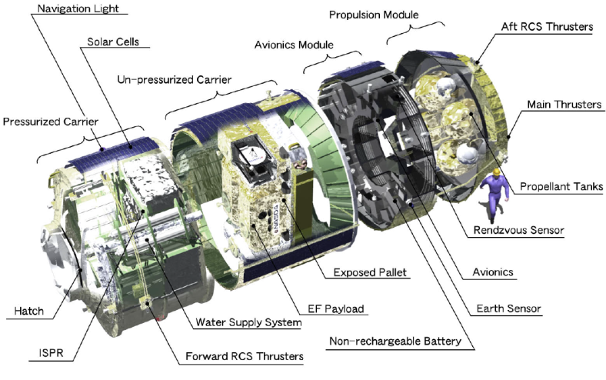
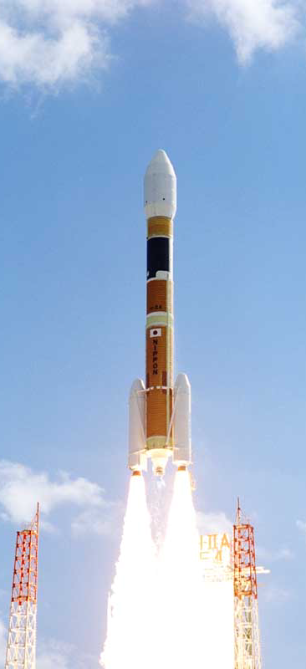
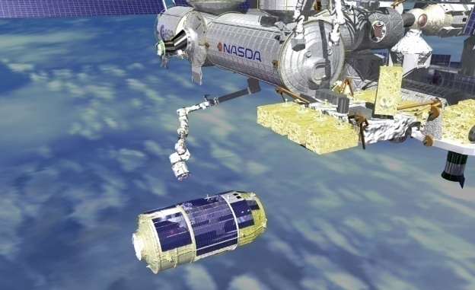
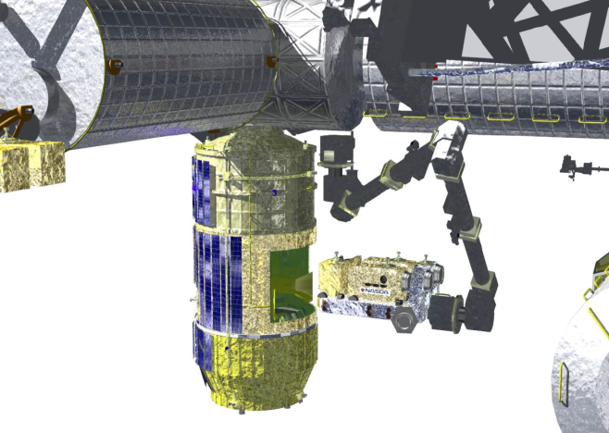
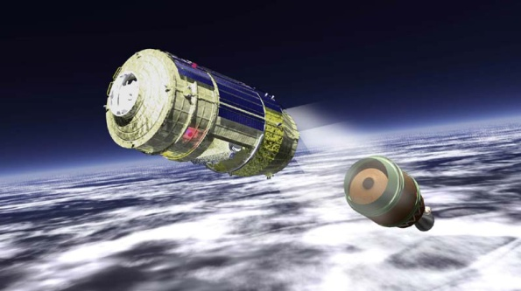
Launching Procedure of CALET
CALET
H2-B Transfer Vehicle（HTV)
ISS
Pickup of CALET
HTV
Approach to ISS
HTV
Launching by
H-IIB Rocket
Separation from H2-B
CALET

Slide 11
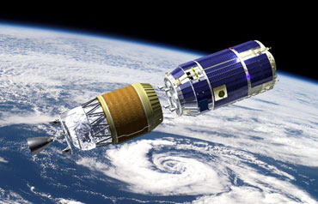
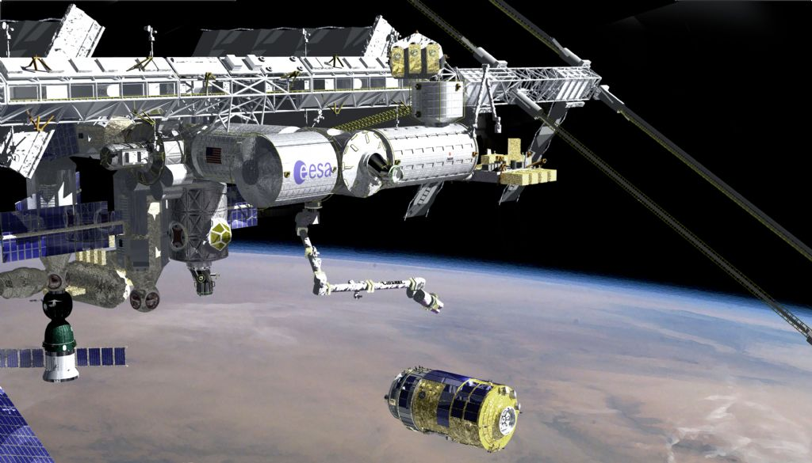
Launch of the H-IIB Launch Vehicle Test Flight
Launched on Sep.11, 2009 at Yoshinobu Launch Complex at
the Tanegashima Space Center in Japan
Docked successfully to ISS on Sep. 18, 2009.
HTV-2 was also launched in Jan, 2011
c
JAXA

Slide 12
Concept of Data Downlink
NASA Link
Real-Time Connection
> 50 % (max. 17 hr/day)
NASA Data
Archive Center
Waseda Univ.
CALET Mission
Science Center
CALET
International
Collaboration
Organization
JAXA ICS Link
Real-Time Connection
~20 % (5 hr/day)

Slide 13
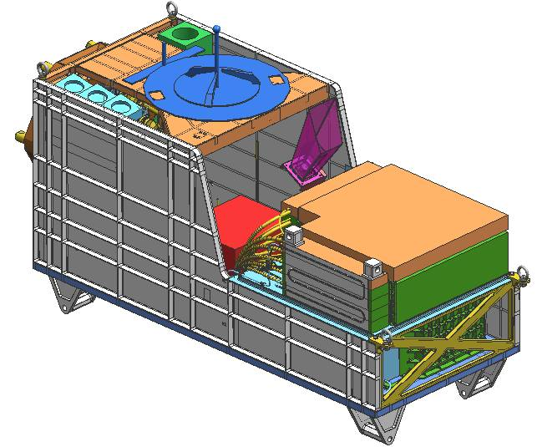
Current Version of the CALET System
Calorimeter: CHD+IMC+TASC
CGBM: SGM+HXM ( reduced :3 ⇒2)
ASC: Advanced Star Camera
( will be move to top)
GPSR: GPS Receiver
MDC: Mission Data Controller
HV: HV Brick
SGM
HXM
ASC
MDC
HV
Calorimeter

Slide 14
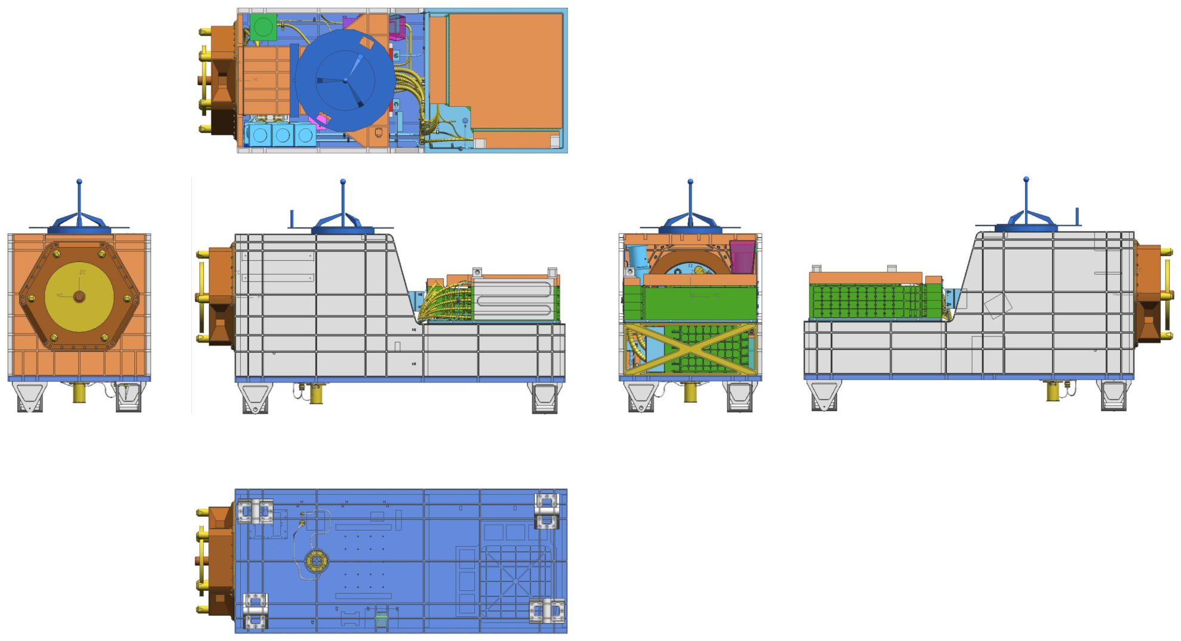
CALET views from various aspects

Slide 15
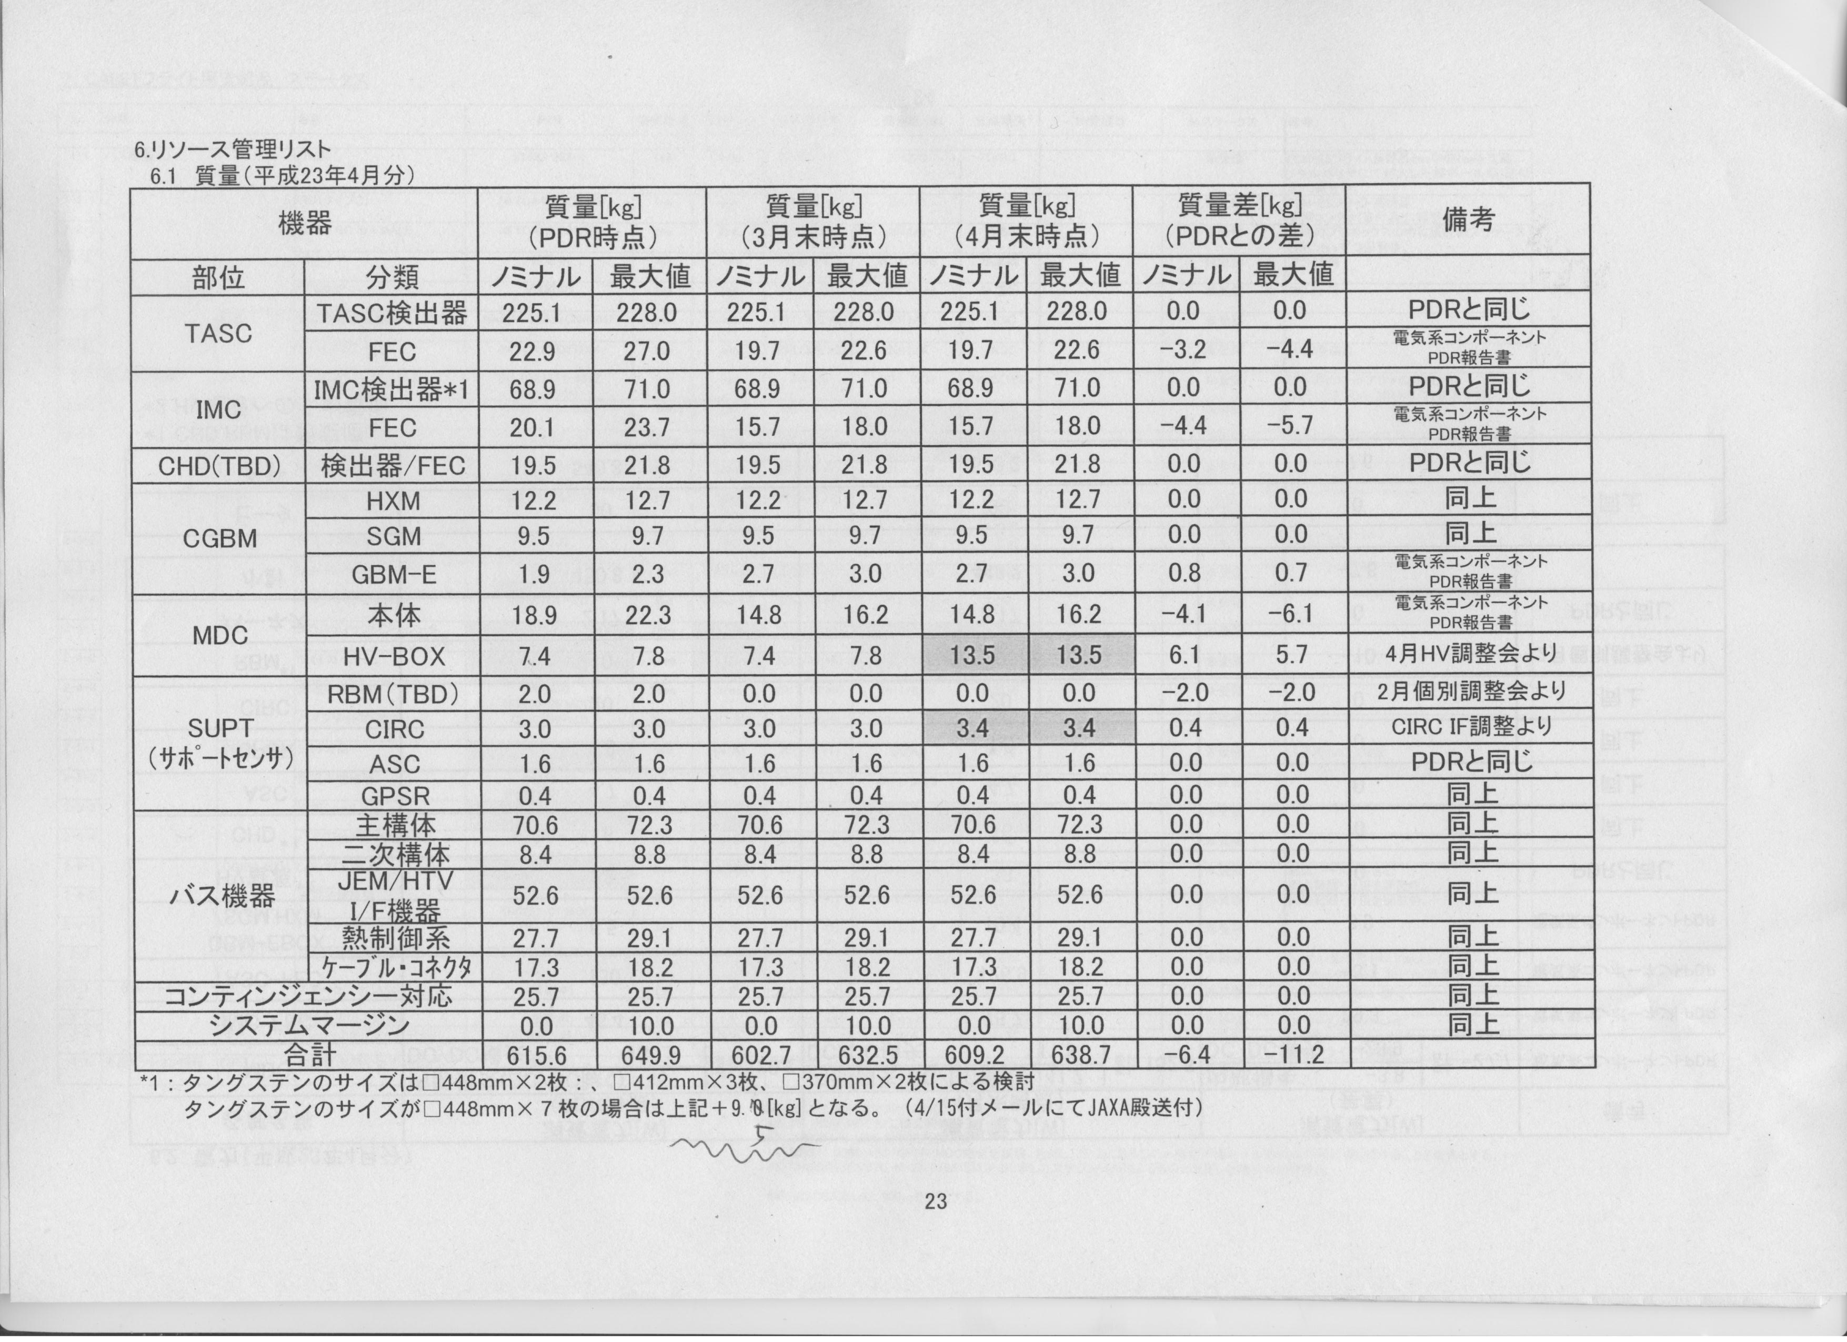
Mass Allocation in Sub-Component
Component
Weight (Nominal Max.)
as of April/E

Slide 16
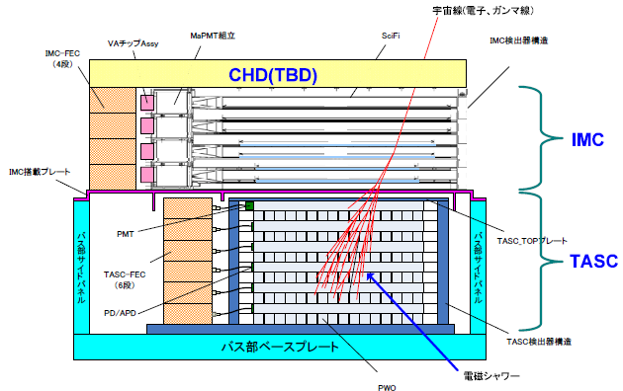
Side View of Calorimeter
IMC is supported by a structure of JEM/EF bus
system

Slide 17
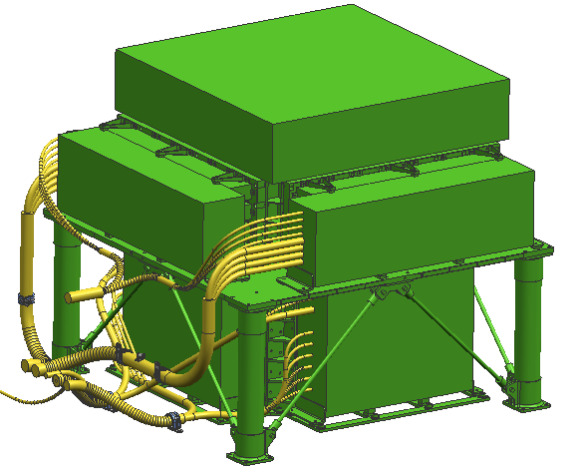
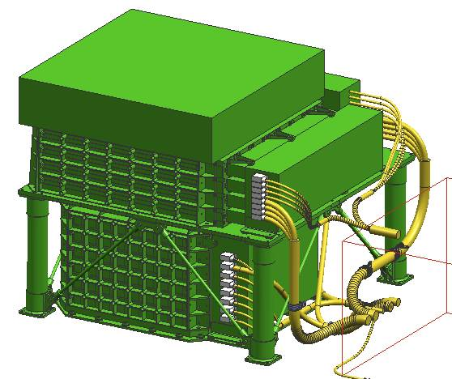
Calorimeter with Front End Electronics Box

Slide 18
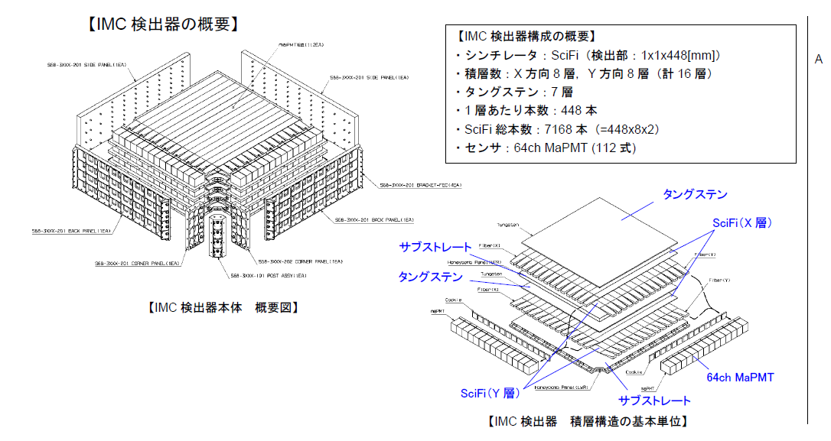
Configuration of IMC
Sensitive Layer: 1mm Sq SciFi Belt 448mm L x 448
Layer Number: 8Layers for X and Y
Tungsten Absorber: 0.2 r.l.x5 + 1 r.l. x 2 (from top)
Total Number of SciFi: 7168 (=448x8x2)
Number of 64-anode PMT: 112
(Dynode sum signal is used for trigger)

Slide 19
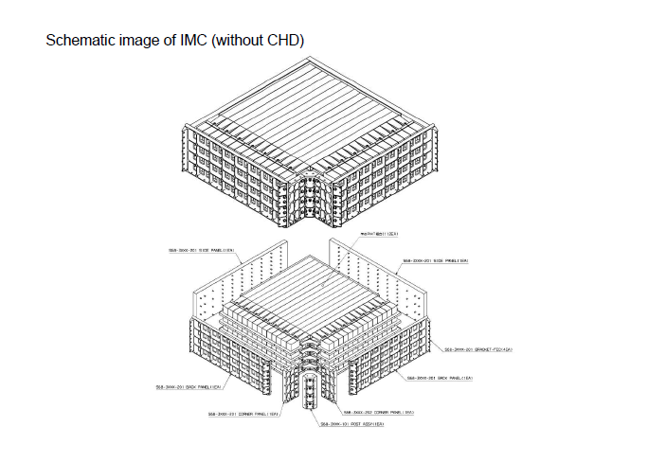

Slide 20
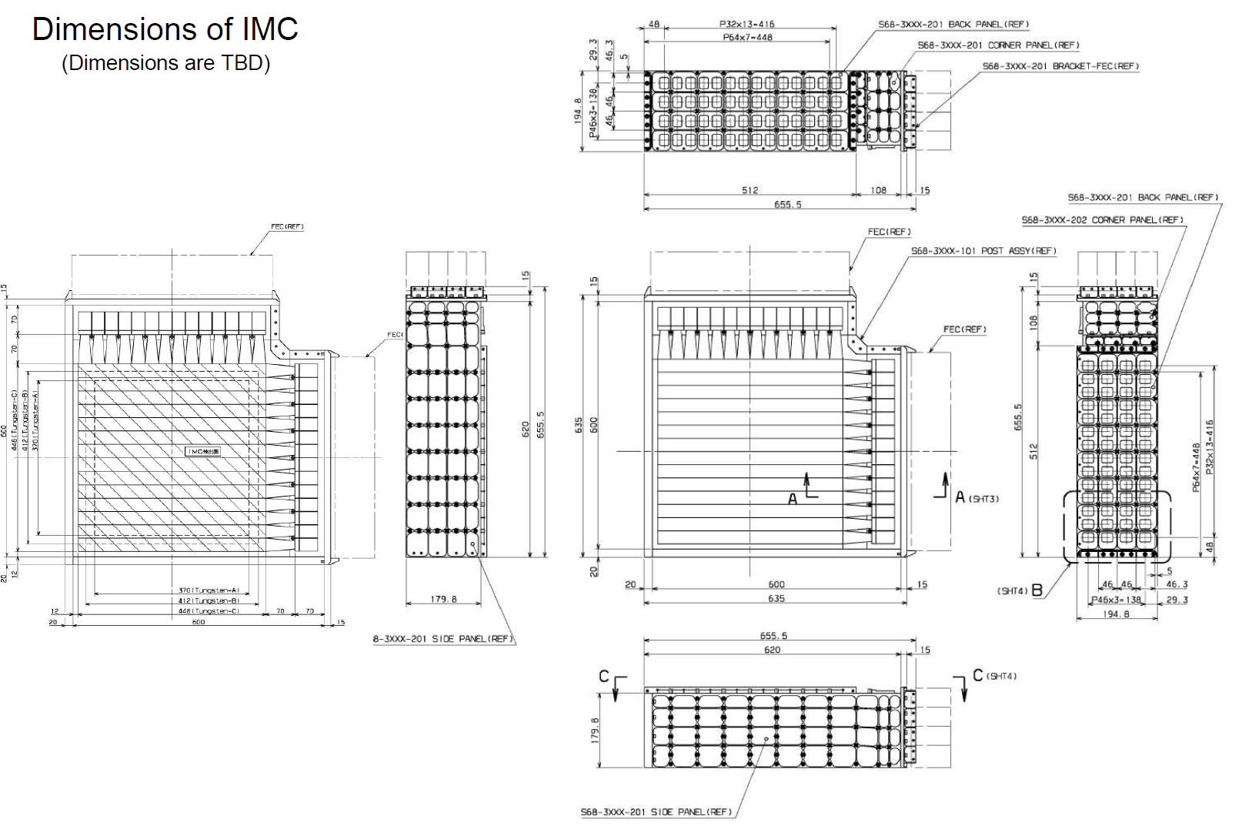

Slide 21
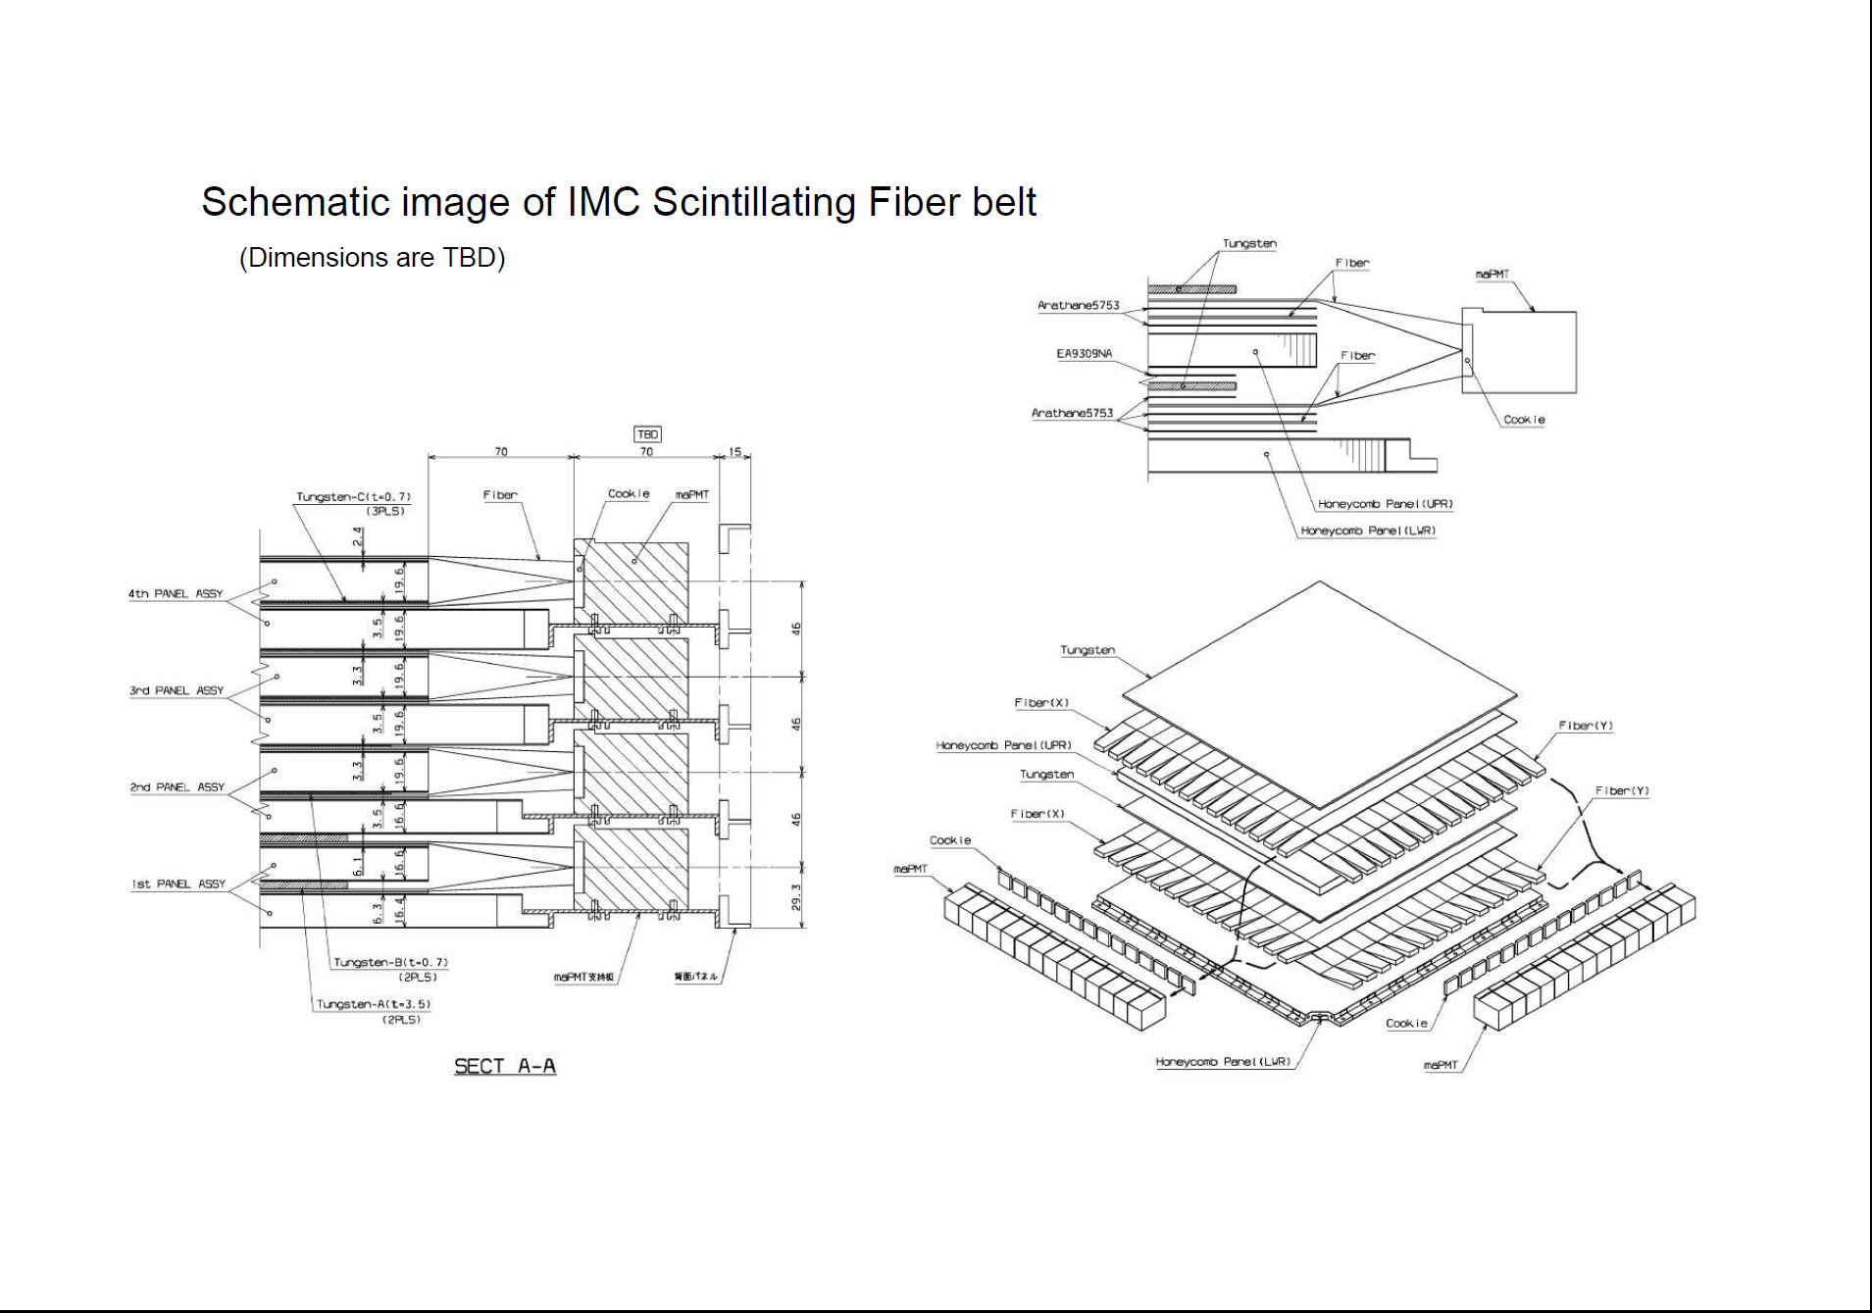

Slide 22
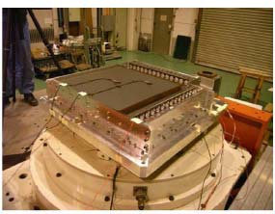
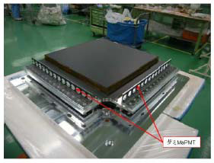
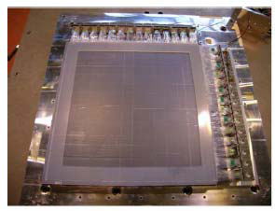
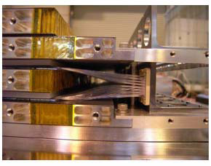
BBM of IMC
Vibration Test of IMC
SciFi Belt Glued on Substrate
PMT and SciFi Connection

Slide 23
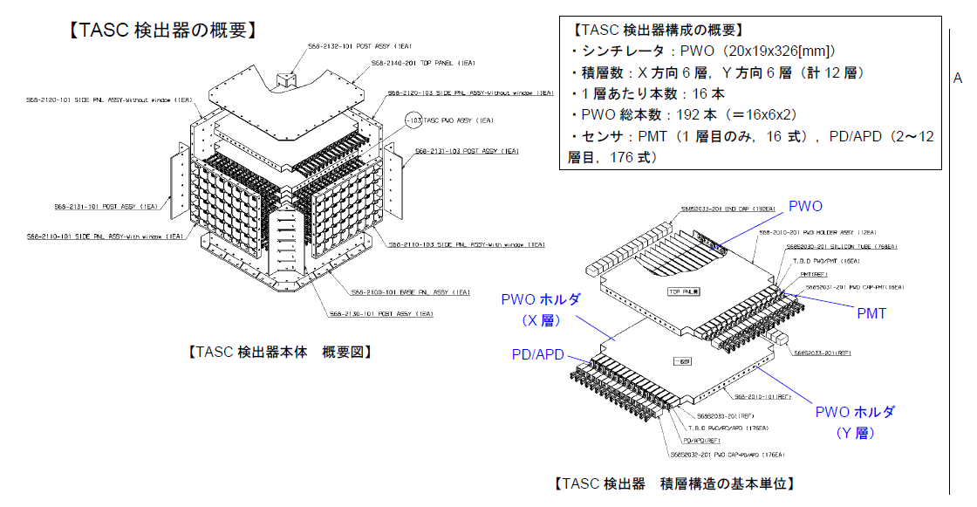
Configuration of TASC
Sensitive Layer: PWO log 20mmH x 19mmW x 326mmL
Layer Number: 6Layers for X and Y
Number of PWO in one layer: 16
Total Number of PWO log: 192 (=16x2x6)
Number of Sensor:
Top(X) layer 16 PMT: Sum signal is used for Trigger
Top(Y) + 2-6 layer (X,Y) APD/PD ( 16x11=176)

Slide 24
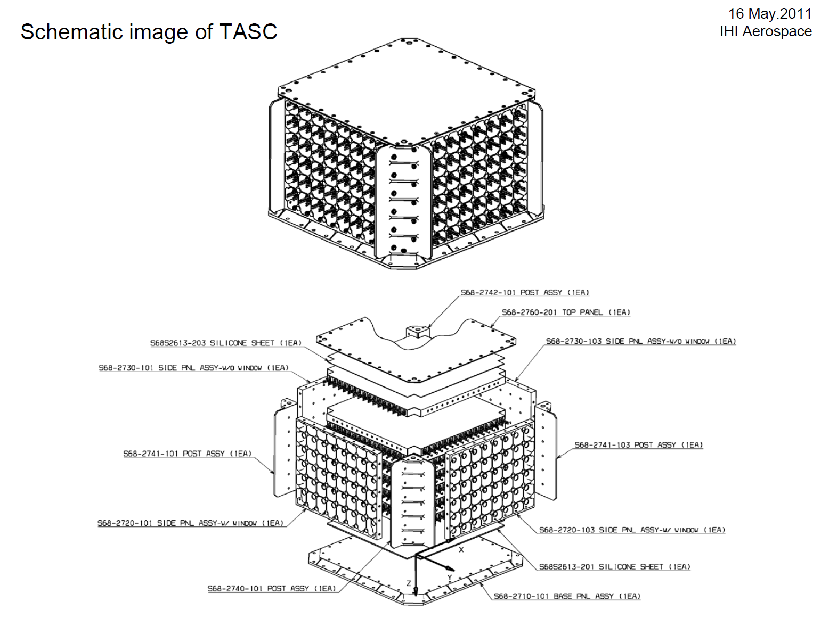

Slide 25
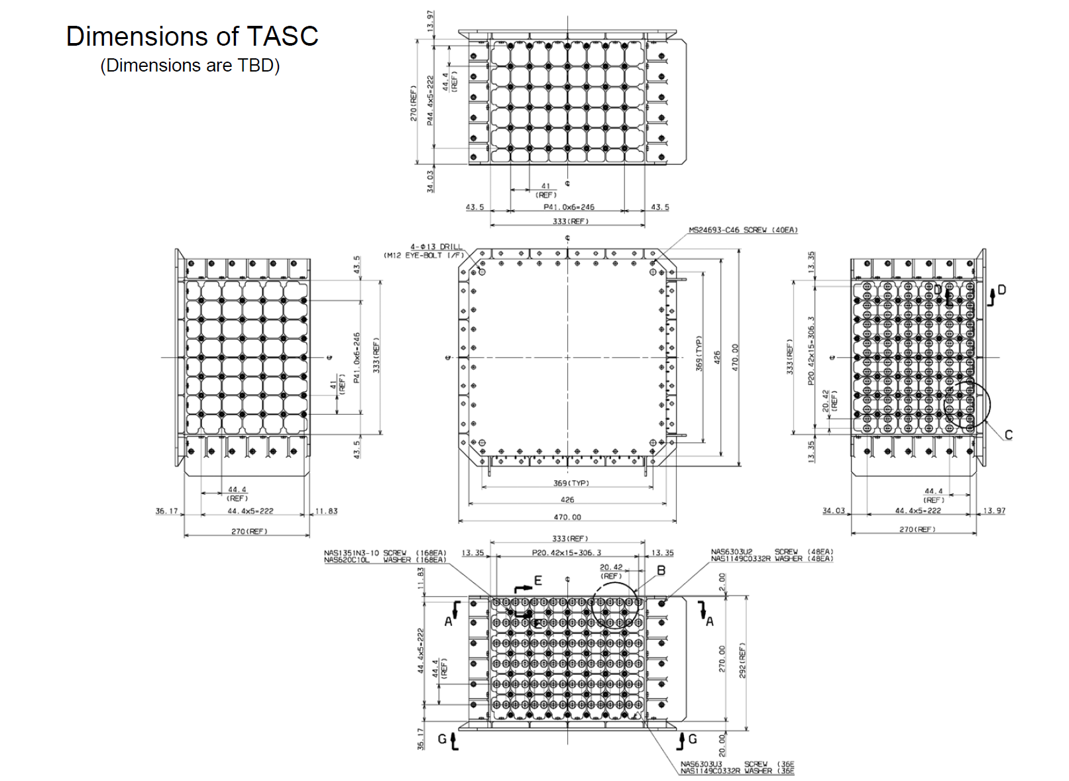

Slide 26
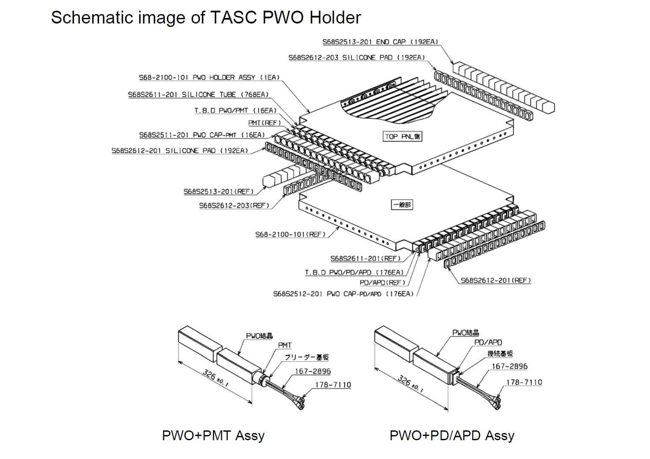

Slide 27
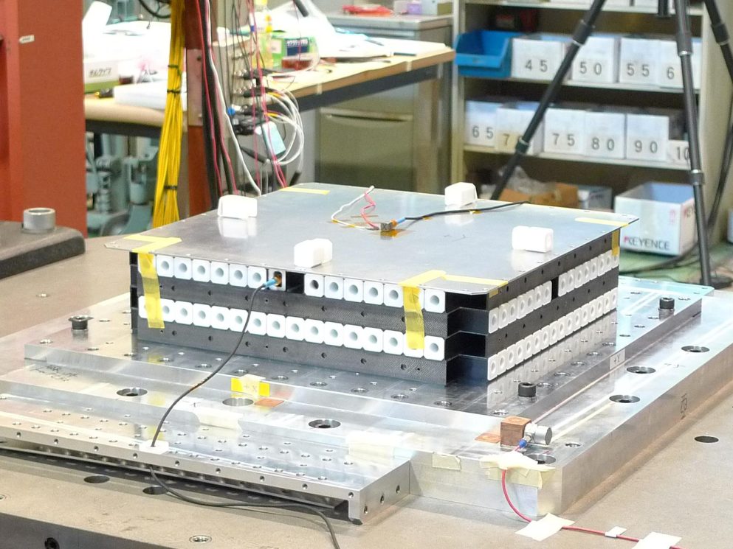
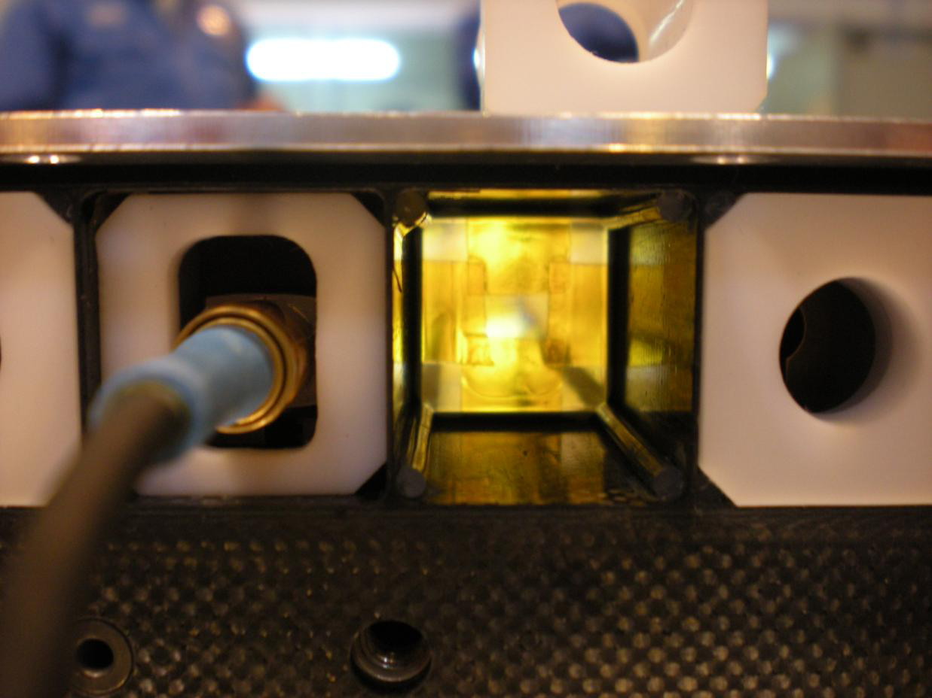
BBM of TASC for Vibration Test
PWO Crystal
Silicone Rubber at Four Corners

Slide 28
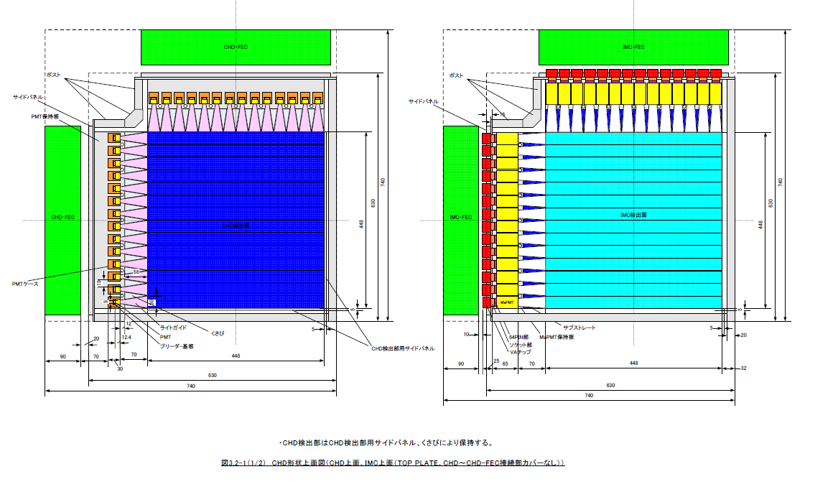
CHD Baseline Design
Plastic Scintillator
(L: 45 cm W: 3.2cm H:1cm )
45cm
Light Guide
PMT
(R7600U)
Top View

Slide 29
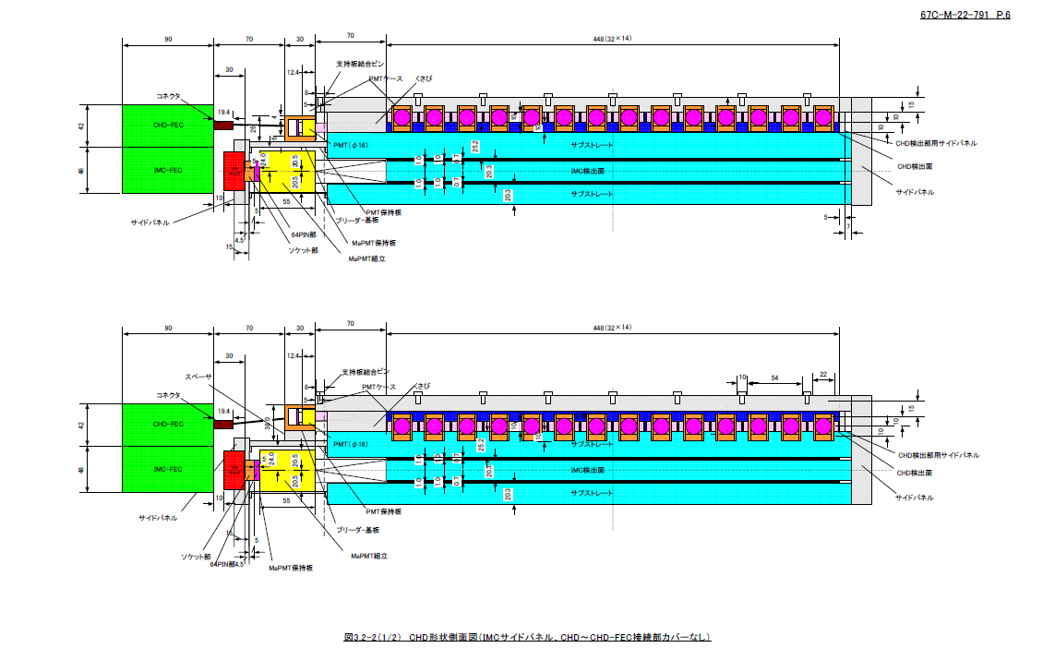
Side View of CHD

Slide 30
Charge sensitive amp.
Pulse Height
Buffer
amp.
Shaping
amp.
(slow)
Plastic Scintillator
PMT
Sample & hold
16bit ADC
DAQ
(FPGA)
・・・
・・・
×14
・・・
×14
・・・
×14
×14
Shaping amp.
(fast)
Amp
Switch
Sum
amp.
Comparator
Trigger
(FPGA)
・・・
・・・
Read out system of CHD:
Sum of 14 PMTs in X and Y
Is used for trigger signal
with two kind of discrimination
level for protons and Heavy Ions
(Z >2).
Trig #1:single
×14
×14
DAC
Trigger
(FPGA)
Trig #2:heavy
Discriminator

Slide 31
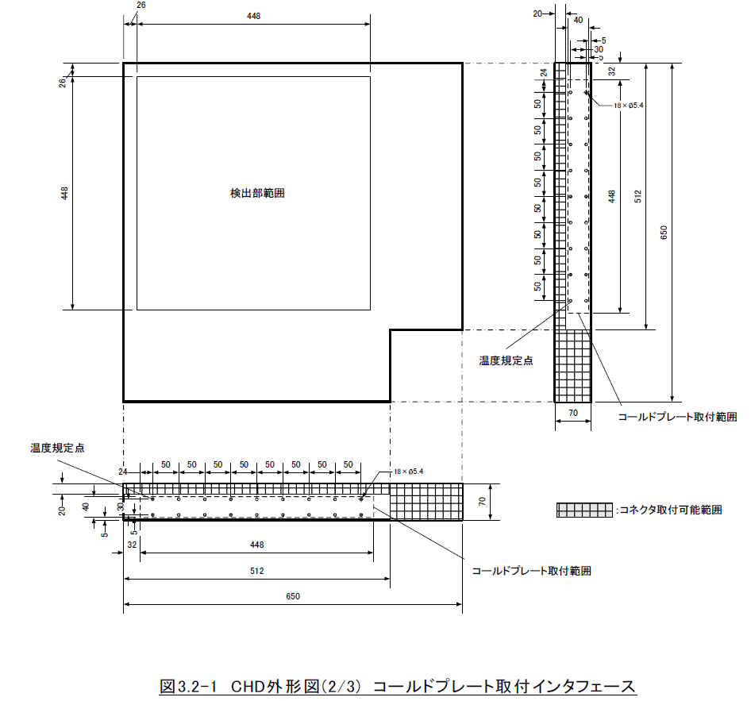
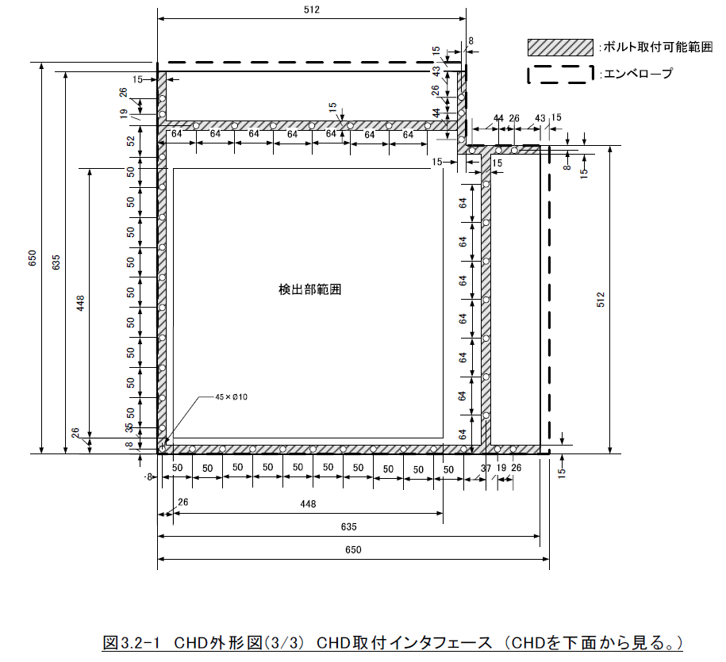
Structure and Size of CHD

