Slide 1
Fluka-based CALET simulation
Design, status and preliminary performance
Paolo Maestro
CALET Modeling & simulation meeting
Pisa 17-18/5/2011

Slide 2
Fluka Monte Carlo simulation package
FLUKA is a general purpose tool for calculations of particle transport and interactions with matter, covering an extended range of applications (calorimetry, dosimetry, detector design, cosmic rays, neutrino physics, radiotherapy, accelerator shielding …)
Accurate physical models have been developed and are maintained/updated.
Fluka can simulate with high accuracy the interaction and propagation in matter of about 60 different
particles.
FLUKA can handle even very complex geometries, using an improved version of the well-known Combinatorial Geometry (CG) package.
For most applications, no programming is required from the user.
User can implement a specific applications by preparing an input card describing
the geometry, materials, physical processes, beam and quantities to score.
The input card is a formatted ASCII cards written as a list of OPTIONS (commands) with
parameters chosen by the user.
However, a number of user interface routines (in Fortran 77) are available for special requirements or complex task. Possible interface with C++ classes.
Well documented http://www.fluka.org

Slide 3
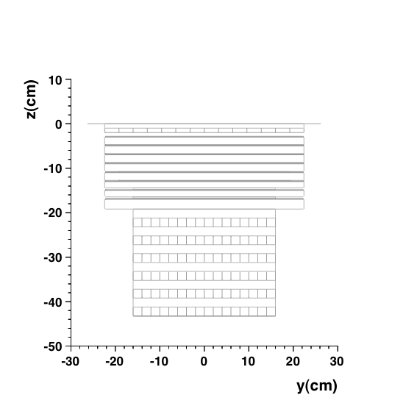
Geometry
CHD
IMC
TASC
Text card (calet.geo) with geometry description is used as input by Fluka. Definition of shapes and dimensions of each region, volumes position in space, material assignment to volumes.
flukaGUI is a tool to visualize the implemented geometry and debug the text card, and inspect the USRBIN standard output files generated during a simulation.
No support structure for CHD, IMC and TASC is implemented at the moment. Need info from CAD
Detector | # layers | segmentation | Material | Segment size (mm) | Density g/cm³
CHD | 2 layers | 14 paddles/layer | PVT (C₉H₁₀) | 32x10x448 | 1.032
IMC (absorber) | 7 layers |  | W | 3: 448x448x0.7 2: 384x384x0.7 2: 320x320x3.5 | 19.32
IMC (active) | 8 layers | 448 Scifi/layer | Polystyrene(C₈H₈) | 1x1x448 | 1.035
TASC | 12 layers | 16 crystals/layer | PbWO₄ | 20x20x320 | 8.30

Slide 4
Particles source
Particles: electron, positron, photons, nuclei (A and Z can be set by the user)
Energy/momentum options:
- Fixed kinetic energy or momentum
- Random extraction in a user-defined energy range: uniform or from a power-law spectrum
Possible implementation of spectral features (e.g. for CR electrons)
Spatial distribution of the particle beam:
- fixed incidence point
- uniform generation inside a rectangular XY area placed at a given Z
- uniform generation on a sphere
Beam direction: - fixed (user defines the X and Y cosines)
- isotropic generation on a sphere for acceptance study
In the particle generator, it is possible to define and set some acceptance criteria (e.g.: particle crossing top CHD and bottom TASC, top CHD-top TASC etc.) for events generated on a sphere, in order to reduce the simulation time avoiding propagation of particles with generated position/direction not satisfying the criteria. Keep track of the number of rejected particles.

Slide 5
Physical processes
In a Fluka simulation with option CALORIMETRY/PRECISION activated:
All e.m. processes ON
Detailed photoelectric edge treatment and fluorescence photons activated
Low energy neutron transport on down to thermal energies included
Particle transport threshold set at 100 keV, except for e+ e- and gamma @ 1 keV
Multiple scattering threshold at minimum allowed energy, for both primary and secondary charged particles
Delta ray production ON with threshold 100 keV
Accurate treatment of multiple Coulomb scattering and ionization fluctuations for hadrons/muons (to handle some challenging problems such as electron backscattering and energy deposition in thin layers even in the few keV energy range)
Heavy particle e+/e- pair production activated with full explicit production
Heavy particle bremsstrahlung activated with explicit photon production above 300 keV
Muon photonuclear interactions activated with explicit generation secondaries
Heavy fragment transport activated
Hadron inelastic nuclear interactions. The FLUKA hadron-nucleon interaction models are based on resonance production and decay below 5 GeV/c (PEANUT package), and on the Dual Parton Model (DPM) above (<20 TeV).
Nucleus (Ions)-Nucleus interactions are treated through interfaces to external event generators
5 GeV/n - 10 PeV: DPMJET-III
0.1 - 5 GeV/n: modified RQMD

Slide 6
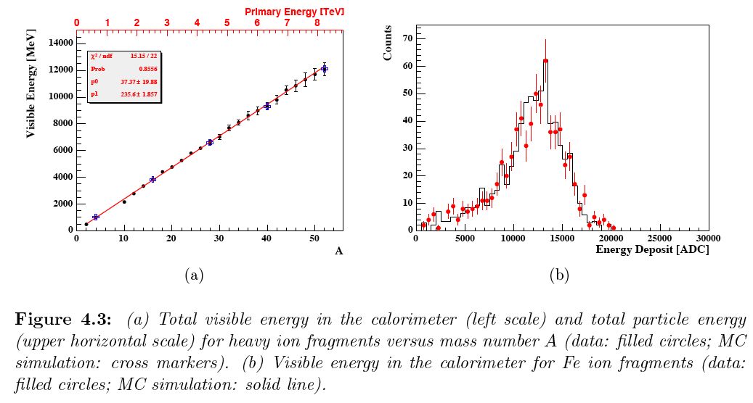
Fluka vs. ion beam data – Energy deposit
Fe ions @158 GeV/n
A/Z=2 ions @158 GeV/n
0.5 λ thick C target + 20 X₀ W/scifi calorimeter

Slide 7
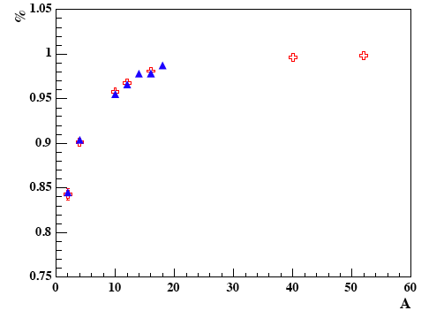
Fluka vs. ion beam data – Interaction probability
Crosses MC, triangle data

Slide 8
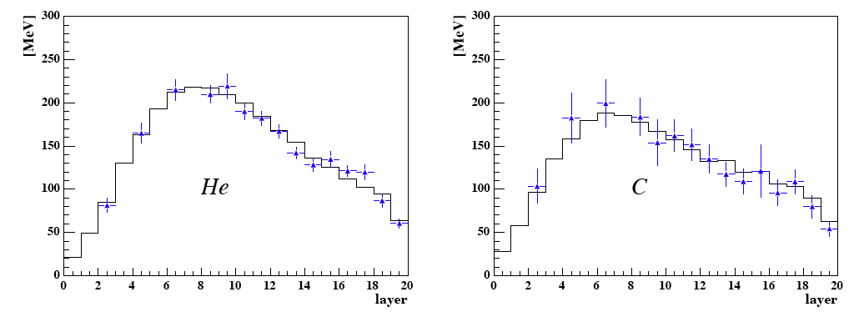
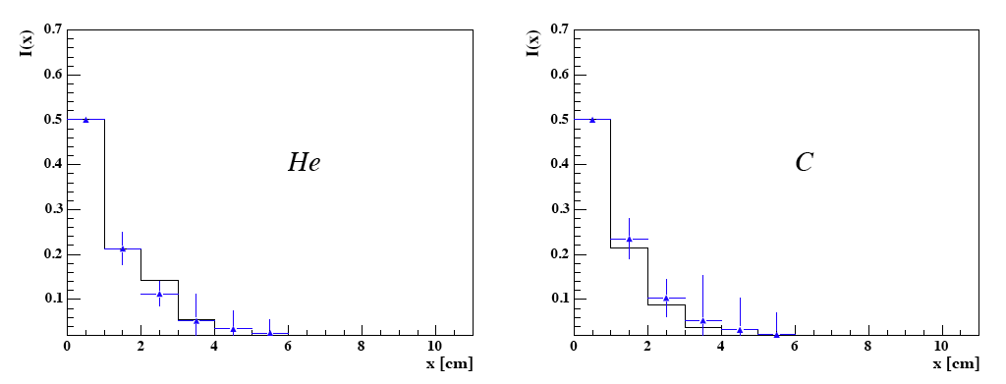
Longitudinal and lateral profiles- Fluka vs. flight data
histo Fluka
dots CR data

Slide 9
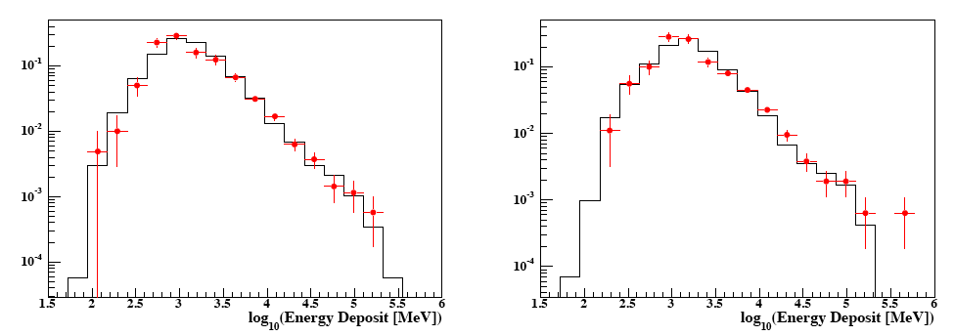
Energy deposit by CR nuclei – MC vs. flight data
Carbon
dots: flight data
histo: Fluka MC
Oxygen
dots: flight data
Hhsto: Fluka MC

Slide 10
Data output
Fluka provides standard binary output files.
- Flexible (user may choose which quantity to score, in which region, for all particles or only a given type).
- Formatted in a compact array, they are written during simulation and must be post-processed by the user with standard Fortran routines.
File types:
EVENTBIN: scores energy or star densities in a binning structure independent from the geometry, and prints the binning output after each "event”. Used for energy deposited in CHD paddles, IMC fibers and TASC crystals, event-by-event.
EVENTDAT: prints event by event the scored star production and/or energy deposition in each region, and the total energy balance, energy leaking out of TASC from bottom and lateral sides for both neutral and charged particles
USRBIN scores distribution of one of several quantities (energy, e.m. energy, dose, neutron fluence, particles momentum etc.) in a regular spatial structure (binning detector) independent from the geometry. It can be visualized with flukaGUI
USERDUMP a collision file and defines the events to be written. In our case, it stores the backscattered particle tracks (kinetic energy, direction, type) crossing CHD and the energy they deposited in CHD. Energy deposited by primary particle vs. albedo particles, important to understand albedo contribution to charge measurement with CHD and contamination (see Simone Bonechi’s talk).

Slide 11
Data output (2)
After the simulation, the standard output files are processed by a C++ program which reads the arrays stored in the binary files and writes the information in a ROOT TTree, and then in a TFile.
Our conversion program is based on two libraries:
- libReadCalet containing the definition of the formats of the different Fluka binary files.
General purpose library independent on the specific application (i.e. detector geometry). Frozen
- libCaletEvent contains the definition of the class written in the ROOT TTree.
This library depends on the specific application.
It can be changed (undergoing work to uniformize with G4 output)
Information stored in the TTree:
- collection of hits (no threshold on energy deposited is applied at this step) for CHD, IMC, TASC
- Primary particle momentum, kin. energy, direction, generation point, A, Z.
- Albedo particle tracks crossing CHD and their energy deposit
- Energy balance in the detectors (deposited energy, e.m. energy, energy leaking out, transported by neutron, gamma etc.)
- Coordinate of the point in which the first inelastic interaction occurs (for nuclei)

Slide 12
Benchmarks
Need for common benchmarks to check different MC simulation and validate results
So far, simple common benchmarks have been generated with Fluka and G4
- Proton and electron @ 10, 100, 1000 GeV kinetic energy
- Normal incidence
- Generated in 4x4 cm² area on top of CHD at the center of the detector
Comparison (G4 vs. Fluka) of the following quantities (in progress):
    Total energy deposited in TASC of interacting particles
    Distribution of energy deposited by mip’s
    Longitudinal profile
    Lateral profile at shower max
    For nuclei: probability of inelastic interactions vs. interaction depth in the detector

Slide 13
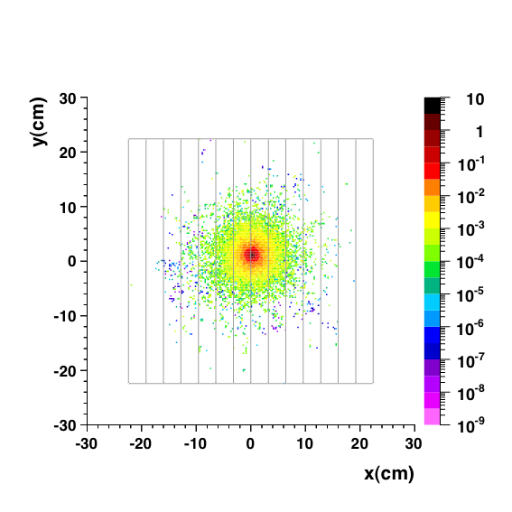
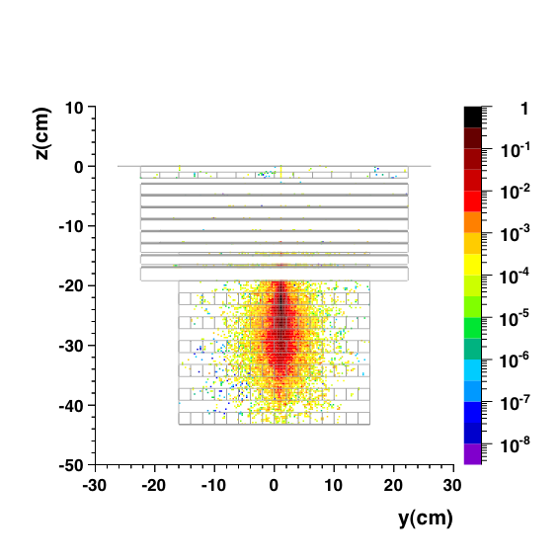
Electron event @ 100 GeV

Slide 14
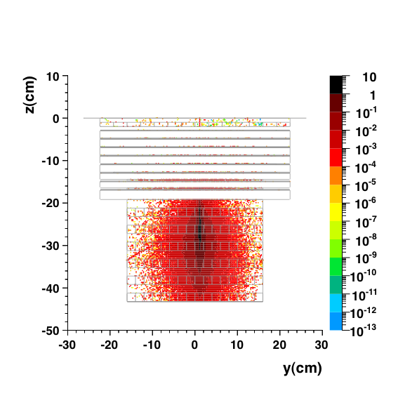
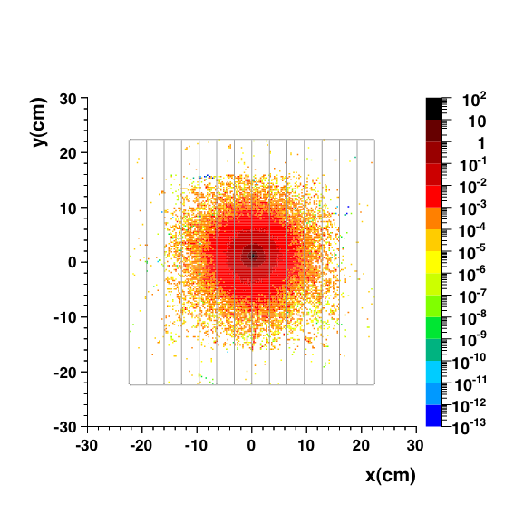
Electron event @ 1000 GeV

Slide 15
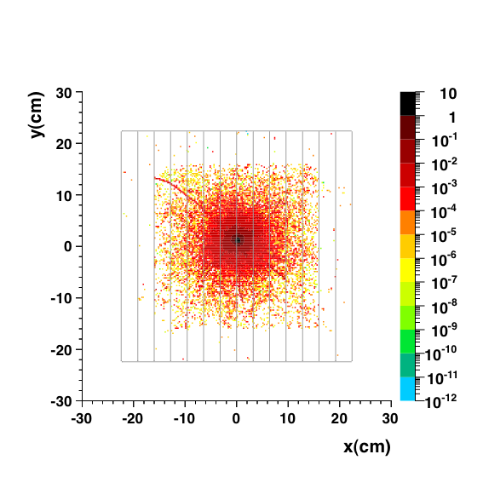
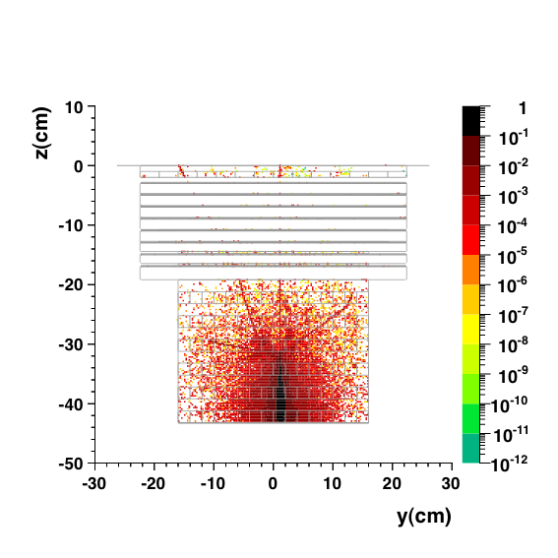
Proton event @ 1000 GeV

Slide 16
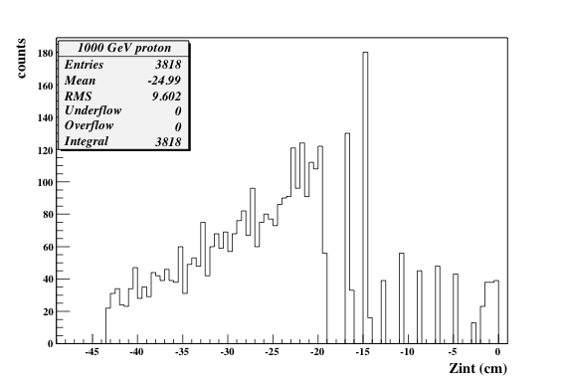
Nuclear inelastic interactions
Very useful to tag the Z coordinate of the first inelastic interactions in the detector, to study the TASC energy response to p/heavy nuclei.
About the same probability of interaction for p @ 10, 100, 1000 GeV:
~ 24% mip
~ 45% interact in CHD (3%) or
IMC (12%) or
first 4 TASC layers (30%)
IMC
TASC
CHD

Slide 17
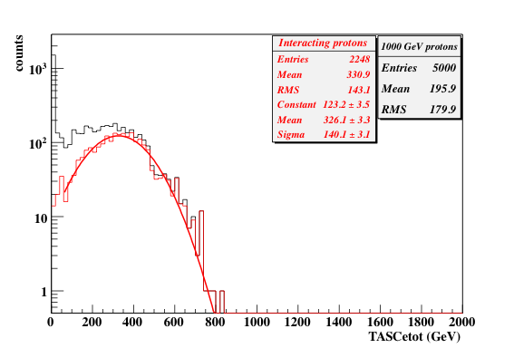
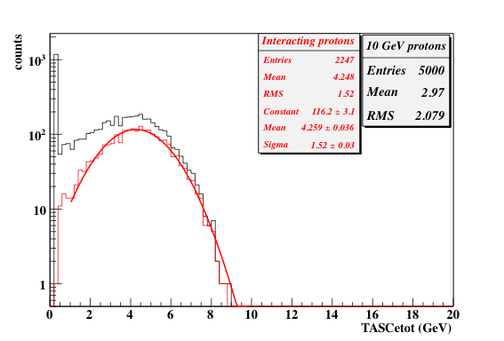
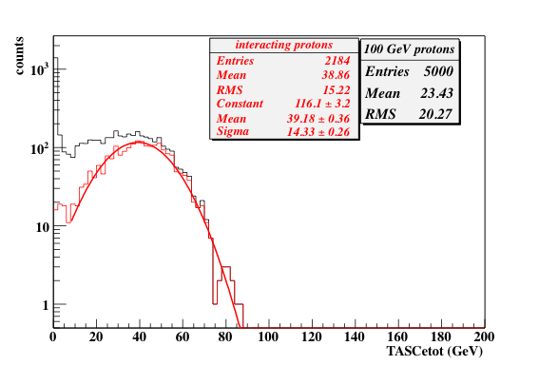
Energy deposited in TASC by protons
10 GeV
100 GeV
gen E (GeV) | <E> (GeV) | σ (GeV) | σ/<E> | <E>/genE
10 | 4.26 | 1.52 | 35.2% | 0.42
100 | 39.2 | 14.3 | 36.5% | 0.39
1000 | 326 | 140 | 43% | 0.33
1000 GeV

Slide 18
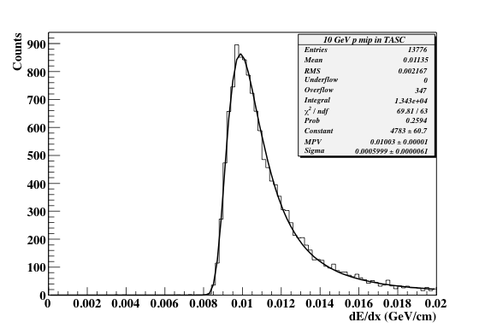
Non interacting protons in TASC

Slide 19
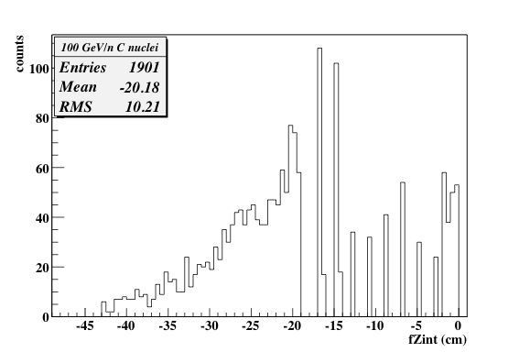
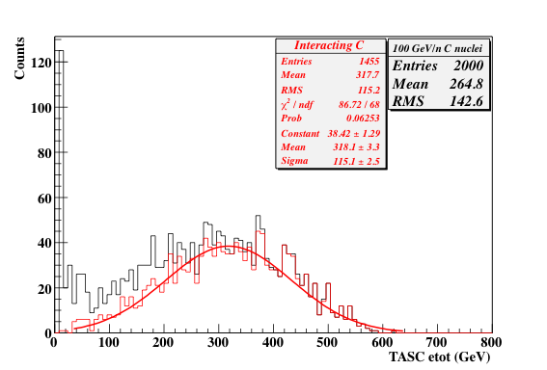
100 GeV/n ¹²C nuclei in TASC
IMC
CHD
TASC
~ 5% non interacting
~ 73% interact in CHD (10%) or IMC (23%) or first 4 TASC layers (40%)
How to measure the energy of heavy nuclei
IMC W thickness 1.05 cm = 3 X₀ = 0.11 λ (interaction length)
TASC thickness 24 cm = 27 X₀ = 1.23 λ
To force nuclei interaction, it needs about 0.5 λ = (IMC + 1/3 TASC) thickness (e.g.: CREAM, ATIC)
The remaining 2/3 of TASC thickness = 0.8 λ = 8 layers = 18 X₀ are used to measure the e.m. shower core

Slide 20
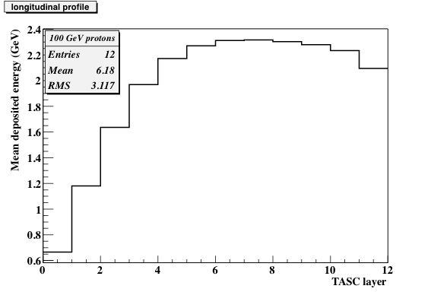
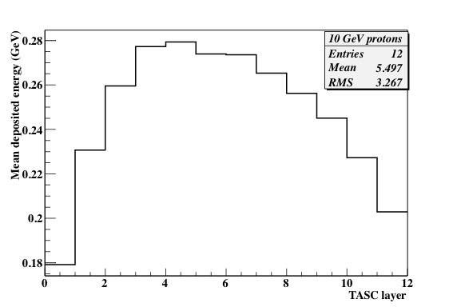
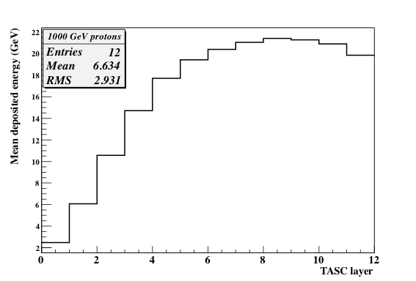
Protons – Longitudinal profile in TASC

Slide 21
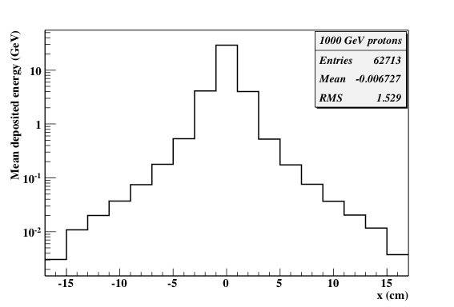
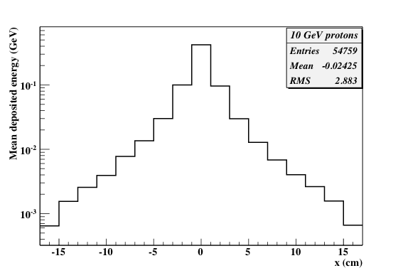
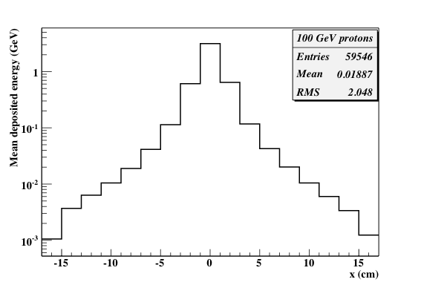
Protons – Lateral profile @ shower max in TASC

Slide 22
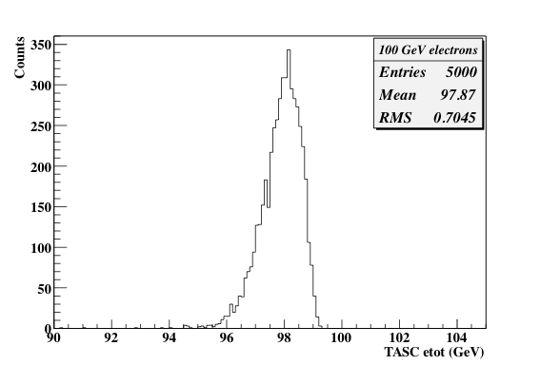
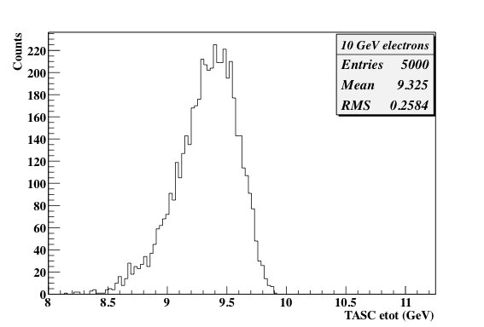
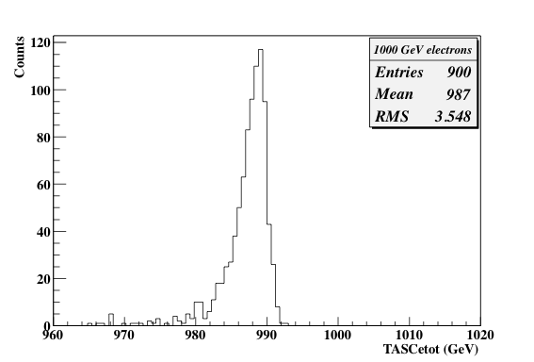
Energy deposited in TASC by electrons
Rough energy resolution: <1% @ E>100 GeV
At this level not realistic response: add digitization,
channel non-unifomity, etc.
- Asymmetric distributions: left-hand tail to due fluctuations
in energy deposited in 3 X₀ of IMC.
- Understand how to cross-calibrate IMC and TASC
to provide a unique energy measurement.

Slide 23
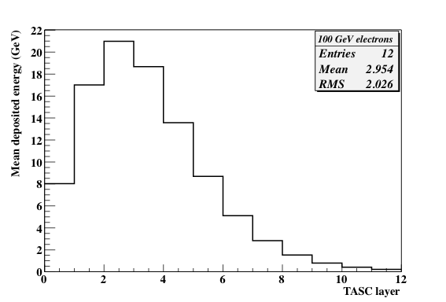
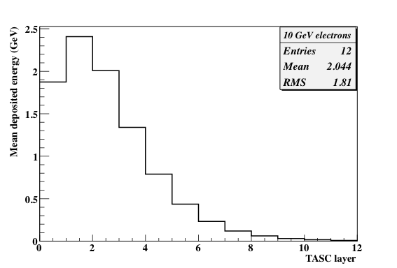
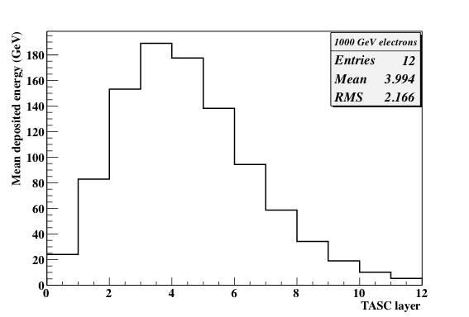
Electrons – Longitudinal profile in TASC

Slide 24
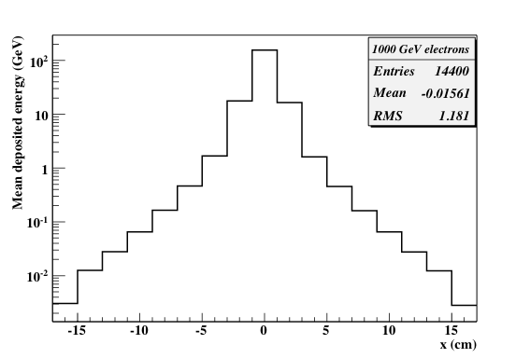
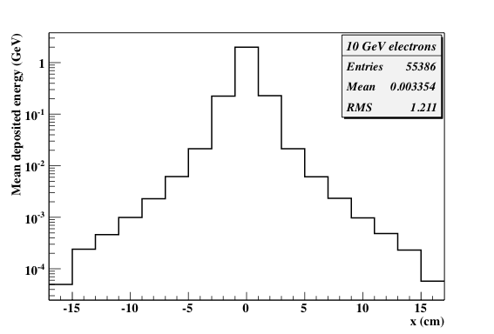
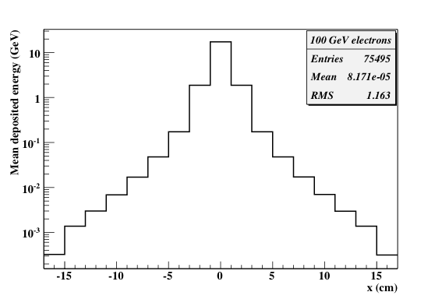
Electrons – Lateral profile @ shower max in TASC

Slide 25
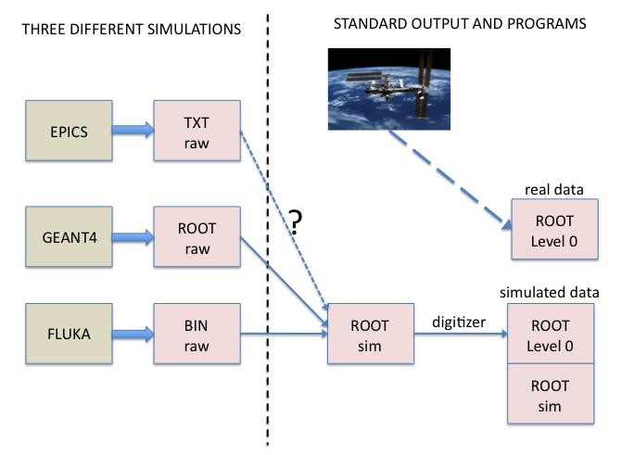
Common scheme to handle MC data
Each MC code has its own output format (text, binary, ROOT files).
Need for a common and unique MC data format to be used by the different simulations (EPICS, G4, Fluka)
- easy data sharing/comparison between MC
- same analysis programs can be used
- common benchmarks to validate results
An interface program converts these formats to common ROOT sim. files, containing hit collections + MC truth.
At this stage, a hit is the raw energy deposited in a crystal/fiber/paddle: no digitization, light yield, attenuation, pedestal fluctuations, calibration, etc. are applied
1
1
At a next stage, a digitization program will be applied to ROOT sim. files to produce ROOT
Level 0 data (digitized hits, electronics threshold, calibration, attenuation, etc.).
No need to produce new MC data when the detector response parameters are changed.
- Same format as flight data (level 0) + specific MC information.

