Slide 1
Proposal for the connection of the SPS extraction sextupoles and bumpers to the BIS post-LS3 A. Colinet with inputs from BE-OP, SY-ABT and SY-EPC November 7th, 2025 – MPP #264

Slide 2
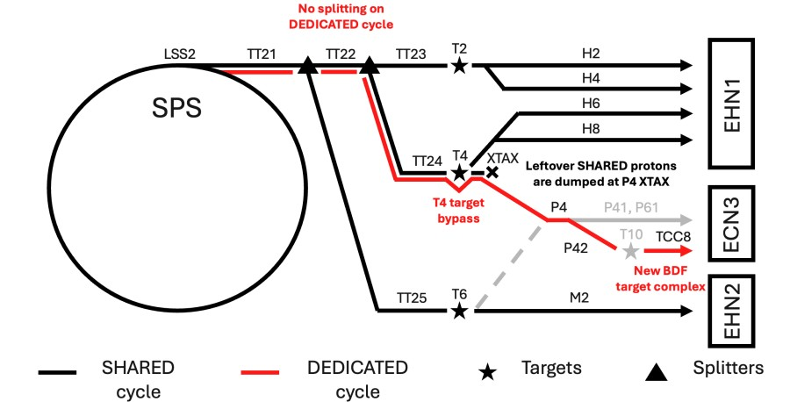
North Area Beam Interlock System introduction
A new BIS will be deployed for the protection of the North Area starting in LS3
ECR in EDMS 3324656
Engineering Specification of the North Area BIS in EDMS 2810115
Aim of MPP discussions: get expert feedback on key MP points and approve strategy before deployment in LS3
Series of presentations at the MPP will be organized, with schedule yet to be defined
Topic of today:
SPS extraction sextupoles
and bumpers

Slide 3
Extraction sextupoles and bumpers
Magnets located in the SPS ring with power converters in BA1, 2, 4, 5, 6
Location | Extraction sextupoles | Extraction bumpers
BA1 | LSE.10602, LSE.12402
BA2 | LSE.20602, LSE.22402 | MPSH.21202, MPSV.21303, MPLH.21431, MPSV.21503, MPNH.21732, MPLH.21995, MPSV.22103, MPLH.22195, MPSV.22303
BA4 | LSE.40602, LSEN.42402 | MPSV.41303, MPSV.42303, MPSH.41402, MPLV.41501, MPLV.42101, MPSH.42198, MPLH.41658, MPLH.41994
BA5 | LSE.50602, LSE.52402
BA6 | LSE.62402 | MPSH.6140, MPSV.6130, MPLH.6165, MPSV.6150, MPSH.6219, MPSV.6210, MPSV.6230, MPLH.6199

Slide 4
Situation today
Magnets located in the SPS ring with power converters in BA1, 2, 4, 5, 6
Situation today:
LSS4/6 extraction bumpers controlled with MUGEF that provide the FEI to the SPS extraction BICs. These implement an evaluation of the current at flat top. These interlocks are maskable when I<5e11p.
If a fault is reported, the BIS inhibits the beam permit to the extraction kicker but doesn’t request a beam dump in the SPS. The beam is consequently dumped on the Standard Dump event at the end of the flat-top, or potentially on beam losses if the resulting orbit shift triggers the BLMs in the SPS.
Location | Extraction sextupoles | Extraction bumpers
BA1 | LSE.10602, LSE.12402
BA2 | LSE.20602, LSE.22402 | MPSH.21202, MPSV.21303, MPLH.21431, MPSV.21503, MPNH.21732, MPLH.21995, MPSV.22103, MPLH.22195, MPSV.22303
BA4 | LSE.40602, LSEN.42402 | MPSV.41303, MPSV.42303, MPSH.41402, MPLV.41501, MPLV.42101, MPSH.42198, MPLH.41658, MPLH.41994
BA5 | LSE.50602, LSE.52402
BA6 | LSE.62402 | MPSH.6140, MPSV.6130, MPLH.6165, MPSV.6150, MPSH.6219, MPSV.6210, MPSV.6230, MPLH.6199
Connected to
CIB.BA4.TT40A
Connected to
CIB.BA6.TT60A

Slide 5
Requirements post-LS3
Magnets located in the SPS ring with power converters in BA1, 2, 4, 5, 6
LS3 upgrade
LSS4 Extraction bumpers to be used with the LSS4 TECA (crystal) to shadow the ZS in LSS2
All PCs will be equipped with renovated FGC3 controls replacing the legacy MUGEF
Certain selected PCs will also have renovated power parts (Polaris)
EPC agreed to develop a feature to have multiple thresholds along the cycle as specified in EDMS 3253361
Location | Extraction sextupoles | Extraction bumpers
BA1 | LSE.10602, LSE.12402
BA2 | LSE.20602, LSE.22402 | MPSH.21202, MPSV.21303, MPLH.21431, MPSV.21503, MPNH.21732, MPLH.21995, MPSV.22103, MPLH.22195, MPSV.22303
BA4 | LSE.40602, LSEN.42402 | MPSV.41303, MPSV.42303, MPSH.41402, MPLV.41501, MPLV.42101, MPSH.42198, MPLH.41658, MPLH.41994
BA5 | LSE.50602, LSE.52402
BA6 | LSE.62402 | MPSH.6140, MPSV.6130, MPLH.6165, MPSV.6150, MPSH.6219, MPSV.6210, MPSV.6230, MPLH.6199
Required to be interlocked for North Area cycles
Interlocked for
LHC/AWAKE cycles
Interlocked for
LHC/HiRadMat cycles

Slide 6
Operational aspects
Since all these magnets are part of the SPS ring beam line, they act on the beam trajectory regardless of the cycle.
Even if an element is not used for a given cycle, we must ensure that its corresponding PC is regulating correctly.
SPS OP would like these elements to be interlocked in any cycle. Nevertheless, the breakdown of one of these elements should be mitigated by the possibility to mask the interlock and resume operation to the destinations that don’t use it.
Today, all these elements are interlocked in the SIS (on top of the existing SPS extraction BIS interlocks for LSS4/6 bumpers)
For Slow Extraction, it is deemed acceptable to have the possibility to mask these interlocks at any beam intensity. In case one element required for slow extraction breaks down, then OP reconfigures the super cycle to remove the North Area users. The aim is to permit operation to the unaffected destinations.
Masked elements in the SIS and BIS are reported to the SPS logbook at the end of every shift.

Slide 7
Proposal for post-LS3
The LSS4/6 bumpers interlocks connected to the SPS Extraction BICs remain as today to retain the same level of protection (i.e. User permit true at flat top if regulation is ok, interlock maskable when I<5e11p).
On top of these, it is proposed to interlock all these elements with the SPS ring BIS. They would be connected to the BIS via dedicated concentrator User Interface boards (CIBFX), and be maskable. The Setup Beam Flag controlling the maskability of the interlocks in the SPS is permanently set to true, meaning that the interlocks can be masked regardless of the beam intensity.
Pros | Cons
Higher level of protection than today as these elements see the beam in any cycle Dump earlier at a lower energy in case one of these elements is not following its function -> less energy deposited on the SBDS FGC3 multiple thresholds feature allows for OP flexibility on ramp up/down -> EPC confirmed that a valid user permit can be reliably provided to the BIS More ‘logical’ implementation than interlocking them with the NA BIS Simpler infrastructure than interlocking them all in BA2 | Loss of SPS availability if one element raises a fault. SPS-OP keeps the possibility to mask the interlock. Maskability regardless of beam intensity for flexibility at the expense of safety. Will be mitigated by a software check to verify that for NA cycles, none of the required interlocks is masked.
Note: For cycles without function settings, the detailed design hasn’t been agreed upon between EPC and OP yet. Two possibilities: use non-ppm interlocks settings (one threshold for all users), or OP to provide settings for all users.

Slide 8
Interlocks connections
CIB.BA2.S2
CIB.BA3.S3
Interlock maskable when I<5e11
Ext. Sext. BA2
Interlock maskable regardless of I
Ext. Bump. BA2
CIB.BA1.S1
Ext. Sext. BA1
Ext. Sext. BA4
CIB.BA4.S4
Ext. Bumpers BA4
CIB.BA6.TT60A
Ext. Bump. BA6
Ext. Sext. BA6
CIB.BA4.TT40A
CIB.BA6.S6
Ext. Sext. BA5
CIB.BA5.S5

Slide 9

List of interlocks
Building | Interlock | BIC | Regulation error in any cycle monitoring the entire function, maskable at any intensity | Regulation error for any cycle at flat top, maskable when I<5e11
BA1 | Extraction sextupoles BA1 | CIB.BA1.S1
BA2 | Extraction sextupoles BA2 | CIB.BA2.S2
BA2 | LSS2 extraction bumpers | CIB.BA2.S2
BA4 | LSS4 extraction bumpers | CIB.BA4.TT40A
BA4 | LSS4 extraction bumpers + sextupoles | CIB.BA4.S4
BA5 | Extraction sextupoles BA5 | CIB.BA5.S5
BA6 | LSS6 extraction bumpers | CIB.BA6.TT60A
BA6 | LSS6 extraction bumpers + sextupoles | CIB.BA6.S6

