Slide 1
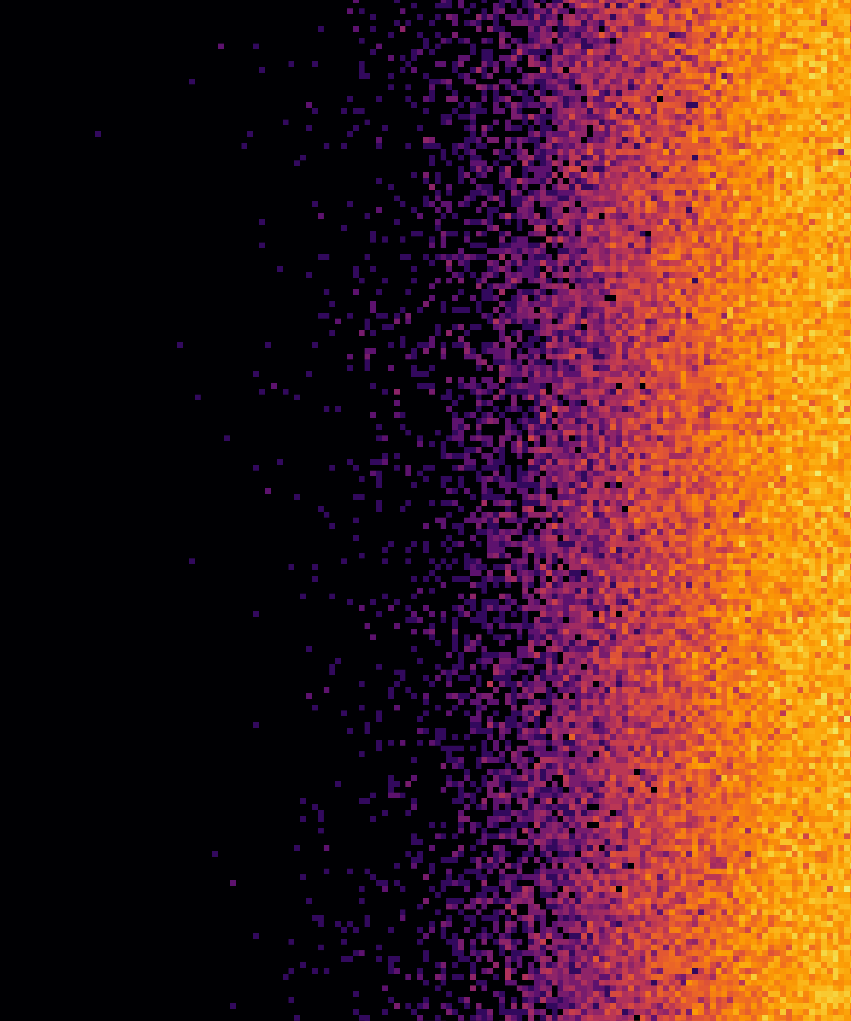
BIPXL/BGI DAQ platform
H. Sandberg on behalf of the BIPXL team
BI-TB: https://indico.cern.ch/event/1607561

Slide 2
Introduction
This presentation is intended to show the proposed solution for the BIPXL DAQ version 5
The Beam Gas Ionization (BGI) beam profile instruments are the main application of the BIPXL DAQ
The primary goal is to make PS and SPS BGIs operational in 2026!
Related meetings and presentations:
  2024-09-03 - PS & SPS BGI Review
  2024-09-20 - CTTB #45: Outcome of PS and SPS BGI review
  2024-11-28 - TB: BGI review outcome discussion
  2025-04-10 - TB: BGI hardware architecture
  2025-06-19 - BI-DD #30
  2025-09-23 - BI-DD #31
Not discussed in this presentation:
  EMI issues with pixel detectors (SPS-BGI) - resolved, see slides at SPS MPC #63

Slide 3
Review findings
Review findings document
We recommend that the OP group takes the lead in preparing a functional specification, in close collaboration with the BI group (BGI team). In addition to the fundamental technical requirements (resolution, stability, etc), operability criteria such as the acceptable time delay between acquisition and analysis being available, desired number of acquisitions per super cycle, acceptable rate of rejected measurements, etc should be included.
Due to the likely changes in the data processing architecture, we recommend reducing the deliverables to the machine in the short term. Testing can continue in an expert mode if needed, and delivery of a truly operational instrument should be foreseen when a definitive implementation is more mature.
We observe that the BGI project strives for a simplified controls implementation. We fully support the proposal to move processing from the SoC towards a powerful server computer. We believe this opens the possibility of a controls architecture that more closely resembles that implemented by other Timepix users and would allow easier adoption of frameworks and code already in use by the community.
[1]
[2]
[3]

Slide 4
Review findings
Review findings document
The existing hardware is relying on a commercial development kit, which will present maintenance challenges in the future. In the context of moving to a server-based solution, the front-end hardware should also evolve to a more standard part. Suitable hardware may be the DIOT platform, or the ATS SoM (if its availability is compatible with the updated milestone plan).
Explore the possible adaptation of existing frameworks and drivers from the Timepix and experiment community.
We recommend a strong focus on data processing solution independent of the backend of the instrument, which is also the likely roadmap to a suitable LHC implementation and has use for other BI devices (eg telescope). Where possible, this architecture should adopt an existing supported hardware solution.
We recommend that any new gateware and software development should strictly obey the criteria of reusability and portability even if the platform changes. This entails preparations for the foreseen move of data processing and analysis to a server and the modifications of the current architecture to use the incoming SoC framework.
[4]
[5]
[6]
[7]

Slide 5
PS/SPS BGI functional specification
Met with PS/SPS OP:
  2025-07-16
  2025-08-19
  2025-09-16
Document created by OP and sent around for approval on 2025-09-17:
  Functional specifications for the PS and SPS beam gas ionisation monitors: EDMS-3330791
Note: LHC OP perspective is not included in this document
Earlier agreement to not provide operational support for the currently installed BGI instruments running version 4 of the system, as suggested by the reviewers
Addresses review findings [1] and [2]

Slide 6
BIPXL DAQ - Historical context
Version | Deployed | Front-End | Back-End | Achievements | Main Limitations

Slide 7
BIPXL DAQ - Historical context
Version | Deployed | Front-End | Back-End | Achievements | Main Limitations
1 | 2017/18 | GEFE | VC707 (FPGA) | First use of Timepix3 inside accelerator beam pipe. [MSc, PhD] | Data rate out of the detectors limited to < 3.2 Gbit/s.

Slide 8
BIPXL DAQ - Historical context
Version | Deployed | Front-End | Back-End | Achievements | Main Limitations
1 | 2017/18 | GEFE | VC707 (FPGA) | First use of Timepix3 inside accelerator beam pipe. [MSc, PhD] | Data rate out of the detectors limited to < 3.2 Gbit/s.
2 | 2021 | Versatile Processing Board (FPGA) | VC707 (FPGA) | Integration with FESA using IPbus. [PhD] | Limited pixel event processing in gateware.

Slide 9
BIPXL DAQ - Historical context
Version | Deployed | Front-End | Back-End | Achievements | Main Limitations
1 | 2017/18 | GEFE | VC707 (FPGA) | First use of Timepix3 inside accelerator beam pipe. [MSc, PhD] | Data rate out of the detectors limited to < 3.2 Gbit/s.
2 | 2021 | Versatile Processing Board (FPGA) | VC707 (FPGA) | Integration with FESA using IPbus. [PhD] | Limited pixel event processing in gateware.
3 | 2022 | Versatile Processing Board (FPGA) | ZCU102 (SoC) | Bunch-by-bunch and turn-by-turn measurements. [MSc] | Front-End FPGA stability (radiation).

Slide 10
BIPXL DAQ - Historical context
Version | Deployed | Front-End | Back-End | Achievements | Main Limitations
1 | 2017/18 | GEFE | VC707 (FPGA) | First use of Timepix3 inside accelerator beam pipe. [MSc, PhD] | Data rate out of the detectors limited to < 3.2 Gbit/s.
2 | 2021 | Versatile Processing Board (FPGA) | VC707 (FPGA) | Integration with FESA using IPbus. [PhD] | Limited pixel event processing in gateware.
3 | 2022 | Versatile Processing Board (FPGA) | ZCU102 (SoC) | Bunch-by-bunch and turn-by-turn measurements. [MSc] | Front-End FPGA stability (radiation).
4 | 2023 | GBTx | ZCU102 (SoC) | FPGA-free front-end working. Telescope prototype deployment successful. | SoC processing and raw data access limited. ZCU102 not standard hardware. Ref. PS & SPS BGI Review

Slide 11
BIPXL DAQ - Historical context
Version | Deployed | Front-End | Back-End | Achievements | Main Limitations
1 | 2017/18 | GEFE | VC707 (FPGA) | First use of Timepix3 inside accelerator beam pipe. [MSc, PhD] | Data rate out of the detectors limited to < 3.2 Gbit/s.
2 | 2021 | Versatile Processing Board (FPGA) | VC707 (FPGA) | Integration with FESA using IPbus. [PhD] | Limited pixel event processing in gateware.
3 | 2022 | Versatile Processing Board (FPGA) | ZCU102 (SoC) | Bunch-by-bunch and turn-by-turn measurements. [MSc] | Front-End FPGA stability (radiation).
4 | 2023 | GBTx | ZCU102 (SoC) | FPGA-free front-end working. Telescope prototype deployment successful. | SoC processing and raw data access limited. ZCU102 not standard hardware. Ref. PS & SPS BGI Review
5.1 | 2025 Q4 | GBTx | ZCU102 + PCIe | TBD: PCIe-based DAQ. | ZCU102 not standard hardware.

Slide 12
BIPXL DAQ - Historical context
Version | Deployed | Front-End | Back-End | Achievements | Main Limitations
1 | 2017/18 | GEFE | VC707 (FPGA) | First use of Timepix3 inside accelerator beam pipe. [MSc, PhD] | Data rate out of the detectors limited to < 3.2 Gbit/s.
2 | 2021 | Versatile Processing Board (FPGA) | VC707 (FPGA) | Integration with FESA using IPbus. [PhD] | Limited pixel event processing in gateware.
3 | 2022 | Versatile Processing Board (FPGA) | ZCU102 (SoC) | Bunch-by-bunch and turn-by-turn measurements. [MSc] | Front-End FPGA stability (radiation).
4 | 2023 | GBTx | ZCU102 (SoC) | FPGA-free front-end working. Telescope prototype deployment successful. | SoC processing and raw data access limited. ZCU102 not standard hardware. Ref. PS & SPS BGI Review
5.1 | 2025 Q4 | GBTx | ZCU102 + PCIe | TBD: PCIe-based DAQ. | ZCU102 not standard hardware.
5.2 | < 2026 Q4 | GBTx + lpGBT | ATS-SoM + PCIe | TBD: Operational use. lpGBT + Timepix4 integration into the DAQ.
Pixel Detectors in SY-BI-XEI 2025 edition: EDMS-3320794

Slide 13
BIPXL DAQ version 5 key points
Keep existing GBTx-based front-end (for Timepix3)
Change interface from 1G Ethernet between back-end and computer (FEC) to PCIe
Use existing ZCU102 until ATS-SoM production versions are available
Addresses review findings [3] (partially) and [4]
What about:
  [3]: adoption of frameworks and code already in use by the community
  [5]: adaptation of existing frameworks and drivers
    -> Use existing frameworks and software
  [6]: data processing solution independent of the backend […] adopt an existing supported hardware solution
    -> Software independent of the back-end
    -> Use existing hardware solutions
  [7]: reusability and portability even if the platform changes
    -> Clearly structured stack with independent layers
Need a PCIe-based back-end with existing hardware, software, drivers and frameworks
[3]: move processing from the SoC towards a powerful server
[4]: Suitable hardware may be the ATS-SoM

Slide 14
Is EDGE the solution?
After the previous technical boards and digital designer meetings, it was decided to buy 2x Techway PCIe cards, see confluence pages:
  BIPXL V5: Demonstrator PCIe Card choice
  Techway PCIe PFP_ZU Notes
Use Cheby for defining the register map in the gateware (merge request !147)
Generate EDGE file and kernel driver from the Cheby file
Use BI-SW EDGE library generation tool to create the BIPXL Wrapper
Add an extender above the wrapper using BI-SW template -> BIPXL Extender
Add a BIPXL Core library above the extender with high-level procedures and an API to the FESA class
-> Reading/writing registers in the gateware of the Techway PCIe card works!
But what about transferring data using DMA over the PCIe interface?
  EDGE4 does not support this!
  There is one project in the RF group that is using EDGE2 with XDMA
  No documentation or support for EDGE4 to get DMA over PCIe working!
FESA
BIPXL Core
BIPXL Extender
BIPXL Wrapper
EDGE driver
PCIe card

Slide 15
What is required for a FPGA-PCIe framework?
There is no standard for interfacing an FPGA with a PC using PCIe for DMA and register read/write!
Every solution therefore requires a full framework to get it working:
  DMA module in gateware
  Register read/write module in gateware
  PCIe module in gateware
  Linux kernel driver in software
  Hardware abstraction layer (HAL) in software (optional but could be convenient as a user)
EDGE4 does not have a DMA module for PCIe implemented in gateware and a corresponding kernel driver, only register read/write by using the direct PCIe BAR access
FPGA
PC
Registers
User software
DMA
HAL
PCIe
Kernel driver

Slide 16
Is Xilinx XDMA/QDMA the solution?
Gateware modules and Linux kernel driver to interface with are provided
Gateware modules as black boxes, that tend to change functionality for each tool version update
Linux kernel driver available on Github
  Support refers to the Xilinx forum
XDMA used by a project in RF group together with EDGE2
QDMA could potentially be used with EDGE4 using two different physical functions (PF), but no documentation on how to do this or if it’s been done
Is this a good candidate for “use existing frameworks and software”?
I would argue no since it would be a custom solution for our specific application with unknown support…

Slide 17
PCIe frameworks in the community
Community = physics/accelerator/light-source/pixel-detector bubble
Nikhef Wupper:
SPIDR4 is a Timepix4 DAQ developed by Nikhef using PCIe interface
FELIX is an ATLAS project for a readout system of the experiment
Both are using the Wupper: PCIe DMA Engine for Xilinx FPGAs
  DMA over PCIe + register read/write + Linux kernel driver
  Supported hardware boards are custom and some Xilinx development boards
No experience in the group of using this and unclear how much short/long-term support there is
SLAC PCIe framework:
See slides from BI-DD #31 for more details and links to resources
Provides DMA over PCIe + register read/write + Linux kernel driver + HAL + pre-compiled bitstreams
Can/should be used as a generic PCIe back-end solution that any DAQ can connect to
I have personal experience with using it and it’s being used at SLAC in the same applications as we have here at CERN in BI

Slide 18
Is SLAC PCIe framework the solution?
Everything in the server is common for all types of DAQs connecting to it
The PGP4 optical links is the “common language”
Software stack with kernel driver and Rogue (HAL) is the same
Application software is different for each DAQ
SLAC Register Protocol (SRP) channel handles register read/write

Slide 19
Is SLAC PCIe framework the solution?
Review findings:
[3]: adoption of frameworks and code already in use by the community
[5]: adaptation of existing frameworks and drivers
  -> Use existing frameworks and software ✅
[6]: data processing solution independent of the backend […] adopt an existing supported hardware solution
  -> Software independent of the back-end ✅
    The PCIe card, kernel driver and Rogue HAL is transparent to the software
    From the software it looks as though it’s communicating with the DAQ FPGA back-end directly
  -> Use existing hardware solutions ✅
    Several commercial PCIe cards are supported and available, more added continuously
[7]: reusability and portability even if the platform changes
  -> Clearly structured stack with independent layers ✅
    The SLAC framework is designed with a layered and modular approach
Addresses the remaining review findings -> This a good candidate!

Slide 20
Long-term: ATS-SoM in 1U + PCIe card
ATS-SoM in a 1U crate:
Only using the FPGA (PL) side of the SoC to begin with
Rear: 4x QSFP -> 16 high-speed transceivers
Front: 6x QSFP, 4x SFP, FMC -> 32 high-speed transceivers
Triggers through our existing FMC board (EDA-04540)
Commercial PCIe accelerator card (Xilinx Varium C1100) in the FEC:
Same architecture as SLAC PCIe framework: download bitstream, program PCIe card and run!
Use existing and supported hardware, gateware and software!

Slide 21
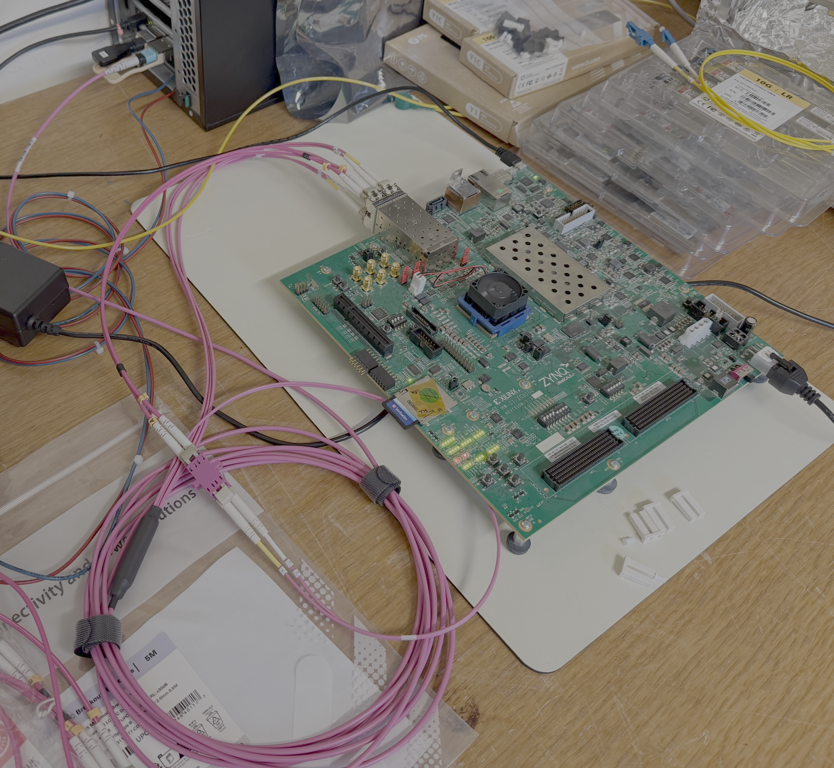
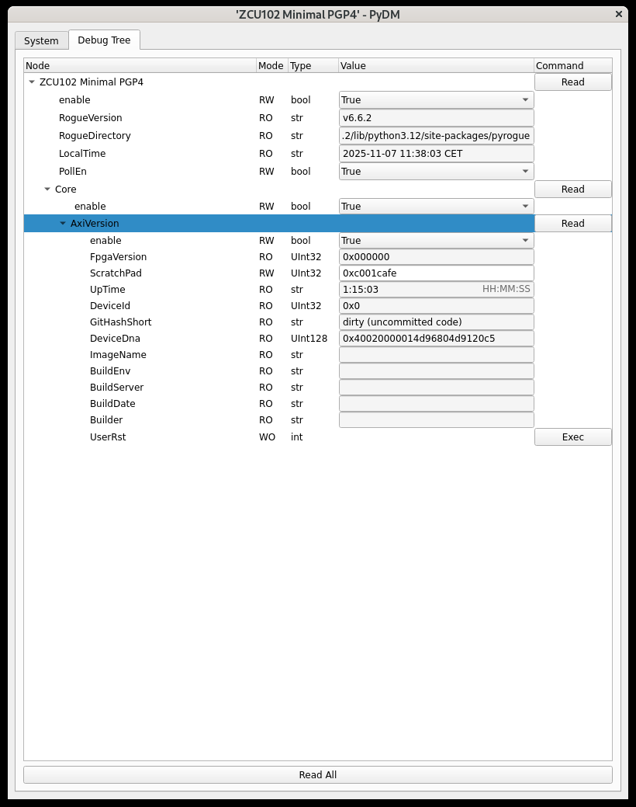
Short-term: ZCU102 + PCIe card
While waiting for ATS-SoM + 1U crate design
Reuse our existing ZCU102-based crates
PC <-> ZCU102 connection over PCIe and PGP4 fibers tested and working in the lab! (BIPXL-200)
ZCU102 connected to C1100 PCIe card
Rogue debug GUI

Slide 22
BIPXL V5 software stack
Layered stack with FESA on top
  The only interface for users to access the system
Left: acquisition side
  Produces the raw data
Right: processing side
  Consume the raw data
Raw data always produced
Option to copy raw data to remote location for further processing or storage
Libraries provided to load raw data, convert it and create application-specific outputs
[7]: reusability and portability even if the platform changes

Slide 23
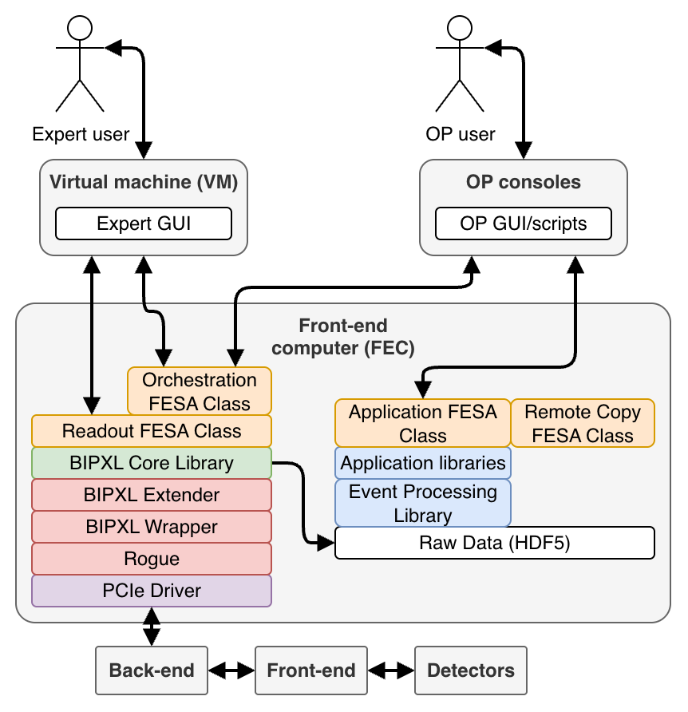
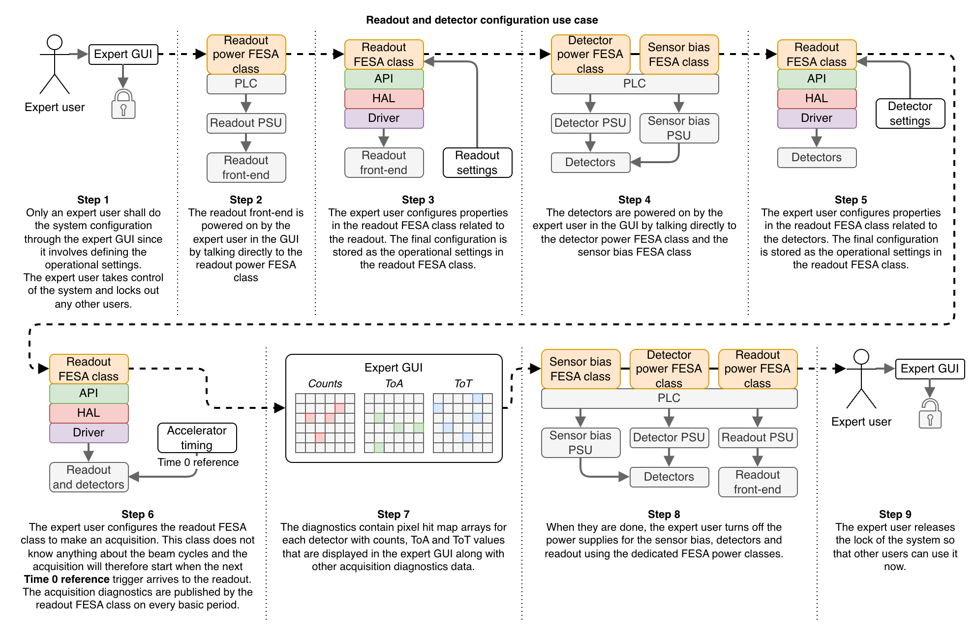
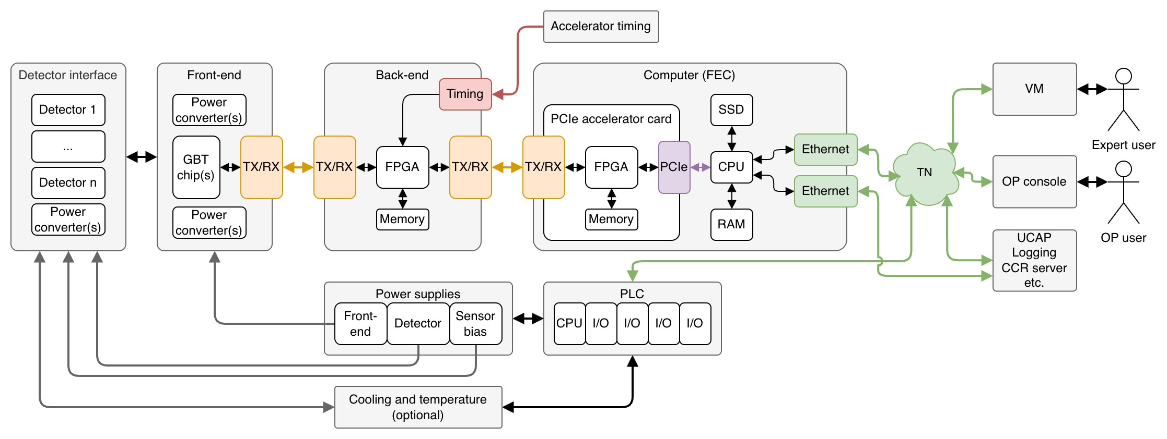
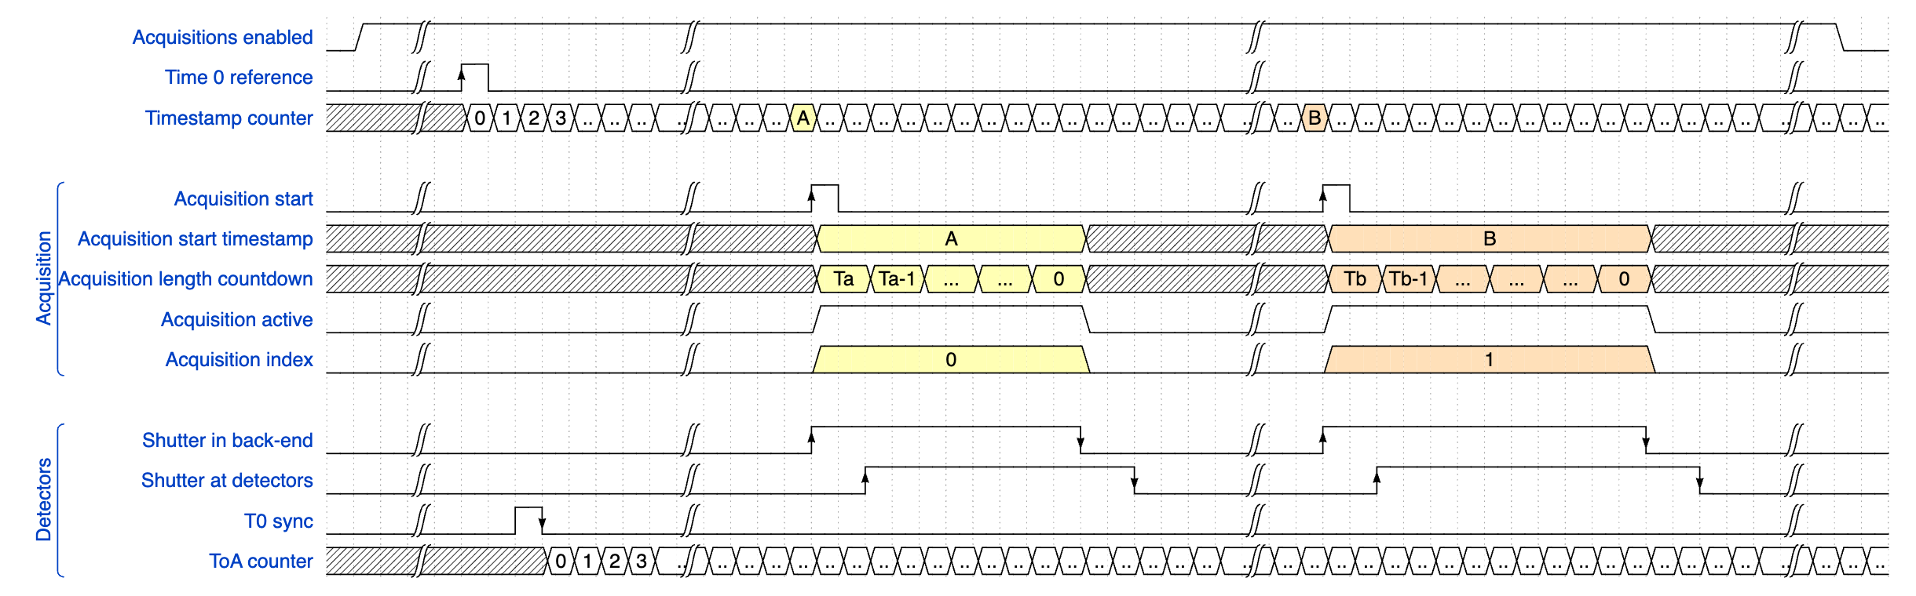
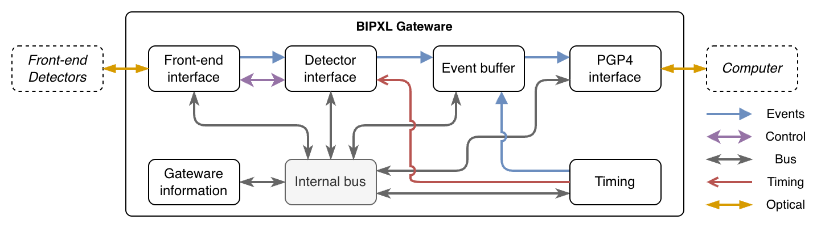
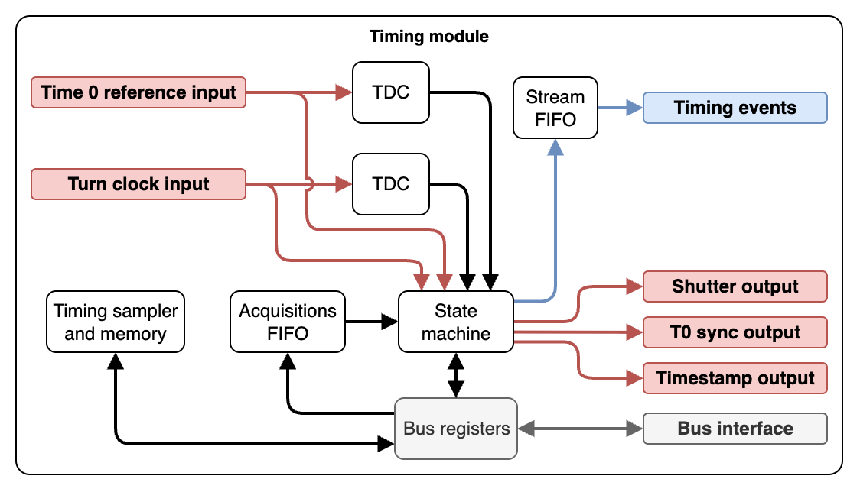
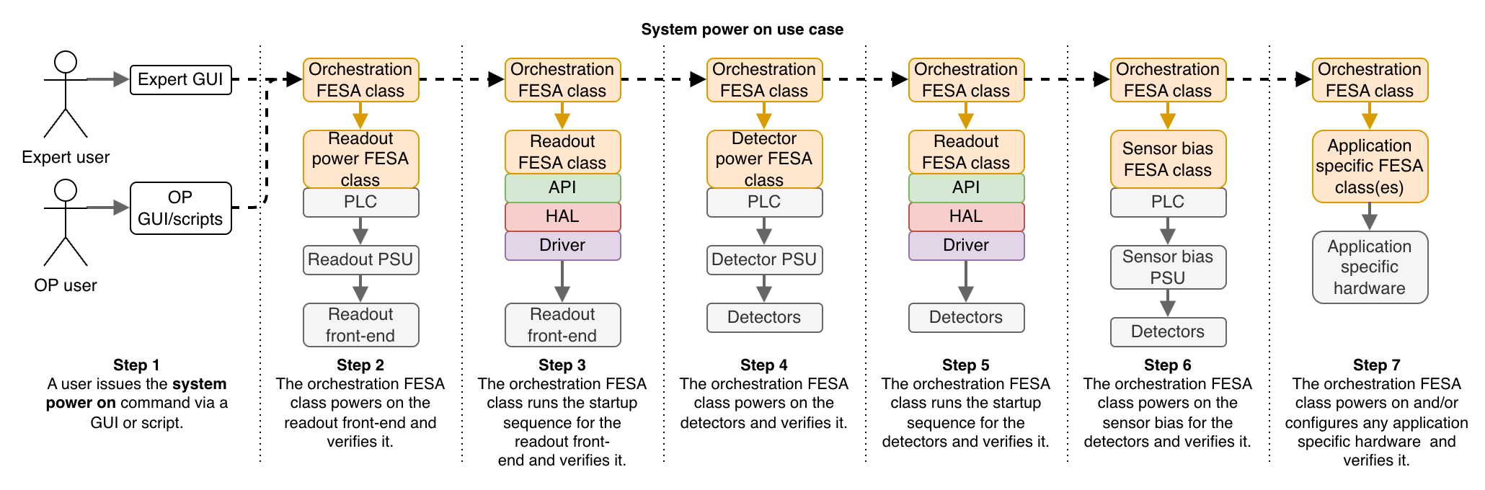
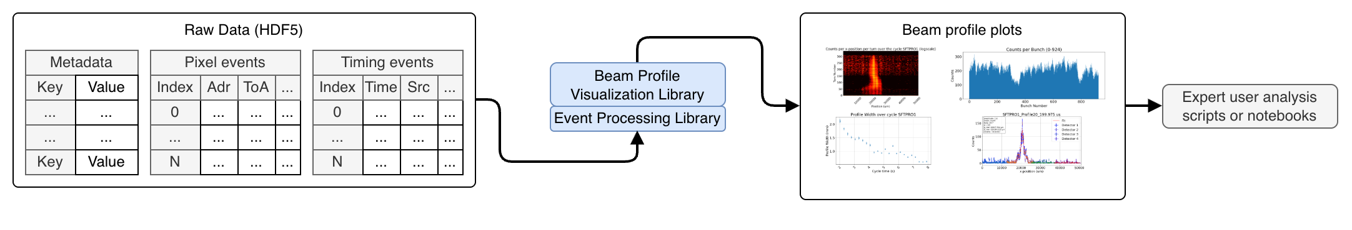
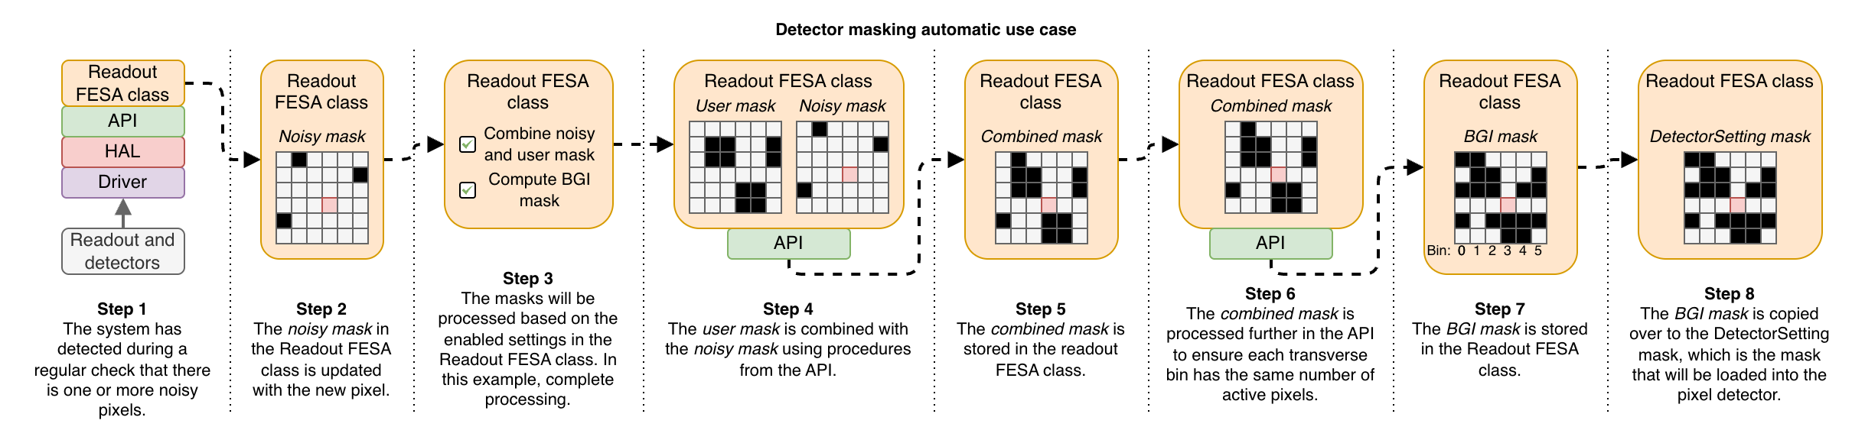
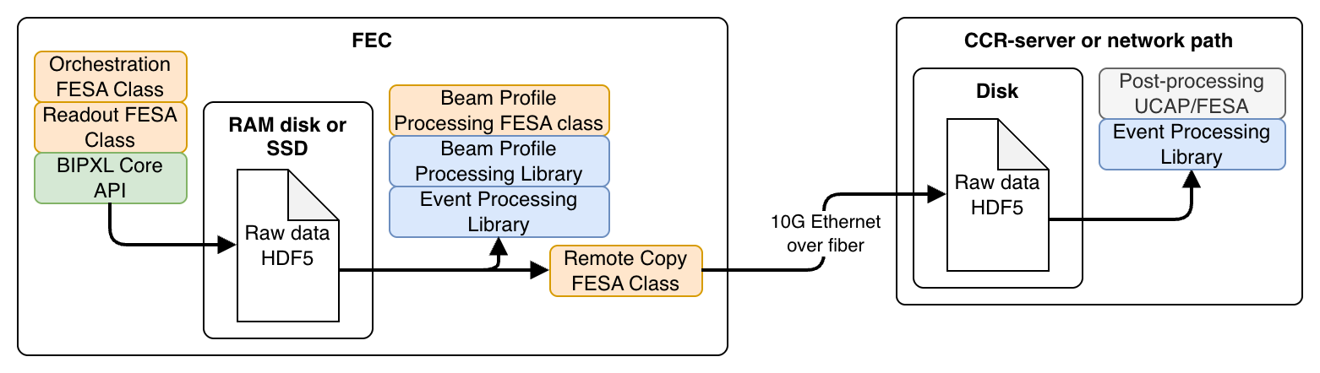
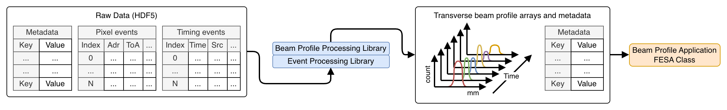
BIPXL V5 Engineering Specification
Outlines the requirements and guidelines for developing and implementing the BIPXL Version 5 Data Acquisition (DAQ) system. It is intended to serve as a comprehensive reference for all project stakeholders, including developers, project managers, and end users
Draft document on Confluence page: https://confluence.cern.ch/x/Yw3aJQ
Will be made into an EDMS document for release
Very useful resource for discussion between us working in the project
Mix of visual diagrams and text describing the system

Slide 24
Bonus: SLAC DMA on SoC
PCIe DMA (same as shown before)
In the SLAC open-source framework there is also support to have DMA between the processing system (PS) and the programmable logic (PL) on a Xilinx MPSoC
It’s sharing many of the components from the PCIe DMA
Nothing has to change from the application software or application gateware point-of-view
DMA data streams + register read/write between PL and PS of the SoC
This means that the BIPXL DAQ can be deployed for an application with lower processing requirements on an ATS-SoM + FESA-on-SoC with no changes to the application software and the application gateware
[6]: data processing solution independent of the backend
SoC DMA

Slide 25
Timeline
2025 Q4
  Demonstrate the PCIe-based BIPXL DAQ (v5.1)
  Using ZCU102 + C1100 PCIe board + SLAC PCIe framework
  Timepix3 with GBTx front-end
  Full stack all the way up to FESA
2026 Q1-Q3
  Last opportunity with beam before LS3
  Deploy PCIe-based BIPXL DAQ (v5.1) in PS and SPS -> Make them operational!
  Make sure OP can use the system as early as possible to get their feedback and verify it matches the functional specification
  In parallel: integrate Timepix4 detectors and lpGBT front-end into the system for the telescope application
2026 Q4 + LS3
  Move from ZCU102 to ATS-SoM (v5.2)
  LHC-BGI with Timepix4
  Integrate new Picopix pixel detector (?)

Slide 26
Thanks for the attention!
Questions, comments?

Slide 27
Backup

Slide 28
Procured PCIe cards
Techway PFP-ZU+_11
  2 pcs
  DAI-11037953, DAI-10734777
  Not supported by the SLAC pgp-pcie-apps
    But could be done as an exercise to show how to add a new board (very low priority)
Xilinx Varium C1100
  5 pcs
    2 more needed to cover our basic needs for 2026
  MAG-11314118, MAG-11329668, MAG-11329670
  Supported by the SLAC pgp-pcie-apps
Other supported boards by SLAC pgp-pcie-apps, see targets
Could perhaps have a common ”BI stock of PCIe cards” that are all compatible with this framework?
QSFPs, SFPs and fibers to be procured
  Multi-mode used since short distance between FEC with PCIe card and ZCU102/ATS-SoM
  Could use direct attached copper (DAC) but only PVC versions found so far (e.g. FS DAC cable)

Slide 29
GPU support in SLAC PCIe framework
The framework also supports direct DMA transfer between the PCIe FPGA and a GPU
Can accelerate processing using GPU hardware instead of the CPU
More info: https://indico.phy.ornl.gov/event/510/contributions/2227/

