Slide 1
Predicted CALET UH-Nuclei Abundances and Analytical Work
Brian Flint Rauch
Washington University in St. Louis
CALET TIM, Tokyo
August 8-10, 2011

Slide 2
Overview of Work
CALET UH-GCR measurement prediction.
Scoping calculation of CALET ability to resolve CR anisotropy observed by MILAGRO.
Scoping calculation of CALET abundance measurement of Crab.
Planned assessment of simulation charge changing cross sections.

Slide 3
CALET UH-GCR Measurement Prediction
Steps in Calculation
Determination of rigidities seen in ISS orbit.
Estimation of integral CR-flux spectra.
High and Low energy regimes:
  Determination of thresholds.
  Determination of geometry factors.
Determination of CALET charge sensitivity range.
Prediction of abundances measured by CALET in 5 years.

Slide 4
ISS Orbit
Rigidity Cutoffs based on Smart, D.F. and Shea, M.A., 2009AdSpR..44.1107S

Slide 5
Weighted Rigidity Spectrum
Cutoff Rigidities from Epoch 1990 at 450 km on a 5° latitude × 15° longitude grid.
Orbit residence time based on an ISS inclination of 51.6° weighted for time in latitude bins and evenly sampling longitude bins.

Slide 6
Fe Integral Spectra Used for UH
Spectra have not been measured for UH GCRs, so the Fe spectrum is scaled by relative abundances.
Modulation seen by CALET is likely to be between Solar Minimum and Maximum, so calculations use averages.
Spectra 5 ≤ Z ≤ 32 from 2009ApJ...698.1666G

Slide 7
High Energy Scintillator Resolution
Above a C1 threshold of ~5000 Fe-peak resolution does not vary with energy.
Charge determinations of UH GCRs can be made with scintillator signals alone.

Slide 8
UH Charge Determination Regimes
At high enough energies charge can be determined based on trajectory corrected scintillator signal only.
This requires passage through the CHD and the top five fiber layers in the IMC, which gives a larger geometry factor, 0.44 m²-sr, than for the total instrument, 0.12 m²-sr.
  Particles with tracks through the calorimeter can have energy corrections that will improve resolution.
Lower energy particles require energy correction, and hence passage through the calorimeters.
CHD
IMC
TASC
Larger geometry factor calculated simply using formula in Sullivan, 1971NucIM..95....5S

Slide 9
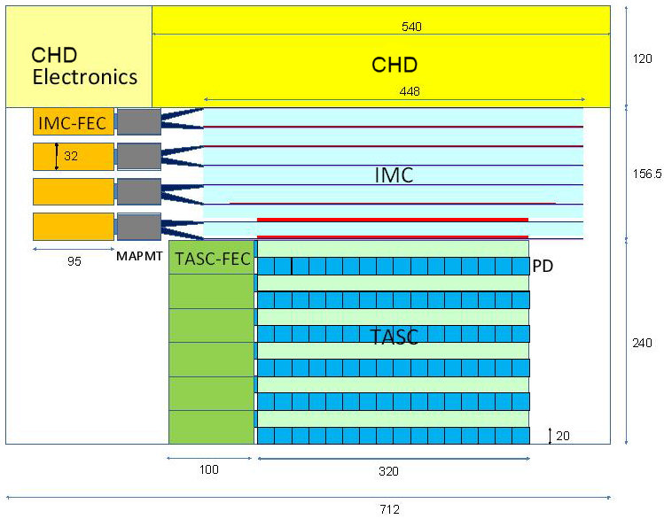
~70 deg

Slide 10
Differential Geometry Factor
Differential geometry factor for UH-GCR measurement for top 4 IMC layers (5 fiber planes).
Reduction for 45° FOV limit on one side of CALET (dashed curve).
Interactions in CHD calculated for angle bins as a function of differential geometry factor.

Slide 11
Average Interaction Losses in CHD
Fraction of events that do not undergo nuclear interactions in passing through the CHD: ~2 cm of PVT plastic at an average incidence of 30° for 2.38 g/cm² areal density.

Slide 12
Summary of measurable range
 | 1MIP | Fe (z=26) | Maximum
Scintillator EJ204 | 100% (no quenching) 300 p.e. | ～40%, S ~ Z^{1.72} 81,000 p.e.
PMT (gain: 5000) R7400 (at 400 V) | 240 fC | 64,000 fC | 375,000 fC 320,000 (linearity <2% )
CSA (C_{f} = 100 pF) : Charge Sensitive Amp. | 2.4 mV | 640 mV | 3,000 mV
ADC (16bits) | 32 counts | 8,600 counts | 32,768 counts
Scintillation yield is expected to be about 300 p.e. for a MIP with R7400 (QE ~30%) and EJ204.
The PMT gain and feedback capacitance of CSA are adjustable.
Data courtesy of Shoji Torii.

Slide 13
Maximum Resolved Charge
Signals derived for 0°, 30° and 45° incidence assuming S~Z^{1.7} * from Fe for:
  Scintillator (PE)
  PMT (fC)
  CSA (mV)
  ADC (counts)
The ADC appears to determine the maximum resolved charge: Z~45 at high incidence angles.
* 22nd ICRC, 1991, 2, 511

Slide 14
Estimated Abundances for 5 Years

Slide 15
Comparison with Existing Data

Slide 16
Conclusions
30≤Z≤40 charge range
  CALET should obtain numbers of events ~5x that of TIGER
  Comparable to numbers of events expected from Super-TIGER for 60 days at float
  CALET measurements will be clearer since there will be smaller corrections for nuclear interactions
50≤Z≤56 charge range
  If the dynamic range is sufficient, CALET can make exploratory measurements with statistical precision of ~25-30% for even-Z nuclei
We conclude that UH-element abundances for 30≤Z≤40 on CALET are well worth doing. For 50≤Z≤56, the statistics are modest, but is still worth doing if the dynamic range is sufficient
Critical importance
  A trigger mode based on CHD and top layers of IMC
  Adequate dynamic range of the CHD PMT and signal processing chain

Slide 17
Scoping calculation of CALET ability to resolve CR anisotropy observed by Milagro
Milagro reported fractional excesses in the CR fluxes for two spatial regions of ~6×10⁻⁴ and ~4×10⁻⁴; PRL 101, 221101 (2008).
Larger excess seen in “Region A”, defined by 66° < RA < 76° and 10° < δ < 20°, and the smaller excess in “Region B” is more spread out.
The CR dataset had a median energy of 1 TeV, with the excess peaked at ~10 TeV.

Slide 18
Observed Milagro Excess
Top Figure: Map of significances for the Milagro data set.
Bottom Figure: Signal and Background in 10° < δ < 20° .
From: PRL 101, 221101 (2008).

Slide 19
Expected CALET CR Observation
Starting with high energy proton flux:
  dF/dE = 0.11×E^{-2.27} (s×sr×m²×TeV)⁻¹
A rough estimate of the CR events that CALET would see in 10°×10° bins based on the geometry factor of 0.12 m²×sr and a mission time of 5 years.
CALET clearly cannot resolve the relative excess seen by Milagro of order 10⁻⁴ measuring fewer than 10⁴ events without even considering instrument CR detection efficiency.
Energy (TeV) | F(E) ((s×sr×m²)⁻¹) | N(E) (counts) | n(E) (counts/bin)
0.5 | 0.211 | 4×10⁶ | 6.2×10³
1.0 | 0.064 | 1.2×10⁶ | 1.8×10³
10 | 0.0012 | 2.3×10⁴ | 3.5×10¹

Slide 20
Scoping Calculation of CALET Gamma-Ray Observation of Crab
Starting with the CALET FOV of ~45° and finding solid angle of ~1.84 sr.
CALET observes ~1.84/4π=0.146 or ~14.6% of the sky.
CALET see point sources for ~53.4 days/year, which is close to the ~48 days/year given in S. Torii et al., 30th ICRC, Merida, Mexico (2007), for ~0.132 observation fraction.

Slide 21
Estimated Crab Gamma-Ray Flux Seen by CALET
Crab gamma-ray flux:
  dN/dE = 3.2×10⁻⁷(E/1 TeV)^{-2.5} (m²×s×TeV)⁻¹.
Integral flux:
  N(E)= 2.1×10⁻⁷(E/1 TeV)^{-1.5} (m²×s).
Estimate of Crab gamma-rays CALET would see in 5 years for the TASC area 0.1024 m² and the 0.132 observation fraction.
E (TeV) | N(E) (m²×s) | n(E) (counts)
0.01 | 2.1×10⁻⁴ | 4.5×10²
0.4 | 8.4×10⁻⁷ | 1.8
10 | 6.7×10⁻⁹ | 1.3×10⁻¹

Slide 22
CALET and Gamma Ray Point Sources
Considering instrument detection efficiency would further reduce the expected observation statistics.
There are inadequate statistics for CALET to measure point sources at gamma-ray energies at the high end of CALET’s sensitivity (10 GeV – 10 TeV).
Doubtful that CALET can make overlapping observations with ground based Imaging Cherenkov telescopes like VERITAS (50 GeV - 50 TeV).

Slide 23
Planned Assessment of Simulation Charge Changing Cross Sections
Use both Epics and Geant4 simulations with:
Incident nuclei projectiles on simple target, e.g. Hydrogen, and compare fragmentation products with expected results from semi-empirical cross sections.
Simulate accelerator run experiments and compare results with measured fragmentation products.
Simulate CALET response to heavy nuclei.

Slide 24
Backup Slides

Slide 25
High Energy Scintillator Resolution
Above a C1 threshold of ~5000 Fe-peak resolution does not vary with energy.
Charge determinations of UH GCRs can be made with scintillator signals alone.
TIGER analysis divided data into regions based on the threshold of its aerogel Cherenkov radiator (~2.5 GeV/nuc), shown in scatter plot on the left and giving the Above C0 (red) and Below C0 (blue) ranges in the plot on the right.

Slide 26
TIGER Kinetic Energy
C1 = 5000 for ~600 MeV/nucleon

Slide 27
Impact of Solar Modulation

Slide 28
Anticipated UH Charge Resolution
TIGER 2003 high energy scintillation peaks show separation for ₃₀Zn and above. CALET will have statistics to resolve more Z ≥ 30 peaks.

