Slide 1
Needs for FITS format in gamma-ray analysis
Masaki Mori
Ritsumeikan University
CALET Technical Interchange Meeting, Waseda University, August 8-11, 2011

Slide 2
FITS (Flexible Image Transport System)
Standard astronomical data format endorsed by both NASA and the IAU
Primarily designed to store scientific data sets consisting of multi-dimensional arrays (1-D spectra, 2-D images or 3-D data cubes) and 2-dimensional tables containing rows and columns of data.
Fermi
  archived data are provided in FITS format
  most parameter files are in FITS format
http://heasarc.nasa.gov/docs/heasarc/fits.html

Slide 3
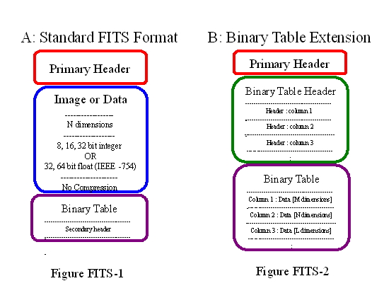
FITS structure
ASCII

Slide 4
Example of primary header
SIMPLE = T / file does conform to FITS standard
BITPIX = 8 / number of bits per data pixel
NAXIS = 0 / number of data axes
EXTEND = T / FITS dataset may contain extensions
TELESCOP= 'GLAST ' / name of telescope generating data
INSTRUME= 'LAT ' / name of instrument generating data
EQUINOX = 2000. / equinox for ra and dec
RADECSYS= 'FK5 ' / world coord. system for this file (FK5 or FK4)
DATE = '2010-08-06T15:22:36.0000' / file creation date (YYYY-MM-DDThh:mm:ss U
DATE-OBS= '2008-08-04T15:43:36.0000' / start date and time of the observation (U
DATE-END= '2009-02-03T23:59:58.0000' / end date and time of the observation (UTC
TSTART = 239557417. / mission time of the start of the observation
TSTOP = 255398400. / mission time of the end of the observation
TIMEUNIT= 's ' / units for the time related keywords
TIMEZERO= 0. / clock correction
TIMESYS = 'TT ' / type of time system that is used
TIMEREF = 'LOCAL ' / reference frame used for times
MJDREFI = 51910. / Integer part of MJD corresponding to SC clock s
MJDREFF = '7.428703703703703D-4' / Fractional part of MJD corresponding to SC cl
OBSERVER= 'Peter Michelson' / GLAST/LAT PI
FILENAME= '3C279_region_filtered_gti.fits' / name of this file
ORIGIN = 'FSSC ' / name of organization making file
CREATOR = 'photonDatabase $Name: $' / software and version creating file
VERSION = '105 ' / release version of the file
DATASUM = ' 0' / data unit checksum updated 2009-08-04T17:41:55
END

Slide 5
http://fermi.gsfc.nasa.gov/ssc/data/analysis/scitools/
Fermi analysis of point sources
FITS files:
Data extract
FSSC website
Specify position, period & energy
Data selection
Event selection
Time selection
Exposure calculation
Livetime cube generation
Exposure map generation
Source analyis
Likelihood analysis
Unbinned / Binned
Photon data
Spacecraft data
Tools:
gtselect
gtmktime
Data display
gtltcube
gtexpmap
ds9 / fv
Source model
gtlike
modeleditor
Catalog
sources
Platform: Scientific Linux 4/5, Mac OS 10.4/10.5
♣ See also ”Fermi Data Analysis Workshop” presentations:
Ex. http://fermi.gsfc.nasa.gov/workshops/da2010_boston/

Slide 6
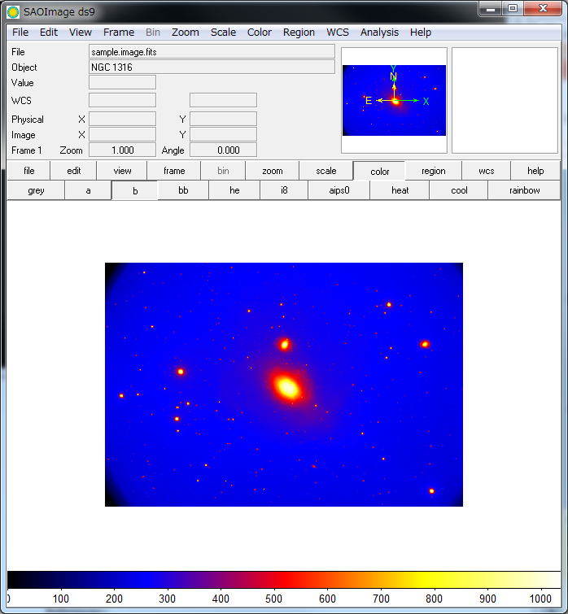
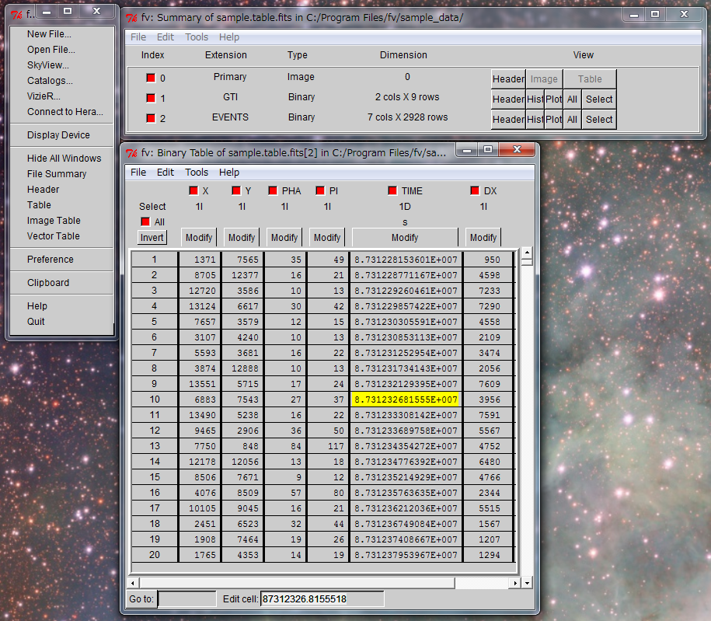
FITS tools
DS9 (image manipulation)
fv (FITS viewer)
FTOOLS: large set of programs for analyzing data in FITS format
IRAF (Image Reduction and Analysis Facility)
CFITSIO: library in C/FORTRAN
  CCfits - object oriented C++ interface to CFITSIO
  Perl interface to CFITSIO
JAVA FITS library

Slide 7
FITS I/O option wanted!
Especially useful in analyzing gamma-ray data
Fermi Science Tools could be modified for CALET rather easily
ROOT/FITS converter at least in high-level data, including Monte Carlo data!
In NASA/NSSDC (and elsewhere) archive, FITS is a preferred format

Slide 8
NSSDC data format
(National Space Science Data Center)
NSSDC ingest can support a variety of data formats. Many data formats can be packaged (encapsulated) with NSSDC AIPs to streamline the process and ensure intergrity of the data on the provider end. The data formats listed below are detailed at NOST.
FITS (Flexible Image Transport System)
CDF (Common Data Format)
PDS (Planetary Data System)
HDF (Heirarchical Data Format)
IDFS (Instrument Data File Set)
ASCII with format description
Binary with format description
http://nssdc.gsfc.nasa.gov/nssdc/submitting_data.html

